Slide 1
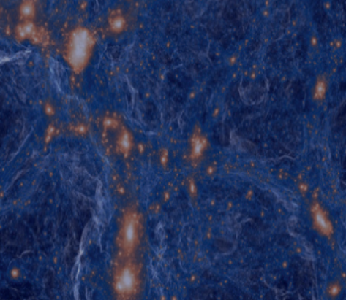
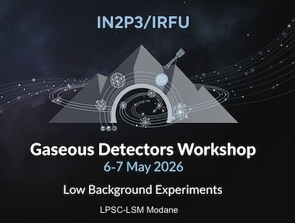
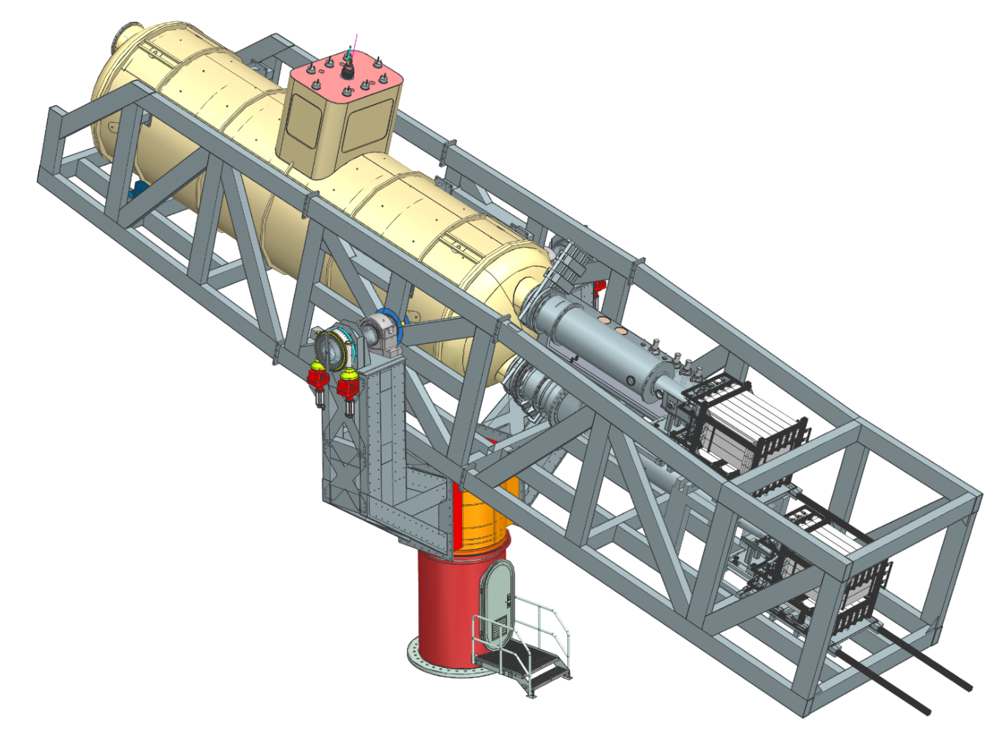

BabyIAXO: The Next Generation of Helioscopes
Status, detector developments and future plans
Esther Ferrer Ribas (IRFU/CEA)
6th May 2026

Slide 2
Axions in a nut shell
Most compelling solution to the Strong CP problem of the SM
Axion-like particles (ALPs) predicted by many extensions of the SM (e.g. string theory)
Axions, like WIMPs, may solve the DM problem for free. (i.e. not ad hoc solution to DM)
Astrophysical hints for axion/ALPs?
  Transparency of the Universe to UHE gammas
  Stellar anomalous cooling → g_{ag} ~ few 10⁻¹¹ GeV⁻¹ / m_{a} ~few meV ?
Relevant axion/ALP parameter space at reach of current and near-future experiments
Experimental efforts growing fast but still small

Slide 3
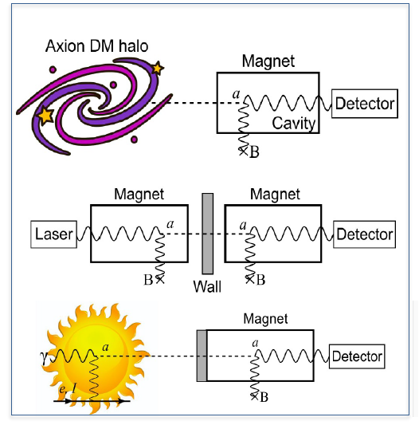
Detection of axions
Source | Experiments | Model & Cosmology dependency | Technology
Relic axions | Haloscopes ADMX, HAYSTAC, CASPEr, CULTASK, CAST-CAPP, MADMAX, ORGAN, RADES, G-LEAD, GraHAL … | High | New ideas emerging, Active R&D going on,…
Lab axions | Laboratory experiments ALPS, OSQAR, CROWS, ARIADNE,… | Very low
Solar axions | Helioscopes SUMICO, CAST, IAXO, (Baby)IAXO | Low | Ready for large scale experiment
Large complementary between the different approaches

Slide 4
Parameter space
Armengaud et al. JCAP (2019) 06 047

Slide 5
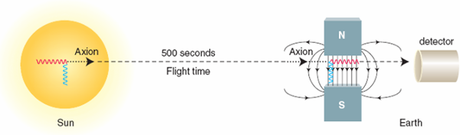
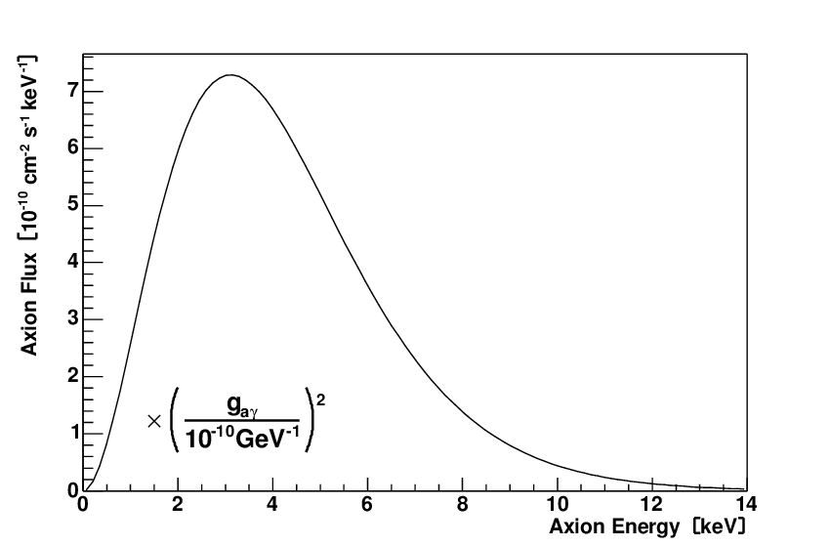

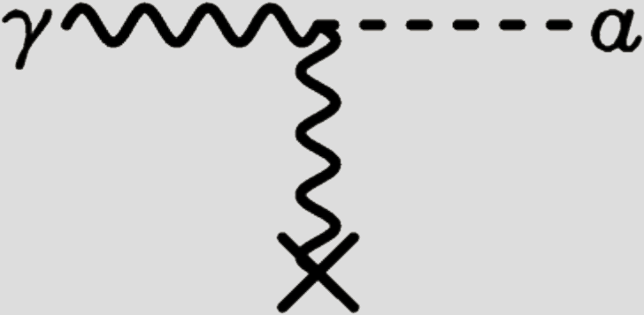
SOLAR AXIONS
Photons (keV) in solar core can be converted into axions in the presence of a strong electromagnetic field via the Primakoff Effect
Van Bibber et al. Phys. Rev D39:2089 (1989)
CAST JCAO 04 (2007)010

Slide 6
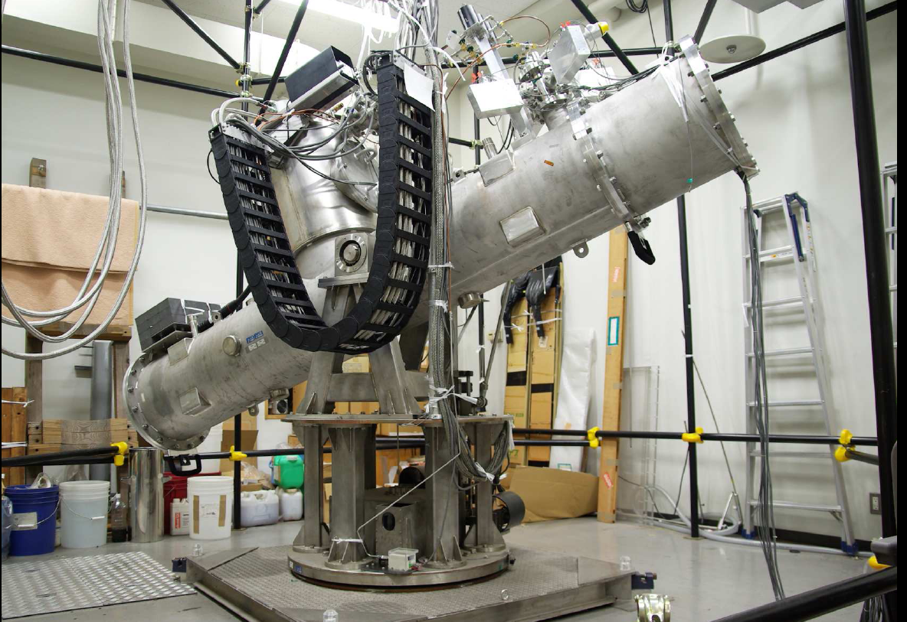
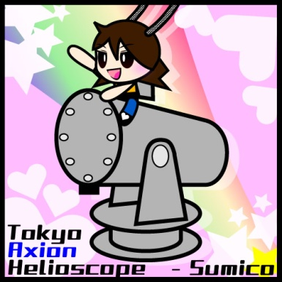
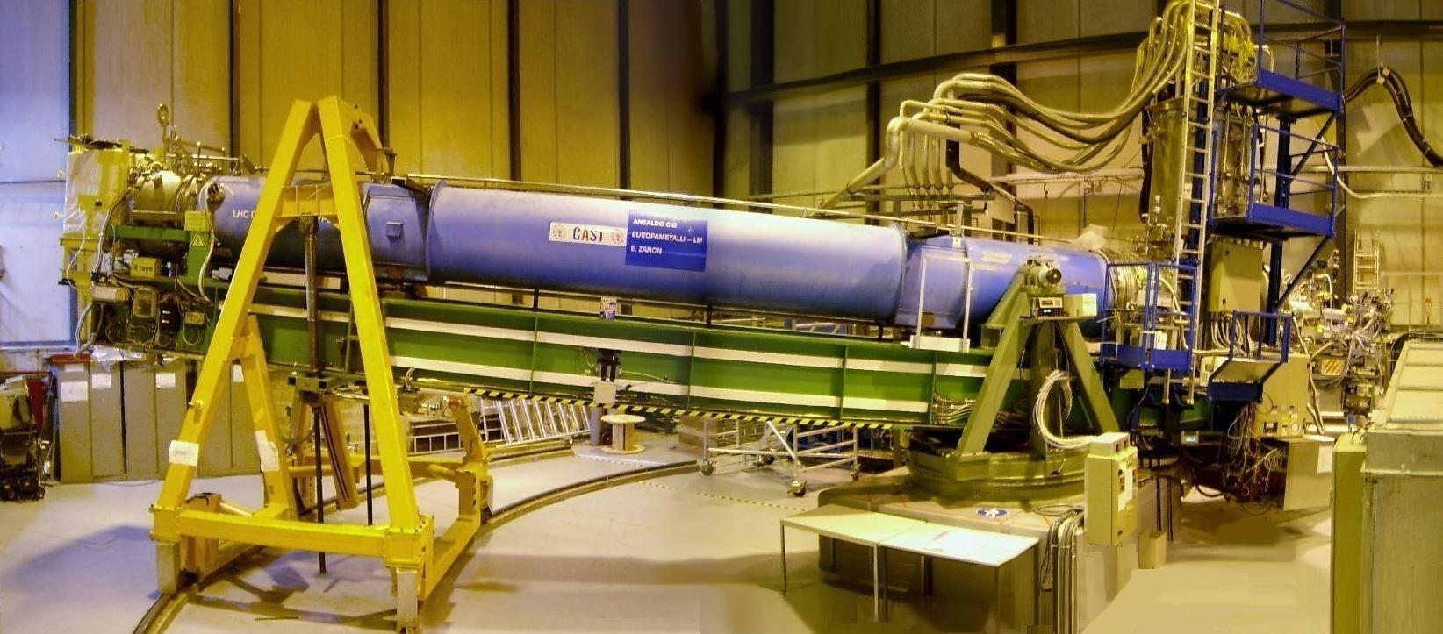
SOLAR HELIOSCOPES
1st generation: Brookhaven (a few hours of data):
1.8 m, 2.2 T
2nd Generation: Tokyo Helioscope (SUMICO):
2.3 m long 4 T
3rd Generation: CAST (CERN Axion Solar Telescope):
10 m long, 9 T 2002-2022
Lazarus et al. PRL 69 (92)
Inoue et al. Phys.Lett.B668:93-97,2008.
Nature Phys. 13 (2017) 584-590
JHEP 2021 75, (2021)
Nature Commun. 13 (2022) 1, 6180
Phys.Rev.Lett. 133 (2024) 22, 221005

Slide 7
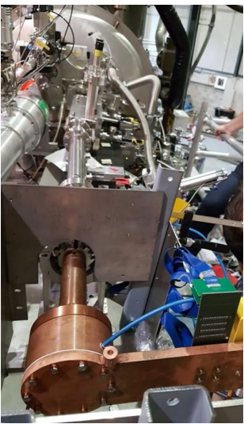
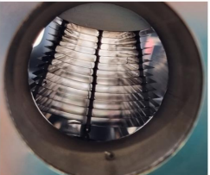
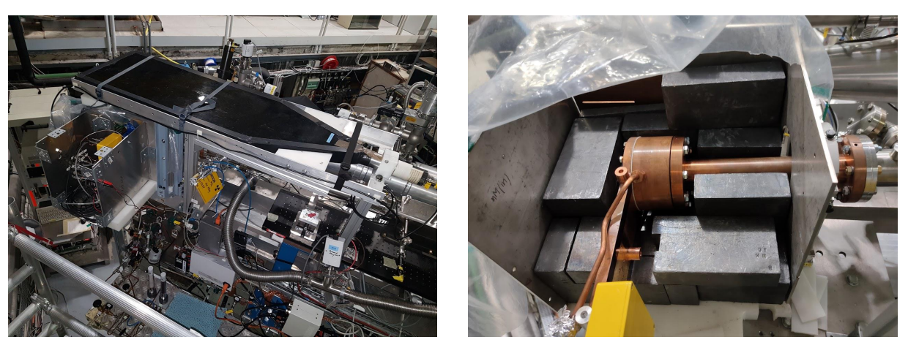
CAST
Decommissioned LHC dipole magnet (L= 10 m, 9 T)
X-ray focussing and using low background techniques for detection: active and passive shieldings, low background materials, discrimination techniques
Solar tracking possible suring sunrise and sunset (2x 1.5 h per day)
Phases
Phase I, vacuum: 2003-2004
Phase II, buffer gas: 2006-12
Improved vacuum run I: 2013-15
Improved vacuum run II: 2019-21 (with improved detectors performances, Neon)
Cavities RADES + CAPP
X-rays optics
Muon veto
Passive shielding

Slide 8
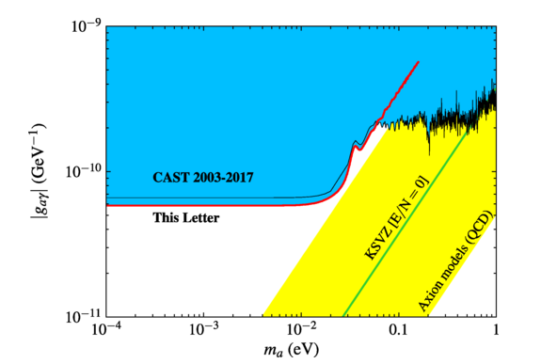
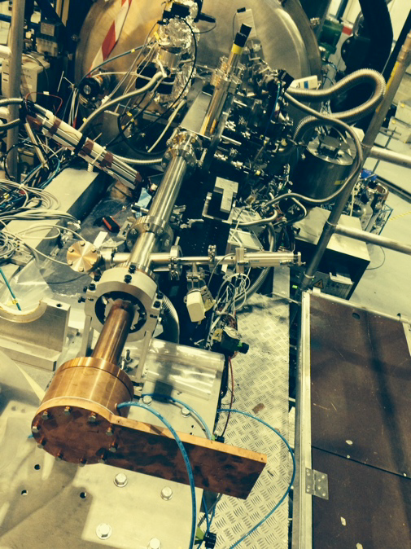

CAST
X-ray optics specifically built for axions
Phys. Rev. Lett. 133, 221005
Low background Micromegas
X-ray focusing + low background Micromegas detector
Small-scale version of IAXO baseline detection lines

Slide 9
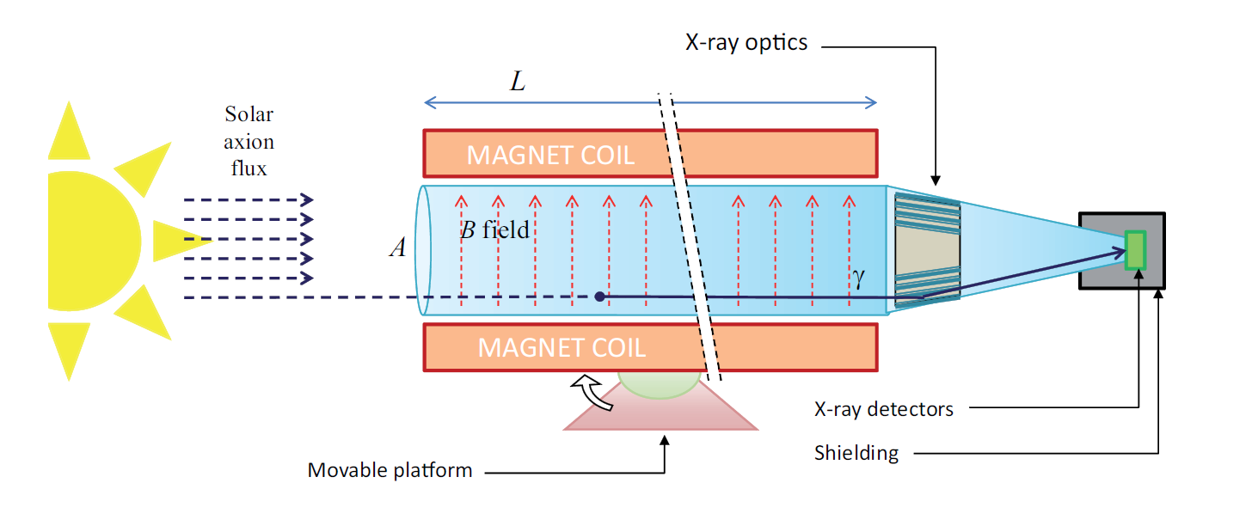
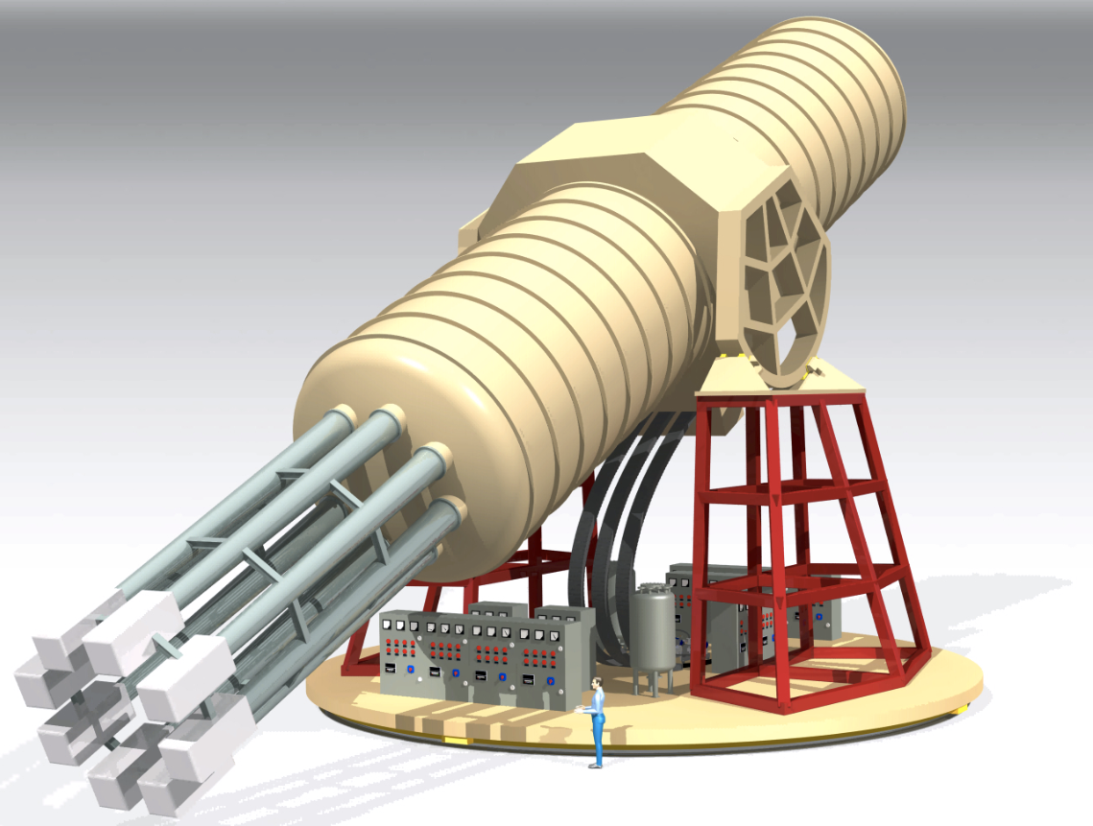
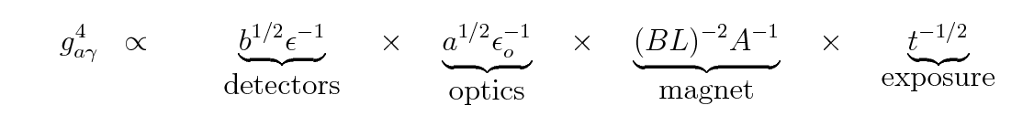
International Axion Observatory
IAXO conceptual design
Purpose-built large-scale magnet
  >300 times larger B²L²A than CAST magnet
  Toroid geometry
  8 conversion bores of 60 cm Ø, ~20 m long
Detection systems (XRT+detectors)
  Scaled-up versions based on experience in CAST
  Low-background techniques for detectors
  Optics based on slumped-glass technique used in NuStar
~50% Sun-tracking time
>10⁴ better SNR than CAST
Sensitive to g_{ag} ~ x20 lower than CAST
Armengaud et al, 2014 JINST 9 T05002

Slide 10
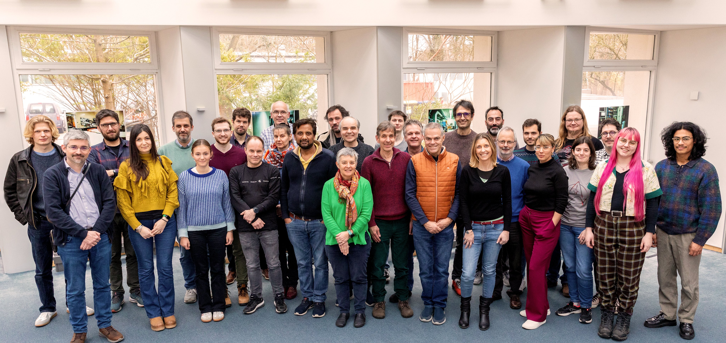
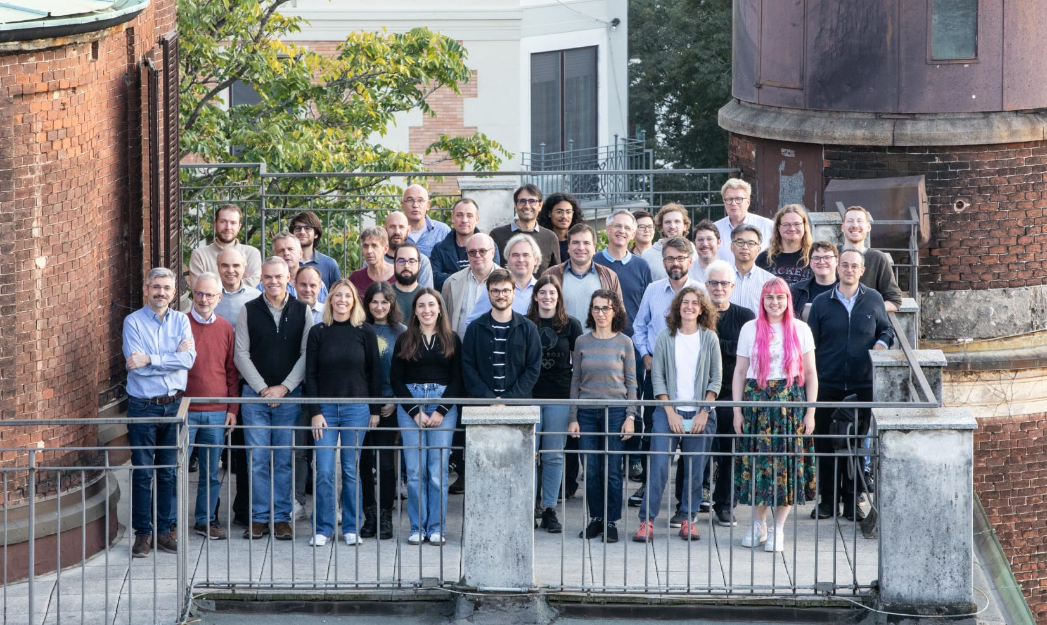
IAXO
125 scientists from 21 full member instituts + 5 associate institutions
Full members: Kirchoff Institute for Physics, Heildelberg U. (Germany) | IRFU-CEA (France) | CAPA-UNIZAR (Spain) | CERN (Switzerland) | INAF-Brera (Italy) | ICCUB-Barcelona (Spain) | Siegen University (Germany) | Barry University (USA) | CEFCA-Teruel (Spain) | University of Bonn (Germany) | MIT (USA) | LLNL (USA) | University of Cape Town (S. Africa) | MPP Munich (Germany) | U. Polytechnical of Cartegena (Spain) | Technical University Munich (TUM) (Germany) | University of Hamburg (Germany) | MPE/PANTER (Germany)
Associate members: DTU (Denmark) | U.Columbia (USA) | SOLEIL (France) | IJCLab (France) | LIST-CEA (France)

Slide 11
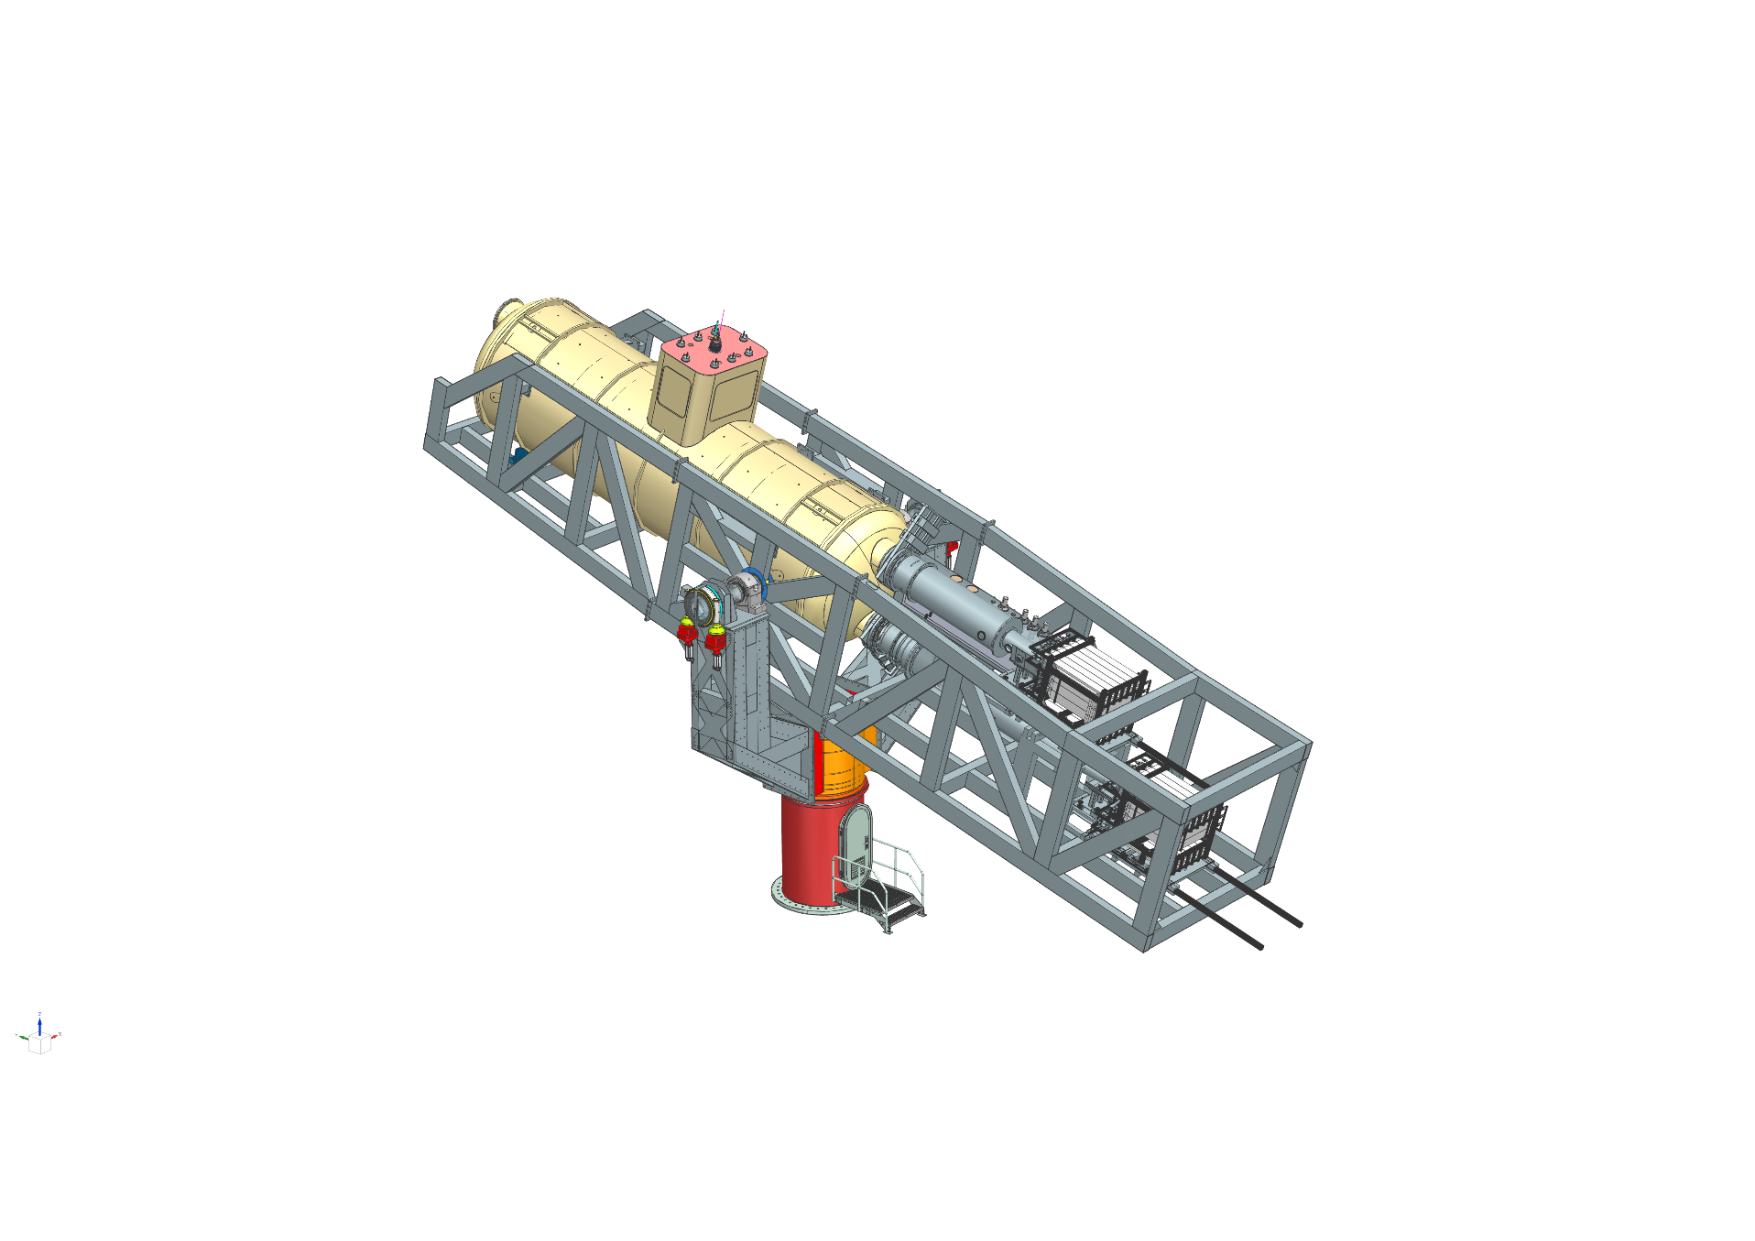
BabyIAXO
Prototype: Intermediate experimental stage before IAXO
  Two bores of dimensions similar to final IAXO bores → detection lines representative of final ones.
  Magnet will test design options of final IAXO magnet
  Test & improve all systems. Risk mitigation for full IAXO
Physics: will also produce relevant physics outcome
  (~100 times larger FOM than CAST)
>100 x CAST SNR
Abeln et al. JEHP 05 (2021) 137

Slide 12
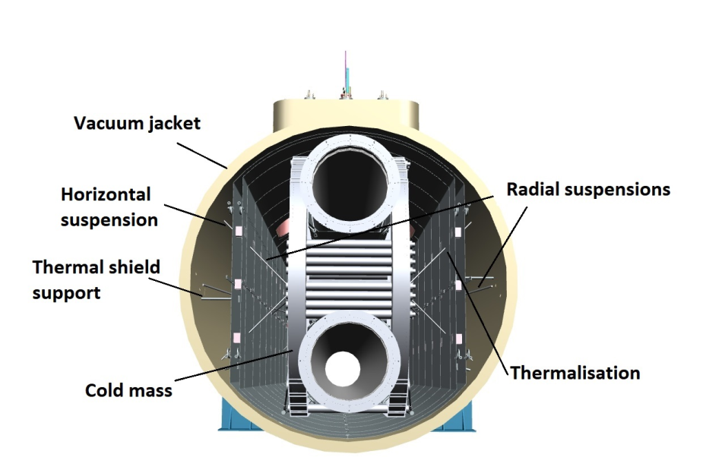
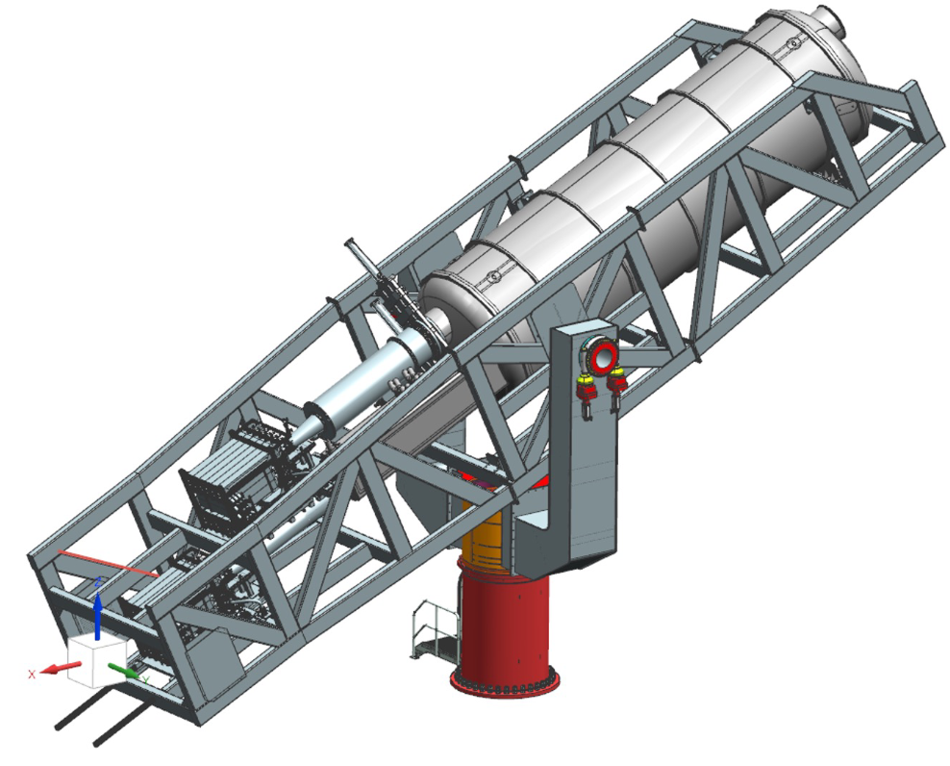
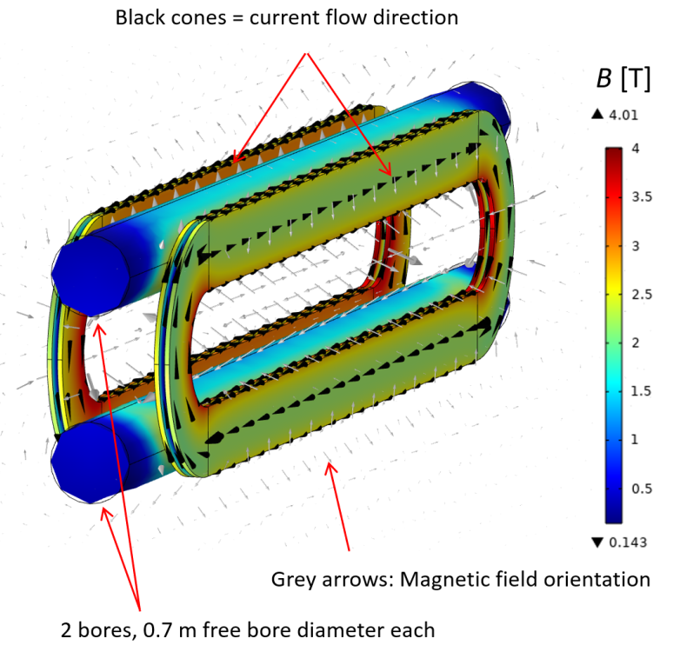
BabyIAXO magnet
Superconducting dipole inside vacuum vessel
Parameter | Value
Operating current [kA] | 6.0
Free bore diameter | 0.7
Transverse magnetic field during operation [T] | 2.1
Stored magnetic energy [MJ] | 56
Inductance [H] | 3.1
Cold mass weight (preliminary) [tons] | 38
Energy density (preliminary) [kJ/kg] | 1.5
Overall coil conductor length [km] | 22
Conductor length per pancake [km] | 2.5
Peak magnetic field magnitude on the Rutherford cable [T] | 4.7
~2 T of transverse magnetic field over a free bore volume of about 8 m³, i.e. the combined free bore volume of 120 LHC dipoles
“Standard” Aluminum-stabilized Nb-Ti/Cu conductor: Nb-Ti/Cu Rutherford cable cladded with high-purity aluminum.

Slide 13
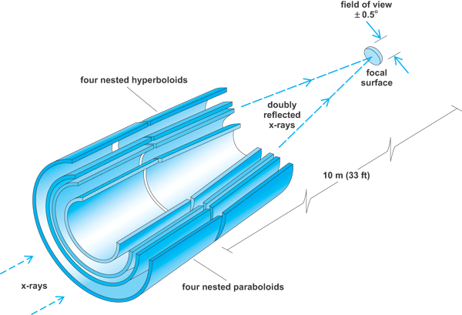
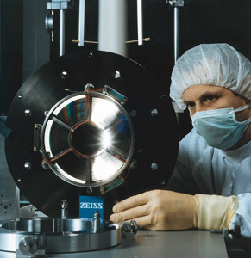
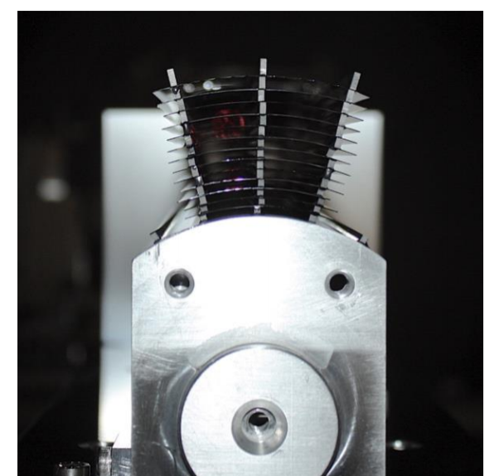
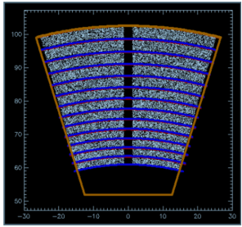
BabyIAXO optics concept
BabyIAXO optics
X-rays are focused by means of grazing angle reflection (usually 2)
Many techniques developed in the X-ray astronomy field. But usually costly due to exquisite imaging requirements
5 cm
Focal length
First X-ray optics specifically built for axions in CAST (LLNL)
ABRIXAS spare telescope, used in one of the 4 bores of CAST (pioneer use of x-ray optics in axion research)

Slide 14
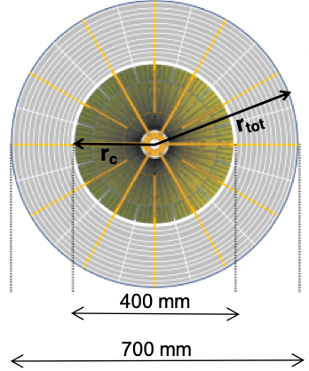
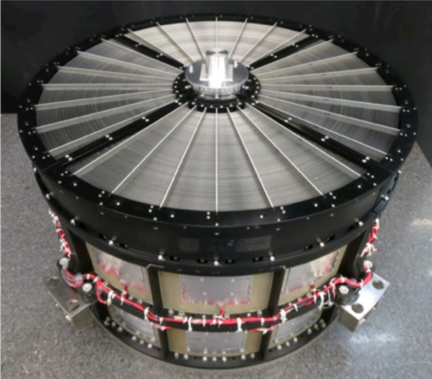
BabyIAXO optics
BabyIAXO optics
Columbia, INAF, DTU, LLNL, TUDo, MPE-Panter, NASA(*), ESA(*)
2 detection lines in BabyIAXO with different solutions:
Hybrid approach for custom BabyIAXO optic
Inner part Al-foil or segmented glass optic
Outer part cold-slumped Willow-glass technology
Fabrication of actual parts already started!
Design of support structure and vessel to hold, co-align and calibrate both underway
XMM Flight Spare XRT
Property of ESA, loan agreement with IAXO.
Actual optic currently at PANTER (MPE). To be recalibrated at PANTER in 2026, then to be sent to DESY.
Vessel to host it in the BabyIAXO detection line being designed.

Slide 15
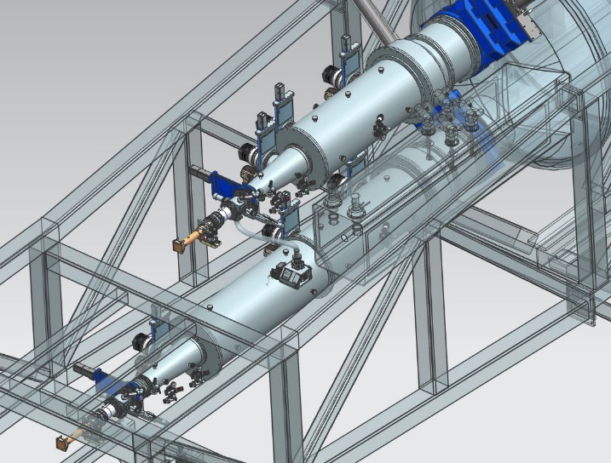
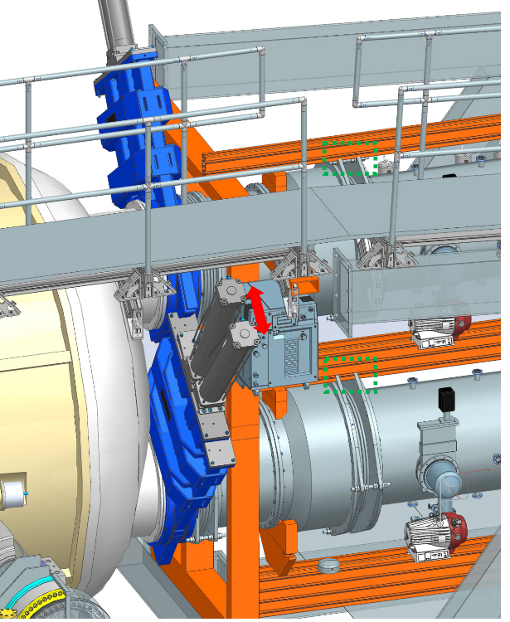
BabyIAXO beamlines
  Experimental Setup Interfaces: Finalized.
  Beamline Sectors: Fabrication ongoing.
    Expected delivery Nov. 2025
  Vacuum Bellow Design: Completed.
    Purchase in preparation (U. Zaragoza)
  Surrounding Structure: Designed
  Vacuum equipment
  (pumps, valves,…):
  already purchased and
  at DESY

Slide 16
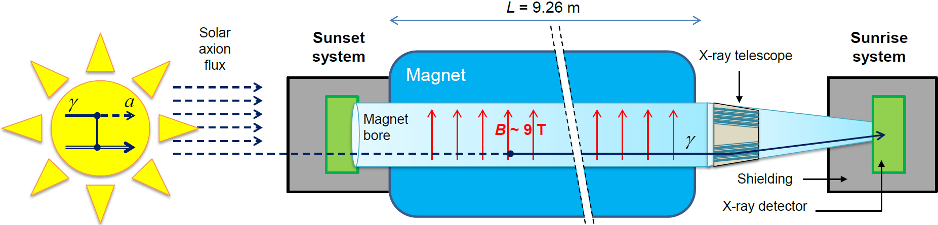


BabyIAXO detectors
High detection efficiency in the RoI (0-10 keV)
Very low background < 10 keV: 10⁻⁷ c/keV/cm²/s :
less than 1 event per 6 months of data taking!
  ➔ use of shielding
  ➔ radiopurity
  ➔ advanced event discrimination strategies
Baseline detector technology: Time Projection Chambers (TPC) based on the Micromegas technology after the experience of the CAST experiment.
UDY7AR
ANR-19-CE31 0024
16
16

Slide 17
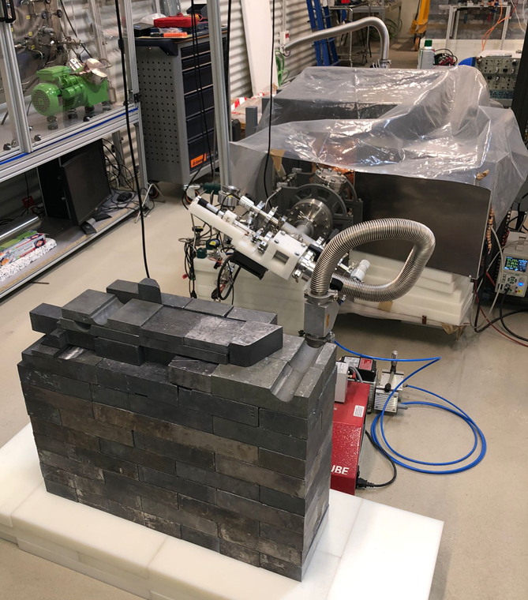
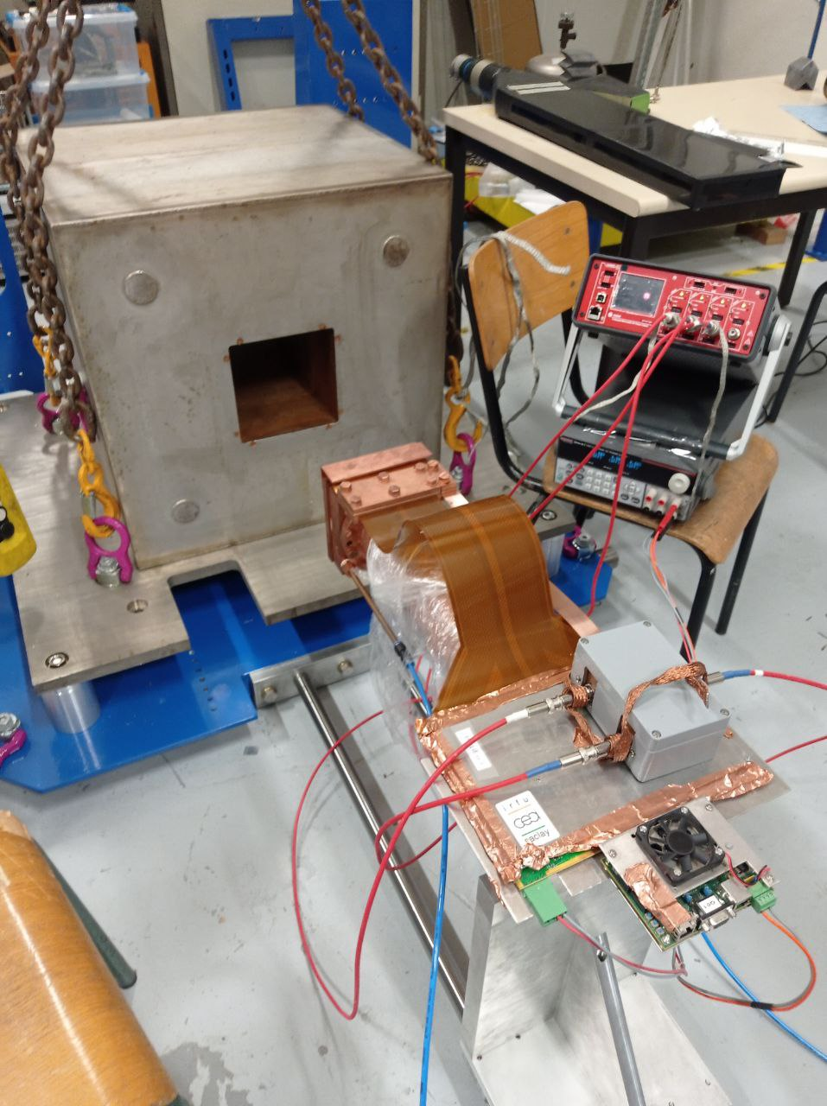
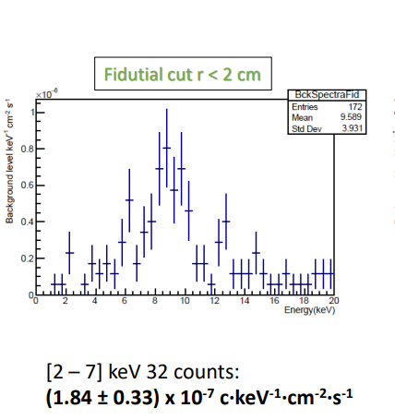
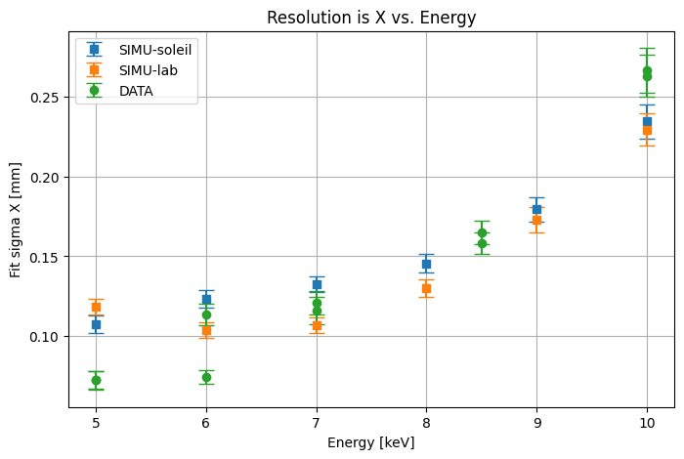
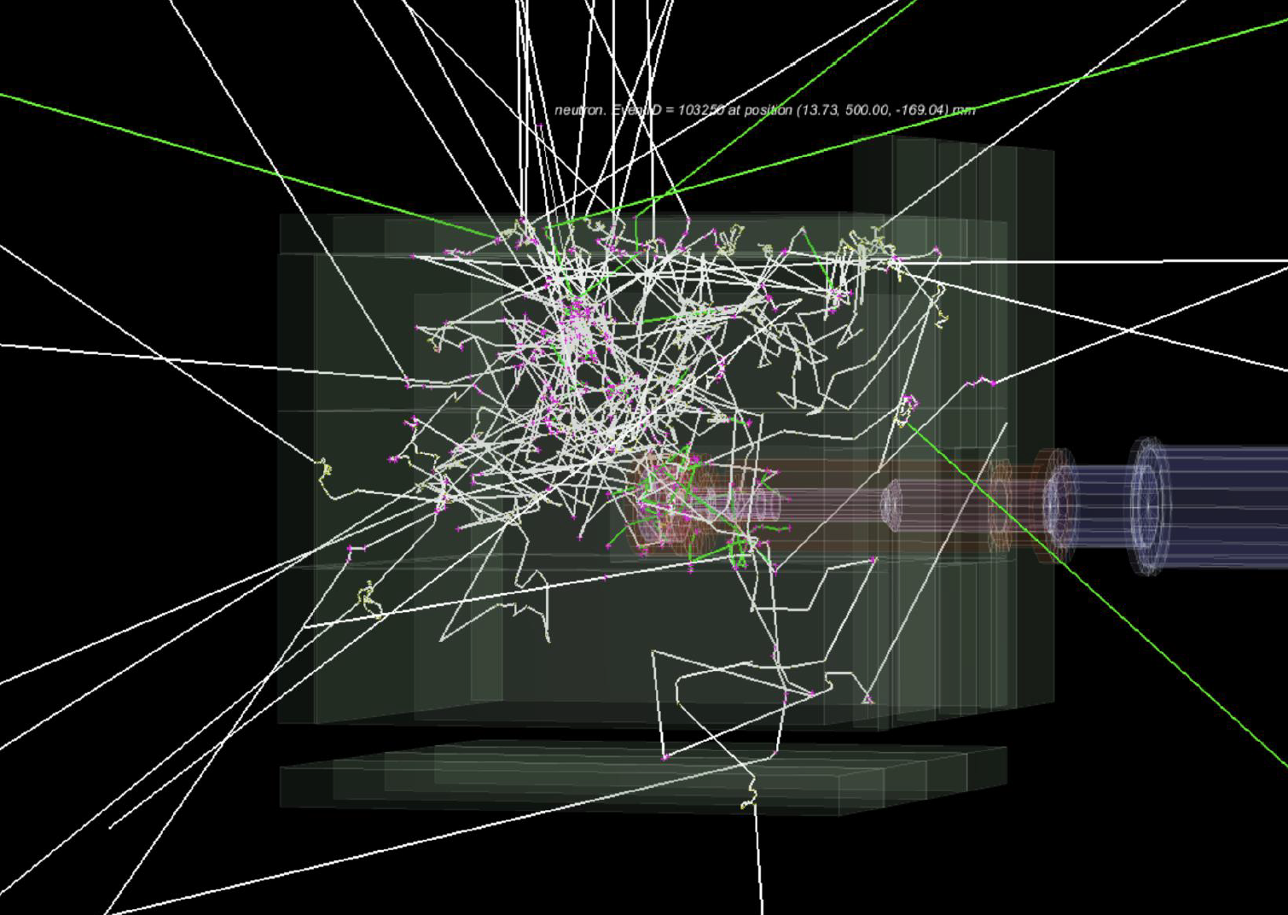
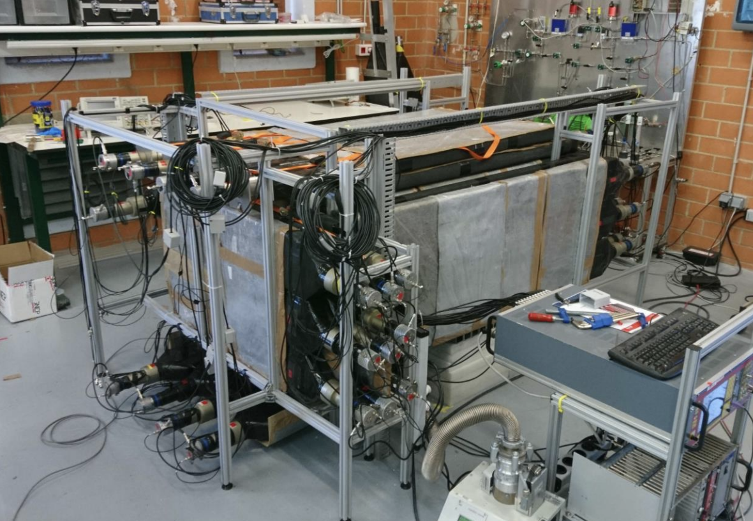
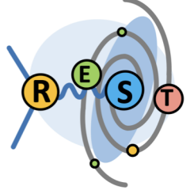
Detectors: IAXO-D1 prototypes
BabyIAXO Micromegas prototypes
BabyIAXO target background recently demonstrated in underground location
  Now working on reproducing same result on surface
Saclay➔DESY
Canfranc
(underground)
~1 count/month background in the RoI!
Simulation studies (neutron event)
SOLEIL test: spatial resolution
System on suface to test active shielding concepts (cosmic neutron tagging)
CAPA-Zaragoza
A. Quintana et al. Nucl.Instrum.Meth.A 1083 (2026) 171176

Slide 18
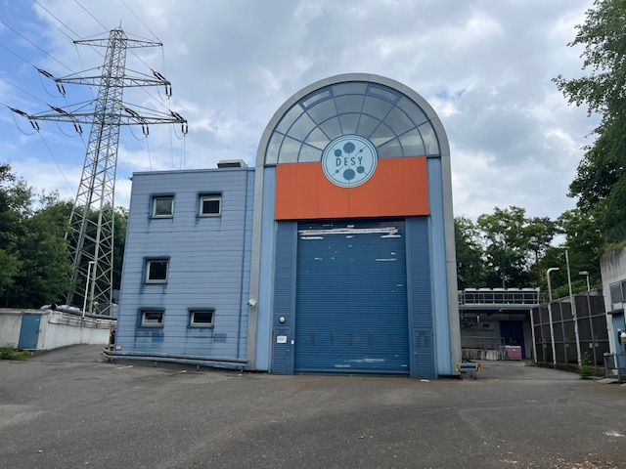
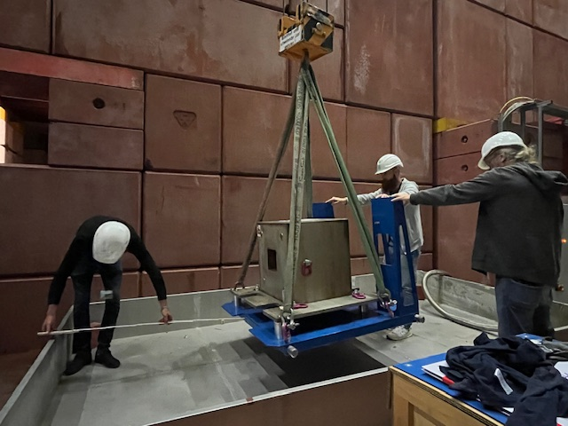
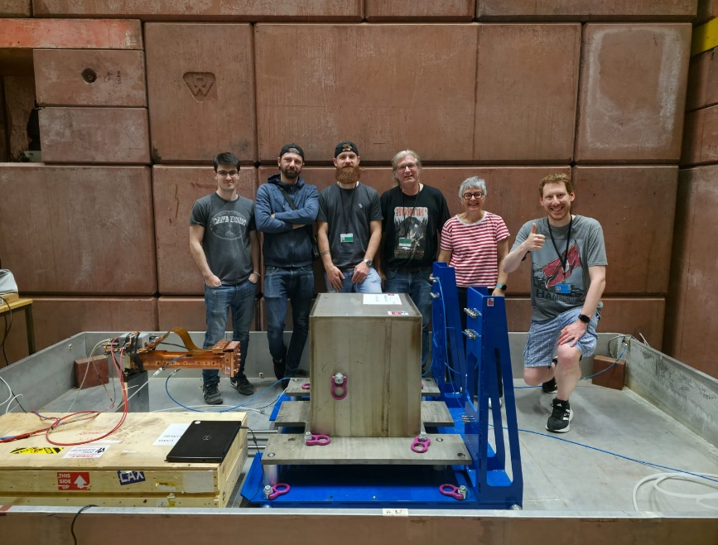
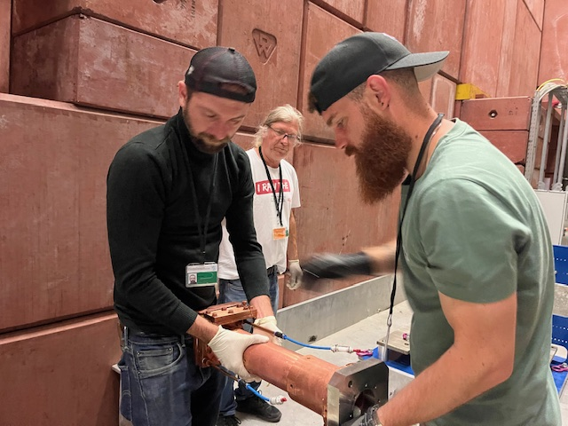
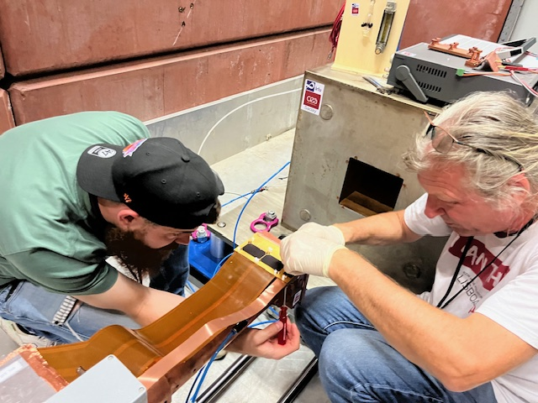
Detectors: IAXO-D1 prototypes
First Micromegas prototype @ DESY
Transport from Saclay to DESY in June 2025
HERA NORTH
ANR-19-CE31 0024

Slide 19
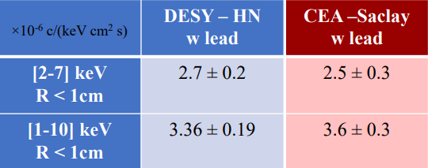
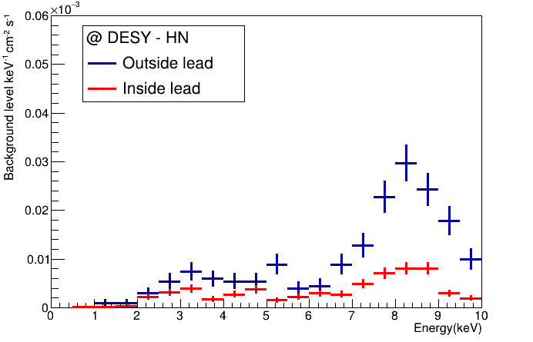
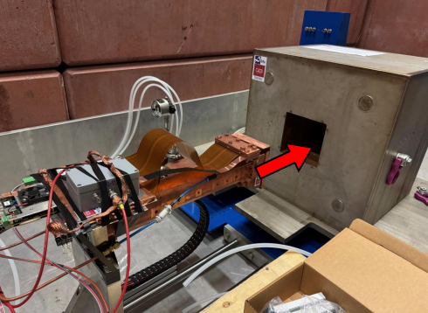
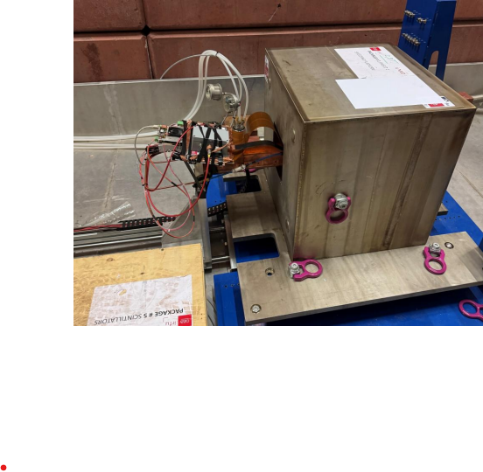
Detectors: IAXO-D1 prototypes
First Micromegas prototype @ DESY
Compatible data takings in the two sites
Next steps:
  Muon/neutron veto
  Radiopure electronics

Slide 20
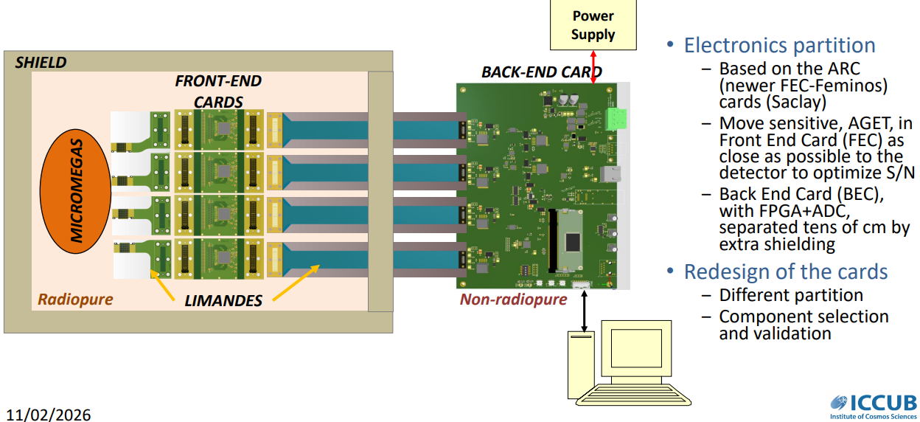
Complementary technologies
Development of radiopure electronics
Eduardo Picatoste (ICCUB)

Slide 21

Complementary technologies
Development of radiopure electronics
Eduardo Picatoste (ICCUB)
Tests with an operating detector at the University of Zaragoza on-going

Slide 22




Complementary technologies
Complementary detector technologies
Beyond baseline, “high precision” detectors : Gridpix, Metallic Magnetic Calorimeters (MMC), Transition Edge Sensors (TES) and Silicon Drift Detectors (SDD)
  Better threshold & energy resolution
  Design and material optimization ongoing in all fronts
  Background studies with different shielding configurations
Post-discovery scenario: If positive signal, low threshold + good energy resolution➔ possibility to determine m_{a} and g_{ae}
Minimization of systematics effects and reinforcement of the claim significance
Phys. Rev. D 99, 035037
Gridpix
SDD
MMC
TES

Slide 23

Complementary technologies
Radiopurity measurements at Canfranc
The radioassay of materials and components for IAXO at the Canfranc Underground Laboratory mainly based on Ge gamma spectroscopy
Items related to all detector technologies
Example by Susana Cebrian

Slide 24


BabyIAXO construction at DESY
Site: DESY on-surface site.
Support and Drive System: Reusing (parts of) CTA MST Prototype (Berlin)
Technical coordination and project office very active, WBS, PBS, …

Slide 25


BabyIAXO under construction at DESY
Current BabyIAXO timeline:
2026: Site activation
2027: magnetless- commissioning
2028: dark photon run
2029: magnet installation
2030+: commissioning + axion runs

Slide 26
CONCLUSIONS
IAXO has a unique physics case in the “axion experimental landscape”. A discovery is possible, already at the BabyIAXO stage (expected commissioning~2030)
BabyIAXO is under construction at DESY: support drive system, vacuum lines, the first Micromegas detector is on site
Active detector development: discovery and energy resolution detectors
BabyIAXO constitutes a great infrastructure that can be used to target other physics goals beyond Primakoff solar axions

Slide 27
BACK UP

Slide 28




BabyIAXO: beyond solar axions
BabyIAXO as a generic axion(-like) facility
BabyIAXO constitutes a great infrastructure that can be used to target other physics goals beyond Primakoff solar axions:
Dark Matter axions: haloscope setups inside the BabyIAXO bores
Axions from SN
BACK UP
Other (non-Primakoff) solar axion production mechanisms
Other WISPs: hidden (dark) photons, chameleons, …
post-Discovery “precision” physics

Slide 29







RADES: born at CERN
RADES (Relic Axion Detector Experimental Setup)
Exploratory project emerged at a later stage of CAST: use of “helioscope” magnets for “haloscope” searches
Creation and build-up “axion haloscope” community in Europe
Strong boost by ERC-StG (B. Döbrich) in 2018
Now ultra-cryogenic setup being built at MPP-Munich
DarkQuantum ERC-SyG started 2024 (Irastorza, Kontos, Paraoanu, Wernsdorfer)
Various R&D and physics results
Physics result at single f point in CAST and in SM18 magnets
Inner HTS coatings to improve Q factor
New geometry concepts to scale in V but keeping high resonant f
JCAP 05 (2018) 040
JHEP 07 (2020) 084
IEEE Trans. Appl. Supercond. 32 (2022) 45
JHEP 21 (2020) 075
JHEP 04 (2025) 113
RENATA meeting, CAPA, 22/9/25
Igor G. Irastorza / CAPA - Zaragoza

