Slide 1
Evolution of underground science in LSM
Laboratoire Souterrain de Modane
From digging to modern experiments

Slide 2
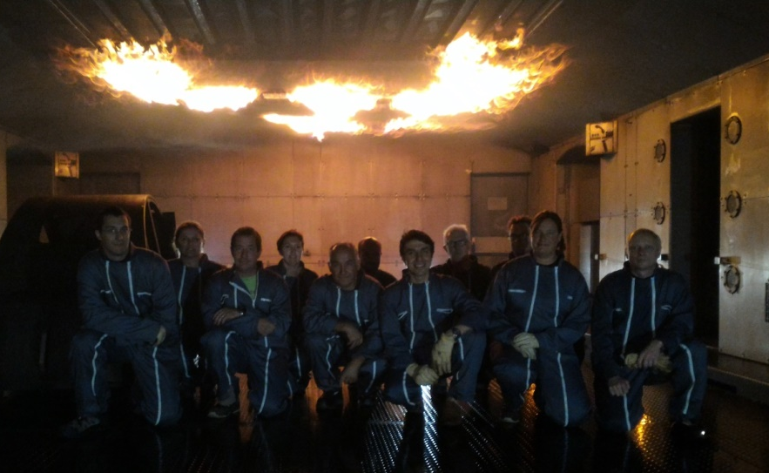


Laboratoire Souterrain de Modane
Located in Modane,France
Middle of Fréjus tunnel
Part of LPSC; Lab in Grenoble
National facility for underground science
1000 visitors days per year
Wide range of interdisciplinary topics
Astroparticles, nuclear physic, environment, electronics, radioactivity measurement, biology

Slide 3

Laboratoire Souterrain de Modane
Merger with Laboratoire de Physique Subatomique & Cosmologie (LPSC-IN2P3) in Grenoble
  70 researchers, 90 Engineers & technicians
  Covering fields in particle & nuclear physics, astroparticle and cosmology
LSM now becomes a « national facility » as labelled by the CNRS
  National facility for IN2P3 / CNRS
LSM as a national experimental facility for :
  Fundamental Physics
    Neutrino property determination
    Direct Dark matter search
  Gamma spectrometry measurement
    14 detectors measuring continuously
    Open to geosciences, materials, biology and medecine
      Actually 1000 samples measured per year
    PARTAGe project to automatize measurments
      Increase significantly the scope of the LSM

Slide 4
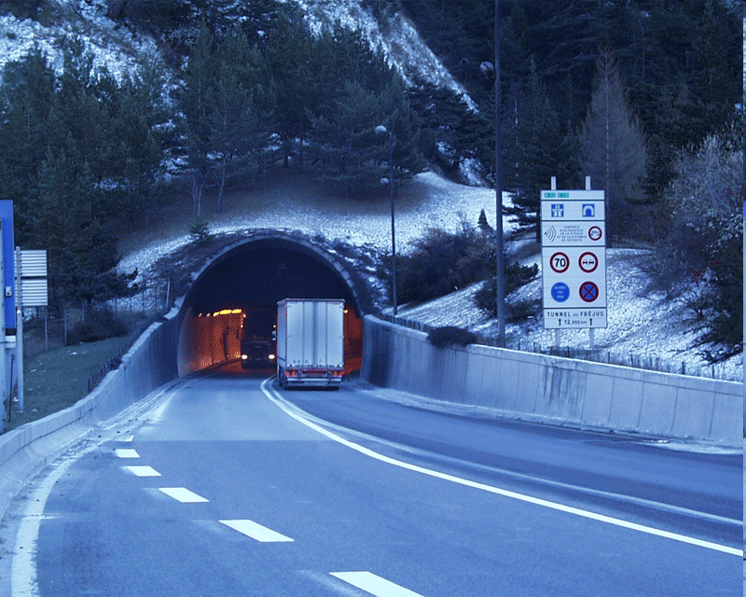
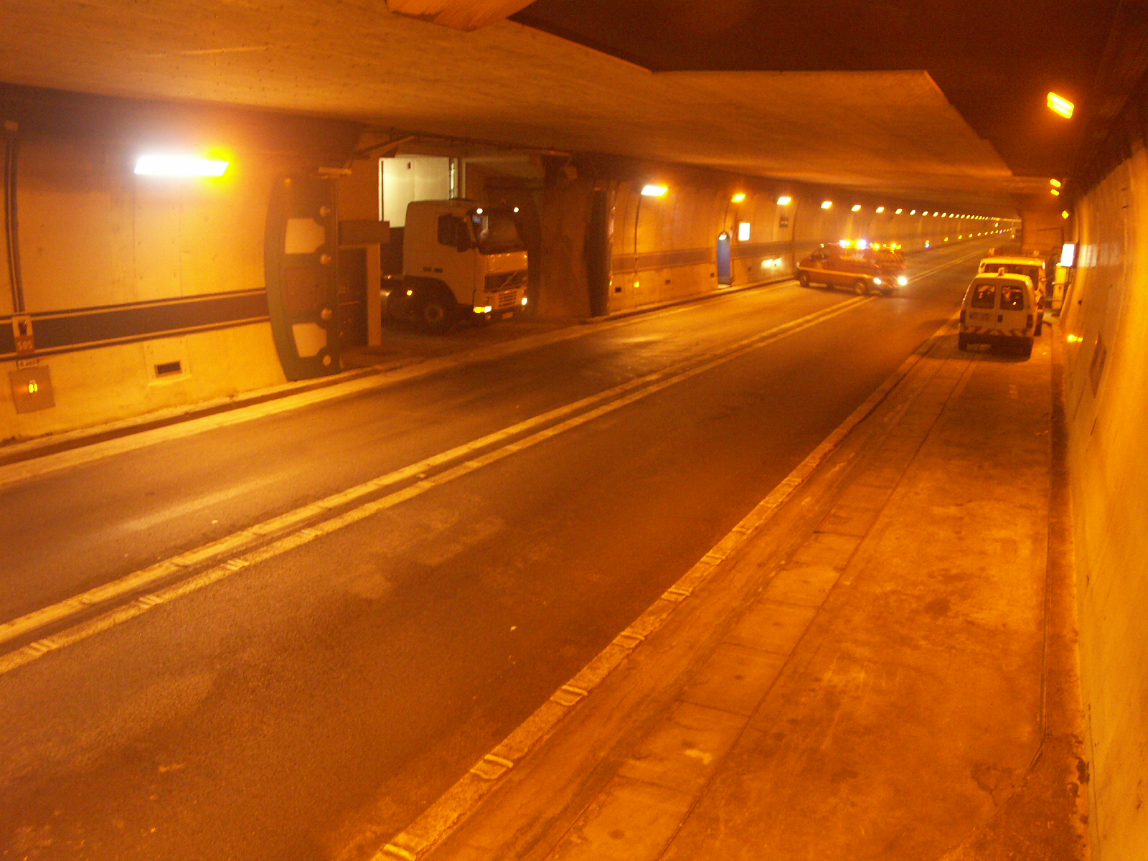
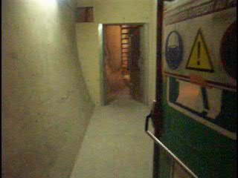
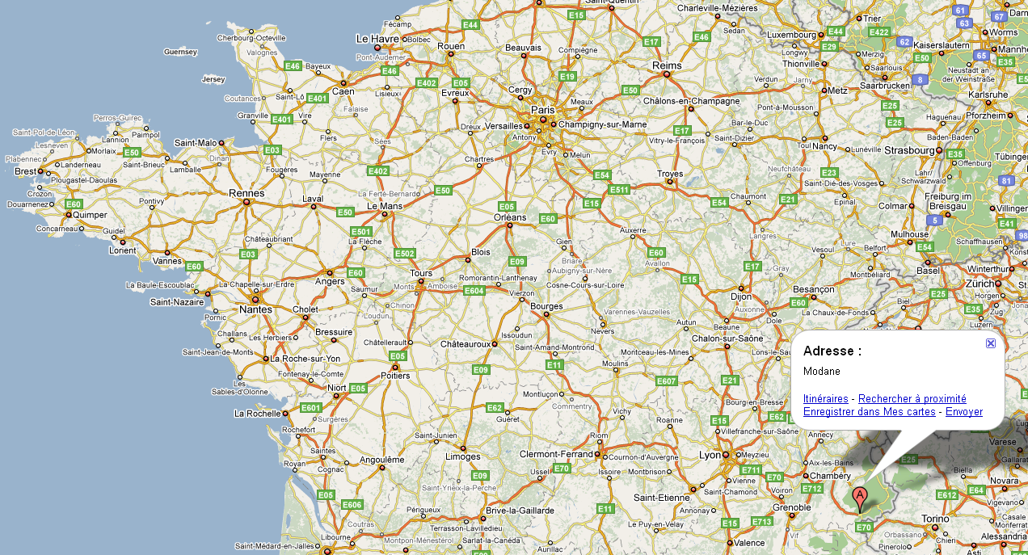
Location and access
4 fire-proof doors
Footmen entrance
LSM
Tunnel Routier du Fréjus

Slide 5
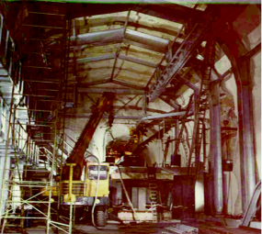
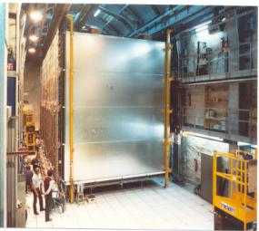
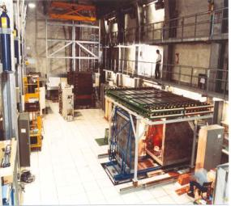
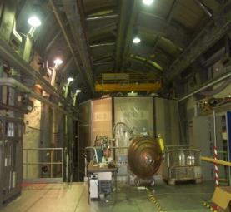
History of LSM
1979 - 1981
1982- 1990
1990- 2000
2000 - ….
Digging
Proton decay
Prototypes Experiments
2.10⁻⁶ n/cm².S
4 µ/m².d
3500m³
400m²
15Bq/m³ Rn in air
Radonless air 125m³/h 15mBq/m³

Slide 6
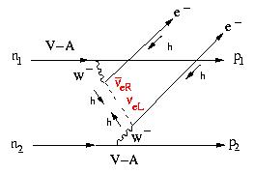
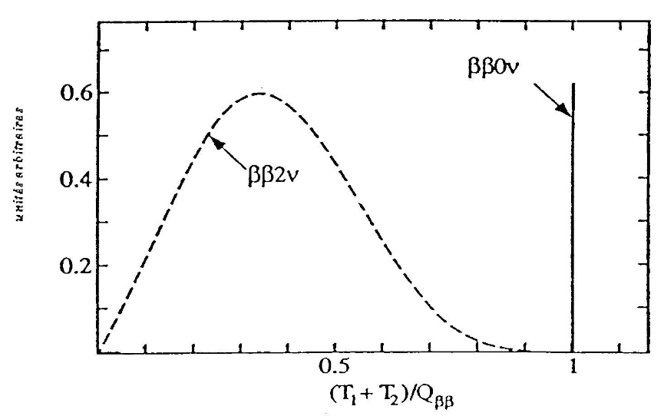
Double beta decay
bb0n : (A,Z) → (A,Z+2)+2e⁻
Double beta decay
DL = 2
n = ‾n Majorana’s neutrino
m_{n} ≠ 0
⇔
Measure
( )⁻¹ = C ( ) M² <m_{n}>²
Q⁵
_{bb}
C : phase space factor
M : nuclear matrix element
< m_{n} > : effective neutrino mass
(Q_{bb} ~ MeV)
Full electron energy
< m_{n} > ⇒ mass hierarchy

Slide 7
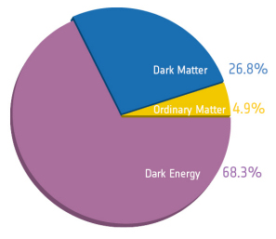
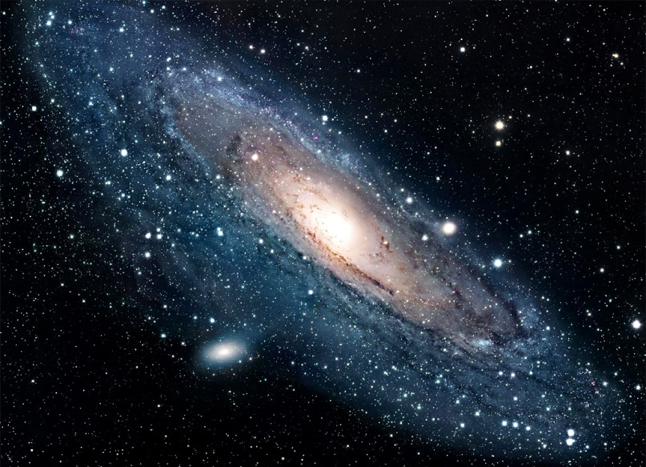
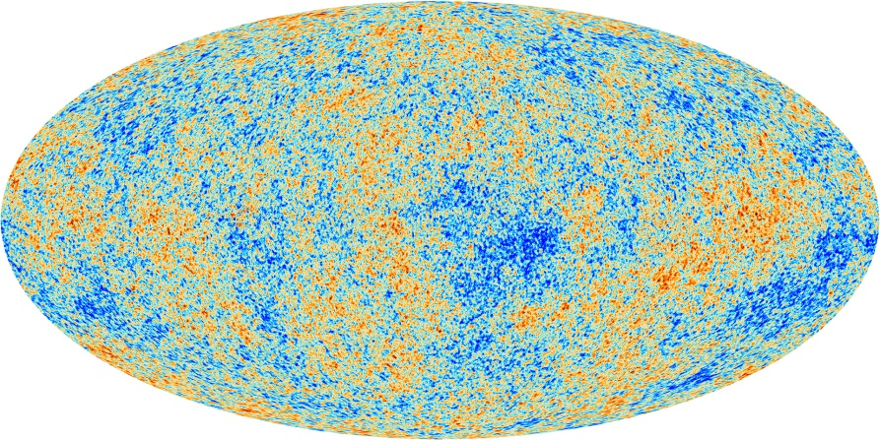
Dark matter search
Major physics goal
Direct detection would answer to a lot of question
WIMP candidate is a target for underground detection
CMB anisotropy
Speed
Measured
Theoretical

Slide 8
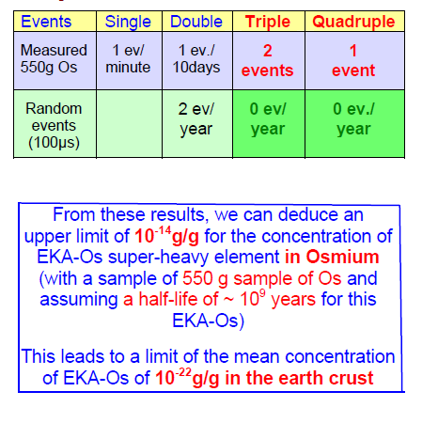
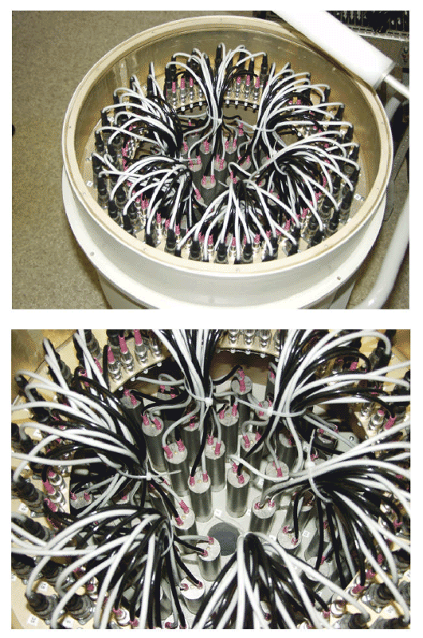
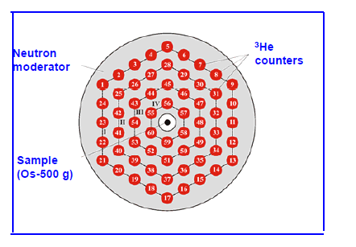

SHIN
Super heavy element with half life >²³⁸U
Z=108 targeted with self fission producing >5n
Nuclear physics
Super Heavy Element In nature
SHIN (osmium ore surrounded by 3He neutron detectors)
TGV II

Slide 9
Low radioactivity constraints
Requirement on material below mBq
Strong pressure on analytical capabilities
Increased number of pieces and longer time
Main measurement performed by gamma ray spectrometry
Constant effort took place in LSM to develop ultra low background germanium
Hosting 22 HPGe by 2020
16 effectively in shield

Slide 10
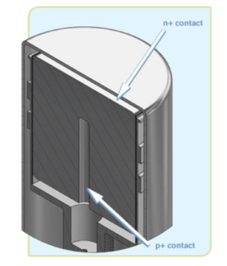
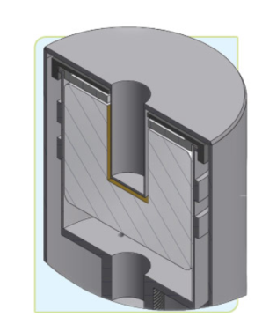
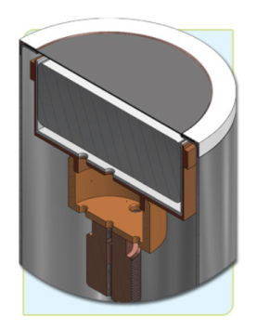
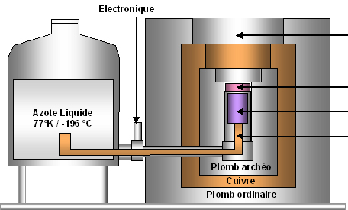
High purity germanium
Semi conductor crystal cooled down to 77 K
Sample at room temperature
Sensitive to gammas from 20keV up to 3MeV
Non destructive measurement
Sensitive to muons and cosmic activation
Different detectors adapted to samples shape
Coax
Well
Planar
endcap
sample
crystal
cold finger
Notes:
Quick reminder of the basis of a Germanium detector

Slide 11
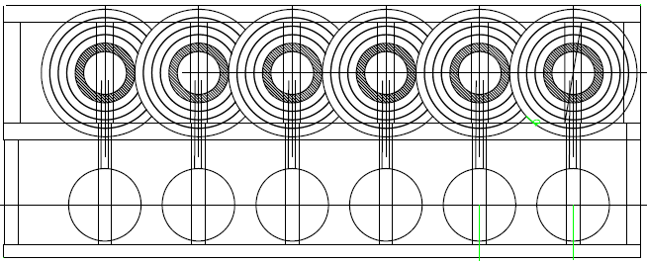
Future of measurement at LSM
PARTAGe project
  Combining shields in common walls
Robotisation
Optimisation of measurement time based on the radiopurity objectives

Slide 12
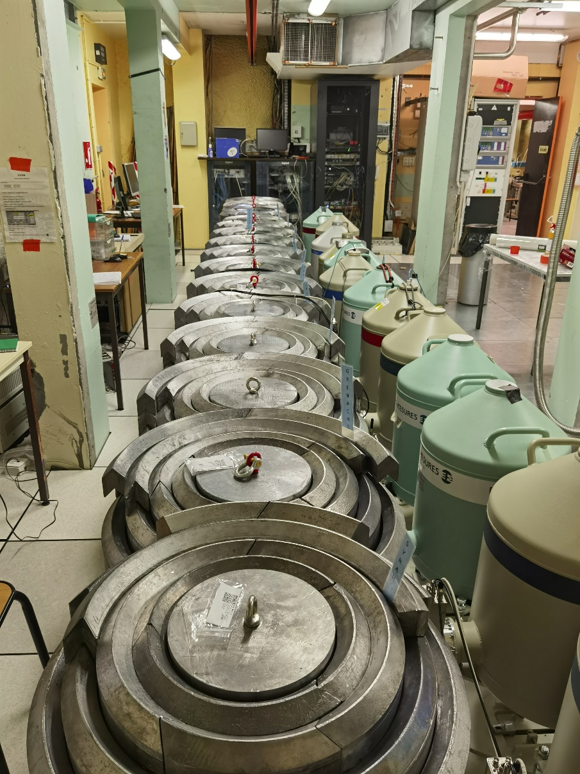
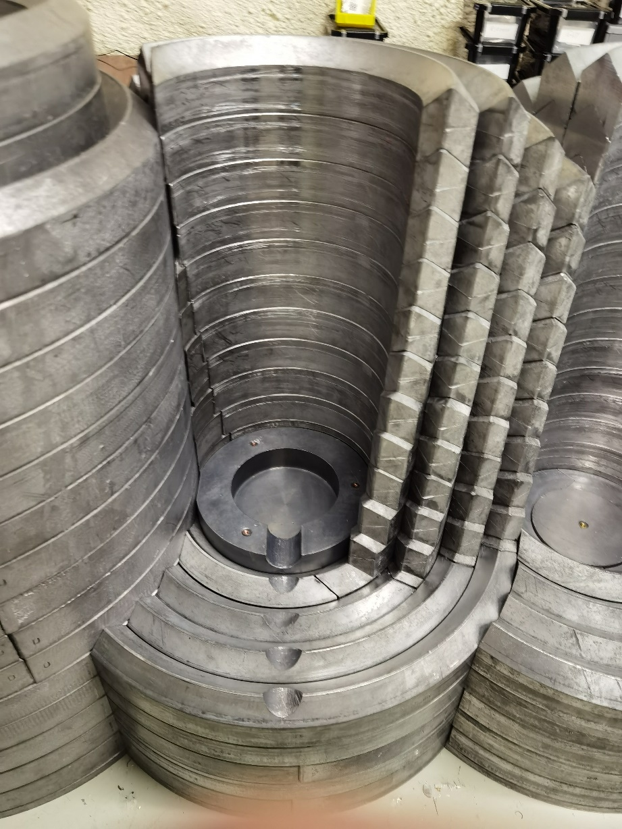
Shielding in progress

Slide 13
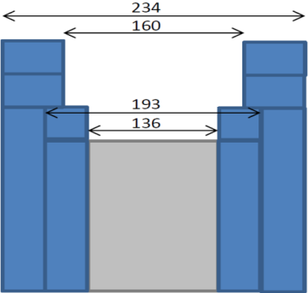
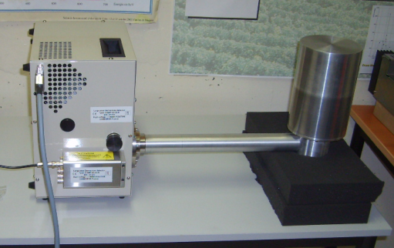
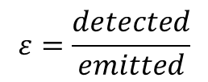

Germanium facility
Example of detection limits
Mafalda : (our swiss army knife)
Size 150 cc – 43,1%
  Φ 80mm h 31,7mm
Resolution
  122 keV 920 eV
  1,33MeV 1,97keV
  Background
    Integral 115±3,5 count/day
    133 c/kg
    Peaks
    46,5 keV 1,49 ± 0,37 c/d [210Pb]
    75 keV 3,6 ± 0,62c/d [Pb]
Shielding
536
Std
Std
ARCH
Silicon wafer measurement
700 000s 650g
limit (Bq)$=\frac{1,43+2,36\sqrt{1,36+bdf×t}}{ε\left(m\right) m t}$
Nucleide |  | Bq/kg
210Pb | < | 1,58E-02
²²⁶Ra | < | 1,27E-03
238U | < | 6,27E-03
228Ra | < | 3,82E-03
228Th | < | 8,66E-04
$$ε=\frac{detected}{emitted}$$

Slide 14
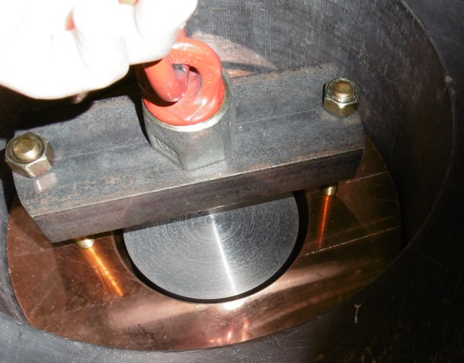
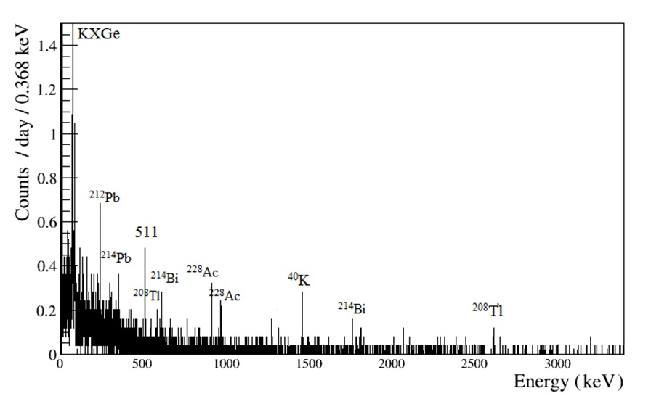
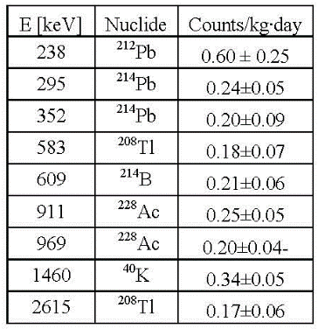
Germanium facility
Improving detection limit :
  Imply choices :
Theoretical sample of 1kg for 500000s
This detector can welcome much bigger sample but the low energy gamma are stopped by the dead layer around the detector.
Obélix :
Size
  600cc-160%
Background
  95 counts/kg.d
Resolution
  122 keV 1,1 keV
  1,33MeV 2keV
Nucleide |  | Bq/kg
210Pb |  | NA
²²⁶Ra | < | 4,96E-4
238U |  | NA
228Ra | < | 1,78E-03
228Th | < | 4,37E-04
Sample Chamber
250 mm
200 mm

Slide 15
Nickel measurement
Decay mode | Final state or Decay transition | T_{1/2}, (90% CL) | Previous limits, T_{1/2}
β⁺EC | g.s. | 1.7×10²² y | 7.0×10²⁰ y (68%CL)*
β⁺EC | 811 keV | 2.3×10²² y | 4.0×10²⁰ y (68%CL)*
EC/EC | 811 keV | 3.3×10²² y | 4.0×10¹⁹ y (90%CL)**
EC/EC | 1675 keV | 3.4×10²² y | 4.0×10¹⁹ y (90%CL)**
0νEC/EC resonant | Radiative 1918 keV | 4.1×10²² y | 2.1×10²¹ y (90%CL)***
*S.I. Vasil'ev et al., JETP Lett. 57 (1993) 631.
**E. Bellotti et al., Lett. Nuovo Cim. 33 (1982) 273.
***B. Lehnert et al., J. Phys. G: Nucl. Part. Phys. 43 (2016) 065201
N.I.Rukhadze (JINR, Dubna)

Slide 16
Germanium detector
Example of detection limits
Mafalda : (our swiss army knife)
Size 150 cc – 43,1%
  Φ 80mm h 31,7mm
Resolution
  122 keV 920 eV
  1,33MeV 1,97keV
  Background
    Integral 115±3,5 count/day
    133 c/kg
    Peaks
    46,5 keV 1,49 ± 0,37 c/d [210Pb]
    75 keV 3,6 ± 0,62c/d [Pb]
Shielding
536
Std
Std
ARCH
Silicon wafer measurement
700 000s 650g
limit (Bq)$=\frac{1,43+2,36\sqrt{1,36+bdf×t}}{ε\left(m\right) m t}$
Nucleide |  | Bq/kg
210Pb | < | 1,58E-02
²²⁶Ra | < | 1,27E-03
238U | < | 6,27E-03
228Ra | < | 3,82E-03
228Th | < | 8,66E-04
$$ε=\frac{detected}{emitted}$$

Slide 17
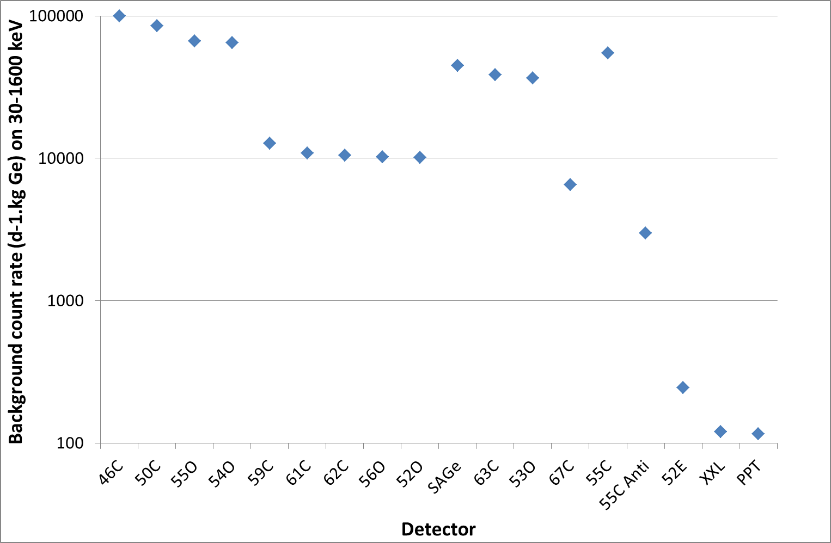

IRSN
anti-cosmic devices
Orsay
Modane
 | 52E | XXL | PPT
Pb (cm) | 20 | 25 | 15
Archeologiocal Pb (cm) | 5,4 | 4 | 6
Background coute rate 30-1600 keV (d⁻¹.kg_{Ge}⁻¹) | 245 | 120 | 116

Slide 18
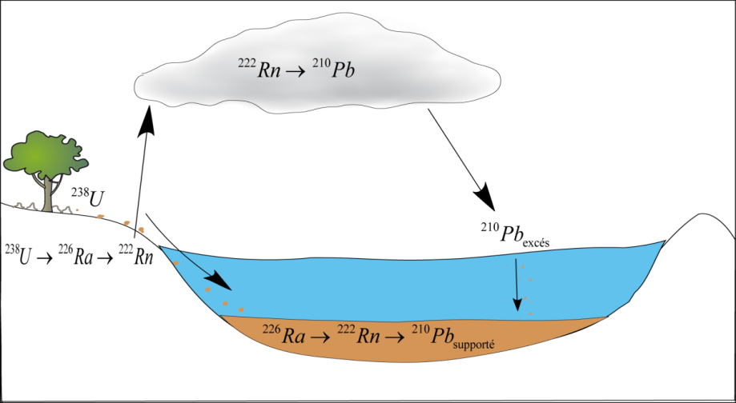
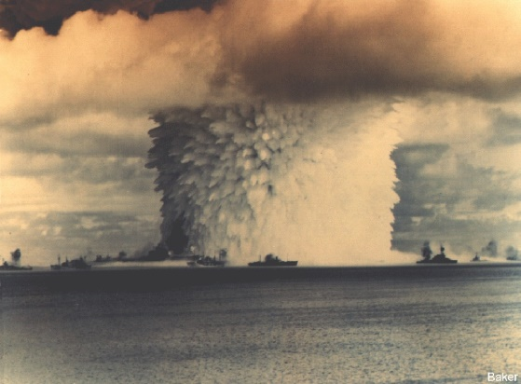
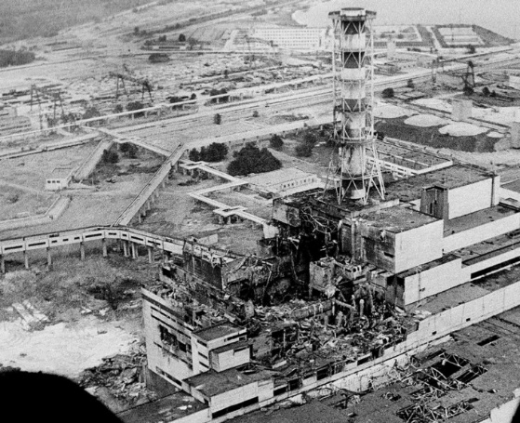

Analitycal power for interdiciplinarity
Possibility to measure a wide range of nucleides
Used in many environmental datation
Relative datation
Absolute datation
¹³⁷Cs + ²⁴¹Am
1963
¹³⁷Cs only
1986

Slide 19
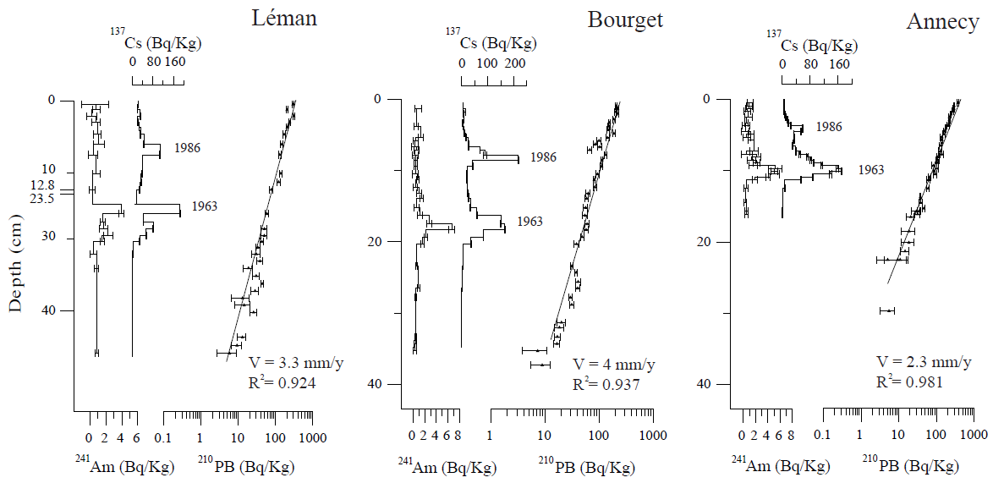
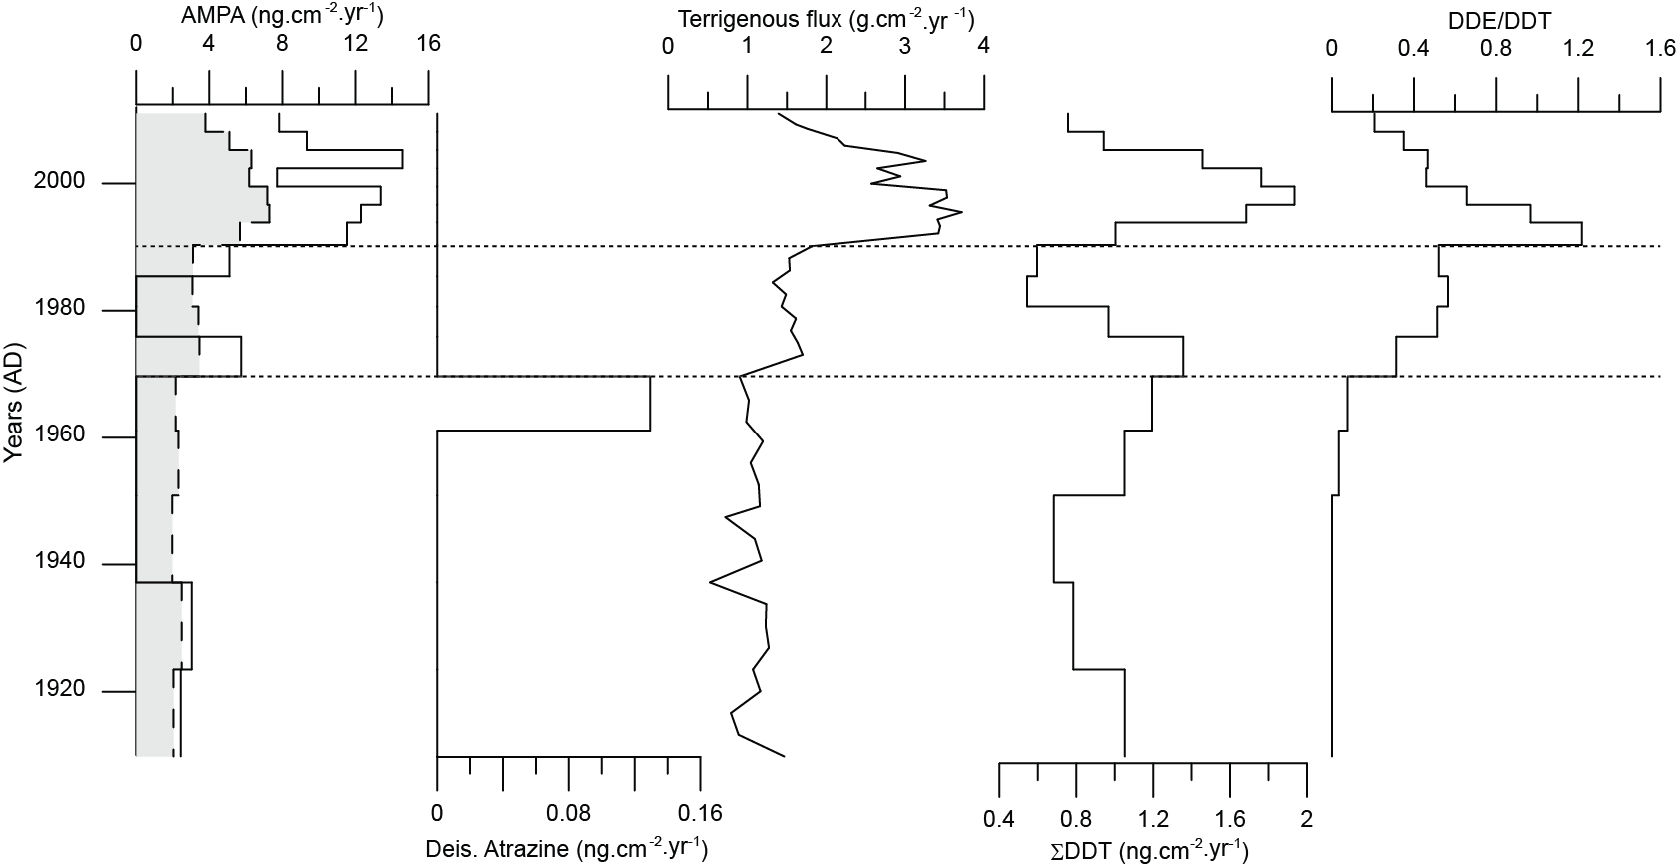

Lake survey
210Pb gives the sedimentation rate
Confirmed by artificials nucleides
Allowing to reconstruct the history of a lake without archives
Sabatier et al., 2014, PNAS

Slide 20
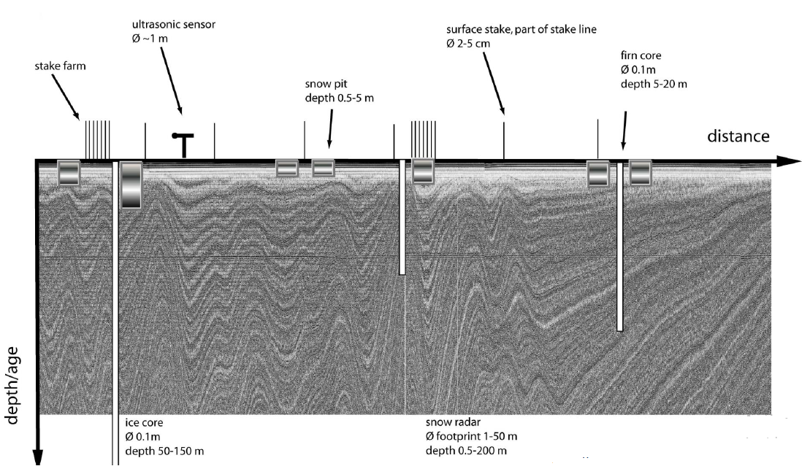
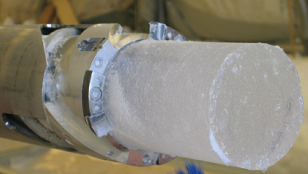

Ice survey
Datation of ice core in antartica
Calibration of radar
Temporal marker for climate change
2 days measure needed in underground lab

Slide 21
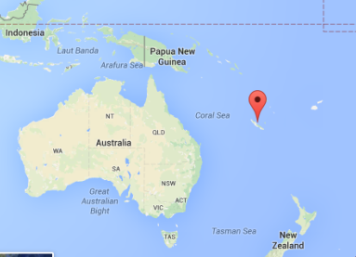
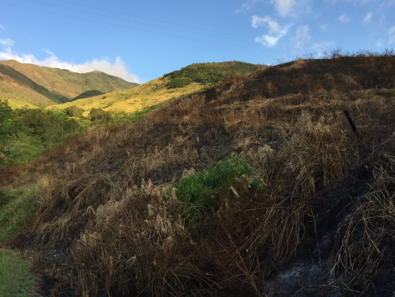
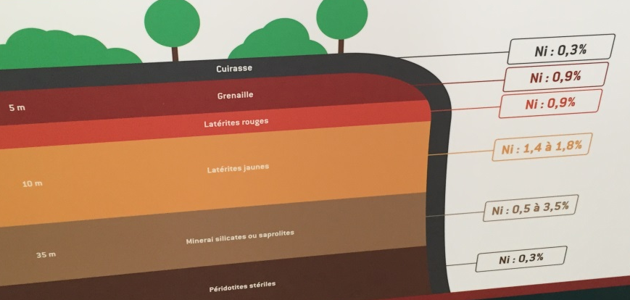
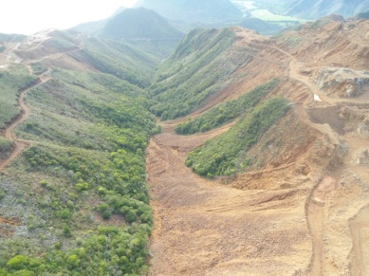
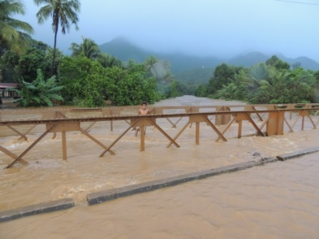


Erosion survey
Sources of sediment in mining catchments of New Caledonia
Two main sources of sediment to the main river
Non-mining tributaries
Mining tributaries
¹³⁷Cs
Ø ¹³⁷Cs
Discrimination of contributions of both types of tributaries based on their activities in natural/artificial radionuclides
Quantification using mixing models
Analysis of sediment cores collected in the delta to reconstruct changes in source contributions with time

Slide 22
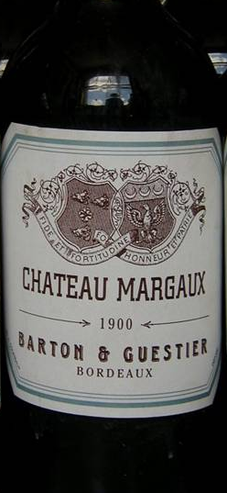
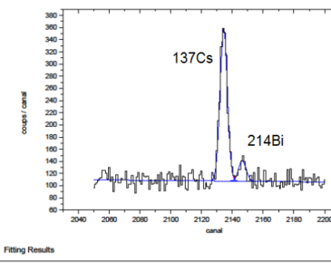
Millesime identification
Nuclear fallout
1 Bq/l
Margaux 1900 ?
Tchernobyl
year /

Slide 23
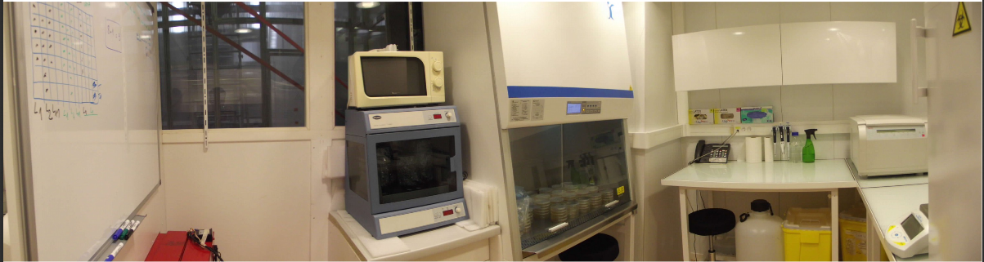
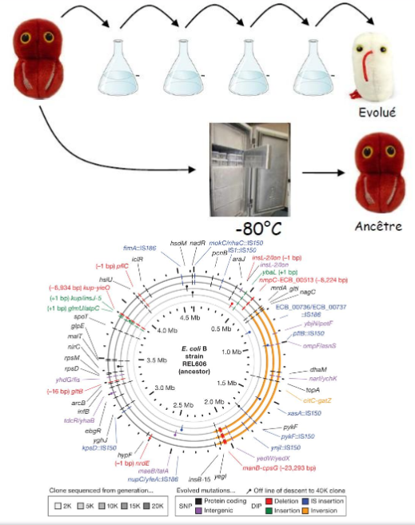
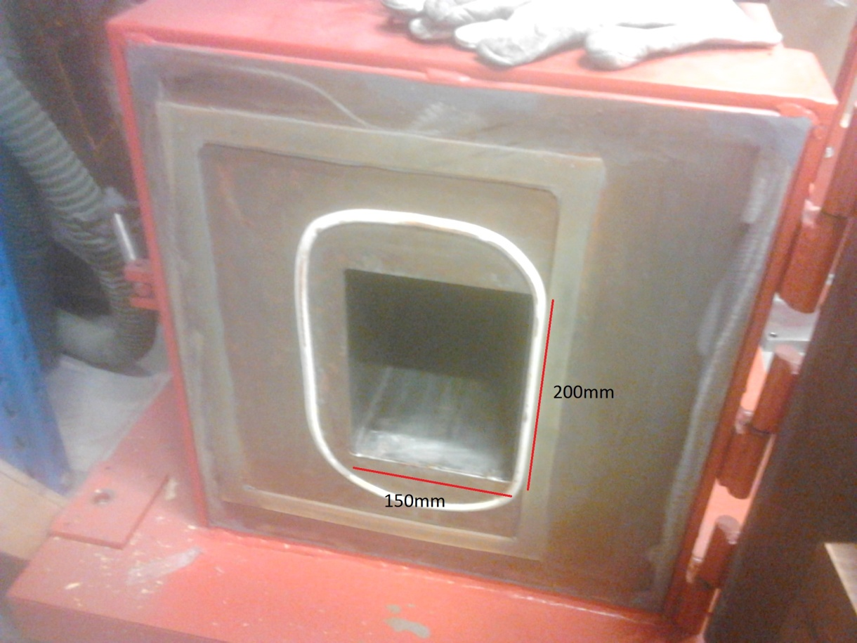
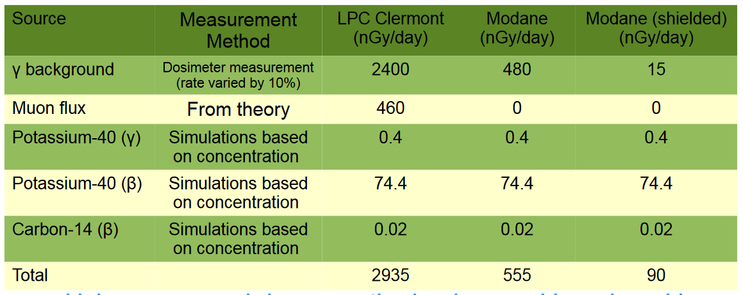
Biology at LSM
Evolution driven by radiation
Comparison between surface and underground bacteria culture 800 generations harvested

Slide 24
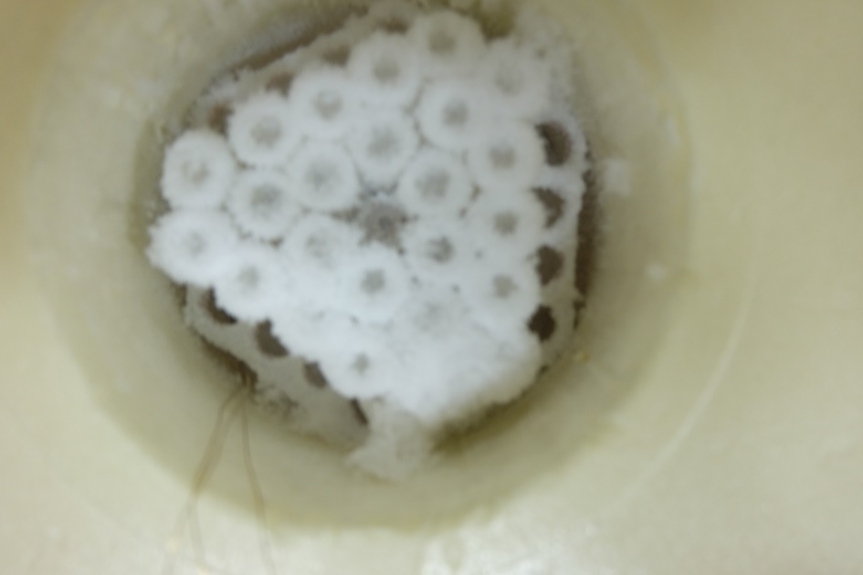

Stem cell storage
LSM-pasteur institute collaboration
Funded by interdisciplanary mission from CNRS
Allowed to test a stem cell storage shielded from natural radioactivity and terrestrial cosmic rays
Patented solution
Publication in progress
P. ROCHETEAU, G. WAROT, M. CHAPELLIER,
M. ZAMPAOLO, F. CHRETIEN et F. PIQUEMAL –
Cryopreserved Stem Cells Incur Damages Due to
Terrestrial Cosmic Rays Impairing their Integrity Upon
Long-Term Storage, Cell Transplantation, 2022.

Slide 25
Conclusion
Underground labs are designed for large scale fundamental physics
Unique environment find always a use sometimes unforeseen at digging
Leaves room for interdisciplinary program at moderate cost
New fields and discoveries made possible by the access to low level radiation environment

