Slide 1










SPARC – Sensor Pixel Asynchronous Readout CMOS
Camille Fournier on the behalf of SPARC core team
Phd student, Institut Pluridisciplinaire Hubert Curien (IPHC)
Subatomic Research Department, C4PI team
This work was supported by IdEx Unistra (ANR 10 IDEX 0002), and by SFRI STRAT’US project (ANR 20 SFRI 0012) and EUR QMAT ANR‐17‐EURE‐0024.

Slide 2
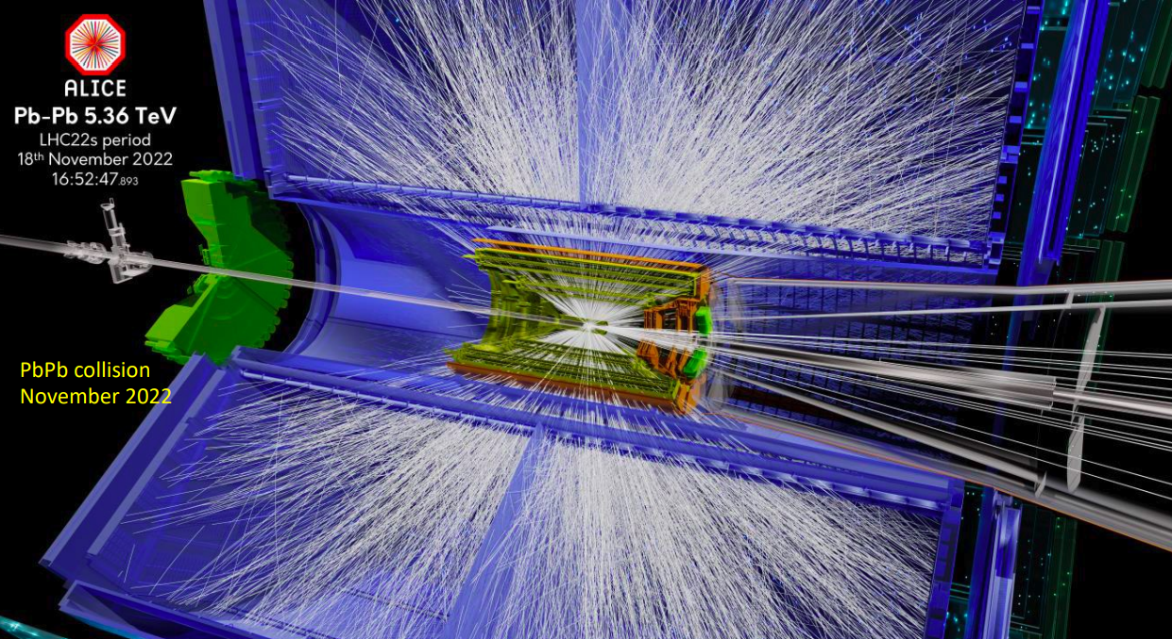
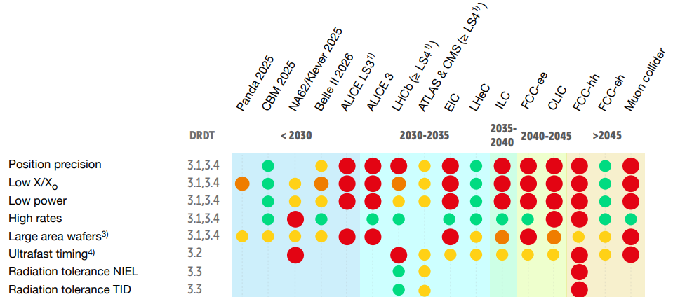
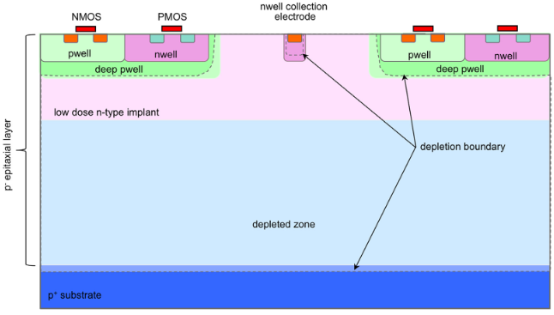

Context
MAPS : Monolithic Active Pixel Sensors
Hit
Detection and readout on the same chip
retrieve the exact hit coordinates within the pixel matrix
Established in the CERN ALICE ITS2 experiment since 2021 (ALPIDE sensors)
Comparator
Amplificator
e-

Slide 3
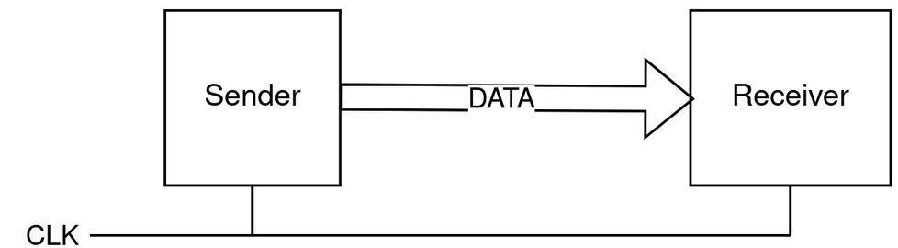
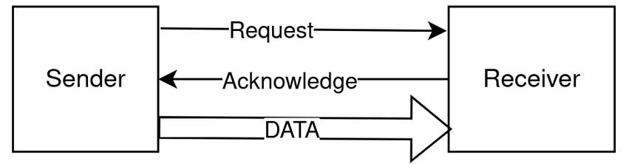
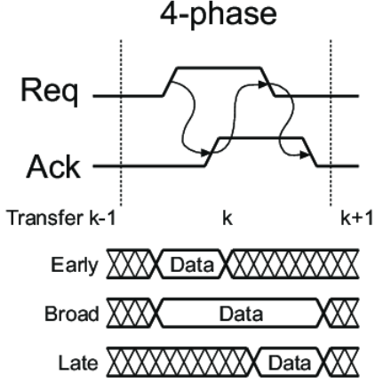
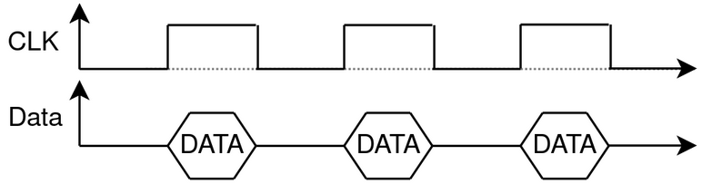
Asynchronous readout reminders
Synchronous
Data are read at regular intervals, synchronized to a common
clock running at a specific frequency
Asynchronous
Data are read immediately when they become available through a handshake protocol
S = sender
R= receiver
S issues data and sets Req high
R absorbs the data and sets ack high
S respond by taking Req low
R put Ack low
(-) Continuous readout (Wastes bandwidth)
(-) Sensitive to synchronization issues
(-) Complex clock distribution (increases latency)
Carlsson, J., Palmkvist, K., & Wanhammar, L. (2003). An 8-by-8 point 2D DCT processor based on the GALS approach. In IEEE NorChip Conference
(+) Data-driven readout

Slide 4
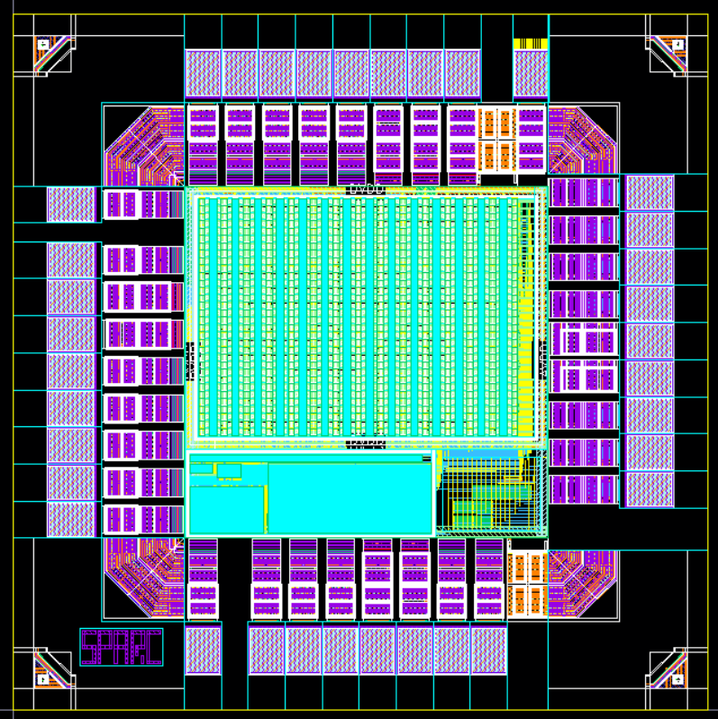
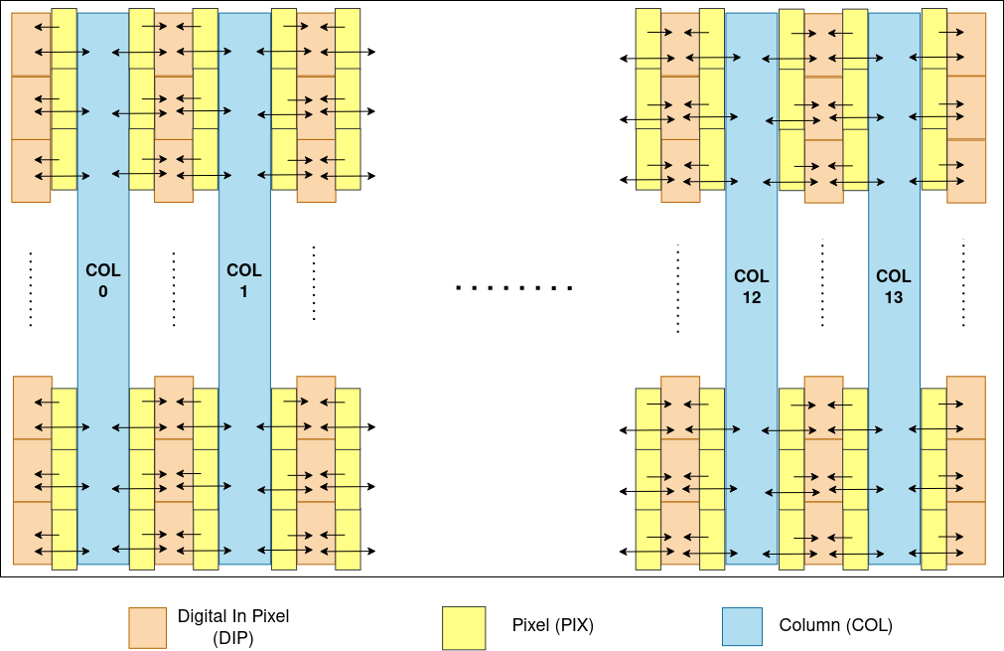
SPARC – Sensor Pixel Asynchronous Readout CMOS
1.5mm
13 double columns of readout :
4 for 2-to-1
4 for 4-to-1
3 for 16-to-1 + 4-to-1
3 for 64-to-1
Enable a comparative evaluation of arbitration granularity and its impact on readout performance.
Soudier, J. (2024). Small prototype of an asynchronous versatile readout. Poster, TWEPP 2024
1.5mm
Layout of SPARC 1.5x1.5 mm build in a TPSCo 65nm
32x28 pixel matrix with a pixel pitch of 25x16 um²
The front-end is directly borrowed from CERN's DPTS

Slide 5
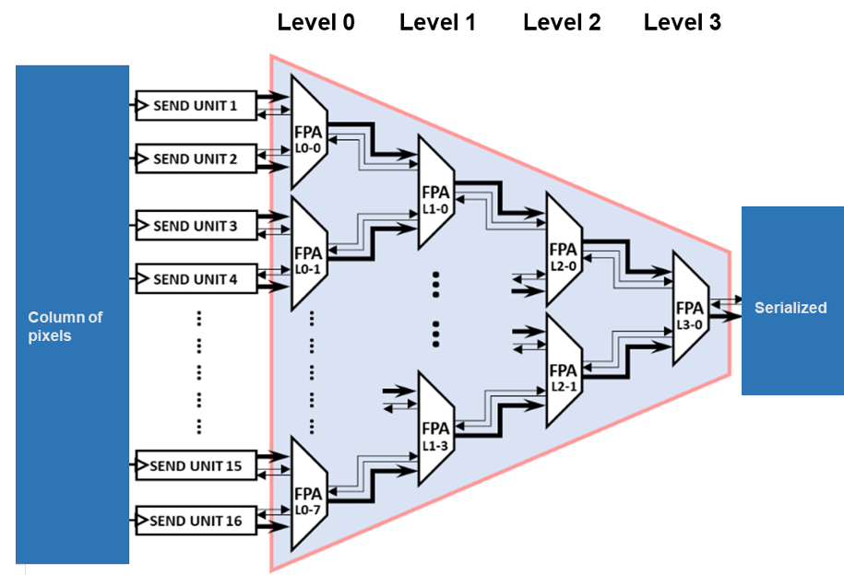
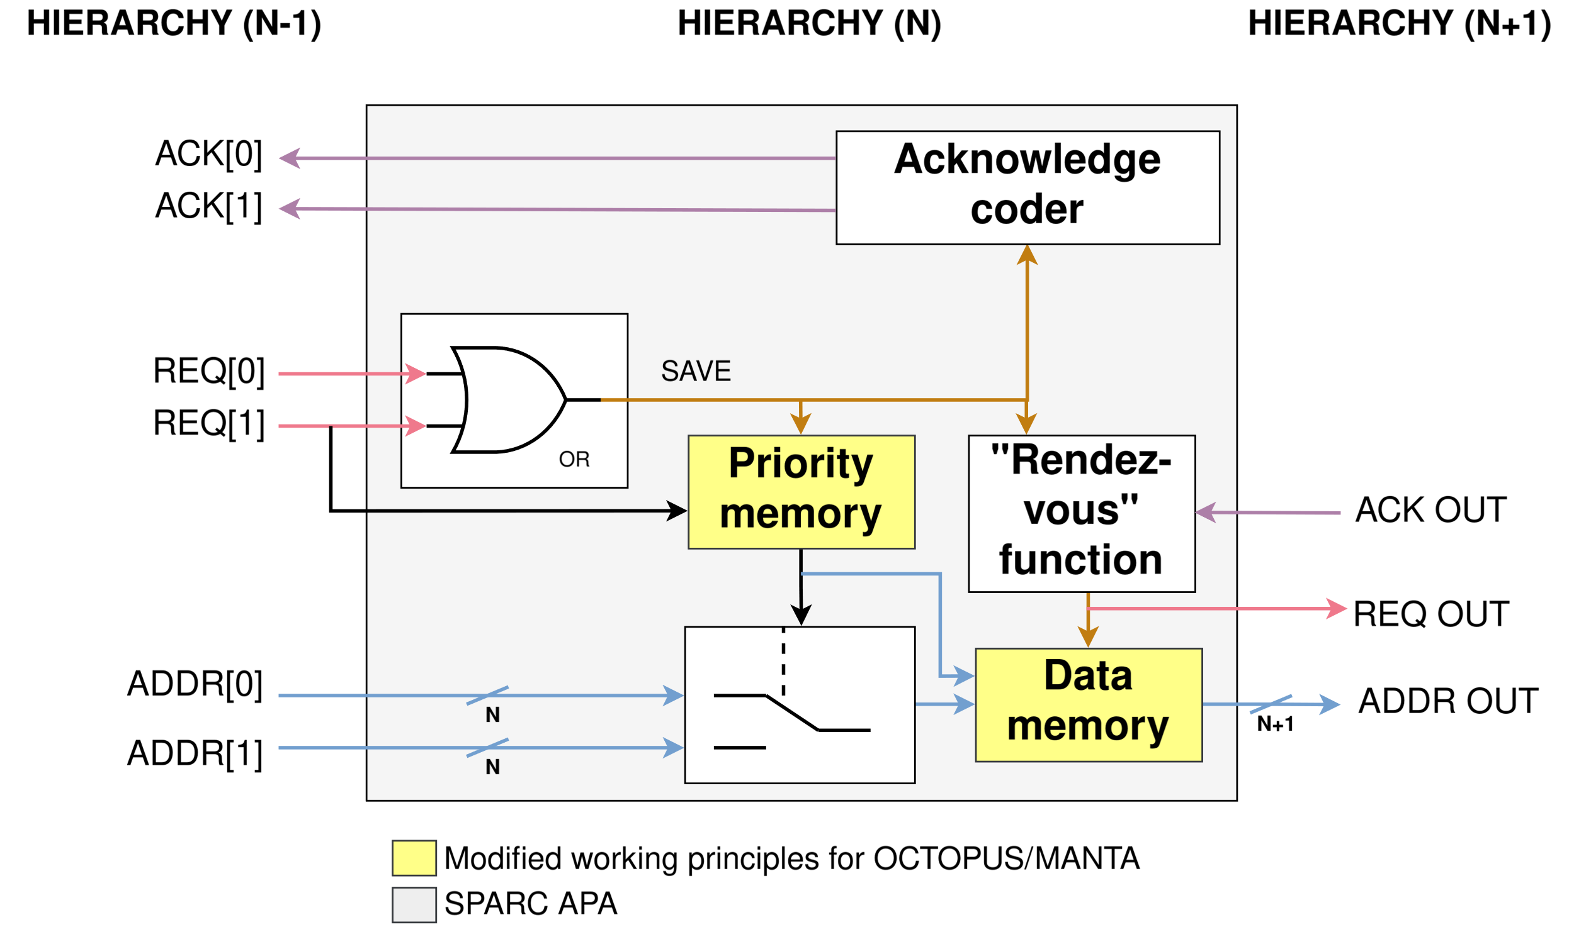
Working principle of the asynchronous readout
Detection : OR gate (SAVE signal)
Arbitration : priority memory, selects the winner
Selection : MUX who routes the winner's address
Handshake : 4-phase rendezvous (REQ↑ ACK↑ REQ↓ ACK↓)
Acknowledgement : ACK coder to releases the served master
Architecture of the APA tree inside of readout columns in the matrix
APA architecture inside of readout columns of SPARC
Conflict-free, multi-speed compatible, event-driven

Slide 6
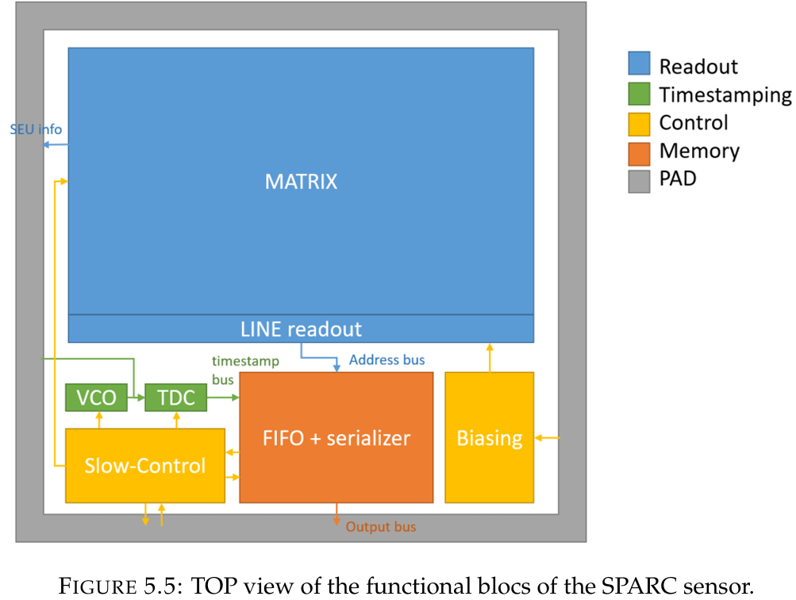

Sensor Architecture
FIFO + serializer
FIFO: buffers hit data (addr + timestamp) to absorb burst traffic
Serializer: formats and sends data out on the output bus
Output bus carries the complete hit word to the DAQ system
Slow-control
Configuration interface (16 registers of 8 bits) for the whole chip
Controls : pixel masking, threshold tuning, TDC calibration, test injection
TDC + VCO
VCO : generates a fine time base
TDC : captures VCO phase at the moment of the hit
Produces a digital timestamp per event
Driven by Slow-Control for calibration
Feeds timestamp directly into the FIFO alongside the pixel address
Biasing
Generates analog bias voltages for the pixel front-ends
Configurable via Slow-Control registers

Slide 7
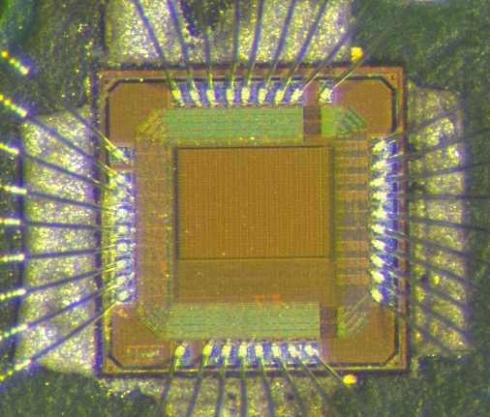
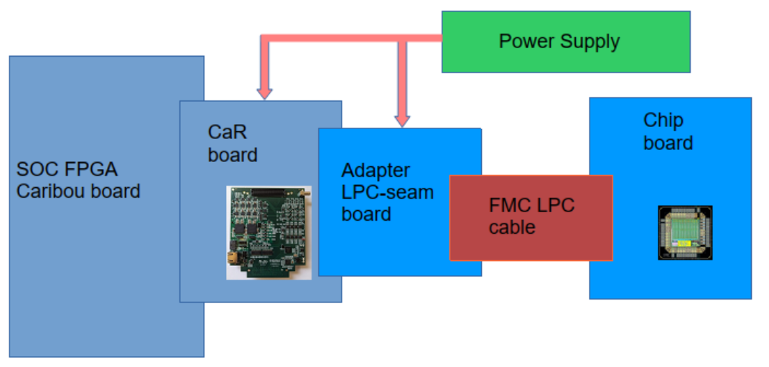
Test bench block diagram with FPGA-SOC as DAQ board
“CARIBOU only” test bench : It is the collaboration test bench for SPARC which will be distributed
SPARC
Chip board / CaR board via FMC LPC cable
Adapter board for LPC / seam 320 pins
Caribou board
  Slow control (I2C) config CaR
  Slow control (SPI) config SPARC, Chip board
  Acquiring data
HW signal for SPARC testing (pulsing, etc) not presented on this slide
There is two possible configurations:
Plug the Chip Board directly onto the CaR Board.
Insert a flat ribbon cable between them for greater flexibility but the adapter board is required.
Not ready yet !

Slide 8
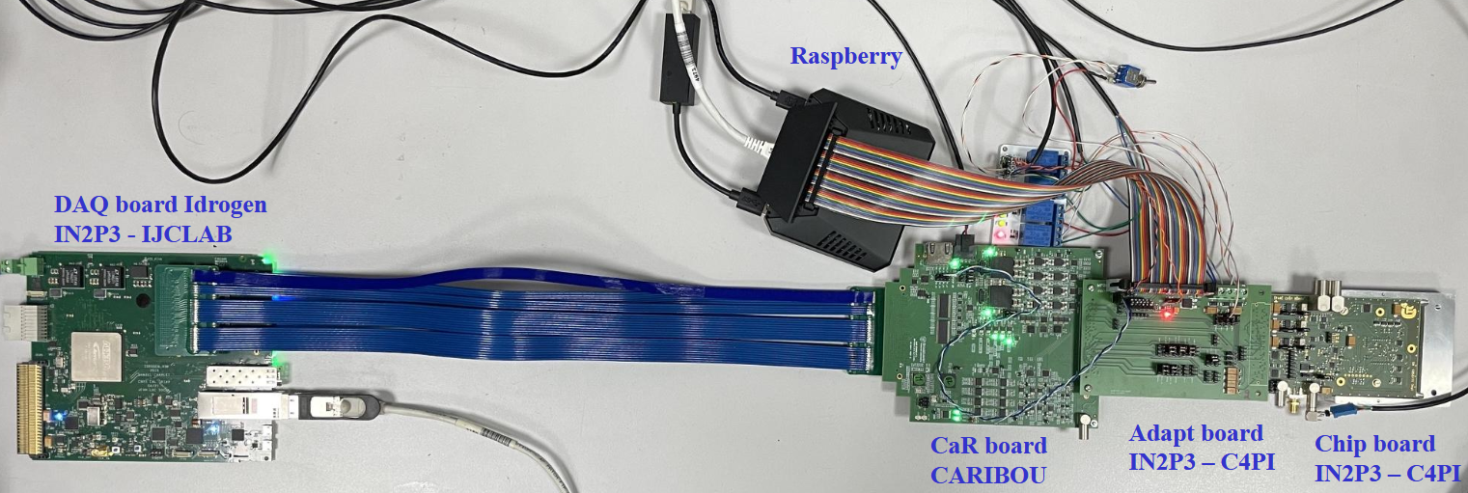
Test bench block diagram with Idrogen (IJCLab IN2P3) as DAQ board
Chip board / CaR board via FMC LPC cable
Adapter board for LPC / seam 320 pins
CaR to IDROGEN via FMC HPC cable
DAQ Raspberry PI 5
  Slow control (I2C) config CaR
  Slow control (SPI) config SPARC, Chip board
  Control IDROGEN (Ipbus ~ 20 MB/s)
HW signal for SPARC testing (pulsing, etc) not
presented on this slide

Slide 9
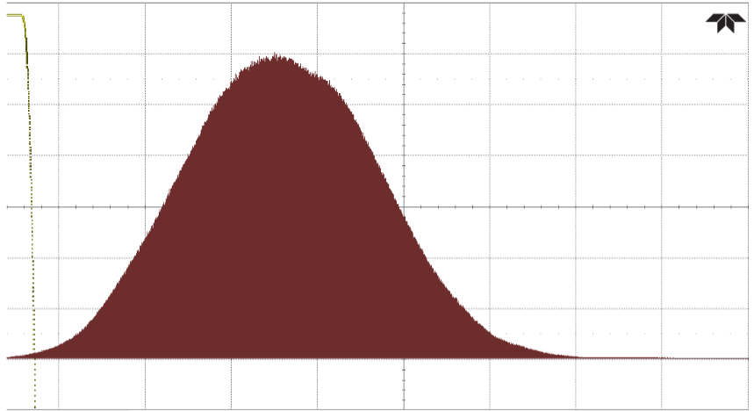
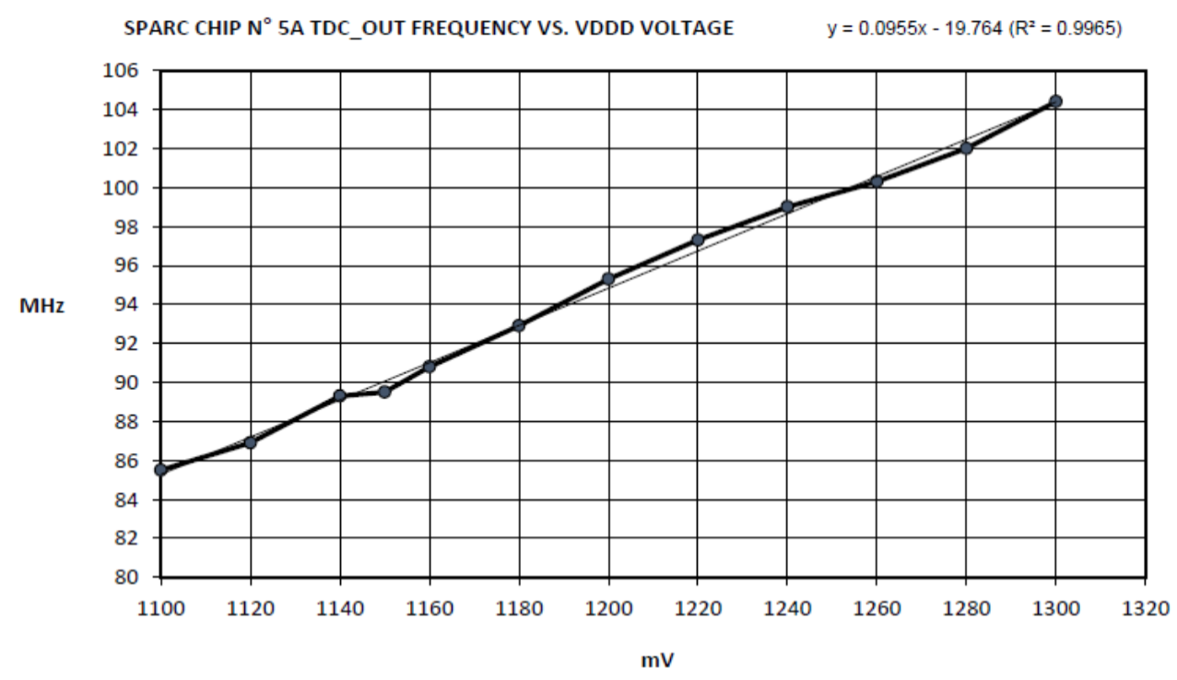

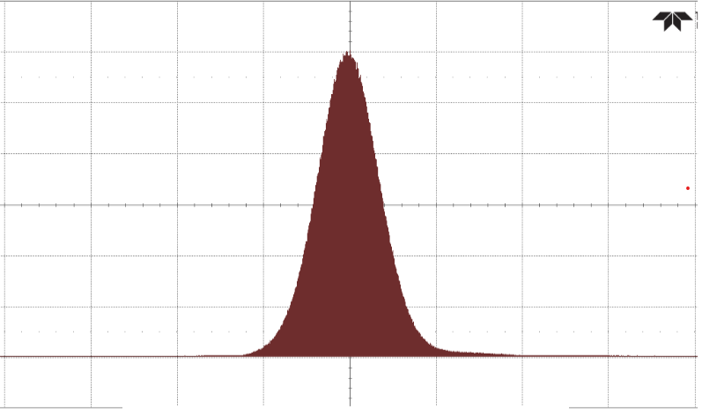

Preliminary Measurement : Ring Oscillator Clock Jitter
Measured conversion gain of the TDC_OUT related to power supply DVDD voltage: 96 KHz/mV
Conversion gain KVDDD-to-ring_osc of the RING_OSC related to DVDD voltage: 8 * 96 KHz/mV = 764 kHz/mV
Jitter performance of TDC_OUT output with the internal ring oscillator
Jitter performance of TDC_OUT output with the external clock reference
Ring oscillator shows significantly larger jitter than external clock
Internal oscillator is mainly intended for debug and tests, it is not designed to get a low jitter
We will use external clock from Idrogen

Slide 10
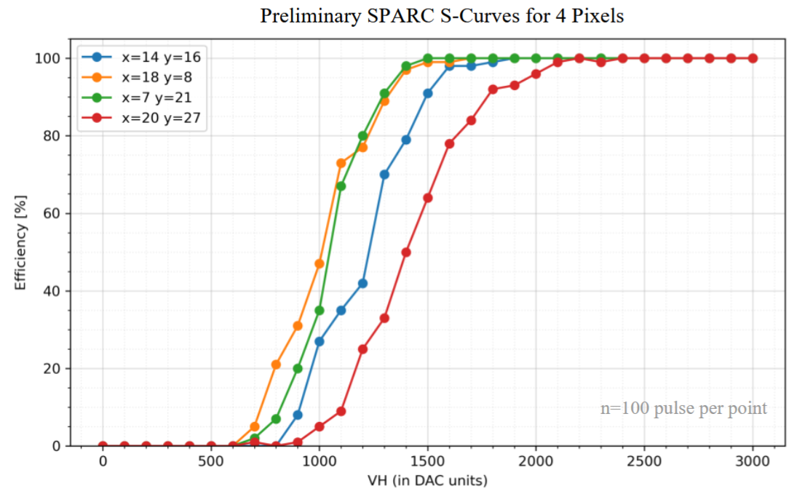
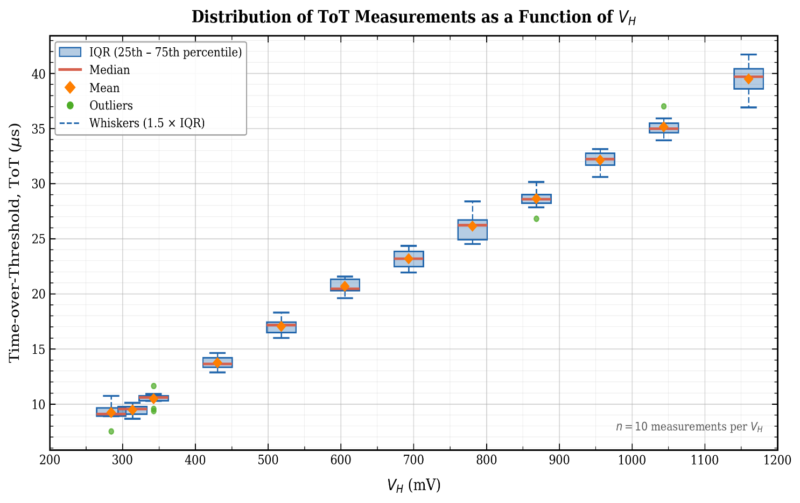
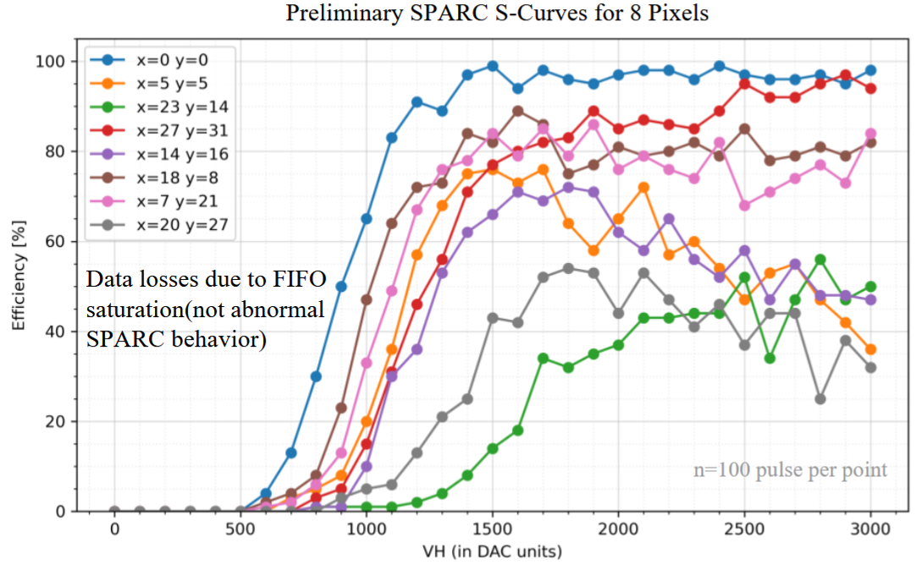
Preliminary Measurement
First ToT measurements are consistent with simulations and confirm the functionality of the ToT mode.
Simultaneous pulsing of 8 pixels ➔ SPARC FIFO saturation (FIFO depth = 32) and data losses.
An upgrade of the acquisition software is ongoing to perform the scan
using smaller groups of pixels (less than 8), avoiding FIFO saturation.

Slide 11
Thank you for your attention
Camille Fournier on the behalf of SPARC core team
Phd student, Institut Pluridisciplinaire Hubert Curien (IPHC)
Subatomic Research Department, C4PI team
This work was supported by IdEx Unistra (ANR 10 IDEX 0002), and by SFRI STRAT’US project (ANR 20 SFRI 0012) and EUR QMAT ANR‐17‐EURE‐0024.

