Slide 1



R2D2: a xenon TPC for neutrinoless double beta decay search
F. Piquemal (LP2i Bordeaux - CNRS/IN2P3)
On Behalf of R2D2

Slide 2


Introduction: physics case
The search of neutrinoless double beta decay (ββ0ν) is related to the determination of the nature of neutrino.
The determination of the neutrino nature has huge implications in particle physics (generation of neutrino masses) and cosmology (leptogenesis model).

Slide 3
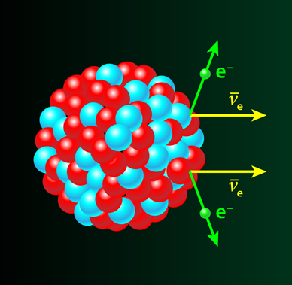
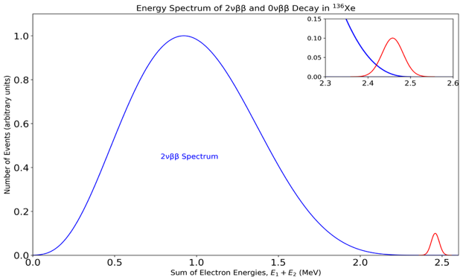
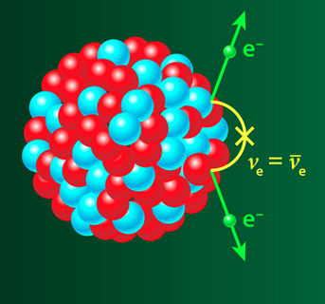
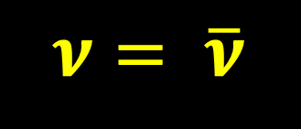




Introduction: physics case
Double beta decay
35 isotopes emitter ββ including ¹³⁶Xe
ββ (2ν)
Experimental signatures
The emission of the 2 electrons
¹³⁶Xe → ¹³⁶Ba + $2e^{−}+2\overline{υ_{e}}$
Sum of the electron energies (MeV)
$$T_{1/2}^{2υ} ≈ 2.2 {10}^{21} yr$$
ββ(0ν)
Neutrinoless double beta decay ββ (0ν)
¹³⁶Xe → ¹³⁶Ba + $2e^{−}$
ββ(2ν)
ββ(0ν)
$ν= \overline{ν}$
Domain of energy of natural radioactivity
Not yet discovered
$$T_{1/2}^{0υ} > {3.8 10}^{26} yr$$
Sum of electron energies E₁ + E₂ (MeV)
Q_{ββ}
Transition energy
The observation of ββ0ν decay requires to have very low background (mostly from natural radioactivity)
Observation of the 2 electrons is mandatory to confirm any signal

Slide 4
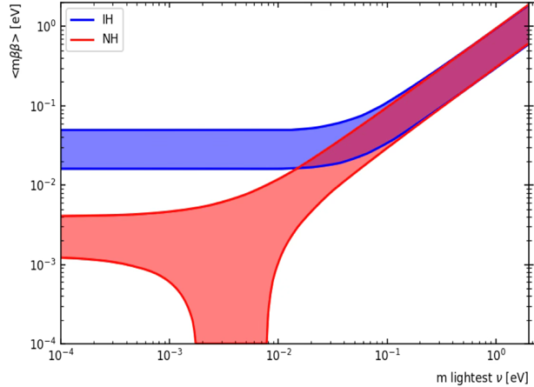



Next generation requirements
Limitations:
Background from natural radioactivity in detector materials or surroundings
No identification of 2e⁻
Inverted hierarchy
Normal hierarchy
Inverted hierarchy
Normal hierarchy
$\left\langle m_{ν}\right\rangle$ (eV)
light neutrino exchange process
$$T_{1/2}^{0υ} ∝\frac{1}{{\left\langle m_{ν}\right\rangle }^{2}}$$
KamLAND-Zen (800 kg ¹³⁶Xe)
Next generation objective
Next generation challenges
Ton-scale
Zero background
      Suppression residual natural radioactivity
      Excellent energy resolution
      Identification of the 2 emitted electrons
R2D2 project

Slide 5
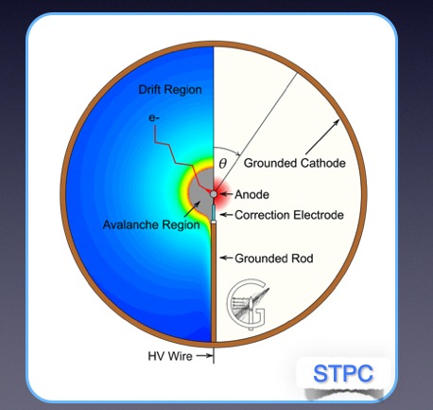
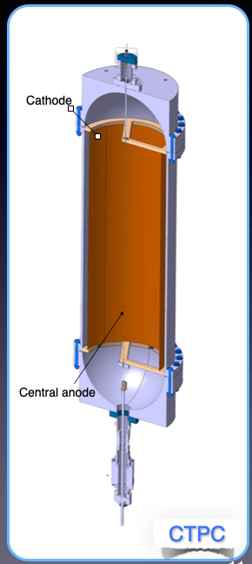
R2D2 : Radial Detector for rare Decay
Objectives:
Large mass of isotopes
Two electron identification
Excellent energy resolution
Low background
To optimize number of readout channels
High pressure TPC with a single anode
Two possible configurations
Spherical TPC
Cylindrical TPC

Slide 6
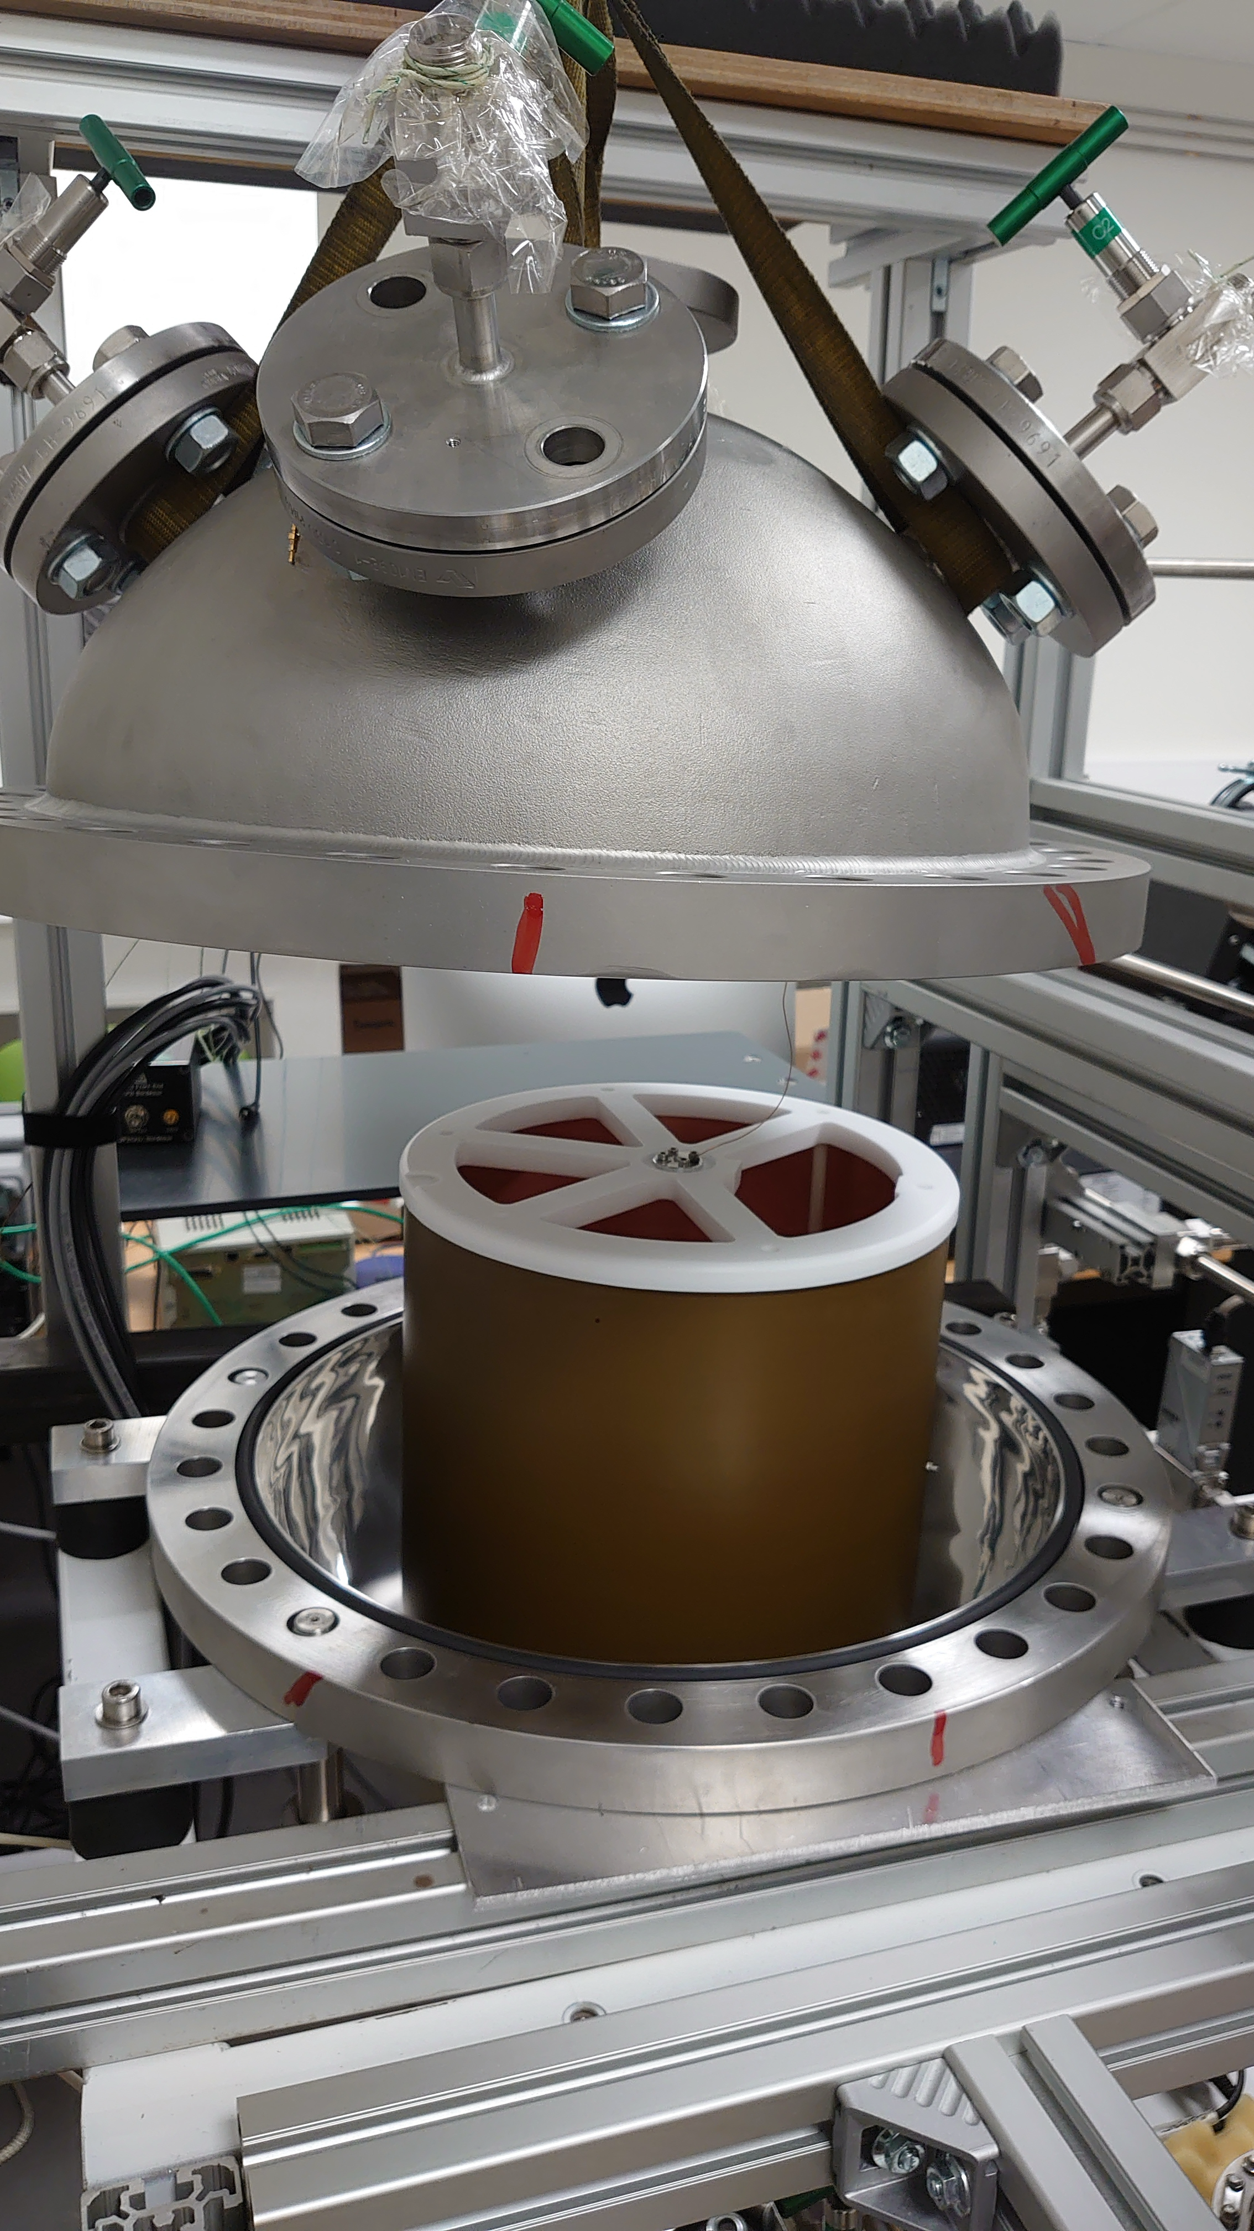
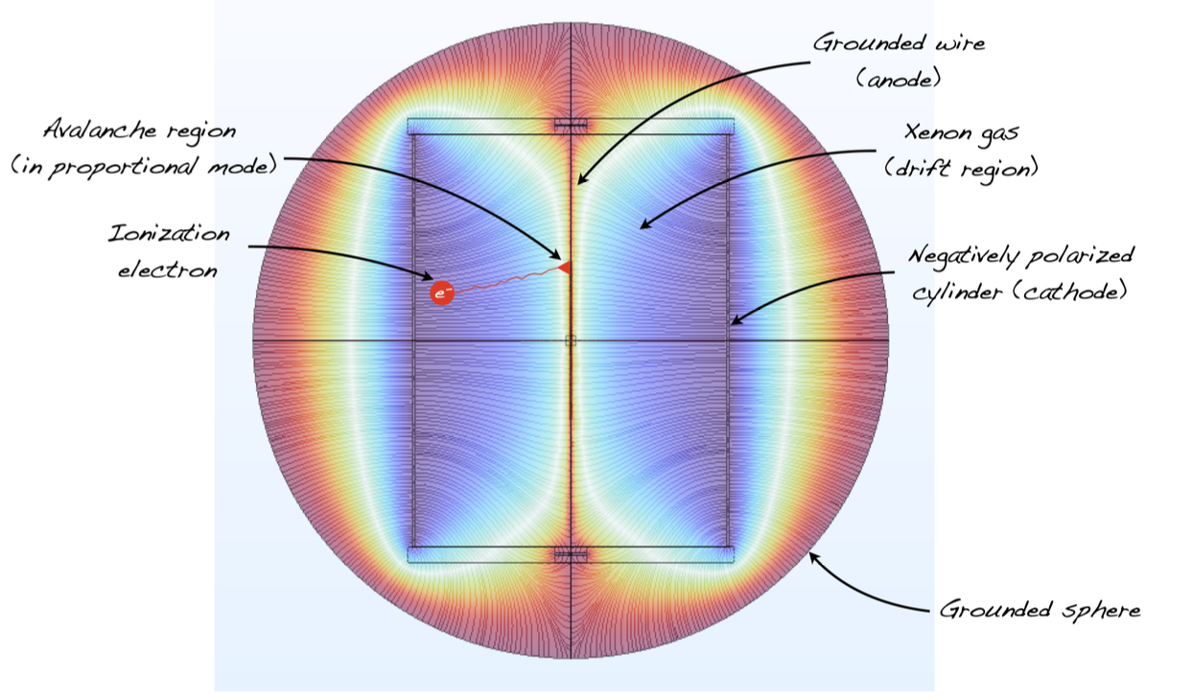
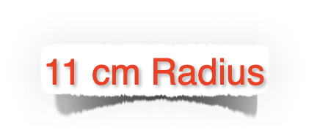
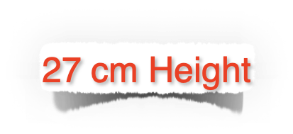
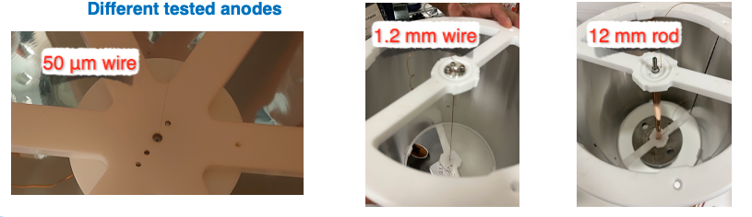
CTPC prototype
The HV was applied to the cathode up to values of 5 kV
Different anodes were tested from wires of 50 μm diameter, to rods of 1.2 and 12 mm diameter.
Operation in ionisation mode.

Slide 7
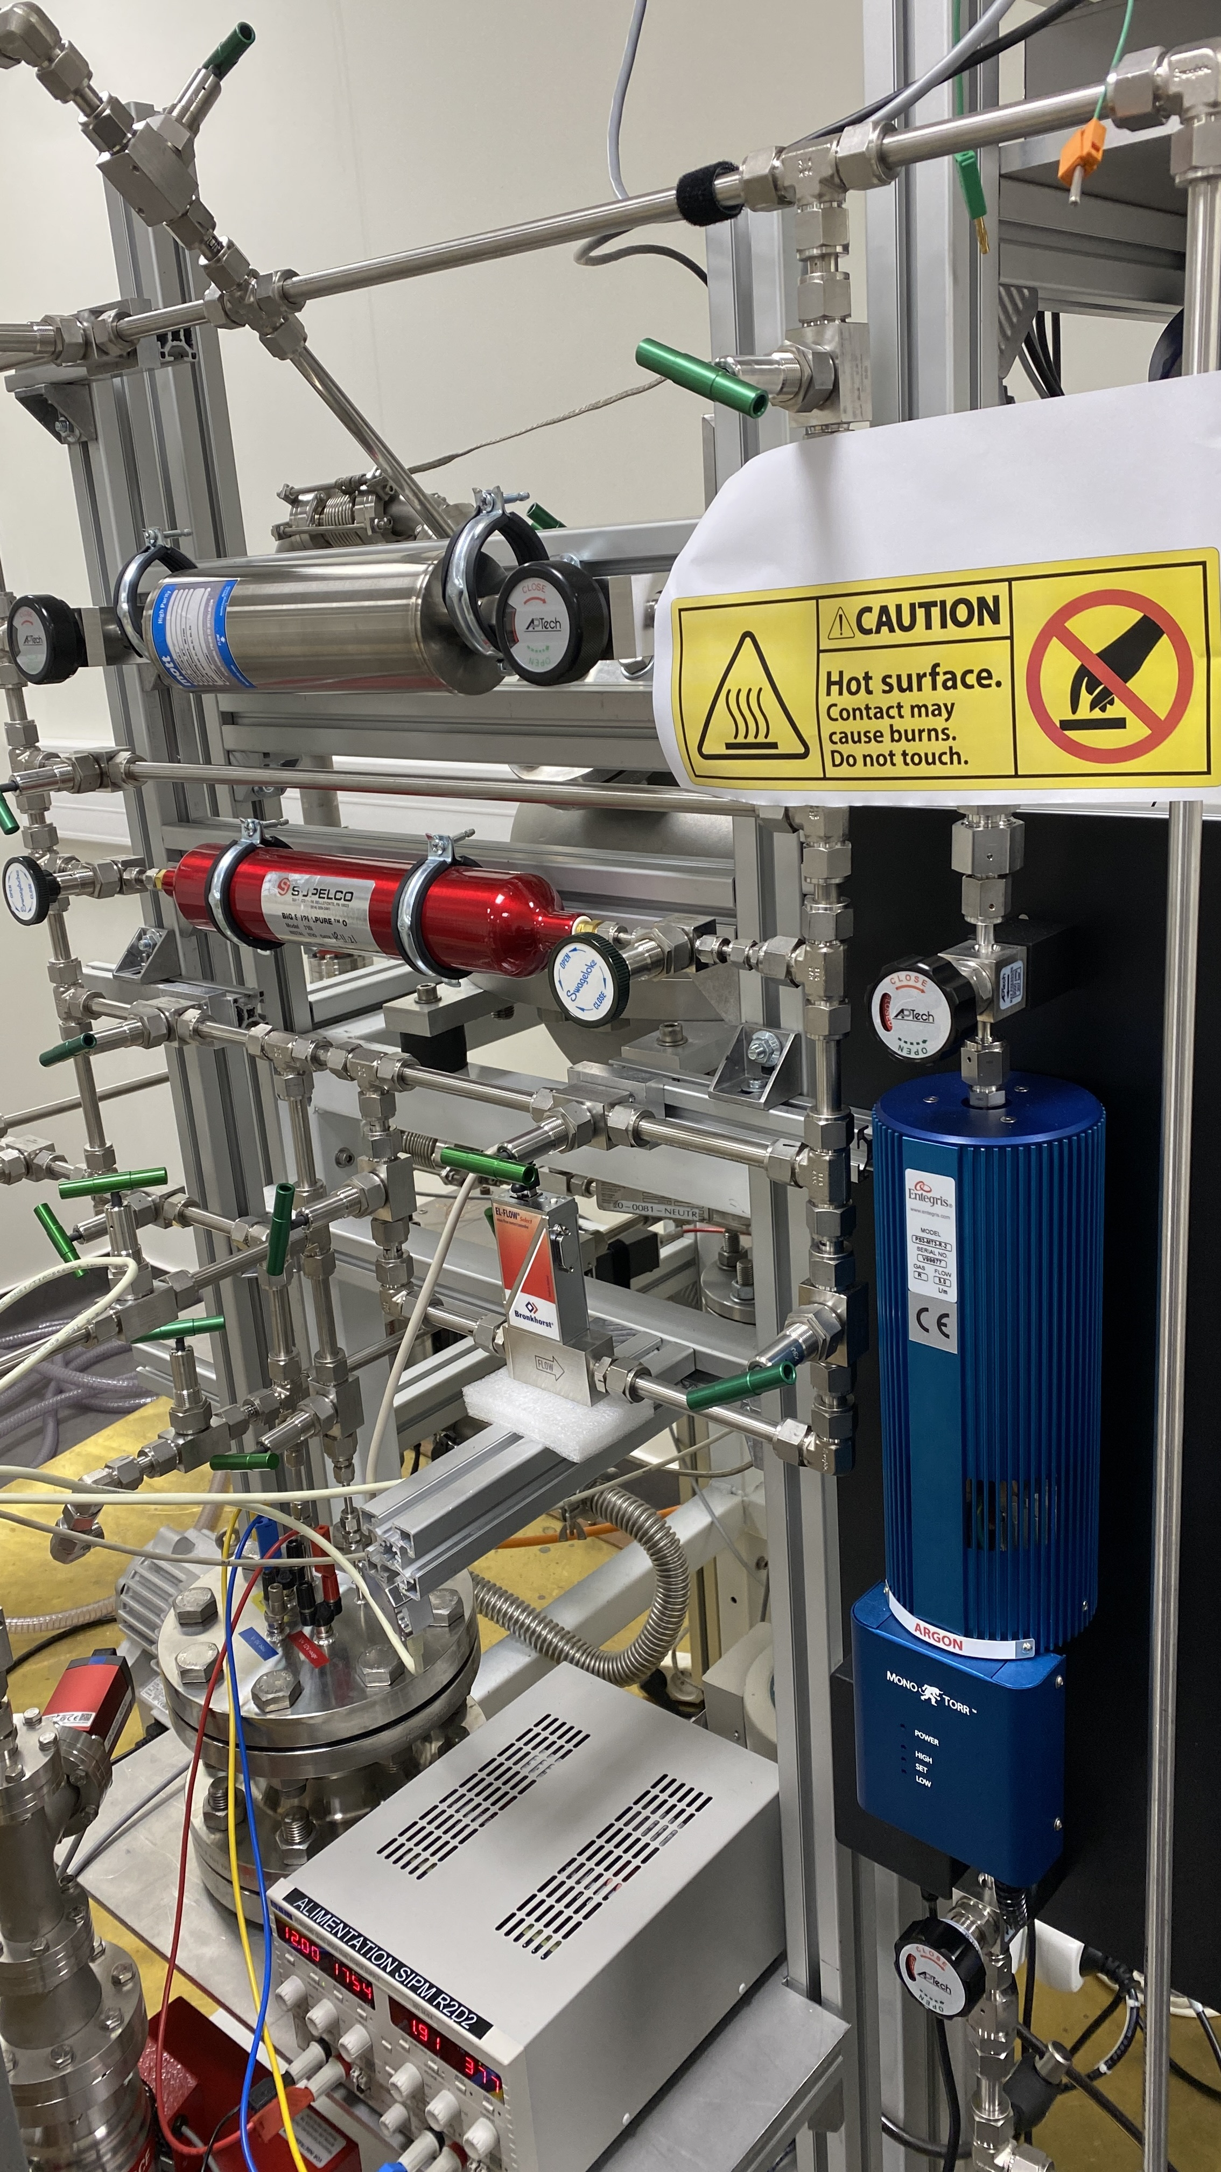


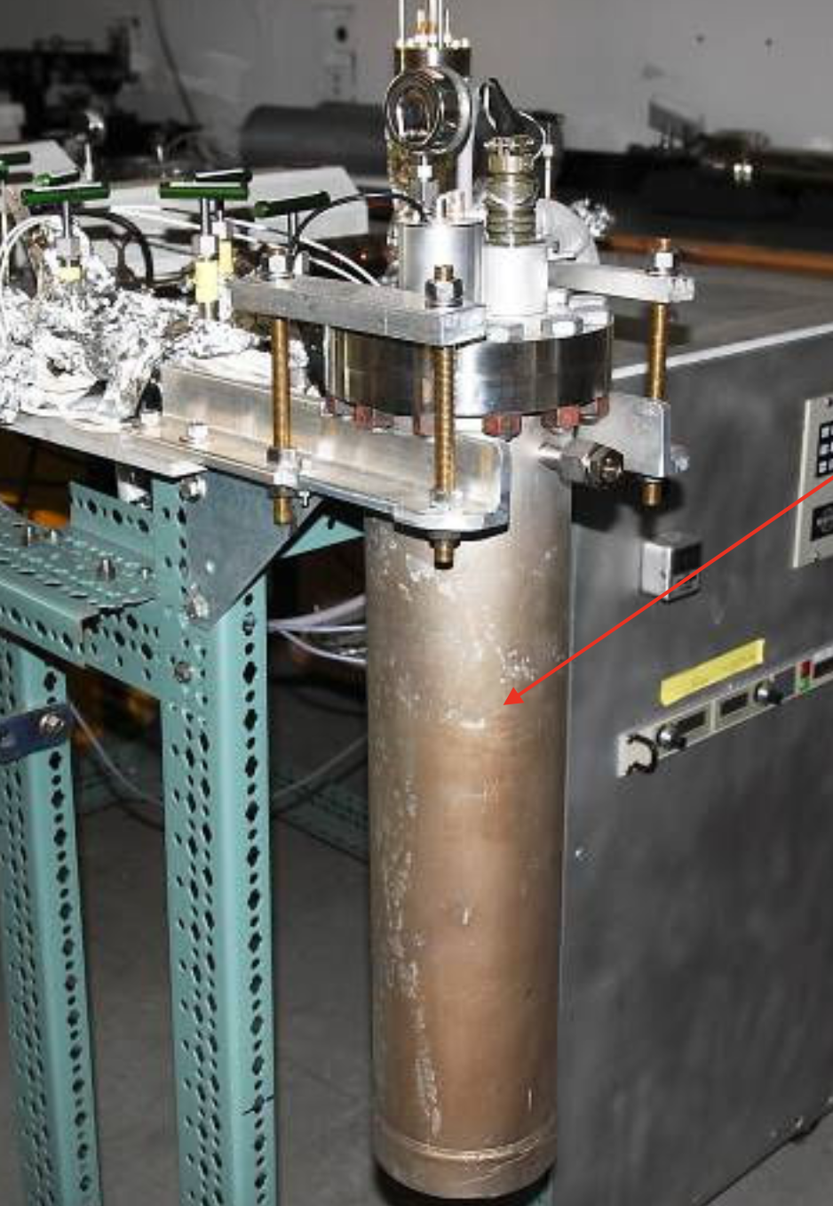
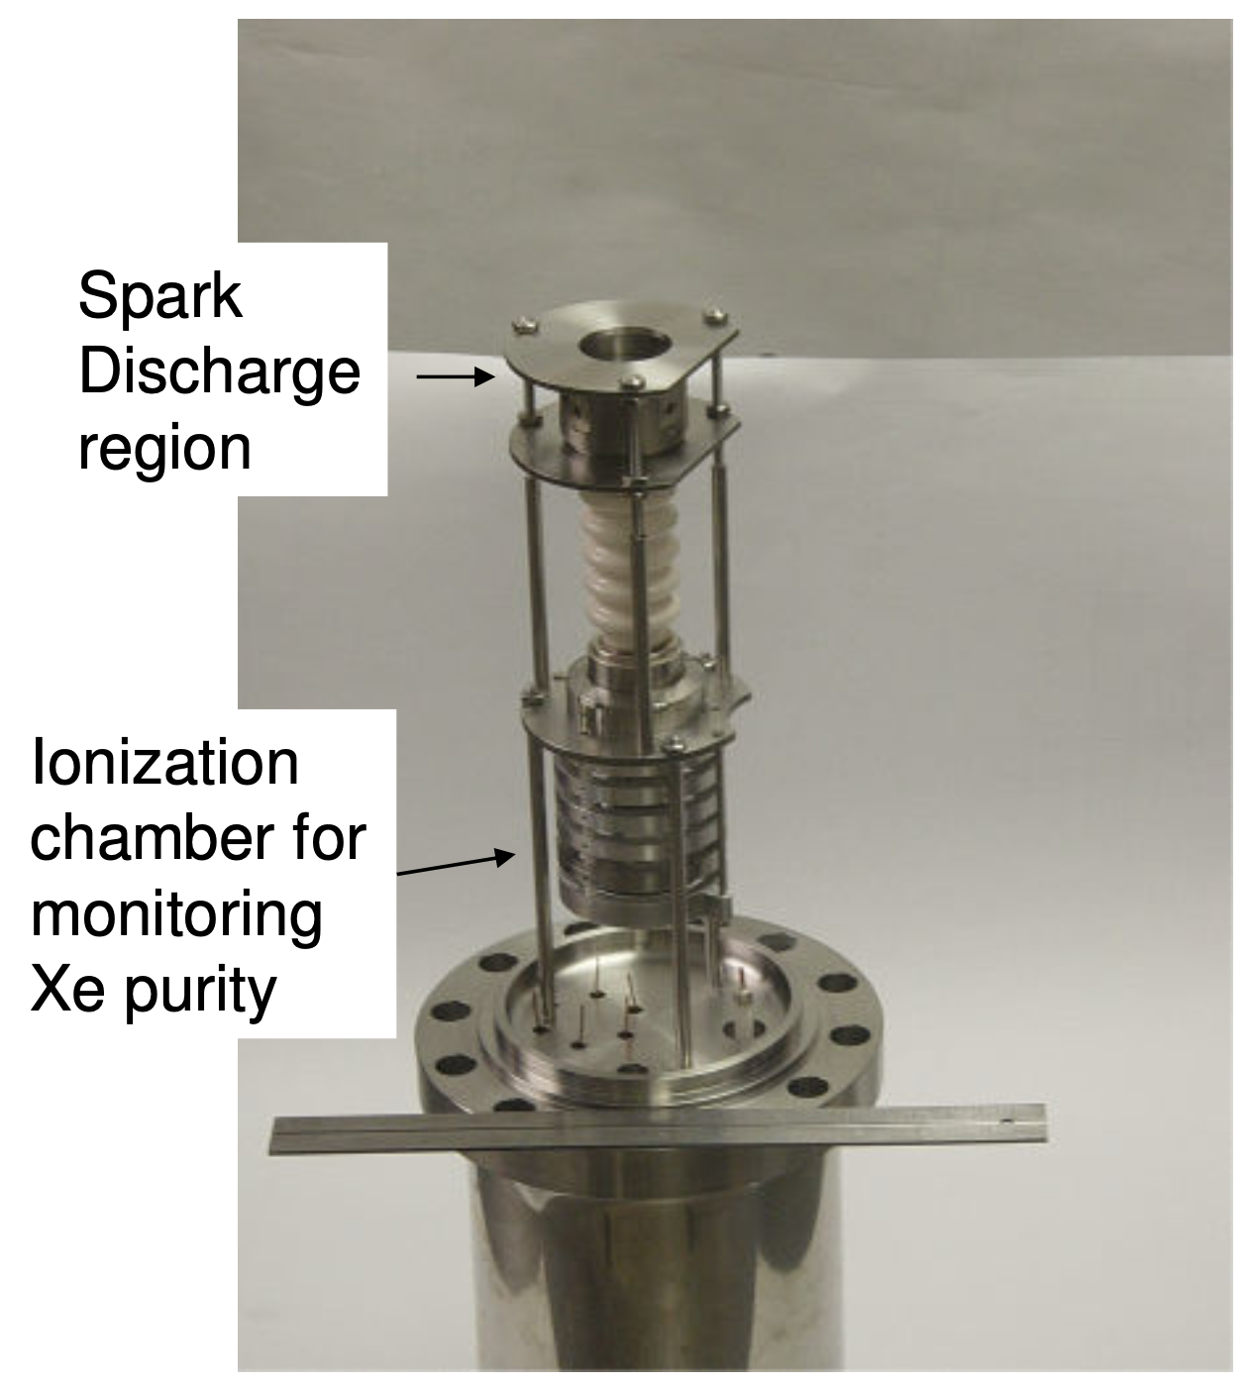

Gas purity
Gas purity is a key issue for the operation of the CTPC.
A system based on cold and hot getter was set up granting purities up to few ppb in terms of electronegative impurities such as Oxygen.
However, the purification system limits the operation of the detector at 10 bar.
Development new purification system
Ti spark discharge

Slide 8
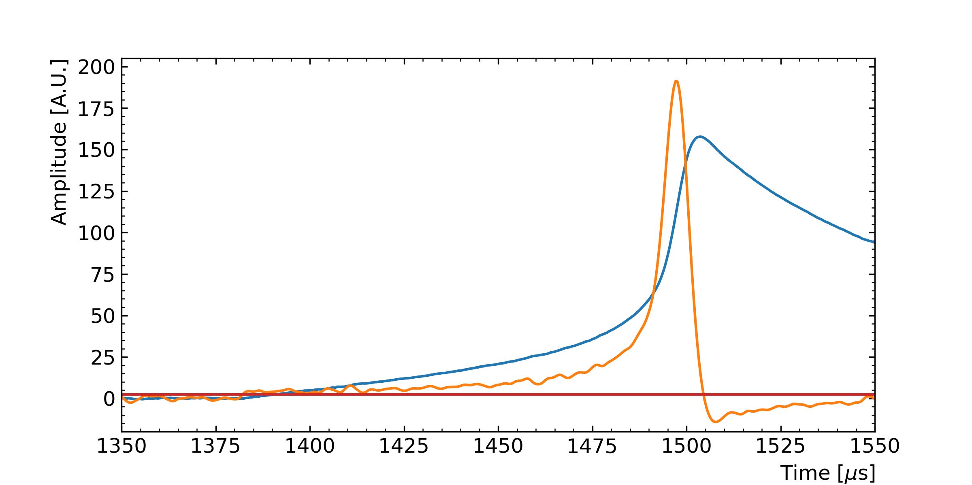

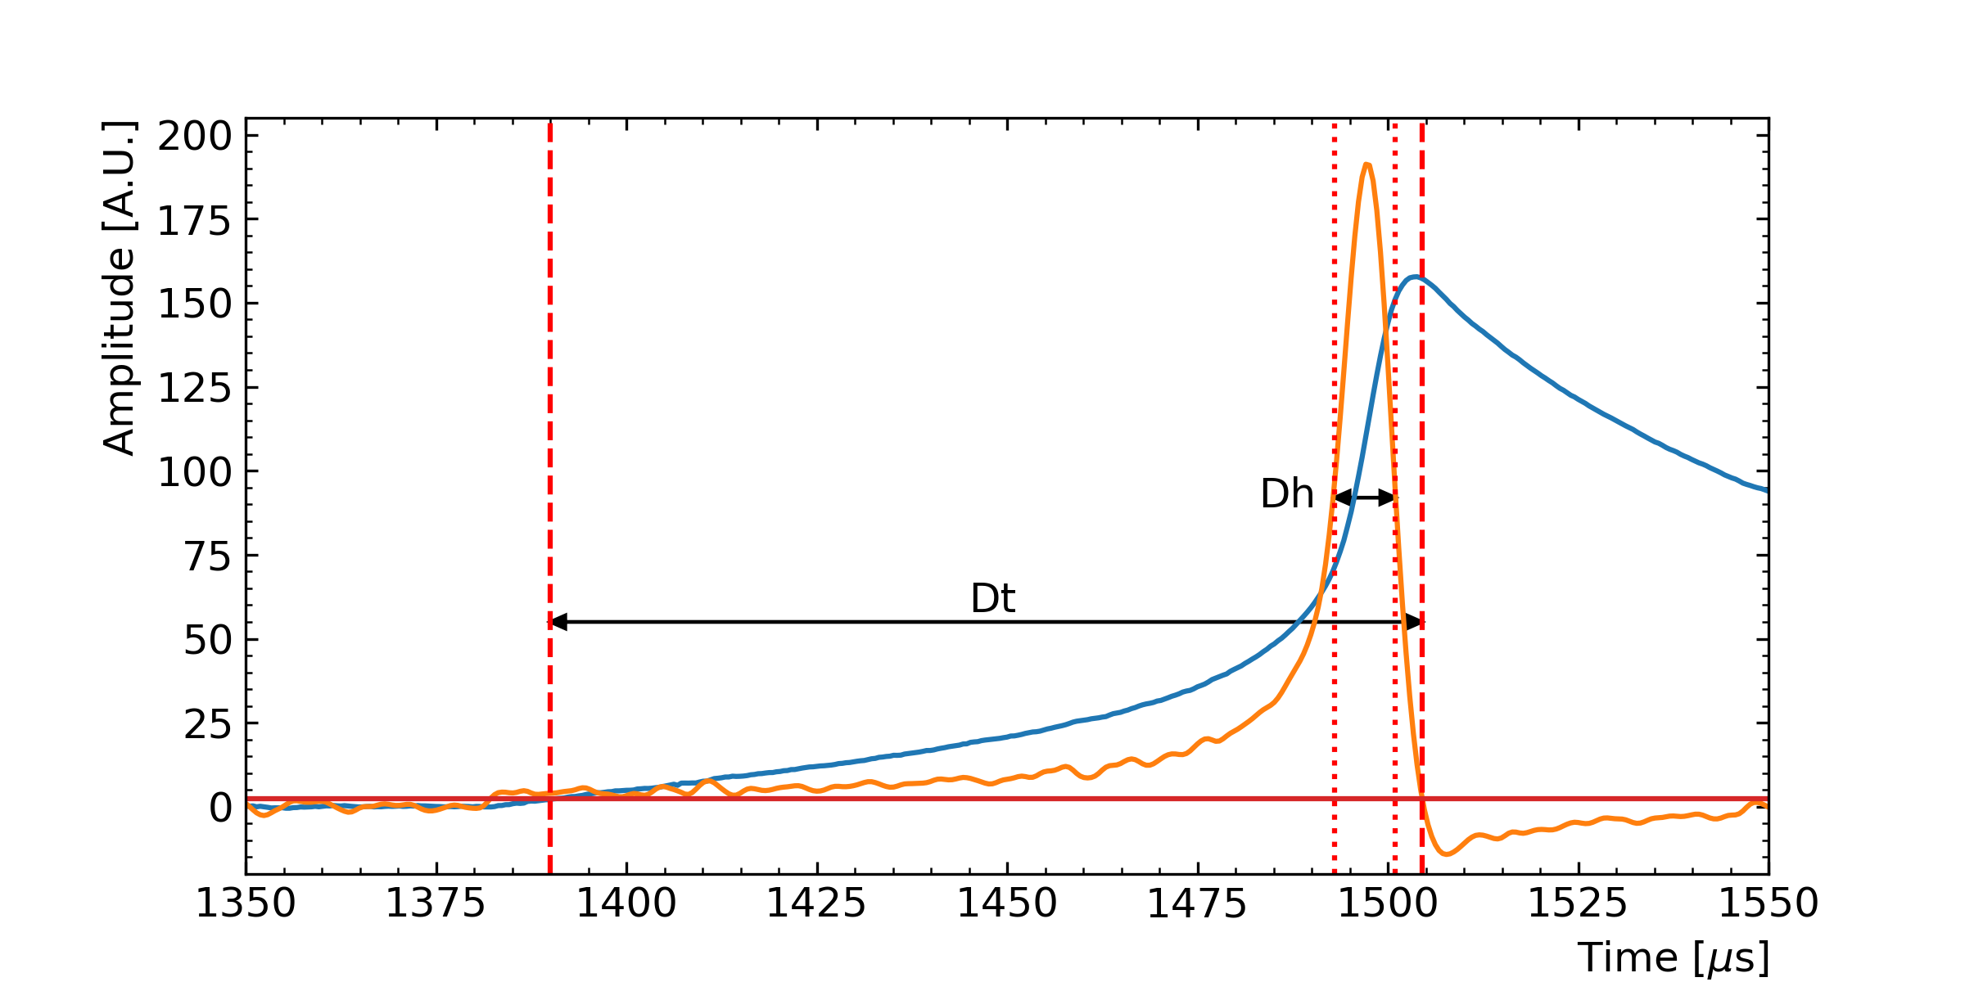
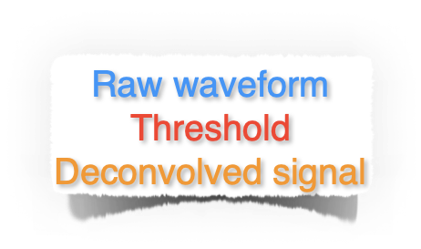

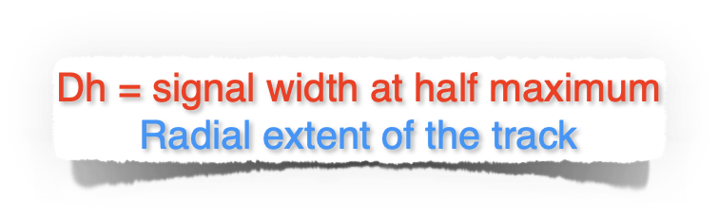
Signal
The reconstructed waveforms are used to extract observables such as the total charge of the event, its duration and the width at half height.
Each observable is associated to a specific feature of the original signal.

Slide 9
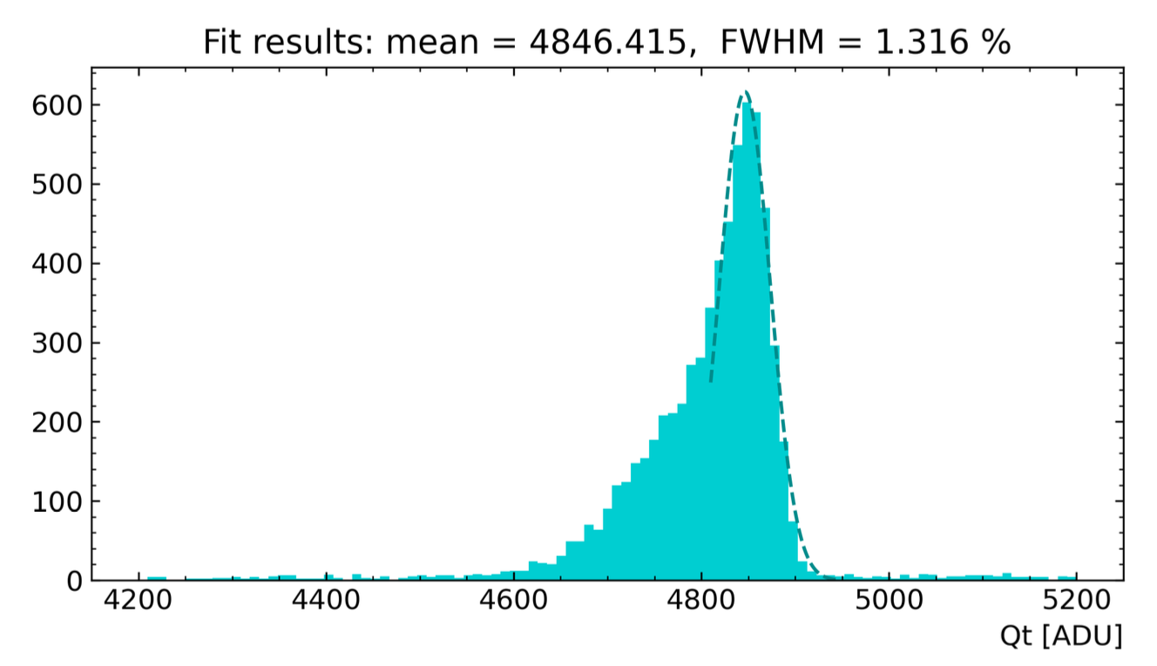
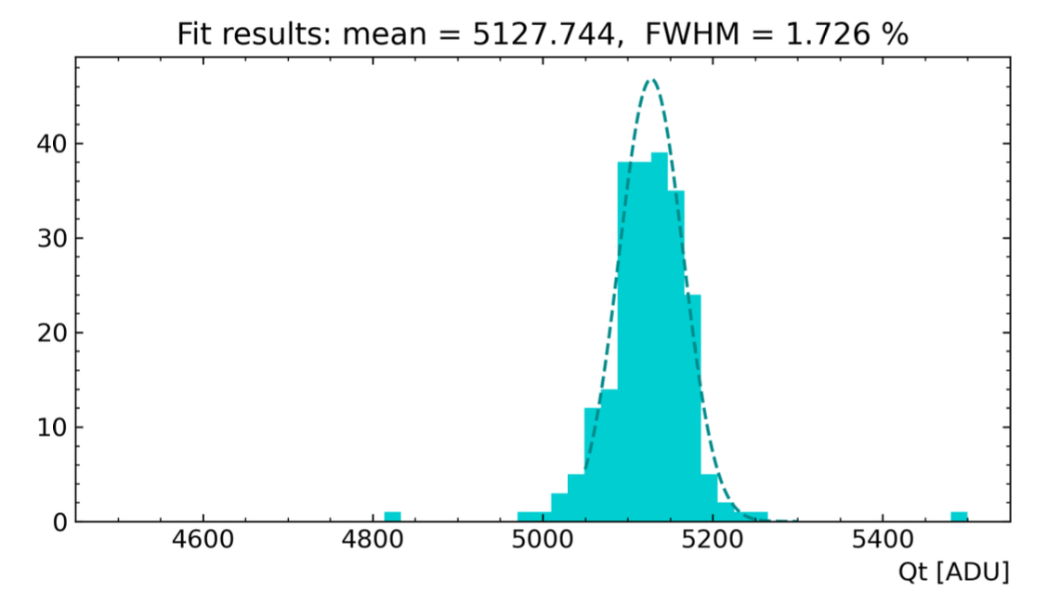

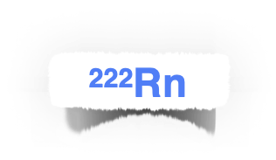
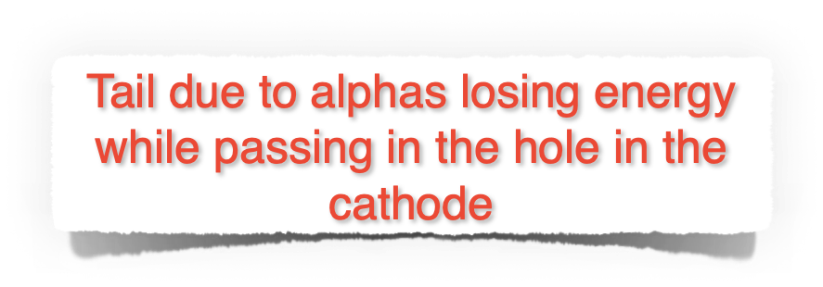
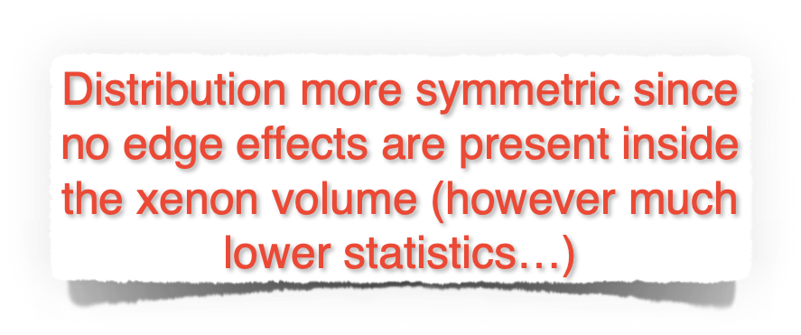
Data analysis
The Qt of selected events (cuts on Dt and Dh) were fitted to establish the energy resolution.
Data for xenon at 3 bar, anode of 1.2 mm diameter, and -3000 V applied to the cathode

Slide 10


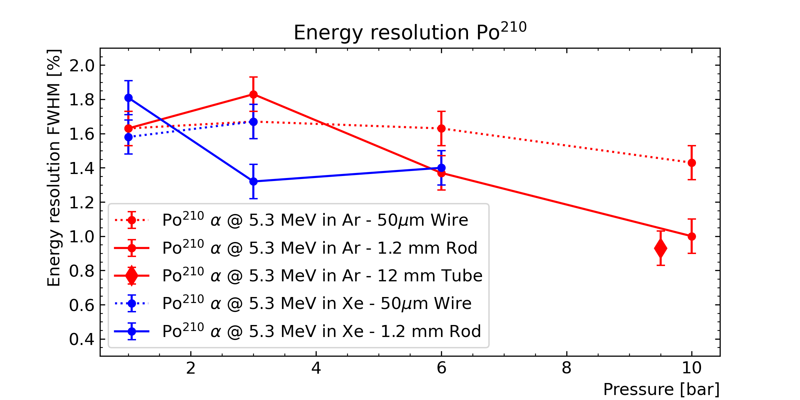
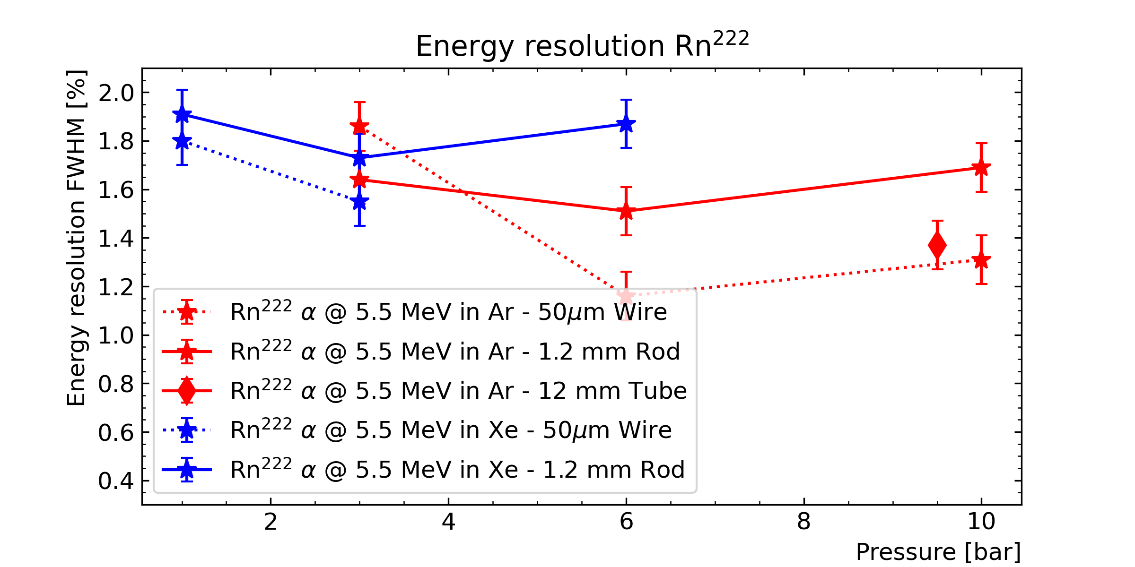
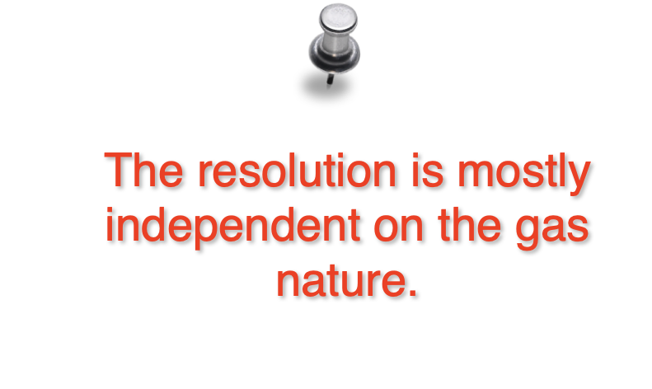
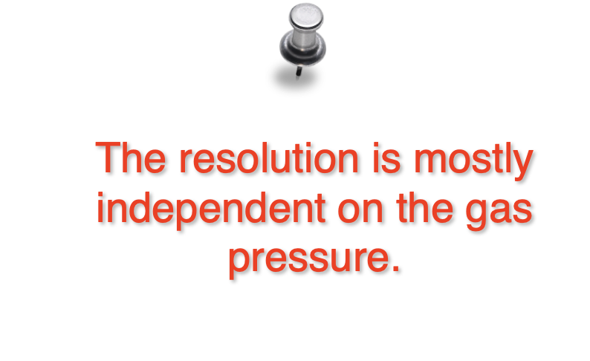
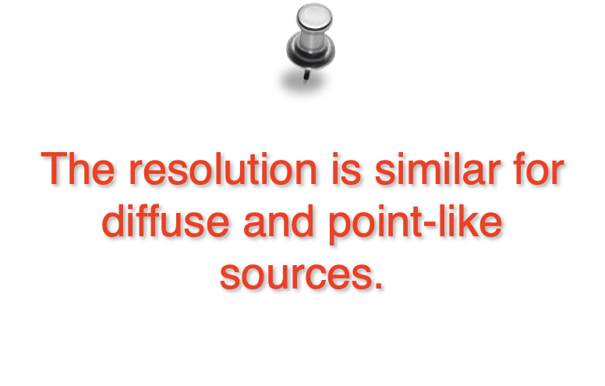
Resolution results
The same procedure was applied filling the detector with different gases (Ar and Xe) at various pressures and with different anode sizes.

Slide 11
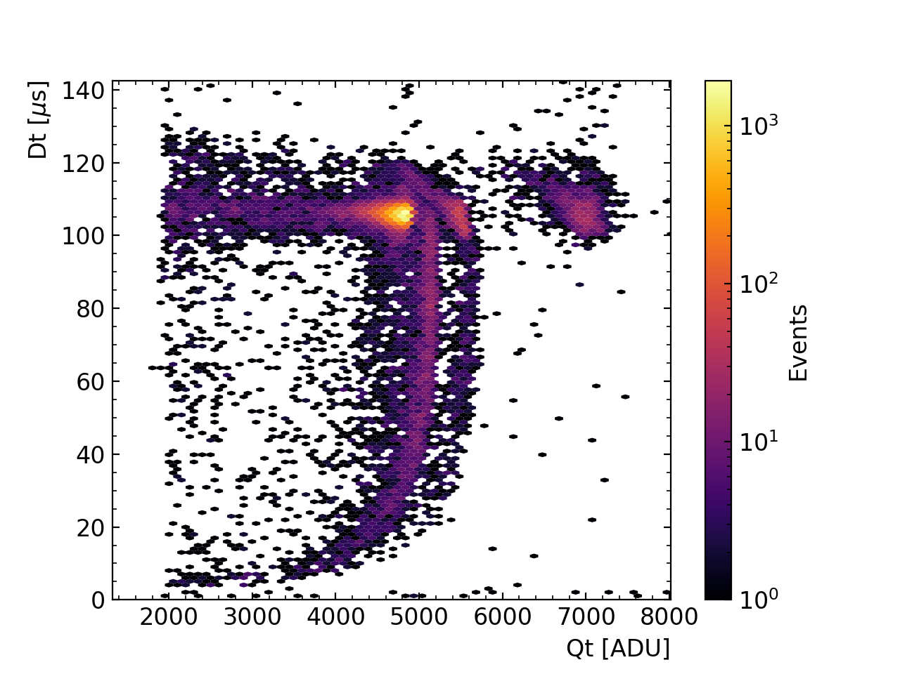



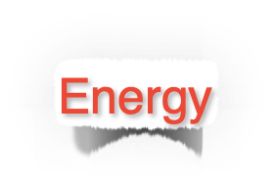
Data selection
The observables were used to select the events, namely the Po or the Rn issued alphas.
Data for xenon at 3 bar, anode of 1.2 mm diameter, and -3000 V applied to the cathode

Slide 12
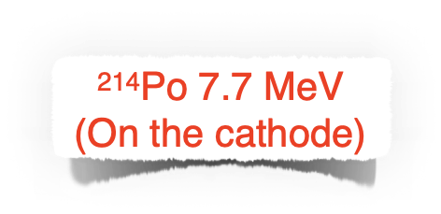
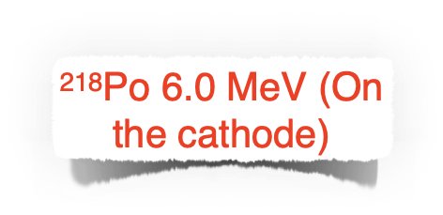
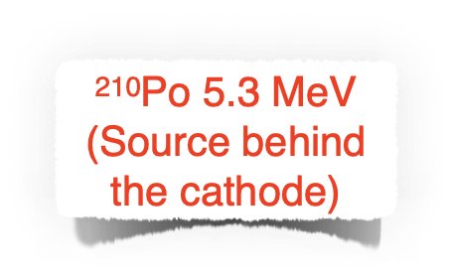
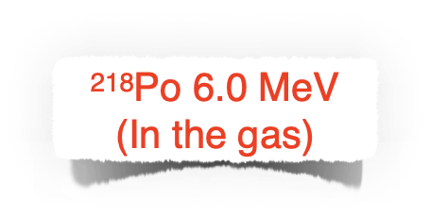
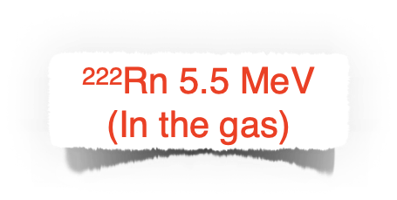
Data selection
The observables were used to select the events, namely the Po or the Rn issued alphas.
Data for xenon at 3 bar, anode of 1.2 mm diameter, and -3000 V applied to the cathode

Slide 13
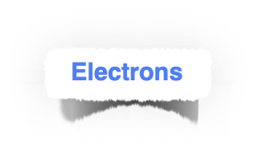
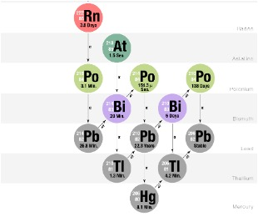
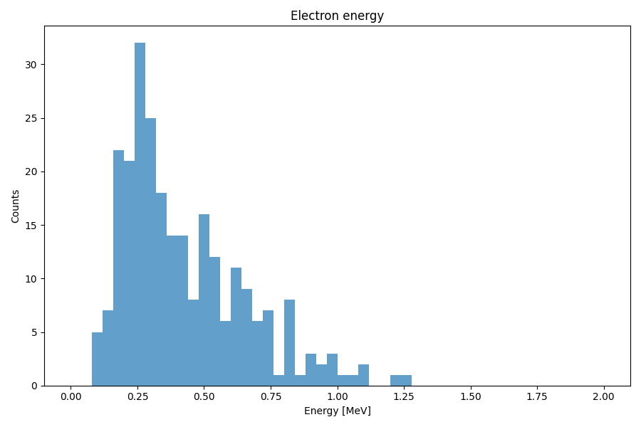
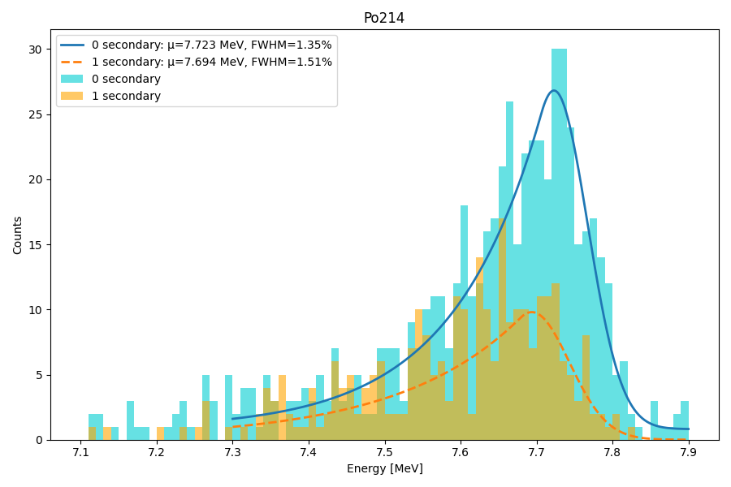

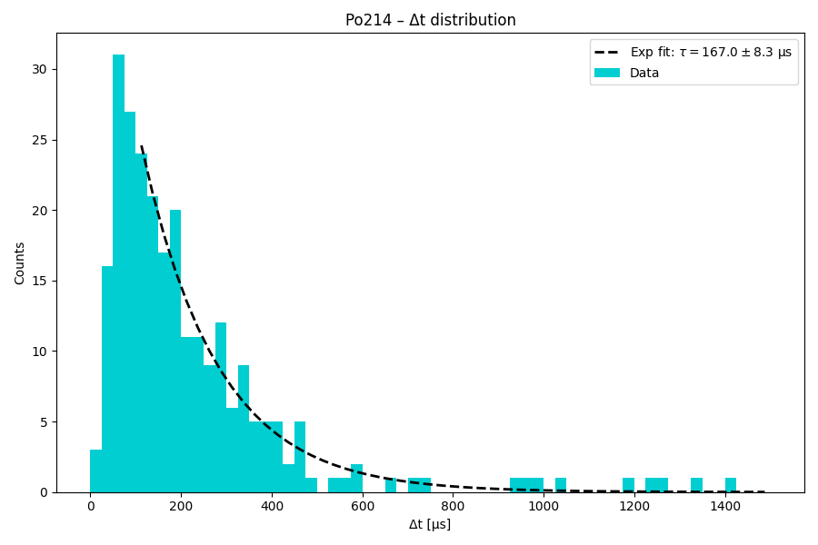
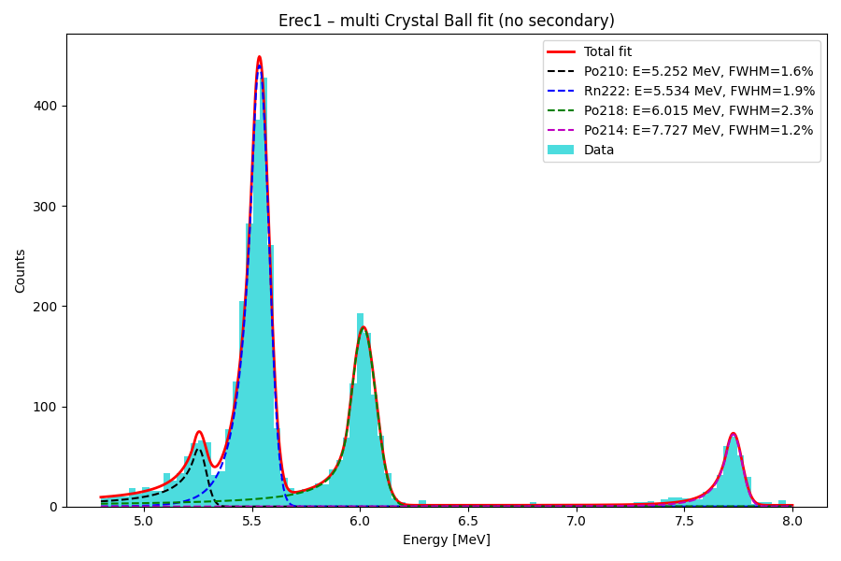
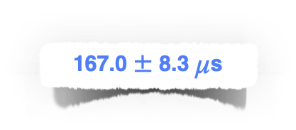


Data analysis
Measurement of the BiPo decay
Data for argon at 16 bars, anode of 1.2 mm diameter, and -4000 V applied to the cathode

Slide 14
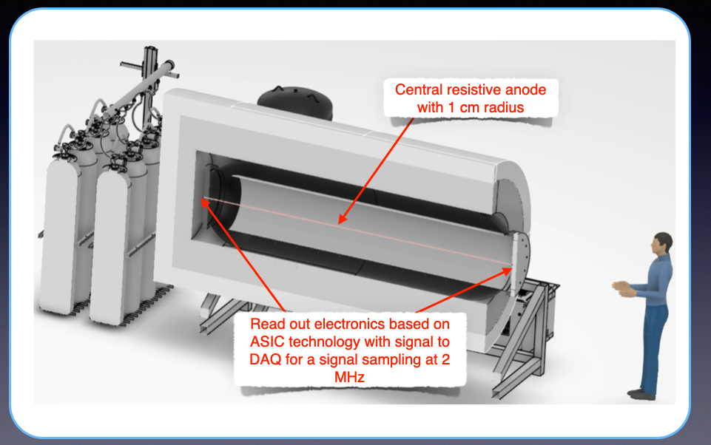
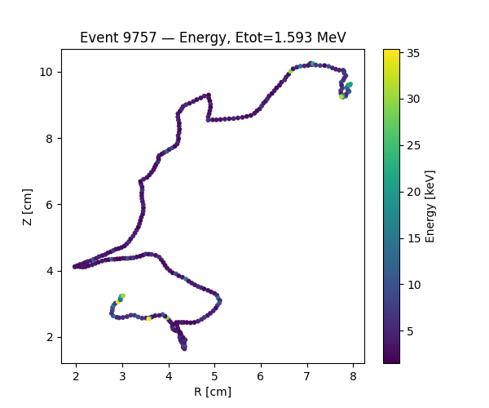
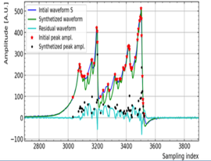
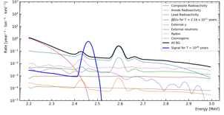
Simulation of 500 kg prototype
Objectives : to demonstrate 2 e⁻ identification by measuring ββ(2ν) of ¹³⁶Xe
to demonstrate zero backgound in ββ(0ν) energy region
Use of 500 kg of ^{nat}Xe (44 kg of ¹³⁶Xe)
ββ Simulated event (Xenon, 40 bars)
Bragg peak
electron 1
Bragg peak
electron 2
Background simulations
Eur.Phys.J.C 85 (2025) 7, 732

Slide 15
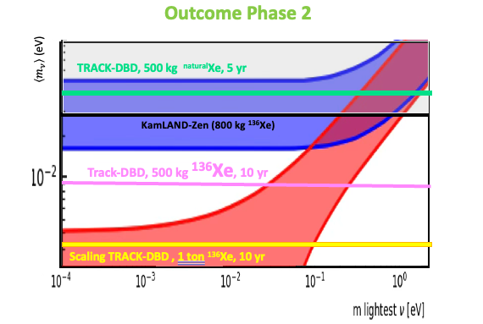
Simulation of 500 kg prototype

Slide 16
NEXT STEPS
Readout of the longitudinal position along the anode :
Current pre-amplifier ASIC (Subatech) produced
Electronic card (LP2i Bordeaux) in production
Resistive anode design in progress
Experimental identification of the 2 electrons at high pressure :
Use of e⁺e⁻ pair creation from 2.6 MeV gamma-rays
Coïncidence with 511 keV anihilation gamma-rays
Purification of gas by Ti spark discharge :
    Setup is in commissioning
    Efficiency to be measured
Low radioactive composite vessel development (pressure and vacuum)
Work with IRT Jules Venre (Nantes), ICMCB and LCTO (Bordeaux)
Choice of the fiber (carbon, Si carbure,…)
Choice of Epoxy
Low radioactive measurements in progress

Slide 17
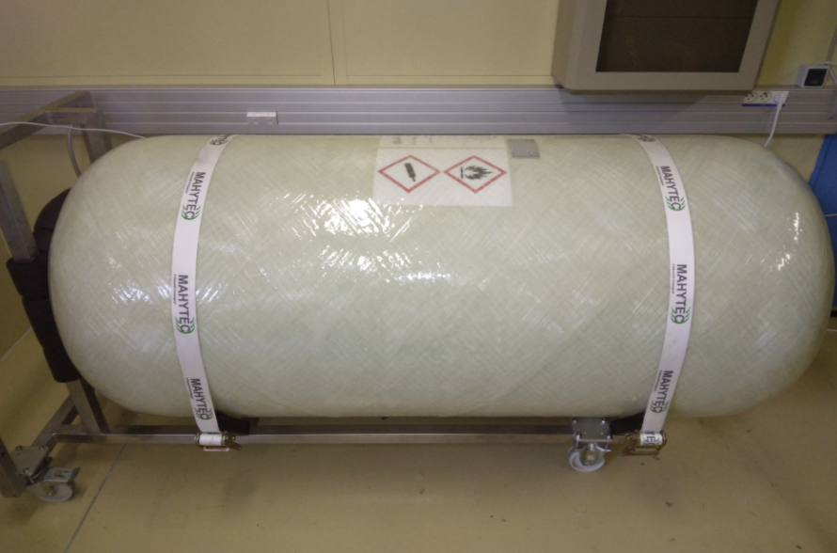
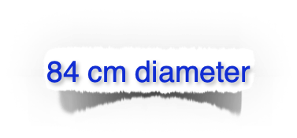


Conclusions
The R2D2 R&D demonstated the simple CTPC detector can be used for neutrinoless double beta decay search.
All possible technical issues (gas purification, recirculation etc.) can be solved based on the know-how developed by R2D2 and the existing one in the xenon community.
The R&D to achieve a composite low radioactivity thin vessel is ongoing with industrial partners.
A “full scale” demonstrator (commercial composite tank, no low radioactivity) to validate the drift over 42 cm is under commissioning.
The simplicity of the detector results on low electric consumption.
R2D2 collaboration
France: LP2iB, Subatech, CPPM, IPHC
CZ : IEAP Prague
SK: U. Bratislava
PL: Astrocent
Option for PANDA-X gas detector

