Slide 1





Diamond-based beam monitors
for real-time quality assurance in advanced radiotherapy techniques
Tiago Bettio (tiago.bettio@lpsc.in2p3.fr)
Date : 17/06/26
Assemblée Générale GDR DI2I
Supervisors:
Jayde Livingstone
Jean François Adam
Marie Laure Gallin-Martel
Notes:
Bonjour à tous, name, im phd student at UGA, colab LPSC and STROBE, supervisors , group also colab GIMED and LABEX PRIMES, read title.

Slide 2
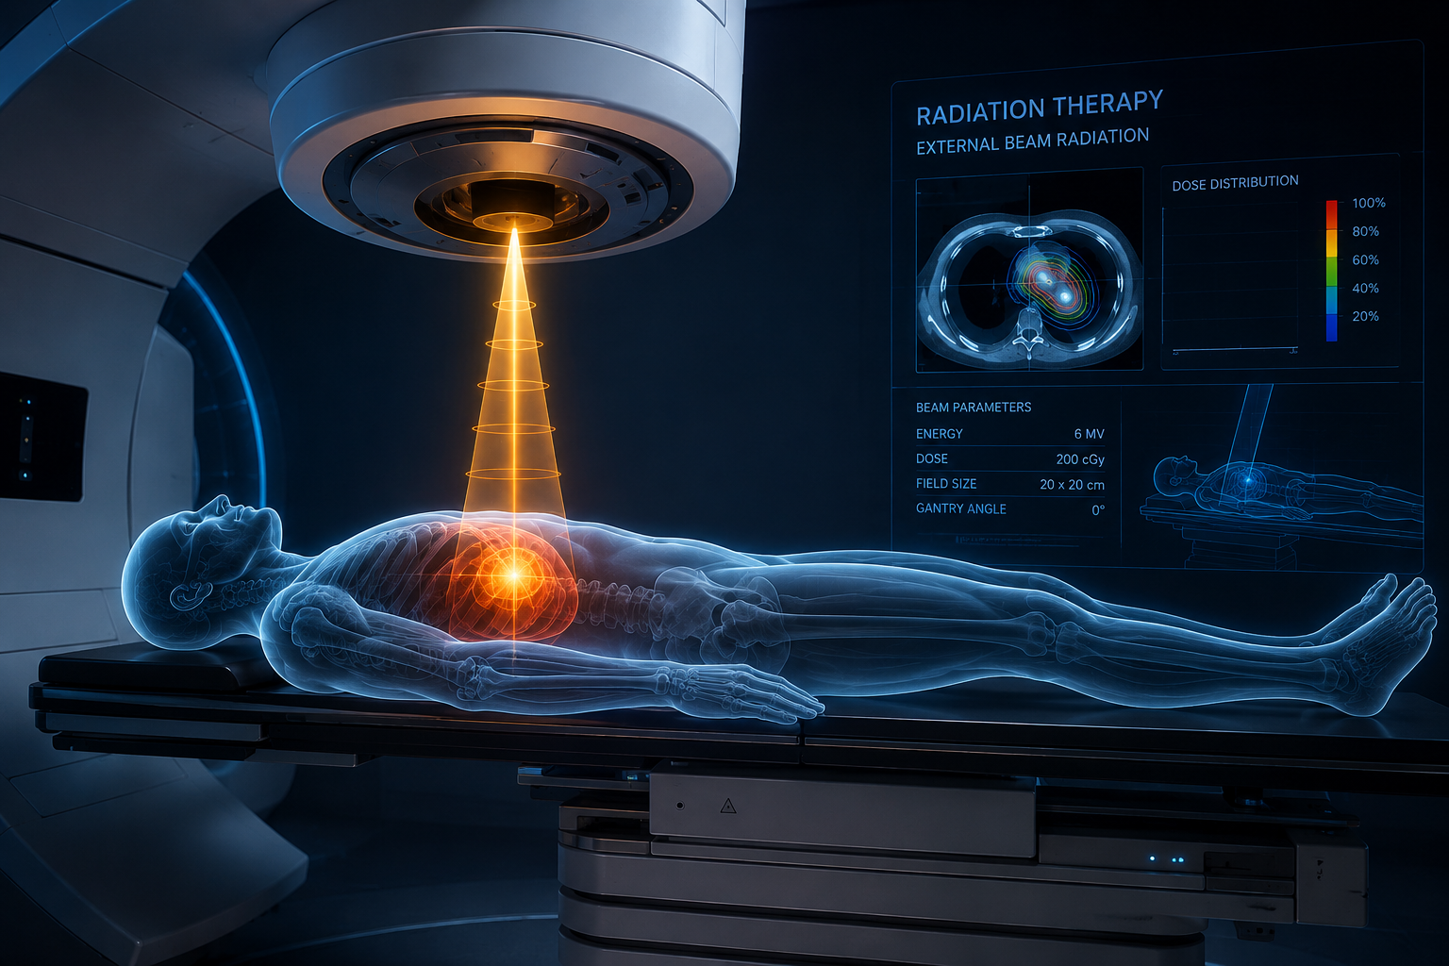
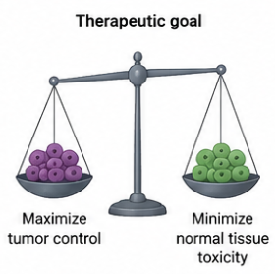
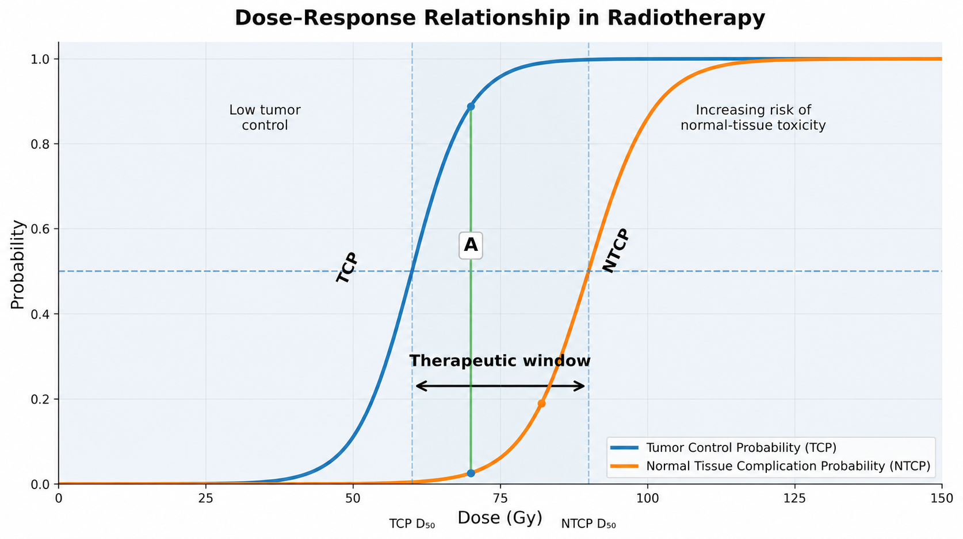
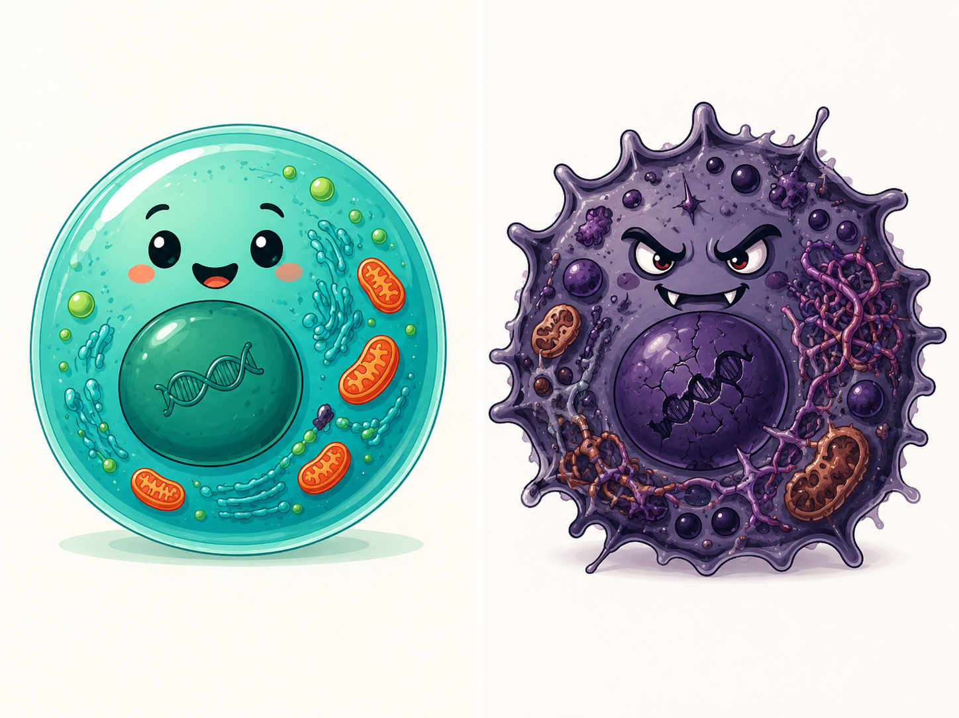
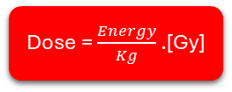
Introduction
The concept of External Beam Radiotherapy - EBRT
More than 50% of cancer patients are expected to receive radiotherapy as part of their treatment pathway. European Organisation for research and treatment of cancer (EORTC)
The use of an external beam of ionizing radiation for the eradication of cancer cells.
Dose = $\frac{Energy}{Kg}$ .[Gy]
Healthy cells
Cancer cells
Notes:
Use this slide to define the scope: two devices, two irradiation platforms, one monitoring/transit-dosimetry goal.

Slide 3
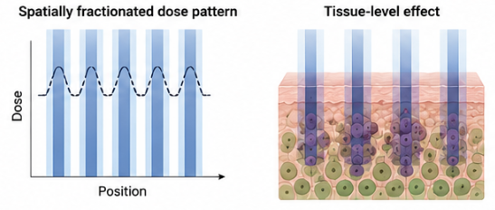
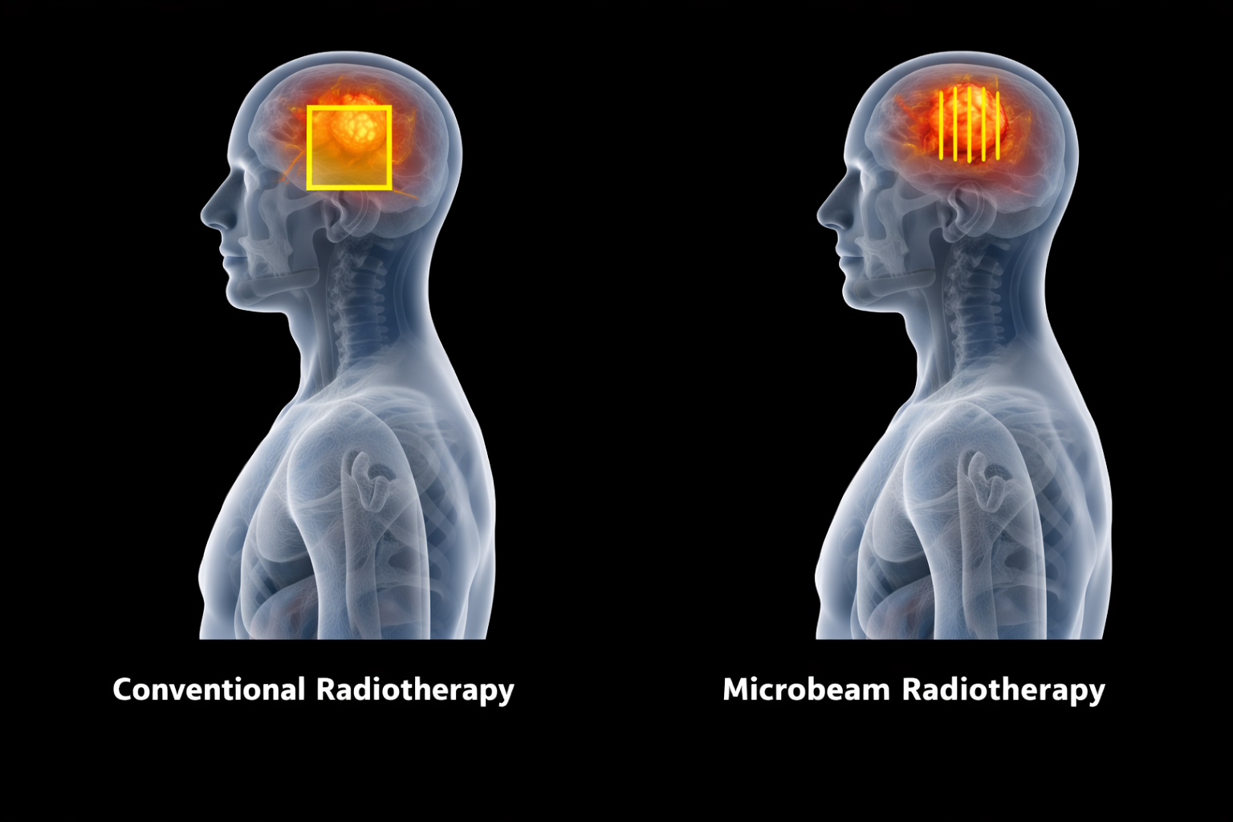
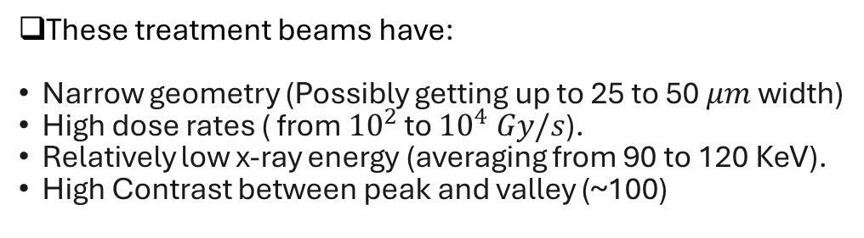

Introduction
Advanced Radiotherapy Techniques
These treatment beams have:
Narrow geometry (Possibly getting up to 25 to 50 $μm$width)
High dose rates ( from ${10}^{2}$ to ${10}^{4} Gy/s$).
Relatively low x-ray energy (averaging from 90 to 120 KeV).
High Contrast between peak and valley (~100)
1. Spatially Fractionated Radiation therapy (SFRT).
2. Ultra high dose rate radiation therapy (FLASH-RT)
Delivers a very high dose of radiation (typically $≥$ 40 Gy/s) in an extremely short time (milliseconds) . Conventional 0.08 Gy/s
Yan, W., Khan, M. K., et al.(2020). Spatially fractionated radiation therapy: History, present and the future. Clinical and Translational Radiation Oncology, 20, 30–38.
Notes:
Use this slide to define the scope: two devices, two irradiation platforms, one monitoring/transit-dosimetry goal.

Slide 4
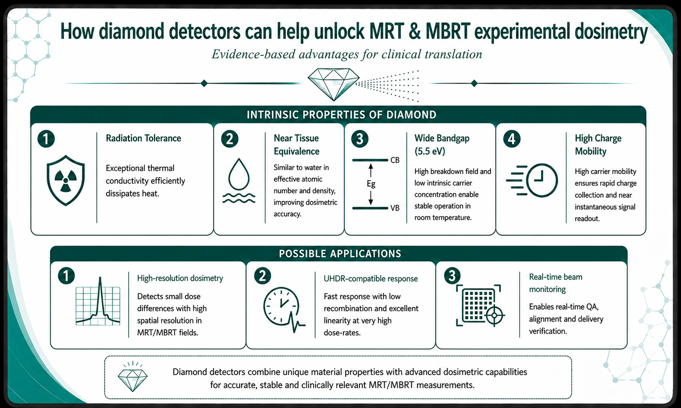
Diamond-Based Detectors
Notes:
Use this slide to define the scope: two devices, two irradiation platforms, one monitoring/transit-dosimetry goal.

Slide 5
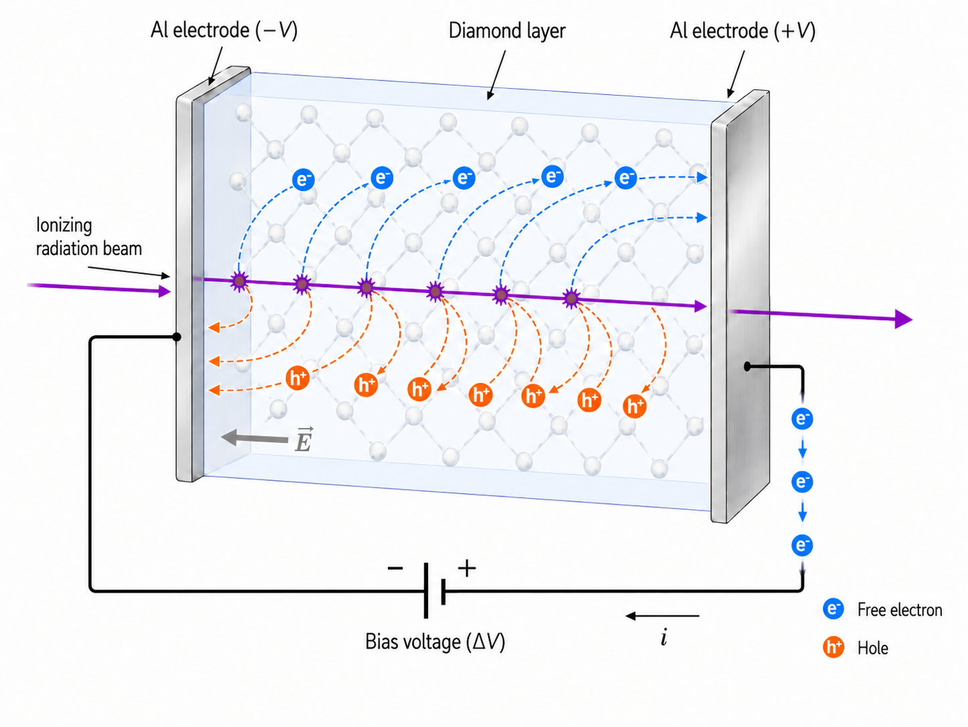
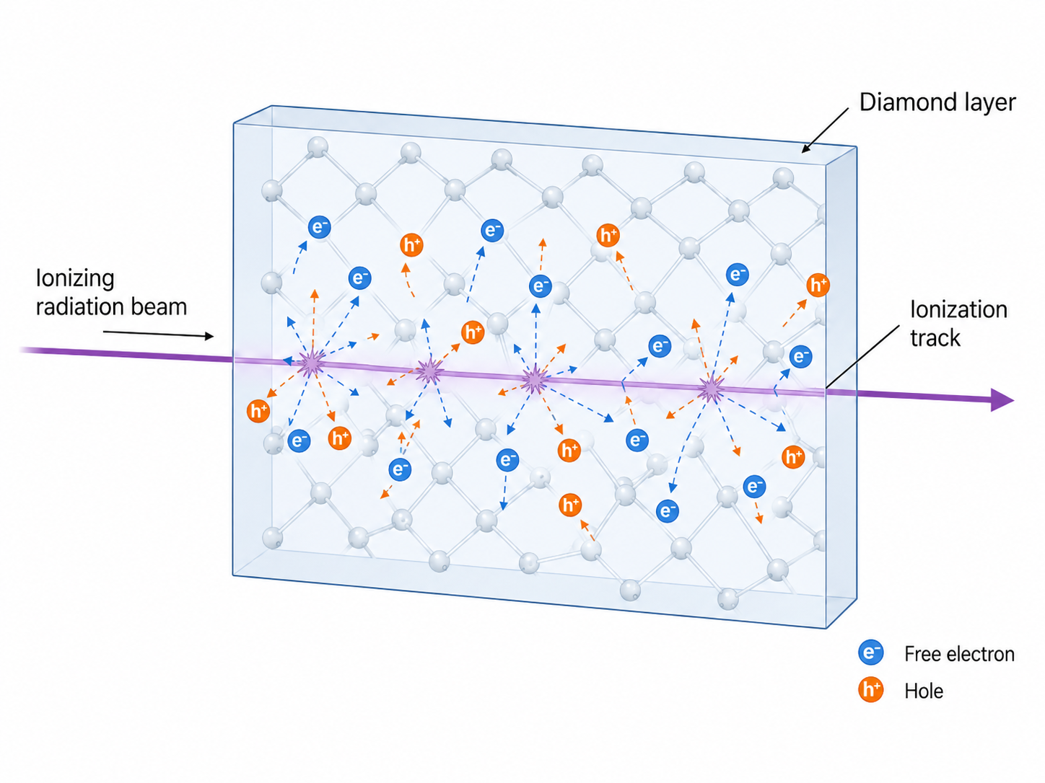
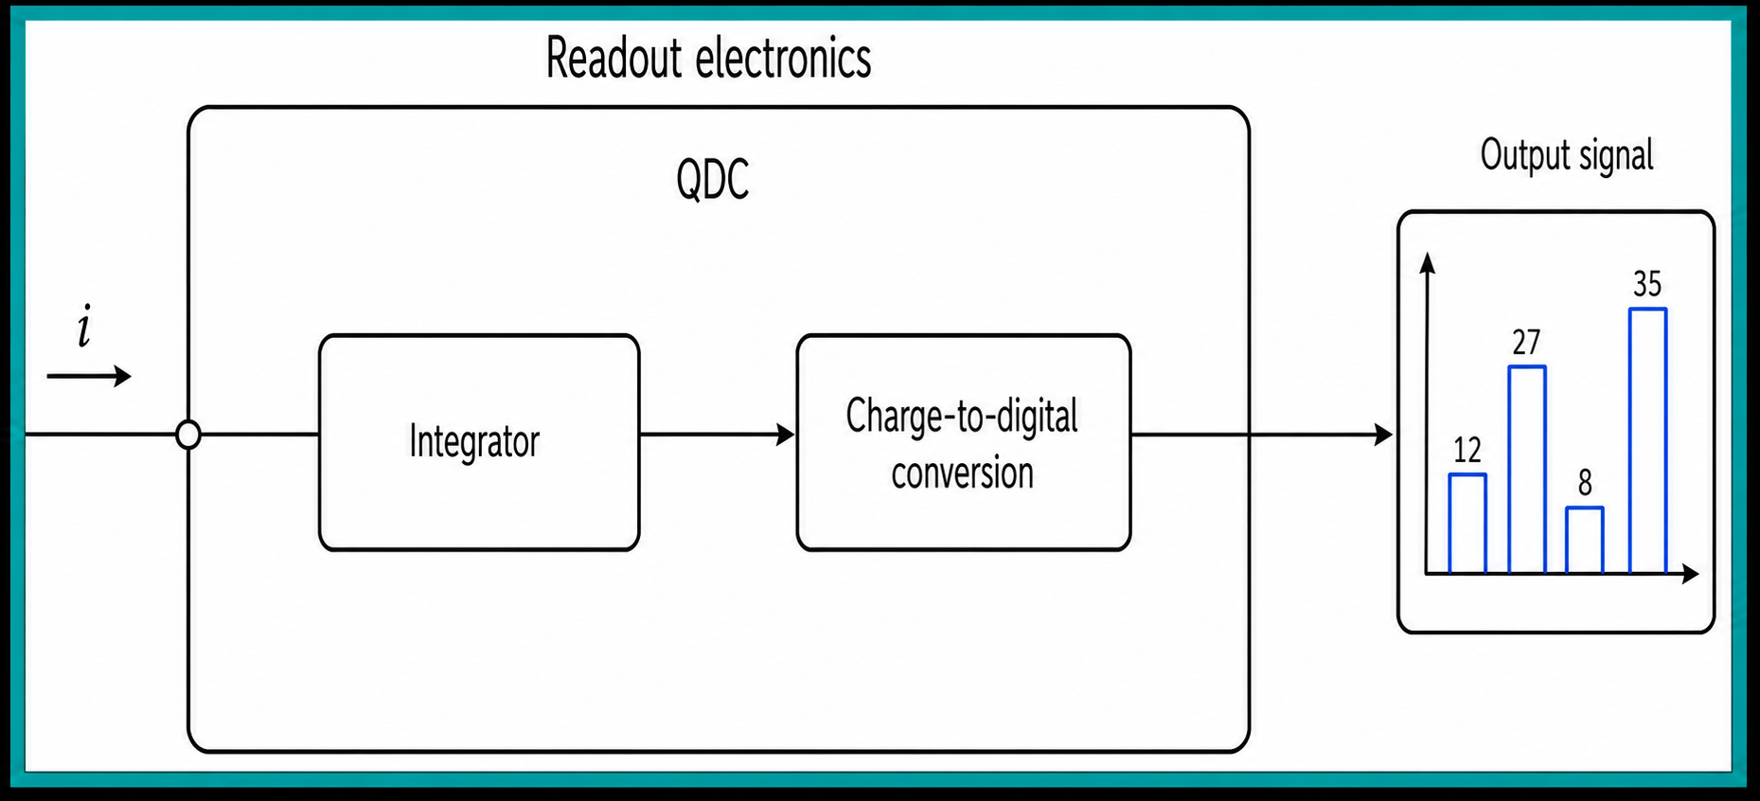
Diamond-Based Detectors
How diamonds detected ionizing radiation?
Solid state ionization chamber regime
Notes:
Use this slide to define the scope: two devices, two irradiation platforms, one monitoring/transit-dosimetry goal.

Slide 6

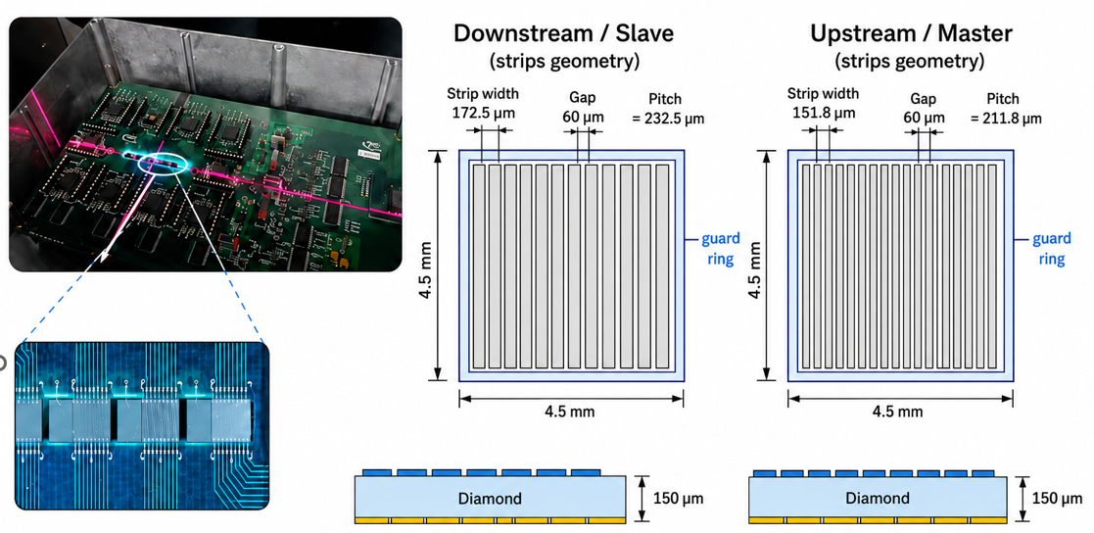
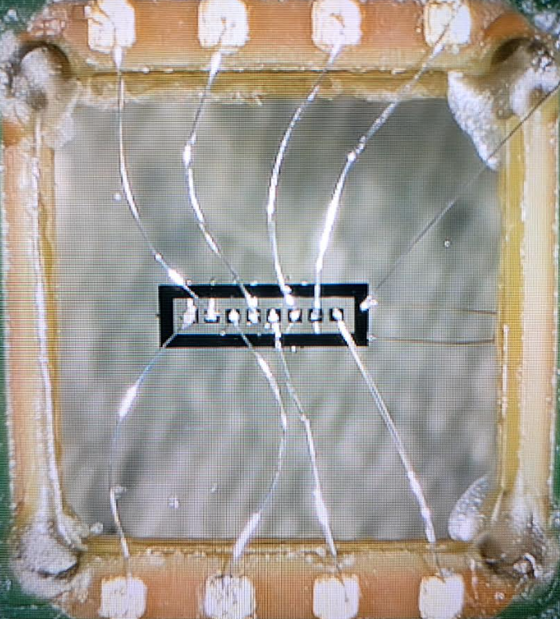
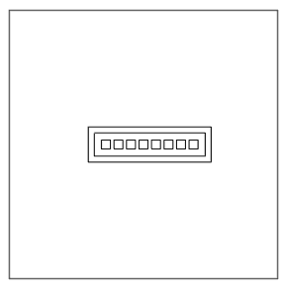
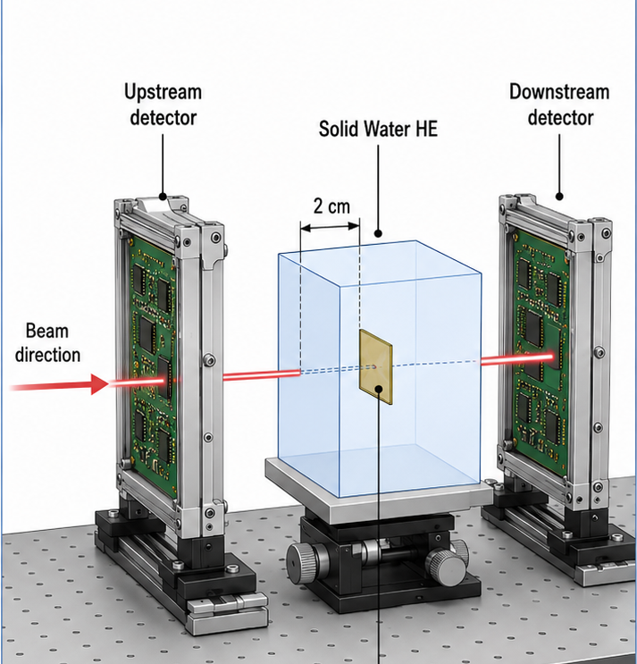

Diamond-Based Detectors
Detector’s Geometry
Microstrip Detectors
Pixelized Detector
Pixel size : 300 $μ$m x 300 $μ$m
Thickness : 150 $μ$m
Synchronized acquisition
QDC acquisition system on the board with about 20 ASICS
Works in continuous mode
Almost no dead time
USB comunication
Notes:
Use this slide to define the scope: two devices, two irradiation platforms, one monitoring/transit-dosimetry goal.

Slide 7
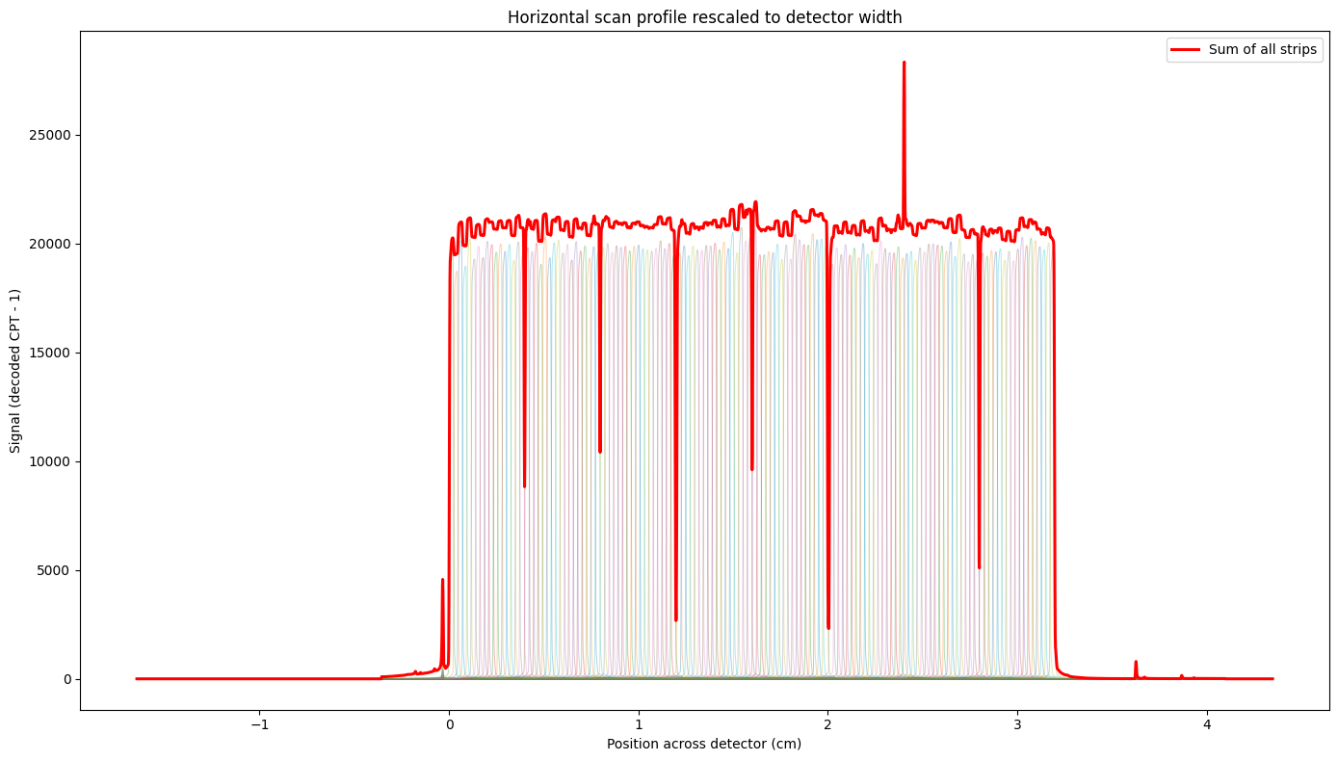
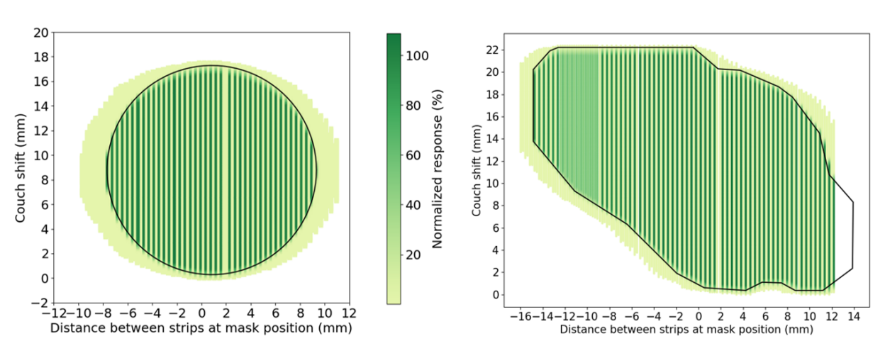
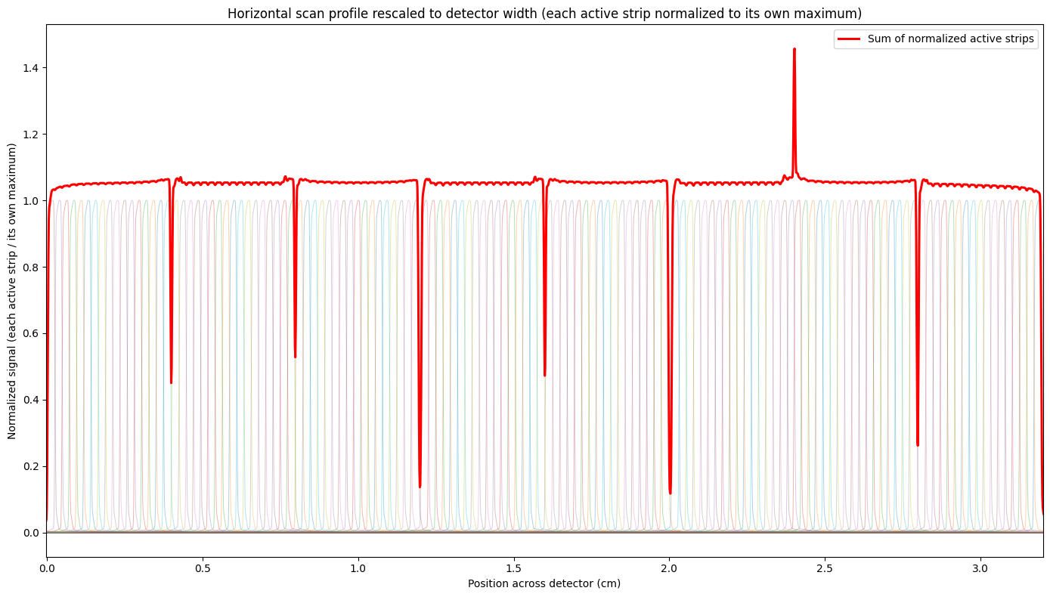
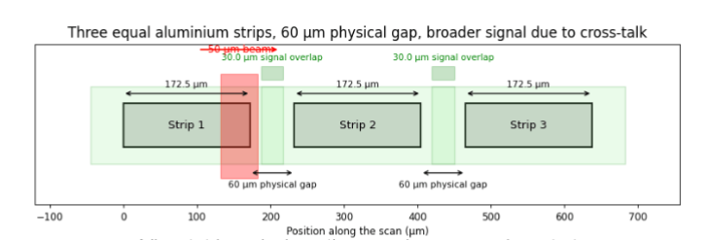
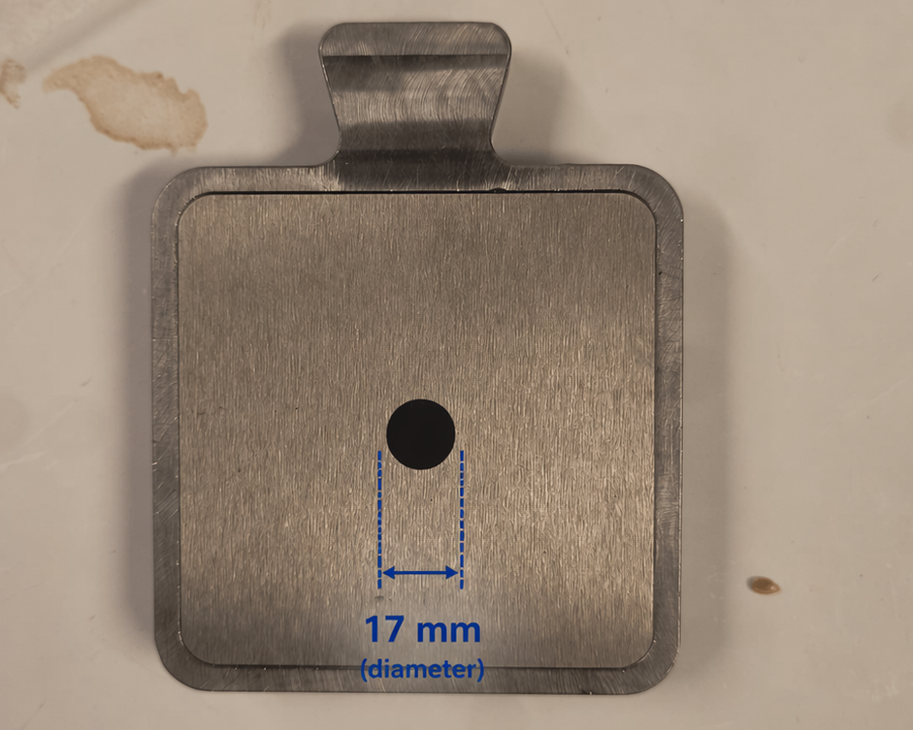
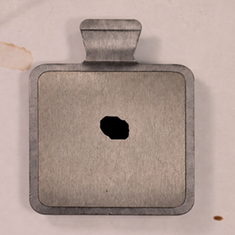
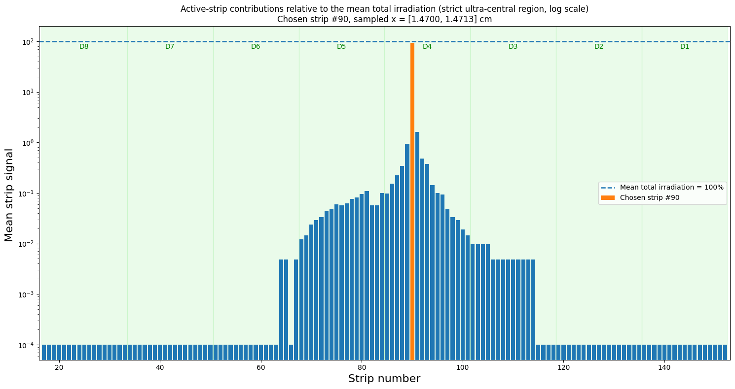

Detector’s Geometry
Horizontal Scan
2D image of tungsten's masks
On average the sum curve is 5% bigger than the top of the strips.
Signal contribution by strip:
Strip centred : 94.4 $±$ 0.61 %
Remaining strips: 5.6 $±$ 0.61%
Notes:
Use this slide to define the scope: two devices, two irradiation platforms, one monitoring/transit-dosimetry goal.

Slide 8
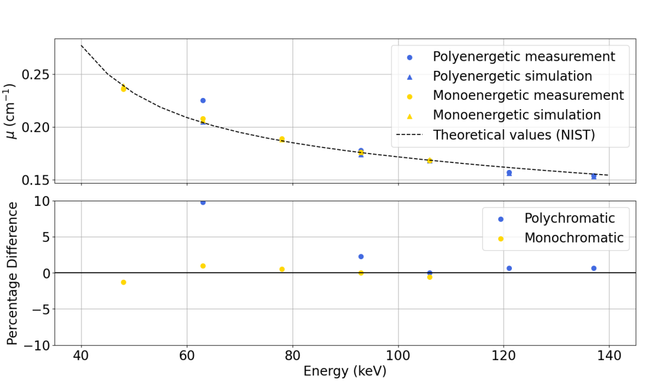
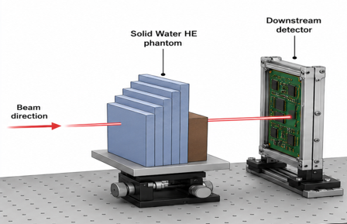
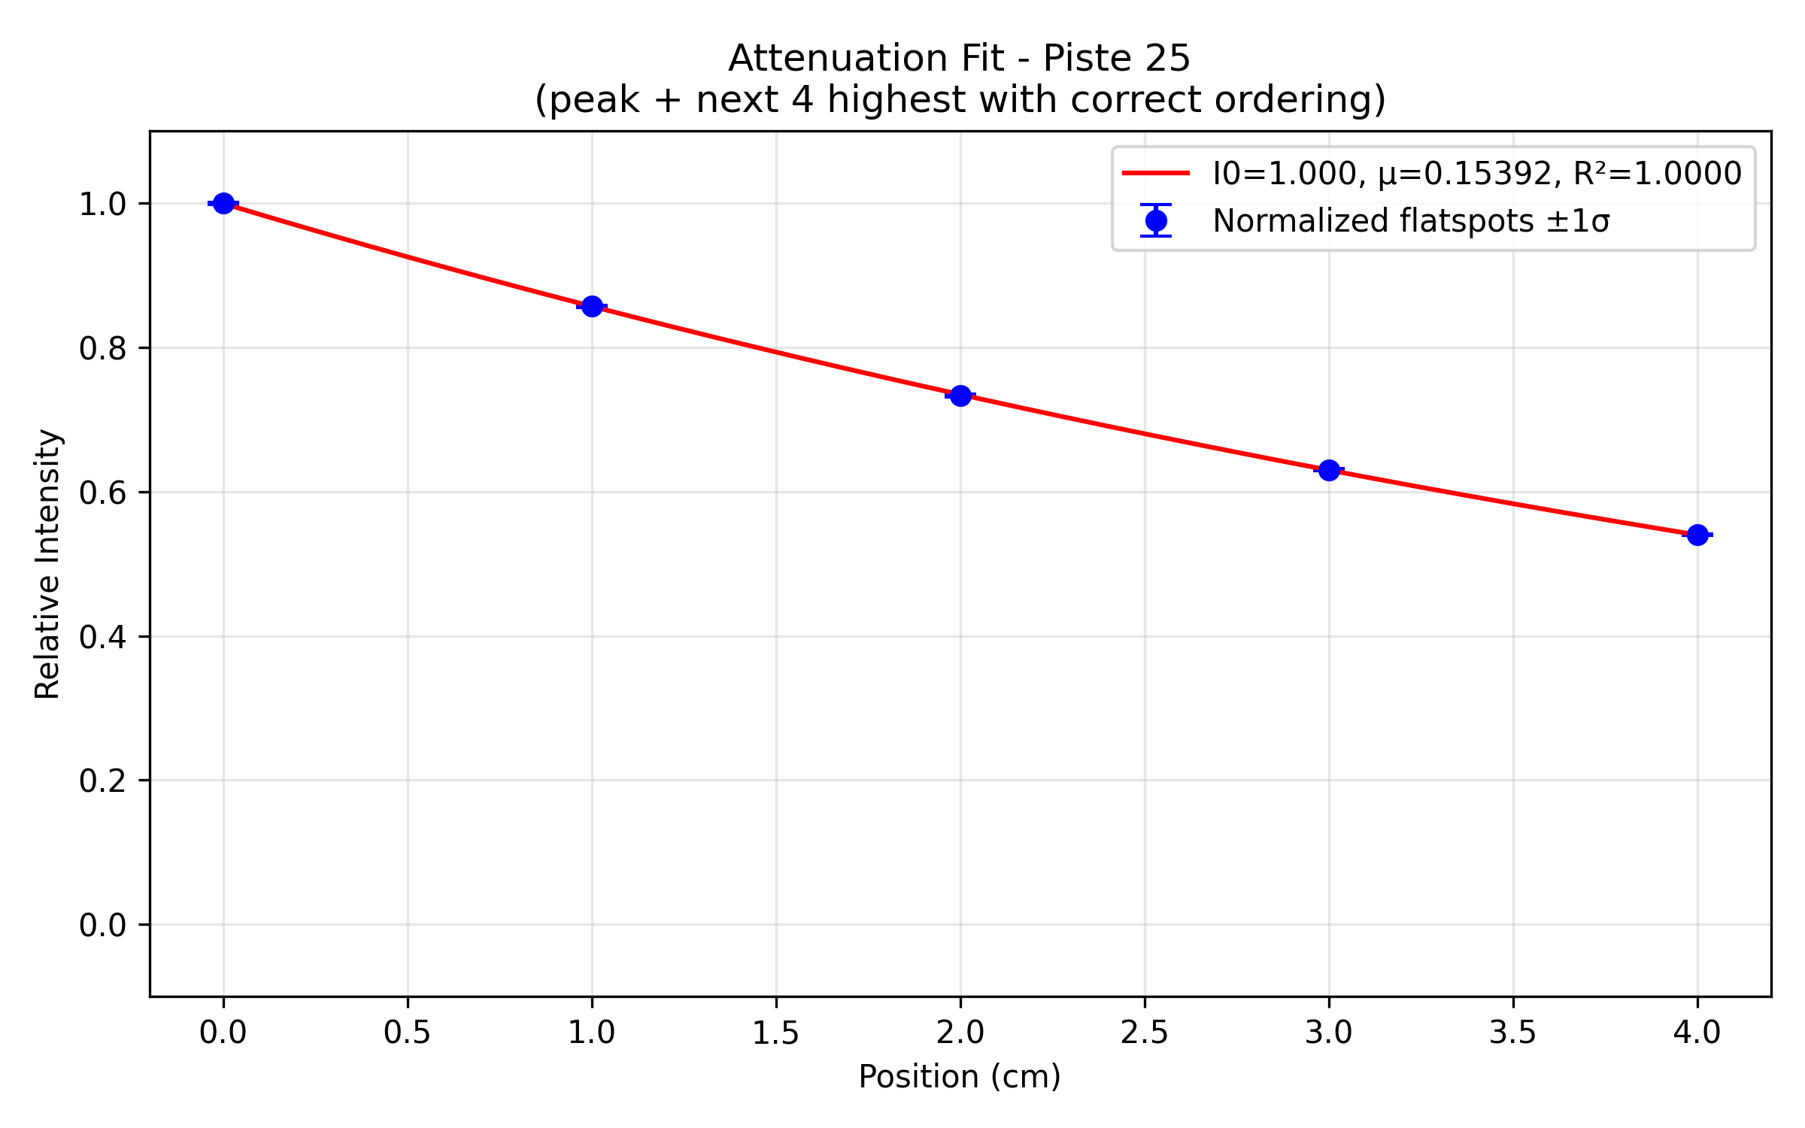
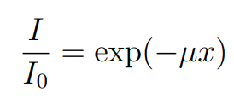

Detector’s Geometry
Microstrip Detectors
Pixelized Detector
Linear Attenuation Coefficient ($μ$)
At 63 keV, the experimental μ is ~10% lower than the simulated value, due to very high photon flux (and dose rate, ~6000 Gy/s) induced a non-linear response in the detector.
Relative difference below 2%
Notes:
Use this slide to define the scope: two devices, two irradiation platforms, one monitoring/transit-dosimetry goal.

Slide 9
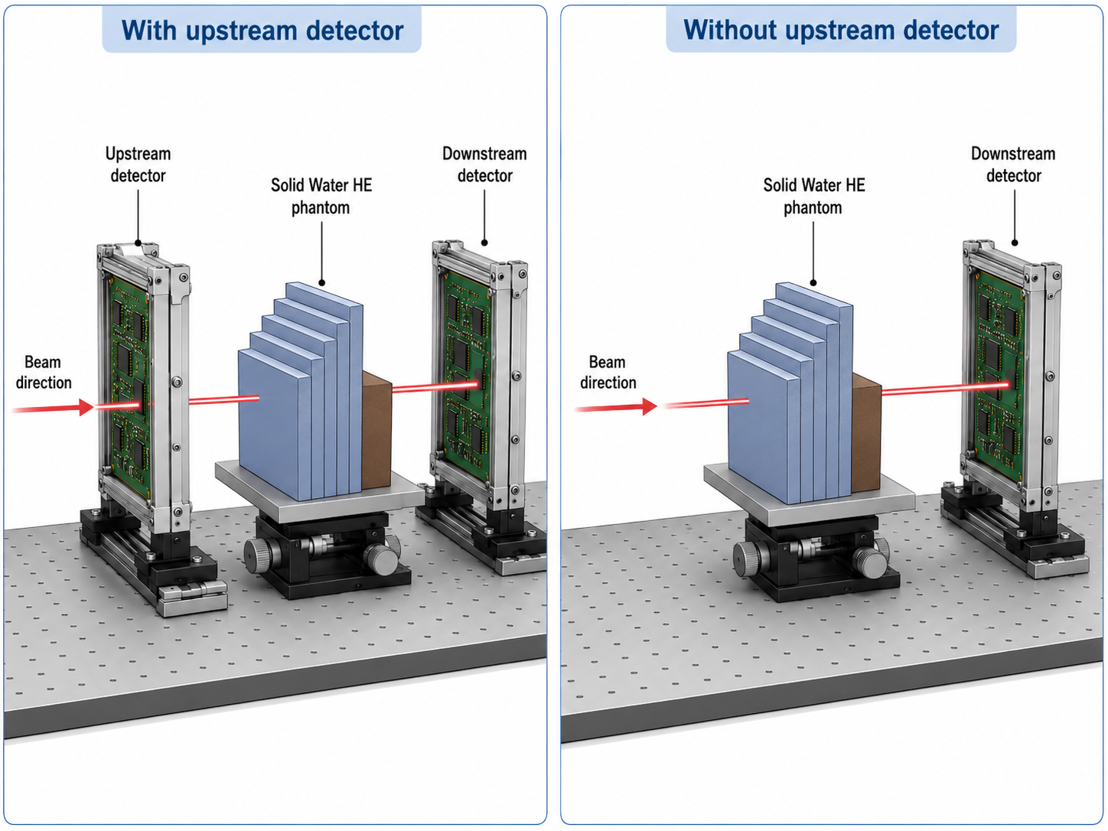
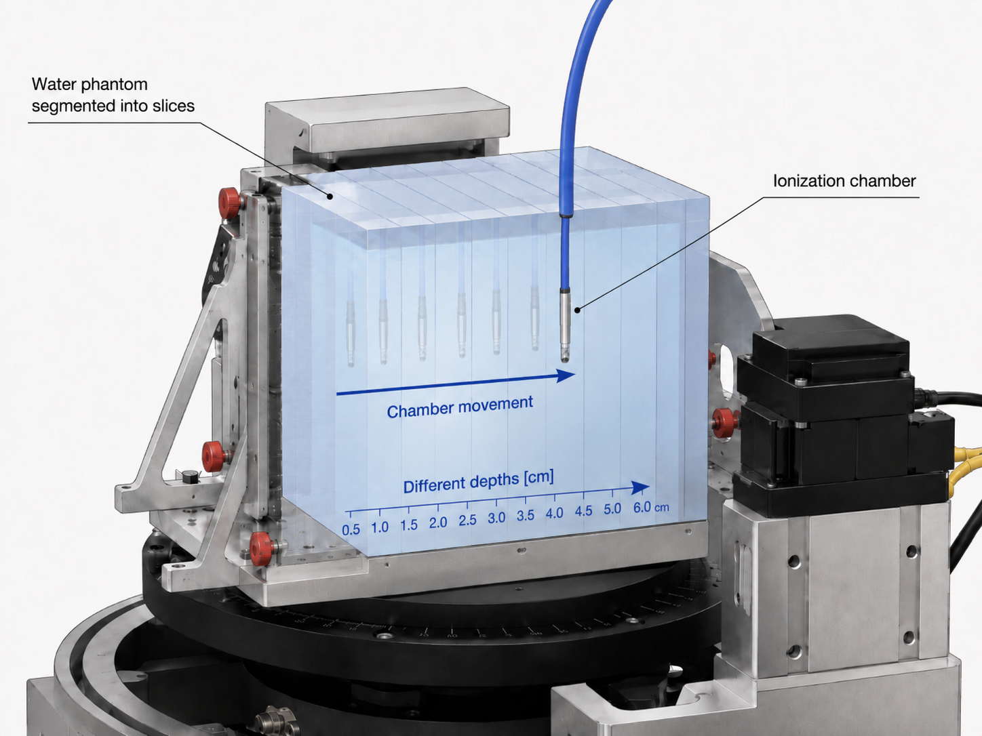
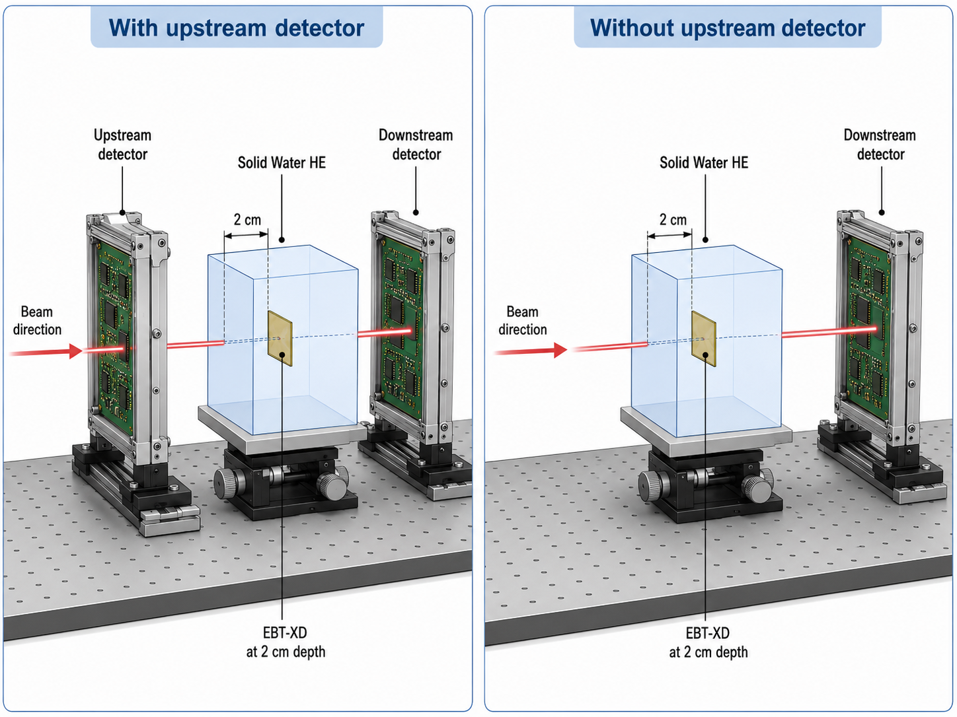
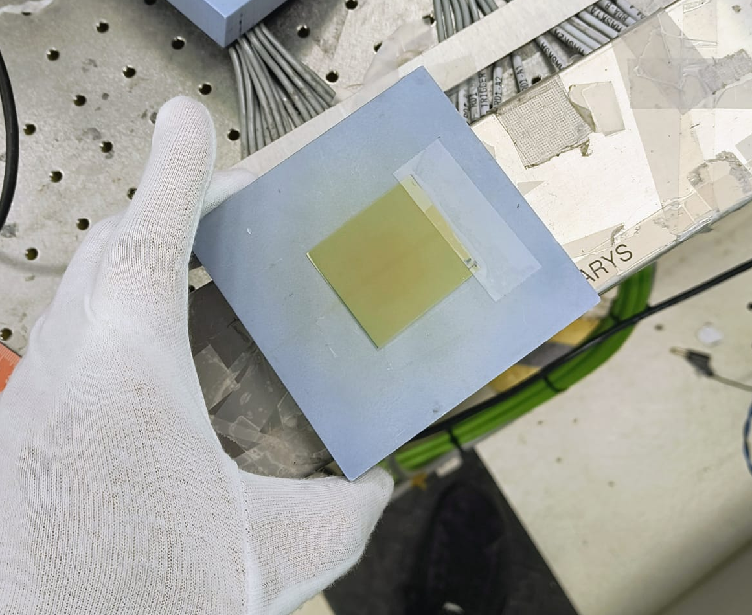
Linear Attenuation Coefficient
Australian Synchrotron 2026
Polyenergetic beam.
Average energy → 137 KeV
Dose rate = 114.1 Gy/s
Microstrip detectors
How does the presence of an upstream detector affect the beam properties?
Polyenergetic beam.
Average energy → 106 KeV
Dose rate = 489 Gy/s
Percentage Depth Dose
Beam Profile
Notes:
Use this slide to define the scope: two devices, two irradiation platforms, one monitoring/transit-dosimetry goal.

Slide 10
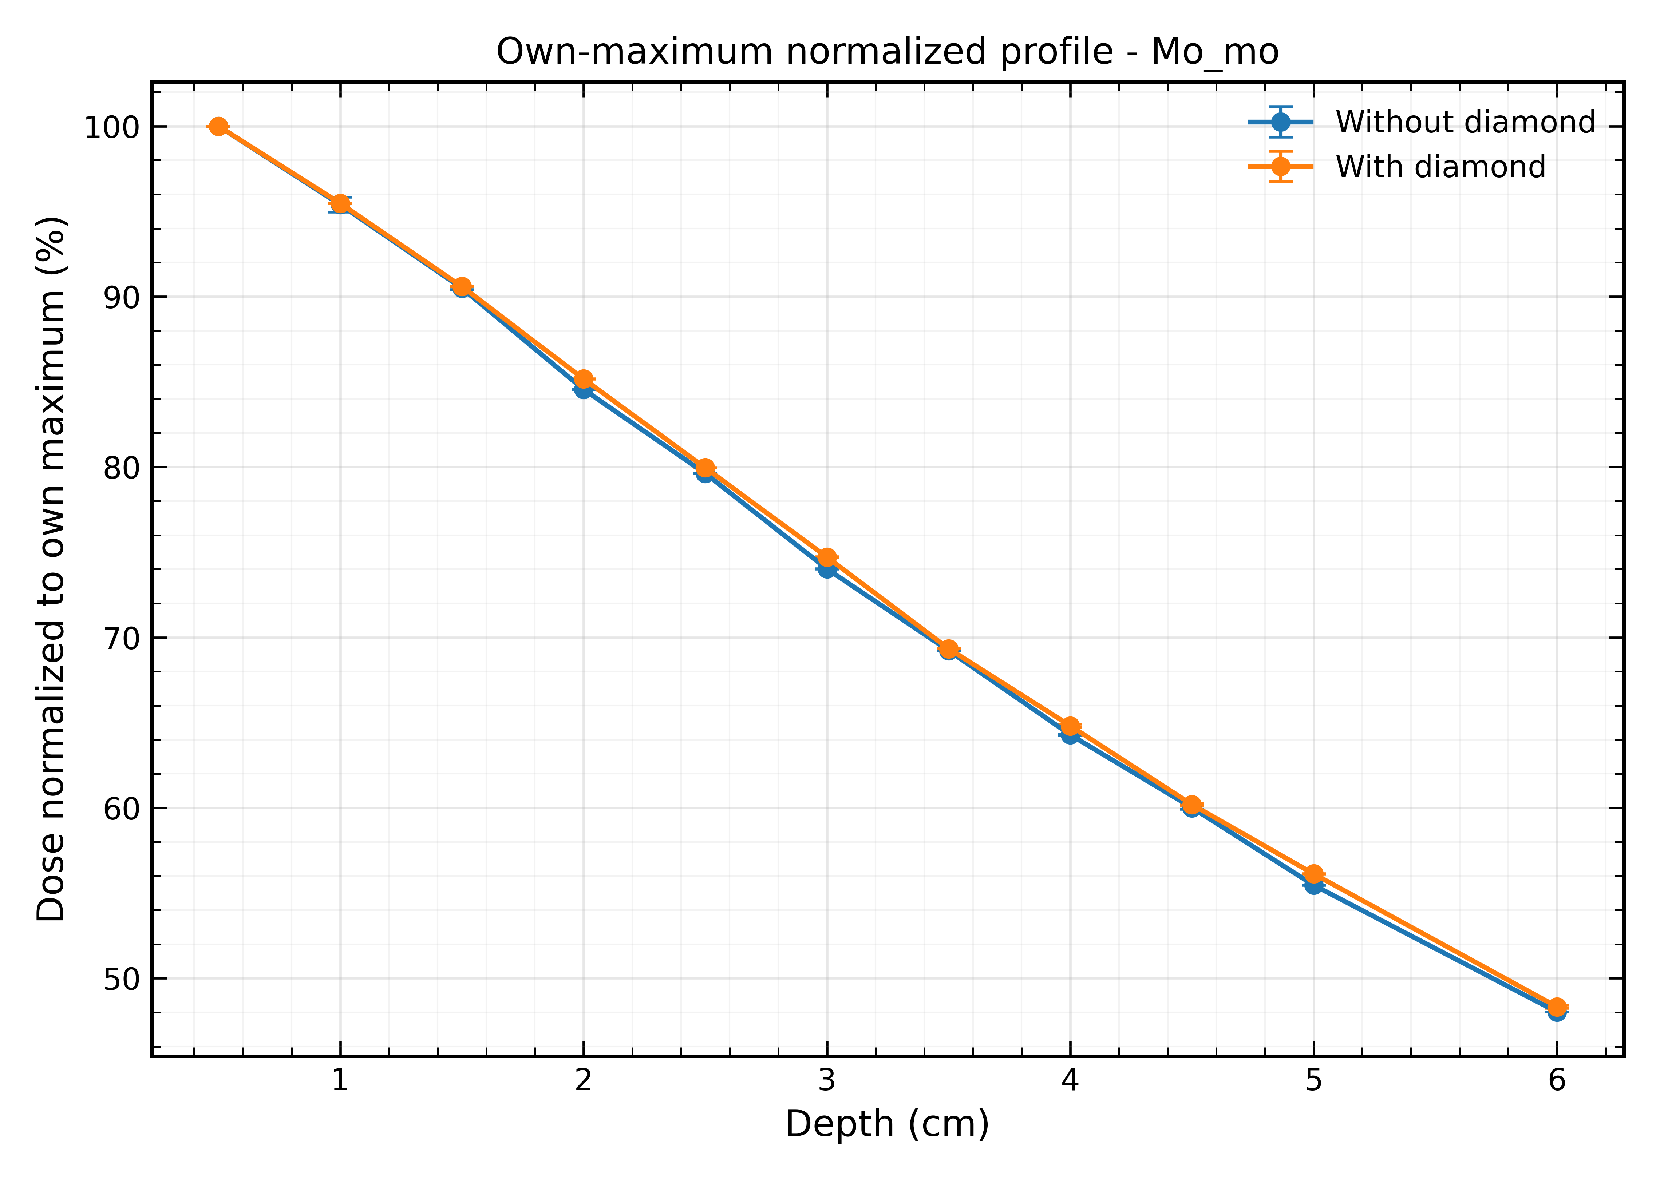

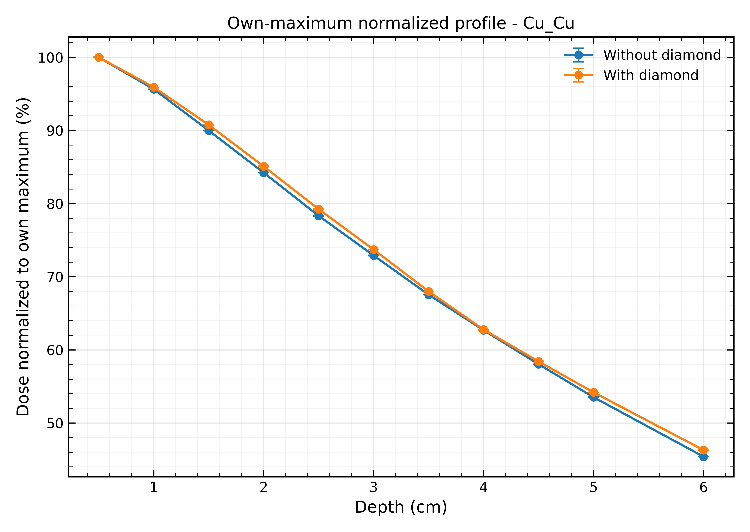
Australian Synchrotron 2026
Polyenergetic beam.
Average energy → 137 KeV
Mean raw dose attenuation = 1.595%
Percentage Depth Dose
Polyenergetic beam.
Average energy → 106 KeV
Mean raw dose attenuation = 1.742%
Notes:
Use this slide to define the scope: two devices, two irradiation platforms, one monitoring/transit-dosimetry goal.

Slide 11
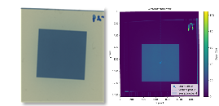
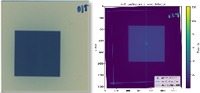
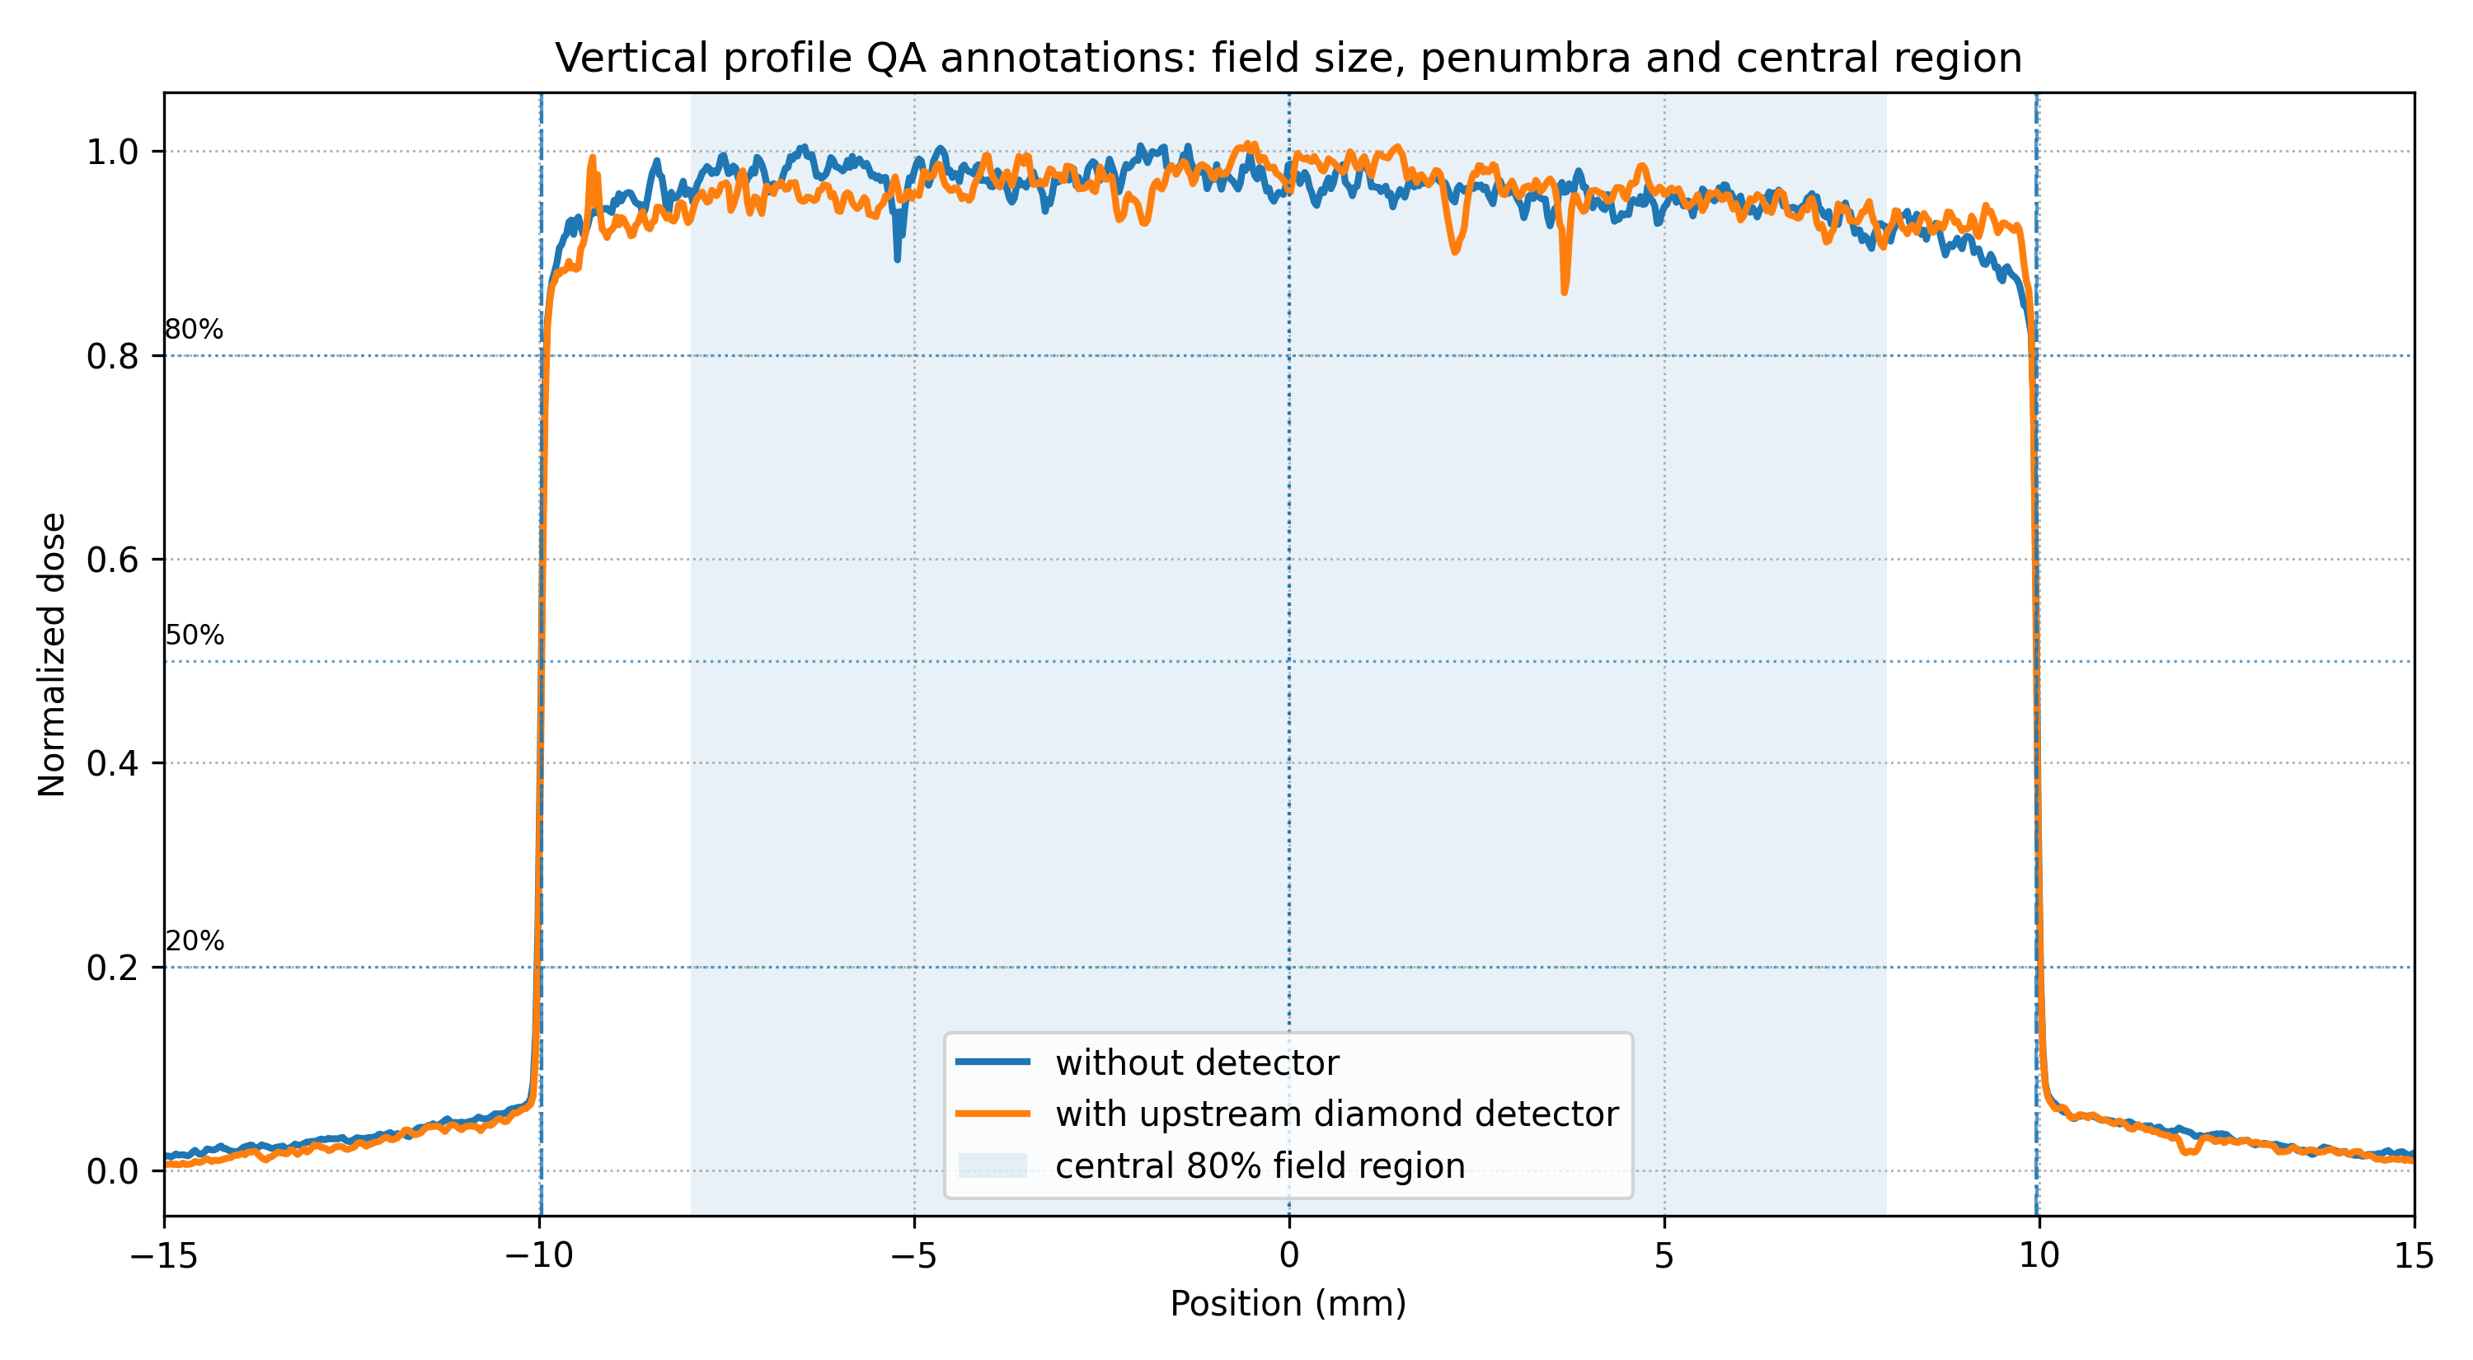
Australian Synchrotron 2026
Beam Profile
Beam profile more laterally symmetric
Narrowed the mean penumbra
Flatter and more uniformed dose distribution across the plateau
The lateral field size (FWHM) is highly preserved
The detector introduced an asymmetric perturbation in the out-of-field dose tails.
Notes:
Use this slide to define the scope: two devices, two irradiation platforms, one monitoring/transit-dosimetry goal.

Slide 12
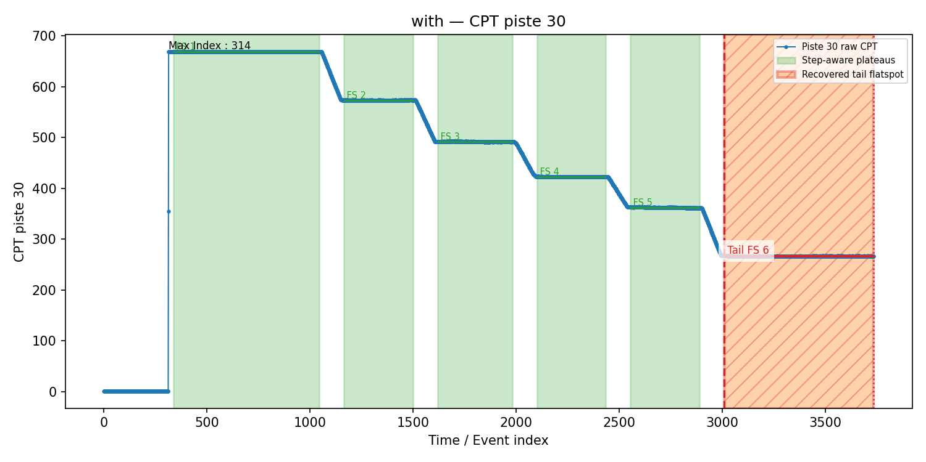
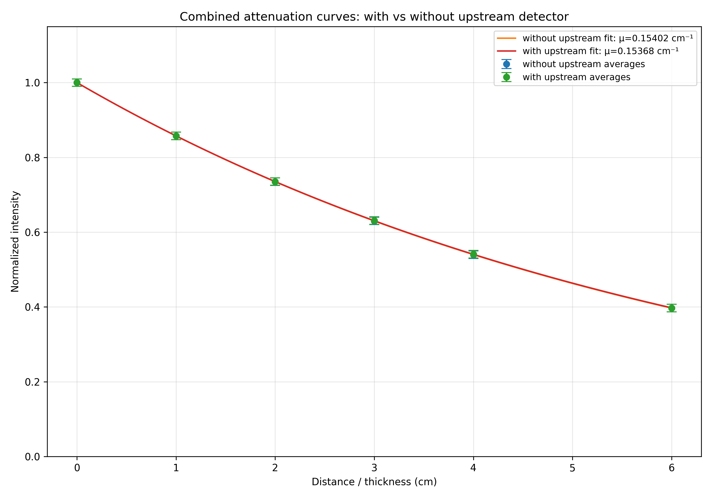
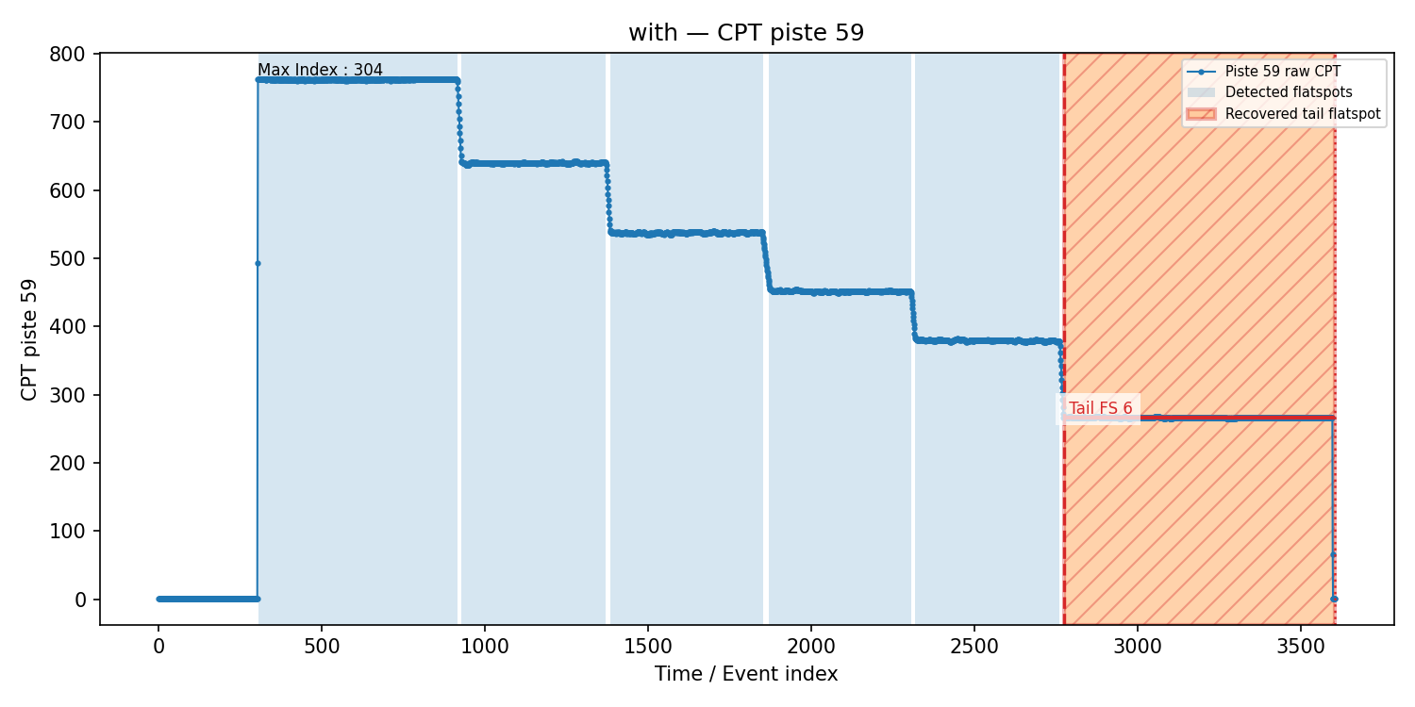
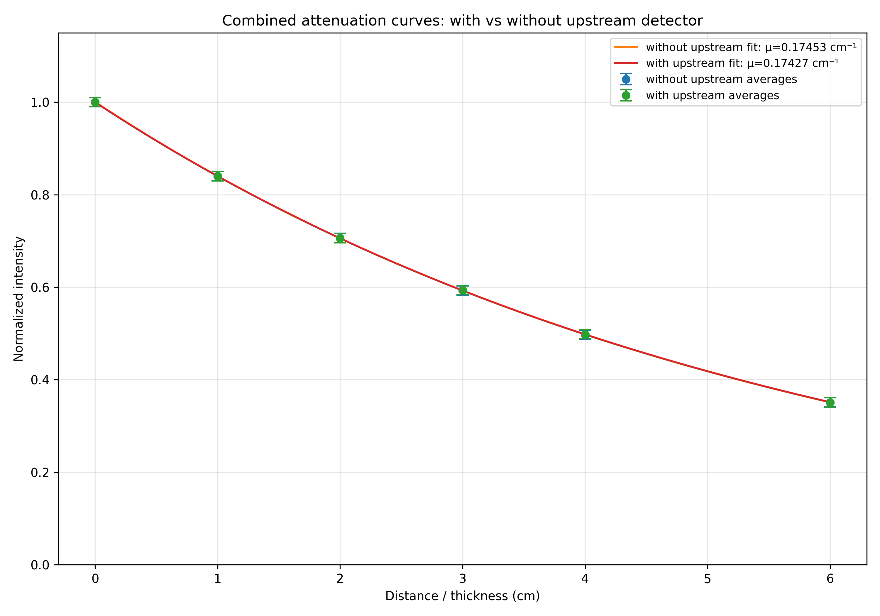
Australian Synchrotron 2026
Polyenergetic beam.
Average energy → 137 KeV
Relative difference below 0.2%
Linear Attenuation Coefficient
Polyenergetic beam.
Average energy → 106 KeV
Relative difference below 0.15%
Notes:
Use this slide to define the scope: two devices, two irradiation platforms, one monitoring/transit-dosimetry goal.

Slide 13

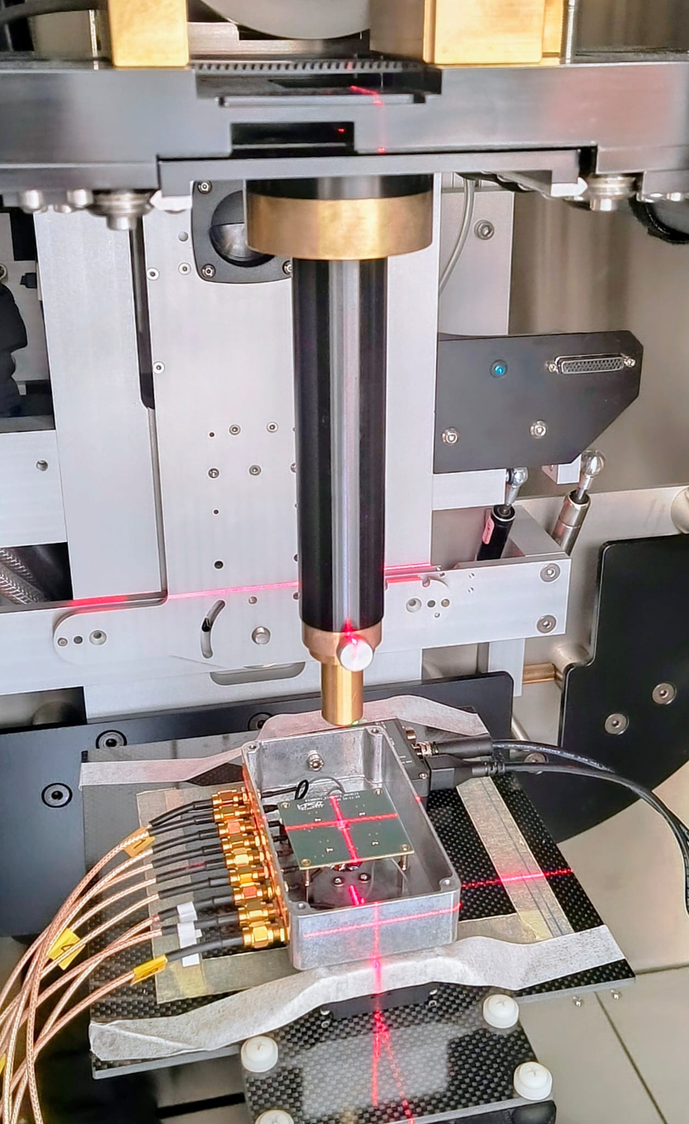
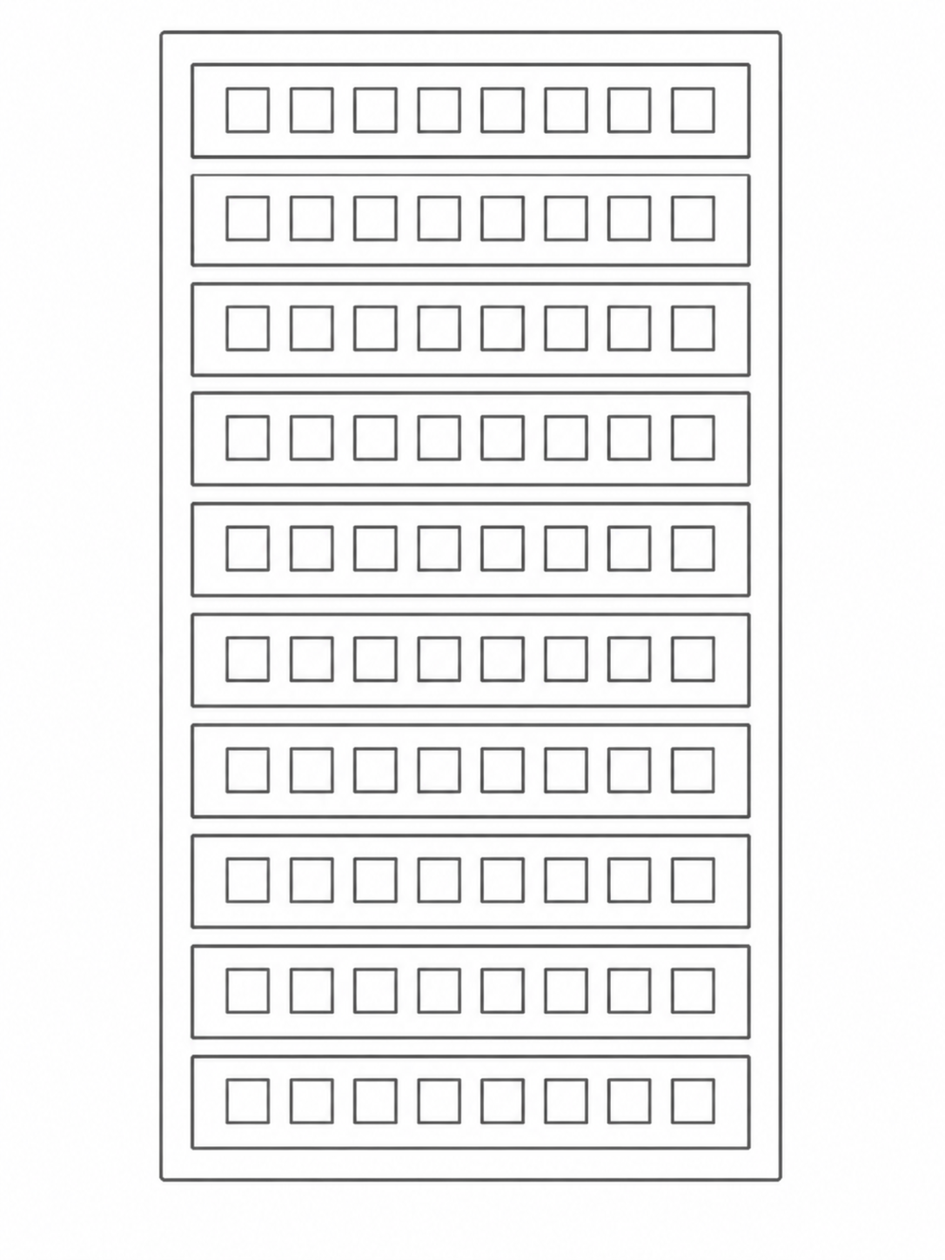



Small Animal Radiation Therapy Platform 2026
Pixelized detector
SARRP beam :
Mean average energy = 150 KeV
Dose rate → Gy/m
What is the detector's ability to distinguish closely spaced structures?
Gold standard for high-spatial-resolution dosimetry
1 mm beam collimator.
1 mm beam
360$μm$
360$μm$
Pixelized detector
Simulation 2D detector
Notes:
Use this slide to define the scope: two devices, two irradiation platforms, one monitoring/transit-dosimetry goal.

Slide 14
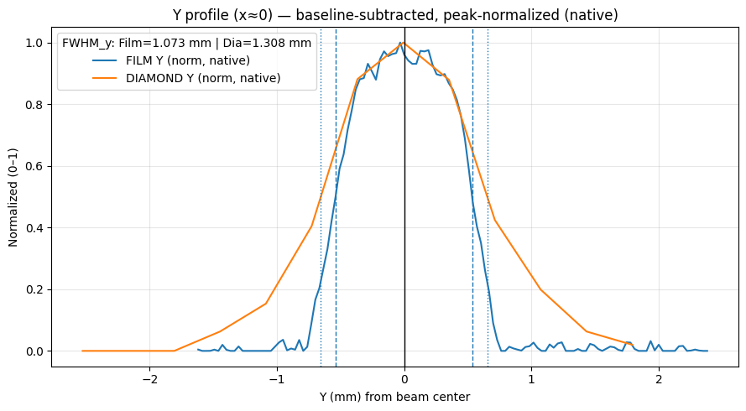
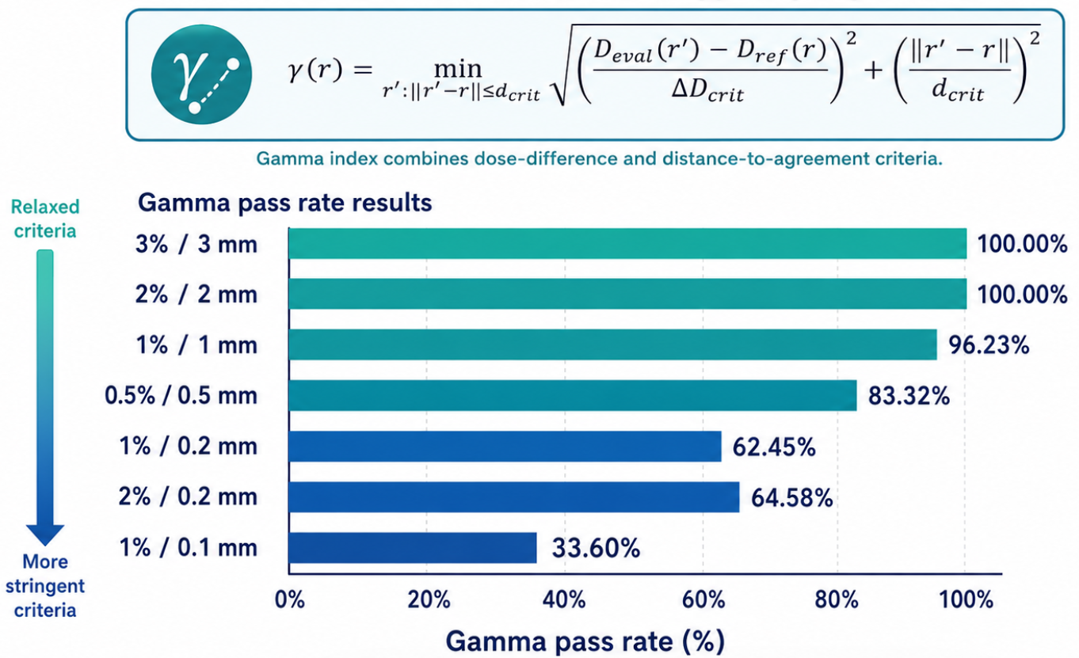
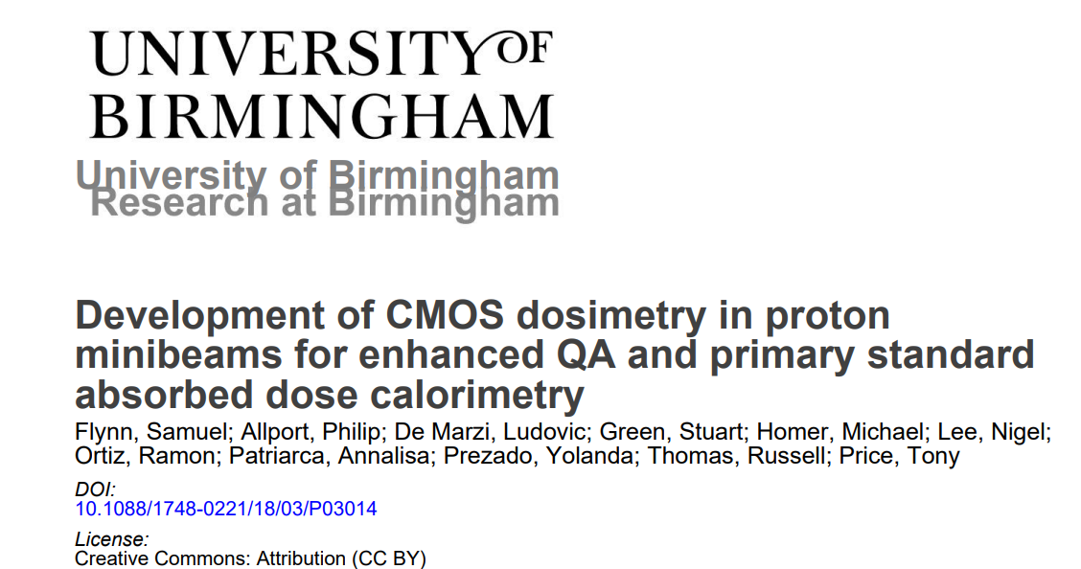
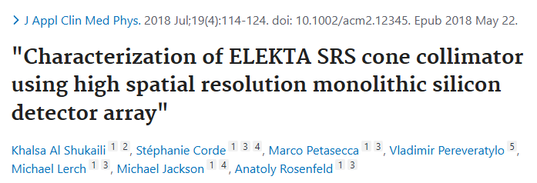
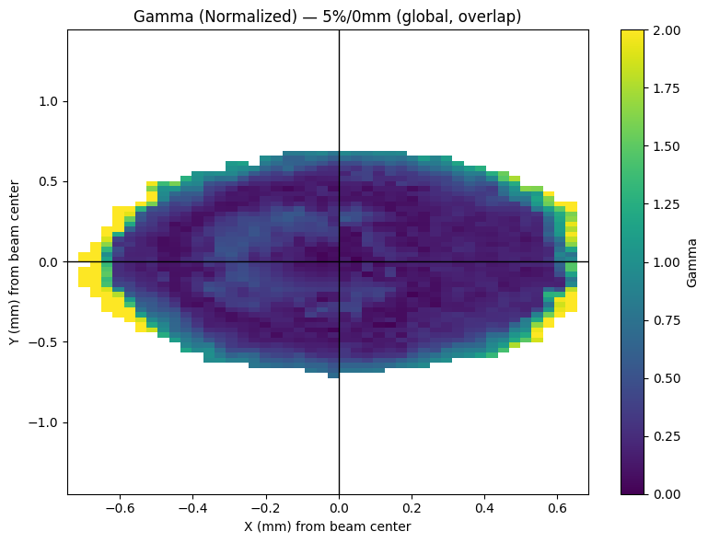
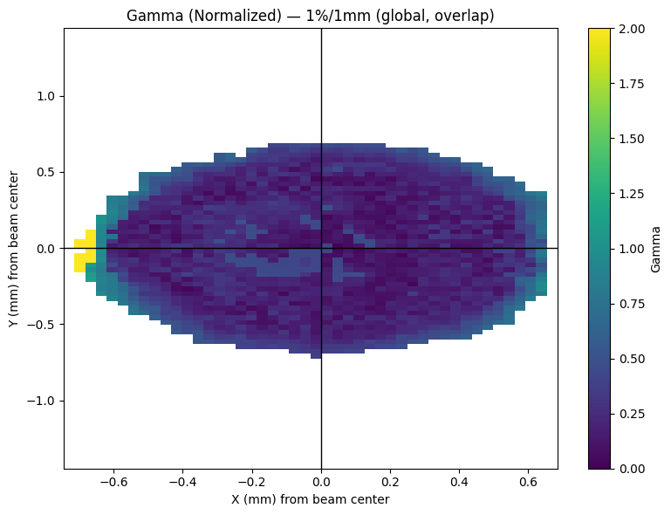
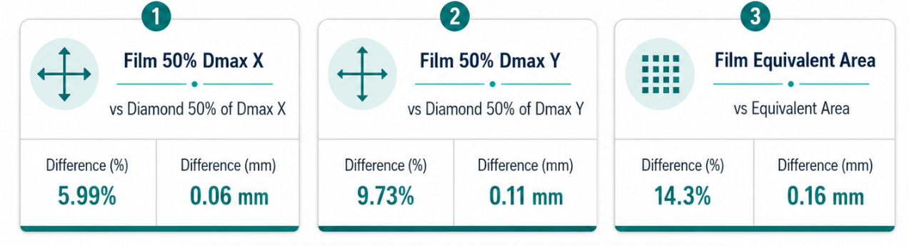
Small Animal Radiation Therapy Platform 2026
Pixelized detector
Notes:
Use this slide to define the scope: two devices, two irradiation platforms, one monitoring/transit-dosimetry goal.

Slide 15

CLOSING
Conclusions and take-home messages
The presence of the upstream diamond detector on the MRT synchrotron has a negligible impact on the beam characteristics, indicating that it does not introduce a clinically or dosimetrically relevant perturbation under the investigated conditions.
The microstrip detector has been validated for synchrotron MRT beam imaging and transmission measurements.
The pixelized detector extends the same monitoring strategy to SARRP compact-source experiments.
Final one-line message
Diamond-based beam monitors provide a practical route from passive Quality assurance toward active, real-time verification of preclinical SFRT delivery.
Thank you
Questions? | tiago.bettio@lpsc.in2p3.fr | @tiagobettio
Jean François Muraz
Melvyn Reynaud
Laurent Gallin-Martel
Notes:
End with the bridge: synchrotron validation + compact-source deployment + transit dosimetry.

Slide 16
BACKUP
References
Livingstone et al., Journal of Synchrotron Radiation, 2017 — preclinical MRT at the Australian Synchrotron.
Livingstone et al., Medical Physics, 2016 — diamond dosimetry in spatially fractionated synchrotron X-ray fields.
Davis et al., Journal of Synchrotron Radiation, 2022 — transmission-mode strip detectors for MRT monitoring.
di Franco et al., Journal of Synchrotron Radiation, 2023 — monocrystalline diamond detector for online MRT monitoring.
Keshmiri et al., Scientific Reports, 2025 — recent advances in MRT film dosimetry QA.
Yan, W., Khan, M. K., et al.(2020). Spatially fractionated radiation therapy: History, present and the future. Clinical and Translational Radiation Oncology, 20, 30–38.
Laub, W. U., & Wong, T. (2003). The volume effect of detectors in the dosimetry of small fields used in IMRT. Physics in Medicine & Biology.
Notes:
Keep this as backup or convert to final reference slide according to conference style.

