Slide 1


Slide 2



Radiation hardness of CVD diamond detectors efficiency, defects and annealing
Robin Molle
Robin Molle – robin.molle@diamfab.com – GdR Di2i 2026

Slide 3
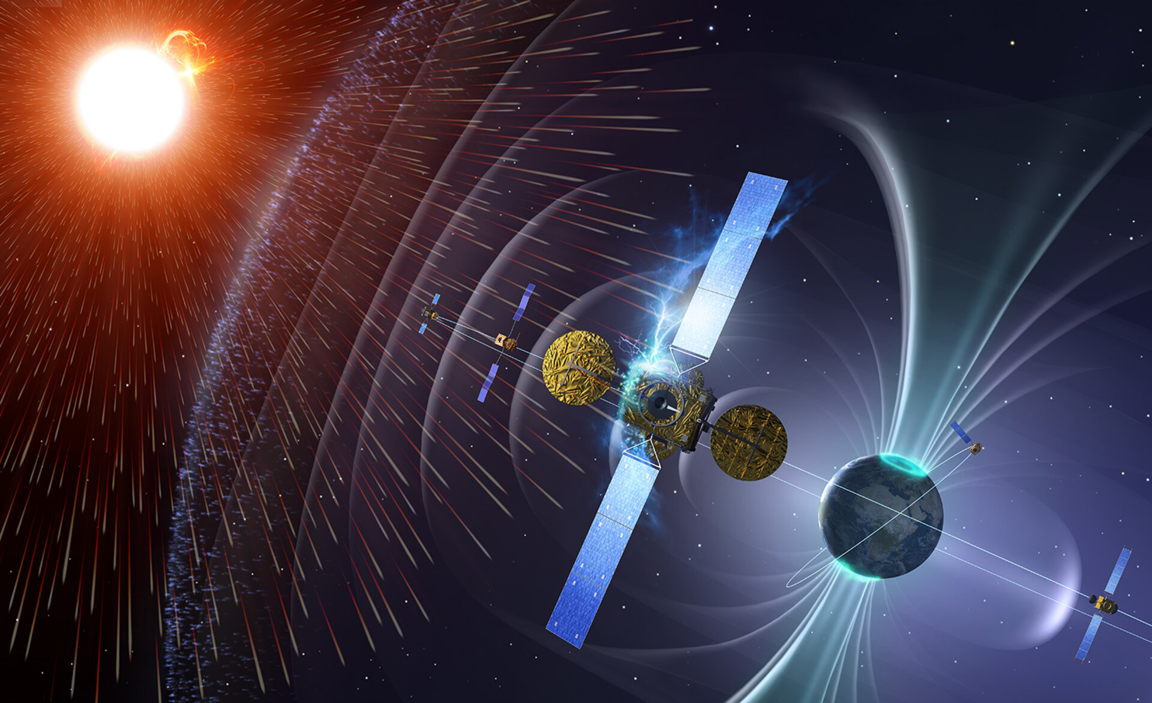
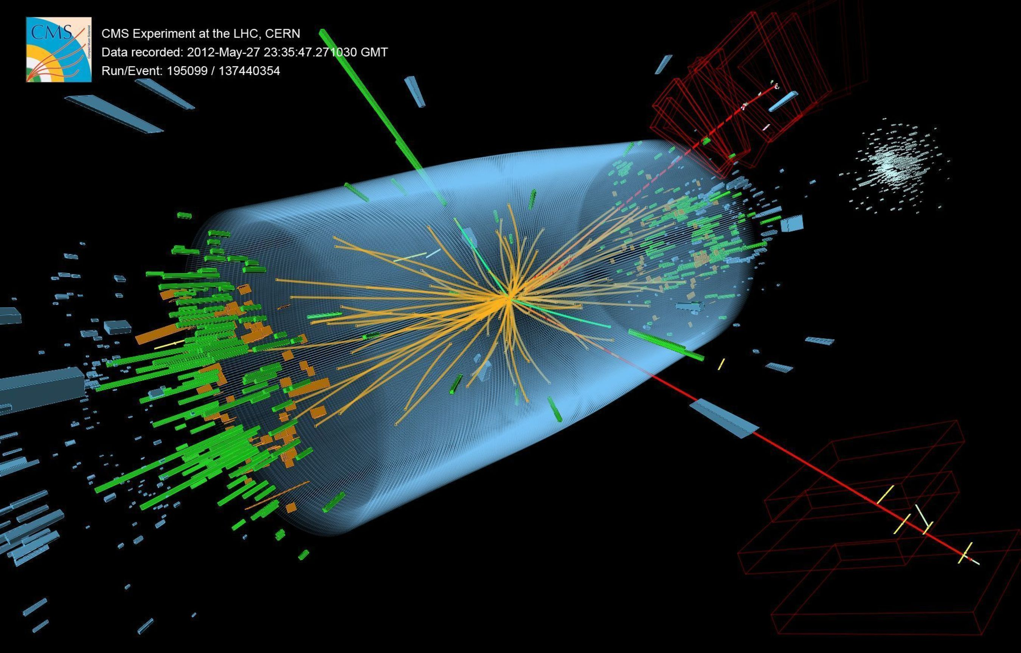
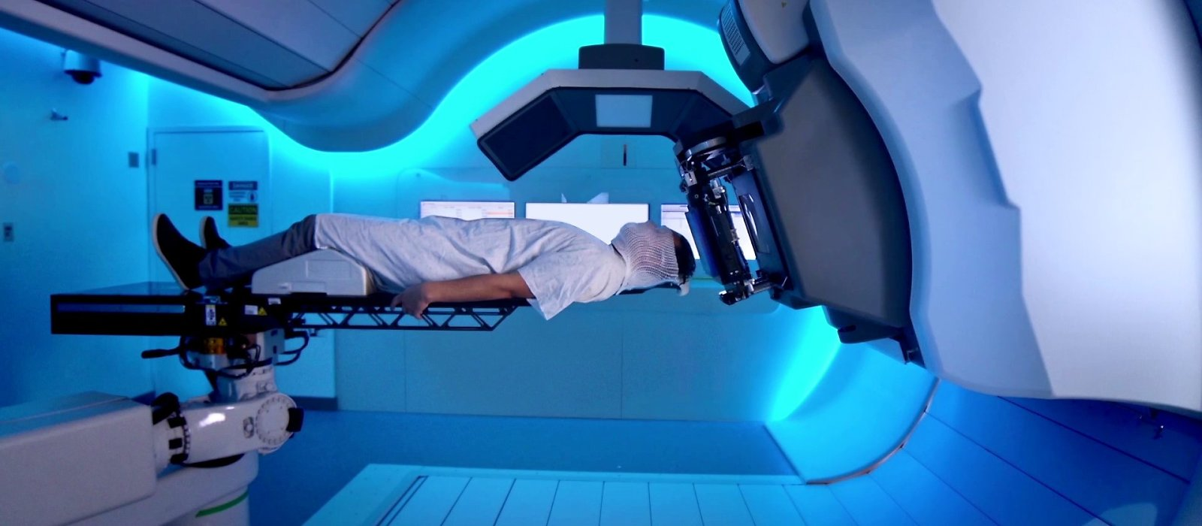
Why Radiation Tolerance ?
Study of detector behavior in extreme conditions
Spatial
High Energy Physics
Medical applications
Notes:
Why radiation tolerance ? (clic)
Multiple fields where radations are important to take into account or even are the targetted physics : spatial, high energy physics, or medical applications. I participate to a detector development for beam monitoring, particularly for high flux of light ions for radiation therapy (clic). In conventinal radiotherapy, X rays are used. They irradiate healthy tissues before and after targetted tissues, the tumor. Light ions got a peaked dose deposition that helps to not preserve healthy tissues.

Slide 4
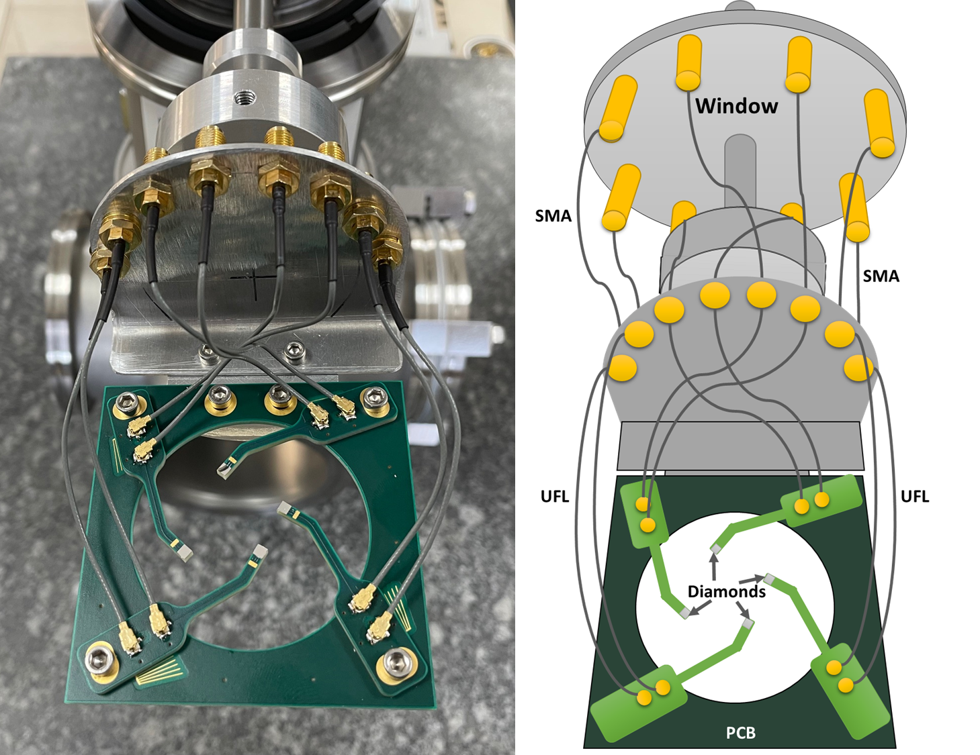

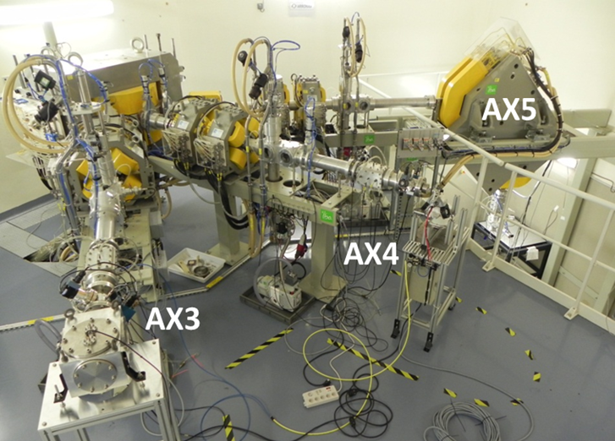
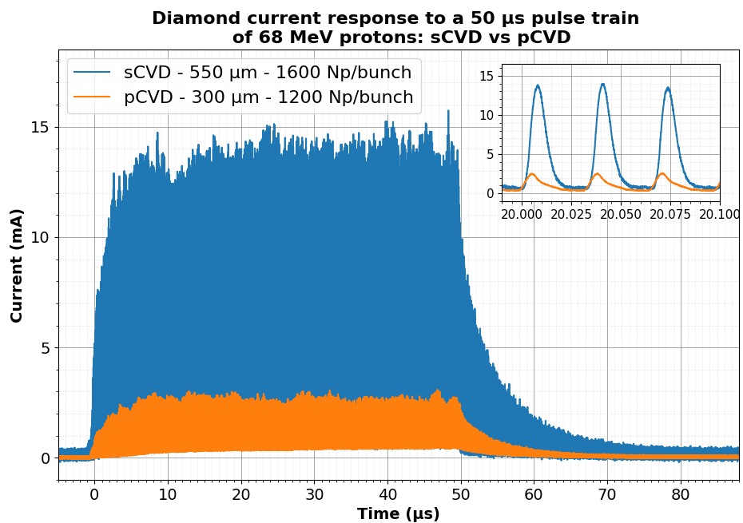
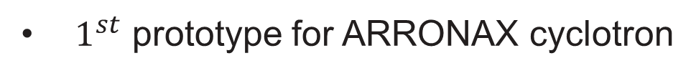
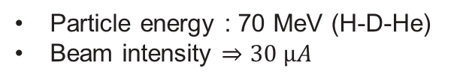
DIAMMONI detector
DIAMMONI detector : a radiation detector for light ion beams at high flux and fluences (40→ 250 MeV)
$1^{st}$ prototype for ARRONAX cyclotron
ARRONAX cyclotron :
Particle energy : 70 MeV (H-D-He)
Beam intensity $⇒30 µA$
ARRONAX beam
ARRONAX AX casemate
Beam structure :
Train duration : 50µs (« dt »)
Bunch duration : 4ns ON, ~29ns OFF
Robin Molle – robin.molle@diamfab.com – GdR Di2i 2026

Slide 5
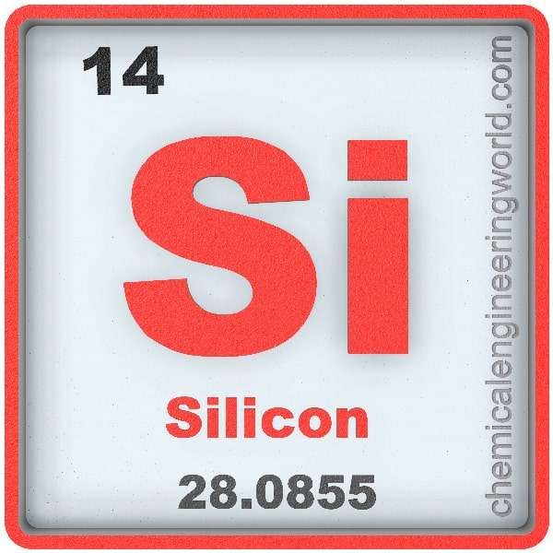
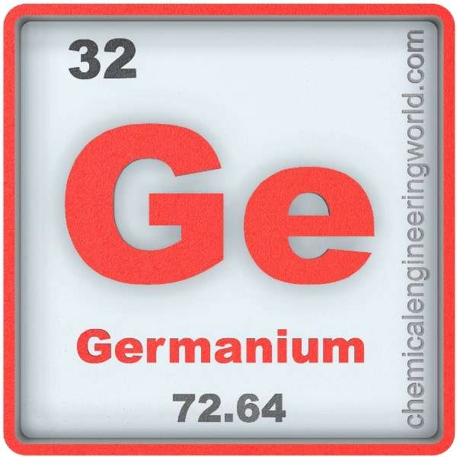

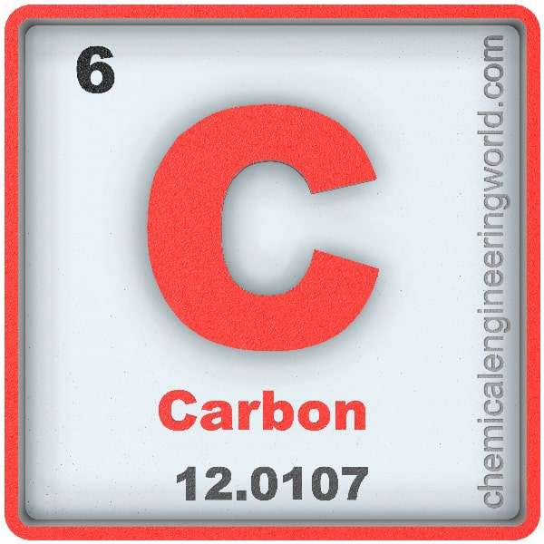
diamond among other semiconductors
Silicon (Si)
Germanium (Ge)
Easy to produce,
Cost, knowledge
Excellent energy resolution
Large volume
Low breakdown field
Low radiation hardness
Need to be cooled down
Compactness
Silicon Carbide (SiC)
Diamond (C)
High Breakdown Field
Cost
Radiation hard, low Z,
High breakdown field, Fast
Cost, production
Small area
Mechanical fragility

Slide 6

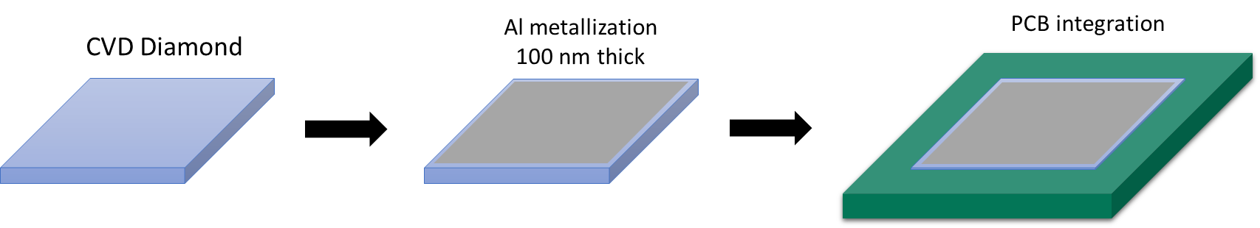
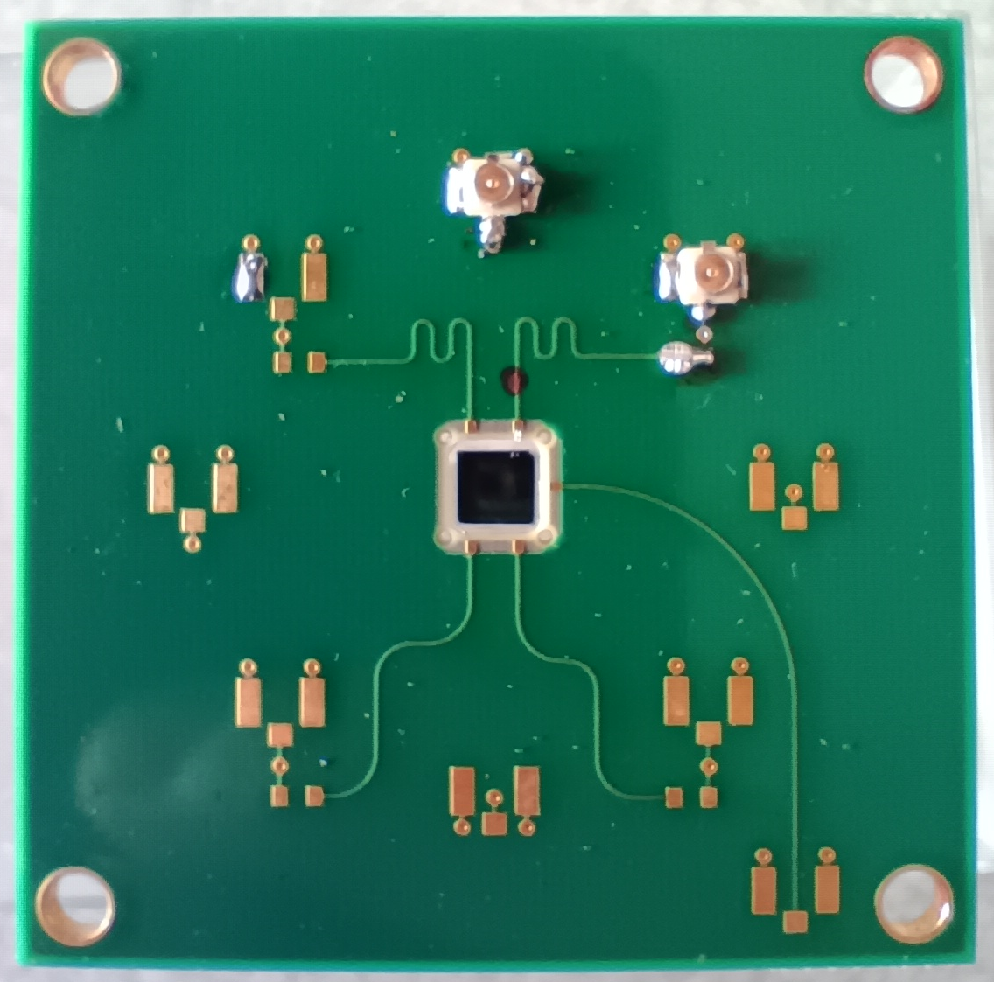
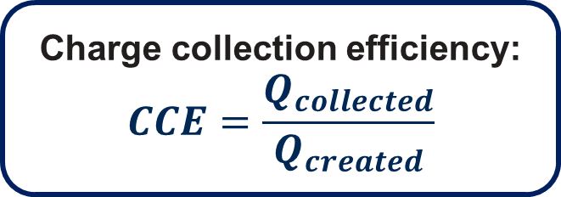

Solid State ionizing Chamber
Ionizing particle
Readout electronic
Charge collection efficiency:
$$CCE=\frac{Q_{collected}}{Q_{created}}$$
Diamond
$$\vec{E}$$
+
+
-
Ramo, S. (1939). Currents induced by electron motion. Proceedings of the IRE, 27(9), 584-585.
Shockley, W. (1938). Currents to conductors induced by a moving point charge. Journal of applied physics, 9(10), 635-636.
Robin Molle – robin.molle@diamfab.com – GdR Di2i 2026

Slide 7


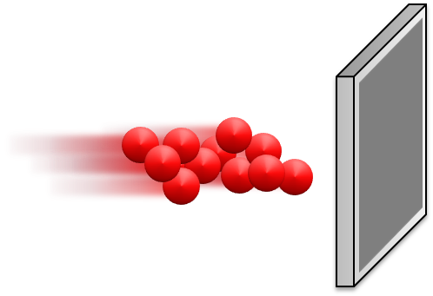
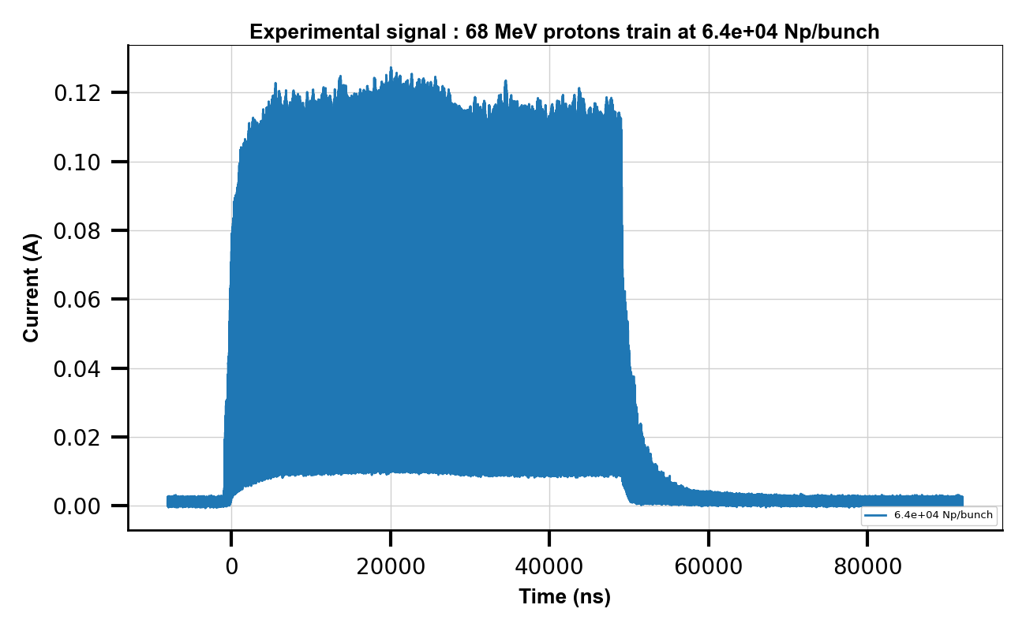
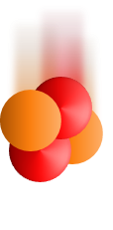
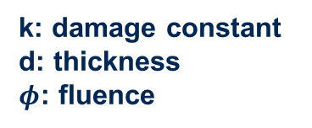
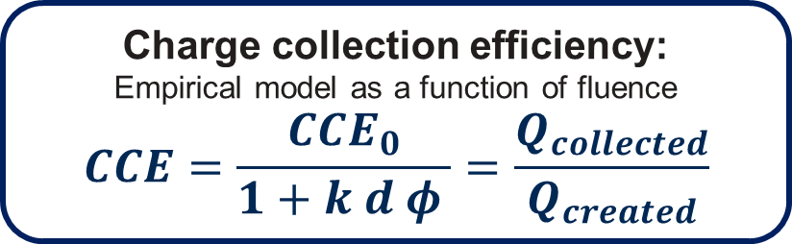
Fluence measurements
Fluence relate to the history of the device
(particle/cm²)
Charge collection efficiency:
Empirical model as a function of fluence
$$CCE=\frac{CCE_{0}}{1+k d φ }=\frac{Q_{collected}}{Q_{created}}$$
k: damage constant
d: thickness
$φ$: fluence
Measure the k of diamond under ions
1st method:
2nd method :
CCE calculated for each train
Irradiation & CCE measurement
CCE measurement
Irradiation
CCE
Bäni, L., Alexopoulos, A., Artuso, M., Bachmair, F., Bartosik, M., Beck, H., ... & RD42 Collaboration. (2019). A study of the radiation tolerance of poly-crystalline and single-crystalline CVD diamond to 800 MeV and 24 GeV protons. Journal of Physics D: Applied Physics, 52(46), 465103.
Robin Molle – robin.molle@diamfab.com – GdR Di2i 2026

Slide 8
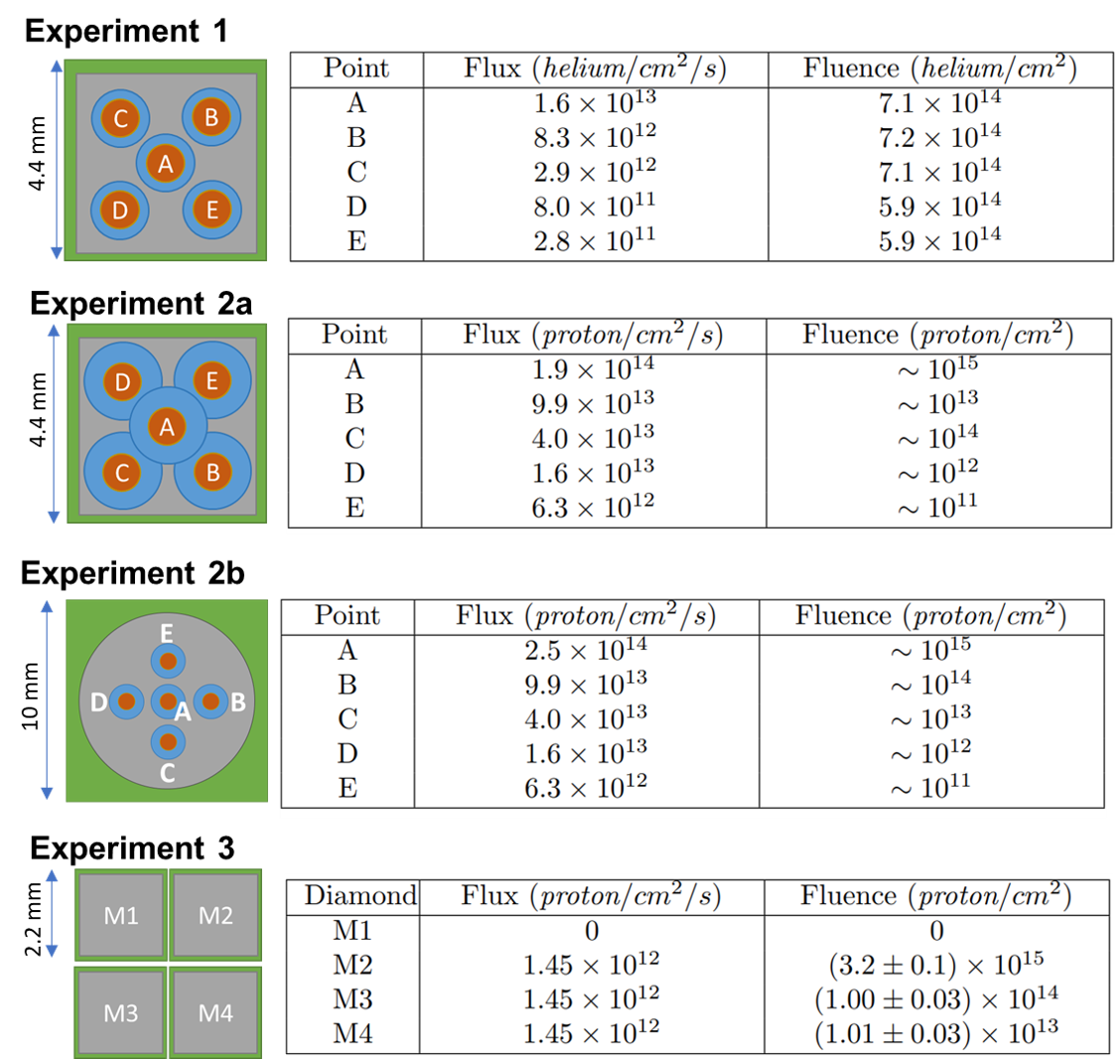
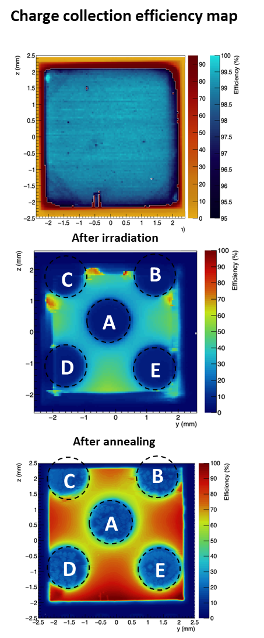
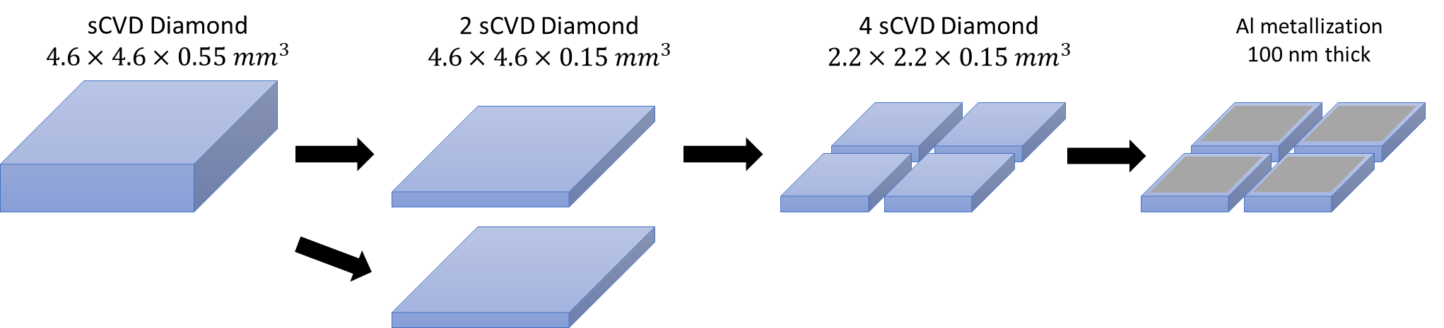
Fluence experiments
Helium
64 MeV
Single crystal CVD Diamond
sCVD – 550µm thick
Proton
68 MeV
Single crystal CVD Diamond
550 µm thick
Spectroscopie alpha
Proton
68 MeV
XBIC - ESRF
Annealing
Raman-PL
Polycristalline CVD Diamond
300 µm thick
Single crystal CVD Diamonds
1 diamond cut in 4
150 µm thick
Proton
68 MeV
Robin Molle – robin.molle@diamfab.com – GdR Di2i 2026

Slide 9
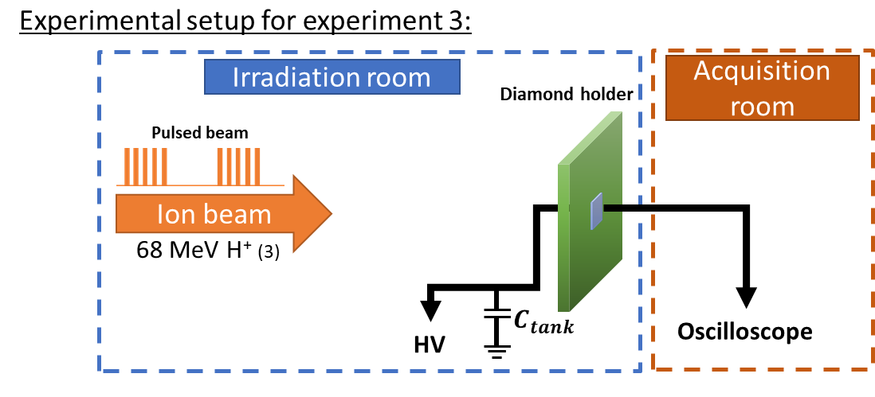

Experimental setup
68 MeV proton range in diamond : $12.23 mm$
Experimental setup for 68 MeV H⁺
Irradiation of the whole diamond surface
Homogeneous irradiation
No scattering
Robin Molle – robin.molle@diamfab.com – GdR Di2i 2026

Slide 10
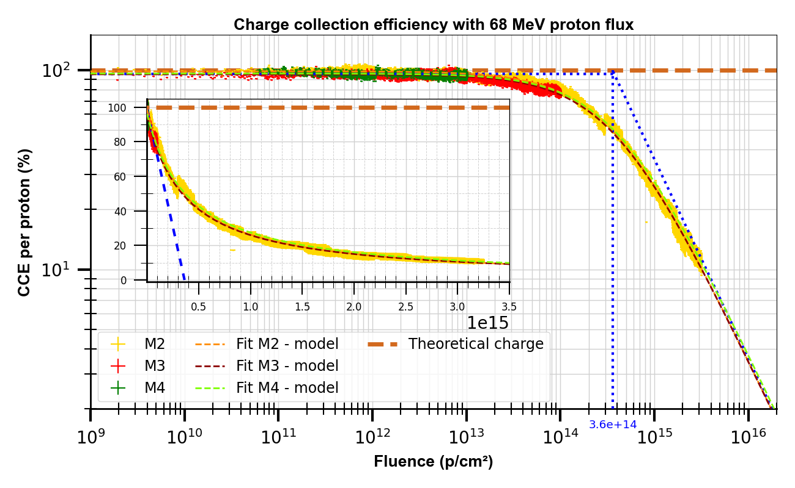
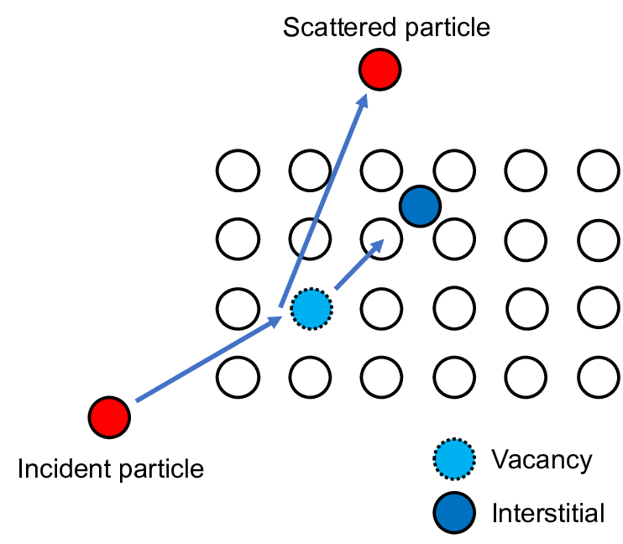

Diamond response to proton fluence
M1 = control sample
$$k=\left(18,7±0,1\right)×{10}^{−18}cm²/p/µm$$
Frenkel defects created with irradiation
Vacancies trap charge carriers
Robin Molle – robin.molle@diamfab.com – GdR Di2i 2026

Slide 11
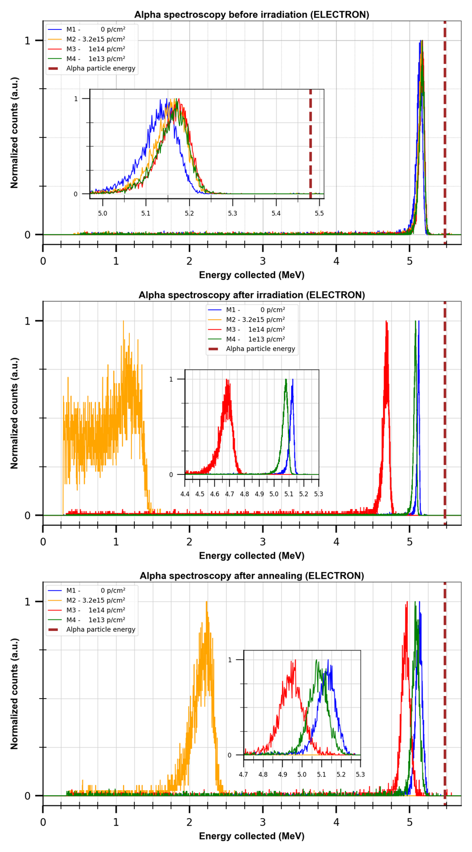
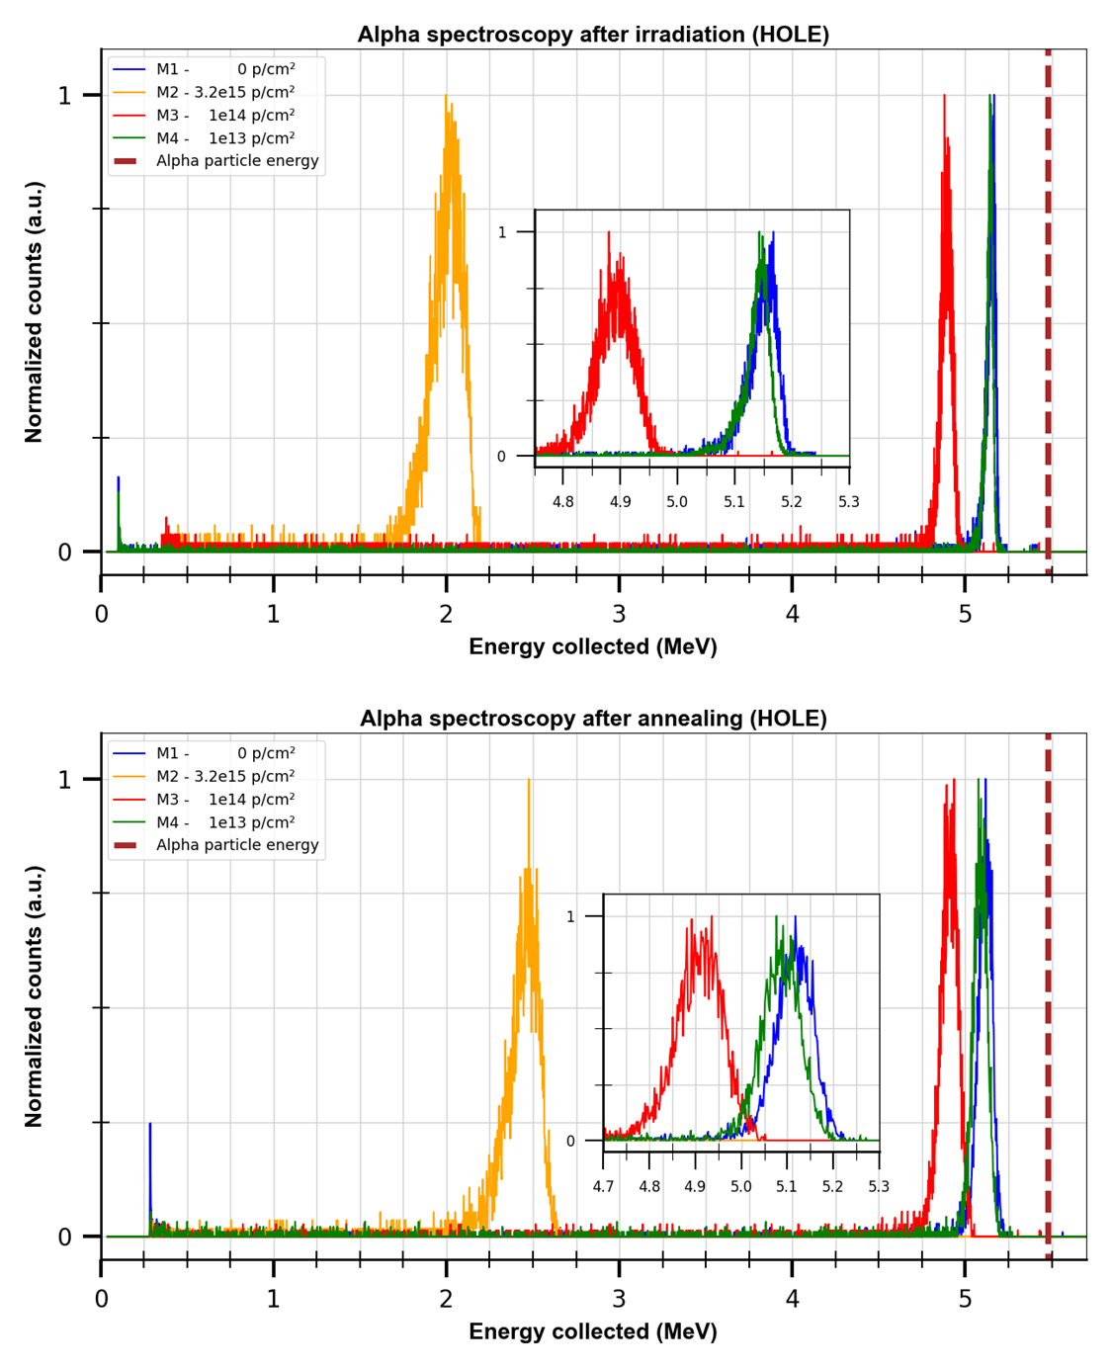
Diamond response to proton fluence
Electron and hole are not equivalent with irradiation
Annealing = increase of CCE
Robin Molle – robin.molle@diamfab.com – GdR Di2i 2026

Slide 12
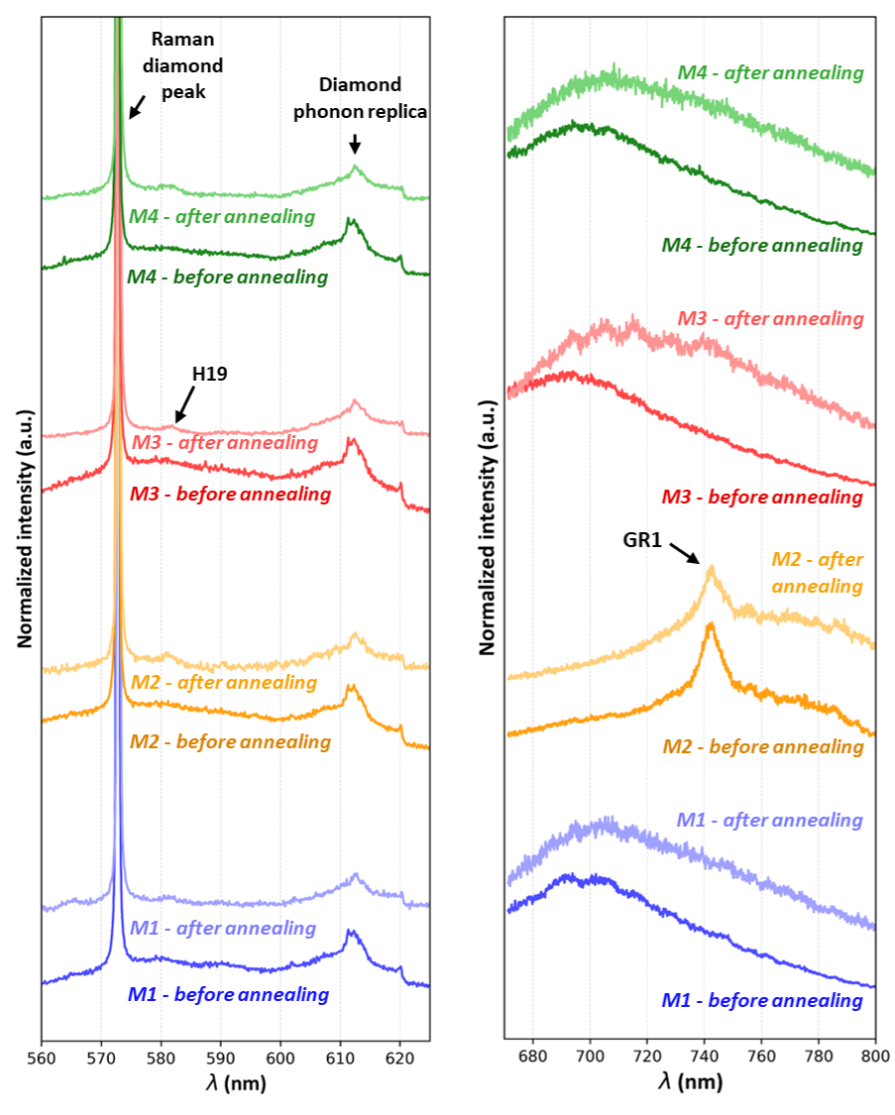
Diamond response to proton fluence
GR1 = vacancies : Raman sensivity > 2e14 vac./cm²
Vacancies = GR1
H19 creation : annealing
No NV centers created
Robin Molle – robin.molle@diamfab.com – GdR Di2i 2026

Slide 13
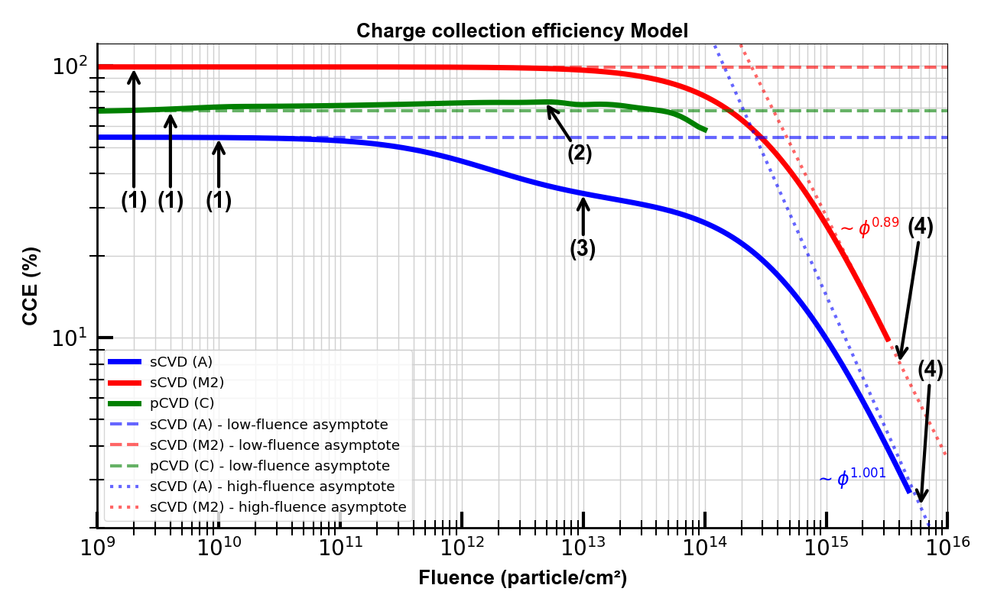
Model of CCE with fluence
Initial overall crystal quality
Trap filling
Heterogeneity of point defect distribution
Accumulation of irradiation-induced defects
Robin Molle – robin.molle@diamfab.com – Réseau Semi-conducteur 2026

Slide 14
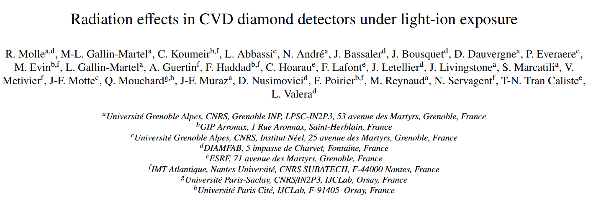
To be published
Diamond and Related Materials

Slide 15
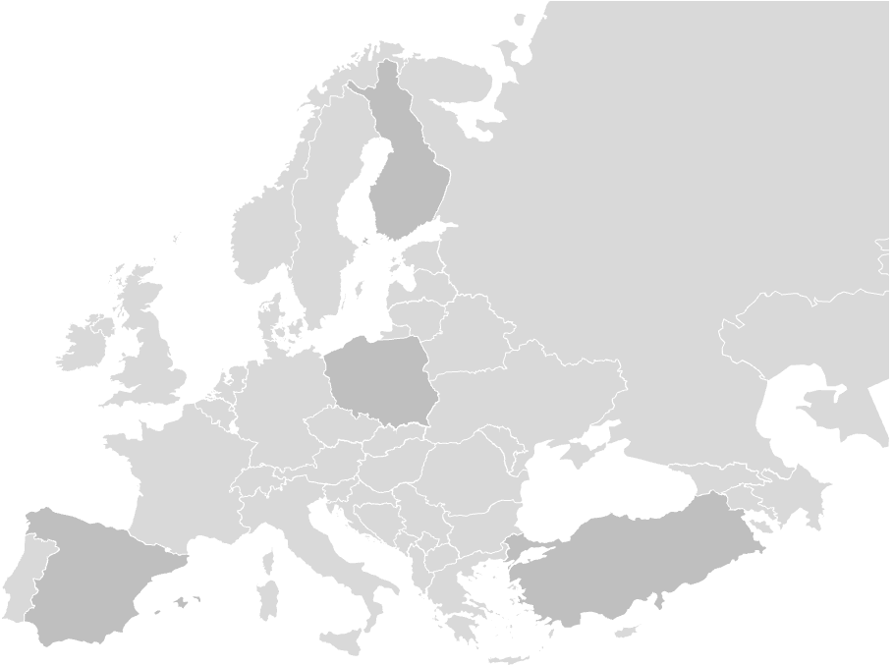
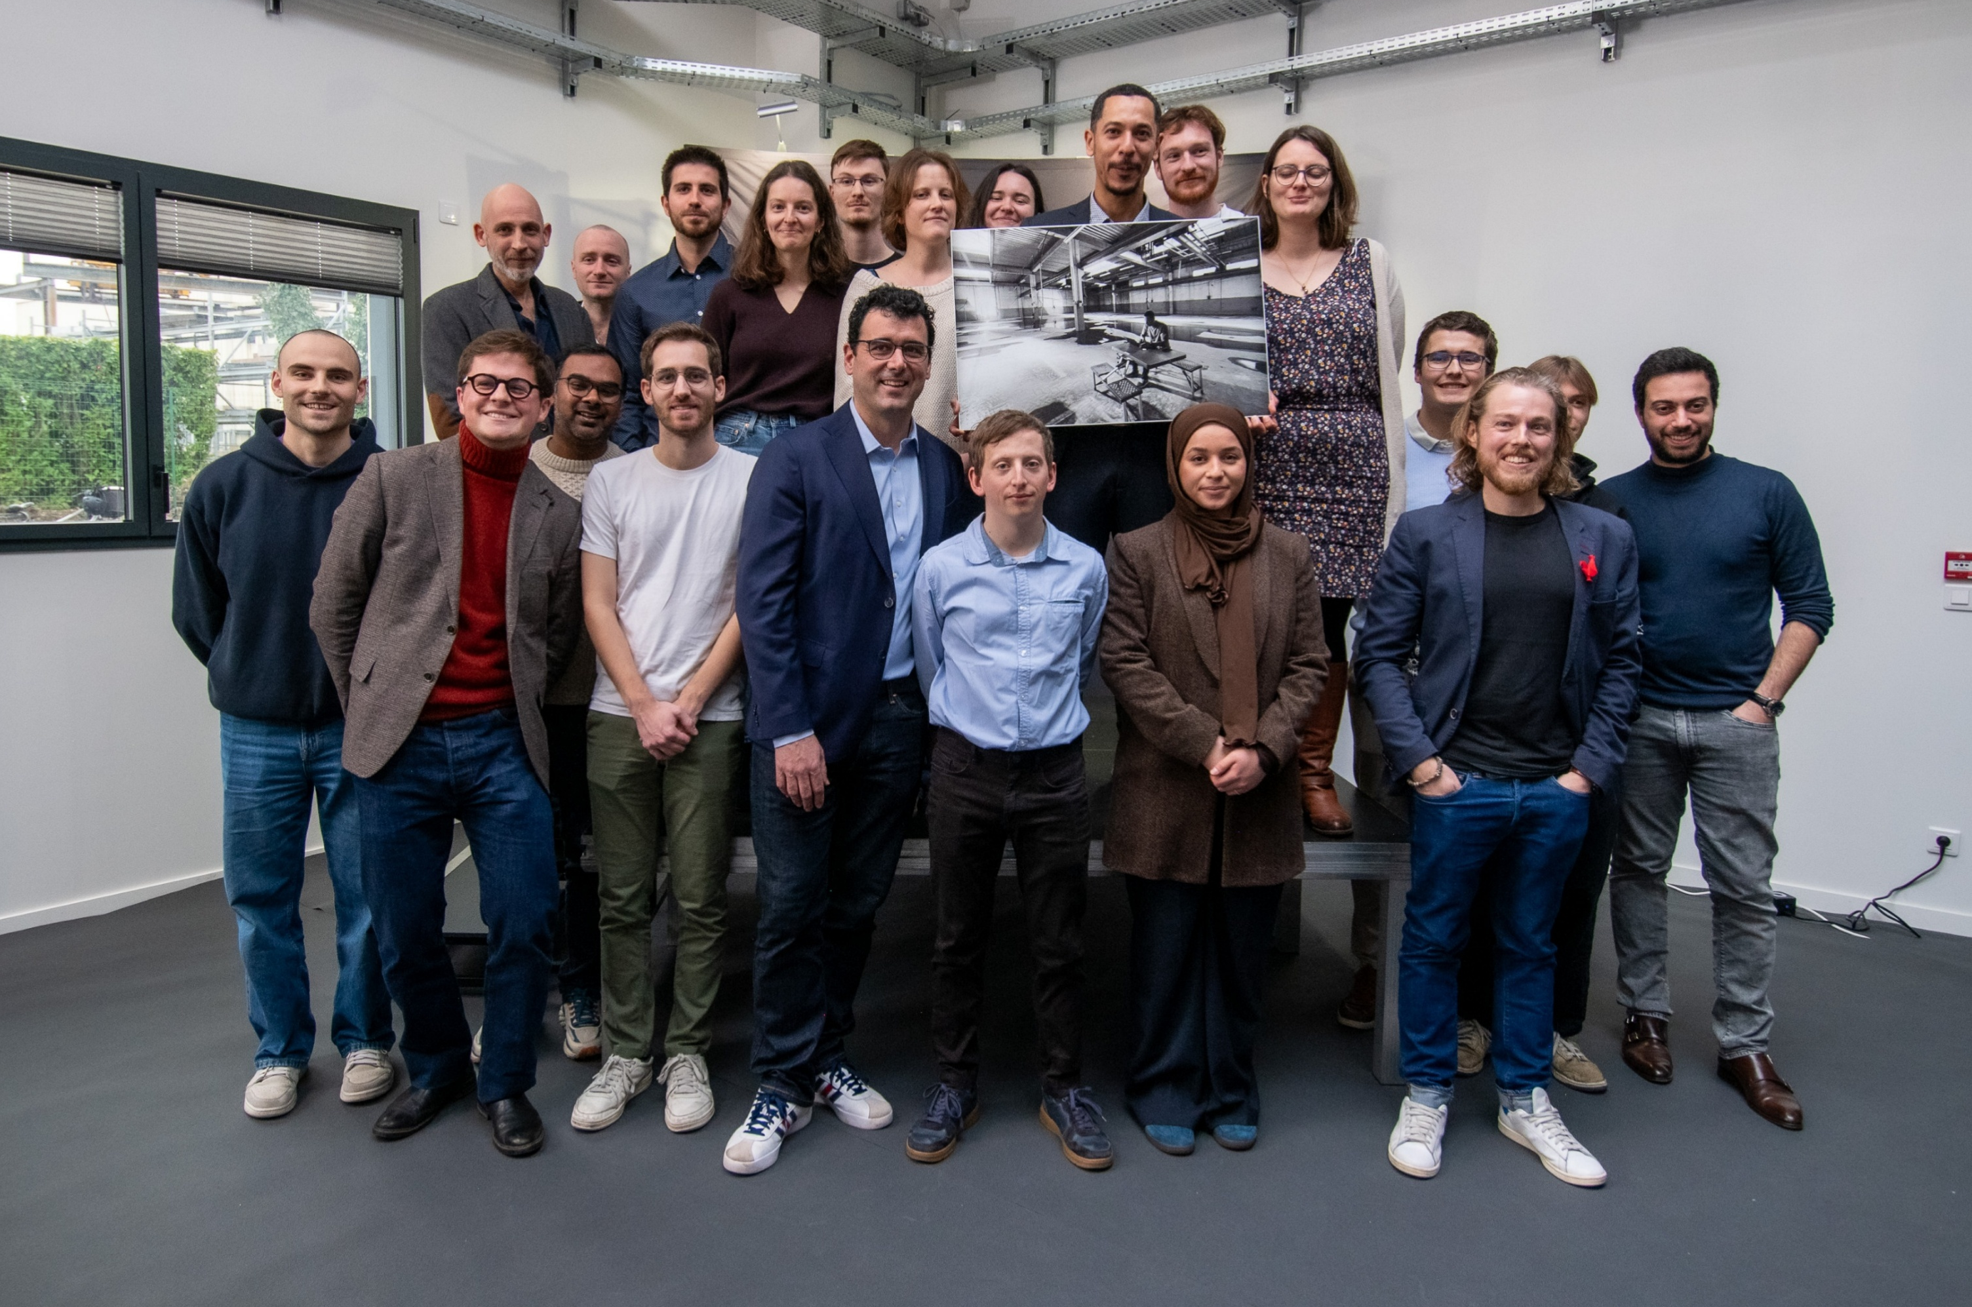

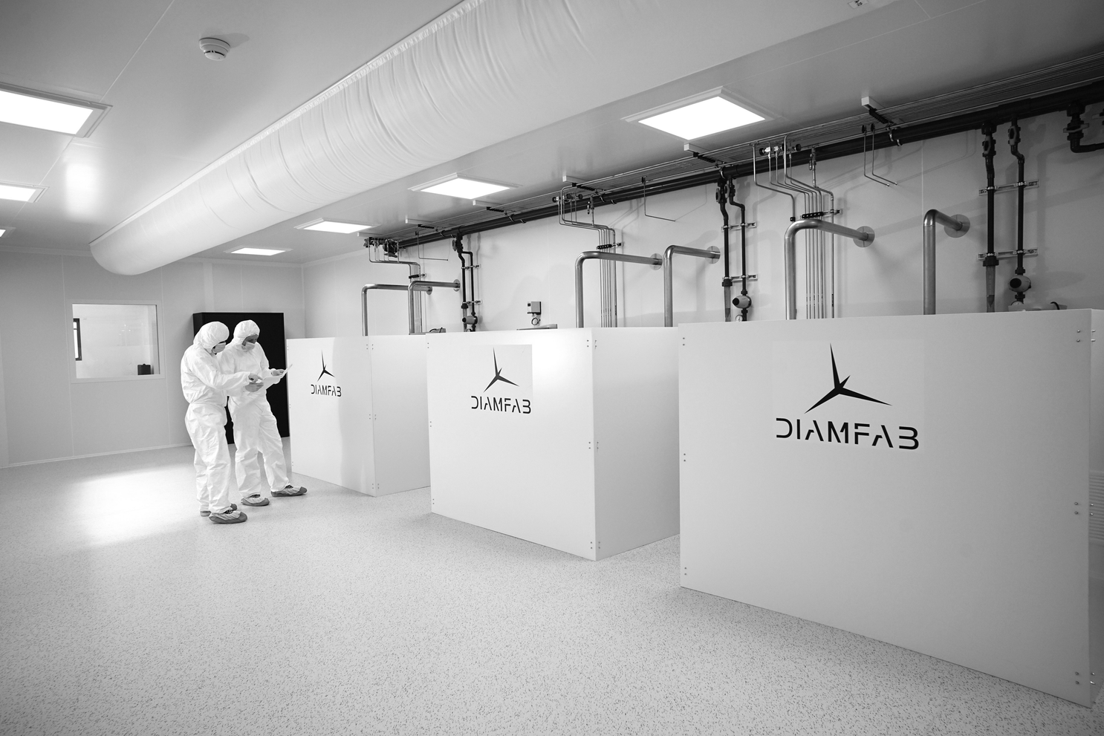
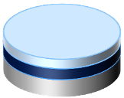
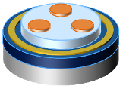
And now ?
Substrate
  Start-up created in 2019
Based on more than 30 years of
R&D developed at Intstitut Néel- CNRS
+ 8 patents and know-how
  26 People
+ 5 advisors
Diamfab unique know-how :
EPITAXY, DOPING, DEVICE DESIGN & PrOCESSING
GrenOBLE
FRANCE
  Business targeted
Power electronics
Quantum application
Hardened electronics (space, nuclear and high temperature)
High Value-added Diamond Wafer
Diamond Electronic Devices
Robin Molle
IF you want to work with us, don’t hesitate to contact me !
robin.molle@diamfab.com
Notes:
So, at Diamfab we fabricate diamond.
Our solution is based on a technology developed for more than 30 years at CNRS Grenoble and protected with 8 patents and secrets know-how.
Today, Diamfab is 26 people and 5 world recognised advisors
We target power electronics and hardened electronics market as well as quantum market
Our unique know-how is to grow electronic grade doped diamond as a semiconductor on a diamond substrate and our expertise is to design and process devices.
Therefore, we have a dual model model allowing us to offer either High value-added wafer solution or bare die devices solution

Slide 16
Thank you for your attention

Slide 17
Back-Up

Slide 18


Diamond response to Helium fluence
64 MeV helium
irradiation
XBIC map
Annealing: 6h / 1000°C
XBIC map
Frenkel defects
Vacancies ➔ NV centers
XBIC map
Robin Molle – robin.molle@diamfab.com – GdR Di2i 2026
18

Slide 19
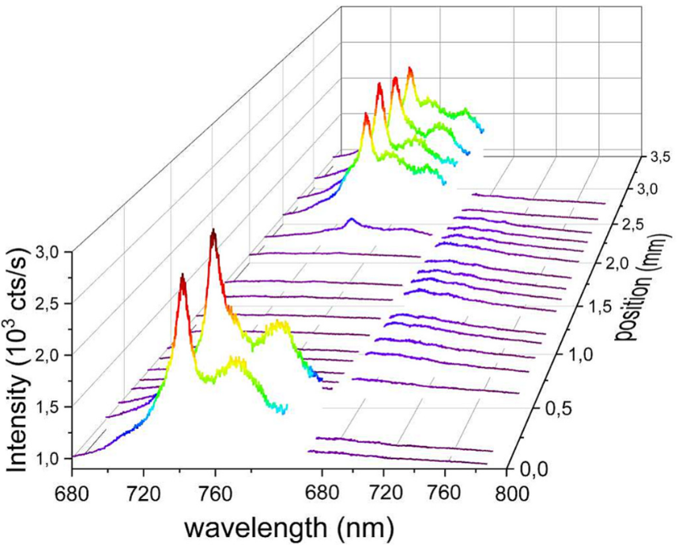
Diamond response to Helium fluence
Frenkel defects created with irradiation
Vacancies (GR1 centers) trap charge carriers
After irradiation
After annealing
After irradiation
Before annealing
Electron and hole are not equivalent with irradiation
Annealing = increase of CCE
GR1 converted with annealing in NV centers
Robin Molle – robin.molle@diamfab.com – GdR Di2i 2026
19

