Slide 1









Development of high-sensitivity TES for next-generation polarimetric millimeter-wave observation instruments
Michel Piat, Laurent Dussopt, Abdelkader Aliane, Ludovic Montier, Louis Rodriguez, Vincent Revéret, Aritoki Suzuki, Timothée Tollet, Damien Prèle, Manuel Gonzalez, Paul Tagnon, Oliver Jeong

Slide 2
Summary
Context and objectives of the proposal
Technical objectives
The Collaboration Team
Development plan
Developments status
Perspectives

Slide 3

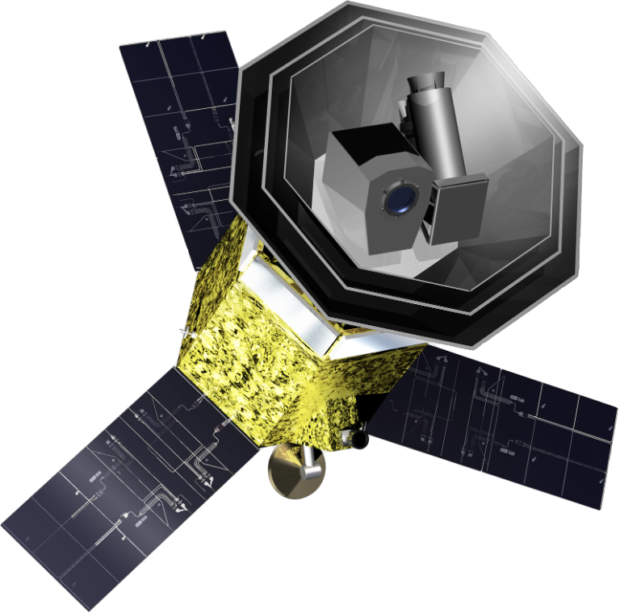
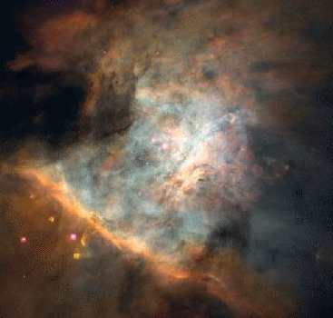
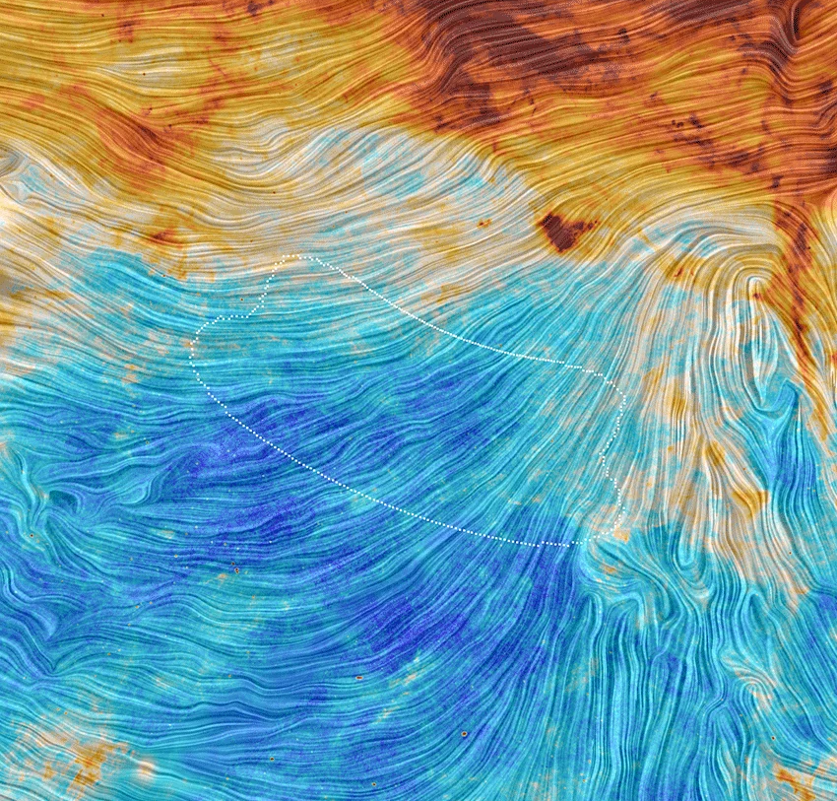
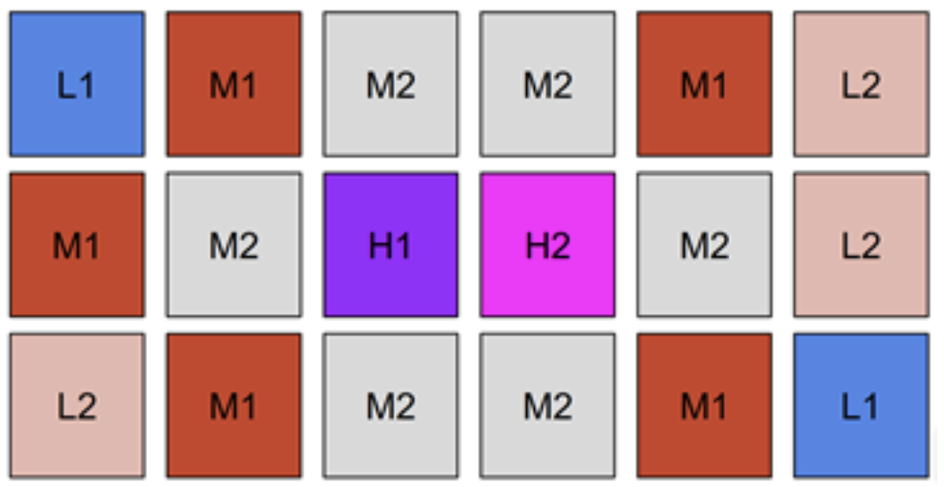
1. The LiteBIRD space observatory
Cold Universe study
The earliest moments of the Universe:
  Polarization of the cosmic microwave background (CMB)
Foreground characterization:
  Interstellar clouds
  Galactic dust polarization
  The Mission
  5 Main contributors
  (Japan, France, Netherlands, Italy, Canada)
  3 Years of operation
  Expected Launch: 2037
  The Instrument
  1 focal plane (~4000 detectors)
  12 frequency bands (40-400 GHZ)
  TES bolometers cooled ~100 mK
  Sensitivity limited by CMB photon noise
  Sensitivity to polarization: horn coupled to antenna and planar superconducting circuit
Support for the LiteBIRD project: identified by CNES and IN2P3 as a major priority
Development of the high-frequency (HF) bands not covered by SRON’s design plan

Slide 4
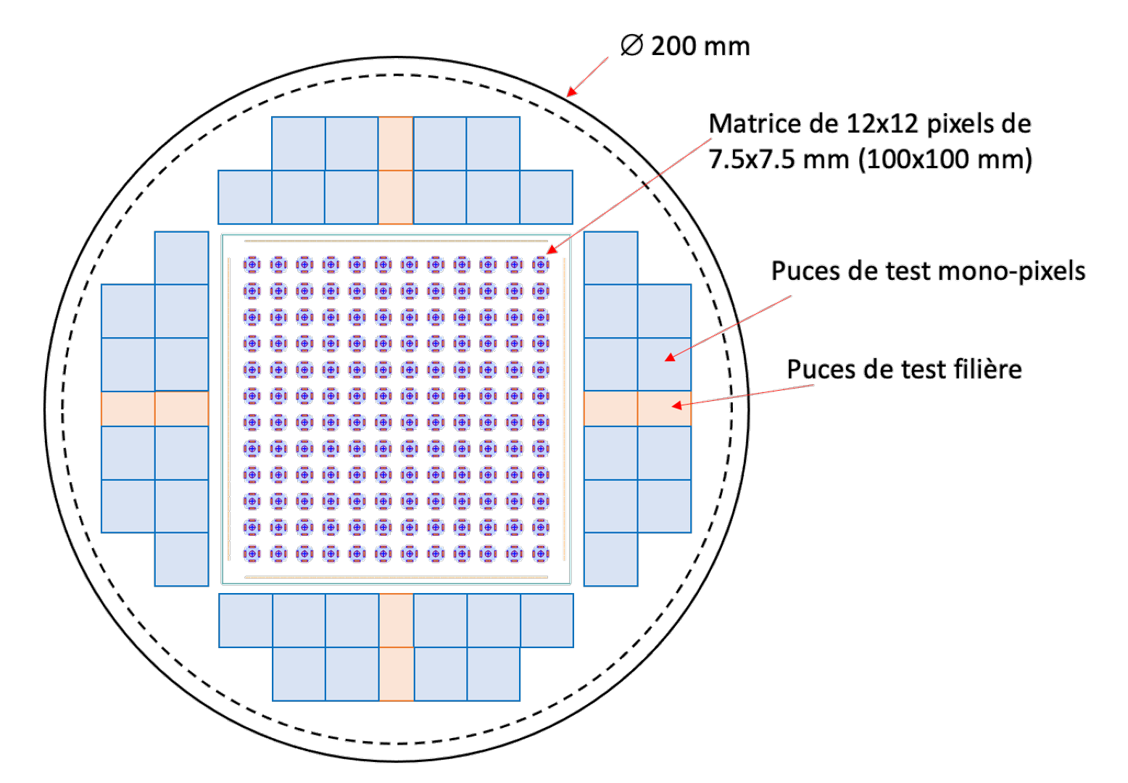
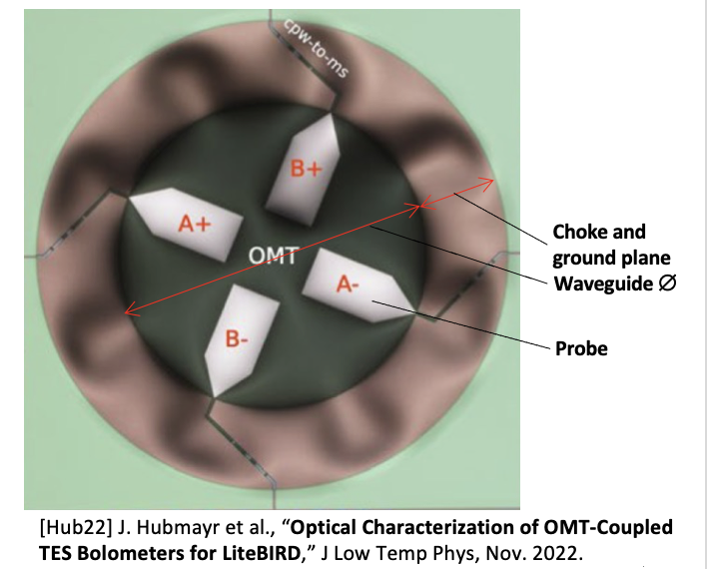
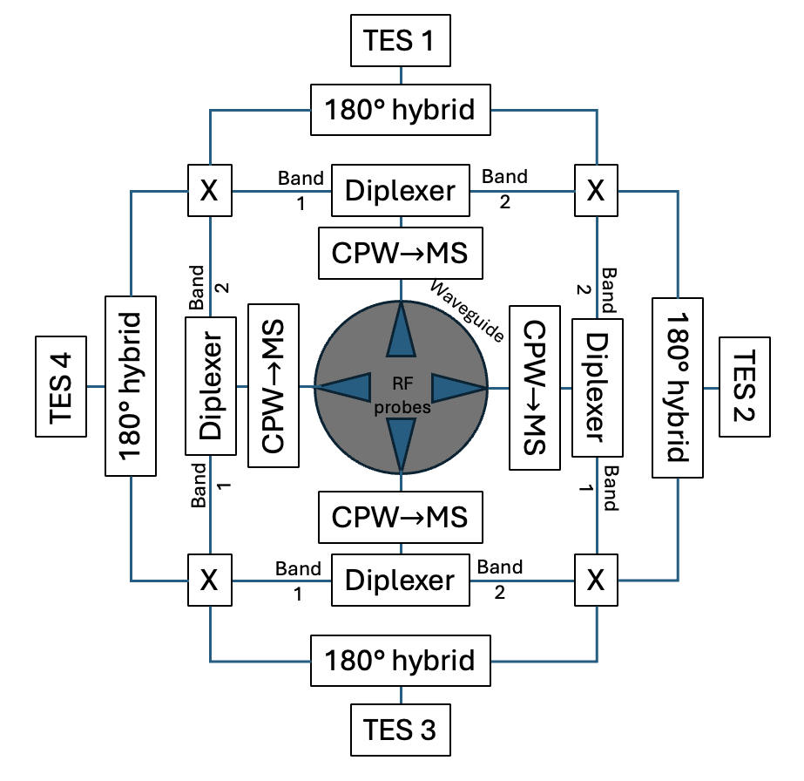
2. Technical objectives
Develop a TRL5 prototype of a dual-polarization, dual-band TES (Transition Edge Sensor) detector array in the millimeter-wave range for future scientific missions such as LiteBIRD or other ESA missions under the Voyage 2050 program.
Ø 200 mm
Specifications:
12x12 pixels arrays
Temperature: 100mK
HF1 LiteBIRD band: 217GHz & 334GHz, ∆𝝂/𝝂 = 30%
2 polarizations
NEP ~ 6.10⁻¹⁸ W.Hz^{-0.5}
Array of 12x12, pixels of 7,5x7,5 mm (100x100 mm)
Single pixel test chips
Process test chips
Pixel Architecture
Deliverable:
Two fabrication lots, each consisting of 12 (200 mm) wafers with:
    144-pixel array (100×100 mm²)
    Process test chips
    ~40 single pixels and RF structures for testing technological variants to optimize and validate the design
Process-level testing of each wafer
Electrical testing at 100 mK
Optical measurements

Slide 5
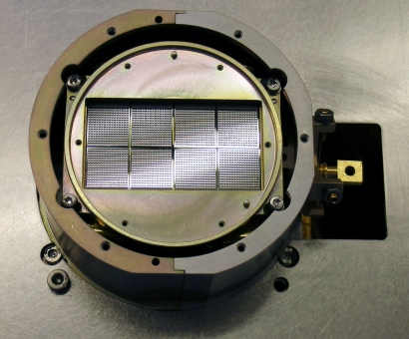
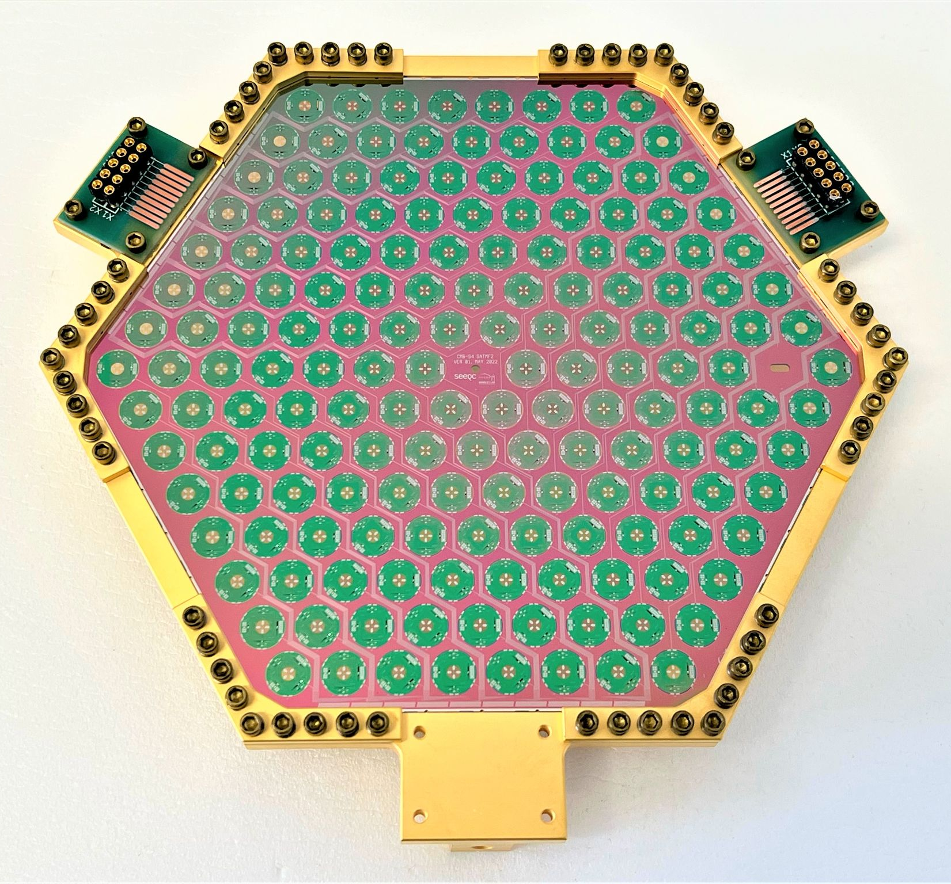
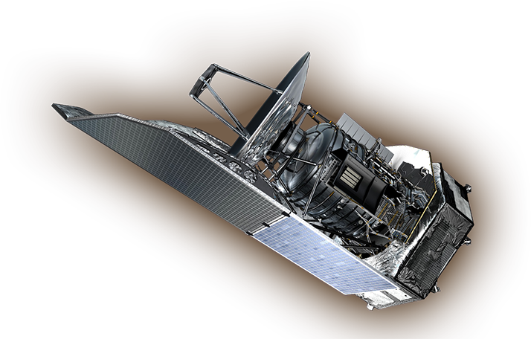
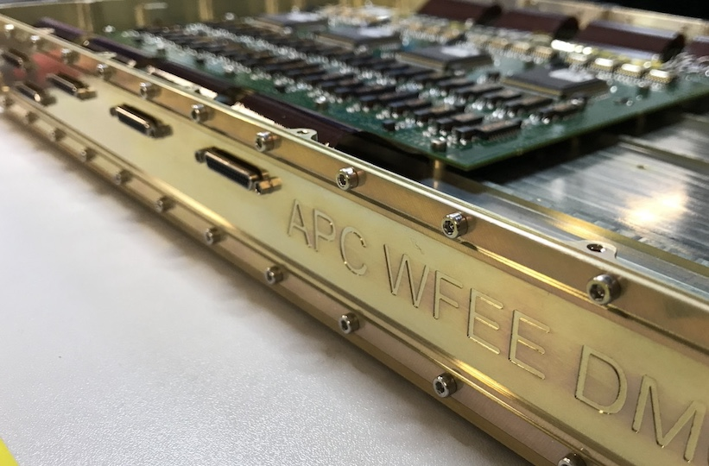

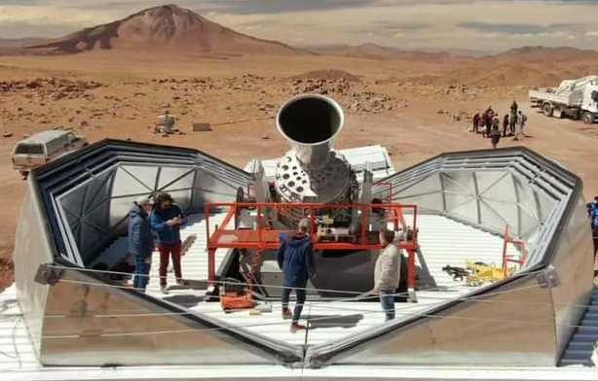
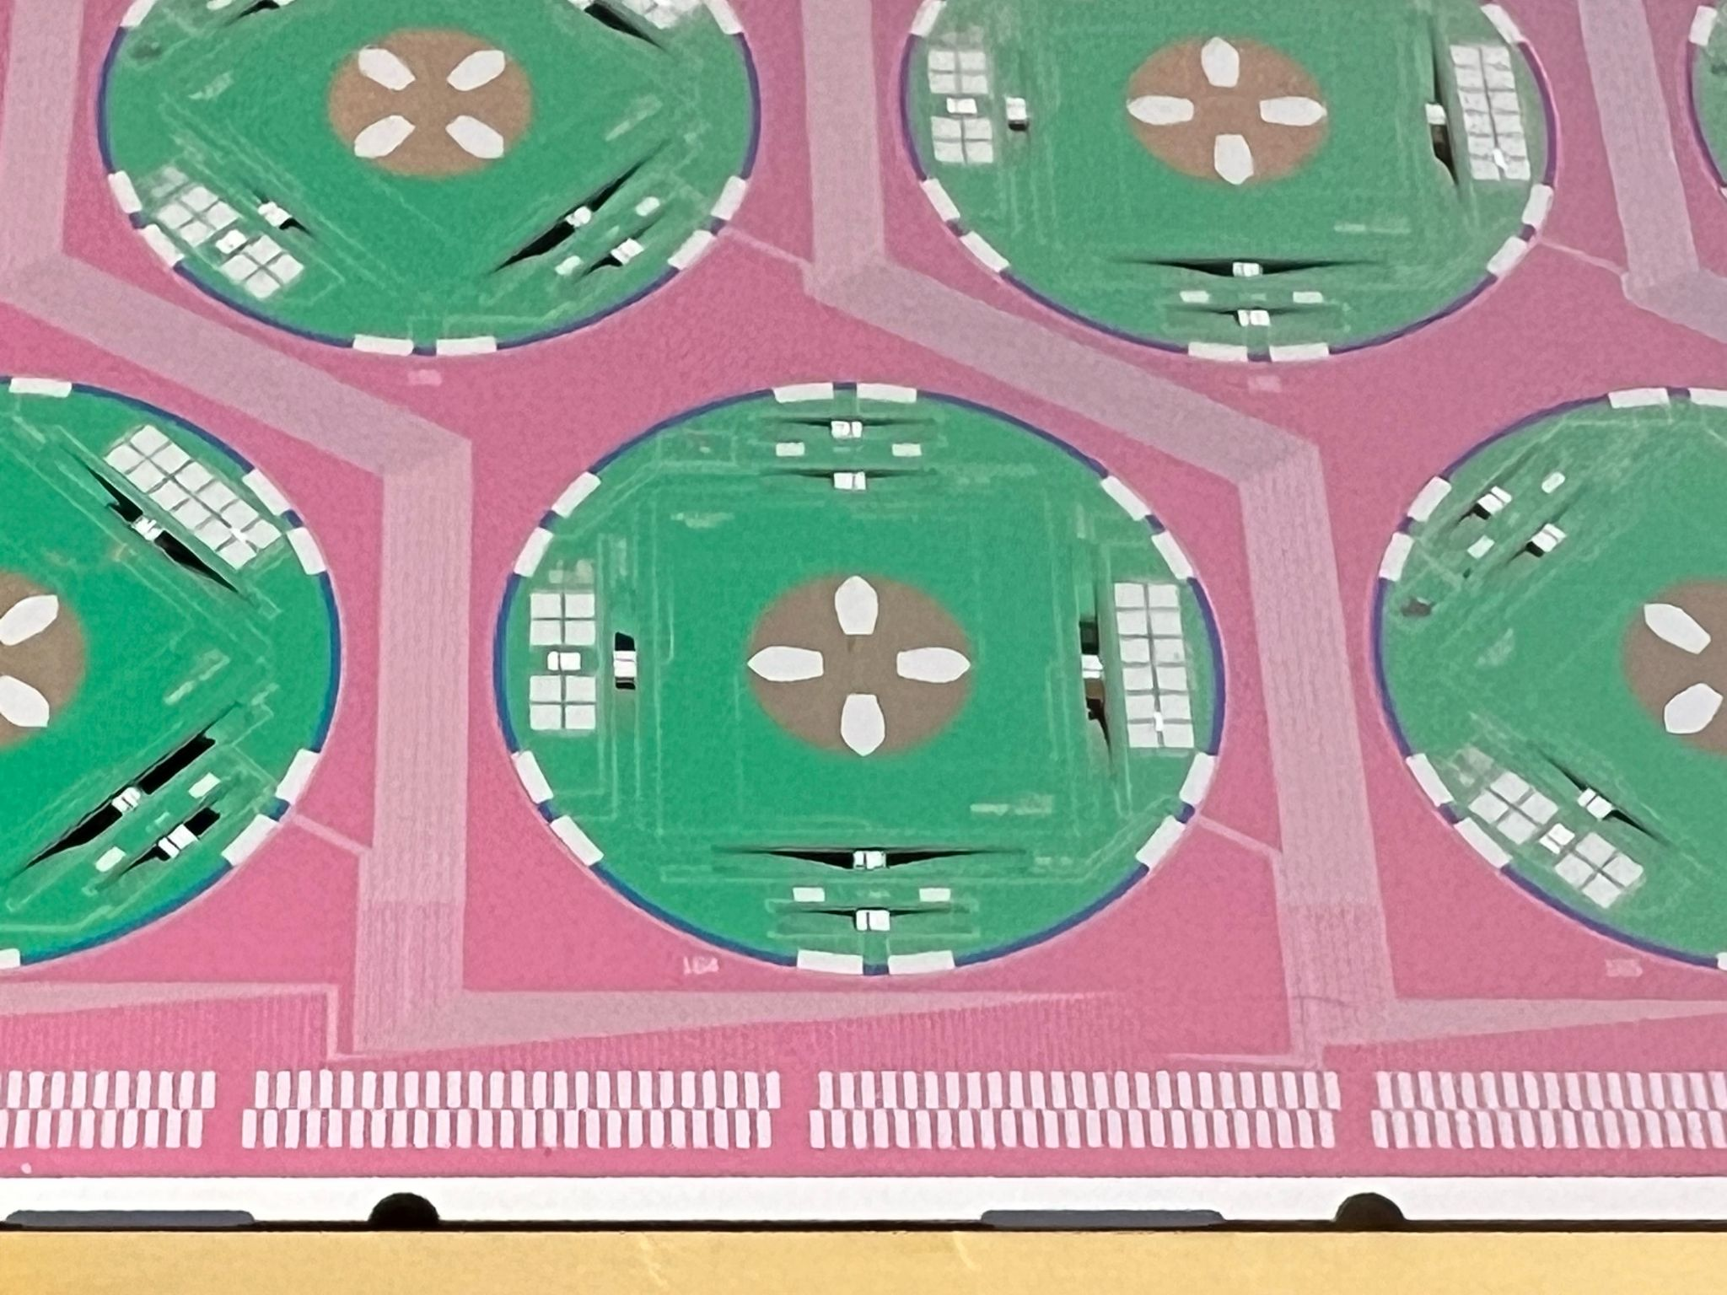
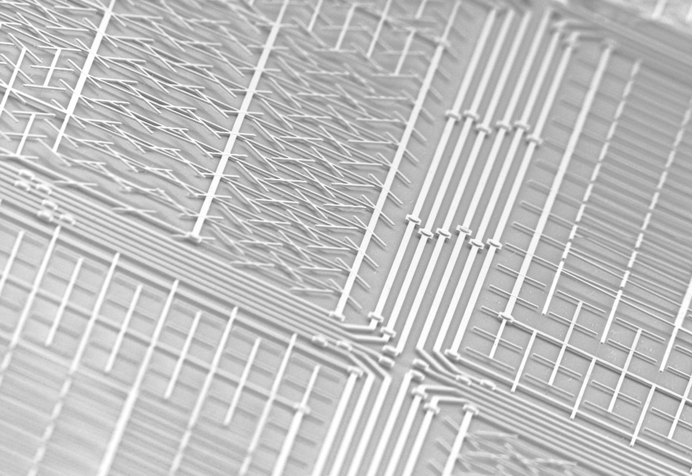
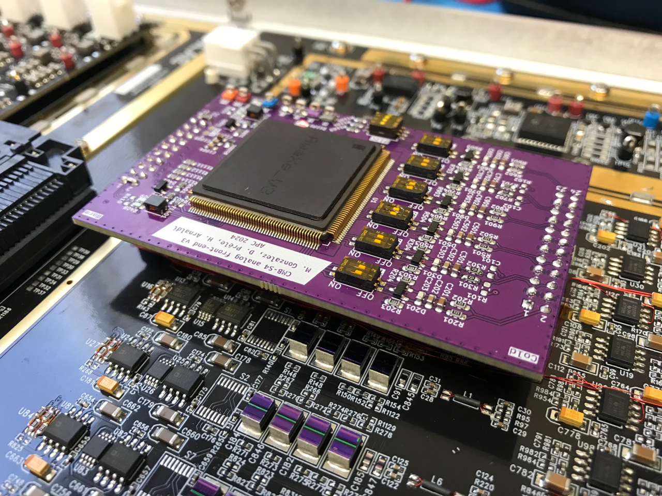

3. The collaboration Team
Michel Piat
Damien Prêle
Manuel Gonzalez
Timothée Tollet
Paul Tagnon
Laurent Dussopt
Abdelkader Aliane
Louis Rodriguez
Vincent Revéret
Ludovic Montier
Aritoki Suzuki
Oliver Jeong
Key projects:
Bolometer development for: Herschel/PACS, APEX/Artemis and SPICA/B-BOP
QUBIC’s TES design and tests
Athena/X-IFU and CMB-S4 readout development
CMB-S4 TES design, fab and test,
new Hf TES techno development
CMB-S4 TES
QUBIC
PACS
B-BOP
CMB-S4 WE
Member of the LiteBIRD collaboration

Slide 6
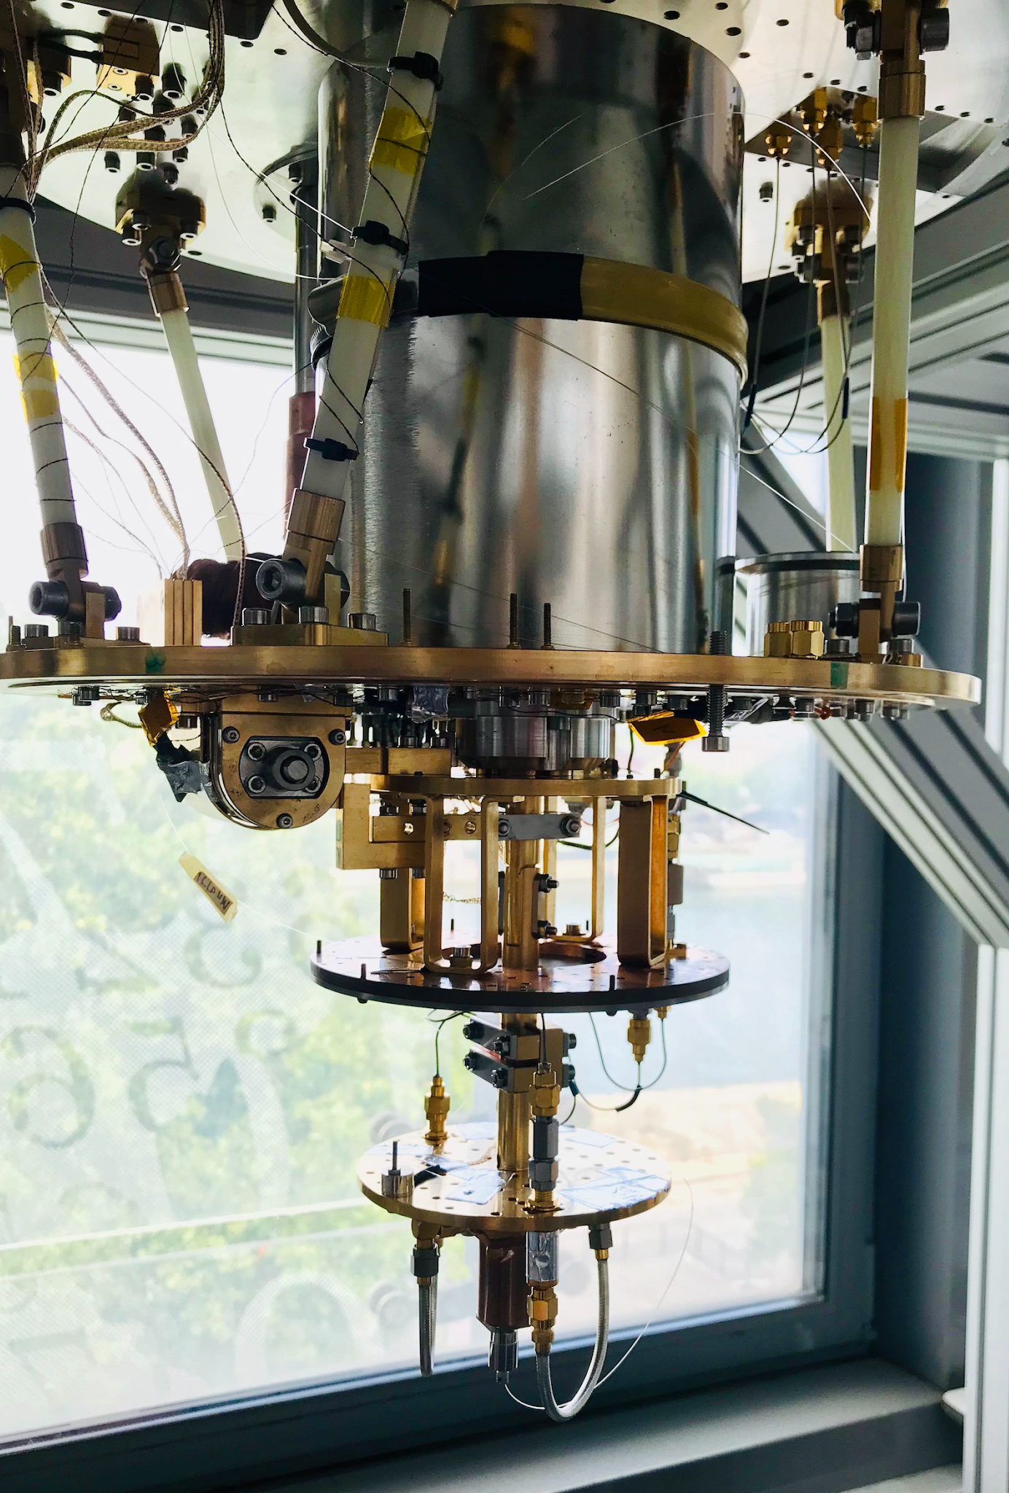
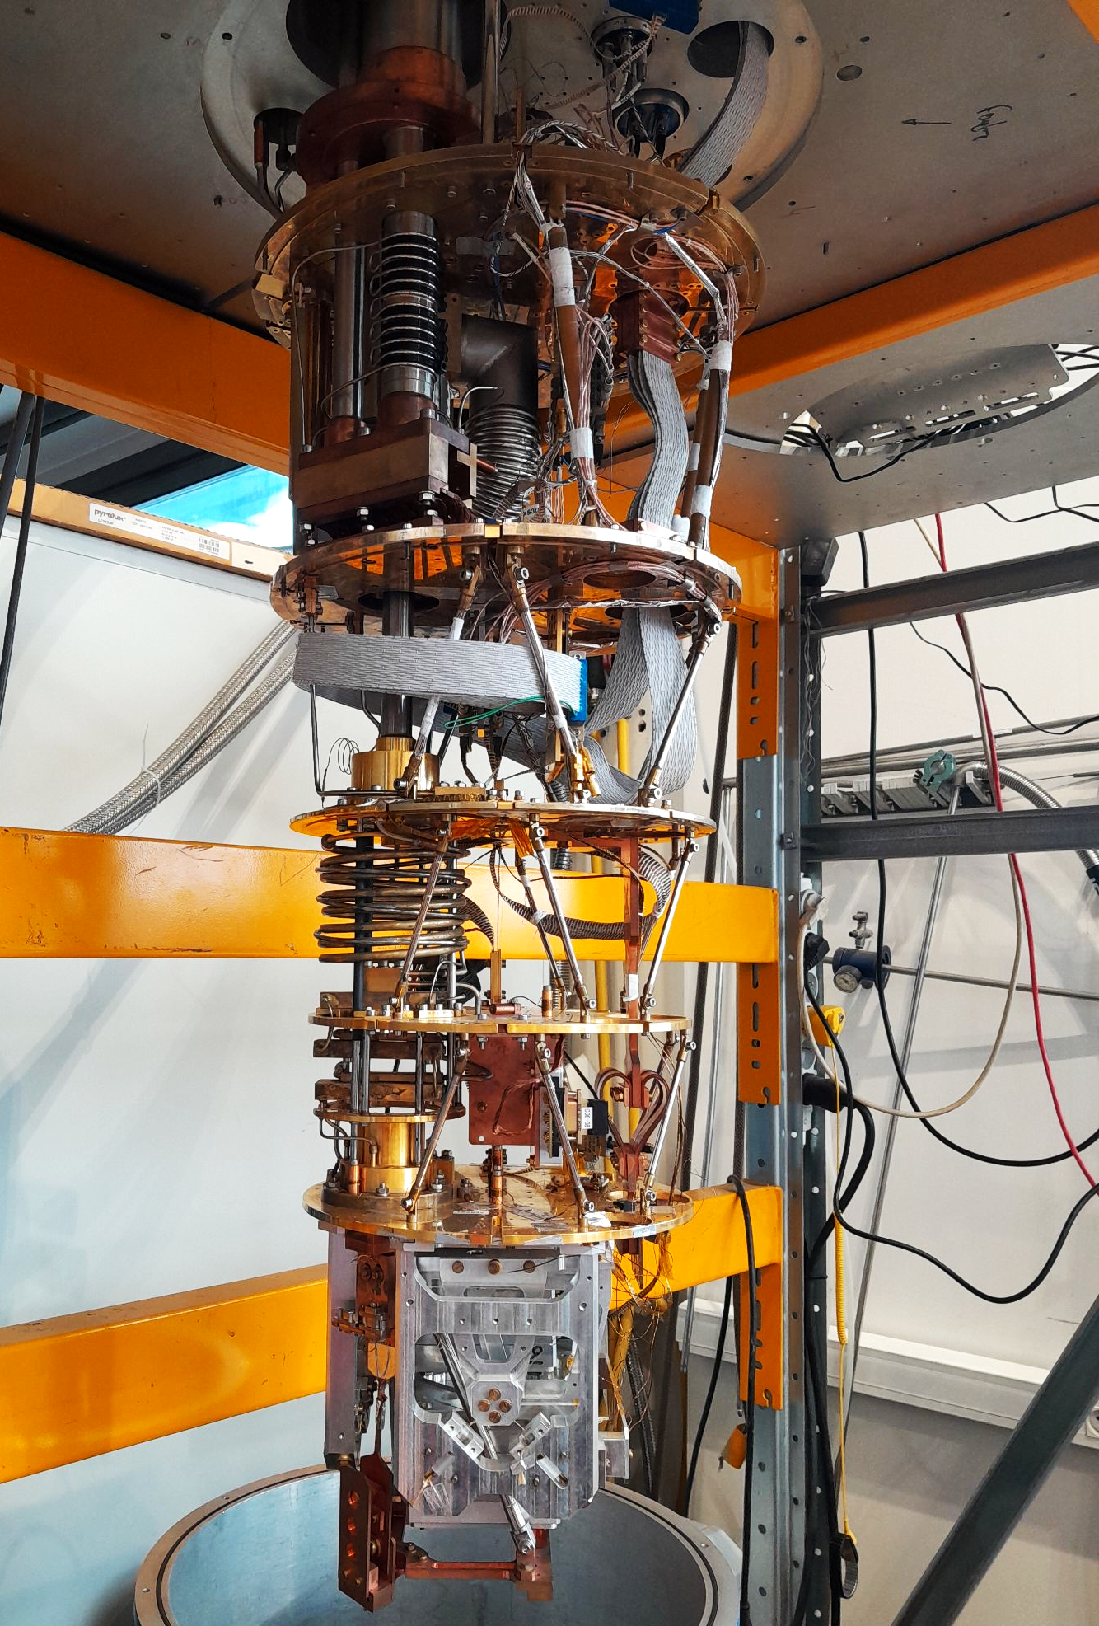
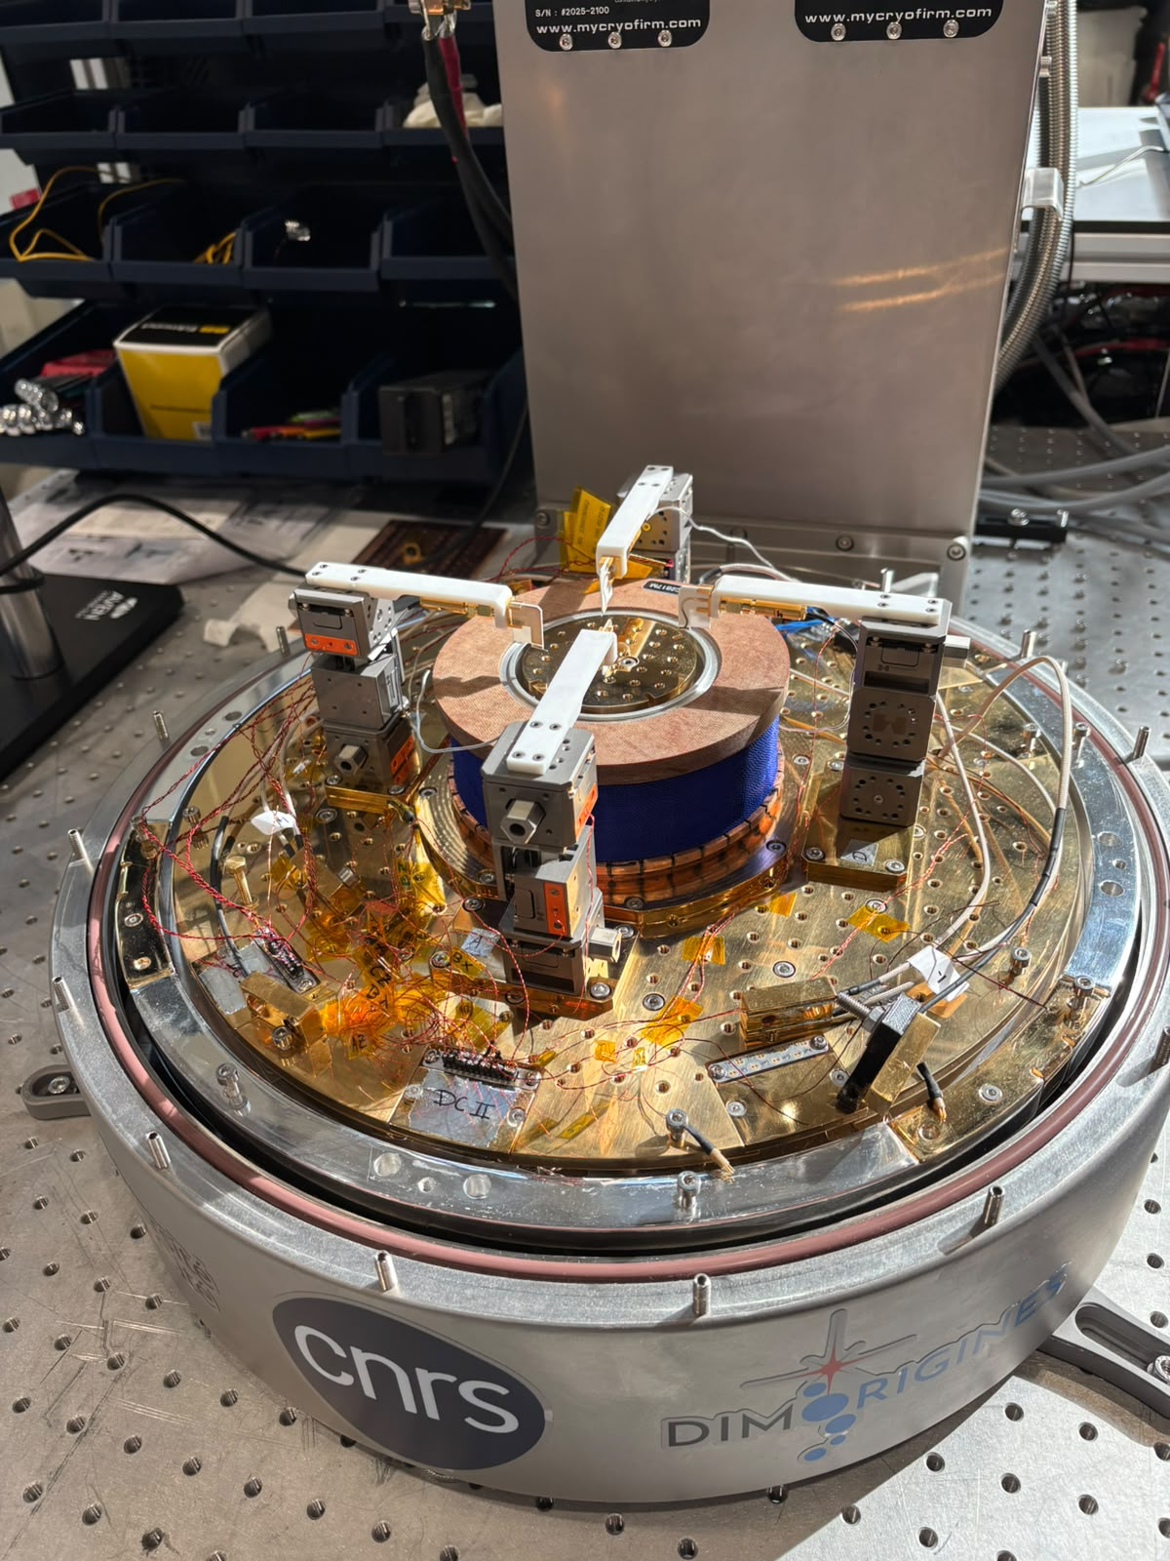
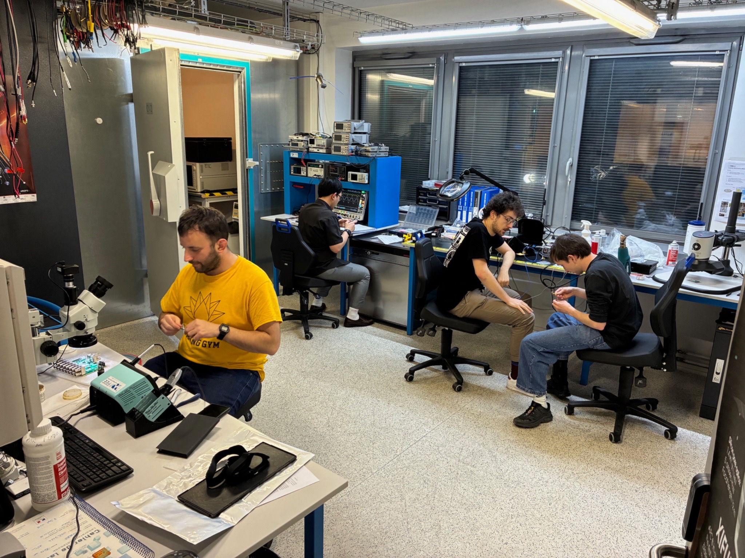
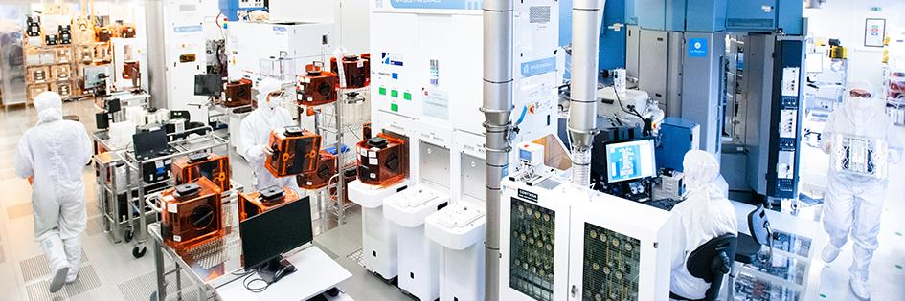
3. The collaboration Team
The fabrication and test facilities
DRTBT Lab
  Dilution fridge with TDM readout (from CMB-S4)
→ To be opened for optical tests
Cryo-Mat sub-K characterization platform
  Electrical properties (2025)
  Thermal properties (2026)
  Mechanical properties (2027)
  Low Noise Room: electric tests & integration
Semi-industrial lab in Grenoble
Cleanrooms: 11000 m²
  200mm and 300mm wafers
  characterization,
  prototyping,
  validation,
  testing capabilities
ADR 35mK
Dilution 20mK
Cryomat
electrical cryostat
Low Noise Room

Slide 7
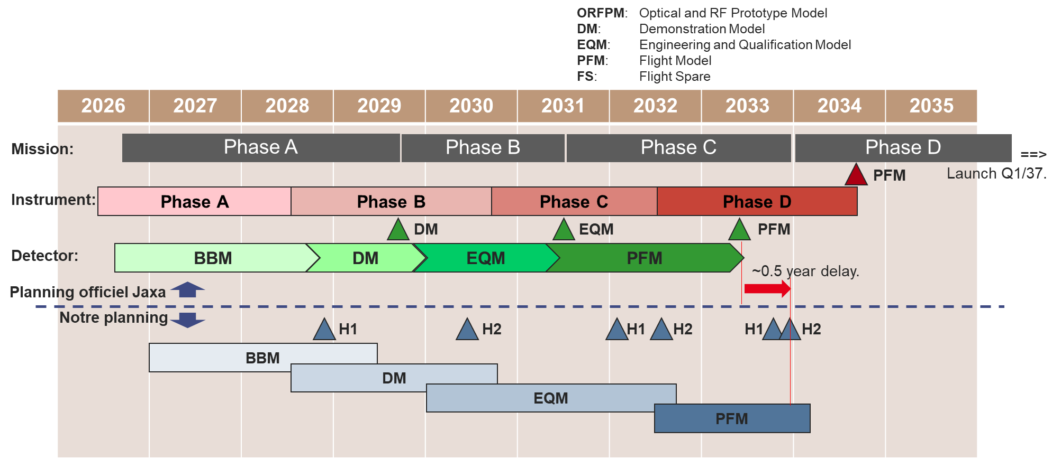
4. Development plan

Slide 8
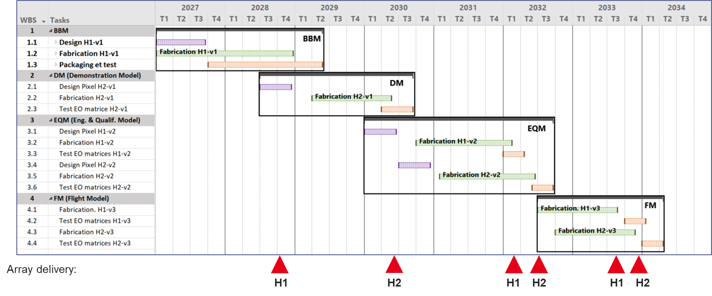
4. Development plan
Proposed project
WP1: Management
WP2: Pixel and prototype design
Design report
WP3: Technology
Year 1: Fabrication process study runs
Year 2:
  Two prototype runs
  Full DC testing at 300K
  First low-Temperature DC tests
  DC fabrication and test report
Supporting activities with LiteBIRD partners
WP4: Packaging
Design and fabrication of mounts, feedhorns, and test interfaces.
WP5: Tests
Preparation and performance of cryogenic optical tests.

Slide 9
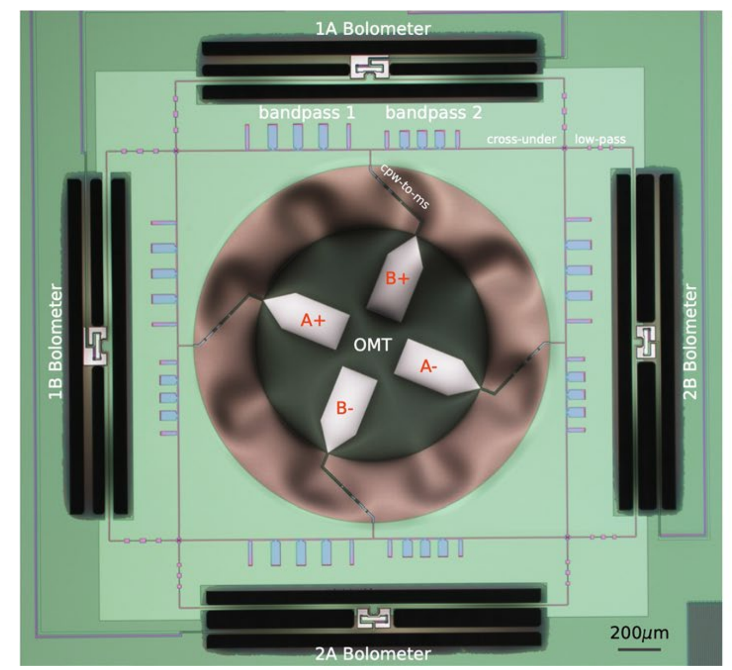

5. Development status
NIST Pixel
TES pixel design:
OMT design
RF lines design
TES characteristics and expected performance
Choice of materials
Mechanical Study

Slide 10
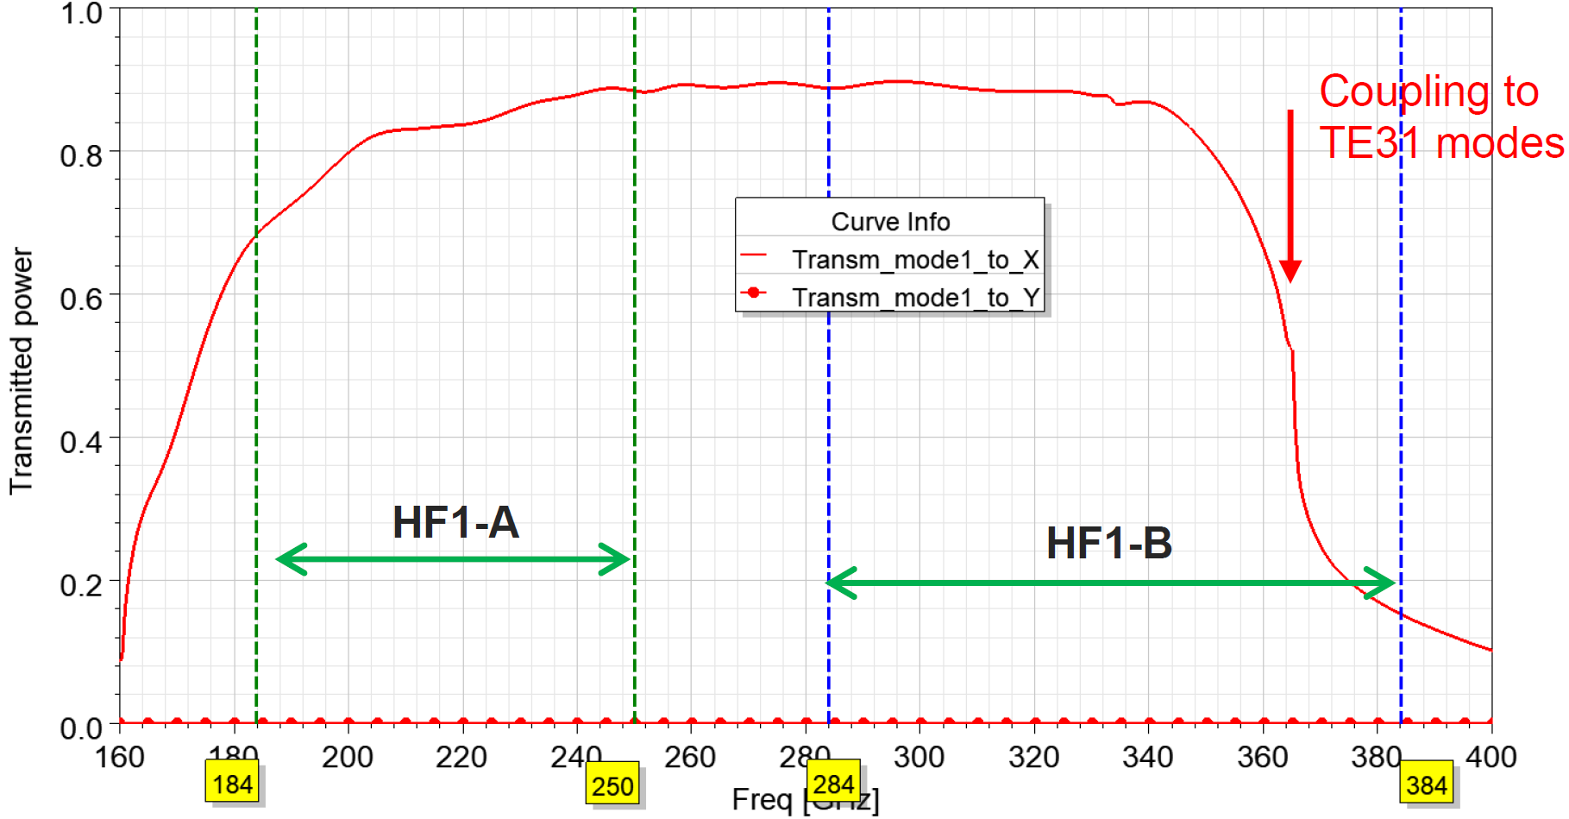
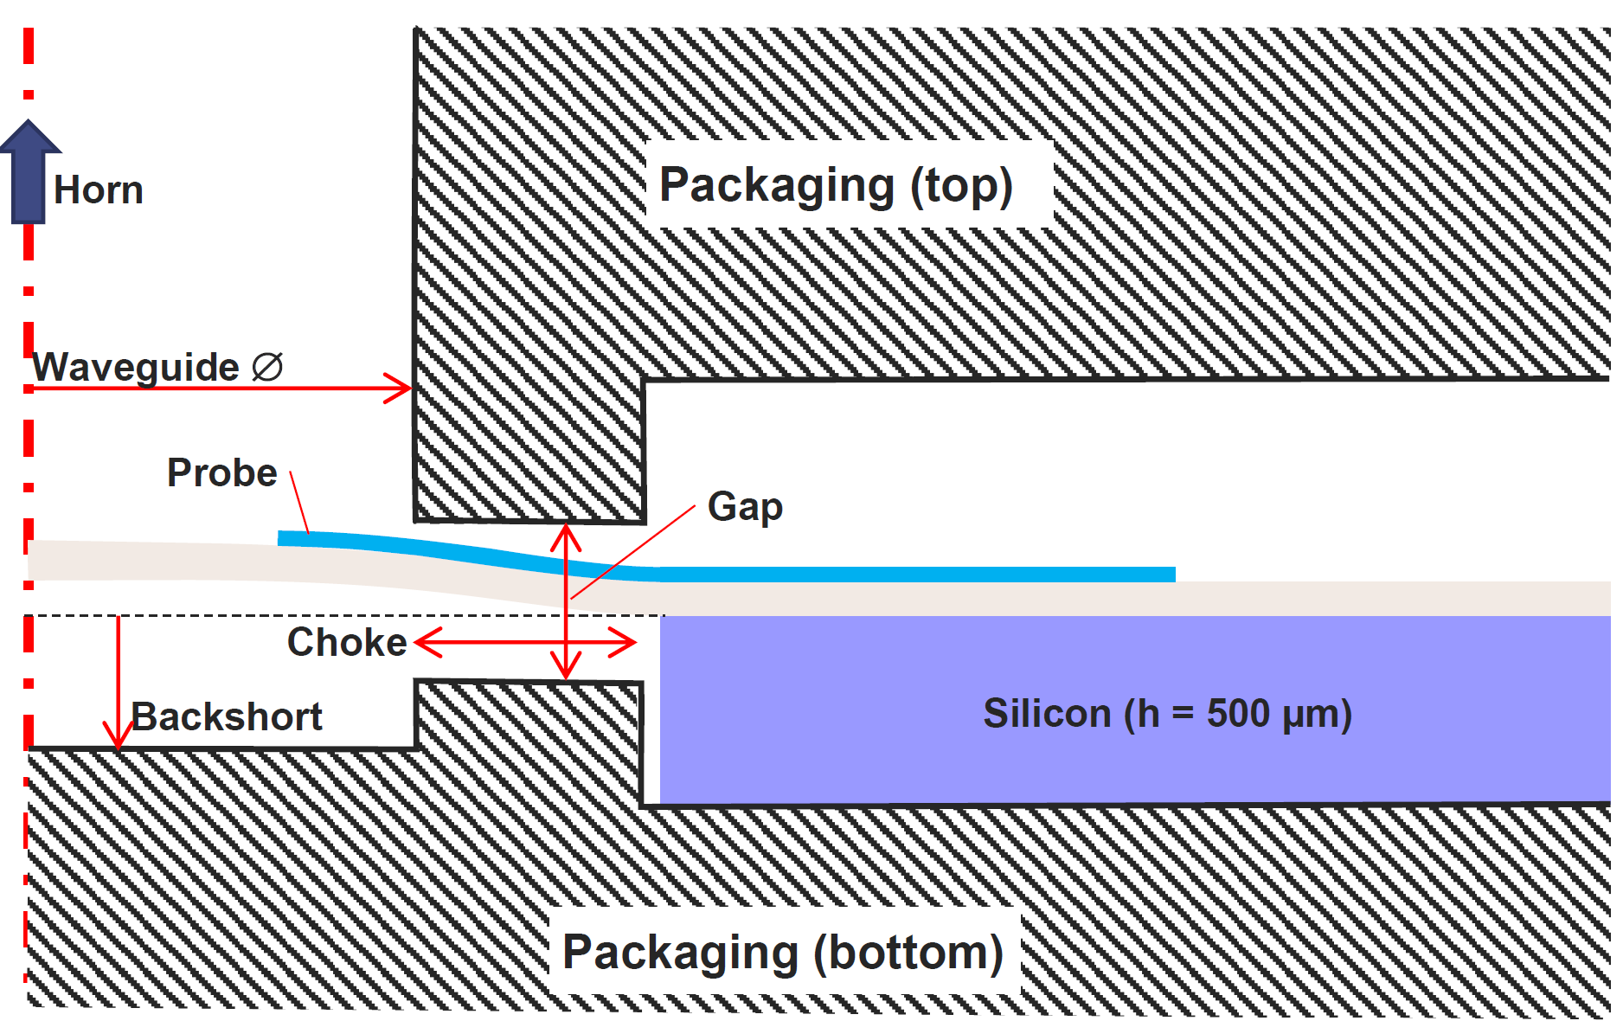
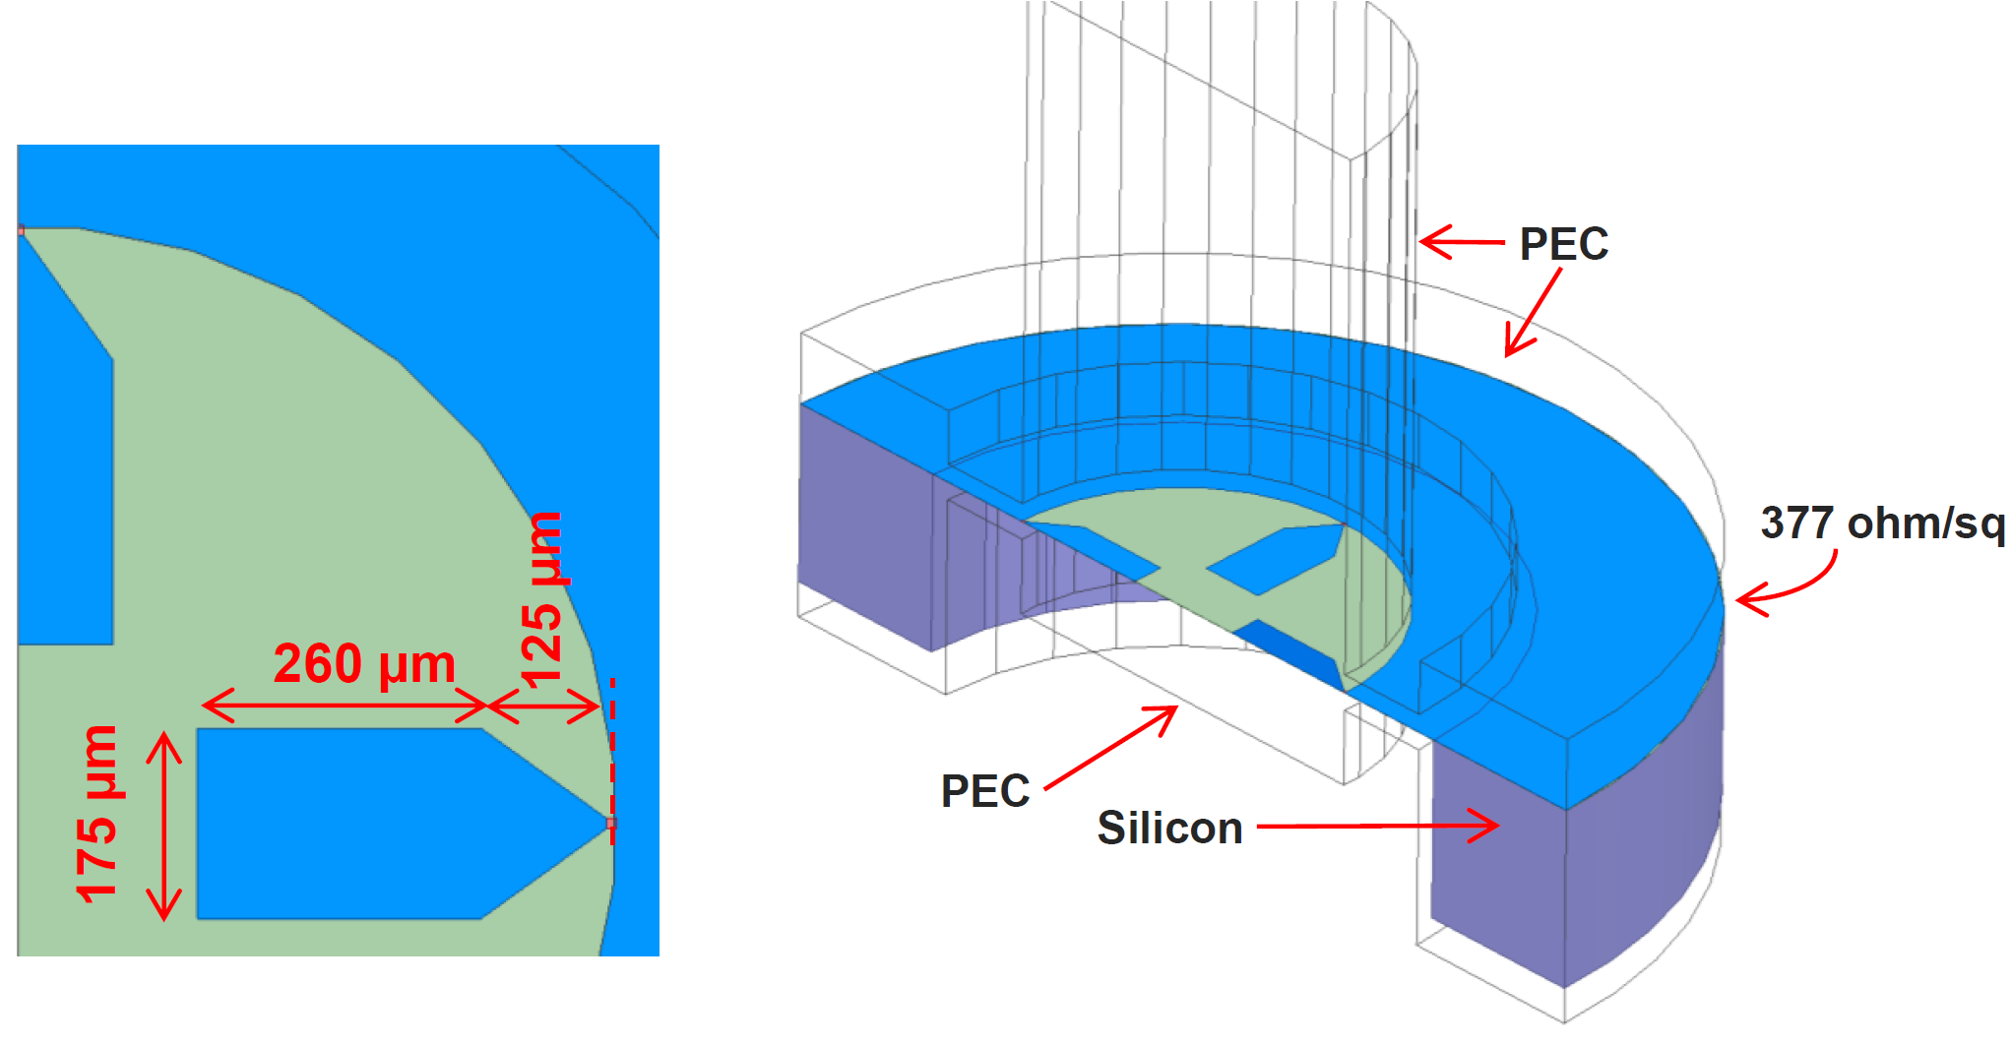
5. Development status - OMT design
Transmission from the waveguide (TE11 mode, X pol.) to the
2 X-probes and the 2 Y-probes.
Preliminary design based on published examples:
• Waveguide : 1.1mm => mode TE11 ~160 GHz
• Backshort: 260 μm
• Choke: 250 μm
• Gap: 100 μm (±50 μm wrt to the wafer top surface)
• Probe port impedance: 200 ohms (not optimized)

Slide 11
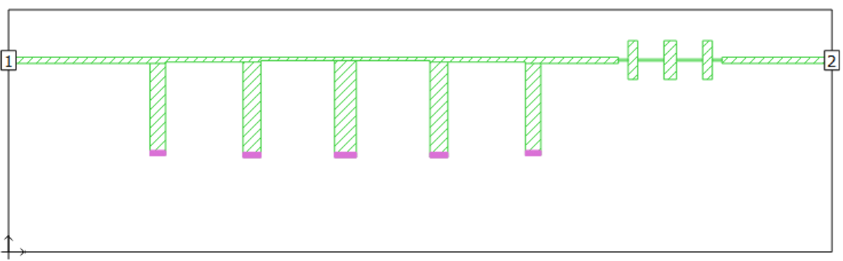
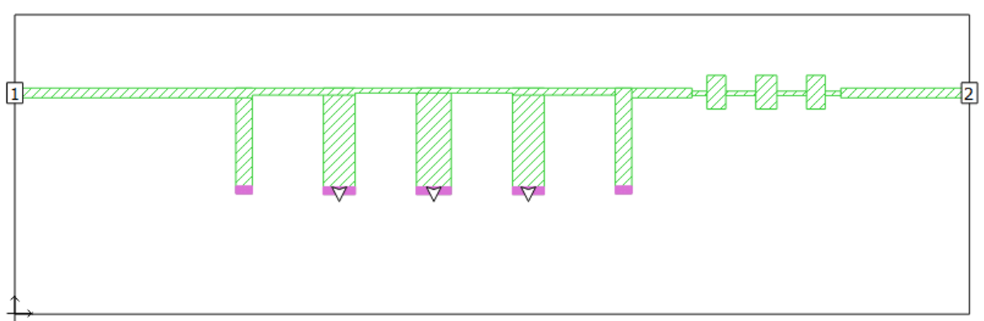
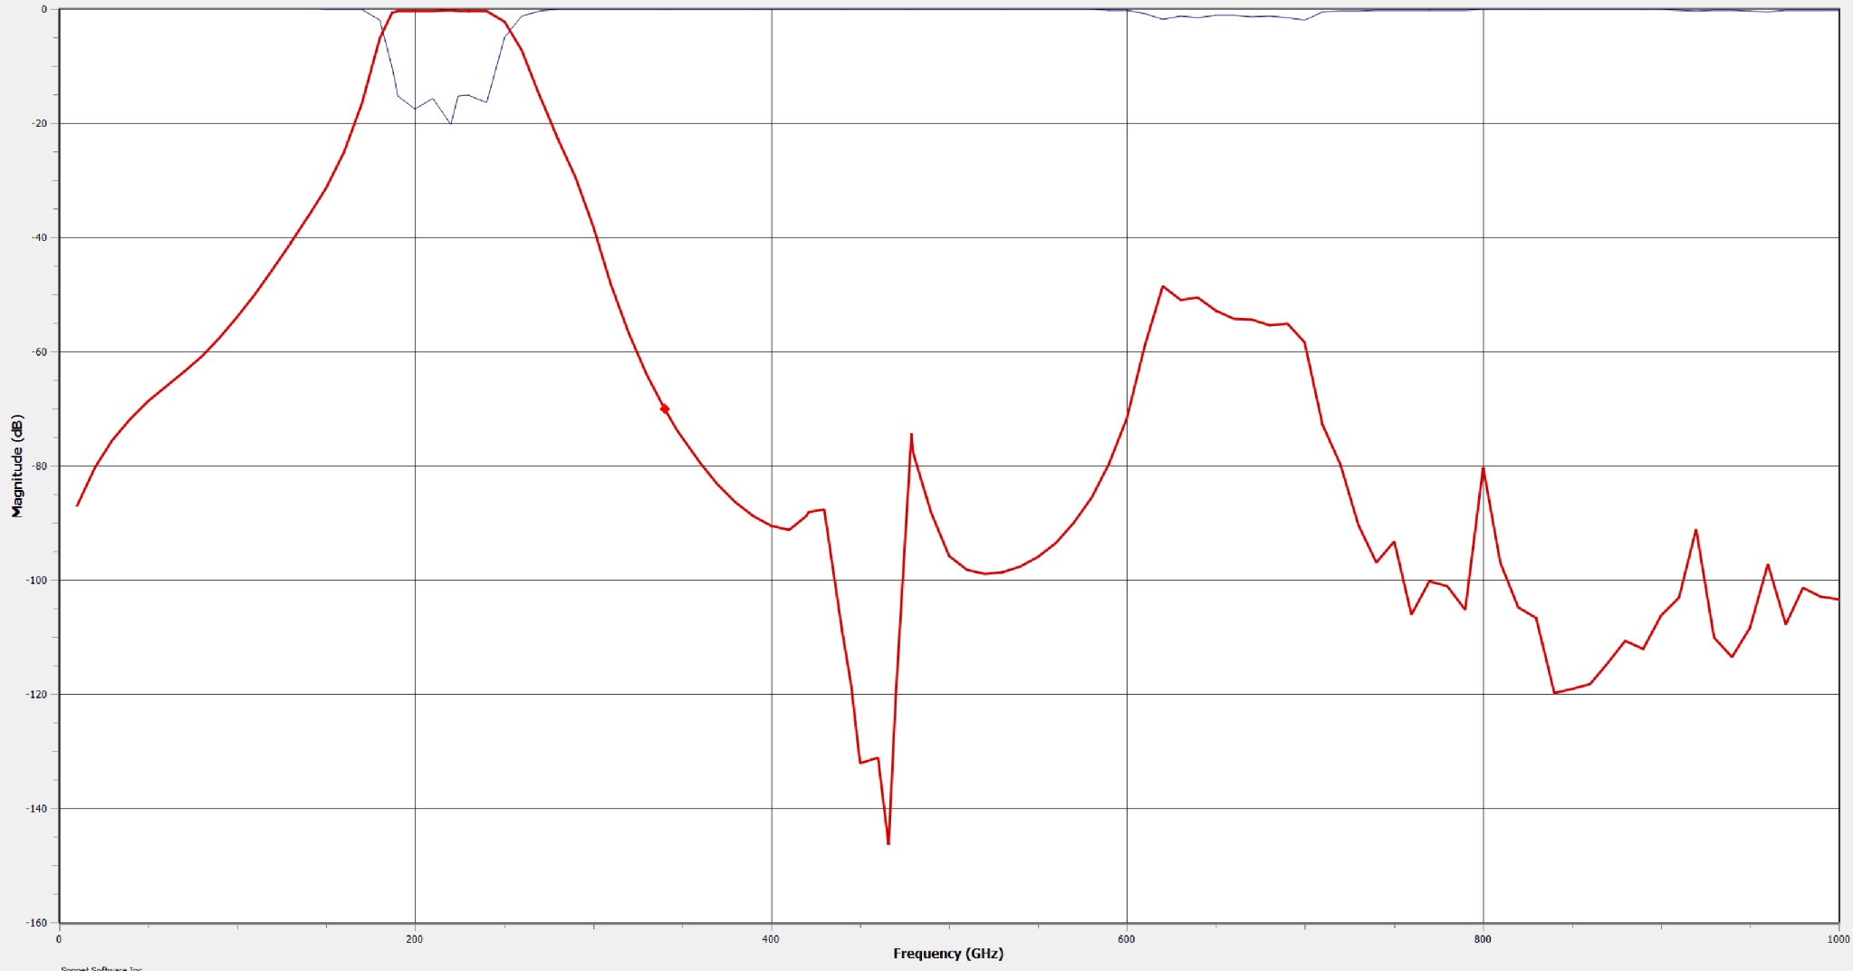
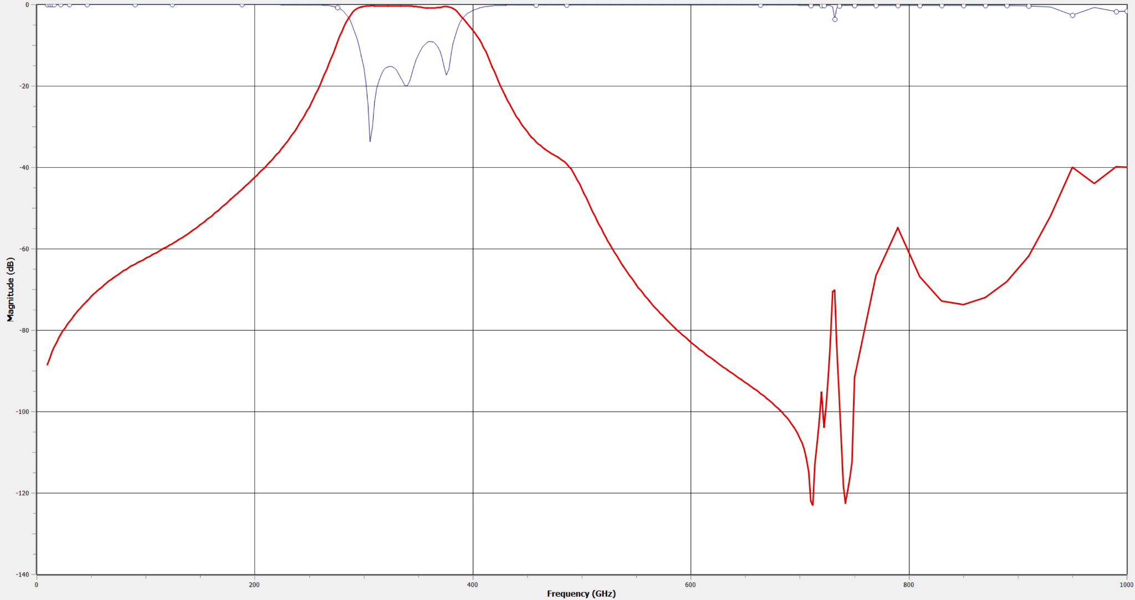
5. Development status - RF Filters
217 GHz band
334 GHz band
600 µm
400 µm
0
0
-20
-20
-40
-40
-60
-60
-80
Magnitude (dB)
Magnitude (dB)
-80
-100
-120
F_{min} - F_{max} (GHz) | F₀ (GHz) | Bandwidth
184 – 250 | 217 | 66 GHz -30%
-100
F_{min} - F_{max} (GHz) | F₀ (GHz) | Bandwidth
284 – 384 | 334 | 100 GHz -30%
-140
-120
-160
200
400
Frequency (GHz)
600
800
1000
-140
Frequency (GHz)
1000
0
0
200
400
600
800
PRELIMINARY RESULTS

Slide 12
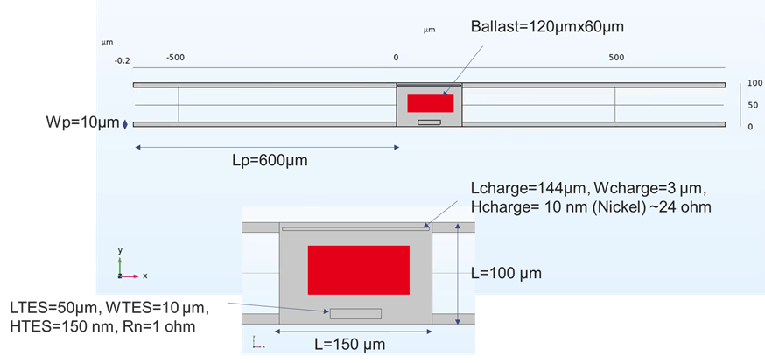
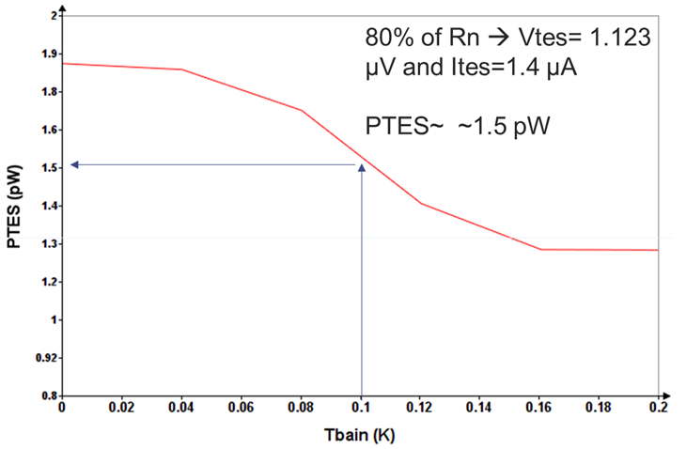
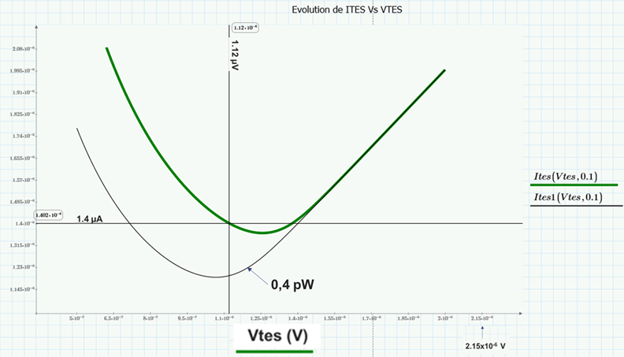
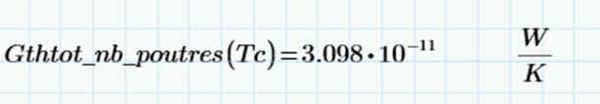

5. Development status - TES design
PRELIMINARY RESULTS

Slide 13
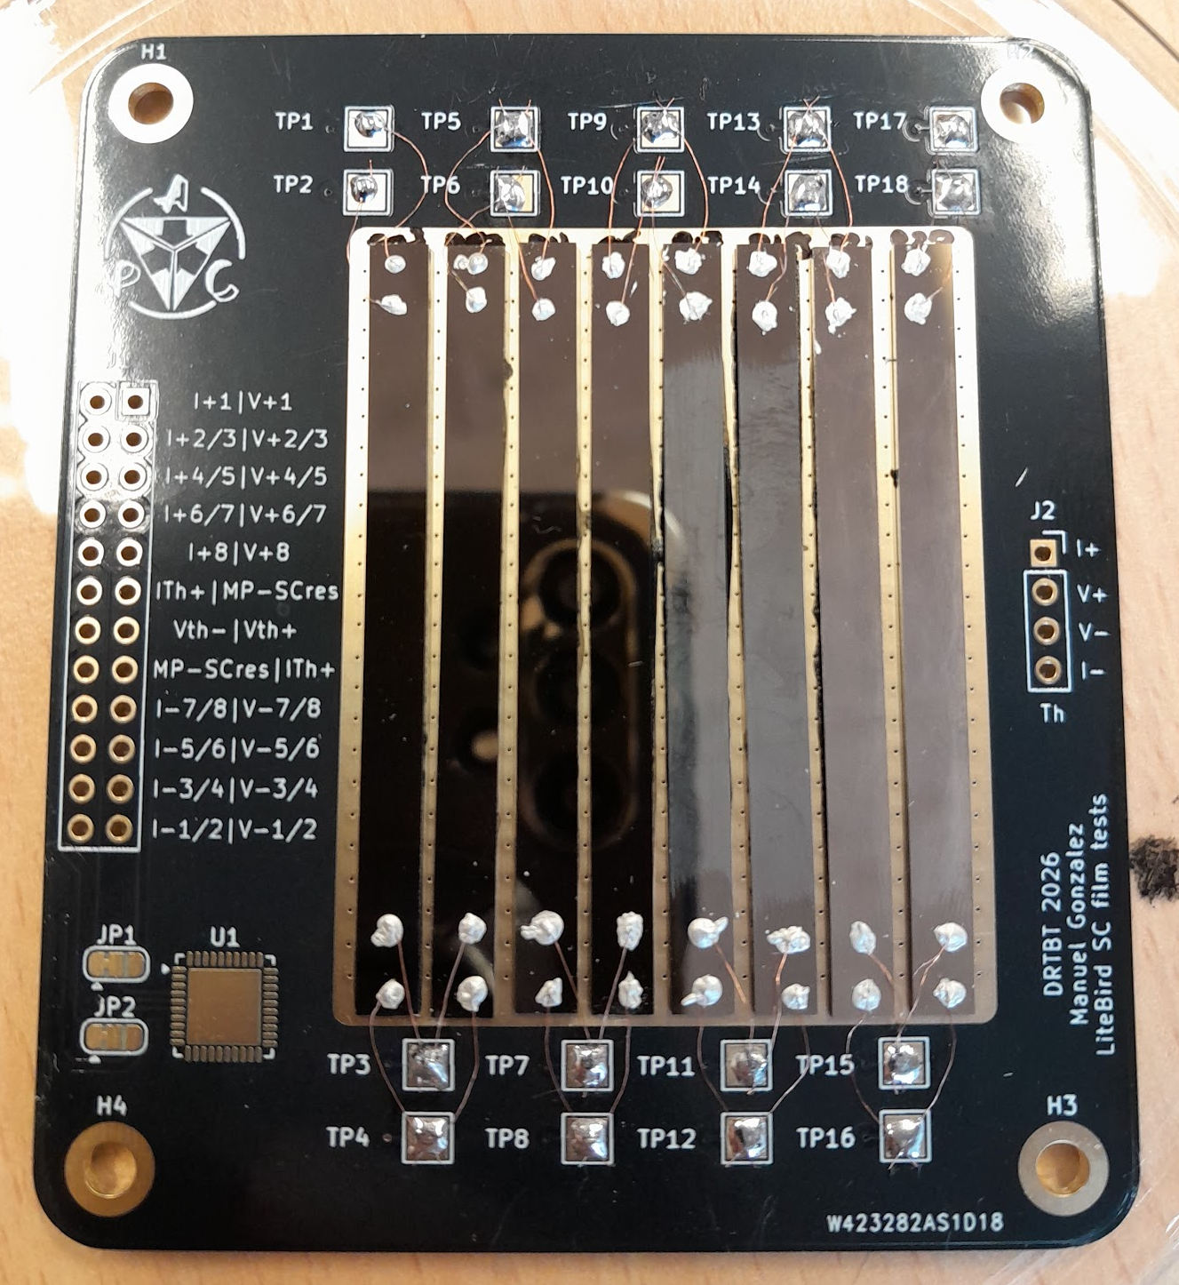
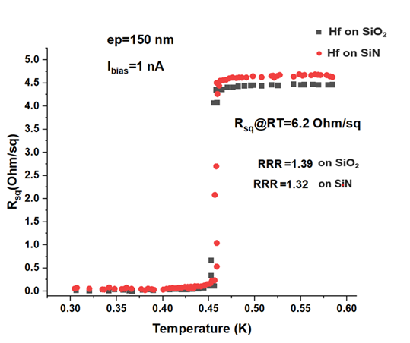
5. Development status - Superconducting materials
Target: Tc ~160 to 180 mK and Rn~0.1 Ohm
Deposition at CEA/Leti, measurement at Irfu and APC
Different Metals were used for the study:
→ Tungsten (W) 200 nm thick, deposited by sputtering at 50, 250, 350, 450 °C
Not superconducting down to 25 mK
→ Hafnium (Hf) 150 nm thick, deposited by sputtering at RT: Rsq ~6.3 Ohm/sq @RT
(+Post deposition annealing to reduce and stabilize the Tc)
Tc ~450 mK
→ Iridium (Ir) 150 nm thick, deposited by sputtering at RT: Rsq ~1.3 Ohm/sq @RT
Tc ~158 mK
Hafnium As-deposited
W
Ir
Hf
PRELIMINARY RESULTS

Slide 14
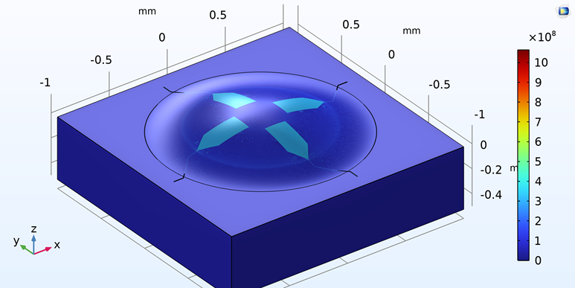
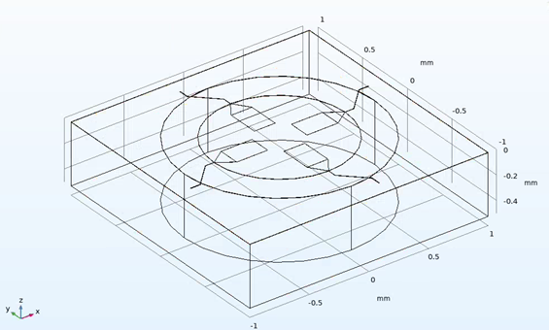
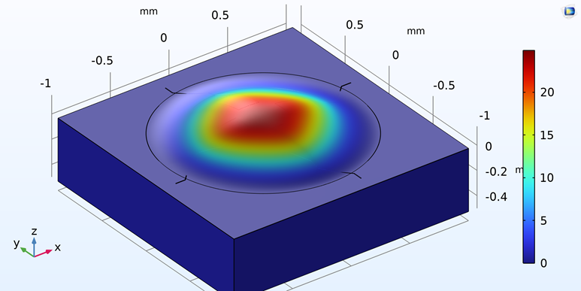
5. Development status - OMT Mechanical Simulation
Stack:
SiN membrane (thickness: 500nm with a residual stress (~100 MPa)
Nb ground (thickness: 200nm with a residual stress (~350 MPa)
SiN insulator (thickness: 350nm, with no residual stress
Nb Metal 2 (thickness: 400nm with a residual stress (~350 MPa)
→ Max displacemnt: 23 µm upward
PRELIMINARY RESULTS

Slide 15
6. Perspectives
Fundings by ESA and CNES ?
Technology process development
Complete pixel design
Wafers fabrication at CEA/Leti
Pixel performance demonstration at APC and CEA/Irfu
Official integration in the LiteBIRD project and collaboration
New french expertise and manufacturing capability TES for future ground- and spaceborn (sub)-mm observatories

Slide 17
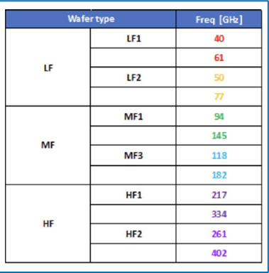
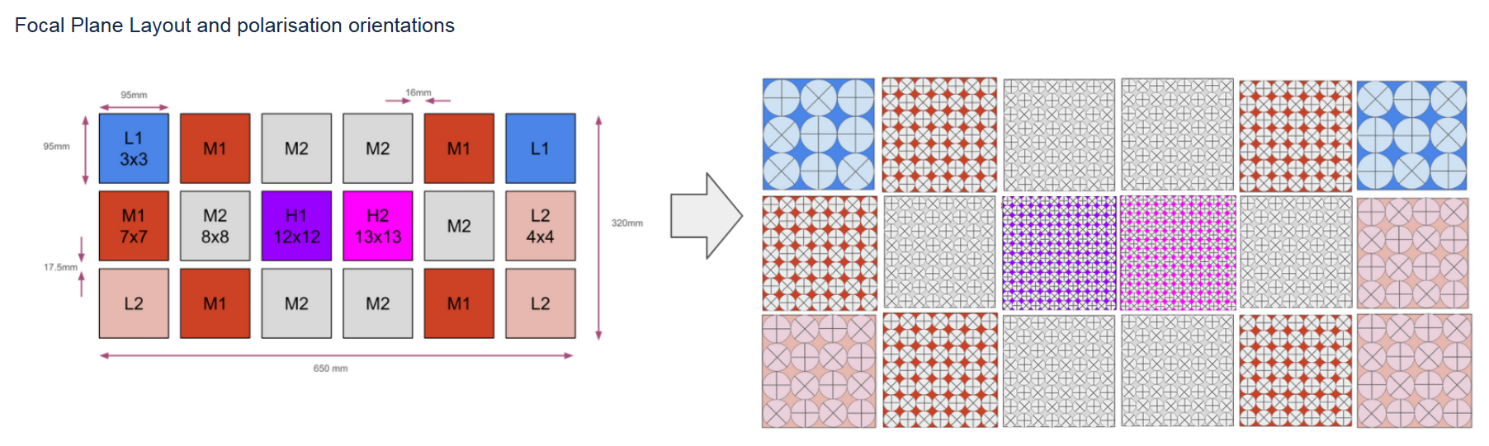
LiteBIRD Focal Plane

