Slide 1
Space charge effect in ProtoDUNE-VD
DUNE France Analysis meeting
01/04/2026
A. Lopez Moreno - L. Manzanillas - M. Martin - L. Zambelli

Slide 2
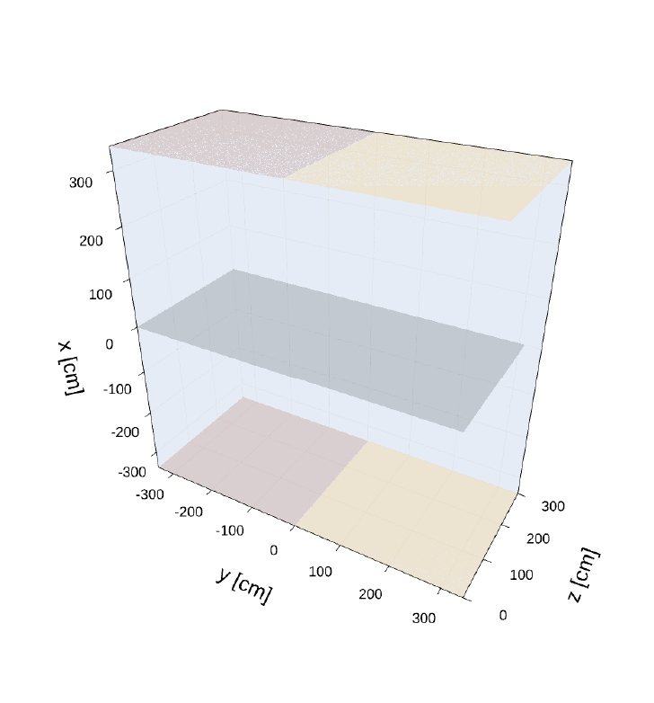
Study goal and parameters
CRP2
CRP3
→Characterize the space charge in ProtoDUNE-VD by using cosmic muon tracks
Parameters :
Lardon as the data reconstruction software
Run 39350 :
→ Cosmics run before CRP2 incident (2025-09-09 to 2025-09-15)
Cathode plane
CRP5
CRP4
PDVD representation used

Slide 3
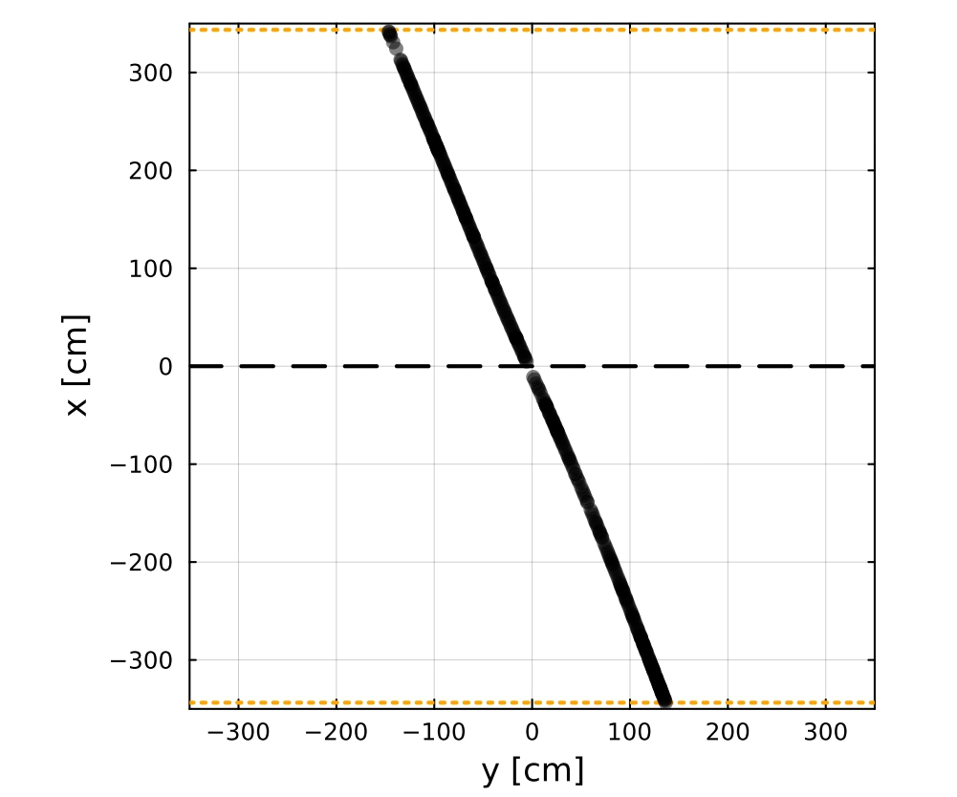
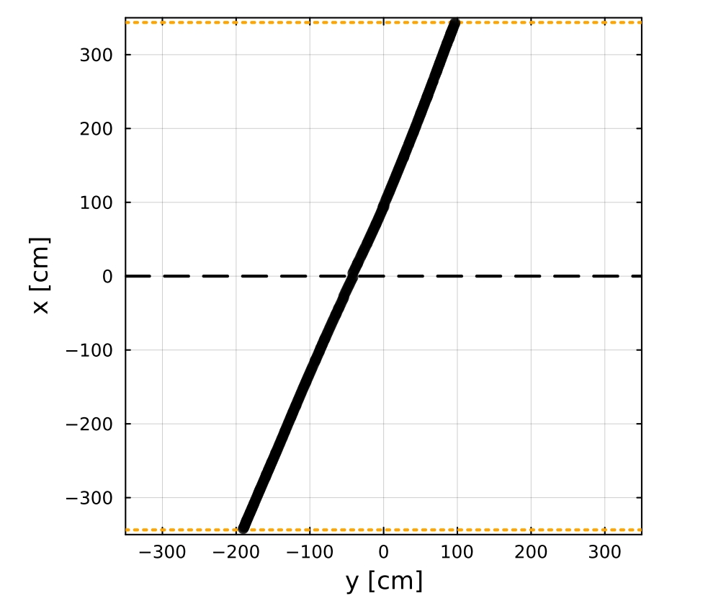
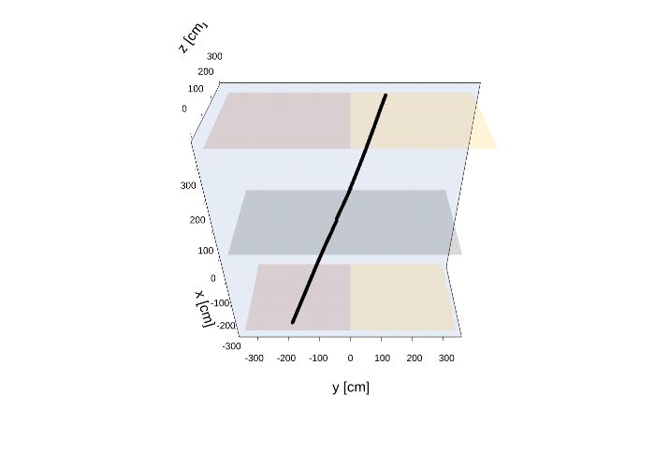
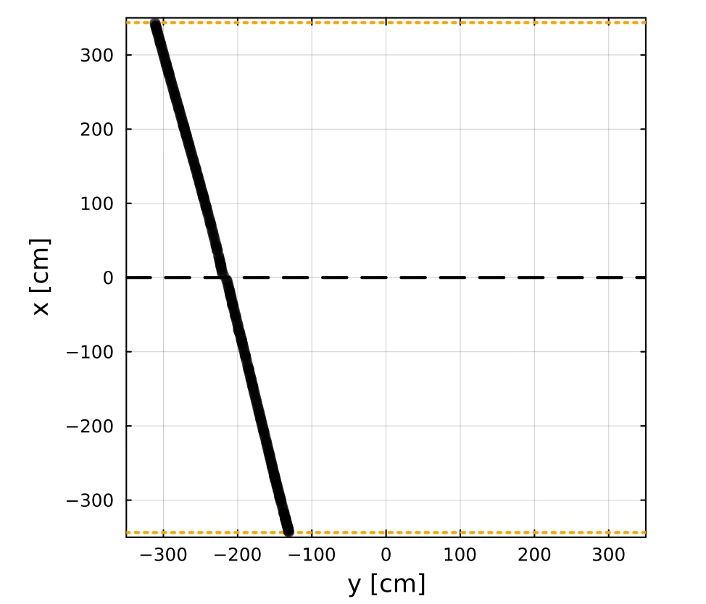
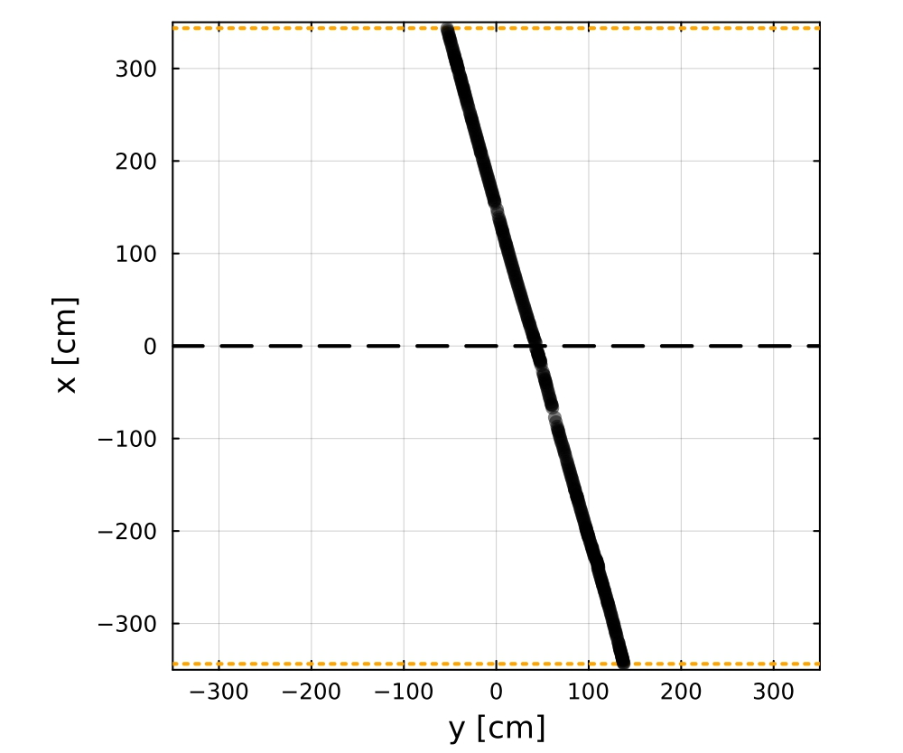
Selected tracks
Example of selected tracks :
Anode-Cathode-Anode tracks : Go through the top anode planes, the cathode plane and the bottom anode planes
→The entry point and the exit point are known
→ Lardon allows us to select them via boolean variables
Additional selection :
The number of hits in the tracks has to be > 30
A sanity check is done to verify if the tracks go through each anode planes
Number of selected tracks : 3396 (out of more than 2 million of tracks)

Slide 4
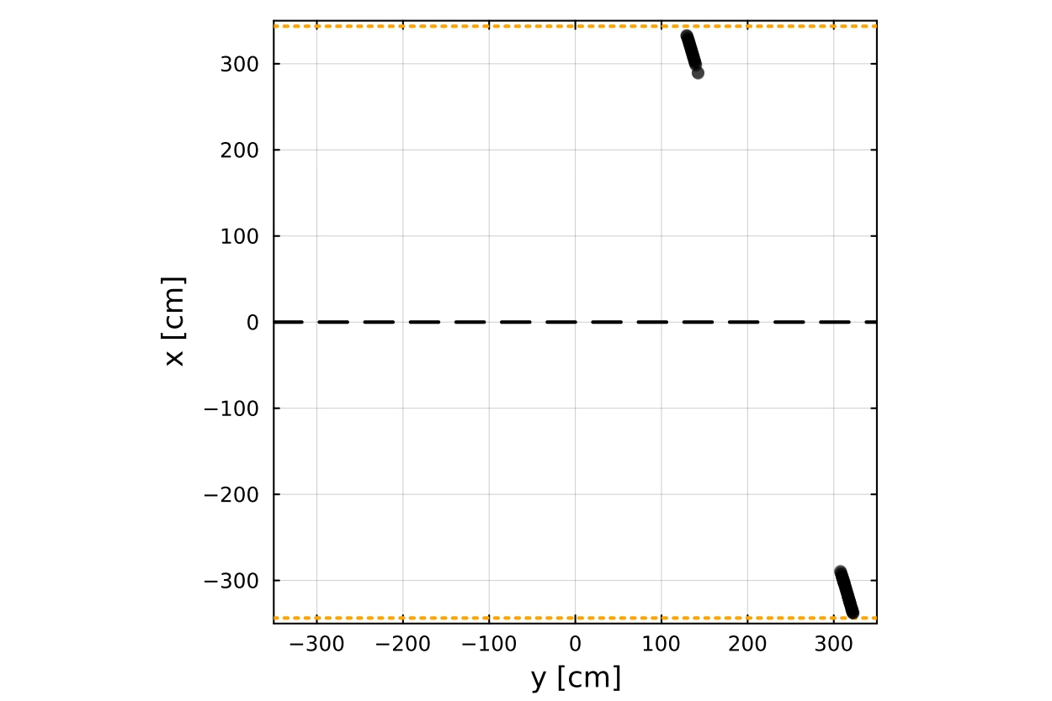
Space charge computation
Space charge is computed by comparing the expected positions with the reconstructed positions
How the expected positions are calculated :
→Hits of the track in the first 50cm near the anode planes are selected
→A direction is computed with a reference point (barycenter) and the covariance of the hits
→The reconstructed positions are projected on the fitted straight line
→The difference between the reconstructed position and the expected position is calculated for each axis at each position

Slide 5
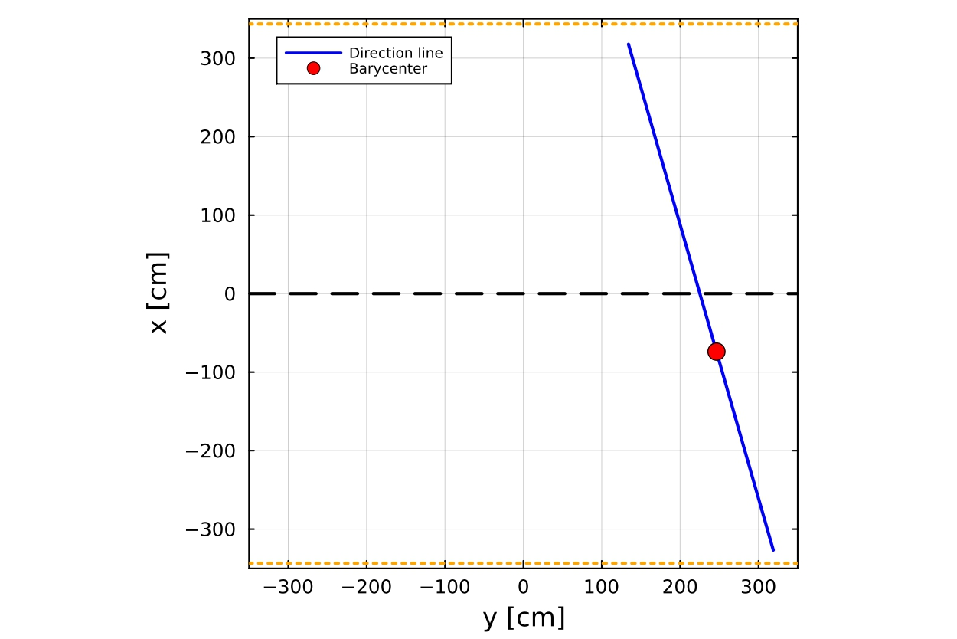
Space charge computation
Space charge is computed by comparing the expected positions with the reconstructed positions
How the expected positions are calculated :
→Hits of the track in the first 50cm near the anode planes are selected
→A direction is computed with a reference point (barycenter) and the covariance of the hits
→The reconstructed positions are projected on the fitted straight line
→The difference between the reconstructed position and the expected position is calculated for each axis at each position

Slide 6
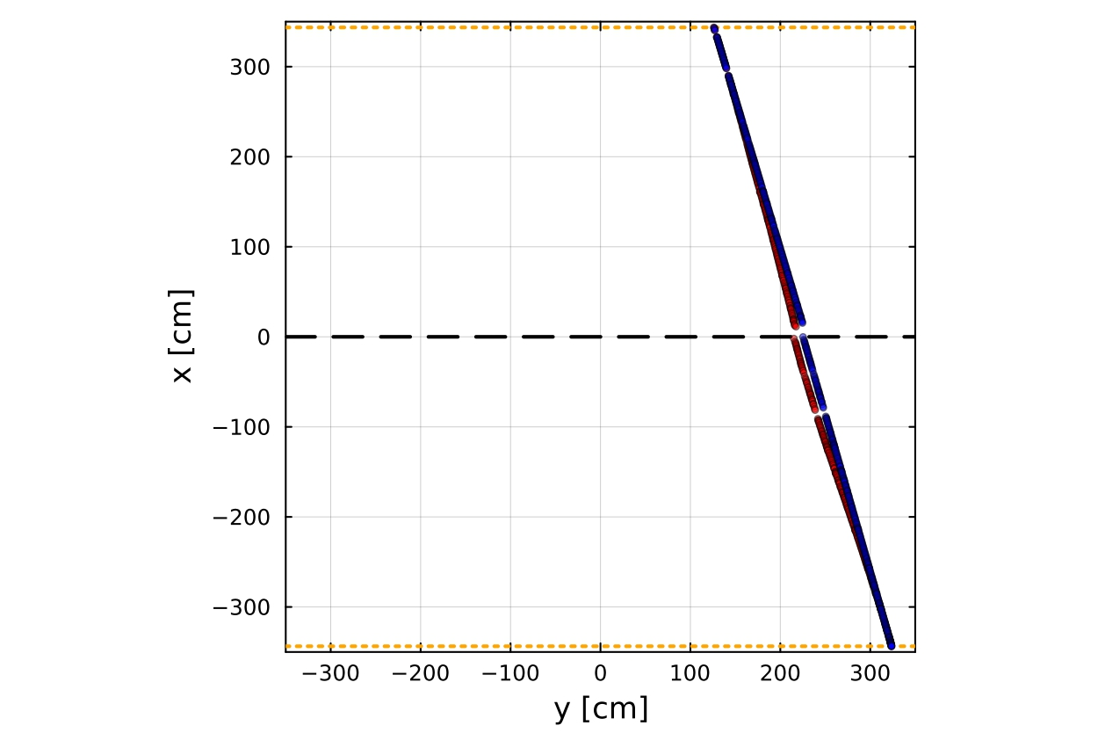
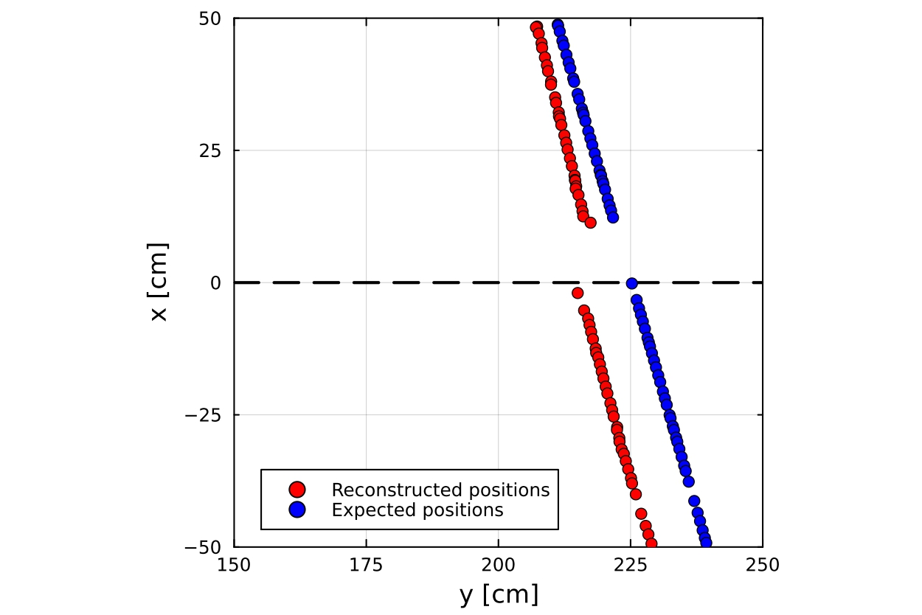
Space charge computation
Space charge is computed by comparing the expected positions with the reconstructed positions
How the expected positions are calculated :
→Hits of the track in the first 50cm near the anode planes are selected
→A direction is computed with a reference point (barycenter) and the covariance of the hits
→The reconstructed positions are projected on the fitted straight line
→The difference between the reconstructed position and the expected position is calculated for each axis at each position

Slide 7
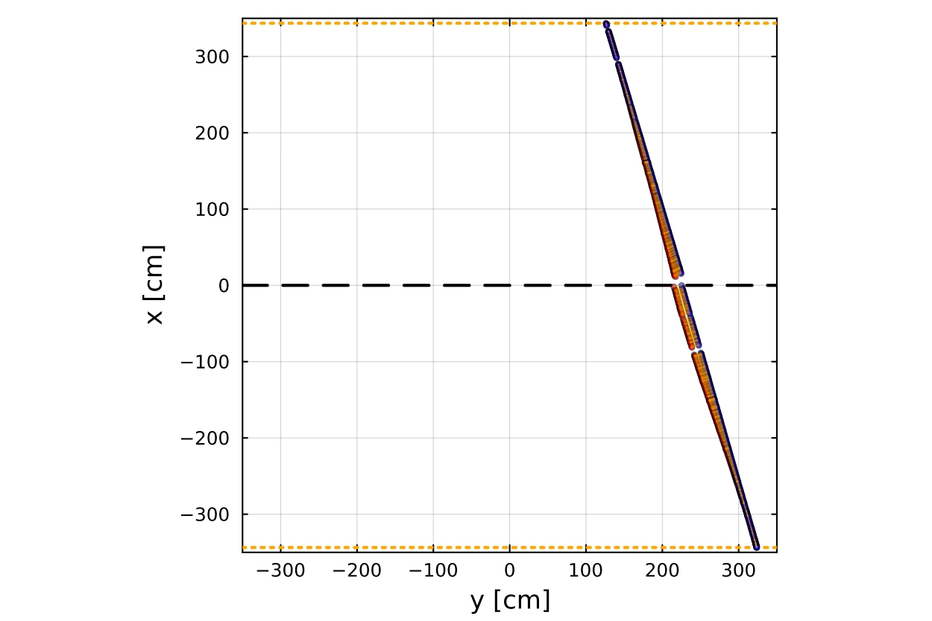
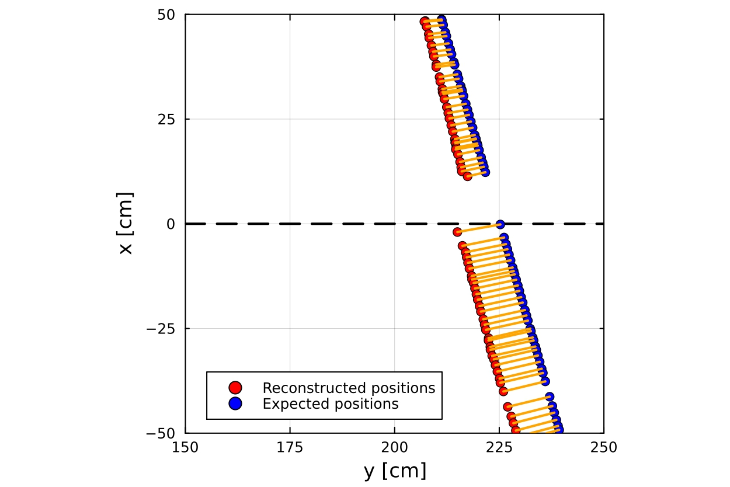
Space charge computation
Space charge is computed by comparing the expected positions with the reconstructed positions
How the expected positions are calculated :
→Hits of the track in the first 50cm near the anode planes are selected
→A direction is computed with a reference point (barycenter) and the covariance of the hits
→The reconstructed positions are projected on the fitted straight line
→The difference between the reconstructed position and the expected position is calculated for each axis at each position

Slide 8
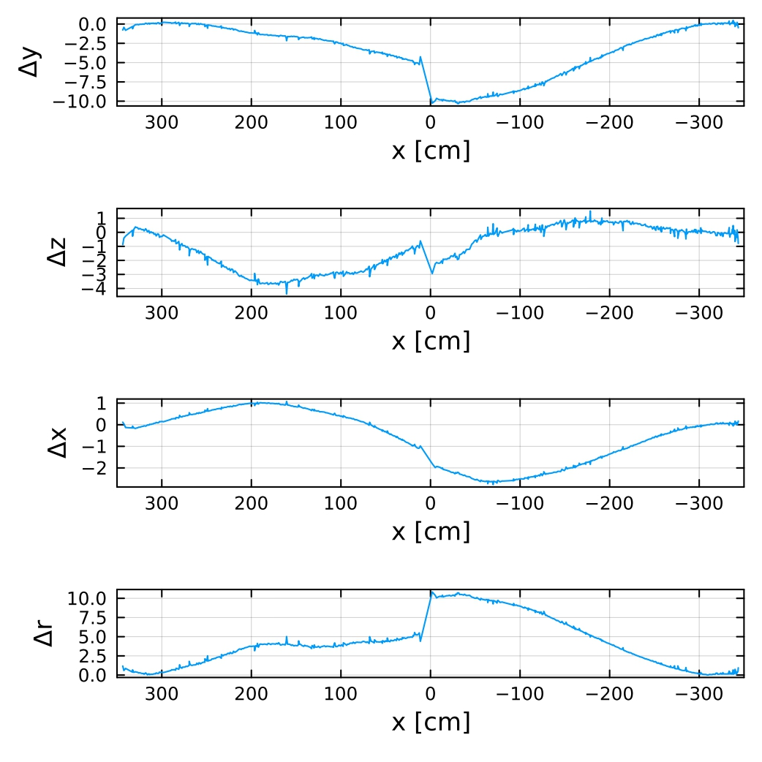
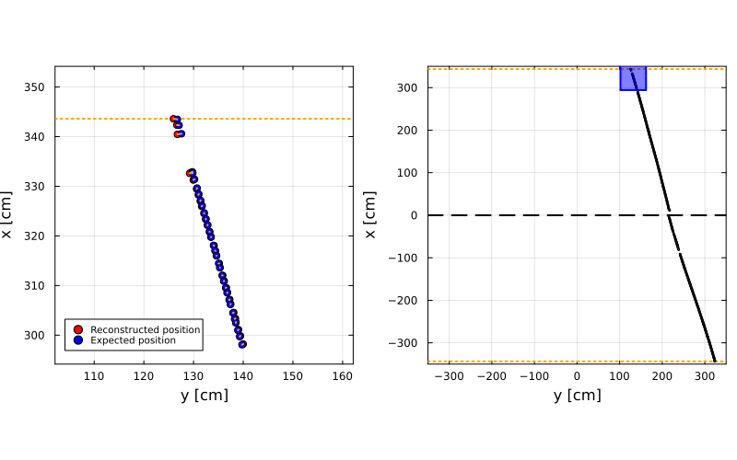
Space charge computation
Top Anodes
Bottom Anodes
→ Along the track, the differences become more and more important when moving toward the cathode

Slide 9
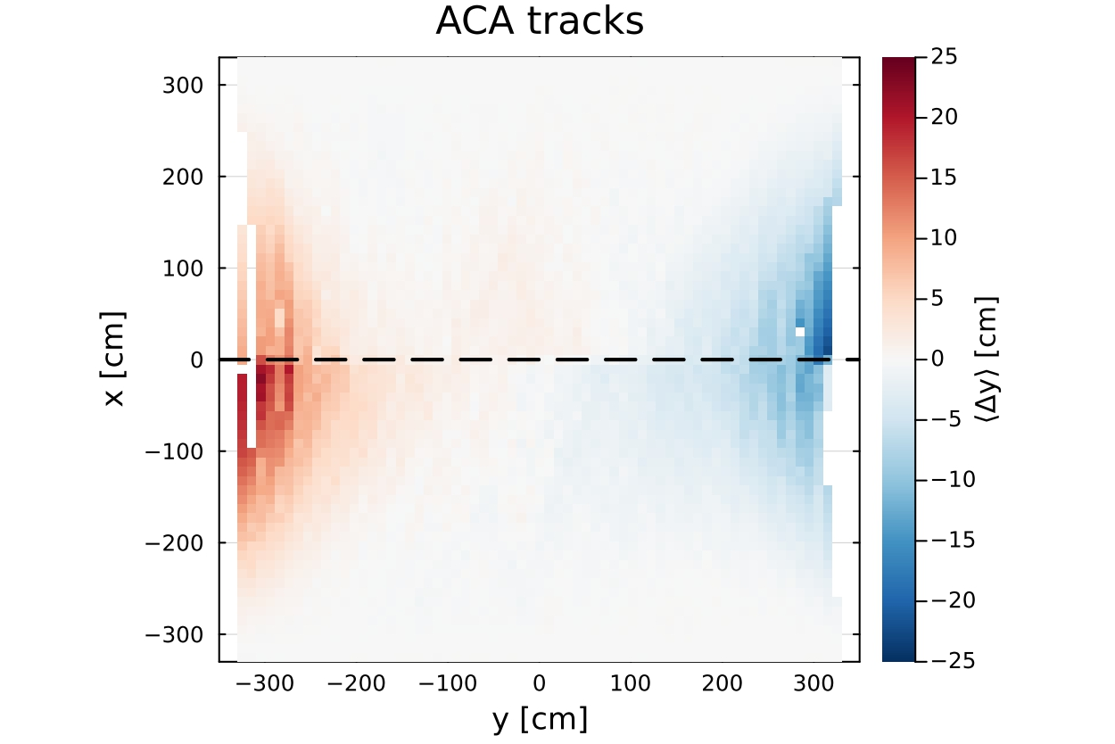
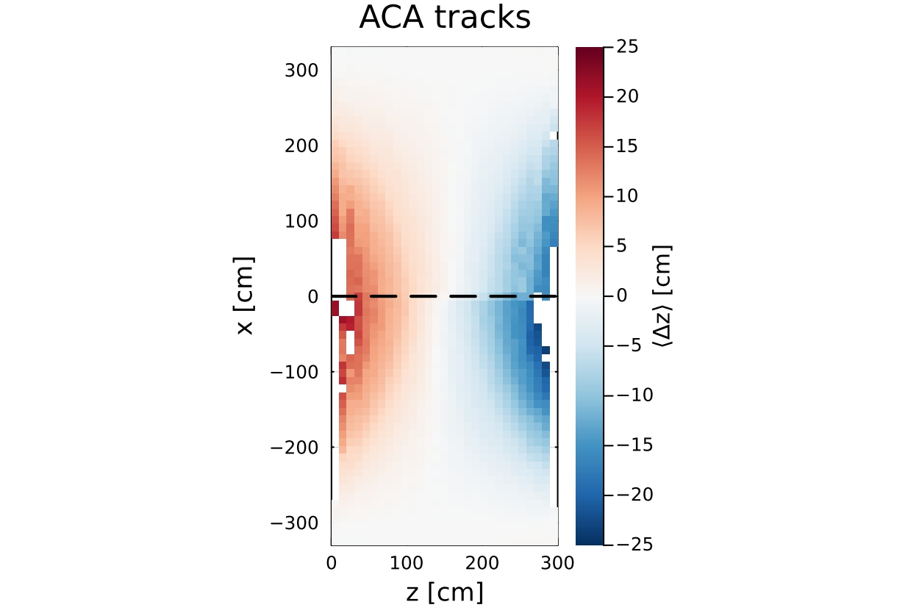
Results for Anode-Cathode-Anode tracks
Average horizontal differences of all the Anode-Cathode-Anode tracks : Δy and Δz
Color description :
Red : right shift
Blue : left shift
→ The differences along the horizontal axis show that the space charge shifts the positions towards the center of the volume
→ The modification of the electric field lines by the space charge effect is more significant at the edge of the detector, near the field cage and the cathode

Slide 10
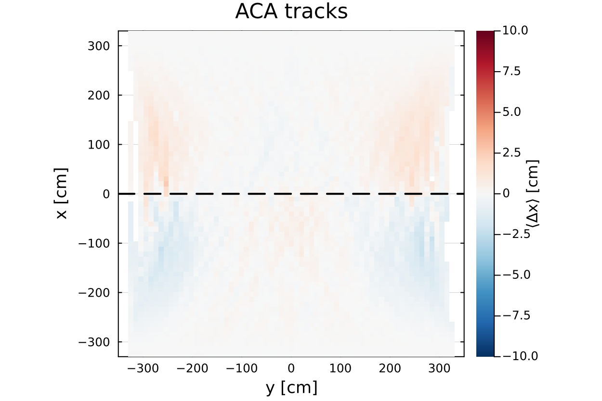
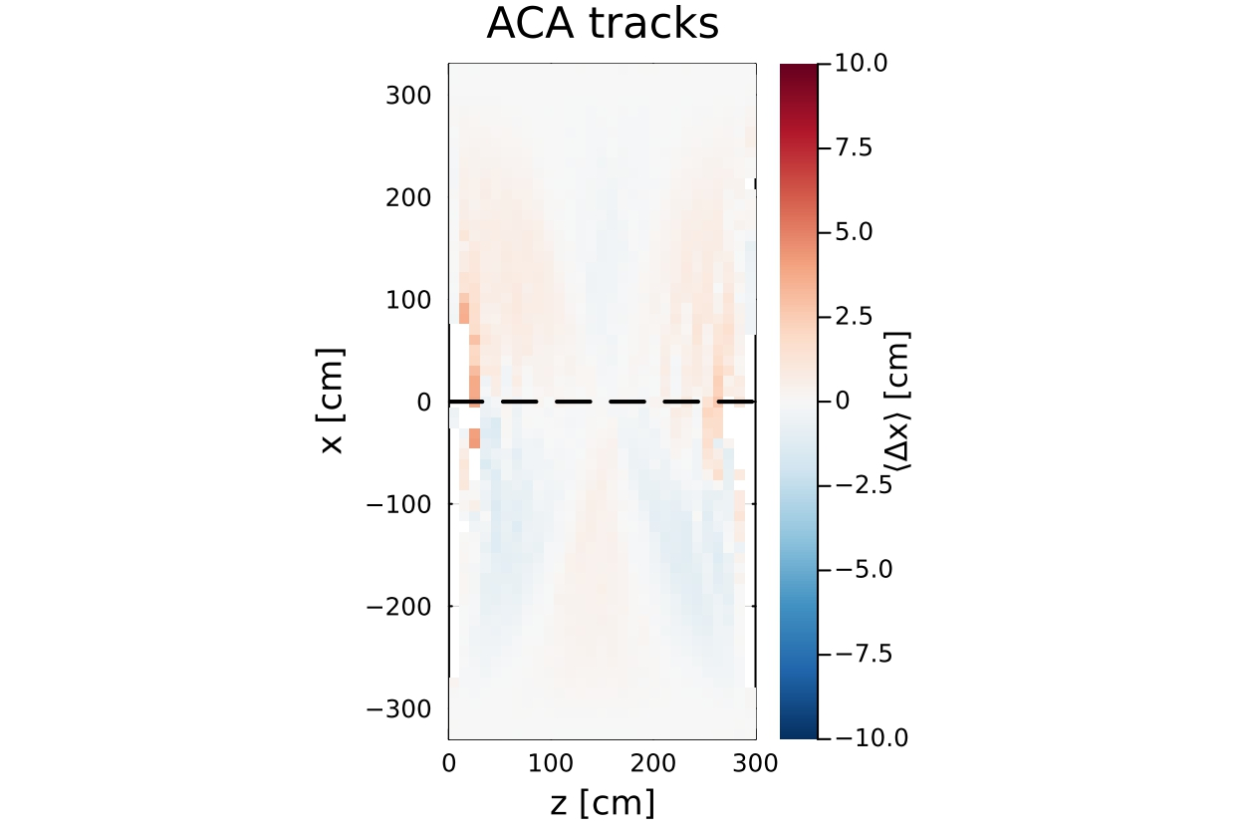

Results for Anode-Cathode-Anode tracks
Average vertical differences of all the Anode-Cathode-Anode tracks : Δx
Color description :
Red : up shift
Blue : down shift
Color scale is reduced to (-10,10)
→ The differences along the vertical axis are less important and show that the space charge shifts the positions differently according to the location in the detector
→ The flow of argon is not uniform at the center of the detector due to different components (ex : ARAPUCAs) and the electric field lines are modified according to the number of accumulated ions

Slide 11
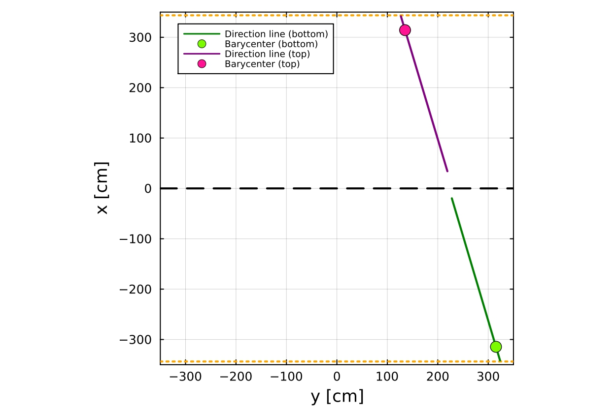
Space charge computation for both volumes
Do we obtain the same results if we separate the two volumes ?
Space charge is computed by comparing the expected positions with the reconstructed positions
How the expected positions are calculated :
→Hits of the track in the first 50cm near the anode planes are selected
→Two directions are computed (top and bottom) with two reference points and two covariances
→The reconstructed positions are projected on the fitted straight line
→The difference between the reconstructed position and the expected position is calculated for each axis at each position

Slide 12
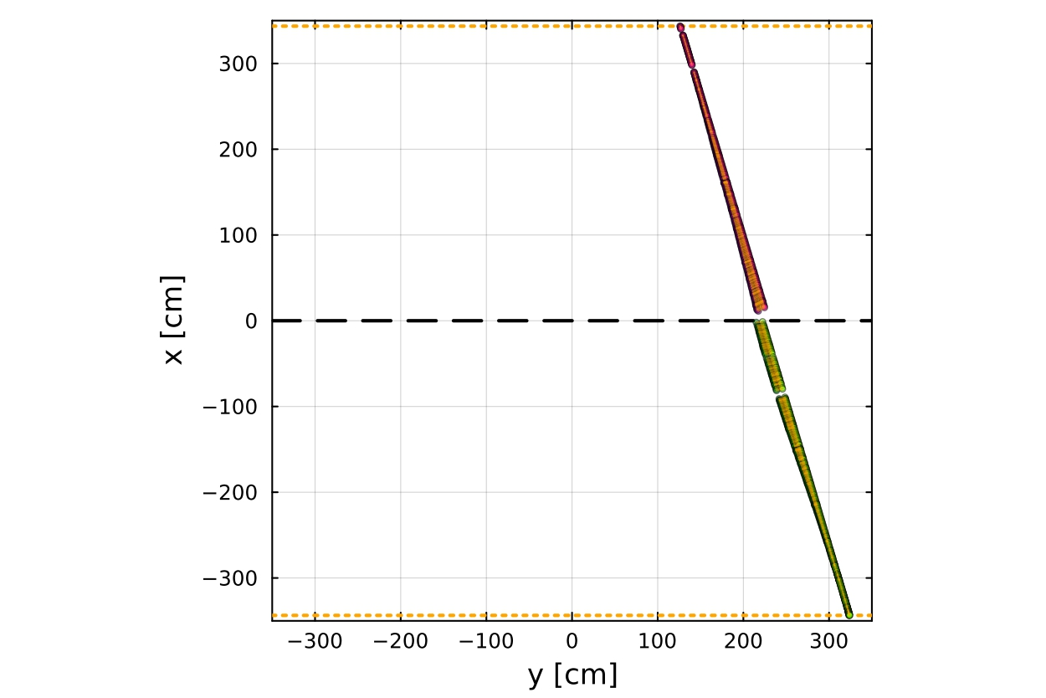
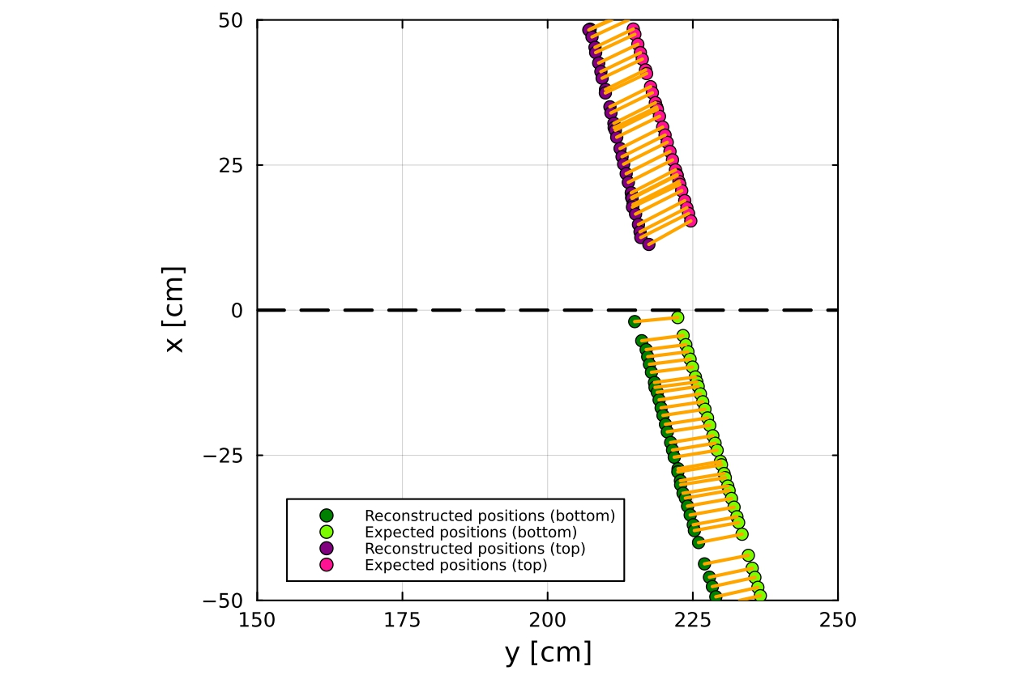
Space charge computation for both volumes
Do we obtain the same results if we separate the two volumes ?
Space charge is computed by comparing the expected positions with the reconstructed positions
How the expected positions are calculated :
→Hits of the track in the first 50cm near the anode planes are selected
→Two directions are computed (top and bottom) with two reference points and two covariances
→The reconstructed positions are projected on the fitted straight lines
→The difference between the reconstructed position and the expected position is calculated for each axis at each position

Slide 13
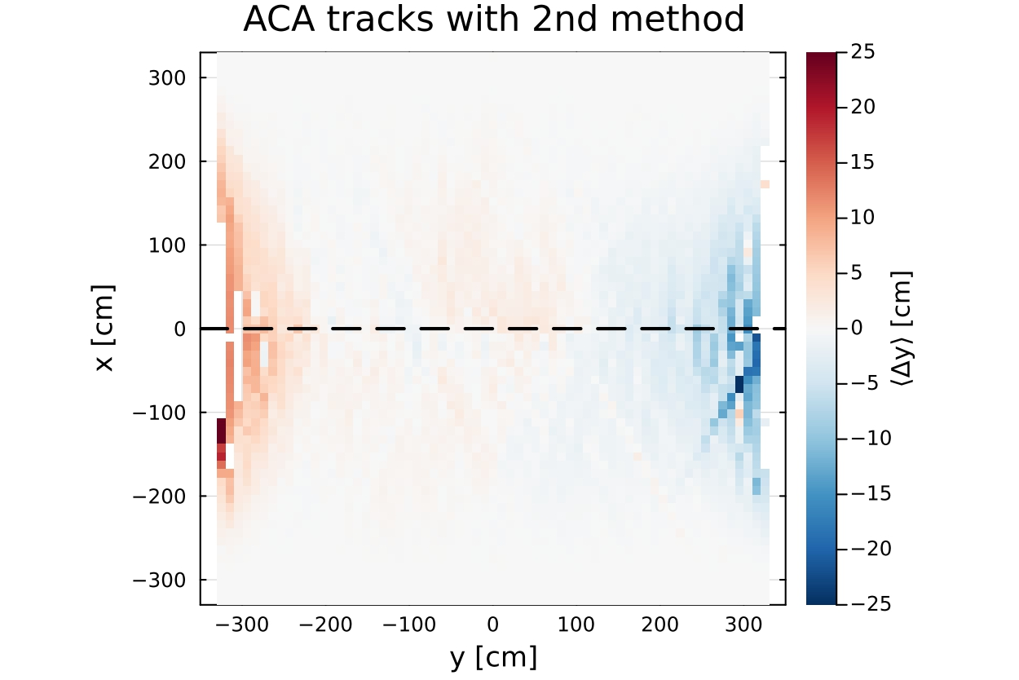
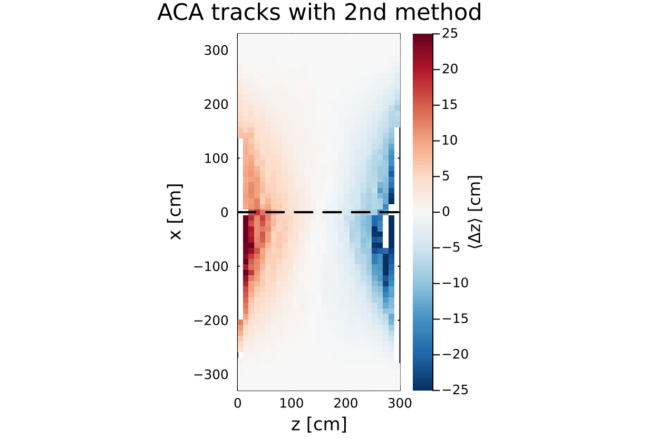
Results for both volumes
Average horizontal differences of all the Anode-Cathode-Anode tracks : Δy and Δz
Color description :
Red : right shift
Blue : left shift
→ The two different methods show very close results

Slide 14
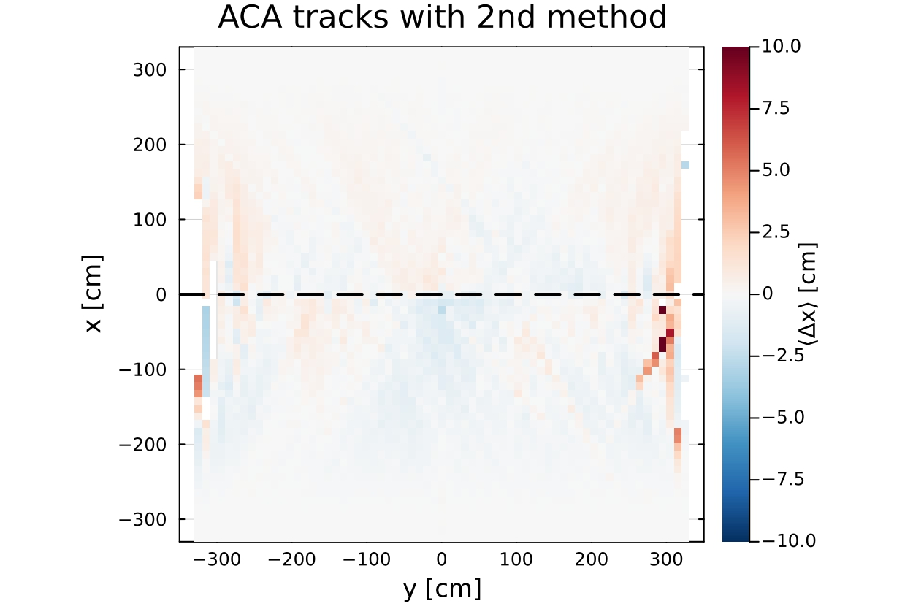
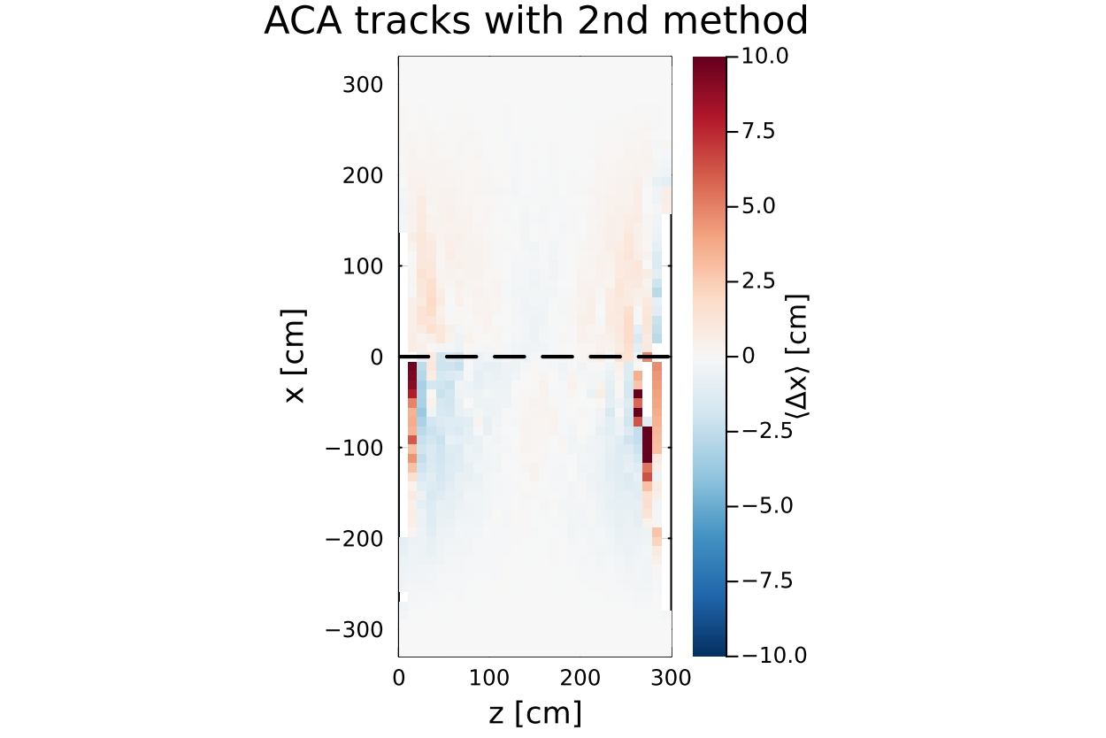
Results for both volumes
Average vertical differences of all the Anode-Cathode-Anode tracks : Δx
Color description :
Red : up shift
Blue : down shift
Color scale is reduced to (-10,10)
→The precise comparison between the two methods is complex but they both show similar trends

Slide 15
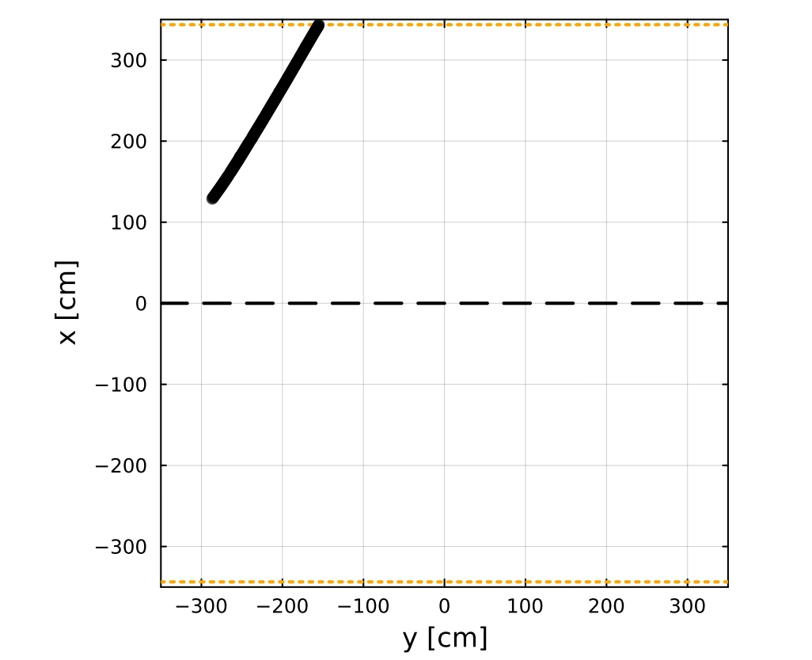
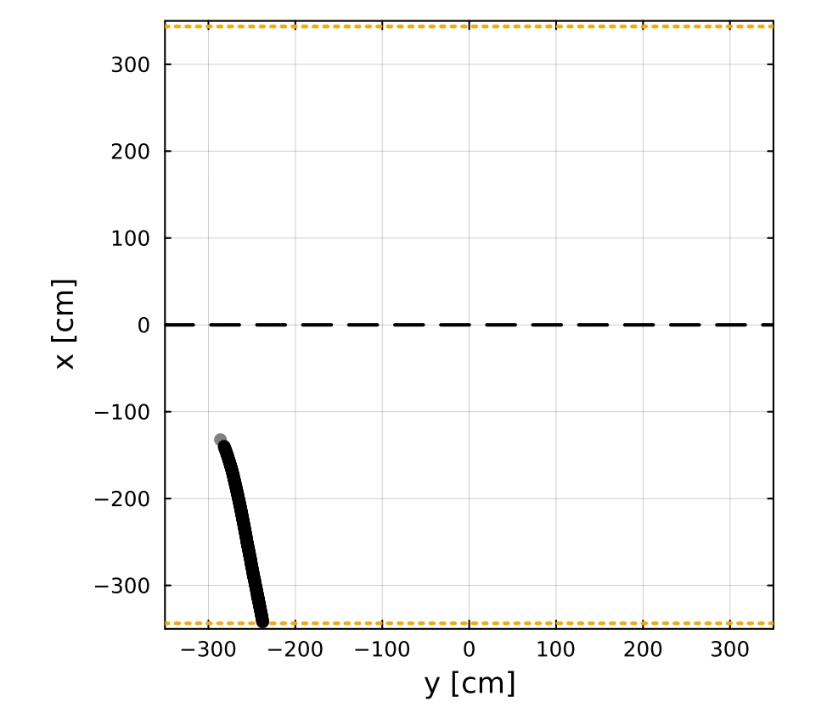
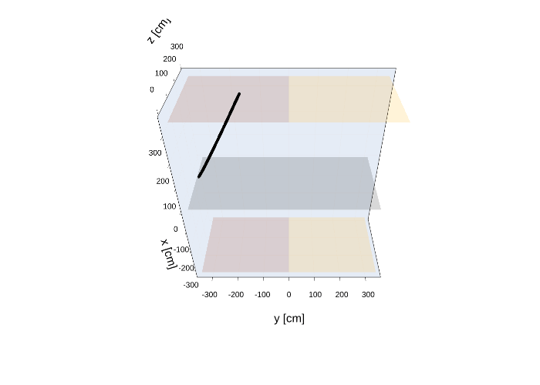
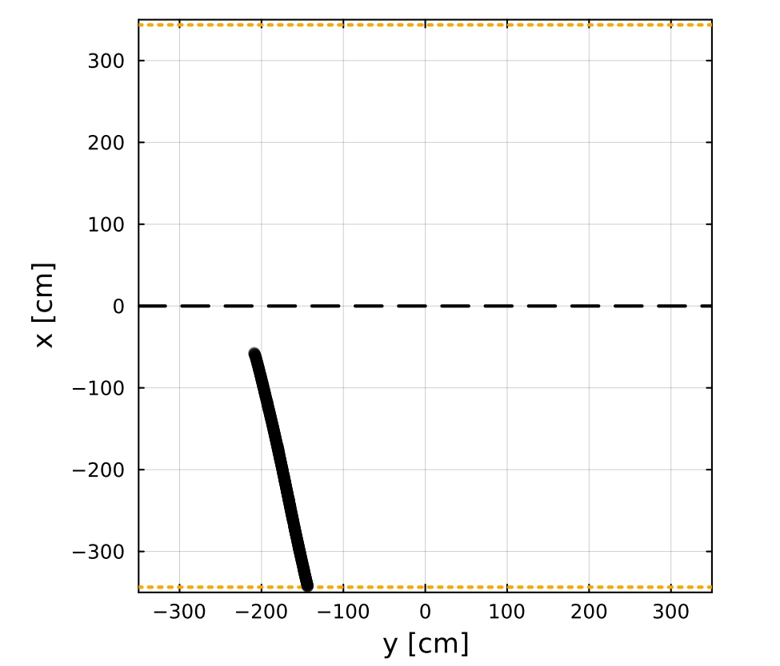
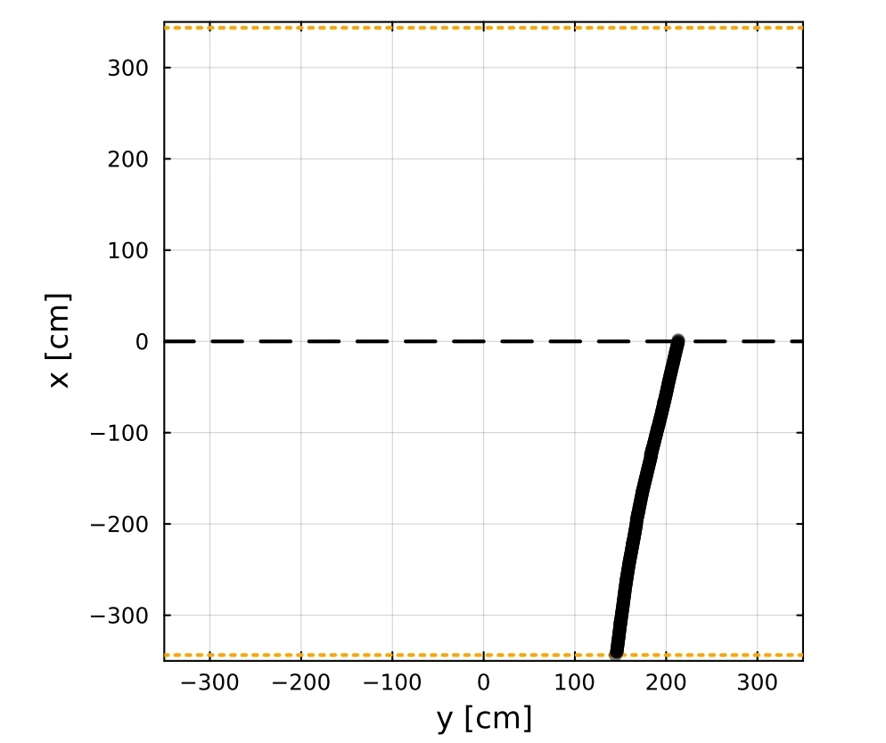
Second selection
Example of selected tracks :
Selection extended to Anode crosser tracks : Go through either the top anode planes, or the bottom anode planes
→The entry point is known
→ Lardon allows us to select them via boolean variables
Additional selection :
The number of hits in the tracks has to be > 30
A sanity check is done to verify if the tracks go through each anode planes
Number of selected tracks : 262 555 (out of 500 000 tracks)

Slide 16
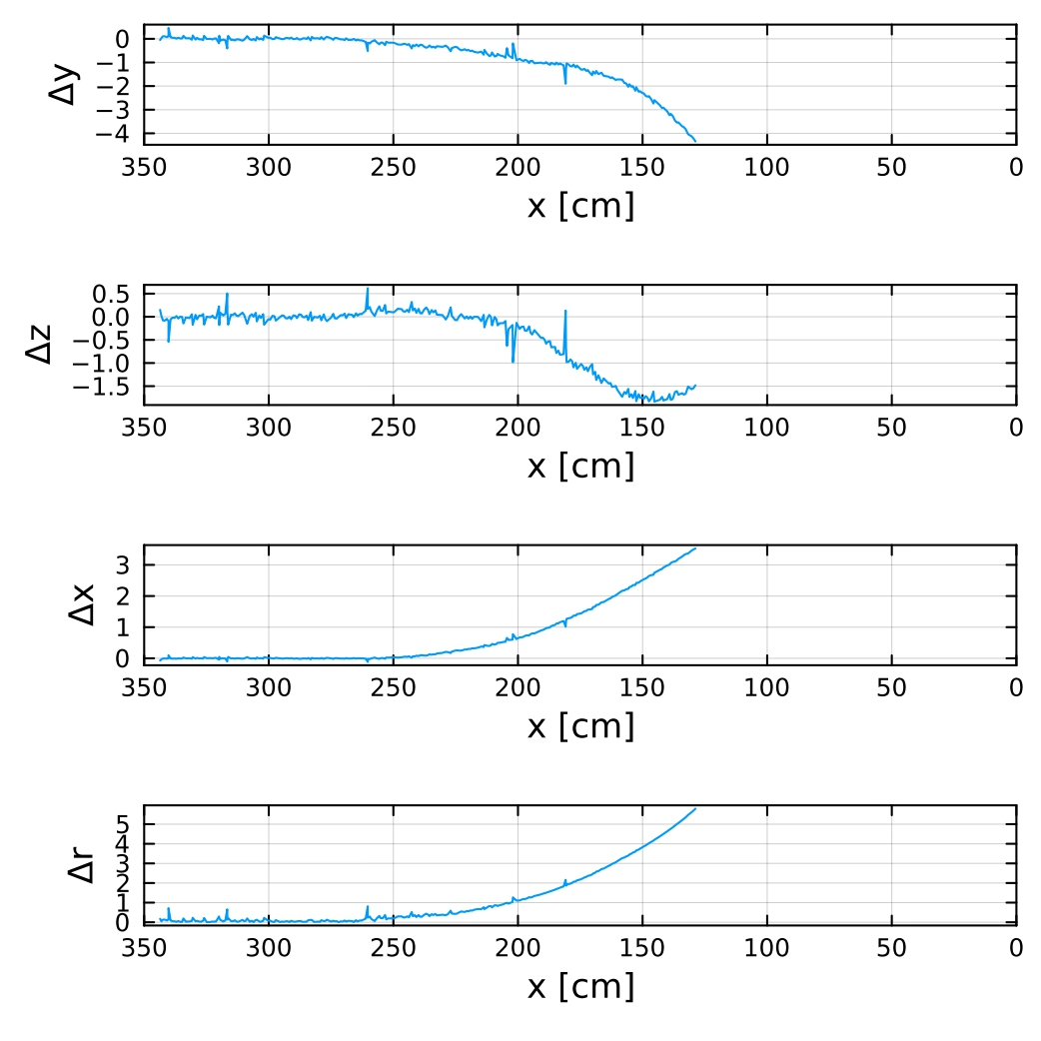
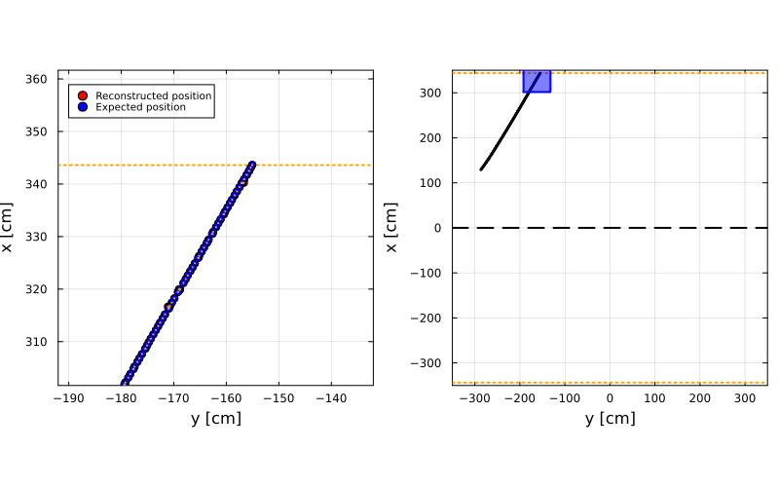
Space charge computation
Top Anodes
Cathode
The same method is applied here :
first 50cm hits selection →Direction fit→Projection→Differences
→ The differences becomes increasingly significant as one moves away from the anode plane

Slide 17
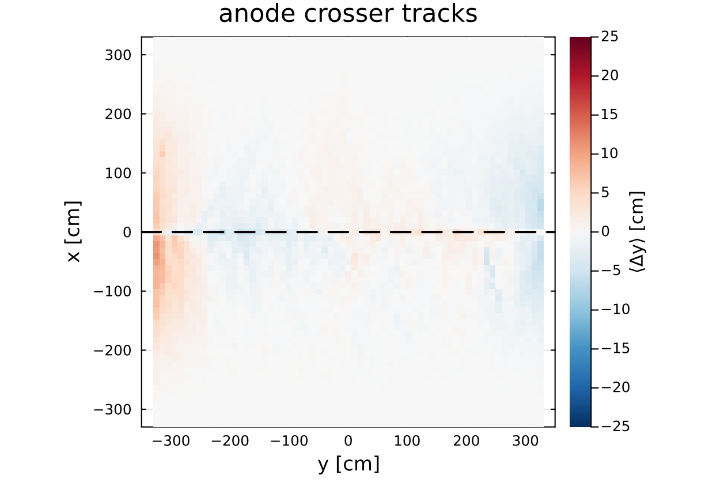
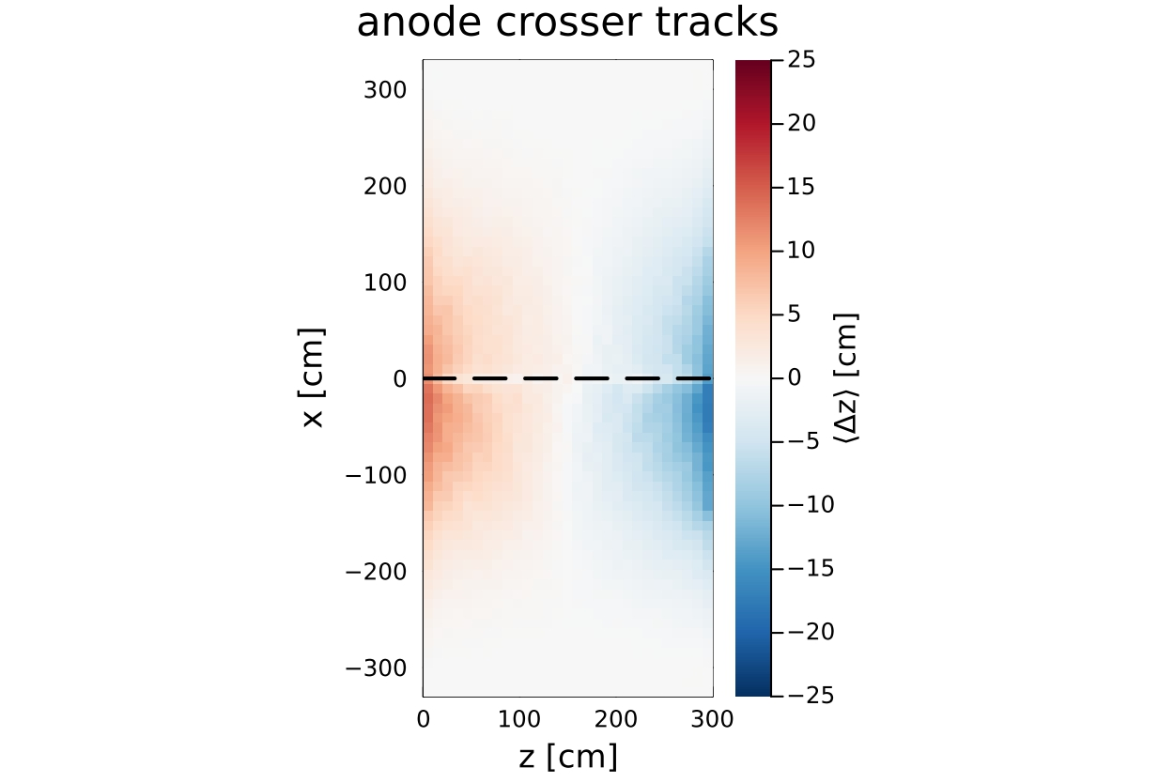
Results for Anode crosser tracks
Average horizontal differences of all the Anode crosser tracks : Δy and Δz
Color description :
Red : right shift
Blue : left shift
→ The differences along the horizontal axis show that the space charge shifts the positions towards the center of the volume
→ As for the Anode-Cathode-Anode tracks, the modification of the electric field lines is more important near the field cage

Slide 18
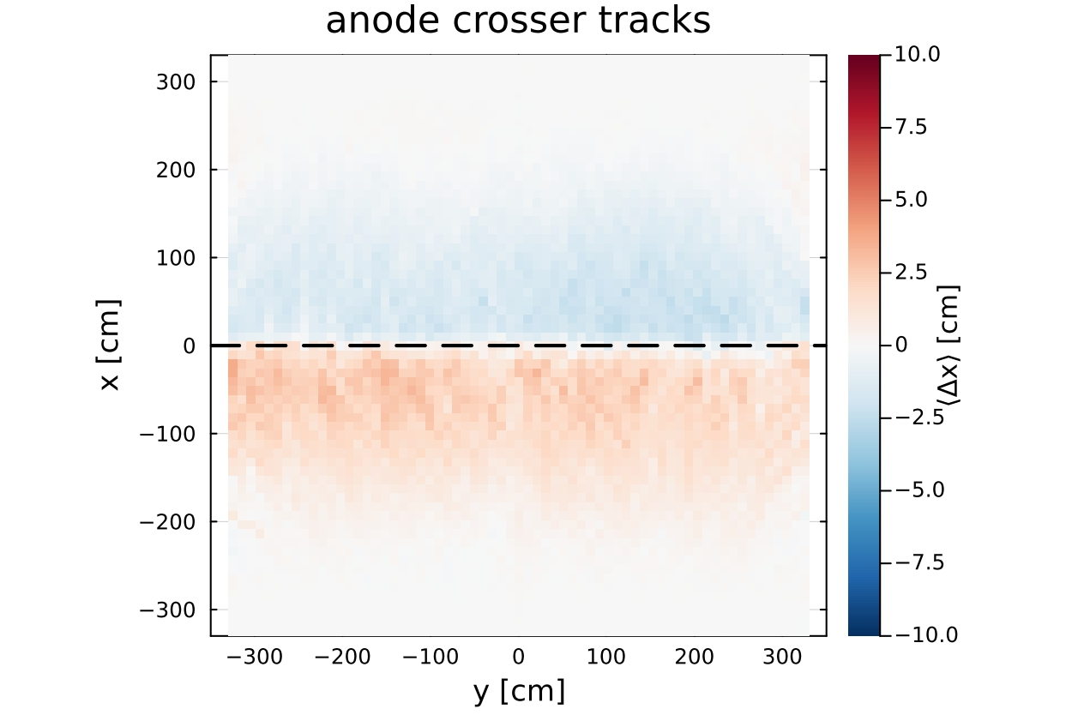
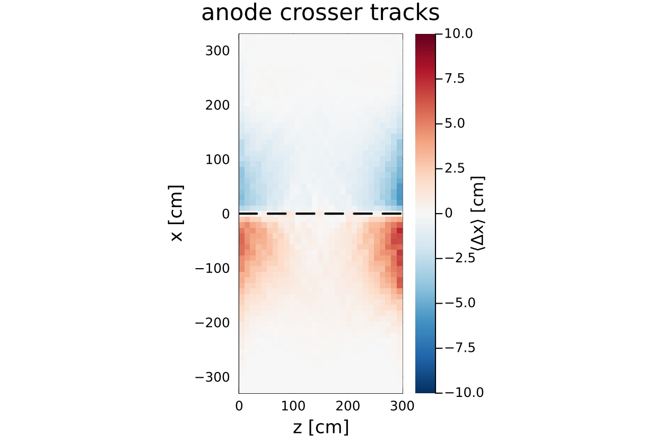
Results for Anode crosser tracks
Average vertical differences of all the Anode crosser tracks : Δx
Color description :
Red : up shift
Blue : down shift
Color scale is reduced to (-10,10)
→ The differences along the vertical axis are less important and show that the space charge shifts the positions towards the cathode plane
→ Unlike the Anode-Cathode-Anode tracks, The space charge effect is uniform and reversed

Slide 19
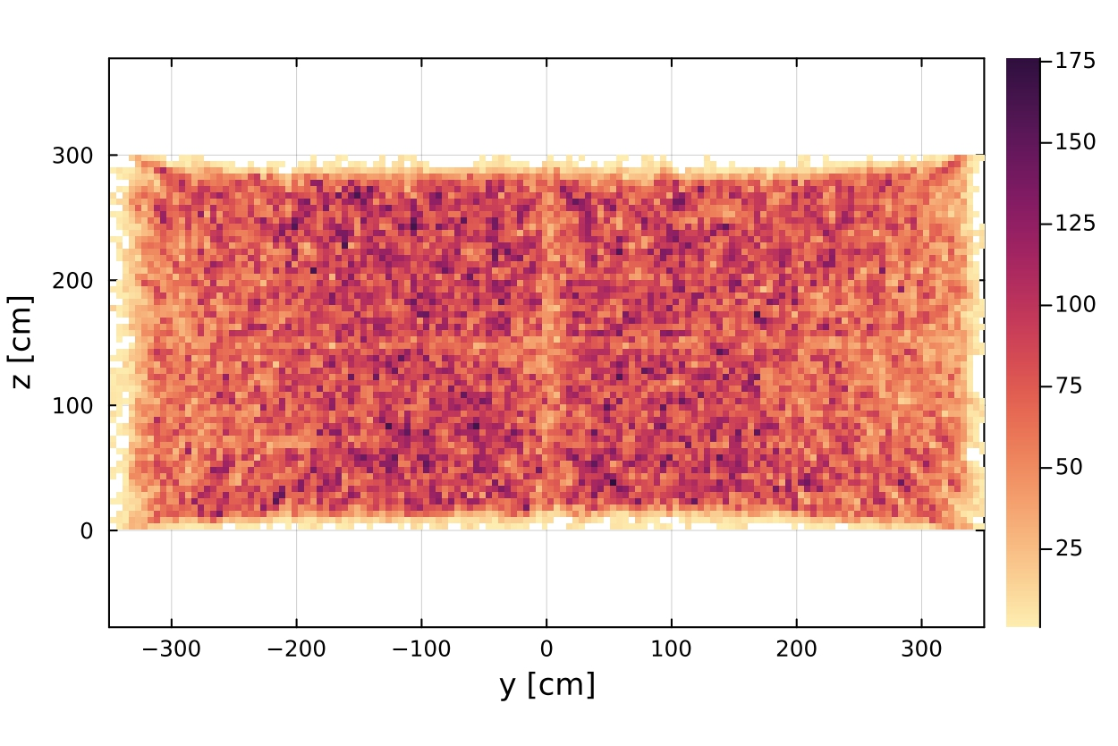
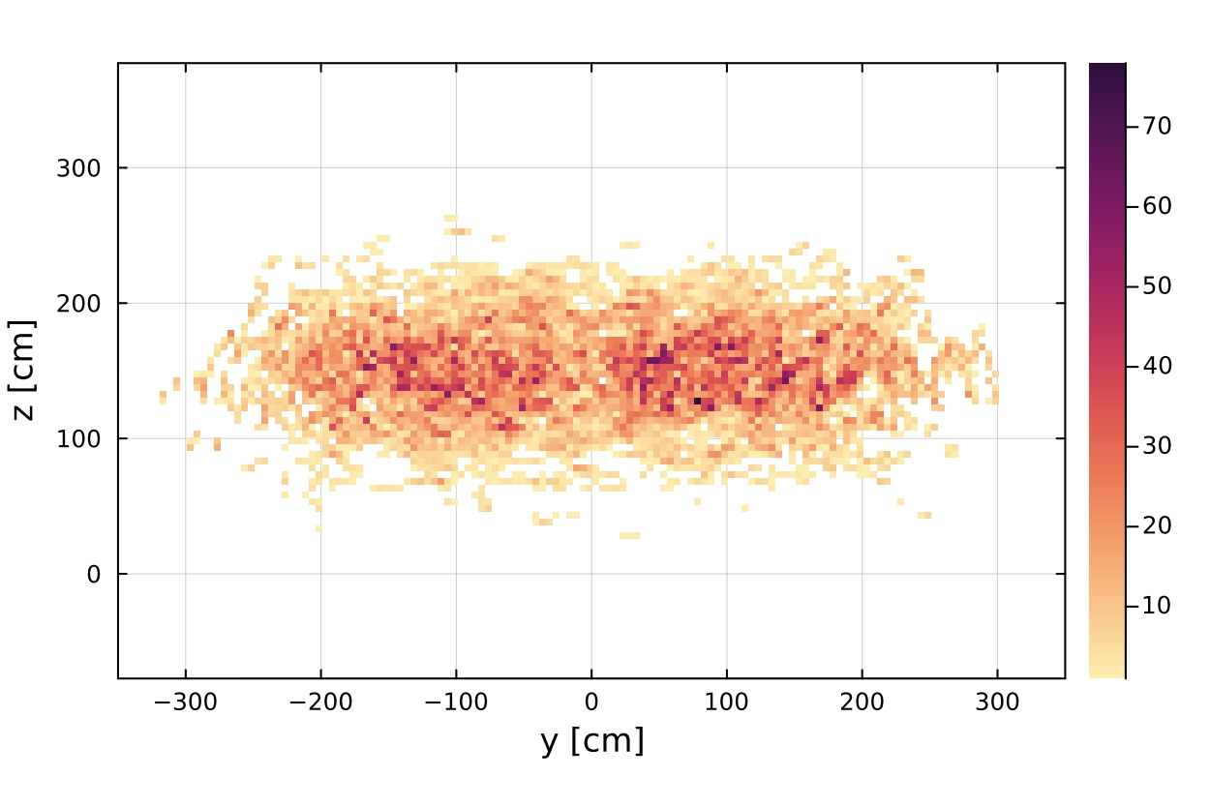
Topography of the selected tracks
Hits of the selected tracks for -25 < x < 25 →hits located around the cathode plane
Anode crosser tracks
Anode-Cathode-Anode tracks
The selected Anode-Cathode-Anode tracks are mostly in the center of the detector
The selected Anode crosser tracks are all over the ZY plane
Different components are involved in the space charge effect →Field cage at the edge of the active volume

Slide 20
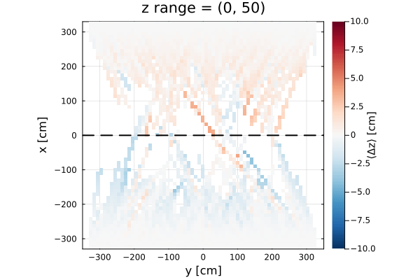
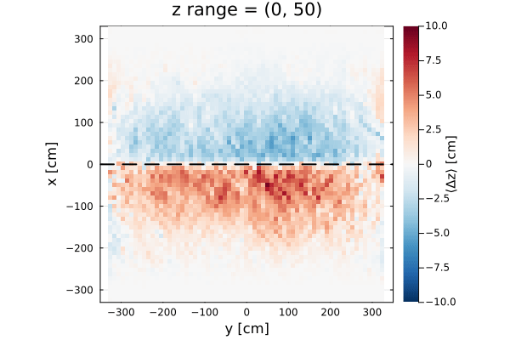
Evolution of the space charge
z range
Anode-Cathode-Anode tracks
Anode crosser tracks
The ranges at the center of the active volume show similar trends between the two selections

Slide 21
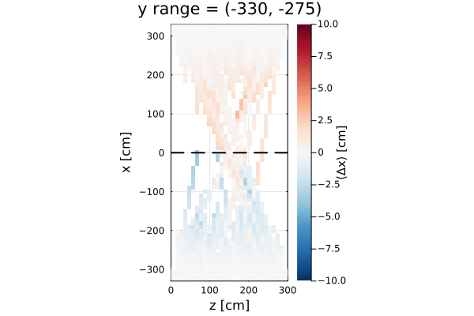
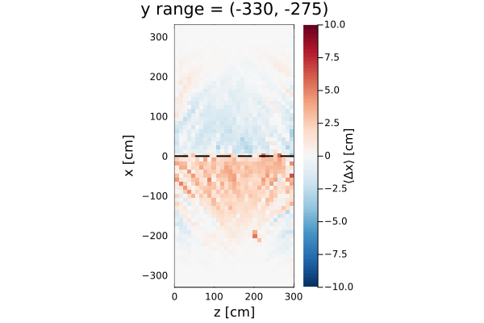
Evolution of the space charge
y range
Anode-Cathode-Anode tracks
Anode crosser tracks
The ranges at the center of the active volume show similar tendencies between the two selections

Slide 22
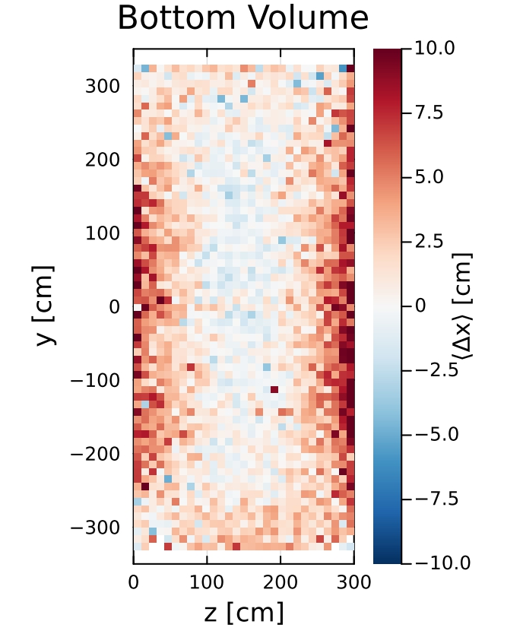
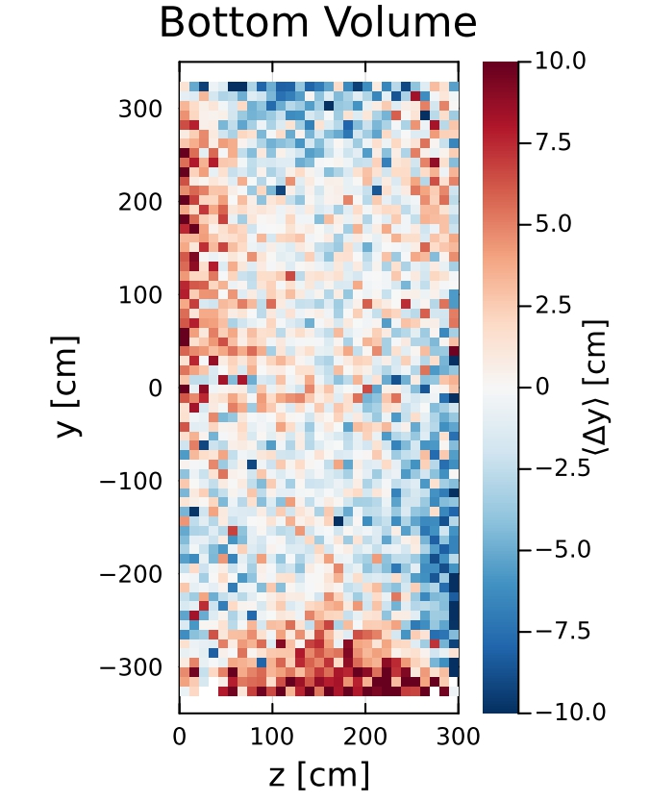
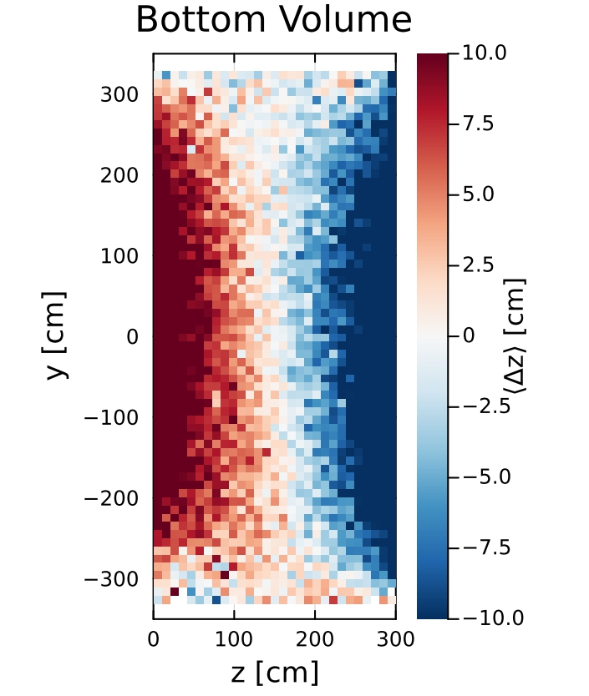
Space charge on the cathode plane
Positive Δx at the edges →up shift → Anode crosser tracks
Negative Δx at the center → down shift →Anode-Cathode-Anode tracks
Both Δy and Δz show shift toward the center of the volume

Slide 23
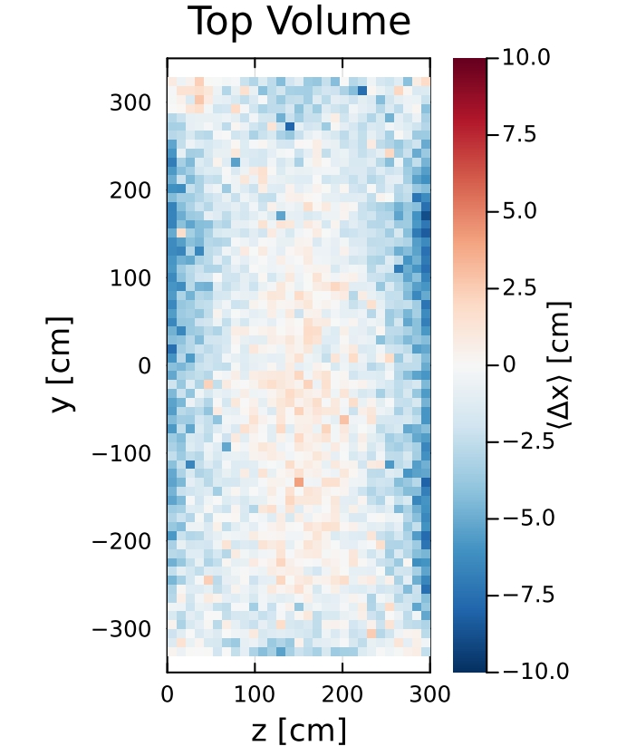
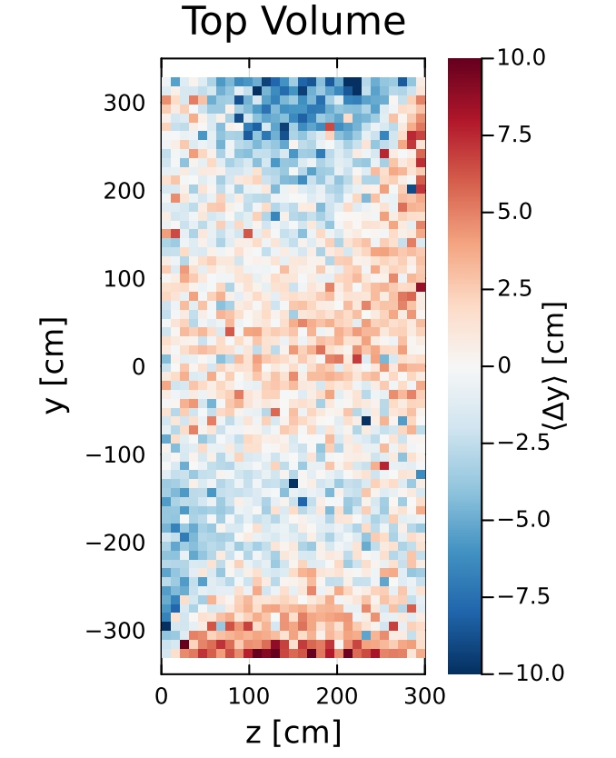
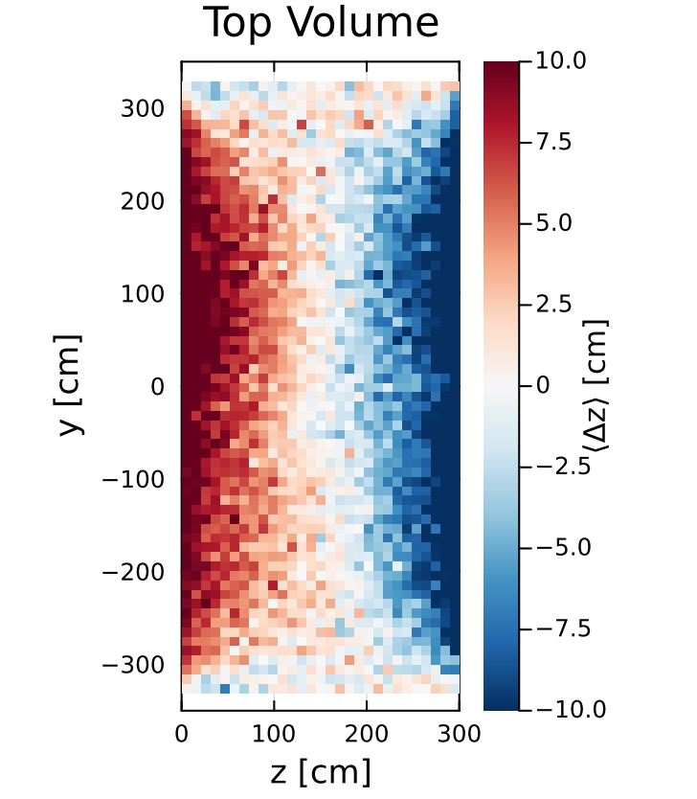
Space charge on the cathode plane
Negative Δx at the edges →down shift → Anode crosser tracks
Positive Δx at the center → up shift →Anode-Cathode-Anode tracks
Both Δy and Δz show shift toward the center of the volume

Slide 24
Conclusion and perspective
Cosmic muon tracks allowed us to do a first characterization of space charge effect in PDVD
Anode-Cathode-Anode tracks show space charge effect pushing horizontally the hits towards the center of the active volume
The vertical differences are less uniform and smaller
→More statistics of Anode-Cathode-Anode tracks might help us to characterize better the space charge effect
The study has been then extended to Anode crosser tracks
Same trend in the horizontal axis
Some regions show different trends compared to Anode-Cathode-Cathode tracks (under investigation)
→By scanning different regions along the horizontal axis, the two cases show similar results
To improve our study, we plan to :
Remove the stopping muons by looking at the dQ/dx (only affect the top volume)
Matching light with the charge to have a better spatial resolution

