Slide 1

Are you ready to speak English? I believe in you.
No! Mercy! Mercy!

Slide 2
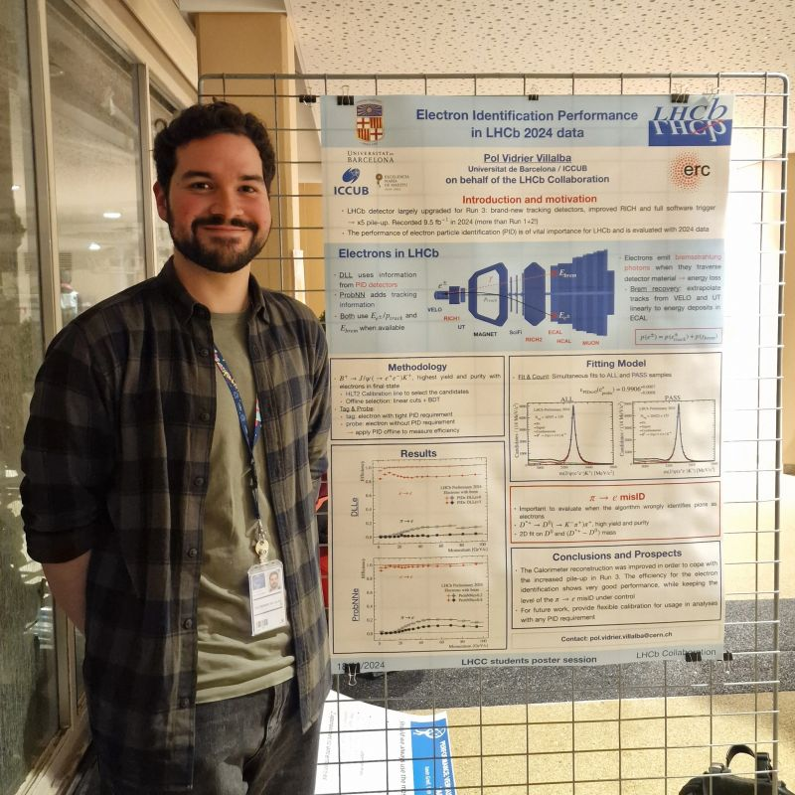
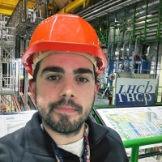
Participants of the video conference
2026-03-12
Students from:
Geneva (Switzerland)
Colmar (France)
Moderators at CERN:
Albert Lopez Huertas (LHCb)
Emilio Rodriguez Fernandez (LHCb)

Slide 3
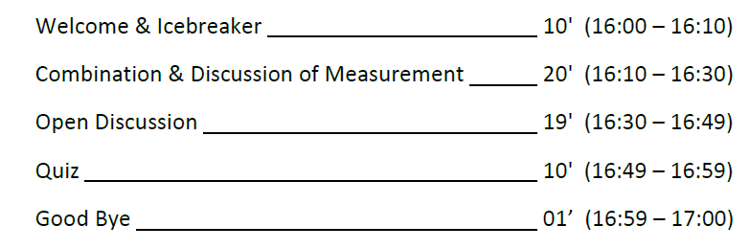
Outlines of the video conference

Slide 4
Let’s test your pronunciation.

Slide 5
What does LHC mean?
L
H
C

Slide 6
What does LHC mean?
Large
Hadron
Collider

Slide 7
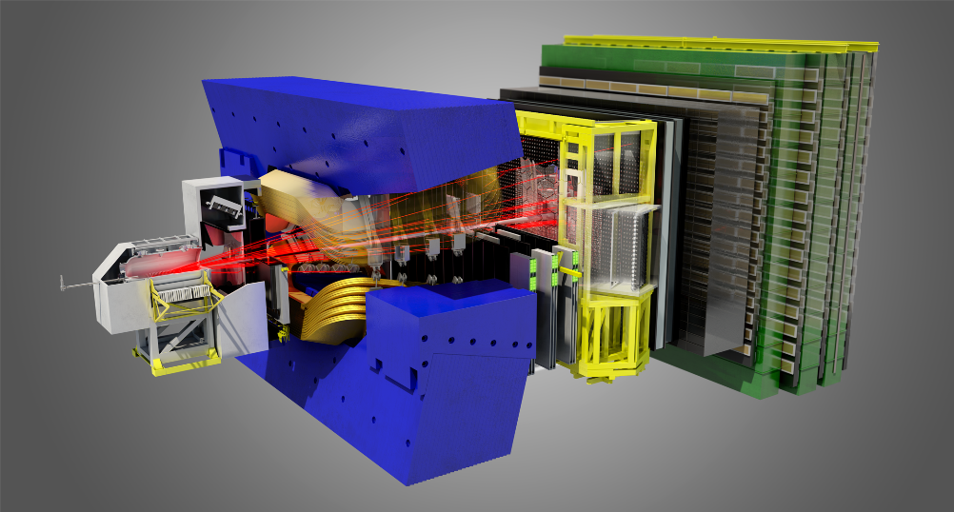
What is the name of this detector?

Slide 8
What is the name of this detector?
LHCb

Slide 9
Can you pronounce the name of these particles?
Electron
Muon
Lepton
Quark
Kaon
Pion
Proton
Neutron
Meson

Slide 10
Can you pronounce these technical words?
Calorimeter
Tracker
Vertex Locator (VELO)
Background
Signal

Slide 11
Do you like multiple choice questions?

Slide 12
The proton beams …….. in the center of the LHCb detector.
Crash
Collide
Merge
Kiss

Slide 13
The proton beams …….. in the center of the LHCb detector.
Crash
Collide
Merge
Kiss

Slide 14
The D⁰ meson …….. Into one kaon and one pion.
Merges
Splits
Breaks
Decays

Slide 15
The D⁰ meson …….. Into one kaon and one pion.
Merges
Splits
Breaks
Decays

Slide 16
What is the mass of the D⁰ meson?
0.511 MeV/c²
1 860 MeV/c²
91 000 MeV/c²
14 000 000 MeV/c²

Slide 17
What is the mass of the D⁰ meson?
0.511 MeV/c²
1 860 MeV/c²
91 000 MeV/c²
14 000 000 MeV/c²

Slide 18
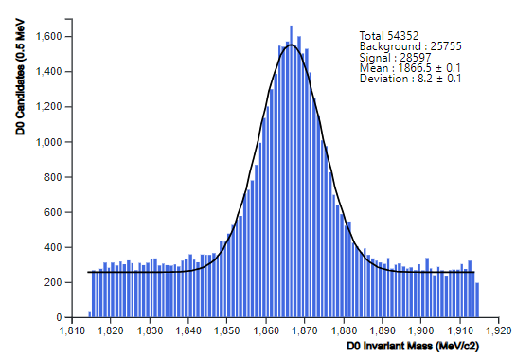
This is the …….. what we get.
drawing
graphics
plot
Smurf
Jul

Slide 19
This is the …….. what we get.
drawing
graphics
plot
Smurf
Jul

Slide 20
For getting an accurate measure, I need a lot of …………
luck
Smurfs
events
steroids
statistics

Slide 21
For getting an accurate measure, I need a lot of …………
luck
Smurfs
events
steroids
statistics

Slide 22
Are you able to describe and explain a plot?

Slide 23
Invariant mass distribution of the D⁰ meson candidates
Signal
Background
What can cause the background in the invariant mass distributions?

Slide 24
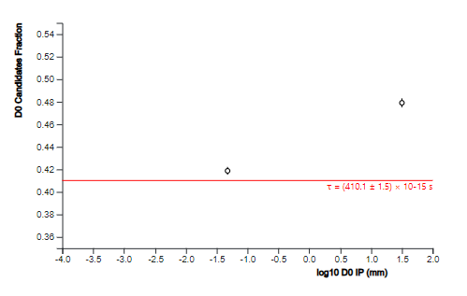

Life-time of the D⁰ meson
D⁰ life-time in ${10}^{−18}s$
world average value
Did the 2 measurements of lifetime agree with the world average value?

Slide 25
Have you any questions for the CERN researchers ?

