Slide 1

Hunting for the dark contents of globular clusters with stellar kinematics and pulsar timing
Andrés Bañares Hernández

Slide 2
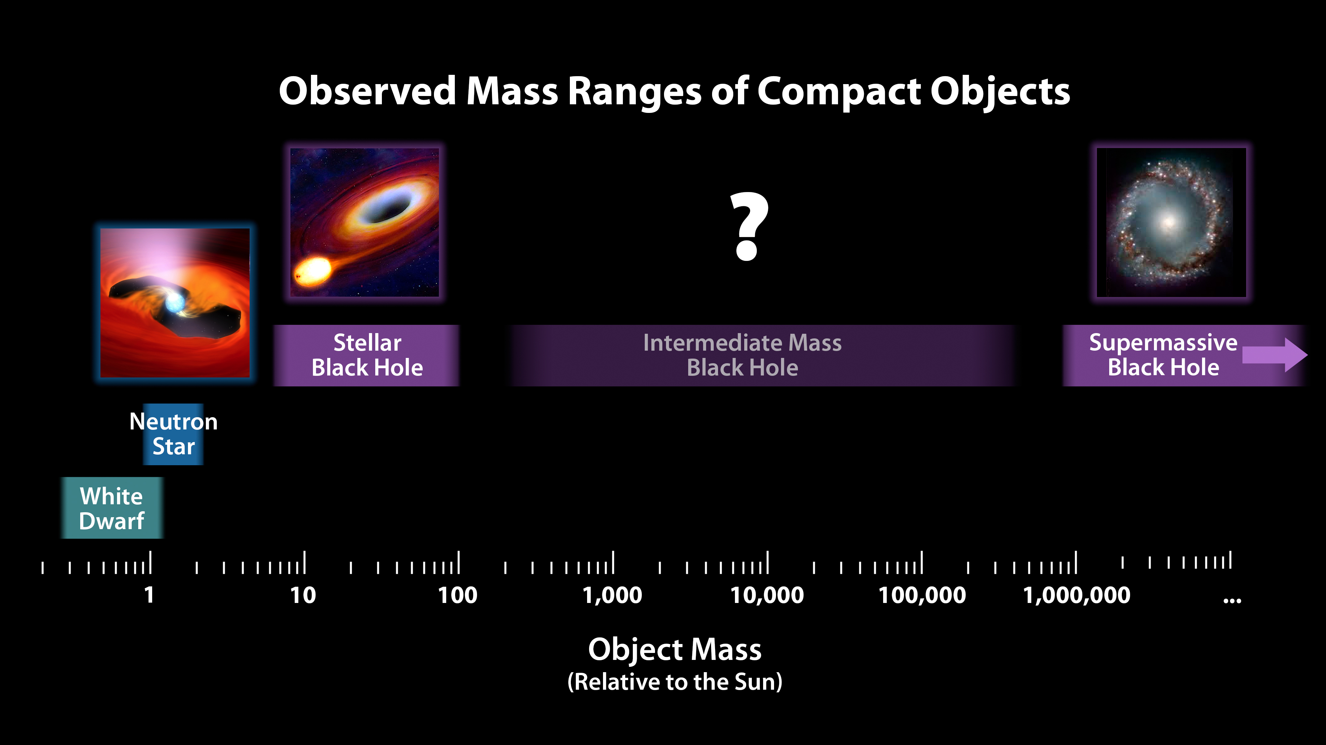
Intermediate-mass black holes (IMBHs)
Credit: NASA /JPL-Caltech

Slide 3
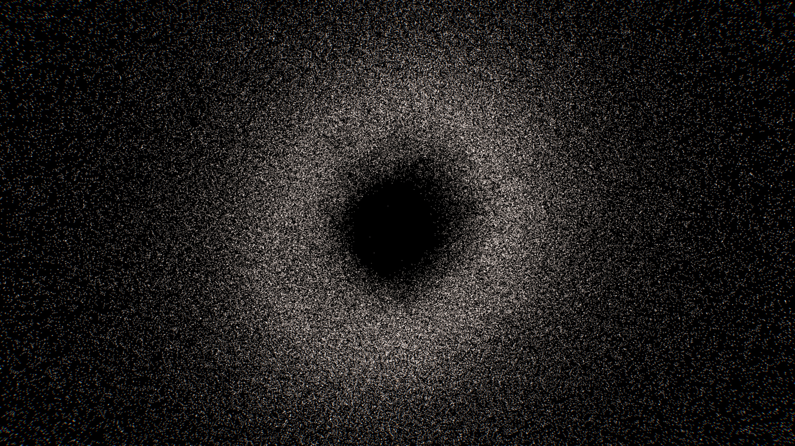
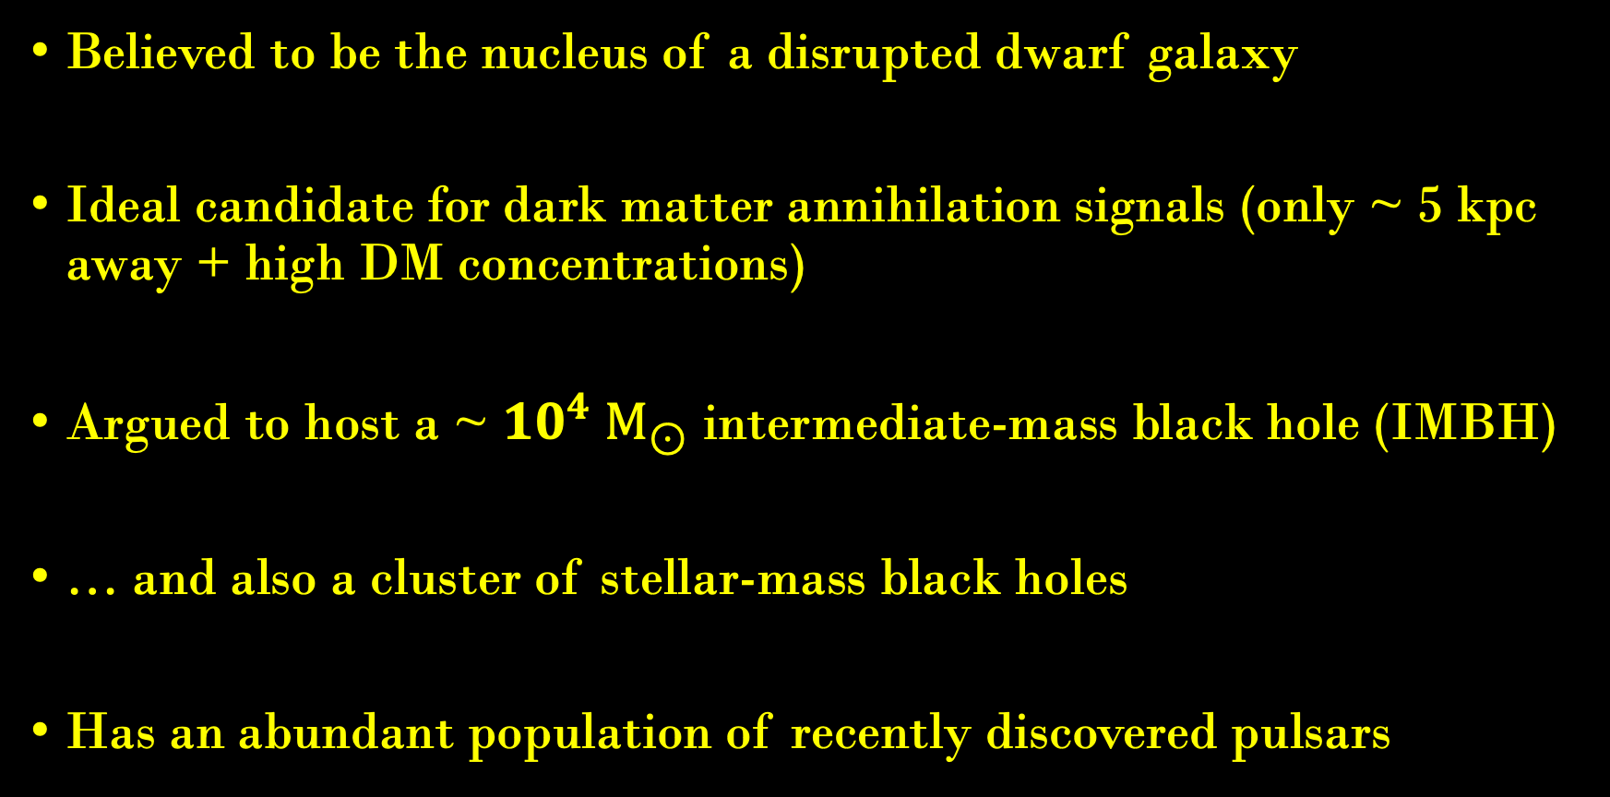
Why is ω Cen interesting?
Image credit: ESA/Gaia/DPAC (CC BY-SA 3.0 IGO)
Believed to be the nucleus of a disrupted dwarf galaxy
Ideal candidate for dark matter annihilation signals (only ~ 5 kpc away + high DM concentrations)
Argued to host a ~ ${10}^{4} M_{⊙}$ intermediate-mass black hole (IMBH)
… and also a cluster of stellar-mass black holes
Has an abundant population of recently discovered pulsars

Slide 4
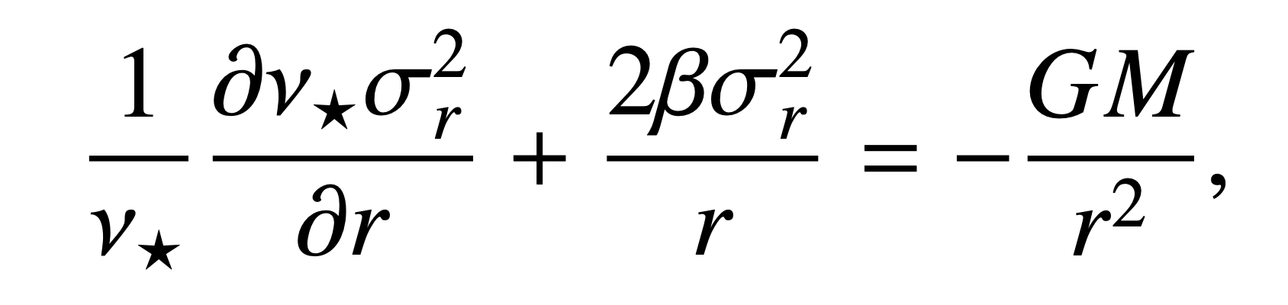
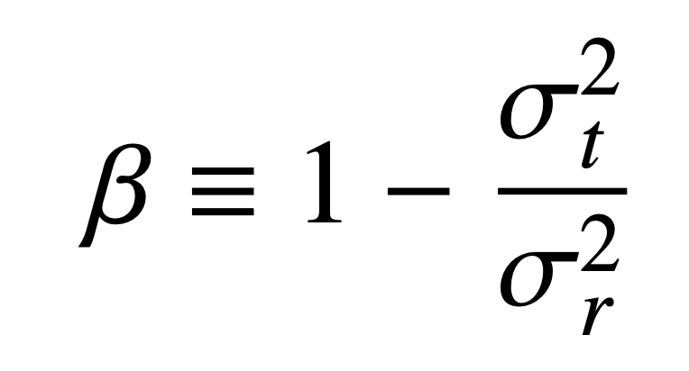
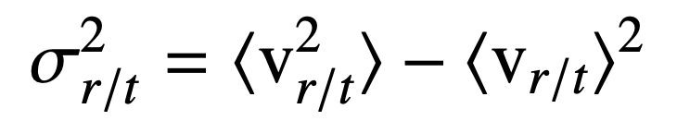
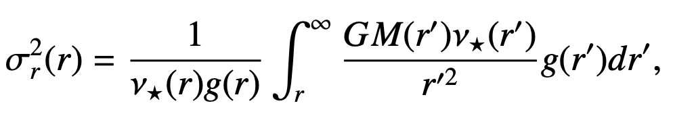
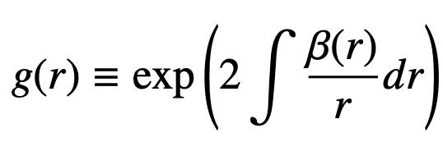
Mass contents from stellar kinematics
Stellar velocity dispersions trace mass contents from the Jeans equations:
where:
,
Solve for the radial velocity dispersion for a given mass profile:

Slide 5
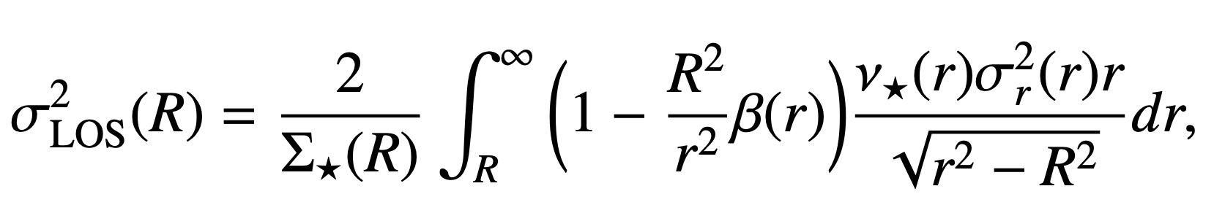
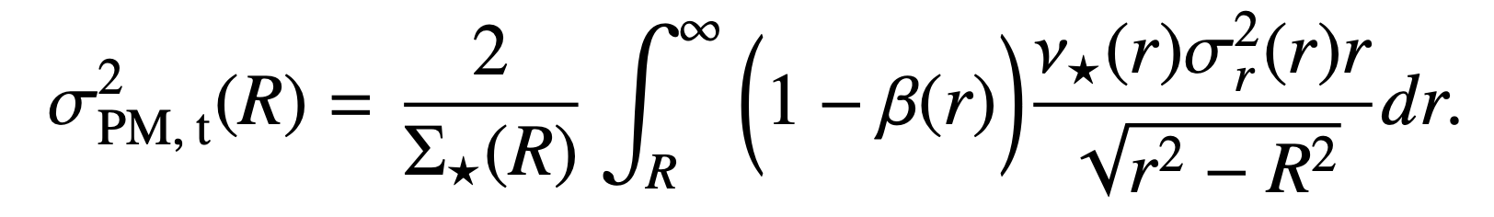
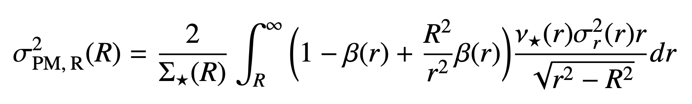
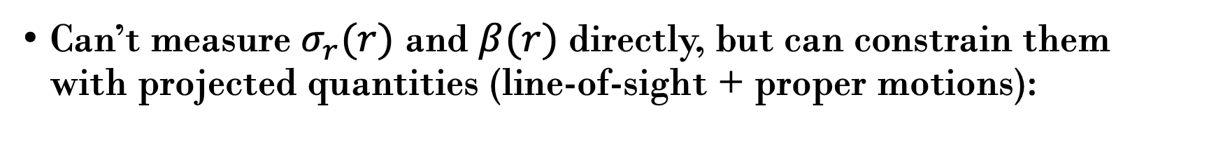
Stellar kinematics observables (LOS + PMs)
Can’t measure $σ_{r}(r)$ and $β(r)$ directly, but can constrain them with projected quantities (line-of-sight + proper motions):

Slide 6
The mass/density - anisotropy degeneracy
Full consideration of observables is important to avoid degeneracies with mass models
Read & Steger (2017)
MNRAS 471, 4541–4558
How to break the density-anisotropy degeneracy
in spherical stellar systems
Looking at higher velocity moments helps (e.g. GravSphere2)
Bañares-Hernández, Read & Júlio (2026)
A&A 705, A212
GravSphere2: A higher order Jeans method
for mass modeling spherical stellar systems

Slide 7
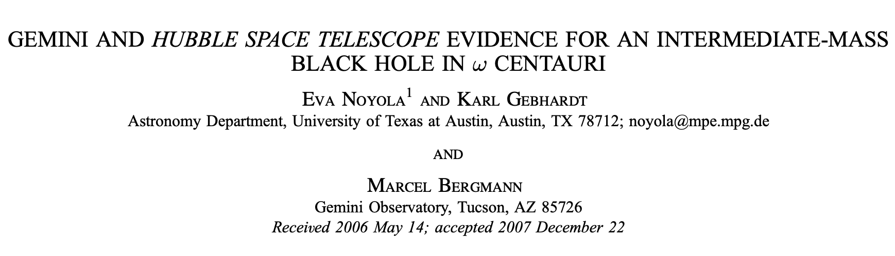

IMBH discovered in ω Cen?
IMBH can produce a steep rise in central velocity dispersions
Susceptibility to issues such as the ‘mass-anisotropy degeneracy’
Concentrated cluster of remnants can produce similar effects

Slide 8
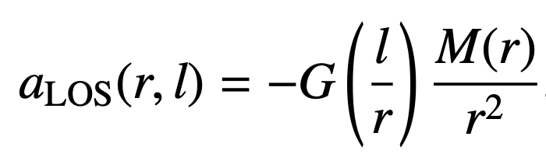
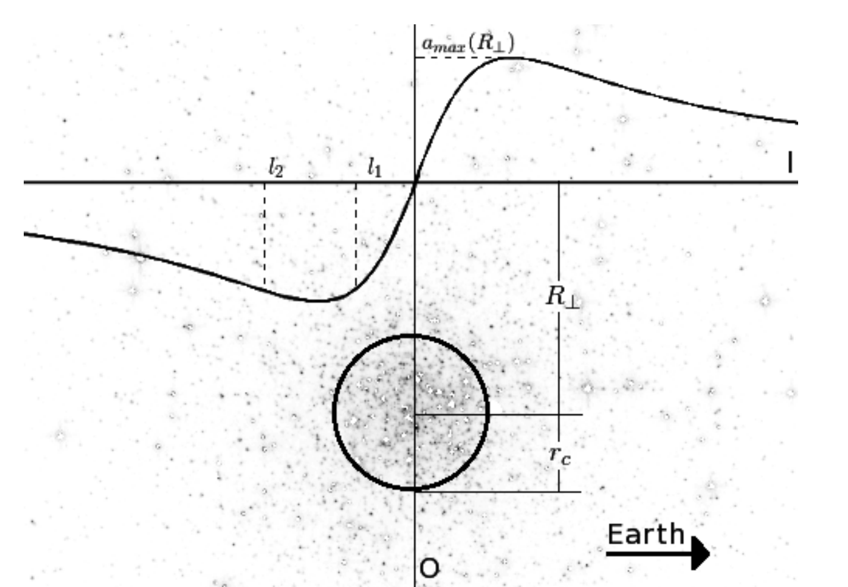
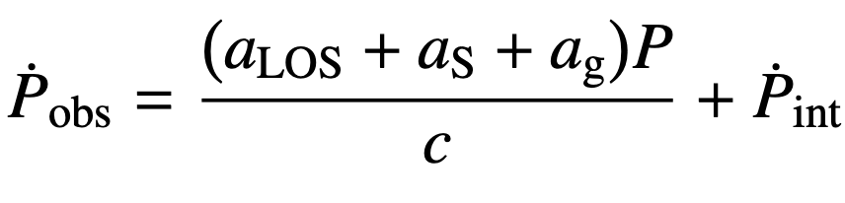
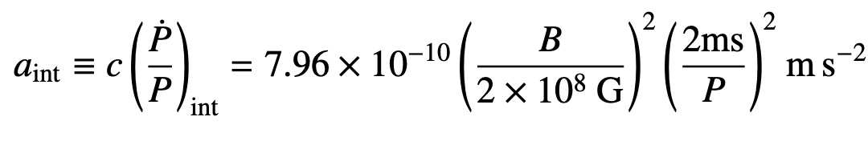
Adding pulsar timing to constrain mass models
Doppler-induced changes in apparent period derivatives trace LOS acceleration due to GC potential
Intrinsic spin-down can be modeled as magnetic dipole emission:
Image credit: Prager et al. 2017

Slide 9
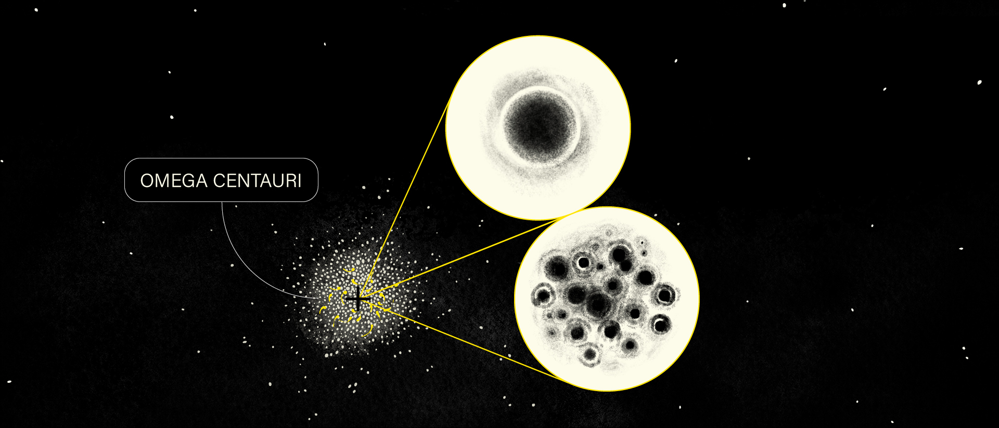
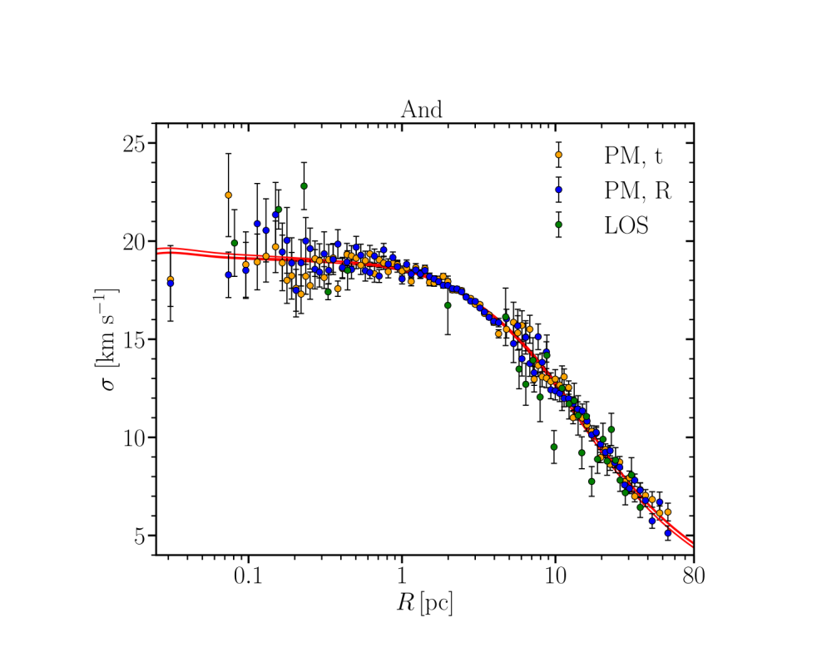
Credit: Ève Barlier
An IMBH of ~ 10,000 solar masses…
Velocity dispersion [km/s]
Distance from center [pc]
… or a cluster of ~ 100,000 black holes?

Slide 10
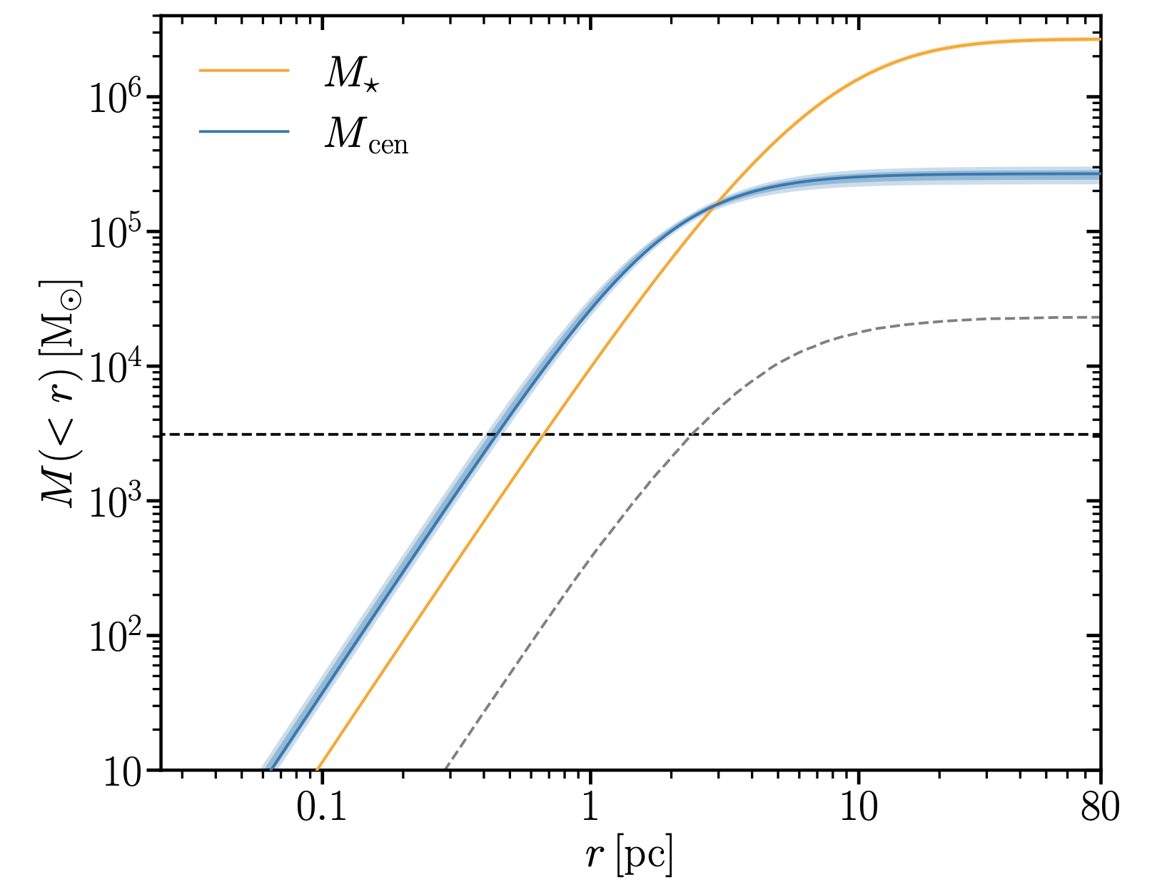
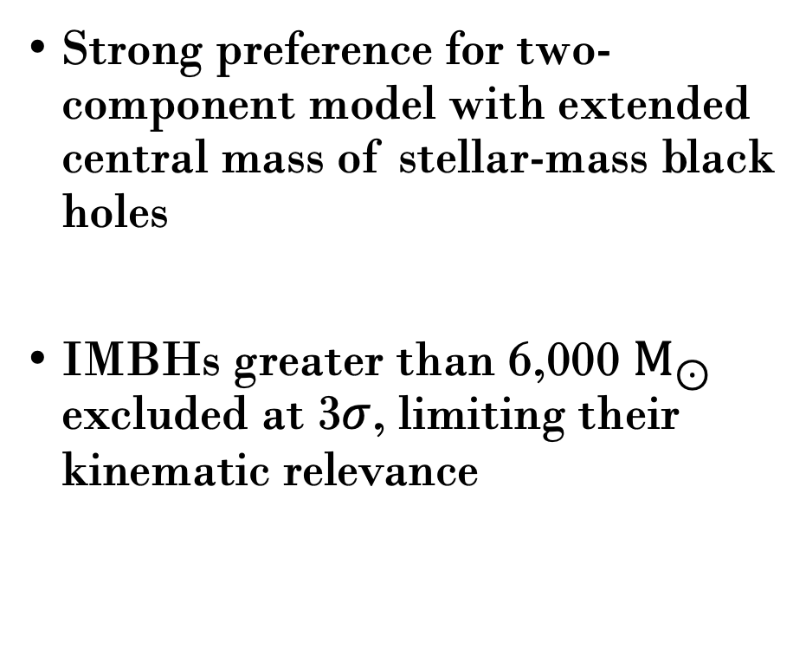
Stellar-mass black holes over an IMBH
Strong preference for two-component model with extended central mass of stellar-mass black holes
IMBHs greater than 6,000 $M_{⊙}$ excluded at 3$σ$, limiting their kinematic relevance
Nested sampling fit

Slide 11
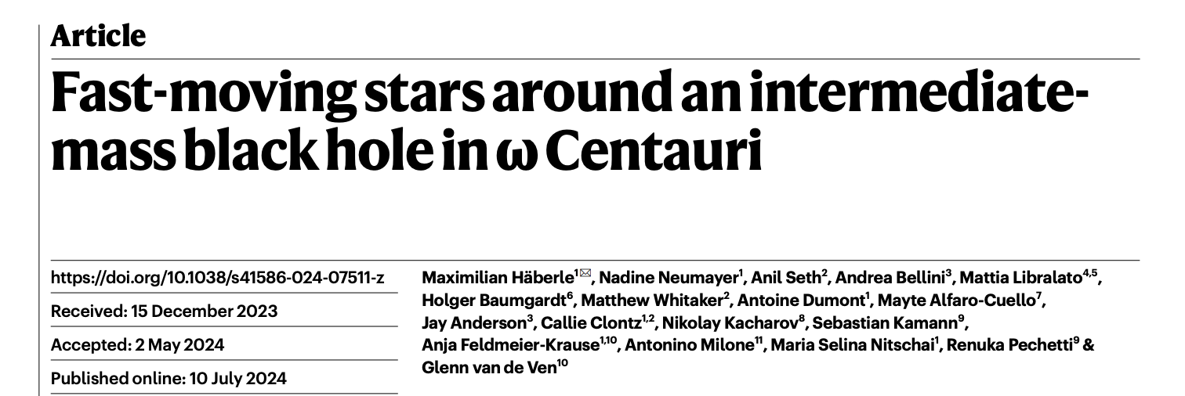

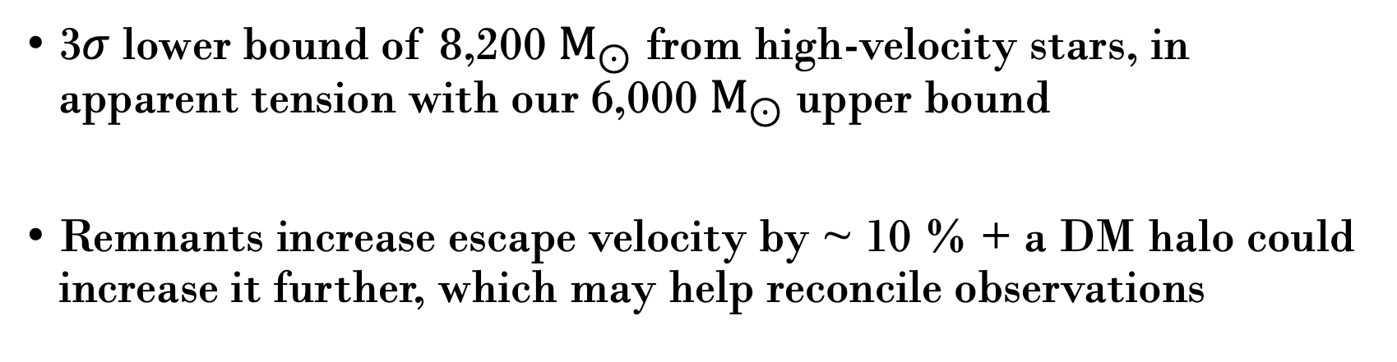
IMBH discovered in ω Cen: a comeback
3$σ$ lower bound of 8,200 $M_{⊙}$ from high-velocity stars, in apparent tension with our 6,000 $M_{⊙}$upper bound
Remnants increase escape velocity by ~ 10 % + a DM halo could increase it further, which may help reconcile observations

Slide 12
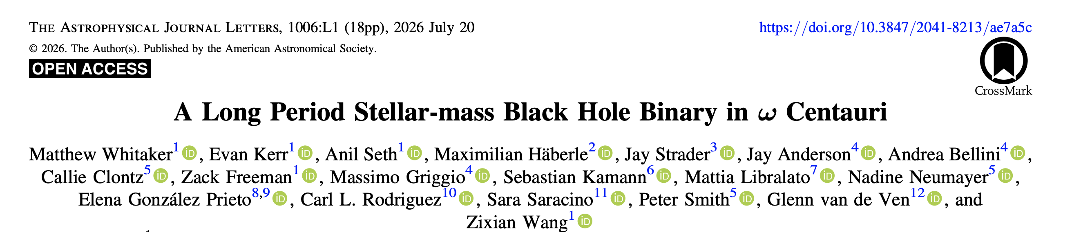
Stellar-mass black hole found in ω Cen
Evidence of the scenario proposed in Bañares-Hernández + 25
First astrometric detection, and third kinematically confirmed black hole in a globular cluster

Slide 13
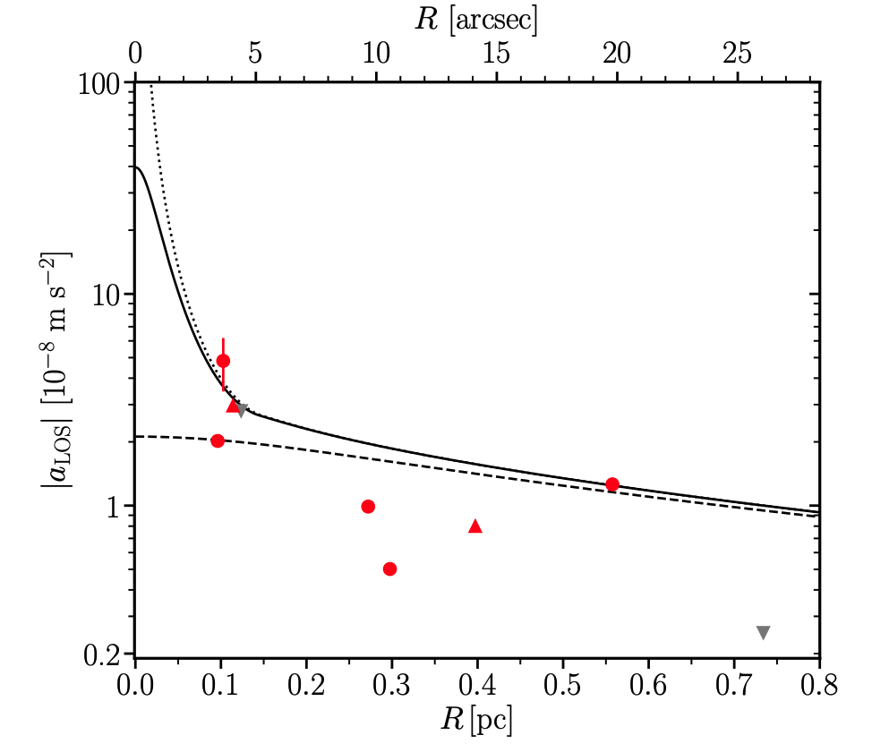
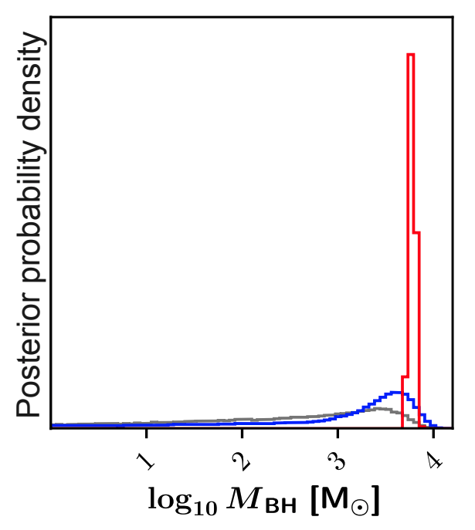
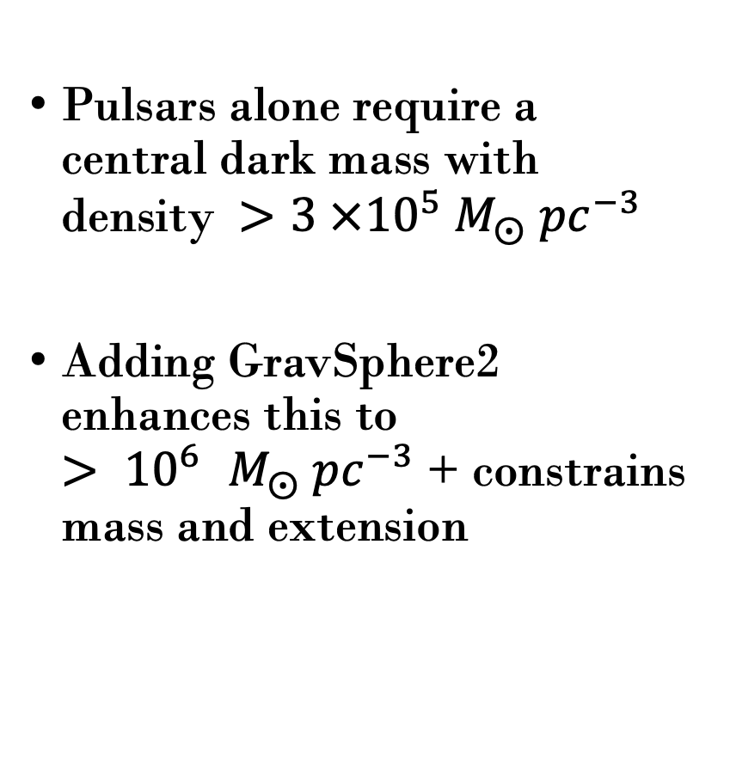
Evidence for an IMBH in M62! (revised paper in prep., Science)
Pulsars alone require a central dark mass with density $>3 ×{10}^{5} M_{⨀}{ pc}^{−3}$
Adding GravSphere2 enhances this to ${> 10}^{6} M_{⨀}{ pc}^{−3}$ + constrains mass and extension

Slide 14
Conclusions
Combining pulsars with stellar kinematics is a promising new way of constraining mass models
Applied to ω Cen, we found evidence that it harbors a cluster of stellar-mass black holes and placed a strong upper bound on an IMBH
Applied to M62, we found a strong IMBH candidate!

Slide 15
Comments / future directions
Can we detect DM dynamically in ω Cen?
Resolving the tension in ω Cen: a lower-mass IMBH?
Data are growing fast, both for ω Cen and many globular clusters
Where are the IMBHs? Are M62 and ω Cen special?

Slide 16
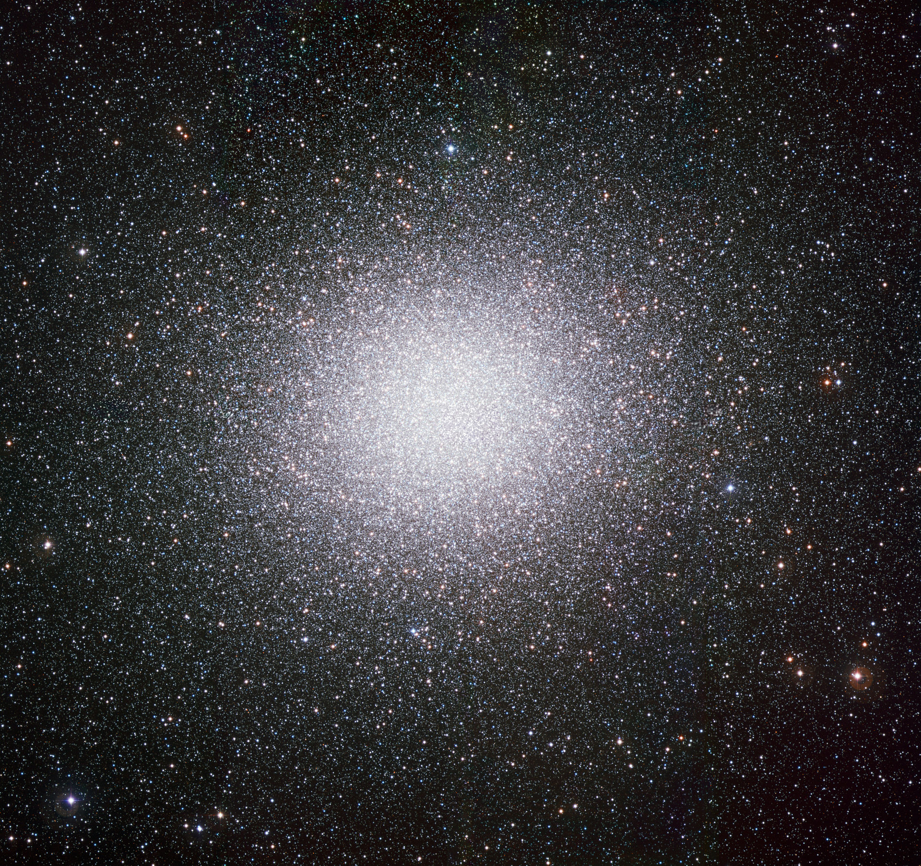
Thank you!
Stay tuned…
Image credit: ESO (CC BY 4.0)

Slide 17
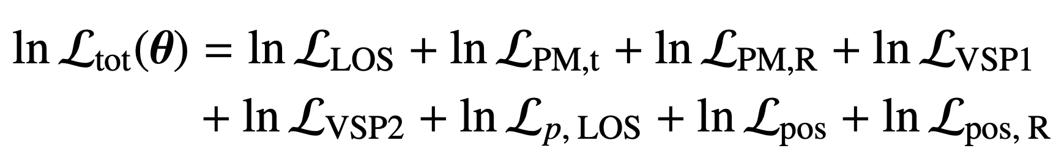
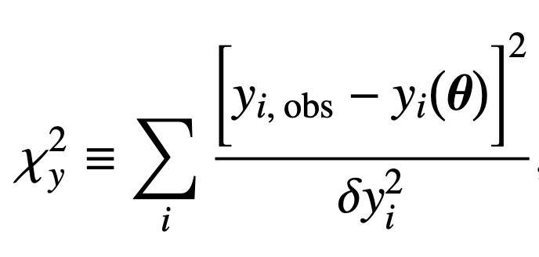
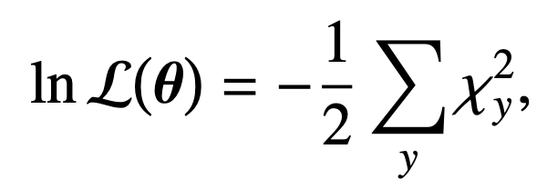
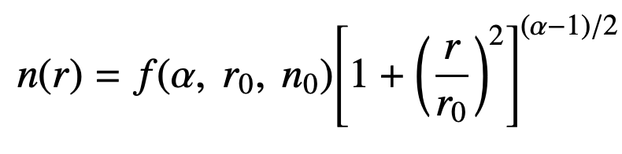
Combining stellar kinematics + pulsar timing
Included all data self-consistently into the likelihood:
For stellar kinematics and LOS accelerations:
For positional likelihoods of pulsars:

Slide 18
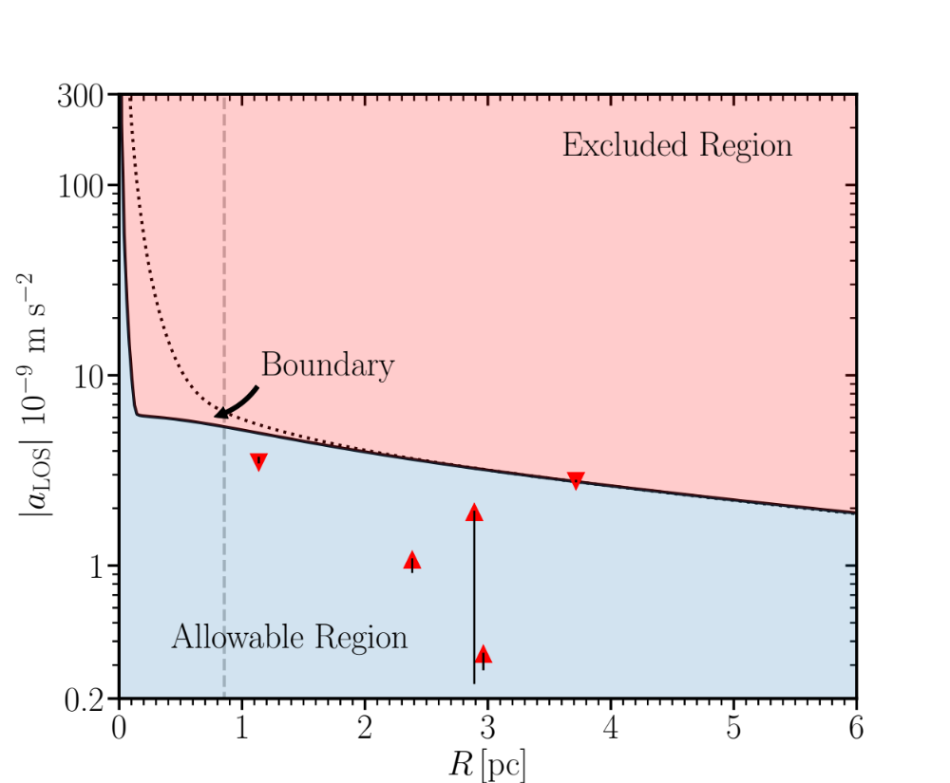
Pulsar accelerations
Favor ~ 20 % more massive and extended central mass than stellar kinematics alone
Extremal central pulsar accelerations are IMBH ‘smoking gun’ signatures
These are not favored by our analysis (except for a small IMBH very close to the center)

Slide 19
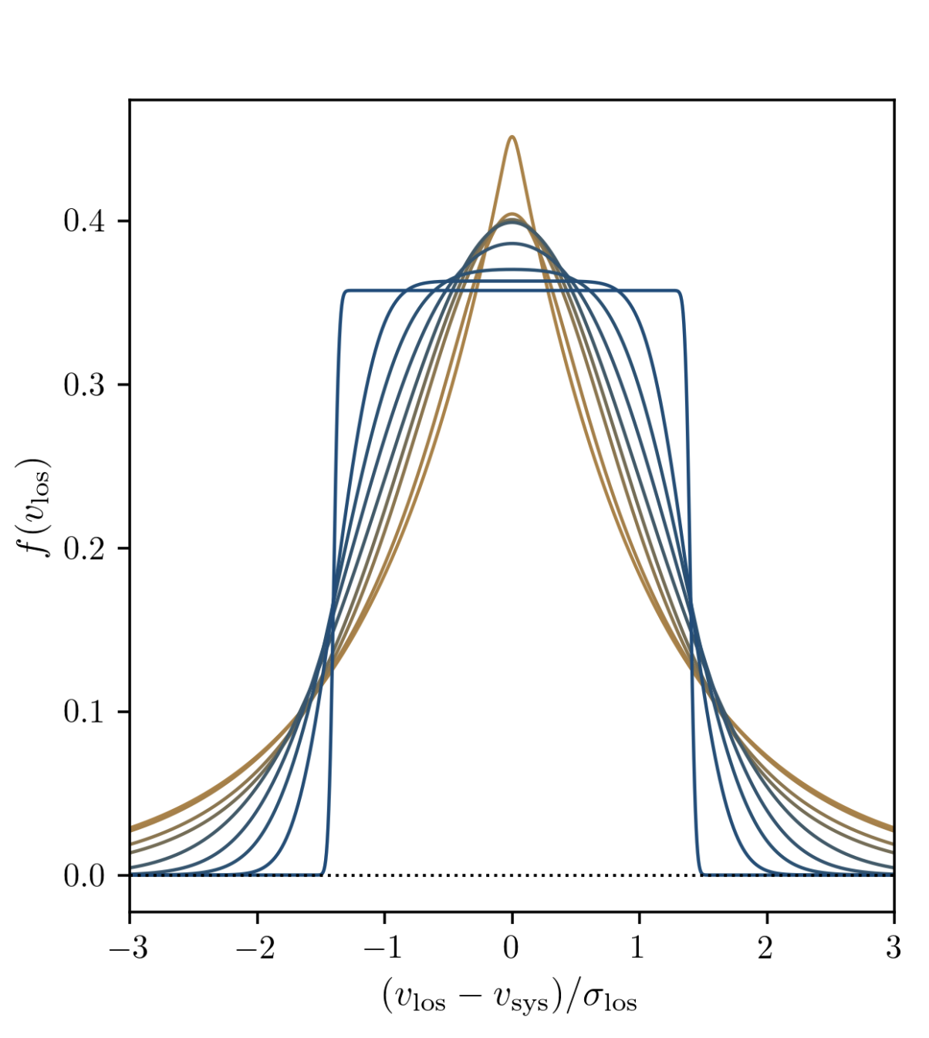
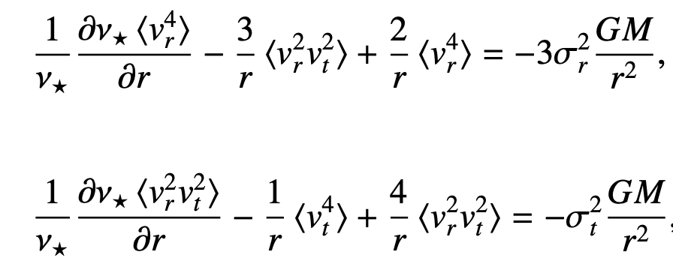
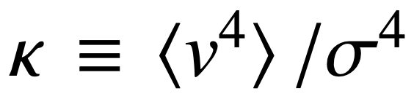
Beyond dispersions: Fourth-order moments
Fourth-order Jeans equations give us information about velocity distribution:
Kurtosis tells us the tailedness:
Wardana et al. (2025)

Slide 20
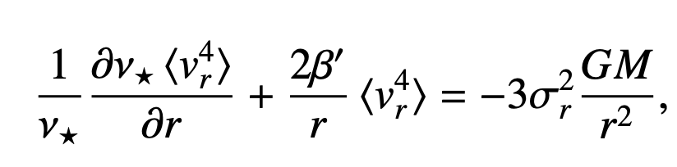
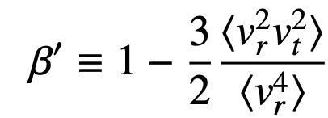
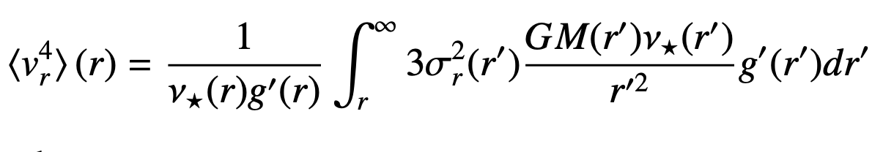
Solving the fourth-order problem
Richardson & Fairbairn (2013) introduce new anisotropy term to solve at 4th order:

Slide 21


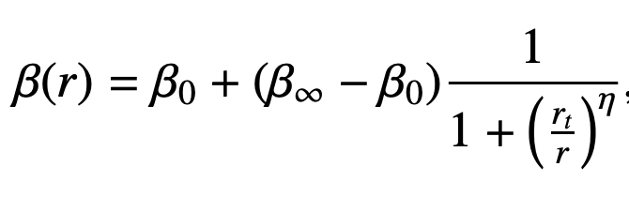
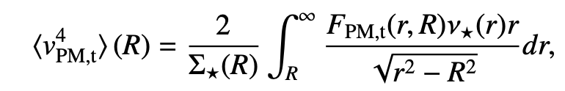
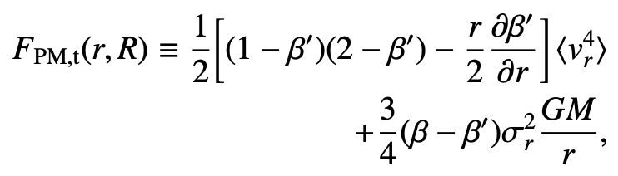
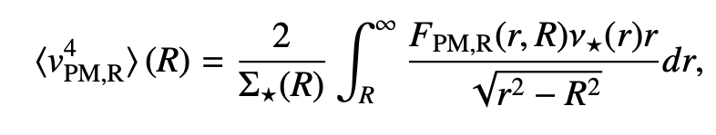
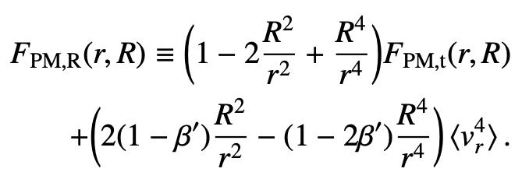
New approach: general anisotropy + PMs
Solve for and as independent general functions:
Introduce new observable: fourth-order proper motions, solving along the full 3Ds (not just LOS):

Slide 22
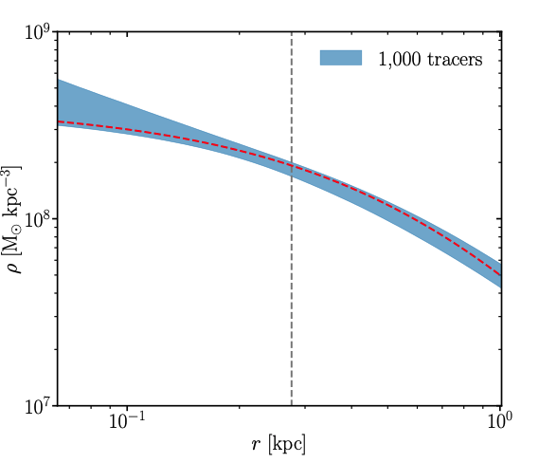
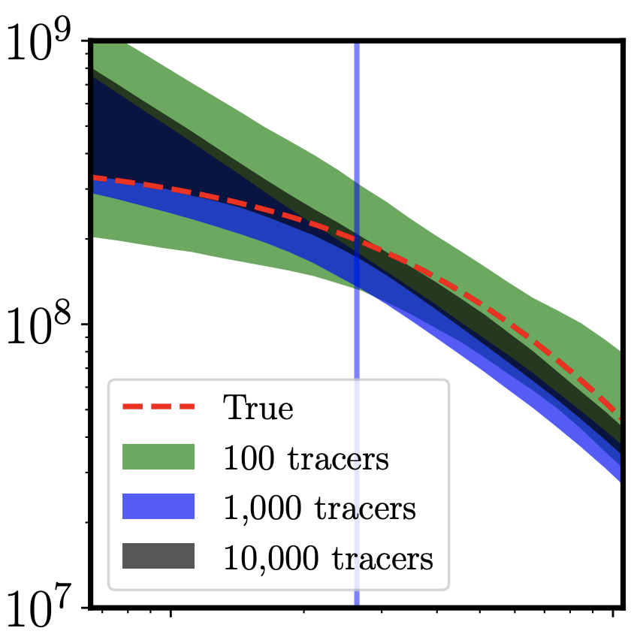

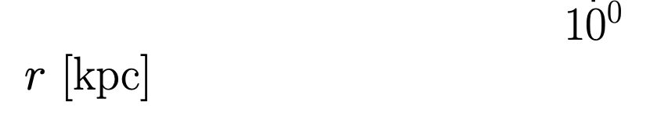
Mock data results: density profiles
Collins et al. (2021)

Slide 23
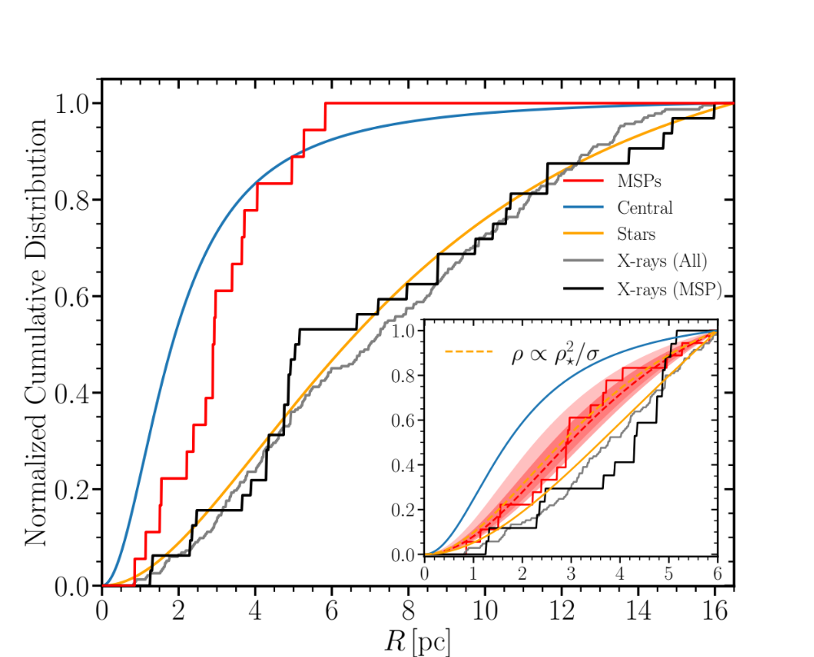
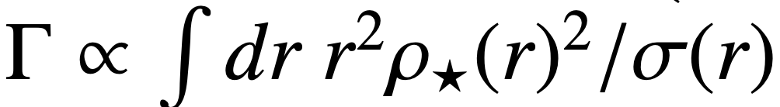
Probing models of pulsar formation in ω Cen
Milli-second pulsars (MSPs) are believed to be ‘recycled’ from stars
Formation models predict MSP abundances scale with stellar encounter rates:
We extend this to describe the spatial distribution of the MSPs, showing excellent agreement (inset)

