Slide 1



News from the Light:
New Physics Searches with Spectroscopy
Cédric DELAUNAY
Laboratoire d’Annecy de Physique Théorique
News from the dark 11 | IphT | September 29, 2026

Slide 2




The Standard Model is incomplete
neutrino masses
dark matter
baryon asymmetry

Slide 3



Even completed, there are ‘aesthetical’ issues, crying out for a better picture:
CC
Higgs mass
flavor
(strong) CP
etc?

Slide 4

E
The legacy of the LHC
~TeV
SM

Slide 5
These questions are answered by pushing the energy frontier
e.g. FCC
E
~10TeV
~TeV
SM

Slide 6
E
These questions are answered by pushing the precision frontier
~TeV
SM
~10³

Slide 7



Ultralight fields are whispers of high-scale dynamics :
spontaneous breaking
in the UV:
weakly-coupled pNGB
in the deep IR:
small explicit breaking

Slide 8



Prominent examples
include:
Axion(-like):
Relaxion:
Dilaton:

Slide 9

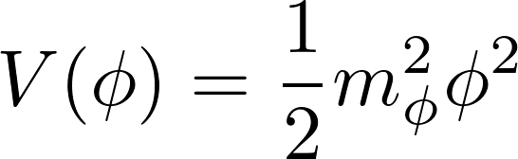
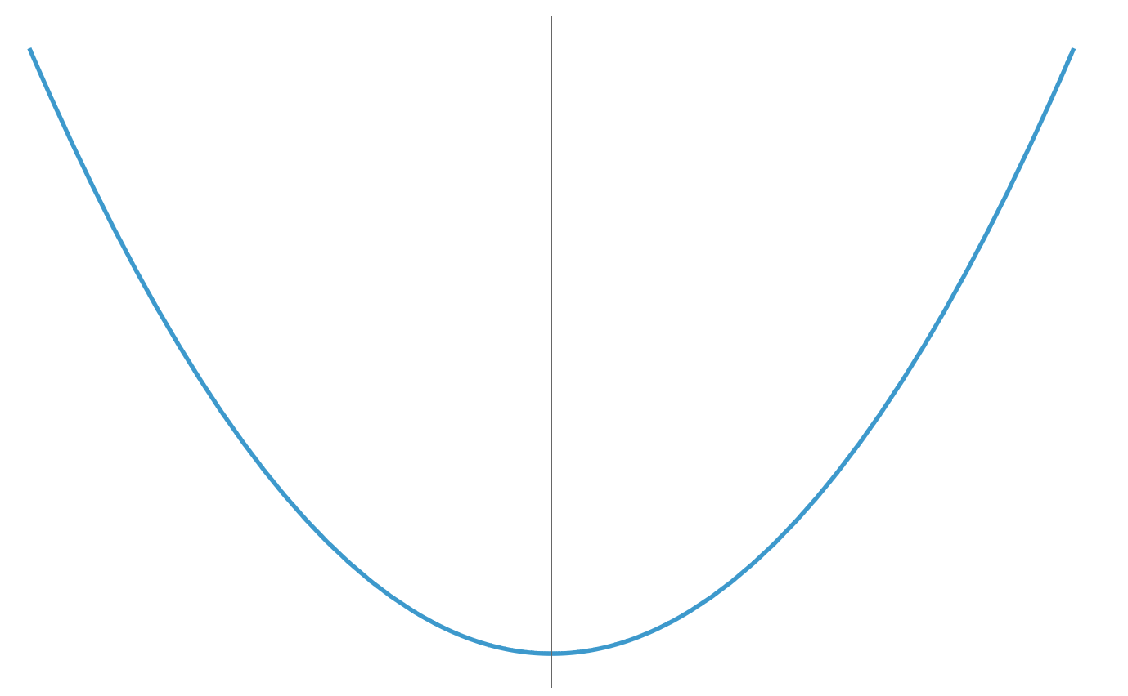



For , such states could be dark matter:
When
the field starts
oscillating, redshifting like
initial displacement
e.g. from inflation

Slide 10
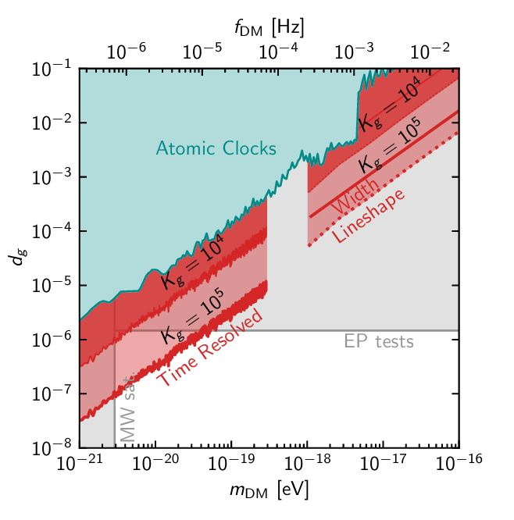
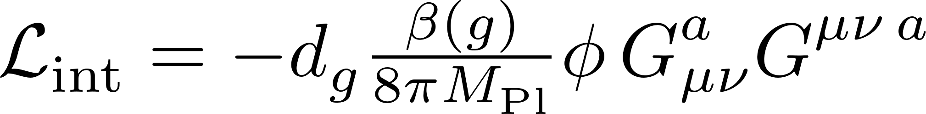
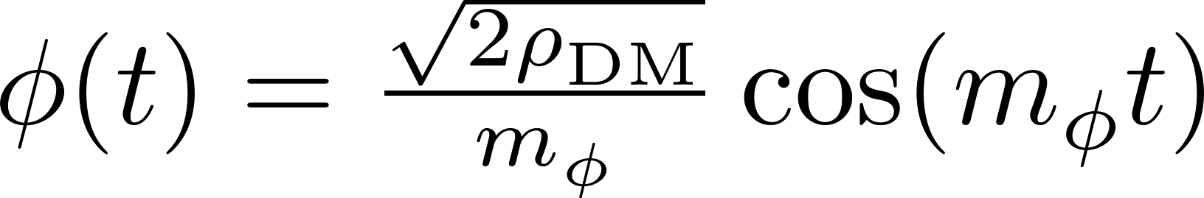
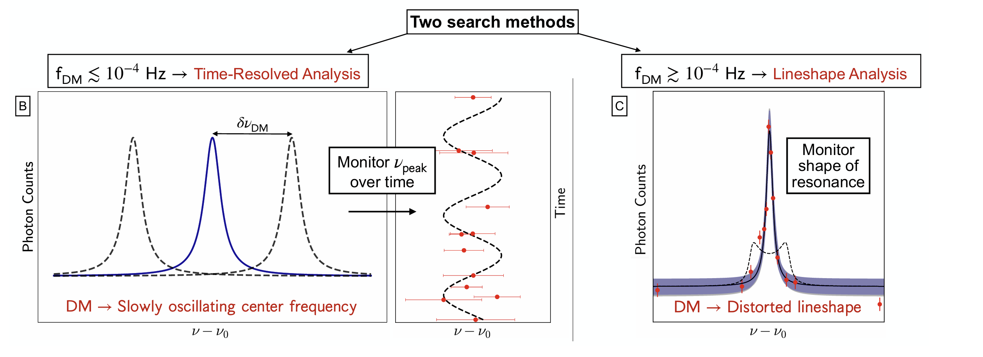
ULDM coupled to QCD:
with
Aragawa et al. 2602.16804

Slide 11

These light states
also induce static
new forces

Slide 12

These light states
also induce static
new forces
short range

Slide 13
These light states
also induce static
new forces

Slide 14
Today, I will present two strategies
to probe such static forces at different ranges:
Atomic & molecular spectroscopy
Nuclear clock ‘quintessometers’

Slide 15
Probing New Physics
at the Atomic Frontier

Slide 16

Transition frequencies in atoms are extremely well measured:
Optical clock transition
e.g.
BACON collaboration, Nature 2021

Slide 17

Transition frequencies in atoms are extremely well measured:
Optical clock transition
e.g.
BACON collaboration, Nature 2021
Bohr radius

Slide 18
Transition frequencies in atoms are extremely well measured:
Optical clock transition
e.g.
BACON collaboration, Nature 2021
Bohr radius

Slide 19
Transition frequencies in atoms are extremely well measured:
Optical clock transition
e.g.
BACON collaboration, Nature 2021
Bohr radius

Slide 20
However, they are poorly known theoretically:
Optical clock transition
e.g.
BACON collaboration, Nature 2021
These atoms have tens of electrons, each of which is subject to e.m. repulsion from the others
Many-body atomic calculations have typically 1% uncertainty

Slide 21

However, they are poorly known theoretically:
Optical clock transition
e.g.
BACON collaboration, Nature 2021
Another important obstable
is nuclear finite size effect
Nuclear charge distribution (radius,…) can be extracted from data
However, new forces of range shorter than cannot be resolved!
Unless it breaks symmetries of QED/QCD: (C)P or time translation

Slide 22
To extract new physics, one has two options:
Direct comparison of
theory and experiment
Theory-independent observable comparison
vs.
e.g. using simple atoms for which high precision QED calculations are available,
e.g. leveraging factorization of nuclear/electronic scales –› isotope shifts & King plots

Slide 23
Probing New Physics
at the Atomic Frontier
Simple atoms
H, D, He, μH, μD, HD⁺, H2⁺

Slide 24
Hydrogen absorption lines are also measured very precisely:
Parthey et al., PRL 2011

Slide 25



The theory prediction is also well known:
The theory prediction is also well known:
Rydberg constant
finite nuclear size
effect 1MHz
QED 1+2 loop, uncertainty 2Hz
nuclear recoil
but requires the precise determination of a few fundamental constants

Slide 26
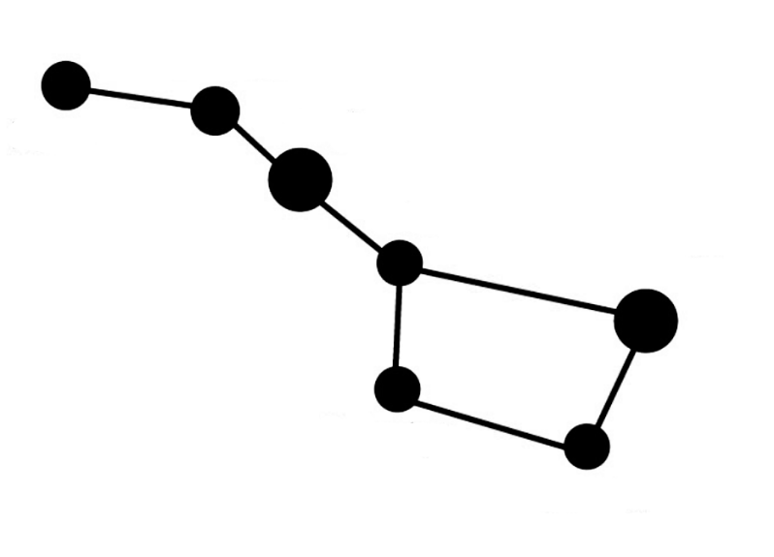
Fundamental constants are intertwined with several observables
and must be extracted together in a global fit, performed by the CODATA collaboration

Slide 27
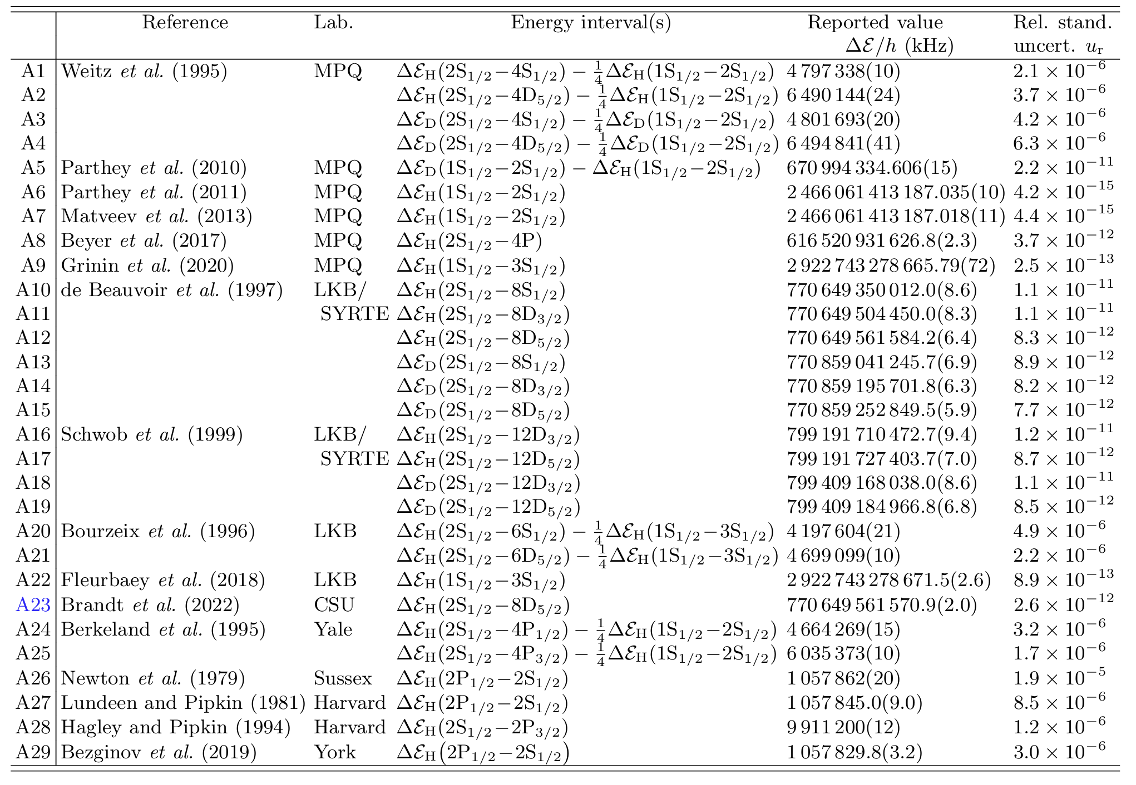
Fundamental constants are intertwined with several observables
Hydrogen & deuterium lines
fix the Rydberg constant
CODATA collaboration, Phys. Rep. 2024

Slide 28

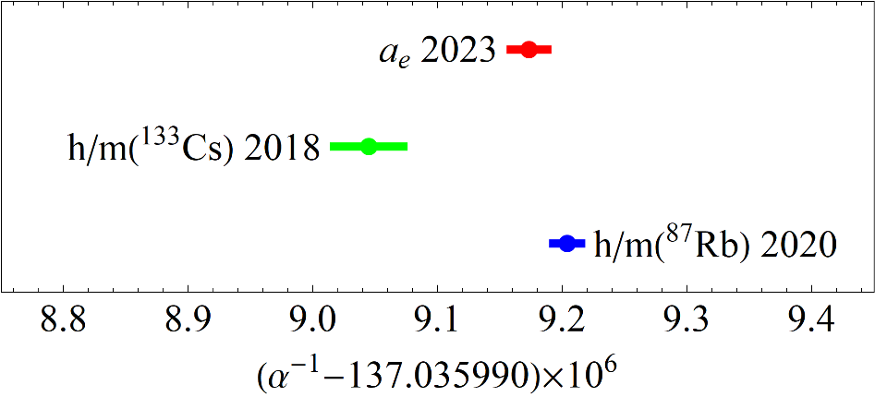
Fundamental constants are intertwined with several observables
Fan et al., PRL
Parker et al., Science
The fine-structure constant is now best determined
by recoil measurements
Morel et al., Nature

Slide 29
Fundamental constants are intertwined with several observables
Lamb shift of μH & μD
are most sensitive to the proton and deuteron charge radii
due to ‘lower’ orbits of the heavy muon

Slide 30
Fundamental constants are intertwined with several observables
Lamb shift of μH & μD
are most sensitive to the proton and deuteron charge radii
due to ‘lower’ orbits of the heavy muon
Mass ratios are now extracted from molecular HD⁺ & H2⁺ rovibration lines

Slide 31
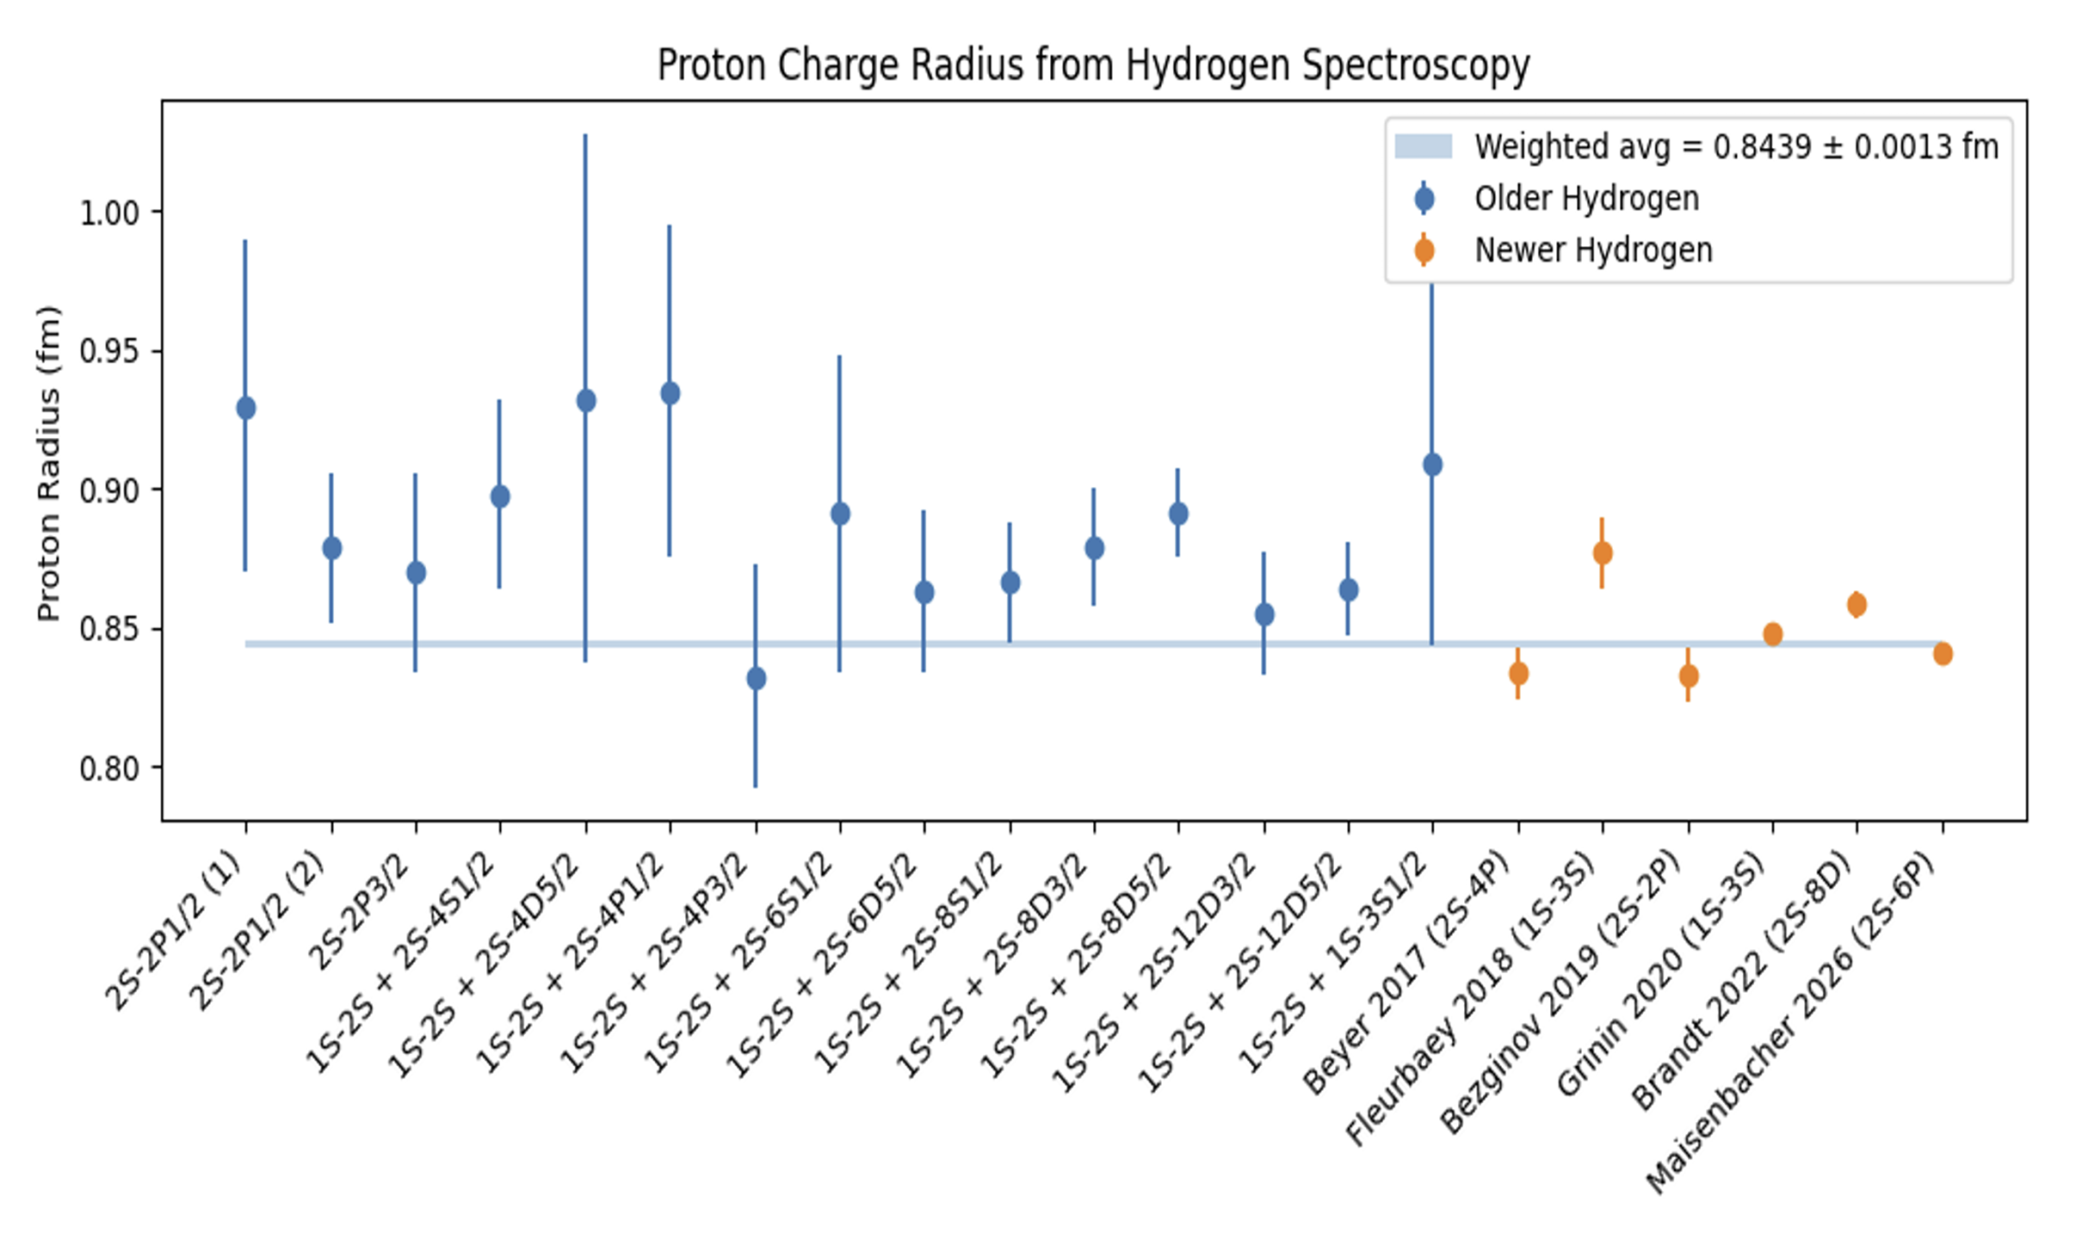
By the way, there is no longer a proton size puzzle:
Muonic Hydrogen
0.8409 ± 0.0004 fm
CREMA collaboration, Science 2013
Miller arXiv:2604.15546

Slide 32
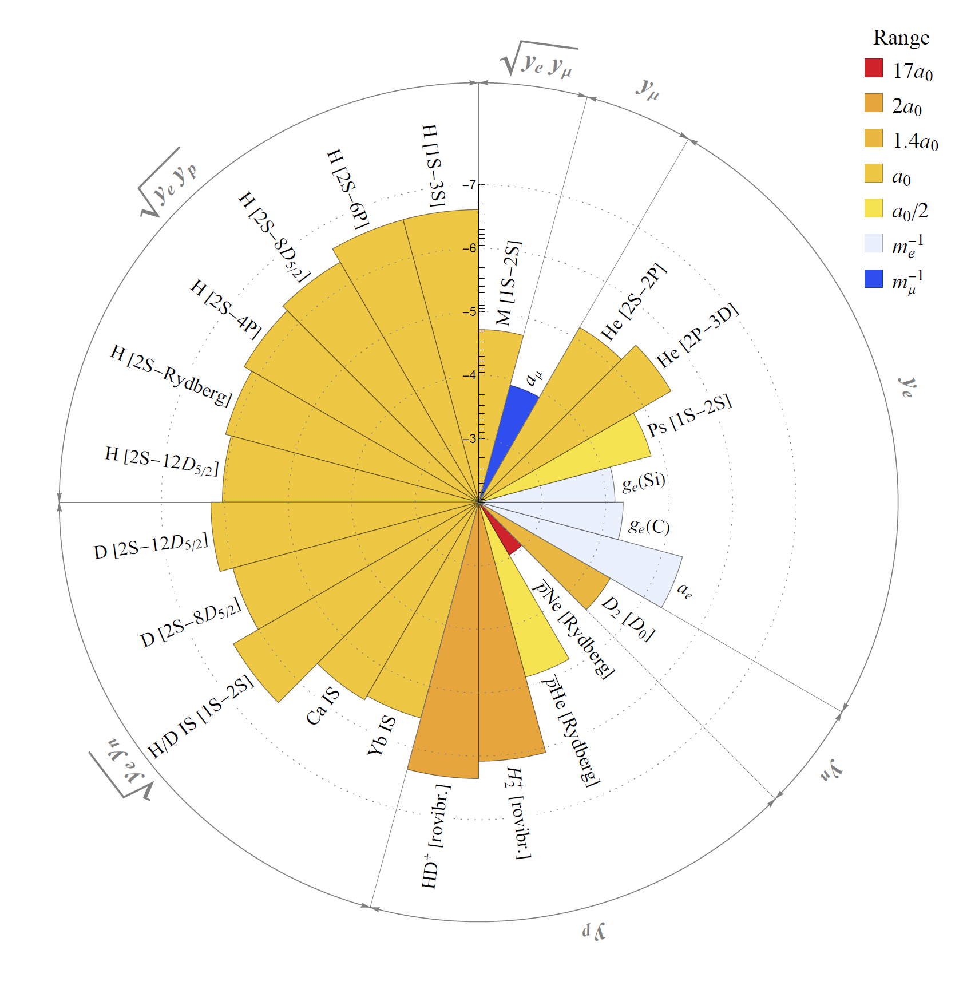


New physics affects
all CODATA inputs
CD-Karr-Soreq, Ann. Rev. 2026
As well as other observables:
muon magnetic anomaly
helium, positronium
muonium

Slide 33
We adapted the CODATA fit, systematically including New Physics effects:
state-of-the-art SM prediction
fundamental constants
SM theory uncertainty
correction from new physics
at leading order in
and extracted FCs and New Physics parameters together
CD-Karr-Kitahara-Koelemeij-Soreq-Zupan, PRL 2023

Slide 34
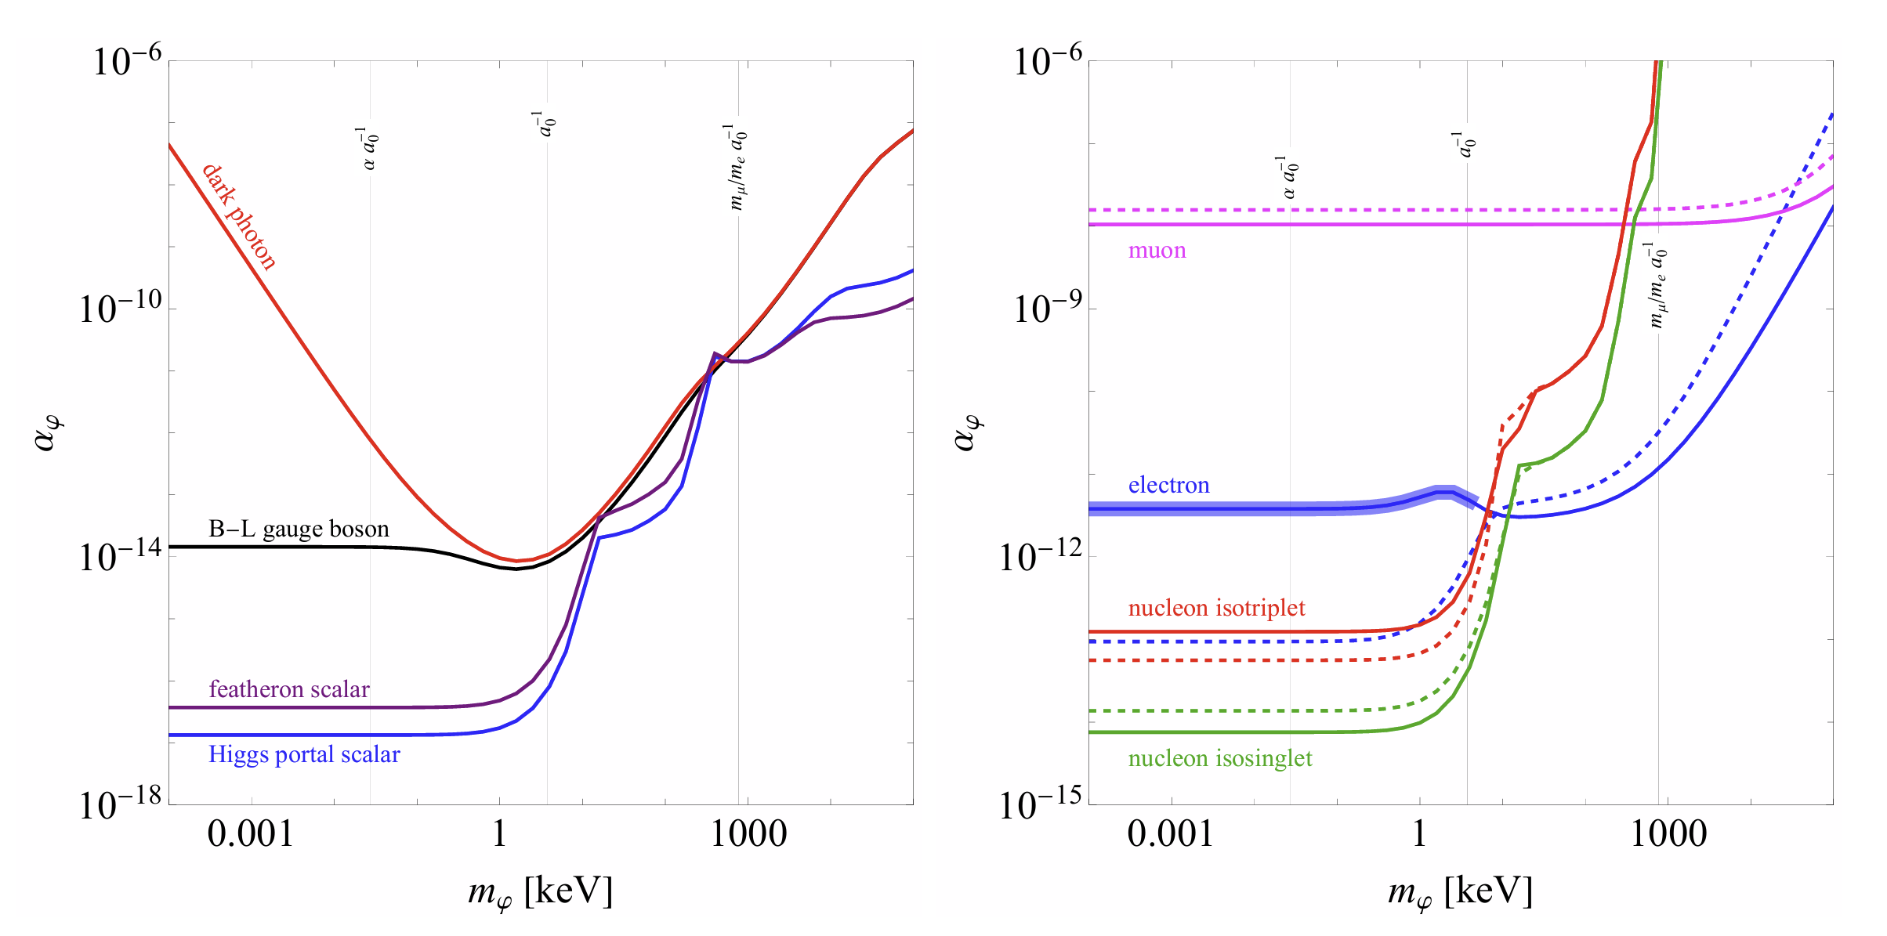
New physics bounds:
CD-Karr-Soreq, Ann. Rev. 2026

Slide 35
Probing New Physics
at the Atomic Frontier
Isotope shifts & King plots

Slide 36


The nuclear charge Z sets atomic frequencies, up to small nuclear effects:
still challenging to calculate ab initio
but allows EFT description

Slide 37


The nuclear charge Z sets atomic frequencies, up to small nuclear effects:
subleading effects
in
mass shift
field shift
precisely measured at using spin-precession in traps
poorly known in general

Slide 38
The nuclear charge Z sets atomic frequencies, up to small nuclear effects:
‘electronic’ constants
independent of nuclear parameters
but depending on atomic states

Slide 39


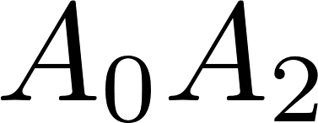
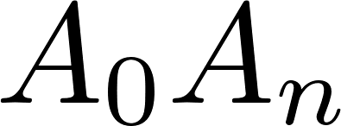
This factorization of scales permits theory-independent comparison of isotope shifts:
modified IS
King plot
predicting a linear relation
among isotope shift data
(independently of )

Slide 40


New Physics forces violate King’s linearity
nonlinear
King plot

Slide 41
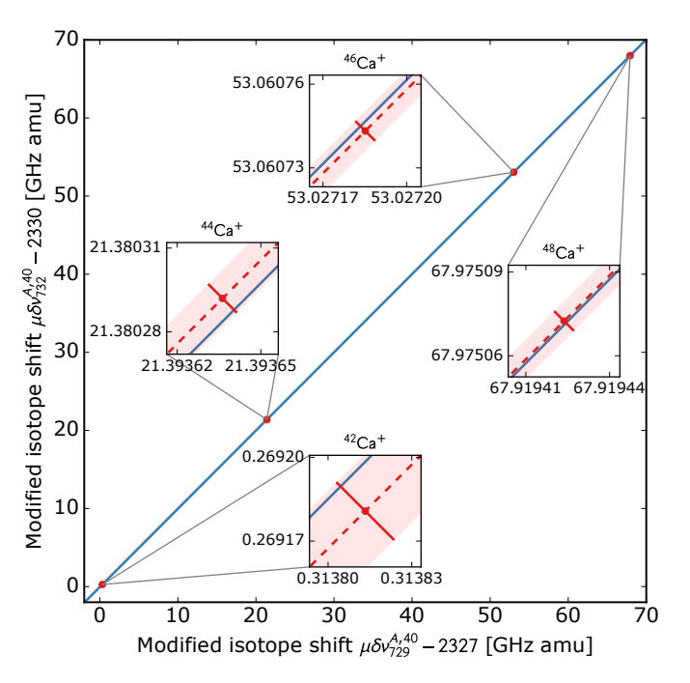

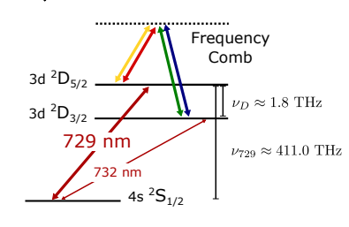
Solaro et al., PRL 2020
Measurements with
calcium ions
consistent with
linearity at

Slide 42
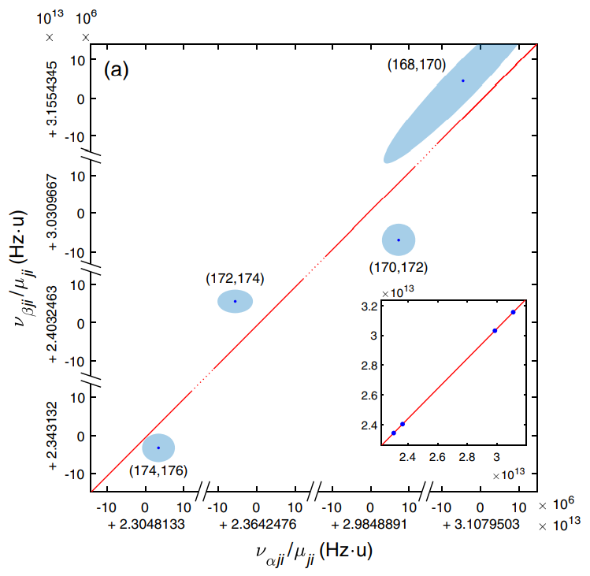

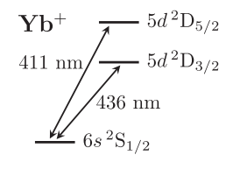
Counts et al., PRL 2020
Other measurements with ytterbium ions
reveal nonlinearities
at

Slide 43
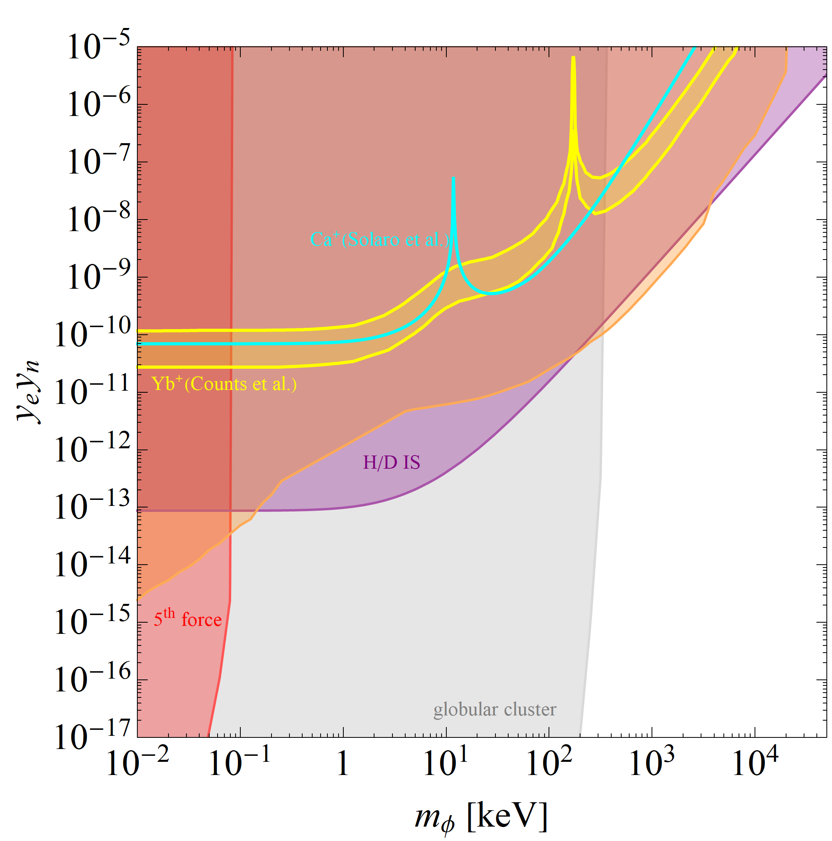
Berengut et al., PRR 2020
Assuming new physics interpretation, these results are marginaly consistent
but excluded by other
observables
electron g-2 and
nuclear scattering
combined bound
Hydrogen/Deuterium
isotope shift bound
CD et al., PRD 2017

Slide 44
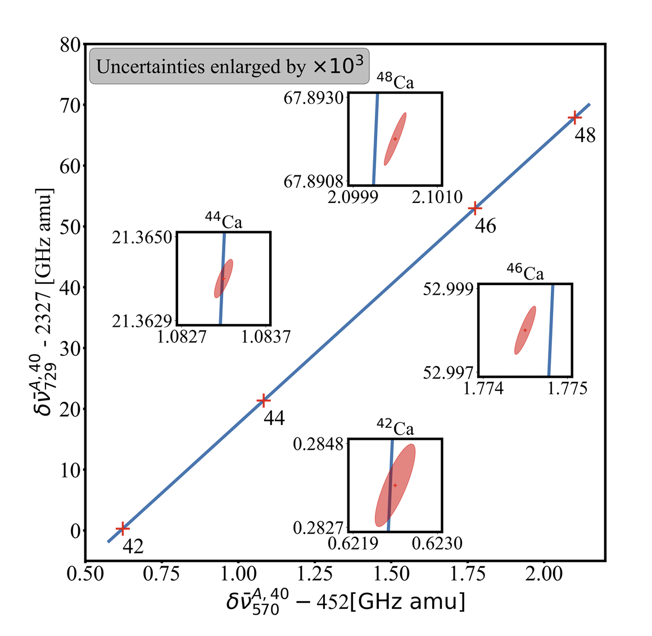

Wilzewski et al., PRL 2025
100-fold improved measurements with calcium ions
are highly nonlinear at
So what are we
possibly seeing here?

Slide 45

Experimentalists begin to resolve
subleading nuclear effects
One can try to absorb them, generalizing linearity
to higher dimensions.
More isotopes & transitions are needed!
Berengut et al., PRR 2020

Slide 46
Probing New Physics
with nuclear clock
‘quintessometers’

Slide 47

Seeking new physics
with highly stable device

Slide 48



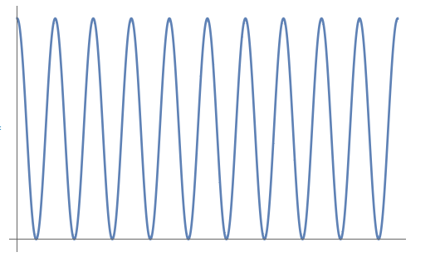
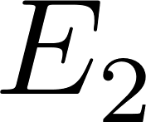



Quantum mechanics provides the most stable/accurate oscillators

Slide 49
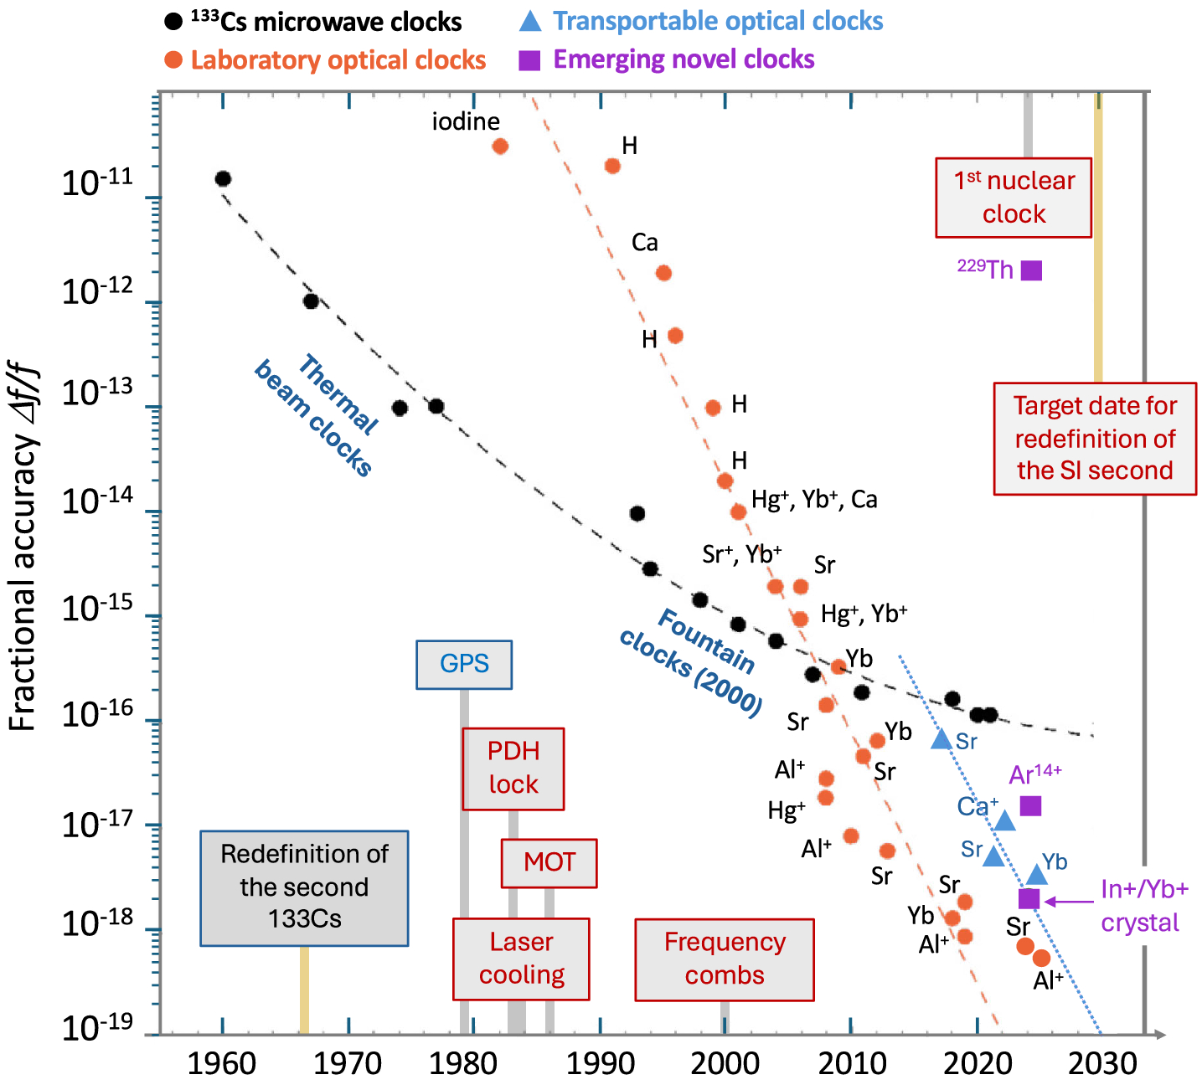

Fortier et al., Optica 2026
Quantum oscillators are the basis of modern clocks
state-of-the-art
atomic clocks

Slide 50
A nuclear clock is based on nuclear states instead of electronic states
The main benefit = external fields are screened
The main issue = splittings are generaly ~MeV (no laser)

Slide 51
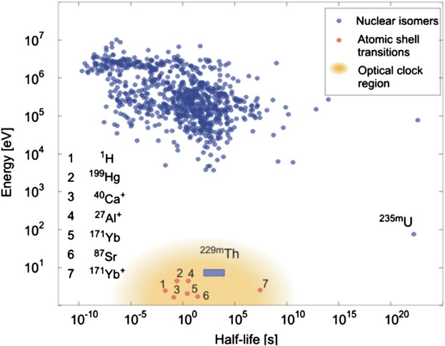
Peik et al., QST 2021
except one nucleus
thorium 229
~8eV
which reachable with VUV laser

Slide 52


The small splitting in thorium 229 is probably accidental
Therefore, small changes in
(or )
are amplified in the frequency

Slide 53

In comparison, changes in nuclear parameters in atomic energies are suppressed in the frequency
At same accuracy, nuclear clock is more sensitive than atomic clocks to new physics coupled to QCD by !

Slide 54
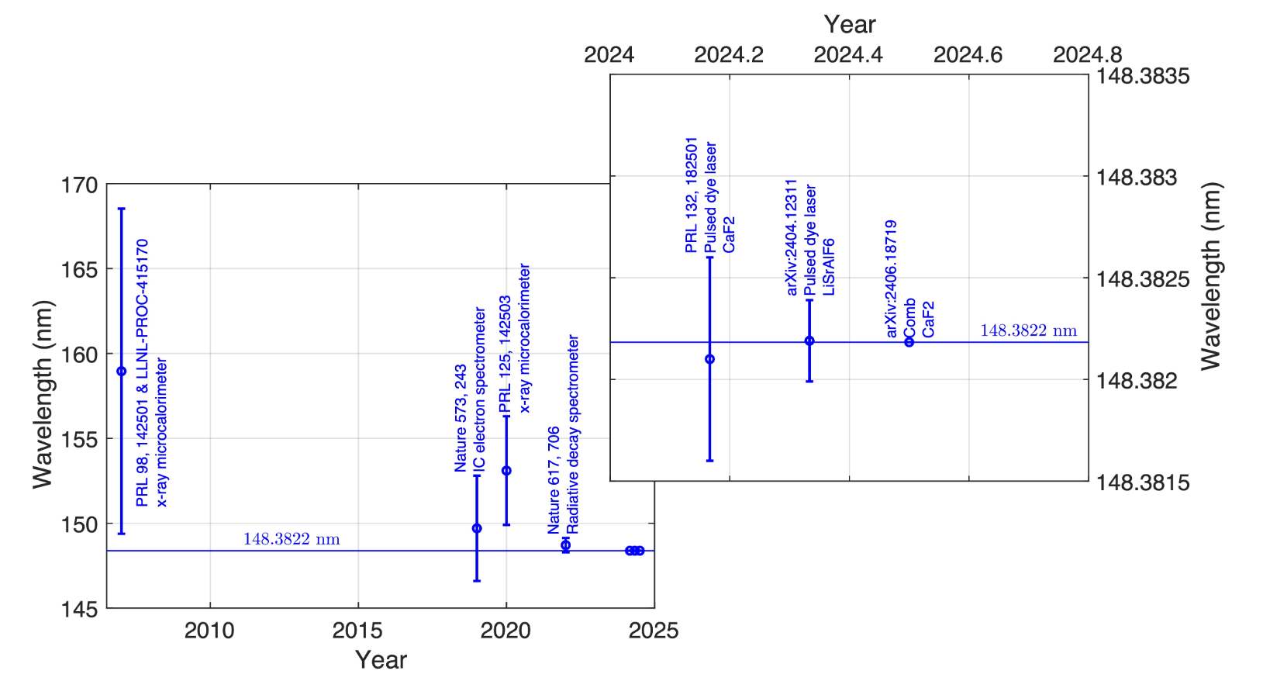

Rapid progress recently,
due to embedding
in crystal hosts
radiative decay
measurements
laser excitations
in crystal hosts
Zhang et al. Nature 2024

Slide 55




Consider a scalar field
linearly coupled to QCD
Massive bodies will source
a background field around them
M

Slide 56

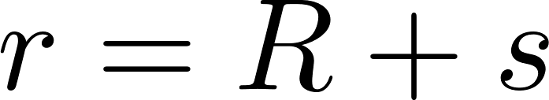

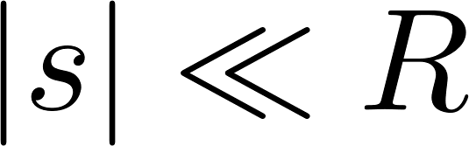

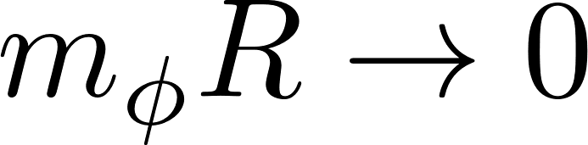
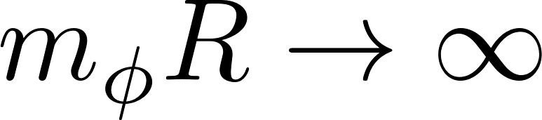


There are two limiting
regimes of interest
M
point-source
infinite-plate

Slide 57


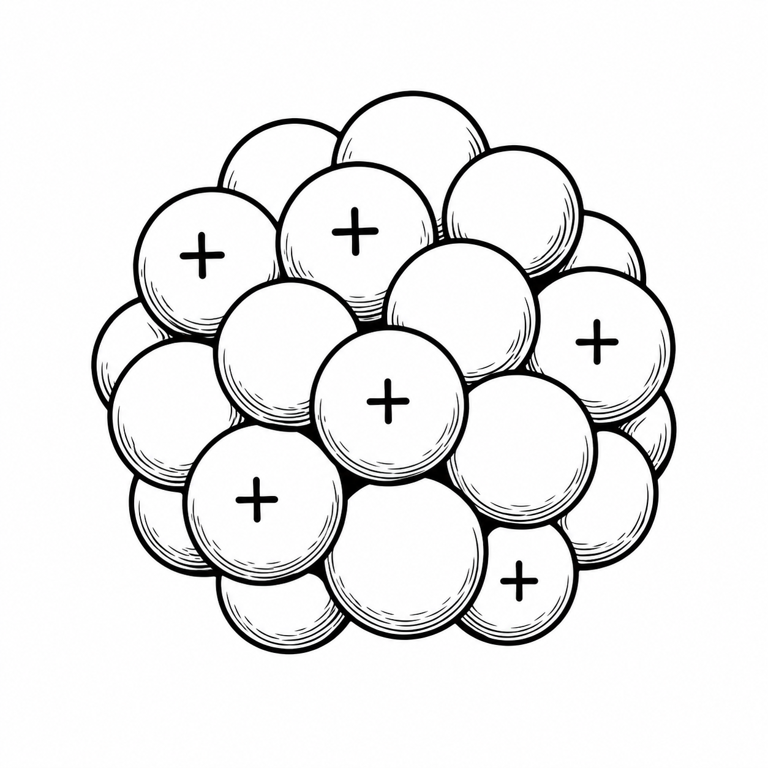

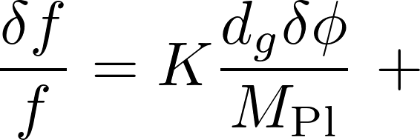
Probe the field’s gradient
with a nuclear clock
M
The nucleus couples to the ambient field,
changing its frequency as
time-dilation from
gravitational field’s gradient

Slide 58


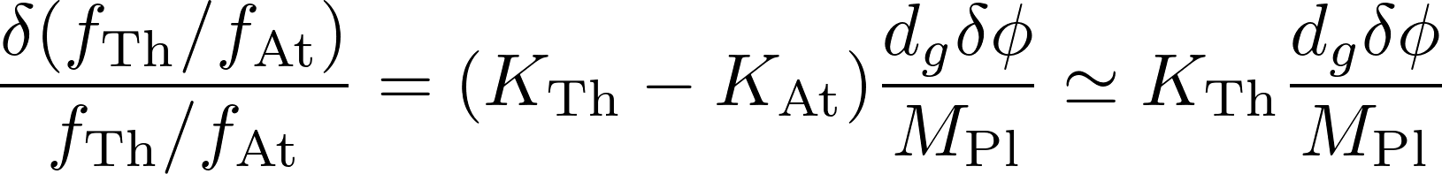
‘Monitor’ gravity field
with another atomic clock
‘quintessometer’
M

Slide 59
I will now describe several applications
of this basic scheme :
Long distance probes using the Earth as a source
Tabletop experiments at shorter distances

Slide 60
Probing New Physics
with nuclear clock
‘quintessometers’
Long distance probes

Slide 61

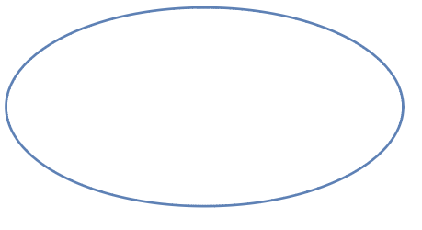
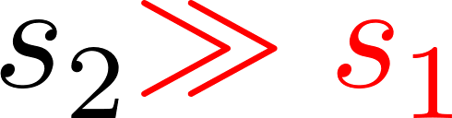
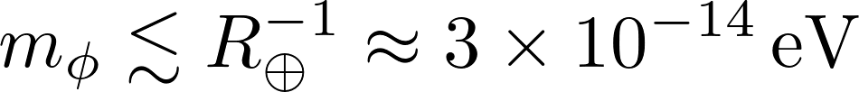



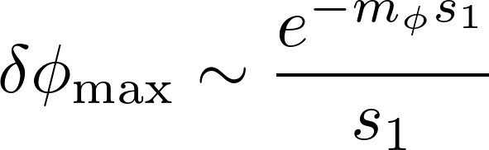
Space-born missions
Monitor a quintessometer
along an elliptic orbit
around the Earth

Slide 62


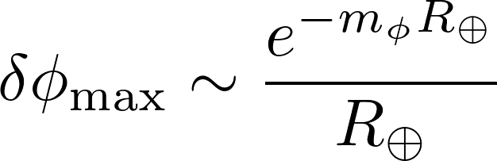
Space-born missions
Evade the altitude suppression
by comparing to another
quintessometer on the ground

Slide 63




Mont Blanc
4806m
Comparing
ground-based
quintessometers
at different altitudes
Annecy
450m

Slide 64
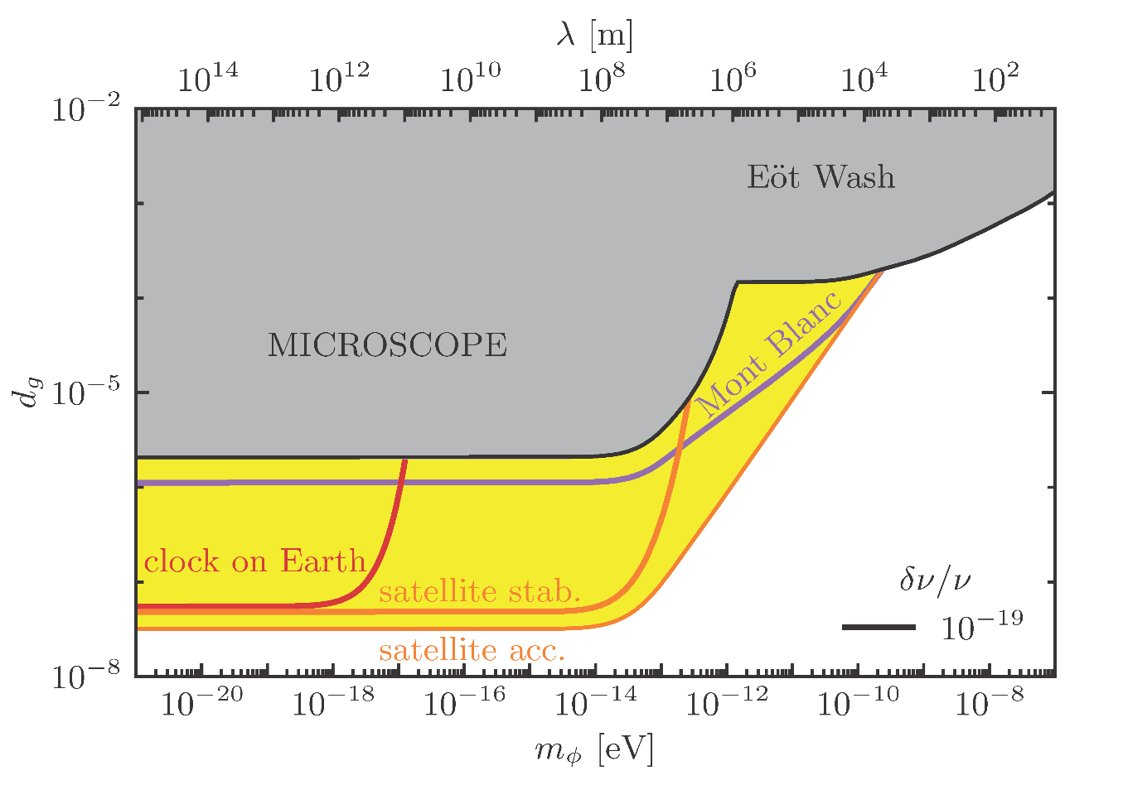


Slide 65
Probing New Physics
with nuclear clock
‘quintessometers’
Small distance probes

Slide 66
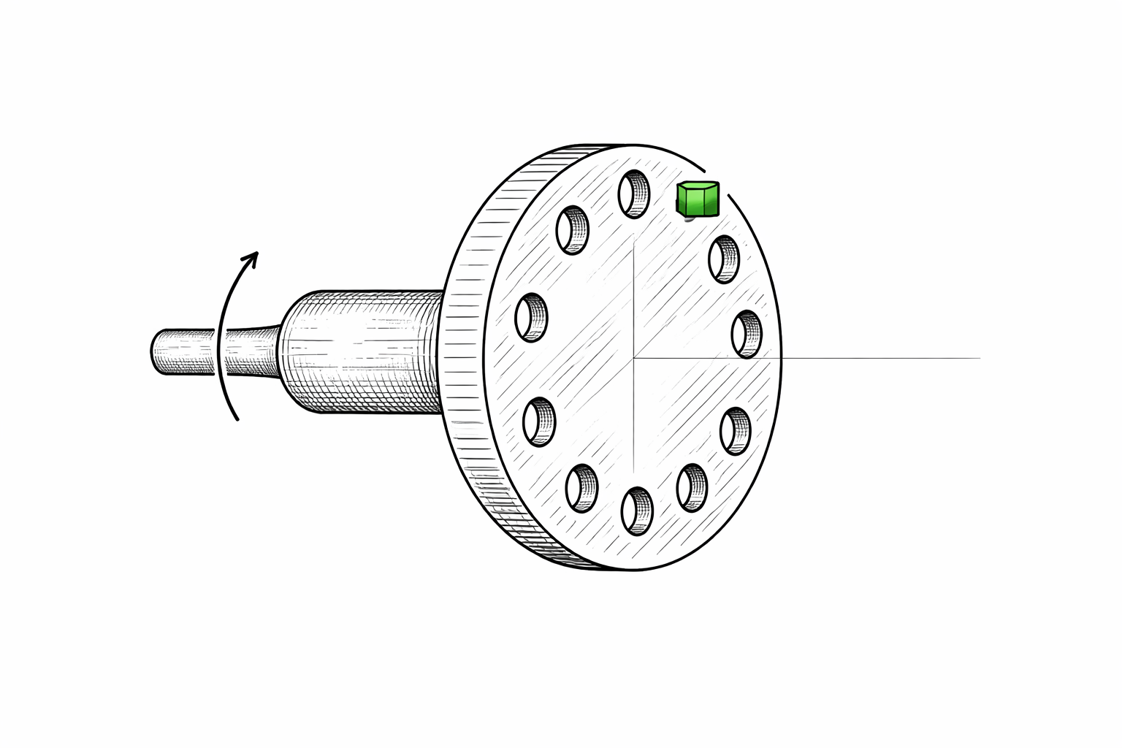



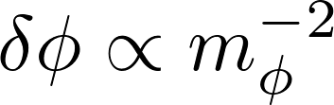
Getting close to thorium,
with a rotating holed disk
separation
crystal doped with
thorium 229
Platinum thick disk

Slide 67
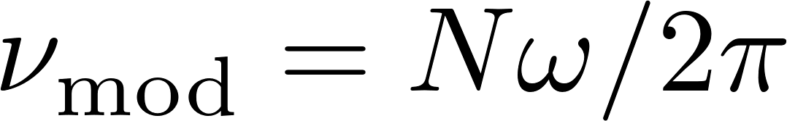

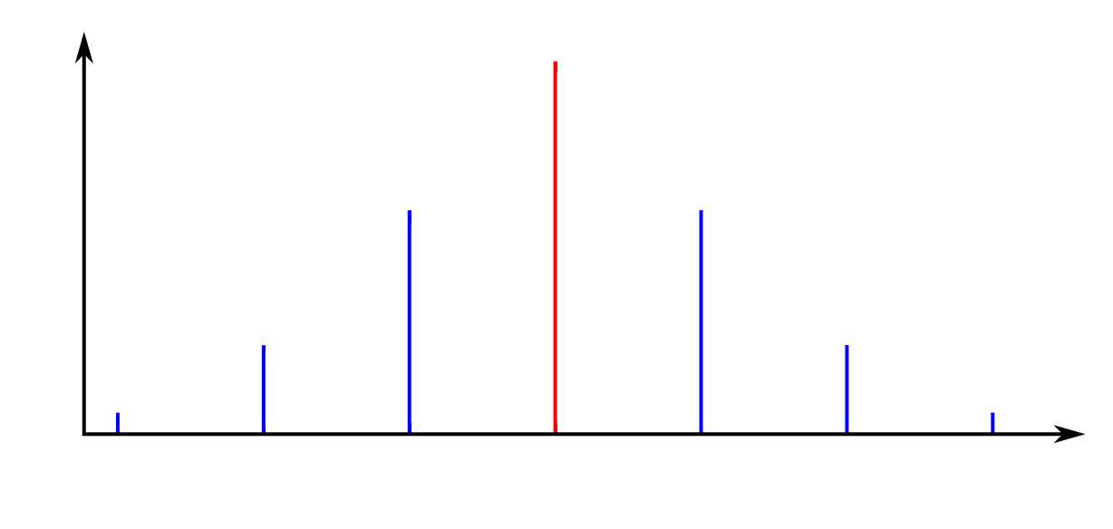
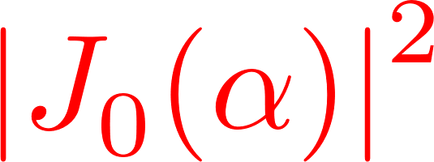
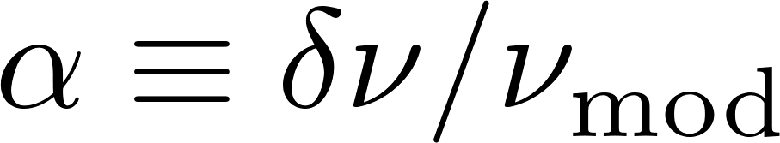
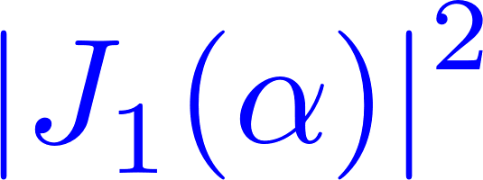
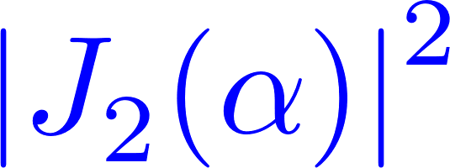
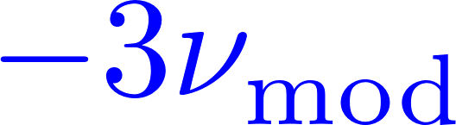
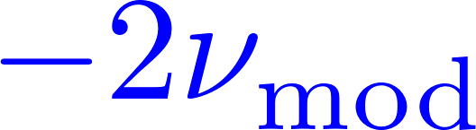



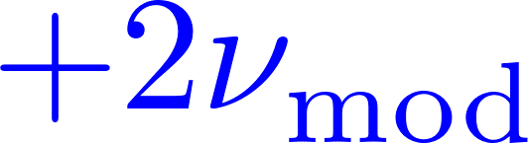


Field variation induces frequency modulation,
and the spectrum develops sidebands
peak heights
set by
intensity

Slide 68
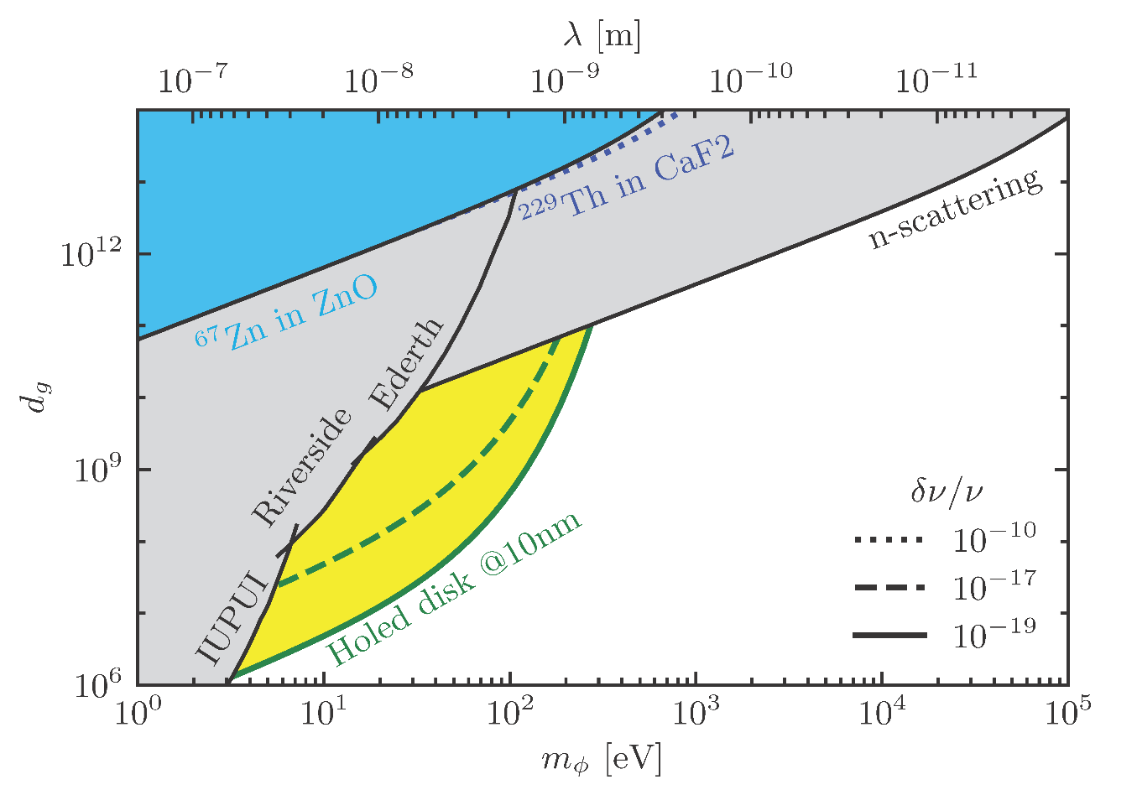

Slide 69
Conclusions
‘There’s plenty of room at the bottom’
for (ultra)light new physics
Repurposing Atomic & Molecular Optics for BSM physics searches offers new perspectives on the fundamental laws of nature.

