Slide 1
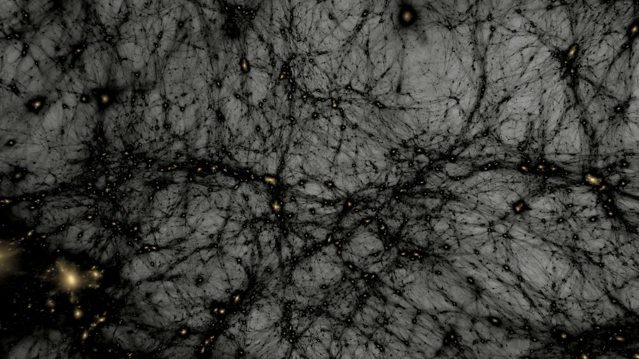

Pros & cons of SIDM
-- Theory development & multi-probe tests from nearby to early Universe
Fangzhou Jiang 姜方周
https://www.fzjiang.com
Kavli Institute for Astronomy & Astrophysics (KIAA), Peking University
Students and postdocs contributed to this talk:
Huapeng Gu (Peking), Zixiang Jia (Peking), Haonan Zheng (KIAA Boya Fellow), Zihao Wang (Peking), Shubo Li (NAOC), Feihong He (KIAA postdoc), Zecheng Yan (Peking)
Collaborators contributed to this talk:
Xian Chen (KIAA/Peking), Andrew Benson (Carnegie), Ran Li (NAOC→BNU), Wei-Xiang Feng (Tsinghua), Haibo Yu (UC Riverside), Xuejian Jacob Shen (MIT), Oren Slone (TAU), Mariangela Lisanti (Princeton), Phil Hopkins (Caltech), Annika Peter (OSU), Carton Zhichao Zeng (OSU)
News from the Dark, Sep 30 2026, IPhT, CEA Paris-Saclay

Slide 2
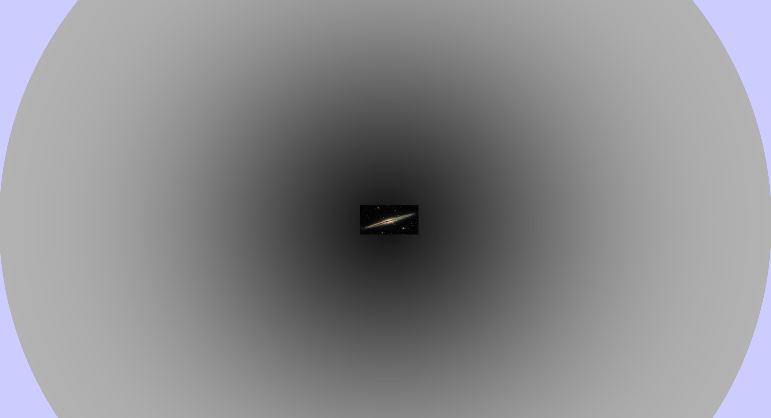
galaxies’ homes:
dark-matter halos
~ 100 kpc
galaxy
~kpc

Slide 3
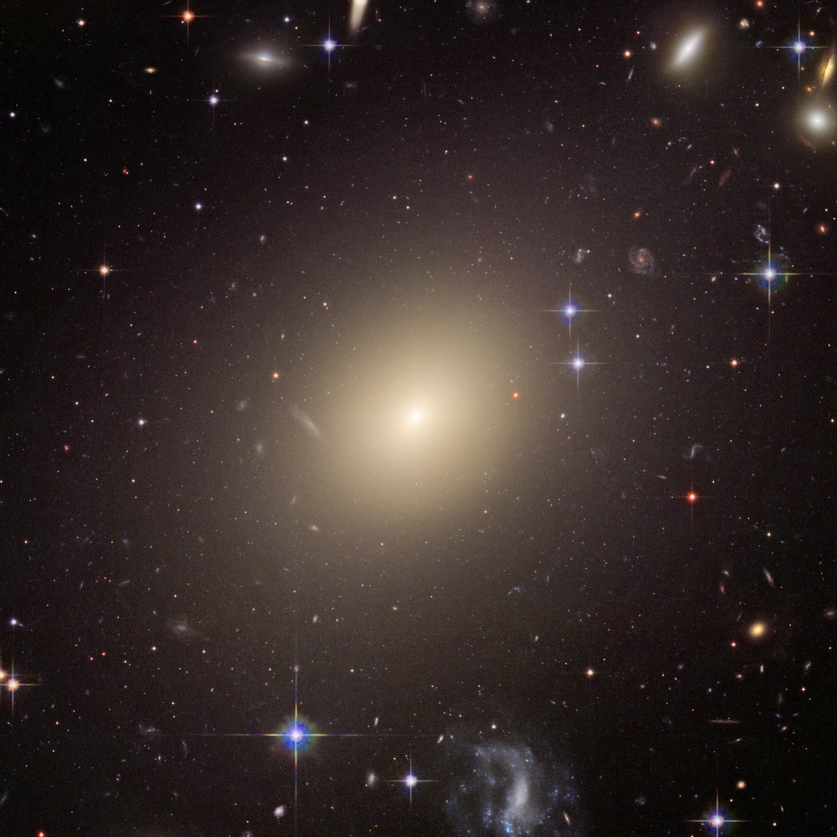


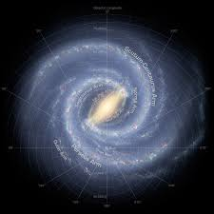
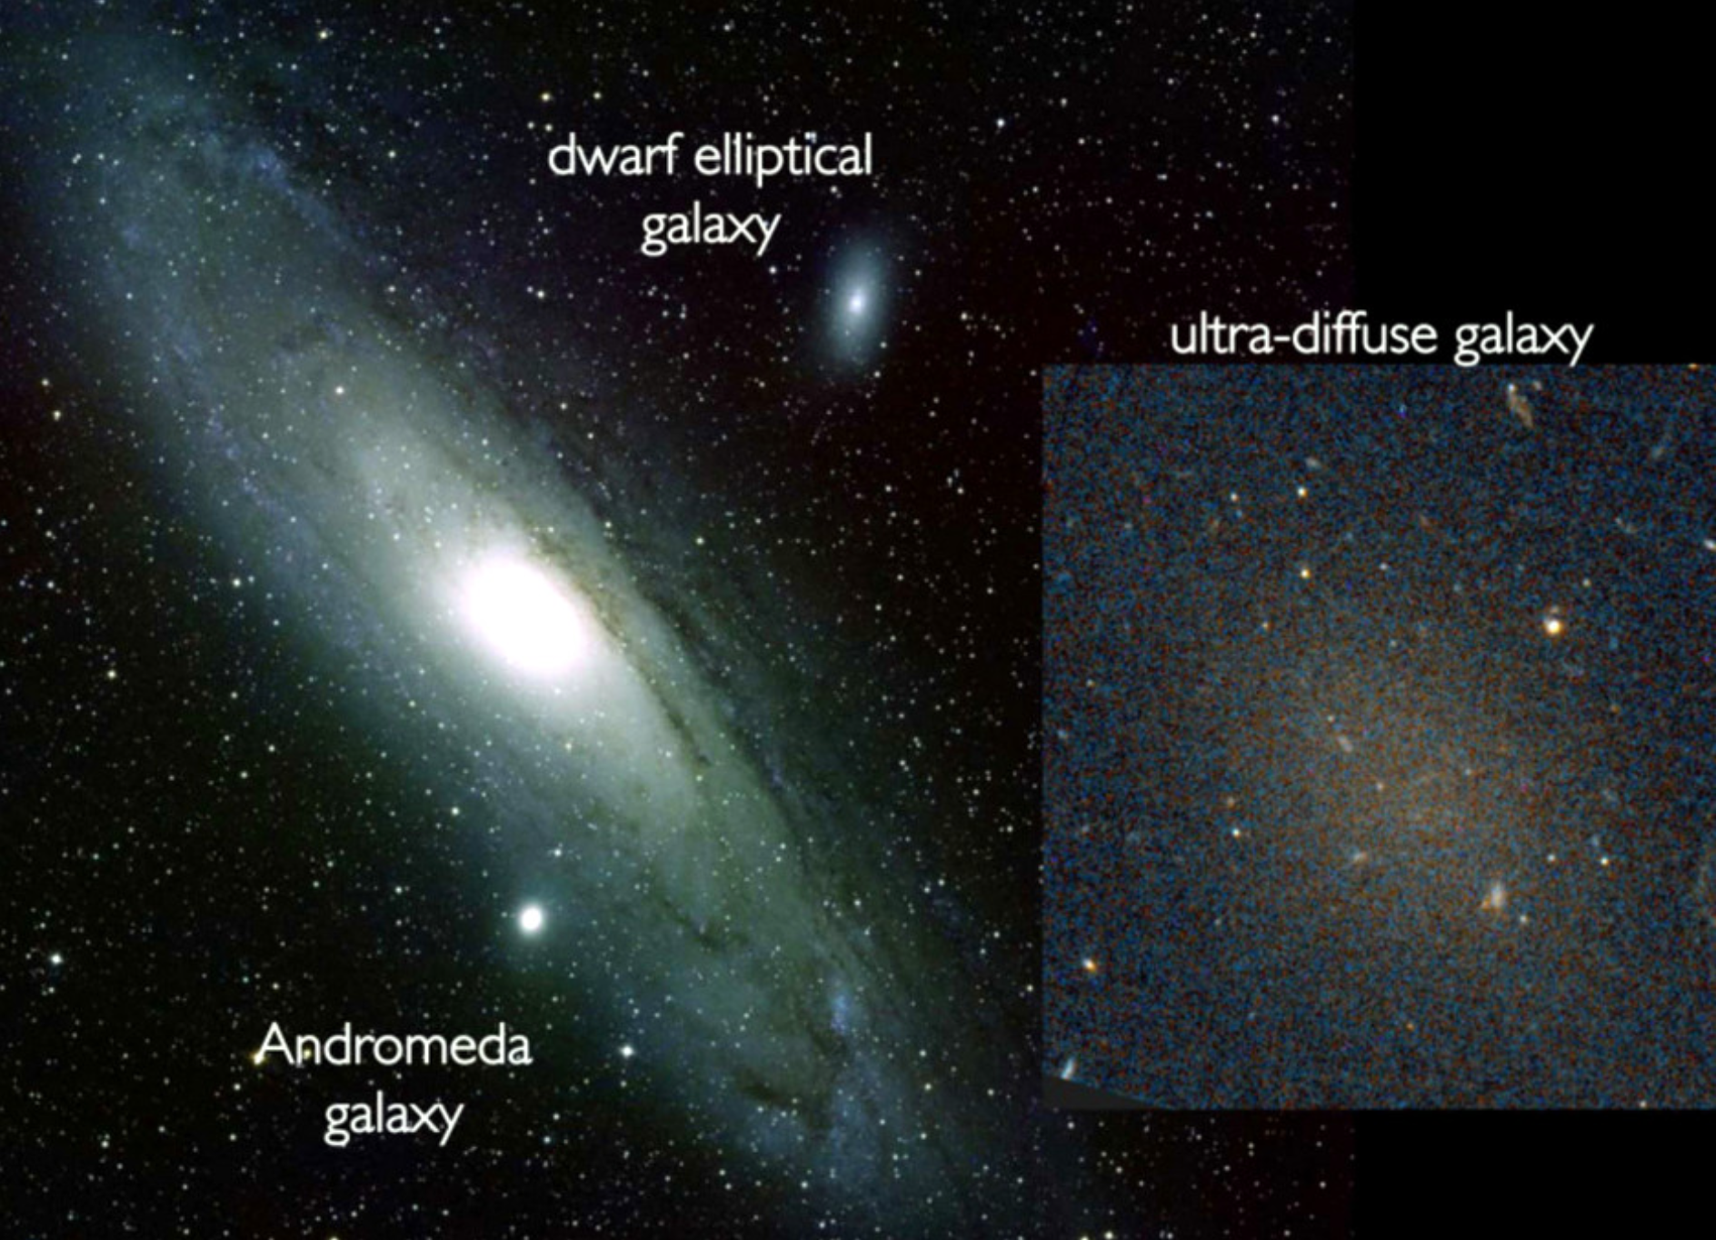
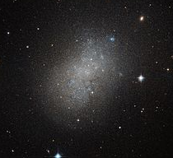






Galaxy-halo connection: what kind of galaxies populate what kind of dark-matter halos?
MW
ultra-diffuse
Elliptical
dwarf
dwarf elliptical
“halo abundance matching” e.g, Behroozi+13; Moster+13
e.g, Mo, Mao, White 98; Kravtsov 13
secondary halo parameters: structure, assembly history, large scale environment, …

Slide 4
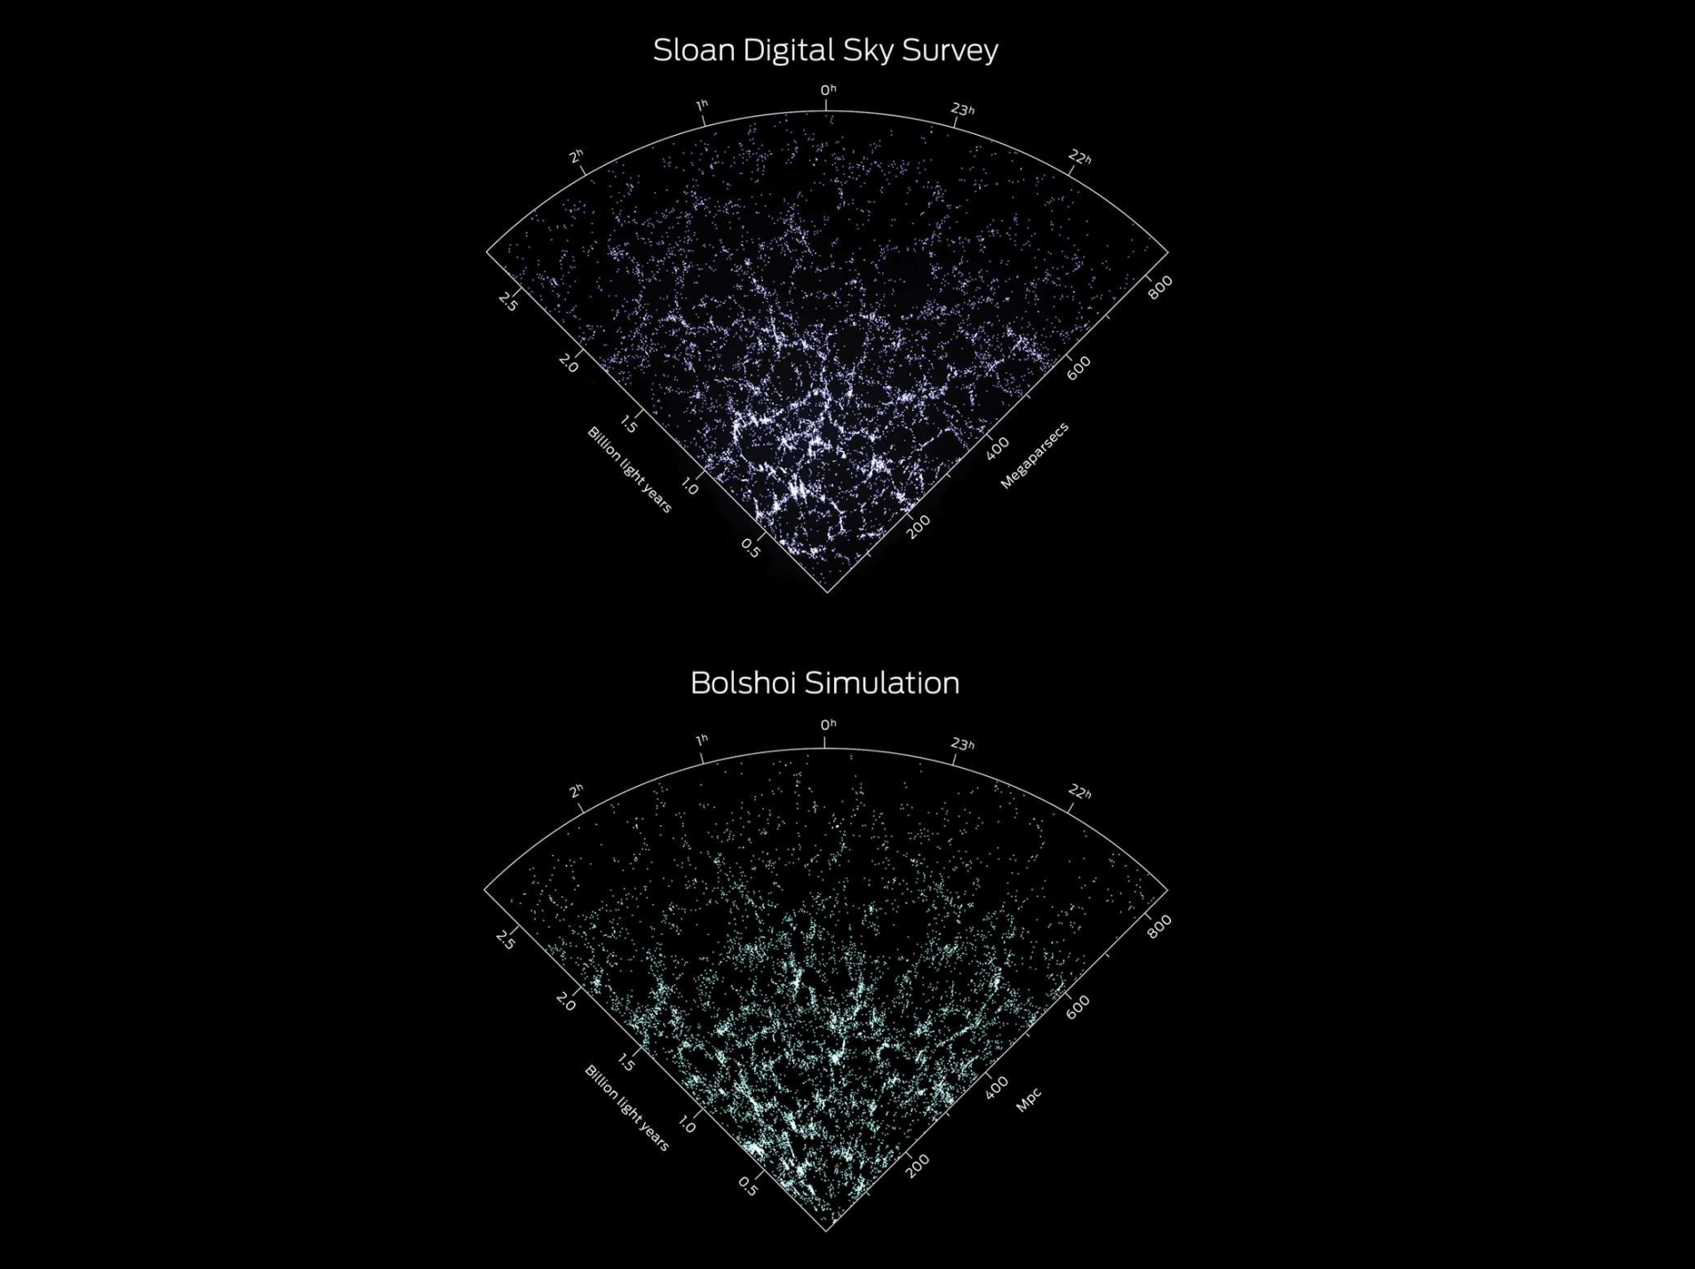
  Standard cosmology (ΛCDM) – remarkably successful on large scales
observation
Cosmological simulation based on ΛCDM

Slide 5
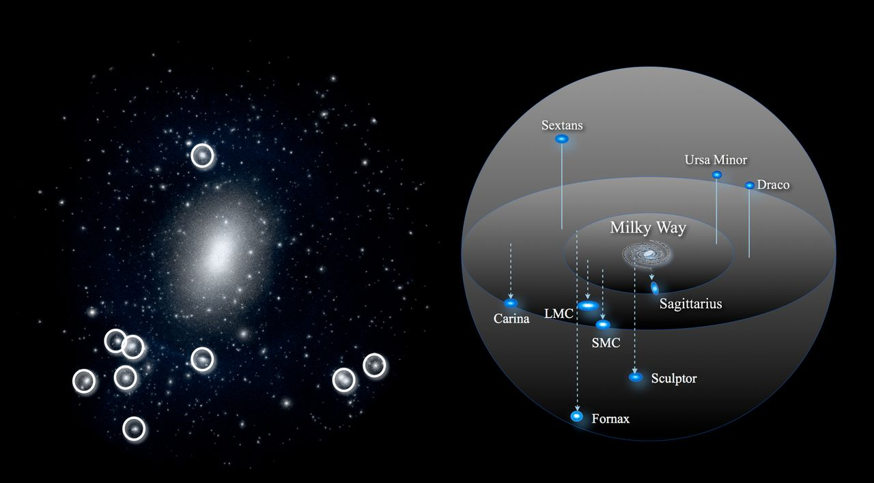
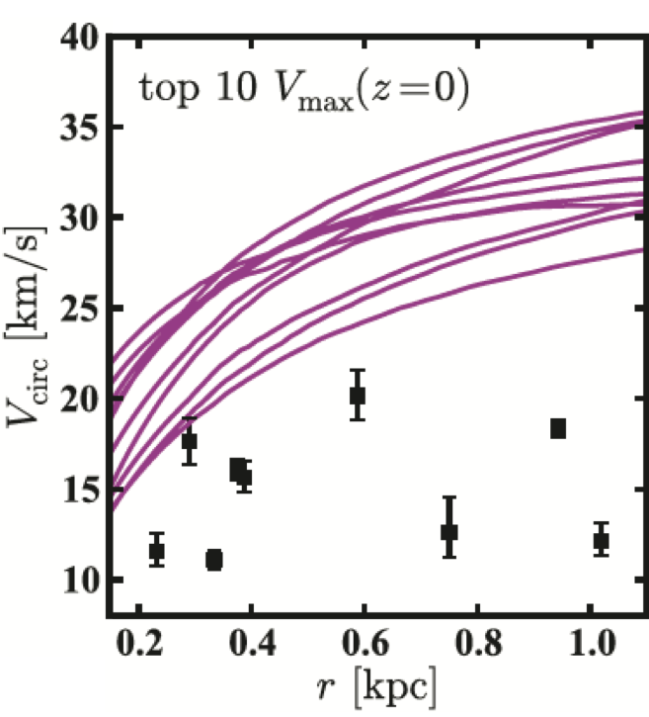
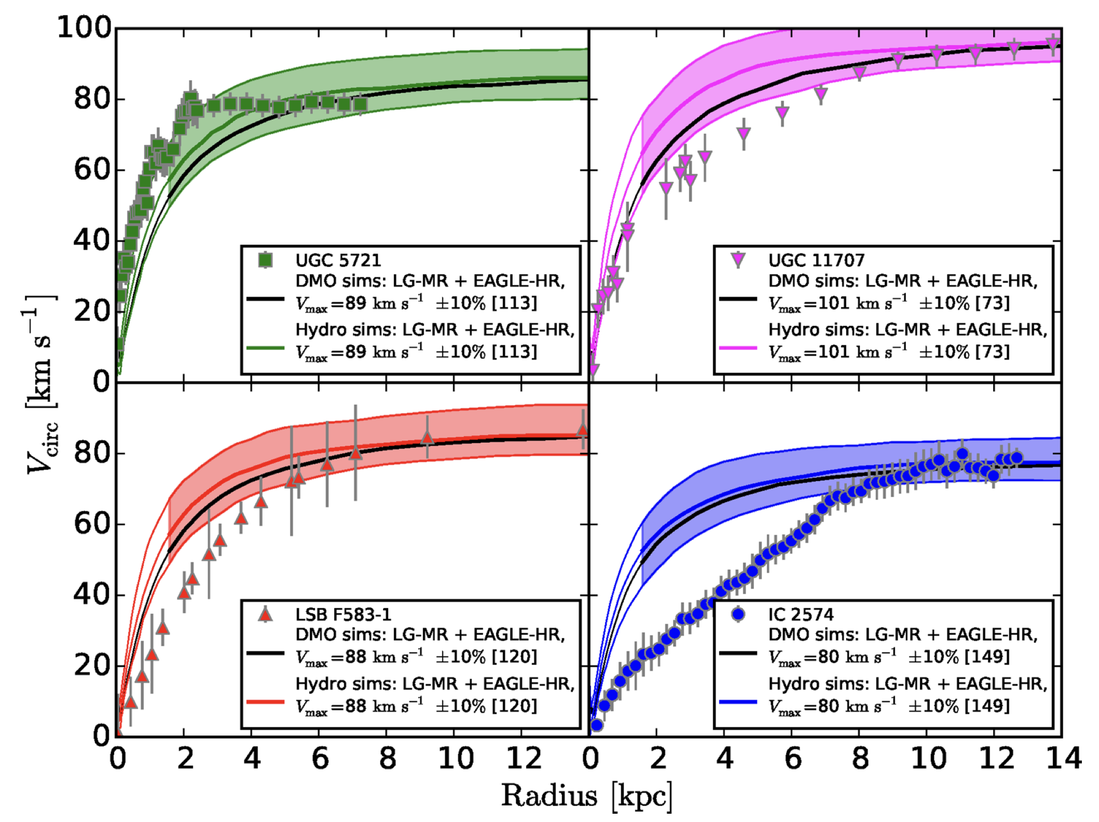
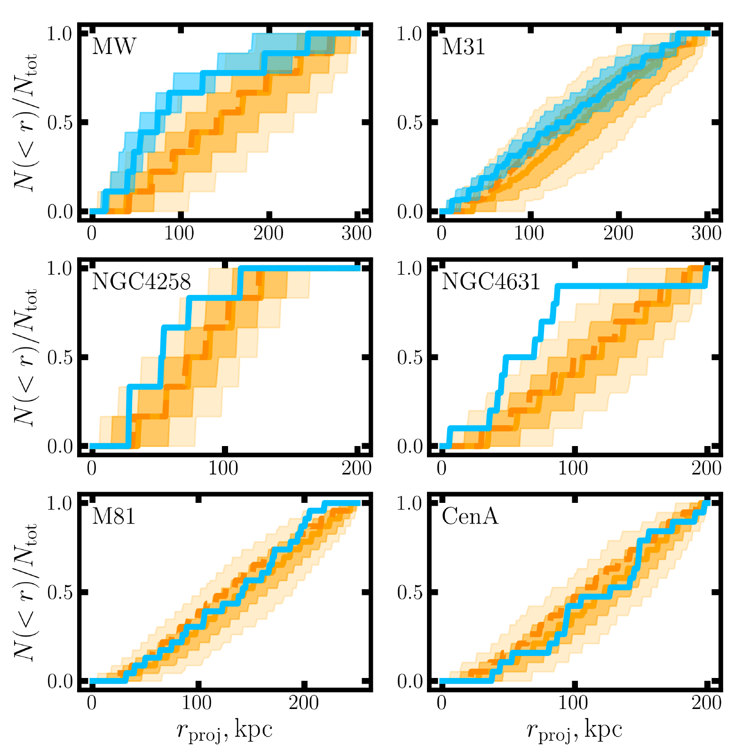

  Small-scale puzzles (1): satellite number, structure, & spatial distribution ALL WRONG!
Simulated MW-mass halo
Real MW
LMC: Vmax ≈ 90
SMC Vmax ≈60
sim
“Too big to fail”: bright satellites too dense; MW satellites have a maximum-circular velocity gap
obs
Weinberg + 15
Boylan-Kolchin + 11
Missing satellite
Structural diversity of bright dwarfs
Spatial distribution
Oman+15
cusp
obs
Carlsten+20
sim
core
center ←
r [kpc]

Slide 6
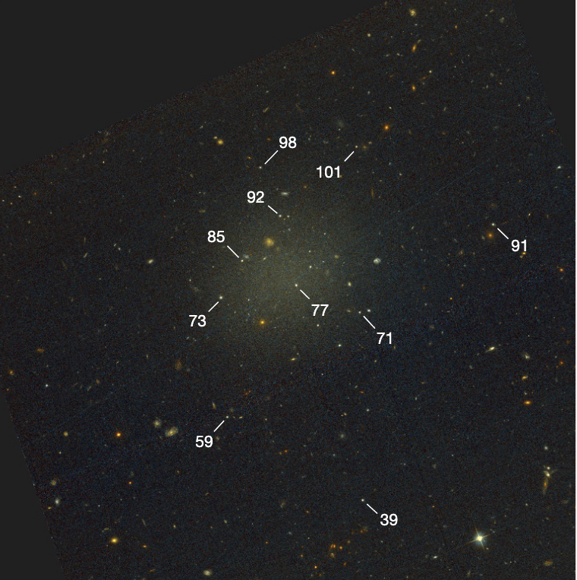
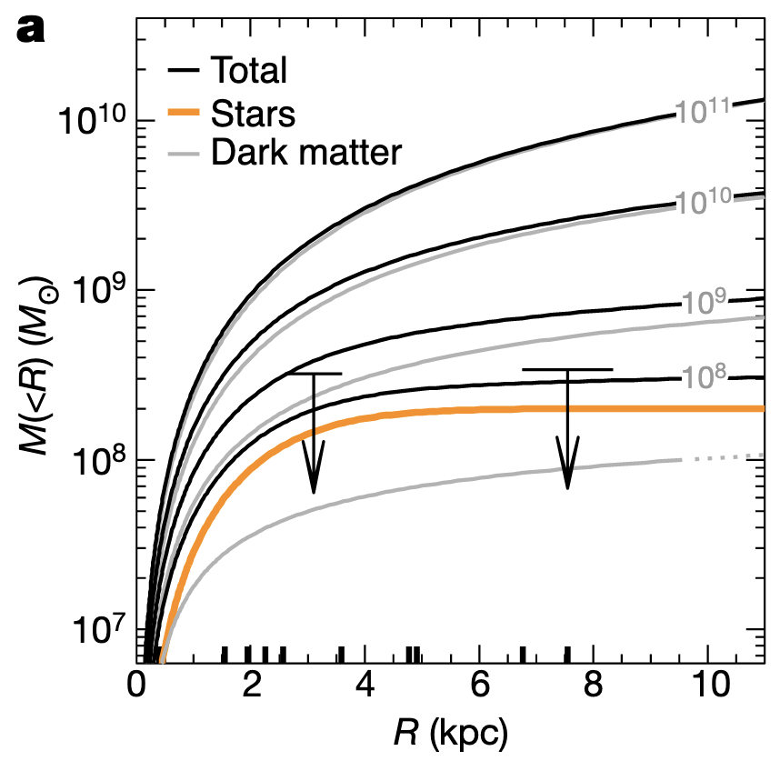
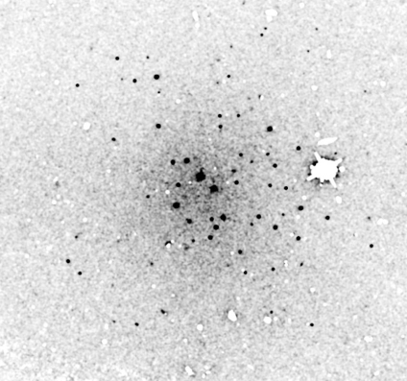
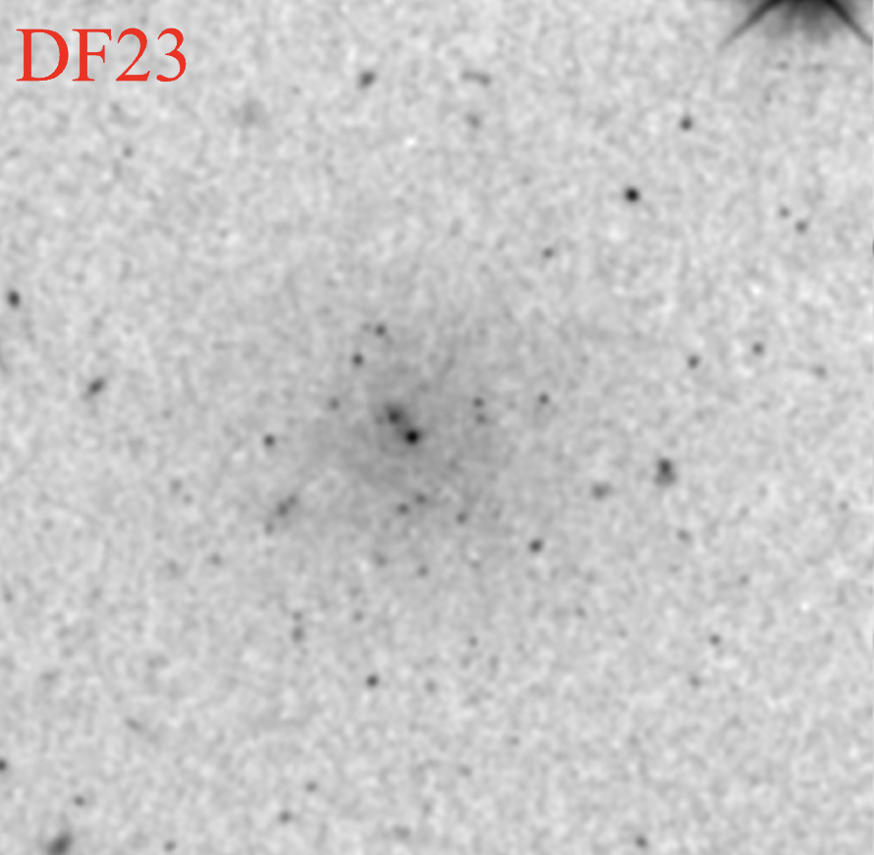
  Small-scale puzzles (2): dwarfs are strikingly diverse – hard to fully reproduce in CDM simulations
Co-existence of compact & diffuse dwarfs
Dark-matter deficient, ultra-diffuse galaxies (DF2, DF4, FCC124, DF9 etc)
van Dokkum + 18
Dwarfs with a lot of globular clusters
Nucleated dwarfs
Nuclear star cluster
Danieli + 21
Lim + 18

Slide 7
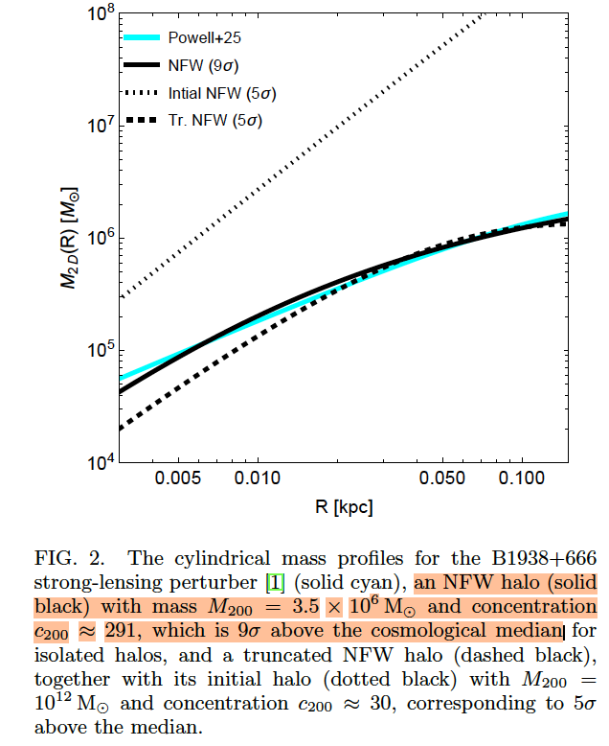
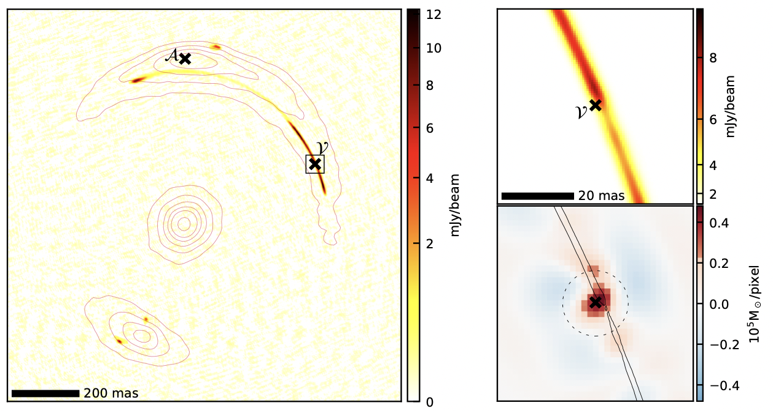
  Small-scale puzzles (2): dwarfs are strikingly diverse – hard to fully reproduce in CDM simulations
Yu 26
Powell+25 JVAS B1938+666

Slide 8
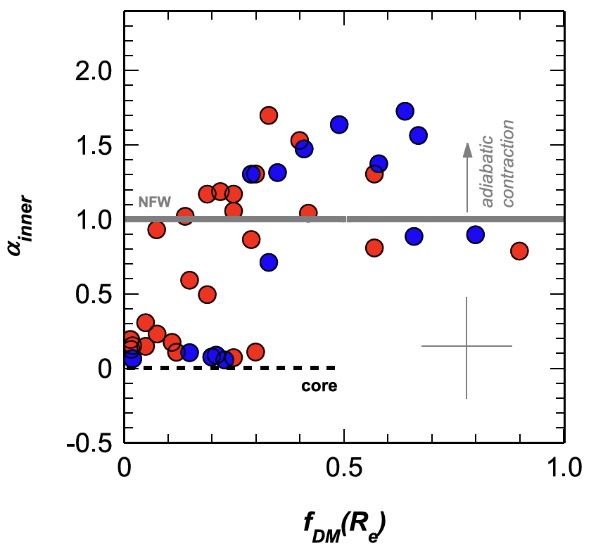
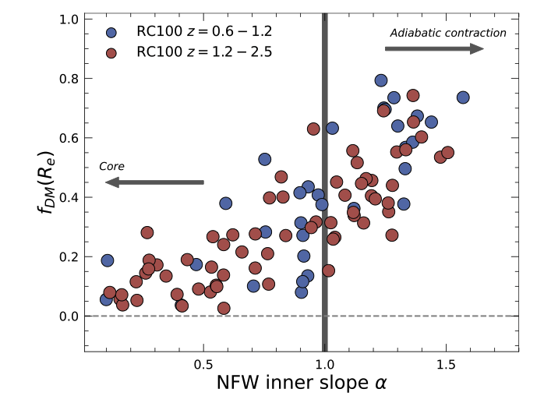
Small-scale Puzzles (3) around cosmic noon: DM cores in massive galaxies ?
Density slope
Genzel+20
Nestor Shachar+23
DM fraction
See Dekel, Freundlich, FJ + 21 for an explanation of massive cores by dynamical-friction heating by compact satellites

Slide 9
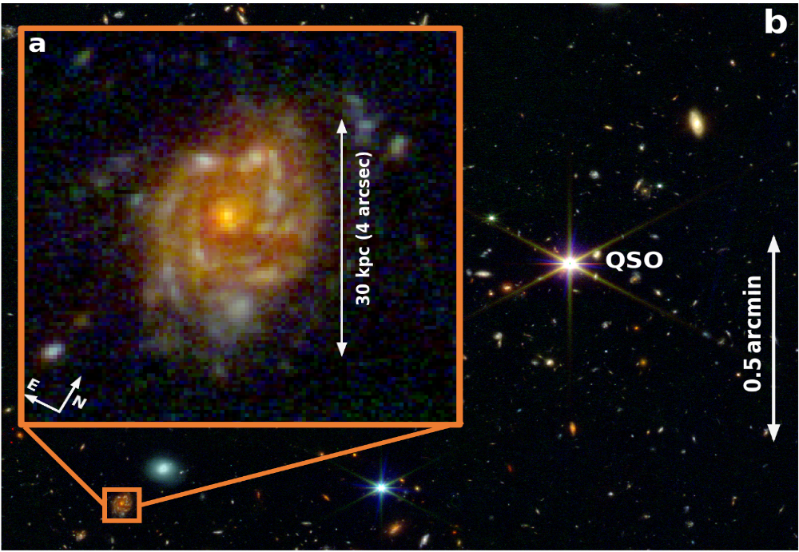
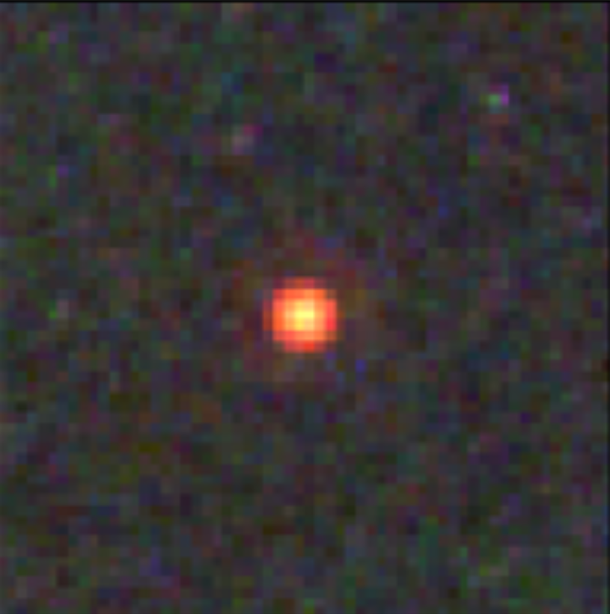
  Small-scale puzzles (4) in JWST era: extreme galaxies in the early Universe
Giant bulge-deficient disk galaxies at z~3: What makes the gigantic disk without a significant nugget stablising the disk？
Little Red Dots (LRDs) at z~6: stellar-host deficient SMBHs of 10⁶⁻⁸ M_{sun} that are aboundant: How to make SMBHs without producing substantial hosting galaxy?
<50pc
Wang, Sebastiano + 2025 Nature Astronomy
Kovceski et al. (2023), Harikane et al. (2023), Greene et al. (2024), Matthee et al. (2024), ... ...
See FJ+25 for their formation conditions 2504.01070
See FJ+26 ApJL, 996, L19 for an SIDM explanation

Slide 10
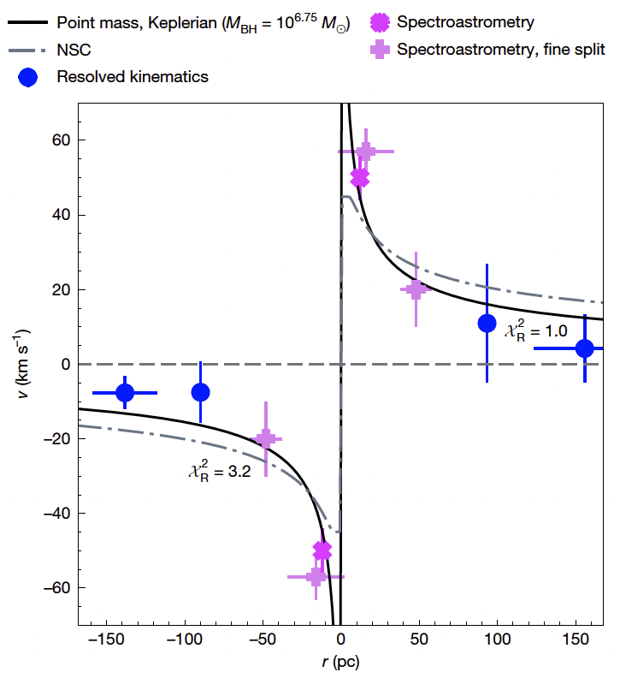
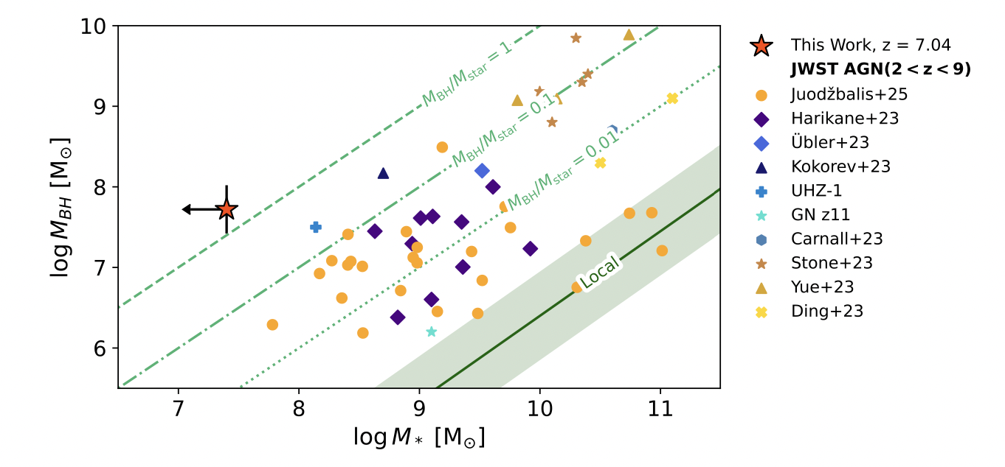
  Small-scale puzzles (4) in JWST era: extreme galaxies in the early Universe
Juodžbalis+26: resolved gas kinematics of a lensed LRD at z~7
Keplerian rotation curve → almost naked SMBH
Consistent with no stellar host, no substantial DM halo either → DM-deficient galaxy in the early Universe?

Slide 11
Part I - Can we solve the small-scale puzzles within the standard CDM paradigm?
We consider:
Cosmological halo-to-halo variance of satellite populations that arise from halo merger trees;
Galaxy-halo connection and halo response to the baryonic processes that diversify galaxies;
Environmental processes that diversify galaxies.

Slide 12
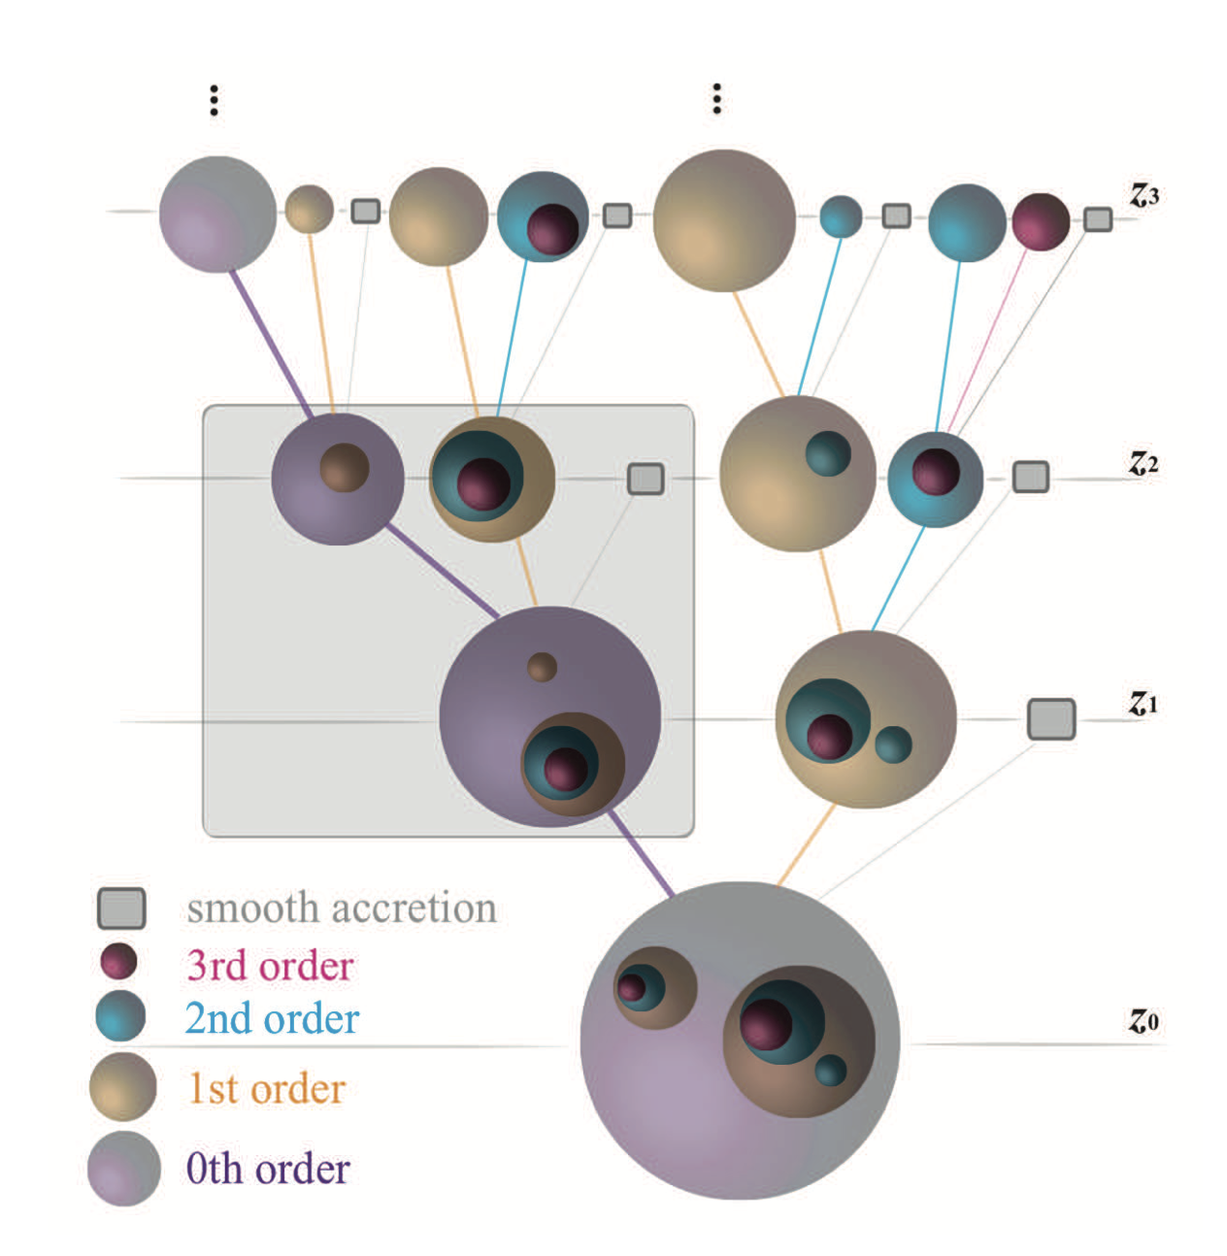
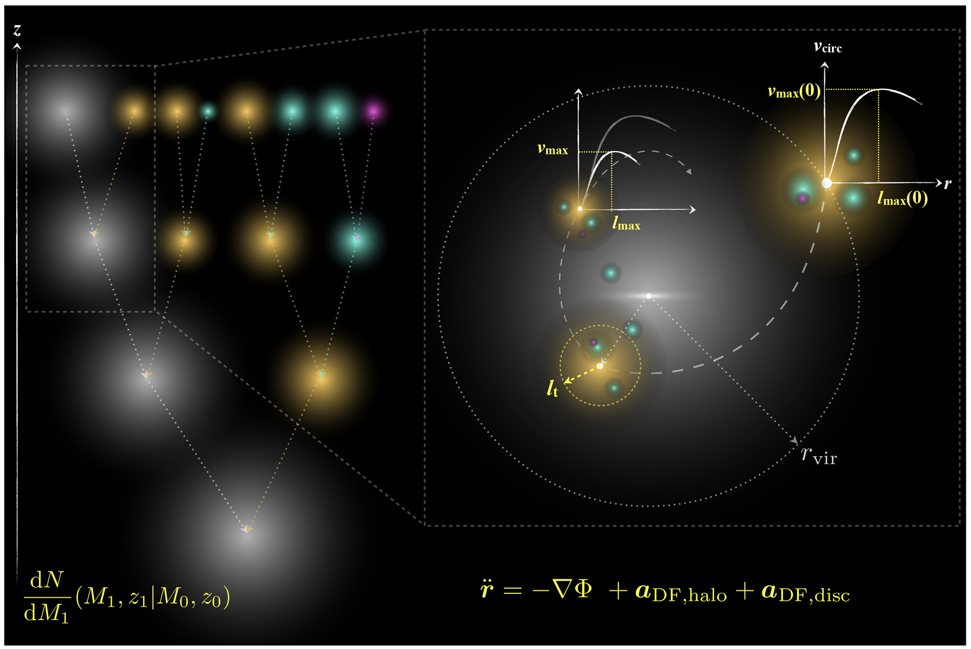
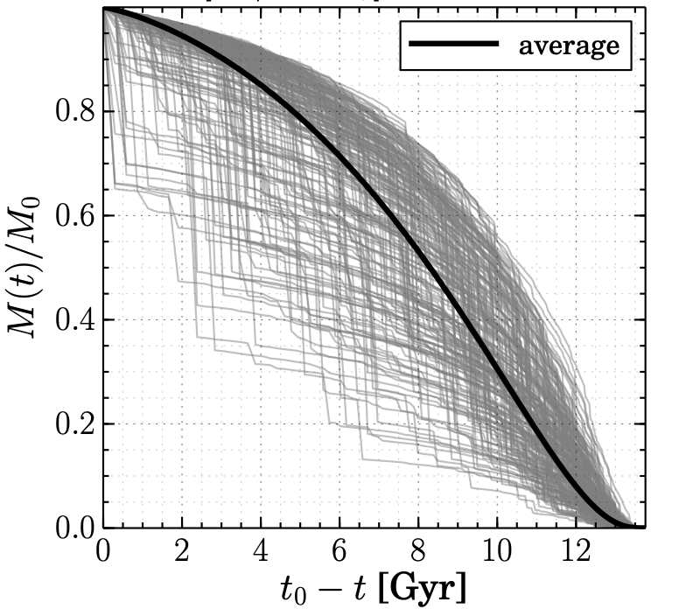
1. Halo merger trees and the halo-to-halo variance in the dark forest
Jiang & van den Bosch 14
  “When the forest is large, you have all kinds of trees…”
Milky Way?

Slide 13
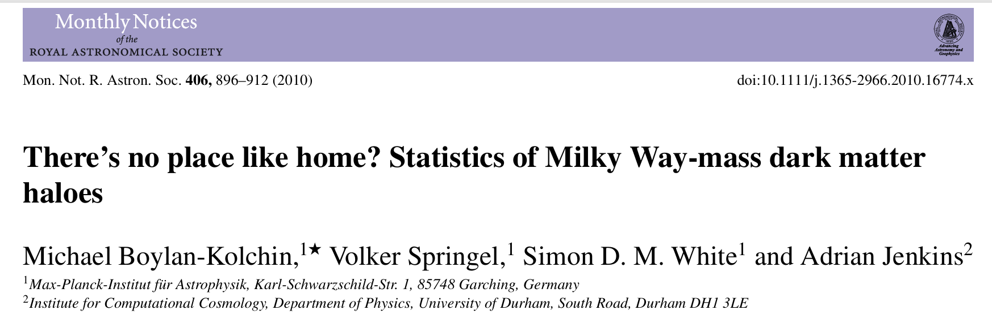
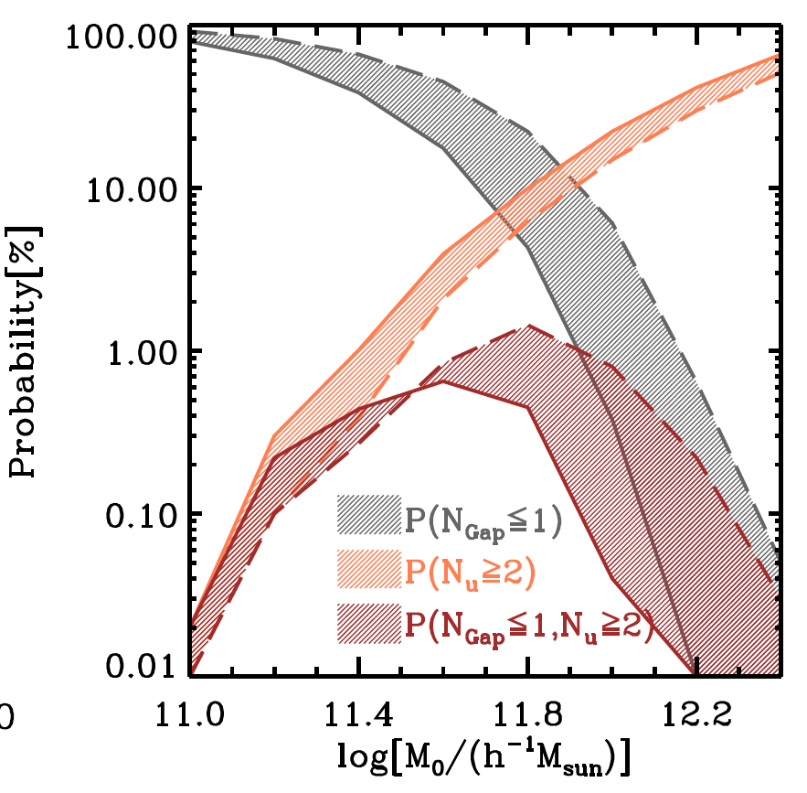
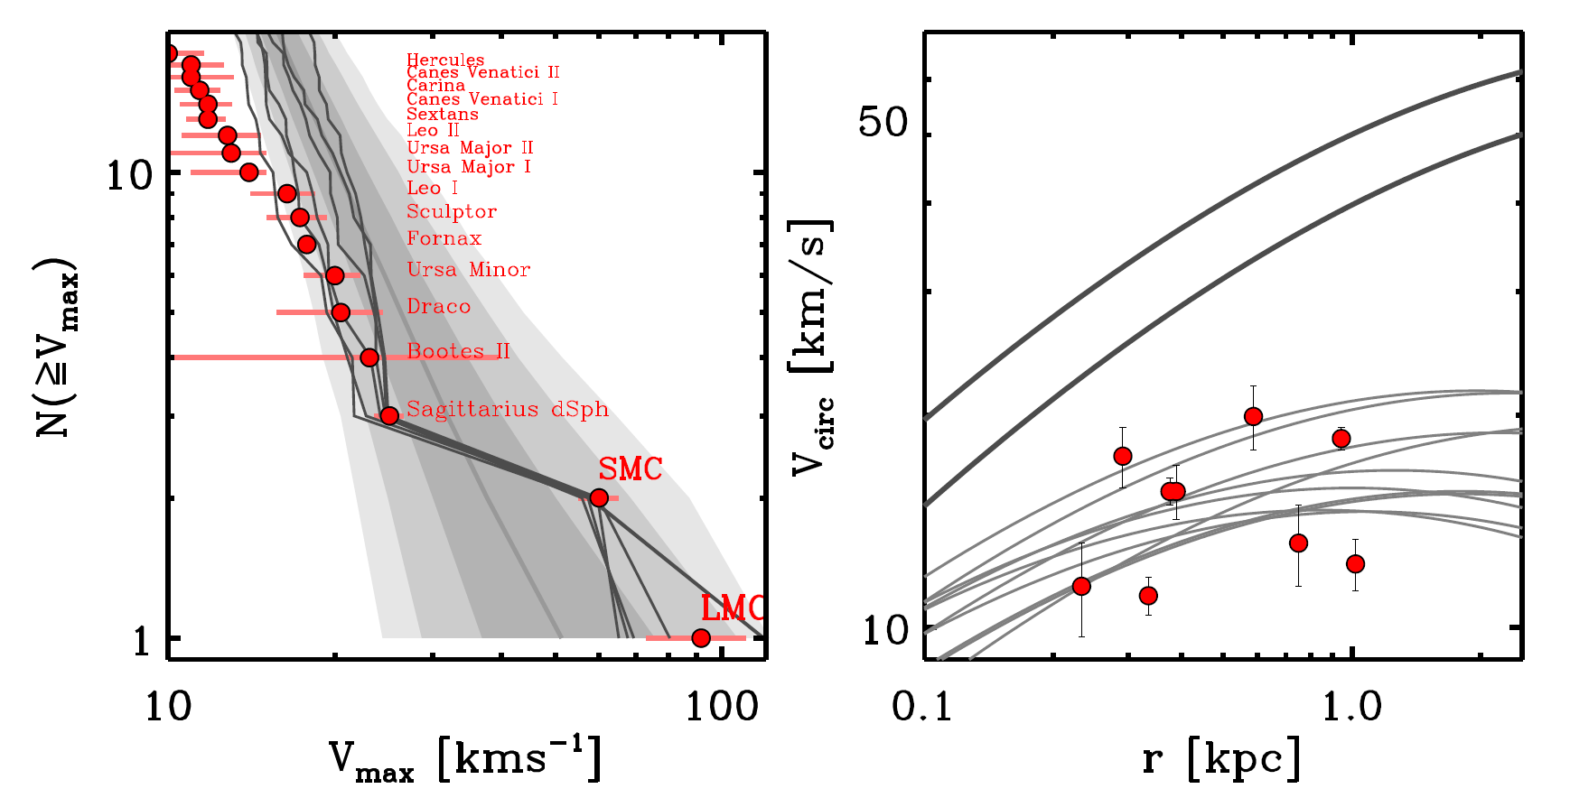
1. Halo merger trees and the halo-to-halo variance in the dark forest
  MW is just a 1 percent outlier in terms of satellite statistics
Jiang & van den Bosch 15
LMC
SMC

Slide 14
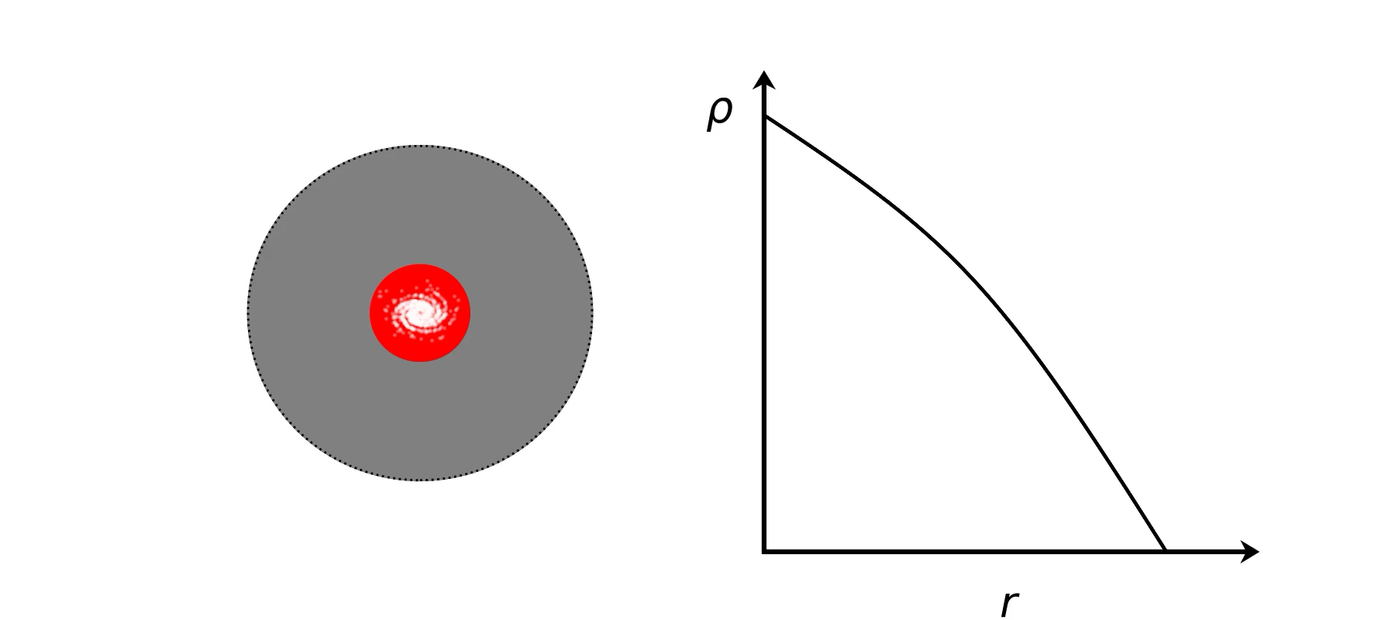
2. Galaxy-halo connection: halo structural response to baryonic processes
“cusp”
DM
gas
“core”
density
galaxy
DM halo
radius
SN / AGN driven gas outflows —> expansion and cusp-core transformation
Baryonic potential —> adiabatic contraction
Freundlich, Dekel, Jiang et al. 20
Freundlich, Jiang, Dekel et al. 21

Slide 15

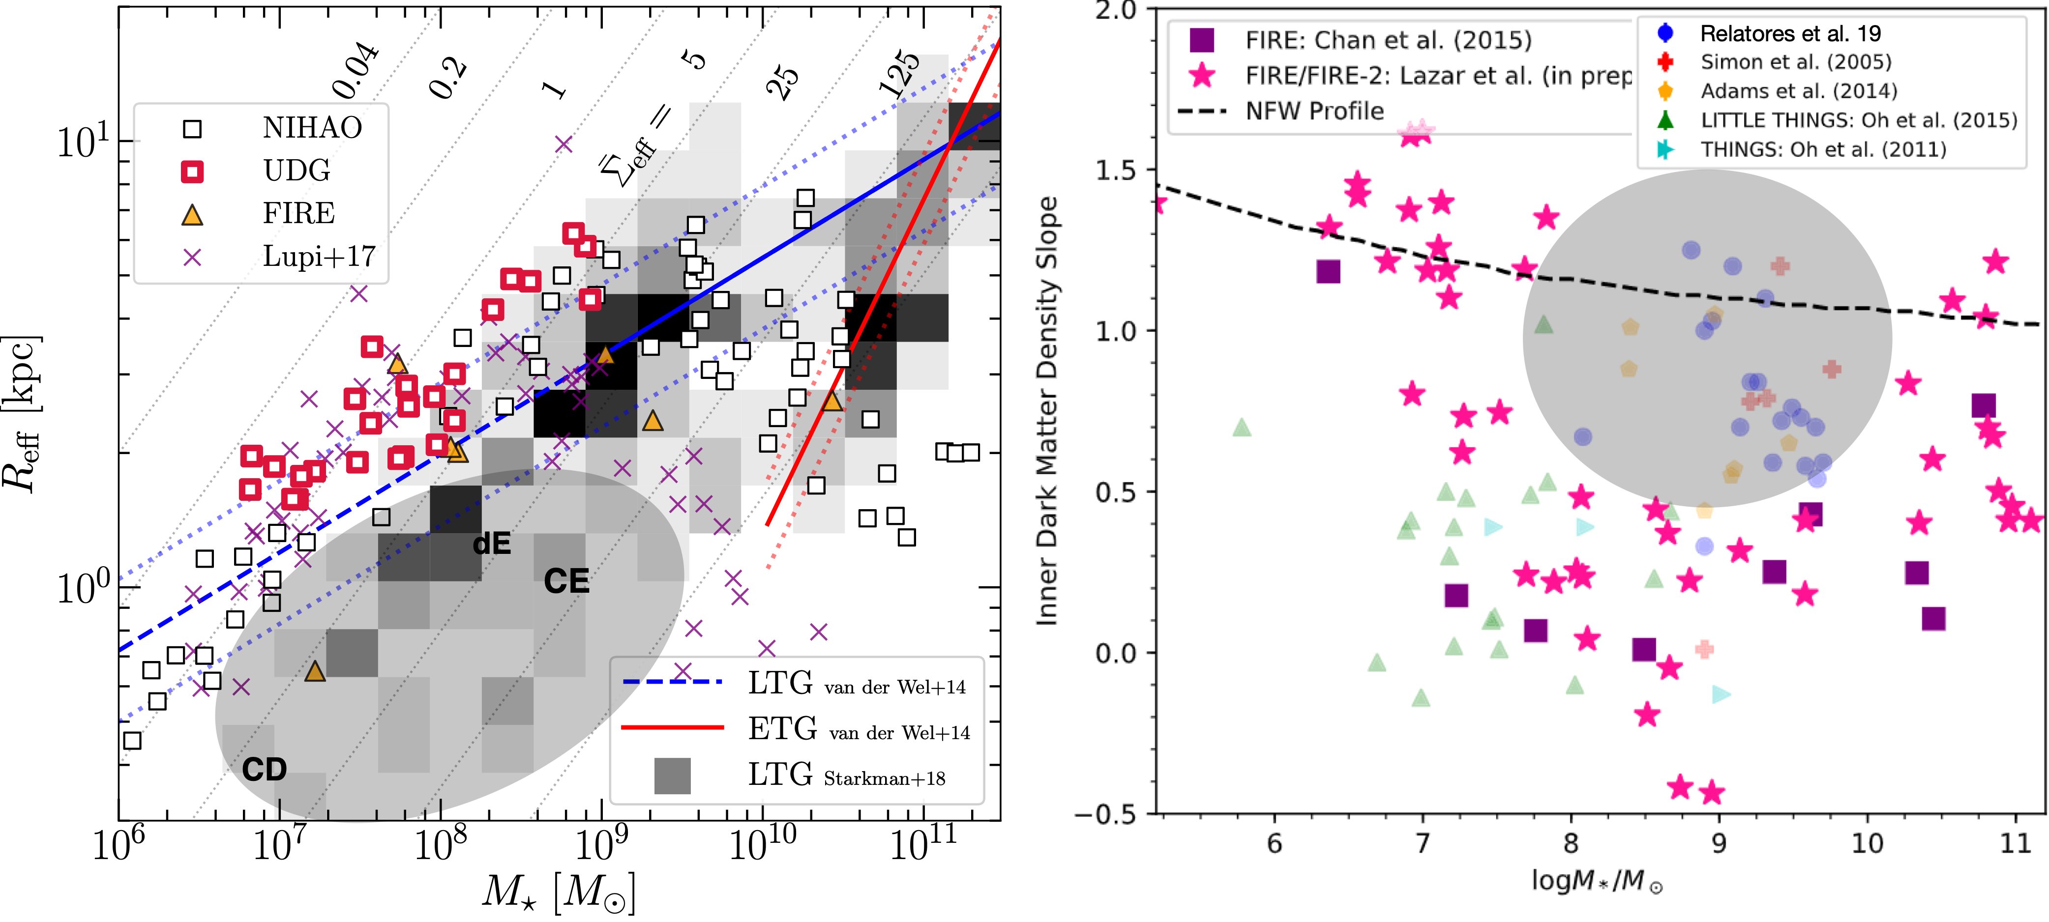
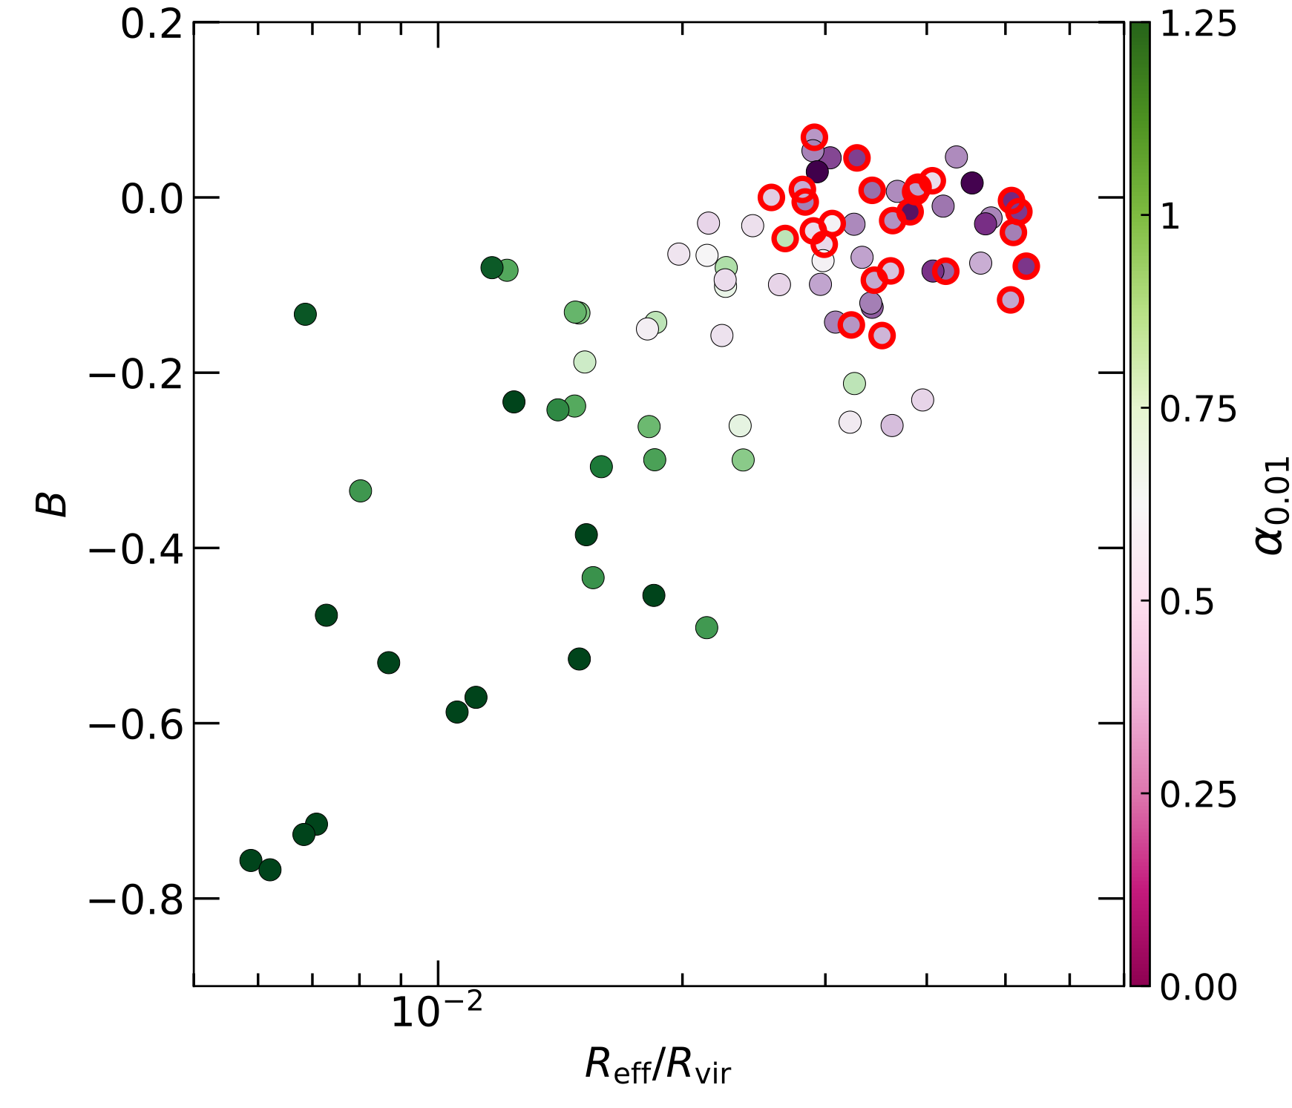
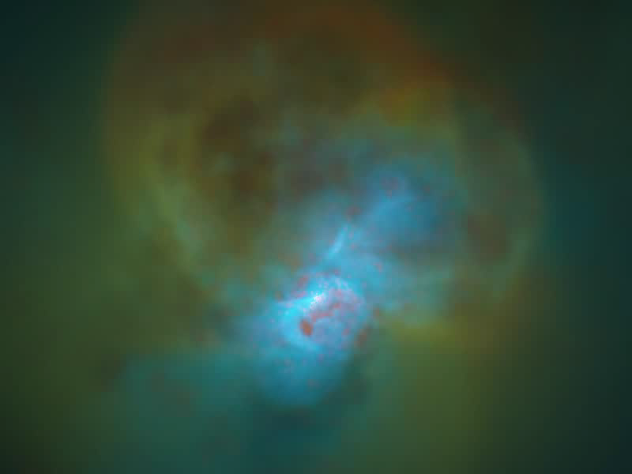
2. Galaxy-halo connection: halo structural response to baryonic processes
size
Several CDM+hydro simulations over-produce puffy galaxies (cored halos), but are short of compact (cuspy) systems, in bright-dwarf regime ( Mstar = 10^{7.5-9.5} Msun )
ultra-diffuse
cusp
bursty star formation
mass
Jiang+19 MNRAS, 1811.10607
cusp
DM density slope
NIHAO simulation
core
smooth star formation
Rgal / Rhalo
core
mass
Relatores + 19

Slide 16
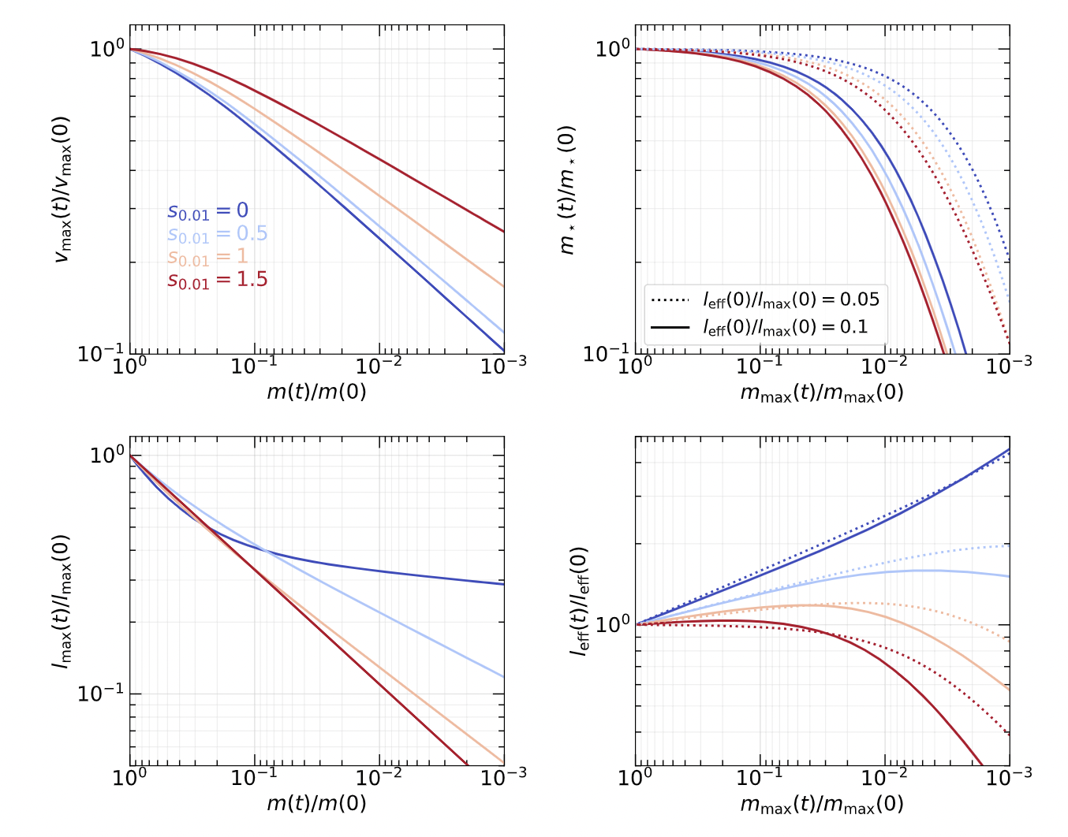
3. Environmental processes diversify galaxies.
Jiang et al. 2021, MNRAS, 502, 621
“tidal evolution tracks” depend on the initial structures and diverge as satellite galaxies evolve
Hayashi+03; Penarrubia+08,10; Errani+15,18,…
Galaxy size
expand
Subhalo structure
cusp
compactify
Initial profile
core
Mass loss→
Mass loss→

Slide 17
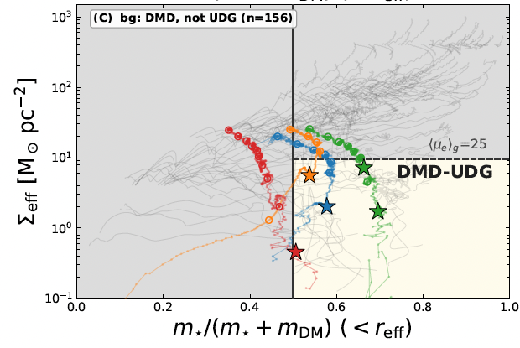
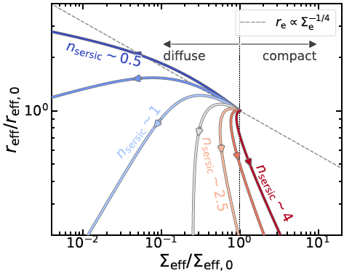
3. Environmental processes diversify galaxies
However, tidal stripping can easily produce DM-deficient galaxies (DMD), but struggle to produce ultra-diffuse DMD (DMD-UDG)
He, FJ* + in prep
DMD-UDG need to be low-Sersic, and residing in cored low-concentration subhalos to begin with

Slide 18
Part I. Can we solve small-scale puzzles within CDM? – Well, sort of…
Cosmic halo-to-halo variance alleviates the satellite tensions – MW can occur at 1% probability in CDM simulations
Diffuse galaxies (cored halos) are over-produced, compact (cuspy) ones missing, in many CDM simualtions with hydro and star formation
Tidal evolution can diversity halo and satellite-galaxy structures, depending on the initial structure, but DM-deficient UDGs are hard to reproduce …
I did not mention nucleated dwarfs, little red dots, bulge-deficient giants, but there exist partial explanations within CDM :
dynamical friction of GCs;
Direct Collapse BHs;
Special halo conditions, respectively …

Slide 19
Part II. Pros of SIDM:
SIDM provides elegant solutions to various small-scale puzzles across time

Slide 20
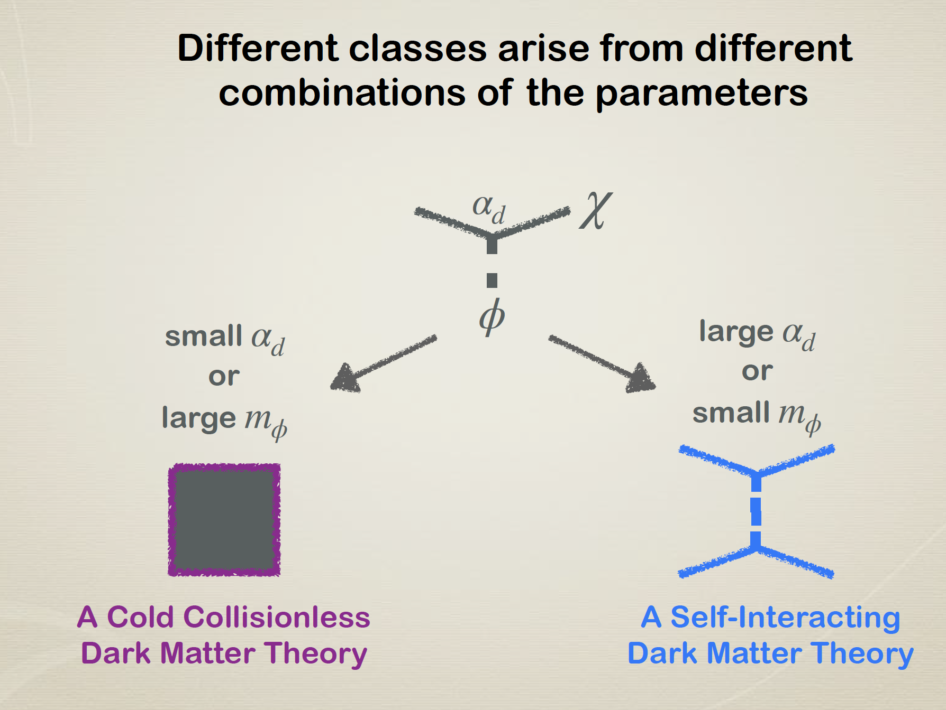
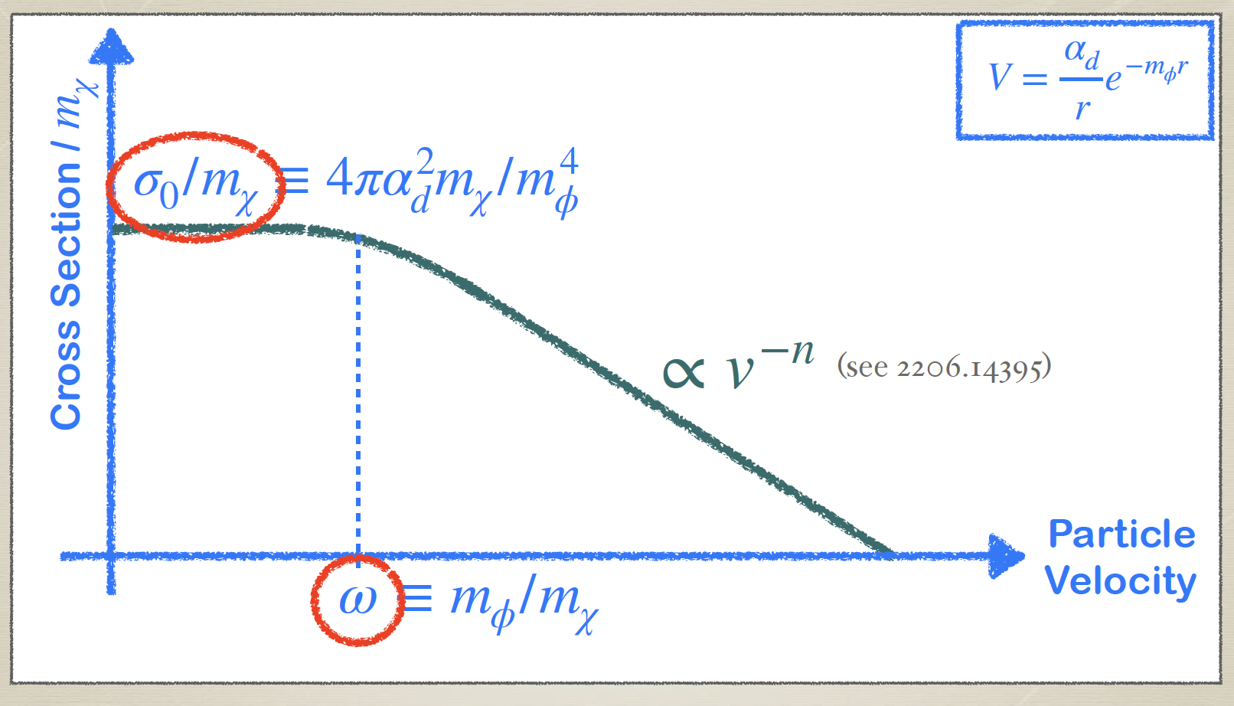
SIDM is not more exotic than CDM -- two sides of the same coin
SIDM and CDM are both extreme cases of self-interactions obeying Yukawa-like potential
Velocity dependent cross-section
Cartoon by Oren Slone
←dwarf
→ cluster

Slide 21


SIDM: same as CDM on large scale, only modifies halo center
CDM
SIDM
Rocha+13

Slide 22
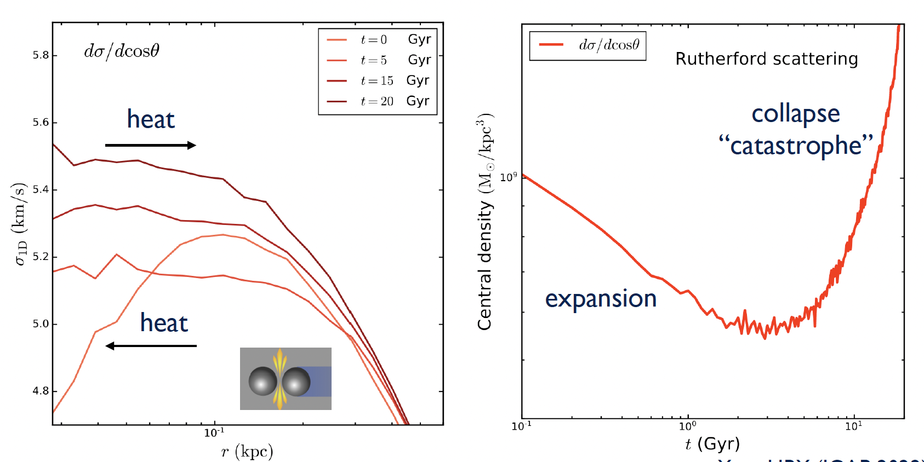
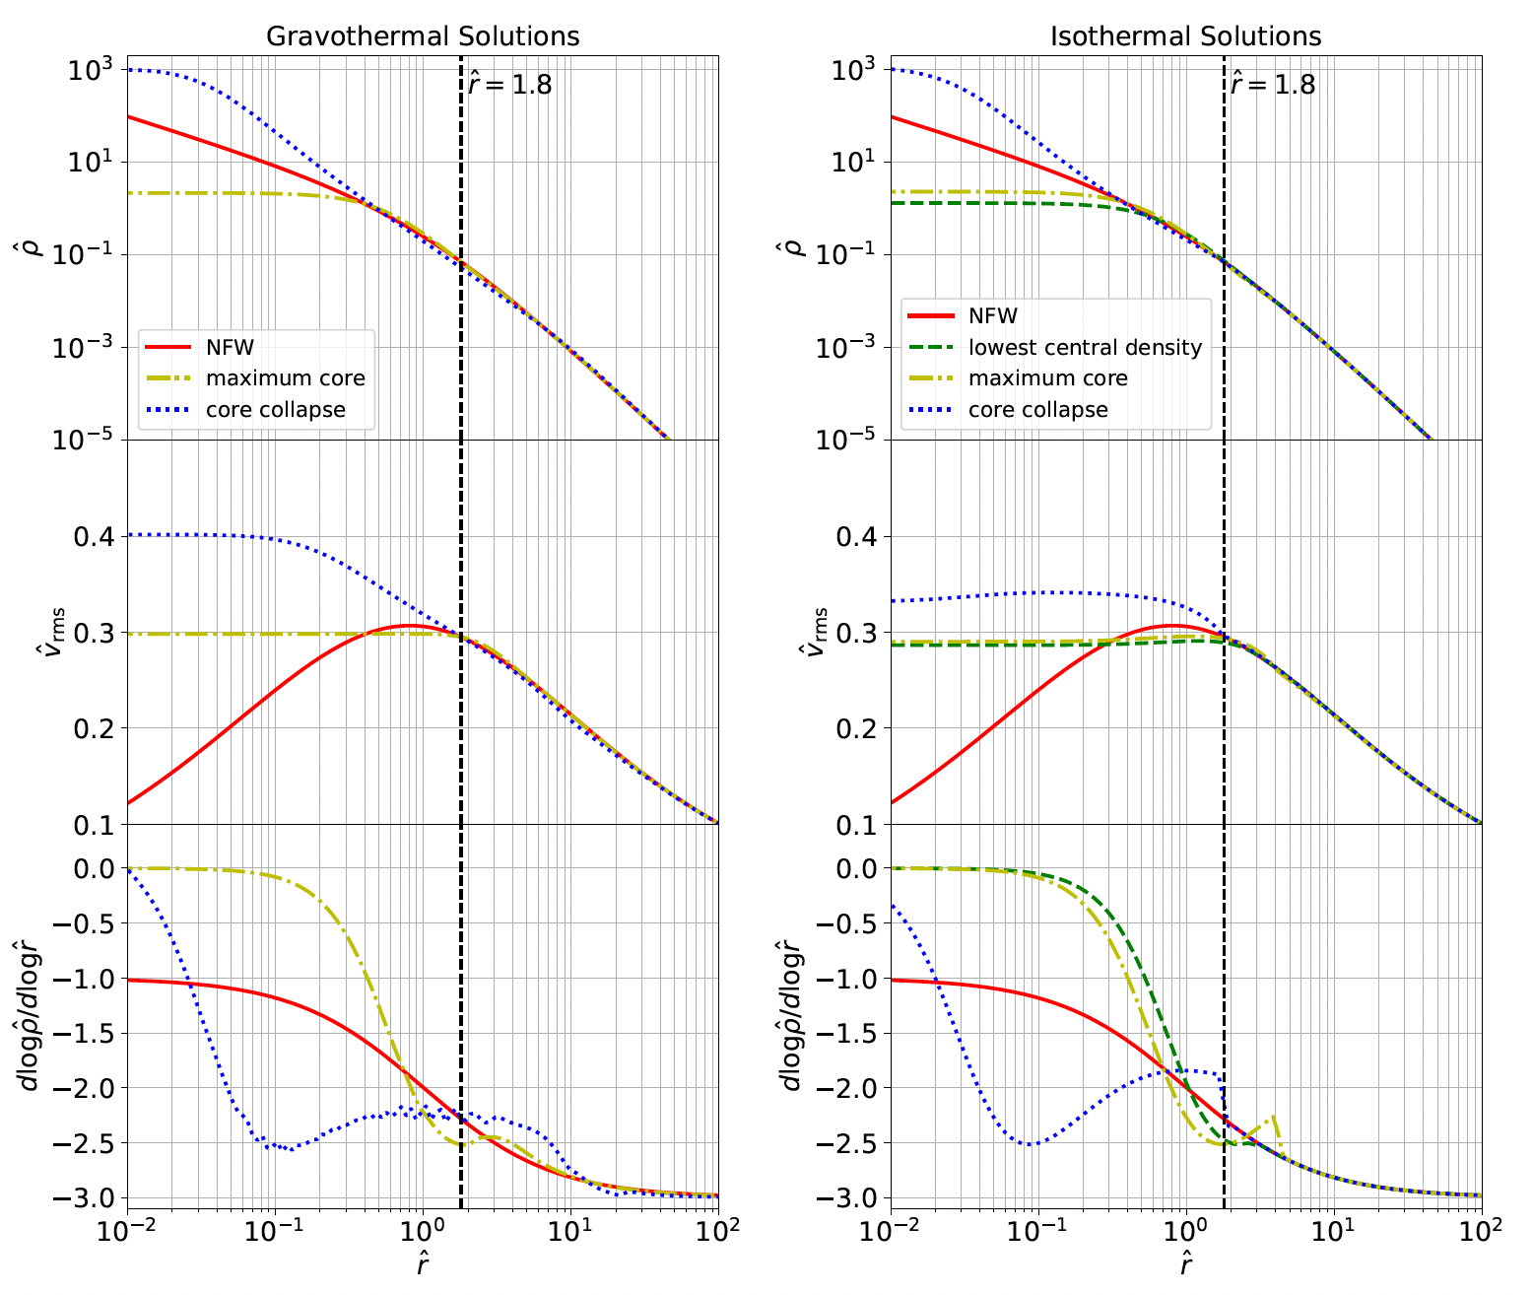
SIDM effects — isothermal core and core-collapse
BH
Yang & Yu 2022
core-collapse
Isothermal core
v dispersion
Yang S.*, FJ* + 24 2305.05067
Radius
Self-interaction thermalizes halo center
Isothermal core hotter than outskirt -> self-gravitating systems have negative heat capacity -> core collapse
core collapse -> 1% halo mass turns into seed BH, independent of halo mass or halo concentration
Pollack+15; Feng + 21,22,25; Gu, FJ*, Chen* + 26a, 26b 2601.17117, 2609.16122
If core-collapse occurs before re-ionization, “naked” BHs in halos without host galaxy can form -> LRDs ??

Slide 23
Pros of SIDM: structural diversity ⬄ different evolution stages of SIDM halo evolution
Yang S.*, FJ*, Benson + 24, 2305.05067
core-collapse
FJ +23, MNRAS, 521, 4630
Jia, FJ + 26, MNRAS, 2601.17118
Public code for computing SIDM profile:
https://github.com/ZixiangJia/SIDM_Jeans _model
maximal core
Normal dwarf in NFW halo
Ultra-diffuse galaxy in isothermal SIDM core
SIDM core-collapse -> nuclear star clusters & BH

Slide 24
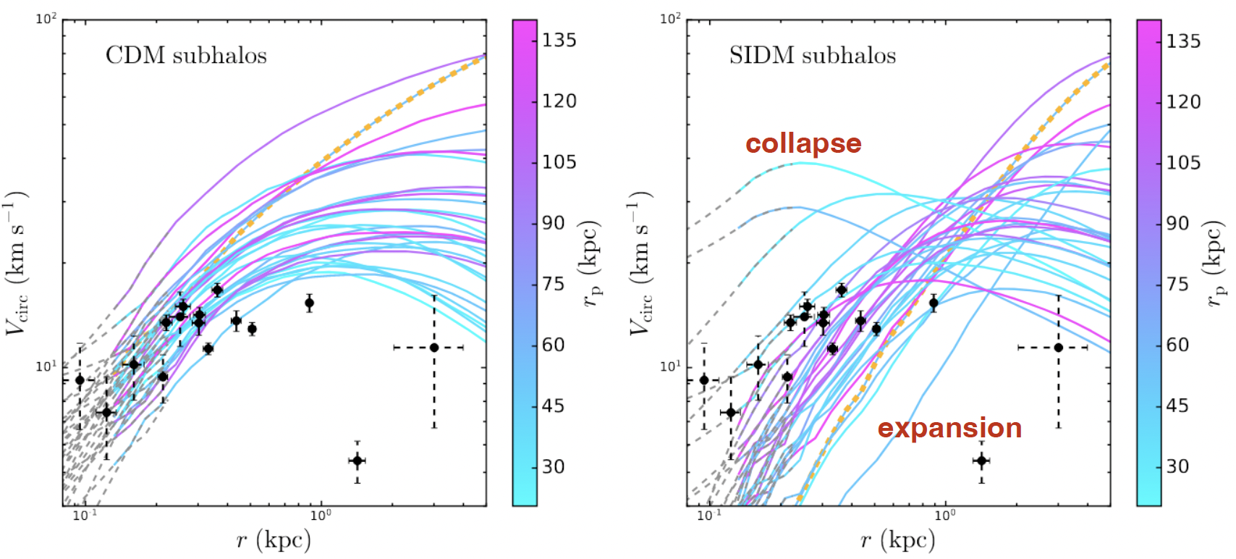

Pros of SIDM: produce sufficient satellite structural diversity
Yang D., Nadler, Yu + 22
SIDM produces substantial satellite structural diversity — a mixture of core-collapsing and isothermal-coring subhalos

Slide 25

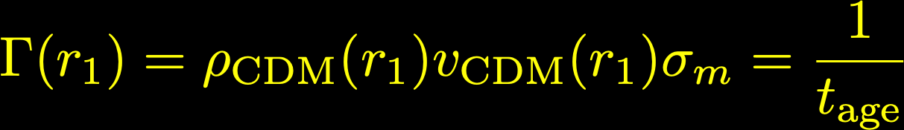
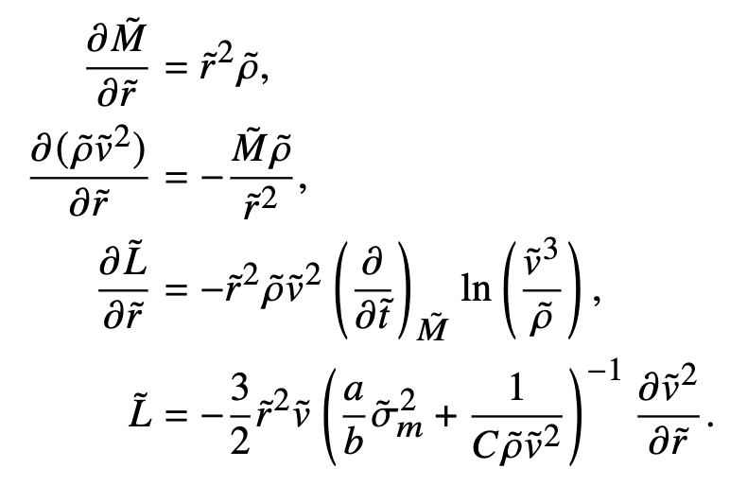

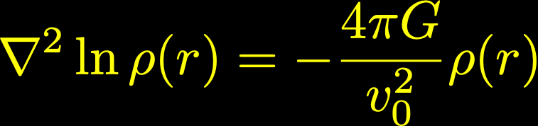
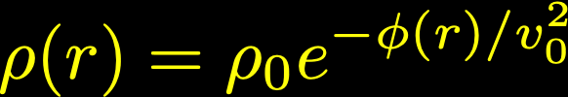

Analytical models for SIDM halos:
isothermal Jeans model & gravothermal fluid model
Isothermal Jeans model
Gravo-thermal fluid model
Inner: isothermal; outer：reduces to CDM
Evolve an initially NFW ( Mvir , c ) profile with self-interaction cross section coming in via conductivity factor in heat transfer, for a time tage
Kaplinghat+14,16; FJ+23, Jia, FJ+26
e.g., Pollack + 15; Gu, FJ*, Chen*+26a/b
mass conservation
hydro equilibrium
isothermal (ρ0, v0)
1st law
density
-
δ
-
flux
NFW ( Mvir , c )
r1
radius
Both methods treat SIDM as a modification to a target CDM halo
Isothermal model uses CDM halo for BC; Fluid model uses the CDM halo as IC

Slide 26

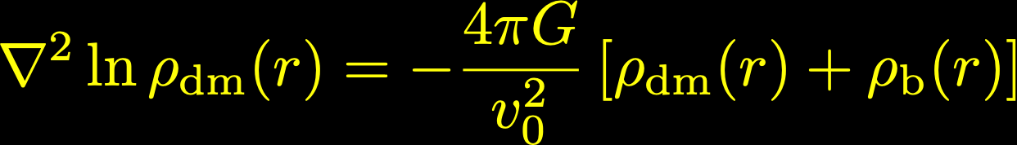
Isothermal Jeans model — adding inhabitant galaxy
given an observed baryon distribution ρb
adiabatic contraction
evaluate r1 using the contracted CDM halo
other steps remain the same
isothermal
contracted CDM halo
density
baryon
r1
NFW
radius
Jiang +23, MN, 521, 4630

Slide 27
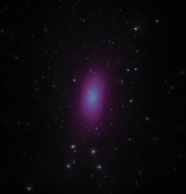






SIDM theory development 1 : co-evolution of galaxy and SIDM host halo
Jia, FJ* + in prep
N-body idealized simulation
Semi-analytical model
$r_{d}=f(M_{vir},c,m_{d},j_{d},λ,t_{age},σ_{eff})$
GIZMO
galaxy profile
$r_{d}$ not converged
(Exp disk)
SIDM halo
Stellar disk
Isothermal
Jeans
model
Iterate for $r_{d}$
at given $t_{age}$
FJ + 23
Jia, FJ* + 26
Mo, Mao, White 1998
DM profile
$$V_{c}\left(r\right)$$

Slide 28
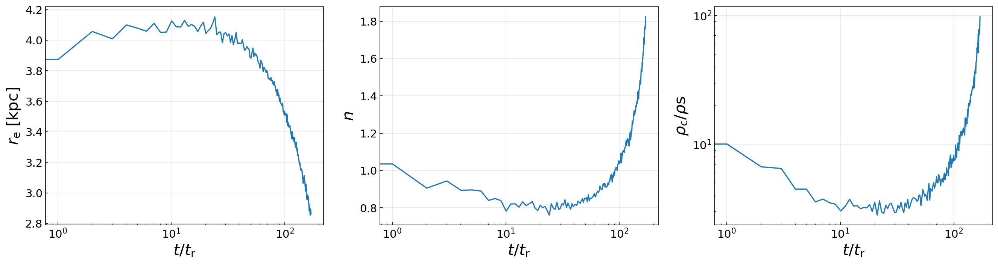

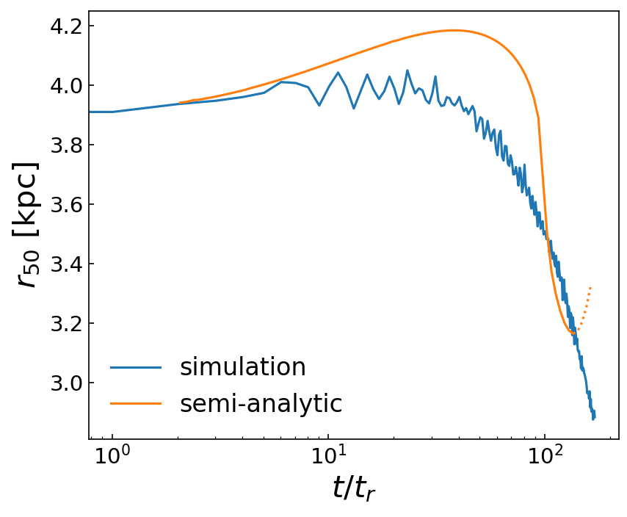
SIDM theory development 1: galaxy – SIDM halo coevolution
Jia, FJ* + in prep
Halo central density
Strong co-evolution
Pro of SIDM:
Halo evolution drives galaxy morphology: Stellar distribution expands during core-formation (UDG); decreases in size during core-collapse, even developing a bulge-like nucleus deep into core-collapse (compact or nucleated dwarf)
Core-collapse
Core-expansion
Zixiang Jia
Sersic index
n~2 (approaching pseudo-bulge)
Disk size
Exponential (n=1)
n<1
Time →

Slide 29
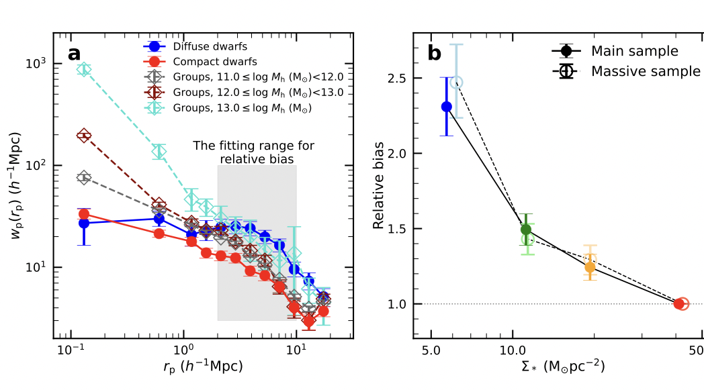

Pro of SIDM: explains the suprising strong clustering of ultra-diffuse galaxies
Zhang, Chen*, Rong*, Wang* + 25 Nature

Slide 30









SIDM theory development 2: first-principle gravothermal core-collapse calculations
Gu, FJ*, Chen* + 26a PRD 2601.17117
Gu, FJ*, Chen* + 26b, 2609.16122
Non-Equilibrium, relativisitic fluid model (Misner-Sharp Formalism)
Equilibrium fluid model
Hua-peng Gu
Enclosed rest mass: A
Enthalpy w
Bulky motion U
Heat flux q

Slide 31


SIDM theory development 2: first-principle gravothermal core-collapse calculations
For a pre-reionization halo of mass M_{vir} ~ 10⁸ M_{sun} and modestly high concentration (c>~6)
→ it can seed a BH rapidly (in ~200Myr), thanks to v-dependent cross section!
→ but the original seed mass at horizon formation is merely ~10⁻⁶ M_{vir}
Gu, FJ*, Chen* +26a/b

Slide 32

Pro of SIDM: explains LRDs as almost-naked SMBHs at high z
Gu, FJ*, Chen* + 26b, 2609.16122
While the original seed is small, DM accretion onto seed BHs are super-Bondi
→ for high-concentration, early-forming halos, their core-collapse BHs (CCBHs) can become SMBHs by the Little-Red-Dot epochs (z~6)

Slide 33

SIDM theory development 2: first-principle gravothermal core-collapse calculations
Gu, FJ*, Chen* + 26b, 2609.16122
Five-stage evolution of SIDM halo, BH seeding, and BH super-Bondi growth

Slide 34

Pro of SIDM: explains almost-naked SMBHs at high z
The original halo center can be absorbed by the growing SMBH via dark accretion → leaving a SMBH surrounded by low-density DM envelop!
→ Powell+25 JVAS B1938+666
→ Juodžbalis+26: lensed LRD at z~7
Gu, FJ*, Chen* + 26b, 2609.16122
We are NOT saying all halos should be like this, because subsequent major merger can rejuvenate NFW-like profile

Slide 35



Halo condition for BH seeding by SIDM core-collapse
Little Red Dots (LRDs) at z~5: almost naked SMBHs of 10⁶⁻⁸M_{sun}
tcc (Mvir, c, σ0m, ω | z )
FJ + 2025, ApJL, 2503.23710
Time to core-collapse and thus seed BH depends on halo mass, concentration, and cross section: higher c, larger cross section -> faster core-collapse
halo mass
halo concentration
e.g., Balberg & Shapiro 2002; Pollack+2015; Yang+2023 …
Given cross-section & c, there is a characteristic halo mass where tcc is shortest
Mass trend: mass too low -> DM density too low -> inefficient self-interaction;
mass too high -> cross section too small (because of velocity-dependence) -> inefficient self-interaction

Slide 36

Little Red Dots formation from core-collapse of SIDM halos
Little Red Dots (LRDs) at z~5: almost naked SMBHs of 10⁶⁻⁸M_{sun}
tcc (Mvir, c, σ0m, ω | z ) < t_{form, lookback} (M_{vir}, z)
Core-collapse timescale depends critically on halo concentration
Jiang + 2026, ApJL, 996, L19
Only early-forming, high-concentration dwarf (<10^{9.5}Msun) in the early Universe (z>8) can core-collapse timely to form CCBHs and to be observed as LRDs by z~6!

Slide 37



Concentration at extremely high z from cosmological simulations
FJ + 25, ApJL, 2503.23710
Halo concentration distribution exhibits marginal trend with mass or redshift at z>~6, and can reach values as high as 10-15, needed for SIDM core-collapse
log c ∈ N [ μ = log(2.8), σ = 0.19]
High-c tail exists !
from “VVV” cosmological simulations optimized for high-z mini halos -- also seen in GUREFT (Yung+24)
Haonan Zheng

Slide 38



Halo condition for BH seeding by SIDM: core-collapse time < time since halo formation
FJ + 26, ApJL, 2503.23710
tcc < tform,lookback(Mvir, c | z)
In this movie, we keep c and cross section fixed, and scan halo mass → SMBH is seeded only for early-forming halos of a certain mass range Mvir ≈ 10^{6.5-9.5}Msun
Interestingly, this seeding mechanism only operates at very high redshift (z>8.5) — so there is no need to worry that all halos eventually collapse such that BHs are too abundant
Technical note: green bands indicate halo formation-time distributions (extended-Press-Schechter theory)

Slide 39

Halo condition for BH seeding by SIDM: gravothermal-evolution not disturbed by major mergers
Just another way of saying the same thing as:
core-collapse time < time since halo formation
Low-mass halos <10^{6.5} M_{sun} : major mergers too frequent → core-collapse easily disrupted
Massive halos >10^{9.5} M_{sun} : too few; also, high mass makes SIDM cross section too low
Sweet-spot for high-z LRD host: M_{vir} ~ 10⁷-10^{9.5} M_{sun}

Slide 40



Pro of SIDM: the first cosmological statistical explanation of LRDs
FJ+26, ApJL, 2503.23710
Model ingredients:
- Halo merger trees
FJ+21 SatGen model
- BH seeding by SIDM core-collapse if
tcc < tform,lookback
- BH mass growth w. Eddington ratio
log λ_{Edd} ∈ N [ μ = log(0.4), σ = 0.3]
- BH mergers by dynamical friction
SIDM cross section adopted: σ0 ≈ 30 cm²/g ω = 70km/s — interestingly consistent with local constraint (see next page) !

Slide 41


SIDM cross section with galaxy kinematics
Improved isothermal Jeans model
Jia, FJ* + 26, MNRAS, 2601.17118
Adiabatic contraction
Empirical treatment of core-collapse
- Enable us to use a larger rotation-curve sample (do not need to throw away baryon-heavy systems)
Zixiang Jia
Current kinematics data cannot break the degeneracy between σ_{m0} ~ 100-1000 cm²/g, ω ~ 10-100 km/s and σ_{m0} <10 cm²/g , ω > 100 km/s

Slide 42


Pro of SIDM: the cross sections that explains LRDs agree with local kinematics constraints !!
σ0 ≈ 30cm2/g ω = 70km/s, as used in the LRD calculation
Blue band : local constraint of SIDM cross section from kinematics using rotation curves from SPARC and an improved SIDM Jeans model of Jia, FJ*+26, FJ+23,
LRD mass function is sensitive to the SIDM cross section — promising way to constrain DM physics
Red star : the cross section used for the LRD mass function — consistent with local constraint!

Slide 43




Pro of SIDM: the cross section that explains early LRDs agrees with local constraints !!
Slone, FJ, Lisanti, Kaplinghat, 23, PRD, 107, 4
over collapsed
✔
core-collapse
over cored
✔
σ0 ≈ 30cm2/g ω = 70km/s, as used in the LRD calculation
CDM like
for SIDM to be interesting, the cross section needs to be large: σ_{m0} ~ 10-1000 cm² /g, ω ~ 10-100 km/s

Slide 44


Pro of SIDM: explains LRD clustering → preliminary observations favor low-mass host and low bias factor, consistent with SIDM prediction
Little Red Dots (LRDs) at z~5: almost naked SMBHs of 10⁶⁻⁸M_{sun}
Only early-forming, high-concentration (c >~ 10) dwarf (<~10^{9.5}Msun) halos in the early Universe (z>~8) can core-collapse timely
Wang, FJ*+26, 2603.15736
LRDs of SIDM origin reside in dwarf halos

Slide 45
Part III. Cons of SIDM:
Hard for cosmological runs to resolve core-collapse from first principles

Slide 46

Con of SIDM:
Hard to simulate in cosmologoical runs: difficulty with core-collapse
Palubski (incl FJ) +24, 2402.12452
Need extremely high temporal resolution to avoid multiple scattering per step, in order to correctly resolve core collapse → Prohibitively slow in cosmological runs once even just one halo collapses
Time step parameter

Slide 47

Con of SIDM:
For large cross sections, dynamical friction is strong, no core stalling…
van den Bosch & Dattathri 26
SIDM host halo has no core stalling for satellites, even if it has an isothermal core → might be a problem for explaining systems like Fornax

Slide 48
Pros & Cons of SIDM
Pros:
produce sufficient satellite structural diversity:
→ alleviates TBTF；
→ explains UDG formation naturally, and explains UDG strong clustering;
→ hopeful to explain compact and nucleated dwarfs
Produce almost-naked SMBHs at high z:
→naturally explains LRDs as host-galaxy-deficient SMBHs;
→naturally produce SMBHs with low-density DM envelop as hypothesized for a few lensed systems;
→provides the first cosmological statistical explanations of LRDs, and explains LRD modestly weak clustering
High-z BH demographics and low-z kinematics require consistent SIDM cross sections! Promising to jointly constrain DM
Core-collapse difficult to resolve in cosmological simulations, prohibitively slow to run from first principles for large v-dependent cross sections
Cons:
Cross section parameter degeneracy
Weak core stalling of star clusters

