Slide 1
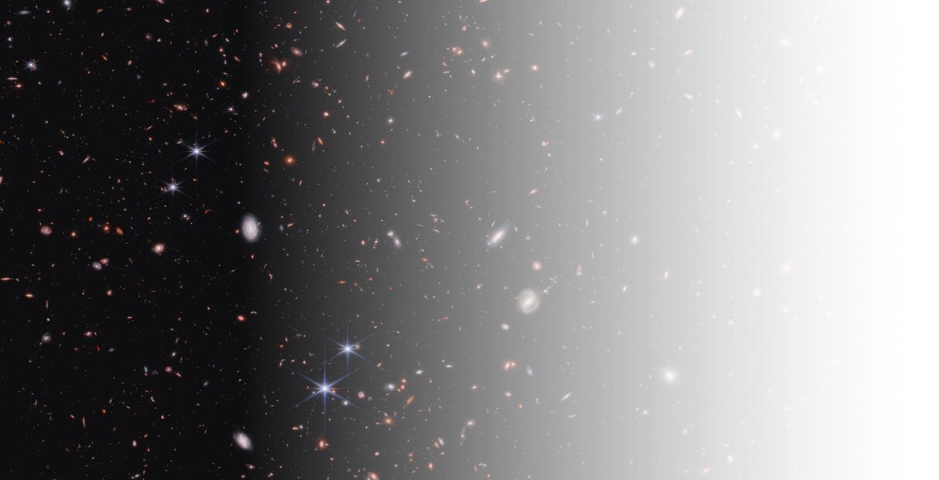


Little red D·ts
Beyond standard scenarios
Wenzer Qin
Simons Junior Fellow, New York University
Sep 30th, 2026 | News from the Dark
Notes:
Thanks for the opportunity to speak in front of you all today
For those of you who don’t know me...simons junior at NYU.
So my research sits at the interface of particle physics, cosmology, and astrophysics---traditionally, much of my work has focused for example on constraining particle properties of dark matter using cosmological observables
But recently, my interests have led me towards thinking about how we can use early structure formation to constrain beyond standard model physics
So for today’s talk, I will be focusing on a phenomenon that we’ve been calling not-quite-primordial…

Slide 2
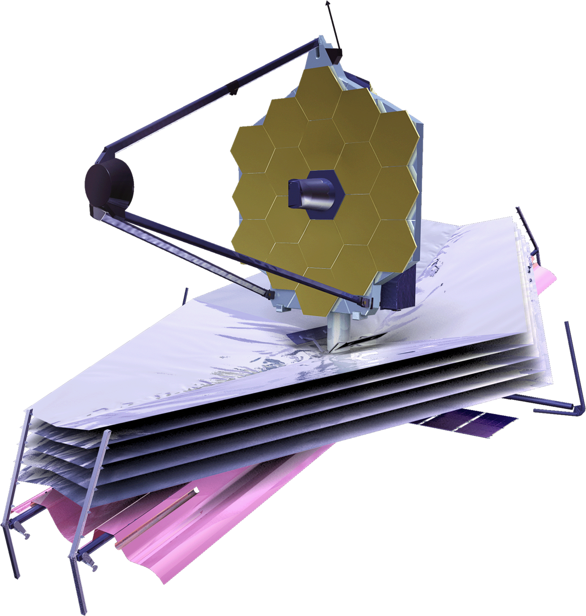
James Webb Space Telescope (JWST)
Launched on Christmas 2021

Slide 3
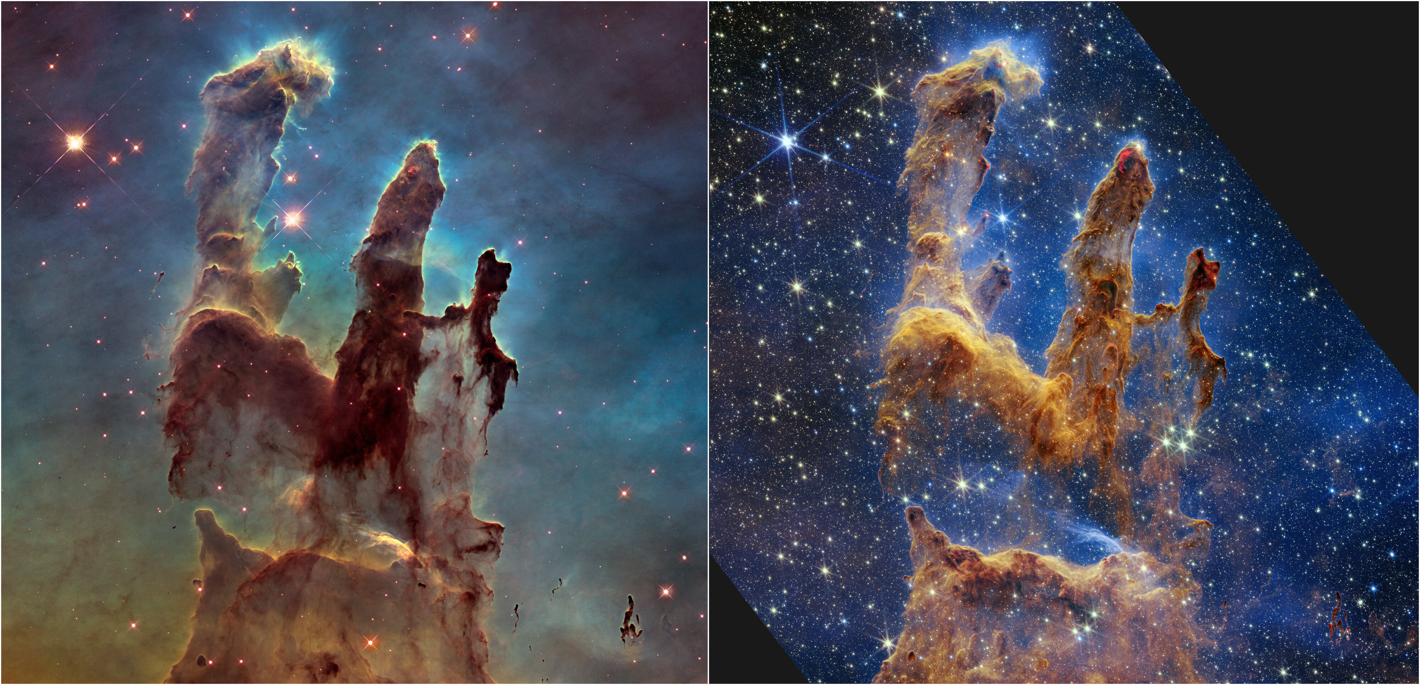
Hubble vs James Webb

Slide 4
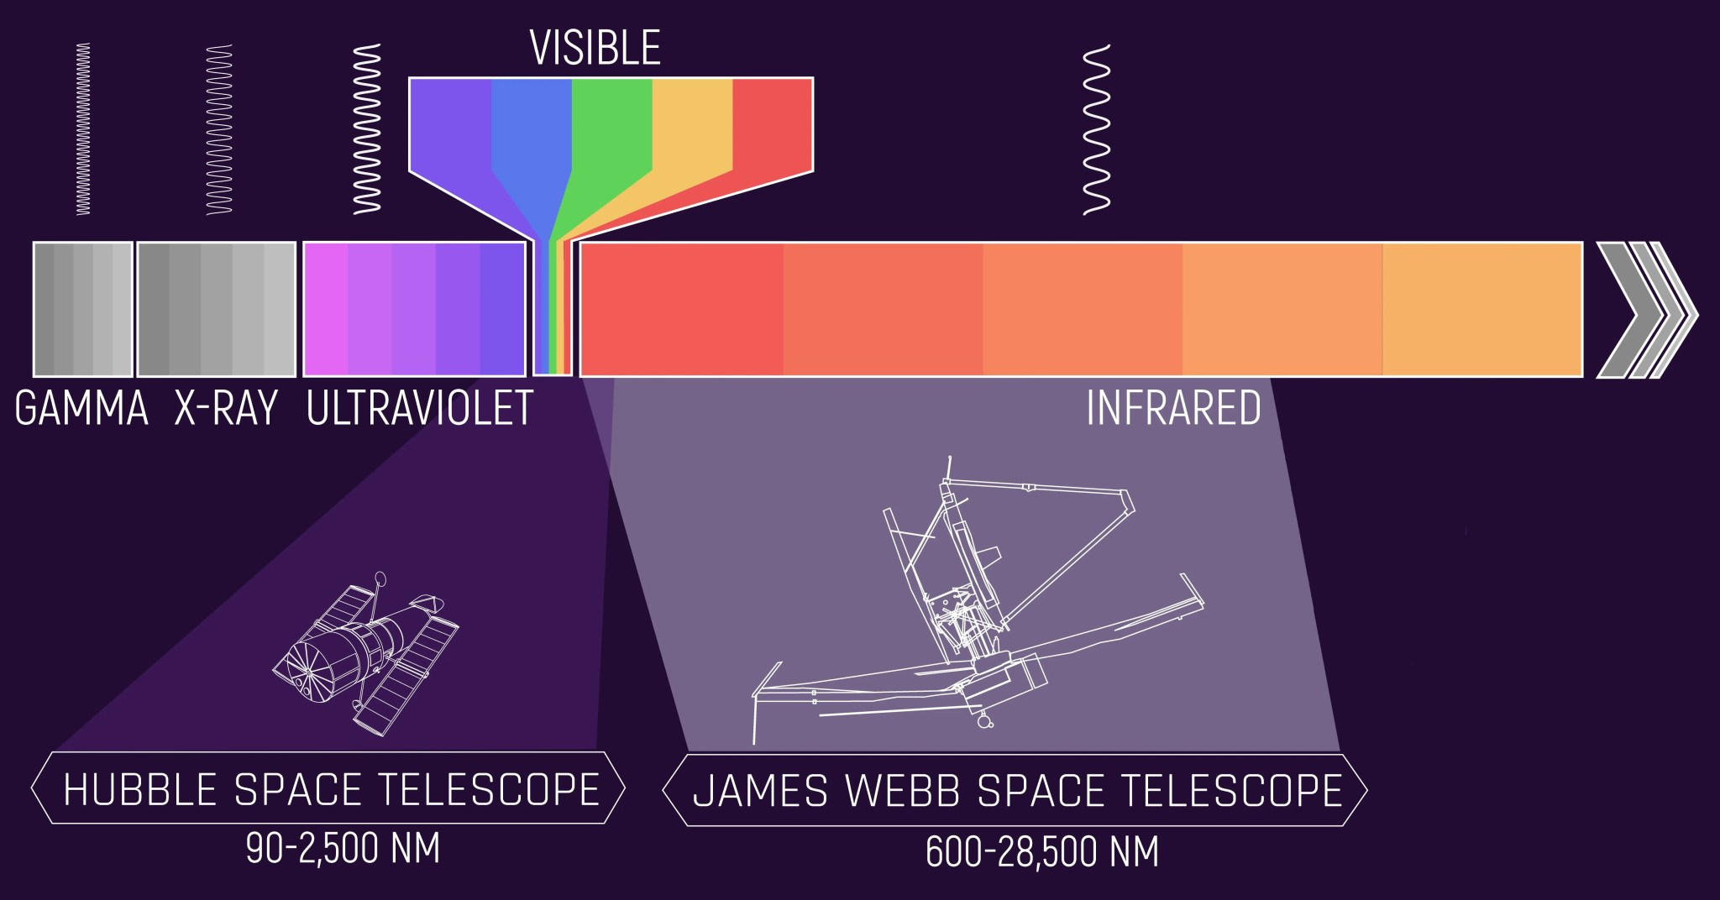
Hubble vs James Webb
James Webb sees redder objects → higher redshift → farther/older

Slide 5
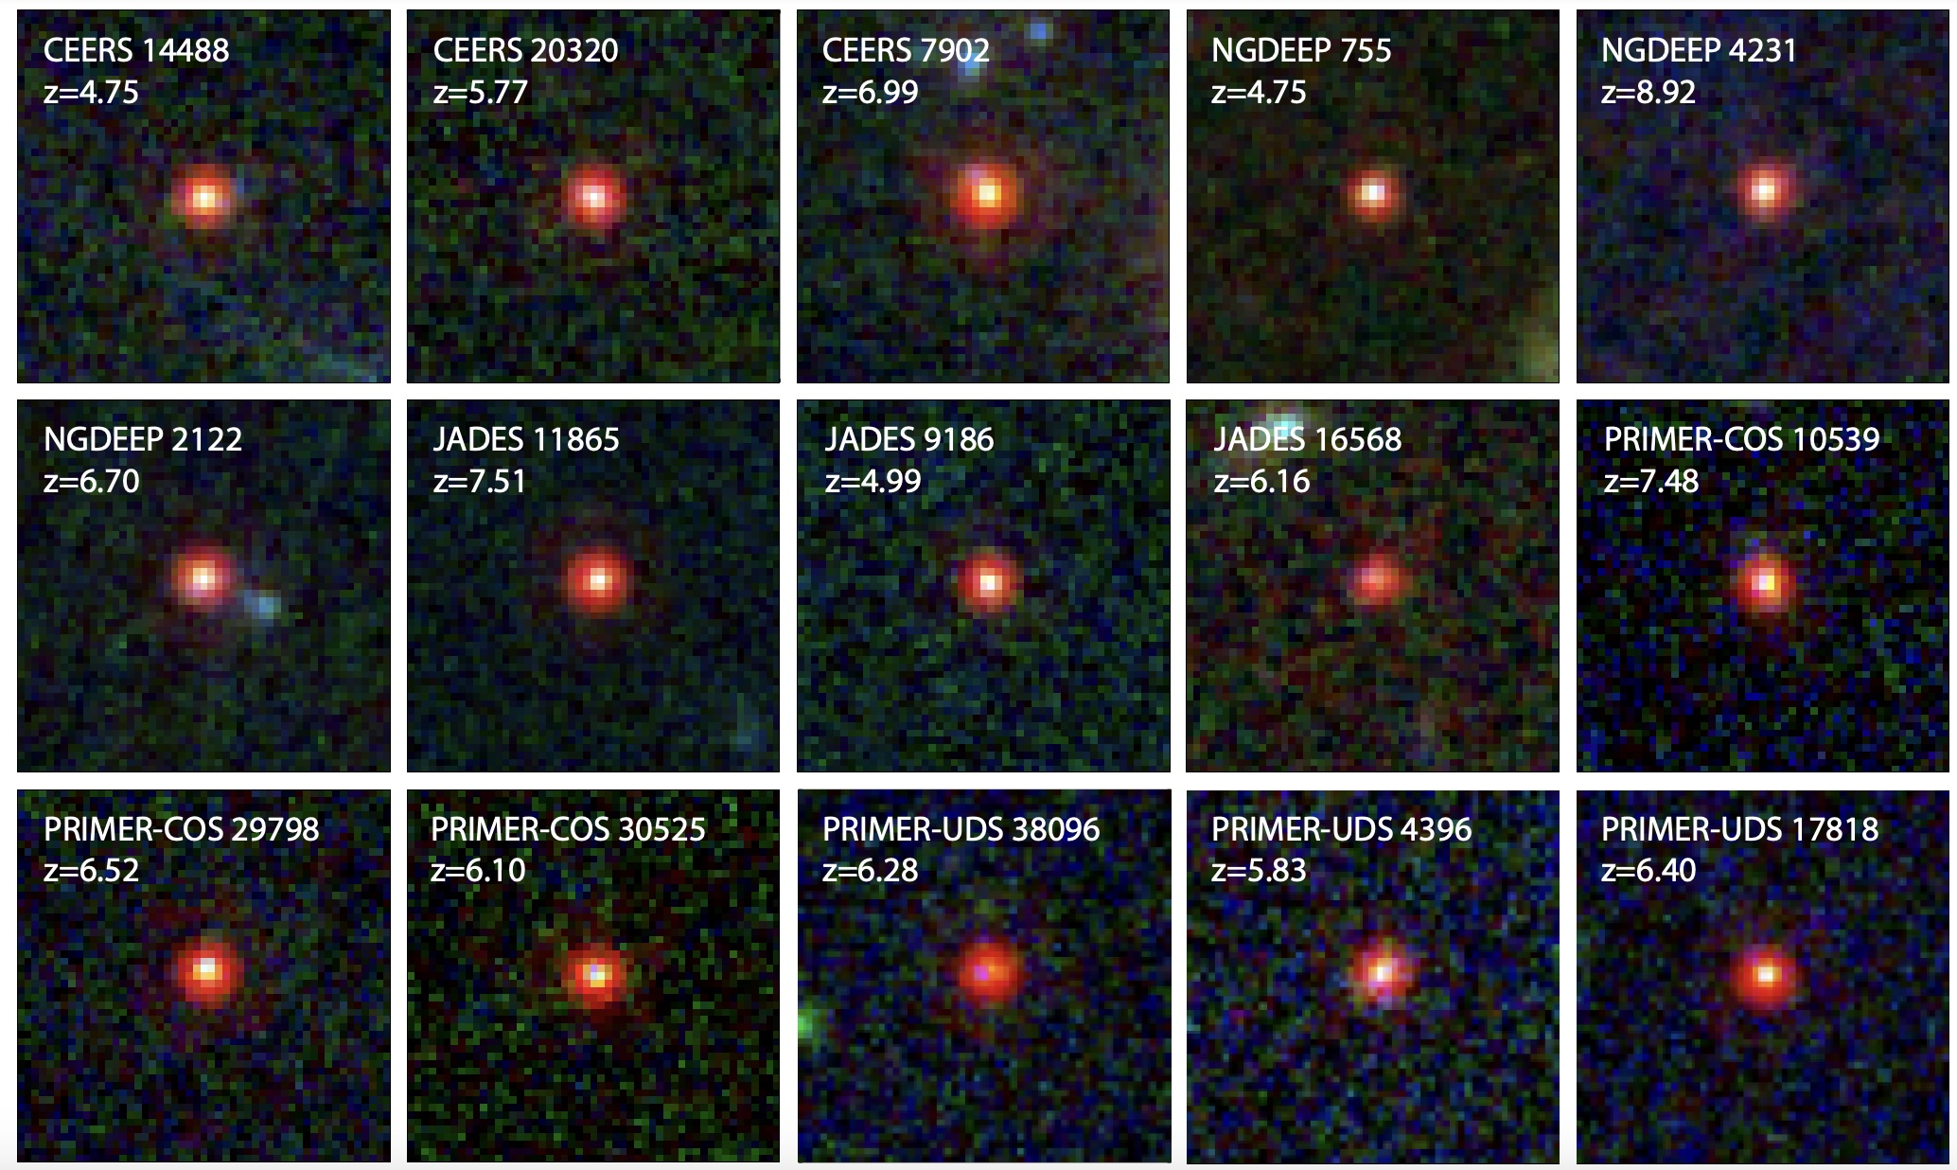

James Webb Space Telescope (JWST)
“Little red dots” (LRDs) at $z=4−9$ [Labbe et al. 2023, Kocevski et al. 2023, Harikane et al. 2023, Matthee et al. 2024, Maiolino et al. 2024]

Slide 6
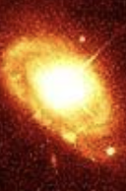
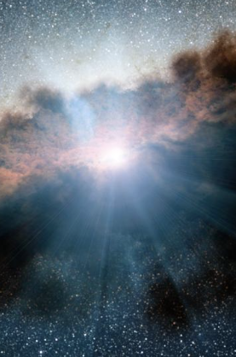
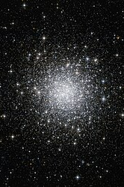
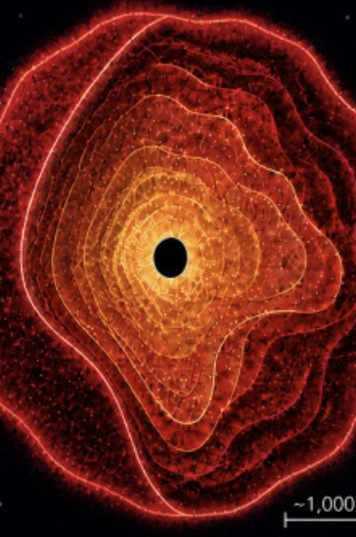
What are the little red dots?

Slide 7
What are the little red dots?
Massive galaxies?
[Labbe et al. 2023, Baggen et al. 2023, 2024, Perez-Gonzalez et al. 2024]
But actually have relatively few stars

Slide 8
What are the little red dots?
Massive galaxies?
[Labbe et al. 2023, Baggen et al. 2023, 2024, Perez-Gonzalez et al. 2024]
But actually have relatively few stars
Dusty BHs?
[Kocevski et al. 2023; Harikane et al. 2023; Matthee et al. 2024]
But not enough dust emission

Slide 9
What are the little red dots?
Massive galaxies?
[Labbe et al. 2023, Baggen et al. 2023, 2024, Perez-Gonzalez et al. 2024]
But actually have relatively few stars
Dusty BHs?
[Kocevski et al. 2023; Harikane et al. 2023; Matthee et al. 2024]
But not enough dust emission
Star clusters + central supermassive star?
[Chisholm et al. 2026]

Slide 10
What are the little red dots?
Massive galaxies?
[Labbe et al. 2023, Baggen et al. 2023, 2024, Perez-Gonzalez et al. 2024]
But actually have relatively few stars
Dusty BHs?
[Kocevski et al. 2023; Harikane et al. 2023; Matthee et al. 2024]
But not enough dust emission
Star clusters + central supermassive star?
[Chisholm et al. 2026]
Gas-enshrouded black holes/
black hole stars?
[Naidu et al. 2025,
de Graaff et al. 2025,
Sun et al. 2026]
Notes:
Since there is strong evidence that these LRDs are black holes, let’s talk about a few other studies based on JWST data….

Slide 11
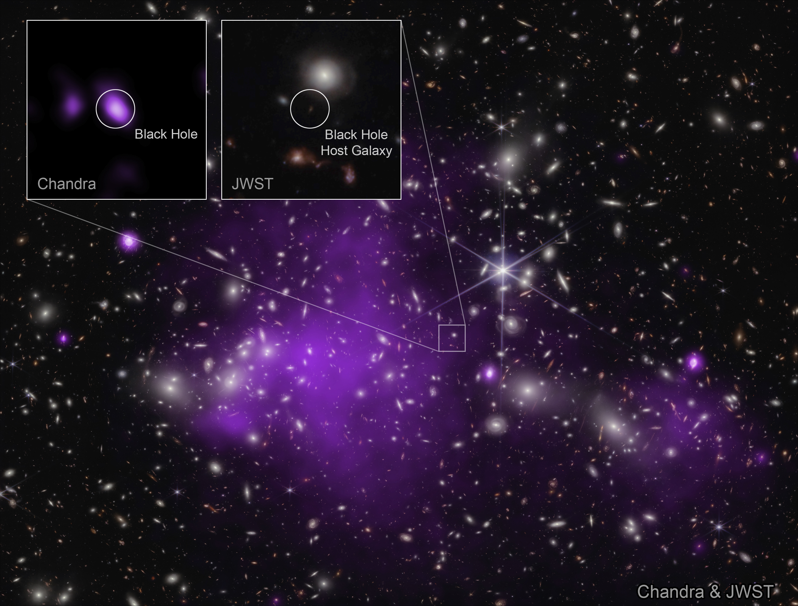

James Webb Space Telescope (JWST)
Overmassive black holes ( $\frac{M_{BH}}{M_{∗}}\sim 1$ ) at $z=10$ [Natarajan et al. 2024]

Slide 12
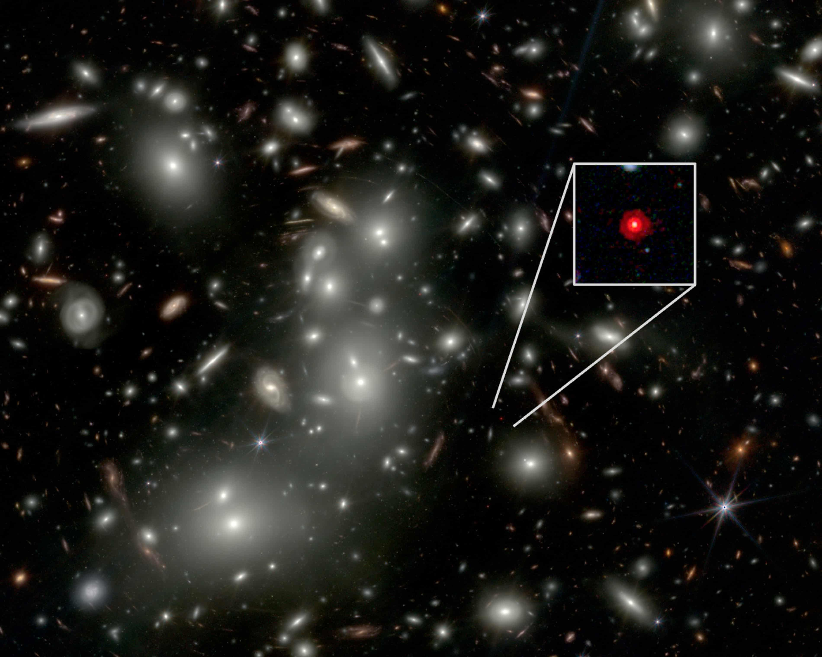

James Webb Space Telescope (JWST)
Black hole in LRD with $M_{BH}>5×{10}^{7} M_{⊙}$, $\frac{M_{BH}}{M_{∗}}>2$
[Juodzbalis et al. 2026]

Slide 13

What are the little red dots?
Massive galaxies?
[Labbe et al. 2023, Baggen et al. 2023, 2024, Perez-Gonzalez et al. 2024]
But actually have relatively few stars
Dusty BHs?
[Kocevski et al. 2023; Harikane et al. 2023; Matthee et al. 2024]
But not enough dust emission
Star clusters + central supermassive star?
[Chisholm et al. 2026]
Gas-enshrouded black holes/
black hole stars?
[Naidu et al. 2025,
de Graaff et al. 2025,
Sun et al. 2026]
Assuming these are relatively large ${10}^{4}−{10}^{7}M_{⊙}$ black holes…
how did they form so early?

Slide 14
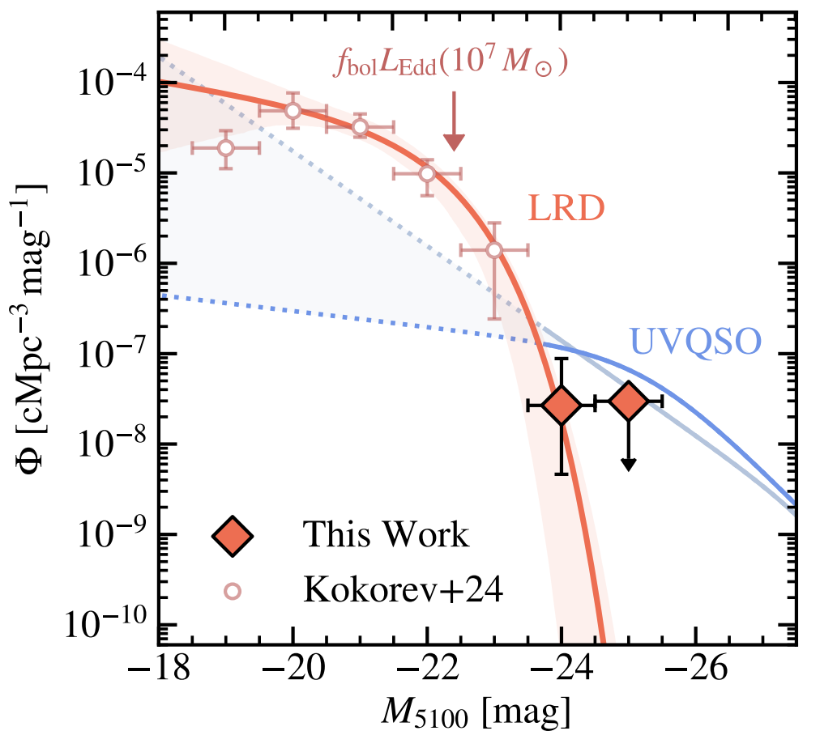
What Are the Little Red Dots?
(seen/inferred)
(predicted)
(i.e. number per brightness bin)
(i.e. brightness)
Ma et al. 2025

Slide 15
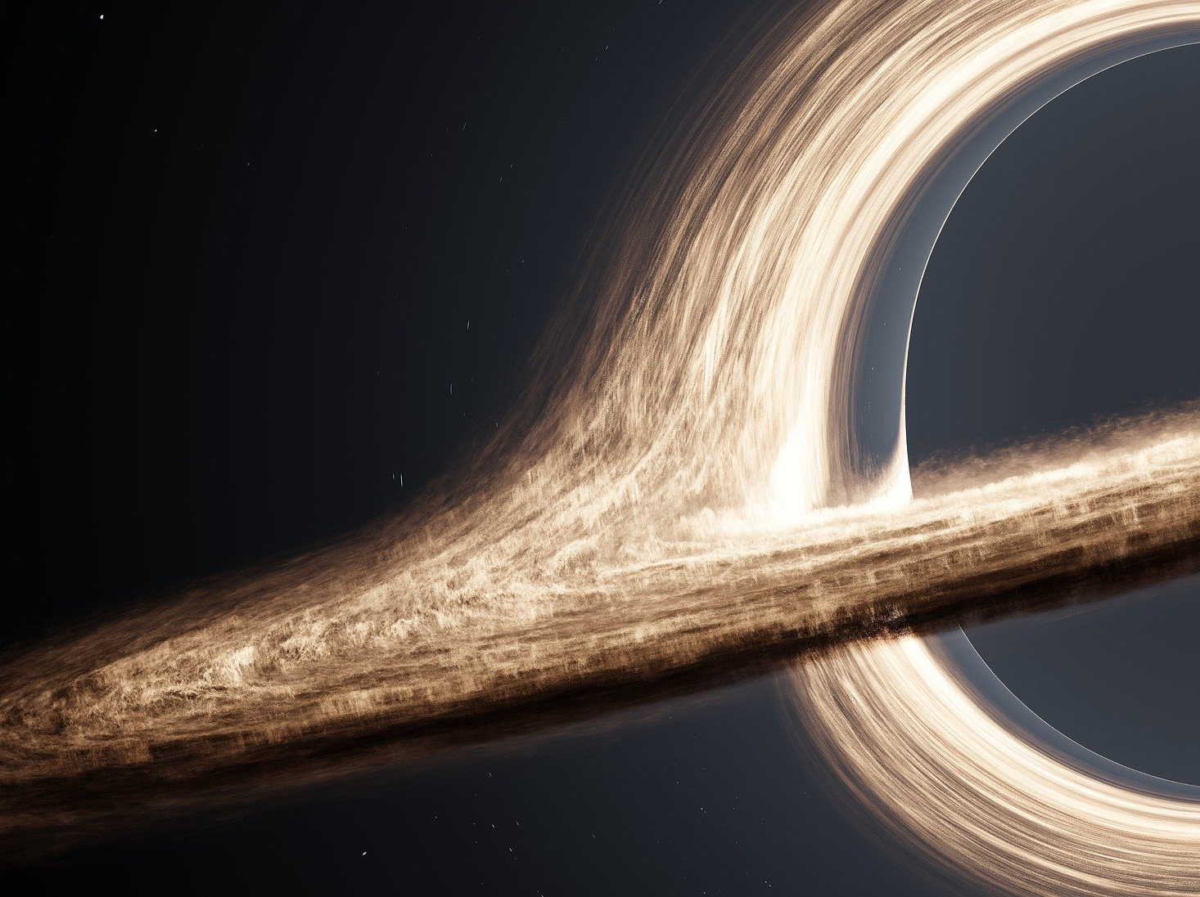
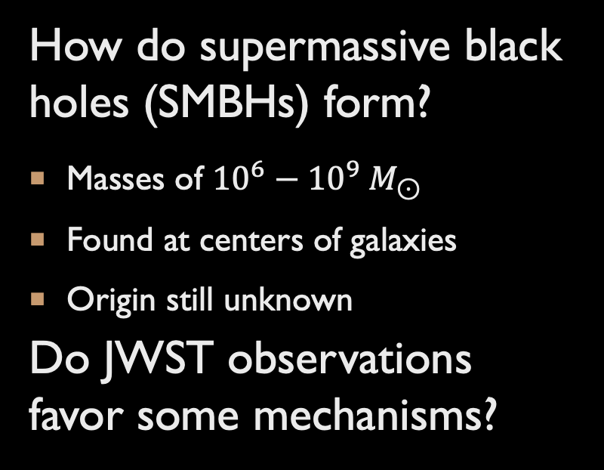
How do supermassive black holes (SMBHs) form?
Masses of ${10}^{6}−{10}^{9} M_{⊙}$
Found at centers of galaxies
Origin still unknown
Do JWST observations favor some mechanisms?
Are the observations consistent with standard physics?
If not, how can we explain them?
Notes:
And because of these observations, there has been revived interest in the question of…

Slide 16
astrophysics?

Slide 17
FORMATION OF A SUPERMASSIVE BLACK HOLE
Initial seed
Growth by accretion/mergers
SMBH

Slide 18
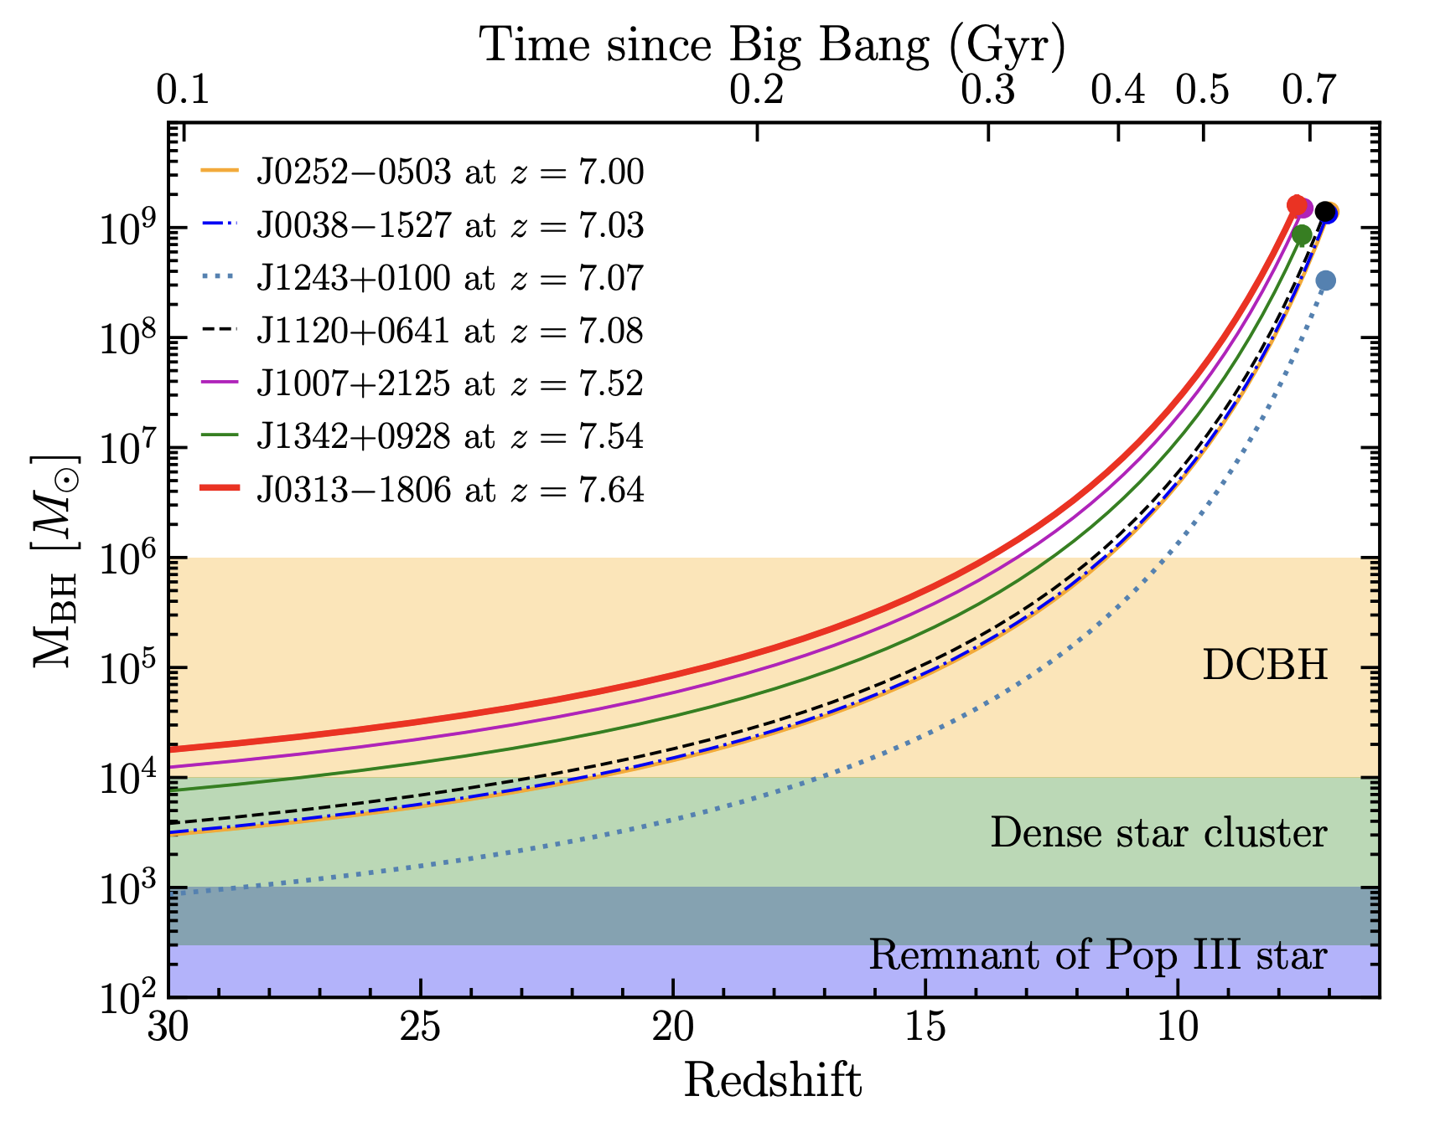
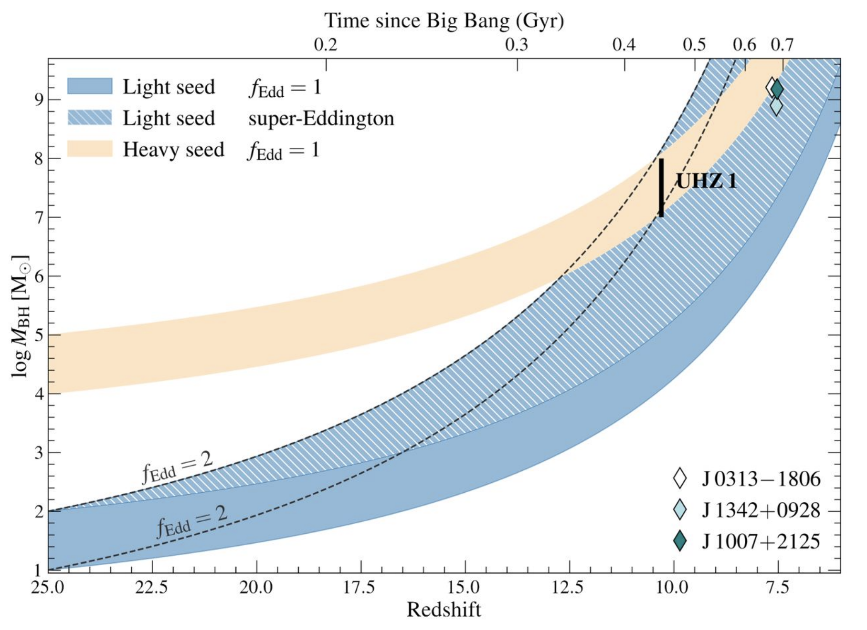
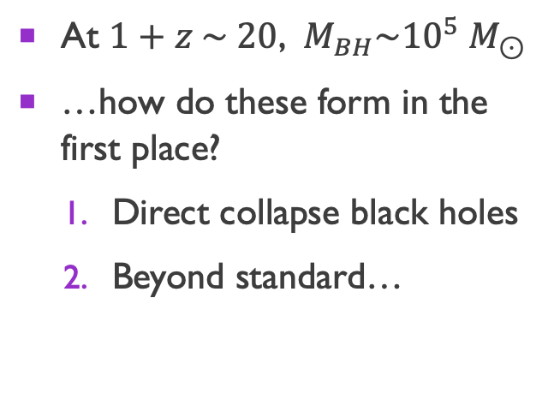
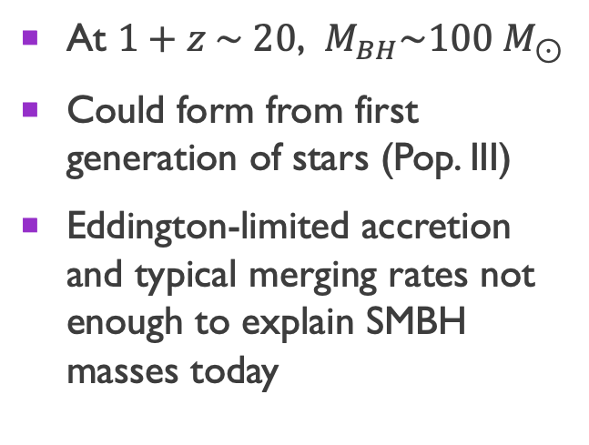
Hypotheses for smbh formation
Light seeds
Heavy seeds
At $1+z \sim 20$, $M_{BH}\sim 100 M_{⊙}$
Could form from first generation of stars (Pop. III)
Eddington-limited accretion and typical merging rates not enough to explain SMBH masses today
At $1+z \sim 20$, $M_{BH}\sim {10}^{5} M_{⊙}$
…how do these form in the first place?
  Direct collapse black holes
  Beyond standard…
Bogdan et al. 2023
Wang et al. 2021

Slide 19

Direct Collapse
First, overdensity must collapse and virialize to form a halo
For baryons to continue collapsing, must dissipate kinetic energy, e.g. have a cooling mechanism
kinetic energy
gravity

Slide 20

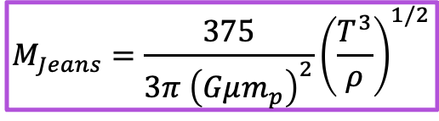
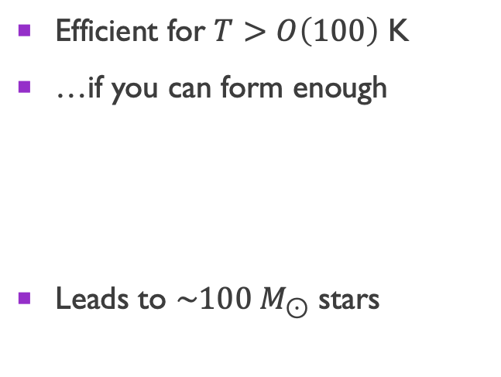

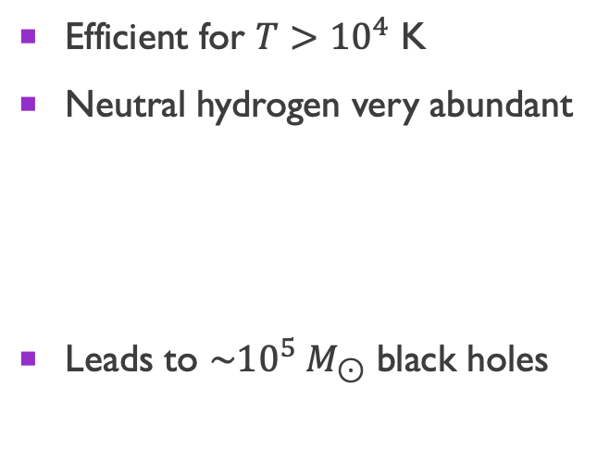
Direct collapse
Atomic hydrogen ($H$) cooling
Molecular hydrogen ($H_{2}$) cooling
Efficient for $T>{10}^{4}$ K
Neutral hydrogen very abundant
Leads to $\sim {10}^{5} M_{⊙}$ black holes
Efficient for $T>O\left(100\right)$ K
…if you can form enough
Leads to $\sim 100 M_{⊙}$ stars
$$M_{Jeans}=\frac{375}{3π {\left(Gμm_{p}\right)}^{2}}{\left(\frac{T^{3}}{ρ}\right)}^{1/2}$$
Suppression of molecular cooling can lead to formation of a heavy seed

Slide 21
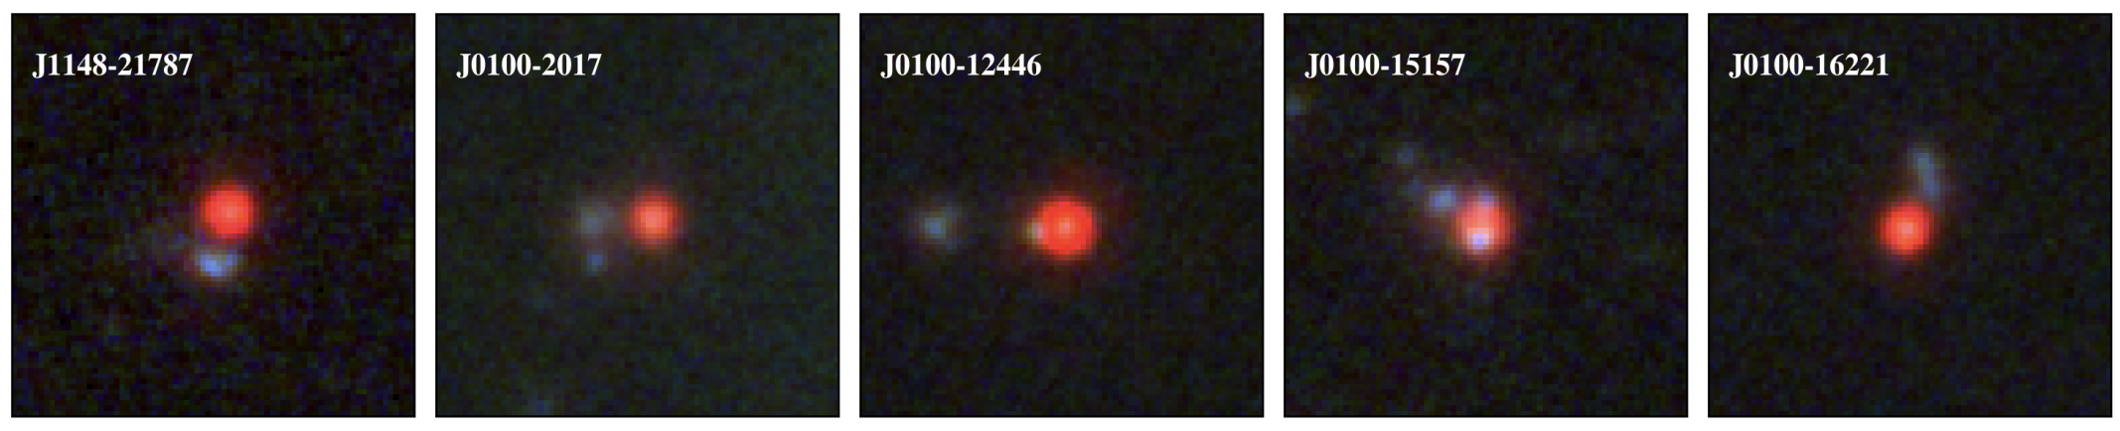
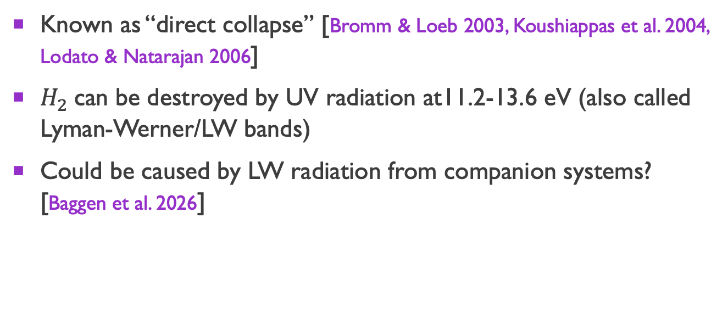
Direct collapse
Known as “direct collapse” [Bromm & Loeb 2003, Koushiappas et al. 2004, Lodato & Natarajan 2006]
$H_{2}$can be destroyed by UV radiation at11.2-13.6 eV (also called Lyman-Werner/LW bands)
Could be caused by LW radiation from companion systems? [Baggen et al. 2026]

Slide 22
Beyond standard?
Please let me know if I missed your favorite model!

Slide 23
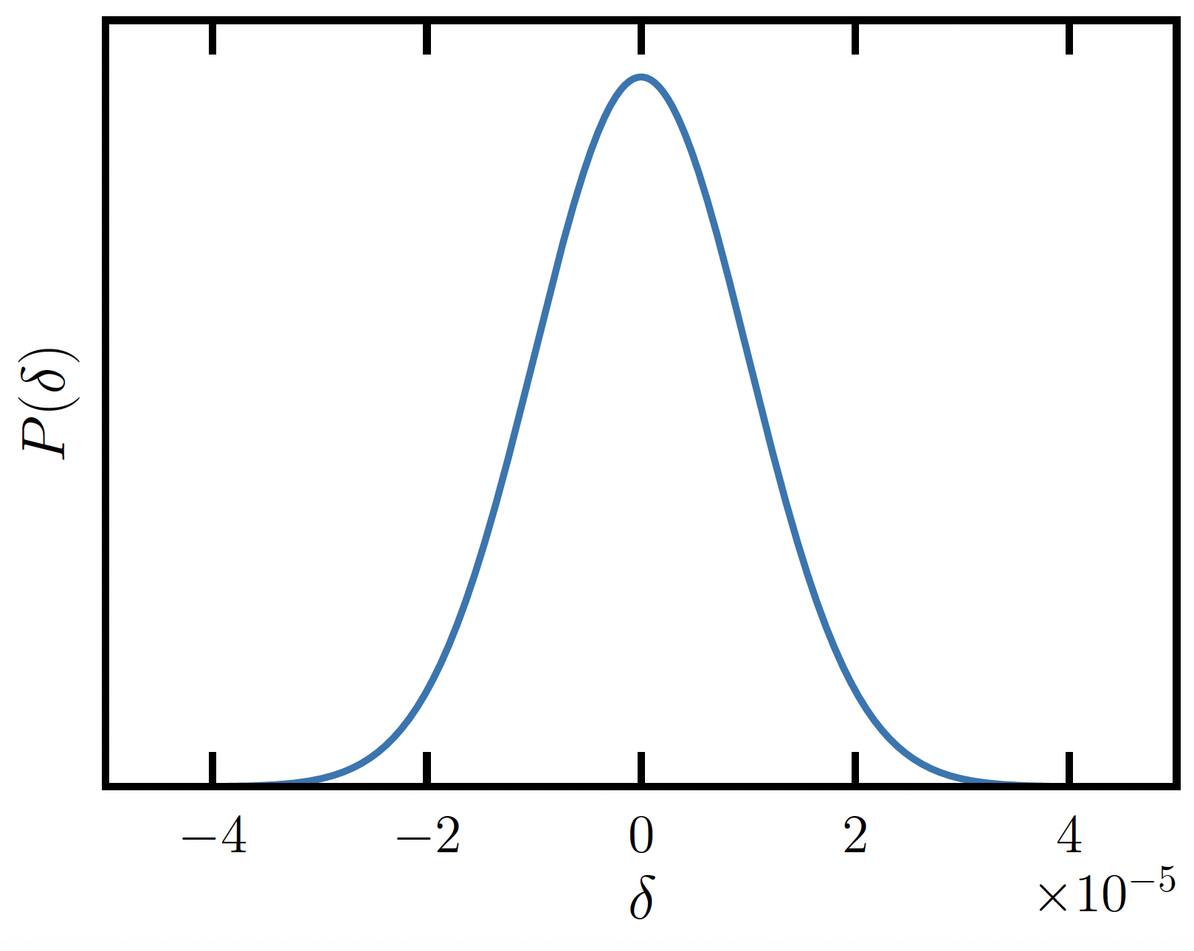
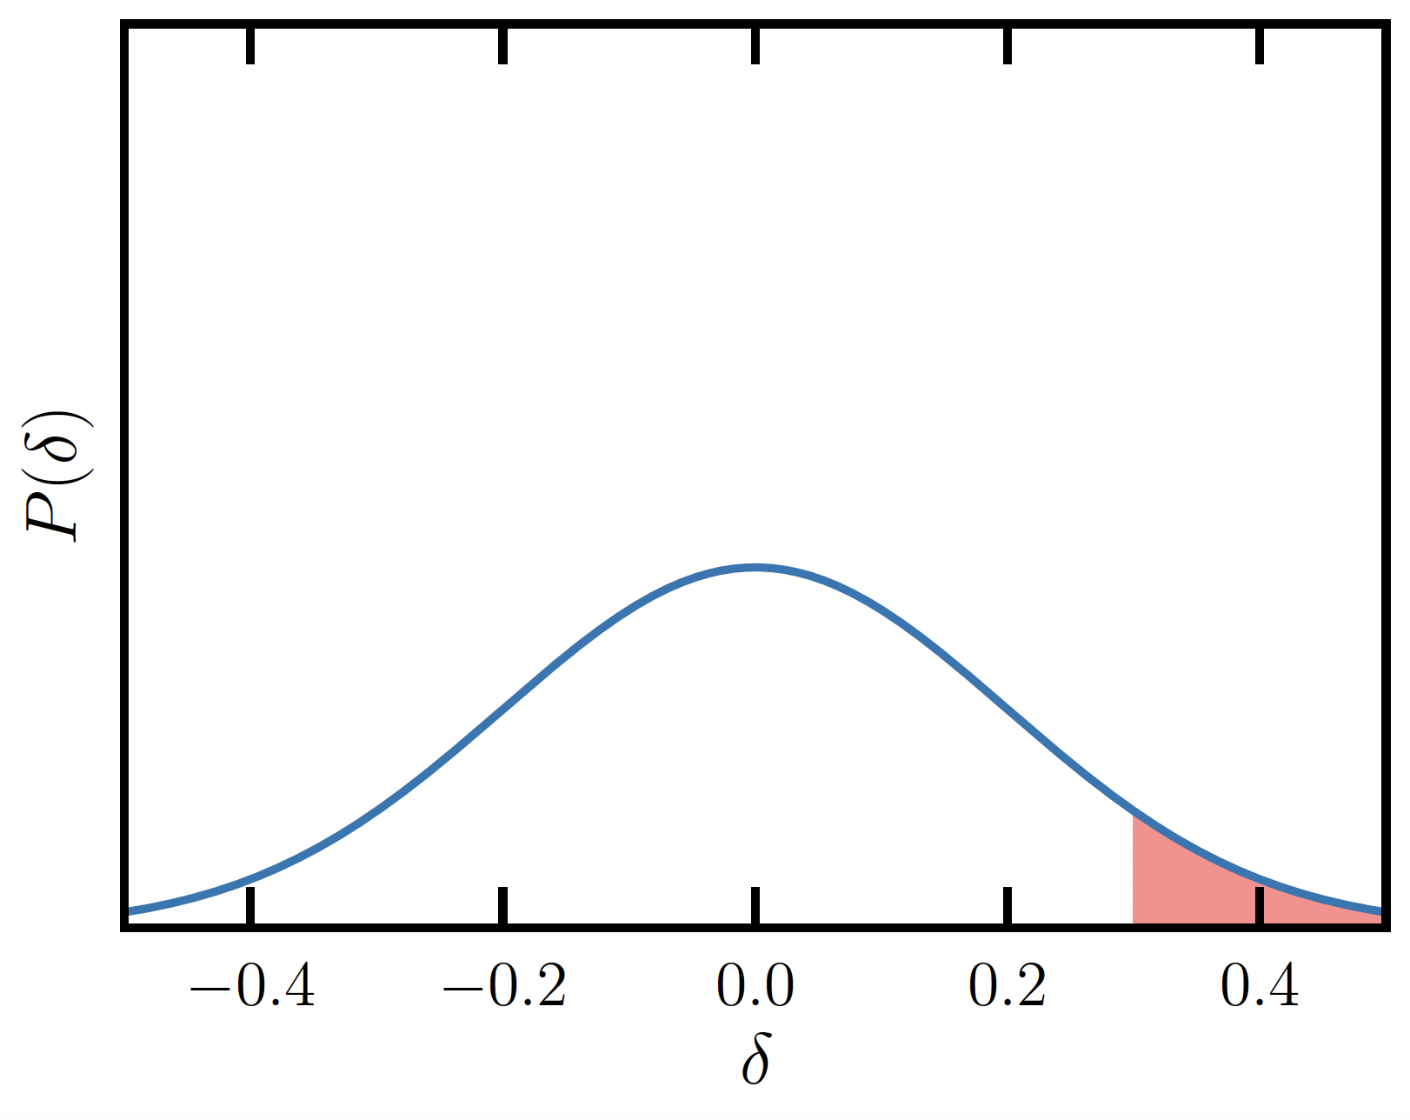
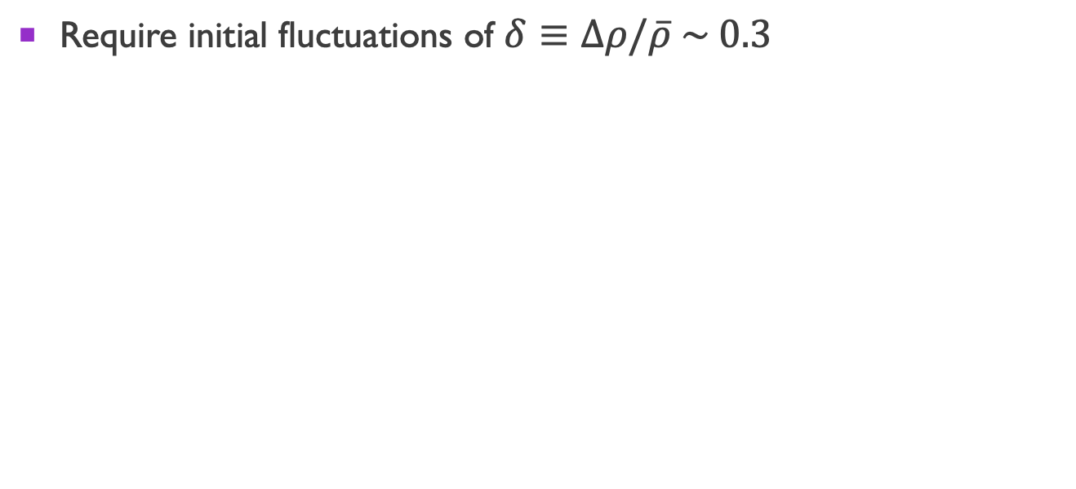
Primordial black holes
Require initial fluctuations of $δ≡Δρ/\overline{ρ} \sim 0.3$
CMB length scales
Necessary for PBH population

Slide 24
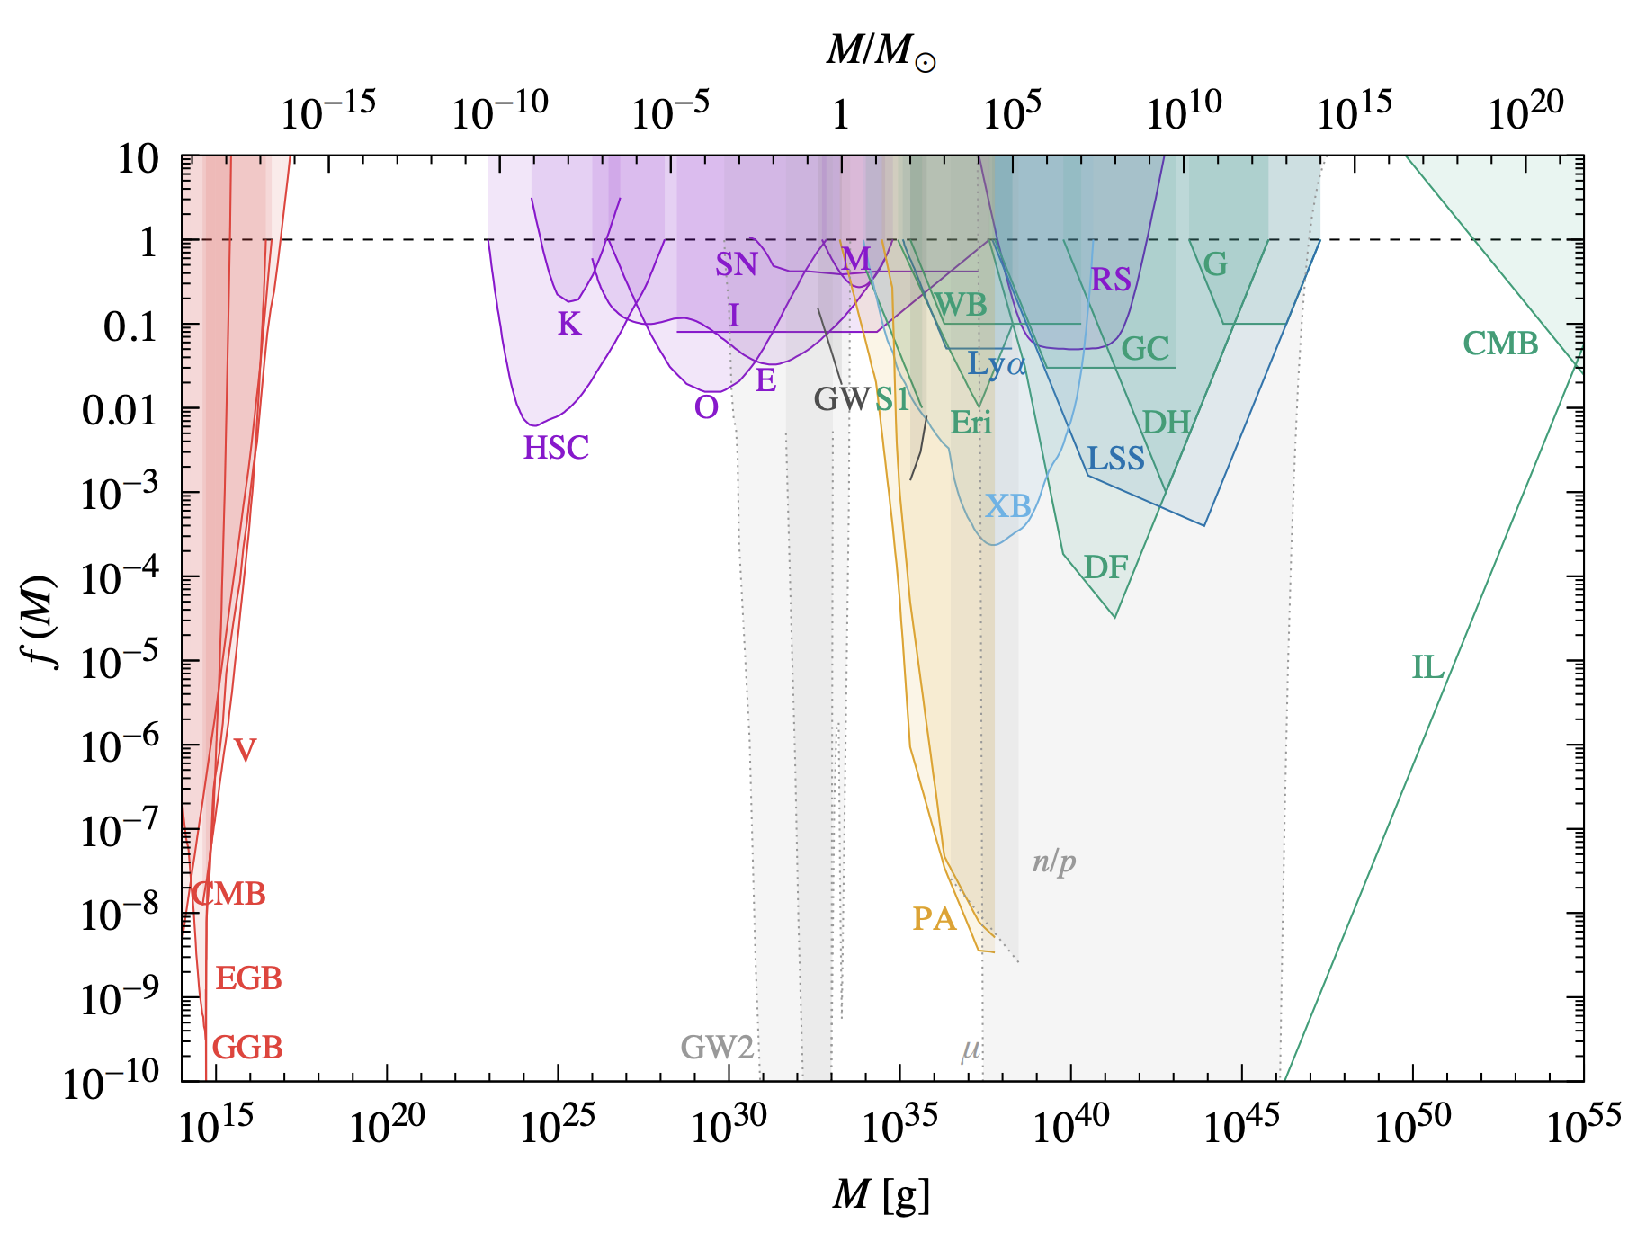
Primordial black holes
concern of this work
PBHs as
dark matter
Carr & Kuhnel 2021

Slide 25
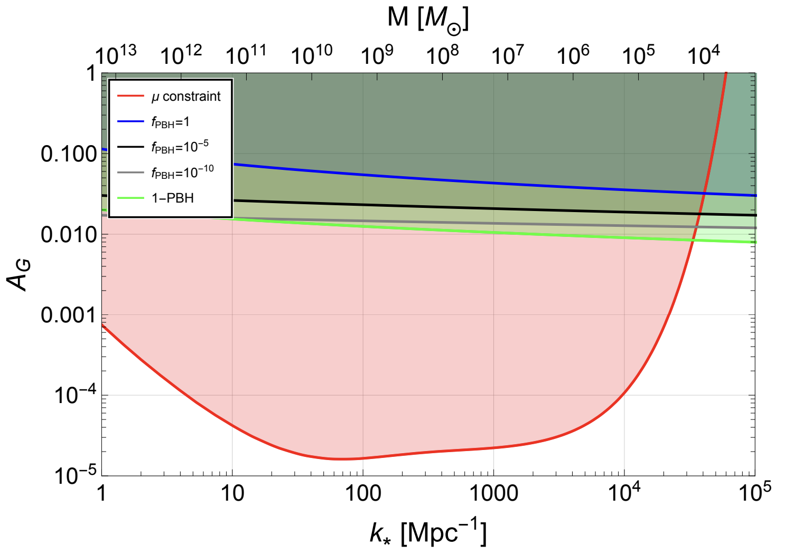
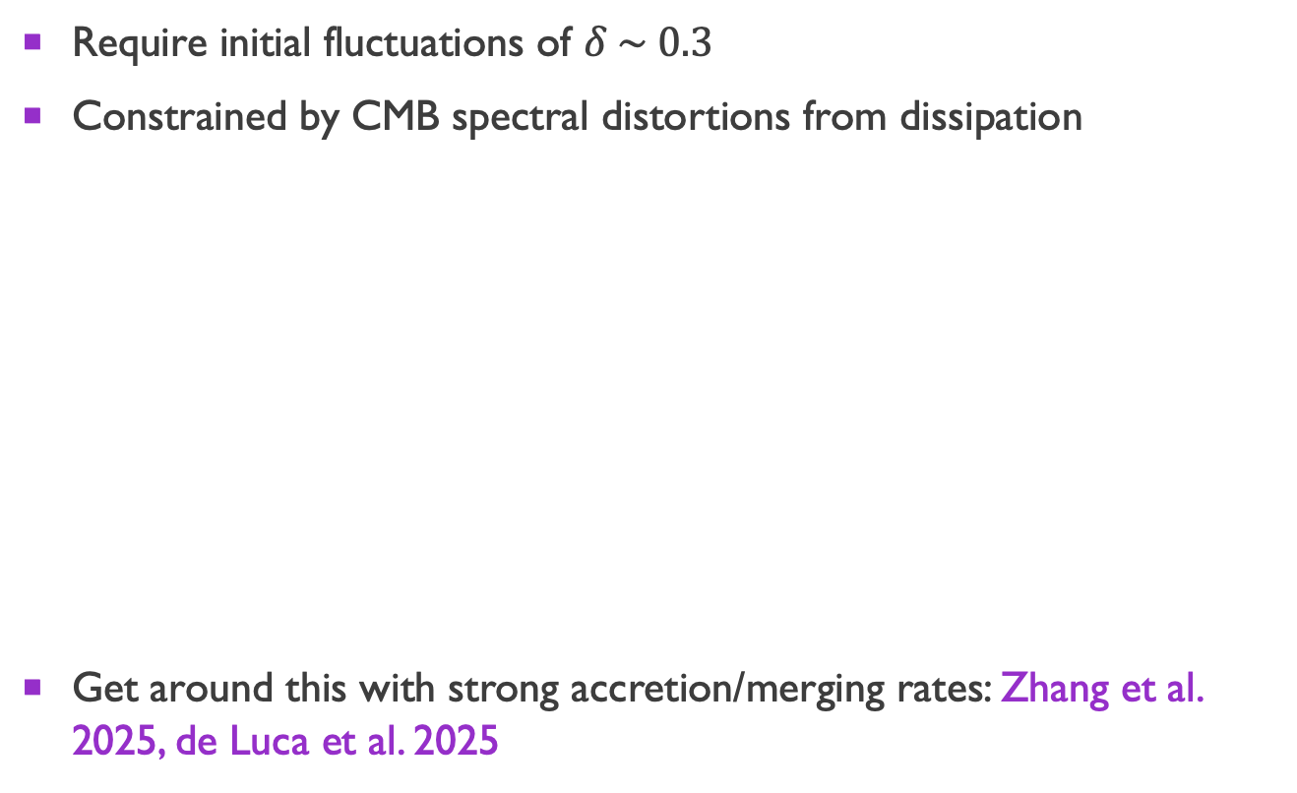
Primordial black holes
Require initial fluctuations of $δ \sim 0.3$
Constrained by CMB spectral distortions from dissipation
Get around this with strong accretion/merging rates: Zhang et al. 2025, de Luca et al. 2025
Byrnes, Lesgourgues, & Sharma 2024
Notes:
doesn’t rule out PBHs as SMBH seeds, but complicates the picture

Slide 26
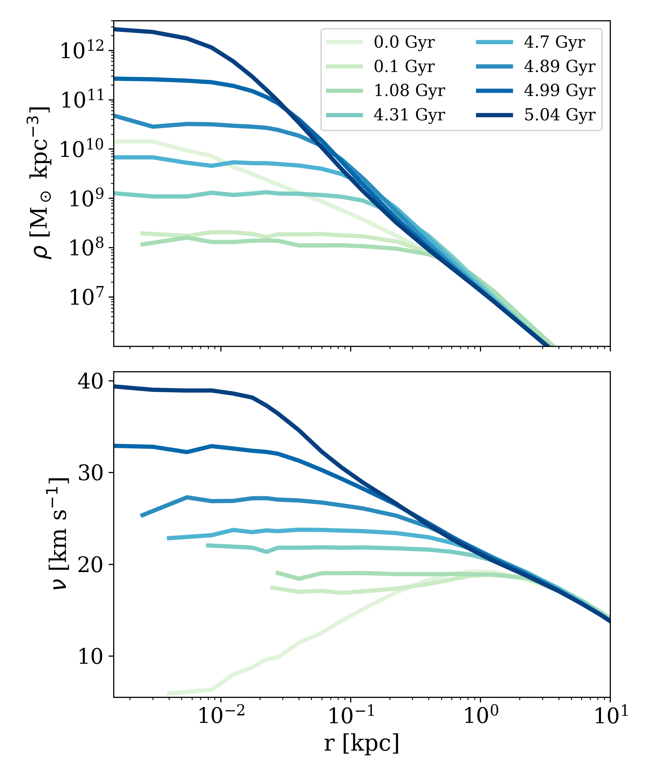
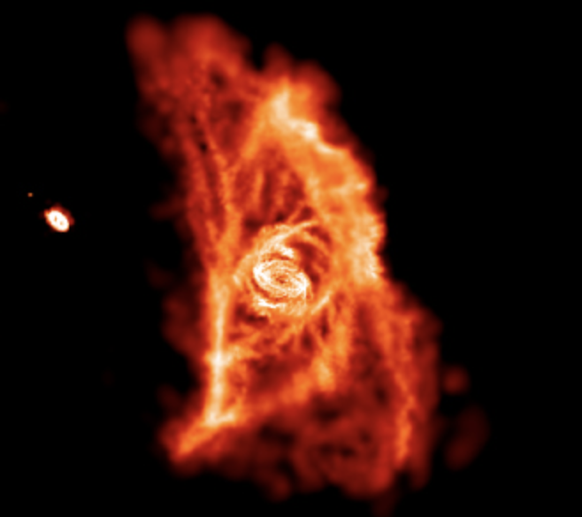
DM forms/facilitates SMBH seeD
Self-interacting dark matter [Jiang et al. 2025; Roberts et al. 2025a, b; Sikivie & Zhao 2026]
  → gravothermal core collapse
  Rapidly rising central density forms central BH
Dissipative dark matter [Buckley & Fernandez 2024]
  Dissipative interactions cause DM to condense
  → BH seed
  Also enhanced accretion onto BH seed
Dark matter capture [Bhattacharya et al. 2025]
  Capture induces PopIII star to prematurely form BH
  More time for accretion
Roy et al. 2023

Slide 27

Direct collapse by exotic energy injection
Molecular hydrogen destroyed by LW radiation from…
  Annihilating dark matter: Friedlander et al. 2022
  Decaying dark matter: Aggarwal et al. 2025
  Primordial black hole evaporation: Lu et al. 2024a
  Relic particle decays: Lu et al. 2024b
  Superconducting cosmic strings: Cyr et al. 2022
  Parametric resonance of ultralight DM: Jiao et al. 2025

Slide 28
Not-quite-primordial?

Slide 29
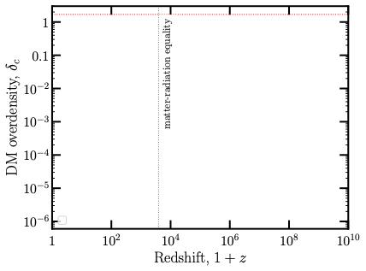
Evolution of density perturbations
WQ, Kumar, Natarajan, and Weiner 2025

Slide 30
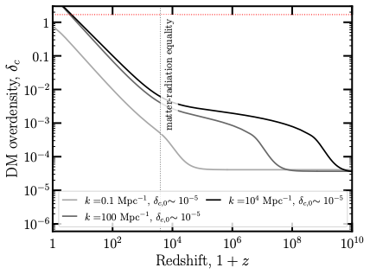
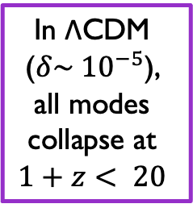
Evolution of density perturbations
In ΛCDM ($δ\sim {10}^{−5}$),
all modes
collapse at
$$1+z< 20$$
WQ, Kumar, Natarajan, and Weiner 2025

Slide 31
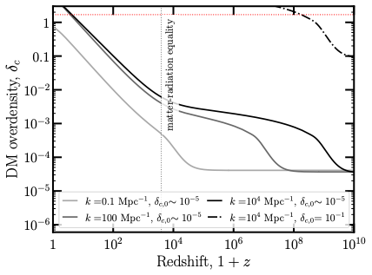
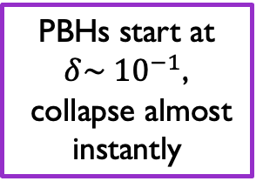
Evolution of density perturbations
PBHs start at $δ\sim {10}^{−1}$,
collapse almost instantly
WQ, Kumar, Natarajan, and Weiner 2025

Slide 32
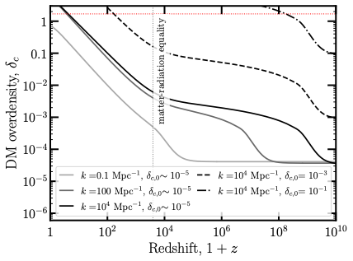
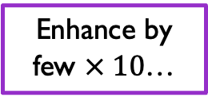
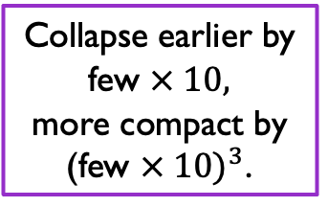
Evolution of density perturbations
Collapse earlier by few $× 10,$
more compact by
(few $× 10)^{3}$.
Enhance by few $× 10$…
WQ, Kumar, Natarajan, and Weiner 2025

Slide 33
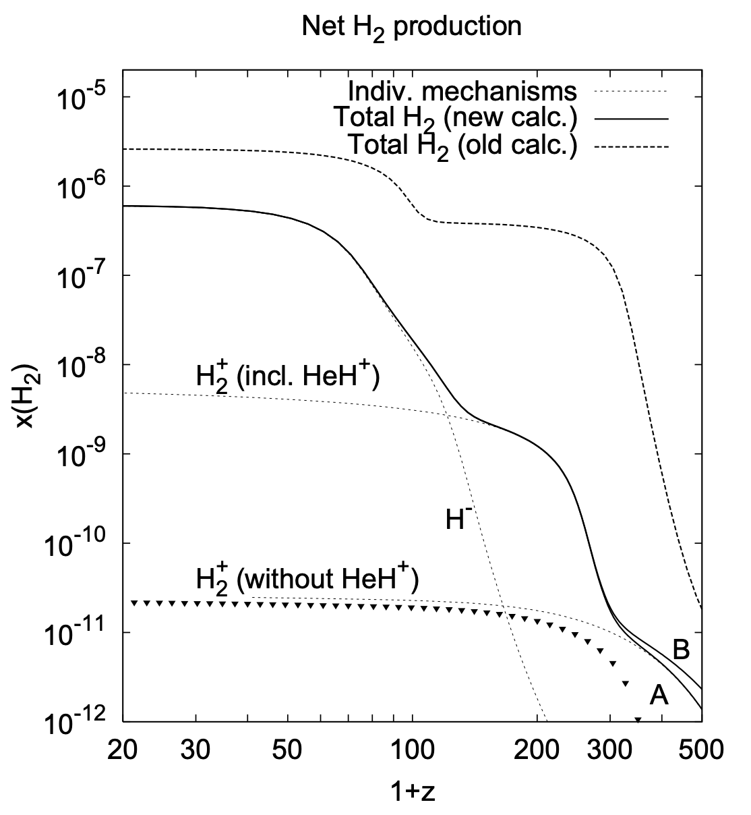
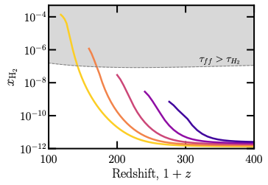
Molecular hydrogen suppressed at early times
Cosmic abundance
(Hirata & Padmanabhan 2006)
Estimated halo abundance
(our work)
direct collapse
for free??
See also Hirano et al. 2015, Ito & Omukai 2024
WQ, Kumar, Natarajan, and Weiner 2025
Notes:
- emphasize that my code ends at virialization

Slide 34
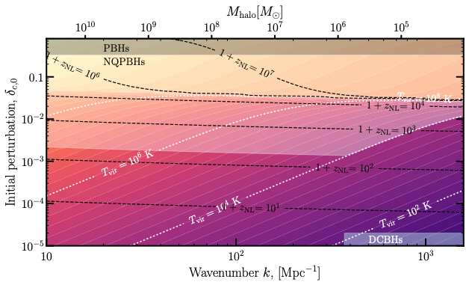
Overdensities and outcomes
Notes:
Point out contours
Lot more parameter space for NQPBHs than PBHs

Slide 35

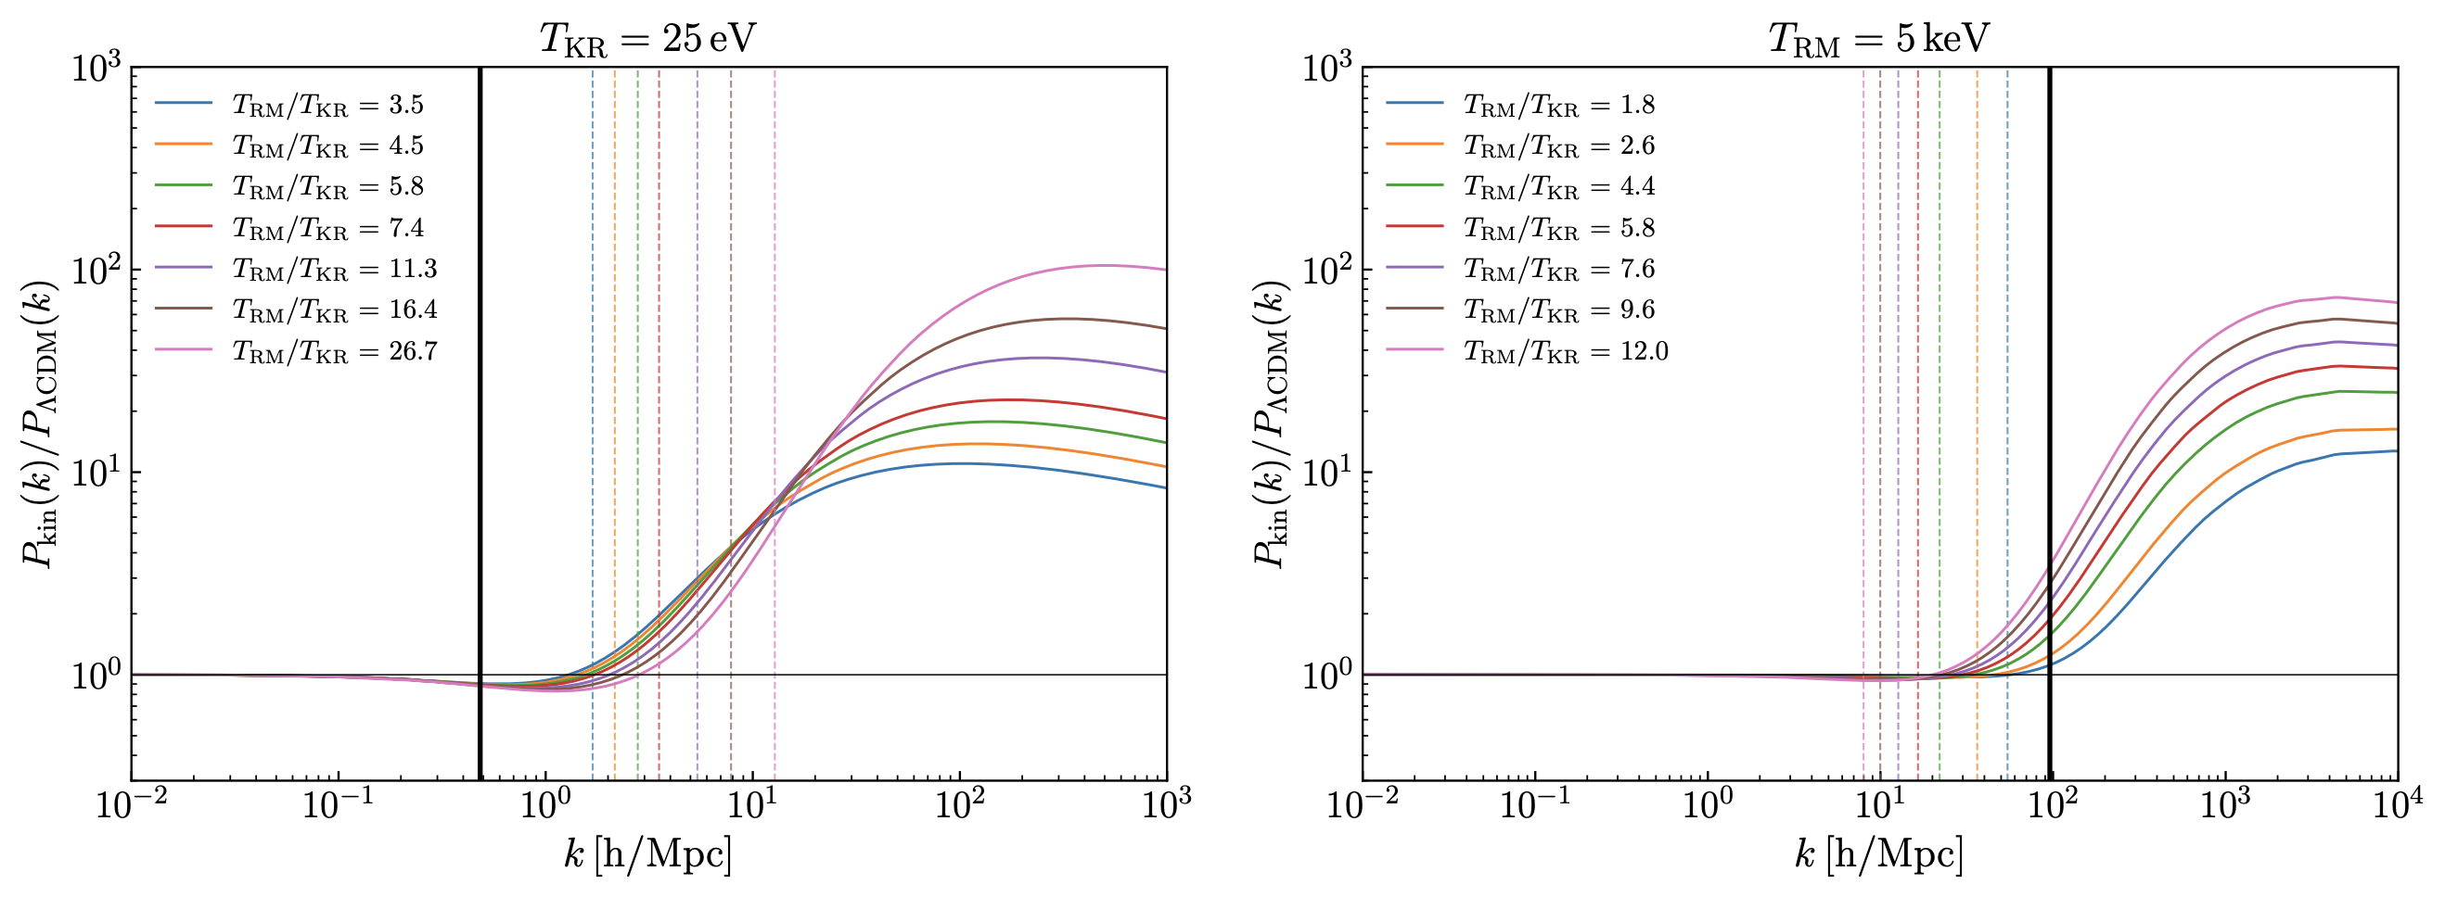
NQPBHs: enhanced growth
Can also be caused by enhanced growth of density perturbations
Investigating NQPBHs in enhanced power spectrum from axion kination causing early matter domination [Co et al. 2025]

Slide 36

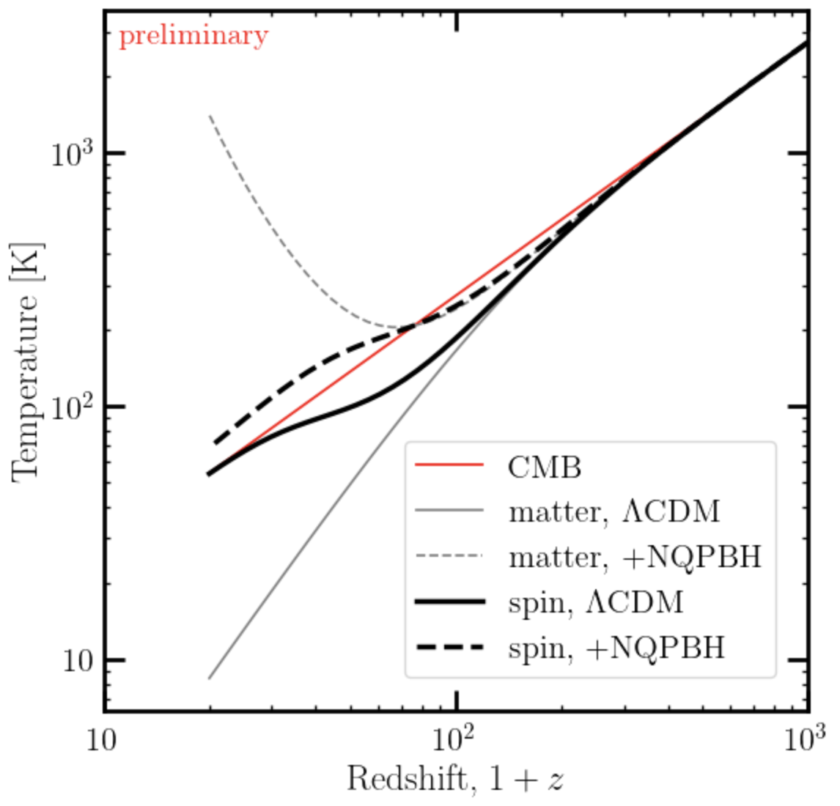
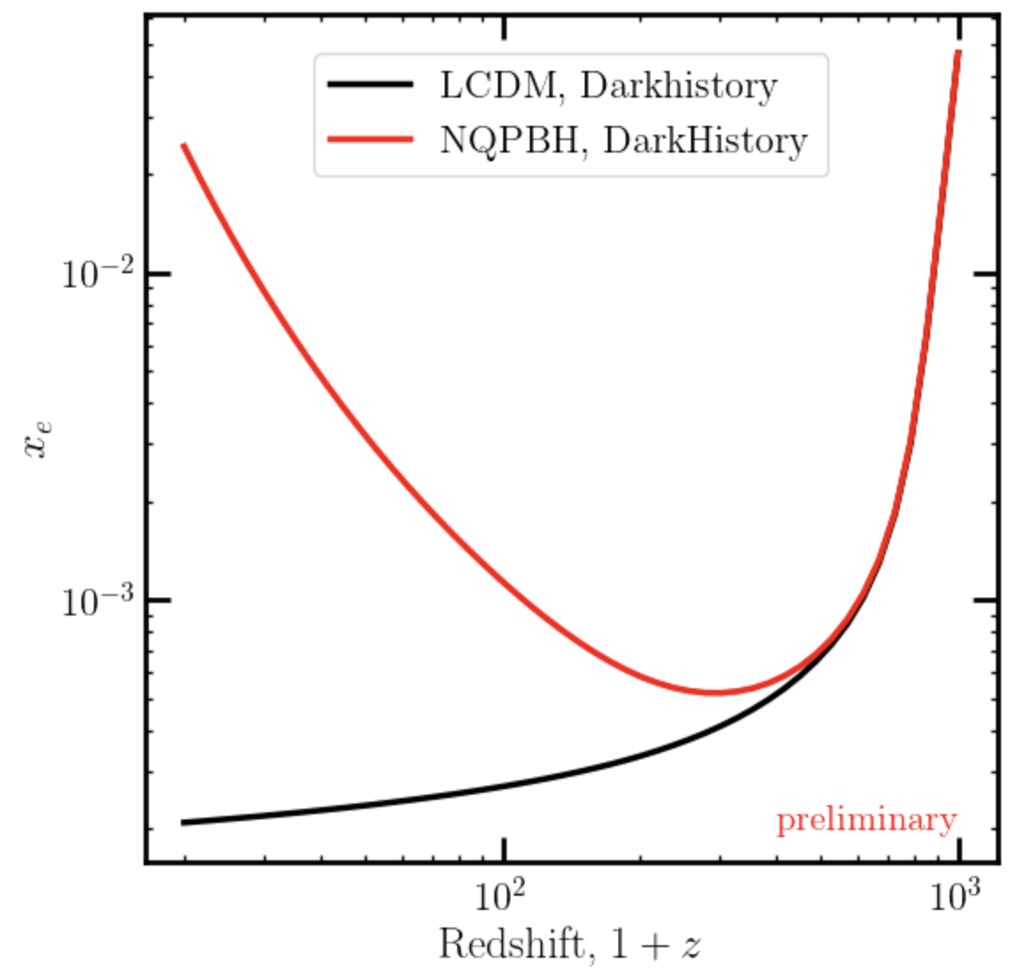
NQPBH: Impact on CMB
NQPBH accretion is a form of exotic energy injection
  Deposit energy in the form of heating/ionization/etc.
  Potentially observable in 21cm signals or CMB

Slide 37
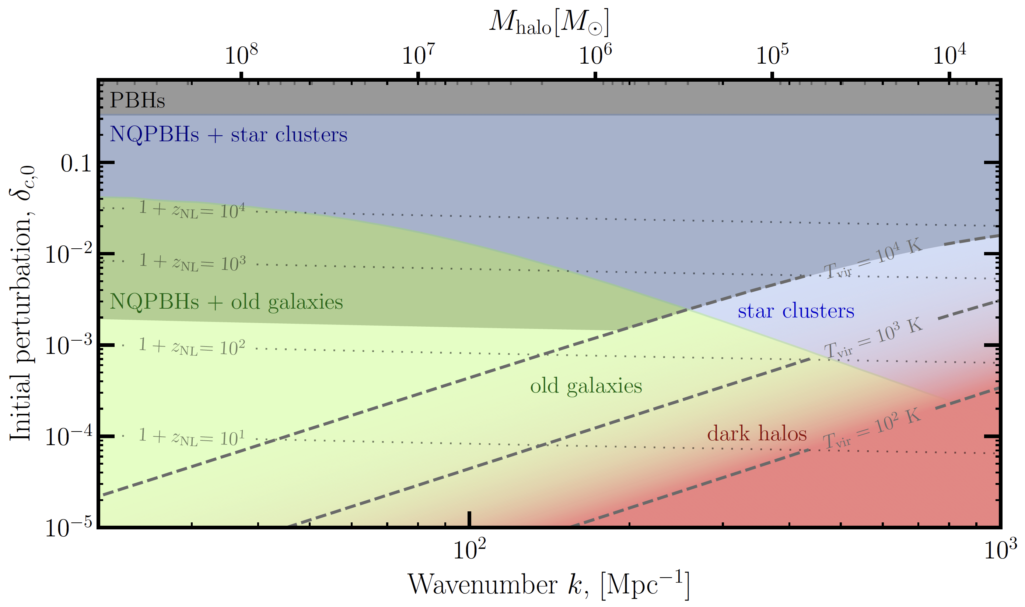
Not quite NQPBHs…
If overdensities fail to form NQPBHs, may form stars
What do such stellar systems look like today?
preliminary

Slide 38
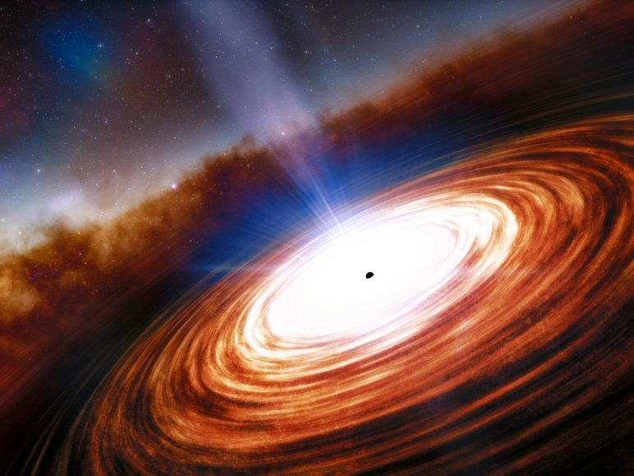
Conclusions
Little Red Dots: Strong evidence for high-redshift massive black holes
Revived interest in question of SMBH origins
Astrophysical explanations still uncertain → room for beyond standard physics explanations
NQPBHs -- a new mechanism explaining origin of SMBHs that is less demanding than PBHs

Slide 39
Backup

Slide 40
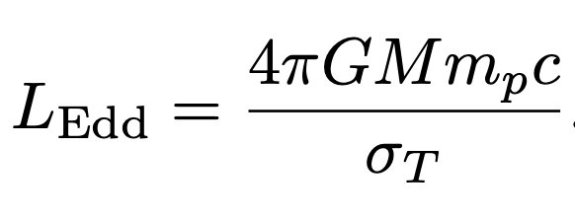

Eddington limit
Theoretical limit on luminosity, when radiation pressure = gravity
Luminosity is caused by accretion onto the black hole
Can therefore translate this to limit on accretion

Slide 41
Super-eddington accretion
Bogdan et al. 2023
Wang et al. 2021

Slide 42
Star clusters
Dense and merging fast…

Slide 43
Old slides

Slide 44
How do supermassive black holes (SMBHs) form?
Masses of ${10}^{6}−{10}^{9} M_{⊙}$
Found at centers of galaxies
Origin still unknown
Do JWST observations favor some mechanisms?
Are the observations consistent with standard physics?
If not, how can we explain them?
Notes:
And because of these observations, there has been revived interest in the question of…

Slide 45
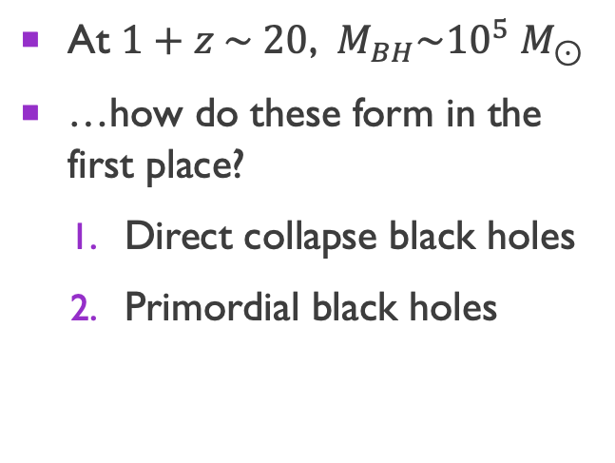
Hypotheses for smbh formation
Light seeds
Heavy seeds
At $1+z \sim 20$, $M_{BH}\sim 100 M_{⊙}$
Could form from first generation of stars (Pop. III)
Eddington-limited accretion and typical merging rates not enough to explain SMBH masses today
At $1+z \sim 20$, $M_{BH}\sim {10}^{5} M_{⊙}$
…how do these form in the first place?
  Direct collapse black holes
  Primordial black holes

Slide 46
Direct Collapse
First, overdensity must collapse and virialize to form a halo
For baryons to continue collapsing, must dissipate kinetic energy, e.g. have a cooling mechanism
kinetic energy
gravity

Slide 47
Direct collapse
Atomic hydrogen cooling
Molecular hydrogen cooling
Efficient for $T>{10}^{4}$ K
Neutral hydrogen very abundant
Leads to $\sim {10}^{5} M_{⊙}$ black holes
Efficient for $T>O\left(100\right)$ K
…if you can form enough
Leads to $\sim 100 M_{⊙}$ stars
$$M_{Jeans}=\frac{375}{3π {\left(Gμm_{p}\right)}^{2}}{\left(\frac{T^{3}}{ρ}\right)}^{1/2}$$
Suppression of molecular cooling can lead to formation of a heavy seed
Notes:
Add references, e.g Eisenstein, Priya
Final sentence: there is a ton of molecular hydrogen! How to avoid it?
Visuals for how line cooling/hydrogen cooling work

Slide 48
Primordial black holes
Require initial fluctuations of $δ≡Δρ/\overline{ρ} \sim 0.3$
CMB length scales
Necessary for PBH population

Slide 49
Primordial black holes
concern of this work
PBH dark matter from multifield inflation:
Geller, WQ,
McDonough, &
Kaiser 2022
WQ, Geller, Balaji,
McDonough, &
Kaiser 2023
PBHs as
dark matter
Carr & Kuhnel 2021

Slide 50
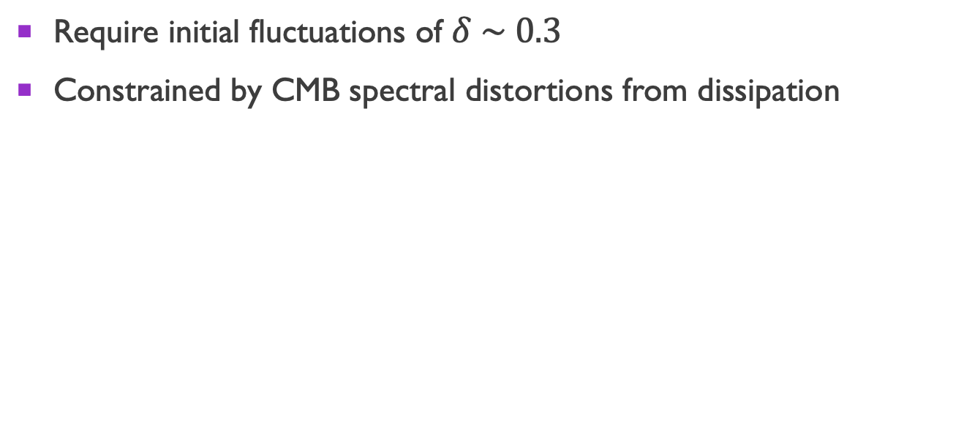
Primordial black holes
Require initial fluctuations of $δ \sim 0.3$
Constrained by CMB spectral distortions from dissipation
Byrnes, Lesgourgues, & Sharma 2024
Notes:
doesn’t rule out PBHs as SMBH seeds, but complicates the picture

Slide 51

What about initial fluctuations of intermediate amplitude?
?

Slide 52

Putting everything together…
Possible to form SMBHs from modest enhancements!
To make a “not-quite-primordial black hole” (NQPBH)…
  Initial density large enough to collapse at $1+z>200$, so that molecular cooling is suppressed
  $M_{halo}$large enough ($k$ small enough) for $T_{vir}≥{10}^{4}$ K, so that atomic cooling is active
Additional considerations
Also need low angular momentum
DM-baryon relative velocities delay collapse in some halos

Slide 53


Can produce density of BHs inferred from JWST little red dots ($n=1.3 × {10}^{−5} {\text{M}\text{pc}}^{−3}$) with narrow peak (x310) and step-function enhancement (x180)
Notes:
- discuss overlap with constraint

Slide 54


Early reionization
Galaxies and accreting black holes emit ionizing radiation
Collapse fraction tracks progress of structure formation
$f_{coll}\left(z, M_{min}\right)= \frac{1}{\overline{ρ}} \int_{M_{min}}^{∞}{dM × M\frac{dn}{dM}(z)}$
Simple model for reionization states $\frac{n_{HII}}{n_{H}}=ζf_{coll}\left(z, M_{atom}\right)$
We require that the universe not reionize too early, i.e.
$$f_{coll}\left(20, M_{atom}\right)<0.1$$
$ζ$ is ionization efficiency,
generally expect $ζ>10$

Slide 55

Constraints on primordial fluctuations

Slide 56

Implications for primordial black holes
Pessimist: So I can’t make PBHs without NQPBHs? :c
Optimist: I can make SMBHs with modest enhancements and less fine-tuning! :D

Slide 57






Examples of PBH → NQPBH Models
Cosmic string loops
Collapsing domain walls…
Ultra slow-roll…
Your favorite model???

Slide 58

Other ways to seed NQPBHs
Snowmass: Cosmic Probes of Dark Matter

Slide 59



Abundance of molecular hydrogen
“Too much” cooling → cooling time shorter than free-fall time
$τ_{H_{2}}=\frac{T}{{\dot{T}}_{H_{2}}}, τ_{ff} =\sqrt{\frac{3π}{32Gρ} }$
* Assuming $T={10}^{4}$ K
and $ρ=18π^{2}\overline{ρ}$

Slide 60

Abundance of molecular hydrogen
Evolve $H_{2}$ abundance in top-hat halos virializing at different $z$
Earlier $z$ → CMB hotter, suppresses abundance of $H^{−}$ and $H_{2}$
Prior to $1+z∼200$, halos are unable to fragment/form stars

Slide 61


DM-baryon relative velocities
Tseliakhovich & Hirata 2010: After baryons decouple from photons, have a velocity relative to DM
When is this a problem for structure formation? Compare to gas sound speed
$$v_{\text{DM−b}}\left(z\right)=30 \text{km/s }× \frac{1+z}{1100}$$
$c_{s}=\sqrt{\frac{5T}{3μm_{p}}}≈11 \text{km/s}$ at $T={10}^{4}$K
$v_{\text{DM−b}}\left(z\right)<c_{s}$ for $1+z<400$

Slide 62


angular momentum considerations
Dimensionless spin parameter $λ=\frac{{J\left|E\right|}^{1/2}}{GM^{5/2}}$
Lodato & Natarajan 2006 find direct collapse occurs for $λ<0.02$
At $1+z=10$, spin distribution is lognormal with $\left\langle λ\right\rangle ∼0.04$ and $σ_{λ}∼0.55$
10% of halos meet criteria
Conservative b/c later halos have more spin

Slide 63


Models
Many models predict enhanced matter power
  Inflation models
  More inflation models
  Alternative dark matter
We will work generally, and model enhancements as
  Narrow peaks
  Step functions
Garcia-Bellido & Morales 2017
Snowmass: Cosmic Probes of Dark Matter
Geller, WQ, et al. 2022
Notes:
So you might be asking what kind of physics can give overdensities that are enhanced relative to our usual standard cosmology expectations
Actually, such enhancements appear in all kinds of particle physics contexts
For example, there many inflationary models in the PBH literature such as this single field example by Garcia-Bellido & Morales that enhance the power spectrum for the primordial perturbations or initial conditions of our universe
There are lots of other models…I personally have worked on multi-field inflation models, you have hybrid inflation, inflation with a spectator field, etc., LOTS OF MODELS
In addition, certain exotic dark matter models also predict enhancements in the matter power spectrum at small scales that could potentially seed NQPBHs
But for this talk we will focus on the primordial curvature perturbations

