Slide 1

Insights/new questions on
early star/galaxy formation from the James Webb
Has the JWST discovered…
Evidence requiring a revision of our theories?
The first stars & galaxies? What did we learn?
New types of objects? (what are the Little Red Dots?)
Evidence for primordial black holes?
David Elbaz
Astrophysics Department, CEA Paris Saclay

Slide 2
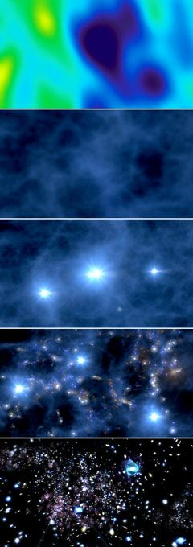
The initial objectives of the James Webb
Big Bang
CMB
--
--
--
--
--
--
--
--
380 000 yr
~100 Myr
~200 Myr
~700 Myr
Dark ages
Origin of…
First stars/galaxies
Cosmic reionization
Galaxy morphology
Population III stars
First galaxies
Reionization
First death of galaxies
time

Slide 3
the big questions for the James Webb
One week after data delivery…
were answered within 7 minutes
When did the first stars/galaxies form? First galaxy 360 Myr post-BB (z=12.2)
Naidu+ : Tue, 19 Jul 2022 17:48:03 UTC / Castellano+ : Tue, 19 Jul 2022 17:50:05 UTC
Within 2 minutes, 2 teams found the same galaxy GL-z2 = GHZ2.
Before GNZ11 = 415 Myr post Big Bang
2. Origin of cosmic reionization? Excess galaxies in luminosity function x10
3. Origin of the shape of galaxies? 10x more disks in the early Universe than HST found
Ferreira+ : Tue, 19 Jul 2022 17:41:16 UTC

Slide 4
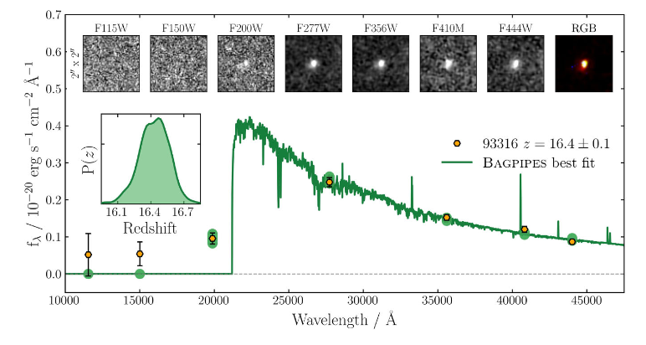
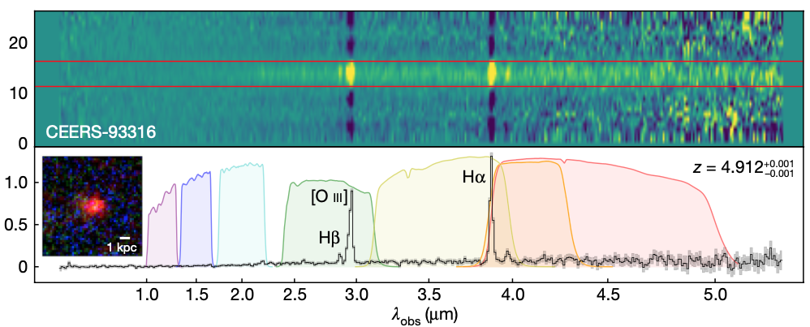
Carnall +2023 (submitted 25 July 2022)
z=16.4
Cosmic age = 237 Myr
10^9 Msun formed 100-200 Myr post BB
Arrabal Haro (sub. 27 March 2023)

Slide 5

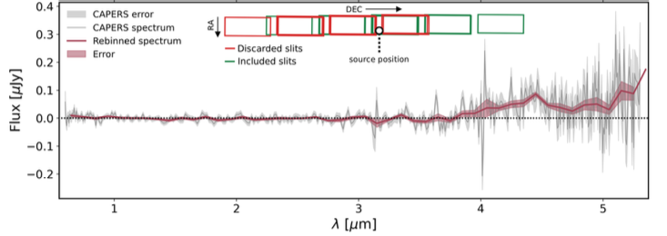
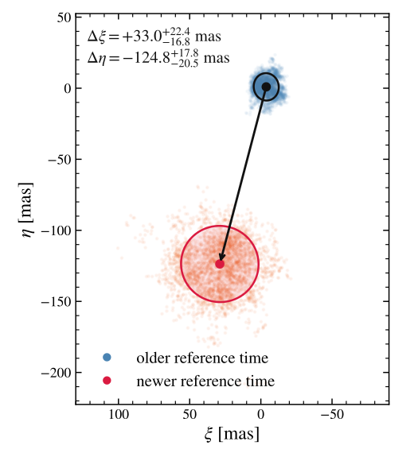
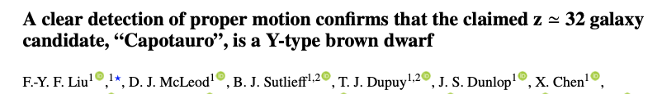
2026
Ferrara +2026: pair instability supernova
250 Msun star at z=15
z=32
Cosmic age = 91 Myr
August 2026

Slide 6
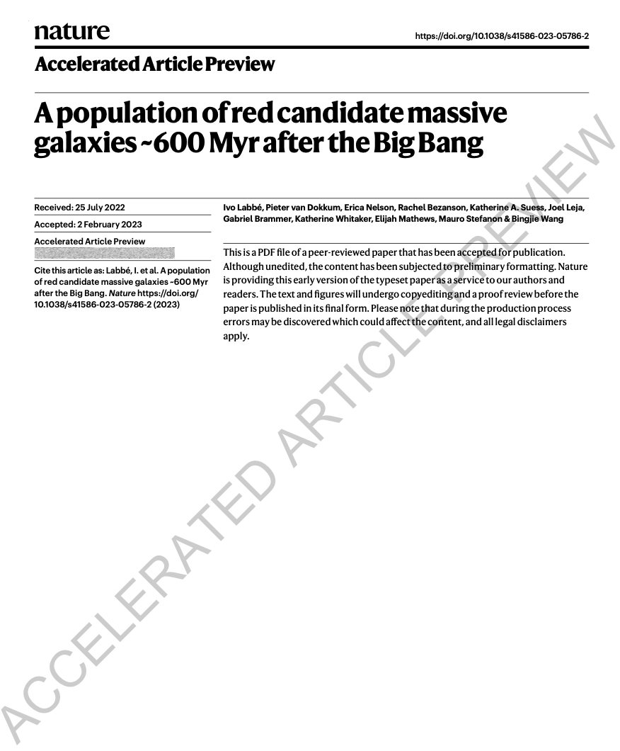

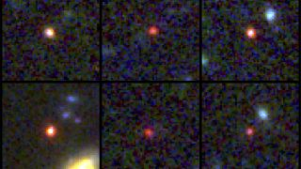

Slide 7
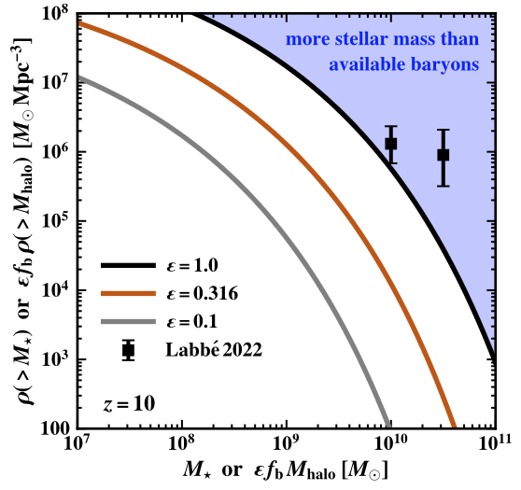
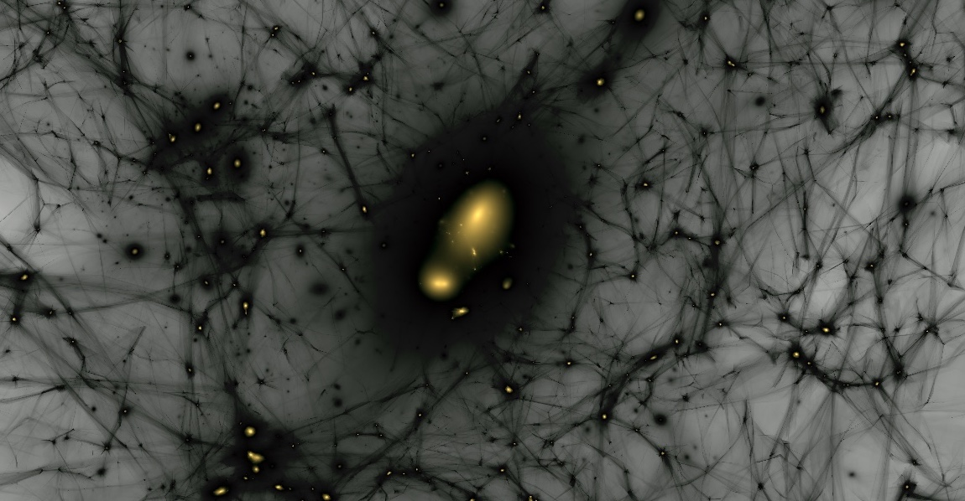
Galactic model
30% efficiency
2022
10% efficiency
100% atoms → stars
100% efficiency
10% atoms
→ stars
30% atoms
→ stars

Slide 8
Forbidden by
cosmology
Star formation with
30% efficiency
2023
10% efficiency
100% atomes → étoiles
100% efficiency
10% atomes
→ étoiles
30% atomes
→ étoiles
Boylan – Koychin et al. 2023

Slide 9
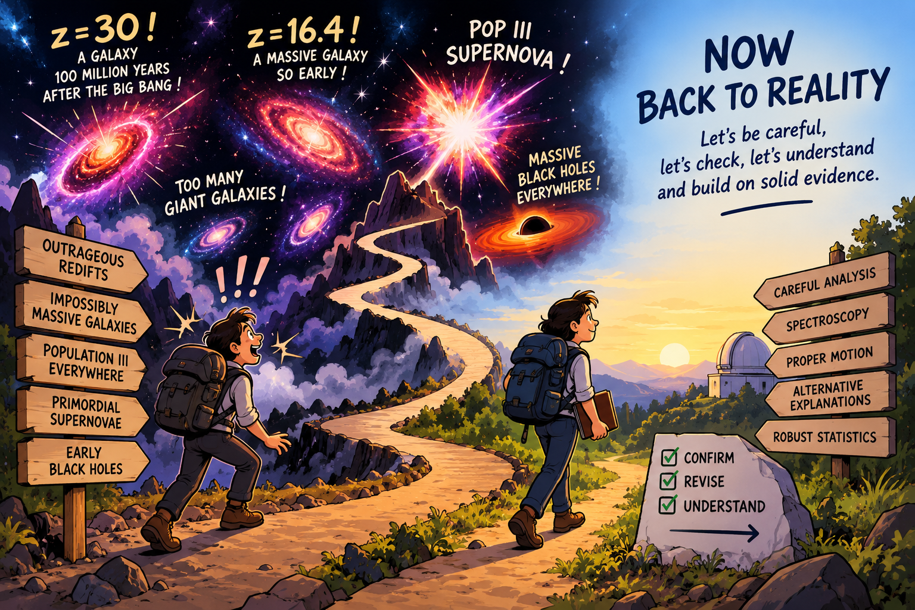
REDSHIFTS

Slide 10
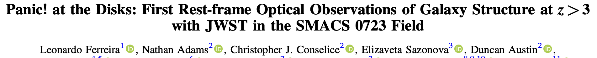
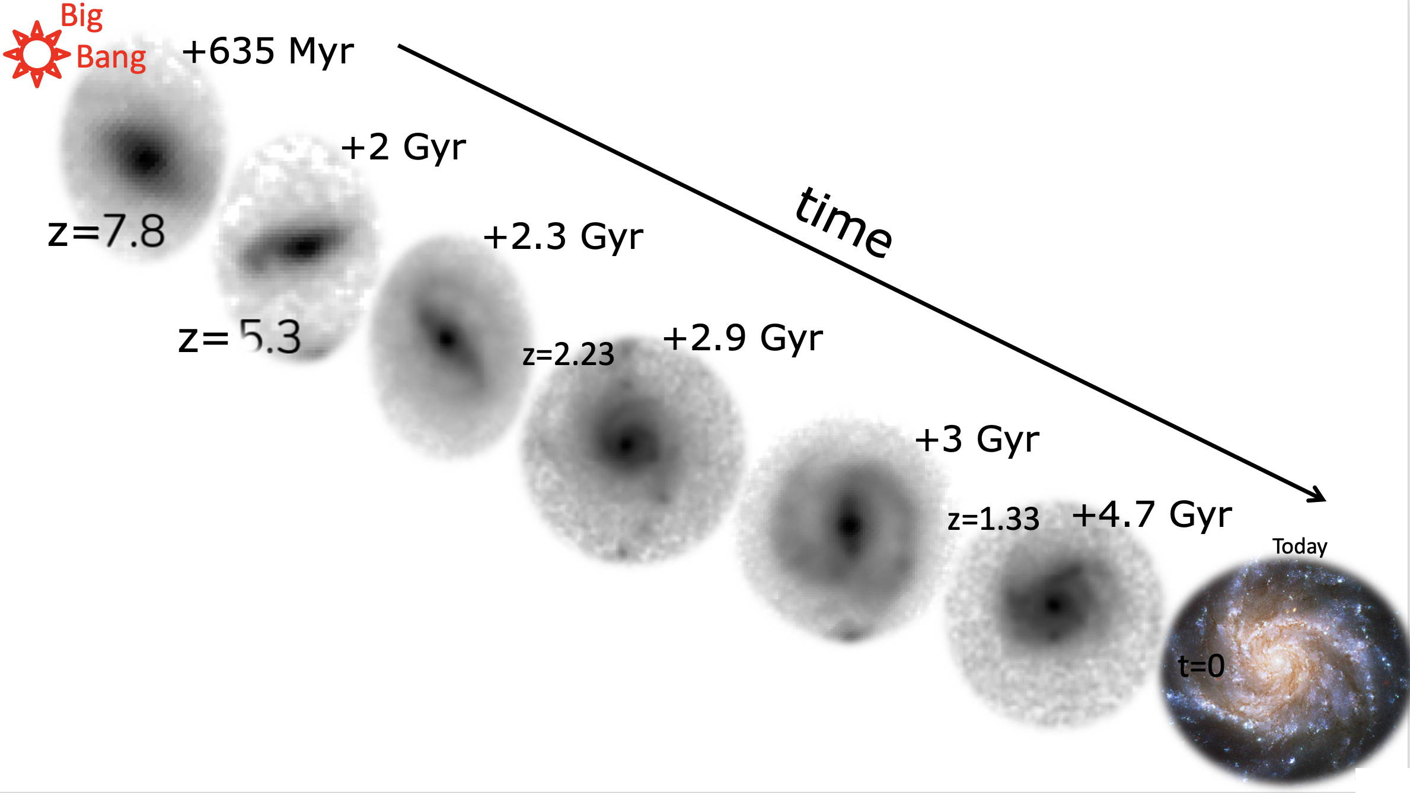
280 galaxies visually at 1.5 < z < 8
disk galaxies = common at z ∼ 3–6 : ∼50% of the galaxy population! > 10 times HST observations.
Cheng +2022, Guo +2022, Ferreira +2022

Slide 11
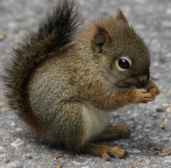
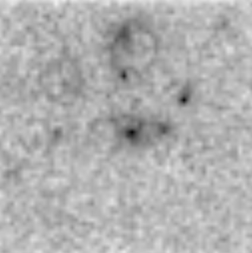
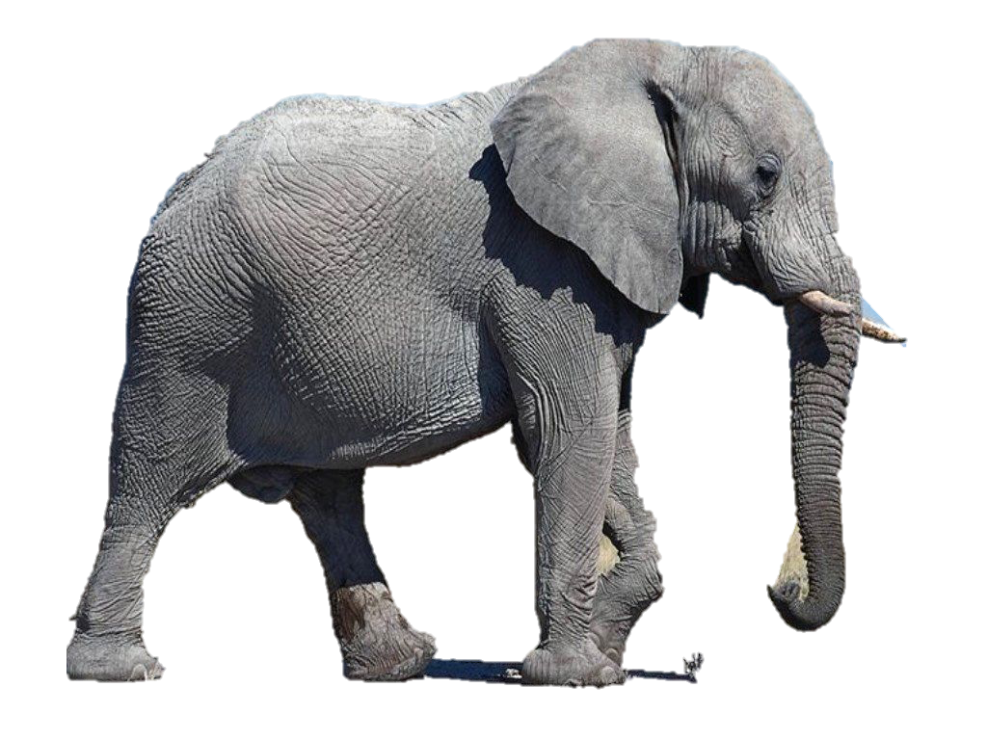
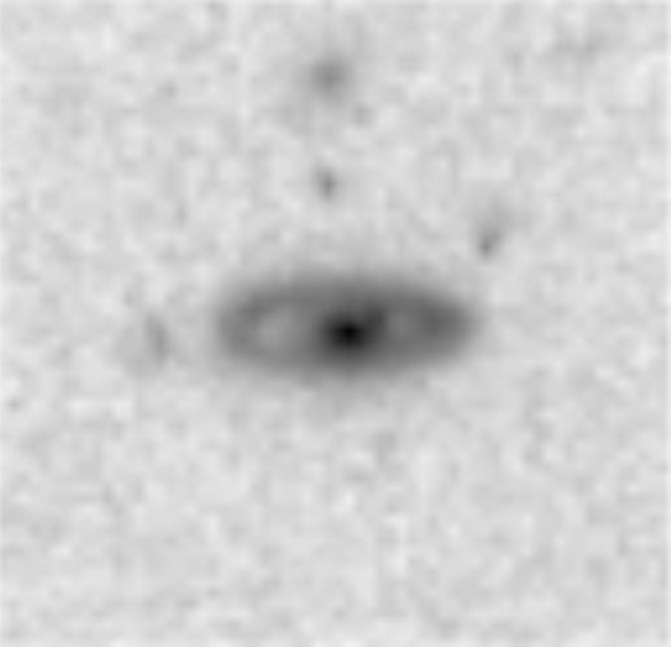
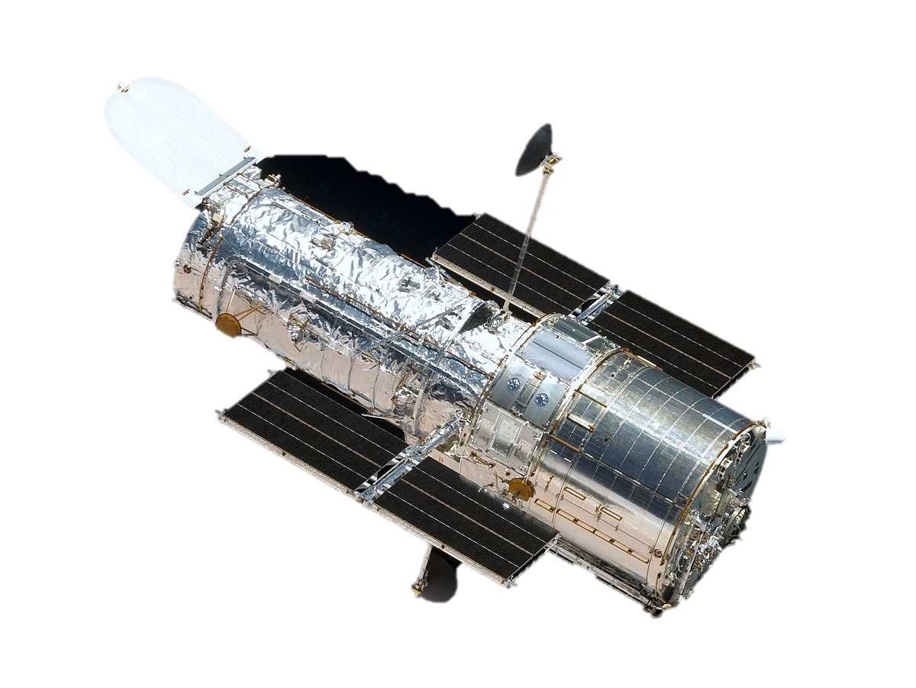
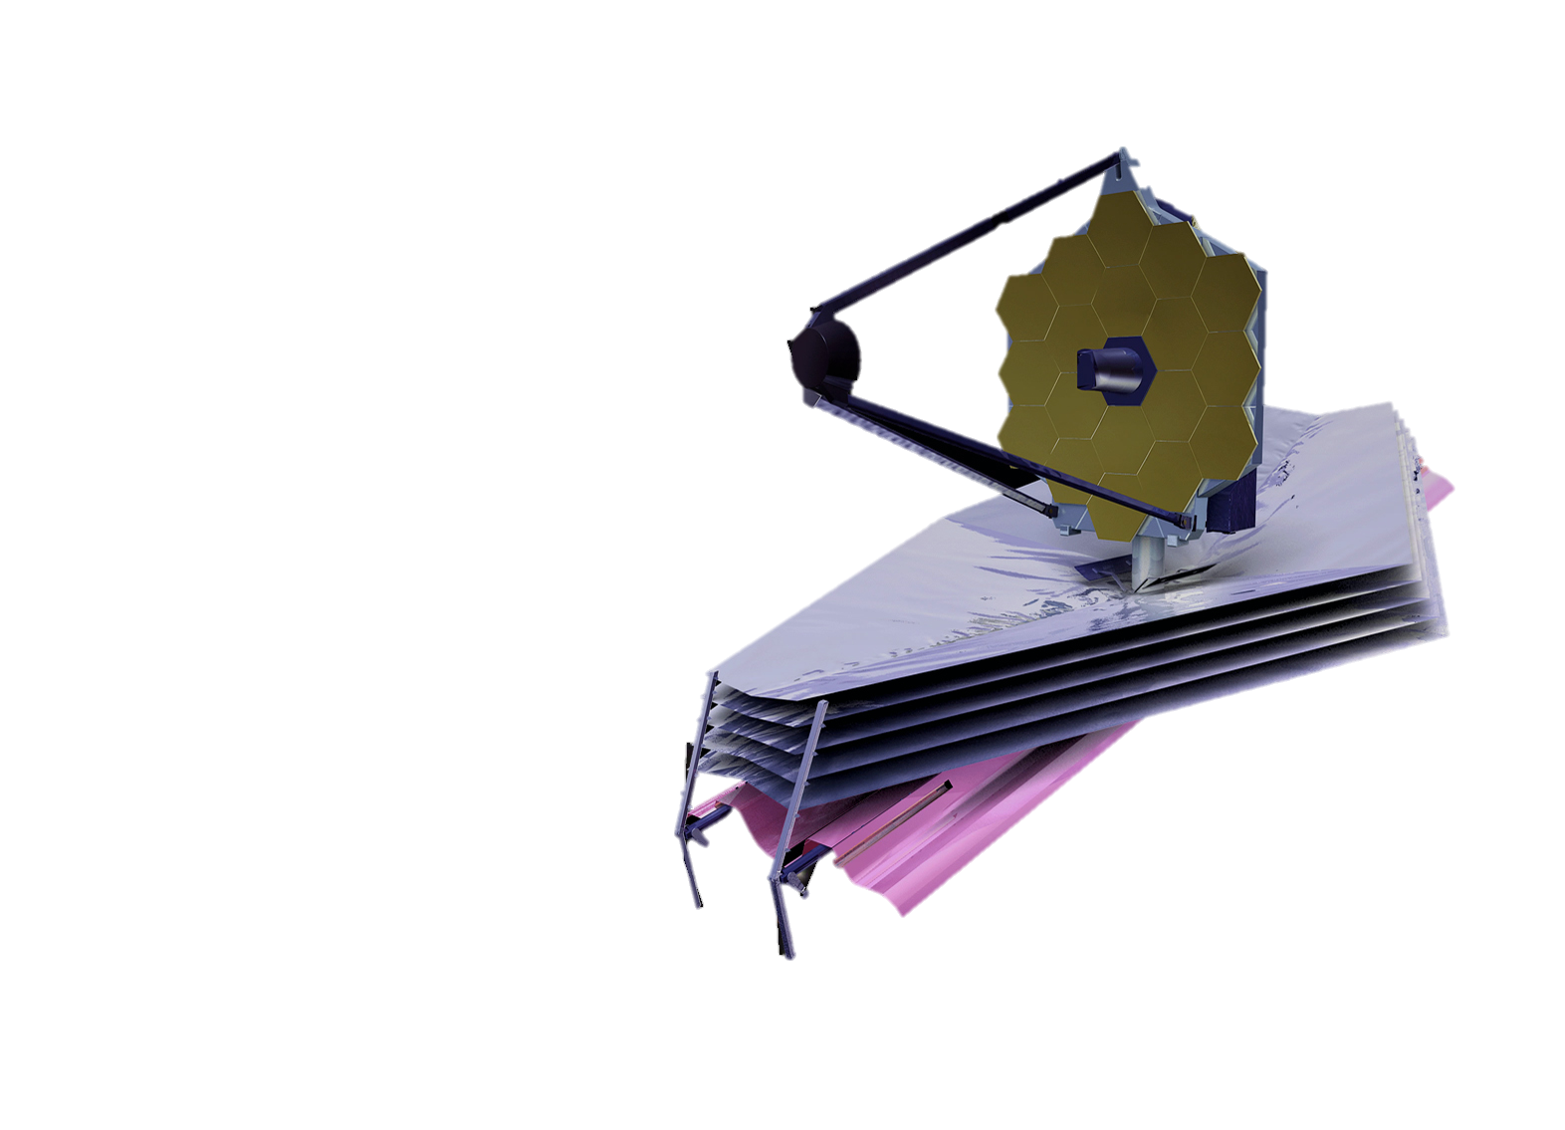
-11 billion years…
Cheng et al. 2022

Slide 12
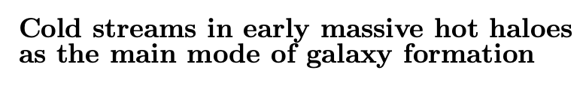
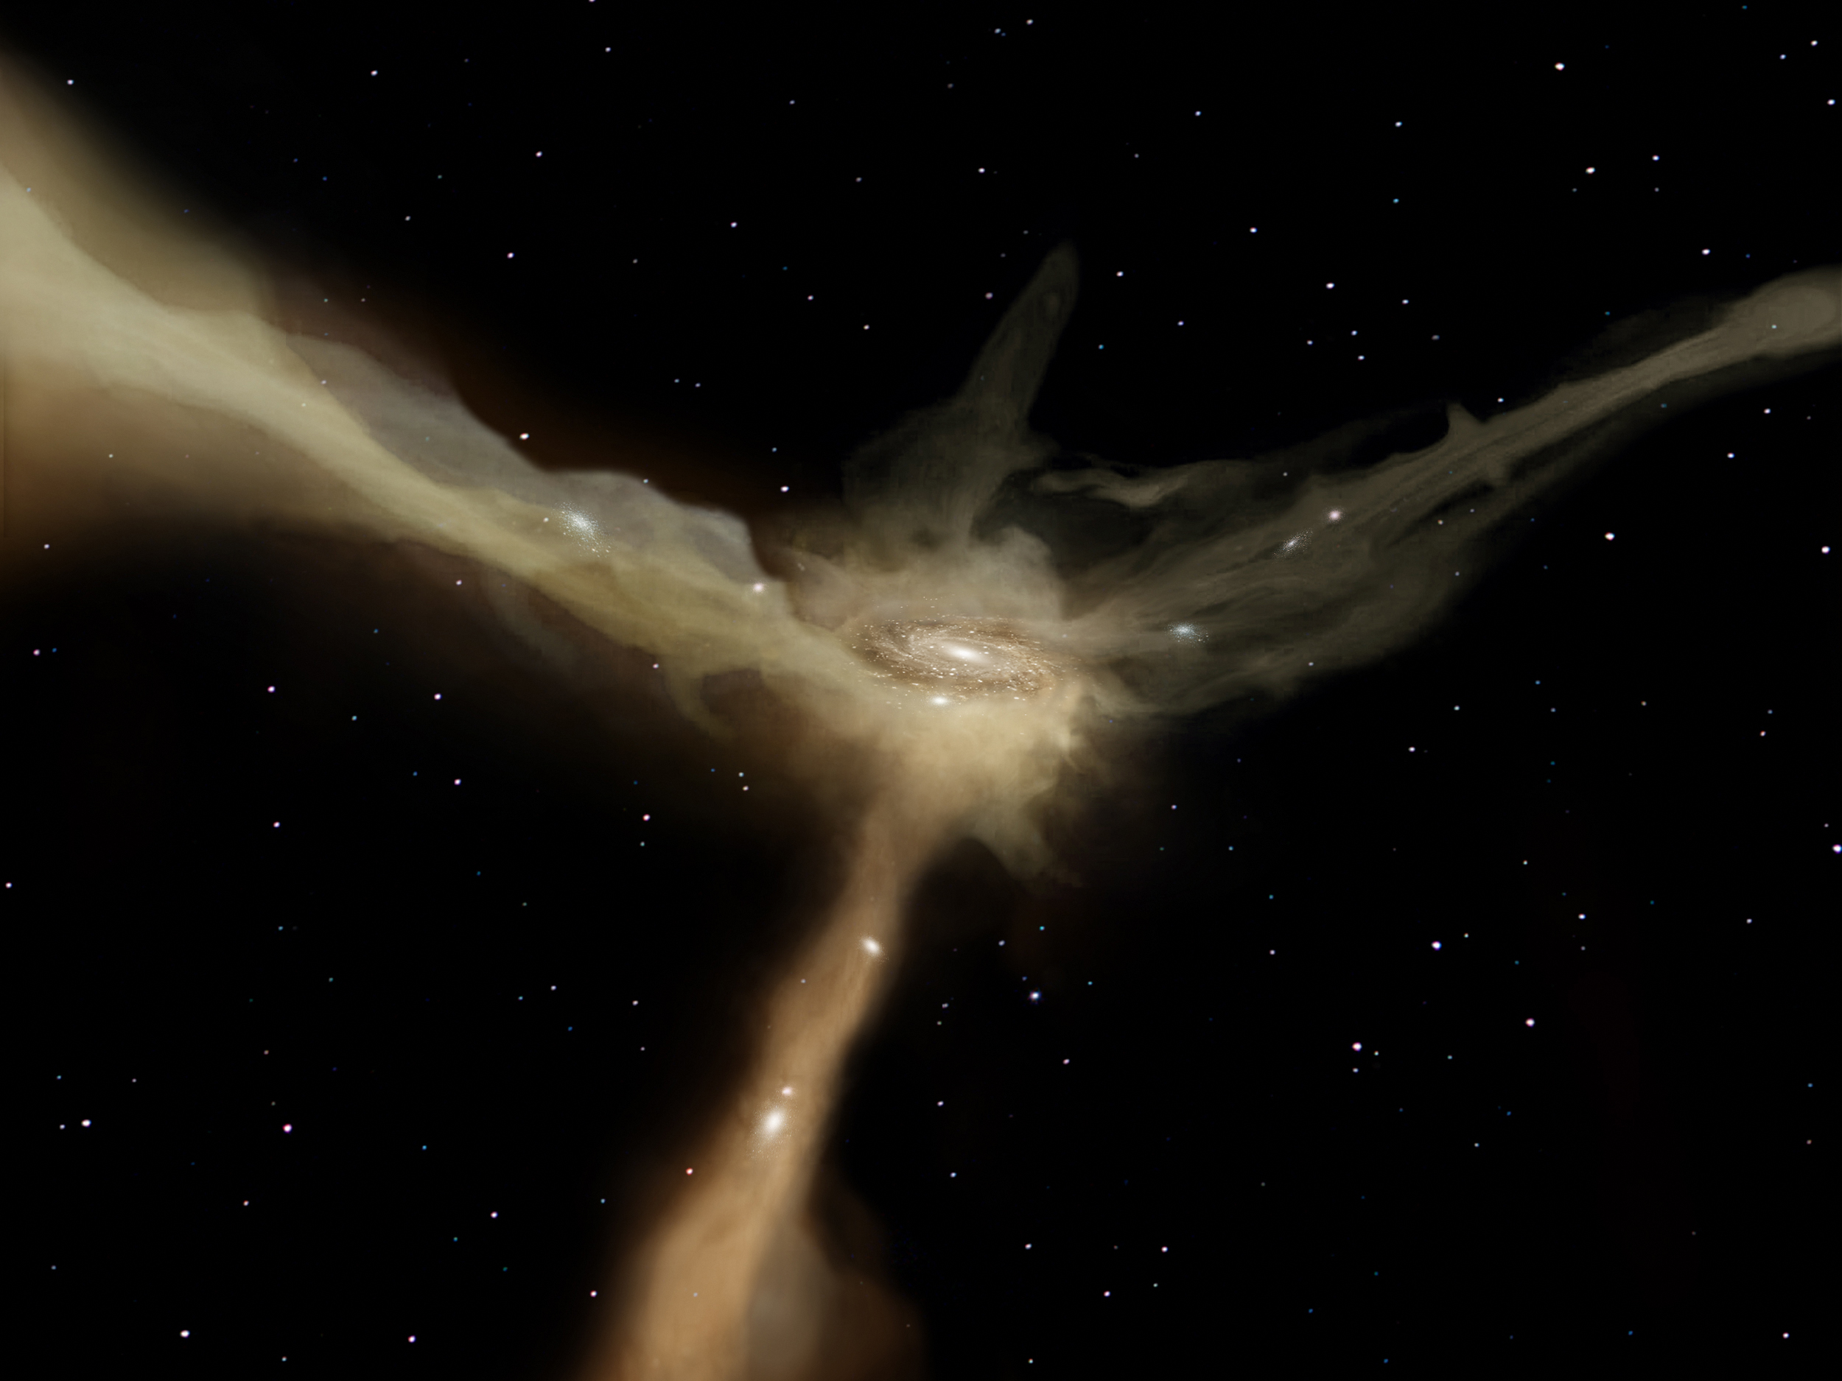
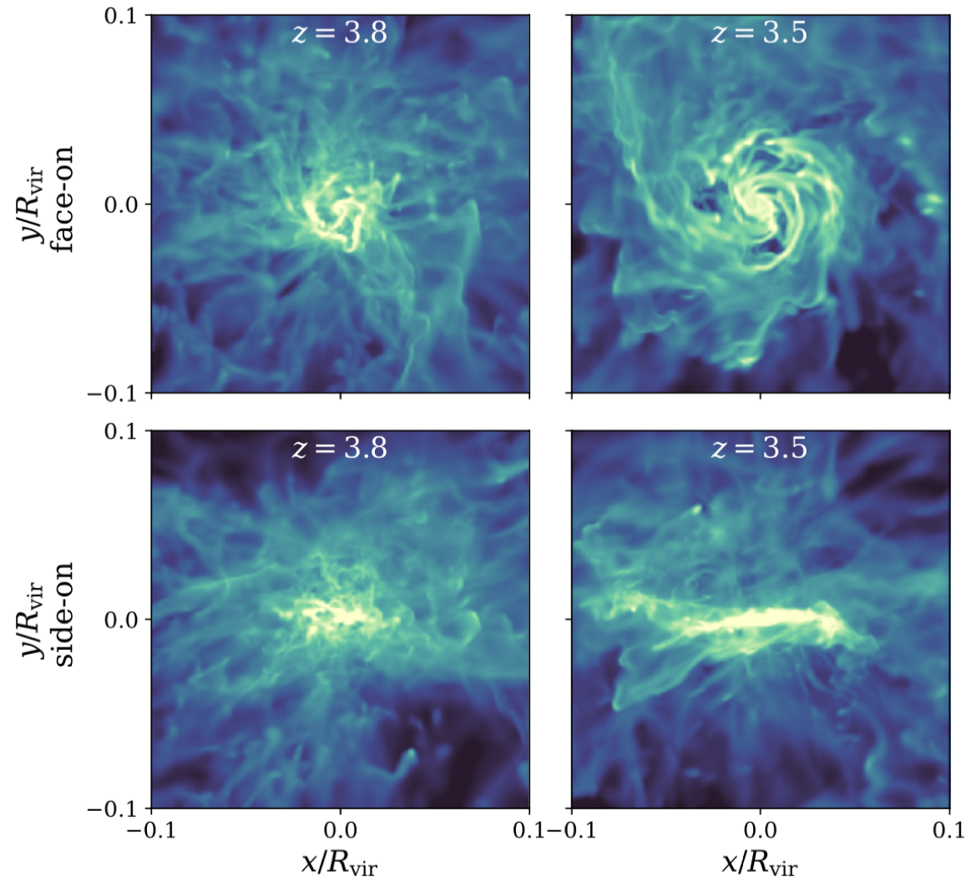

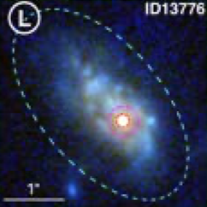
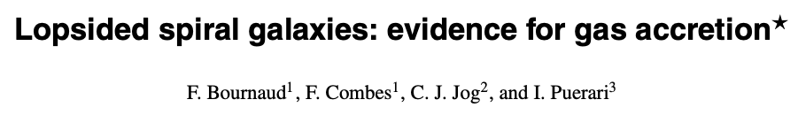
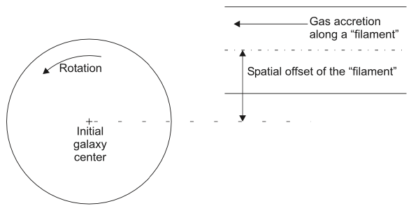
Nature volume 457, pages 451–454 (2009)
Dekel et al.
Kretschmer+2021
Before accretion During accretion
Le Bail, Daddi et al. 2023

Slide 13
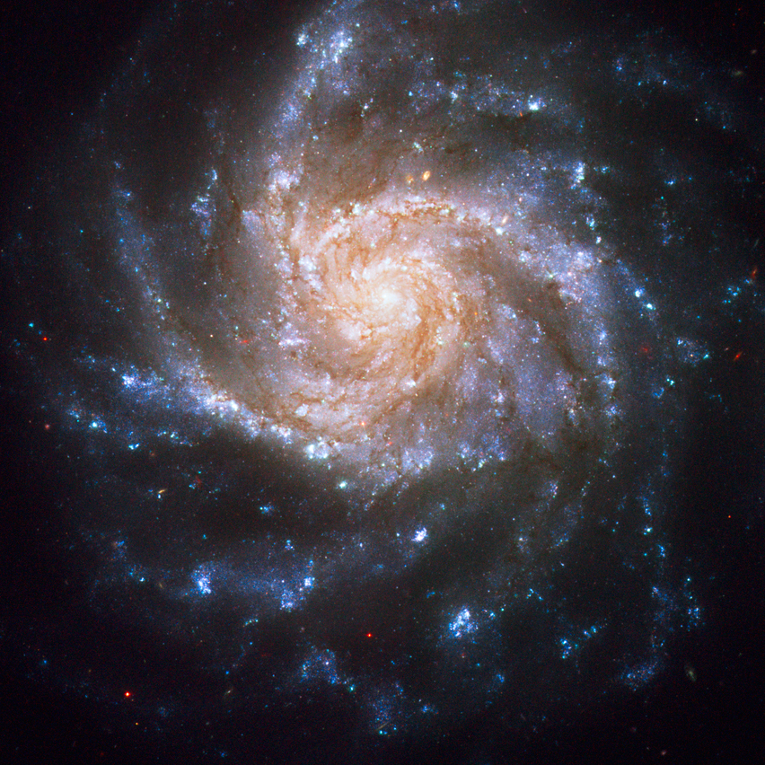
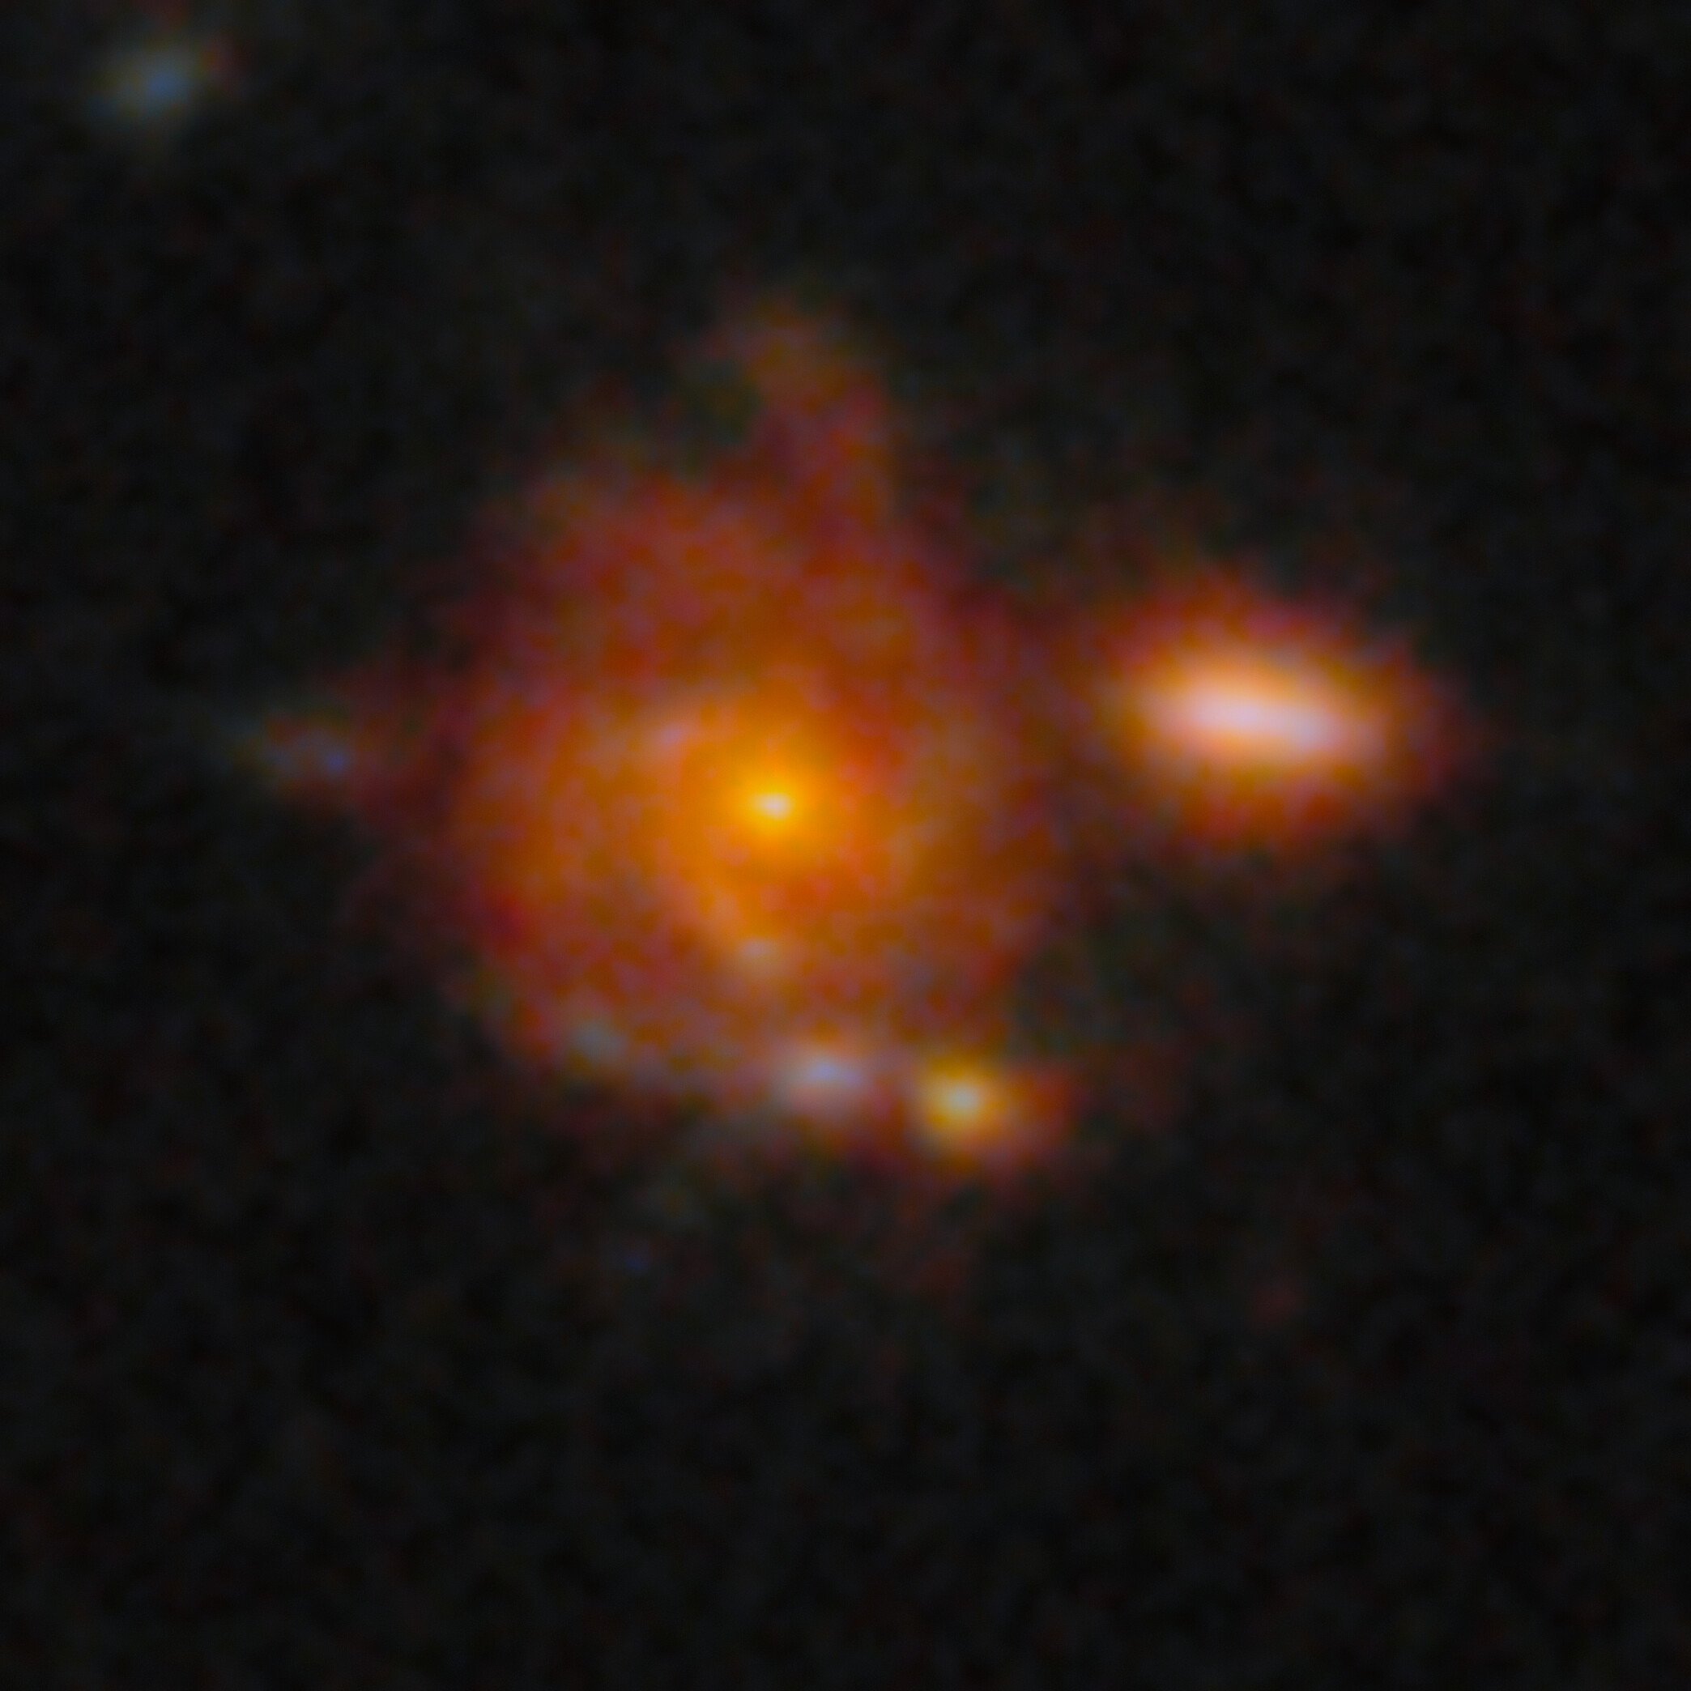
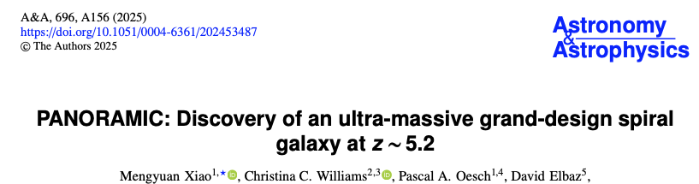
NGC 1376
-0.2 Gyr
Zhúlóng
Size 60 000 light-years ~ Milky Way
z=5.2 → cosmic age= 1.1Gyr

Slide 14


Slide 15
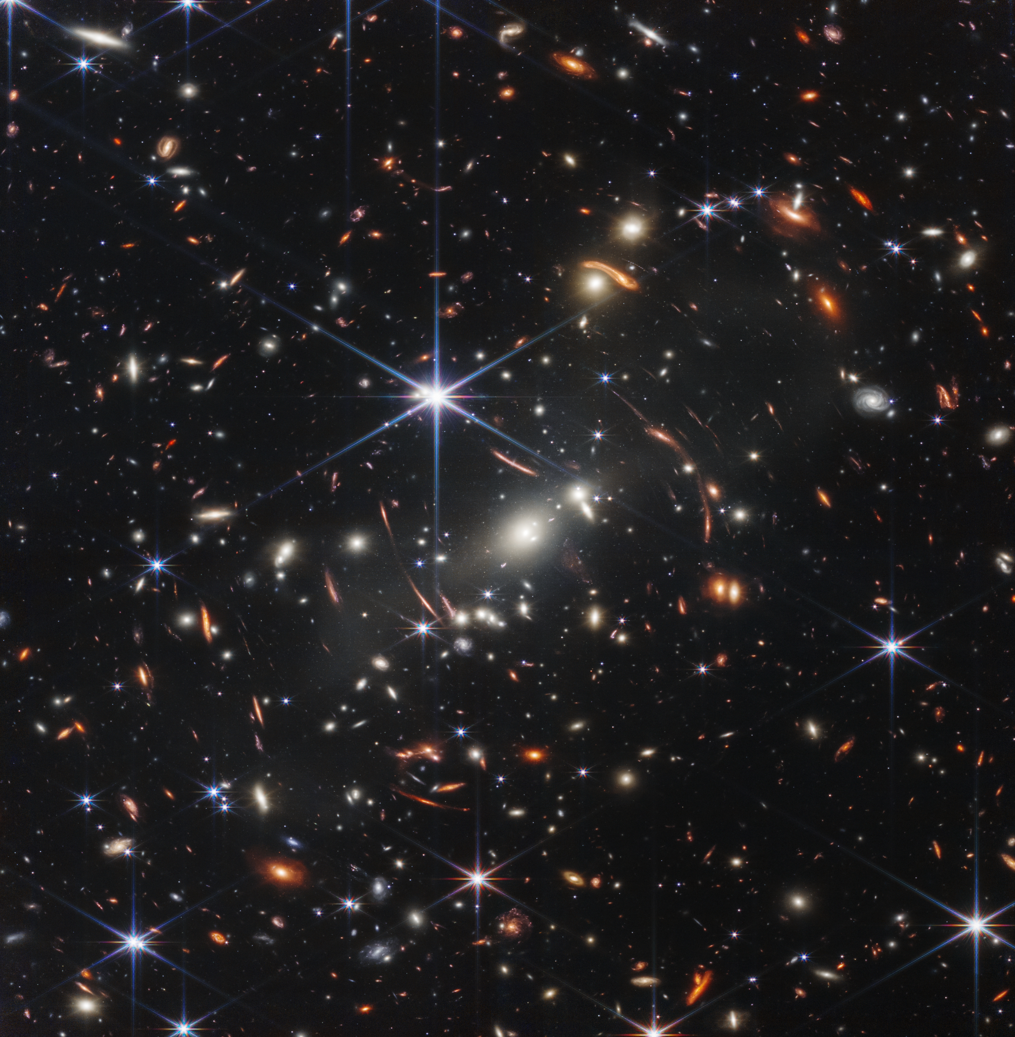
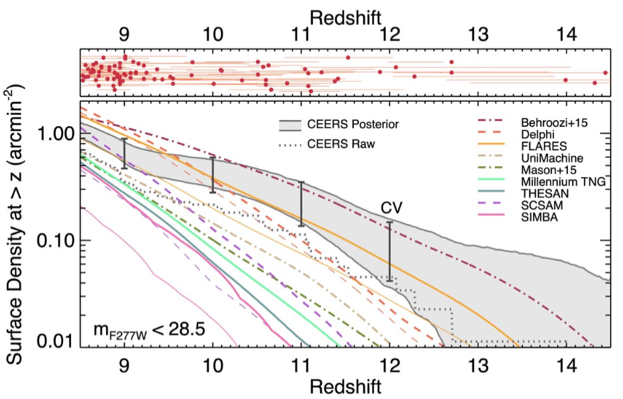
550 475 415 370 330 300
Million years
after Big Bang
Models
Observations
Finkelstein +24

Slide 16
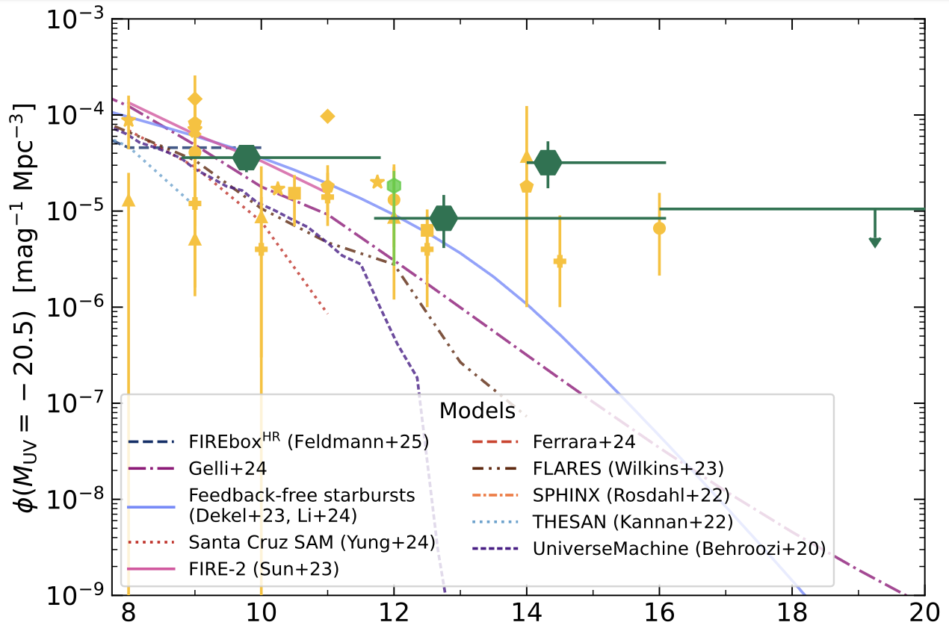
550 475 415 370 330 300
Million years
after Big Bang
Whitler +25
Redshift
Models
Observations
Finkelstein +24

Slide 17

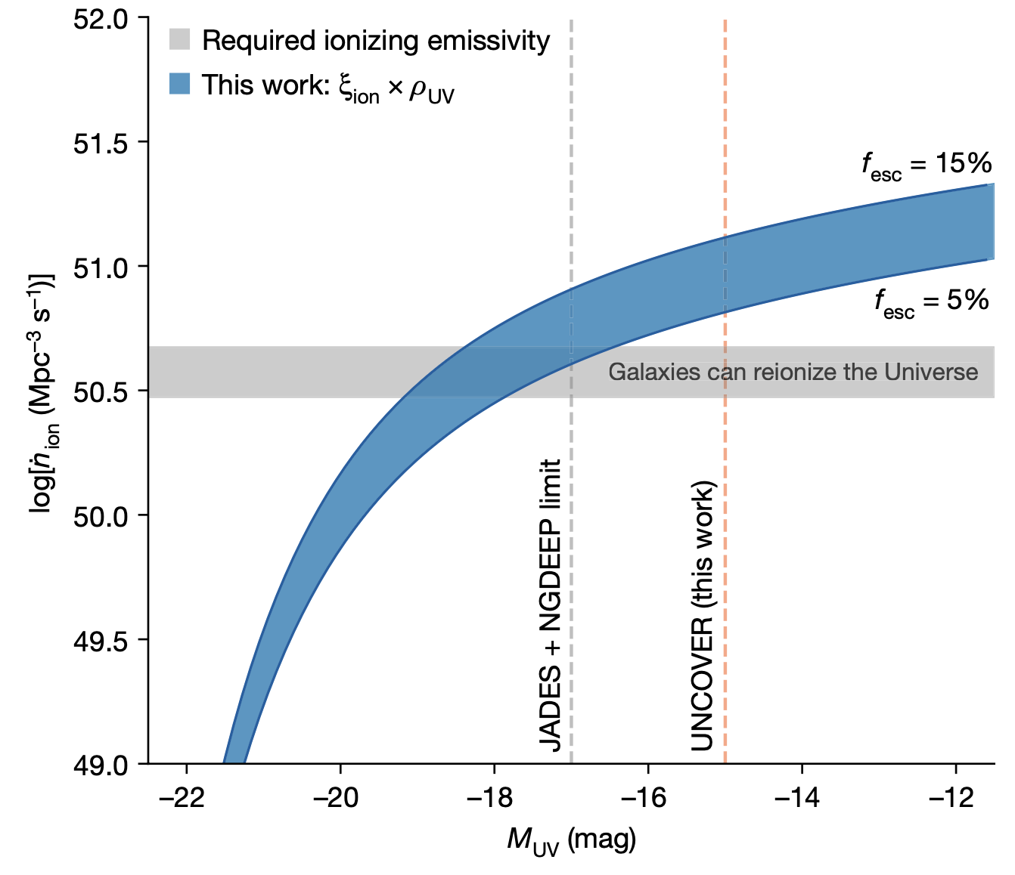
Atek et al. 2023
During the first Gyr, faint galaxies produced ionizing photons with log[ξ_{ion} (Hz erg−1)] = 25.80 ± 0.14
a factor of 4 higher than commonly assumed values
the rate of ionizing photons exceeds that needed for reionization,
even for escape fractions of the order of 5%
Reionization solved

Slide 18
550 475 415 370 330 300
Million years
after Big Bang
Too fast, too early
Whitler +25
Redshift
Models
Observations
Finkelstein +24
Whitler +25

Slide 19
IMPLICATIONS…
FEEDBACK-FREE STARBURST (Dekel et al. 2023): stars form faster than SN explode, helped by cold filamentary accretion
MINIMIZED FEEDBACK EFFECTS IN HIGH-DENSITY « Santa Cruz model » (Somerville et al. 2025): feedback weeker against gravity at high densities (few 10³ M⦿/pc²)
STOCHASTIC STAR FORMATION (bursts artificially boost the LF)
TOP-HEAVY IMF (higher L/M ratio, more luminosity per unity mass)
ACTUAL INCREASE OF STAR FORMATION EFFICIENCY…
DIFFERENT COSMOLOGICAL MODEL (Menci et al)
ROLE OF BLACK HOLES…

Slide 20
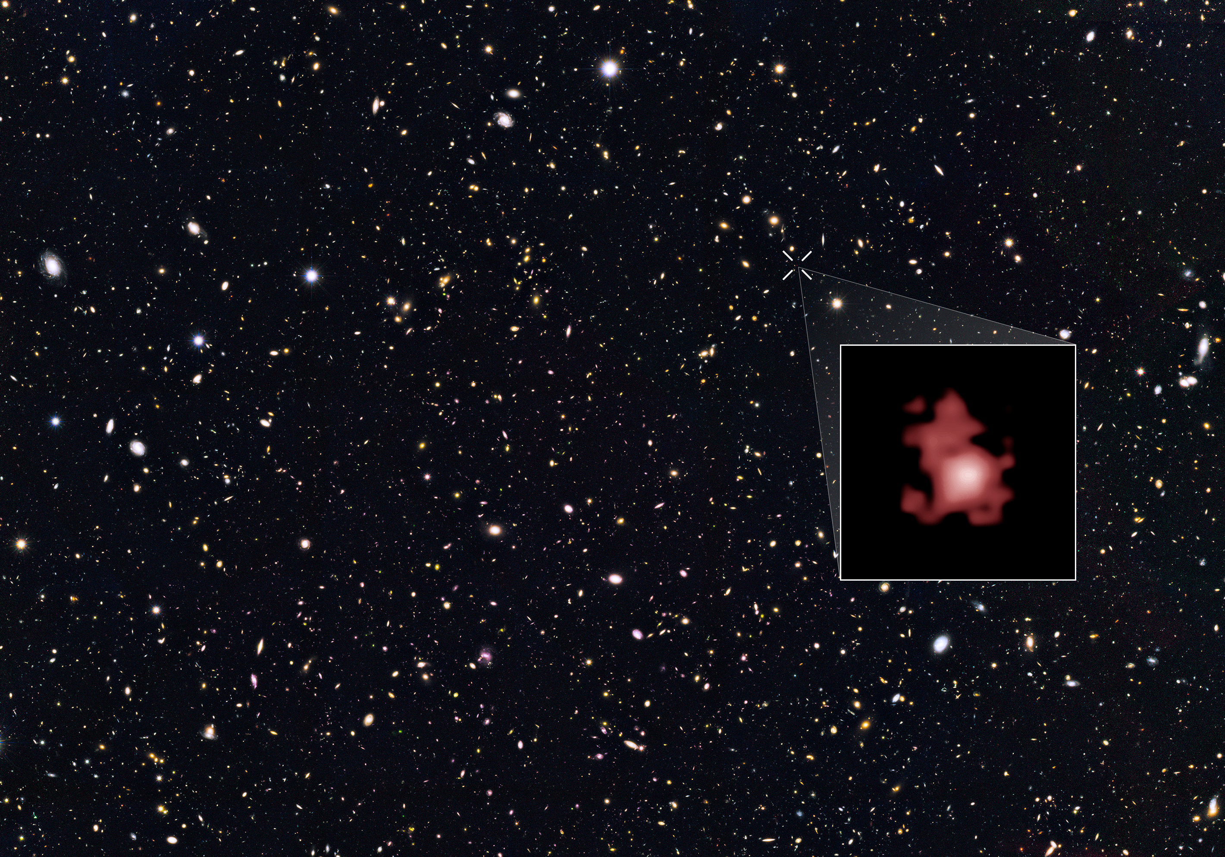
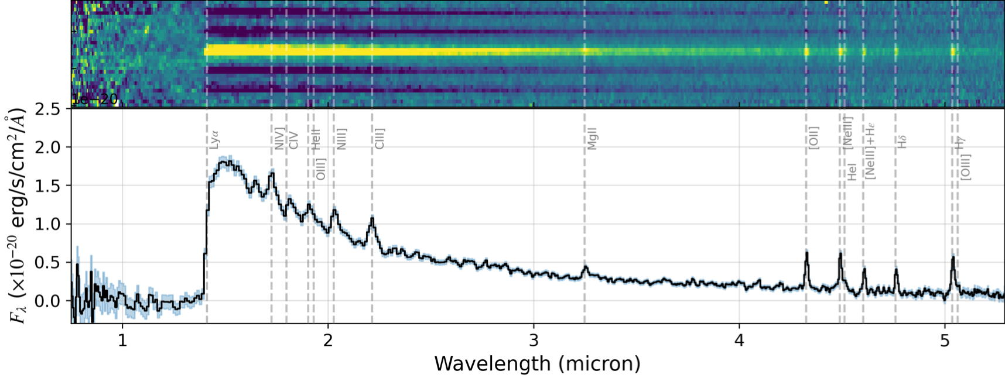
Hubble’s record:
GNz11
BB + 415 Myr
Bunker et al. 2023
JADES JWST/NIRSpec
GNz11 → z=10.6
BB + 436 Myr

Slide 21
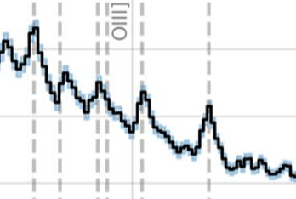
NIV
Hubble’s record:
GNz11
BB + 415 Myr
AGN
CIV
1640Å
HeII
NIII
AGN
CIII
1486 Å
AGN
ionization potential
E > 47.5 eV
1909Å
Signature of a 1.6 million M⊙ black hole.
Maiolino et al. 2023

Slide 22
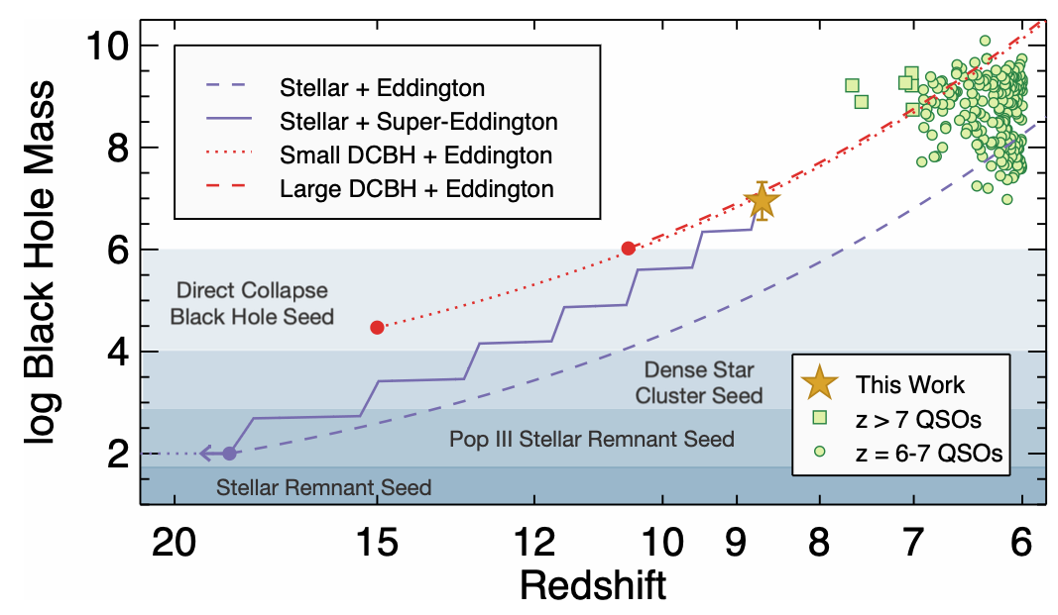
𝑧 = 8.679
GNz11
direct collapse black holes (DCBHs; Bromm & Loeb 2003)
Larson +2023

Slide 23
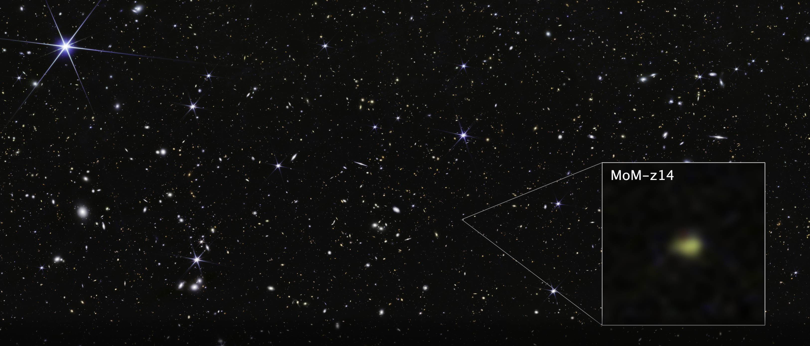
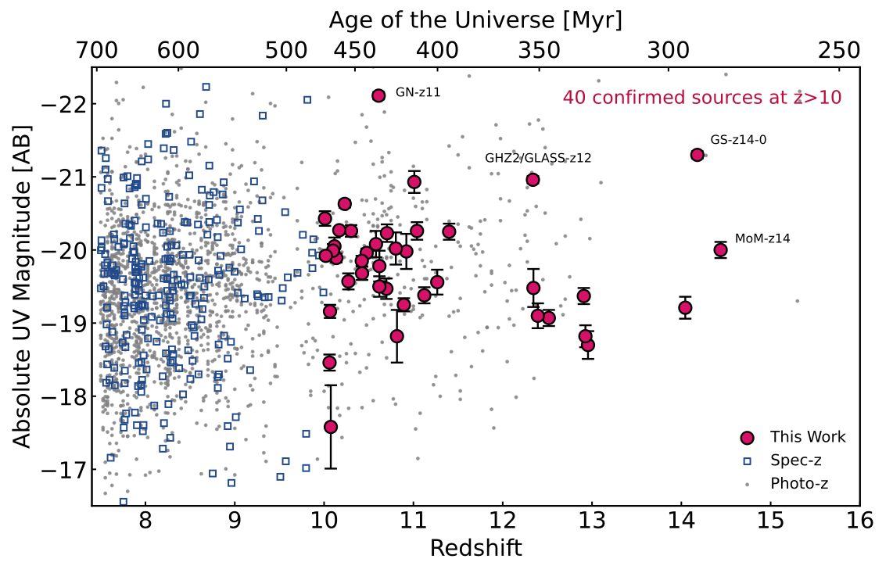
z=10 corresponds to 470 Myr post-big bang
Cosmic age: 280 Myr
effective radius = 74 pc, elongated
Stellar mass= 10⁸ Msun, SFR~10 Msun/yr
4% solar metallicity
stellar population age ~4 Myr
No sign of PopIII stars (HeII1640Å unresolved vs OIII]1661Å)
But high [N/C] possibly due to supermassive stars
Presence of a BH? No high-ionisation lines but…
MoM-z14
Naidu +2026
Roberts-Borsani +2025

Slide 24
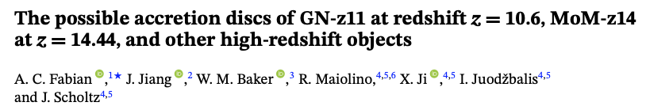
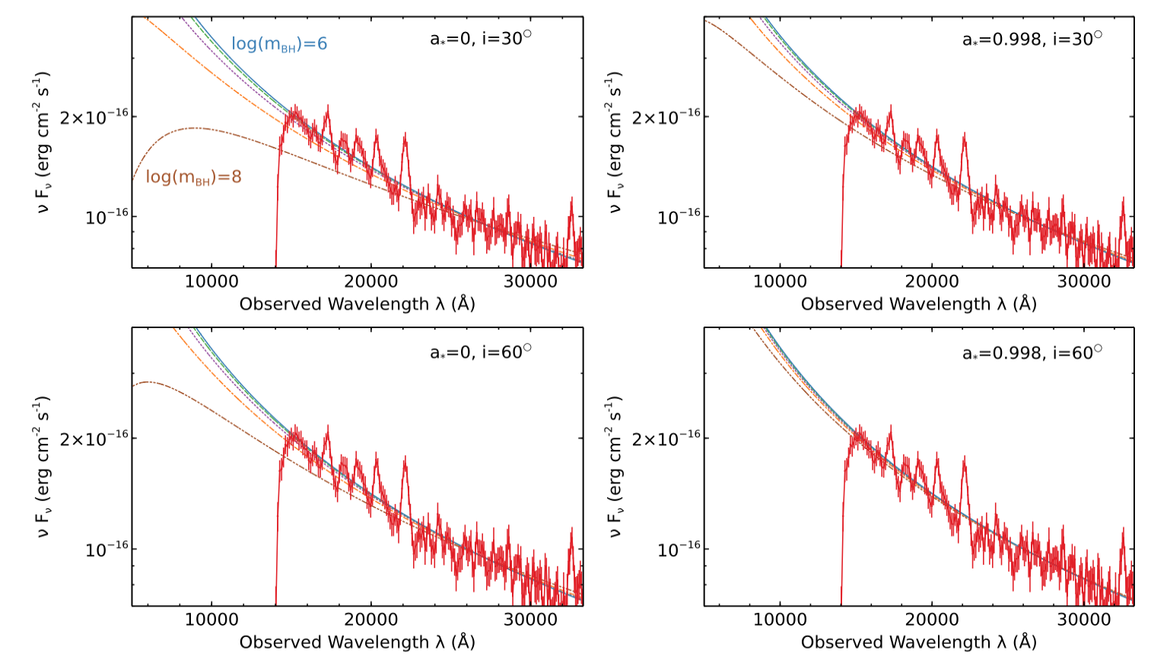
If sub-Eddington accretion (since low lum, no strong lines) cause the UV emission
→ massive BH <300Myr → exceptionally massive seeds or primordial BH distant BH in quasars (SDSS,…)

Slide 25
Forbidden by
cosmology
Star formation with
30% efficiency
December 2022: first spectrum
Broad lines → 1000 km/s
SMBH…
2023
10% efficiency
100% atomes → étoiles
100% efficiency
10% atomes
→ étoiles
30% atomes
→ étoiles
Boylan – Koychin et al. 2023

Slide 26
A new discovery space in the exploration of black hole accretion in the early Universe
# of AGN = 10 - 100 x extrapolation from quasars at z=5-7
10-30% are Little Red Dots
Pushes the maximum redshift to z>11 (<450 Myr)
BH masses inferred from broad lines 10^7-8 Msun
→ Serious challenge to Pop.III star seeds and growth
heavy seeds / super-Eddington accretion / primordial BH
Übler et al. 2023; Harikane et al. 2023; Maiolino et al. 2024a Juodžbalis et al. 2024, 2025; Taylor et al. 2025; Kovács et al. 2024; Dayal & Maiolino 2026

Slide 27
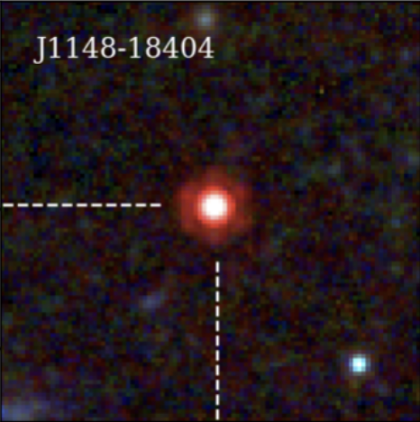
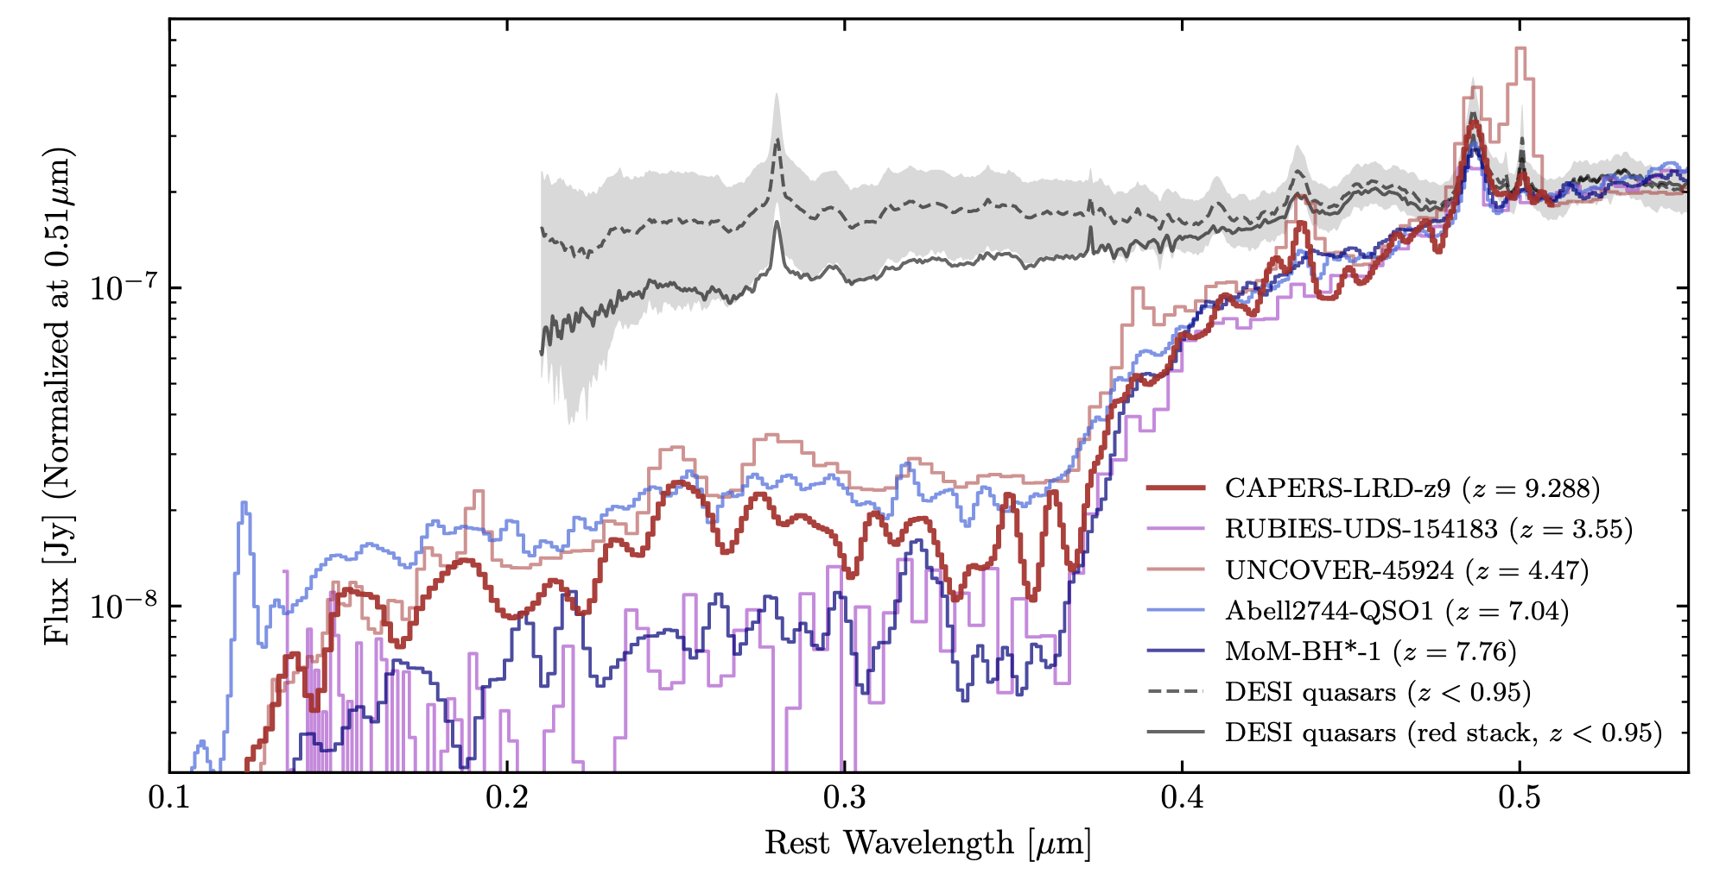
The 4 features making a Little Red Dot
(1) Compact morphology [ little dots ]
(unresolved at 4.4µm, eg., Matthee+24, Pérez-Gonzales)
(2) V-shaped SED [ red ]
(eg., Matthee +24, Kocevski+25, de Graaf+25, Kokorev+24, Akins+25)
(3) Broad Balmer lines [ AGN-like ]
(FWHM > 1000 km.s ; eg., Taylor+25, Hviding+25)
(4) Steep Balmer break [ old? ]
(eg., de Graaf+25)
(1)
(3)
DESI quasars
(2)
(4)
(Taylor+25)

Slide 28
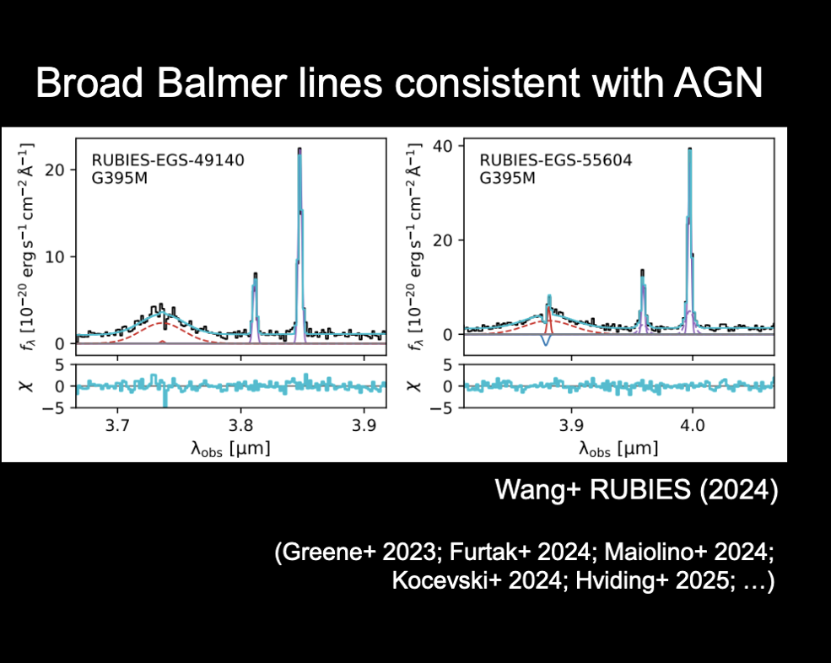
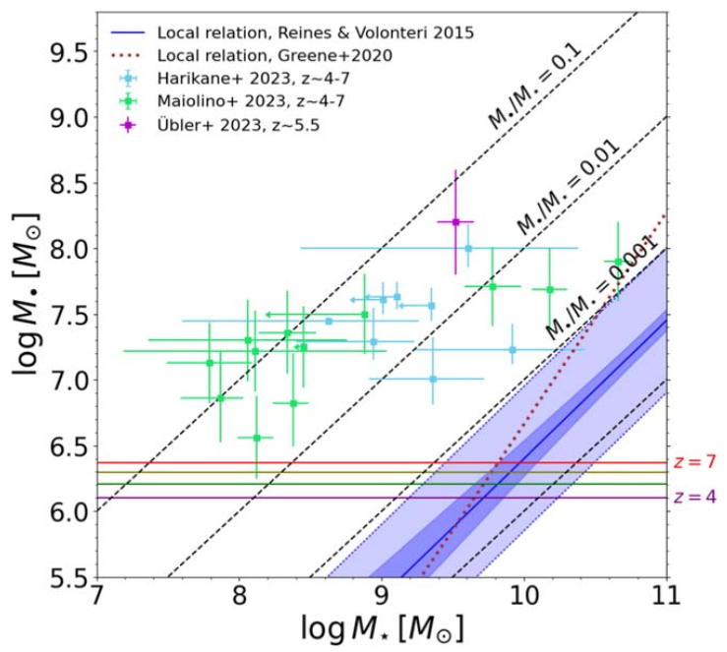
If LRDs are powered by AGNs
Heavy seeds for BH → too fast , too early
+ no X-ray nor dust emission detection…
BH overmassive by ∼10–100×
BH=10% stars
BB+0.7-1.5Gyr
x100
Pacucci +23, Maiolino +
JWST is revolutionizing our understanding of the high-z Universe... Black holes are overmassive by ∼10–100× compared to their low-z counterparts in galactic hosts of the same stellar mass. This fact is not due to a selection effect in surveys.

Slide 29
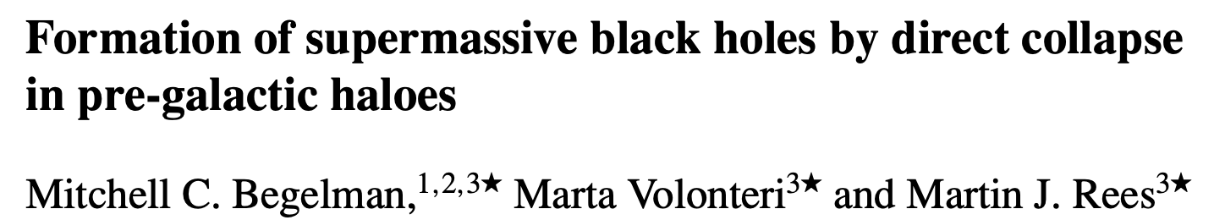
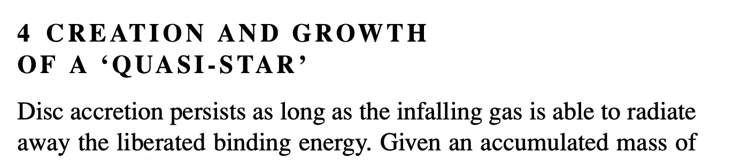
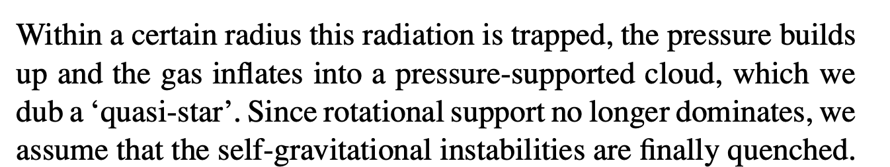
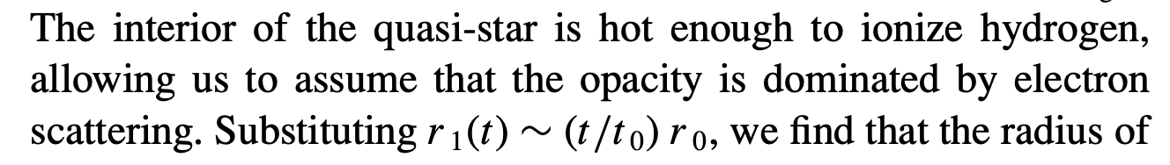
‘bars within bars’ mechanism (Shlosman, Frank & Begelman 1989; Shlosman, Begelman & Frank 1990).
Self-gravitating gas clouds become bar-unstable when the level of rotational support surpasses a certain threshold.
→ direct collapse model for SMBH seed formation = DCBH, last stage of quasi-star (Begelman +06…+26)
Broad line due to electron scattering → BH mass divided by 3 orders of magnitude !

Slide 30
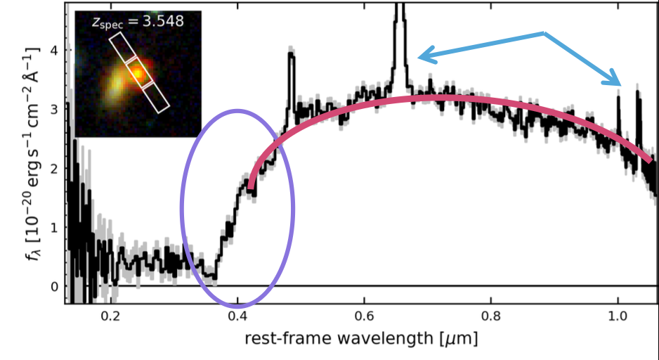
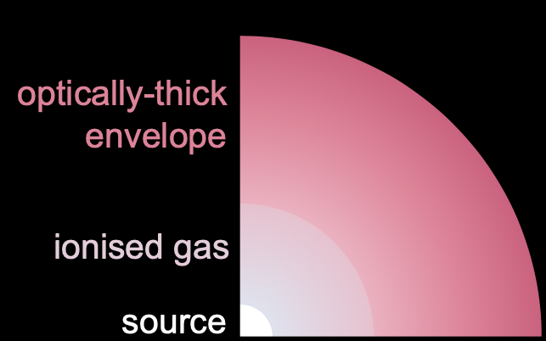
If LRDs are powered by: (1) stars → MW-mass at <600 Myr
(2) AGNs → Heavy seeds for BH
(3) a quasi-star or Black Hole Star
Context: direct collapse model for SMBH seed formation = DCBH, last stage of quasi-star (Begelman +06…+26)
n ∼10¹¹cm⁻³, ionization parameter U∼0.1, column density N_{H} ∼10²⁶cm⁻².
Broad line due to electron scattering → BH mass divided by 3 orders of magnitude !
Naidu +2025
de Graaf +25
Prevents AGN light
from escaping
+ electron scattering
resp. for broad lines
The Cliff
De Graaf +2025
(see also Begelman & Dexter 2026: quasi-star
= super-Eddington accreting BH >10⁶ Msun
→ Short lifetime, would apply to all SMBH
z=3.5

Slide 31


Have we found a new species of cosmic beasts?

Slide 32



Have we found a new species of cosmic beasts?
Galaxies
Galaxies
LRDs
LRDs
Billand, Elbaz +26

Slide 33



NIRSpec IFS
0.02’’ Hα
Evidence for a
primordial BH?...
z=7.04
50 million Msun BH
Maiolino +2026: « Models invoking "primordial black holes" (i.e. putative black holes formed shortly after the Big Bang) may potentially explain the low chemical enrichment associated with this black hole »
Naked BH ?
Juodžbalis et al. 2026
The Keplerian rotation leaves little room for any stellar component in a host galaxy, as we conservatively infer M_{BH}/M∗>2. Such a ''naked'' black hole, together with its near-pristine environment, indicates that this LRD is a massive black hole seed caught in its earliest accretion phase.

Slide 34



Slide 35

Primordial BH seeding :
Seeds: PBH masses of 10^5-6 Msun
Around z~3400: PBH accelerates DM halo formation
Around z~34: DM halo = 100 x M(BH)
Non-linear growth of DM halo followed by gas accretion and star formation
Consequences:
Heavy seeds, high M(BH)/M*, low metallicity

Slide 36




Slide 37


The future of Little Red Dots
    Where are the LRDS at low z ?
    => may acquire an extended star forming component through cold gas accretion
    (Billand+25)
    (Dekel+25)

Slide 38
CONCLUSIONS
In summary everything went too fast too early:
star, BH, galactic disc formation, even passive galaxies
No clear signature of problem with cosmological model, although it could help explaining the absence of galaxies at z>14
Population III stars still out of reach
Accelerated formation of:
first galaxies can be explained by high efficiency, low feedback, but also by BH seeding and/or positive feedback
First SMBH: high Eddington / DCBH / PBH?

Slide 39
ON THE ROLE OF
ENTROPY / PHOTON PRODUCTION
IN STRUCTURE FORMATION

Slide 40

Radiative Cooling Cascade

Slide 41
Radiative Cooling Cascade

Slide 42
Radiative Cooling Cascade

Slide 43
Radiative Cooling Cascade

Slide 44
Radiative Cooling Cascade

Slide 45
Radiative Cooling Cascade

Slide 46
Radiative Cooling Cascade
Same E (energy): N₁hν₁ = N₂hν₂ with N₂ = 10 x N₁ if λ₂ = 10 x λ₂
Different S (entropy): S₂ = 10 x S₁
Different P (probability): P₂ = exp[ (S₂ - S₁)/k_{B} ] x P₁

Slide 47





The second law applies strictly to closed (isolated) systems whose entropy can only increase or remain constant.
S_{photons} = 3.6 N_{photons} k_{B}
Ω = number of microscopic states
(positions and velocities of the particles)

Slide 48


Global entropy produced by a star
L/M★ (W kg⁻¹)
All curves are normalized to a value of 1 at the mass of the Sun

Slide 49
Global entropy produced by a star
L/M★ (W kg⁻¹)
L /M★ / T ( k_{B} kg⁻¹ s⁻¹ )
We assume that the photons are radiated at the peak wavelength of the blackbody given by the Wien’s law.
Difference in wavelength between stars of different masses = inversely proportional to the effective temperature.
All curves are normalized to a value of 1 at the mass of the Sun

Slide 50
Global entropy produced by a star
the HR diagram is a place of convergence for collections of particles to generate entropy with a nearly universal efficiency.
/ T
L/M★ (W kg⁻¹)
x τ_{MS}
L /M★ / T ( k_{B} kg⁻¹ s⁻¹ )
L /M★ / T x τ_{MS} ( k_{B} kg⁻¹ )
All curves are normalized to a value of 1 at the mass of the Sun

Slide 51


Fluctuation theorem applied to stars on the HR diagram
The main driver of the probability is the number of photons produced
Stars spend most of their lives on the MS of the HR diagram during which they convert hydrogen into helium. Stars of different masses produce photons, hence entropy, at a different rate
Chabrier IMF

Slide 52

Main Sequence stars vs Mains Sequence galaxies
Galaxies form most of their stars in a secular star-formation mode = the "star-formation main sequence"
galaxies on their main sequence produce a specific
entropy that also varies little with galaxy mass, in a way that resembles what is seen for individual stars

Slide 53

Extragalactic background light

