Slide 1

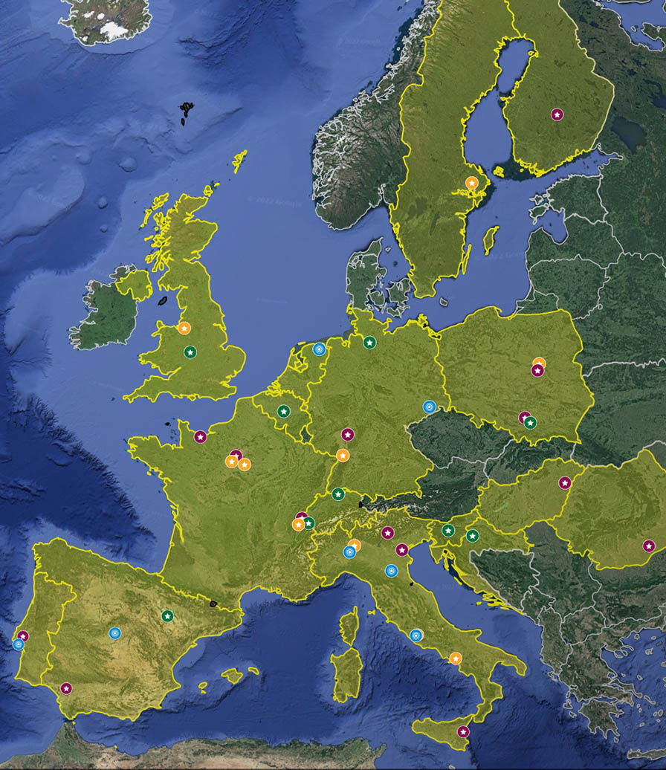
PROJECT ACRONYM: EURO-LABS – EUROpean Laboratories for Accelerator Based Sciences
PROGRAMME: Horizon EU (Research infrastructure services to support health research, accelerate the green and digital transformation, and advance frontier knowledge)
DURATION: September 2022- August 2026 (4 years)
TOTAL BUDGET: 14.5 M€
CONSORTIUM: 33 participants from 18 countries
PROJECT COORDINATOR: Paolo Giacomelli (INFN)
SCIENTIFIC COORDINATOR: Navin Alahari (GANIL)
The project brings together, for the first time, the three research communities of nuclear physics, accelerator and detector technologies for high energy physics, in a pioneering super-community of sub-atomic scientists.
It provides effective access to a network of 45 Research Infrastructures

Slide 2
GOALS
Provide efficient transnational access to the available resources at a major fraction of EUROpean Laboratories for Accelerator Based Sciences (EURO-LABS) at a network including the major European laboratories
Enhance collaborative targeted improvements for the existing services that will lead to an increase of the scientific and technical opportunities at various Ris
Make the results from the tests conducted at the RIs of EURO-LABS during the period of the project freely available to the scientific community and manage the experimental data, when relevant, through a Data Management Plan (DMP) in line with the FAIR principles (Findable, Accessible, Interoperable, Reusable).
Organize the training of the new generation of researchers and young technical staff to best exploit the RIs, through workshops and hands-on experience at specifically chosen RIs

Slide 3
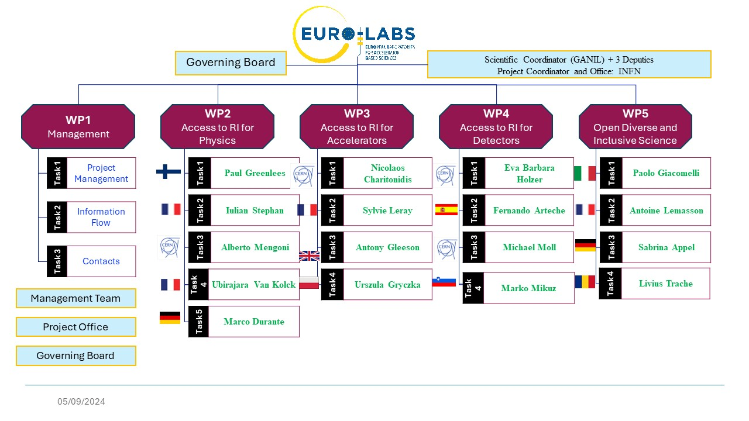

Slide 4
Task | Task Name | Objectives/Activities | Task Leader
2.1 | Stable ion beams | Promote/facilitate the access to stable beams with extremely high intensity and the matching target technology, that is essential to investigate extremely small production cross-sections, e.g. for the synthesis of new chemical elements and specific isotopes | Paul Greenlees (JYU)
2.2 | Radioactive ion beams | Promoting and/or facilitating transnational access to an extremely wide spectrum of radioactive ion beams, including the use of the new facilities at SPES and S3 at SPIRAL2, for path breaking research on nuclei far from stability | Iulian Stephan (CNRS)
2.3 | Neutron beams | Measurements of high-resolution neutron-induced reactions in an extremely wide range of kinetic energies (from sub-meV up to GeV), for the modelling of processes taking place in astrophysical sites and for applications in advanced nuclear technology developments | Alberto Mengoni (CERN)
2.4 | Theoretical support | Foster a stronger synergy between theory and experiments by opening up virtual access to established computing codes and theoretical tools for planning and analysing experiments performed at TA Ris and for the wider community. | Ubirajara van Kolck (IJCLab)
2.5 | Service Improvements | Improve remote access, improved access for biomedical applications, efficient sharing of traveling detectors, improved ion beam variety and stability, targets for high intense beams Provide improvements of the services offered by the RIs: C1) Streamlined and remote access C2) Targets for high intense beams C3) Biomedical application (FLASH@EURO-LABS) C4) Improving Ion Beam services in variety and stability (ERIBS) C5) Optimal employment of travelling gamma detectors (INTRANS) | Marco Durante (GSI) Subtask coordinators: C1) P.Napiorkowski (ŚLCJ UW) C2) M.Cavallaro (INFN) C3) M.Durante (GSI) C4) H.Koivisto (JYU) C5) M.Górska (GSI)

Slide 5
Institutions involved in subtask 2.5.2 «Targets»
12 Institutions, 7 Countries, 50 Researchers
Short Name | Participant organization name | Facility | Country
Beneficiaries
INFN | Istituto Nazionale di Fisica Nucleare | INFN-LNS | Italy
INFN | Istituto Nazionale di Fisica Nucleare | INFN-LNL | Italy
INFN | Istituto Nazionale di Fisica Nucleare | INFN- Turin | Italy
GSI | Helmholtzzentrum für Schwerionenforschung GmbH | GSI | Germany
UNIWARSAW | Uniwersytet Warszawski | SLCJ | Poland
GANIL | Grand Accélérateur National d'Ions Lourds | GANIL | France
CNRS | Centre National De La Recherche Scientifique | CNRS - IJCLab | France
CNRS | Centre National De La Recherche Scientifique | CNRS - IPHC-Strasbourg | France
CEA | Commissariat à l’Énergie Atomique et aux Énergies Alternatives | Saclay | France
IFIN | Institutul National de Cercetare-Dezvoltare Pentru Fizica si Inginerie Nucleara-Horia Hulubei | IFIN-HH Tandem | Romania
Associated Partners
LIP | Laboratório de Instrumentação e Física Experimental de Partículas | LIP | Portugal
PSI | Paul Scherrer Institut | PSI – Lab. of radiochemistry | Switzerland

Slide 6

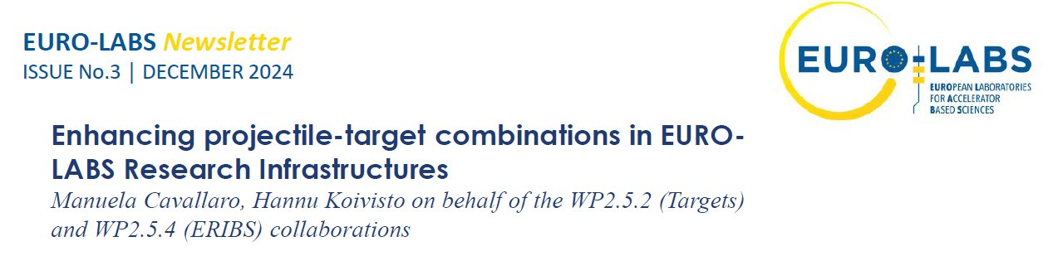
Subtask 2.5.2 «Targets»
The main Goal
12 Institutions, 7 Countries, ~50 Researchers
Gather the community of European “nuclear target makers and users ” having expertise in target manufacturing and characterization, both for nuclear and applied physics purposes
Fostering the connection between different nuclear physics institutions with the aim to create and maintain a distributed infrastructure for target development, production, and characterization.
Feedback and exchange of information among researchers involved in
Target developments
Target fabrication
Target characterization
Final use
Milestones and Deliverables
Month 3 (MS13)
Report to define the state of the art in the field and collect the requests from the community
Month 36 (D2.5)
Report on the Service Improvements
Outcome
Creation of a database (DB) containing the targets information about the preparation and the characteristics of available in various laboratories

Slide 7
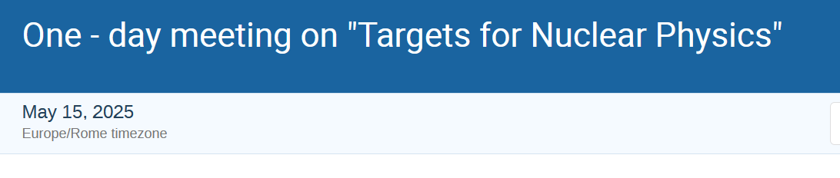
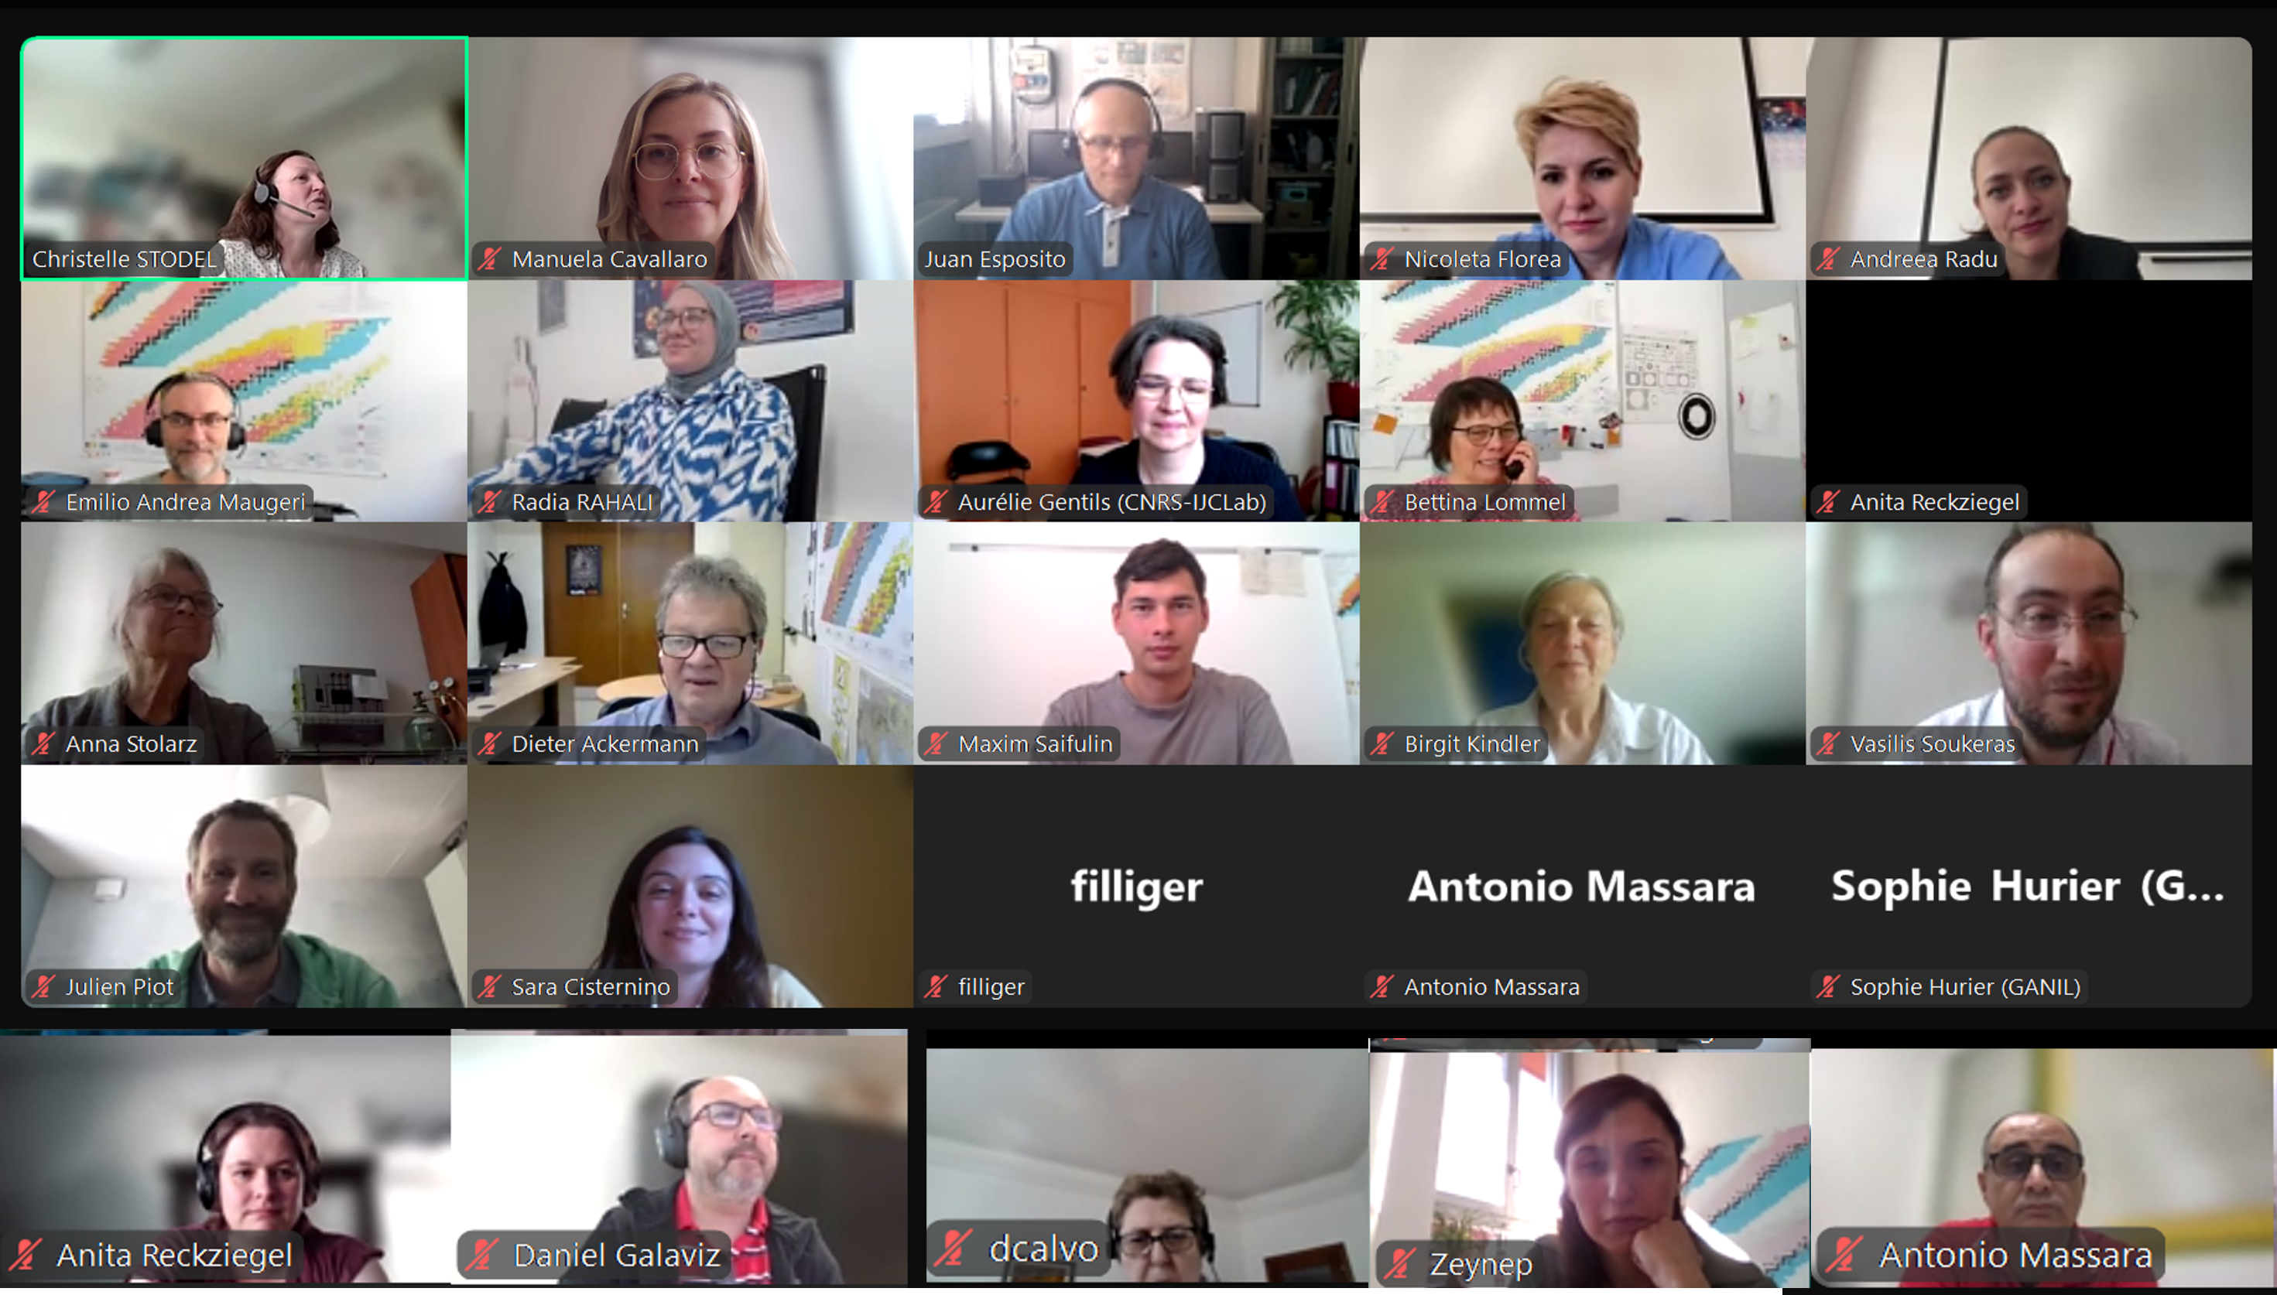
One-day meeting 2024
One-day online meeting on May 15th, 2025
About 40 participants
12 talks from different involved institutions
Very fruitful discussion and exchange of information!

Slide 8
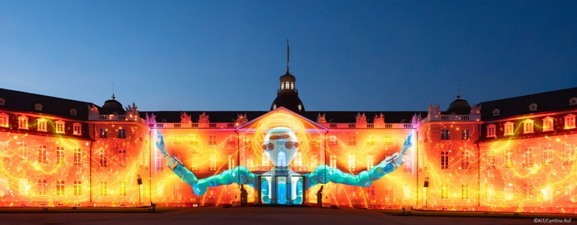
Final Annual Meeting of EURO-LABS (FINE)
June 29th – July 1st 2026 – KIT (Karlsruhe, DE)

