Slide 1


Activity for the nuclear target development within NUMEN
Daniela Calvo – INFN Torino
on behalf of
M. Campostrini, M. Cavallaro, A. Comite, P. De Remigis, M. Giovannini, A. Massara, F. Morello, F. Picollo, B. Reshma, V. Rigato, O. Sgouros, V. Soukeras, S. Sturari

Slide 2




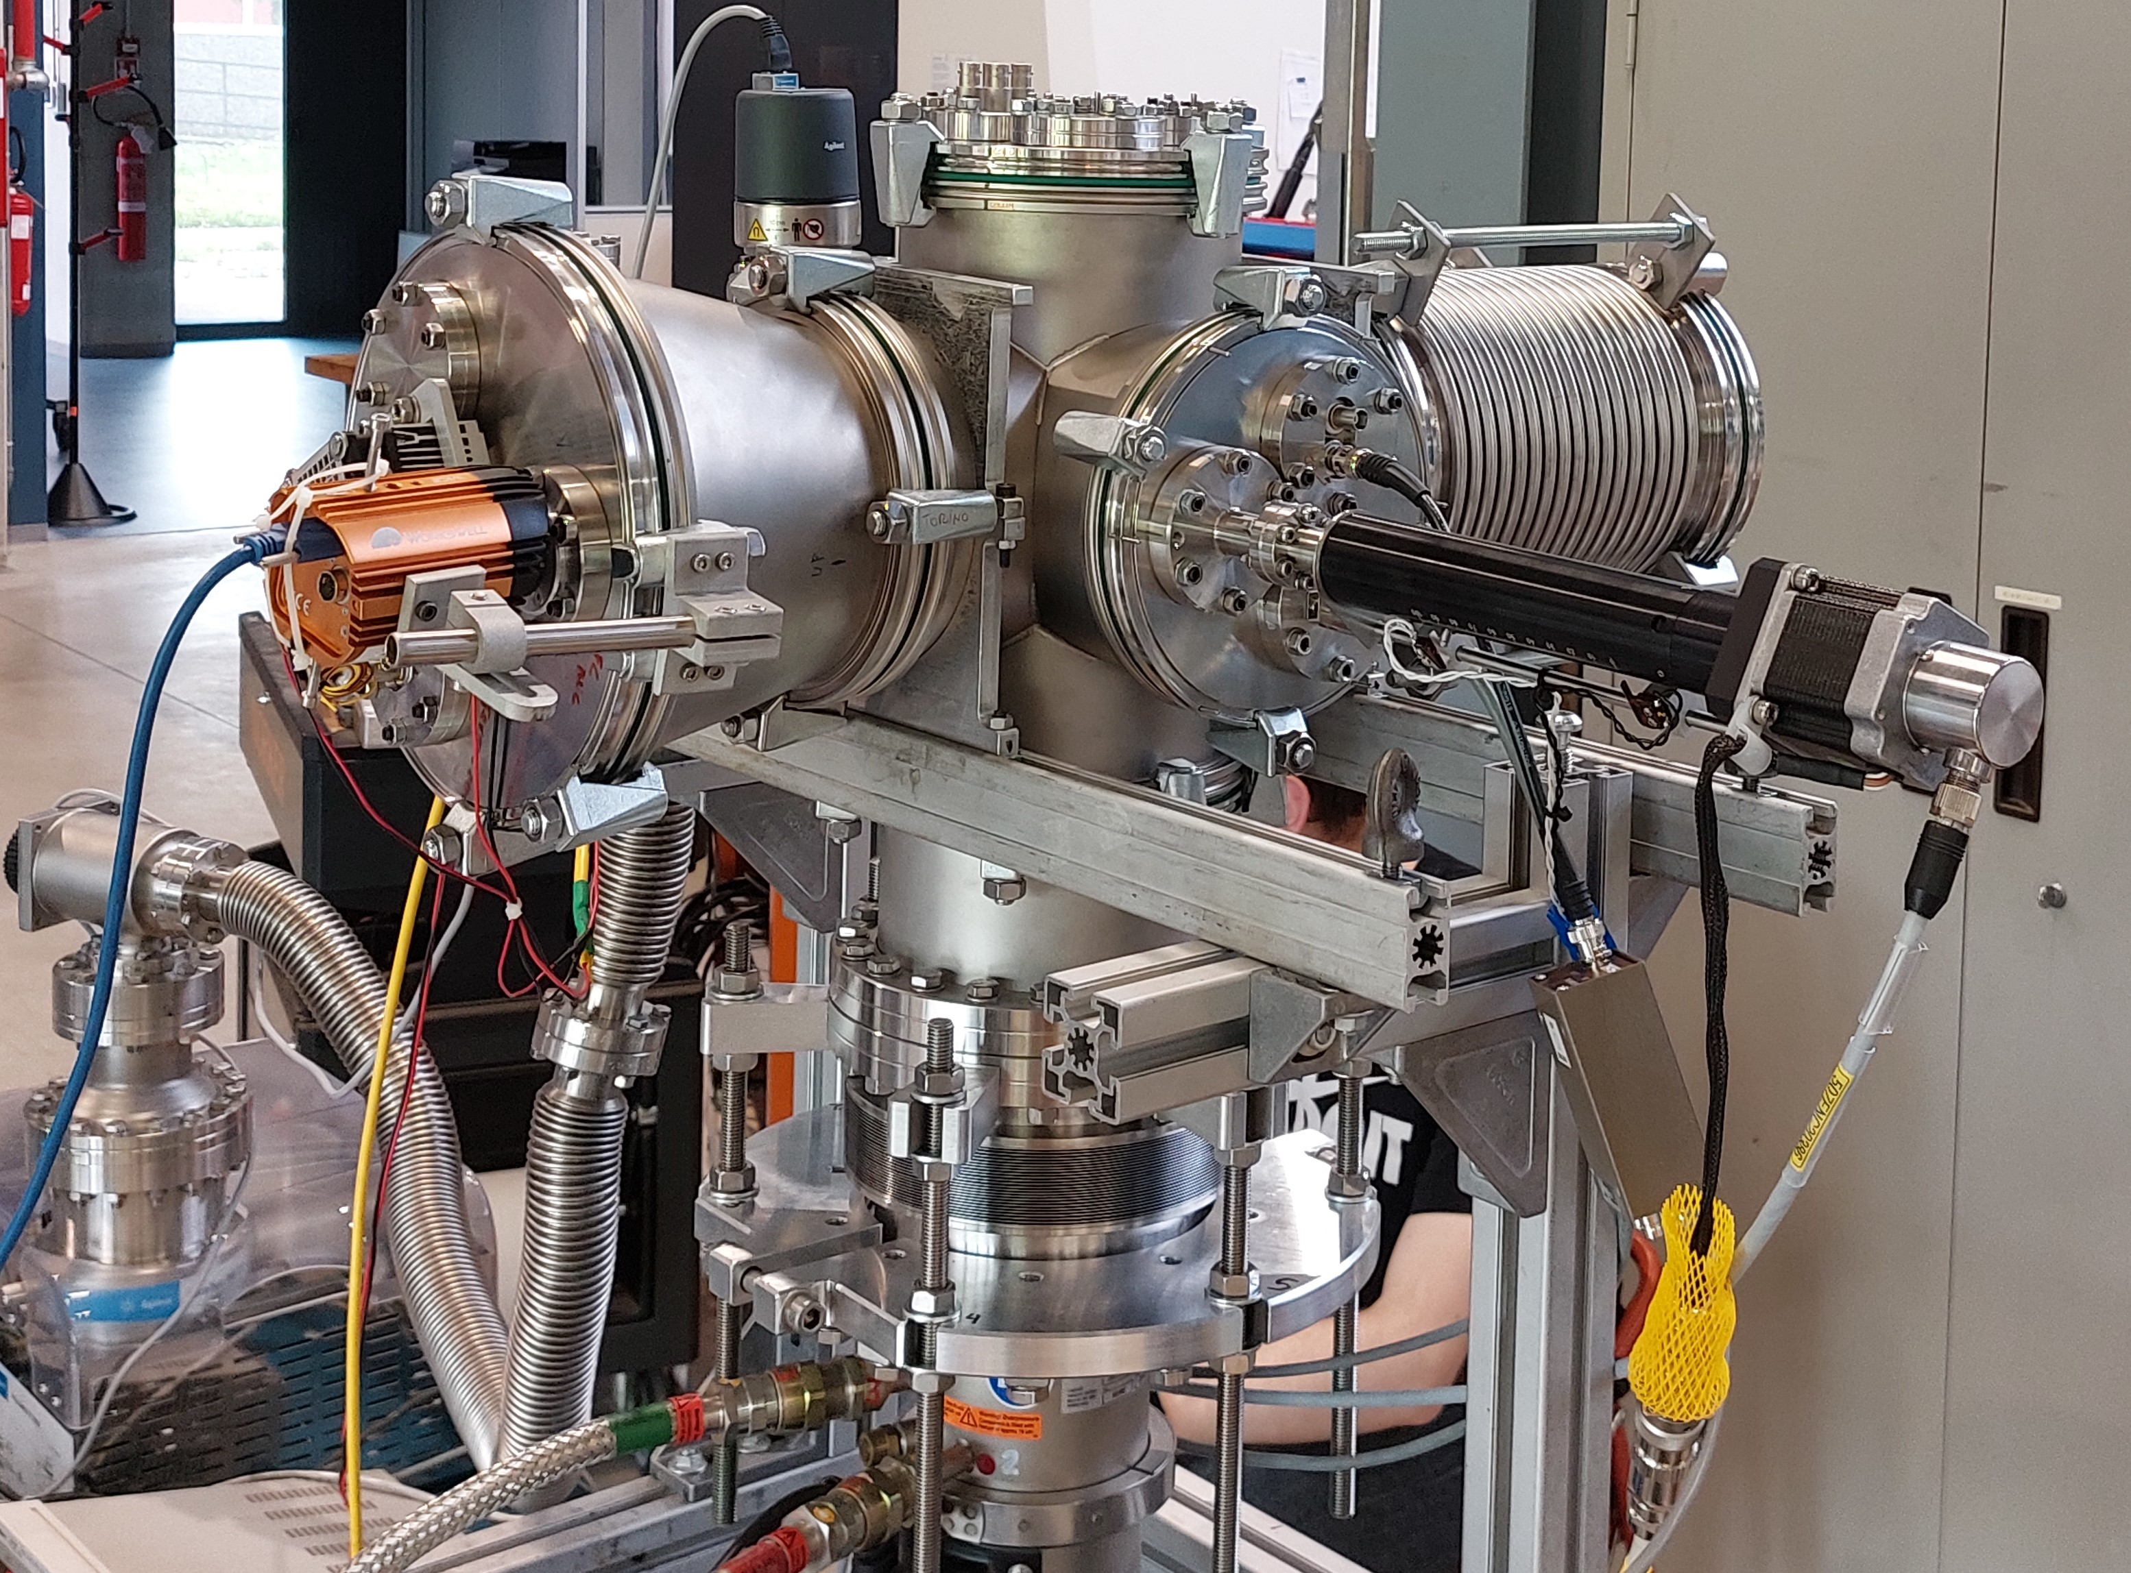

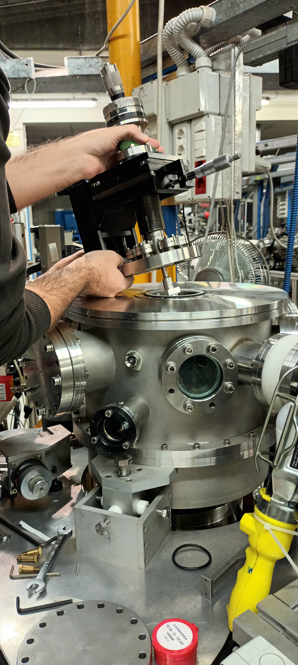
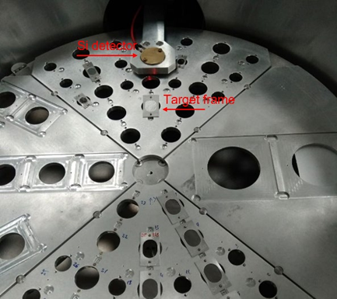

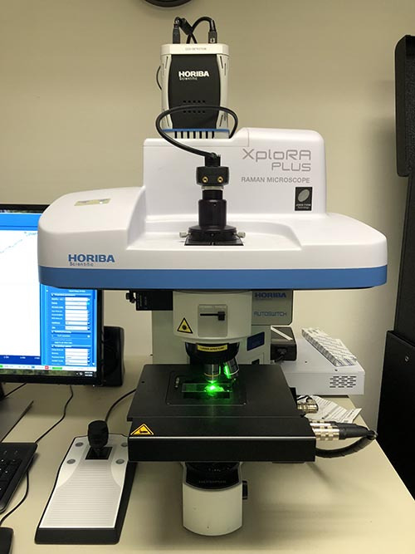

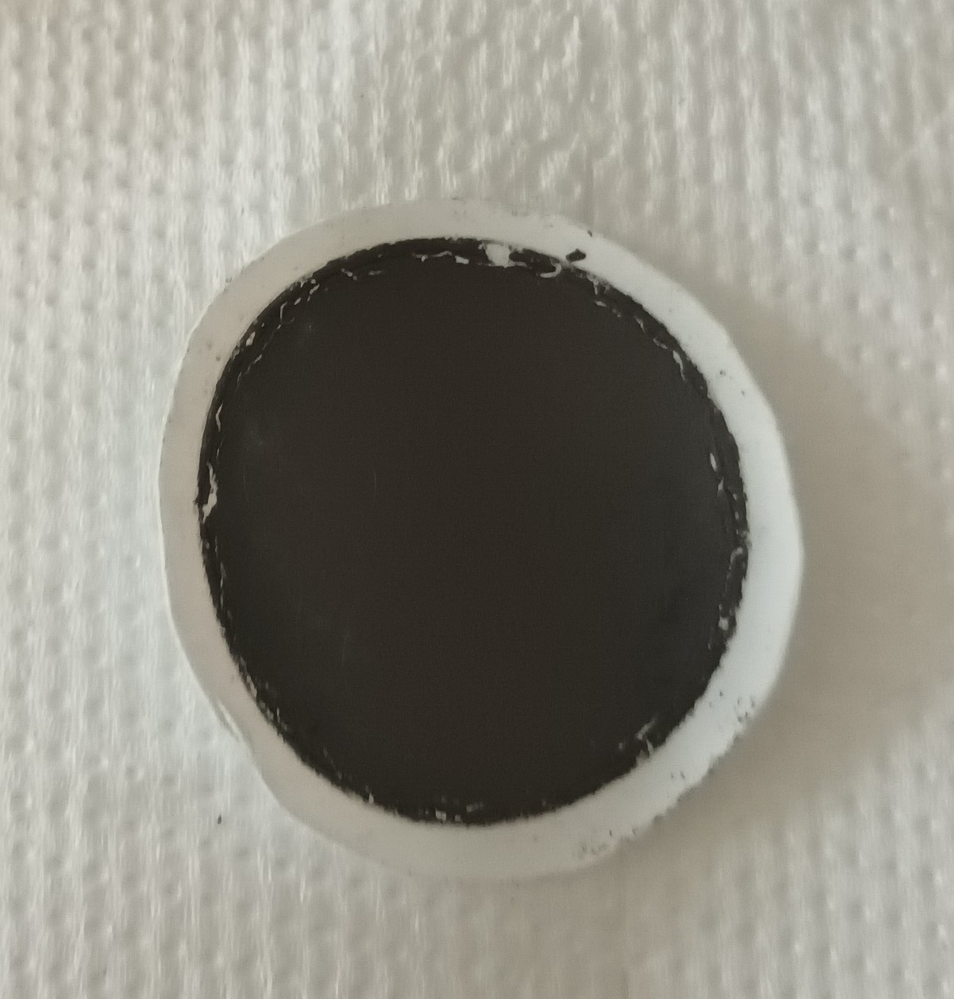
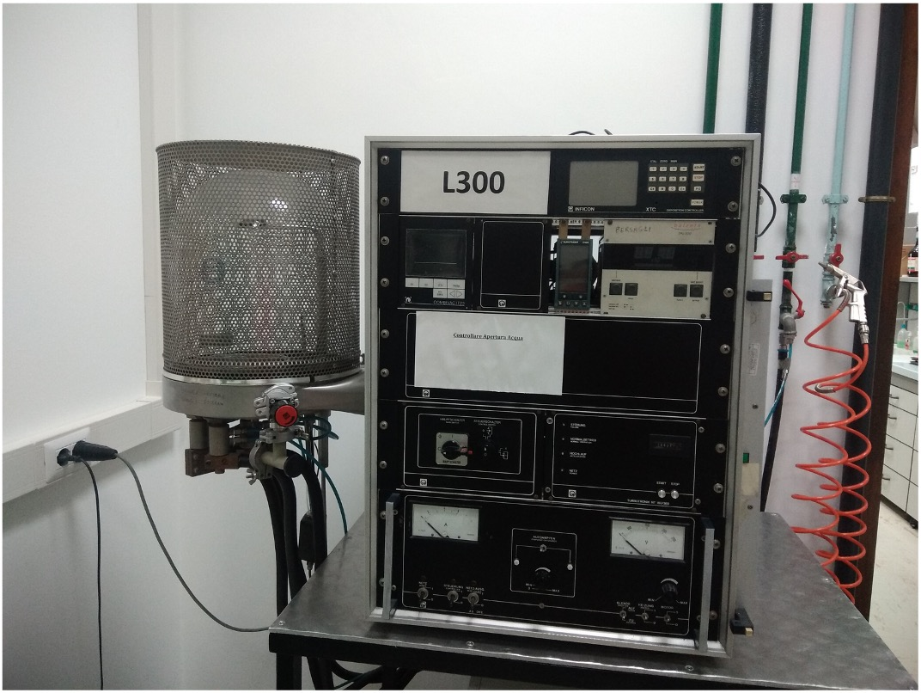
Institutions

Slide 3
Outline
Motivations for the study of new substrates for target deposition
Commercial C-material foils
First custom C-material foils
Preliminary results from measurements of radiation damage

Slide 4
Activity for nuclear targets
The activity finds its motivation in the study of targets for the NUMEN experiment
  Target of isotopes candidates for 0νββ decays
  ²⁰Ne and ¹⁸O ion beams with 15-60 MeV/u energy and up to 10¹³ pps
      → more than 10⁵ W/cm³ power density in the target
      → high thermal stress

Slide 5
Custom solution for the target
The thermal stress of the target is addressed
with a highly thermally conductive substrate that dissipates heat toward a heat sink.
The isotope is evaporated on the substrate by e-beam evaporation or thermal evaporation
Highly Oriented Pyrolytic Graphite (HOPG) and Multilayer Graphene (MLG) featuring higher thermal conductivity (k//=1500-1900 Wm⁻¹K⁻¹), produced in μm-thick foils, are good candidates
Substrate
Target element
Ion beam
Heat sink

Slide 6
Commercial C-material foils

Slide 7
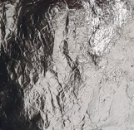
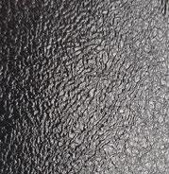
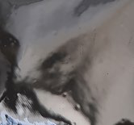
Commercial Carbon foils
HOPG – Optigraph
MLG - Kaneka
MLG – ACF/Nanotech
CVD + HT HP annealing
Pyrolysis of polyimide film
GO and rGO
Material | Calculated density [g/cm³ ] | Purity degree /cristallinity | Thickness [μm] | Thermal diffusivity [mm²/s] | Thermal conductivity [W/(m · K)] | Thickness uniformity by APT (@LNS)
HOPG | 2.265 | 99.9 %/HO | 2 | 1550 | 2.3 | poor
MLG - K | 2.272 | 99 %/HO | 1.6 | 1200 | 2.0 (l.) | good
MLG - A | 2.02 | Fair | 1-3 | 1308 | 1.93 (l.) | good
Thermal conductivity measurements till now FAILED!
Only HOPG was measured with the laser flash method

Slide 8
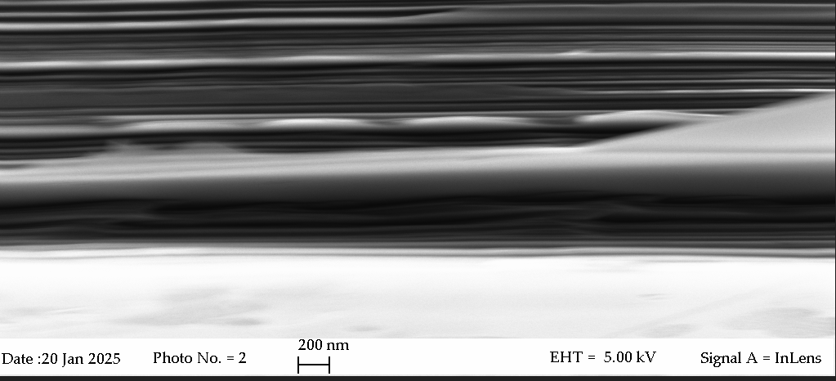
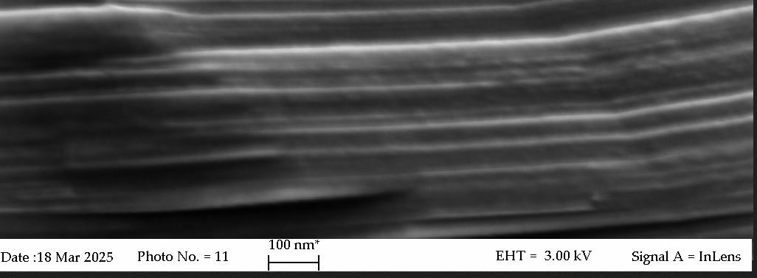
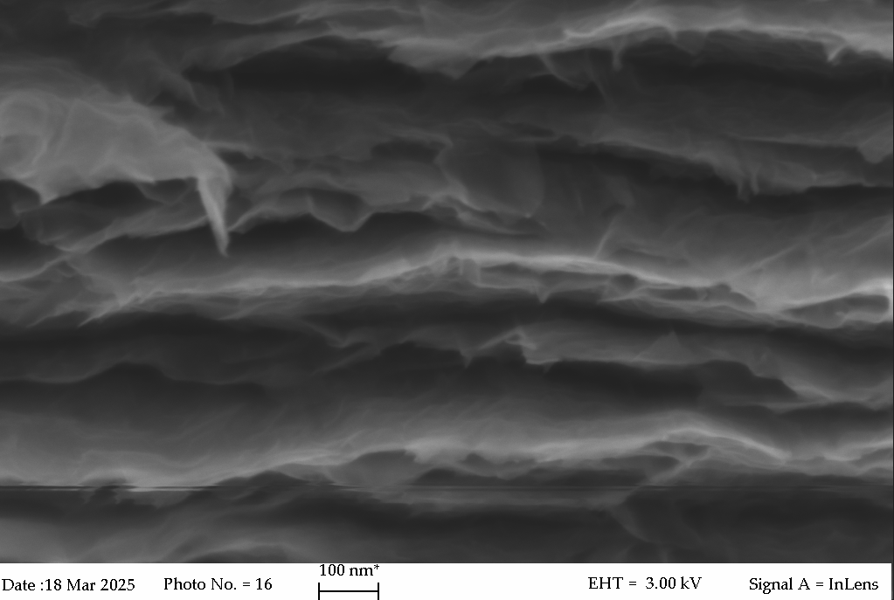
Commercial Carbon foils
HOPG – Optigraph
MLG - Kaneka
MLG – ACF/Nanotech
Material | Measured Electrical Conductivity [S/m] | Literature value [S/m]
HOPG | 3.05 · 10⁶ | 2.10 ·10⁶
MLG - Kaneka | 2.12 · 10⁴ | 1.00 ·10³ to 1.00·10⁴
MLG - ACF | 2.03 ·10⁶ | 1.00 ·10⁶

Slide 9
Custom C-material foils

Slide 10
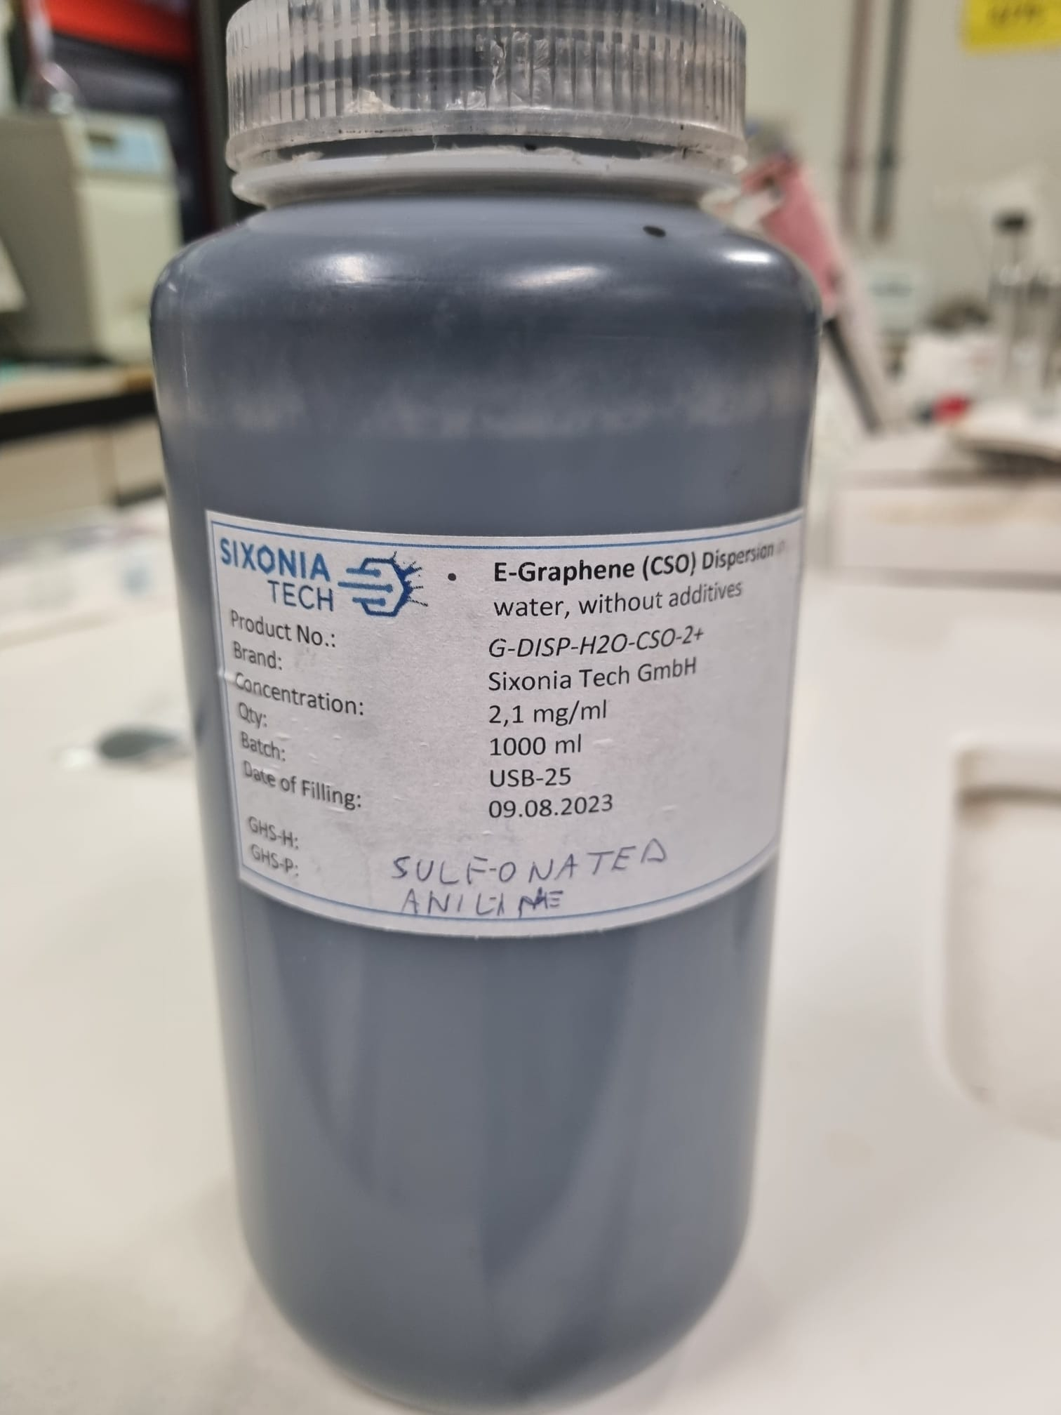
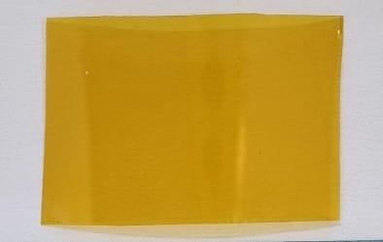
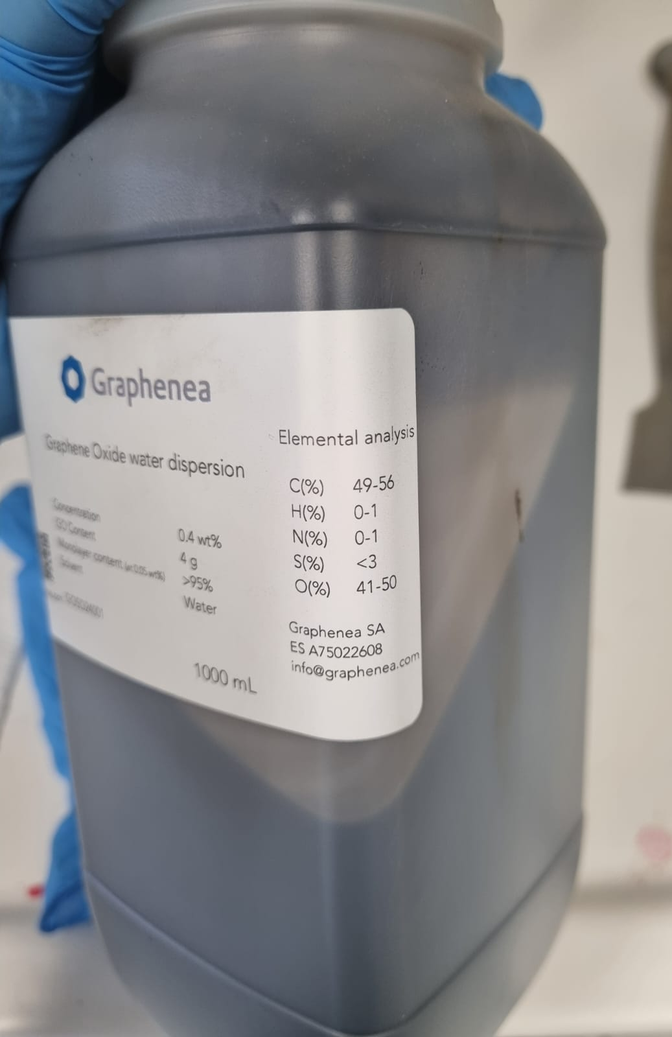
Custom MLG foil production
Filtration of graphene dispersion
Carbonization followed by graphitization of polyimide film (Kapton)
Reduction of graphene oxide (GO) to reduced graphene oxide rGO

Slide 11
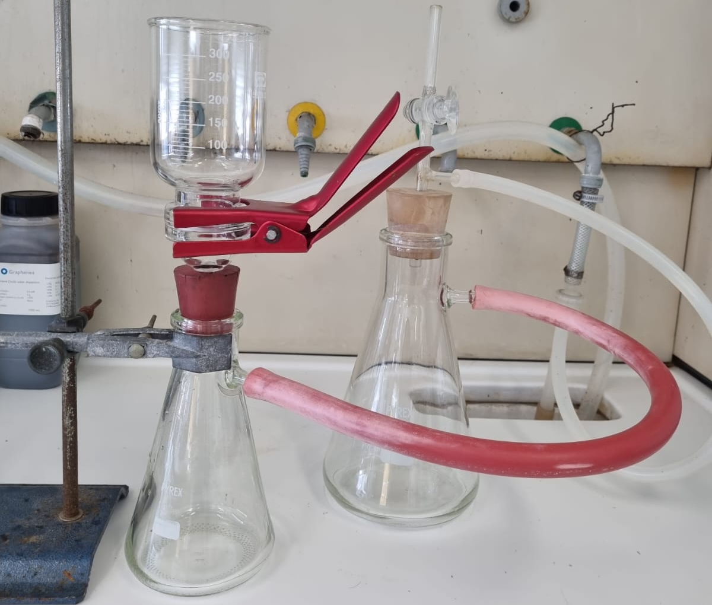

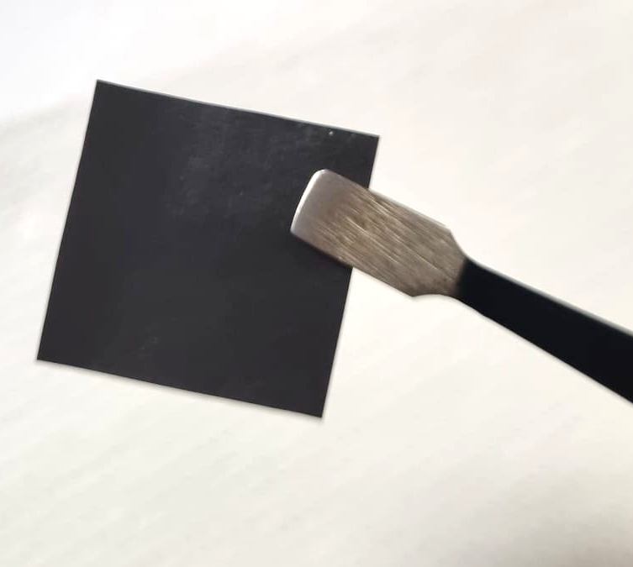
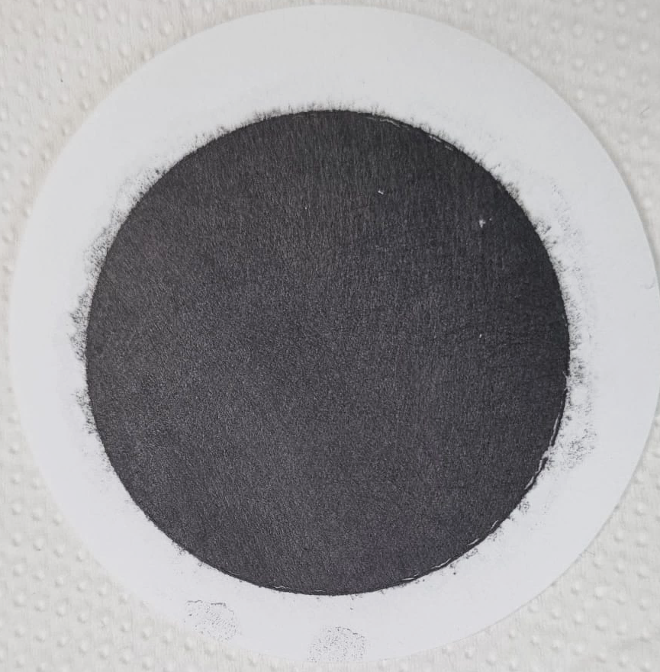
MLG foil production by filtration
Procedure
Known volume (V_{d}) of dispersion diluted with water
Sonicator
Sonicator
E-graphene dispersion
Concentration 2-3 mg/ml
10 mins
few mins
Filtration
Filters: Nylon Polytetrafluoroethylene-PTFE, Mixed cellulose ester -MCE, Polypropylene-PP
Foils separated from filters
either by peeling off
or by pyrolysis at different temperatures (up to 700 °C)
20 x 20 mm²
reshma.babu@edu.unige.it

Slide 12
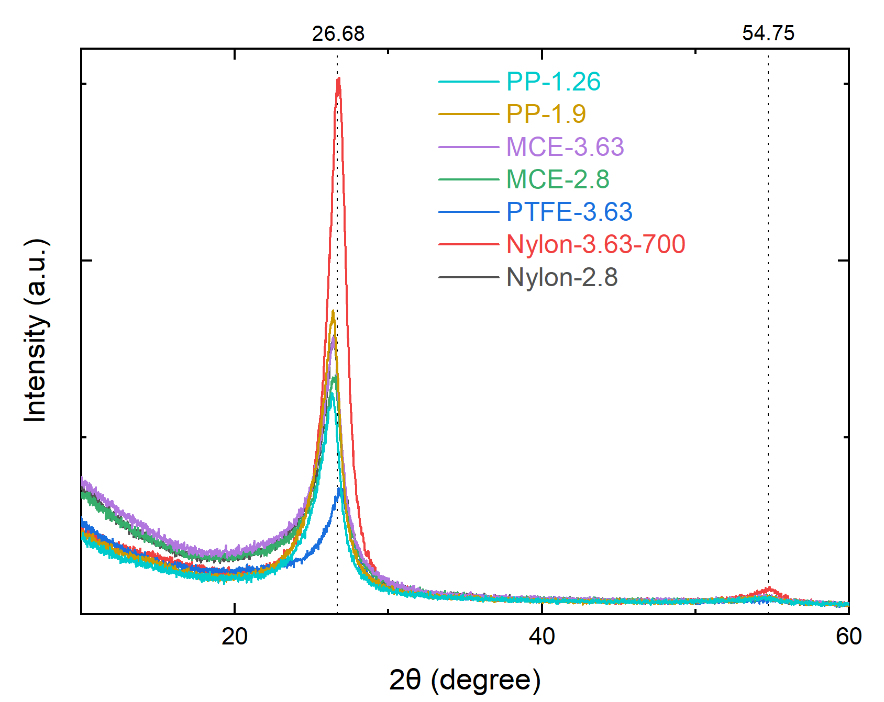
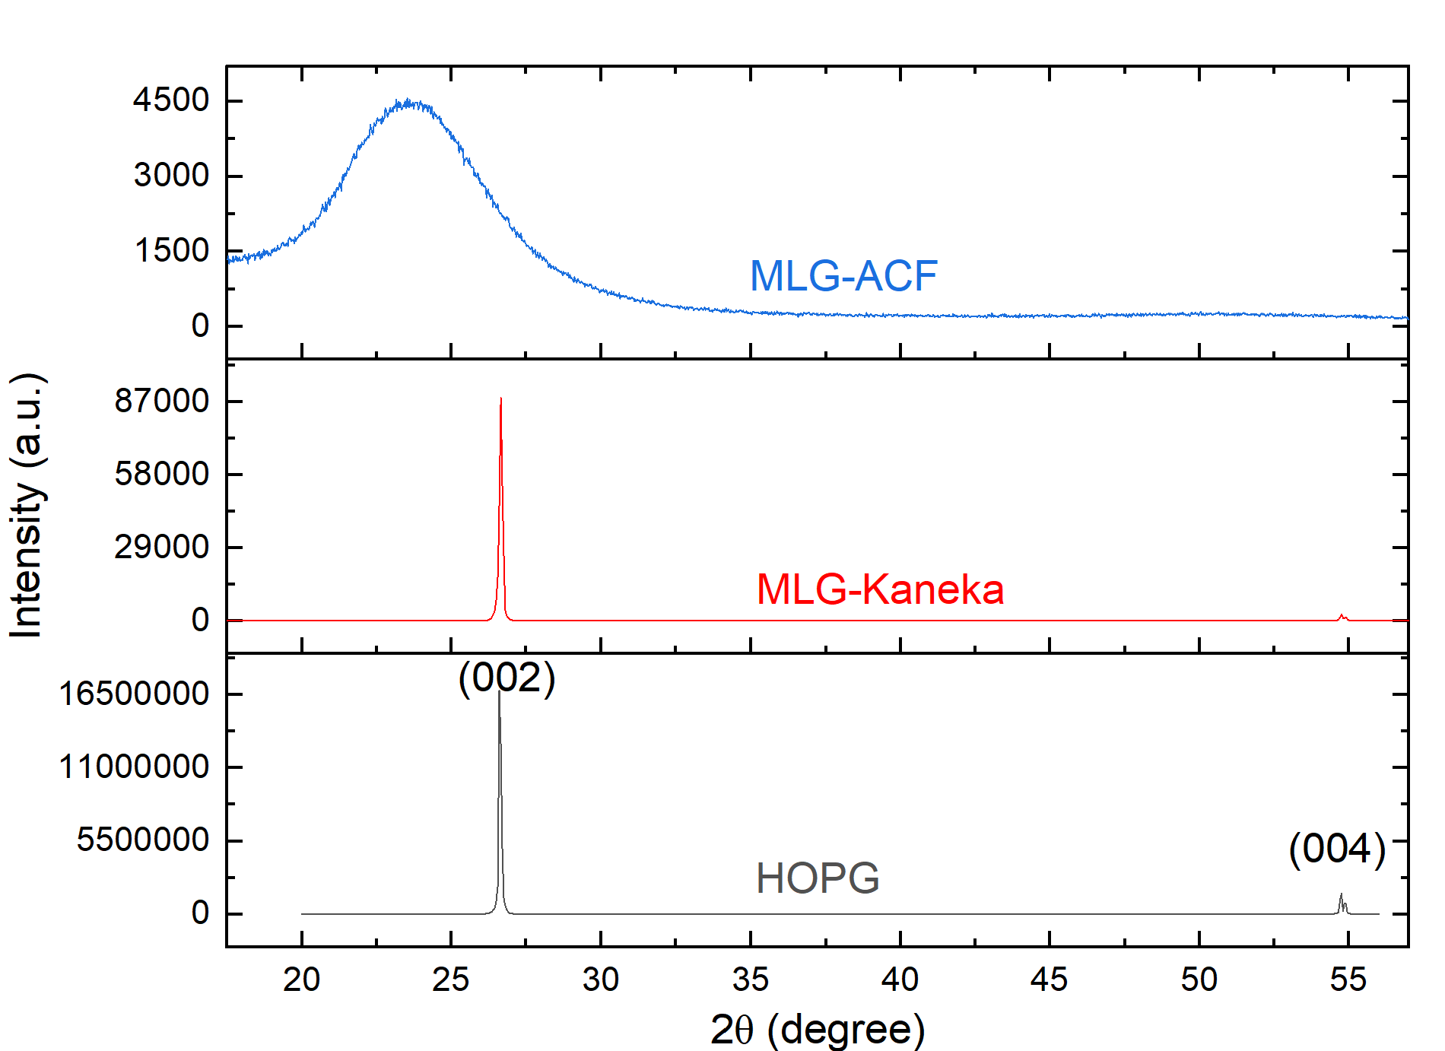
Custom vs Commercial foils – XRD analysis
(002)
(004)
A post-annealing treatment of 700 °C for just 10 minutes improves cristallinity

Slide 13
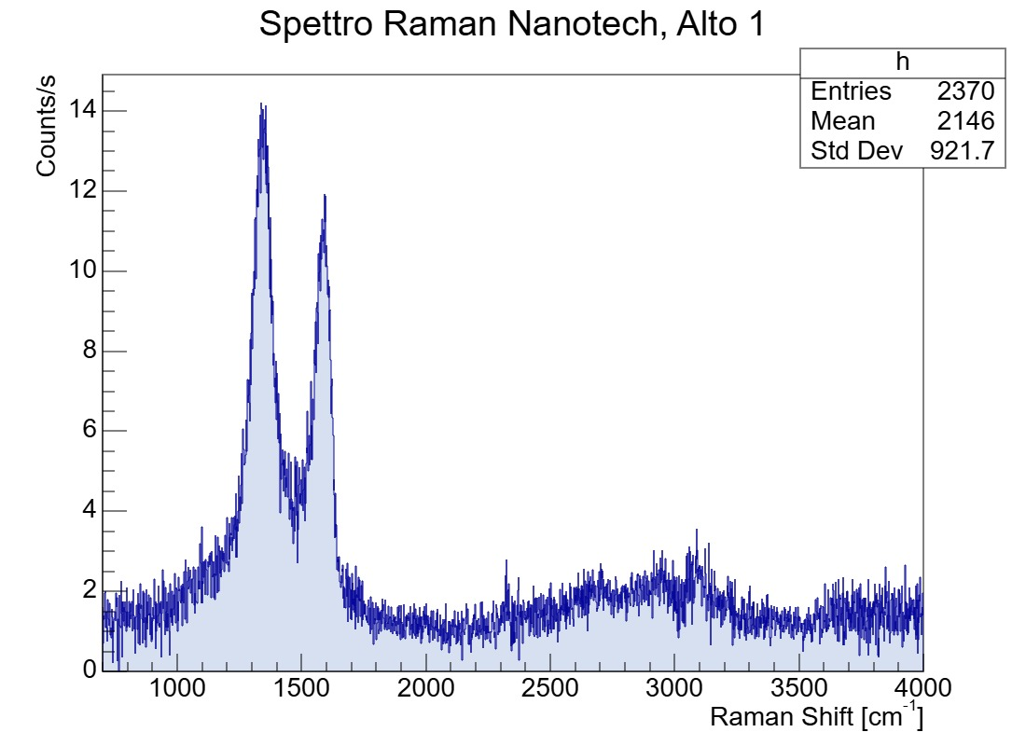
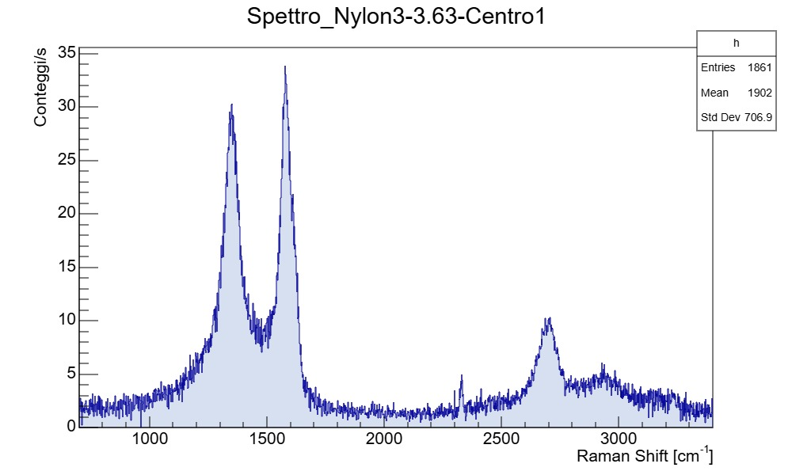
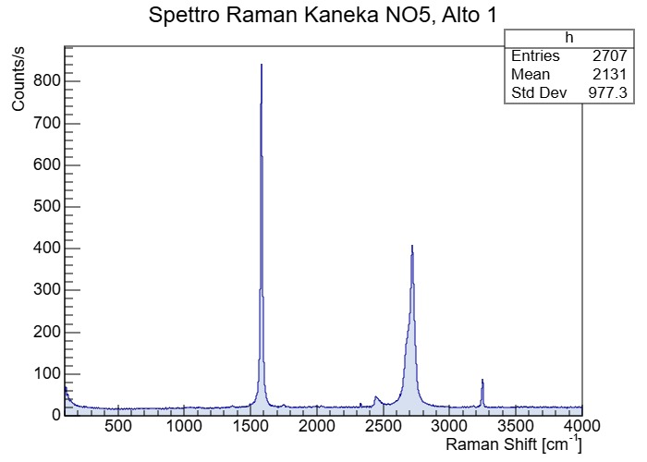
Custom vs Commercial foils – Raman analysis
MLG Nanotech
MLG Genova
MLG Kaneka
G peak
D peak

Slide 14
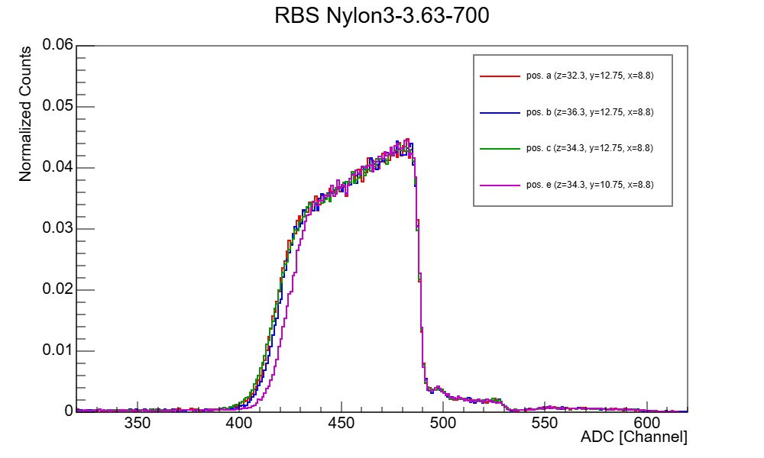
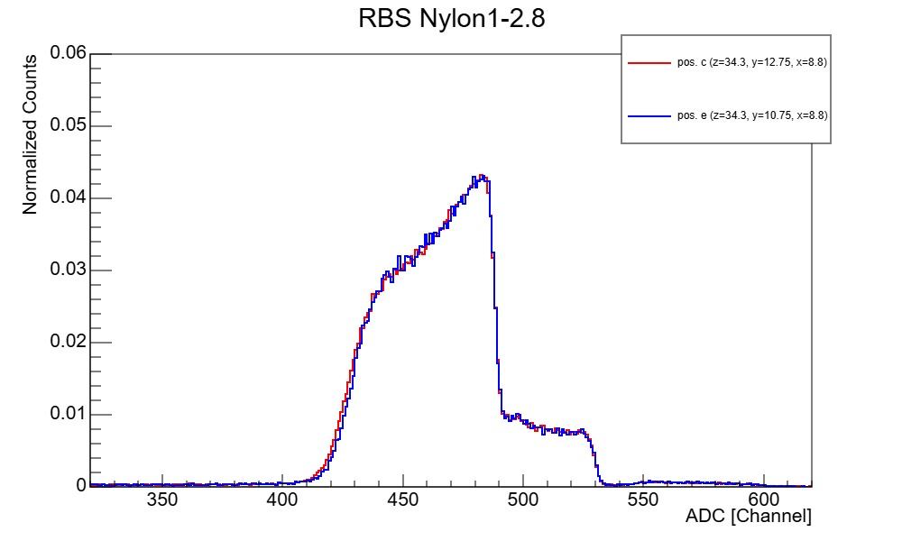
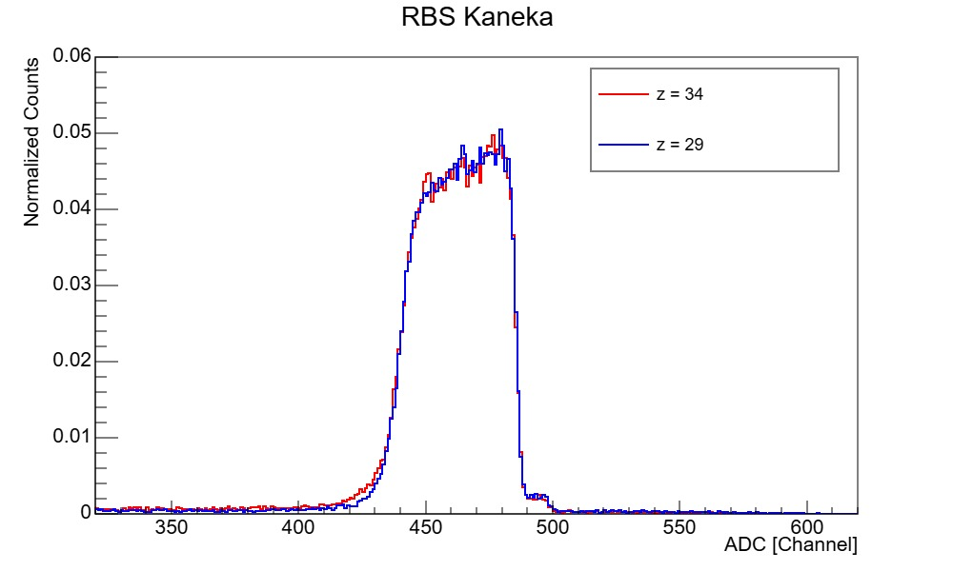
Custom vs Commercial foils – EBS analysis
MLG Genova
MLG Genova
EBS of a sample with annealing at 700°C
EBS of a sample without annealing at 700°C
MLG Kaneka
The non-uniformity of MLG Genova
doubles compared to MLG Kaneka

Slide 15
Preliminary results from measurements
of radiation damage

Slide 16
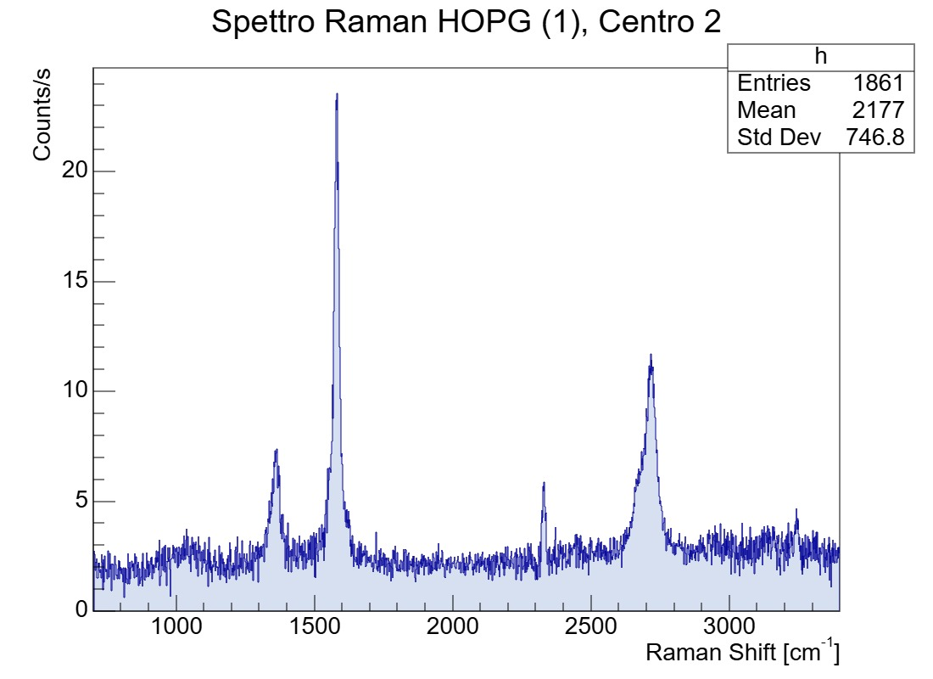
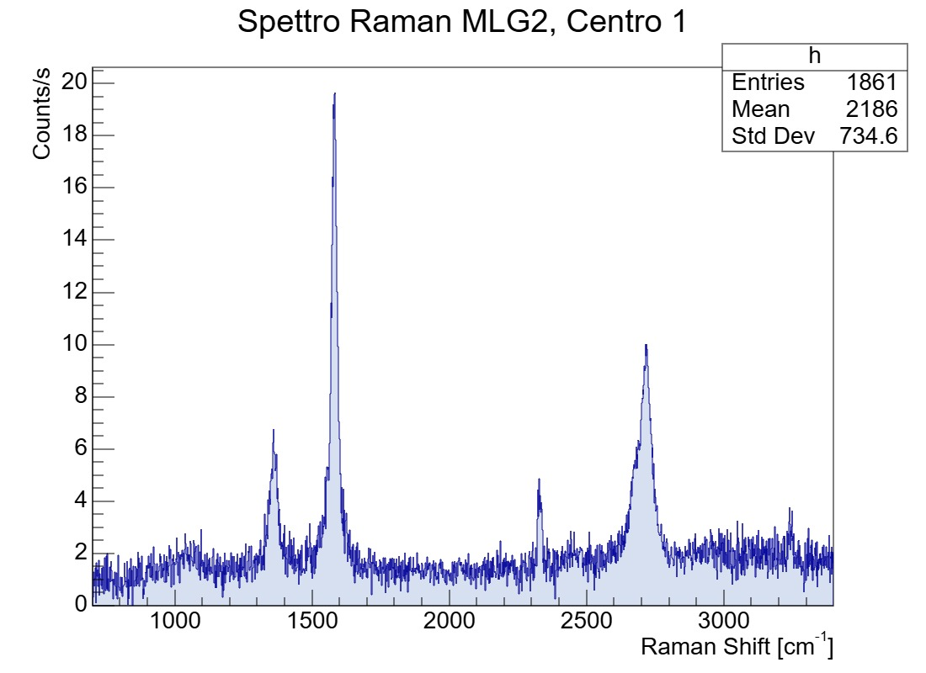
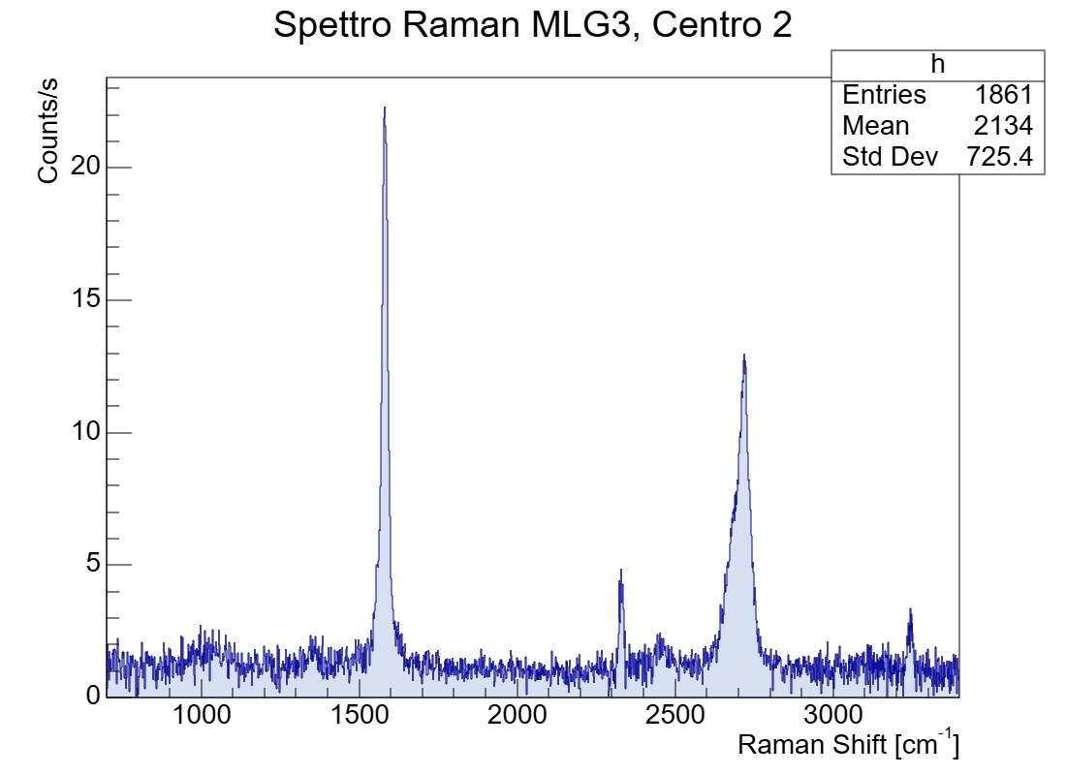
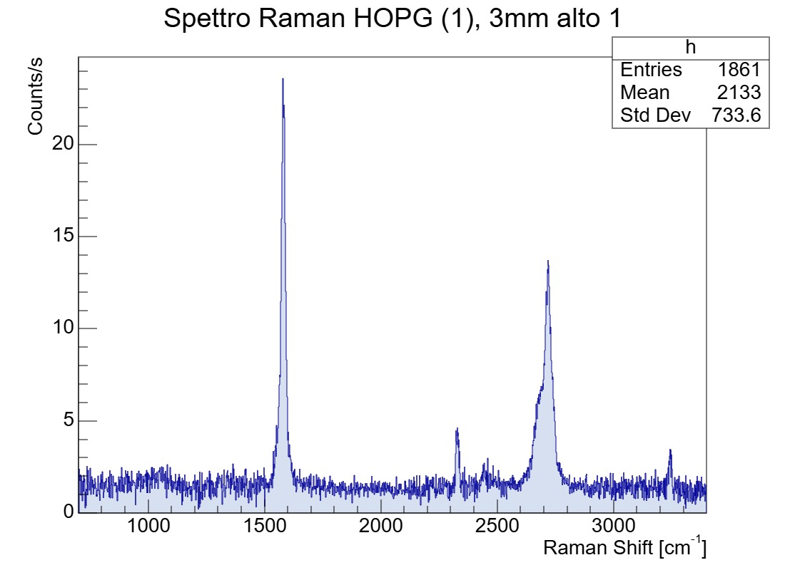
Irradiated samples @ GANIL
HOPG
Post-irradiation
I_{D}/I_{G} ∼ 0.23
MLG Kaneka
Post-irradiation
I_{D}/I_{G} ∼ 0.31
MLG Kaneka
Post-irradiation
Irradiation with ²⁰Ne⁹⁺ beam, 14 MeV/u
Each sample is inside a target holder at room temperature
HOPG, 140 min. with a ∼245 enA beam current
MLG Kaneka 2, 135 min. with a ∼ 245 enA beam current
MLG Kaneka 1, 120 min. with a ∼ 125 enA beam current
HOPG
Pre-irradiation
Thanks to Henning Lebius for the continuous support at GANIL

Slide 17
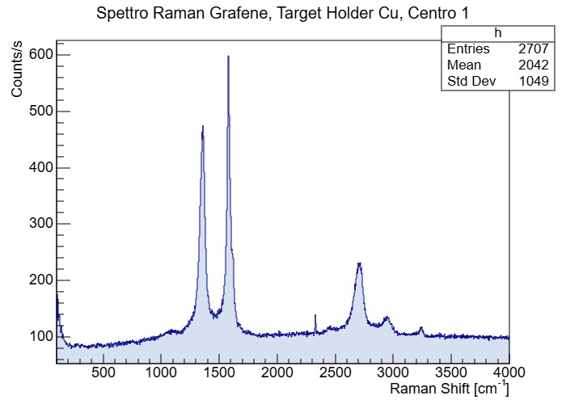
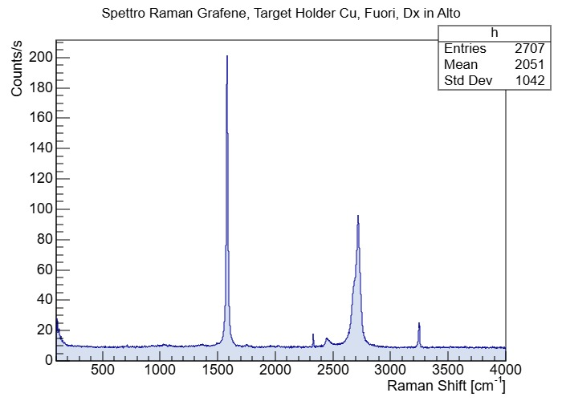
Irradiated sample @ GANIL
MLG Kaneka
Irradiated area
I_{D}/I_{G} ∼ 0.75
MLG Kaneka
Not-irradiated area
Irradiation with ²⁰Ne⁹⁺ beam, 14 MeV/u
Sample inside a target holder kept at cryogenic temperature
MLG Kaneka, 27 hours with a ∼ 200 enA beam current
Thanks to Henning Lebius for the continuous support at GANIL

Slide 18
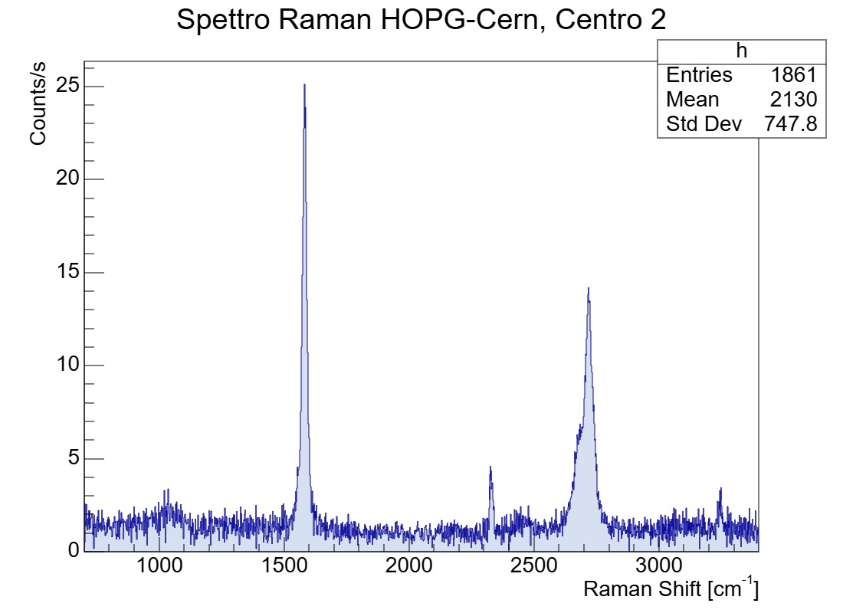
Irradiated sample @ CERN
HOPG
Post-irradiation
Irradiation with a 24 GeV/c proton beam (∼ 7.5 · 10¹¹ p/spill)
Fluence: 2.4 · 10¹⁵ p/cm²
Sample inside a target holder at room temperature

Slide 19
Conclusion and Future work
The first samples produced in Genova are encouraging
Post-annealing treatment of MLG Genova improves crystallinity
Production of new samples with a longer post-annealing
Applying pressure during the synthesis
The peak D was measured in the ion-irradiated samples
The peak D was not measured in the proton-irradiated sample
Correlation between the induced defects and the thermal conductivity
Solve the problem of measuring the thermal conductivity!

Slide 20
SPARES

Slide 21
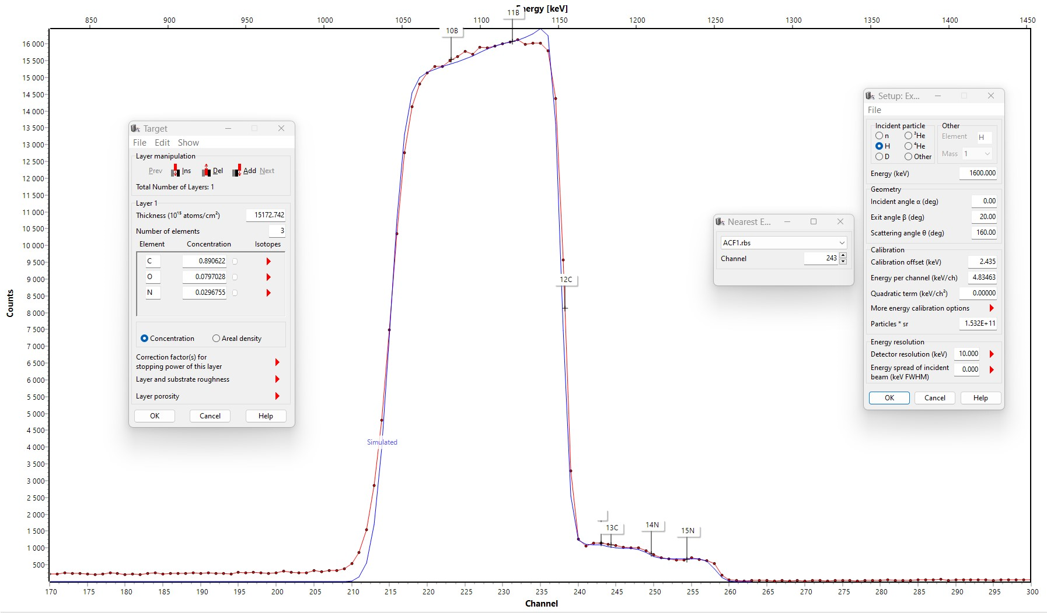
RBS of MLG Kaneka
Se target
MLG

Slide 22
Temperature of heated samples
Graphyte PANASONIC: 10 μm thick
HOPG OPTIGRAPH: 2 μm thick
MLG KANEKA: 1.5 μm thin
MLG NANOTECH, MLG ACF: 1.5 μm thin
PGS- PANASONIC ~1700 W/(m·K)
HOPG-OPTIGRAPH ~1900 W/(m·K)
MLG-KANEKA ~1800 W/(m·K)
MLG-NANOTECH(ACF) ~1500-1900 W/(m·K)
ACF

Slide 23
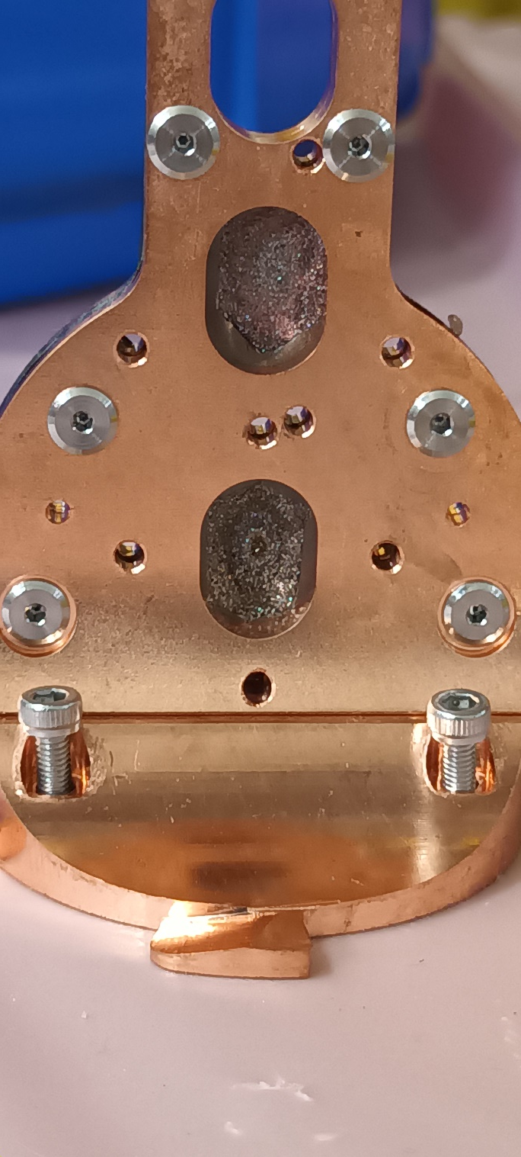
Cooled samples
MLG-KANEKA
Pyrolytic graphite-
PANASONIC
Pyrolytic graphite-
PANASONIC
Se +MLG-KANEKA
Target holder-
copper
Se
MLG-KANEKA (n. 4)
Target holder-
copper

Slide 24
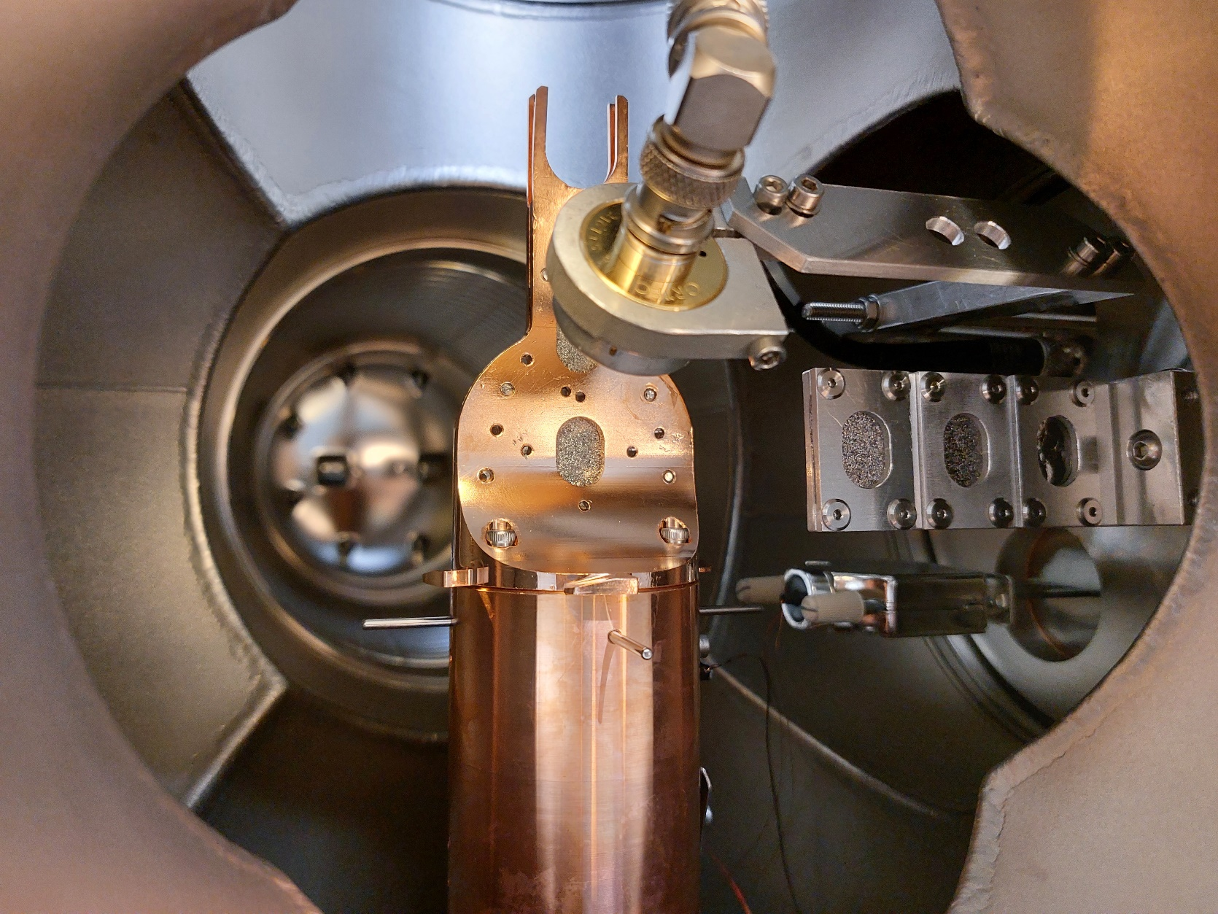
Samples at room temperature
MLG-KANEKA (n. 3)
MLG-KANEKA (n. 2)
MLG-KANEKA or HOPG
Target holder-
aluminum
HOPG (n. 1)

Slide 25
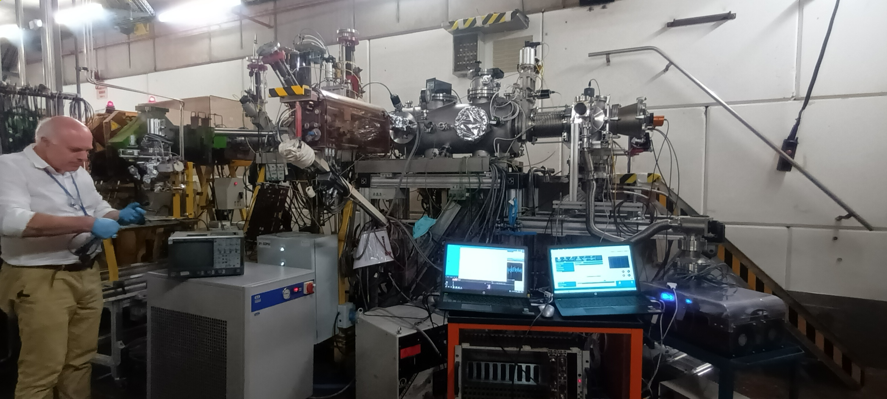
Experimental setup installed at GANIL

