Slide 1


Second Meeting on "Targets for Nuclear Physics" within EURO-LABS​
18–19 May 2026 GSI lab, Darmstadt (Germany)
Target manufacturing activities at INFN-LNL
J. Esposito, on behalf of INFN- Legnaro National labs (LNL) targets group- juan.esposito@lnl.infn.it
A quick review of techniques focused on different topics
“Target production” for nuclear physics (NP) experiments
“Target production” for applied NP (radioisotopes production)
“Quality Control techniques: nuclear targets characterization ”

Slide 2

Target production at LNL
Nuclear Physics (NP) studies

Slide 3
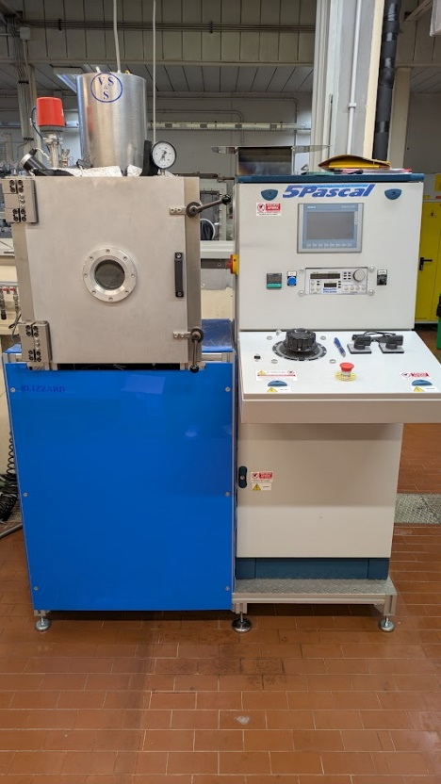
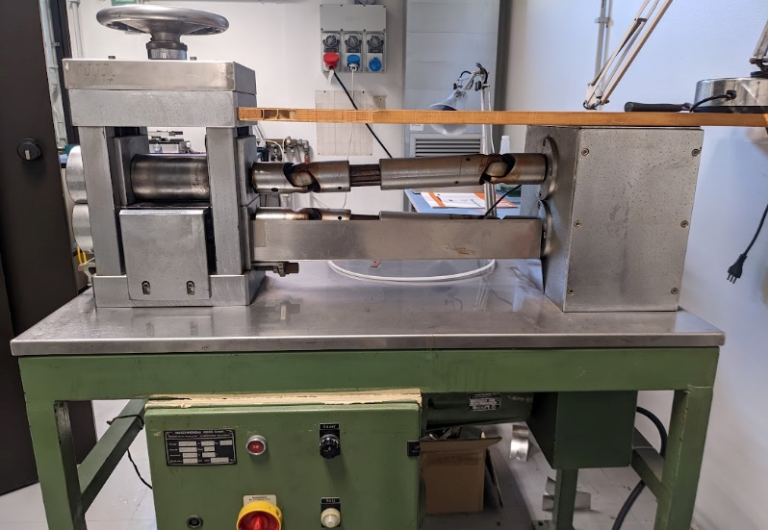
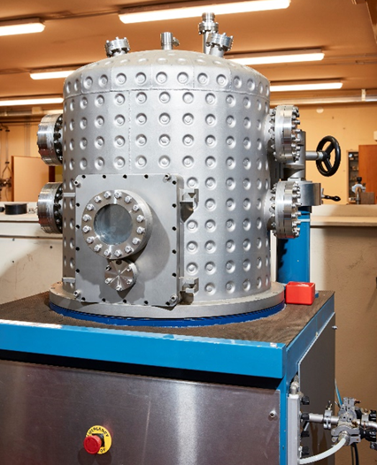
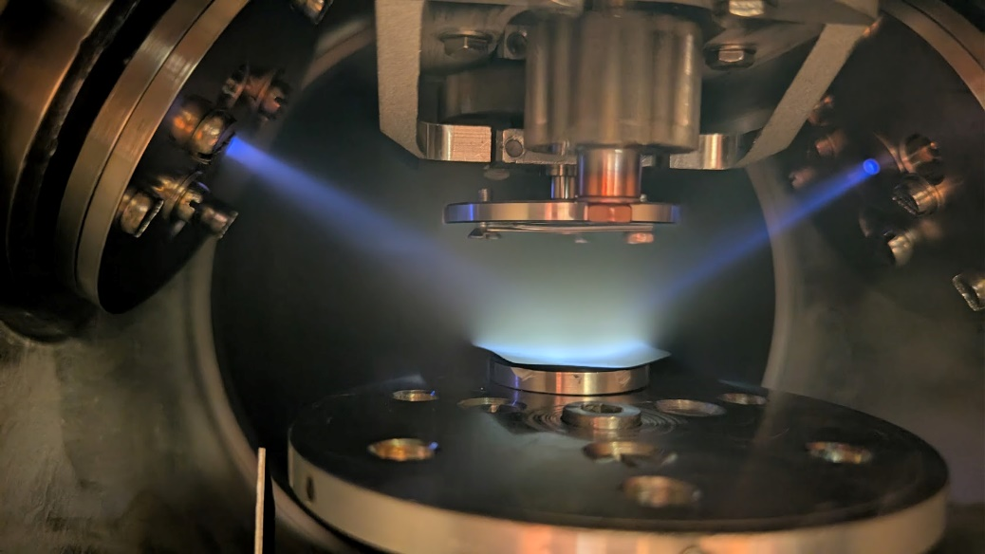
Target production at LNL
NP studies
Target production at LNL – Nuclear physics studies
Text
Targets for nuclear physics experiments typically are thin films of isotope-enriched materials obtained by various techniques:
- lamination (few mg/cm²)
- vacuum evaporation (few tens - few hundred µg/cm²)
- Ion beam sputtering
There are different types of fabrication:
• self supporting
• with backing
• strip-targets
sandwich-target
• plunger – target

Slide 4
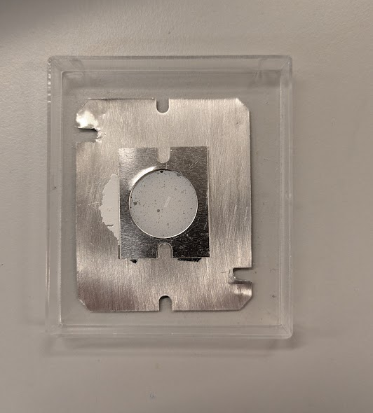

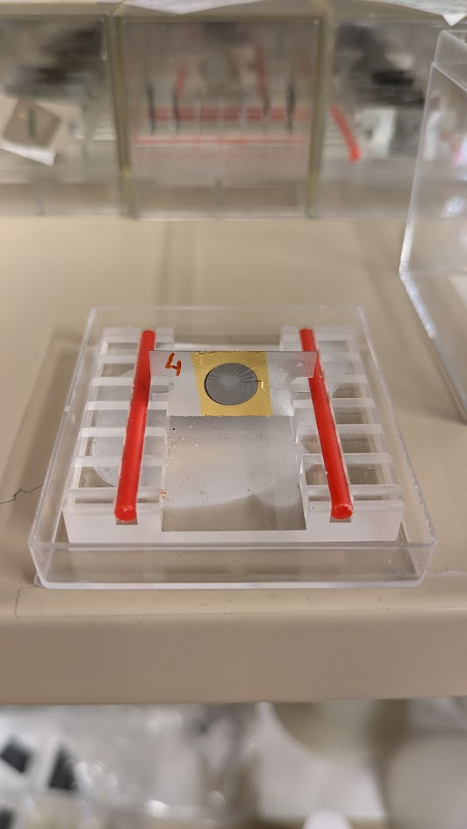
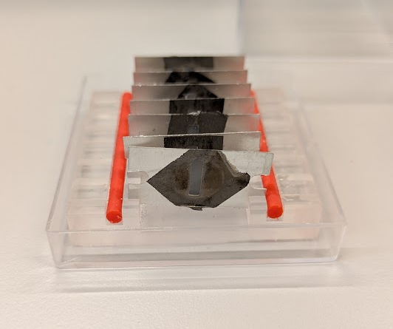
Some examples
Target production at LNL – Nuclear physics studies
Text
Self supporting target of C₂D₄ produced by thermal evaporation (2mg/cm²)
Very fragile film; difficult to peel away from the glass substrate
Target of ¹³⁰Te, thickness 500 µg/cm², on Au backing of 500 µg/cm² obtained by thermal evaporation (Thermal-based PVD) in vacuum.
Adhesion improved by special heat treatment on the Au backing
Target of ¹²⁴Sn, thickness 300 µg /cm², on C backing of
20 µg/cm² and C shield of 15 µg/cm².
(Sandwich target – Strip target)

Slide 5
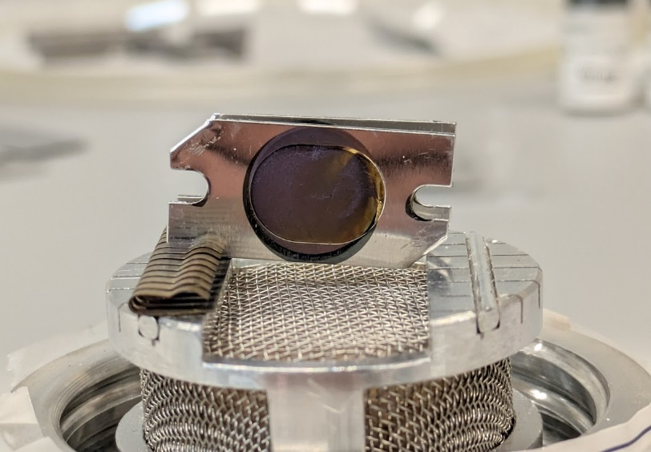
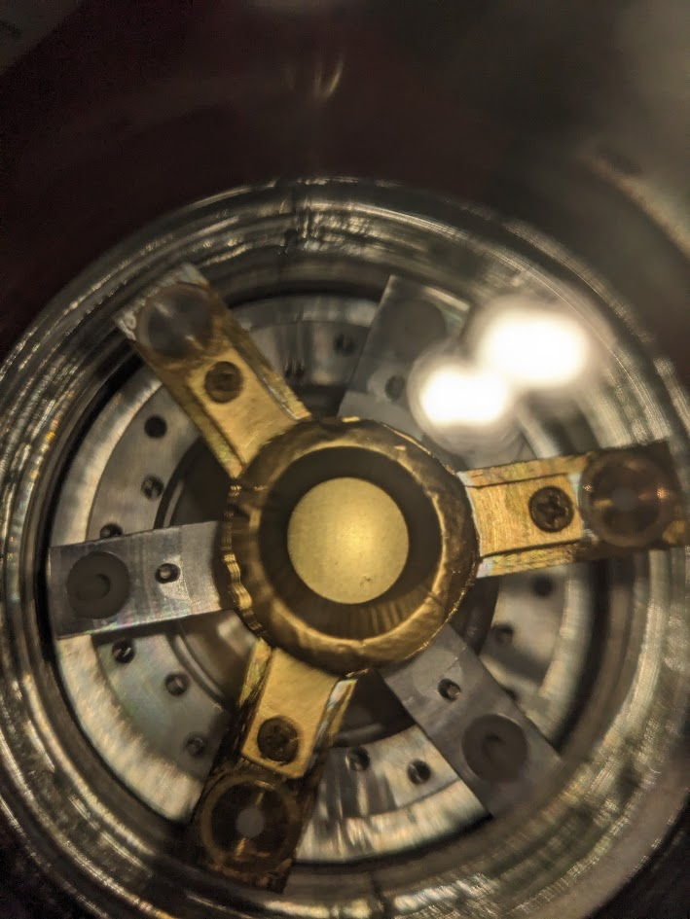
Target production at LNL – Nuclear physics studies
Text
Target of ¹⁰B, thickness 500 µg/cm², on Au backing of 4mg/cm^{2.} The Au backing was previously prepared by rolling.
Extremely slow evaporation of Boron using an electron-beam
Target Plunger of ⁴⁰Ca (800 µg/cm²), on Au 4 mg/cm² and
Au shield of 150 µg cm². Chemical reduction and simultaneous evaporation of calcium metal in vacuum.

Slide 6
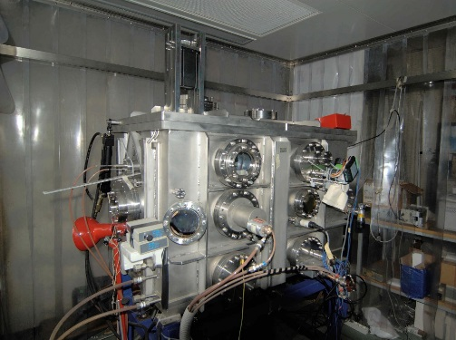
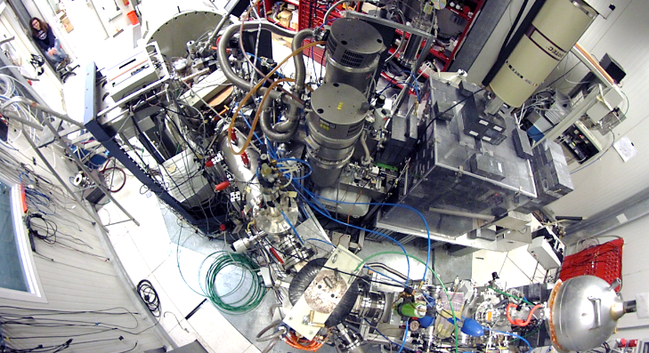
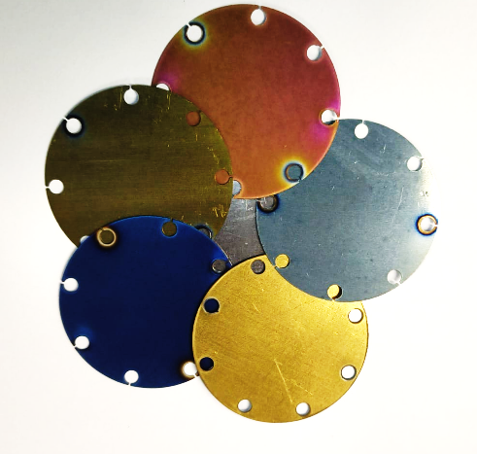
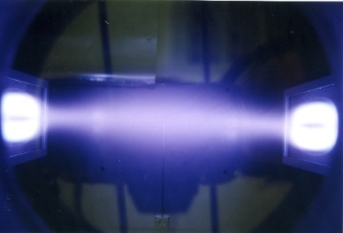
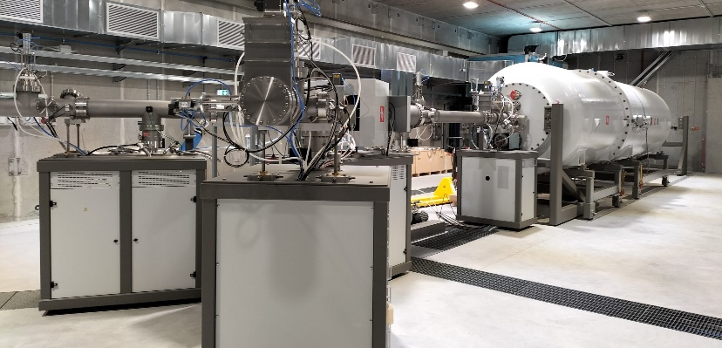
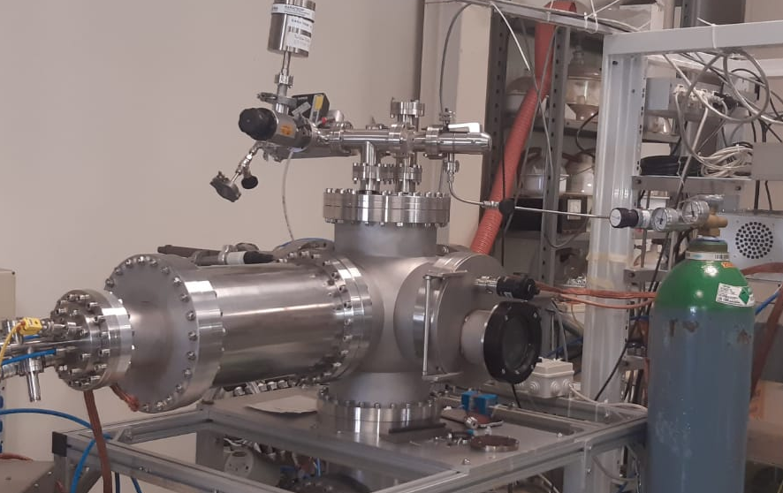
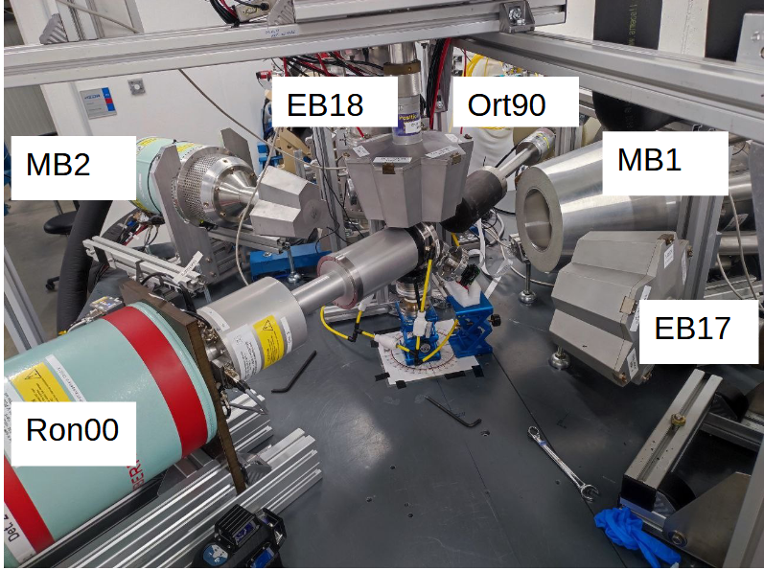
Target production at LNL – Nuclear physics studies
Solid target development by PVD magnetron sputtering technology
Solid targets for nuclear physics experiments
LUNA 400 kV (LNGS)
Bellotti IBF
(LNGS)
HZDR Felsenkeller
Laboratory
High Purity
Enriched compound
Alkali compound

Slide 7
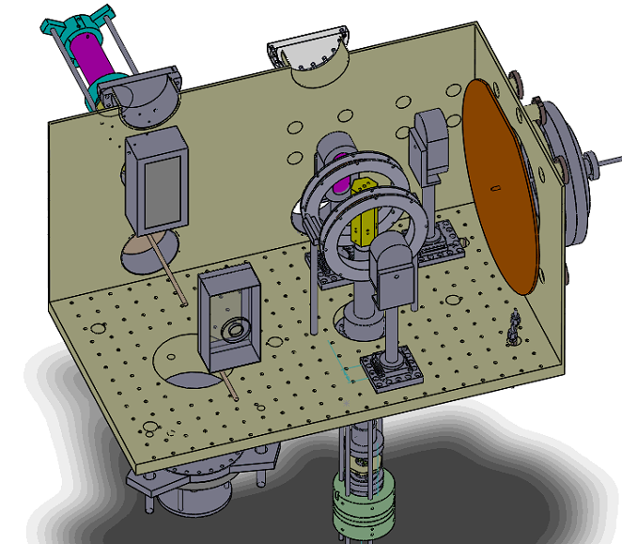
LNL Sputtering chamber and design
Target production at LNL – Nuclear physics studies
Characteristics:
3 sputtering source (50mm x 140mm)
2 sputtering source (150mm x 230mm)
Active gettering system (porous Ti /Ba/Al)
Optical emission plasma diagnostics for reactive processes (deposition of compound layers
Different power supply technologies:
High-power Impulse Magnetron Sputtering (HiPIMS, DC, pulsed-DC, or RF)
2 different sample holder

Slide 8
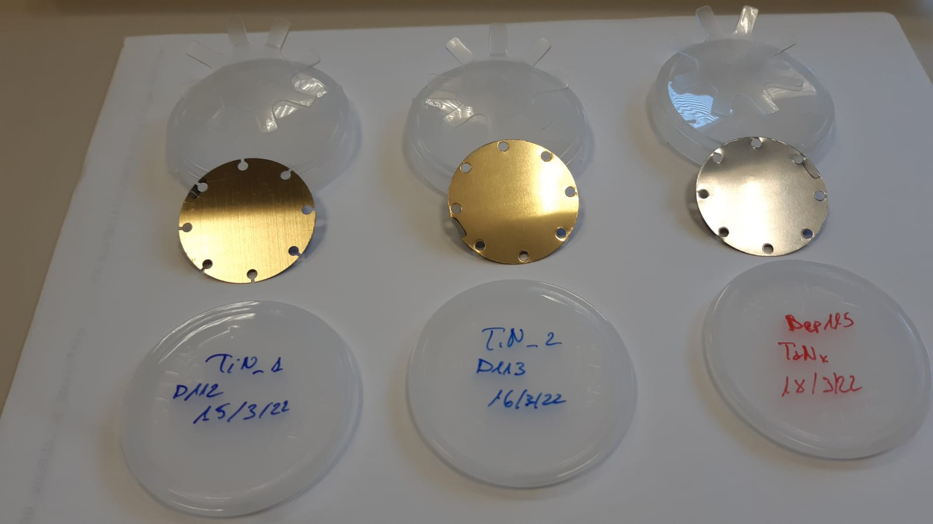
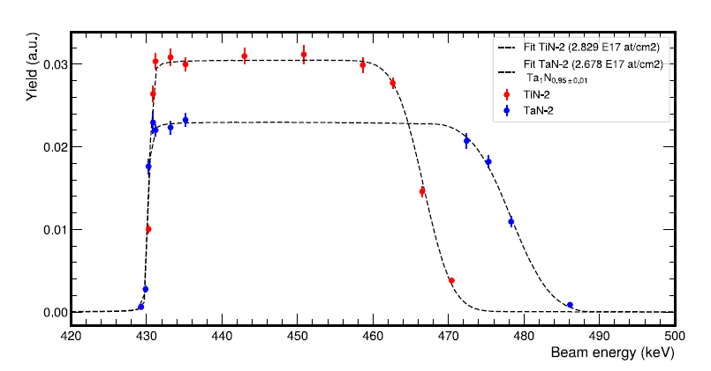
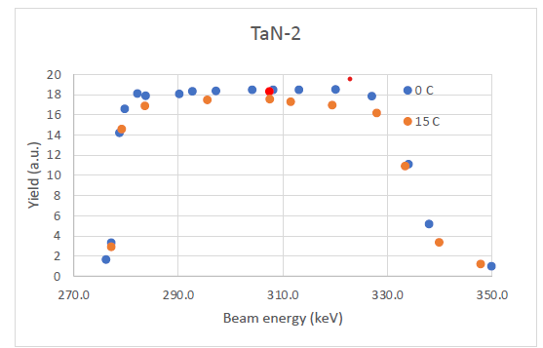
Target production at LNL – Nuclear physics studies
LUNA solid target development by PVD magnetron sputtering technology
Targets preparation for LUNA experiments (INFN Gran Sasso Laboratory):
Nitrides (Ta^{nat}N, Zr^{nat}N, Ti^{nat}N)
High-Z metals nitrides for reduction of neutrons production for LUNA-MV
TaN target produced by PVD techniques using ¹⁴N enriched gas
Production and EBS characterization performed @ LNL (AN2000)
Low energy resonance scan and endurance test performed @ LNGS (LUNA400)
429 keV ¹⁵N resonance scan
of TaN and TiN
TaN 2.8*10¹⁸ atoms/cm² deposited on 7.8*10¹⁷ atoms/cm² of high purity Ta interlayer Tantalum substrate
TiN 2.7*10¹⁸ atoms/cm² deposited Tantalum substrate and Silicon substrate (for EBS analysis)
EBS analyses
Ti
278 keV ¹⁴N resonance
scan of TaN
After an irradiation of 15 C
Ta
Analysis A. Compagnucci

Slide 9
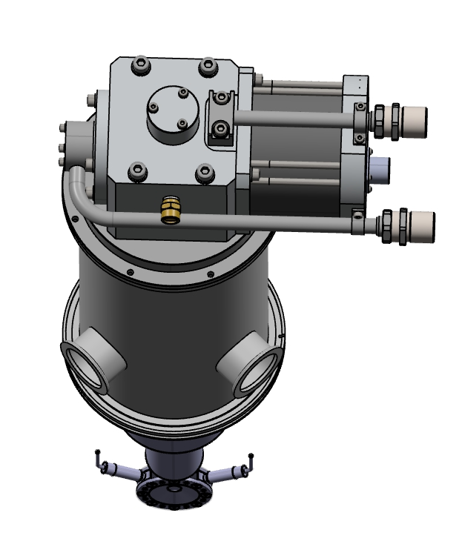

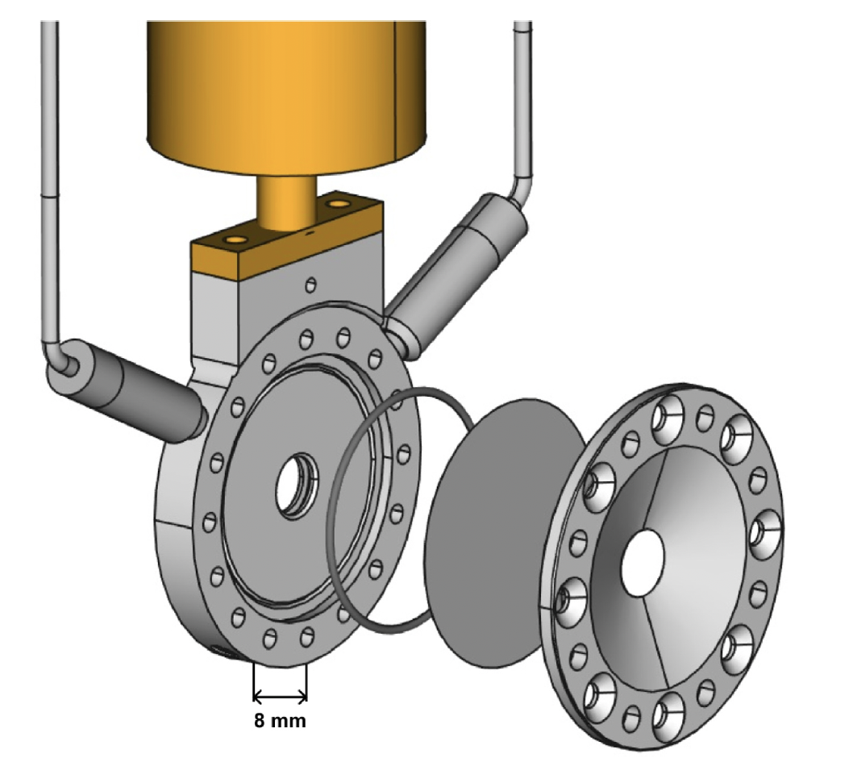
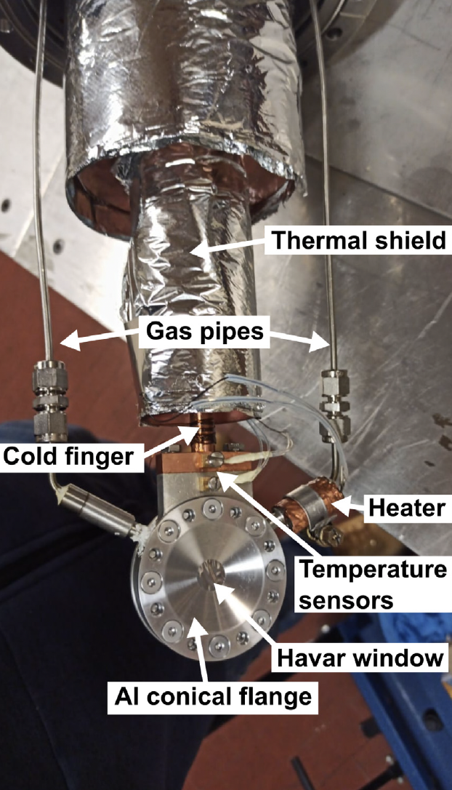
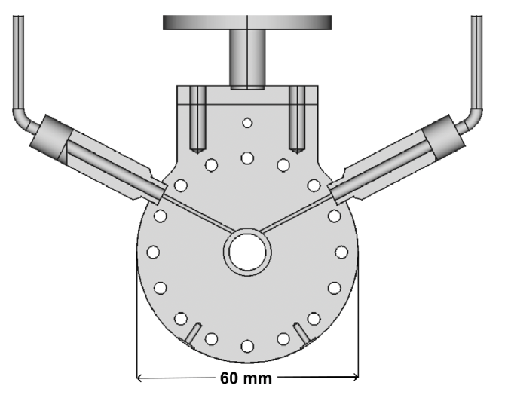
Target production at LNL – Nuclear physics studies
Y. Peinnaud, P. Rosier, C. Soulet
CTADIR: design, construction and commissioning of the prototype of a ^{3,4}He cryogenic target for direct reactions in inverse kinematics.
Next RIB’s @ SPES have opened the opportunity to perform direct reactions with unstable beams in inverse kinematics.
Havar
GM (Sumitomo) cryogenic source
(2W @ 4K) – free orientation
4 mm gas cell
Aluminum body to reduce 𝛾-ray absorption and scattering
As modular as possible for portability
Temperature kept constant by a temperature controller feedback
Havar windows 3.8 or 2.5 𝜇m thickness
At 1 bar, 10 K, ⁴He 3･10²⁰ at/cm²
Al-steel
transition
In seal
Cut view of the central flange

Slide 10
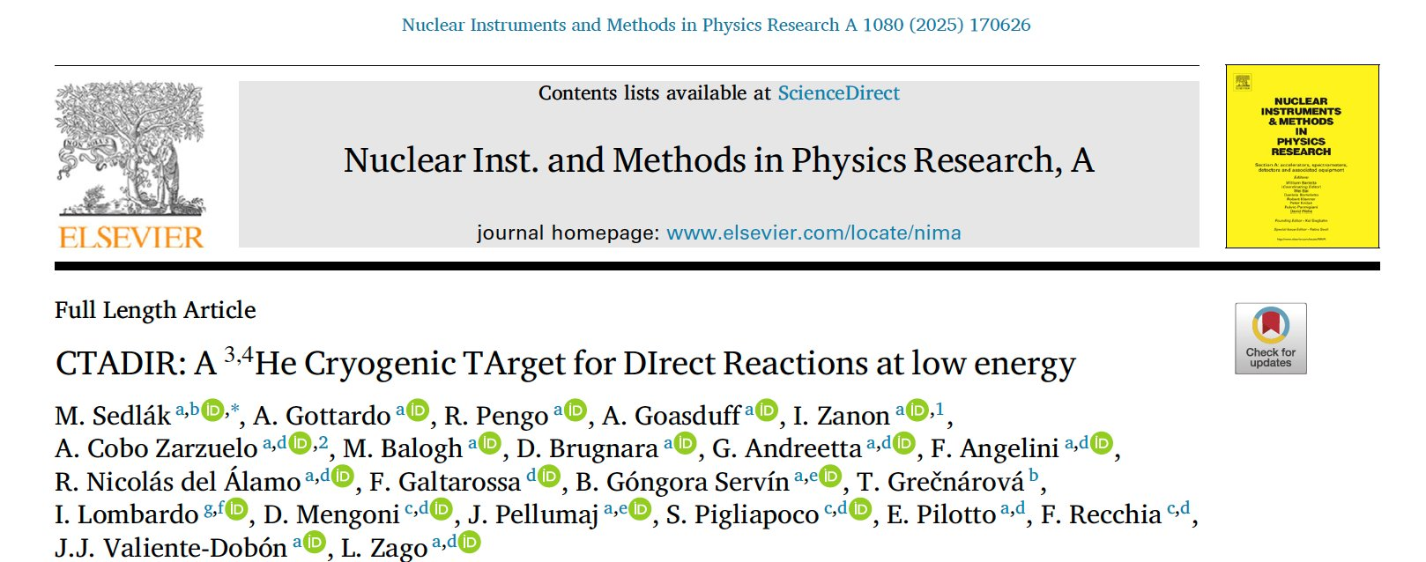
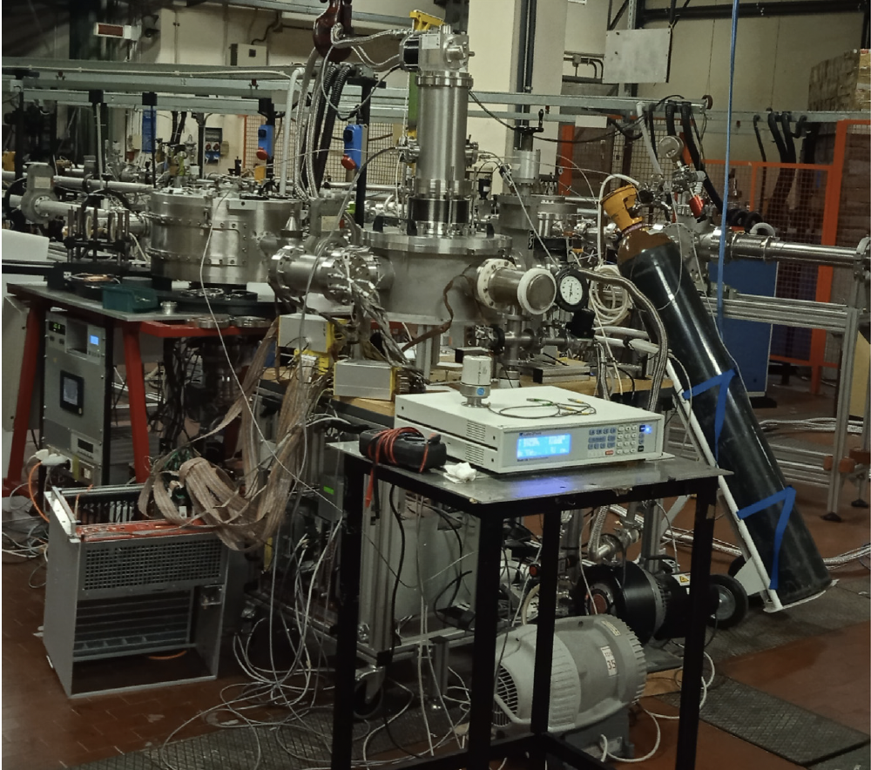
Target production at LNL – Nuclear physics studies
CTADIR in-beam commissioning (I)
Cryocooler
⁴He tank
Scattering chamber
Commissioning at CN accelerator with 5 MeV protons
Manual filling ⁴He gas system
Micron S1 detectors in front and back of the target
Temperature controller
Sauron electronics
M. Sedlak

Slide 11
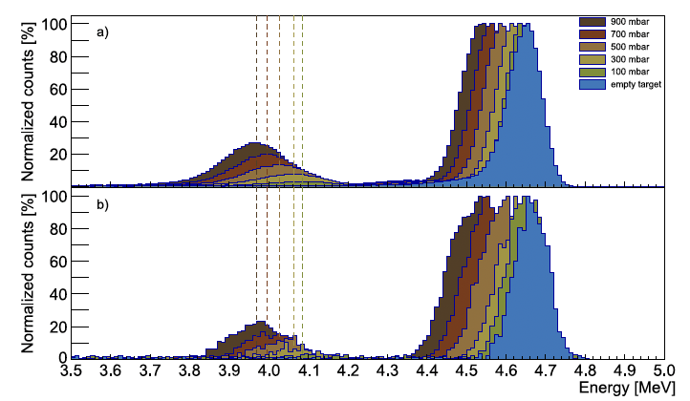
CTADIR in-beam commissioning (II)
Target production at LNL – Nuclear physics studies
Experimental data
5 MeV proton scattering on Havar
3.8 𝜇m windows
Test at different He gas pressures
Temperature kept at 12 K to limit density
Proton energy spread behavior on ⁴He gas target compatible with thickness of few 10²⁰ at/cm²
Scattering on Havar
Scattering
on He
GEANT 4 calcs
The peak at higher energy represents the protons scattered on the Havar® foil window at the exit of the target. The peak with lower energy is due to protons scattered on the ⁴He gas filling the target.
M. Sedlak

Slide 12
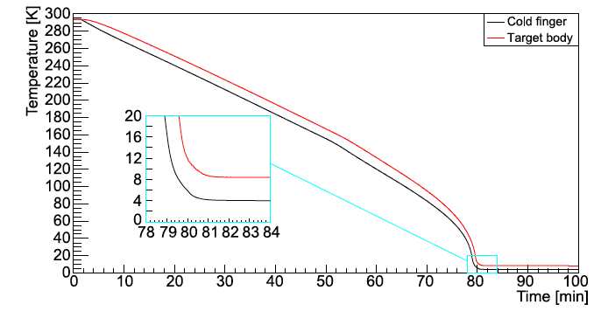
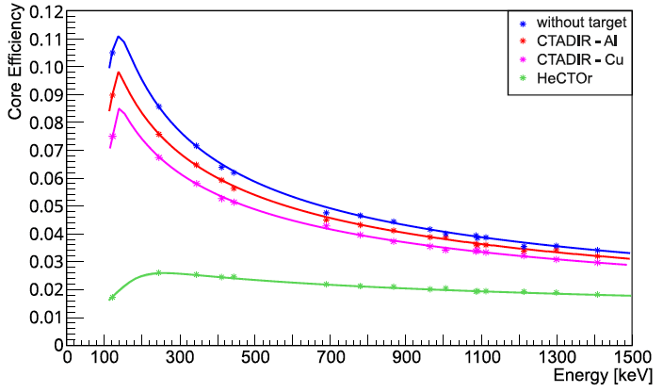
CTADIR performances
Target production at LNL – Nuclear physics studies
Cool down in about 80 minutes
Significant de-icing already at 40 K:
de-icing procedure feasible in 2 hours
(including gas removal/refilling)
Gamma-ray transparency greatly enhanced compared to Hector, thanks to lower material budget and Al body
Exploiting the intense radioactive beams from existing and upcoming ISOL facilities (for instance ISOLDE, TRIUMF, SPES, RAON) the CTADIR target will allow one to perform proton adding (³He,d) and neutron stripping (³He, ⁴He) reactions around the key doubly-magic nuclei ⁷⁸Ni and ¹³²Sn combining the AGATA energy resolution with the granularity of GRIT.
M. Sedlak

Slide 13
Target production at LNL
Applied NP studies
(emerging radioisotopes production for thenanostics radiopharmaceuticals)

Slide 14
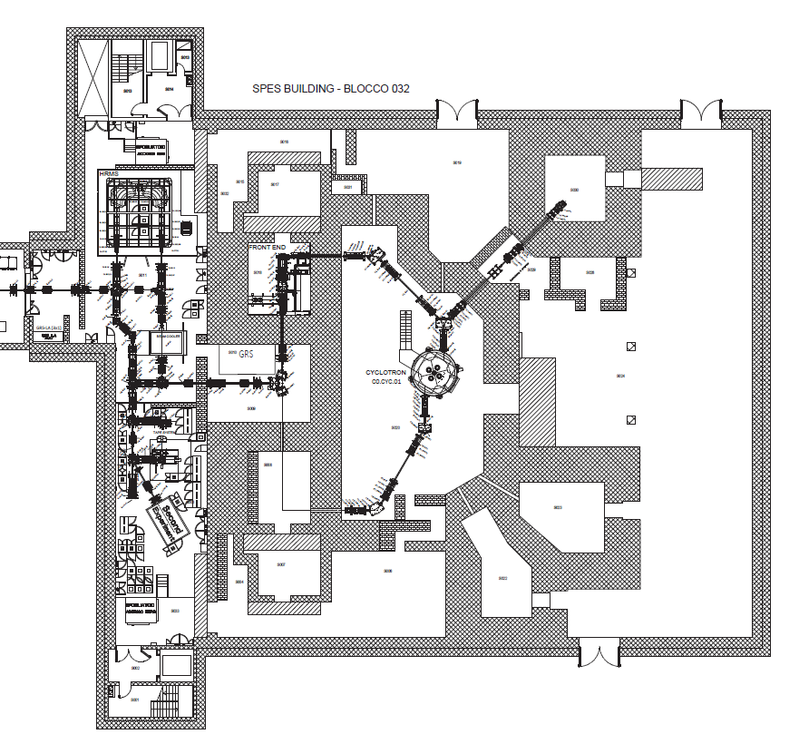
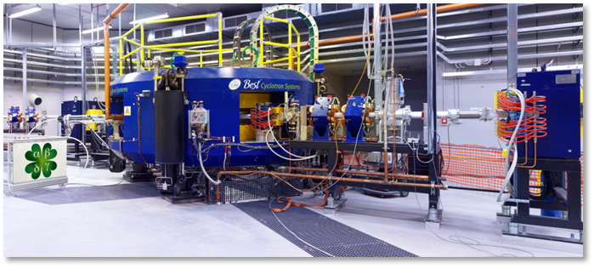

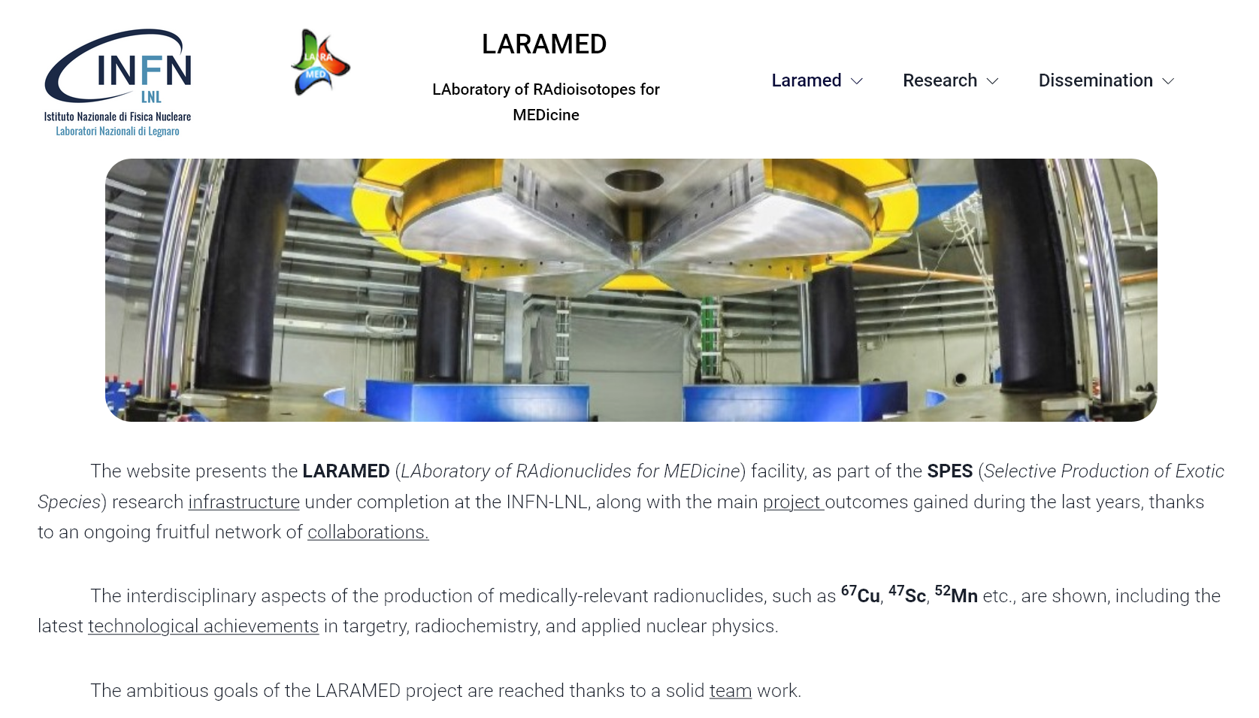


Study and production of novel/emerging medical radionuclides feasible at SPES facility
Target production at LNL – Nuclear physics applications
RILAB
DIRECT technology
ISOL technology
https://web.infn.it/LARAMED/
https://isolpharm.pd.infn.it/web/
Possible collaboration with multinationals to supply the market needs of RIs
RIFAC

Slide 15
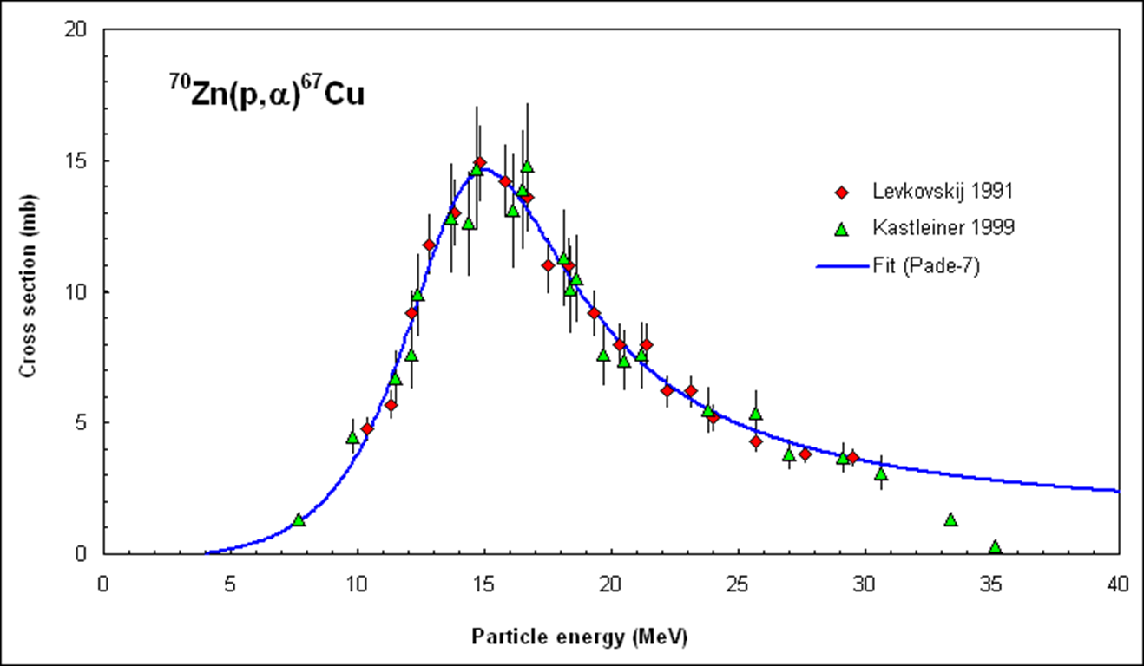
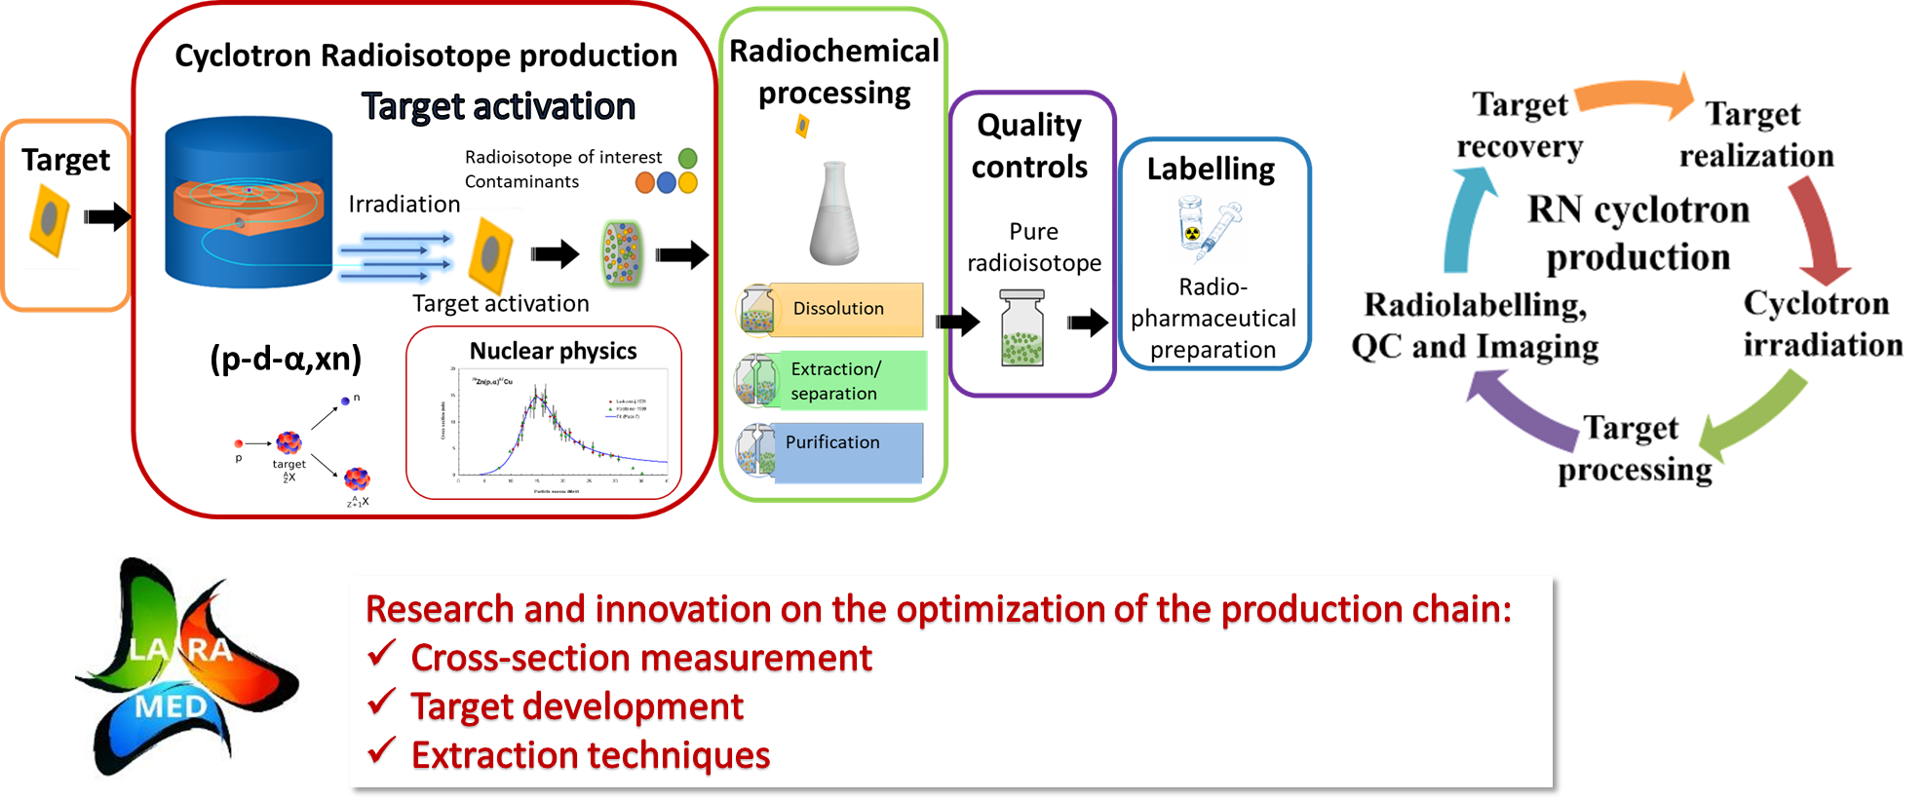
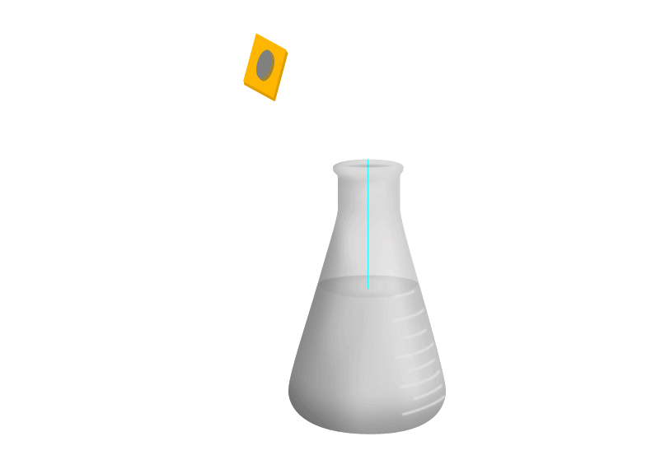

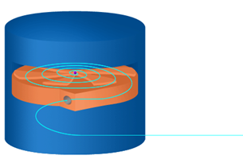
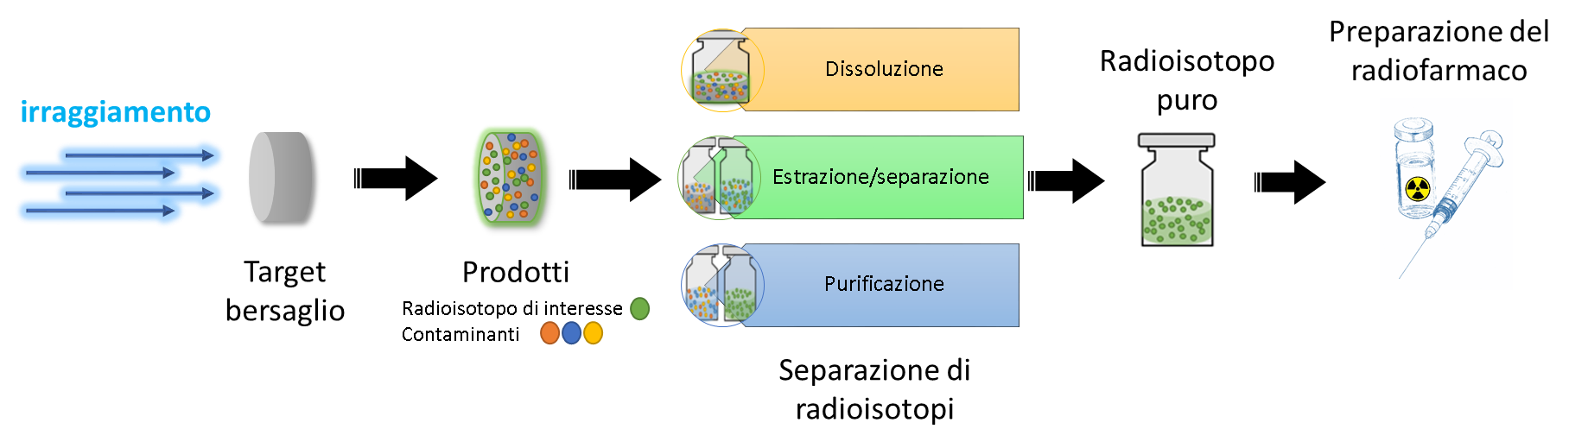
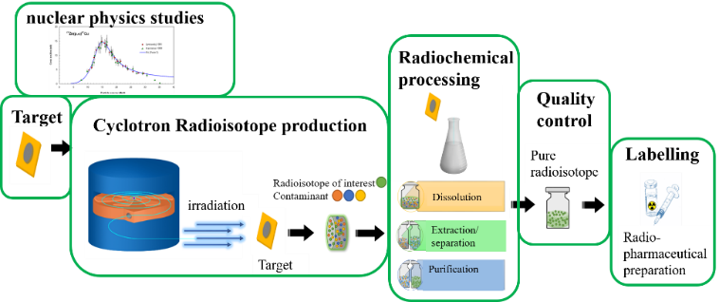
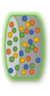

Target production at LNL – Nuclear physics applications
Cyclotron production cycle
Nuclear physics studies
Radiochemistry
process
Quality Control
Radio-
pharmaceutical
preparation
Cyclotron irradiation
Target
preparation
Radioisotope of Interest
Contaminants
Dissolution
Extraction/
separation
Target activation
Pure radioisotope
Purification
Target recovery
Fore more details, follow Sara Cisternino’s presentation right after this one.

Slide 16
Target production at LNL
Quality Control (QC) techniques: nuclear targets characterization

Slide 17
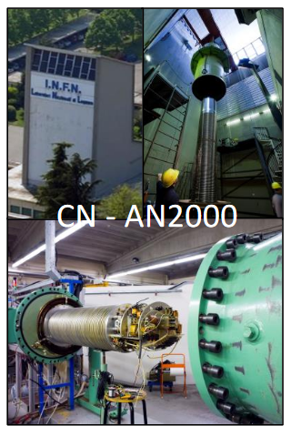
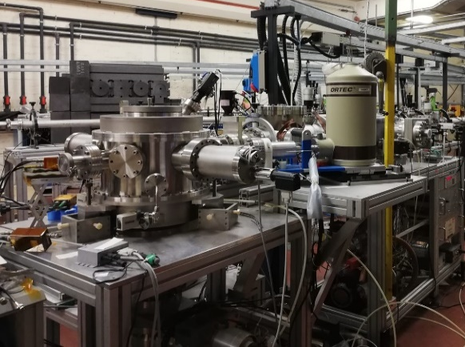
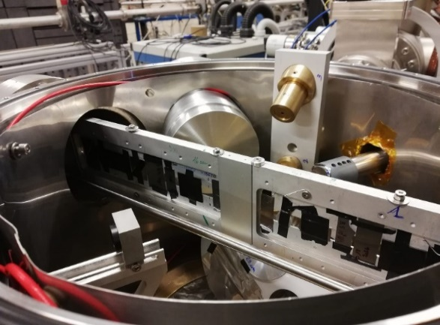
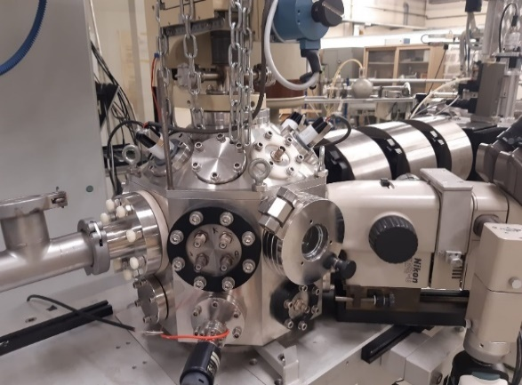
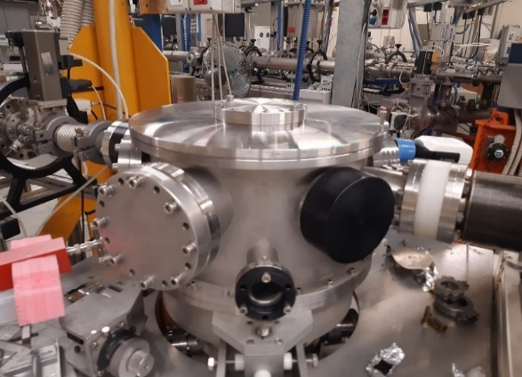
Target characterization at LNL
IBA facilities for nuclear target characterization @ LNL
quantitative determination of composition
thickness measurements in terms of dose (at/cm²)
depth profiles analysis
a)
b)
non-destructive
High accuracy and resolution
c)
d)
-15° beam line at CN facility [a), b)]
EBS analysis
PIXE analysis
PIGE analysis
0° beam line (μ-beam) at AN2000 facility [c)]
EBS analysis
PIXE analysis
60° beam line at AN2000 facility [d)]
EBS analysis
ERDA analysis

Slide 18

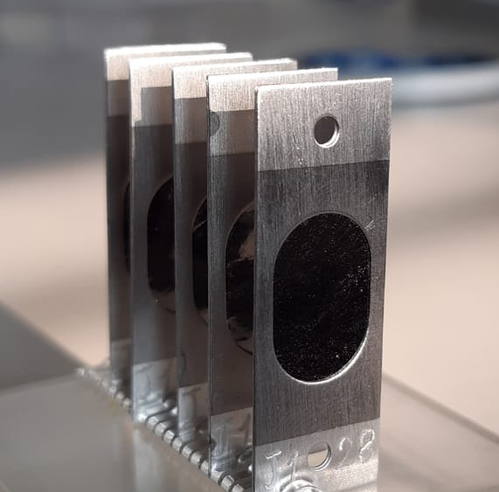
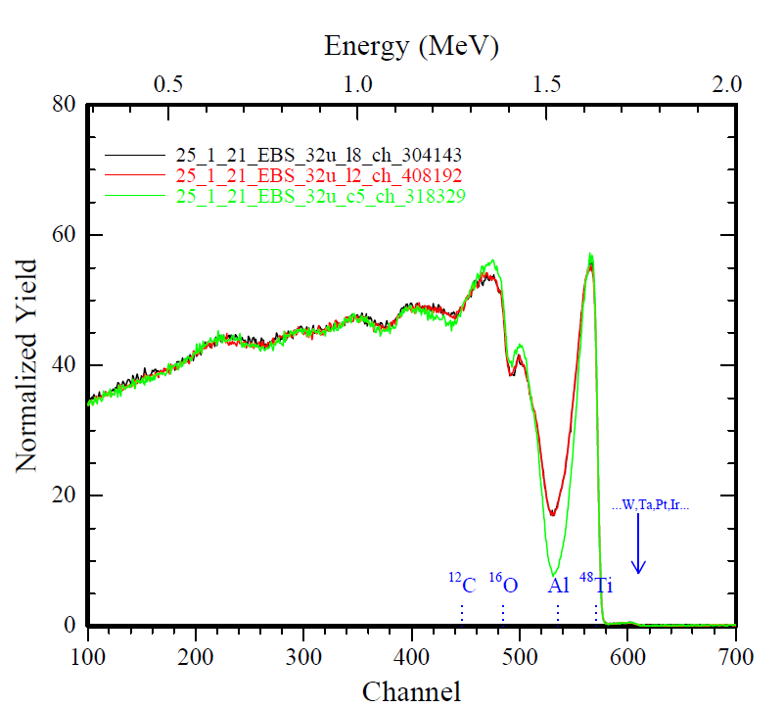
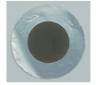

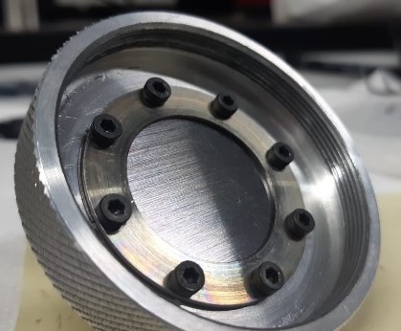
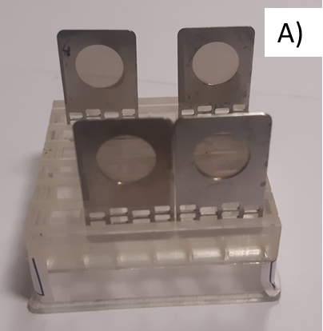
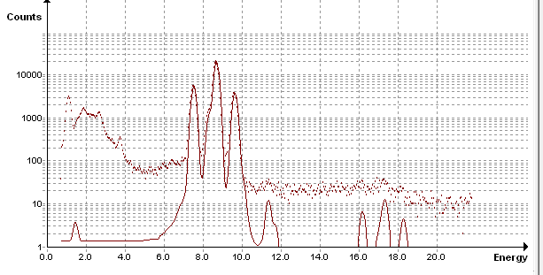


Target characterization at LNL
IBA facilities for nuclear target characterization @ LNL
Dedicated experiments in nuclear target analysis:
Deposition of Elements on Substrates (DES) involved in NUMEN project
Elastic backscattering spectrometry (EBS)
Characterization of HIVIPP targets for REMIX project (HIX) involved in LARAMED project
Elastic backscattering spectrometry (EBS)
Advances Nuclear Target (ANT)
involved in SALVIA project, LUNA collaboration (target development) and LNL target service (target characterization)
Elastic backscattering spectrometry (EBS)
Nuclear Reaction Analysis (NRA)
particle induced X-ray emission (PIXE)
particle induced γ-ray emission (PIGE)

Slide 19



Target characterization at LNL
IBA characterization of nuclear target @ LNL
Boron contamination reduction using High Purity PVD Tantalum deposited on tantalum backing
Beam induced background reduction
SAMPLE TILTED 70°
PVD Ta thickness > 2.5μm (E_{pmax}=400keV)
=Blue color
18O(p,α)15N
Ep=680keV, ~13µm Mylar
Θ_{NRA}=150° ; sample tilt=70°
11B(p,α)8Be[2 α]
Ta(after laser cut)
Ta(acid etched LNL)
Ta(PVD-LNL)

Slide 20




Target characterization at LNL
IBA characterization of nuclear target @ LNL
Targets preparation for : ²³Na(p,α)²⁰Ne experiment (LNGS)
Alkali targets produced by PVD technics and contaminants reduction
Sodium Niobate Nuclear Target
⁷Li content (ppm) in different deposition process setup
Irradiated Target

Slide 21



Target characterization at LNL
IBA characterization of nuclear target @ LNL
Targets for : ¹⁵N(α,γ)¹⁹F experiment (Felsenkeller Laboratories)
TaN target produced by PVD technics using ¹⁵N enriched gas
RBS spectrum α beam 1.6MeV(AN2000)
witness samples
TaN 0.8-1.2-2.4*10¹⁸ atoms/cm² deposited on 1.1*10¹⁸ atoms/cm² of high purity Ta interlayer Tantalum substrate
Irradiated target Ta¹⁵N @ HZDR
Felsenkeller experimental setup
Target degradation under intense He⁺ beam
Thanks E. Masha

Slide 22





Target characterization at LNL
IBA characterization of nuclear target @ LNL
Target degradation induced by blistering (intense He+ beam)
μ-RBS analysis and 2-D maps using AN2000 μ-beam probe
Thickness evaluation using μ-RBS 2-D maps

Slide 23

EURO-LABS WP2.5.2 Collaboration meeting
May 18th, 2026 GSI lab, Darmstadt (Germany)
Thank you from target makers group @LNL
Massimo Loriggiola
Lorenzo Loriggiola
Matteo Campostrini
Valentino Rigato
Andrea Gottardo
Sara Cisternino
Alisa Kotliarenko
Gaja Piteo (PhD UNIPD)
Stefano Corradetti
me

