Slide 1

Horia Hulubei National Institute for Physics and Nuclear Engineering,
30 Reactorului Street, P.O. Box MG-6, Bucharest–Magurele, Romania
www.nipne.ro
Activity at the target laboratory of IFIN-HH
Andreea Radu (Mitu)
Nicoleta Florea, Florin Crisiacu, Denise Piatti, Mihaela Bacalum, Ion Burducea, Gheorghe Ciocan, Celina Damian, Cristina Gheorghiu, Decebal Iancu, Victor Leca, Paul Mereuta, Daniel Tofan, Adrian Toma

Slide 2
Overview:
Improvement of already available fabrication techniques
Target preparation and characterization procedures
Sharing of knowledge - Basic Training School Euro-labs 2026

Slide 3
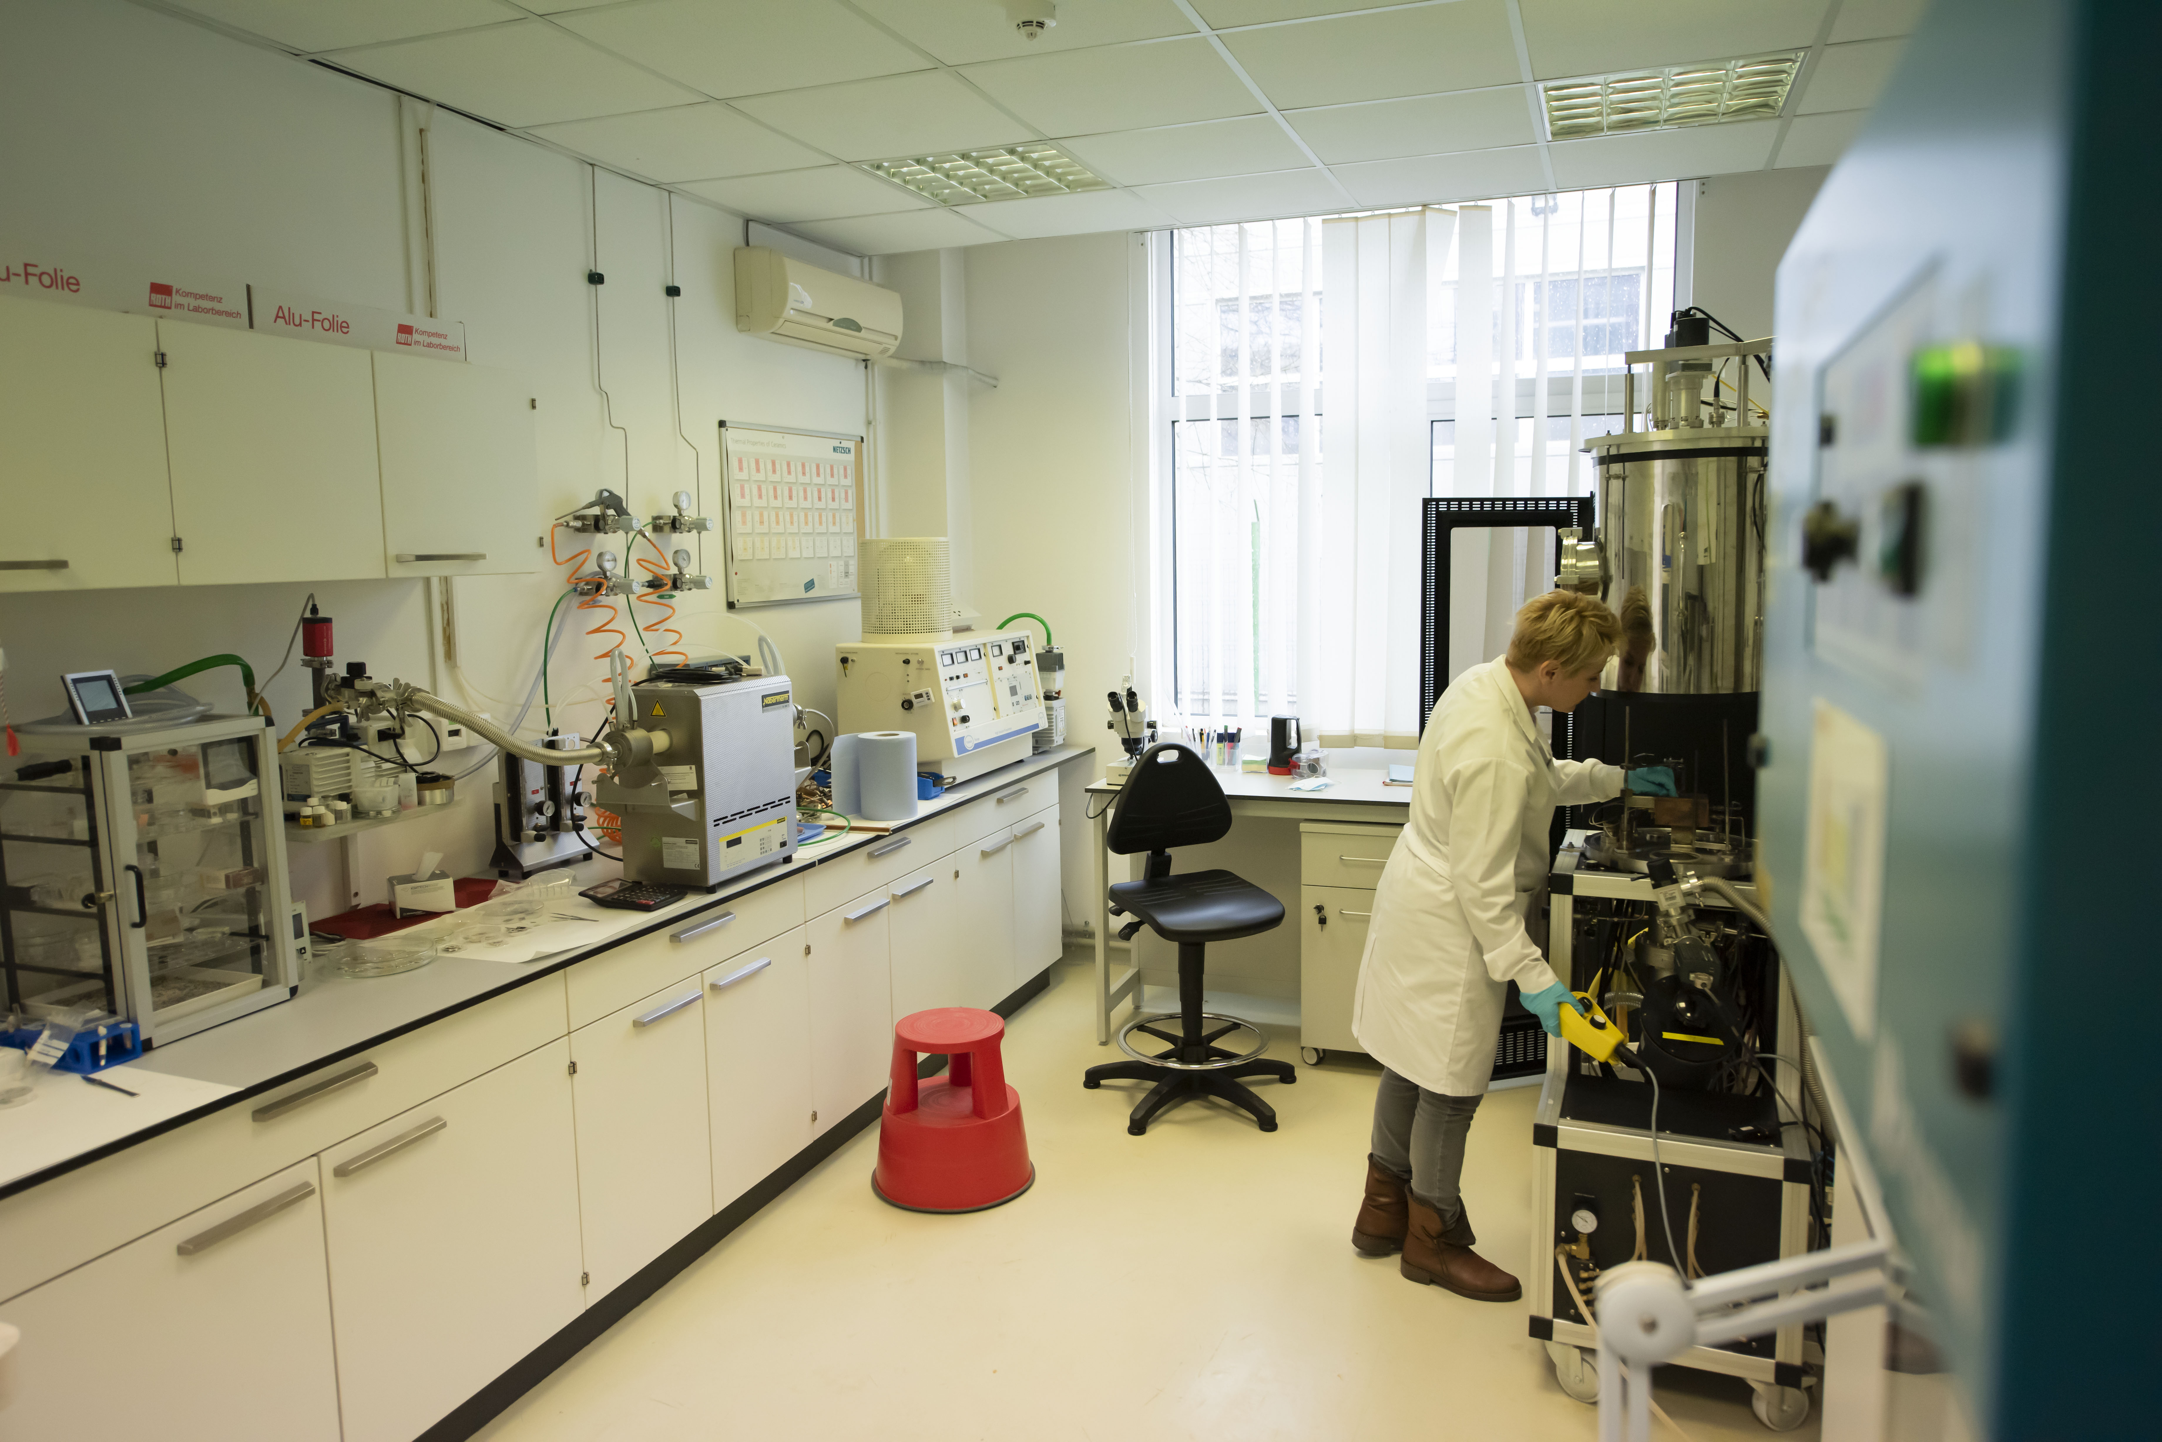
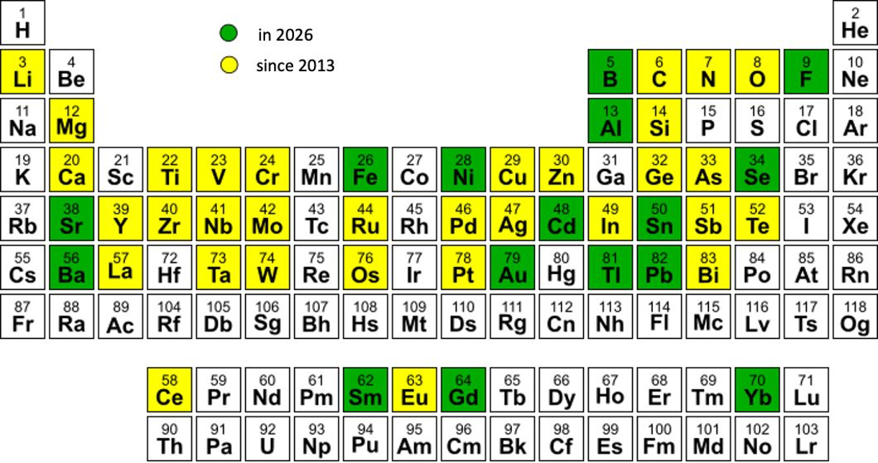
Target Preparation Laboratory
Fully equipped target laboratory:
Methods for target preparation:
Physical Vapor Deposition Methods (PVD)
  resistive heating
  electron-beam gun evaporation
Mechanical reshaping and powder processing
  cold-rolling
  tablet pressing
Laser-based
  PLD (INFLPR)
Anodization – implemented in 2025
  Preparation of Ta₂¹⁸O₅ - oxygen targets
High Energy Vibrational Powder Plating (HIVIPP) – in development
  Preparation of targets from isotopically enriched powdered material
Elements featured in the nuclear targets
N.M. Florea et. all, JRNC, 305, (2015)
A. Mitu et. all, EPJ Web of Conferences, 229, 03001, 2020

Slide 4
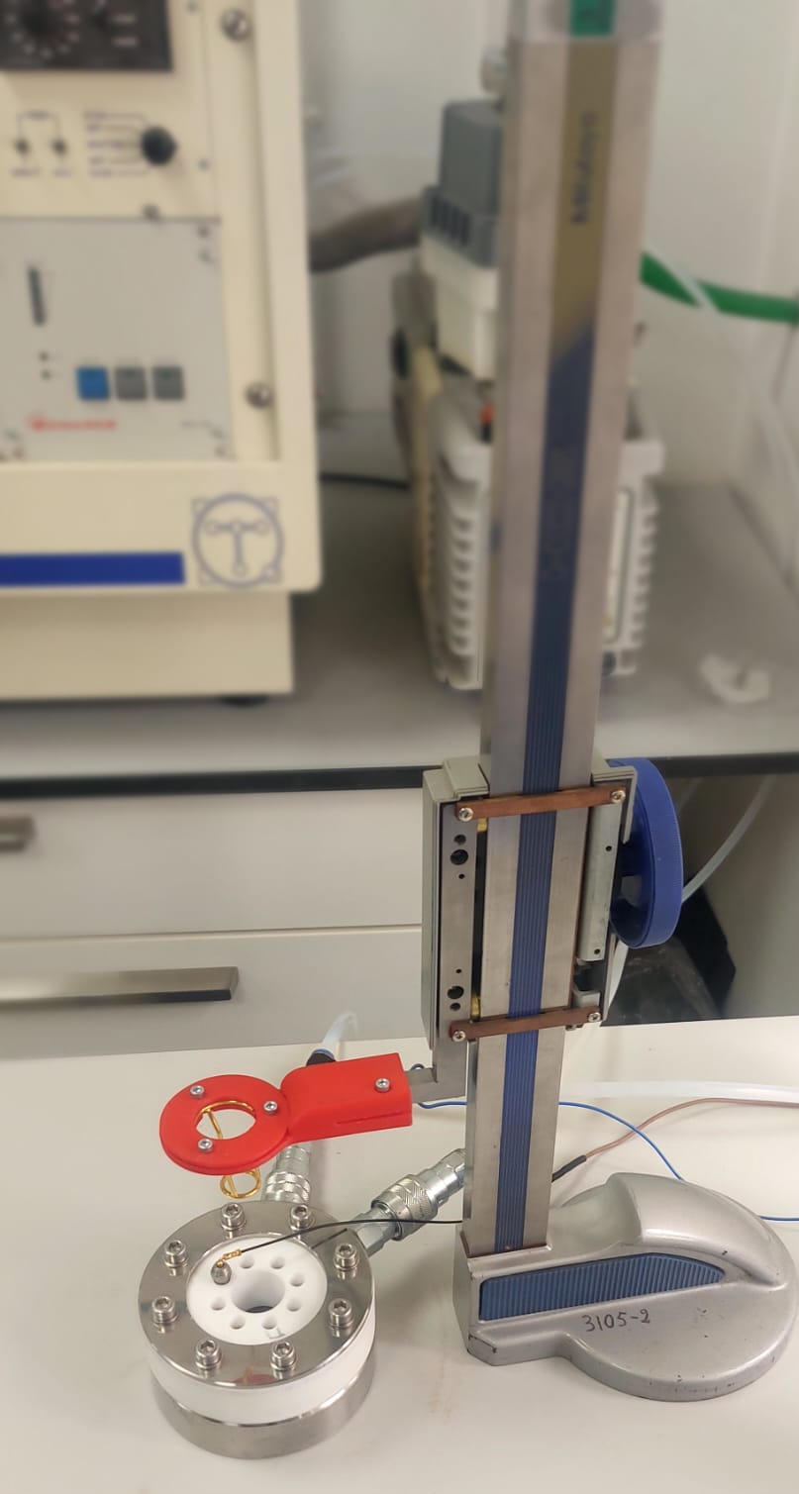
Development of the novel anodization set-up
Manufacturing of isotopically enriched oxygen (Ta₂¹⁸O₅) targets for:
  nuclear reactions in inverse kinematics
  nuclear astrophysics studies
Requirements for oxygen solid targets imposed by experiment:
  known isotopic composition, to allow for measurable yields
  Known stoichiometry, to allow for accurate beam energy loss calculations
  known thickness, to sustain high beam currents over extended periods of time
A. Caciolli et al.” Eur. Phys. J. A, 48, 144 (2012)

Slide 5
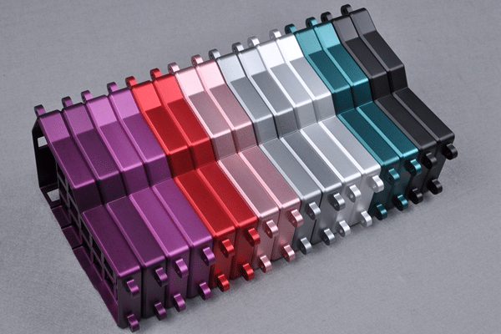
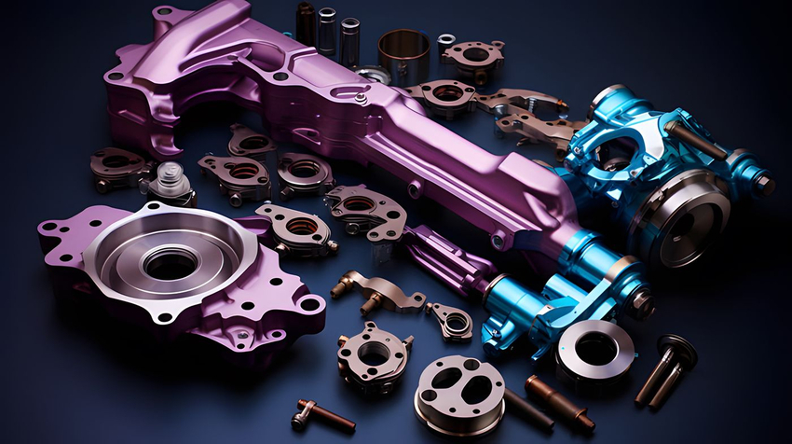
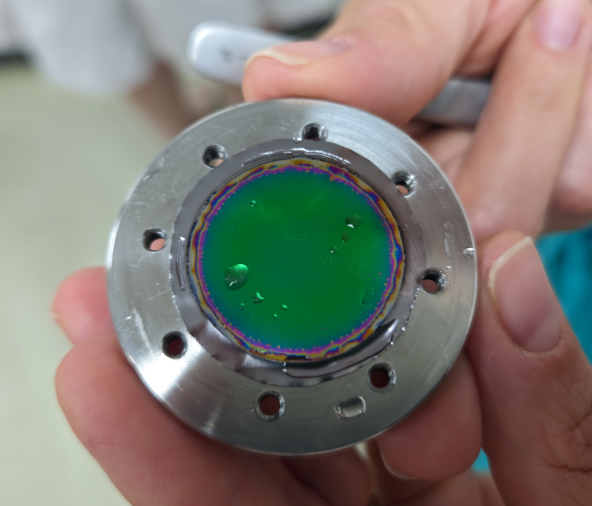
What is anodization? How it works?
Electrochemical process that electrolytically passivates the surface of different metals (Al, Ti, Mg, Zn, Ta, Zr, Hf, Nb), forming on its surface a very uniform and compact oxide layer.
This is typically done to:
  enhance durability,
  increase corrosion resistance
  improved surface hardness
  provides aesthetic options through a variety of colours
  offers better adhesion for paints and adhesives
  creates an electrically insulating surface.
In our case it will be used to
prepare isotopically enriched oxygen Ta₂¹⁸O₅ targets
H₂SO₄, H₂CrO₄, H₃PO₄, etc.
Mathias Kamp et al. / Energy Procedia 67 ( 2015 ) 70 – 75
Al
Ti
Ta₂¹⁸O₅ target

Slide 6

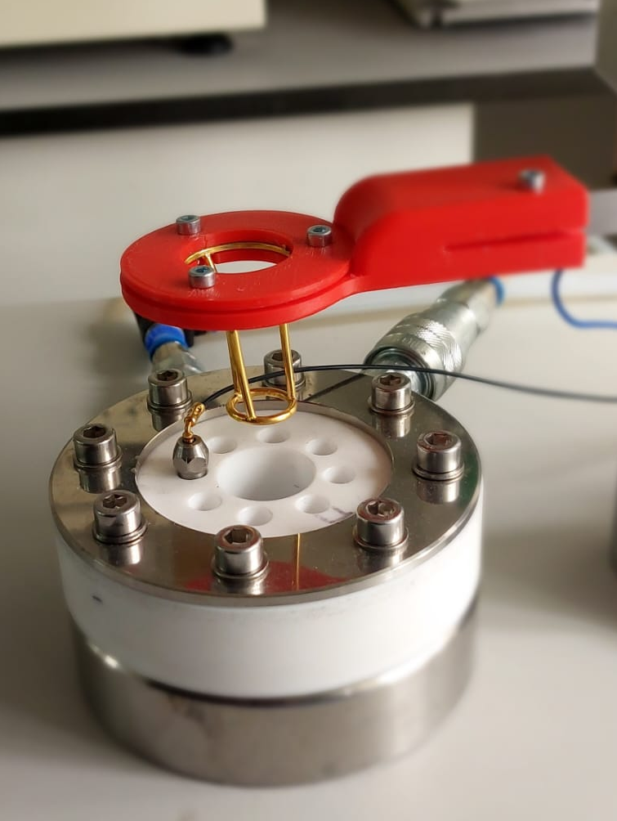
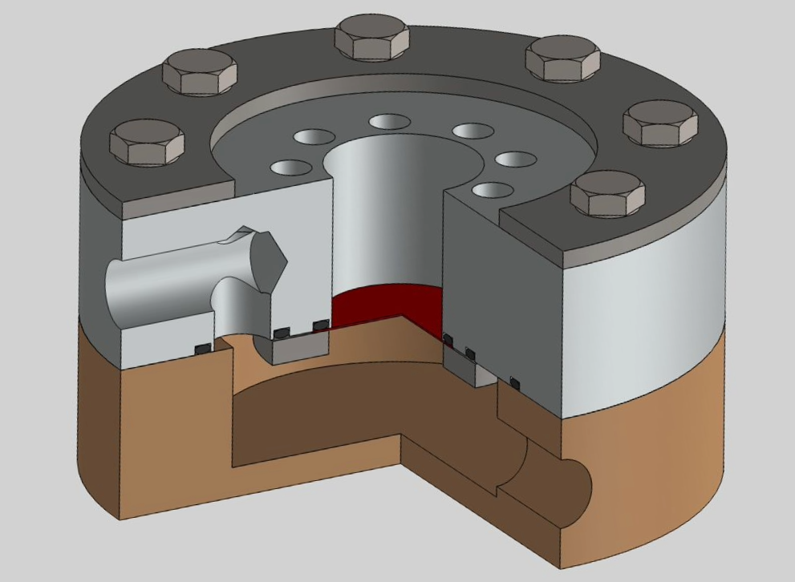
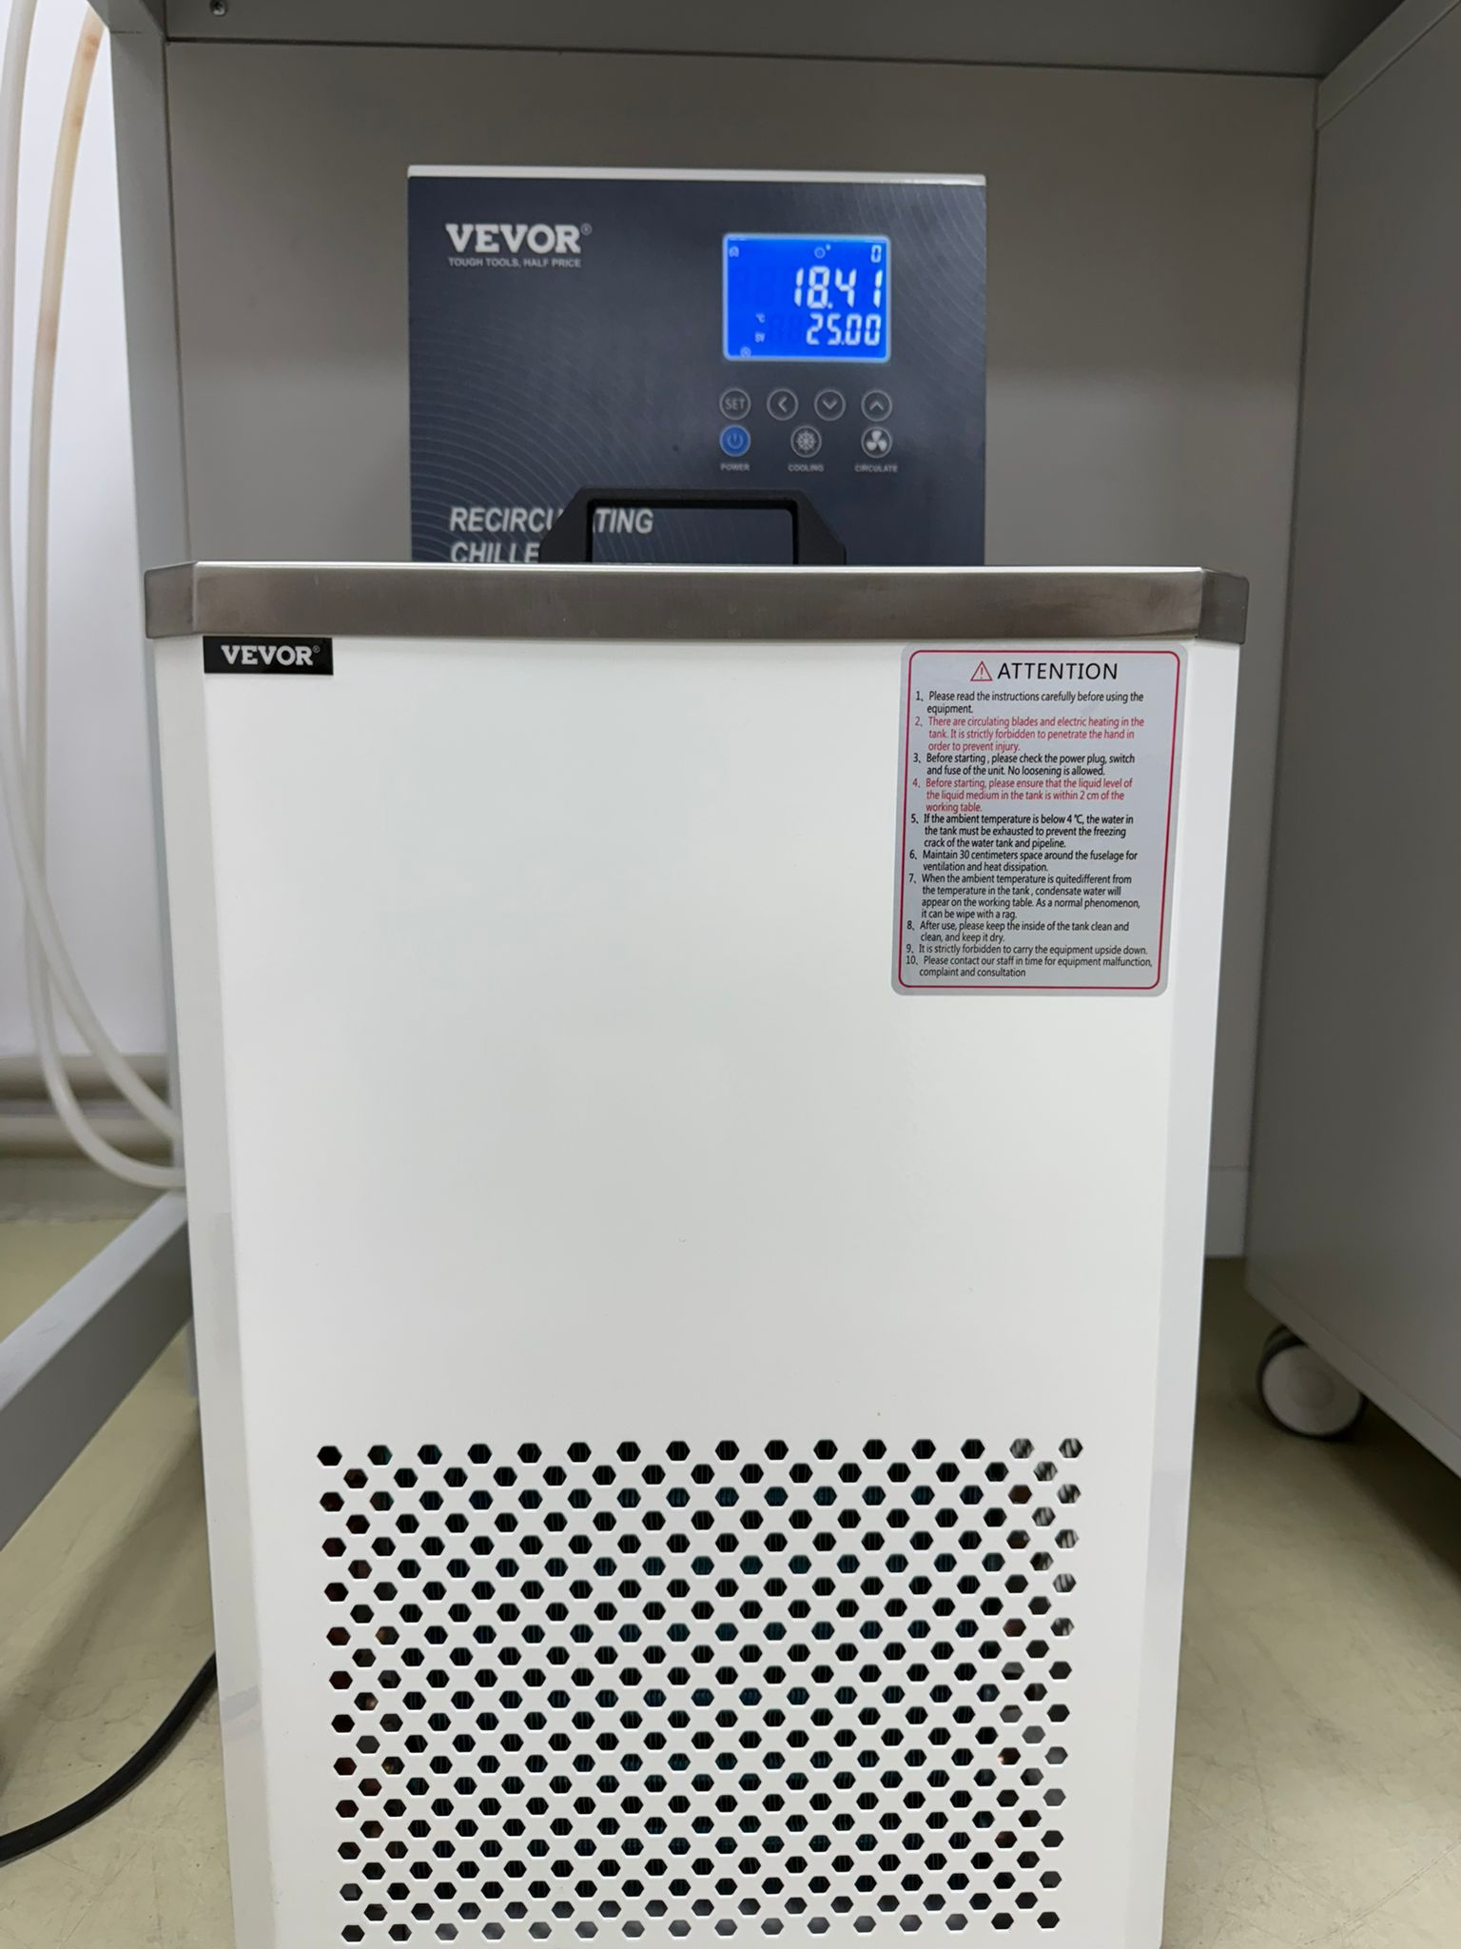
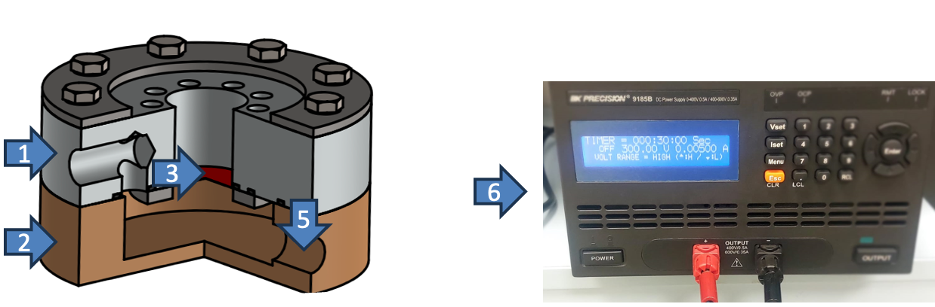
Setup
1. Cylindrical Teflon cavity (outer diameter 100 mm, inner diameter and height 25 mm) - defines the volume of the anodization cell were the electrolyte (H₂¹⁸O) is introduced (2-5ml), which can be recovered and reused for further target production
2. Cylindrical stainless-steel base
3. Tantalum disk to be anodized (the anode)
4. Gold filament (99.999%) with dia. 2 cm (cathode)
5. Water cooling system
6. Constant power supply with voltage (0-600V) and current (0 - 350 mA)
Eng. Florin Crisiacu
1
3
Denise Piatti
5
2
5
4
5
6
1
2
A. Caciolli et al.” Eur. Phys. J. A, 48, 144 (2012)

Slide 7
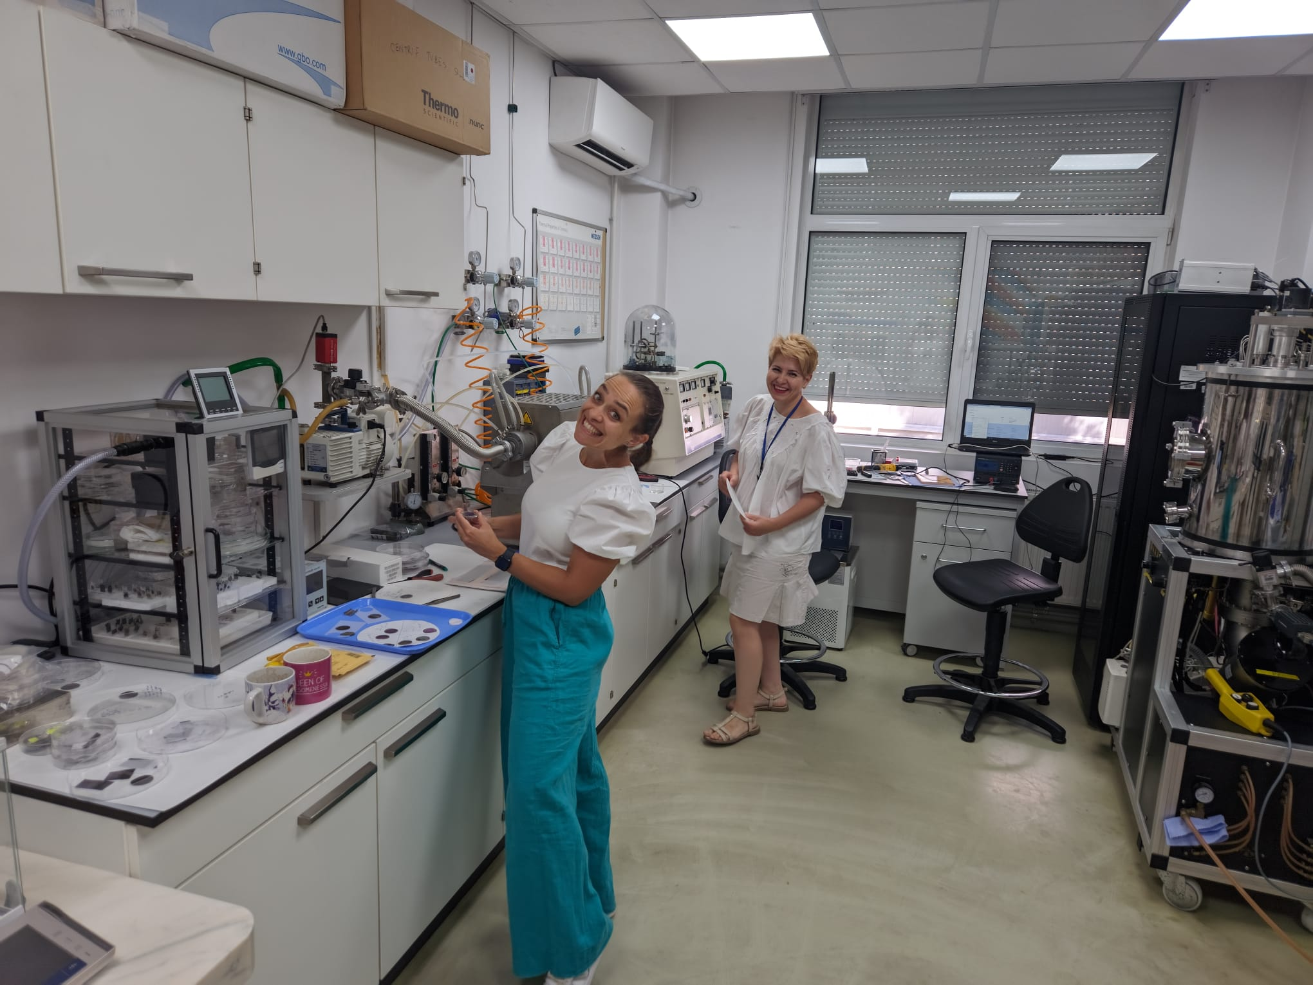
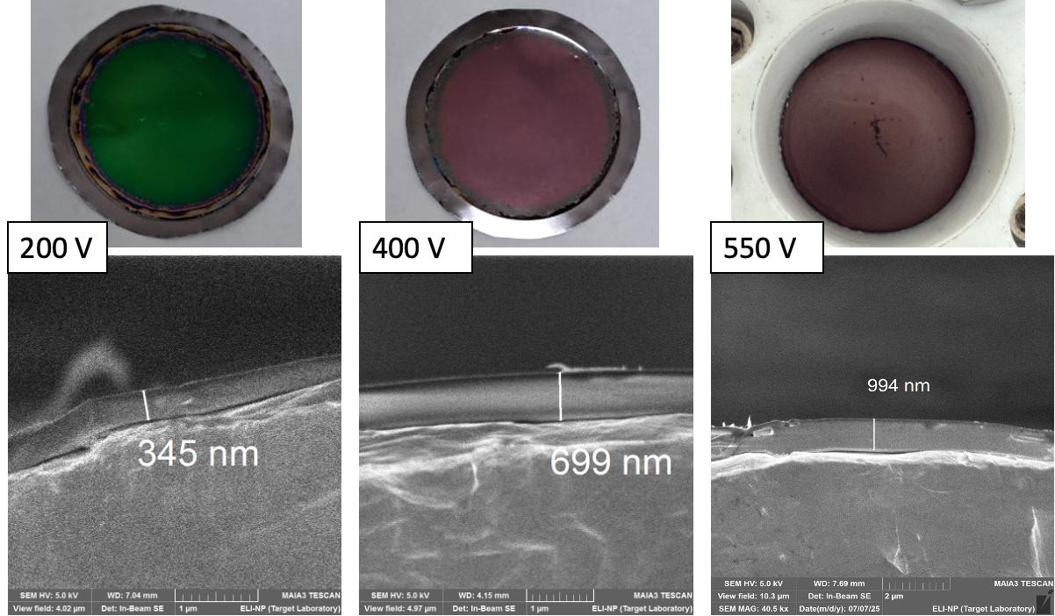
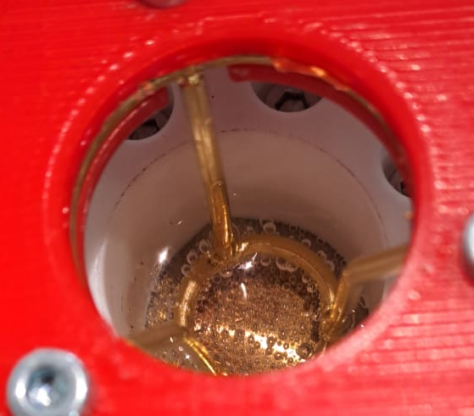
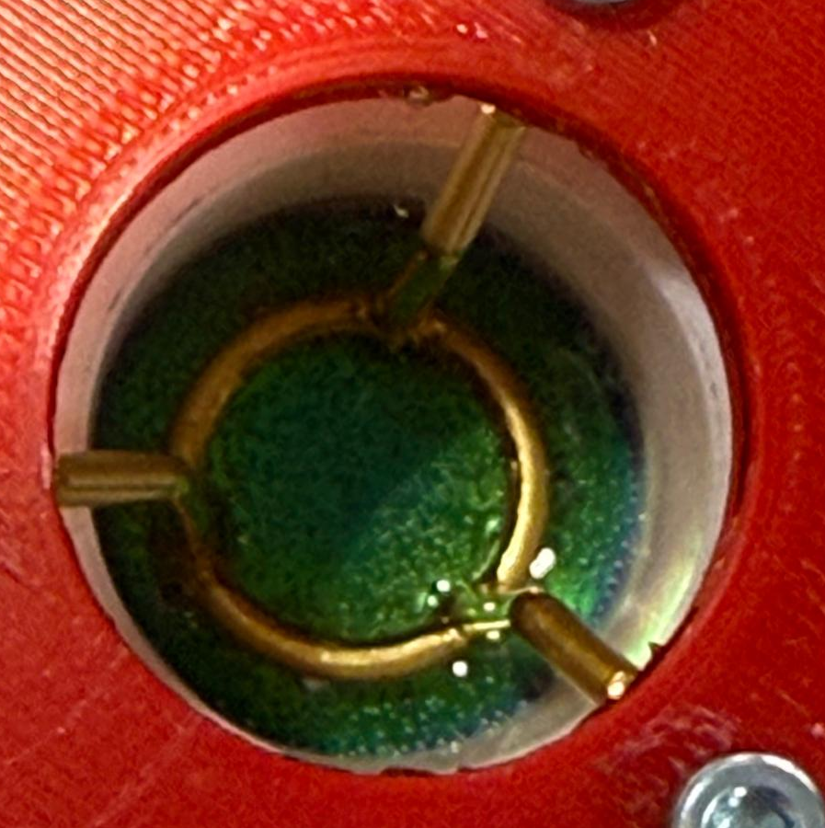
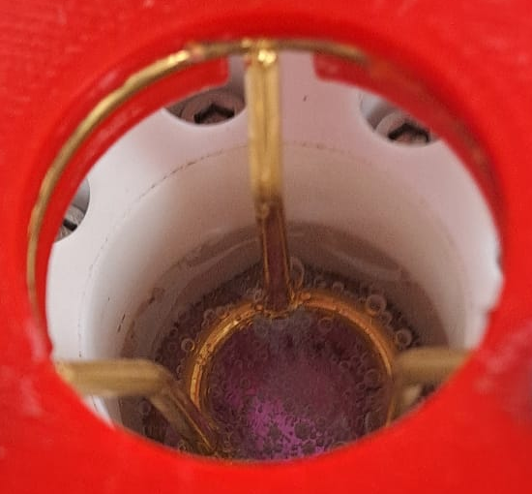
Ta₂¹⁸O₅ preparation and characterization
The influence of the anodization voltage on the Ta₂¹⁸O₅ oxide layer thickness:
Different anodization phases:
200 V
100 V
SEM analyses
Target 1 - 200 V → green layer, ~ 345 nm, 25 ºC , 2 mA ;
Target 2 - 400 V → purple layer, ~ 699 nm, 25 ºC , 2 mA;
Target 3- 550 V → brown layer, ~ 994 nm, 25 ºC , 2 mA.
400 V

Slide 8

Preparation of Isotopically Enriched Oxygen Targets (Ta₂¹⁸O₅) for Nuclear Reactions in Inverse Kinematics and Nuclear Astrophysics Studies
*Andreea Radu, *Nicoleta Florea, *Florin Crisiacu, Denise Piatti, Ion Burducea, Gheorghe Ciocan, Cristina Gheorghiu, Decebal Iancu, Victor Leca, Paul Mereuta, Daniel Tofan, Adrian Toma

Slide 9
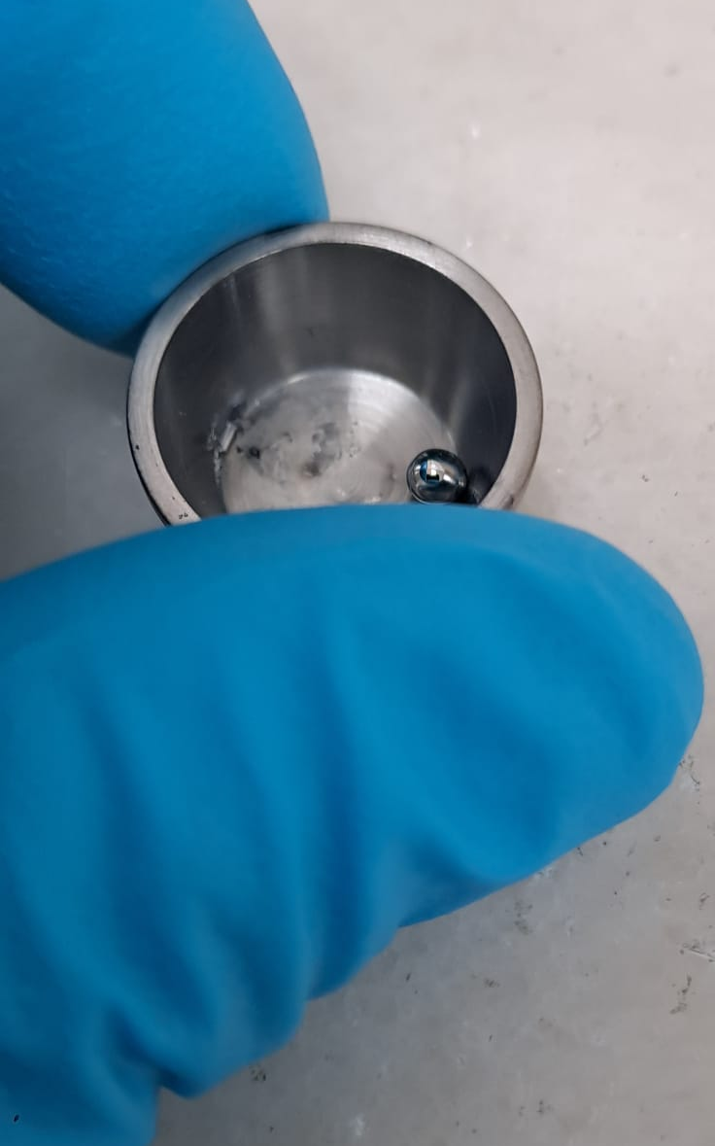
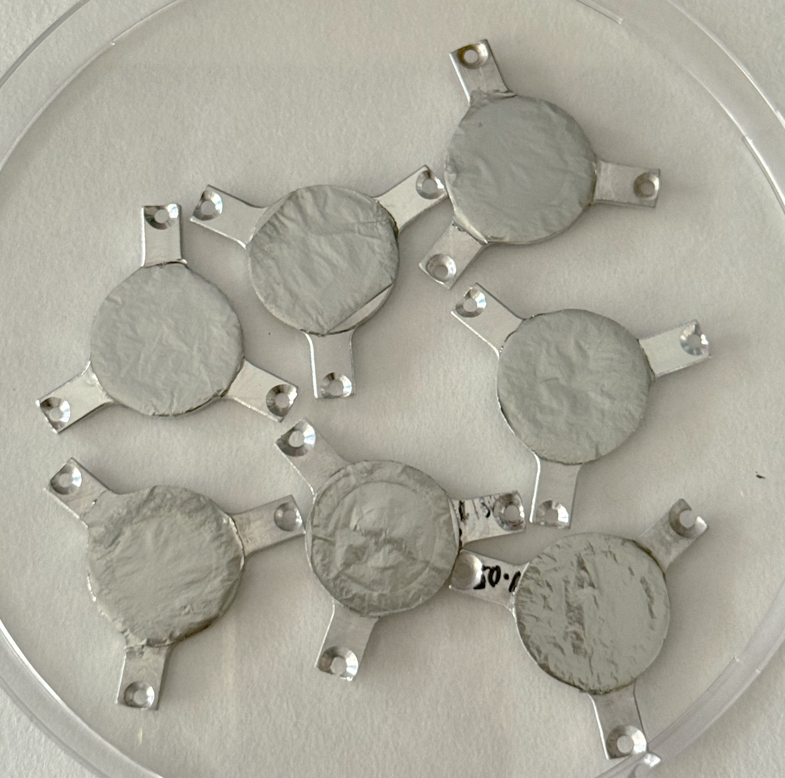
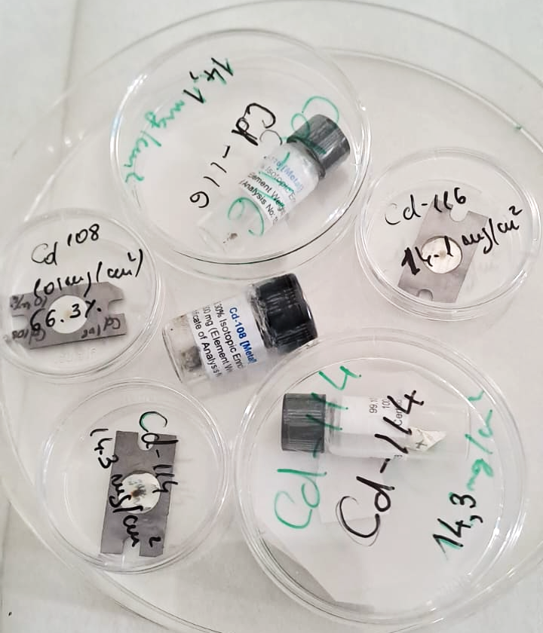
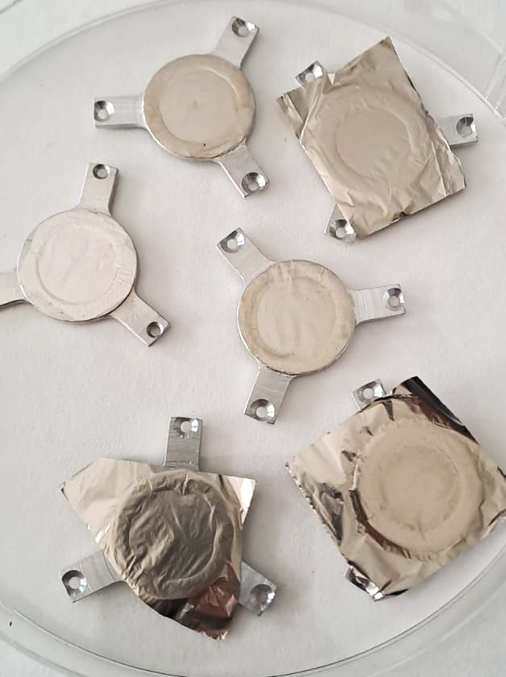
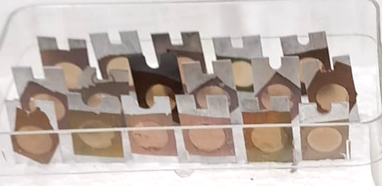
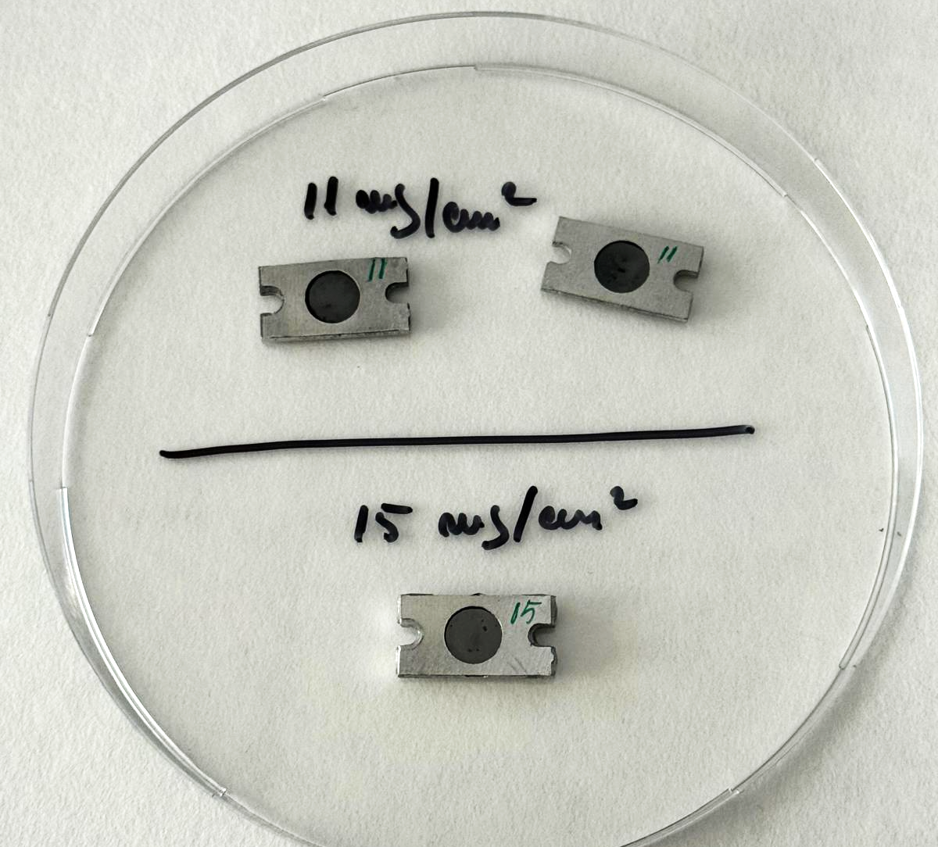
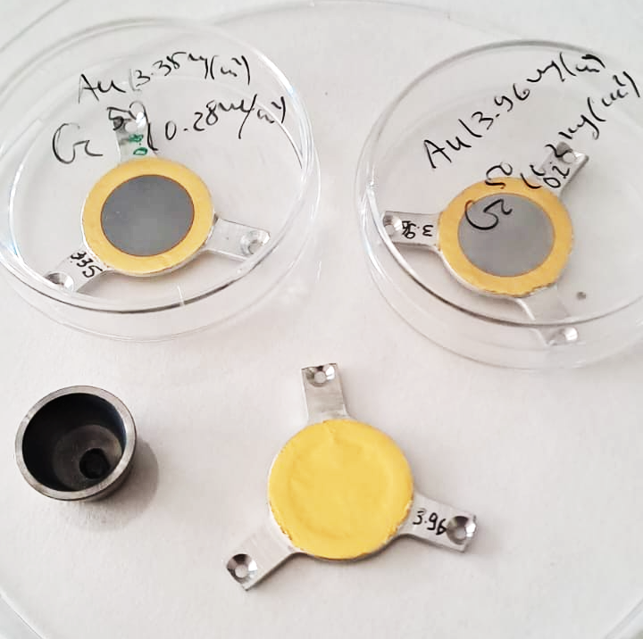
Target preparation and characterization
¹⁴N, ⁴⁸Ca, ²⁴Mg, ⁵⁰Ti, ⁶¹Ni, ⁷⁸Se, ¹⁰⁰Mo, ^{108,114,116}Cd, ^{115,117,119,120,124}Sn, ¹²⁸Te, ¹⁴⁷Sm, ²⁰⁸Pb, ¹⁷⁶Yb, ⁹¹Zr, InCl₃
¹⁰⁰ Mo
^{108,114,116}Cd
⁶¹Ni
^{nat}B
⁵⁰Cr
¹²C

Slide 10
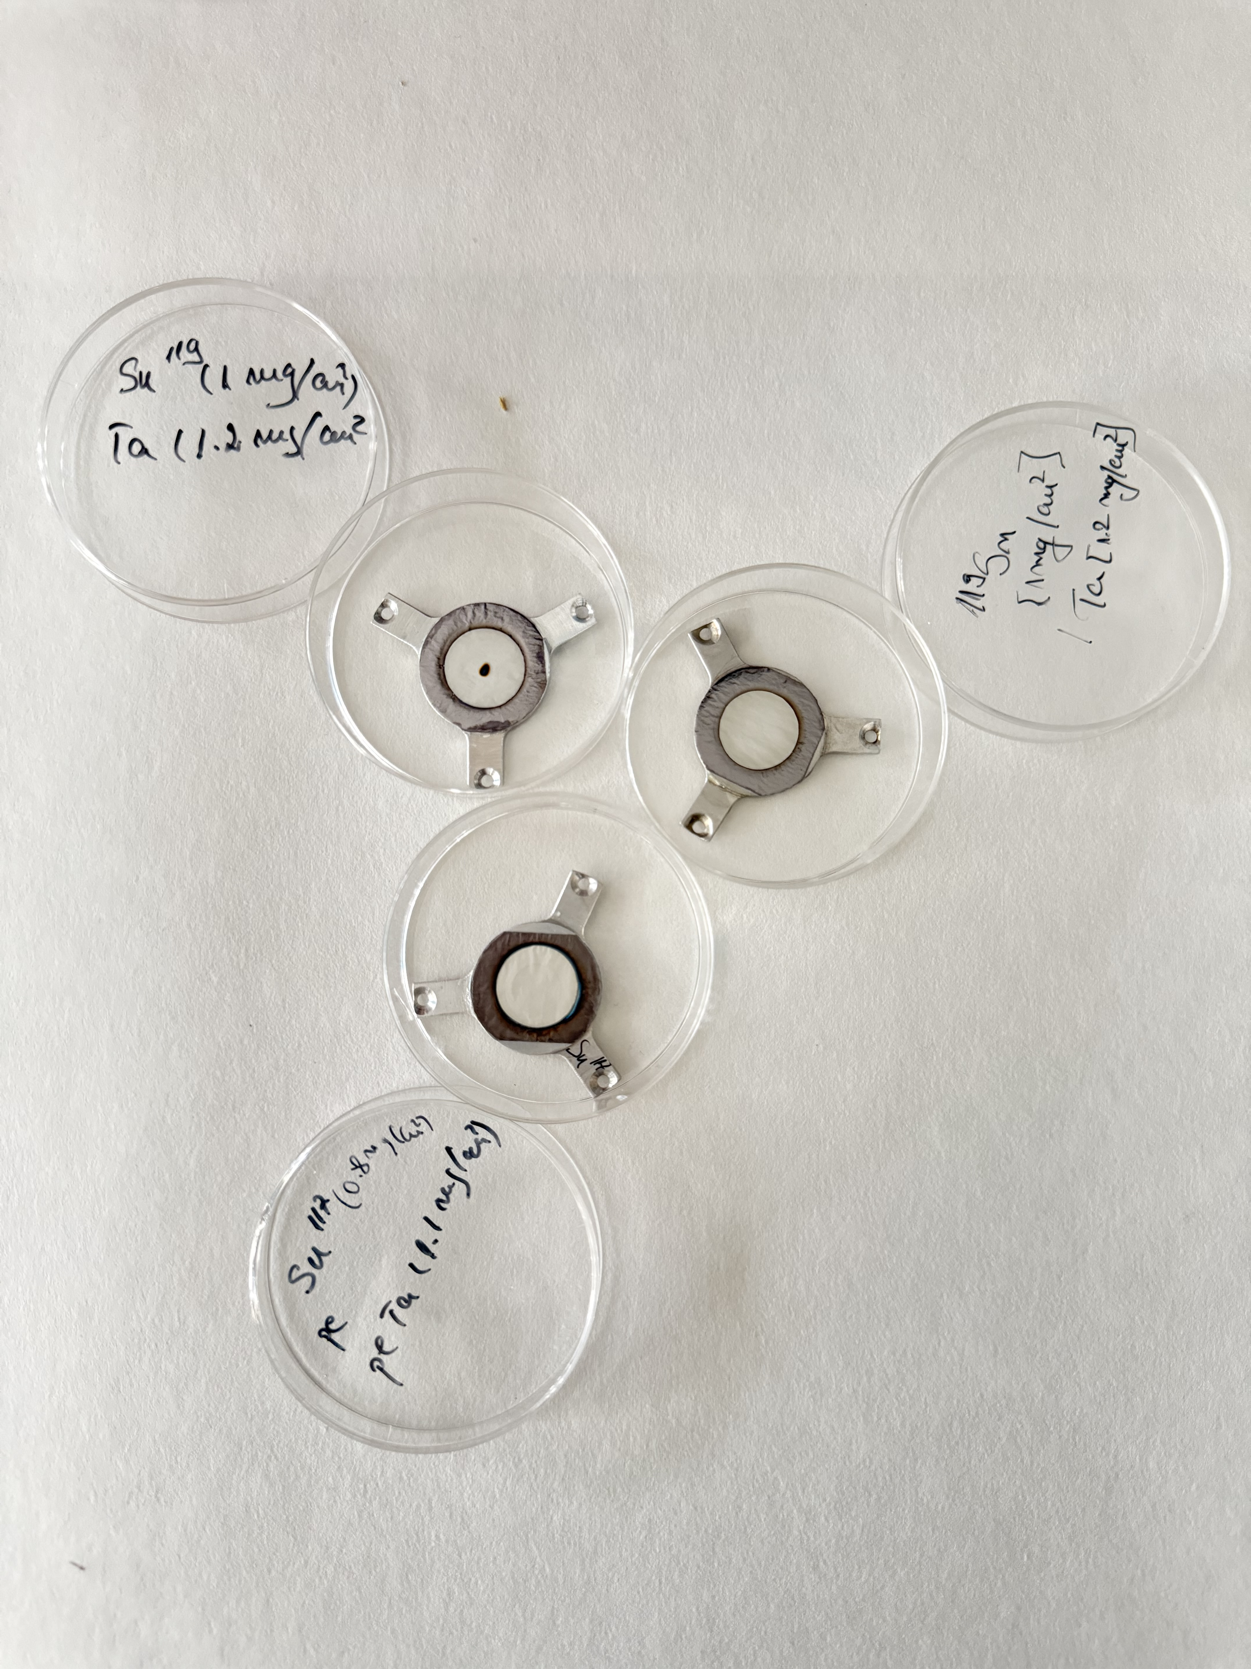
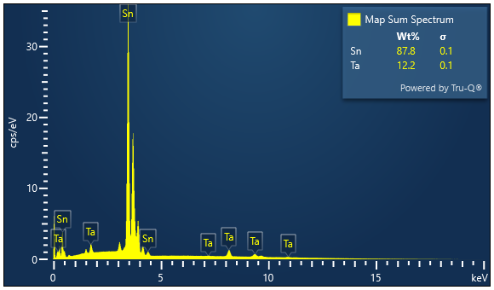
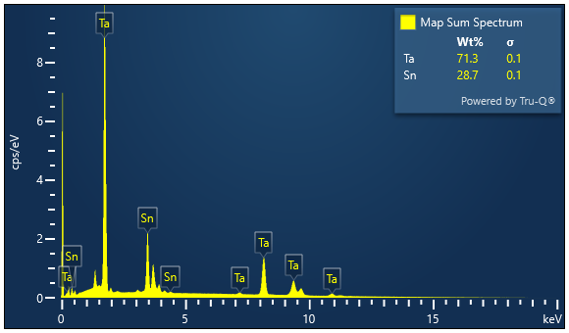
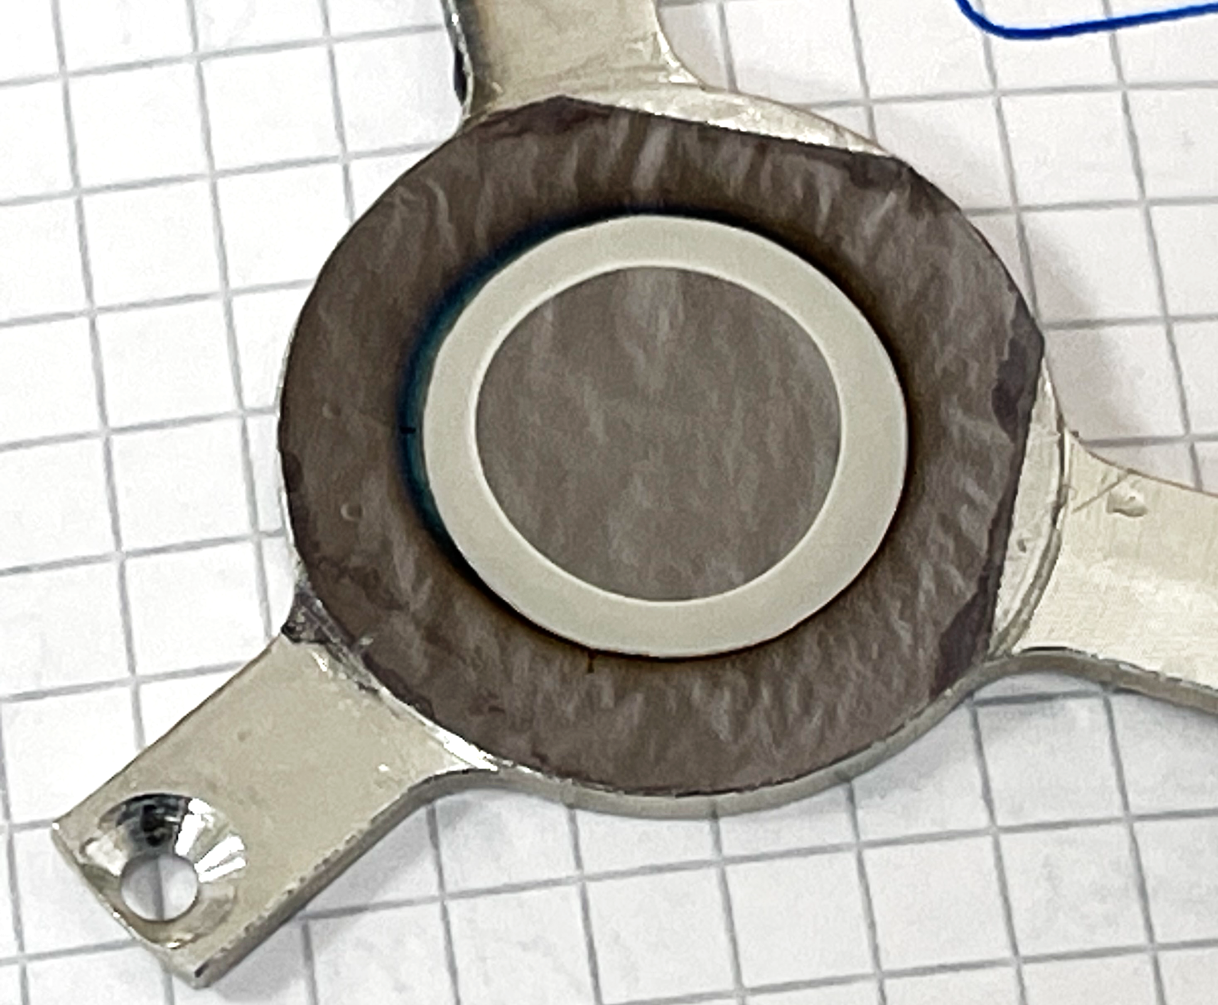
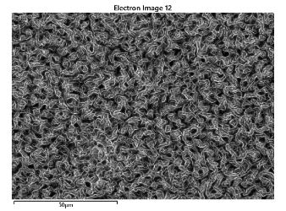
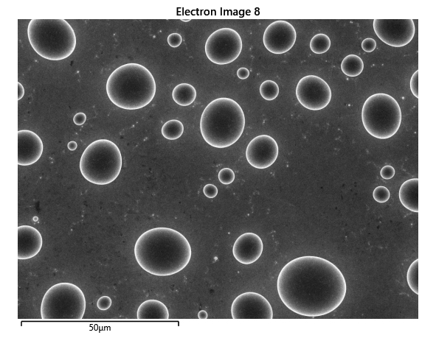
^{115,117,119,120}Sn/Ta

Slide 11
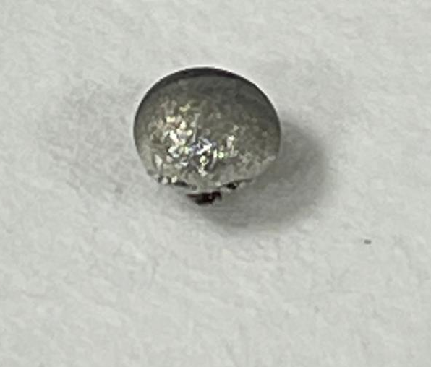
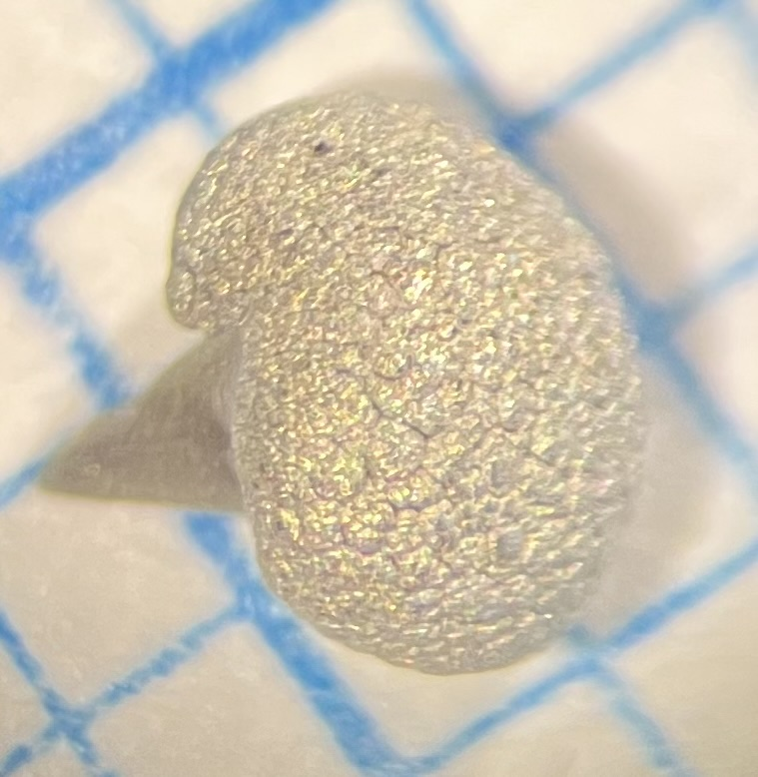
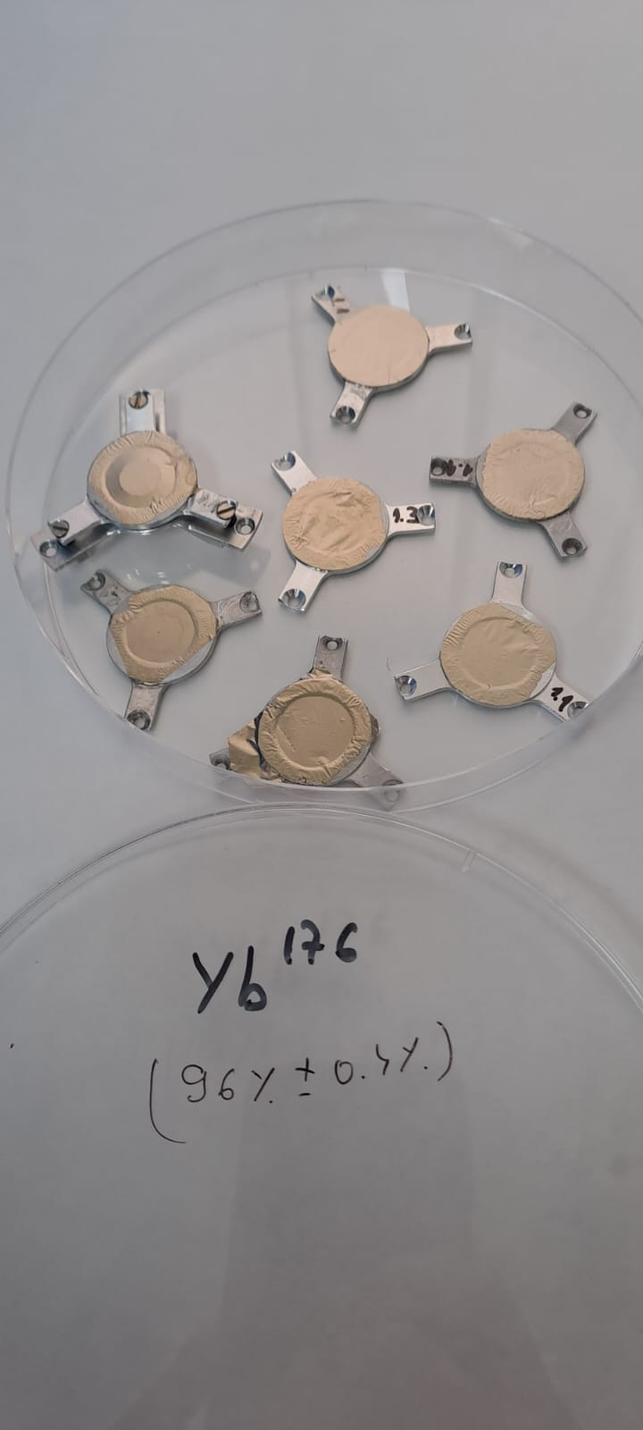
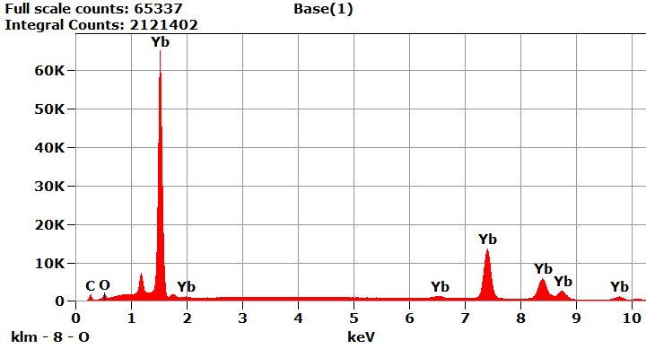
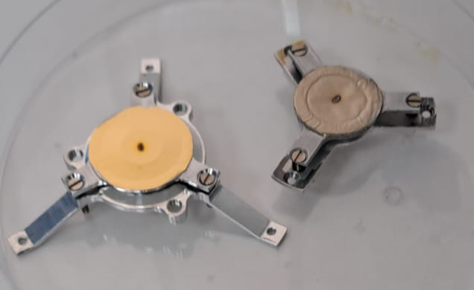
¹⁷⁶ Yb
^{SEM/EDX}
Element | Net Counts | Weight % | Weight % Error | Atom % | Atom % Error
C | 9745 | 5.98 | ± 0.07 | 43.64 | ± 1.05
O | 6407 | 1.76 | ± 0.07 | 9.65 | ± 0.81
Yb | 371011 | 92.26 | ± 0.42 | 46.71 | ± 0.43
Total |  | 100.00 |  | 100.00

Slide 12
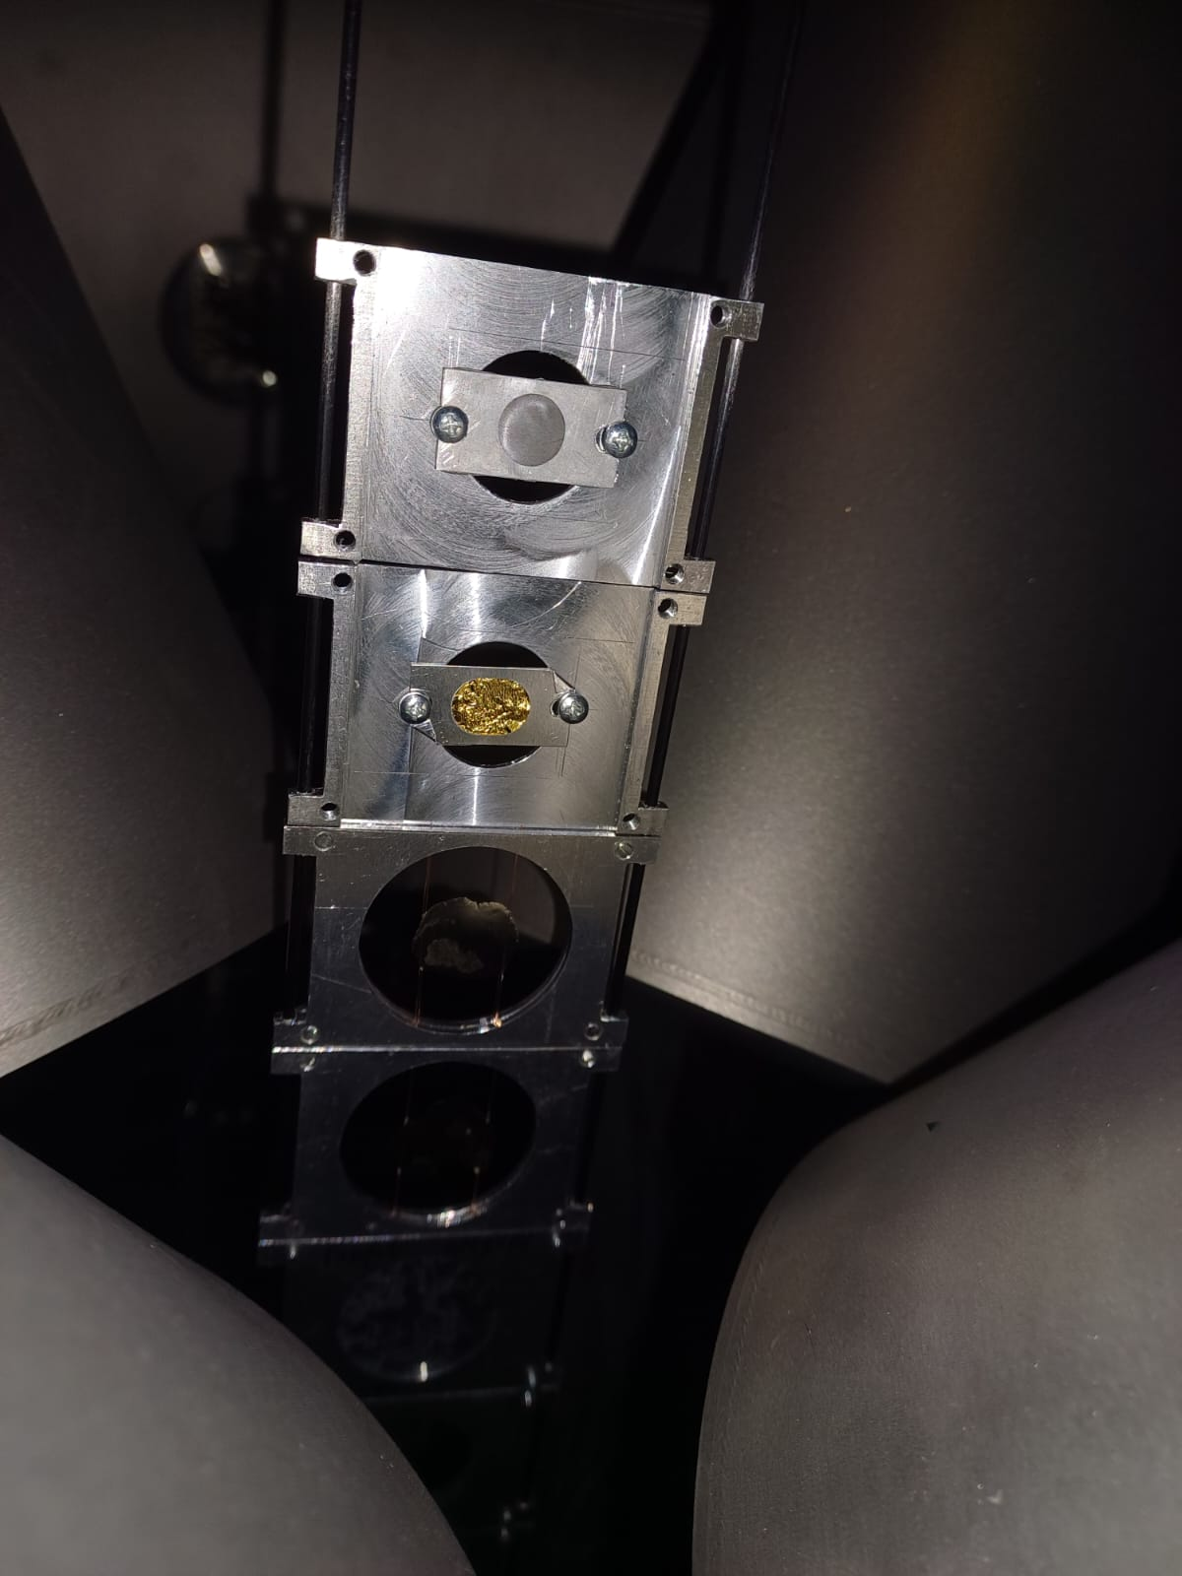
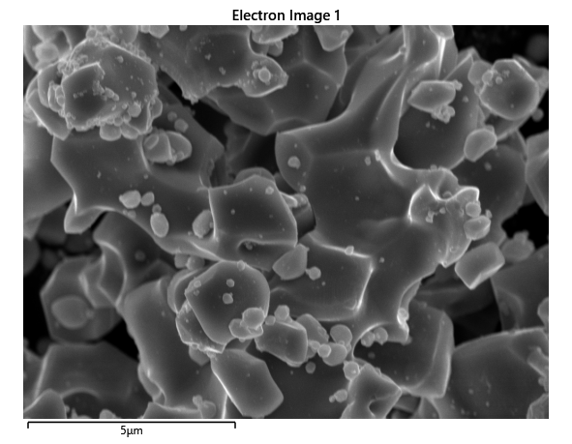
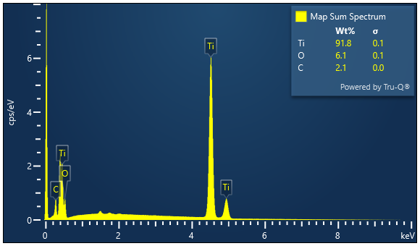
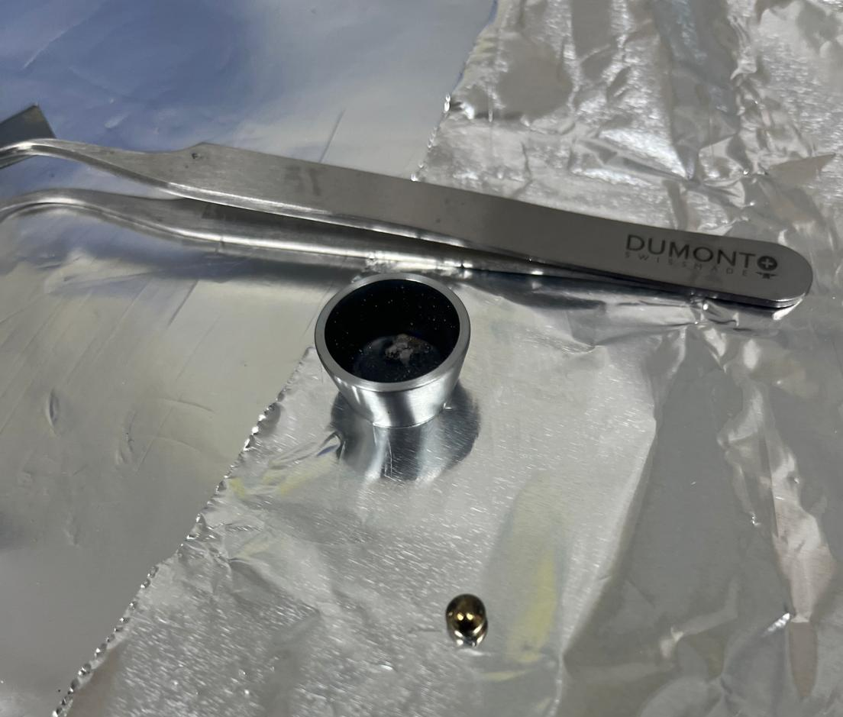
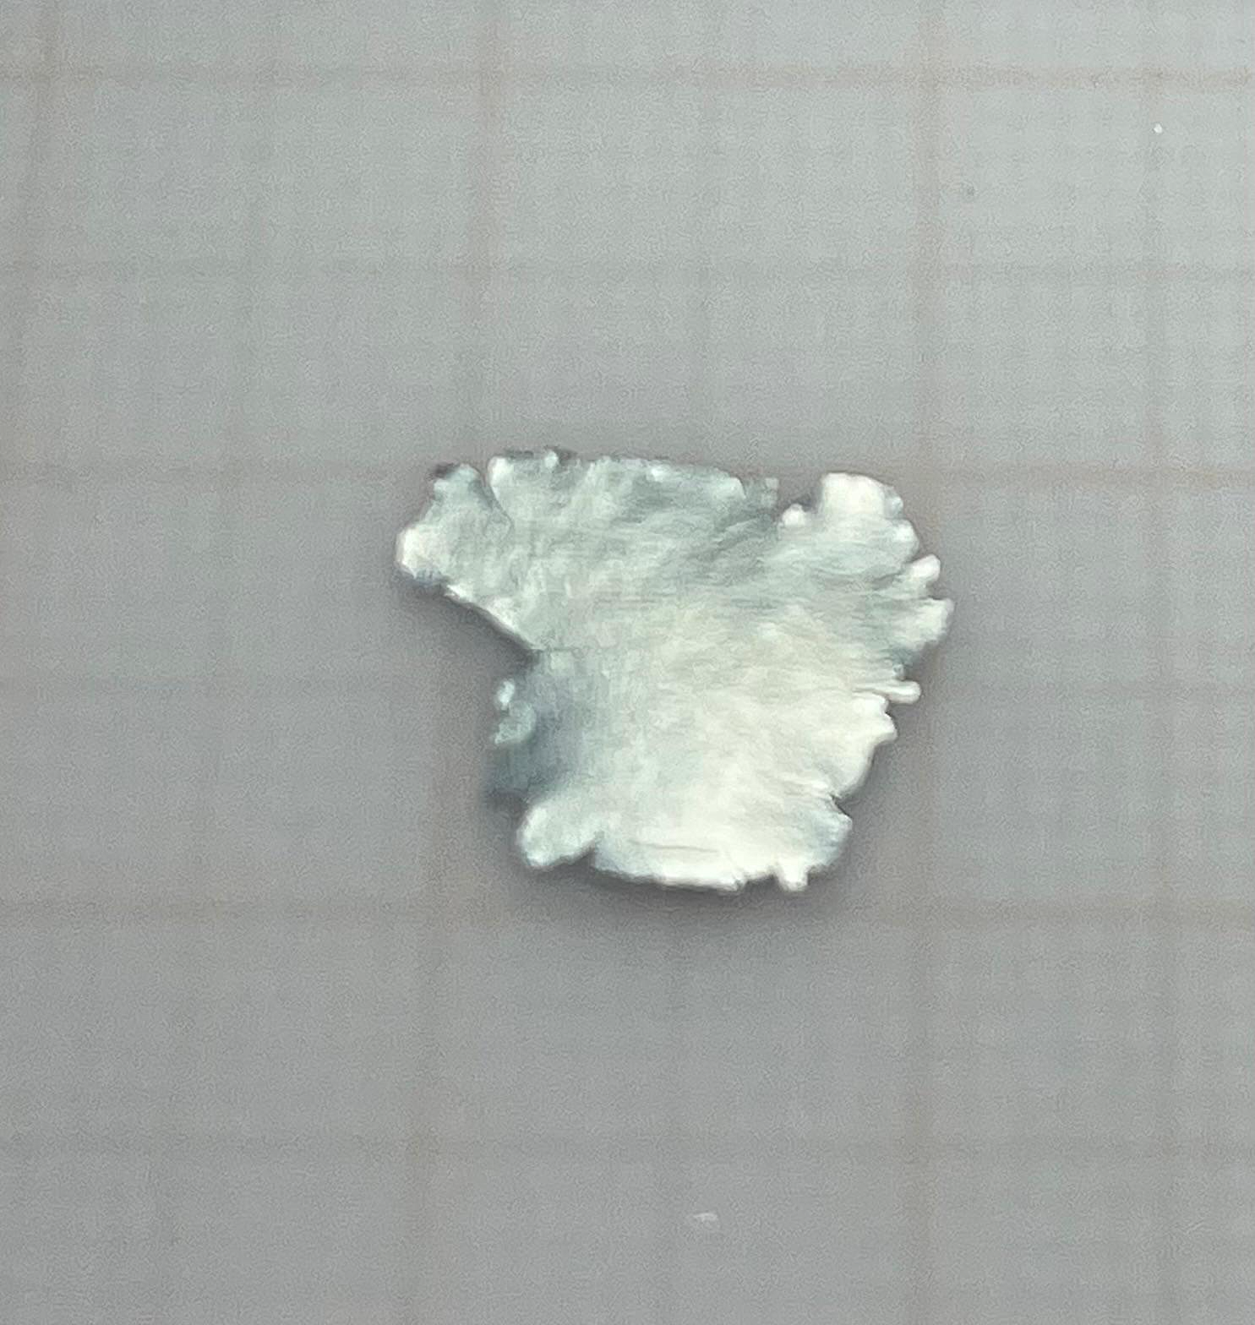
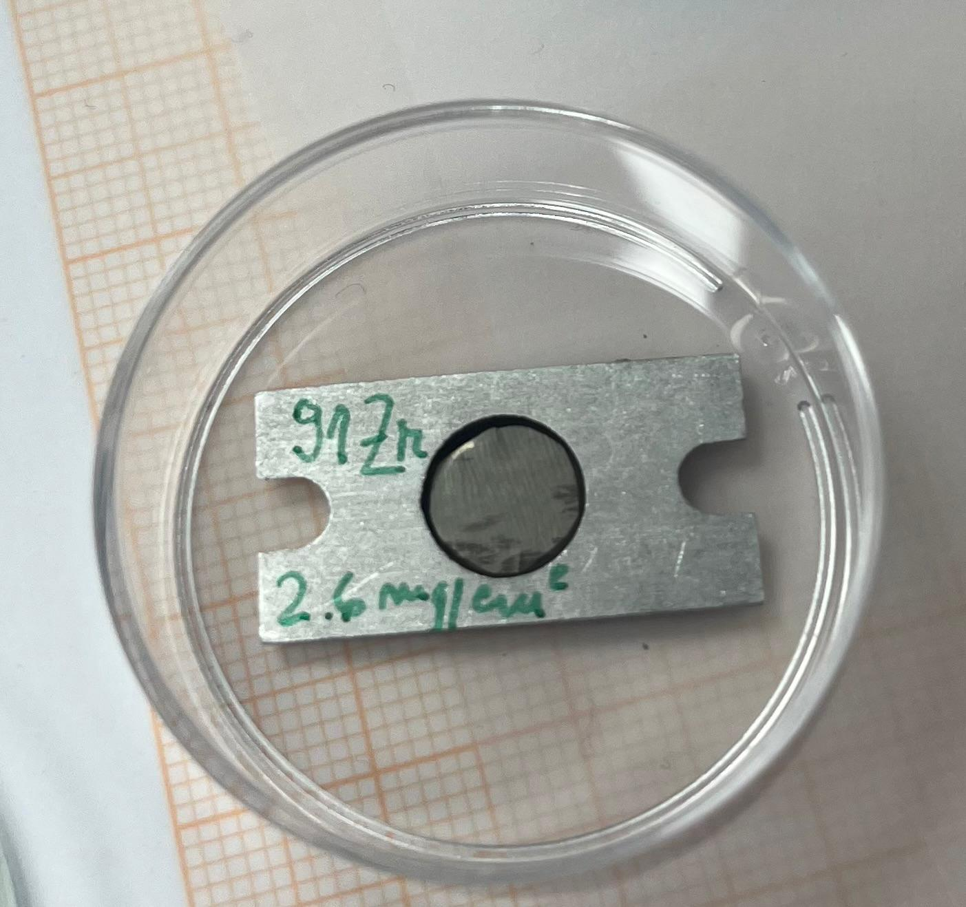
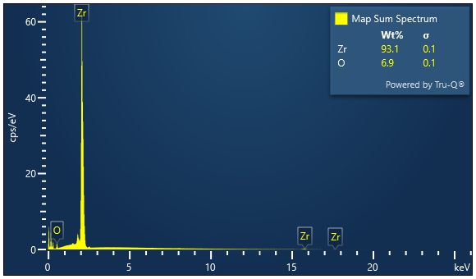
Preparation of metallic ⁵⁰Ti and ⁹¹Zr targets
⁵⁰Ti
⁹¹Zr

Slide 13
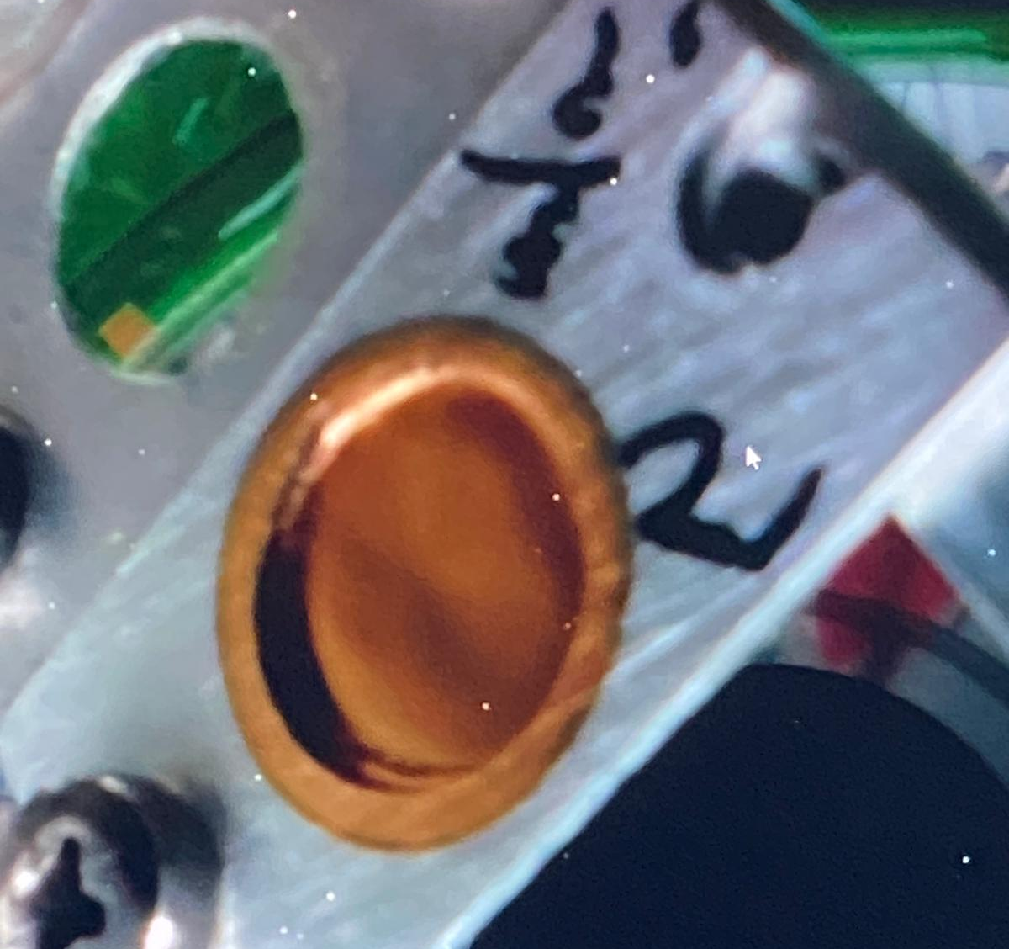
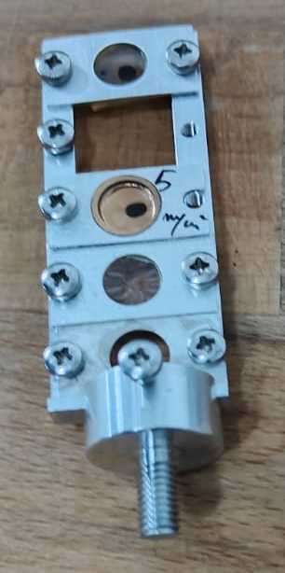
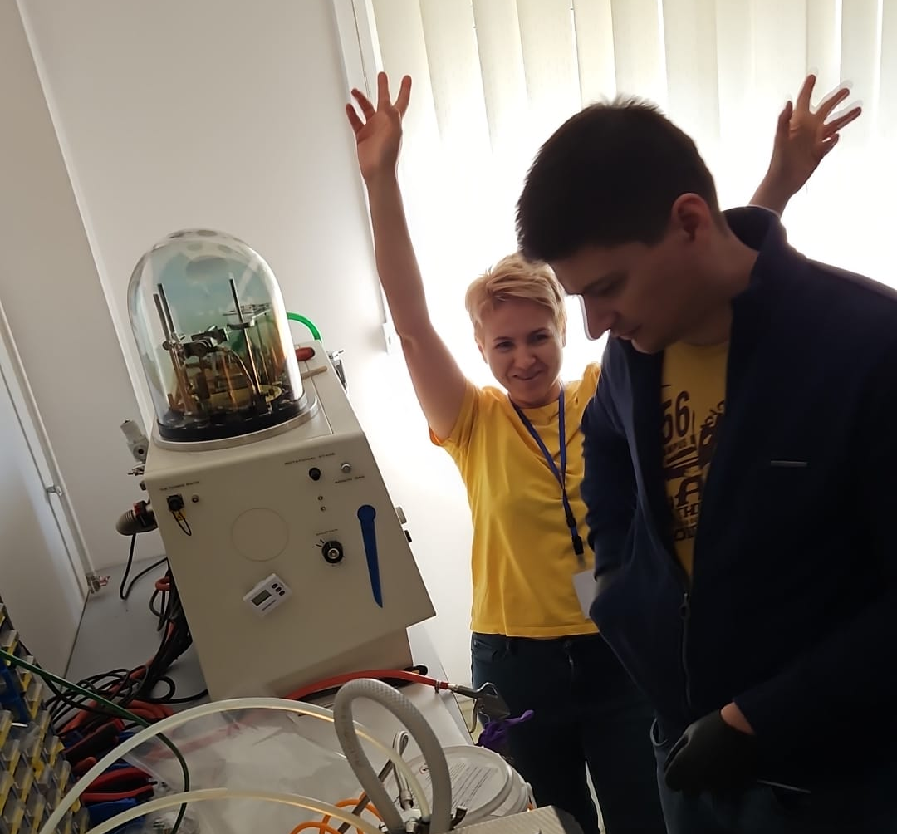
Preparation of ⁴⁸Ca target
before
experiment
after
experiment

Slide 14
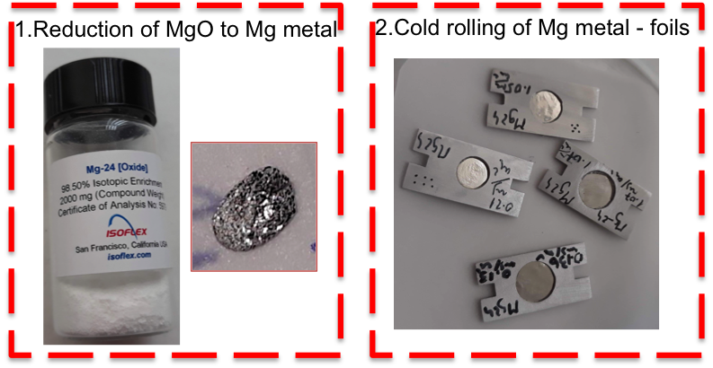
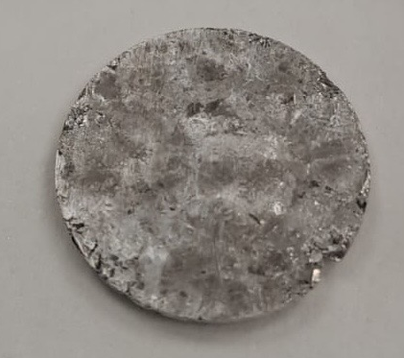
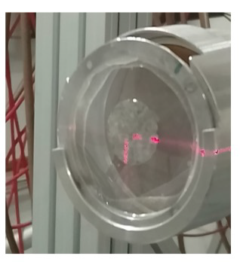
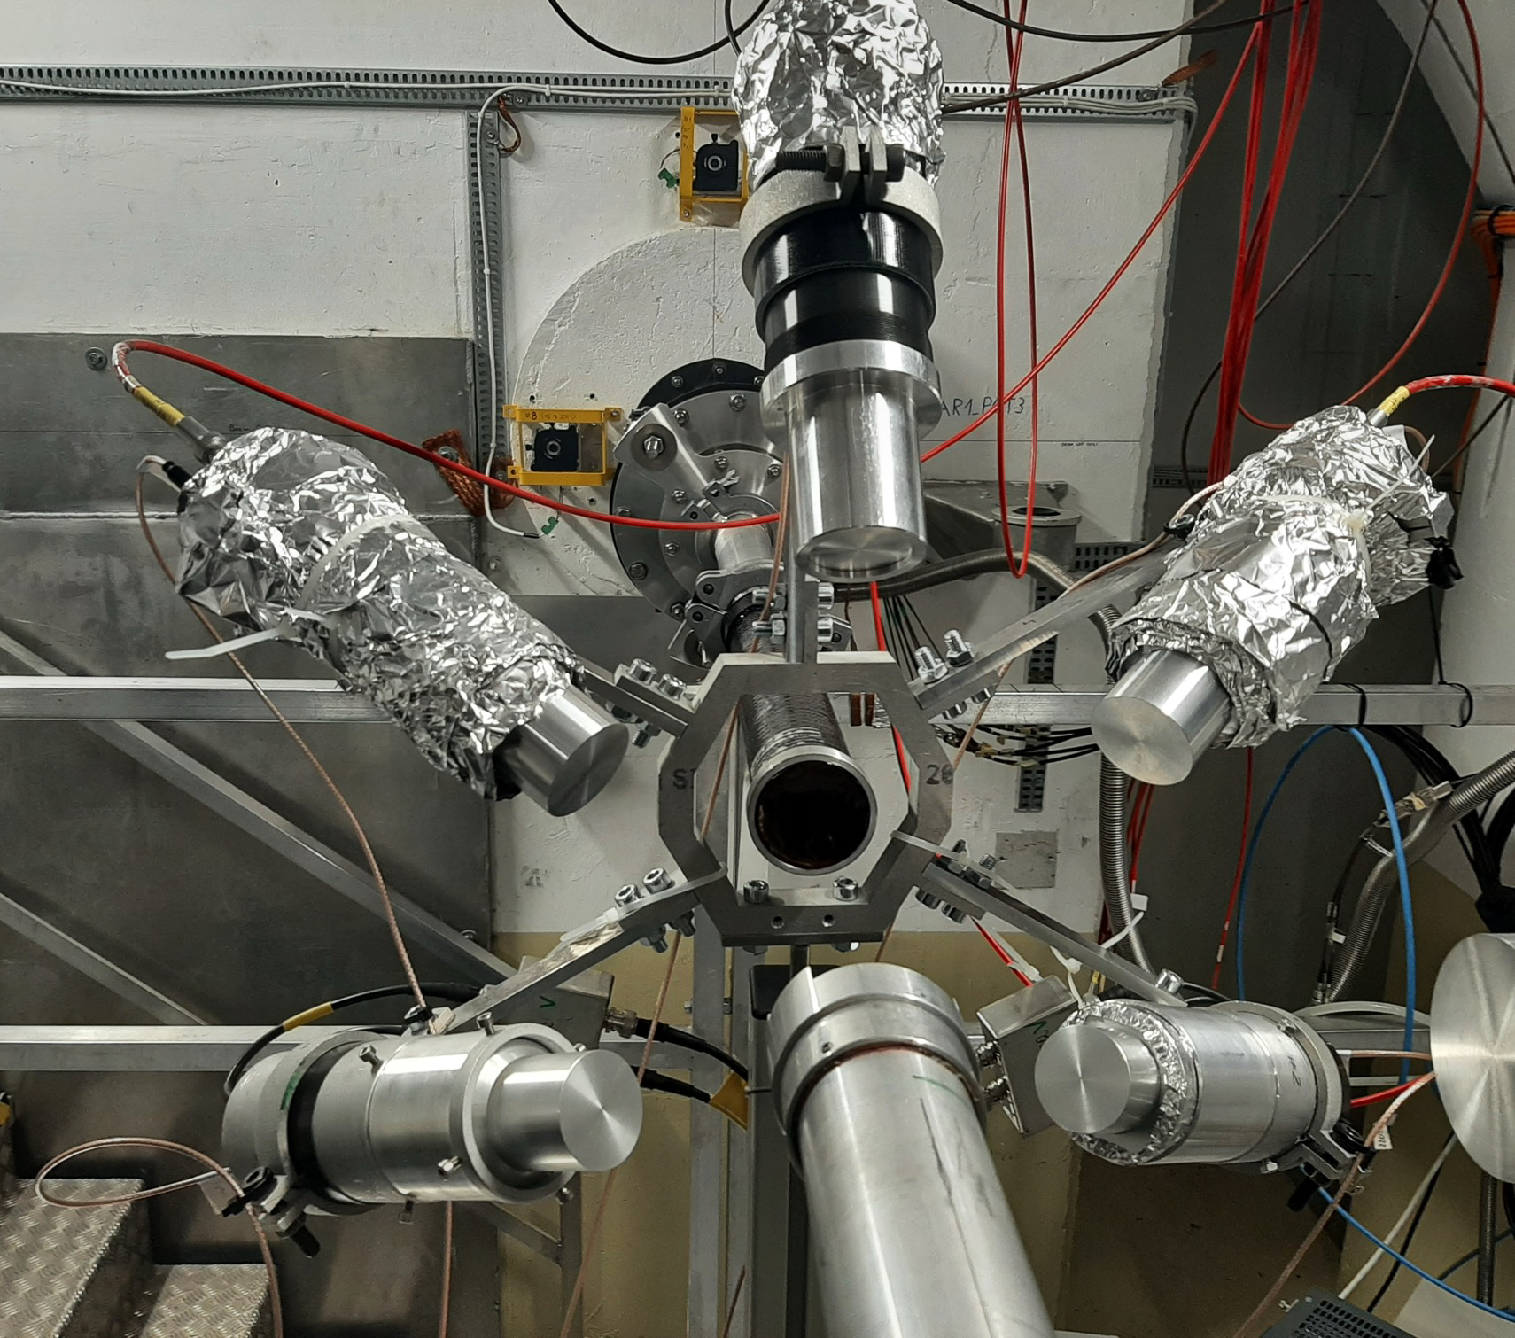
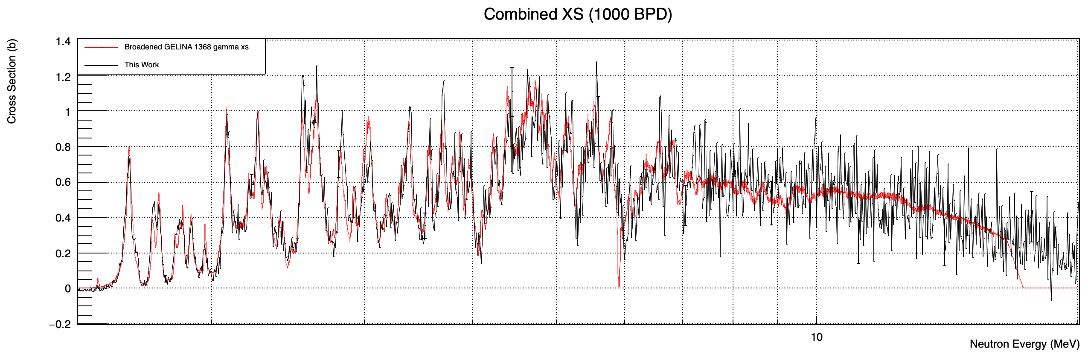
²⁴Mg(n,n’)@n_TOF
high purity metal form of the isotope to be pressed
• MgO enriched to 98.5%
• ²⁴Mg pressed into a disc:
20 mm diameter,
0.75 mm thickness
422 mg mass
²⁴Mg(n,n’)@n_TOF
Cross section results
Experimental Setup
• “Spider” detector mount @ EAR 1 capture
position.
• Five Lanthanum-Bromide (LaBr₃) detectors
• Three of 1.5x1.5” (diameter, depth)
• Two of 1.5x2”
• distance of 17 cm and 125 degrees
• Total campaign was ~10 days
• ~2 days for finalizing the configuration.
• ~6 days of stable beam time.
• ~2 days for ¹⁶O test.

Slide 15
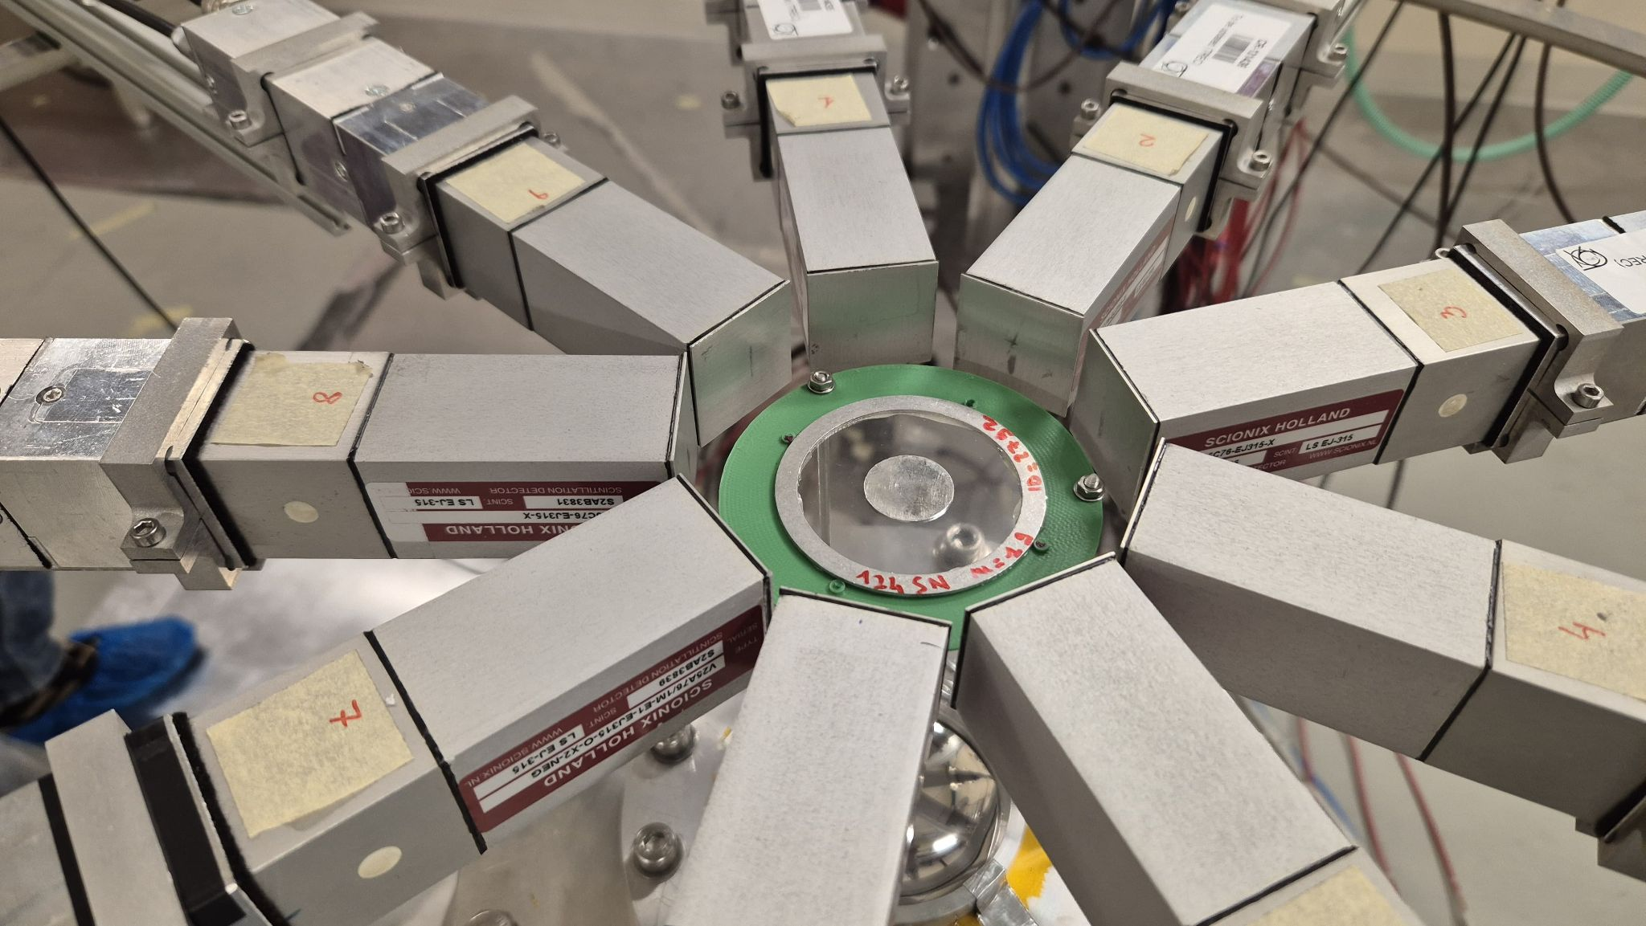
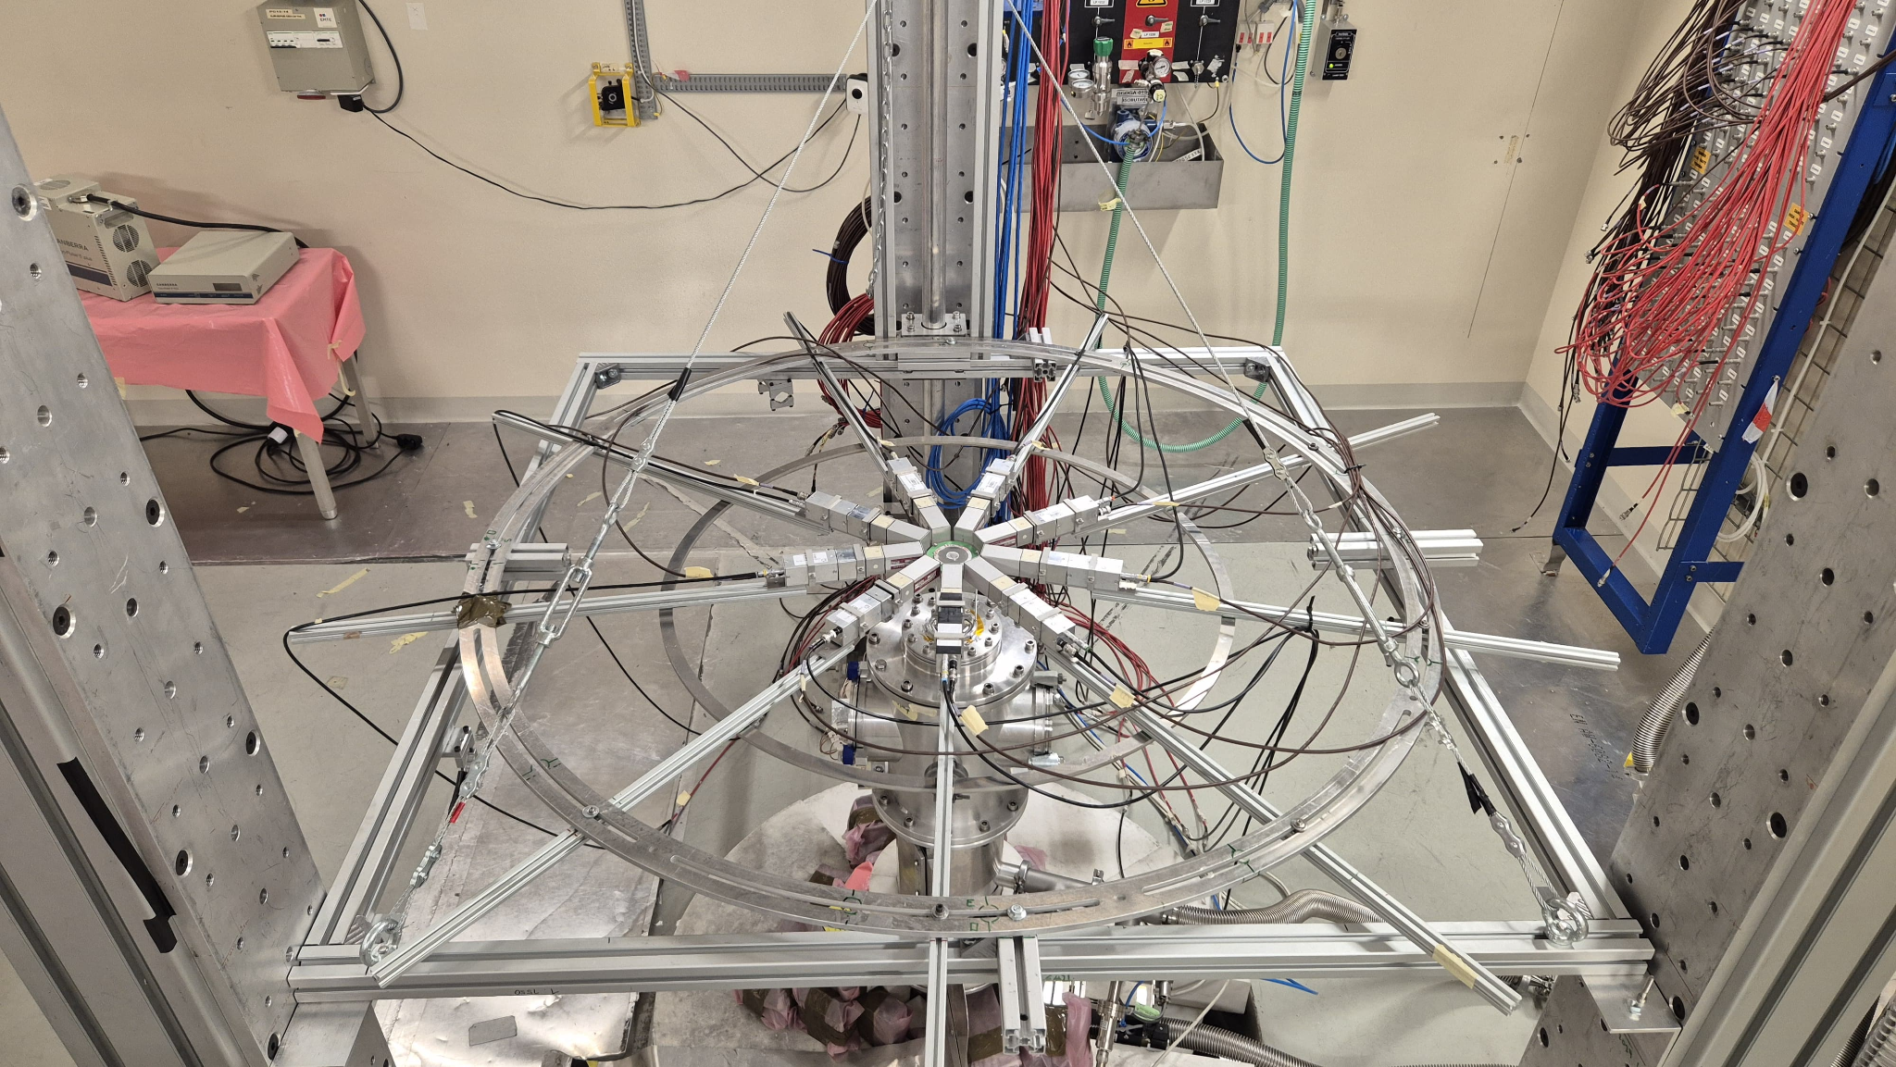

¹²⁴Sn (n, 𝛄) reaction @ n_TOF EAR2
• ¹²⁴Sn enriched to 97.4 % (thin foils)
• ¹²⁴Sn targets pressed into disc shape with:
20 mm diameter
0.5 g, 1 g and 3 g masses
Experimental setup in EAR2 of n_TOF facility (CERN)
Preliminary results:
Neutron Capture resonances for ¹²⁴Sn nuclei

Slide 16











Preparation of Plunger Cr targets
⁵⁰Cr target
Made by K.O.Zell
Natural Cr metallic pieces
⁵⁰Cr metallic material (partially oxidised)
0.5 mg/cm²Cr on Au
Cr on Au
Cr deposited on Au at 350 ⁰C, 2h
Cr deposited on Au at 350 ⁰C, 3h
Good Cr target – used in the experiment
Cr on Ag
Cr deposition during heating the Ag substrate at 350 ⁰C, 2h

Slide 17

Target characterization
Thickness determination methods
Quartz crystal monitor
Weighting method
Rutherford Backscattering Spectrometry (RBS)
Alpha transmission
Microstructure characterization
X-ray Diffraction (XRD)
Morphological characterization
Optical Microscopy (OM)
Atomic Force Microscopy (AFM)
Scanning Electron Microscopy (SEM)
Energy Dispersive X-ray Spectroscopy (EDX)

Slide 18




Future Developments:
High Energy Vibrational Powder Plating (HIVIPP) set-up
Starting material: metal powder
Low amount of starting
material is needed
Efficiency >95%: material losses < 1mg
Two targets are deposited simultanously
Schematic representation of the HIVIPP technique:
LARAMED group of INFN–LNL, Italy
The IFIN-HH HIVIPP set-up
designed by eng. F. Crisiacu
inspired by LARAMED group of INFN–LNL, Italy https://web.infn.it/LARAMED/hivipp/
Cisternino, S et al Upgrade of the HIVIPP Deposition Apparatus for Nuclear Physics Thin Targets Manufacturing. Instruments 2022, 6, 23
Cisternino, S. et al Cryomilling of Isotope-Enriched Ti Powders for HIVIPP Deposition to Manufacture Targets for Nuclear Cross Section Measurement. Materials 2023, 16, 3926

Slide 19
Sharing of knowledge

Slide 20








Hands-on target preparation

Slide 21

Characterization techniques
SEM/EDS
RBS

Slide 22

Conclusions
In the Target Preparation Laboratory of IFIN-HH, the targets are prepared by:
      PVD, Cold Rolling, Tablet pressing, Anodization
The target characterization in terms of thickness, uniformity, purity, surface morphology and roughness achieved by:
      SEM/EDX, AFM, XRD, RBS
The combination of manufacturing processes and characterization techniques enables innovative target development methods.

Slide 23

Thank you!

