Slide 1
Isotope and Target Chemistry Group

Slide 2

Isotope and Target Chemistry Group
Strengths
Unique radionuclide
production facilities
(SINQ, Injector II)
Expertise in separation
chemistry
Infrastructure to handle
high activities
(A, B, C class labs)
Expertise in activity
measurements

Slide 3



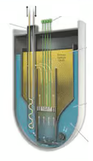

Isotope and Target Chemistry Group
Research Topics
Production and
Separation of
Radionuclides
Chemistry for
Nuclear Energy
Safety
Nuclear Data
Target & Source
Preparation
Production of exotic and medically relevant radionuclides
Development of chemical separation methods
Half-life determination
⁶⁰Fe, ¹⁴⁶Sm, ¹⁴⁸Gd, ¹⁵⁴Dy, ⁹³Mo, ⁵³Mn, ³²Si
Cross-section measurements
Production of target radionuclide
Transpiration method
Preparation
Thermochromatography
Characterization

Slide 4
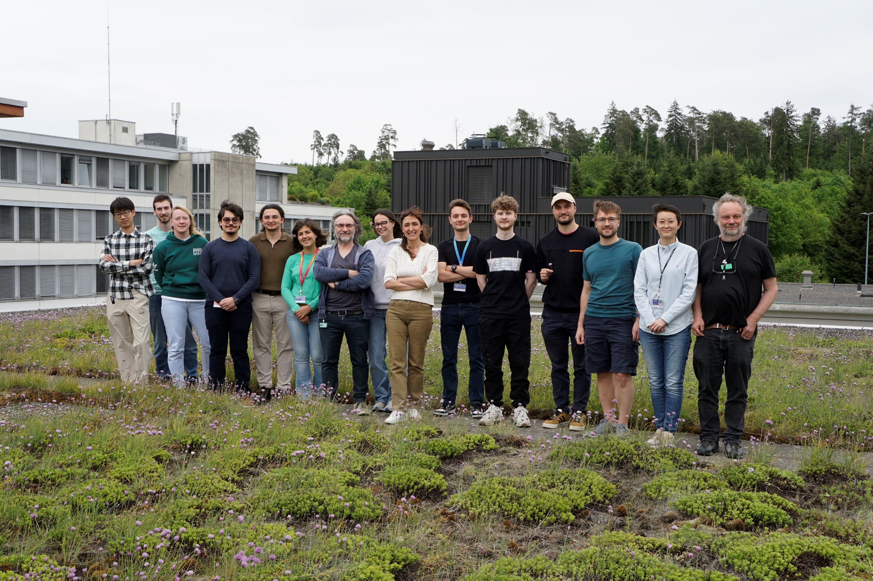
ITC Personel
Head of the group
Dr. Zeynep Talip
Senior Scientist
Dr. Emilio Andrea Maugeri
Lab technician
Colin Hillhouse
Senior Scientist
Dr. Jörg Neuhausen
Vladislav Zobnin
Sofia Pasolini
Francesco Barattini
PhDs
Marius Balizs
Xuandong Kou
Anita Piccoli
Elizaveta Artiushova
Arda Baran Burcak
Postdoc
Dr. Haohan Zhang

Slide 5
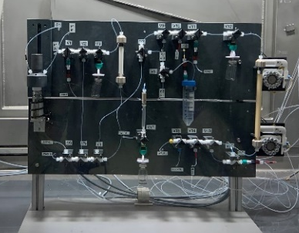
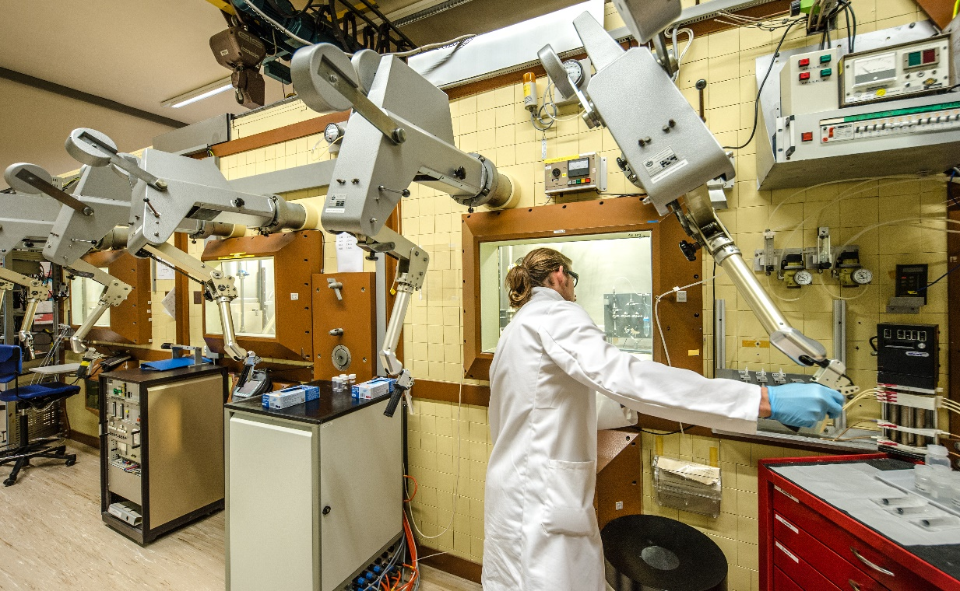
Infrastructure for the separation of radionuclides
Separation Modules

Slide 6
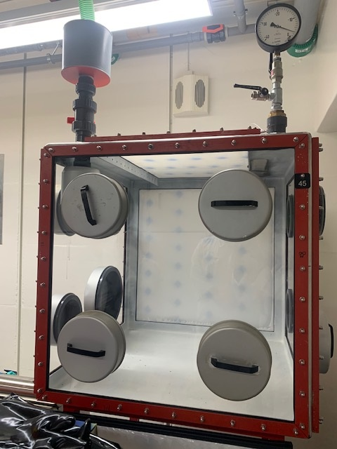

Actinides Target Preparation
Preparation of a glove box for actinide target preparation.

Slide 7


Target and Sources
Targets
Sources
Cross section Measurements
Calibration Standards
Nuclear Structure
Nuclear Data Measurements
Synthesis of Super Heavy Elements
Interaction of Radiation with Matter
Production of Medical Radionuclides

Slide 8
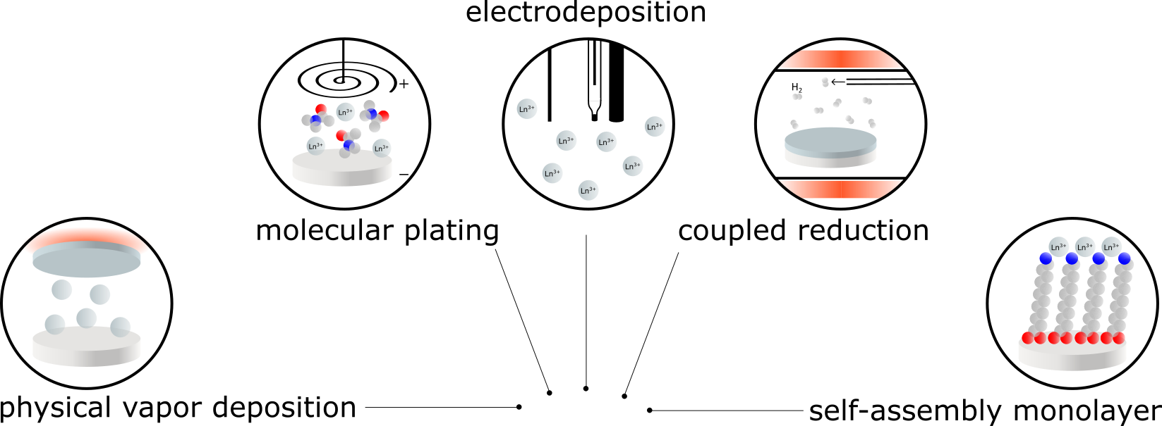
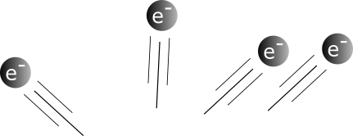
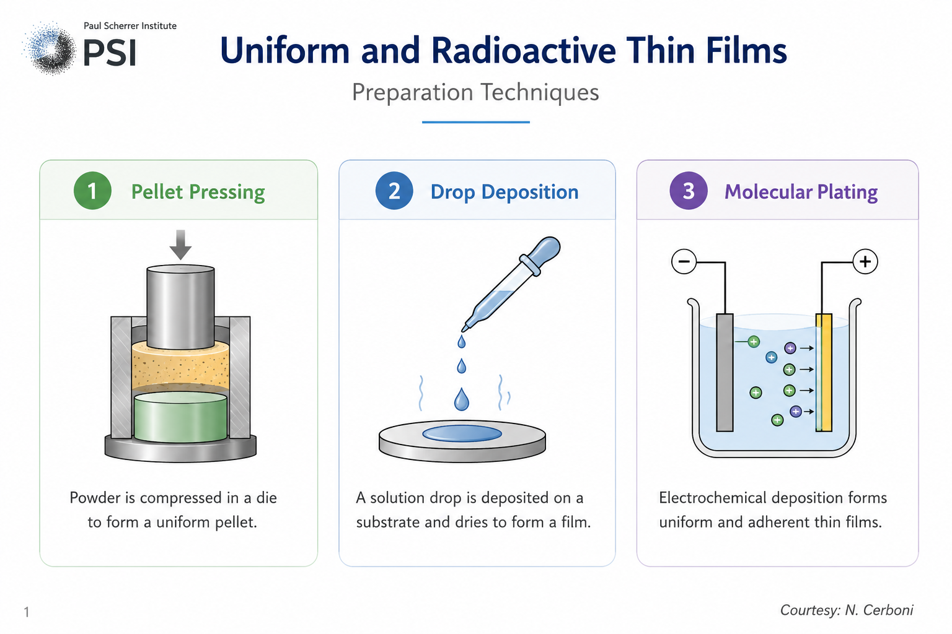
Uniform and Radioactive Thin Films
Preparation
pressing
drop deposition
Courtesy: N. Cerboni

Slide 9
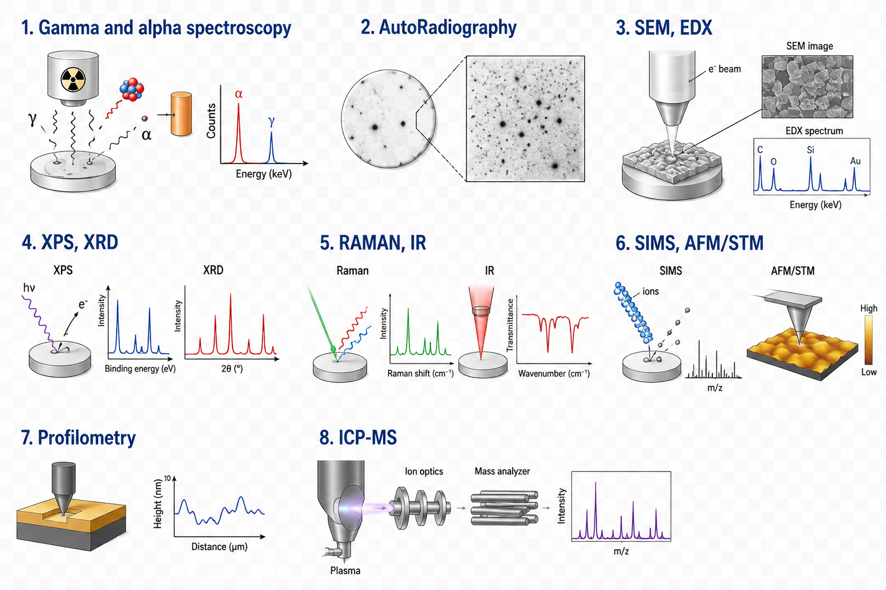
Uniform and Radioactive Thin Films
Characterization
SEM/EDX
XPS
α and γ spectroscopy
XRD
Profilomentry
Auto radiography
RAMAN/ IR
AFM/STM

Slide 10
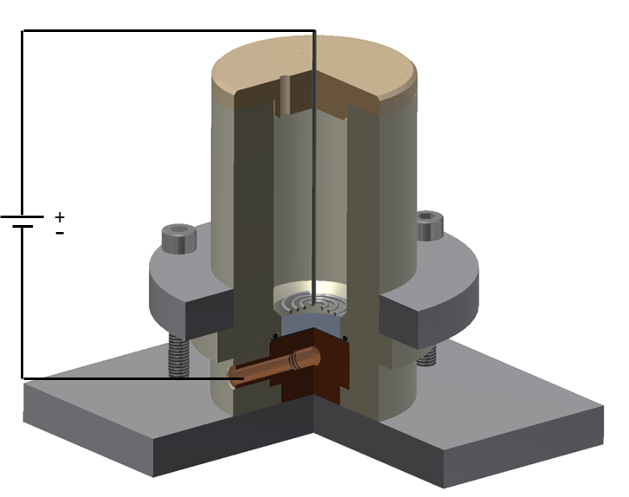
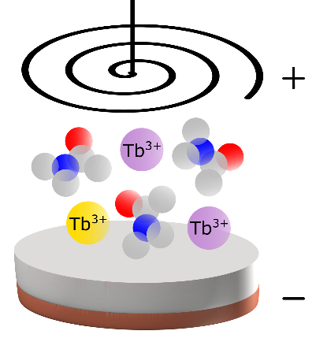
Molecular Plating Technique
Platinum Wire Anode (+)
Organic solvent
Starting material: neutral salt, such as Me(NO₃)_{x}
high voltage (100–600 V), low current (few mA)
$$\text{2 }\text{H}\text{2}\text{O}\text{(}\text{l}\text{)}\text{ + 2}\text{e}\text{−}\text{ → }\text{H}\text{2(}\text{g}\text{)}\text{ + 2 }\text{OH}\text{−}\text{(}\text{aq}\text{)}$$
x OH⁻_{(aq)} + Me^{x+}_{(aq)} → Me(OH)_{x} _{(aq)} ↓
Copper Cathode (-)
Rapid process with low-cost setup
90-95% yield
but…
Me^{x+} can also interact with anionic and radical by-products formed during electrolysis of the organic solvent, and Me(OH)_{x} can react with CO/CO₂, resulting into a complex speciation .
Co-deposition of other species
Poor adhesion to substrate
Amorphous film limits thermal/electrical conductivity

Slide 11
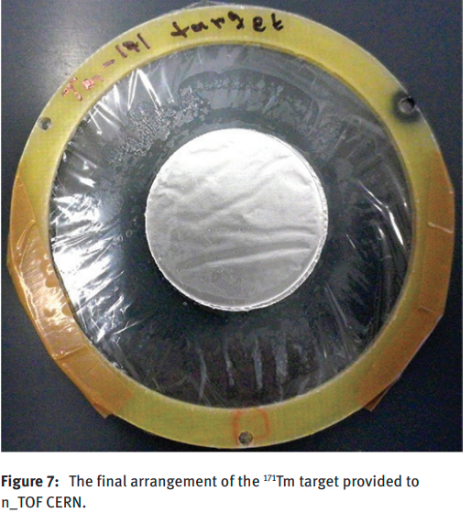
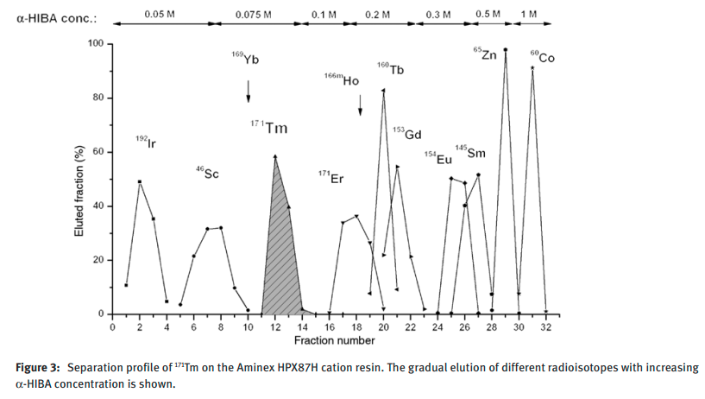
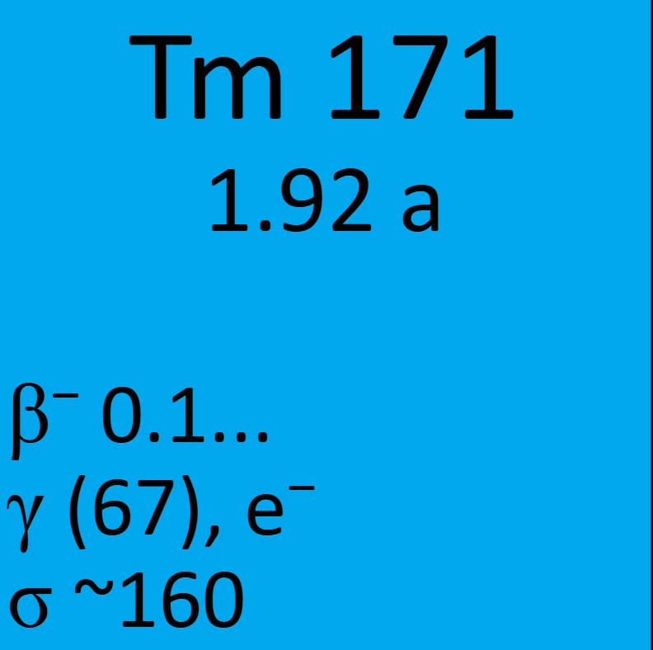
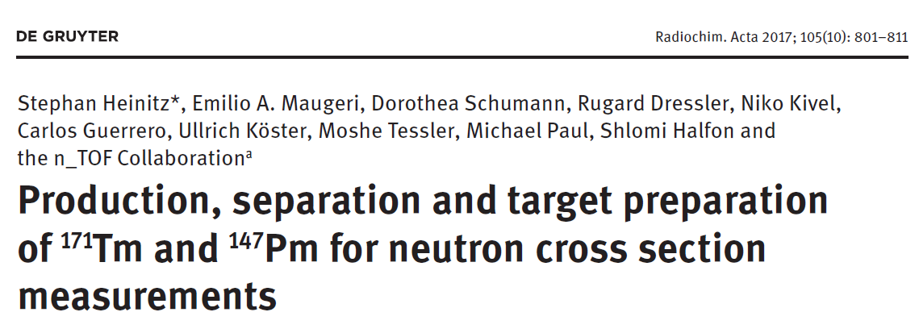

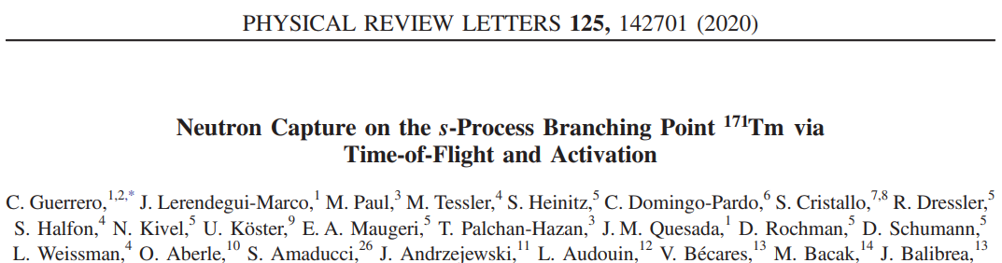
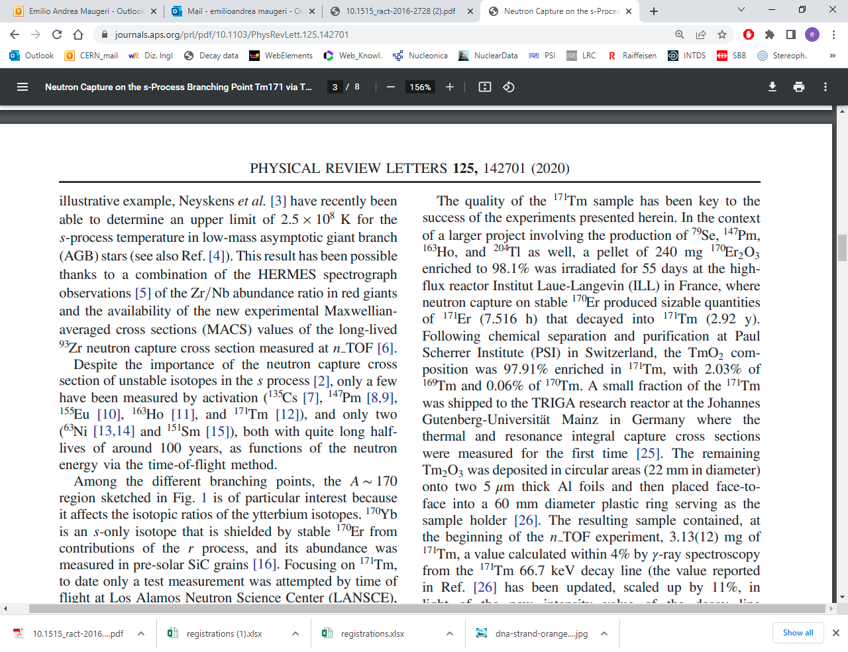
Production of targets for
(n,γ) cross-section measurement
  … targets that must be homogeneous
Molecular plating technique
The final deposition efficiency for the ¹⁷¹Tm target of 93.6 ± 0.4 %
140 GBq¹⁷¹Tm

Slide 12
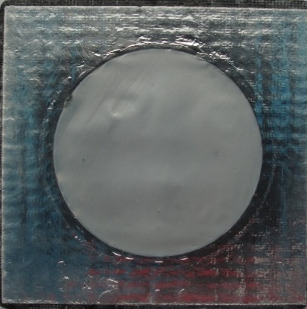
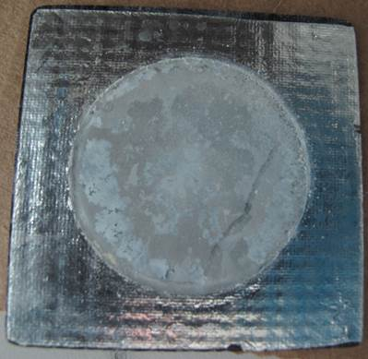
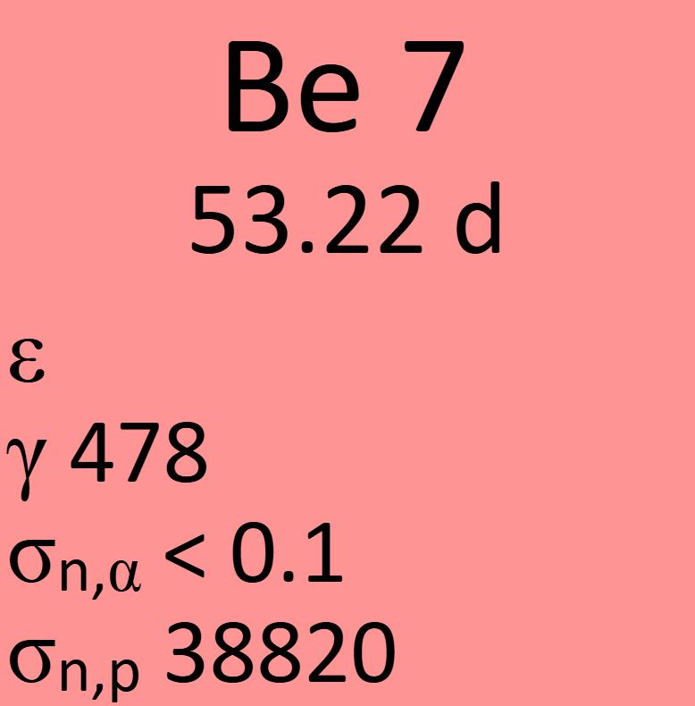
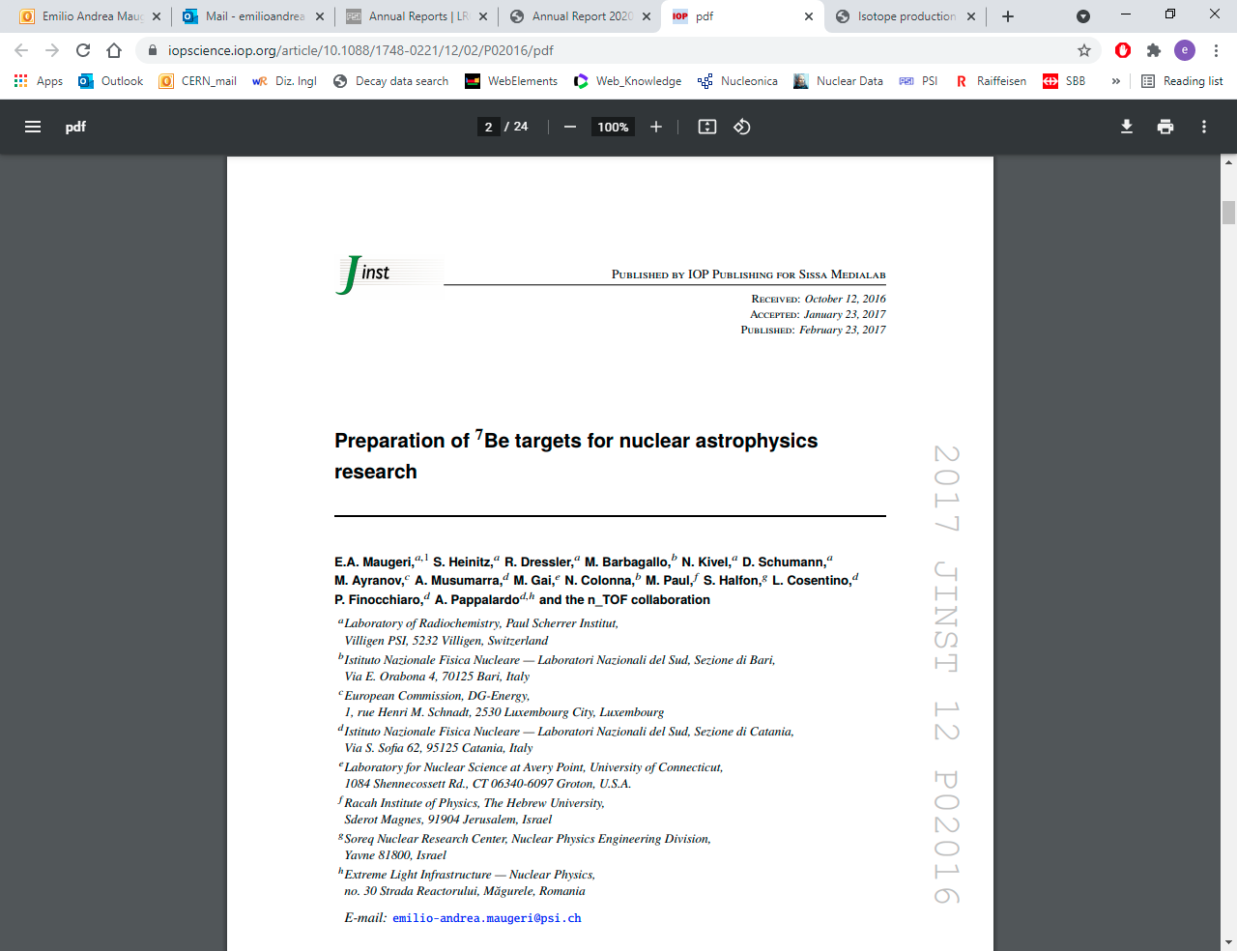
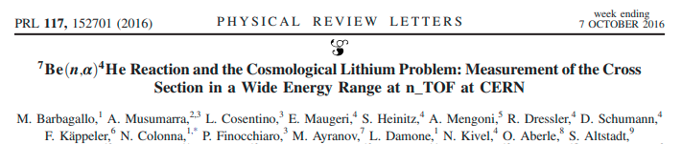
Production of targets for
(n,α) cross-section measurement
  ….targets that must be thin (nm – μm scale)
Drop deposition tehnique
Molecular plating
0.36 µm, 25 GBq ⁷Be
5.25 µm, 25 GBq ⁷Be

Slide 13
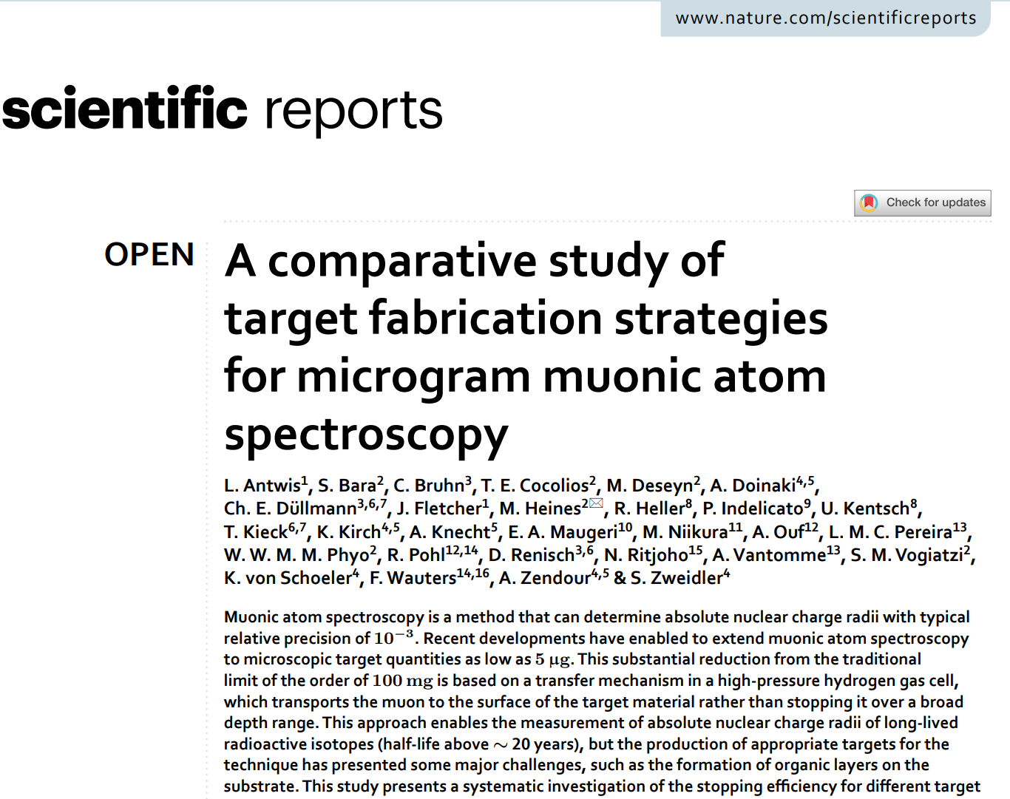
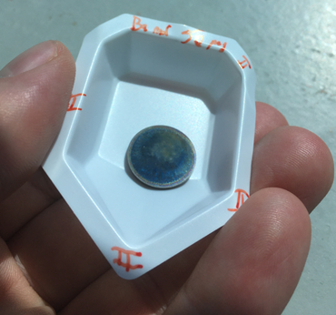
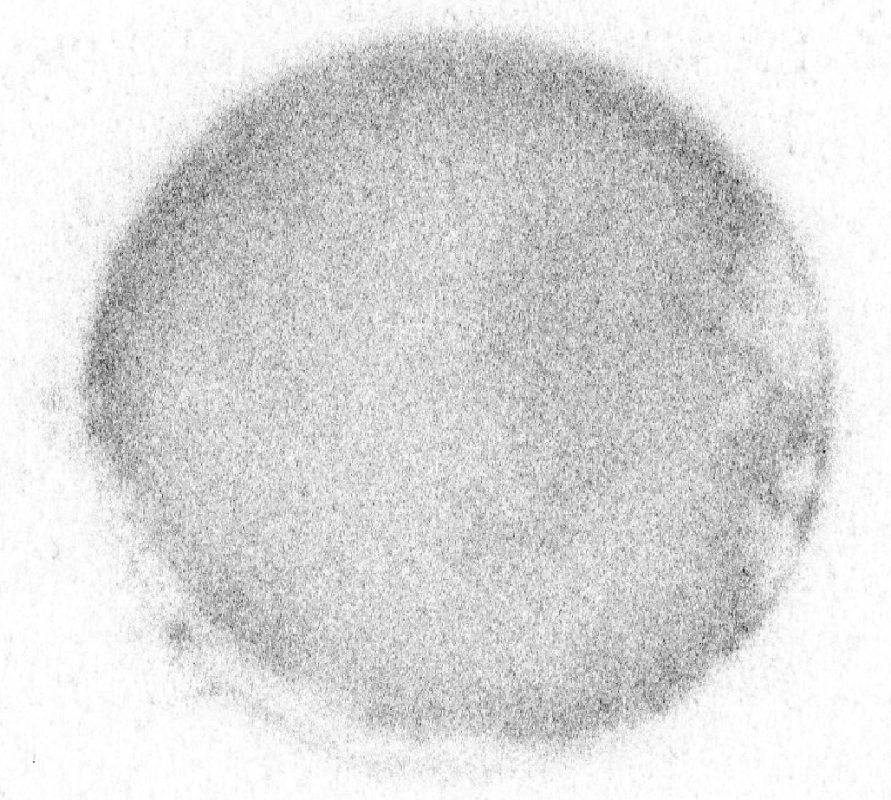
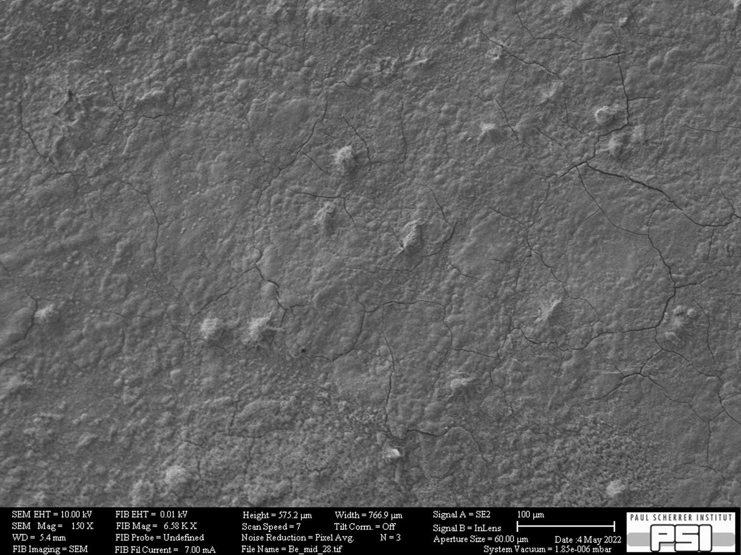
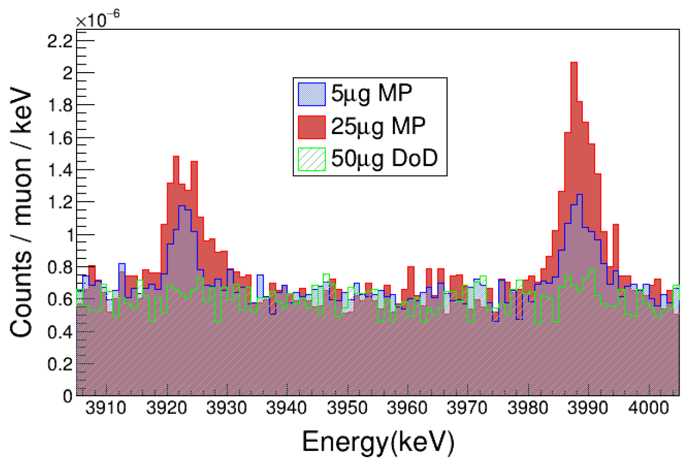
Production of targets for
Muonic Atom Spectroscopy
  ….targets that must be very thin (nm-scale)
^{nat}Ba target and ¹³³Ba target (lighter homologous of ²²⁶Ra)
Solvent: N,N-Dimethylacetamide; backing: Glassy carbon; Quantity of Ba plated: ~ 50 μg; Area plated:3.14 cm²
500 µm
Deposition yield: 99%, Uniform barium target

Slide 14
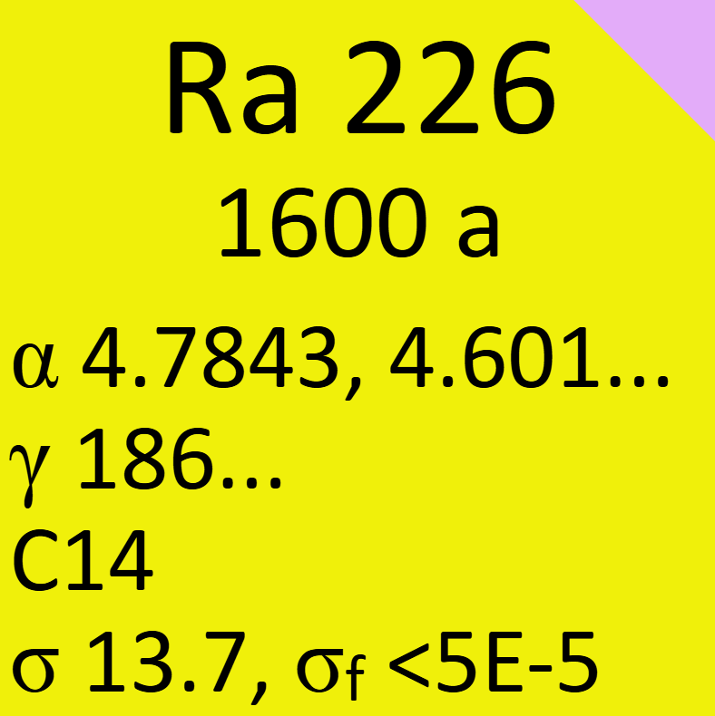
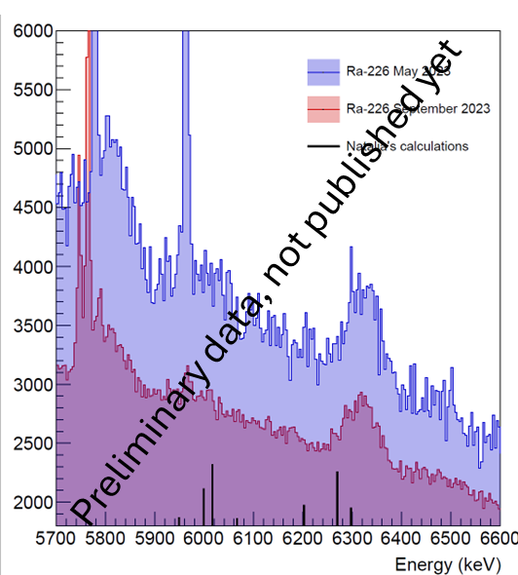
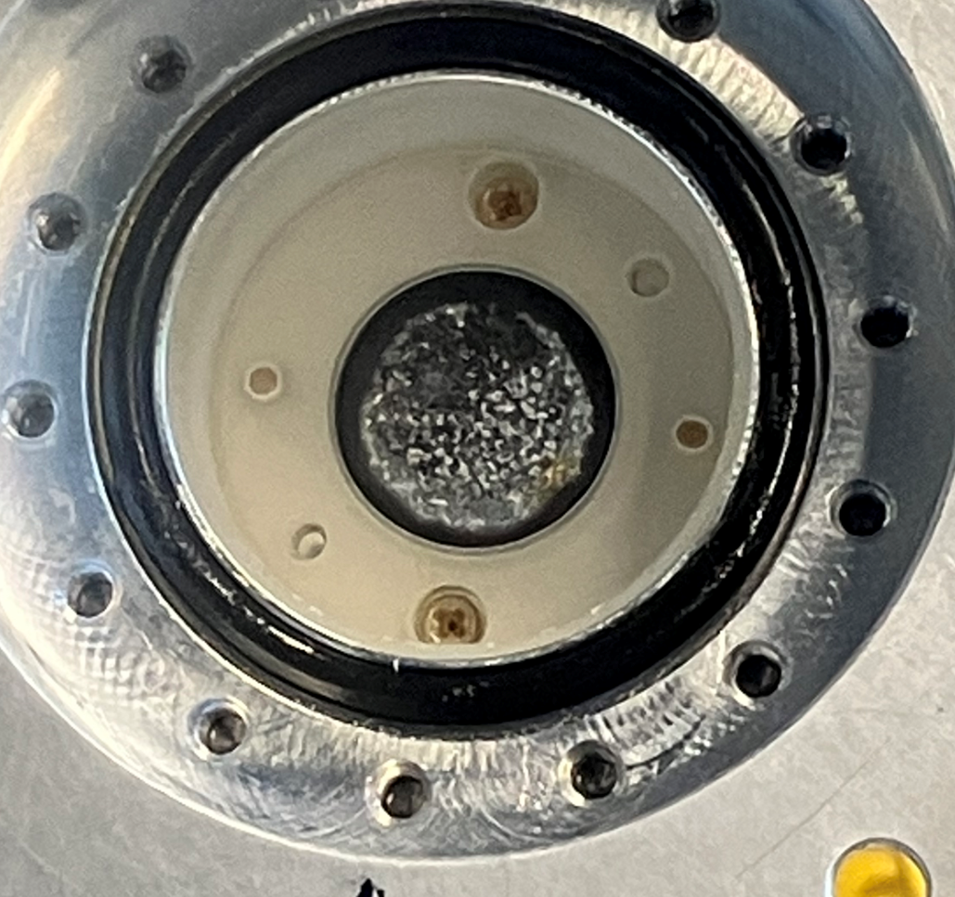
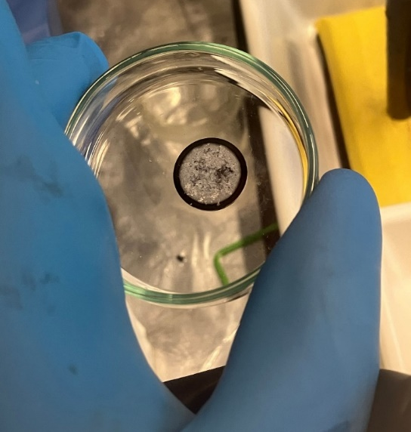
Production of targets for
Muonic Atom Spectroscopy
  ….targets that must be very thin (nm-scale)
Solvent: N,N-Dimethylacetamide; backing: Glassy carbon; Quantity of Ba plated: ~ 5 μg; Area plated:3.14 cm²
Deposition yield: 86%, Thick, non-uniform with poor adhesion

Slide 15
Targetry production: ²²⁶Ra
Ra (Pb, Bi, Po…) in HNO₃ 1M
Ra (Pb….) in HNO₃ 0.01M
HNO₃ 0.01 M:
Retention: Ra; Pb
Elution: Na, Ca,
HNO₃ 1M:
Retention: Bi and some Pb
Elution: Ra, Pb…
TK101 resin
DGA resin
HNO₃ 2 M:
Retention: Pb Elution: Ra
Ra (Pb….) in HNO₃ 1M
Ra in HNO₃ 2M
Large decay chain with many daughter
Dry and dilution to 0.01 M

Slide 16
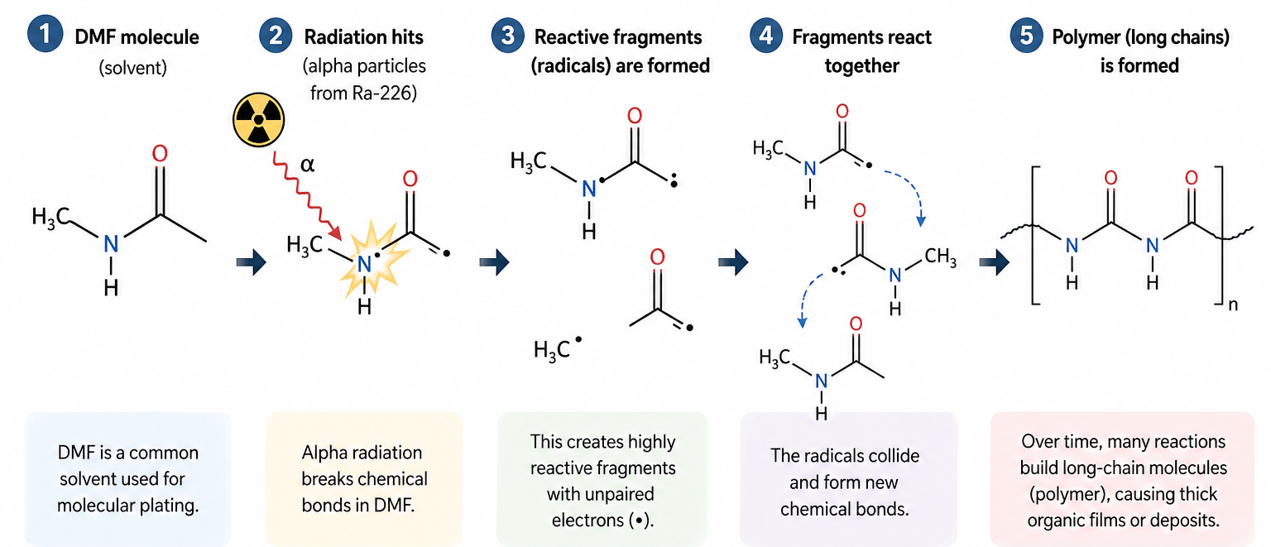
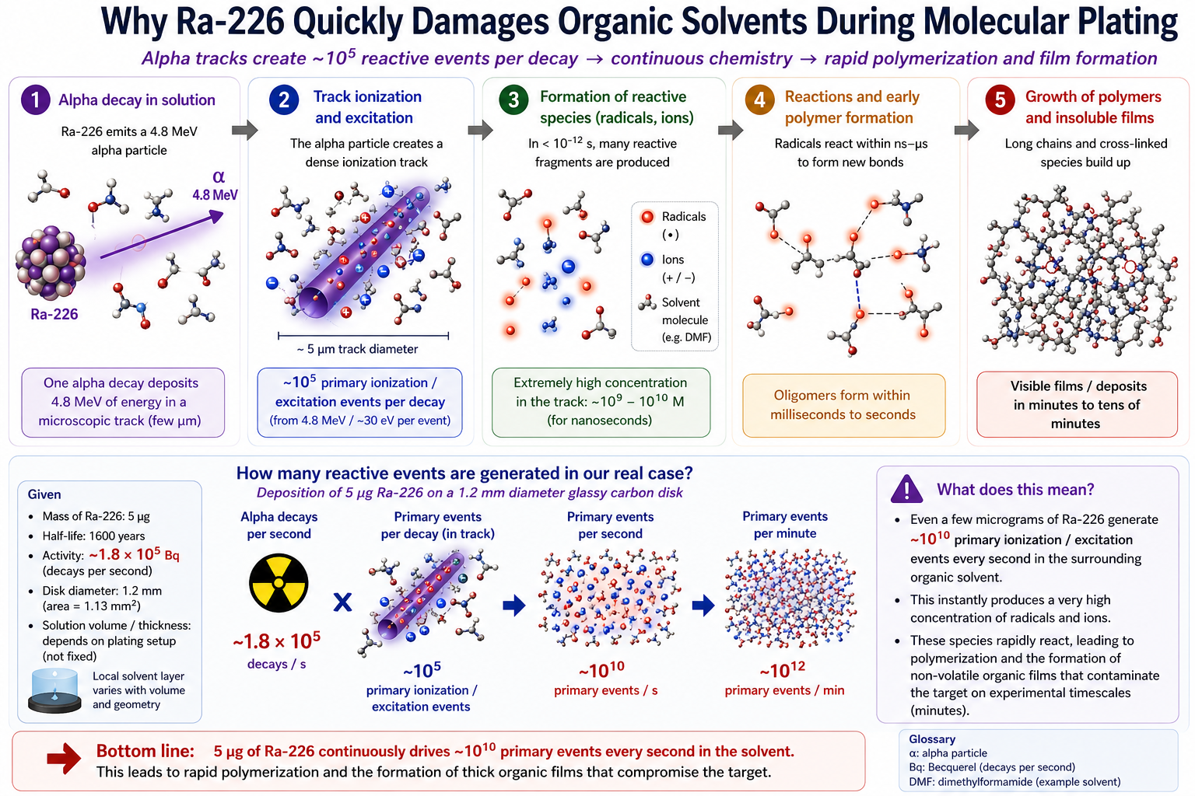
How radiation can turn DMF into a polymer
This figure is intended for illustrative purposes only and does not represent a chemically accurate process

Slide 17
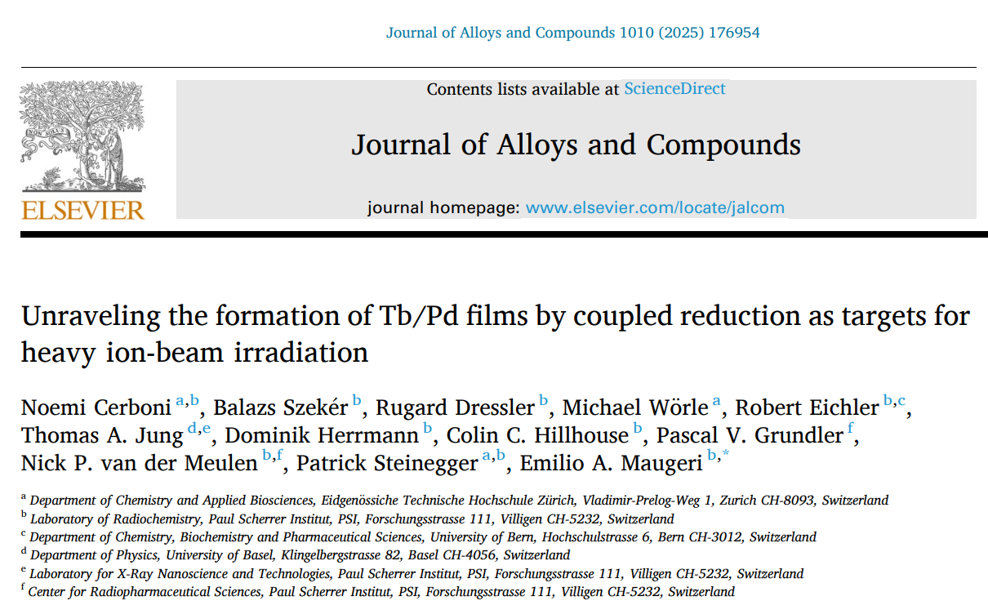
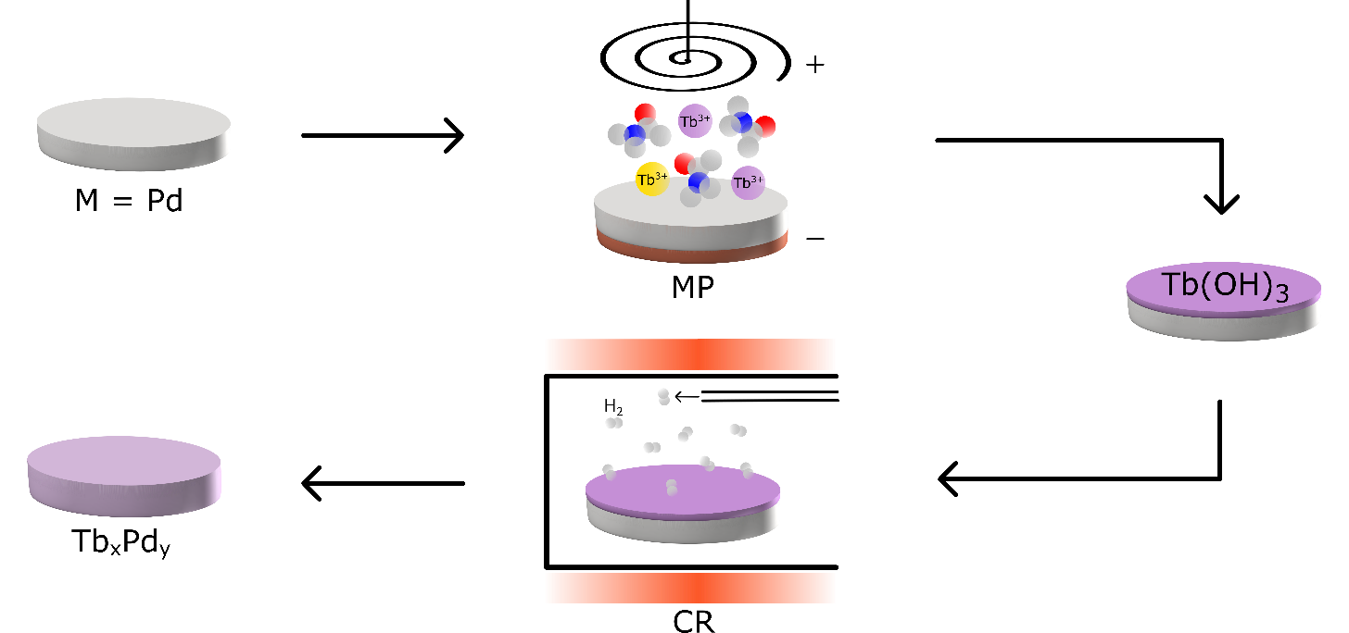

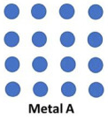

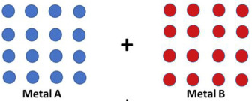
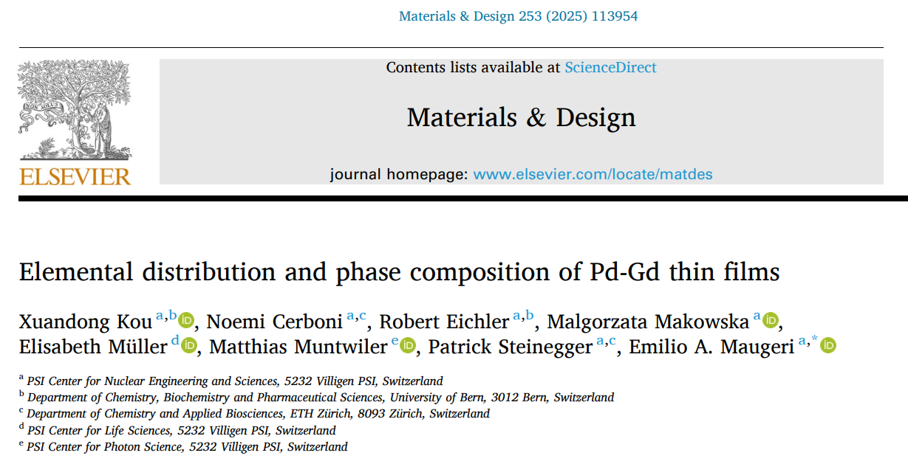

Production of targets for superheavy elements
  ….targets that need to withstand high stress level
T > 1100 °C
x Pd + y Ln(OH)₃ + 3y H₂ → Ln_{y}Pd_{x} + 6y H₂O
  Many advantages over only molecular plated samples
    High thermal and electrical conductivity
    High chemical and mechanical stability

Slide 18

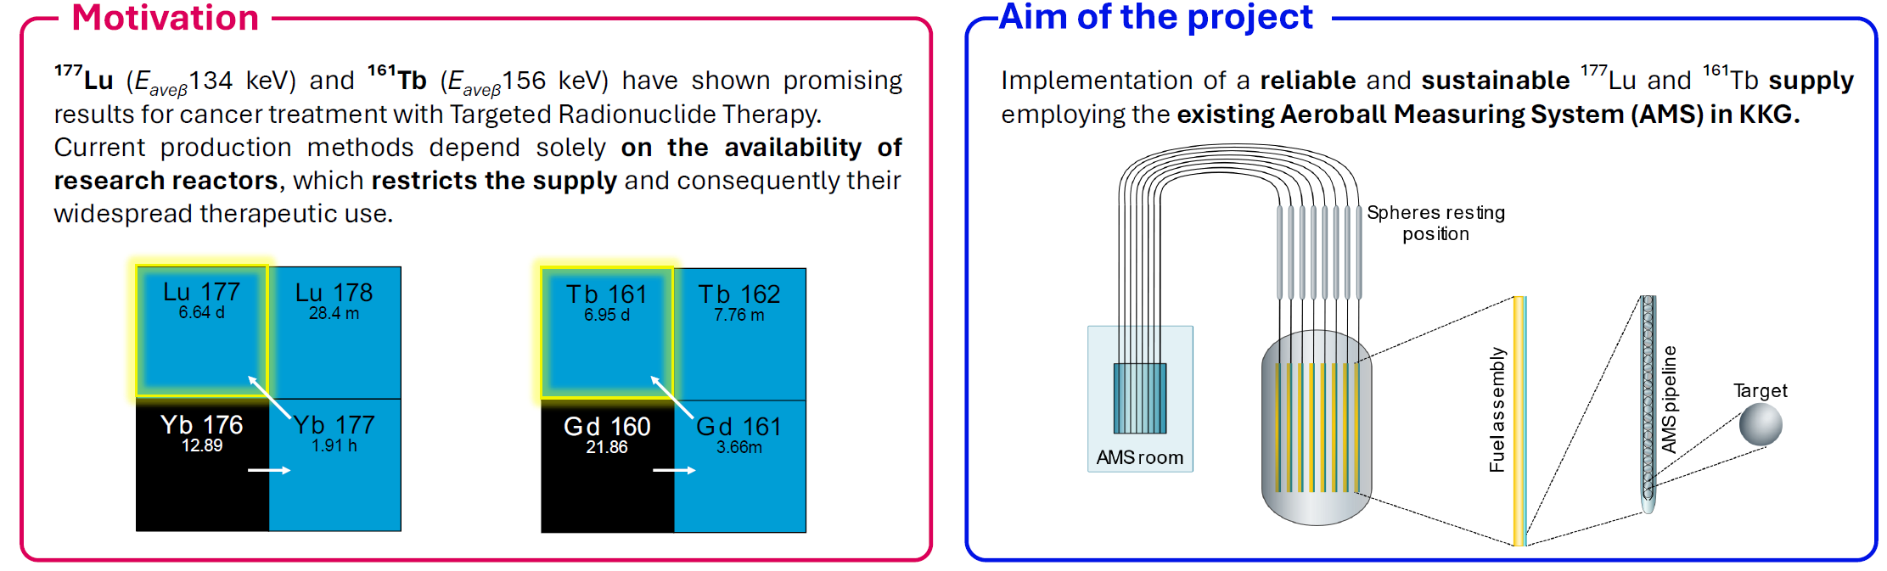
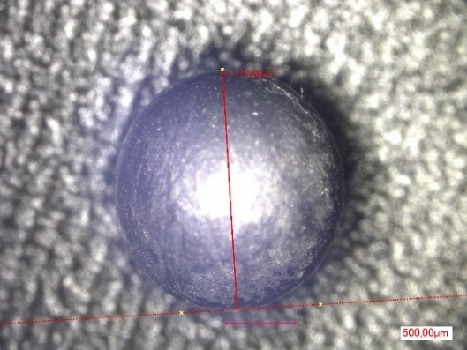
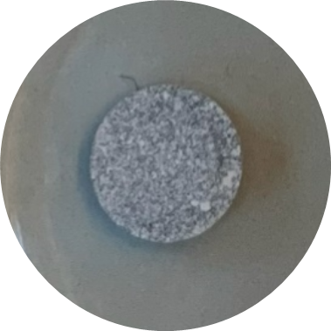
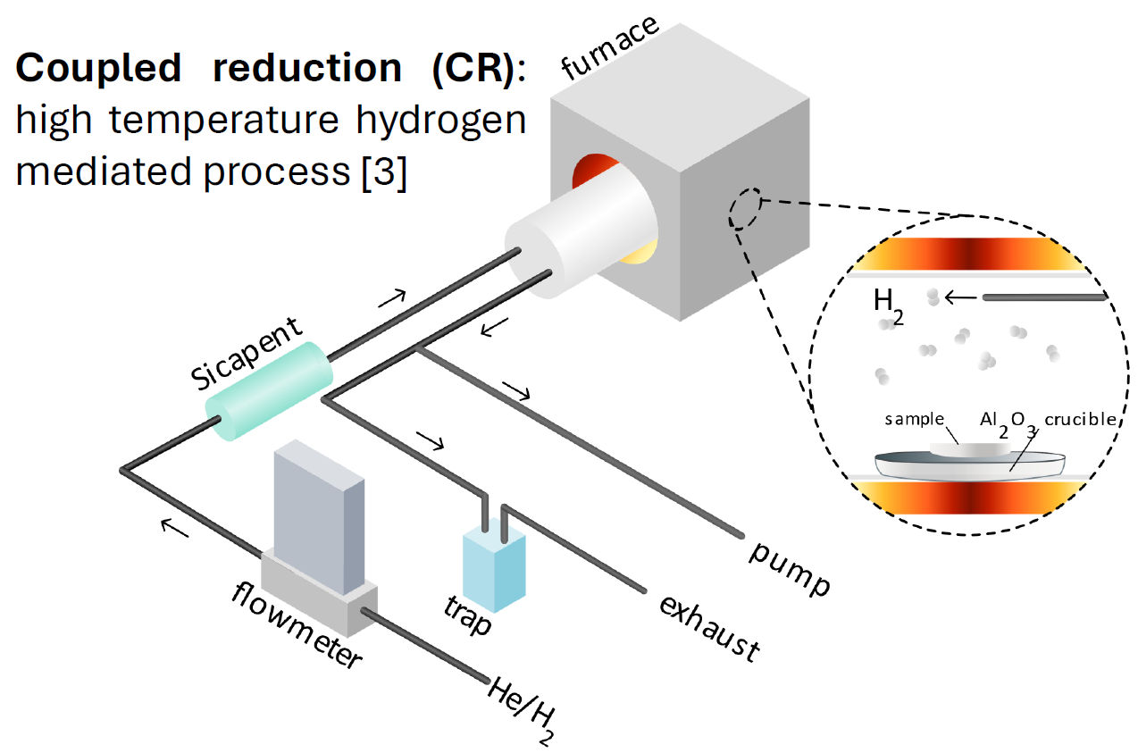
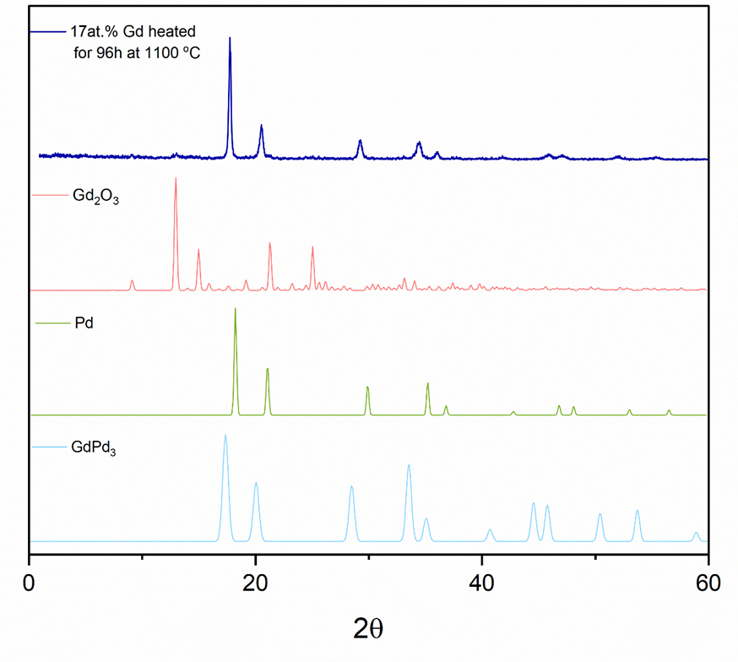
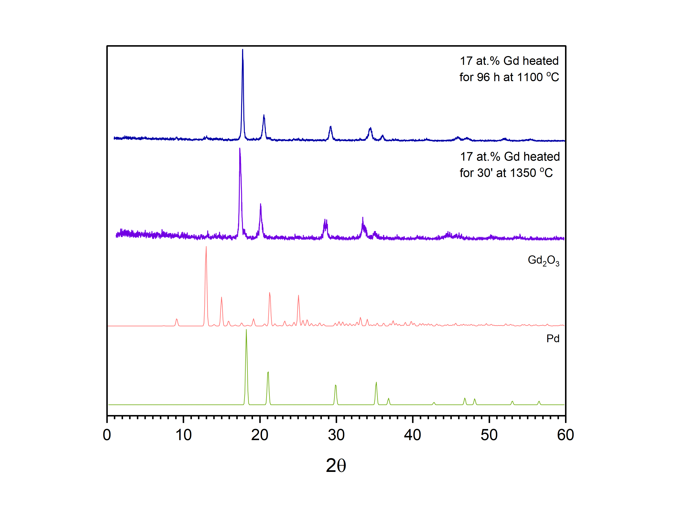
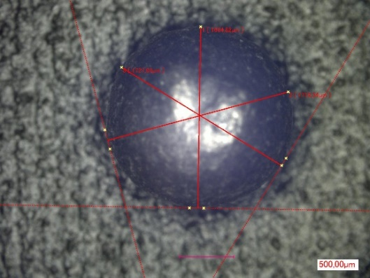
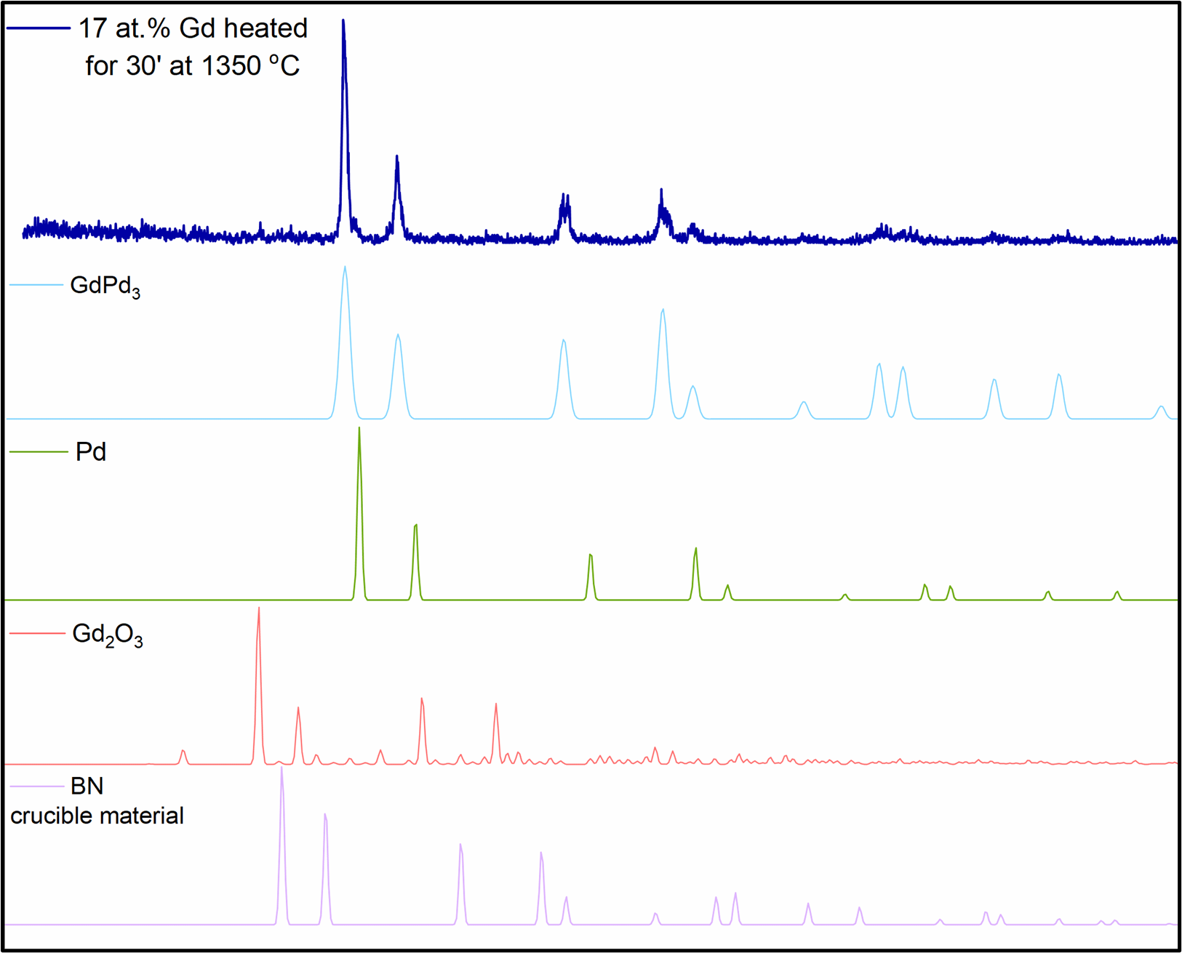
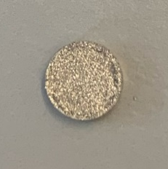
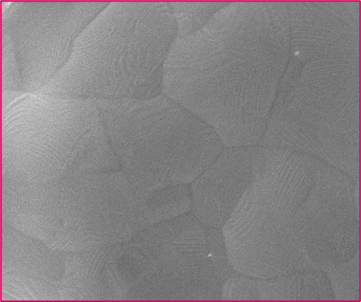
Production of targets for nuclear medicine
RAdiolanthanide Production In Core (RAPIC)
Target before being shot 100 times at 20 bars
Target after being shot 100 times at 20 bars
1μm
1μm
2θ

Slide 19

APRENDE Target Requests

Slide 20






Fostering the target maker network
APRENDE Workshop 2027
Target users
Target producers
Nuclear Data for
Nuclear Medicine, Nuclear Energy,
Astrophysics, Radiation Protection…

Slide 21
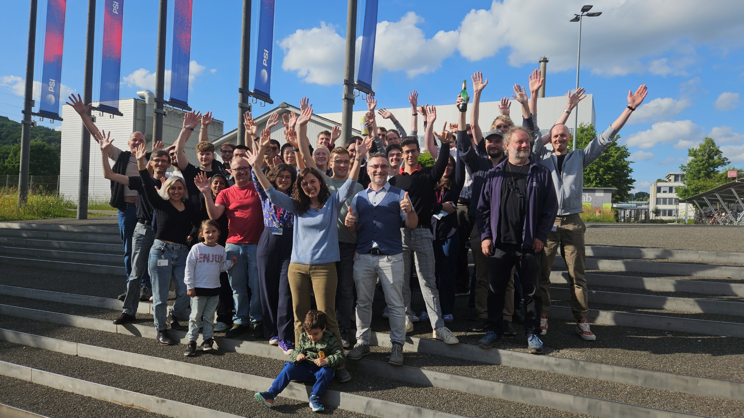
PSI - Laboratory of Radiochemistry

