Slide 1
CFT in AdS and Boundary Criticality
Simone Giombi
ENS Summer Institute
Paris
July 2, 2026
Based mainly on: arXiv:2506.14699 SG, Z. Sun , arXiv:2606.07510 O. Diatlyk, SG, Z. Sun,
arXiv: 2007.04955 SG, H. Khanchandani

Slide 2
Defects in QFT
In QFT, we often focus on local operators O(x). But QFTs also admit a variety of interesting extended (non-local) observables, supported on sub-manifolds of spacetime: Defects. Line operators, surface operators, interfaces, boundaries…
Interesting for a variety of reasons, e.g.:
  Boundaries and impurities in real physical systems
  Non-perturbative dualities
  Generalized symmetries
  New constraints on Renormalization Group flows
  Applications to holography:
  defects <-> extended objects in quantum gravity (strings, branes…)

Slide 3
Conformal boundaries and defects in CFT
In the case of a CFT, special role is played by conformal defects: they preserve a conformal subgroup of the conformal symmetry of the theory.
A p-dimensional conformal defect in CFT_{d} preserves SO(p+1,1) SO(d+1,1)
Some examples in familiar CFTs include
  Boundaries (or interfaces) in various critical systems
  Several types of conformal defects in O(N) or Gross-Neveu models
  (E.g.: Monodromy defects, “pinning-field” line defects, spin impurities, surface defects...)
  Wilson lines in conformal gauge theories (N=4 SYM, ABJM, critical QED₃…)

Slide 4
BCFT
Consider a CFT in the presence of a boundary. For instance, take flat half-space R^{d-1} x R₊, with coordinates (z,x), z≥0. Boundary at z=0.
Such CFTs often admit a variety of conformal boundary conditions, such that the conformal group SO(d+1,1) of the CFT is broken to a subgroup SO(d,1) (the conformal transformations at the boundary).
Each conformal boundary condition corresponds to a different BCFT
Such BCFT have a rich structure and are of interest both for intrinsic theoretical reasons and for practical applications (critical phenomena in the presence of boundaries)

Slide 5
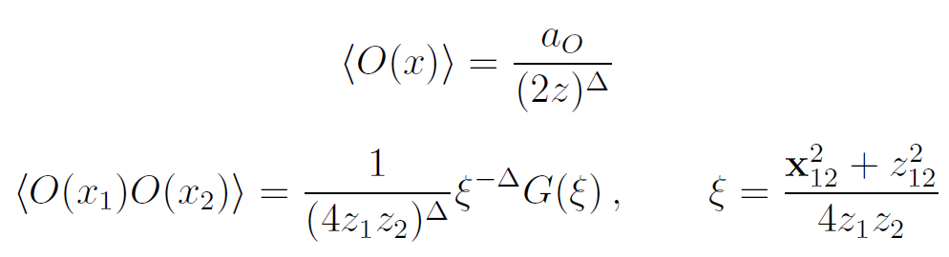
BCFT correlation functions
The BCFT is characterized by a spectrum of scaling dimensions for bulk operators (same as the CFT with no boundary) and for boundary operators (new data in the presence of the boundary), as well as their correlation functions
The reduced conformal symmetry SO(d,1) allows for a richer structure of the correlation functions
One-point functions of bulk scalar operators are non-zero, and two-point functions are non-trivial functions of a conformal cross ratio

Slide 6
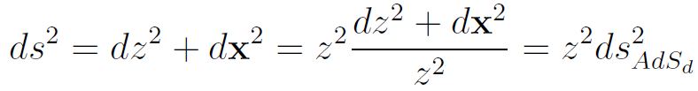

CFT in AdS = BCFT
Let us consider a BCFT in flat half-space R^{d-1} x R₊, with coordinates (z,x), z≥0
The main observation is that, by a Weyl transformation, we can map the problem to hyperbolic space, or Euclidean AdS_{d}
Operators in the flat space and AdS picture are related according to the Weyl transformation
Correlation functions transform accordingly

Slide 7
CFT in AdS = BCFT
The SO(d,1) symmetry of the BCFT is manifest in the AdS approach
Correlation functions take simple form due to maximal symmetry
  One-point functions are constant
  Two-point functions are function of the geodesic distance in AdS (which is simply related to the conformal cross ratio usually defined in BCFT)
Thus, placing a CFT in AdS gives a natural approach to study the BCFT
Paulos, Penedones, Toledo, van Rees, Vieira ’16
Carmi, Di Pietro, Komatsu ‘18 SG, Khanchandani ‘20 …
Note that in the AdS formulation, the SO(d,1) symmetry persists even away from fixed points. Important for perturbative calculations
The AdS approach is especially useful to compute quantities like the boundary central charge, which as we will see can be obtained from the free energy F_{AdS} of the CFT in AdS with a spherical boundary

Slide 8
AdS approach to other defects
A similar AdS approach can be used to study various kinds of defect CFTs. Starting with a CFT_{d} with a p-dimensional defect, one can map to AdS_{p+1} x S^{d-p-1}. Defect then lies at the boundary of AdS_{p+1}.
Examples
  Monodromy defects from AdS_{d-1} x S¹ SG, Helfenberger, Ji, Khanchandani ’21
  Line defects from AdS₂ x S^{d-2}
  Kapustin ‘05; Cuomo, Komargodski, Mezei ’21; SG, Helfenberger, Khanchandani ’21
  Surface defects from AdS₃ x S^{d-3} SG, Liu ‘23
  RG interfaces SG, Helfenberger, Khanchandani ‘24
Note: we are not doing holography this way. It is just a conformal map of the CFT to AdS. Still, various techniques developed in the context of AdS/CFT can often be “recycled” and adapted to this class of problems

Slide 9
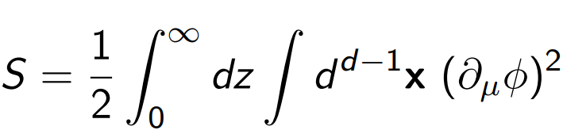
Example: free scalar BCFT
As a simple example, consider a free massless scalar on half space
This defines two possible BCFTs, corresponding to the two conformally invariant boundary conditions
  Neumann Boundary scalar operator has dimension d/2-1
  Dirichlet Boundary scalar operator has dimension d/2
The Neumann and Dirichlet BCFTs are connected by an RG flow Neumann-->Dirichlet triggered by a boundary mass term

Slide 10
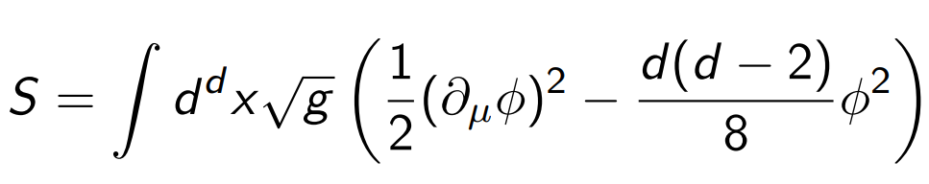
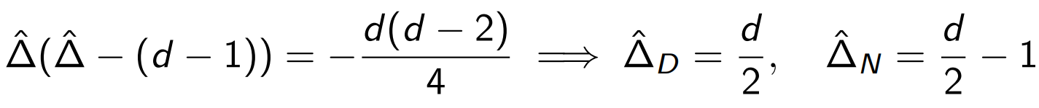
Free conformal scalar in AdS
Mapping the free massless scalar theory to AdS gives
The dimension of the boundary scalar operator can be obtained by the familiar AdS mass/dimension relation
The RG flow between Neumann and Dirichlet BCFTs can be seen essentially as a special case of the general “double-trace flows” in AdS/CFT corresponding to alternate b.c. in AdS

Slide 11

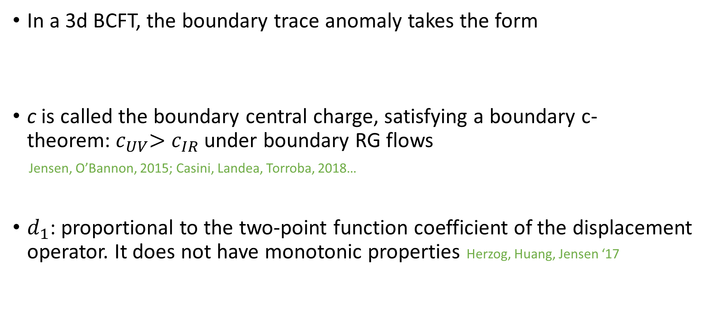
Boundary central charge for 3d BCFT
In a 3d BCFT, the boundary trace anomaly takes the form
c is called the boundary central charge, satisfying a boundary c-theorem:${ c}_{UV}>$ $c_{IR}$under boundary RG flows
Jensen, O’Bannon, 2015; Casini, Landea, Torroba, 2018…
$d_{1}$: proportional to the two-point function coefficient of the displacement operator. It does not have monotonic properties Herzog, Huang, Jensen ‘17

Slide 12

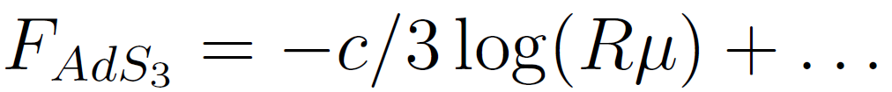
Boundary central charge from free energy
The boundary central charge c can be extracted from the free energy on a hemisphere
Equivalently, it can be extracted from the free energy on Euclidean AdS₃
where the logarithmic divergence now comes from the regularized volume of AdS₃ , vol(AdS₃) =-2πlog(Rμ)+…For the free scalar, one finds c^{Neum}= -c^{Dirich} =1/16
The AdS approach is in practice more convenient than hemisphere for explicit calculations, especially in interacting theories

Slide 13
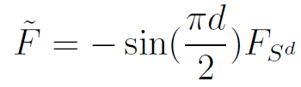



Dimensional continuation of the free energy
We will be interested in the epsilon-expansion, so a natural question is how to define a suitable dimensional continuation of F in general d
For the case of a CFT on the round sphere, a natural quantity is
SG, Klebanov ’14
which smoothly interpolates between a-anomaly coefficients in even d, and F-coefficients in odd d. Satisfies a generalized F-theorem interpolating between a/c-theorems and F-theorem
Its epsilon-expansion was used to obtain estimates for F of 3d Ising and O(N) model CFTs, e.g. predicting SG, Klebanov ’14; Fei, SG, Klebanov, Tarnopolsky ‘15
In very good agreement with recent fuzzy sphere result
Hu, Zhu, He ‘24

Slide 14
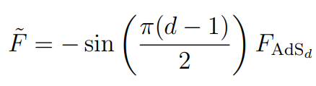

Dimensional continuation of the AdS free energy
For the CFT in AdS, it is natural to define the analogous quantity
SG, Khanchandani ‘20
In d=3 (and other odd d), the sine factor cancels the pole coming from AdS regularized volume, leaving the boundary central charge. Explicitly:
Generalizing the boundary c-theorem in d=3, a natural conjecture is that for all dimensions d, under boundary RG flow it satisfies

Slide 15
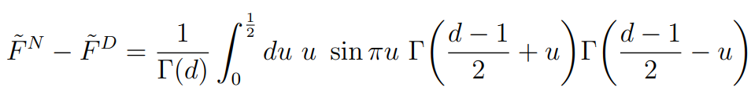

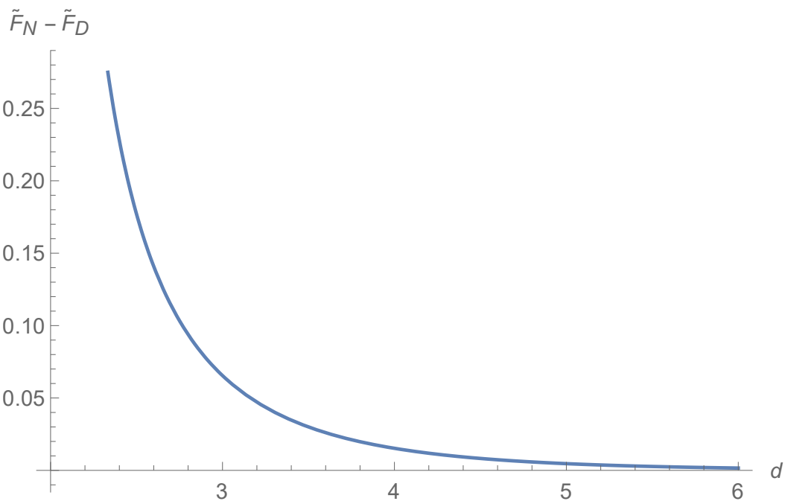

Example: Neumann-Dirichlet flow for free scalar
For the free scalar in AdS, it is straightforward to compute the difference between Neumann and Dirichlet free energies, adapting known formulas for double-trace flows in AdS/CFT. One has
SG, Khanchandani ‘20
In d=3 one finds , in agreement with the known results for the boundary central charges c^{N}=-c^{D}=1/16.
For all continuous d, it satisfies as expected

Slide 16


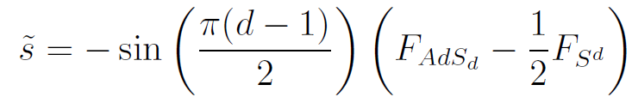
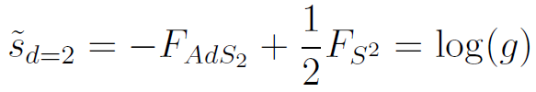

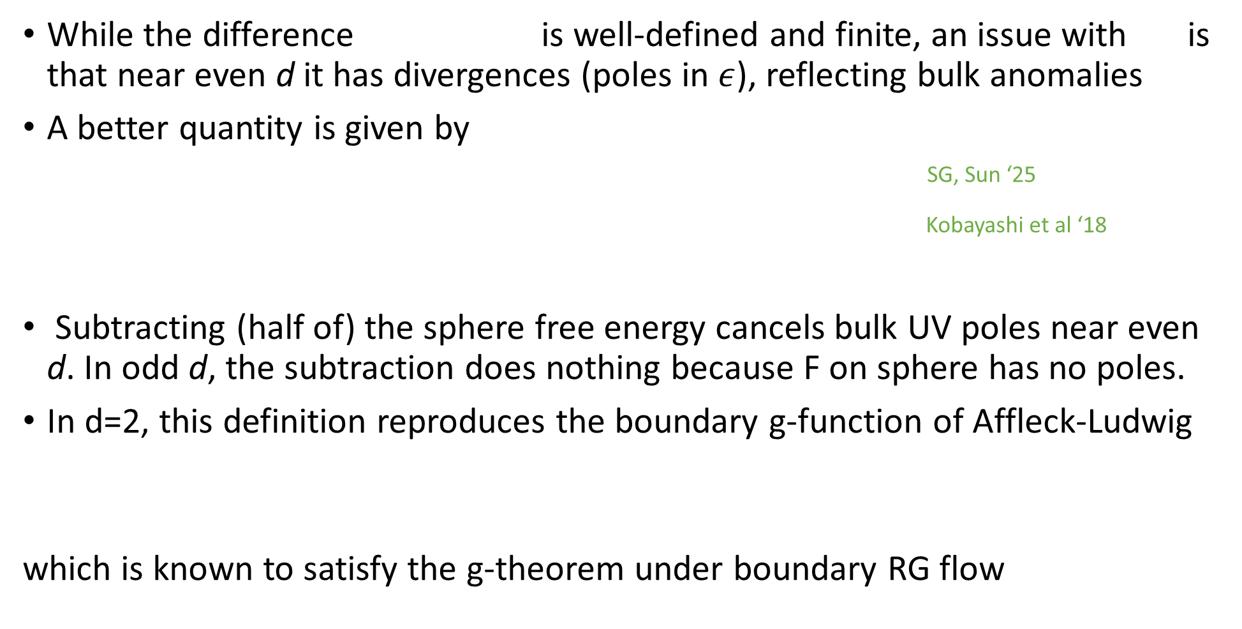
A better quantity
While the difference is well-defined and finite, an issue with is that near even d it has divergences (poles in $ε$), reflecting bulk anomalies
A better quantity is given by
SG, Sun ‘25
Kobayashi et al ‘18
Subtracting (half of) the sphere free energy cancels bulk UV poles near even d. In odd d, the subtraction does nothing because F on sphere has no poles.
In d=2, this definition reproduces the boundary g-function of Affleck-Ludwig
which is known to satisfy the g-theorem under boundary RG flow

Slide 17




Hence this quantity smoothly interpolates between boundary central charge in odd d and g-function (and their higher dimensional analogs) in even d, and should satisfy
This can be viewed as a special case of a “generalized g-theorem” for p-dimensional defects
Kobayashi et al ’18
For line defects (p=1), this is the g-theorem proved in Cuomo, Komargodski, Raviv-Moshe ‘22

Slide 18

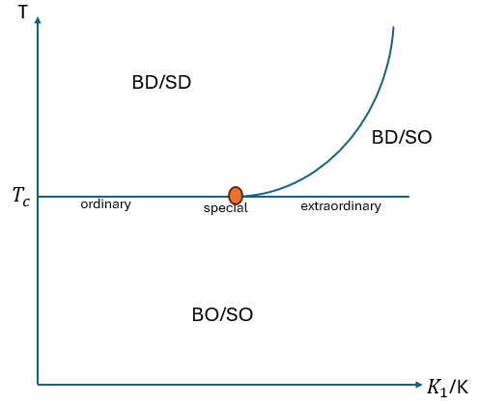

O(N) model with a boundary
K_{ij}=K in bulk, K_{ij}=K₁ on surface
Bray, Moore, Burkhardt, Cardy, Diehl,…
Liendo, Rastelli, van Rees, …
Metlitski ‘22
$$K_{1}$$
K

Slide 19
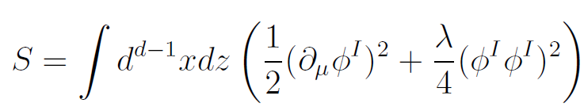


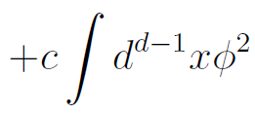
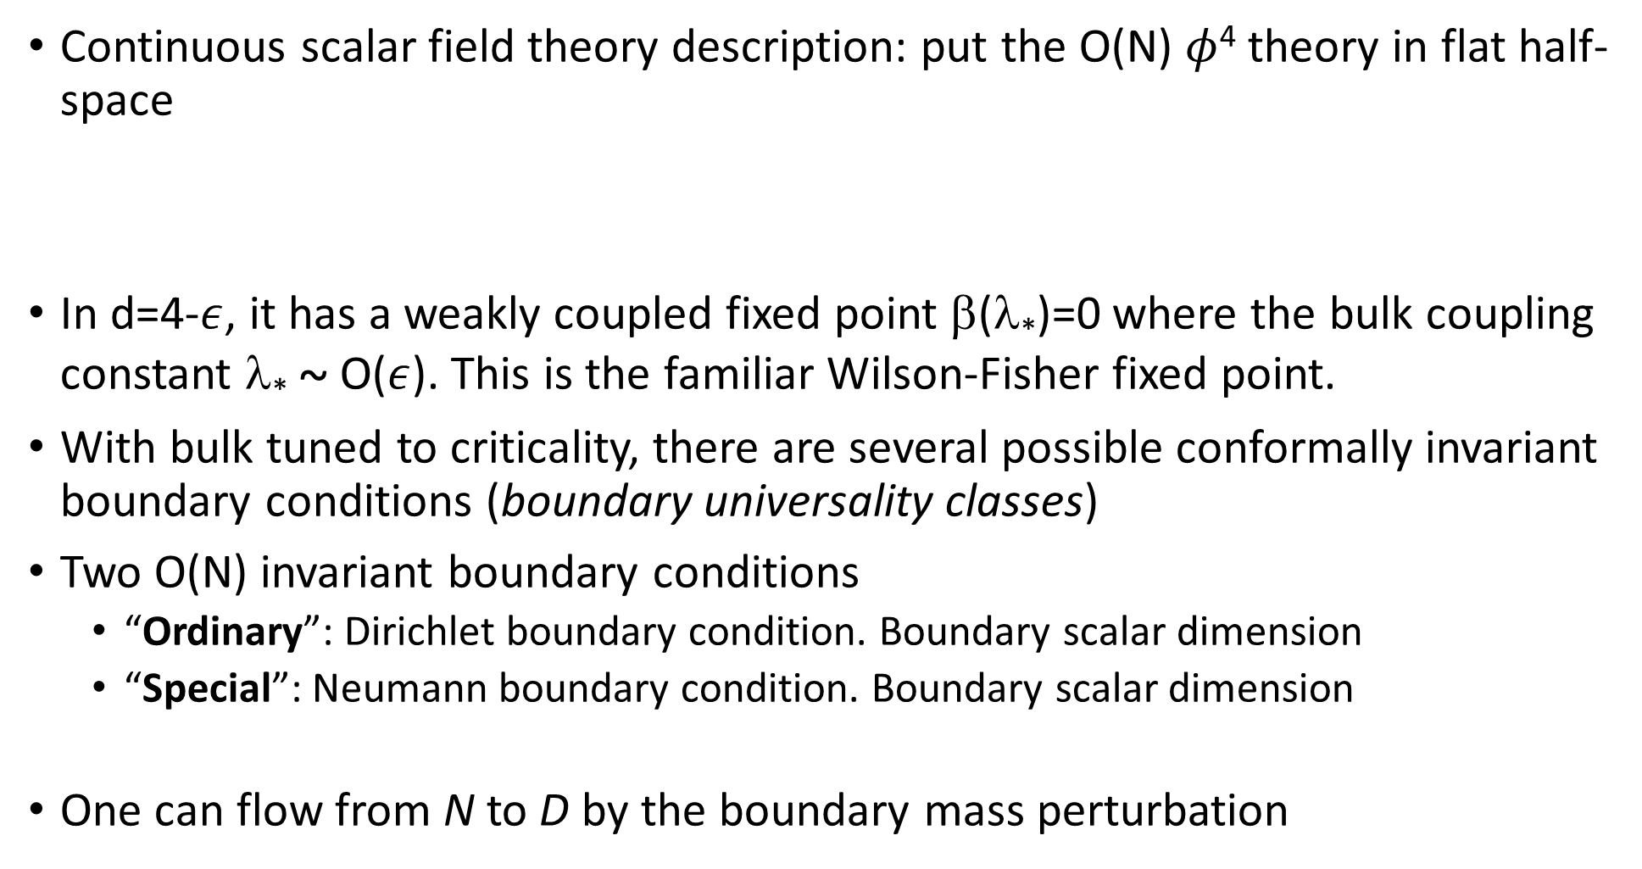
O(N) model with a boundary
Continuous scalar field theory description: put the O(N) $φ$⁴ theory in flat half-space
In d=4-$ε$, it has a weakly coupled fixed point β(λ*)=0 where the bulk coupling constant λ* ~ O($ε$). This is the familiar Wilson-Fisher fixed point.
With bulk tuned to criticality, there are several possible conformally invariant boundary conditions (boundary universality classes)
Two O(N) invariant boundary conditions
  “Ordinary”: Dirichlet boundary condition. Boundary scalar dimension
  “Special”: Neumann boundary condition. Boundary scalar dimension
One can flow from N to D by the boundary mass perturbation

Slide 20

O(N) model with a boundary
The O(N) φ⁴ theory in flat half-space
Two O(N) breaking boundary universality classes
  “Normal”: Explicit O(N) symmetry breaking. Corresponds to adding boundary magnetic field φ^{I} n^{I} , with n^{I} a fixed N-dimensional unit vector.
  Non-vanishing one-point function
  “Extraordinary”: Spontaneous symmetry breaking. Can realize by the same boundary coupling, but with n^{I} dynamical
For N=1 (Ising), the normal and extraordinary classes are equivalent. For d>3 and general N they are also believed to be essentially equivalent Bray, Moore, Burkhardt, Cardy, Diehl,…
In d=3 for 1<N<N_{c} the extraordinary class takes a modified “extraordinary-log” form Metlitski ’22
The “ordinary” and “normal” classes exist for all N and all 2<d<4. We will focus on these two cases

Slide 21
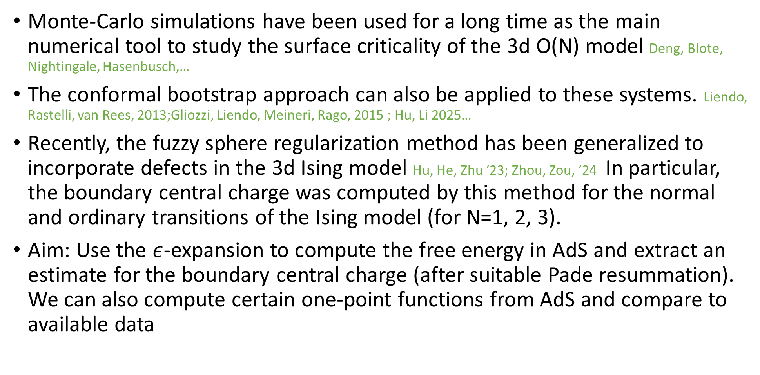
Available methods
Monte-Carlo simulations have been used for a long time as the main numerical tool to study the surface criticality of the 3d O(N) model Deng, Blote, Nightingale, Hasenbusch,…
The conformal bootstrap approach can also be applied to these systems. Liendo, Rastelli, van Rees, 2013;Gliozzi, Liendo, Meineri, Rago, 2015 ; Hu, Li 2025…
Recently, the fuzzy sphere regularization method has been generalized to incorporate defects in the 3d Ising model Hu, He, Zhu ‘23; Zhou, Zou, ’24 In particular, the boundary central charge was computed by this method for the normal and ordinary transitions of the Ising model (for N=1, 2, 3).
Aim: Use the $ε$-expansion to compute the free energy in AdS and extract an estimate for the boundary central charge (after suitable Pade resummation). We can also compute certain one-point functions from AdS and compare to available data

Slide 22
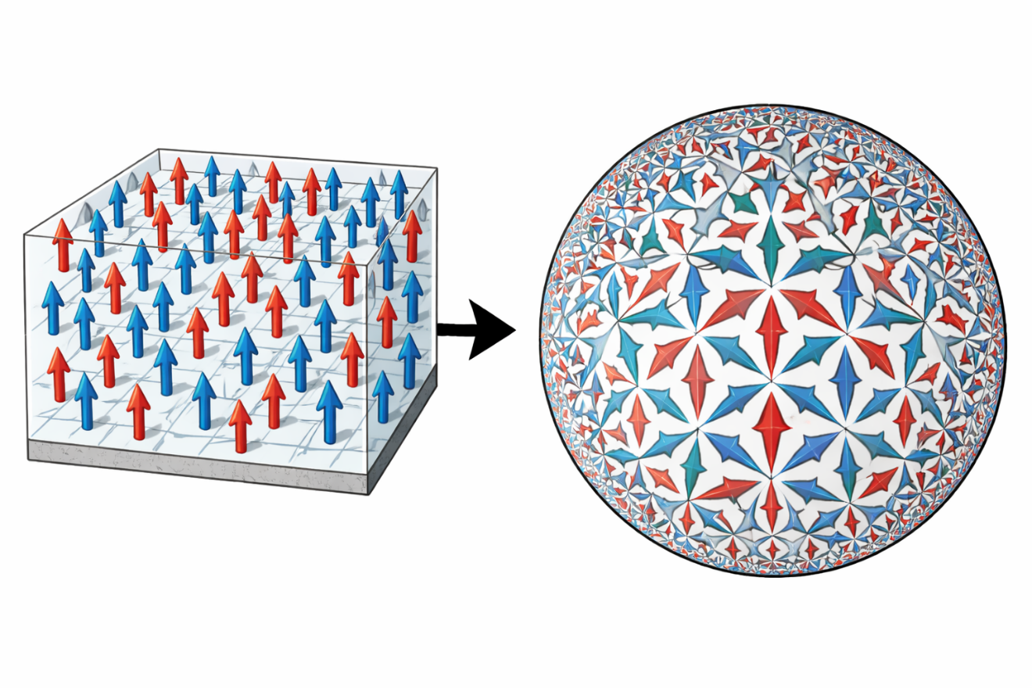
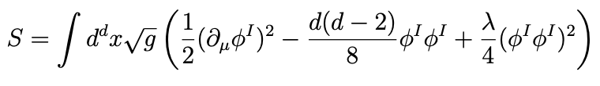
Wilson-Fisher BCFT in AdS
We now map the problem to AdS
The action in AdS is

Slide 23
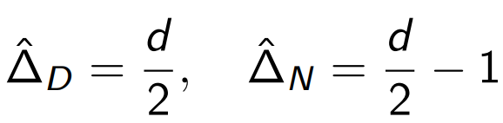
Wilson-Fisher BCFT in AdS
The action in AdS is
The ordinary and special BCFTs are easy to understand: We just do perturbation theory around the two possible boundary conditions
Ordinary Special

Slide 24


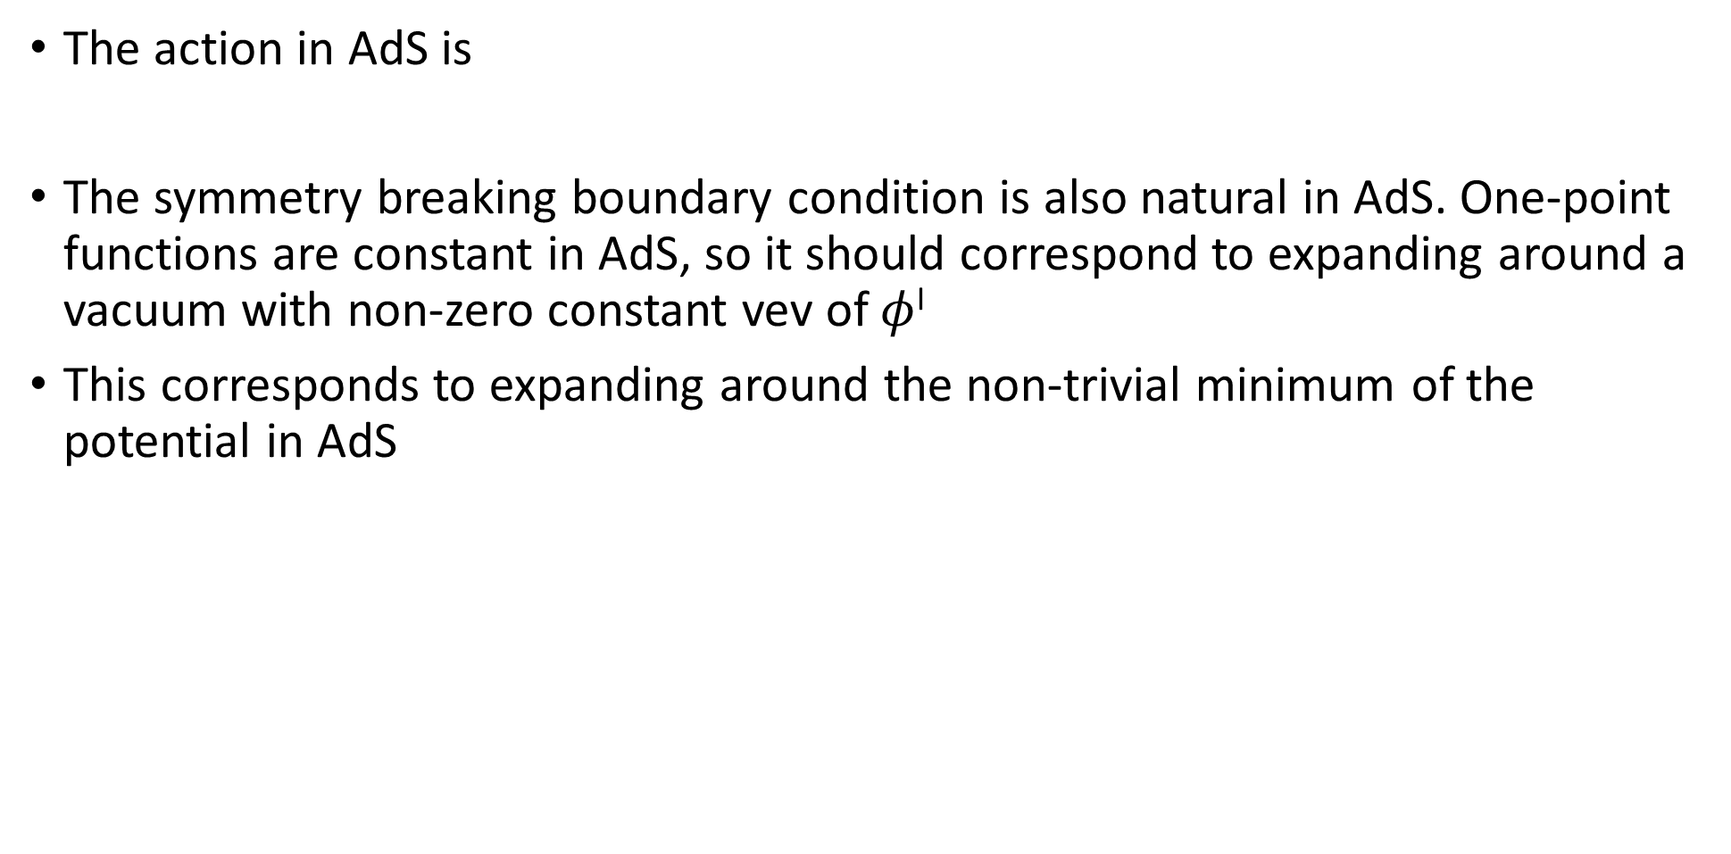


Wilson-Fisher BCFT in AdS
The action in AdS is
The symmetry breaking boundary condition is also natural in AdS. One-point functions are constant in AdS, so it should correspond to expanding around a vacuum with non-zero constant vev of $φ$^{I}
This corresponds to expanding around the non-trivial minimum of the potential in AdS
$$Ordinary/Special$$
$$φ_{∗}=0.$$
$$Normal/Extraordinary$$
$$φ_{∗}^{N}=\sqrt{\frac{d(d−2)}{4λ}}$$

Slide 25

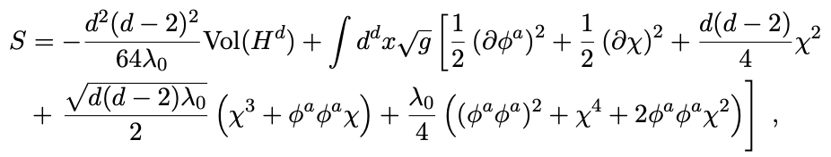



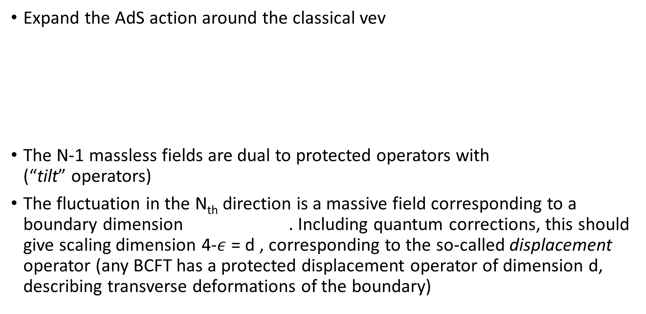
The O(N) breaking “Normal” BCFT
Expand the AdS action around the classical vev
The N-1 massless fields are dual to protected operators with (“tilt” operators)
The fluctuation in the N_{th} direction is a massive field corresponding to a boundary dimension . Including quantum corrections, this should give scaling dimension 4-$ε$ = d , corresponding to the so-called displacement operator (any BCFT has a protected displacement operator of dimension d, describing transverse deformations of the boundary)

Slide 26
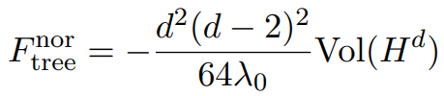


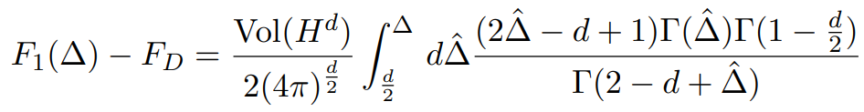
Free Energy of “normal” BCFT: Tree level and one-loop
There is a tree-level contribution from classical action
At one-loop
The one-loop determinants can be computed explicitly as …SG, Khanchandani…

Slide 27
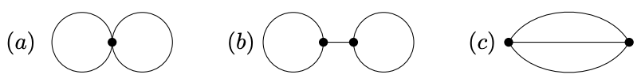
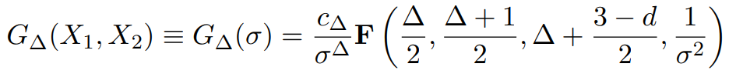


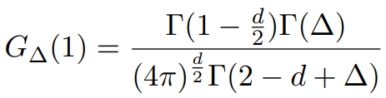


“Normal” Free Energy: Two loops SG, Sun ‘25
At two-loops, we need to compute the diagrams
Each line corresponds to AdS propagator for $φ$ª or χ
At coincident points
First two diagrams give

Slide 28
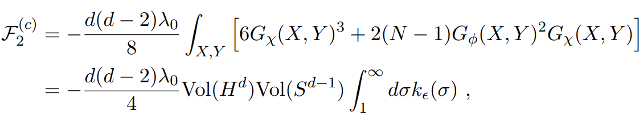


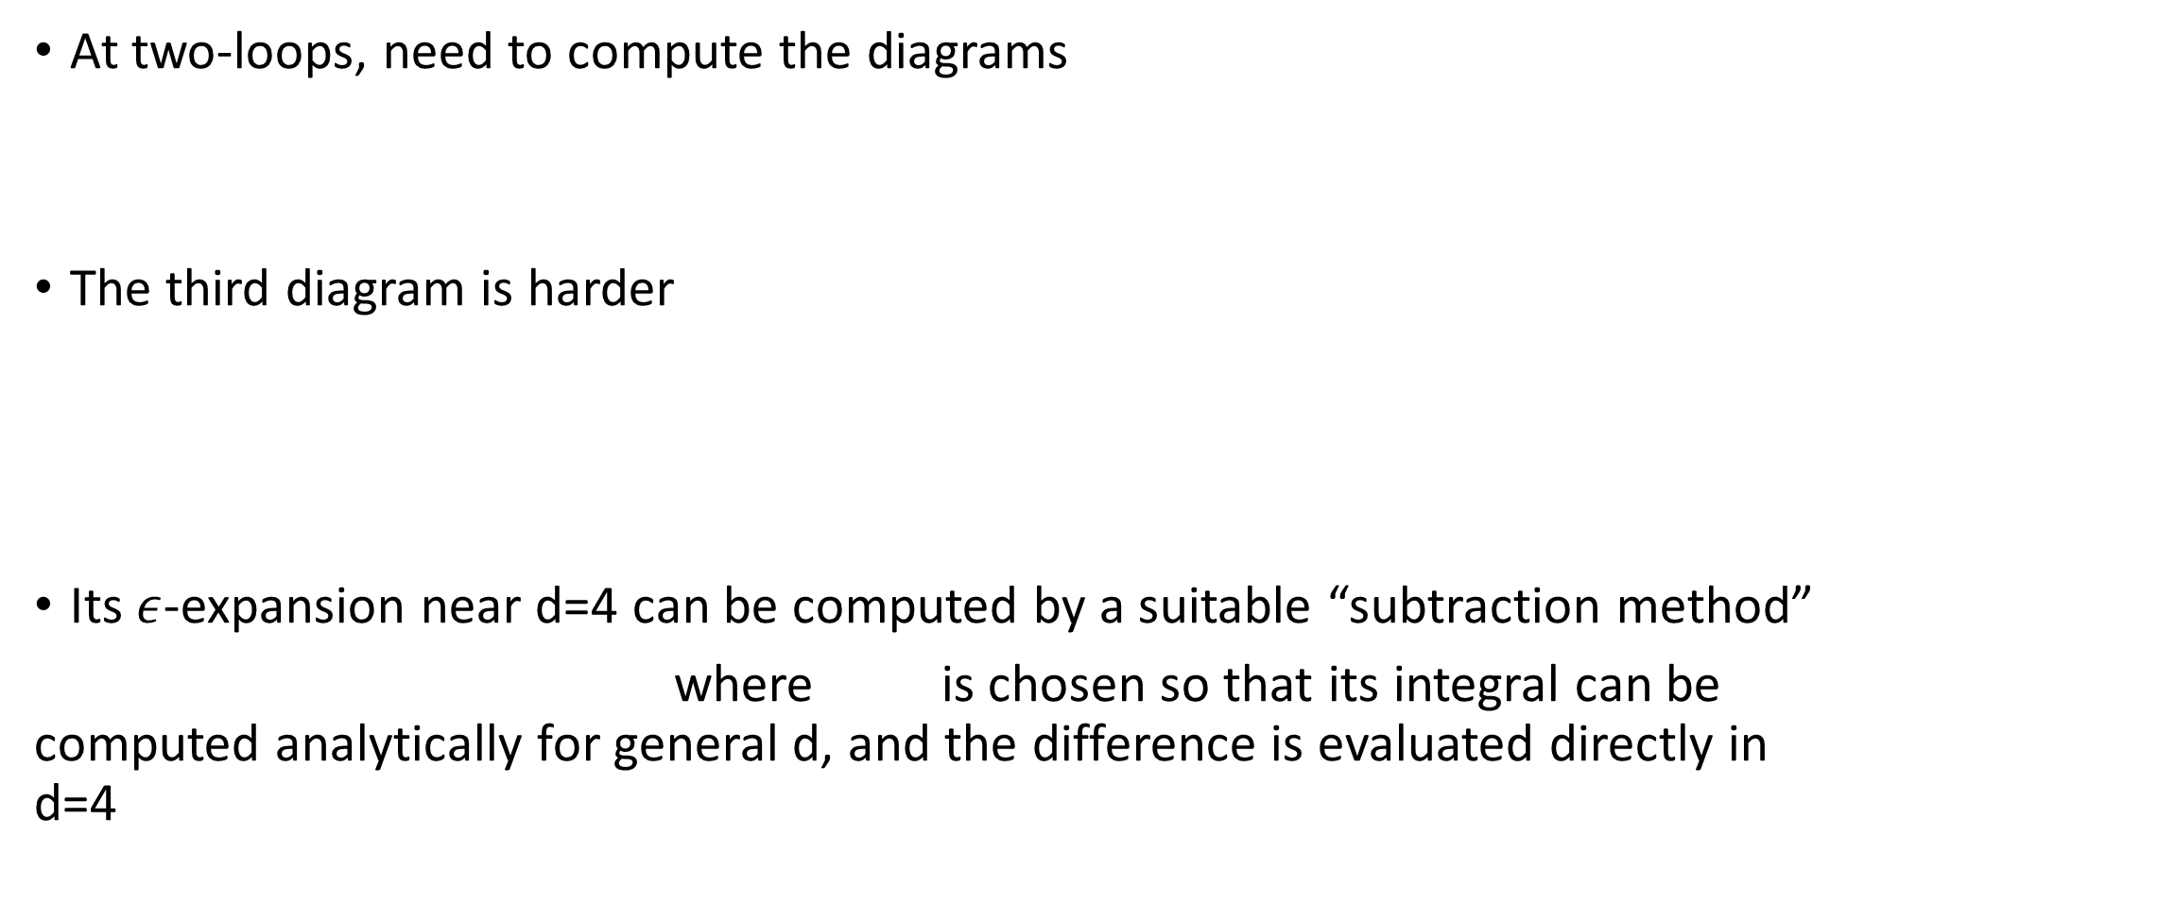
“Normal” Free Energy: Two loops SG, Sun ‘25
At two-loops, need to compute the diagrams
The third diagram is harder
Its $ε$-expansion near d=4 can be computed by a suitable “subtraction method”
where is chosen so that its integral can be computed analytically for general d, and the difference is evaluated directly in d=4

Slide 29

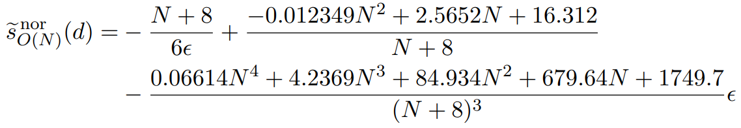

“Normal” Free Energy: Final result
Putting everything together, and expressing bare coupling in terms of renormalized one
we find that all 1/$ε$ UV poles cancel as expected (non-trivial consistency check)
Going to the fixed point , and subtracting half of the sphere free energy, the final result for the function at the normal fixed point is

Slide 30





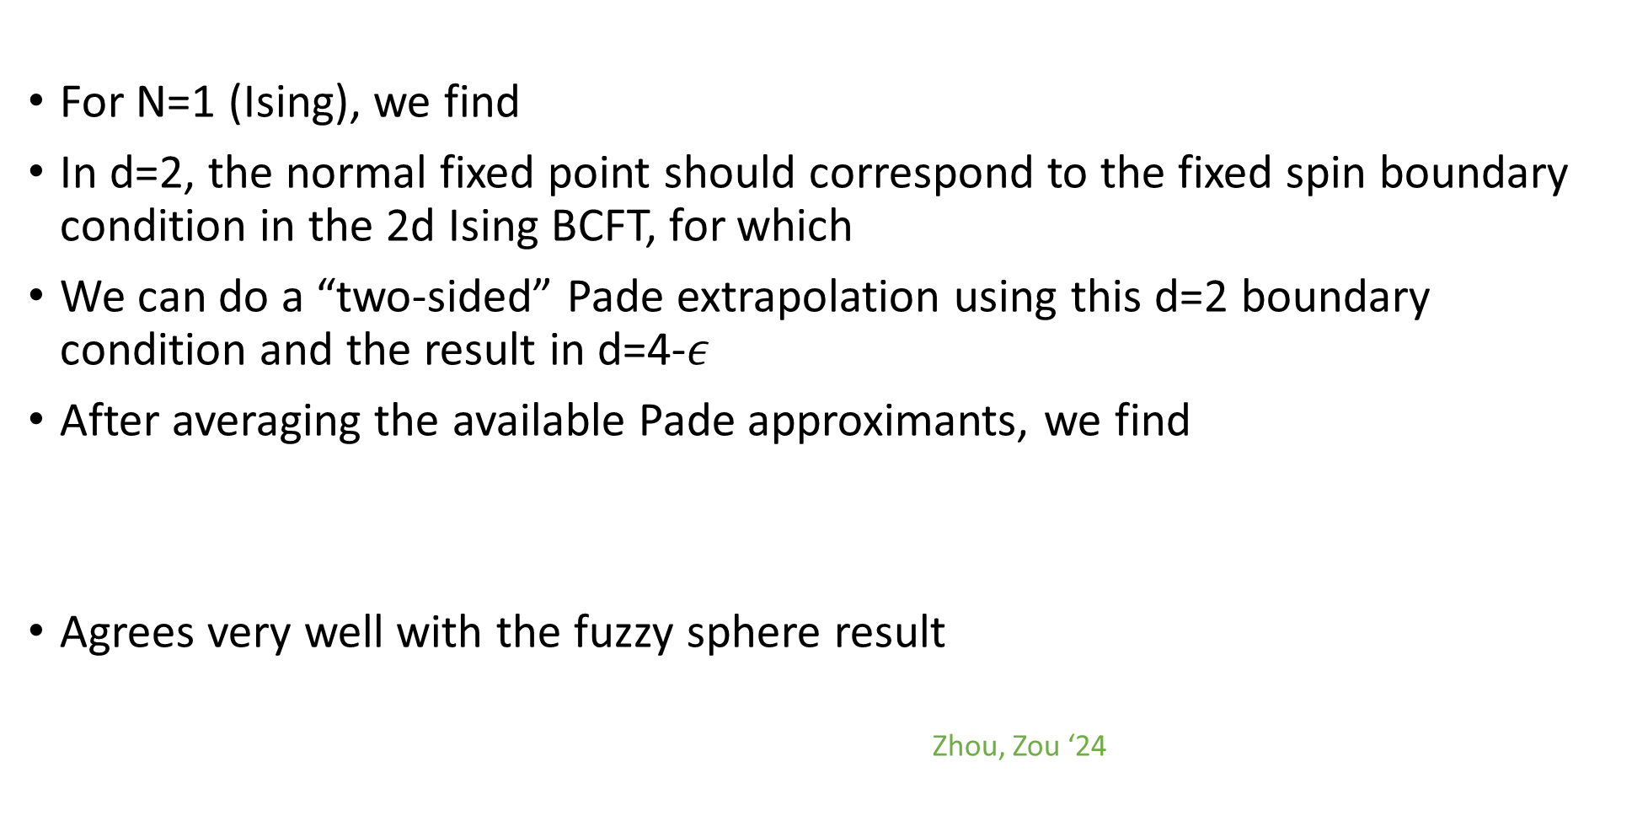
Pade estimate for 3d Ising boundary central charge
For N=1 (Ising), we find
In d=2, the normal fixed point should correspond to the fixed spin boundary condition in the 2d Ising BCFT, for which
We can do a “two-sided” Pade extrapolation using this d=2 boundary condition and the result in d=4-$ε$
After averaging the available Pade approximants, we find
Agrees very well with the fuzzy sphere result
Zhou, Zou ‘24

Slide 31






Estimates for O(2) and O(3) models
For N=2 and N=3, by a standard (one-sided) Pade extrapolation, we get
Recent fuzzy sphere results were given in Feng, Wang ’26
Epsilon-expansion is much better than extrapolation of large N expansion
Krishnan, Metlitski

Slide 32

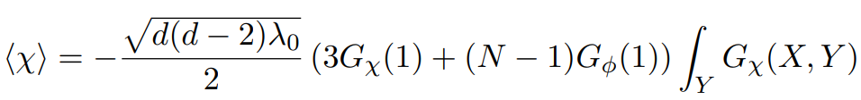


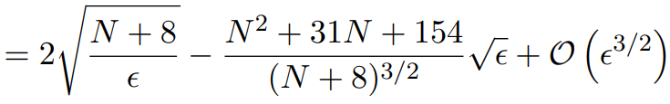

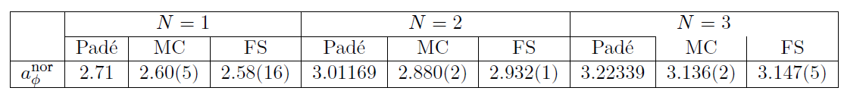

One-point function of $φ$^{N}
We can also compute the one-point function to one-loop
After suitable normalization so that in flat space , we find
Our Pade resummation compared to available results:

Slide 33
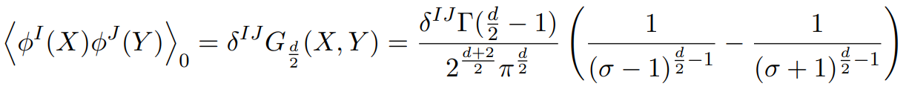
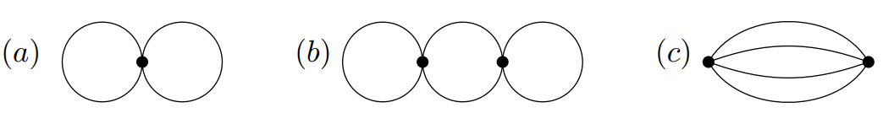
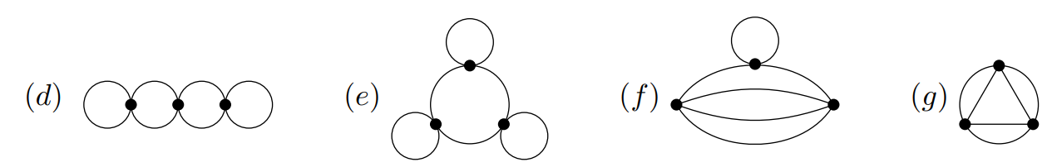
Free Energy of the “Ordinary” BCFT
In this case, we have standard perturbation theory with Dirichlet boundary conditions. Propagators are simpler
We computed the free energy to 4-loop order
SG, Khanchandani ‘20
SG, Sun ’25

Slide 34
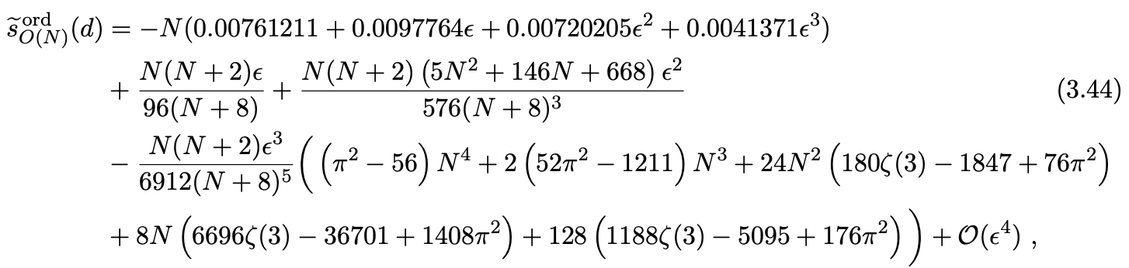

Free energy: final result
Putting together all diagrams and going to the fixed point of the beta function, we find the final result for

Slide 35


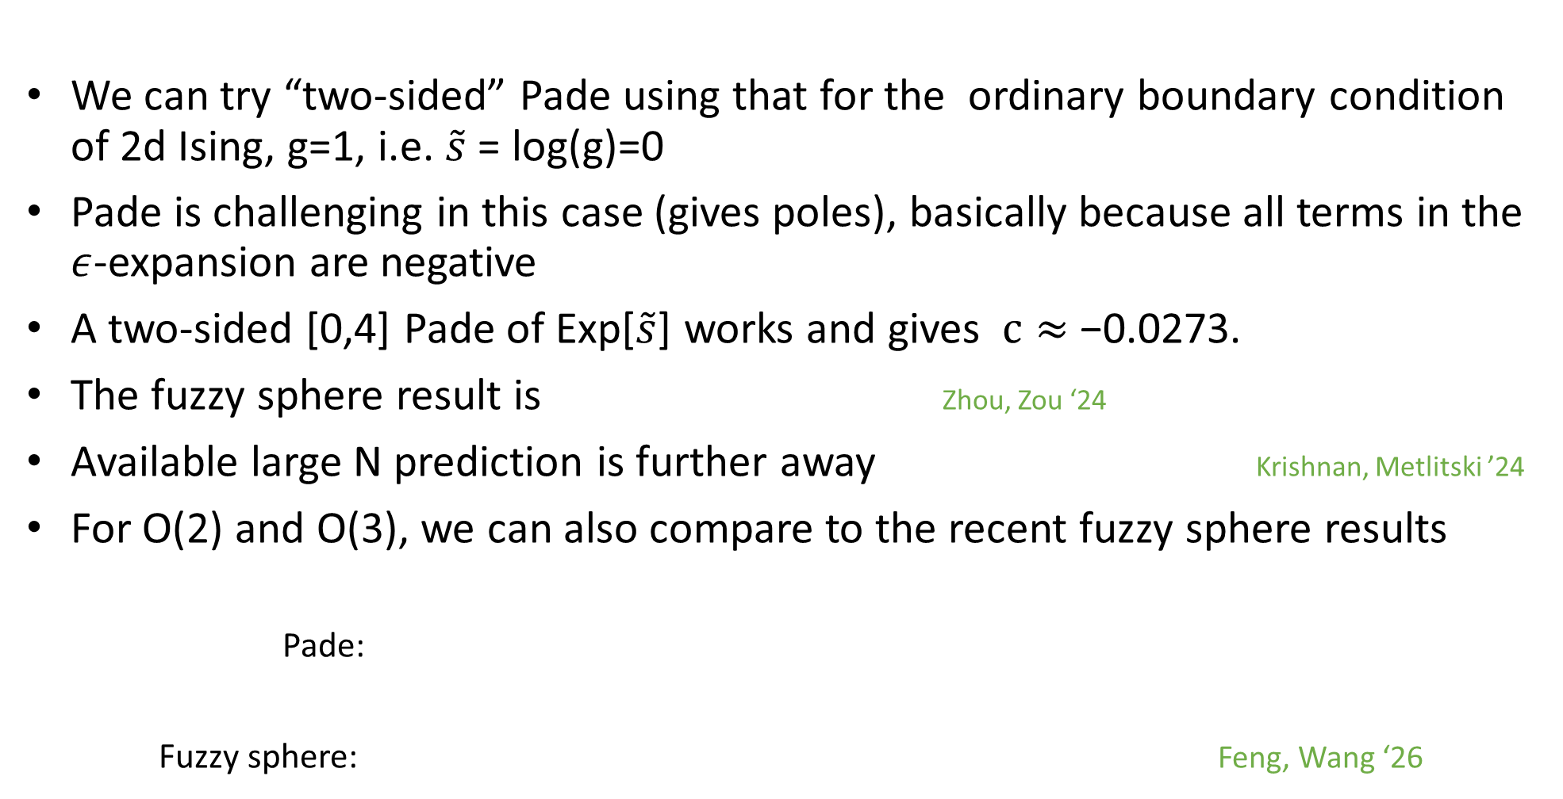
Pade estimates
We can try “two-sided” Pade using that for the ordinary boundary condition of 2d Ising, g=1, i.e. $\tilde{s}$ = log(g)=0
Pade is challenging in this case (gives poles), basically because all terms in the $ε$-expansion are negative
A two-sided [0,4] Pade of Exp[$\tilde{s}$] works and gives $c≈$−0.0273.
The fuzzy sphere result is Zhou, Zou ‘24
Available large N prediction is further away Krishnan, Metlitski ’24
For O(2) and O(3), we can also compare to the recent fuzzy sphere results
Pade:
Fuzzy sphere: Feng, Wang ‘26

Slide 36

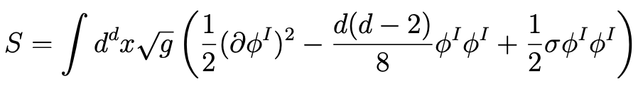
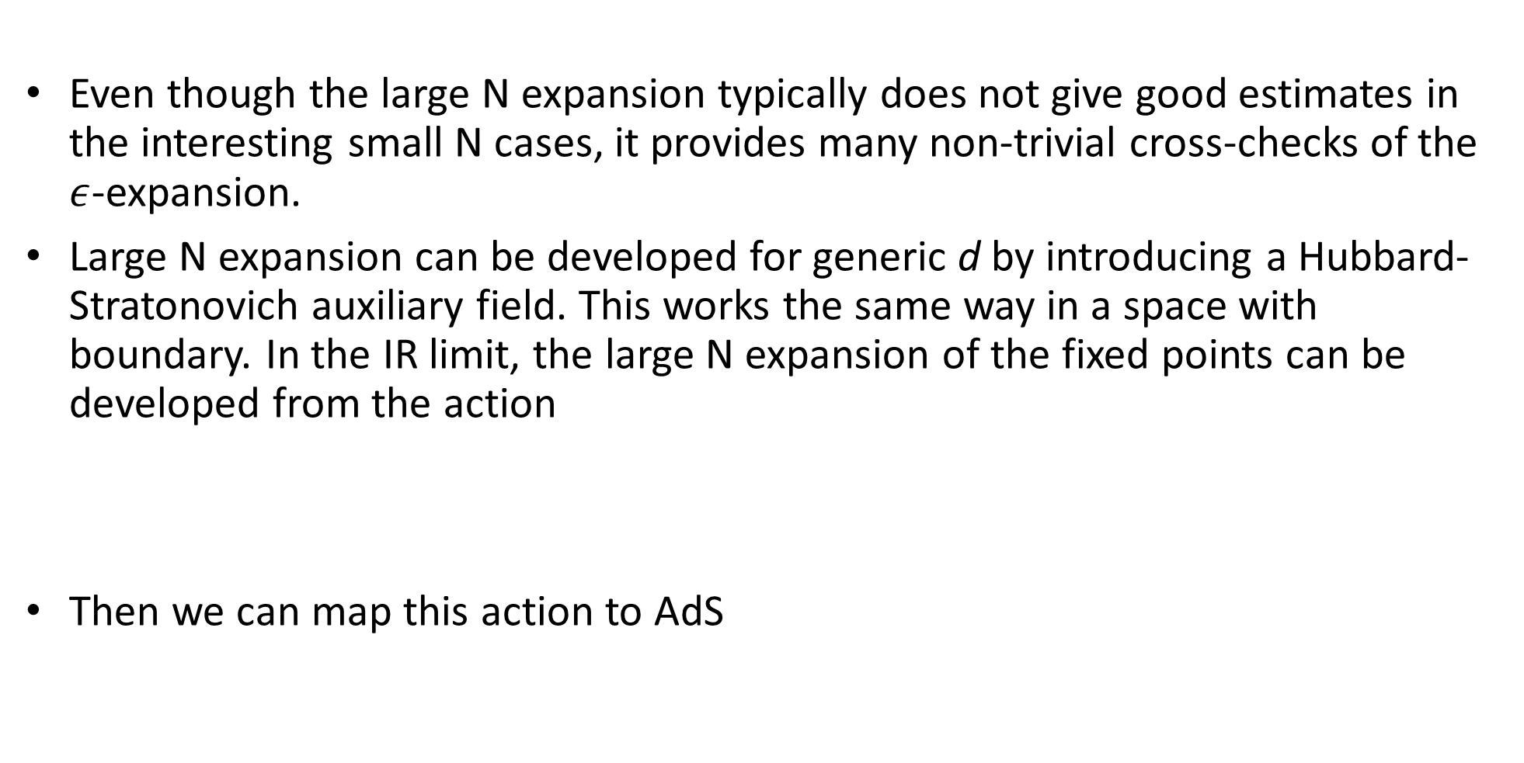
Large N approach
Even though the large N expansion typically does not give good estimates in the interesting small N cases, it provides many non-trivial cross-checks of the $ε$-expansion.
Large N expansion can be developed for generic d by introducing a Hubbard-Stratonovich auxiliary field. This works the same way in a space with boundary. In the IR limit, the large N expansion of the fixed points can be developed from the action
Then we can map this action to AdS

Slide 37




Large N free energy
To compute the free energy at large N:
  Integrate out the scalars, identify saddle point of the auxiliary field
  Compute the path integral over the quantum fluctuations of around saddle point
This gives the expansion
The leading term can be computed easily using well-known results for one-loop determinants of free massive scalars in AdS
For the term of order N⁰, one has to compute the determinant of the non-local quadratic operator for the fluctuations. This requires more work, but it can be done using techniques from harmonic analysis in AdS. In the end one finds analytic expressions for in arbitrary d. Diatlyk, SG, Sun ‘26

Slide 38
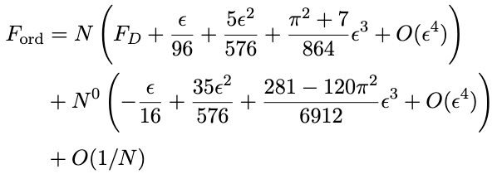
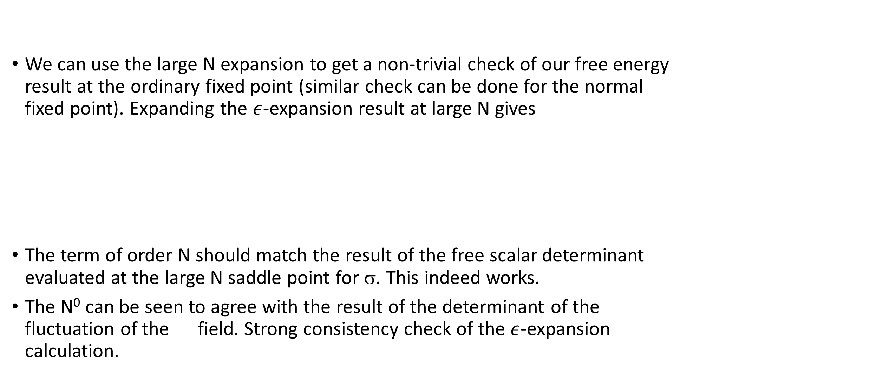
Large N check of the ε-expansion result
We can use the large N expansion to get a non-trivial check of our free energy result at the ordinary fixed point (similar check can be done for the normal fixed point). Expanding the $ε$-expansion result at large N gives
The term of order N should match the result of the free scalar determinant evaluated at the large N saddle point for σ. This indeed works.
The N⁰ can be seen to agree with the result of the determinant of the fluctuation of the field. Strong consistency check of the $ε$-expansion calculation.

Slide 39
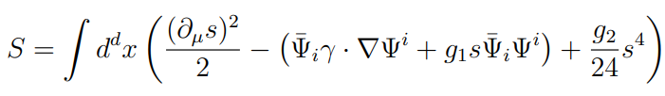



Gross-Neveu-Yukawa
Another well-known model is the so-called Gross-Neveu-Yukawa theory, with N Dirac fermions and one real scalar
In d=4-$ε$, it has weakly coupled Wilson-Fisher fixed points, with the critical coupling given to leading order by (higher-orders known up to 5 loops)

Slide 40


3d GNY CFTs
The continuation of these fixed points to $ε=1$(d=3) is expected to describe interesting 3d CFTs with fermions
A particularly interesting example: formally setting N=1/4, one gets a 3d theory with a single Majorana fermion and a single real scalar. The corresponding fixed point and CFT data exhibit “emergent” supersymmetry
Thomas ’05; Lee ’07; Grover et al ’14; Fei, SG, Klebanov, Tarnopolsky ‘16
We may refer to this SCFT at N=1/4 as the 3d super-Ising model
When continued down to d=2, it corresponds to the well-known supersymmetric formulation of the tricritical Ising CFT
Friedan, Qiu, Shenker ‘85

Slide 41



Gross-Neveu-Yukawa vs. Gross-Neveu
The IR fixed points of the GNY model provide a “UV completion” of the UV fixed points of the Gross-Neveu model at large N Zinn-Justin ‘91
The large N expansion of the GN model can be developed in 2<d<4 using a Hubbard-Stratonovich transformation, and one finds UV fixed points that can be studied in the 1/N expansion in 2<d<4 using the action
All results for CFT data agree with the fixed points of the GNY model in the overlapping regime. Gives useful cross-checks of the $ε$–expansion results.

Slide 42

Gross-Neveu-Yukawa BCFT from AdS
To study the GNY mode with a boundary, we can map it to AdS
For the fermions, one imposes (one of) the boundary conditions
There are three possible boundary universality classes, depending on the boundary conditions for the scalar field, like in the O(N) model.
Two simple possibilities are to impose Dirichlet and Neumann boundary conditions. These are analogs of the “Ordinary” and “Special” boundary universality classes.

Slide 43


Gross-Neveu-Yukawa BCFT from AdS
Like for the O(N) model, the other possibility is to impose boundary conditions such that the scalar has a non-zero one-point function, which in AdS corresponds to expanding around the non-zero classical value at the critical point of the potential
Perturbation theory around this boundary condition defines the “normal” universality class of the GNY model
The free energy for ordinary and special b.c. was computed to order $ε$ in SG, Helfenberger, Khanchandani ‘21, and for the normal b.c. we recently computed it to the same order in Diatlyk, SG, Sun ‘26.

Slide 44


Free energy of the “normal” BCFT in GNY
Expanding around the non-trivial expectation value of the scalar, one obtains the action
This should be supplemented by curvature counterterms, which play an important role in the renormalization (they are essential to get agreement with large N results)
Diagrams to be evaluated

Slide 45



Results
The results for general N are explicit but rather lengthy. For the special case N=1/4, which should describe the super-Ising CFT, the final result for the quantity is given by
As for the O(N) model, we can do a “two-sided” Pade by identifying the corresponding boundary state in the tricritical Ising BFCT in 2d, which has the g-function given by
From such a two-sided Pade, we get the prediction for the 3d boundary central charge

Slide 46

Results
In a similar way, we can get an estimate for the “ordinary” boundary universality class (identifying the corresponding boundary state in 2d and doing a two-sided Pade). We get the estimate
It would be interesting to compare these results to predictions from fuzzy sphere, which are currently unavailable (fermionic CFTs without boundary were studied using fuzzy sphere method in Zhou, Gaiotto, He ‘25)

Slide 47

Conclusion
Placing a CFT in AdS gives a natural way to study BCFT observables
We computed the free energy for the “normal” and “ordinary” boundary universality classes of the O(N) model to high loop order in AdS_{4-ε} , and obtained estimates for the boundary central charge in the 3d BCFT
  For the “normal” universality class, very good agreement with fuzzy sphere result
  For the “ordinary” universality class, some tension with fuzzy sphere result
We performed a similar analysis for the GNY model with a boundary. Obtained predictions for the boundary central charge of 3d super-Ising
Other natural applications
  Conformal gauge theories: e.g. critical QED with N_{f} fermion/scalar flavors in d=4-$ε.$ SG, F. de Cesare, to appear
  Chern-Simons theory with fundamental fermions/scalars in AdS₃ . Explore the 3d Bose/Fermi duality in the presence of a boundary. Higher-spin holographic dual of vector model BCFTs?

Slide 48
Thank You!

