Slide 1




Analysis of ³He neutron proportional counter spectrum taken in potential PAUL site
Gaël Poussot-Pelaez

Slide 2
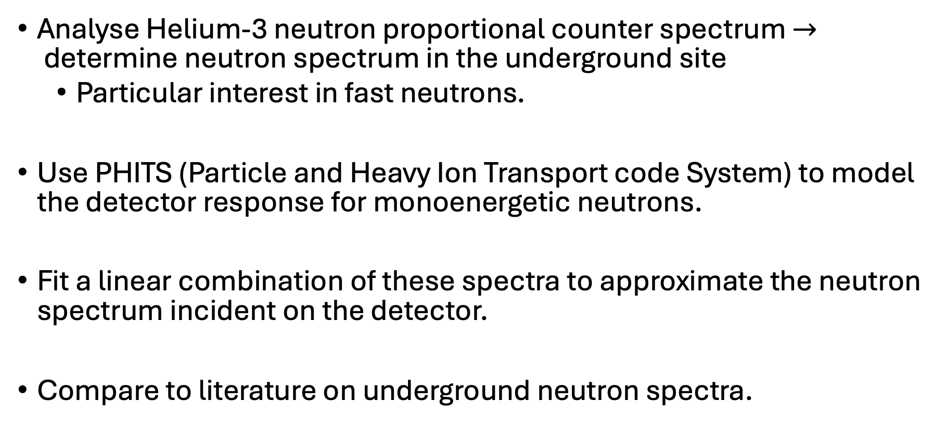
Overview
Analyse Helium-3 neutron proportional counter spectrum $→$determine neutron spectrum in the underground site
Particular interest in fast neutrons.
Use PHITS (Particle and Heavy Ion Transport code System) to model the detector response for monoenergetic neutrons.
Fit a linear combination of these spectra to approximate the neutron spectrum incident on the detector.
Compare to literature on underground neutron spectra.

Slide 3
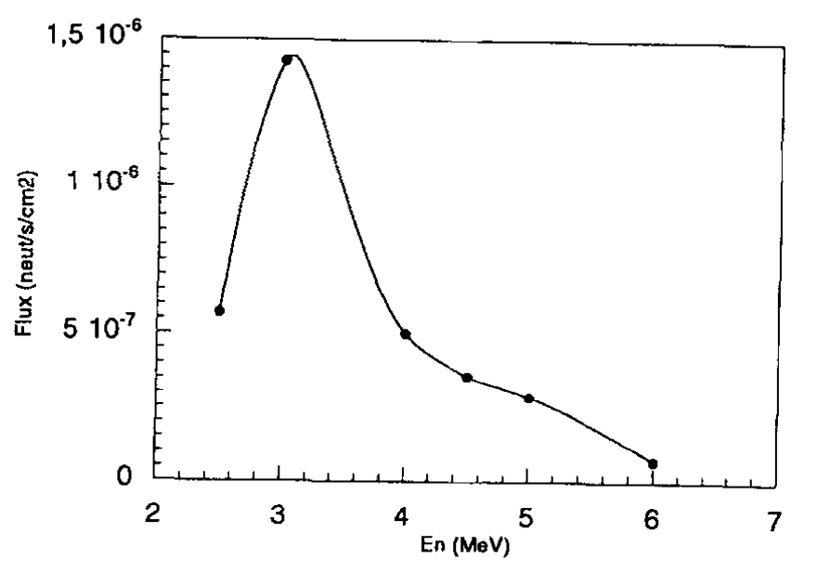
Literature review
V. Chazal et al. (1999) , “Neutron background measurements in the underground laboratory of Modane”
Lithium-6 doped liquid scintillator

Slide 4
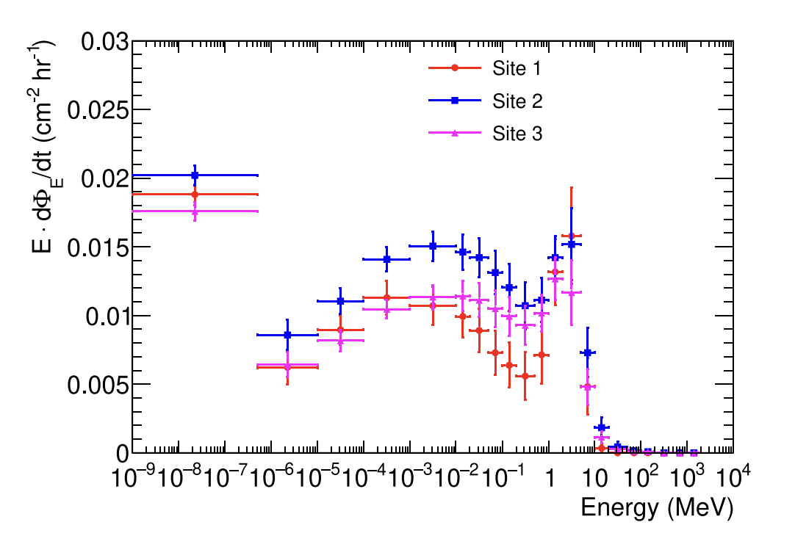
Literature review
Joong Hyun Kim et al. (2026) – “Neutron spectrum measurement in the Yemi underground laboratory”
10 He-3 proportional counters with different levels of shielding

Slide 5
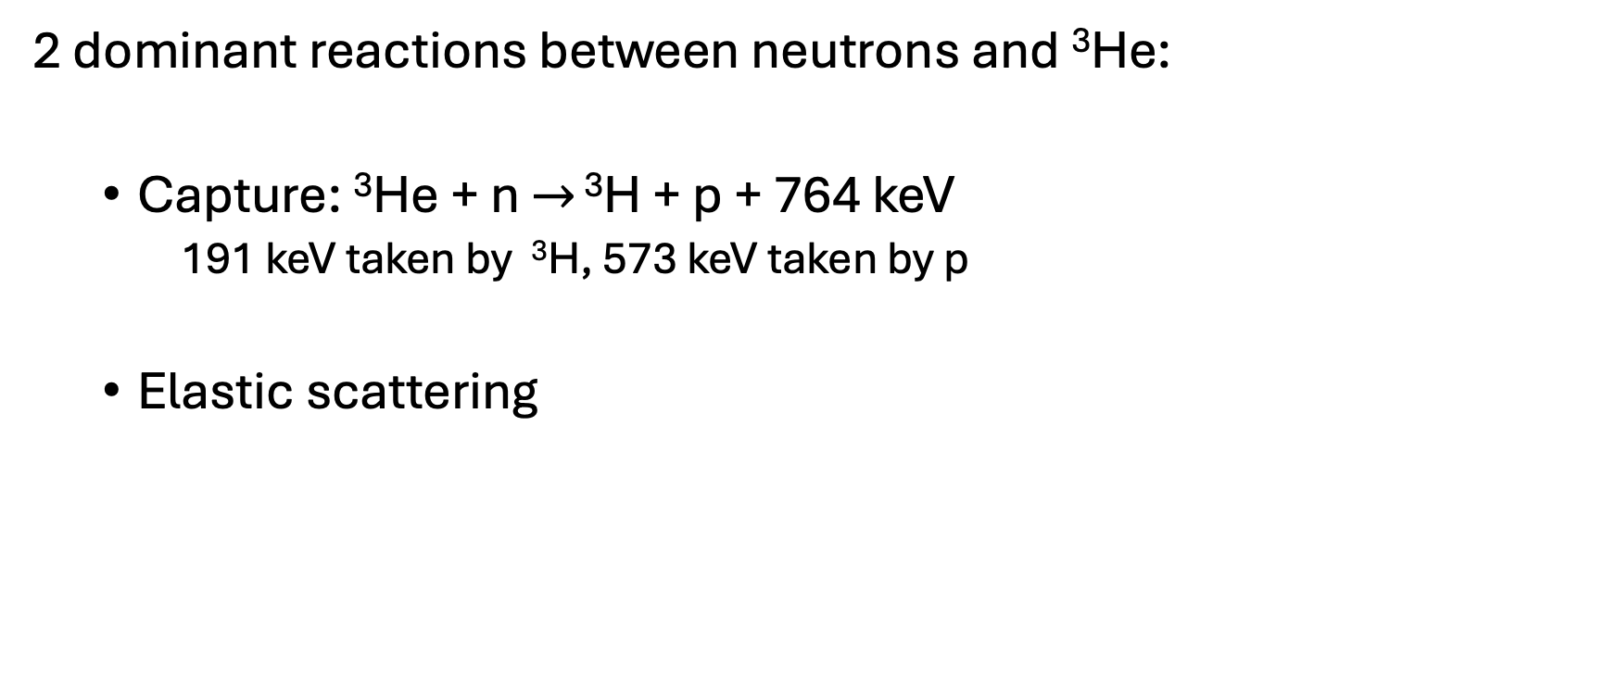
Detector
2 dominant reactions between neutrons and ³He:
Capture: ³He + n $→$ ³H + p + 764 keV
191 keV taken by ³H, 573 keV taken by p
Elastic scattering

Slide 6
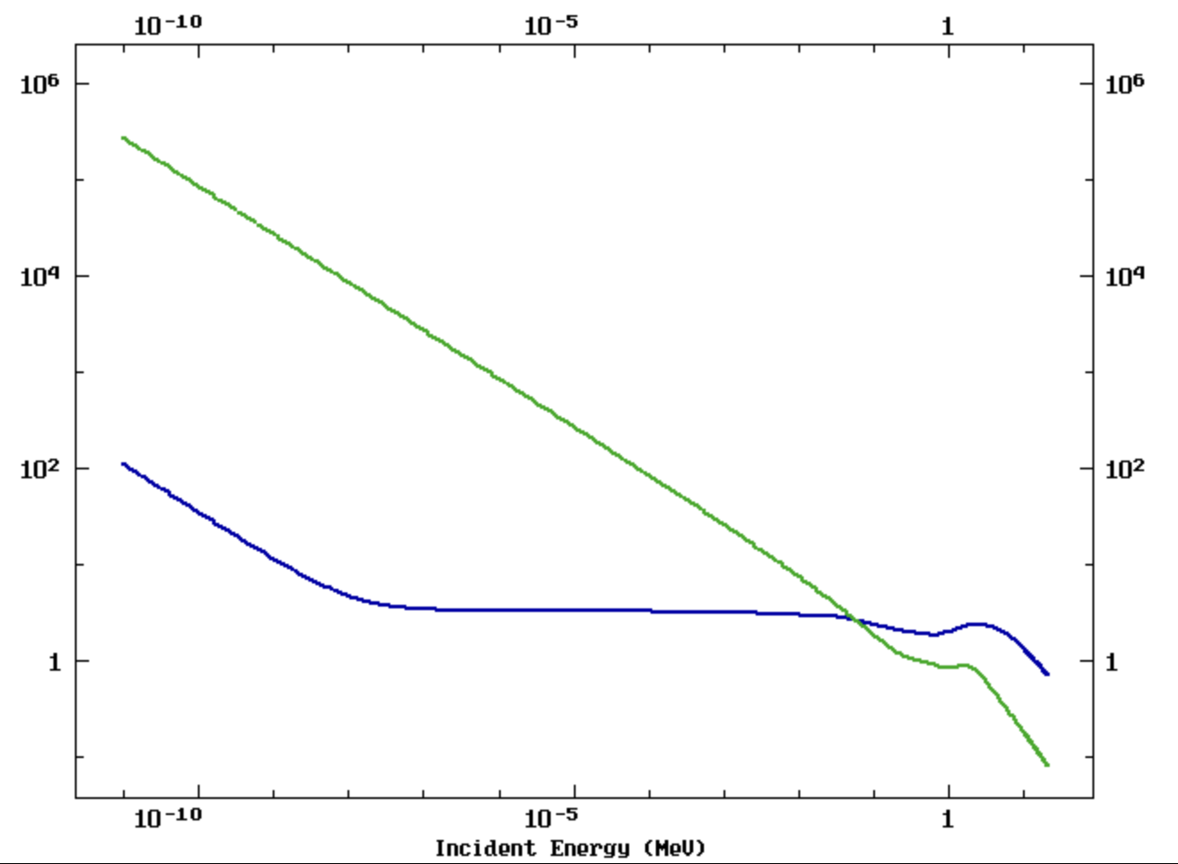
_
Neutron capture cross section
_
Elastic scattering cross section
Overlap ~ 100 keV

Slide 7
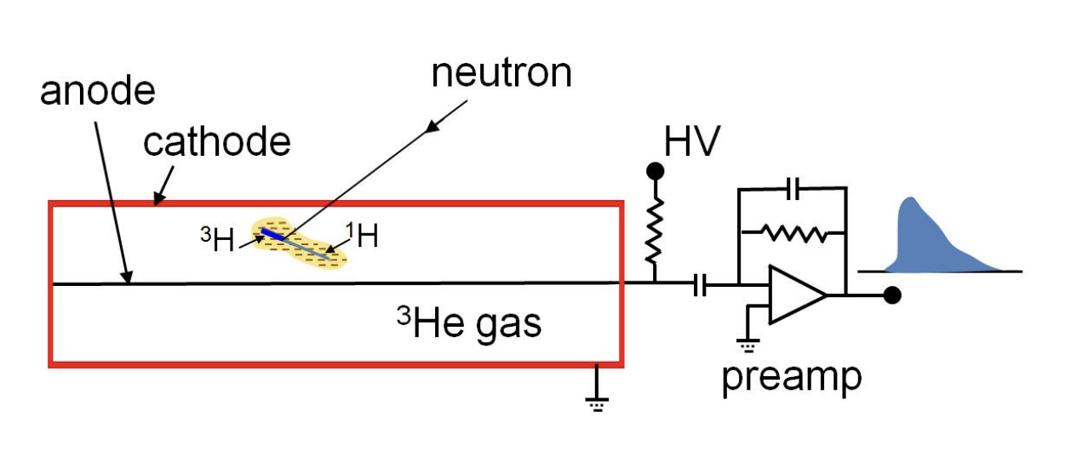
Detector
2.5cm
45cm
Stainless steel tube containing Helium-3 + an unknown percentage of a gas at 4 bar.
likely to be CH₄ + Ar, higher proportion of CH₄ than Ar
Total unknown gas < 10% of total
Neutron captured by ³He, proton and tritium ionise gas.
Electrons drift to anode, avalanche of electrons where number of electrons proportional to energy of proton+tritium

Slide 8
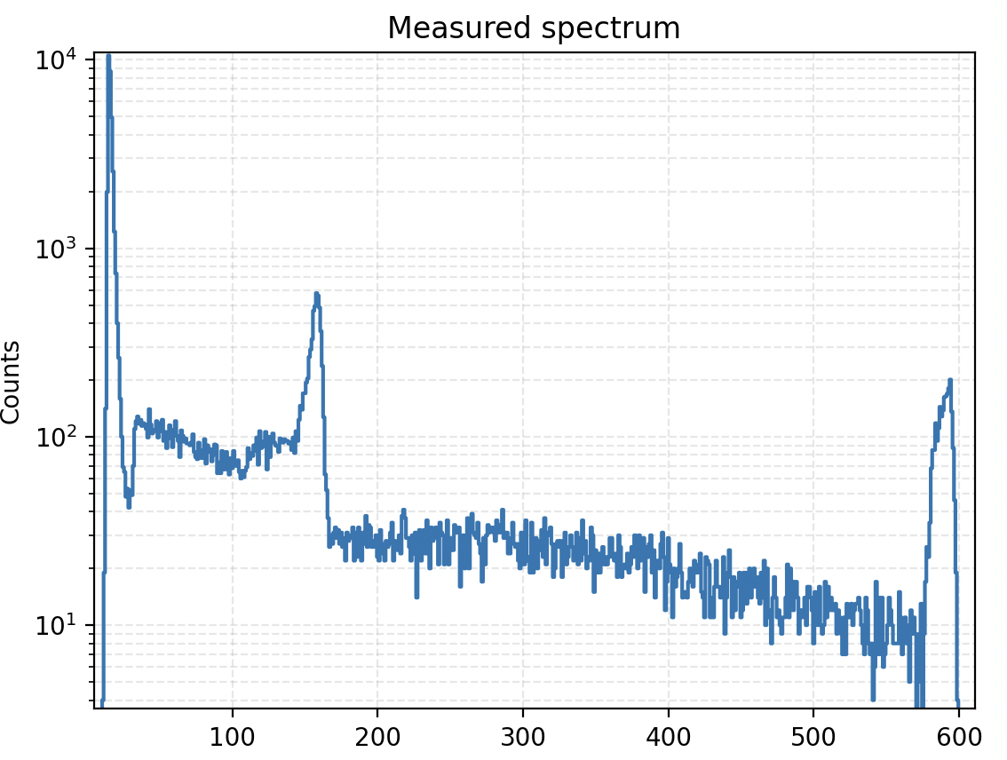
Measured spectrum – taken over ~1 month
Electric noise + gamma background
Peak > 764 keV
Elastic scattering + some high energy captures
Saturation
Partial energy deposition of fragments

Slide 9
PHITS simulations
Goal: deduce the neutron spectrum incident on the detector from the measured spectrum
Method:
Simulate the response of the detector using PHITS for many monoenergetic sources
Fit a linear combination of these monoenergetic spectra to the measured spectrum
Estimate the incident neutron spectrum based on the coefficients of the linear combination

Slide 10
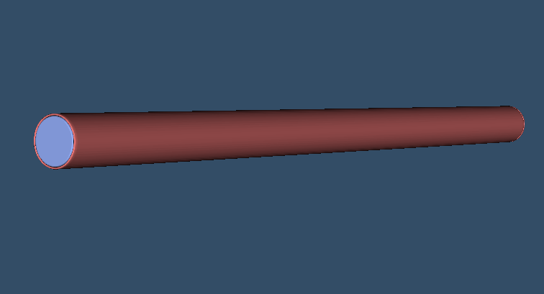
PHITS simulations
Isotropic source of neutrons – cylindrical / cuboidal
10e8 neutrons simulated for each spectrum
Collection of charges is not simulated
Simulations of 3 different gases:
³He + 7% CH₄ + 3% Ar
³He + 8% CH₄ + 2% Ar
³He + 9% CH₄ + 1% Ar
Steel tube
Gas mixture

Slide 11
PHITS simulations
For energies between 10 meV - 0.1 MeV, simulations run for 10 meV, 100 meV, 1eV, 10 eV…, 0.1 MeV
For energies between 0.2-10 MeV: one simulation every 200 keV.
Compromise between time of simulation and statistical fluctuation in spectra.

Slide 12
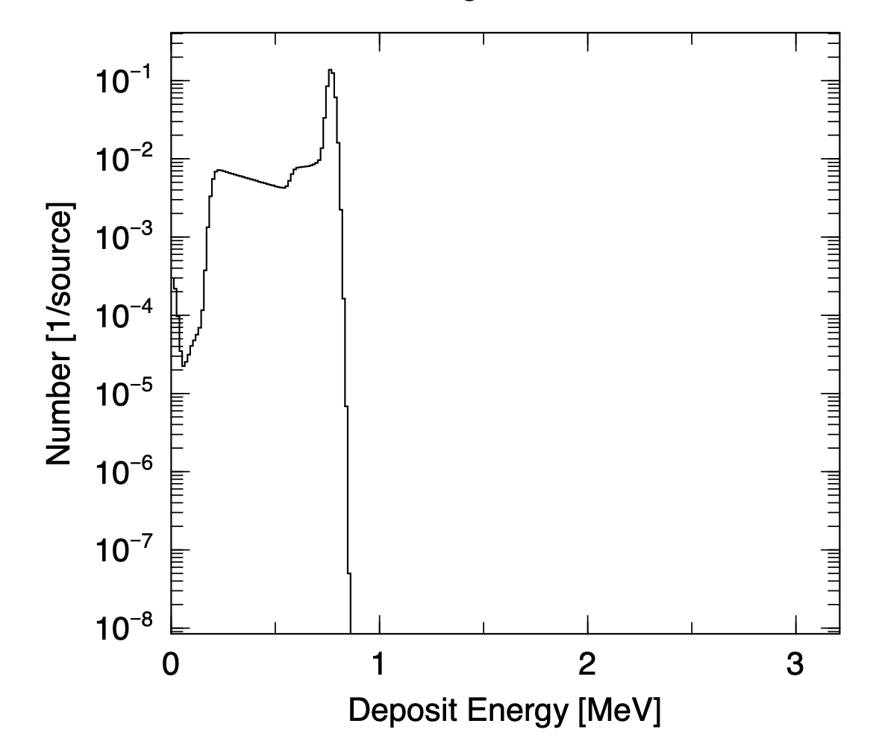
PHITS Simulations
764 keV
Spectrum from simulation of 10 meV neutrons
~100% of contributions are neutron captures
Detector resolution simulated in PHITS
573 keV, tritium no deposition
191 keV, proton no deposition

Slide 13
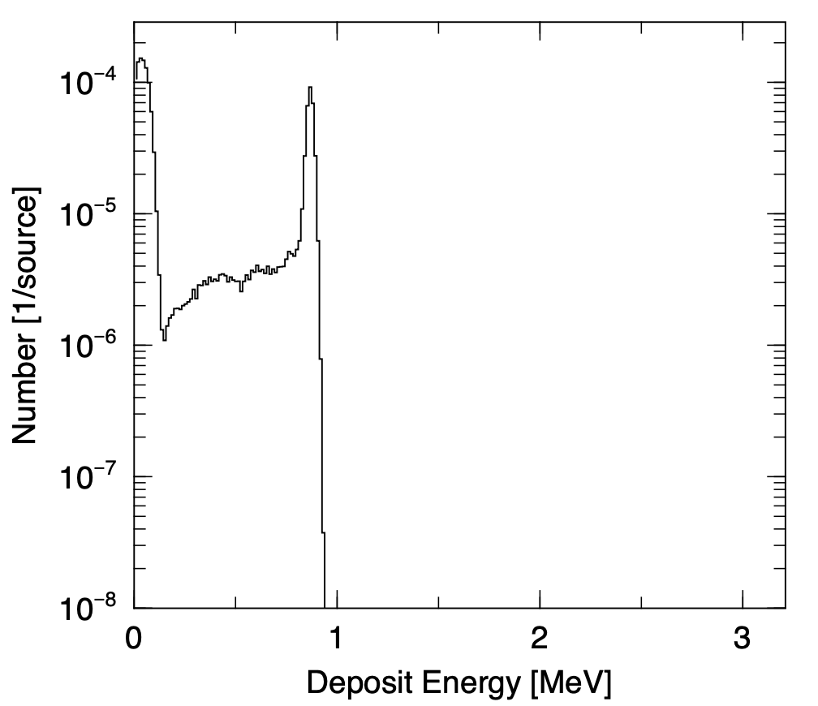
PHITS Simulations
Elastic scattering
Spectrum from simulation of 100 keV neutrons
Capture and elastic scattering cross sections are approximately equal
864 keV

Slide 14
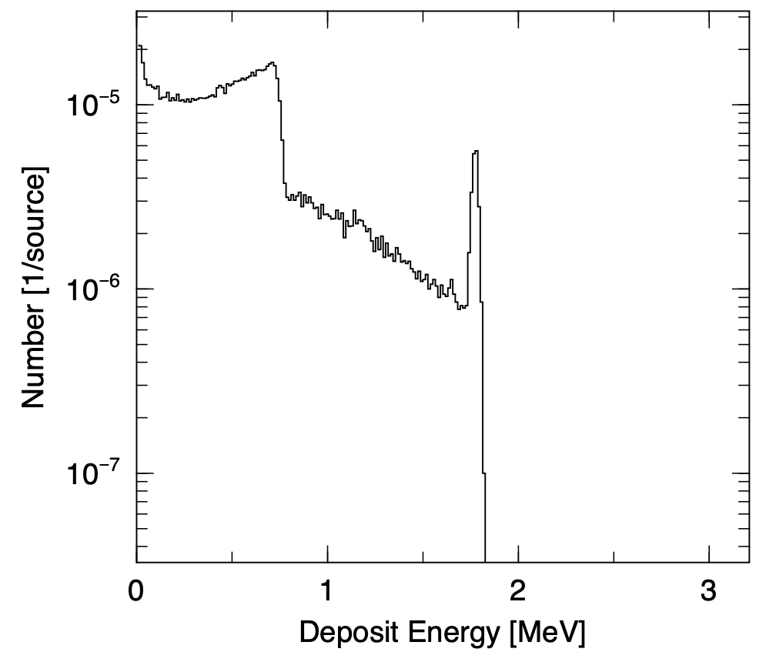
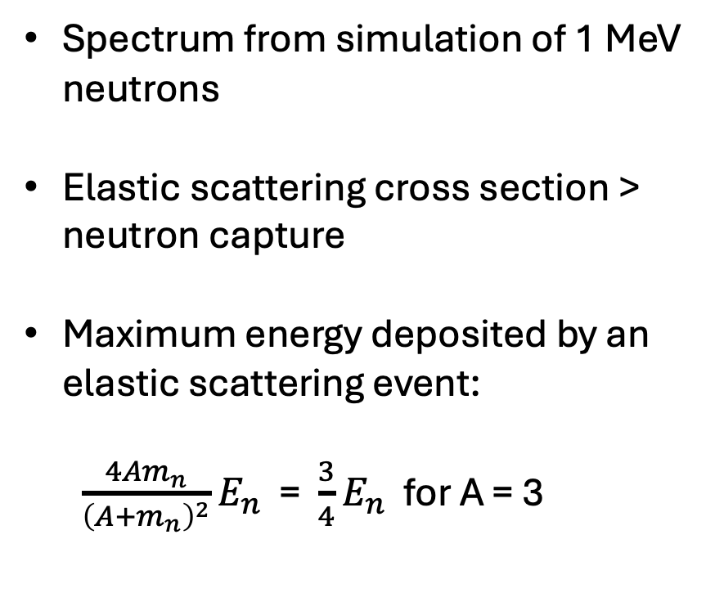
PHITS Simulations
Spectrum from simulation of 1 MeV neutrons
Elastic scattering cross section > neutron capture
Maximum energy deposited by an elastic scattering event:
$\frac{4Am_{n}}{{\left(A+m_{n}\right)}^{2}}E_{n}$ = $\frac{3}{4}E_{n}$ for A = 3
750 keV
1764 keV

Slide 15
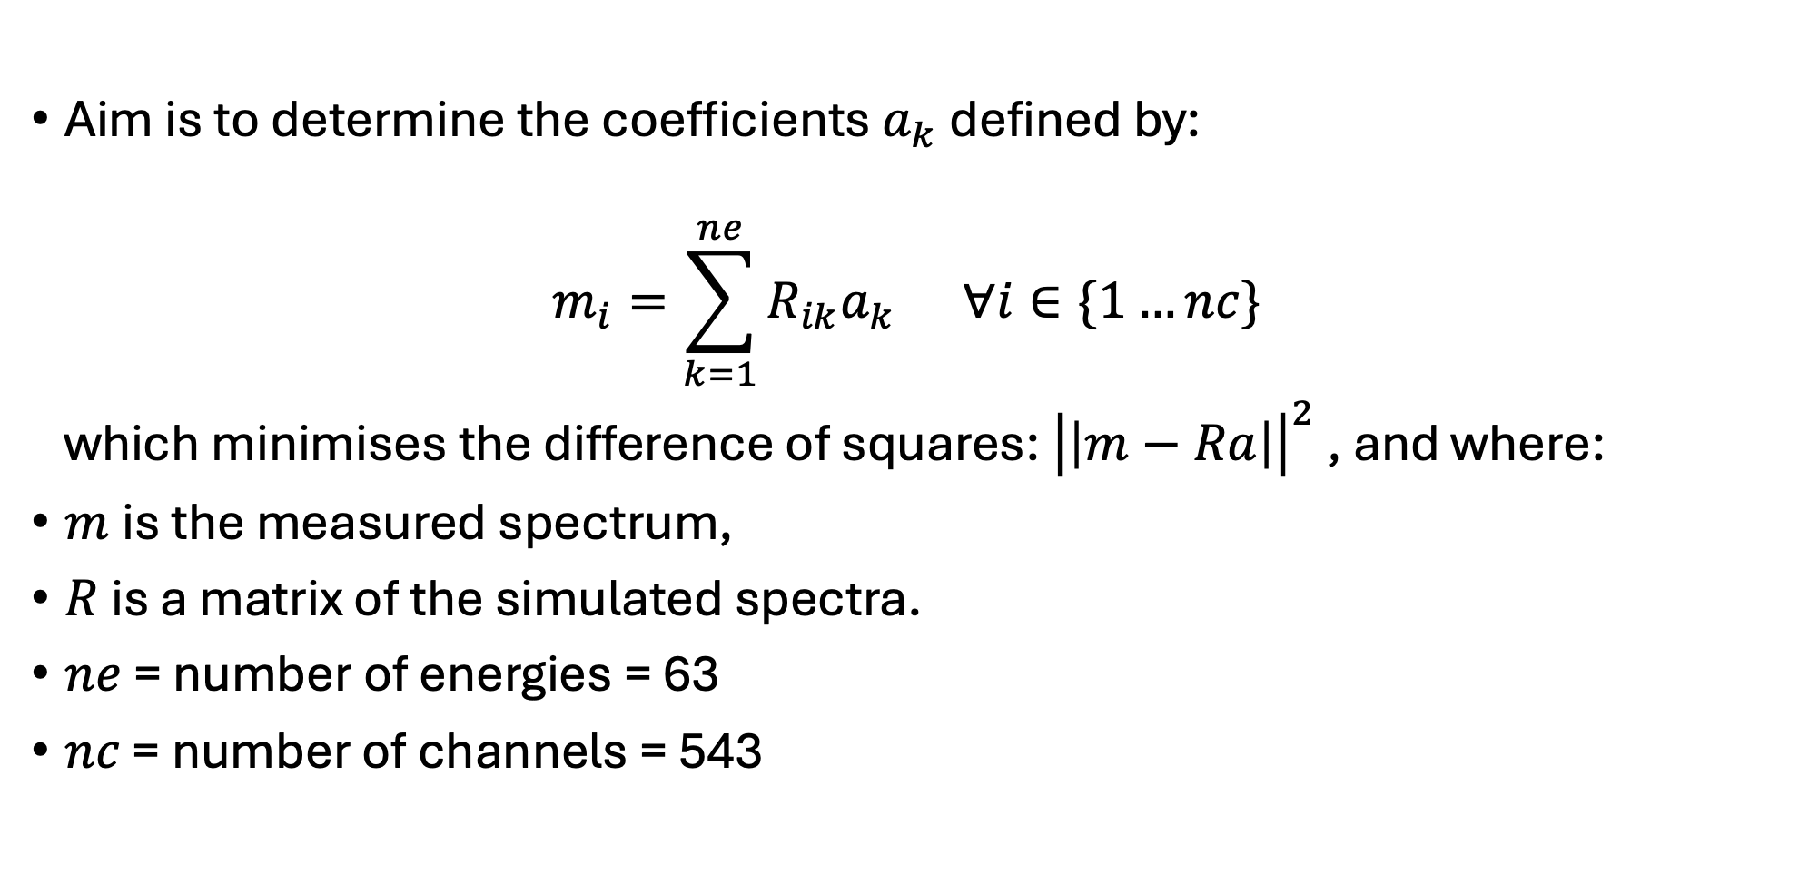
Fitting spectra
Aim is to determine the coefficients $a_{k}$defined by:
$$m_{i}=\sum_{k=1}^{ne}{R_{ik}a_{k } ∀i}∈\{1…nc\}$$
which minimises the difference of squares: ${\left|\left|m−Ra\right|\right|}^{2}$ , and where:
$m$is the measured spectrum,
$R$ is a matrix of the simulated spectra.
$ne$ = number of energies = 63
$nc$ = number of channels = 543

Slide 16
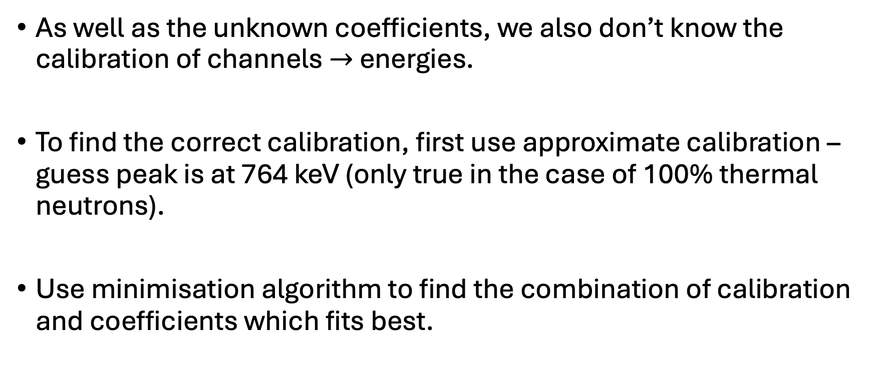
Fitting spectra
As well as the unknown coefficients, we also don’t know the calibration of channels $→$ energies.
To find the correct calibration, first use approximate calibration – guess peak is at 764 keV (only true in the case of 100% thermal neutrons).
Use minimisation algorithm to find the combination of calibration and coefficients which fits best.

Slide 17
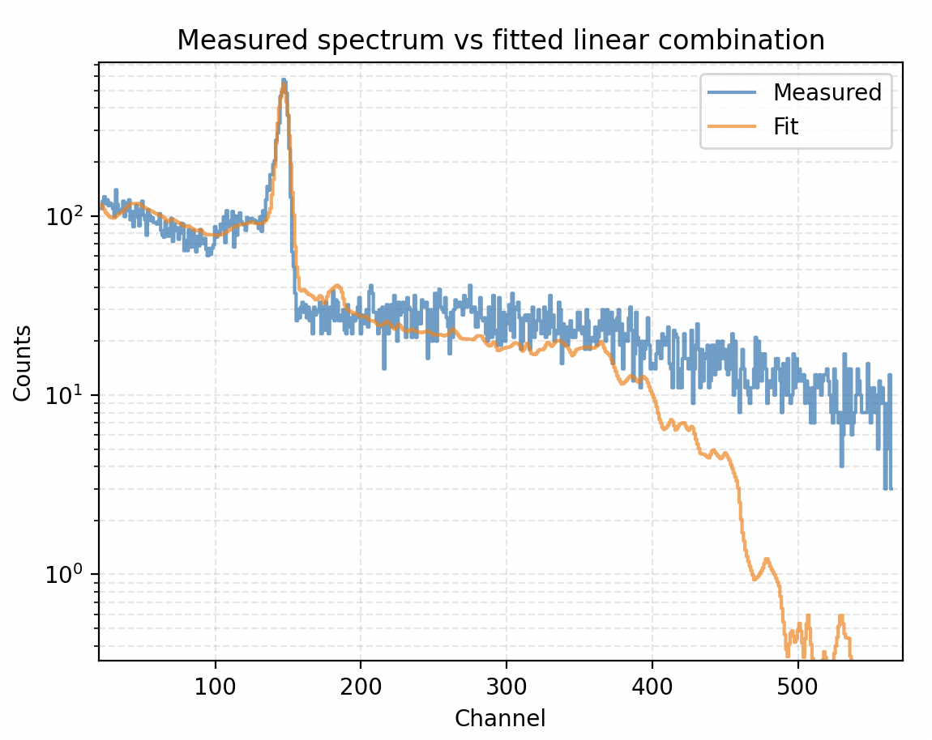
Preliminary results
The best result we have obtained up to now is using 9% CH₄ + 1% Ar and a cuboid neutron source
Good fit at low energies and up to channel 400
Problem of energy deposition at high energies
Peak estimated at 782 keV using best calibration

Slide 18
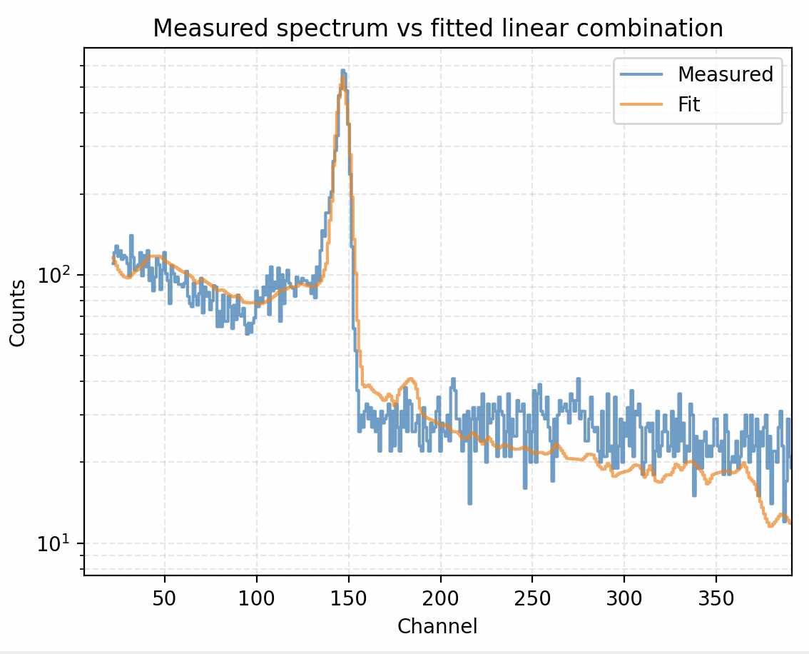
Preliminary results

Slide 19
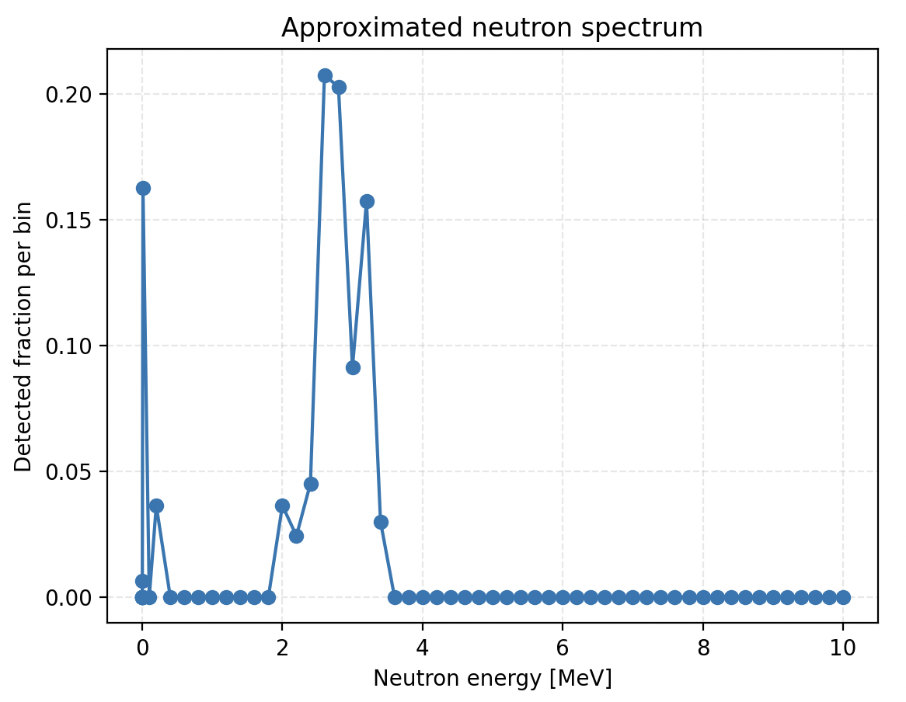
Preliminary results
Approximated incident neutron spectrum
Spectrum for this fit is reasonable
Shows contribution of thermal and epithermal neutrons
Main fast neutron peak around 3 MeV, similar to Chazal et al. paper.

Slide 20
Next steps
Missing information in saturation – attempt to use the number of neutrons above saturation to add information to fit.
Simulation of 4 tubes together.
Increase bin widths in measured spectrum to remove statistical noise.
Continue exploring different gas mixtures, as this is a significant unknown.
Validate our method of analysis by measuring known spectrum e.g. using Americium-Beryllium source

