Slide 1






Astro-CC Pilot
Funded Project
Presenter: Mark Allen, CDS CNRS Strasbourg Astronomical Observatory, 0000-0003-2168-0087
Implemented by
Implemented by
LOGO
LOGO
LOGO
LOGO
LOGO
LOGO

Slide 2
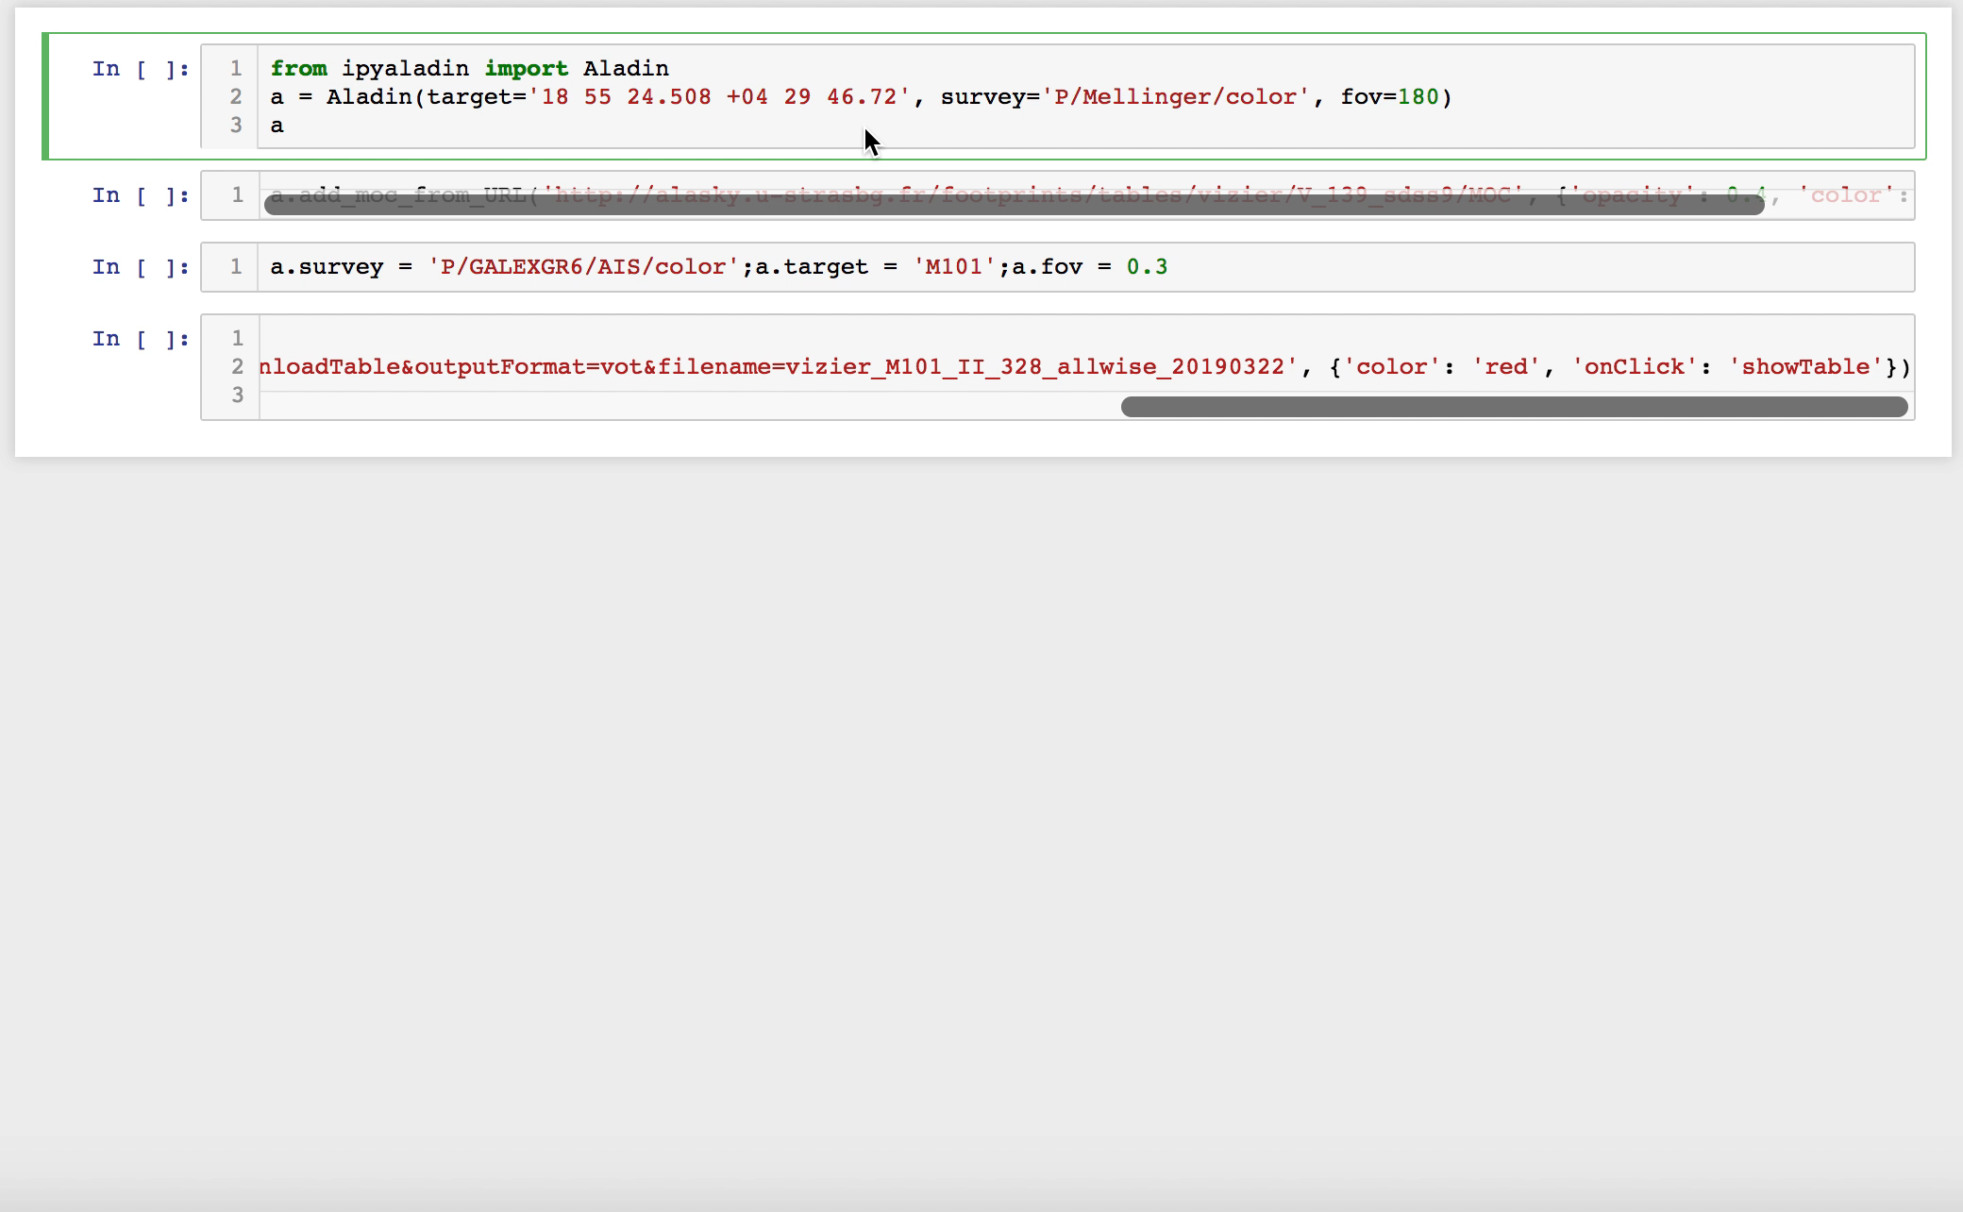
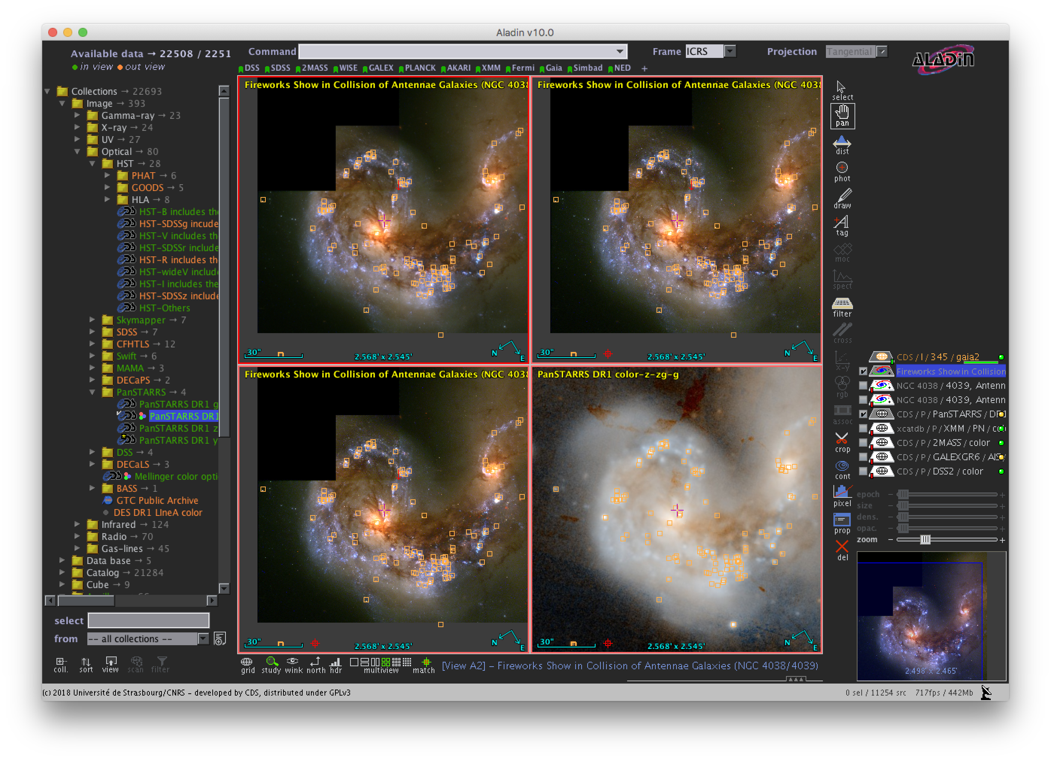
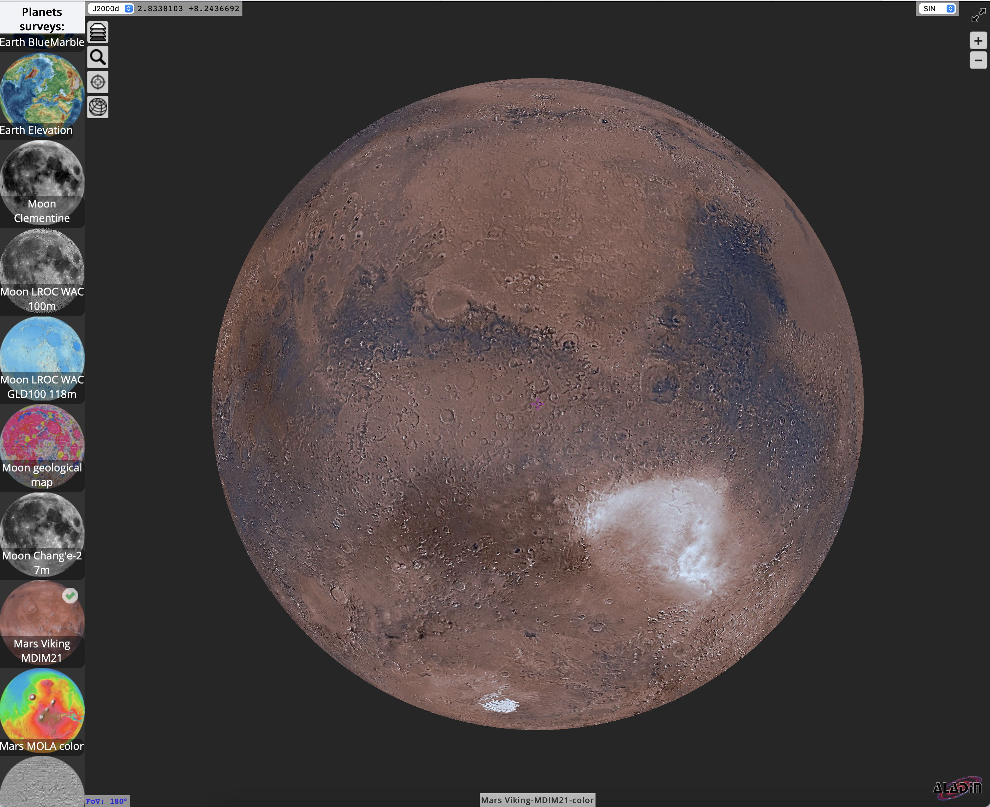
CHALLENGE ADDRESSED
What problem(s) are you going to solve?
Accelerating Open Science in Astronomy by use of standards.
Widening the scope beyond the ESCAPE partners to include planetary science and space weather.

Slide 3
SOLUTION
What have you done to solve the problem?
Organised Astronomy Open Science “Competence Centre events”
2 of the planned events have been successfully held:
Technology Forum 1 (October 2025): https://indico.in2p3.fr/event/36318/
30 participants
Scientific training event 1 (Dec 2025): https://indico.in2p3.fr/event/36738/
48 participants
3 up-coming events:
Data Provider Forum (March 2026): https://indico.in2p3.fr/event/37439/
Scientific Training event 2 (TBD, 2026)
Technology Forum 2 (~October 2026):
3 more planned events coming up:
Data Provider Forum – to share experience on implementing interoperability.
2 Technology Forums – for the cooperation and development of the underlying data sharing frameworks.
2 Scientific Training events – Ph.D and ECRs to exploit the system for their scientific research

Slide 4
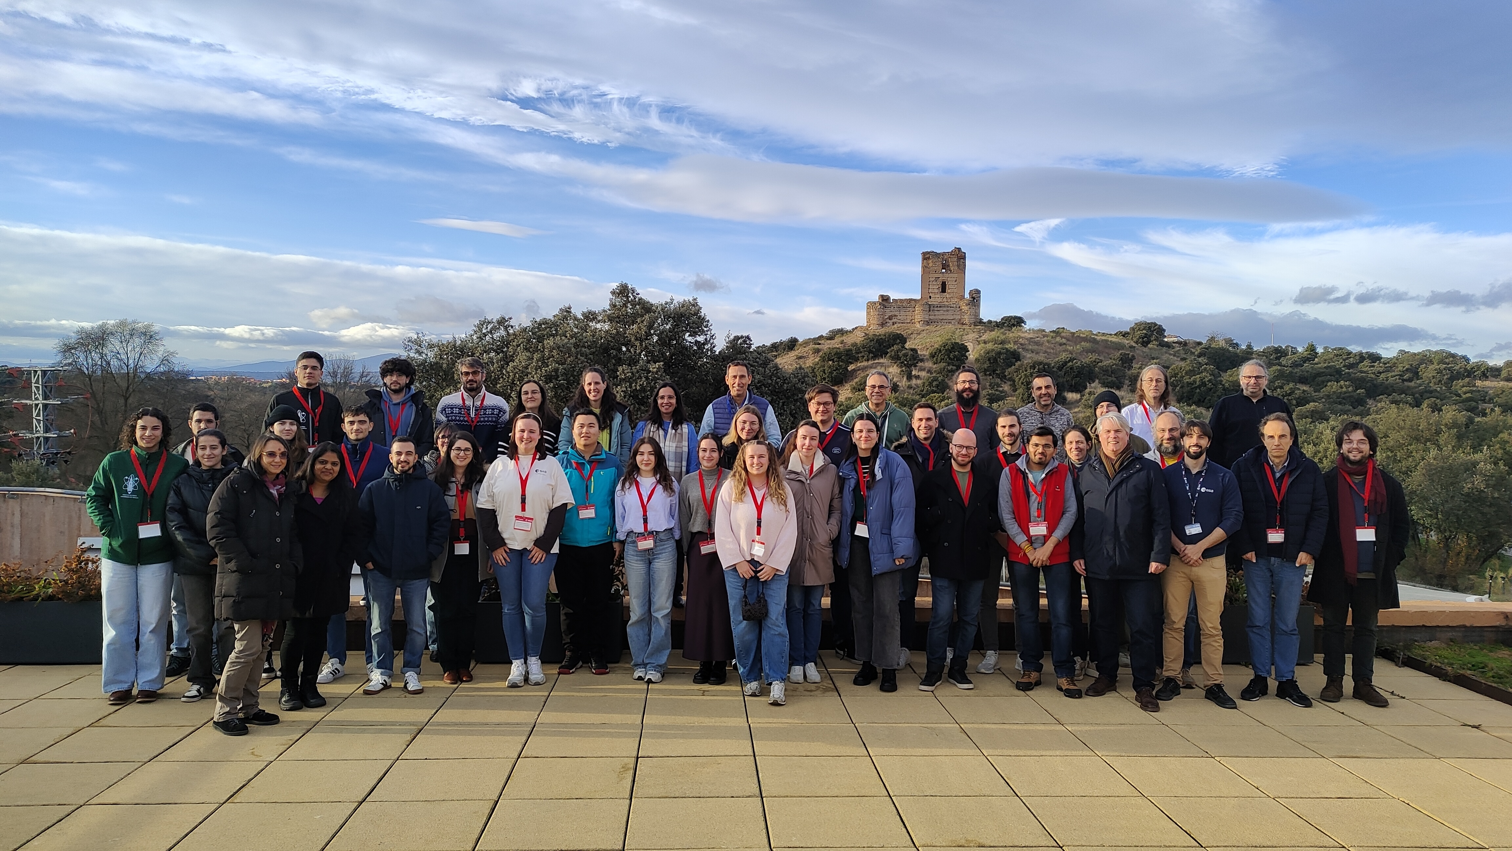
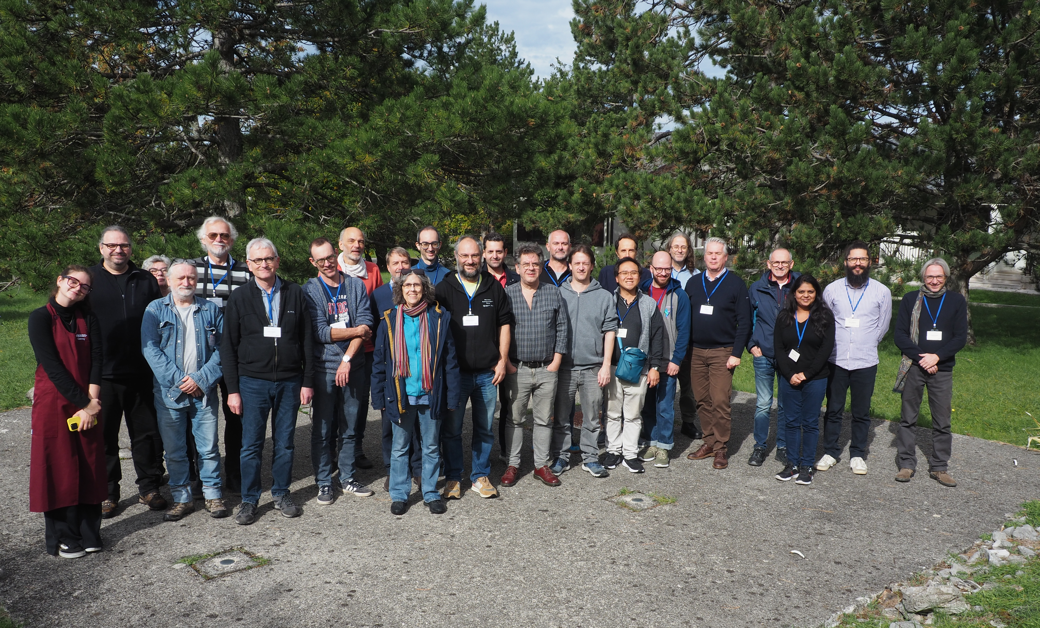
RESULTS
What are the key results achieved to date and how have you made them available to the broader community?
Community engagement and new technical and scientific skills gained.

Slide 5
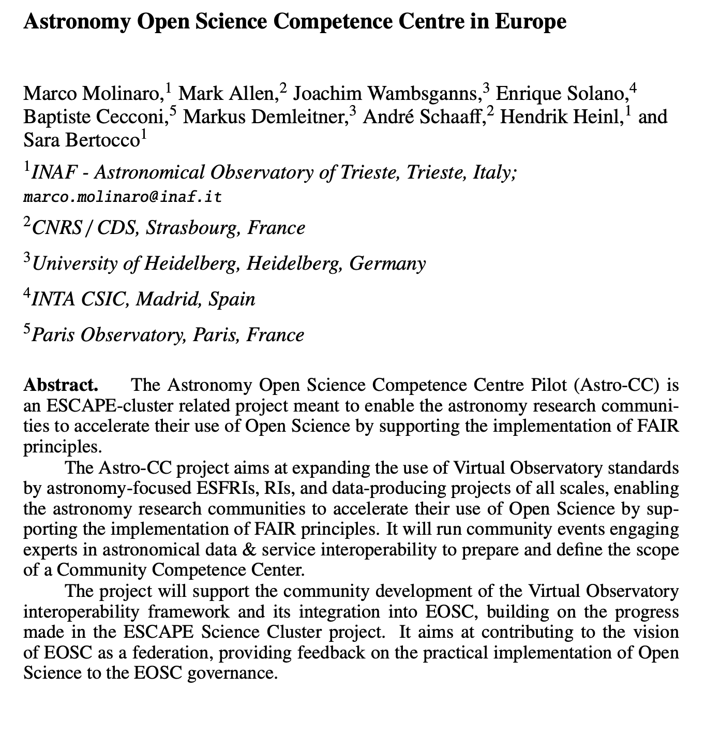

RESULTS
How will make your results sustainable over time - How will the scientific community/-ies further exploit them?
Results have been presented at international conference “Astronomy Data and Software Systems” – Görlitz, Germany, November 2025.
We plan for Competence Centre activities to become sustainable and enlarged via community contributions.

Slide 6
TEAM
Who is doing it?
Project team:
Manon Marchand (CDS), André Schaaff (CDS), Ada Nebot (CDS), Sébastien Derriere (CDS),Anais Gonneau (CDS), Marco Molinaro (INAF), Sara Bertocco (INAF), Hendrik Heinl (INAF), Enrique Solano (INTA), Patricia Cruz (INTA), Joachim Wambsganns (UHEI), Markus Demleitner (UHEI), Margarida Castro Neves (UHEI), Baptist Cecconi (ObsParis), Stephane Erard (ObsParis), Pierre Le Sidaner (ObsParis)
LOGO

Slide 7
Astronomy interoperability
Other events coming up:
  5 day IVOA Interoperability meeting, hosted by CDS Strasbourg 8-12 June 2026
    https://indico.ict.inaf.it/event/3454/
  COSPAR General Assembly (Molinaro)
  PV 2026 - Ensuring Long-Term Preservation and Adding Value to Scientific and Technical Data, hosted by ESA: https://www.cosmos.esa.int/web/pv2026. 23-25 June 2026.
Evolution of VO framework
  e.g. HiPS-3D in development – related to SKA-SRCNet and any 3-D data (ESO, ALMA etc.)
  e.g. Distribution of large catalogue data – new concept based on HiPS + parquet.
  International discussion on ensuring the sustainability of the IVOA infrastructure
Astronomy participation in EOSC Symposium, Winter School
  Astro-CC on topic of Competence Centres
  CDS on topic of Trustworthy Data Centres
  OSTrails on topic of DMPs with Astronomy use case (related to CTA)

