Slide 1



Detecting Active Solar System Objects in the Fink Alert Stream
Preeti Cowan
University of Auckland

Slide 2
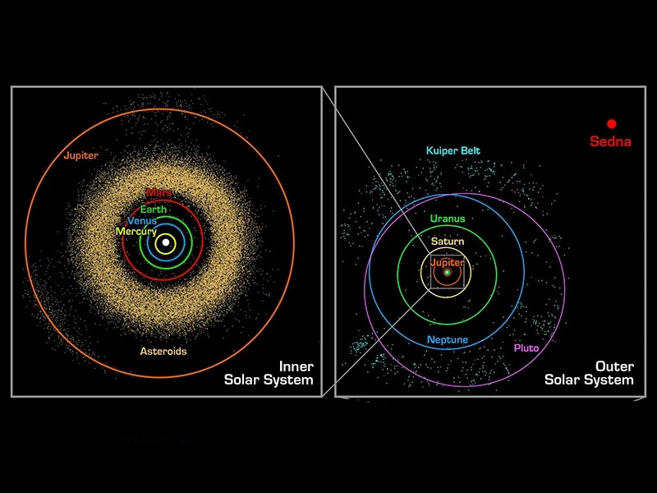
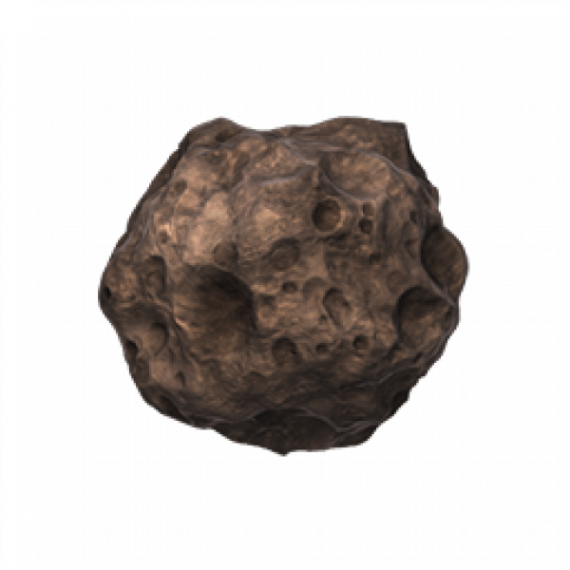
Solar System Objects
Asteroids: near-Earth, main belt, trojans, centaurs, trans-Neptunian objects
Remnants of early Solar System
    Formation
    Composition
Distributed throughout the Solar System
Present is all survey data
Image credit: NASA / JPL-Caltech
Notes:
In many ways, their lives are dominated by interactions with the planets and large bodies they come close to

Slide 3
Dynamical Interactions
Gravitational interactions rule
Mean-motion resonances
Example: Kirkwood gaps
  Asteroids in resonance with Jupiter at multiple resonant bands
  Repeated interactions with Jupiter subtly change eccentricity
  Gaps are depletion zone: (mostly) cleared of objects
Image credit: Thunkii - Own work https://commons.wikimedia.org/w/index.php?curid=192063715
Notes:
This plot here is purely based on position and completely ignores the eccentricity and inclination. What is hopefully clear are the gaps between the various dynamical classes.
The solar system is a dynamically active places and this is clear to see in it’s small bodies.

Slide 4
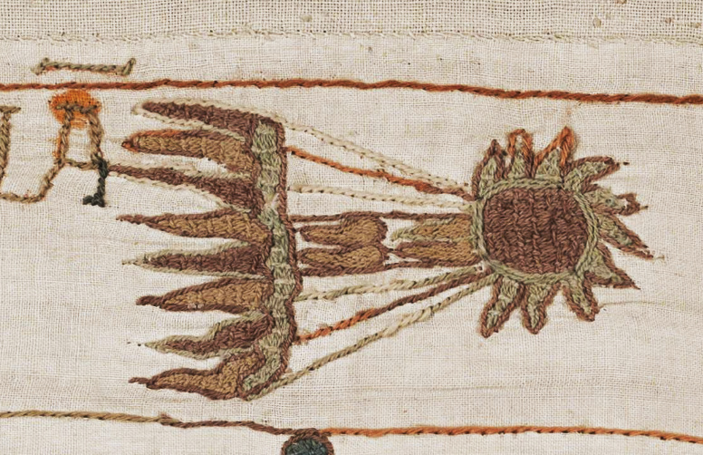
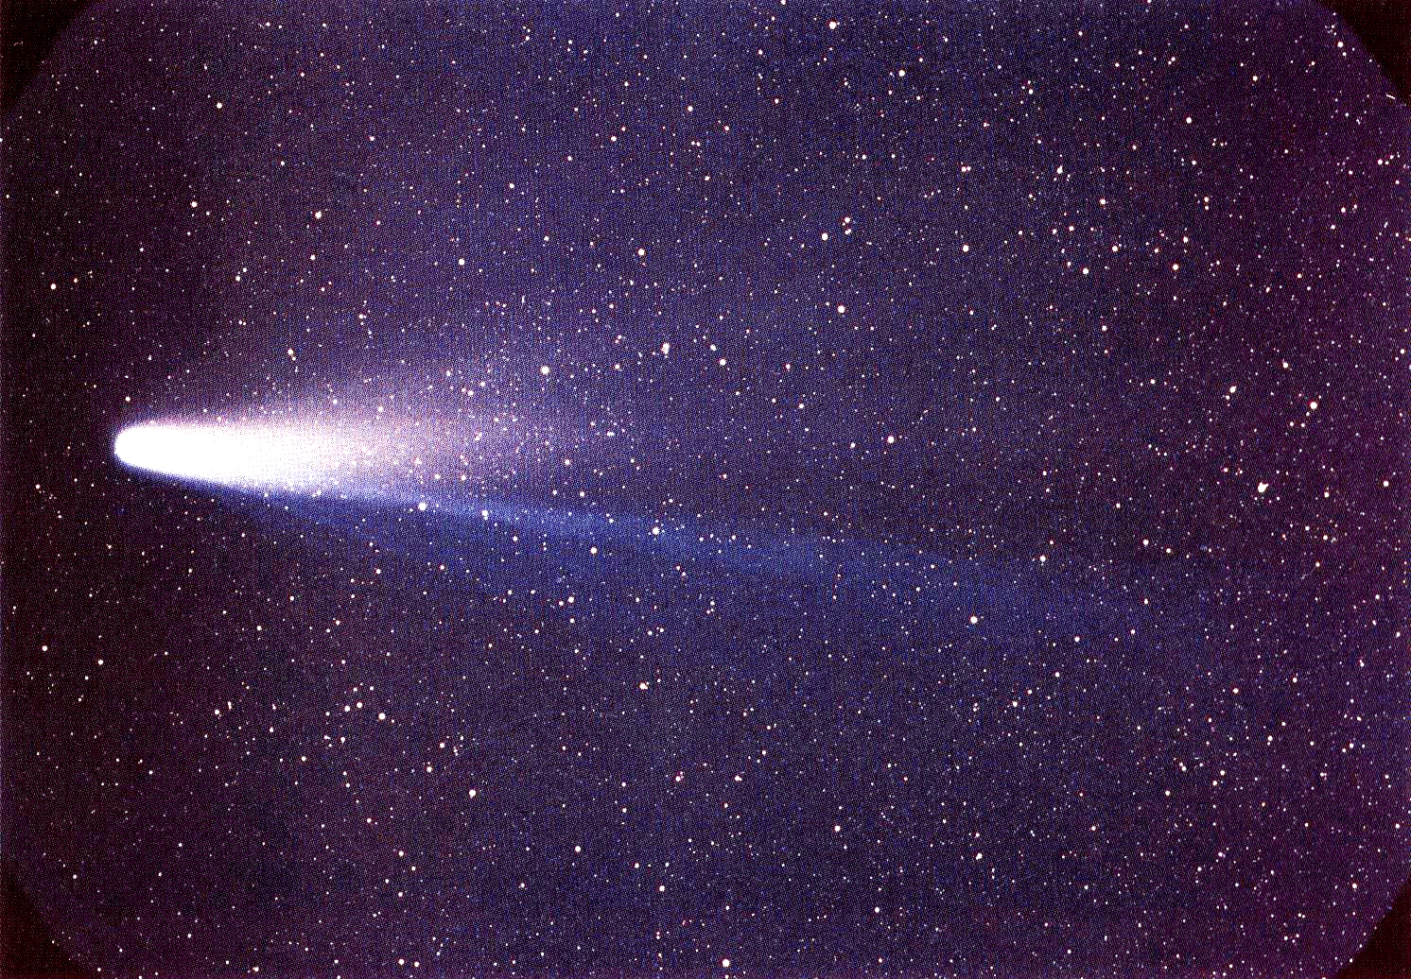
Halley’s Comet - NASA/W. Liller - 1986
Halley’s Comet - Bayeux Tapestry – 11 Century

Slide 5
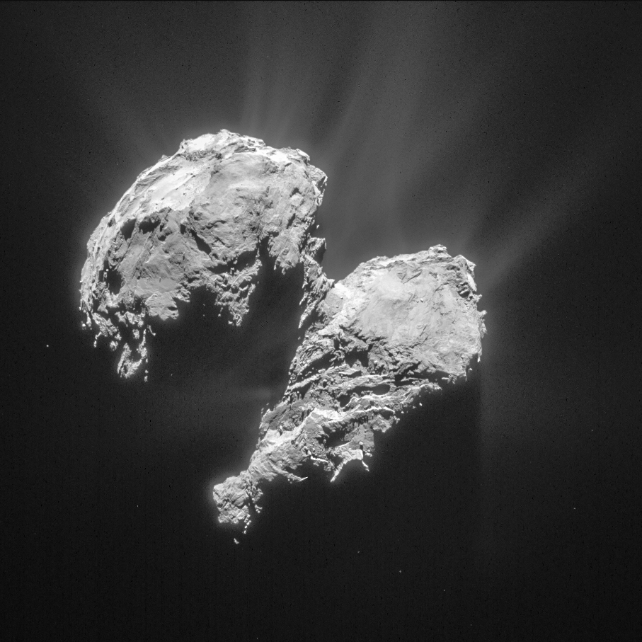
Comets
Cats of the Solar System
Icy bodies
  Ice sublimates
  Escaping gas and dust form an extended, fuzzy coma and “tail”
  … and they look like (really cool) rocks
  If a comet can be like an asteroid, can an asteroid be like a comet?
Image credit: ESA/Rosetta/NAVCAM
Notes:
67p – Rosetta’s comet
Tapisserie de Bayeux

Slide 6
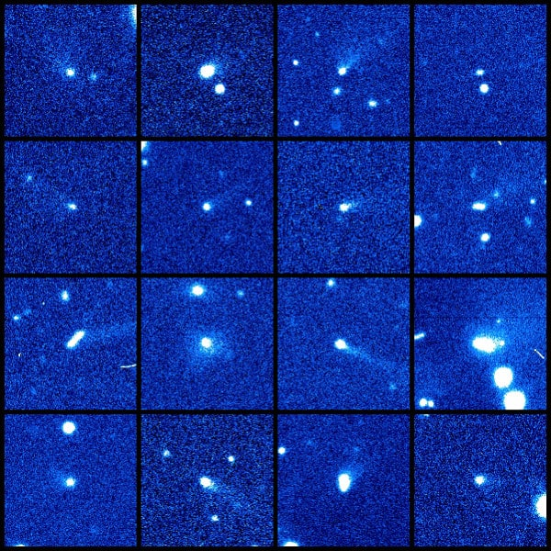
Active Asteroids
Traditional: asteroids are rocky, comets are icy
Evolved: both are icy rocks with varying levels of exposed ice
Asteroids are dynamically active:
  Gravitational stresses
  Uneven heating
  Rotational spin up
  Impacts
Difficult to spot because they are less dramatic
Image credit: H. Hsieh/PSI.

Slide 7
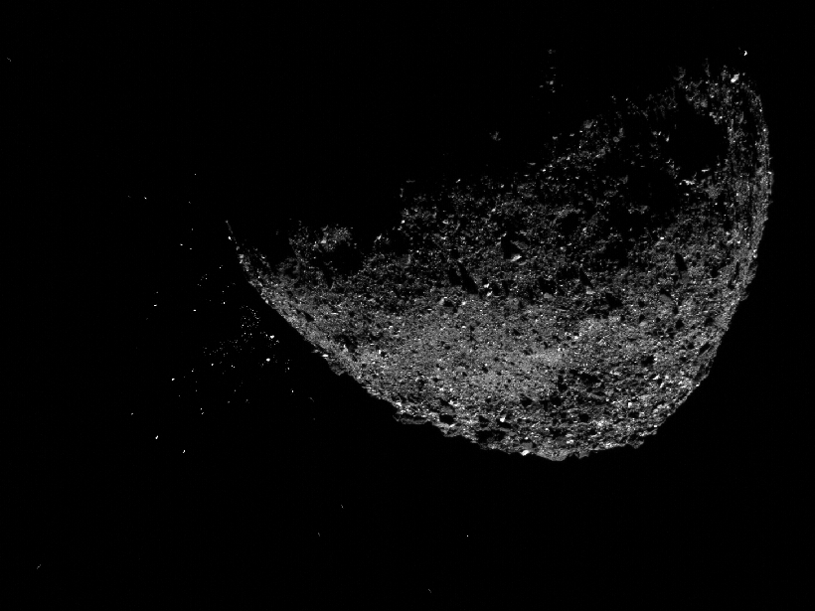
Why do we care?
Water delivery to the inner planets
Primordial water ice and other organics necessary to life that we can actually test via sample return missions (Bennu!)
The onset of activity is like the activation of a little jet engine – affects the orbit
Like any change we can observe in real time, it reveals more about the object and its environment, which happens to be our backyard
If only we had a telescope with the world’s largest digital camera and a broker that is always Finking ahead…

Slide 8
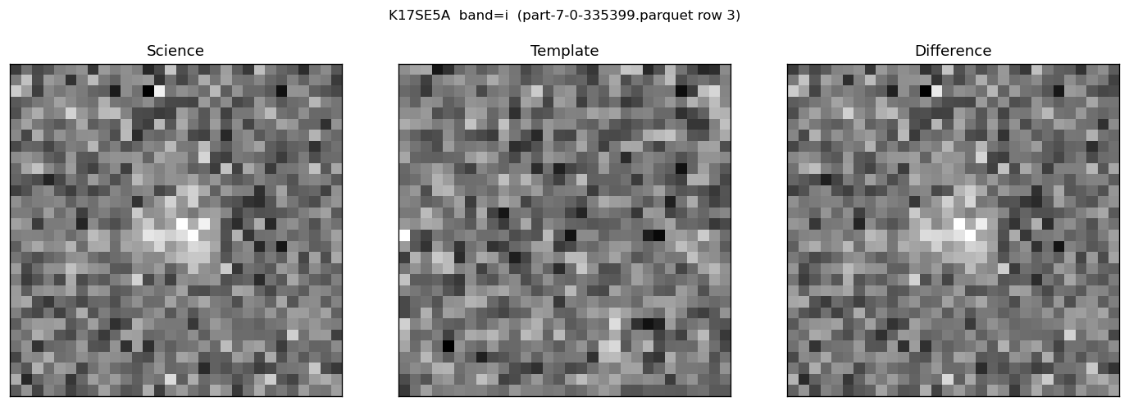
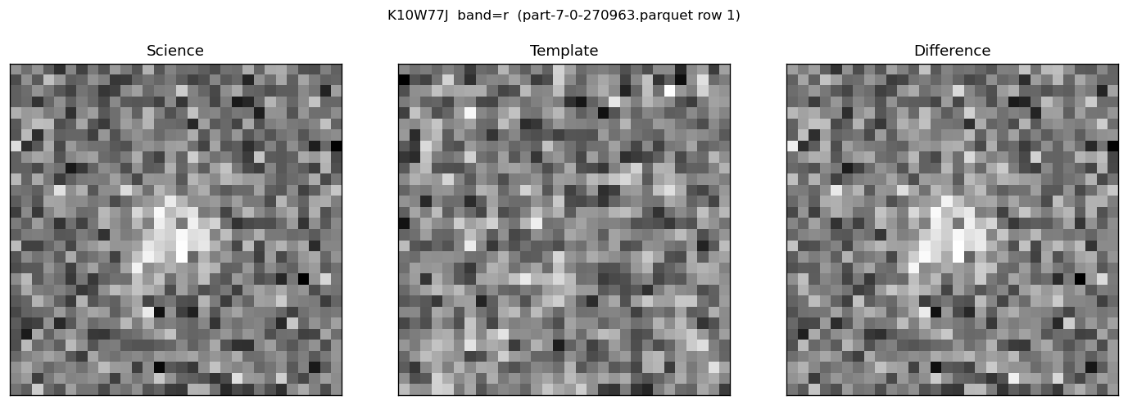
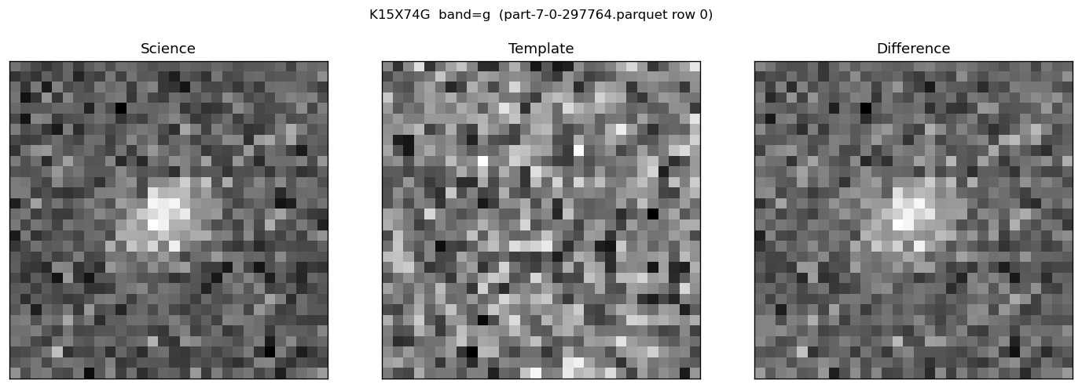
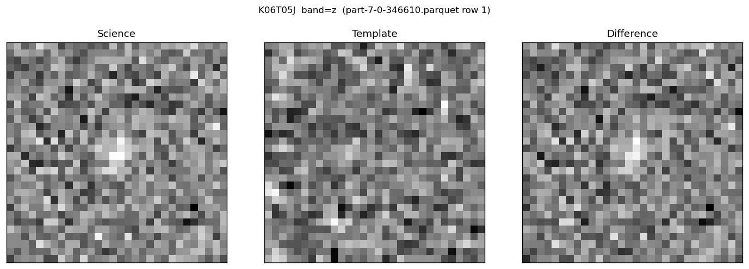
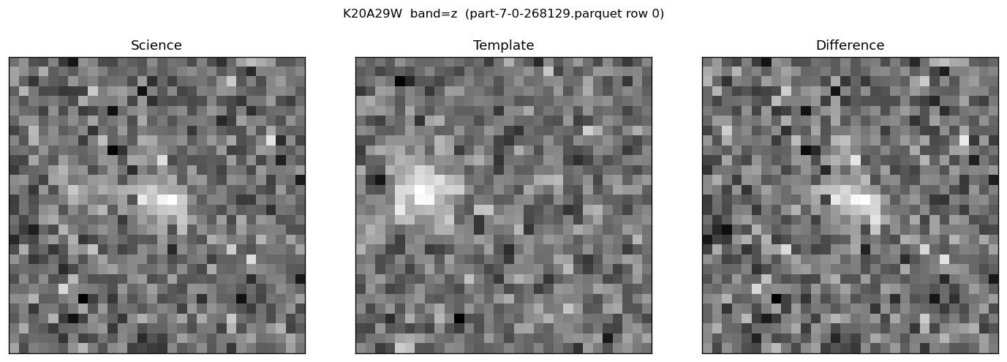
Gems from the LSST Alert Stream

Slide 9
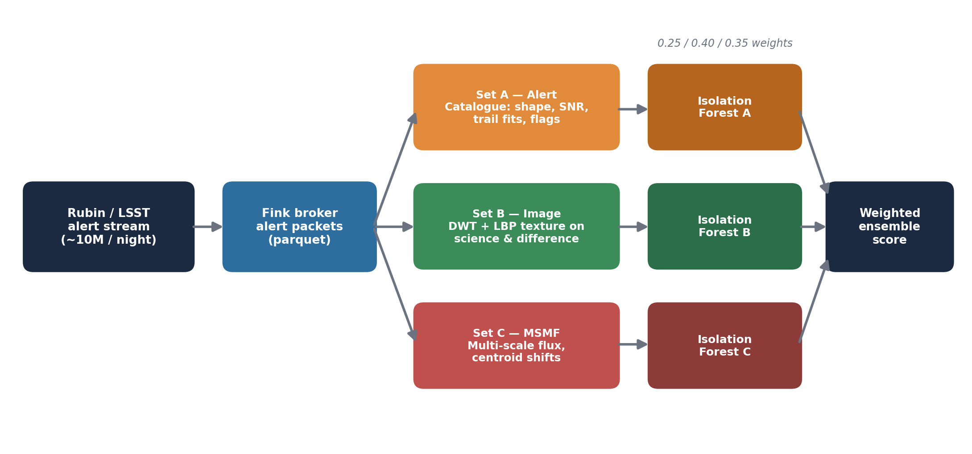
Detection Pipeline
2026-02-25
8,857 alerts ~72,500 sources

Slide 10
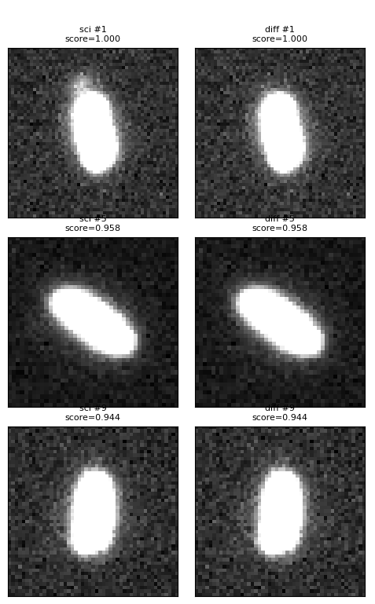
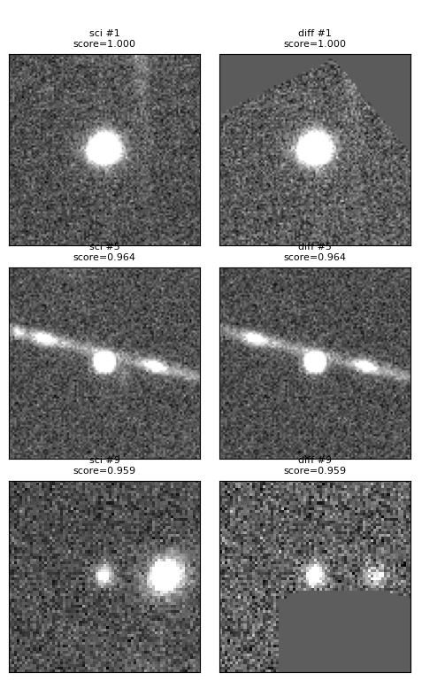
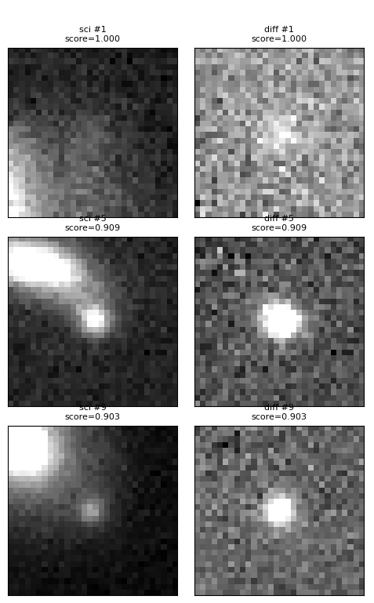
Anomalies
Alert Features
DWT + LBP
MSMF

Slide 11
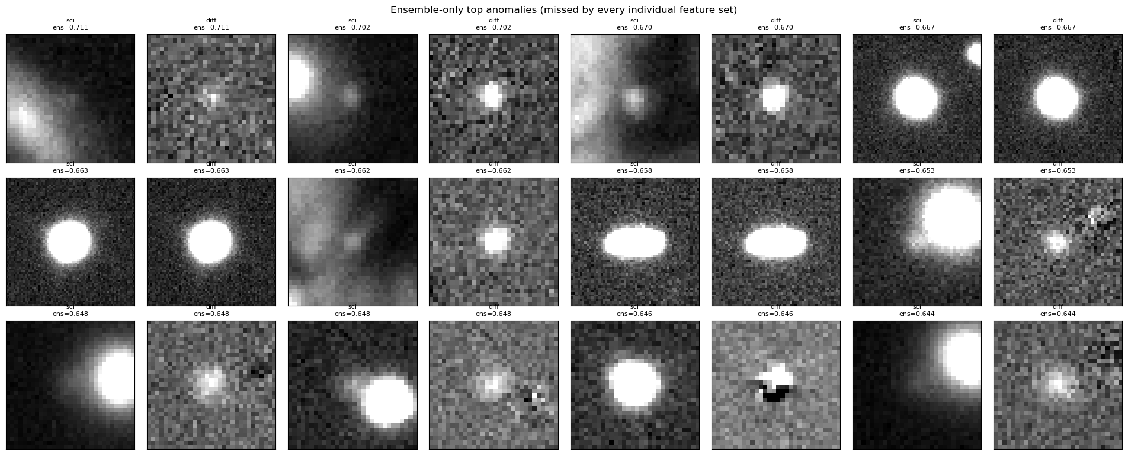
Anomalies
Top anomalies highlighted by the ensemble

Slide 12

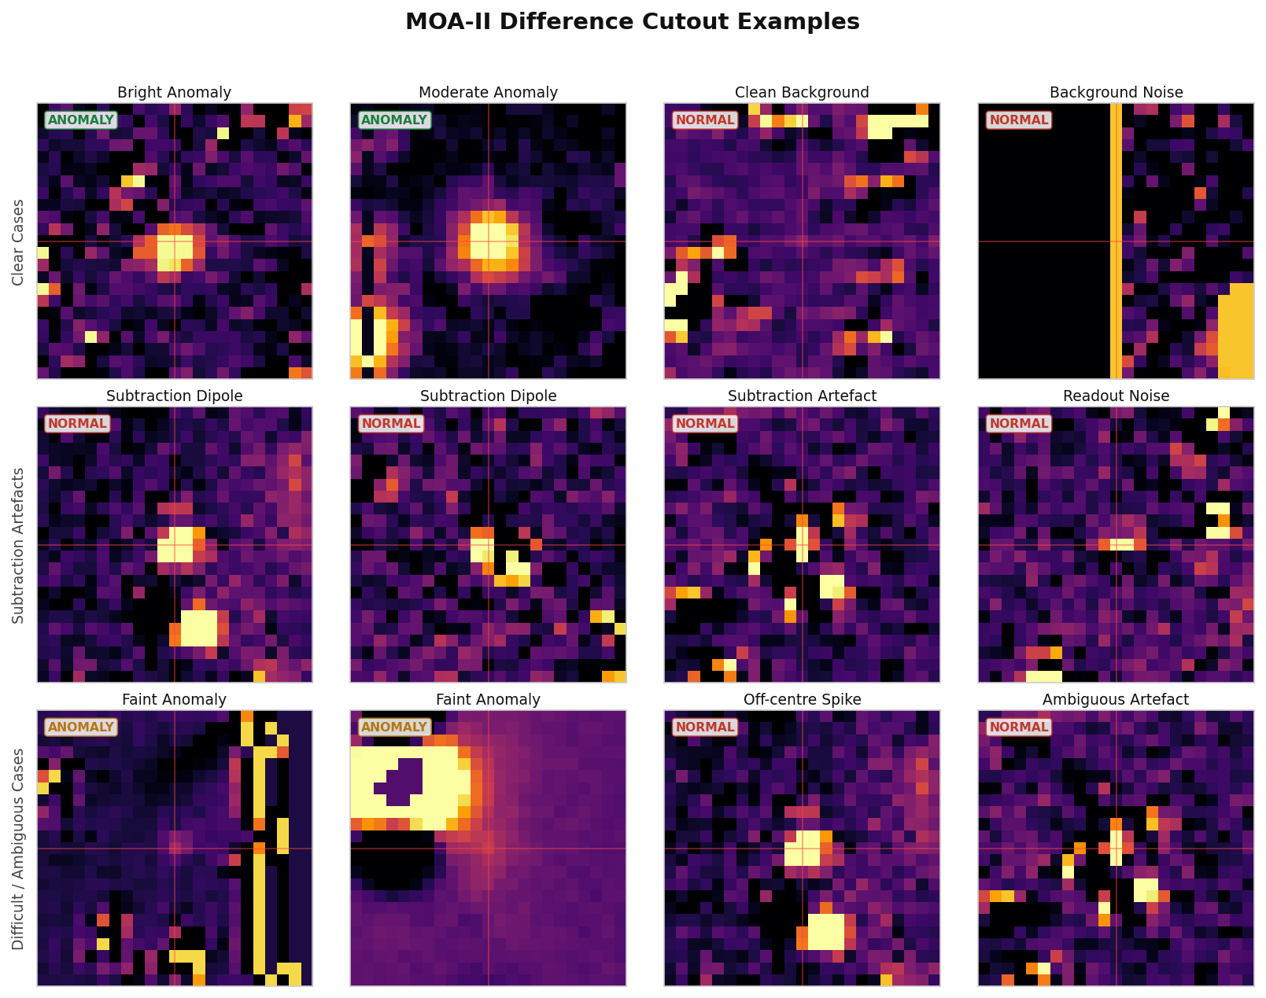
More Feature Extraction
  Manual Concentration Features (20 features)
  Multi-Scale Matched Filter (MSMF) (9 features)
  Autoencoders (25 features)
    Residual Autoencoders
    Dense Autoencoders
    Hybrid Convolutional Neural Network Autoencoder(HybridCNNAE)
    With and without batch normalisation
Andew Hung
17,959 images; 23x23 pixels 1,633 microlensing events

Slide 13
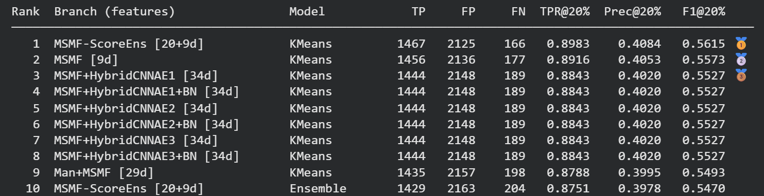
More Feature Extraction
Andew Hung

Slide 14






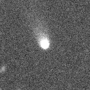
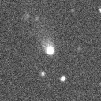
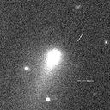
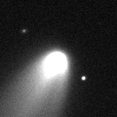
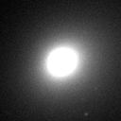
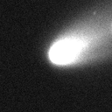
Generative Models for Comets
18,354 Asteroid Images (30 x 30)
Katie Law
495 Comet Images (128 x 128)

Slide 15
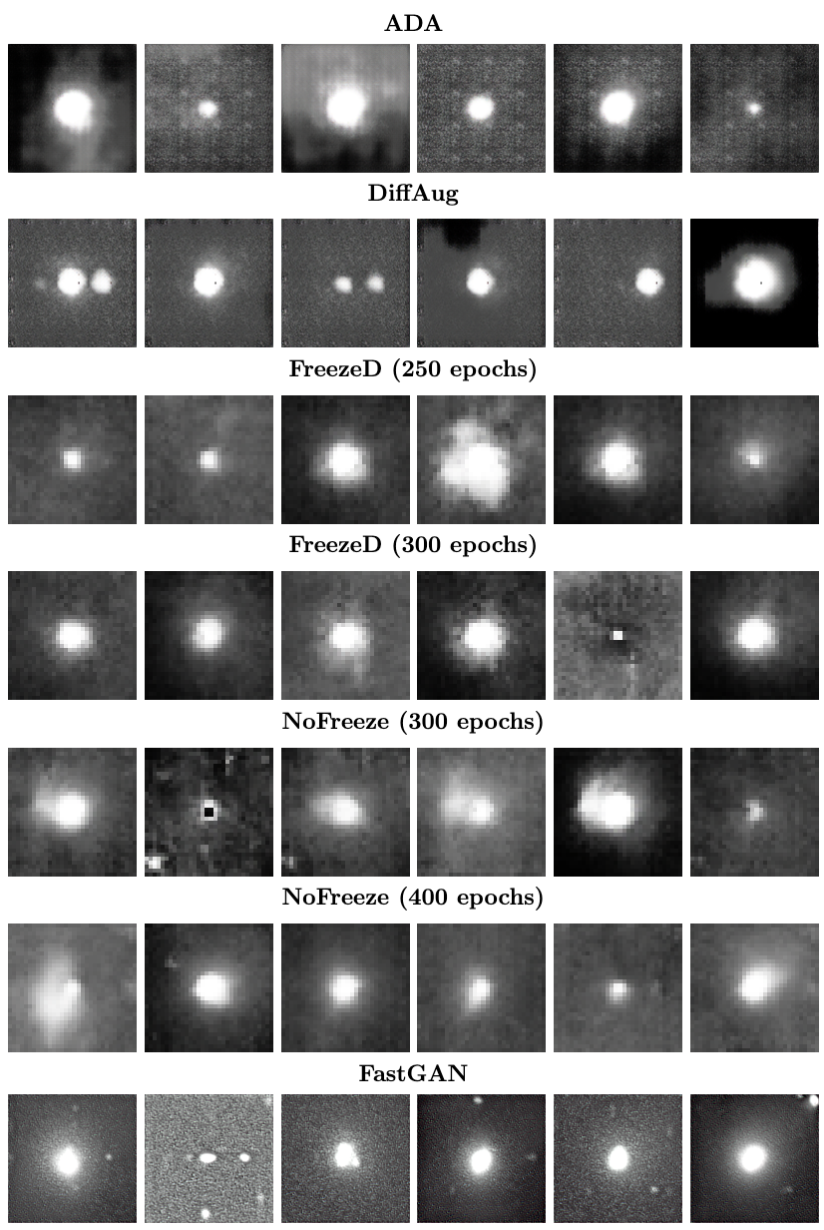
Generative Models for Comets - Results
Katie Law

Slide 16
CNN Semantic Evaluation
Generative Models for Comets - Results
Katie Law
Train:
3000 real asteroids
495 real comets
Test:
500 asteroids
400 generated comets
Higher recall indicates that generated images were recognised as comet-like by a classifier trained on real astronomical observations.
Methods | Recall
ADA | 0.9700
DiffAugment | 0.9925
FreezeD (250 epochs) | 0.9525
FreezeD (300 epochs) | 0.9350
No-Freeze (300 epochs) | 0.8100
No-Freeze (400 epochs) | 0.9825
FastGAN | 0.9900

Slide 17
Thank you! preeti.cowan@auckland.ac.nz
Image credit: NASA/Goddard/University of Arizona/Lockheed Martin

