Slide 1
IDS End 2 End Tests
French instrumental contribution status
DAMERY JEAN-CHARLES (CNES)
Journées LISA France
04 May 2025

Slide 2
Agenda
01 – Context
02 – Progress
03 – Conclusion

Slide 3
01
Context

Slide 4











Instrument components
LISA Constellation
S/C 1
S/C 2
S/C 3
Instrument 1
Instrument 2
Telescope
Gravitational Reference Sensor (GRS)
Laser
Optical Bench
Phasemeter
OB Mechanism Control Unit
SDS
End 2 end tests @ CNES
Full performance testing based on:
  Engineering Model (EM)
  Qualification Model (QM)
OMS @ ESA

Slide 5
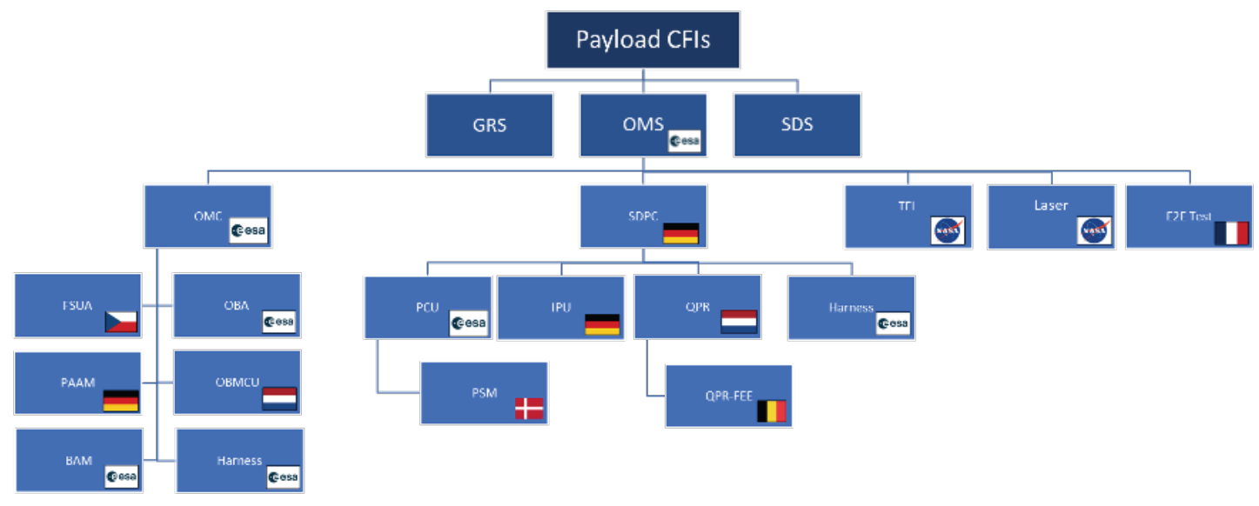
LISA Payload CFI

Slide 6
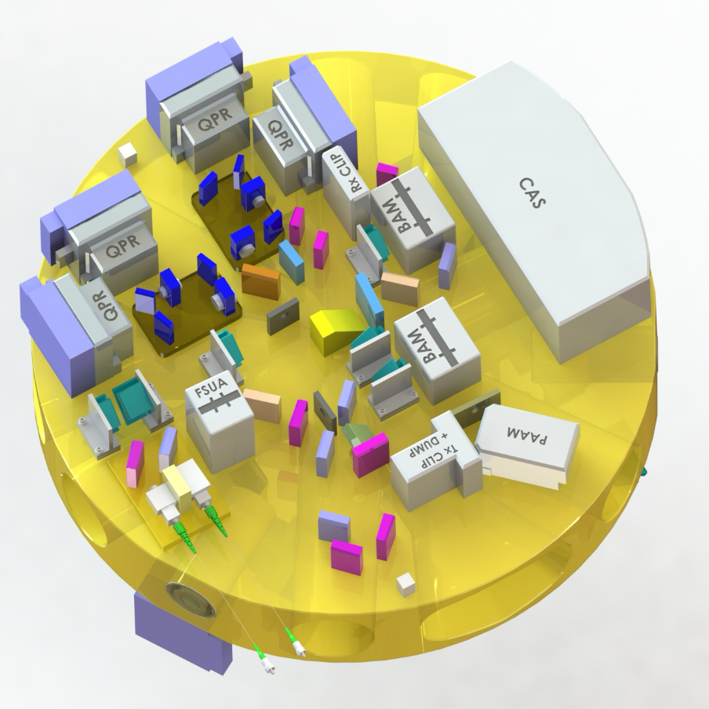
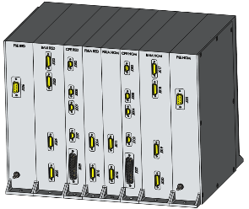
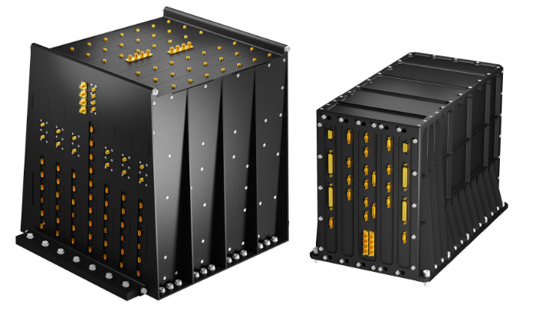

Device under test
The Decive under test for the E2ET system is composed of the following elements:
  OBA: Optical Bench Assembly
    Containts the interferometers, photoreceivers, Fiber injectors and beam alignment mechanisms
    Zerodur baseplate of 45 cm Ø
  PMS: Phase Measurement System
    Read-out electronics, DAC, DPLLs, Laser control logic
    Two electronic units (PMS-IPU & PMS-PCU)
  OBMCU
    C&C of the mechanisms in the OBA
    One electronic box
  Laser Tx
  Harnesses
OBA
OBMCU
Harness
PMS-IPU
PMS-PCU
Laser Tx EDU

Slide 7

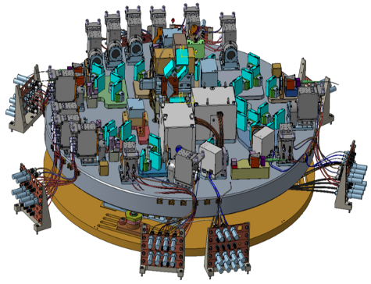
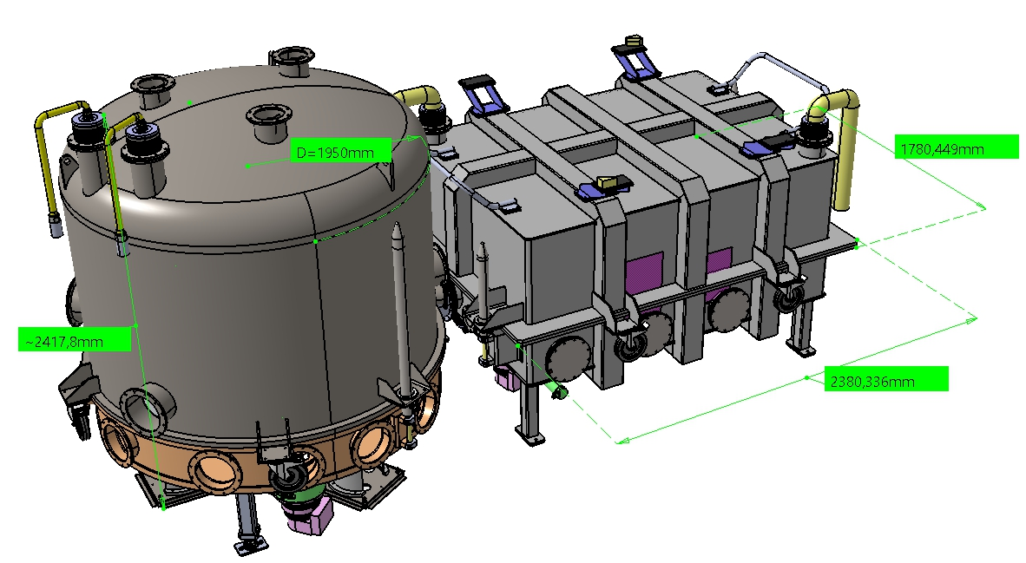
Environment silmulation
Environnement :
-Vide
-Thermique
-Propreté
-EMC
Simulation du satellite distant
Simulation du second instrument
TM

Slide 8

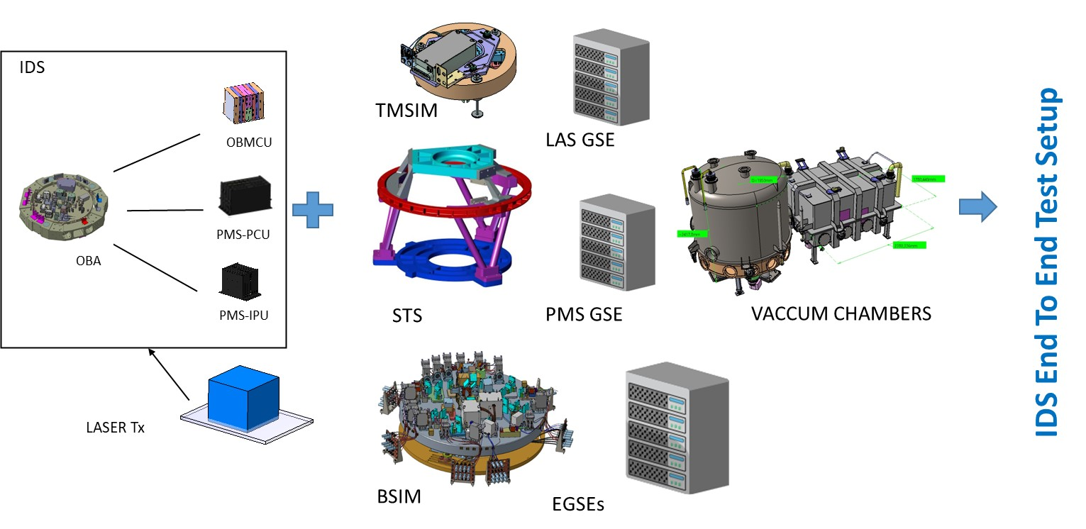






E2ET setup composition

Slide 9
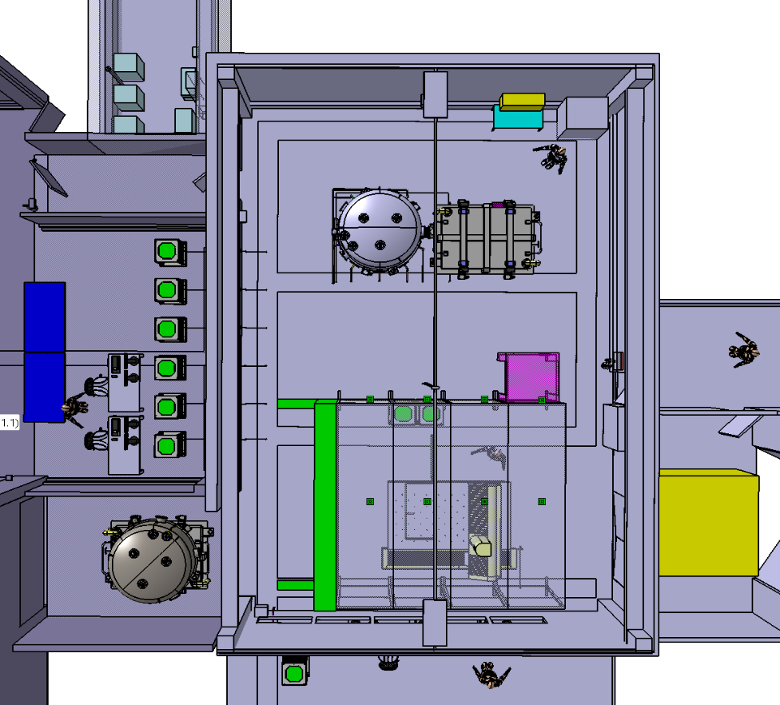
Facility
Optical Vacuum Chamber
Utility Room
Electronics Vacuum Chamber
“Signe3” Clean room at CST (Centre Spatial de Toulouse, CNES) dedicated to host the IDS E2E Test setup
  ~125 m² ISO8 room space
  Vacuum chambers
  CMM
    Capable of holding all the elements on the STS
  ISO5 capability
    Blowing Wall
  Utility room
  GSE room
  Control Room (outside controlled space
EGSE racks
Blowing Wall
Control Room
CMM

Slide 10
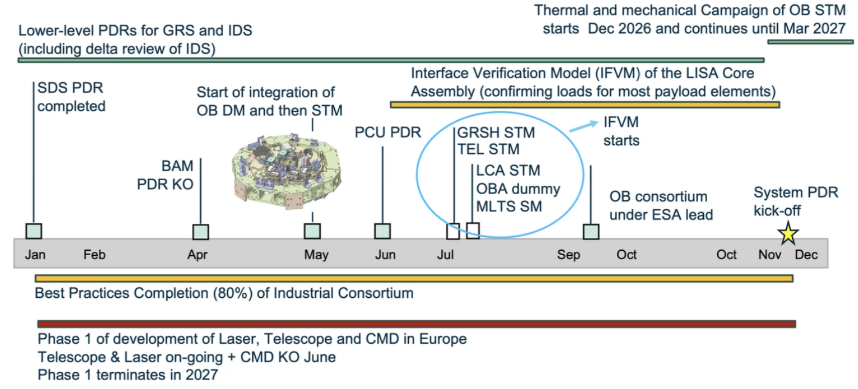
ESA challenges in 2026

Slide 11
02
Progress

Slide 12
E2ET Test setup development
E2ET V-cycle
E2ET System level
  E2ET test setup reaching overall CDR level
  Most critical subsystems have reached or are close to reach CDR completion
  System level E2ET CDR expected Q1 2027
2023
2026
CDR
PDR
Subsystem level
PDR
2025
CDR
2024
E2ET is here!

Slide 13
E2ET V cycle development

Slide 14
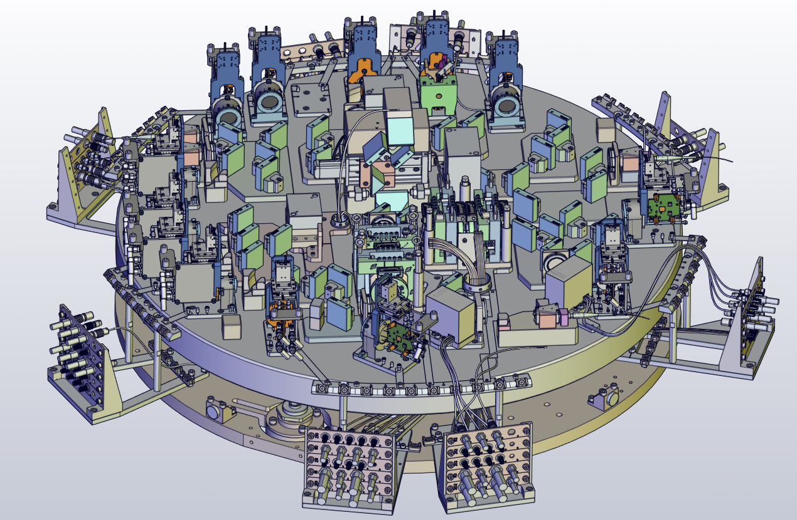
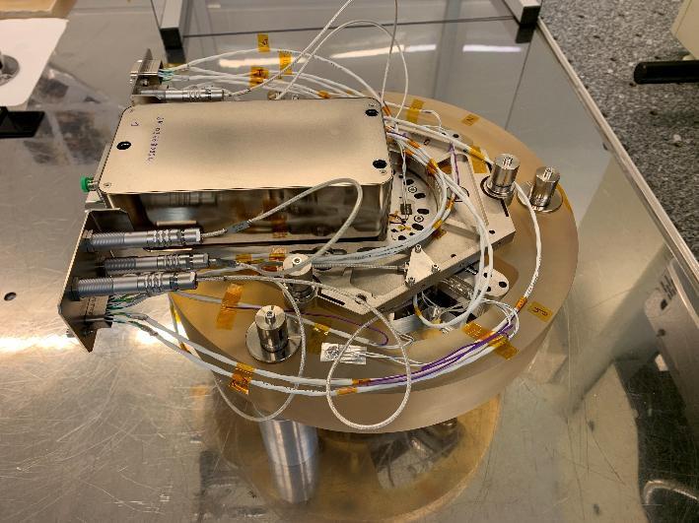
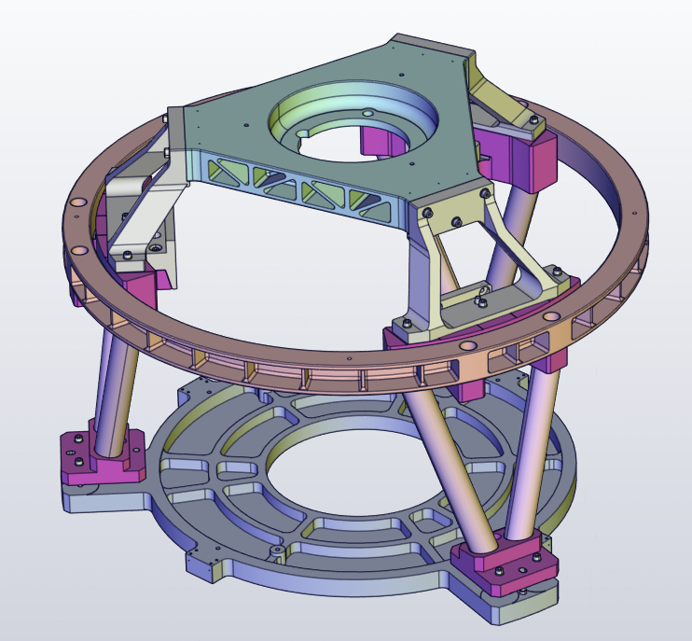
Current status in GSE development
Beams Simulator
System CDR started on April 1, should be closed on May 7
PhotoReceiver delta CDR scheduled on May 28
Manufacturing phase on going
Laser GSE
Integration on going
Tests at LTE of the STAB laser in June
Test Mass Simulator
Performance tests on going using the prototype
Manufacturing key point coming soon
STable Structure
Detailed design activities on going
CDR foreseen in June
Stray Light OGSE
ITT on going ; Proposal expected end of May
Thermal GSE
Passive thermal screen CDR done
Delivery expected mid 2026
PMS-GSE (with UHH)
Manufacturing phase on going
Delivery to APC of a first ADC board
Second milestone (over 3) of the contract done on April 29
TX Beam Dump
PDR closed
Detailed design o, going
Integration phase in CNES in 2026
TX Beam Dump
First version 1.0 of the GI EGSE in preparation
  Including TAU (L and K) and Pyramids (HW and SW)
Delivery expected in May

Slide 15
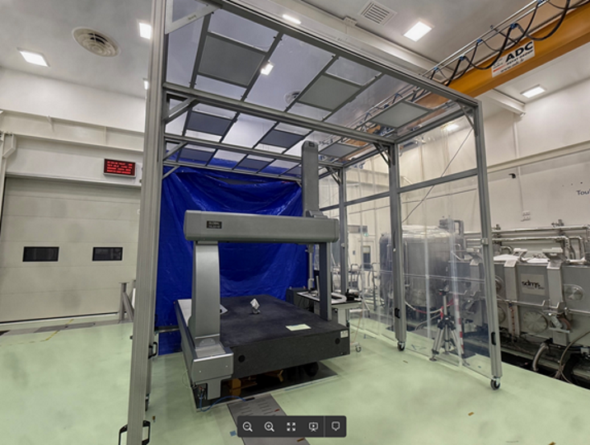
E2ET Facility
  Facility elements are delivered and accepted:
    Clean room
    Vacuum Chambers
    Blowing wall (ISO 5 facility)
    CMM: Site acceptance
  Performance testing of the facility from 2Q2026 to 4Q2026. Including:
    Mechanical characterization: using seismometers and accelerometers. Microvibration levels on the ground and in the optical vacuum chamber
    Acoustic environment
    Thermal characterization: Thermal stability achieved inside the vacuum chambers, both with and without the passive thermal screen
    EMC characterization: Measurements of the radiative coupling between interior/exterior of the chambers, measurement of the CS on available units, test several grounding strategies.

Slide 16
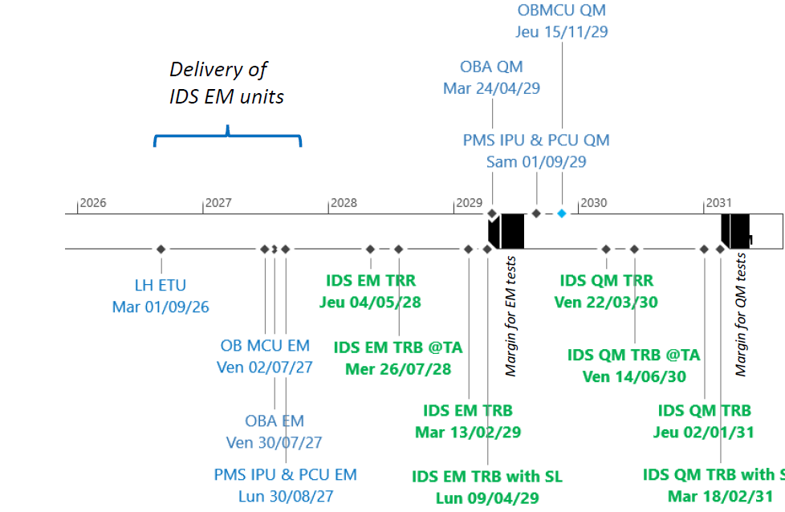
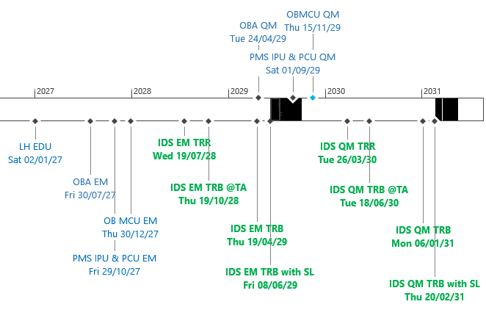
E2ET Schedule
      All GSE development schedules updated
      Update of the integration sequence done in conformance with the last integration sequence
        Nevertheless this integration sequence is still under construction / consolidation
IDS PDR status
Current status

Slide 17
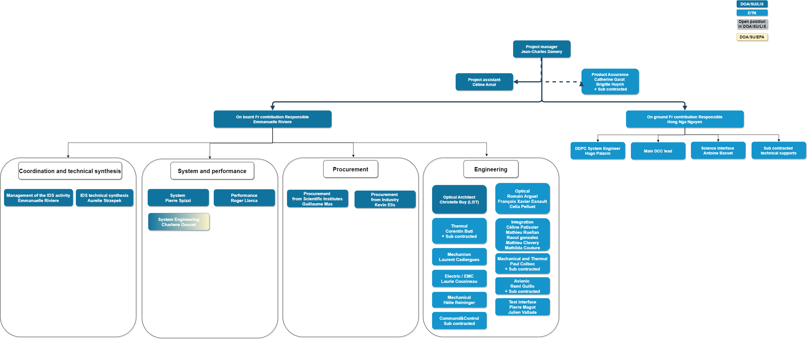
CNES team improvement in 2025

Slide 18
03
Conclusion

Slide 19
The machine is up and running
A solid and well-supported project that has demonstrated and continues to demonstrate a strong capacity for managing risks and changes (e.g., NASA)
Other risks and changes will probably come
A very rich retrospective since adoption (Q1 2024)
Even more work to be done
An instrumental contribution in the implementation phase, a characterization phase beginning, and integration, testing, and analysis phases to follow soon
A ground-based contribution in the early stages, but already showing initial results in terms of data, algorithms, and infrastructure software

Slide 20
Thank you

