Slide 1


Slide 3
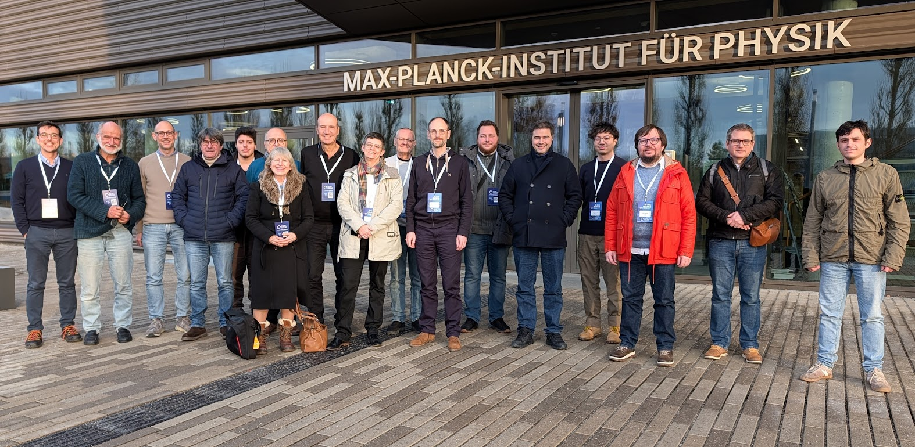
Les français…

Slide 4
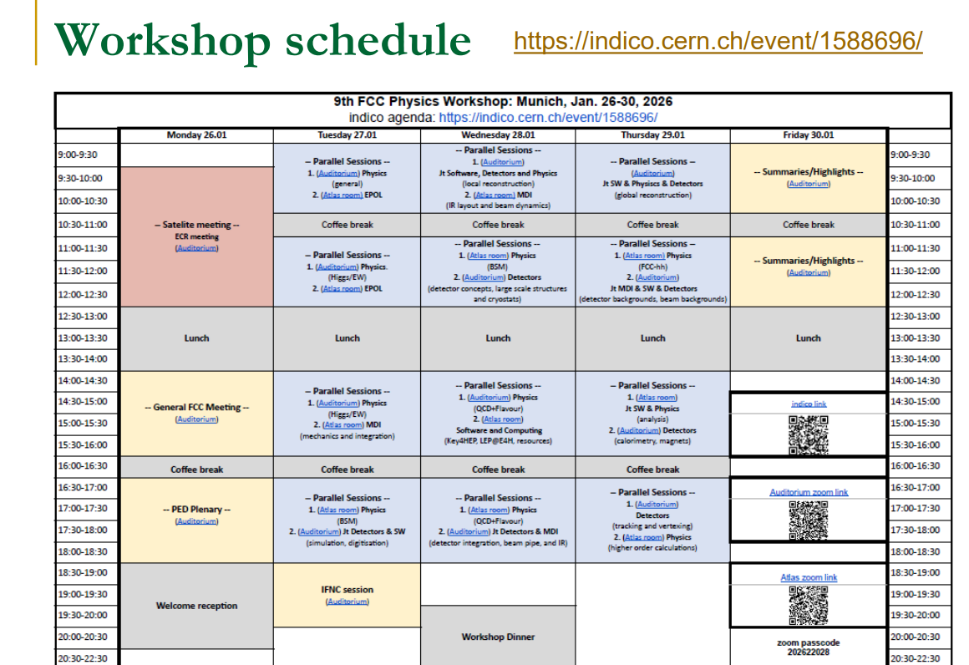
Many parallels
Note INFC session

Slide 5
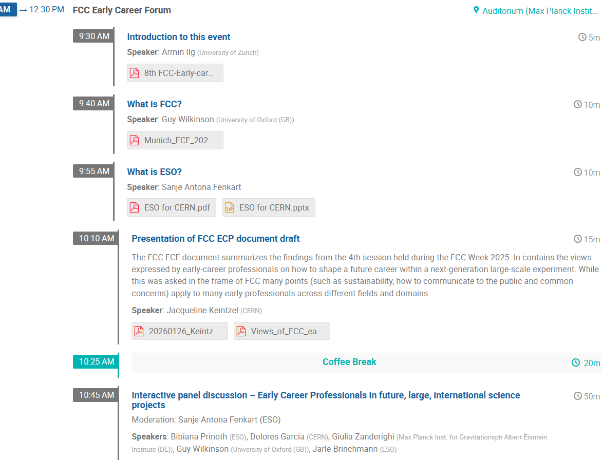
Time Table https://indico.cern.ch/event/1588696/timetable/
Monday Morning : Early Carreer Forum
Remarkable initiative
from ECRs towards strategy 2025
Certainly played a big role!
This little 4-pages paper
is very good reading!

Slide 6
SPHICAS

Slide 7
SPHICAS
See SPHICAS presentation for detailed and justified discussion…

Slide 8
A set of selected highlights
EPOL group (Torrence)
NB this is a joint accelerator-experiment group in charge of ECM calibration
It appears more and more accepted that e+ and e- pilot (non colliding) beams will be polarized at low energy and injected
For energy calibration at Z,W (and more) energy – requires an additional low energy storage ring.
The 100 keV ECM absolute calib. Syst. will certainly be reduced. (promised new number at FCC week in Helsinki June 8-12)
NB statistical precision on Z mass (91.2 GeV) and width (2.5 GeV) is less than 4keV (pres. Syst. 100 and 12 keV resp)
Standard method at the Z … (Yi Wu)
Check of absolute scale with muon pair threshold (Bendavid)

Slide 9
MDI group
Boscolo)

Slide 11
Physics studies
Azzi

Slide 14
Precision EW Physics
My big worry (AB):
We are targeting experimental precisions of a few 10⁻⁶ precision…
… but theorists are still talking about 10⁻⁴ with a very scary tone.
Presentation by Z. Was

Slide 15
Azzi

Slide 16
Detector concepts
AB The talk you must read!
Mogens Dam

Slide 24
See also Wilkinson’s talk for «goals of the workshop» and Janot for ‘next steps’
Conclusions and caveat…
The recommandations of the ESPP2026 are vvery positive
… but the ‘project’ is not approved yet!
a most important parameter will be the buy-in of the community after a long and difficult history of strategies
(see AB for the history)
a very positive development is the buy-in of the linear collider detector collaborations (CLD from CLIC, ILD (from ILC))
In particular the possible descoping (negative) can be mostly turned into a staging (positive)
but the reduction of 4 to 2 experiments would have not be reversible and would have a very negative impact
it must must be avoided

