Slide 1

IGRPT
Image-Guided Radio-Pharmaceutical Therapy
Théo Kaprelian, Corentin Constanza, Eduardo Sanchez-Rios, Ane Etxebeste, Jean-Noel Badel, Jean-Michel Létang, David Sarrut
CNRS - University of Lyon
CREATIS, CNRS UMR5220, Inserm U1044, INSA-Lyon, Université Lyon 1, France
Notes:
20 min

Slide 2
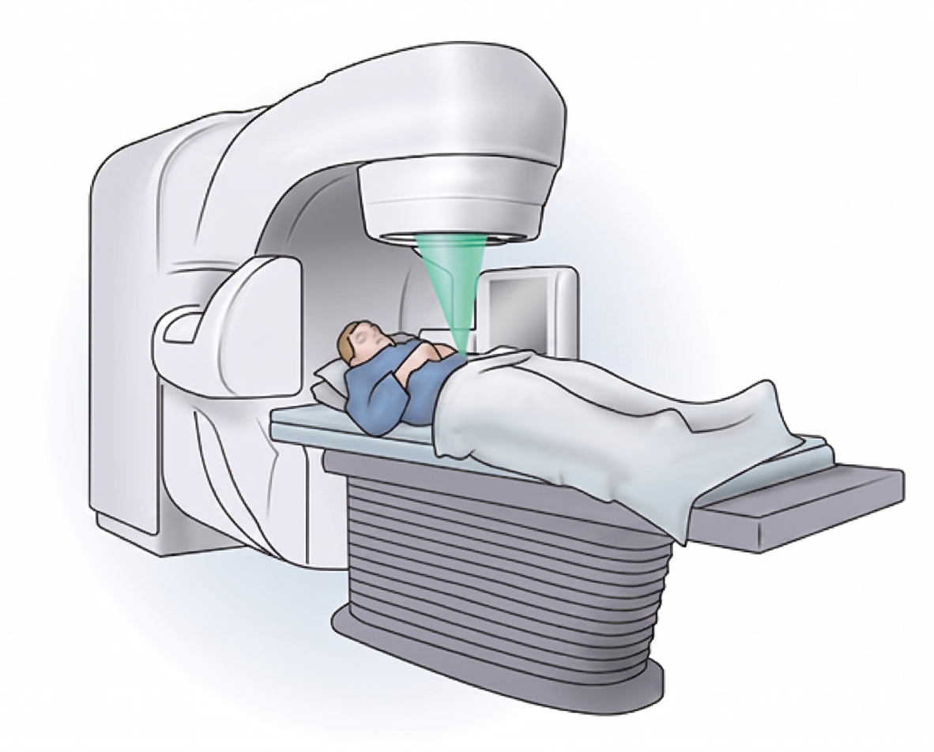
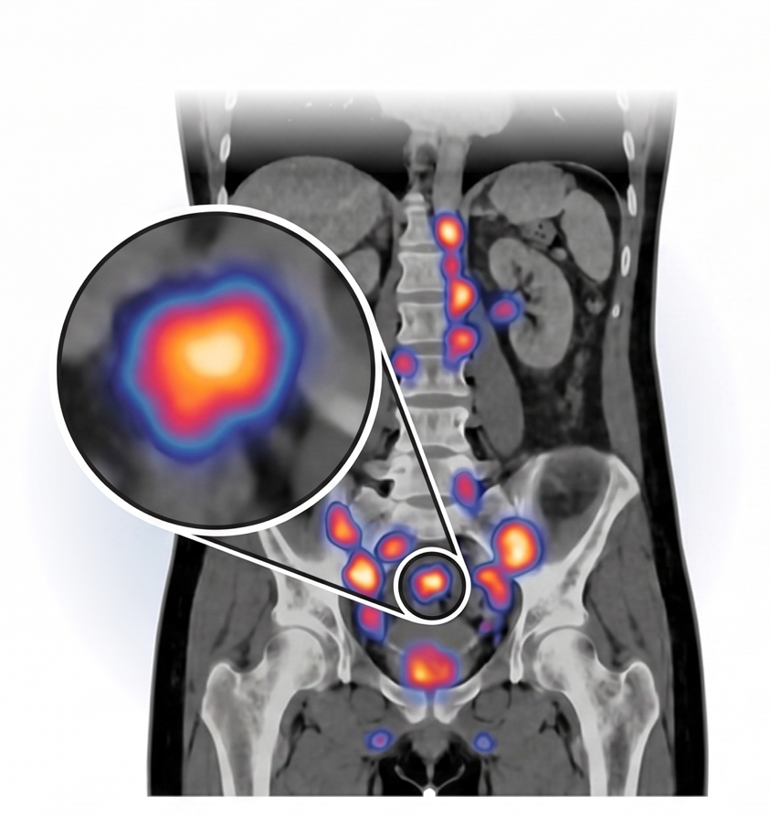
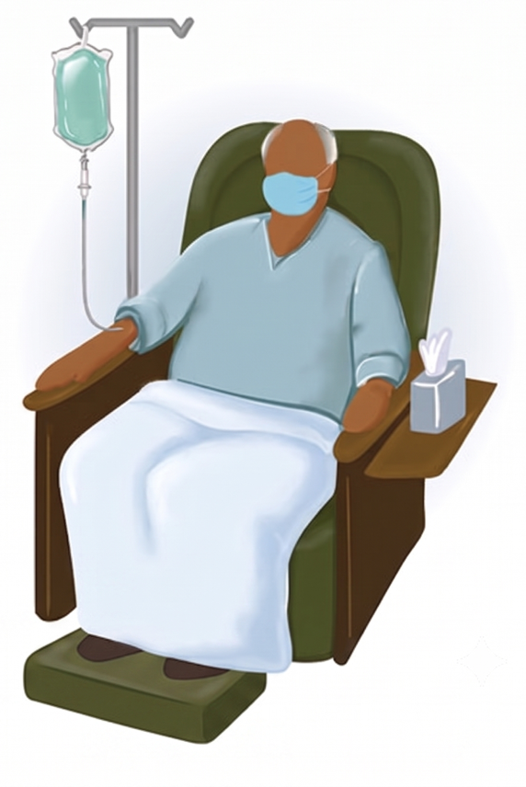
Radiation therapy
External Beam Radiation Therapy (EBRT)
Radio Pharmaceutical Therapy (RPT)
Cleveland Clinic @2026
Notes:
25 min + 10 question
Introduction : NucMed, evolution, imaging + outline
1) prédiction PS50 PET + AI
2) Reconstruction SPCECT AI (unrolling)
3) simus MC GATE10, + projet AIDER
Conclusion
La physique au coeur de l’image
Simulate Reconstruct Predict
Pixels Particles Prediction
Physics guided AI driven ; physics driven AI powered
Physic guided nuclear medicine
Physics guided radionuclide therapy or dosi guided
Image Guided Radionuclide Therapy -> IGRPT
Theranostic

Slide 3
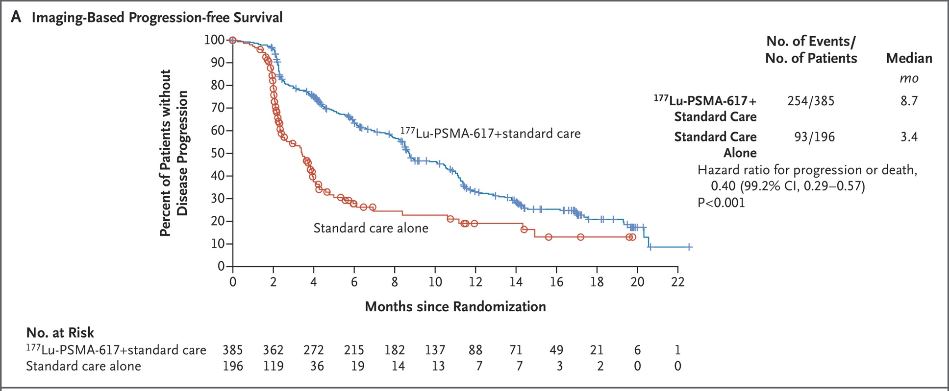
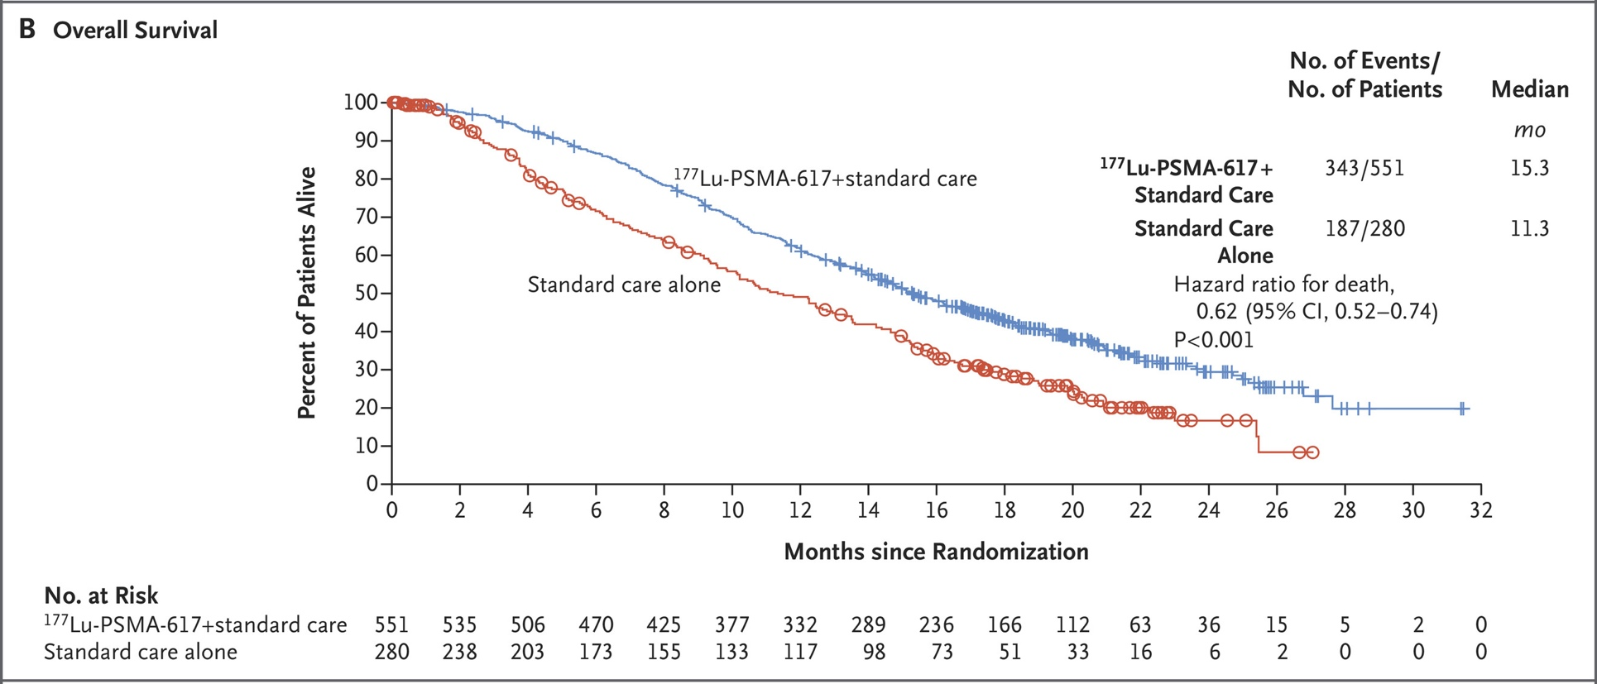
Une (r)évolution en médecine nucléaire
[Ehrlich1907] “magic bullet”
Change patients’s life
High demand
  396 patients in 2021
  1107 patients in 2023
  2500-3000 in 2025 (?)
  France, mCRPC 62/100k
  ~ 7k new patients / y
  [Barthelemy2023]
Change NM departments
[Sartor2021]
Notes:
Repousse frontière thérap
Echappement précoce
Pour échoue sur certains
QoL soulagement majeur, retarde douleur osseuse
Remonter les lignes

Slide 4
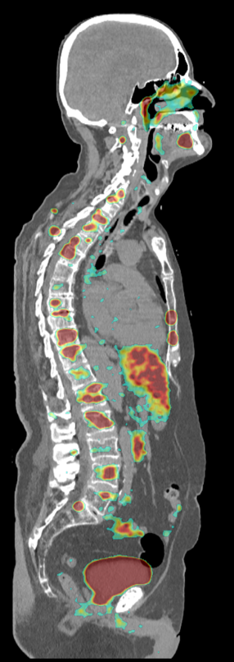
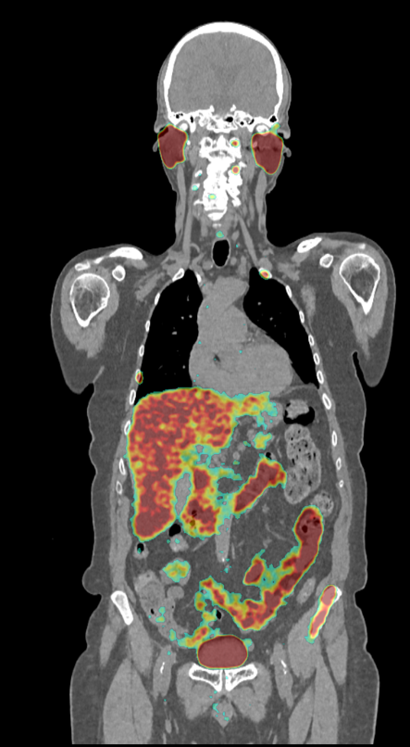
Image-based dosimetry and prediction
Images pre-treatment: PET/CT
  For selection/planning
  For outcome prediction
Images per-treatment: SPECT/CT
  For dosimetry follow-up
  Cycles: “stop or continue”
Image quality is paramount:
  How to increase sensitivity? Resolution ?
  How to reduce physical artifacts? Noise, scatter, partial volume
Dose
distribution

Slide 5
IGRT Image-Guided Radiation Therapy
IGRPT Image-Guided RadioPharmaceutical Therapy

Slide 6
Outline
Outcome prediction from PET/SPECT imaging
SPECT AI-based reconstruction
Monte Carlo simulations with GATE10
Notes:
D’un côté : exploiter les images
D’un autre : améliorer les images

Slide 7
Outline
Outcome prediction from PET/SPECT imaging
SPECT AI-based reconstruction
Monte Carlo simulations with GATE10
Notes:
D’un côté : exploiter les images
D’un autre : améliorer les images
6 min

Slide 8
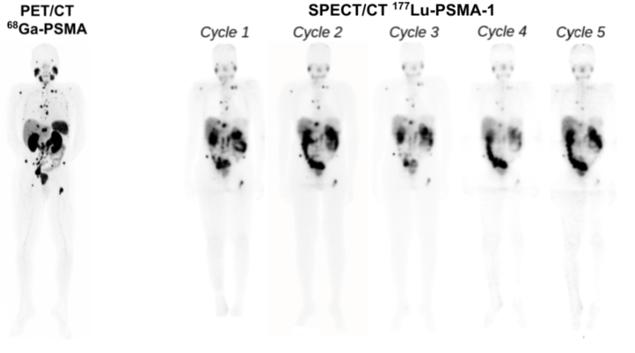
Prediction – 177Lu PSMA therapy
Metastatic Castration-Resistant Prostate Cancer (mCRPC)
  Several cycles (=injections)
  7.4 GBq
  50% biological response
Goal:
  Detect early =
  switch or adjust treatment
  Image-based prediction
511 keV
113 keV (6%) 208 keV (10%)
Notes:
Prostate-Specific Antigen ; protein secrété cellul epitheliale de la prostate ; dans serum (plasma)
Metastatic Castration-Resistant Prostate Cancer (mCRPC) is an advanced stage in prostate cancer in which the patient has already received two lines of treatment (hormone therapy and chemotherapy)
transmembrane glycoprotein

Slide 9
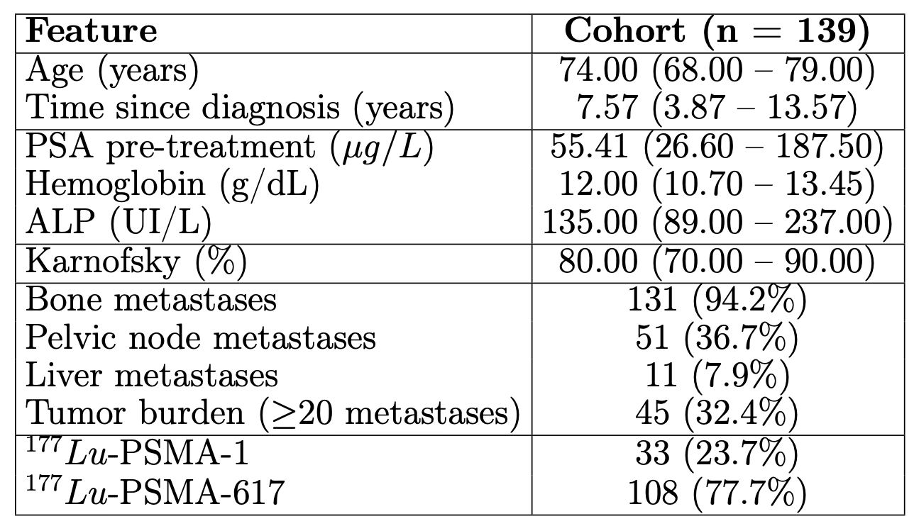
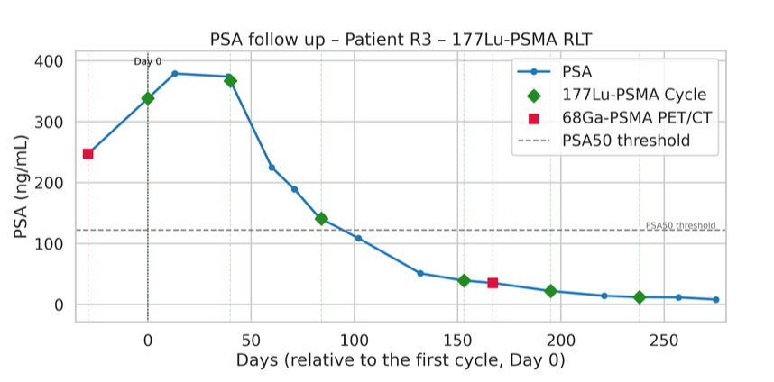

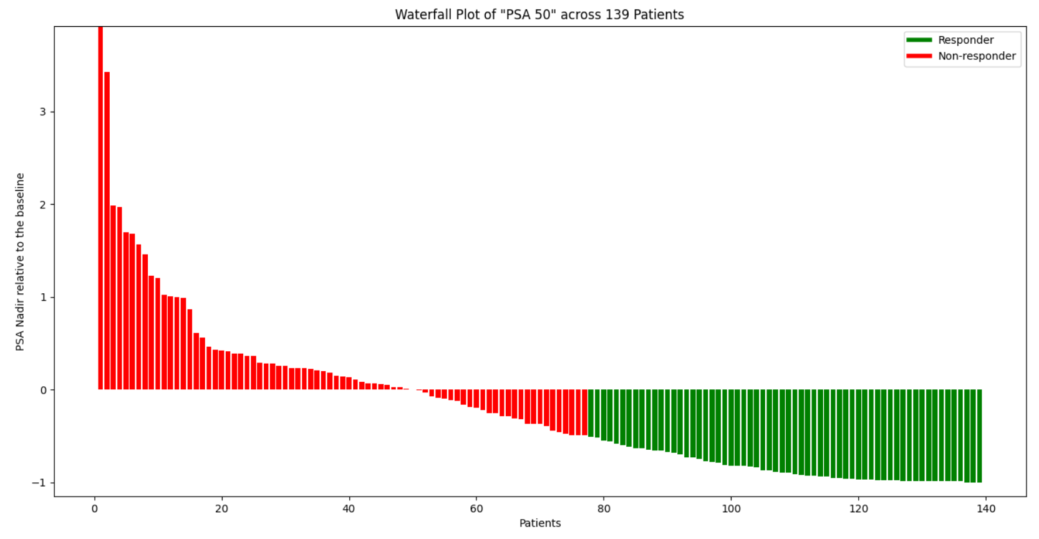
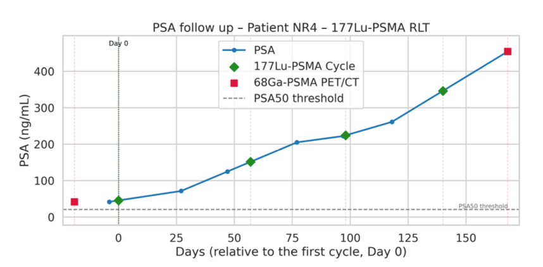
177Lu-PSMA database

Slide 10
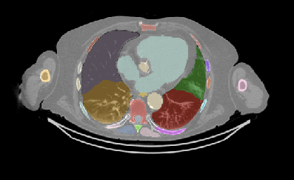
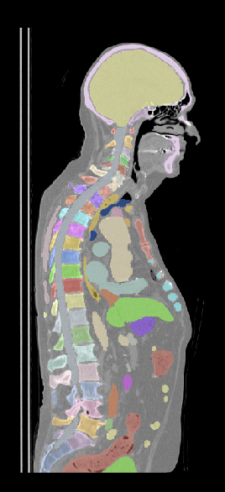
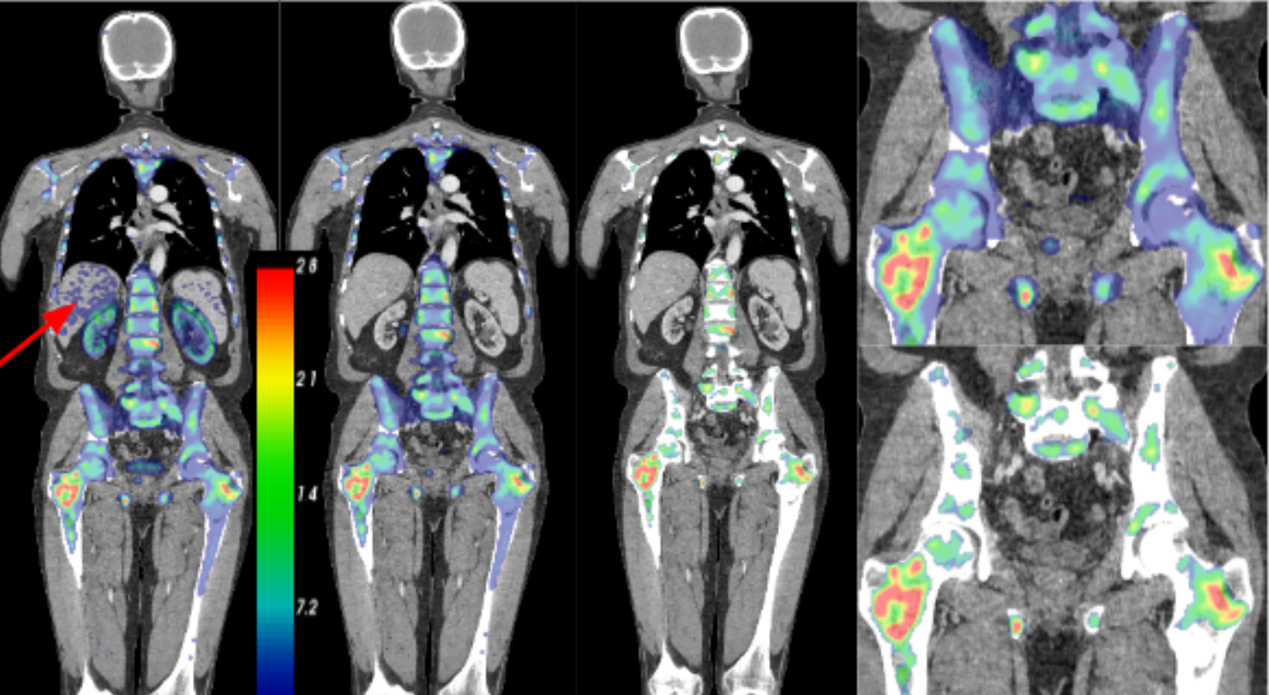
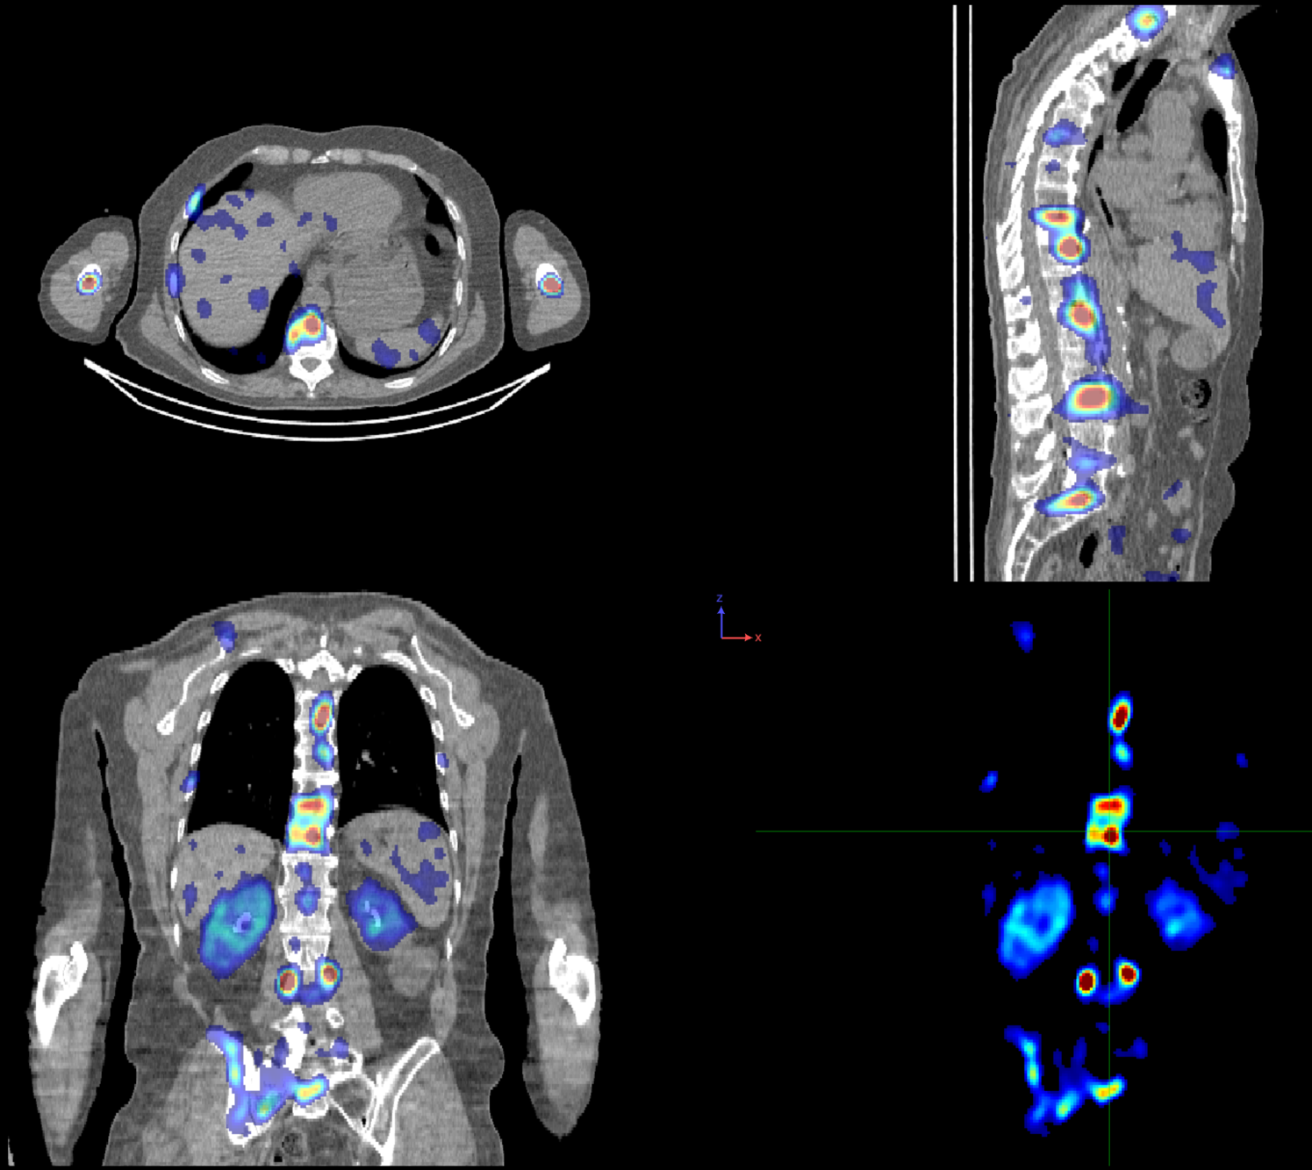
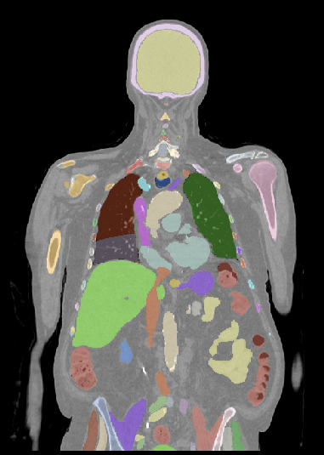
PET : extract TTV = Total Tumor Volume
1) Anatomical ROI
2) Physiol. uptake
3) Noise threshold
TotalSegmentator
[Wasserthal2023]

Slide 11
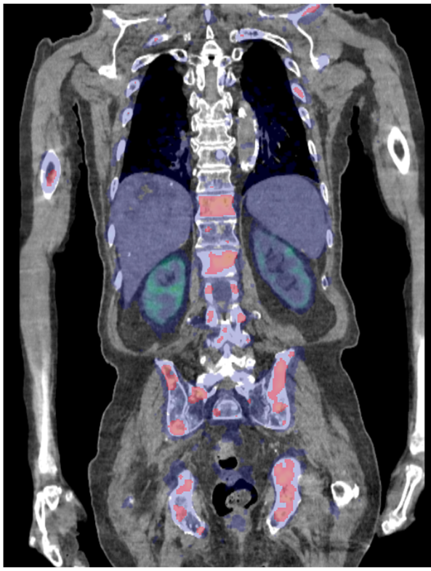


Machine Learning
Gaussian Naive Bayes (GNB)
Support Vector Machine (SVM)
Random Forest (RF)
Least Absolute Shrinkage and Selection Operator (LASSO)
Parameters optimized with Optuna
SUV mean, max (peak), etc
Clinical + biological data

Slide 12
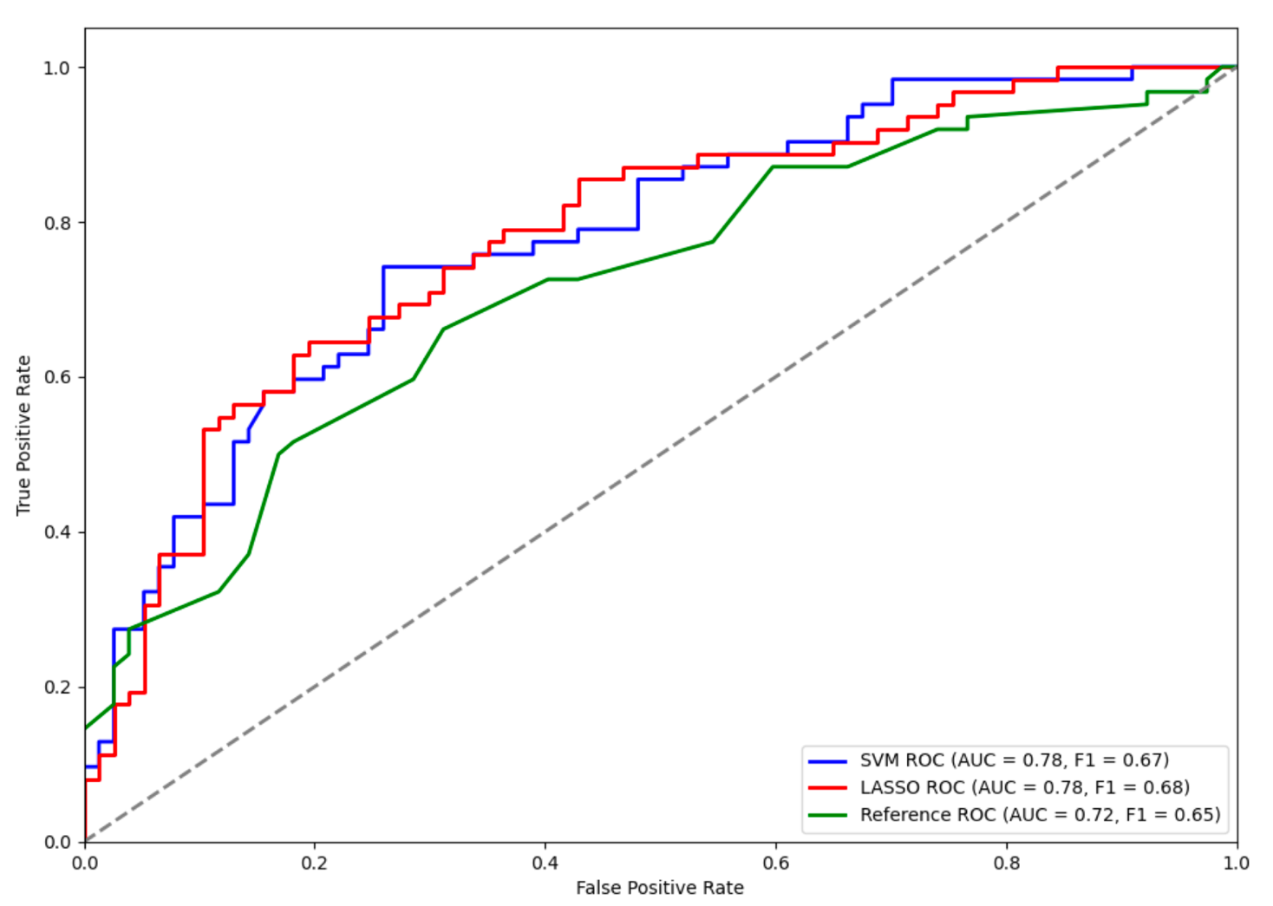
Results
[Rios-Sanchez EJNMMI-phys 2025]
Sensibility
Specificity
Reference : [Gafita2021]
Notes:
Performance en fonction du seuil de décision ; sensibility (recall) vs spécificité
TPR : sur tous les positif combien detecté ?
FPR : sur tous les négatif, combien de faussement detecté

Slide 13
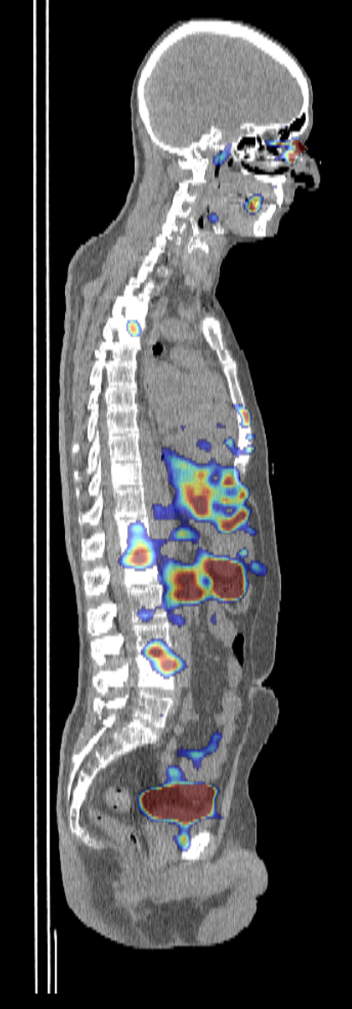
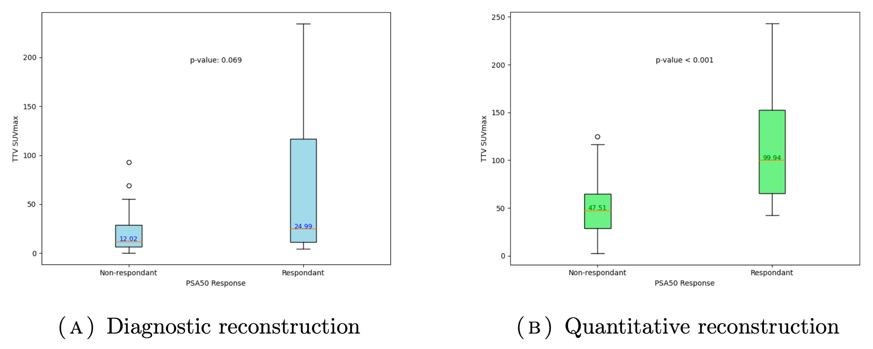
SPECT
[Vergnaud EJNMMI-phys 2023]
[Vergnaud EJNMMI-phys 2024]
[Rios-Sanchez EJNMMI-rech 2026 submitted]
SPECT 177Lu images (Veriton)
24h after injection

Slide 14
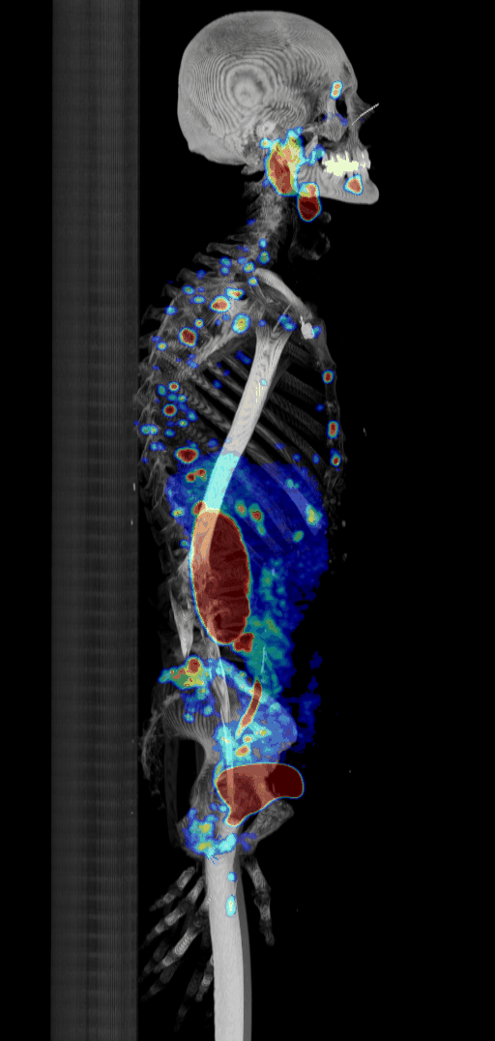
Discussion
PSA50 prediction from PET image
PSA50 prediction from SPECT image
Simple (explainable) image processing
  Anatomical AI segmentation
  Machine Learning
Global lesion burden vs individual lesions
Dose computation [Vergnaud EJNMMI-phys 2024]

Slide 15
Outline
Outcome prediction from PET/SPECT imaging
SPECT AI-based reconstruction
Monte Carlo simulations with GATE10

Slide 16
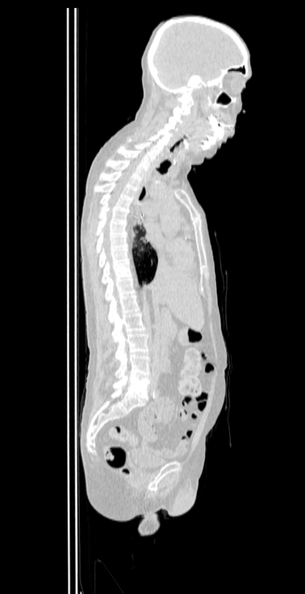
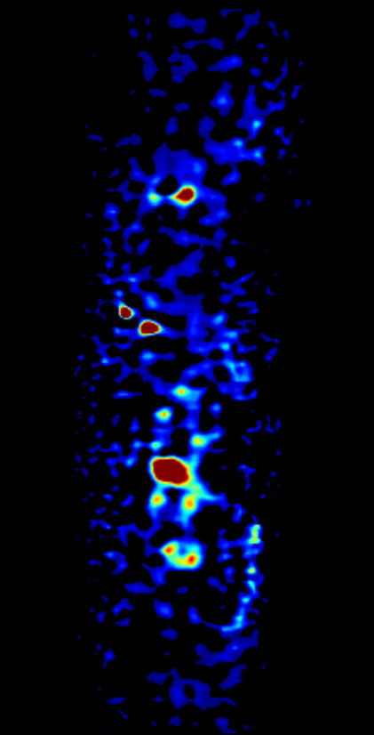
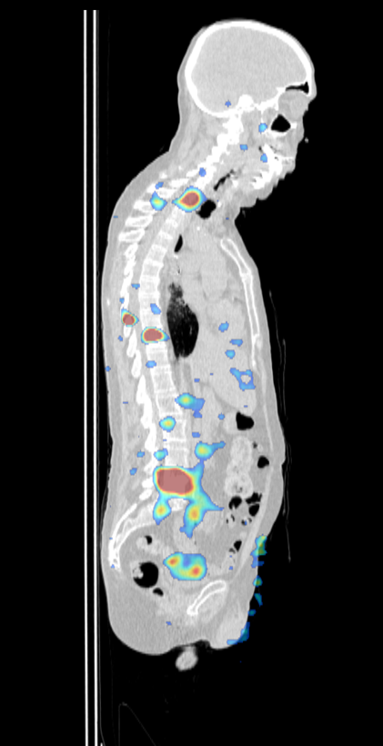
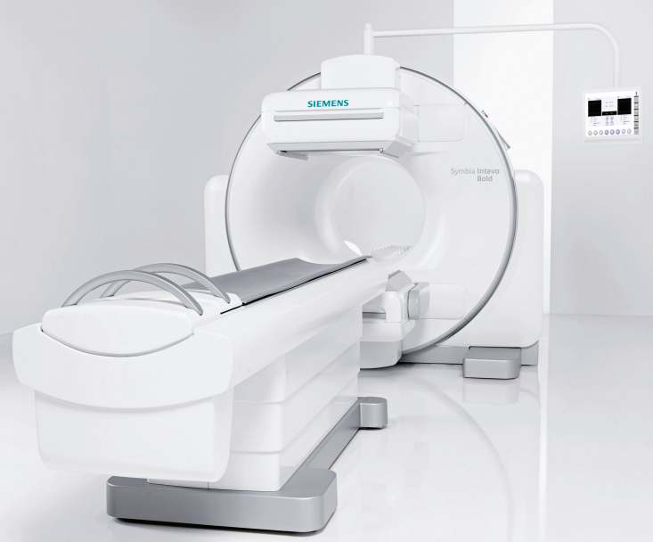
Single Photon Emission Computed Tomography (SPECT)
CT
SPECT
SPECT/CT
Imaging device
177Lu – gamma 113 keV (6.2%) 208 KeV (10.4%)
Notes:
To start with a bit of context, you may all know what a CT scan is: this imaging modality is useful to see the patients anatomy thanks to and external X-ray source.
So this imaging modality belongs to the familly of anatomical imaging.
One the other side, Single Photon Emission Computed Tomography (SPECT) belongs to the familly of functional imaging, which allows to see the metabolism of certain organs. It is a nuclear imaging modality because here the source is a radiopharmaceutical, injected to the patient
Both SPECT and CT images can be combined such as on this device
SPECT imaging has a lot of medical applications and one of them is in cancerology where it is used for lesion detection or quantification.
Recently, in the context of Target Radionuclide Therapies, SPECT has raised a lot of attention to be used for dosimetry, which means to estimate the dose absorbed tumours and healthy regions of the patient during the treatement.
LU177 218 113 kev

Slide 17
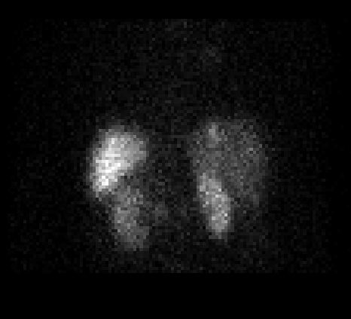
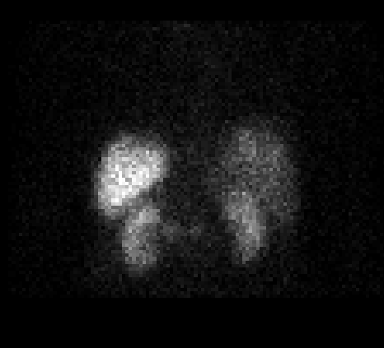
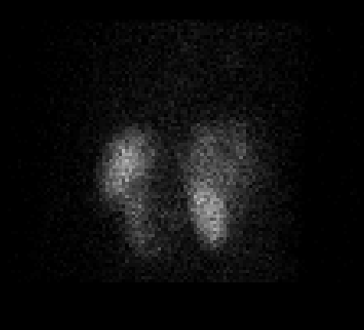
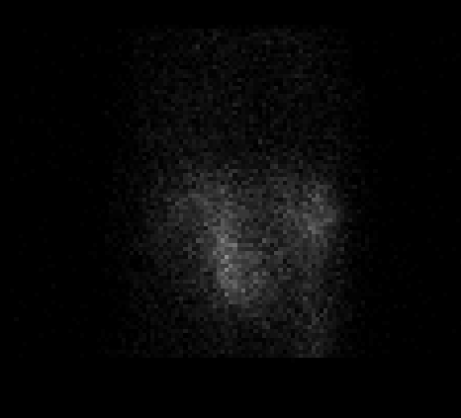
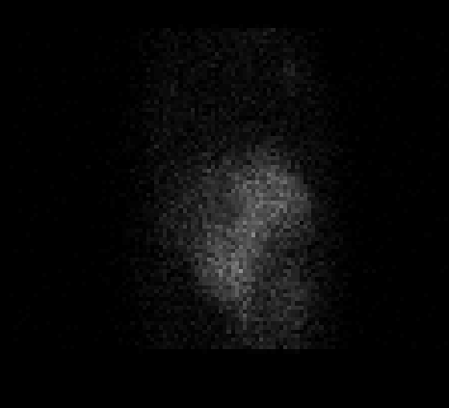
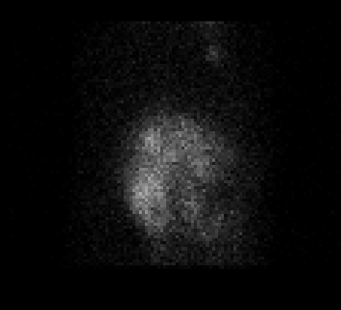
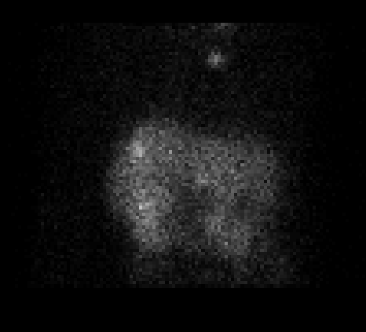
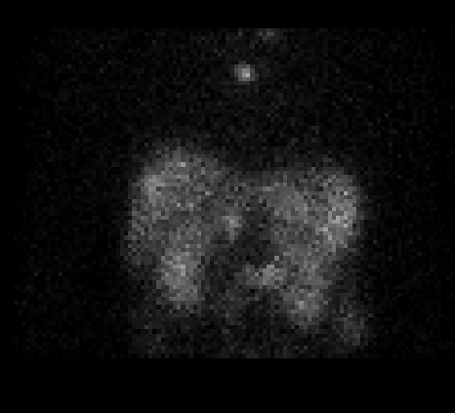
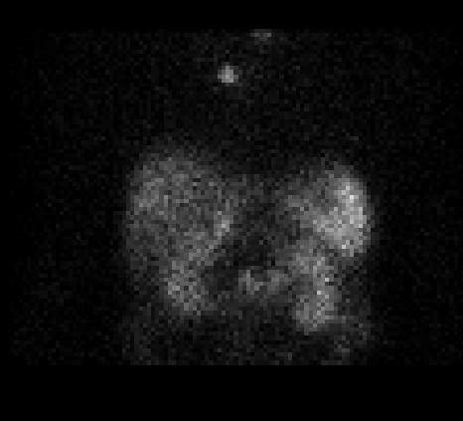
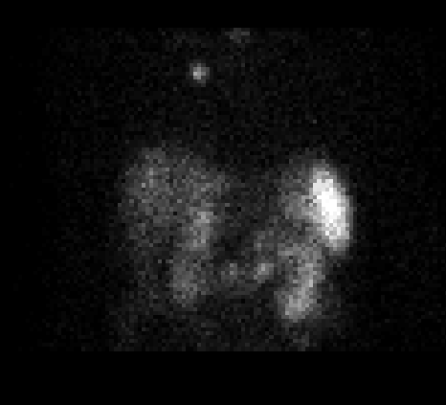
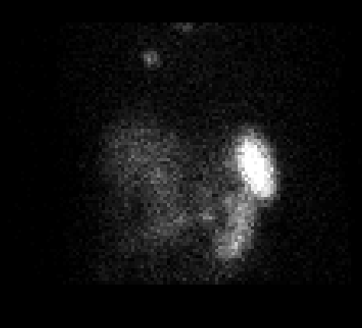
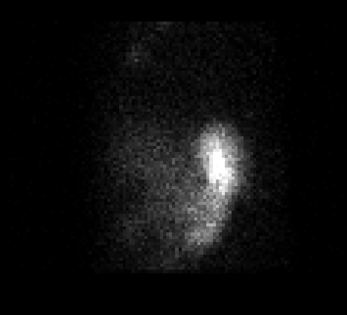
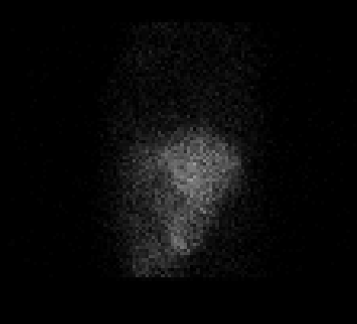
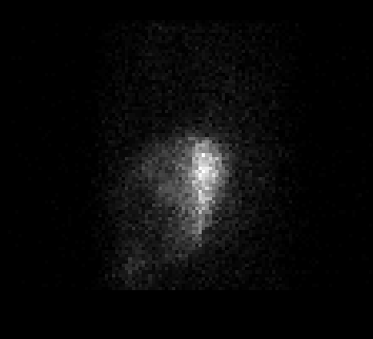
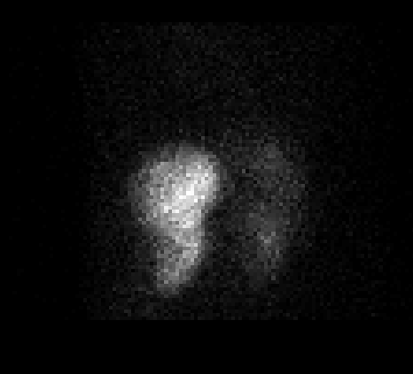
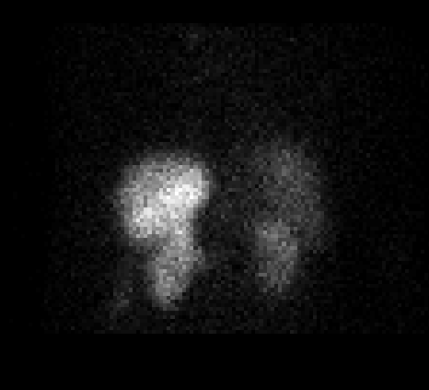



Single Photon Emission Computed Tomography (SPECT)
$γ$ rays
Vector
Radionuclide
Ex: ¹⁷⁷Lu, ^{99m}Tc…
120 x 2D projections
=
sinogram
Notes:
How does the SPECT acquisition work ?
A radiophamaceutical made of a vector and a radionuclide is injected to the patient.
The vector is chosen to bind to a certain type of receptors present on tumour cells
The radionuclide will emit gamma rays during its radioactive decay, among other particles.
2 widely used radionuclides that we will consider in this thesis are technitium and lutetium
Then, a rotating gamma camera will collect 2D projections of the emitted gamma rays. The detector is equiped with a collimator which accepts only the gamma rays emitted in the angle that is orthogonal to the detector’s plane.

Slide 18
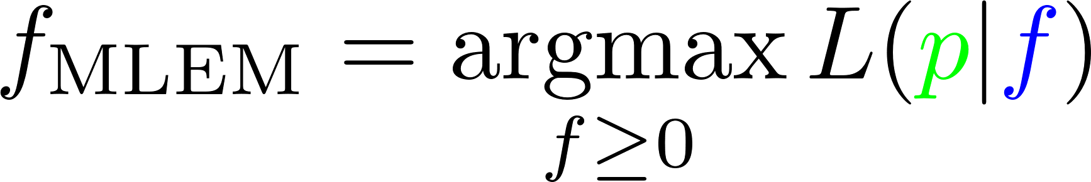
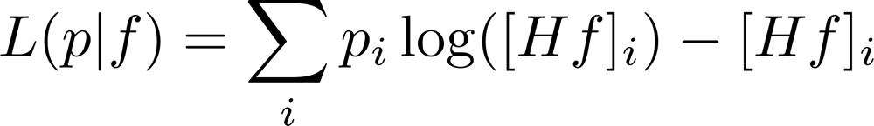
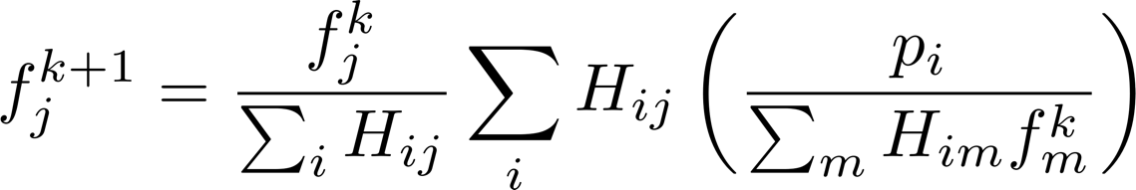
SPECT image reconstruction
3D activity image (goal)
2D projections (measured)
From sinogram (or list mode) to 3D image
Log Likelihood [Shepp and Vardi 1982]
MLEM [Lange and Carson 1984]
Correct for physical effects
  Resolution correction (RM)
  Attenuation correction (AC)
  Scatter correction (SC)

Slide 19
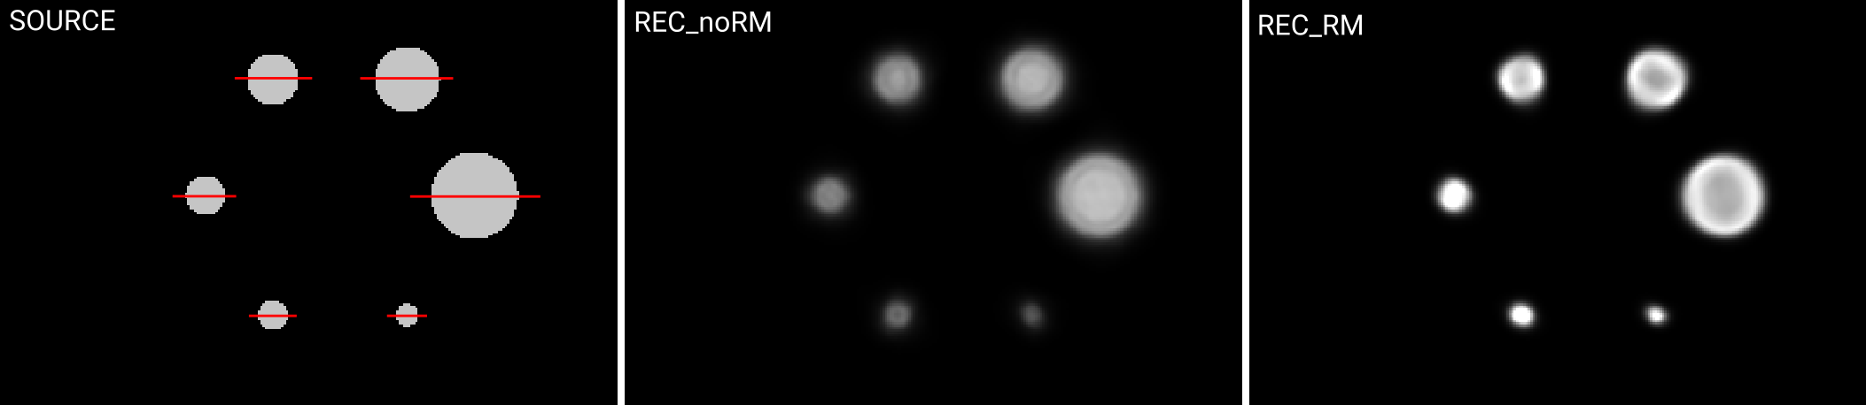
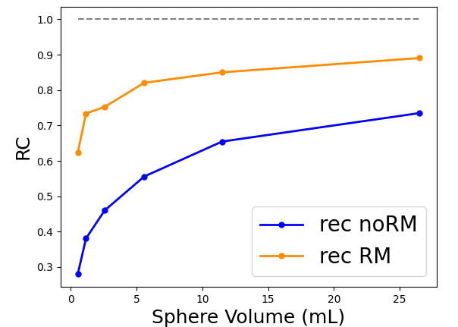
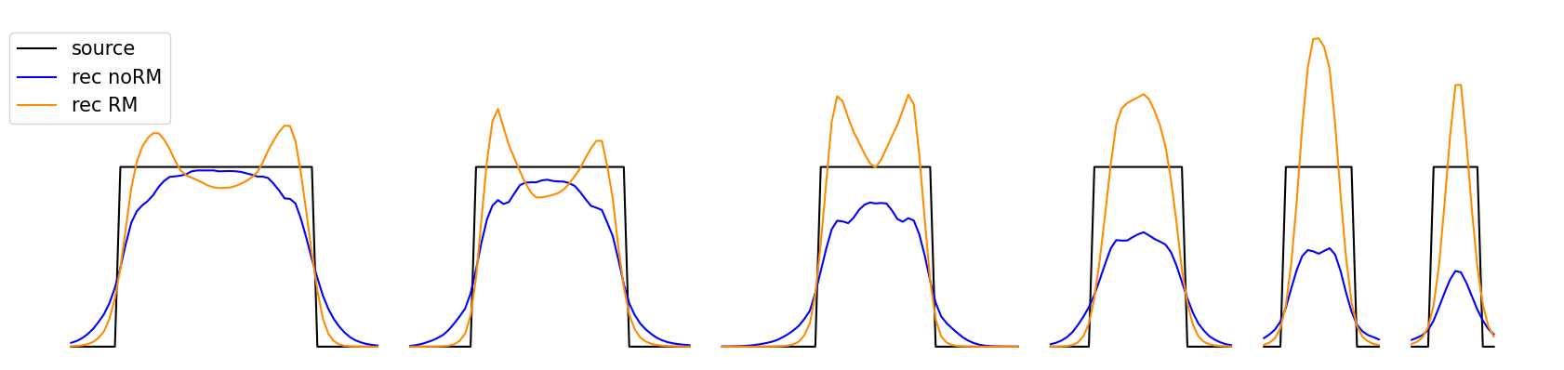
Resolution Modeling
Gaussian distance-dependent modeling

Slide 20
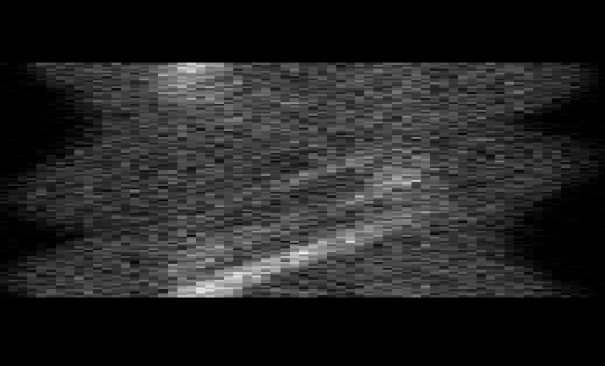
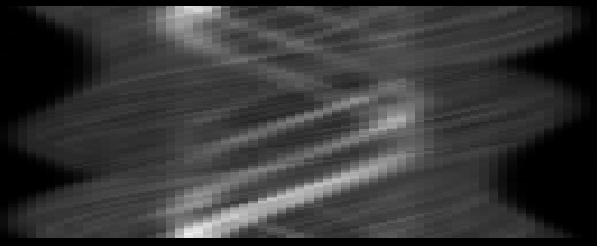




Sinogram
$$P_{PVE,noisy}$$
$$P_{rec10,fp}$$
$${\hat{P}}_{noPVE}$$
Original, scatter corrected
Reprojected, after RM reconstruction
Train a neural network

Slide 21













Supervised training
Need pairs of true / noisy images = simulated database of sinograms
Net1: denoising
Net2: deblurring
20h training 4GPU
~10⁶ parameters
OSEM
20 patients
10 000 sources
OAR + Lesions
Non homogeneous
3
1
$$8$$
$$16$$
$$8$$
128x128x128
$$16$$
$$16$$
$$32$$
$$16$$
Noise + scatter + resolution PSF
64x64x64
Copy and concatenate
$$32$$
$$32$$
$$64$$
$$32$$
Max Pool 3x3x3
32x32x32
Conv 3x3x3 + InstNorm+PReLU
$$64$$
$$64$$
UpSample+Conv 3x3x3+Dropout(0.2)
16x16x16
Conv 1x1x1

Slide 22


















Results
CT
Ground Truth
RM
PVCNet-sino-img
kBq/mL
260
130
0
[Kaprelian 2025 TRPMS]

Slide 23

Discussion
AI in reconstruction: lot of investigations
Supervised with simulated data
  Feasible
  Schema: sinogram ? image ? unrolling ?
  Unclear: needed data ? Bias ? Generalisability?
Unsupervised approaches ?
Evaluation
  On phantom experimental data
  On simulated data
  On real patient?
(unrolling) JFU-MAPEM
[Constanza TRPMS 2026 submitted]
Notes:
Super vised -> simulation

Slide 24
Outline
Outcome prediction from PET/SPECT imaging
SPECT AI-based reconstruction
Monte Carlo simulations with GATE10

Slide 25



GATE, opengate collaboration
GATE is an open-source Monte Carlo simulations
  Dedicated to medical physics
  Developed by the opengate collaboration
[Jan2004], [Jan2011], [Sarrut2014], [Sarrut2021], [Sarrut2022]
New project GATE 10
  Create simulations via Python
  Easy installation
  Robust tests-based development
[Sarrut2026, PMB, Part I], [Krah2026, PMB, Part II]
… on the shoulders of

Slide 26







pip install opengate

Slide 27











AIDER
Advanced Imaging DEtector for targeted Radionuclide therapy
HORIZON-EURATOM-2023-NRT-01-10
Valencia – Lubeck – Milano – Lyon
Lyon = CREATIS + IP2I + CLB
WP2: simulation
WP3: reconstruction
²²⁵Ac
218 keV 440 keV

Slide 28


Conclusion
(R)evolution in nuclear medicine: theranostic
Image-based dosimetry/prediction in clinic
AI methods: prediction, reconstruction
Simulation: for training, validation, optimisation …
Image quality is important
AI is a powerful hammer, not everything is a nail
GATE10 is fun

