Slide 1
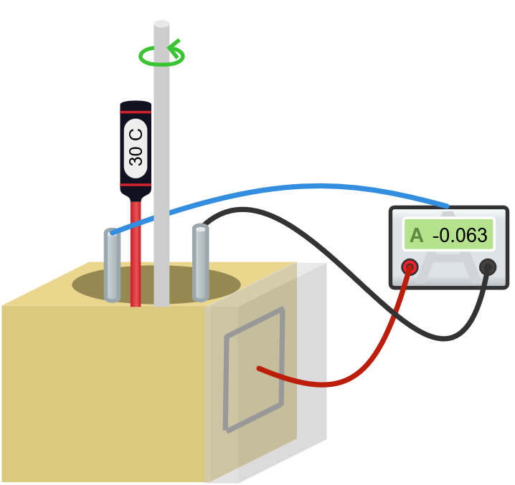
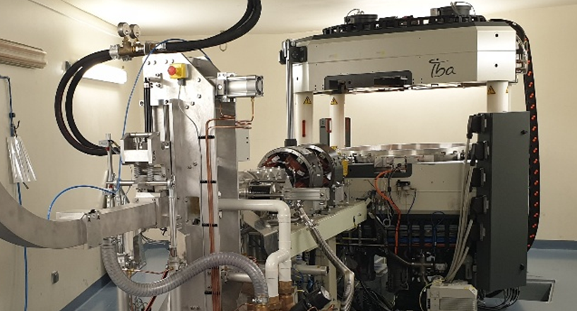
Electroplated Ni Targets for ⁶¹Cu/⁶⁴Cu Production in Clinical Cyclotrons
Jose Daniel Campos Mendez
Thomas Sounalet
Erick Mora Ramirez
Ferid Haddad

Slide 2
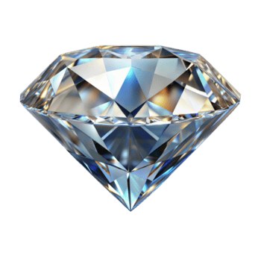

Slide 3
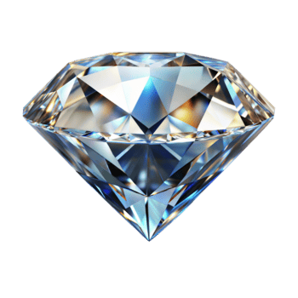

Slide 4
Enriched ⁶¹Ni ⁶⁴Ni
⁶¹Cu
⁶⁴Cu

Slide 5
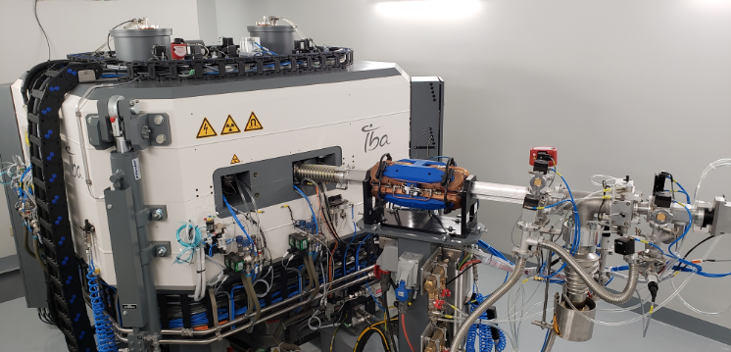
Jose Daniel Campos Mendez
2nd year PhD Candidate
Cyclotron 18 MeV
University of Costa Rica
Costa Rica
Cyclotron 18 MeV
GIP ARRONAX
Nantes, France

Slide 6
⁶¹Cu and ⁶⁴Cu
Therapy and diagnosis (theragnosis) of cancer
Prostatic
Breast
Neuroendocrine
Production in a medical cyclotron by proton irradiation
Enriched Ni target
Most of Ni is not activated

Slide 7

Having a cyclotron means the patients will have Cu benefits?
Benefits of Cu theragnosis options.
Medical Cyclotron could produce this isotopes.
Enriched Ni is really expensive.
Most of the Ni is wasted in the production.
The costs of the production are too high.

Slide 8
Process optimization
Ni target
Electroplating
Target Irradiation
Separation of Cu
Ni Recycling
Enriched ⁶⁴Ni or ⁶¹Ni
⁶⁴Cu / ⁶¹Cu

Slide 9
Process optimization
Ni target
Electroplating
Target Irradiation
Separation of Cu
Ni Recycling
Enriched ⁶⁴Ni or ⁶¹Ni
⁶⁴Cu / ⁶¹Cu

Slide 10
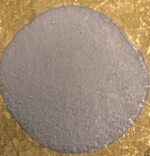
Ni Electroplating
Ni source | NiSO₄ | NiCl₂ | NiCl₂
Buffer | 2M NH₃ / 1M (NH₄)₂SO₄ | 2M NH₃ / 1M (NH₄)₂SO₄ | 2M NH₃ / 1M NH₄Cl
Current density (mA/cm²) | -8 -20 -50 | -10 -20 | -10 -20
pH controller | NH₃ | NH₃ | NH₃
pH range | 10 – 8,5
Support | Au (1mm)
Temperature (°C) | ≈30

Slide 11
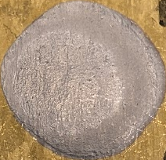
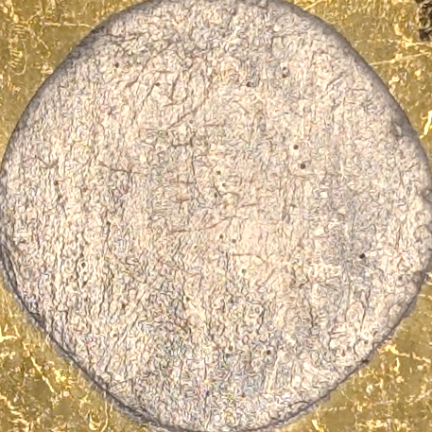

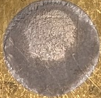
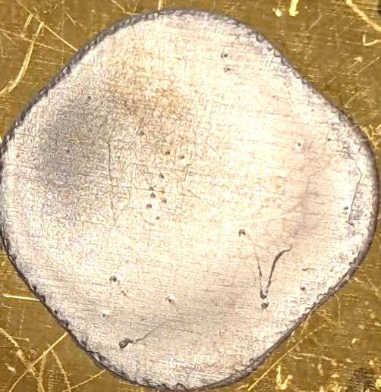
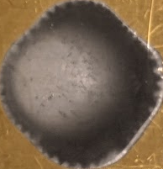
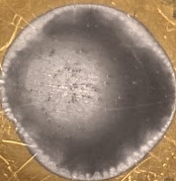
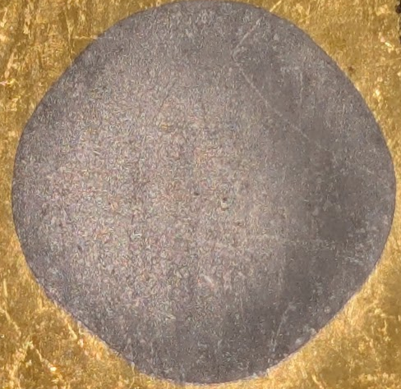
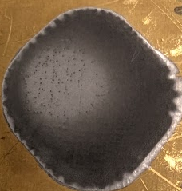
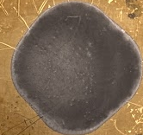
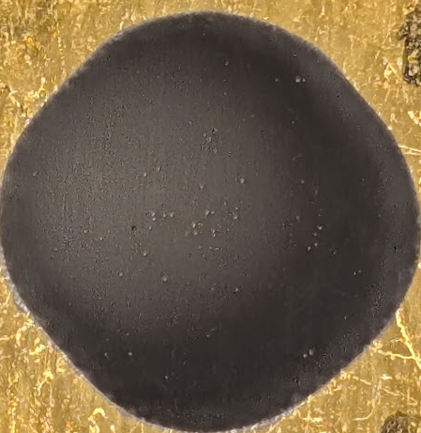
Reusing an electrolyte solution
Sulfate
Sulfate-Chloride
Chloride
1 cm
10 g/L
≈ 35 µm
6 g/L
Ni Concentration
4 g/L
5 g/L
4 g/L

Slide 12
Reusing an electrolyte solution
Sulfate
Sulfate-Chloride
Chloride
pH within the range
1 cm
10 g/L
≈ 35 µm
6 g/L
Ni Concentration
4 g/L
5 g/L
4 g/L

Slide 13
Reusing an electrolyte solution
Sulfate
Sulfate-Chloride
Chloride
pH within the range
1 cm
Current efficiency above 90 %
10 g/L
≈ 35 µm
6 g/L
Ni Concentration
4 g/L
5 g/L
4 g/L

Slide 14
Reusing an electrolyte solution
Sulfate
Sulfate-Chloride
Chloride
pH within the range
1 cm
Current efficiency above 90 %
10 g/L
Homogeneous deposits
≈ 35 µm
6 g/L
Ni Concentration
4 g/L
5 g/L
4 g/L

Slide 15
Reusing an electrolyte solution
Sulfate
Sulfate-Chloride
Chloride
pH within the range
1 cm
Current efficiency above 90 %
10 g/L
Homogeneous deposits
≈ 35 µm
6 g/L
Ni Concentration
Morphology changed
4 g/L
5 g/L
4 g/L

Slide 16
Reusing an electrolyte solution
Sulfate
Sulfate-Chloride
Chloride
pH within the range
1 cm
Current efficiency above 90 %
10 g/L
Homogeneous deposits
≈ 35 µm
6 g/L
Ni Concentration
Morphology changed
4 g/L
5 g/L
4 g/L
Low current efficiency

Slide 17
Reusing an electrolyte solution
Sulfate
Sulfate-Chloride
Chloride
pH within the range
1 cm
Current efficiency above 90 %
10 g/L
Homogeneous deposits
≈ 35 µm
6 g/L
Ni Concentration
Morphology changed
4 g/L
5 g/L
4 g/L
Low current efficiency

Slide 18
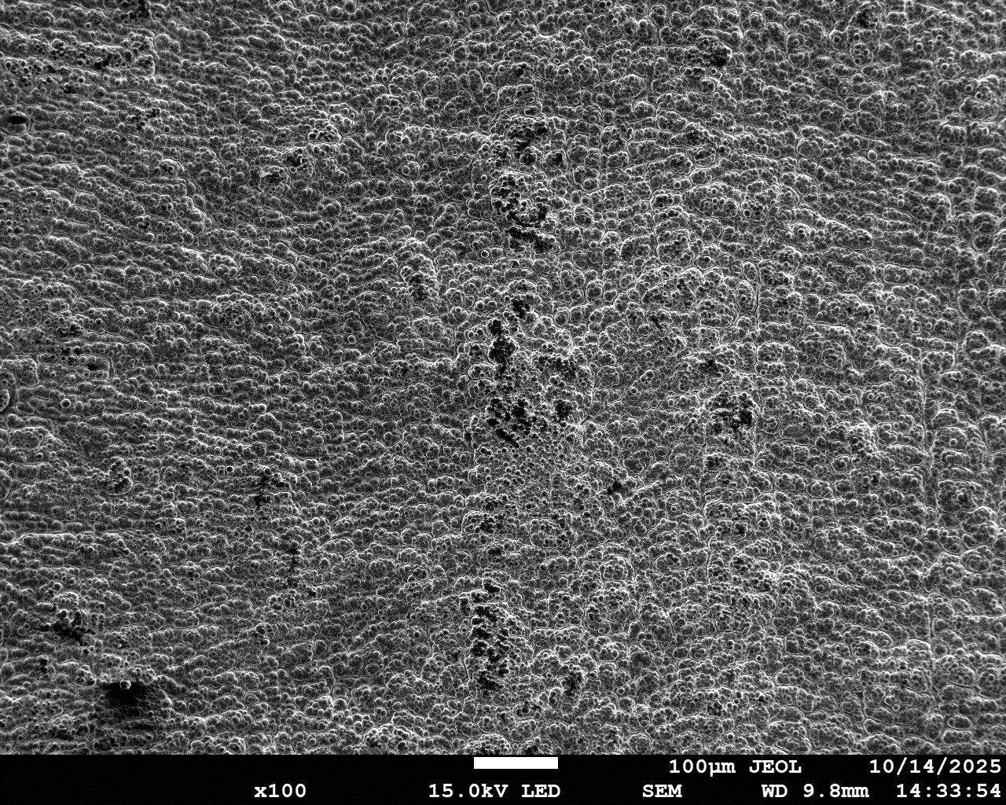
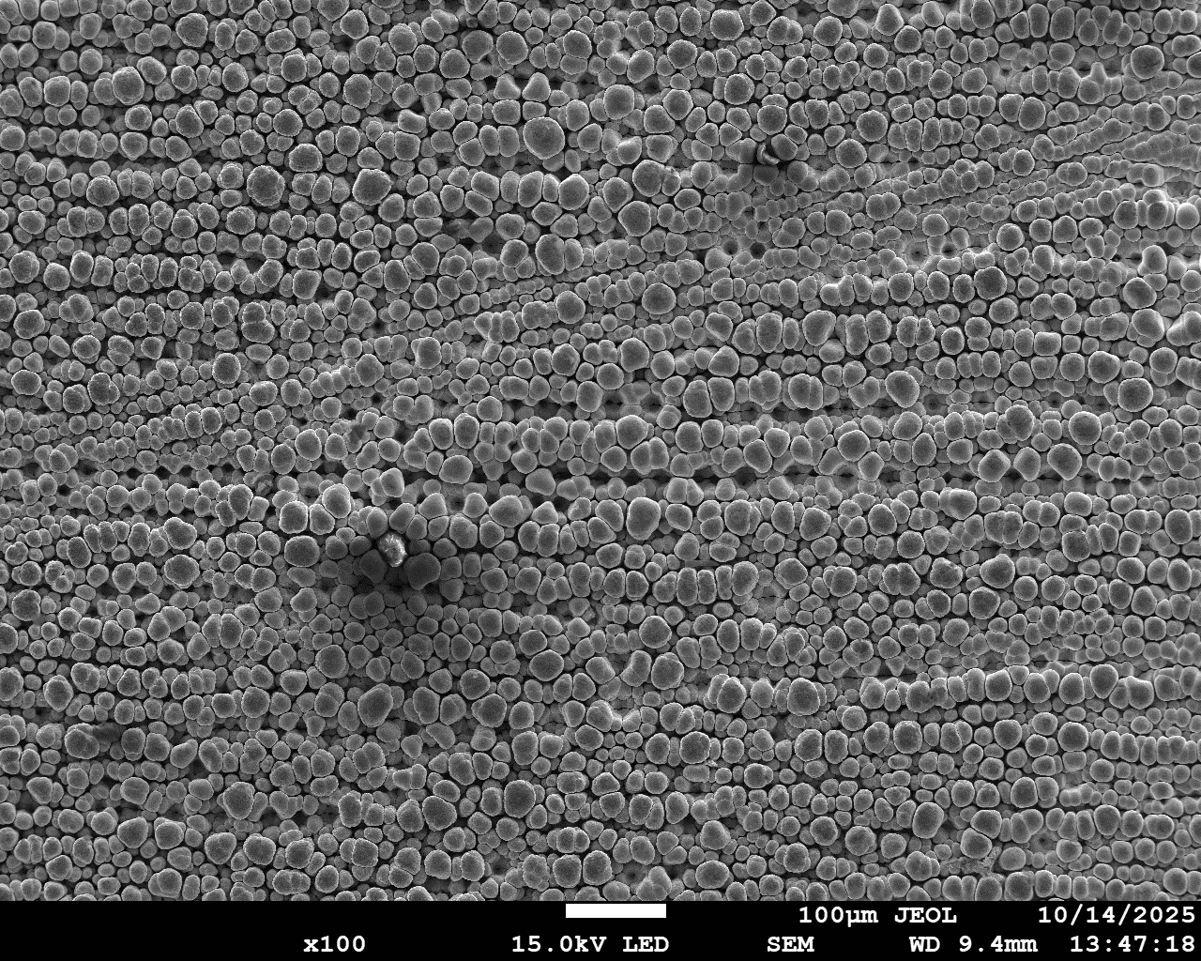
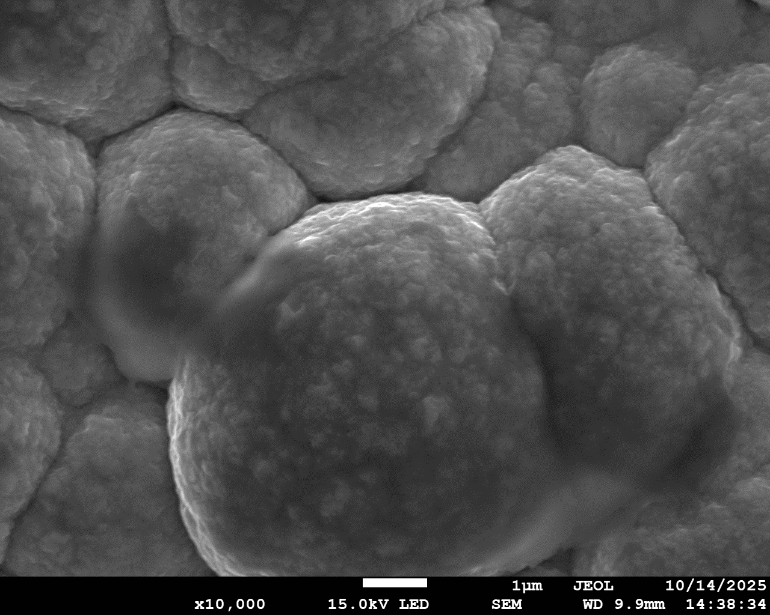
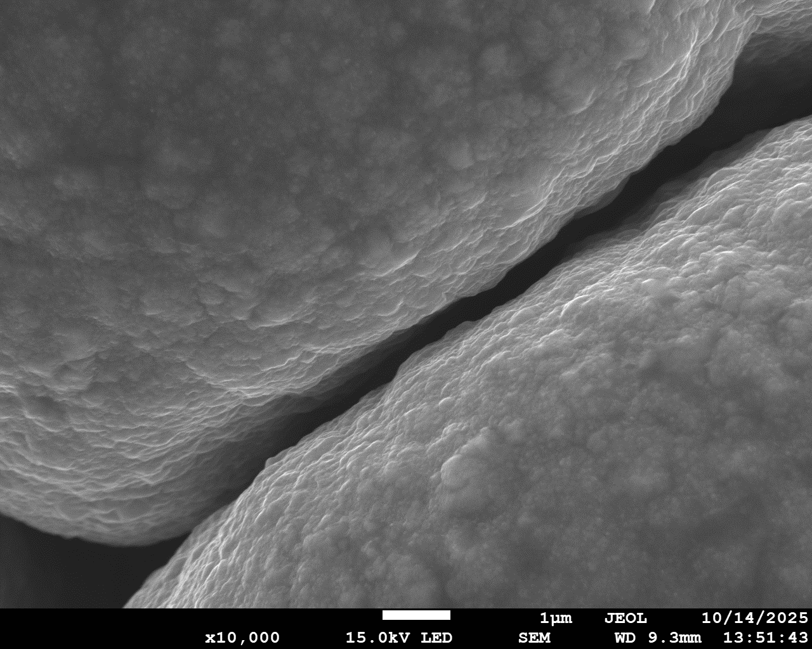
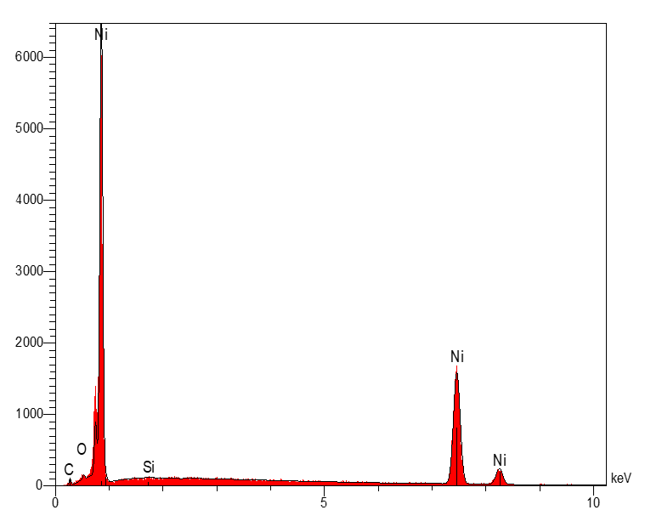
SEM / EDS
Ni
Ni
18

Slide 19
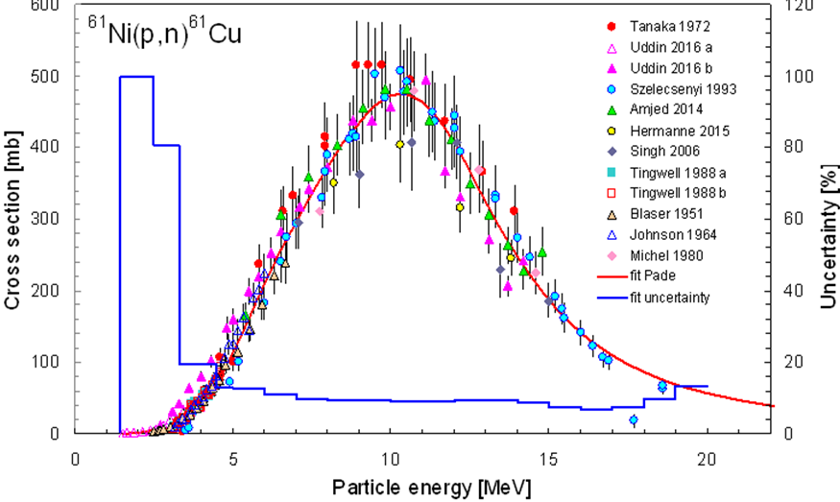
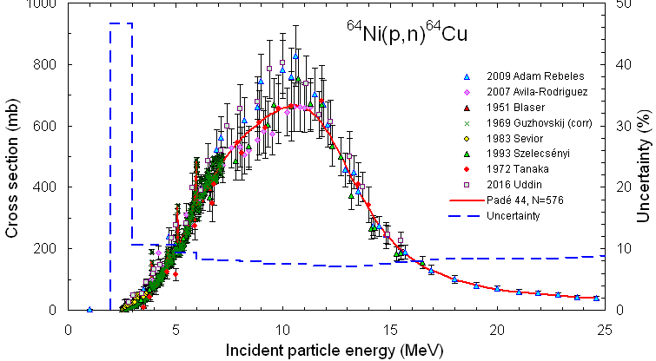
Energy range and cross section

Slide 20
Energy range and cross section

Slide 21
Apparent thickness
Goal target thickness
Real thickness
Produced Isotope | Cu⁶¹ /Cu⁶⁴
Energy range (MeV) | 5-18
Research center | CICANUM | ARRONAX
Tilt from beam axis (°) | 90 | 6
Apparent thickness (µm) | 583 | 583
Real thickness (µm) | 583 | 61
Target mass (mg) | 1631 | 409
9,6 cm
1,0 cm
6°
1,0 cm
M. Sitarz, Radionuclide Yield Calculator. Nantes, France: GIP ARRONAX, (2018). [Online]. Available: http://www.cyclotron-nantes.fr/.

Slide 22
Apparent thickness
Goal target thickness
Real thickness
Produced Isotope | Cu⁶¹ /Cu⁶⁴
Energy range (MeV) | 5-18 → 9-16
Research center | CICANUM | ARRONAX
Tilt from beam axis (°) | 90 | 6
Apparent thickness (µm) | 583 → 352 | 583 → 352
Real thickness (µm) | 583 → 352 | 61 → 37
Target mass (mg) | 1631 → 985 | 409 → 247
9,6 cm
1,0 cm
6°
1,0 cm
M. Sitarz, Radionuclide Yield Calculator. Nantes, France: GIP ARRONAX, (2018). [Online]. Available: http://www.cyclotron-nantes.fr/.

Slide 23
Apparent thickness
Goal target thickness
Real thickness
Produced Isotope | Cu⁶¹ /Cu⁶⁴
Energy range (MeV) | 5-18 → 9-16
Research center | CICANUM | ARRONAX
Tilt from beam axis (°) | 90 | 6
Apparent thickness (µm) | 583 → 352 | 583 → 352
Real thickness (µm) | 583 → 352 | 61 → 37
Target mass (mg) | 1631 → 985 | 409 → 247
9,6 cm
1,0 cm
6°
1,0 cm
M. Sitarz, Radionuclide Yield Calculator. Nantes, France: GIP ARRONAX, (2018). [Online]. Available: http://www.cyclotron-nantes.fr/.

Slide 24
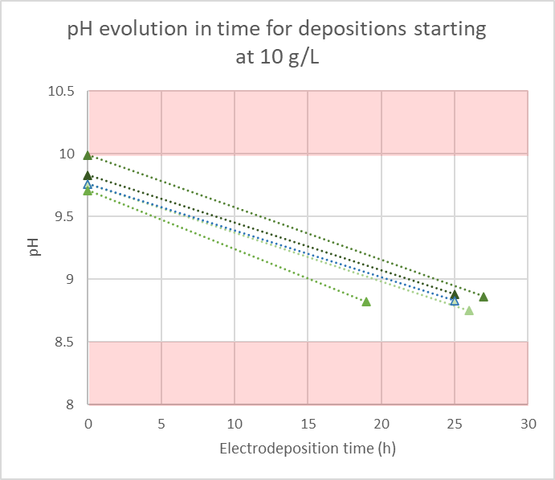
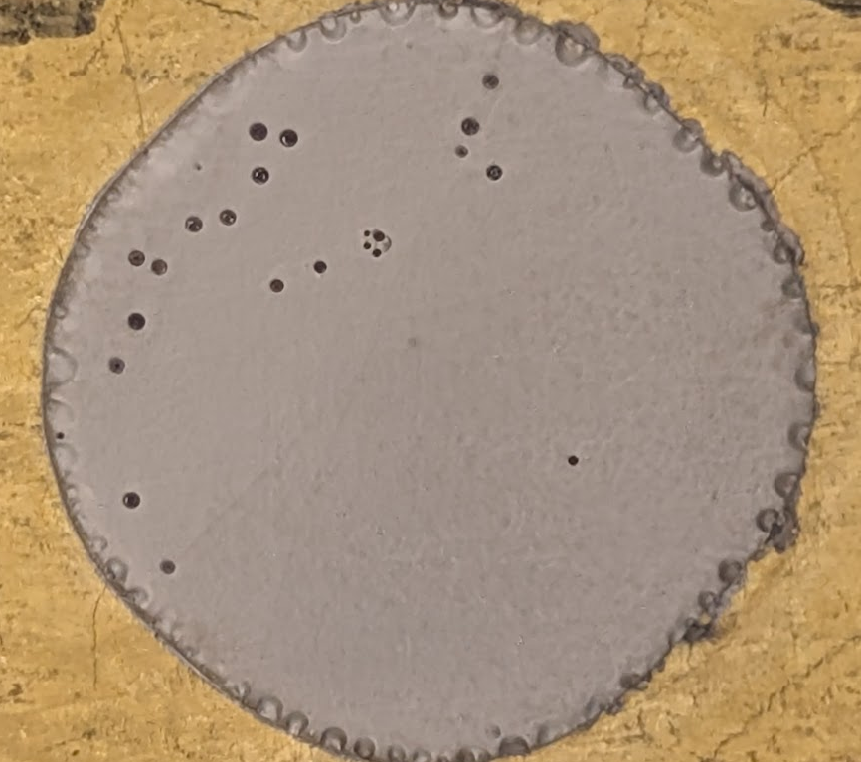
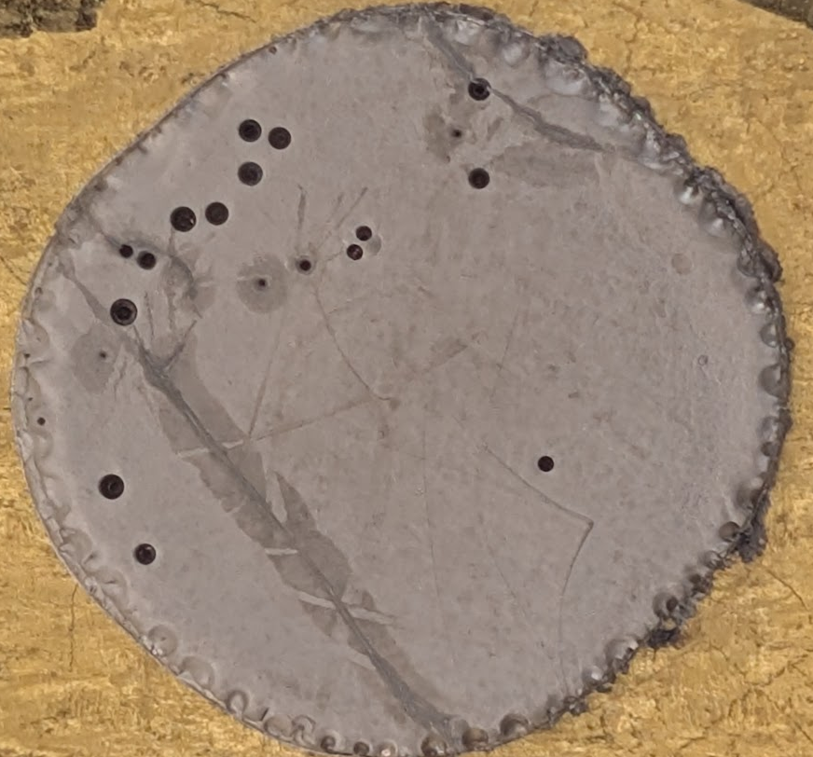
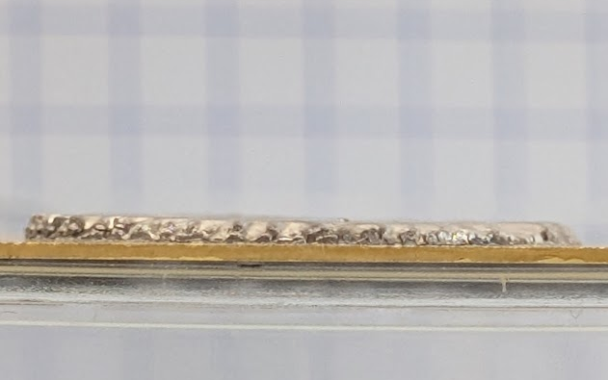
Thick targets
1st layer
25 h
288 µm
CE 93,7%
2nd layer
27 h
600 µm
CE 93,5%

Slide 25
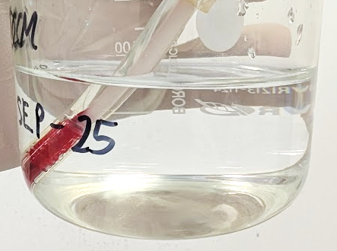
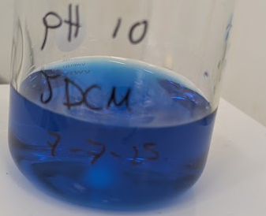
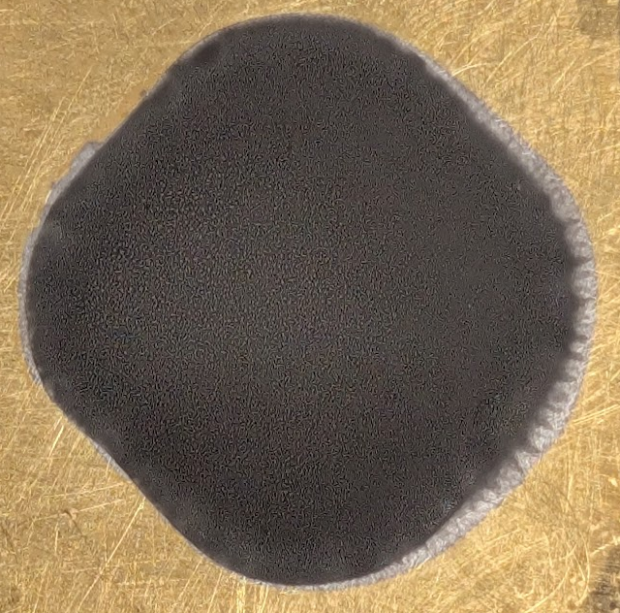
Ni recovery (still in study)
< 5 mg
Electroplating
Ni electrolyte waste
Ni electrolyte after target deposit
> 97%

Slide 26
Conclusions
Nickel Chloride electrolyte is a good option for electroplating.
Color changing comes from morphology variations.
Thick targets until 600 µm can be produced.
Electroplating for Ni recovery looks promising.

Slide 27
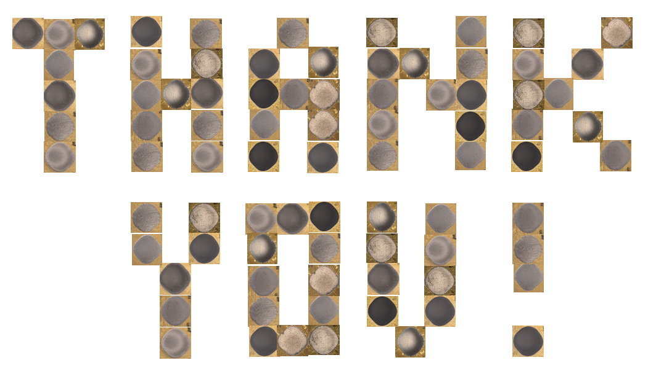
ARRONAX / SUBATECH
CICANUM
Organizers of GDR Mi2B
Contact information:
campos@subatech.in2p3.fr
jose.camposmendez@ucr.ac.cr

