Slide 1





AG GDR, Mi2b
Marseille, le 29.06.2026
Comparison of the simulated response of hybrid pixel detector with synchrotron beam tests
Mélissa Leroy^{1,2}, Mathieu Dupont¹, Christian Morel¹, Elena Gaborieau-Borissenko², Yannick Boursier¹
¹ Aix Marseille Univ, CNRS/IN2P3, CPPM, Marseille, France
² Detection Technology, 38430 Moirans, France
melissa.leroy@deetee.com
mleroy@cppm.in2p3.fr

Slide 2
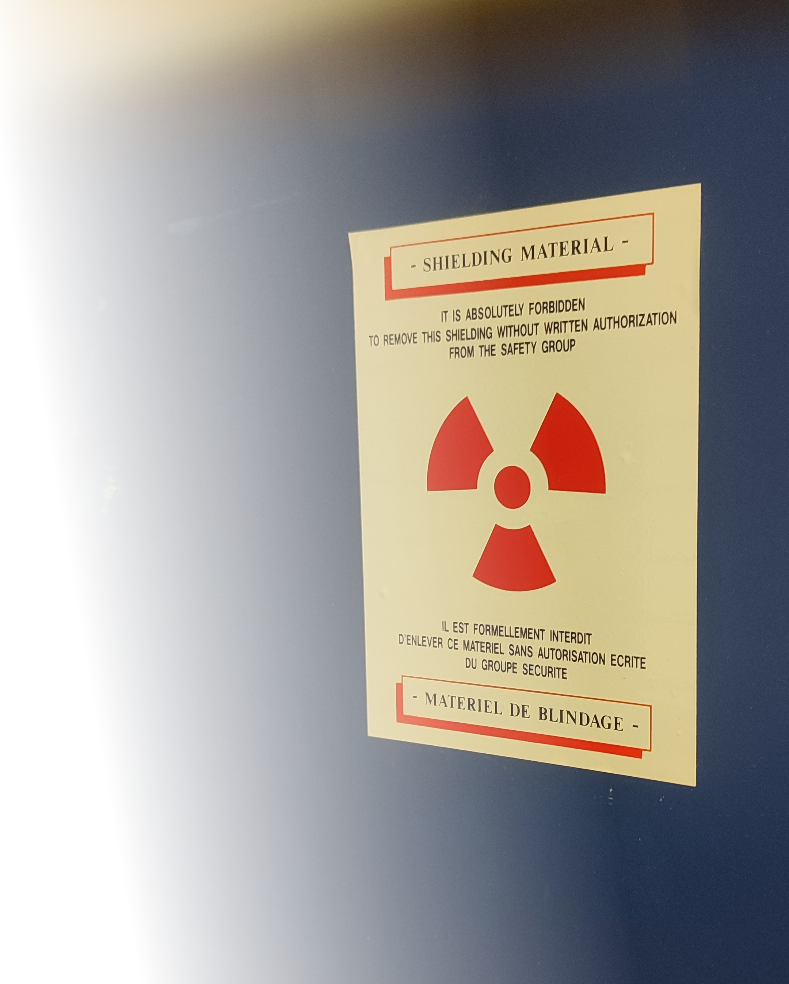
Outline
1 – Context and goals of the thesis
2 – Modelling hybrid pixel detectors response
3 – Simulation pipeline
4 – Validation cases
5 – Conclusion and prospect

Slide 3


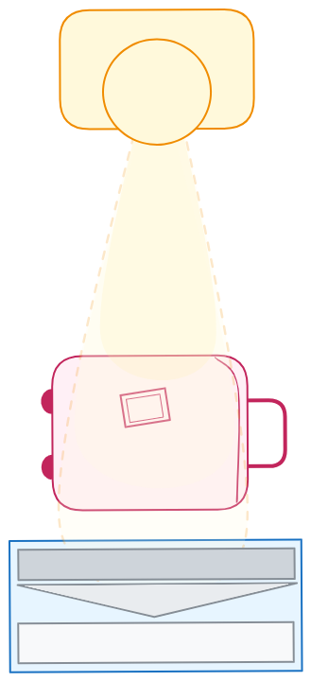
1 - Context of the thesis
Global project in Detection Technology (DT) company:
→ Develop Photon Counting Detectors (PCD) and associated technology solutions
→ Build an X-ray chain simulator as an internal research and development tool for the company
Medical X-ray imaging ​
Computed tomography​
Dental imaging​
Surgical imaging​
Security X-ray imaging​​
Baggage and parcel scan​​
Cargo and vehicle scan​​
People scan​​​​
Industrial X-ray imaging ​​​
Food industry​​​
Recycling and sorting​​​
Mining industry
Thesis: ​​
Simulation of hybrid pixel Photon Counting Spectral Detectors
→ Detection Technology (DT) leverage the simulation expertise of imXgam team (CPPM)
Motivation: why developing a simulation pipeline ?​
→ Optimize detector design ​
→ Generate training datasets for Deep Learning methods
→ Develop correction algorithms
→ Enhance physical understanding of the detector response

Slide 4
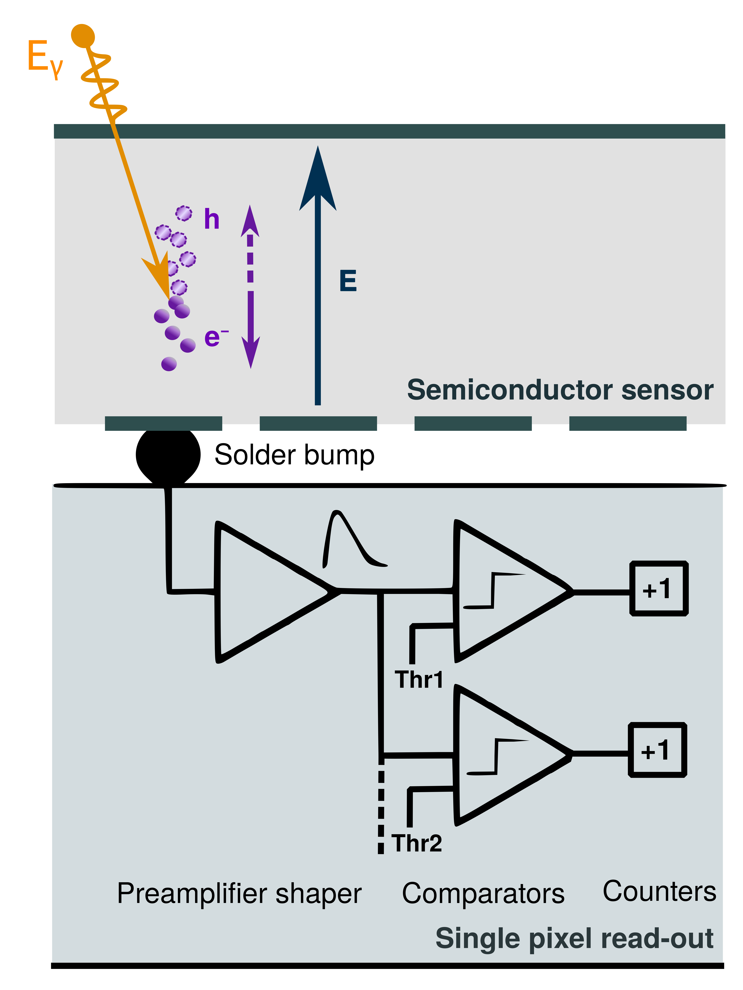
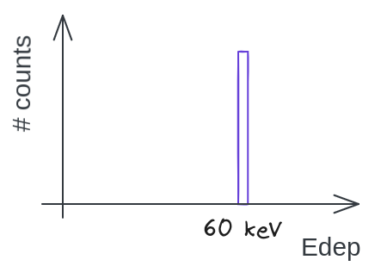
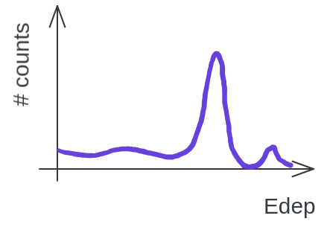
2 – Modelling hybrid pixel detectors response
  a. Ideal detector response
E _{deposited}
Material |  | E_{e/h}
Cadmium Telluride | CdTe | 4.43 eV
Cadmium-Zinc Telluride | CdZnTe | 4.64 eV
Silicon | Si | 3.64 eV
Germanium | Ge | 2.97 eV
Gallium Arsenide | GaAs | 4.2 eV
N_{charges}
=
E _{e-/h}
N_{charges} : Number of electron-hole pairs created
E_{deposited} : Energy deposited in the sensor
E_{e/h} : Electron-hole pair creation energy
Signal ∝ E _{γ}

Slide 5
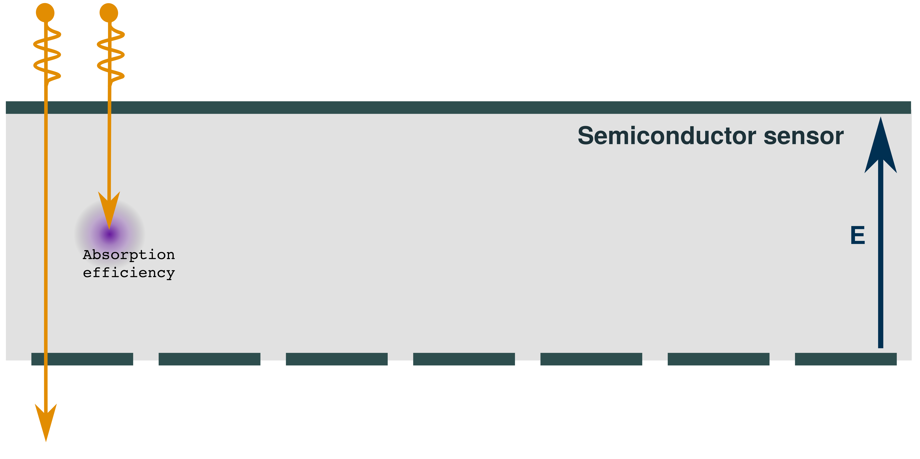
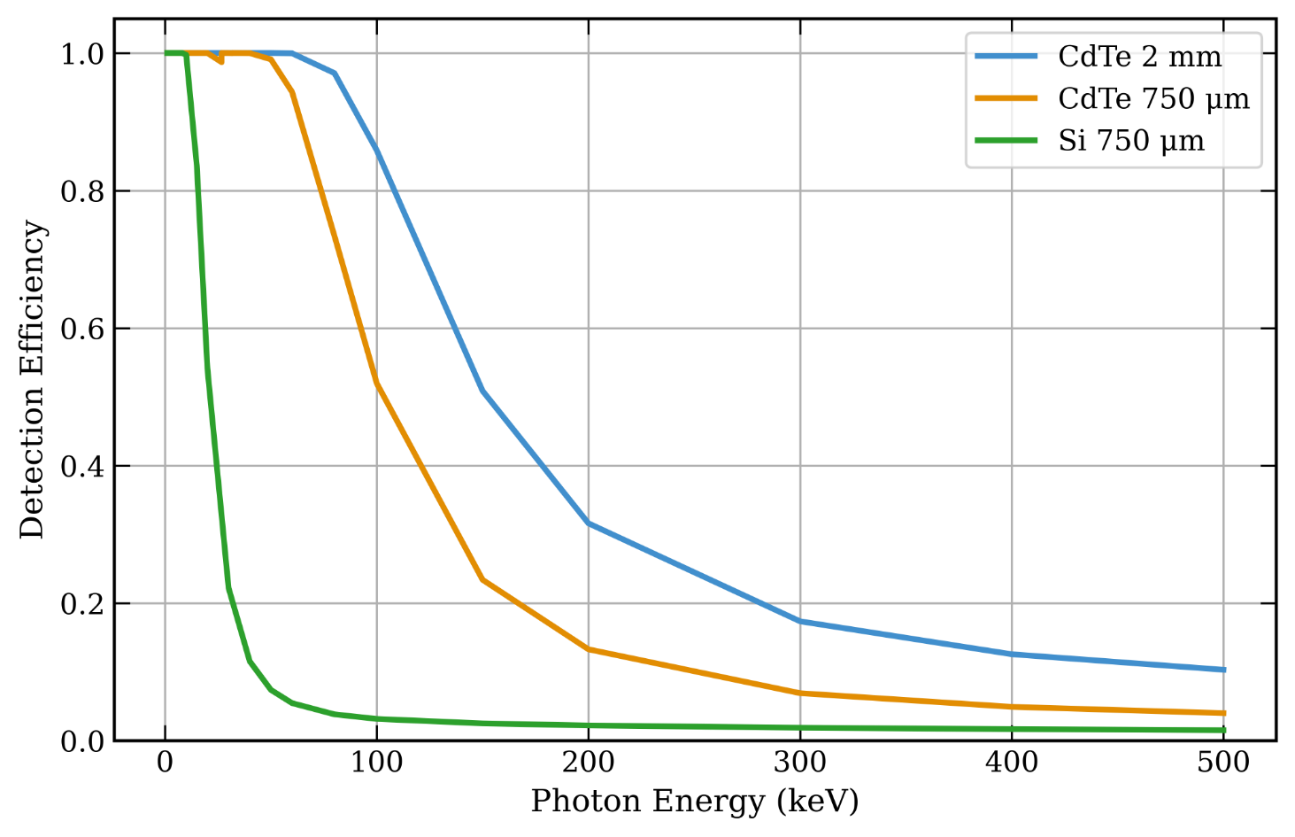
2 – Modelling hybrid pixel detectors response
  b. Physical limitations of real detectors

Slide 6
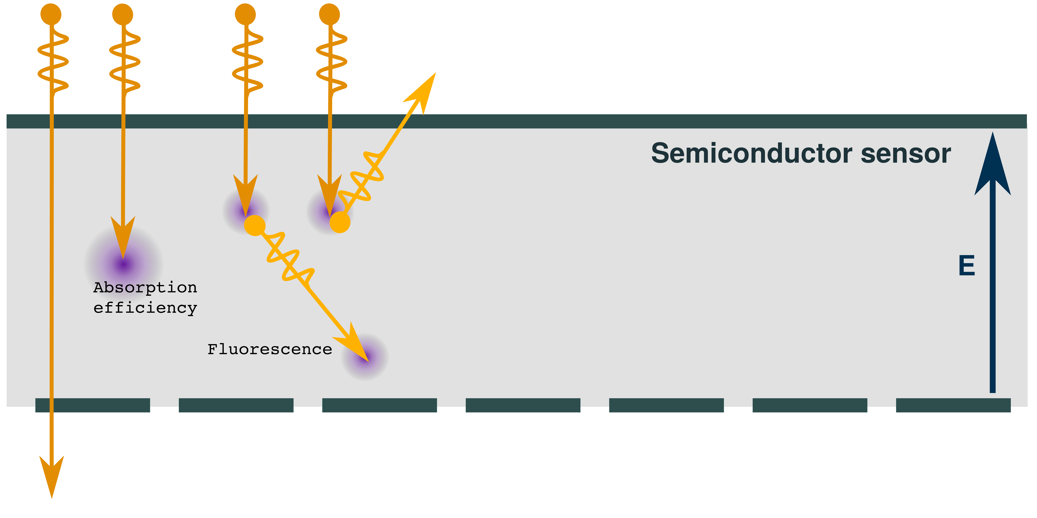
2 – Modelling hybrid pixel detectors response
  b. Physical limitations of real detectors
 |  | Atomic number | X-ray transitions energies |  | Mean free path (1/µ)
Material |  | Z | K_{α1} [keV] | K_{α2} [keV] | d_{α1} [µm] | d_{α2} [µm]
Si |  | 14 | 1.74 | 1.74 | 11.86 | 11.86
CdTe | Cd Te | 48 52 | 23.17 27.47 | 22.98 27.20 | 113.20 59.32 | 110.75 57.85

Slide 7
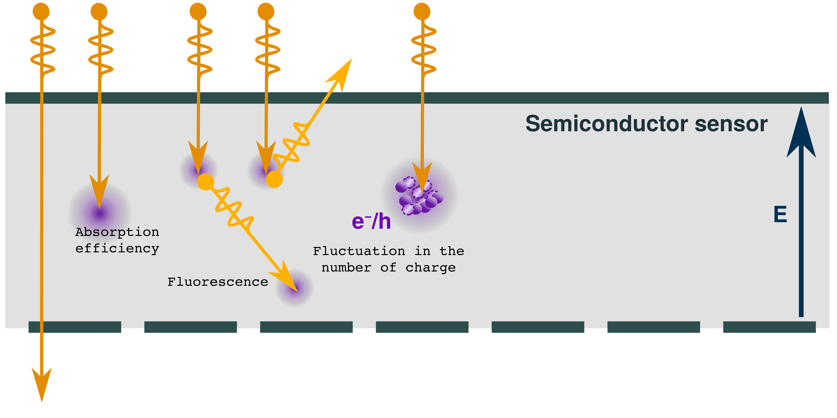

2 – Modelling hybrid pixel detectors response
  b. Physical limitations of real detectors
N: Number of charges created
F: Fano factor
Material |  | E_{e/h} | Fano factor
Cadmium Telluride | CdTe | 4.43 eV | 0.24
Cadmium-Zinc Telluride | CdZnTe | 4.64 eV | 0.14
Silicon | Si | 3.64 eV | 0.115

Slide 8
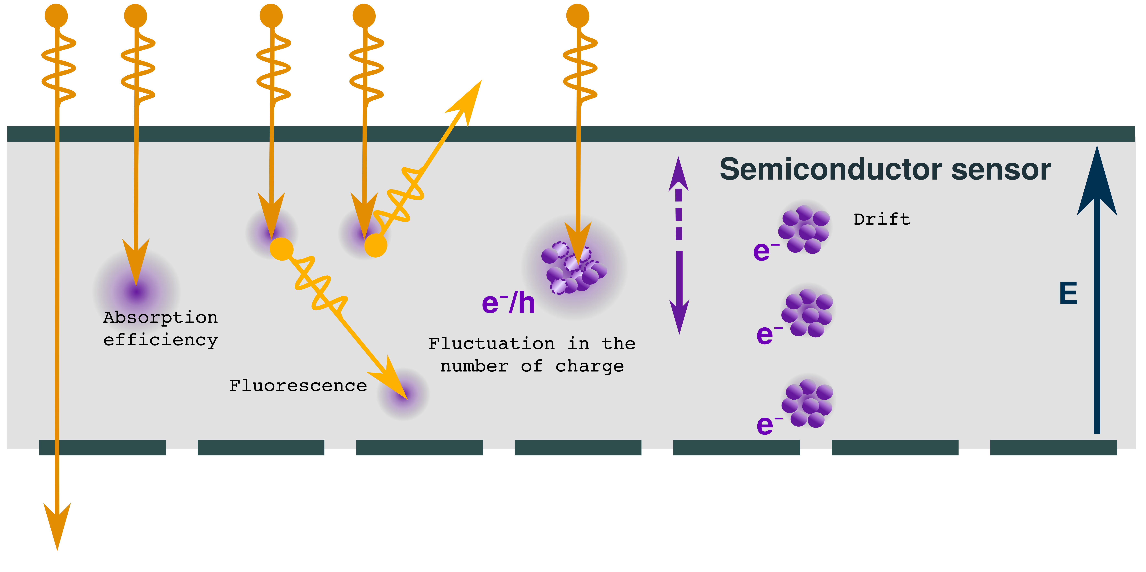
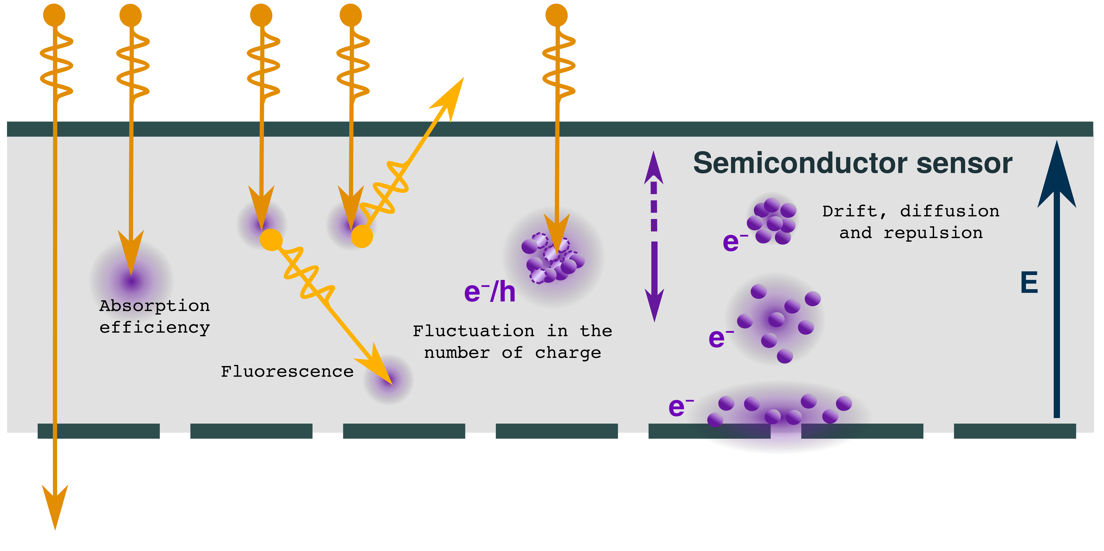
2 – Modelling hybrid pixel detectors response
  b. Physical limitations of real detectors

Slide 9
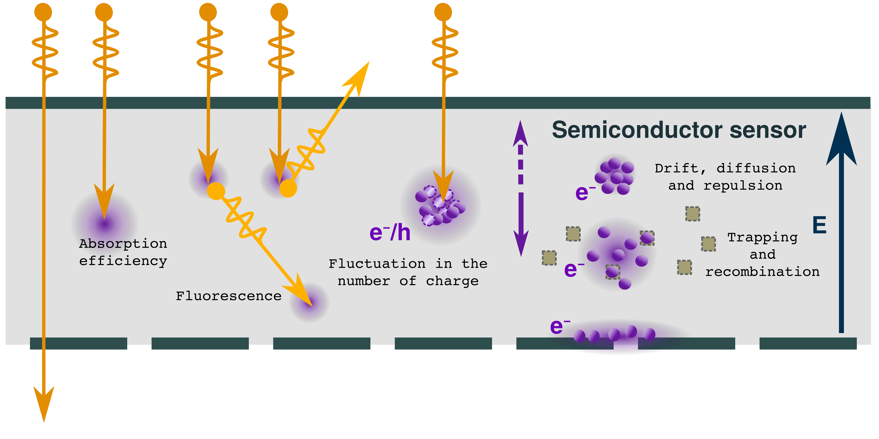
2 – Modelling hybrid pixel detectors response
  b. Physical limitations of real detectors

Slide 10
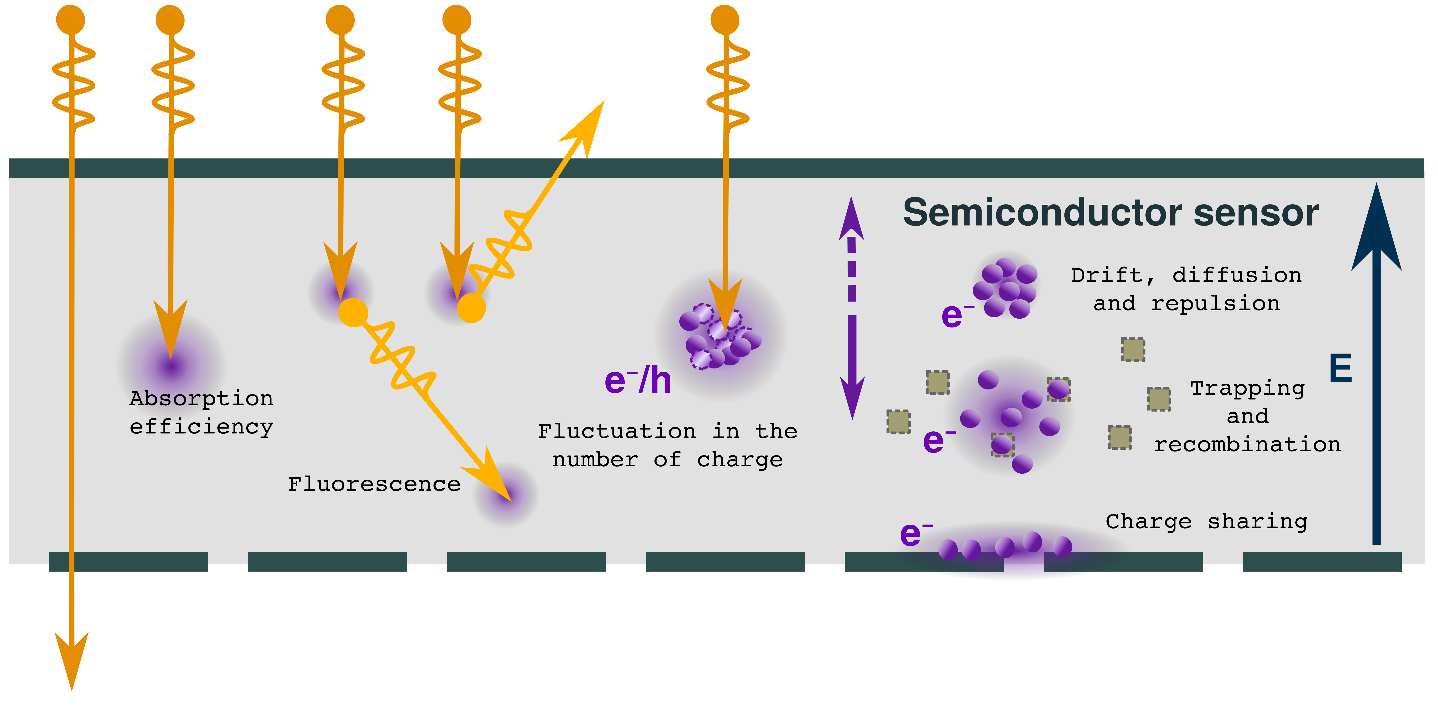
2 – Modelling hybrid pixel detectors response
  b. Physical limitations of real detectors
→ And polarization, pile-up, threshold dispersion...
All these effect combine to shape the detector response (broadened peak, low-energy tail, escape peak)
To predict and disentangle them, we need a detailed physic-based simulation pipeline

Slide 11
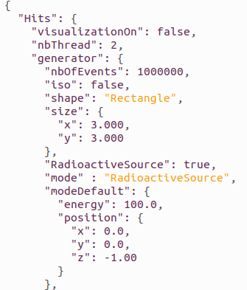

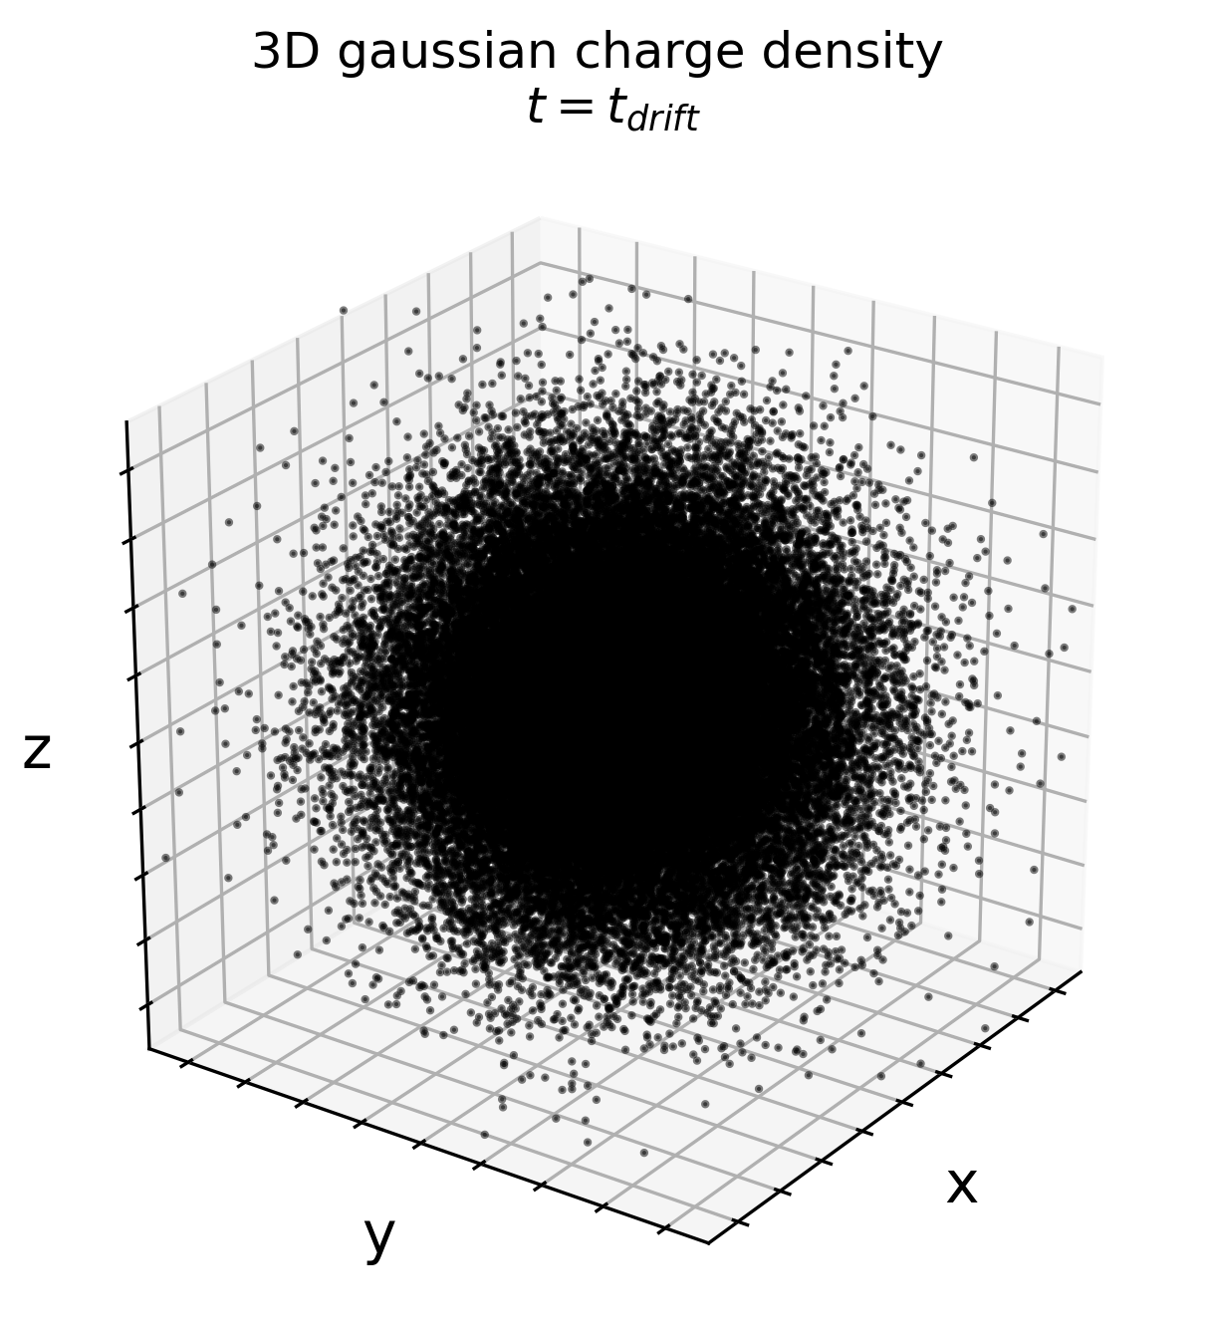

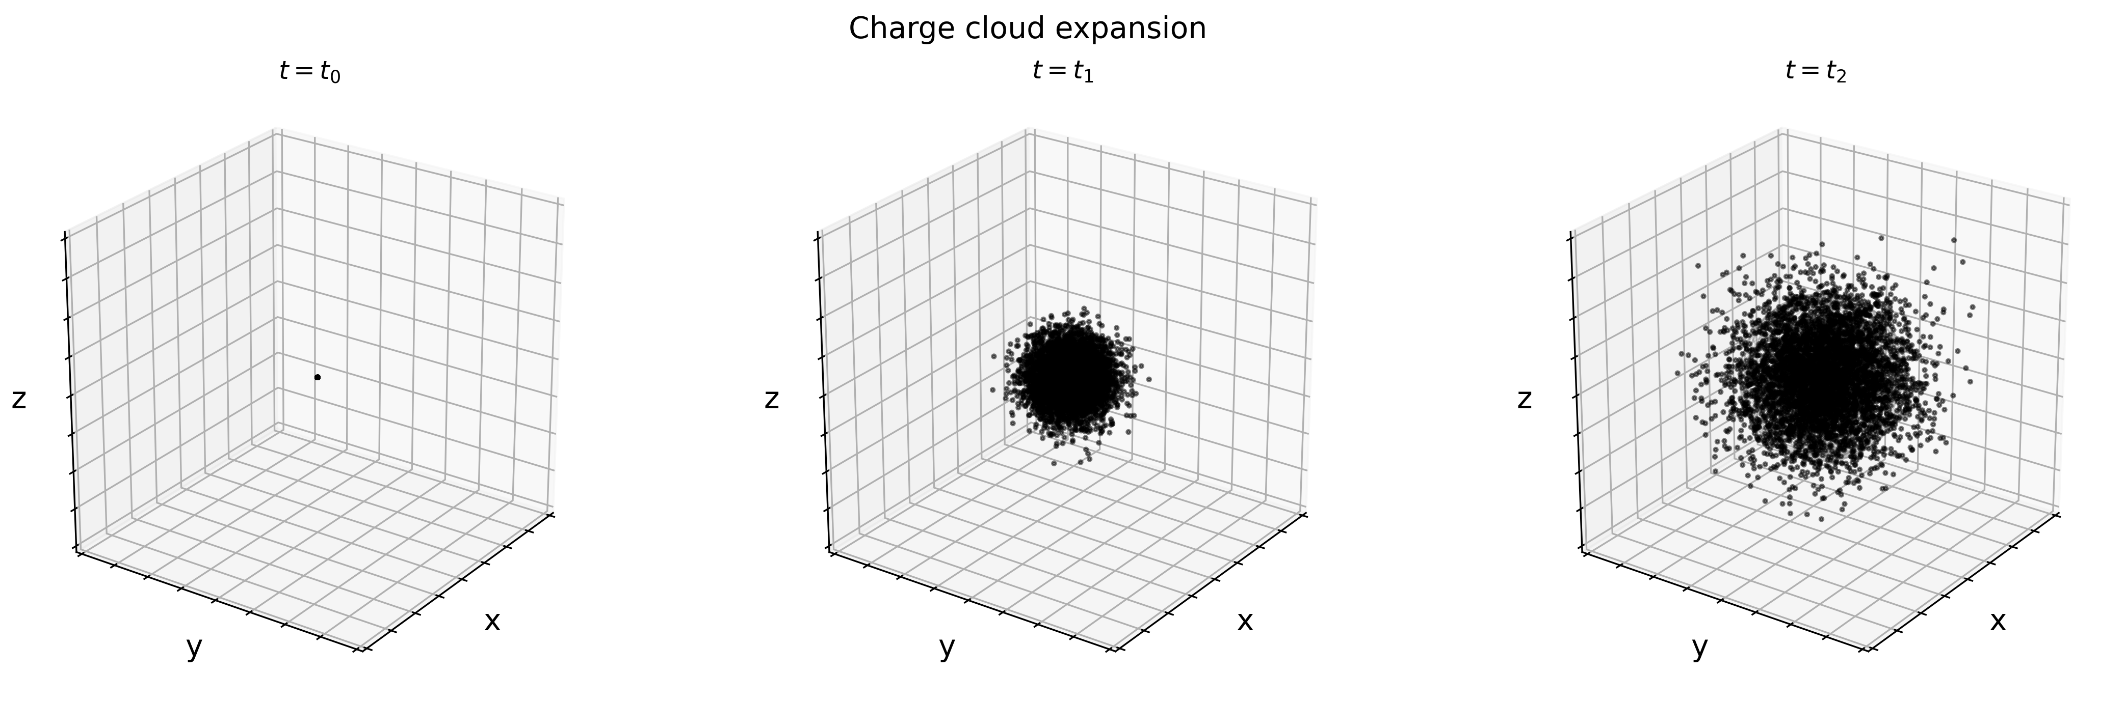
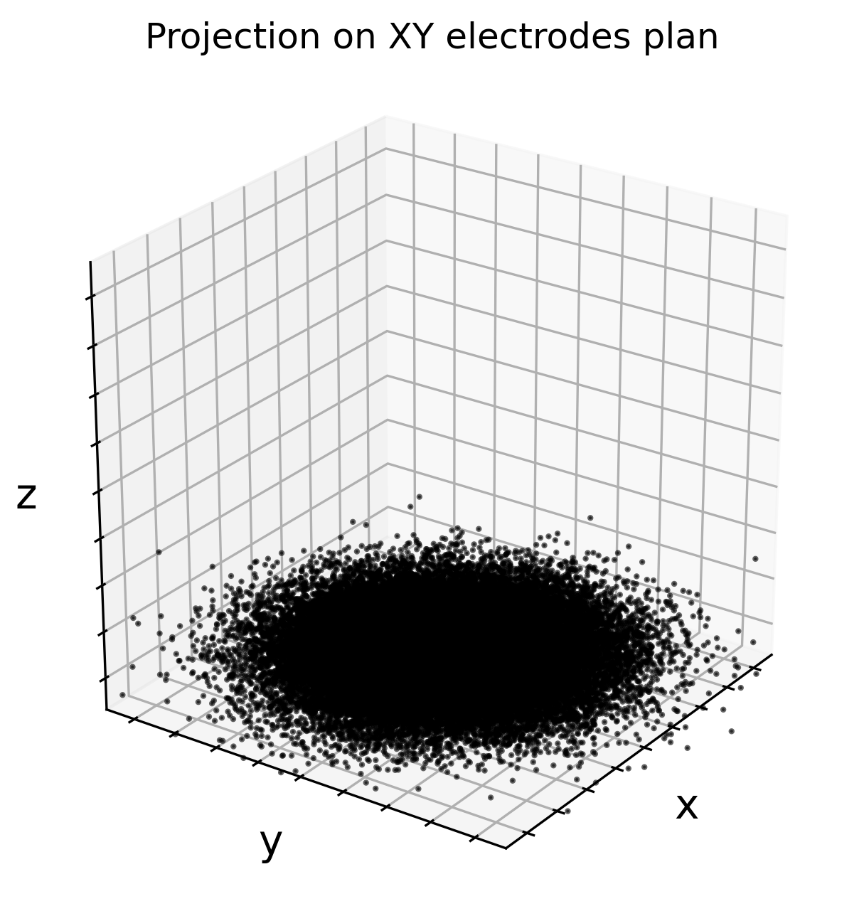
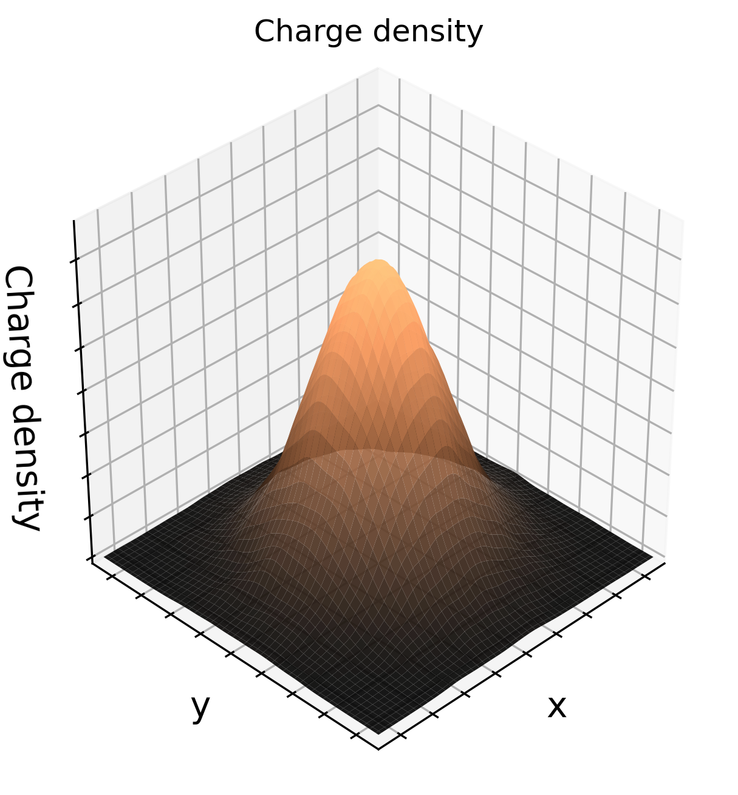
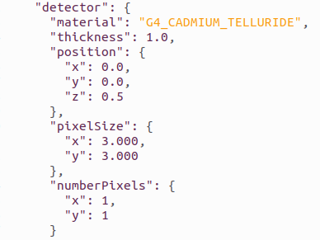



3 - Simulation pipeline
  a. Global diagram
Ignores Shockley-Ramo signal induction, polarization,pile-up
Configuration
X-ray interactions
Carrier generation and fluctuation
Charge carriers dynamics
Charge carriers
collection
Output
Detector geometry
X-ray source properties
Number of charges created and lifetime calculation
New positions of charges after drift, diffusion and repulsion
Electronic noise added to the pixel collected charge spectrum reconstruction
Energy spectrum from the simulated detector
Counts in each of several predefined energy bins
Geant4: Tracking of particles in the sensor, their position and energy loss
N: Number of charges
F: Fano factor
$$\frac{∂ρ}{∂t}={D∇}^{2}ρ−μ∇.(ρE)$$
σ(t_{drift})
Diffusion
Electrostatic repulsion
$$t_{drift}(z)=\frac{1}{µk}\ln\left(\frac{E(z)}{E_{0}}\right)$$
The 2 models studied :
Repulsion and diffusion are independent
E. Gatti et al., NIMA, 253 (1987) 393-399, DOI: 10.1016/0168-9002(87)90522-5.
Repulsion and diffusion are dependent
M.Benoit et al., NIMA, 606 (2009) 508-516, DOI: 10.1016/j.nima.2009.04.019.

Slide 12
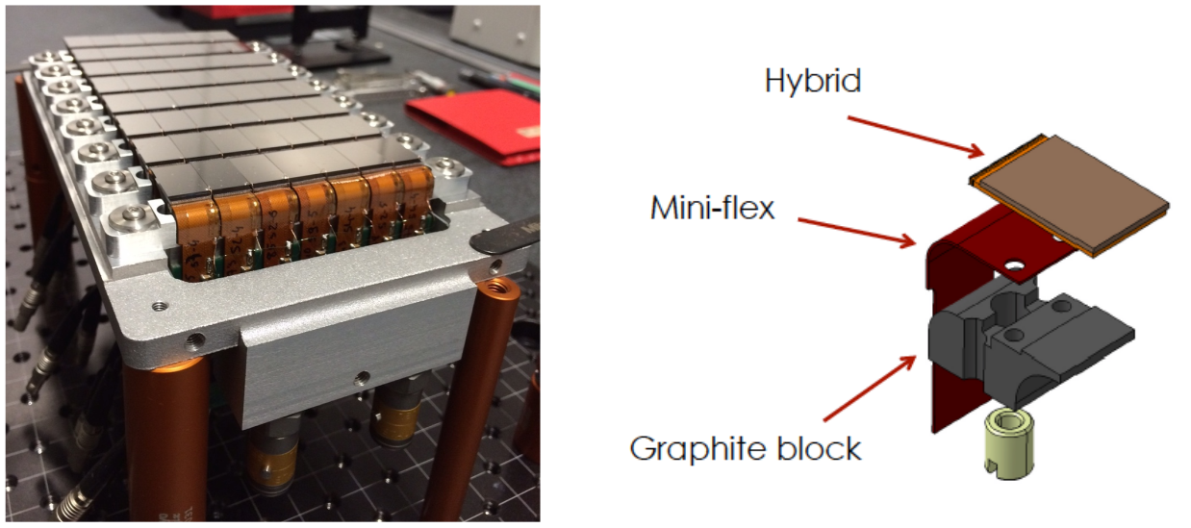
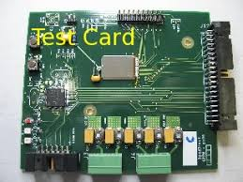
Case 1: XPAD3.2-S/CdTe
CPPM: XPAD3.2-S/CdTe
2D Matrix 130 µm pitch 750 µm CdTe 1 threshold

Slide 13
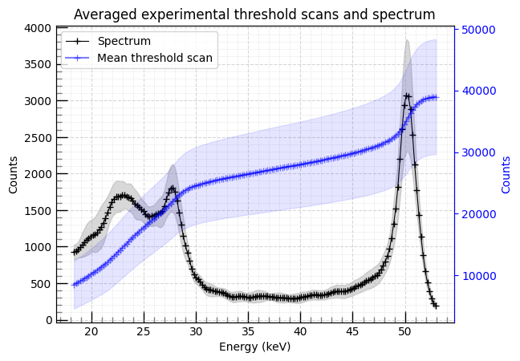
4 - Validation case 1: XPAD3.2-S/CdTe
  a. SOLEIL acquisitions
Synchrotron acquisition with XPAD3.2-S/CdTe
Threshold scan
Flat field 52 keV beam
A sample of 500 pixels reliable pixels
Calibration performed using two different spectral point
  Full energy peak
  Cd K-escape energy

Slide 14
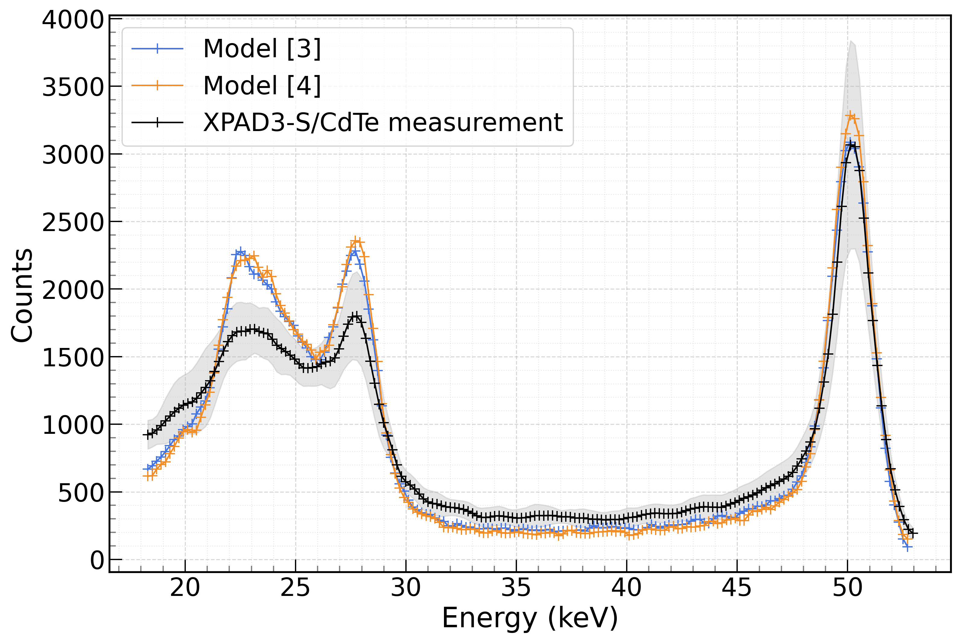
4 - Validation case 1: XPAD3.2-S/CdTe
  b. Simulation vs Measurements
Source of discrepancies:
Higher noise than expected (close to 170 e – RMS)​
Non-uniform distribution of the threshold steps
Missing mechanisms from the simulation
[3]: Repulsion and diffusion independents
[4]: Coupled repulsion and diffusion

Slide 15
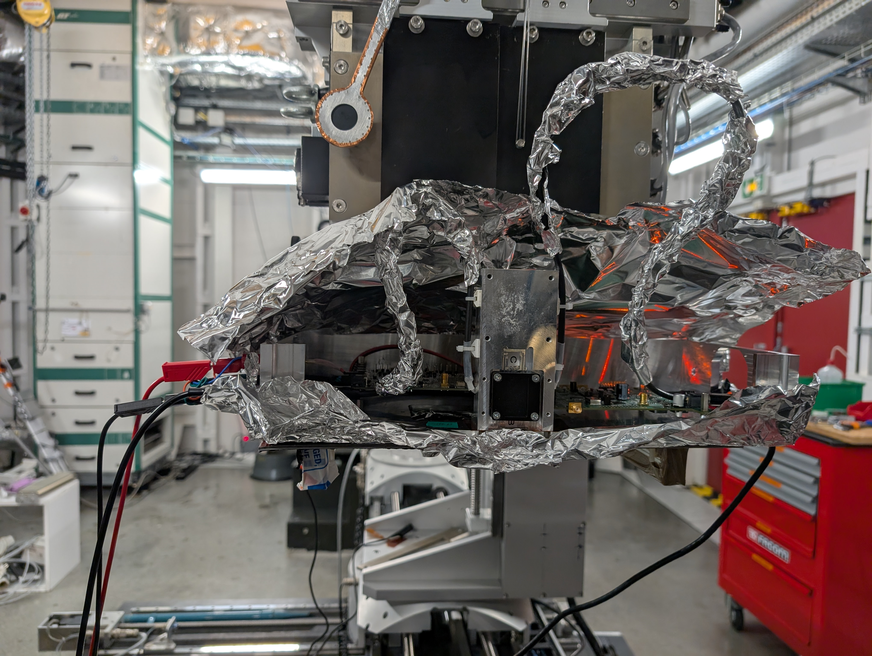
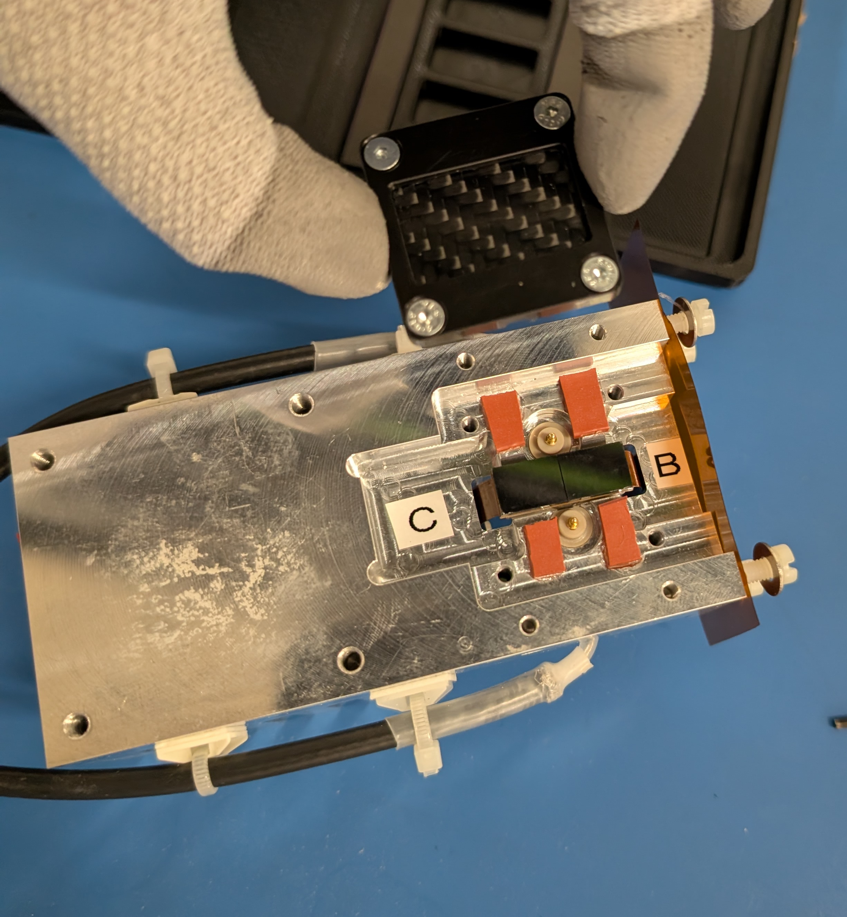
Case 2: DT demonstrator
DT: prototype
2D Matrix 2x 24x36 pixels 350 µm pixel pitch 2 mm thickness CdTe / CZT 6 thresholds

Slide 16
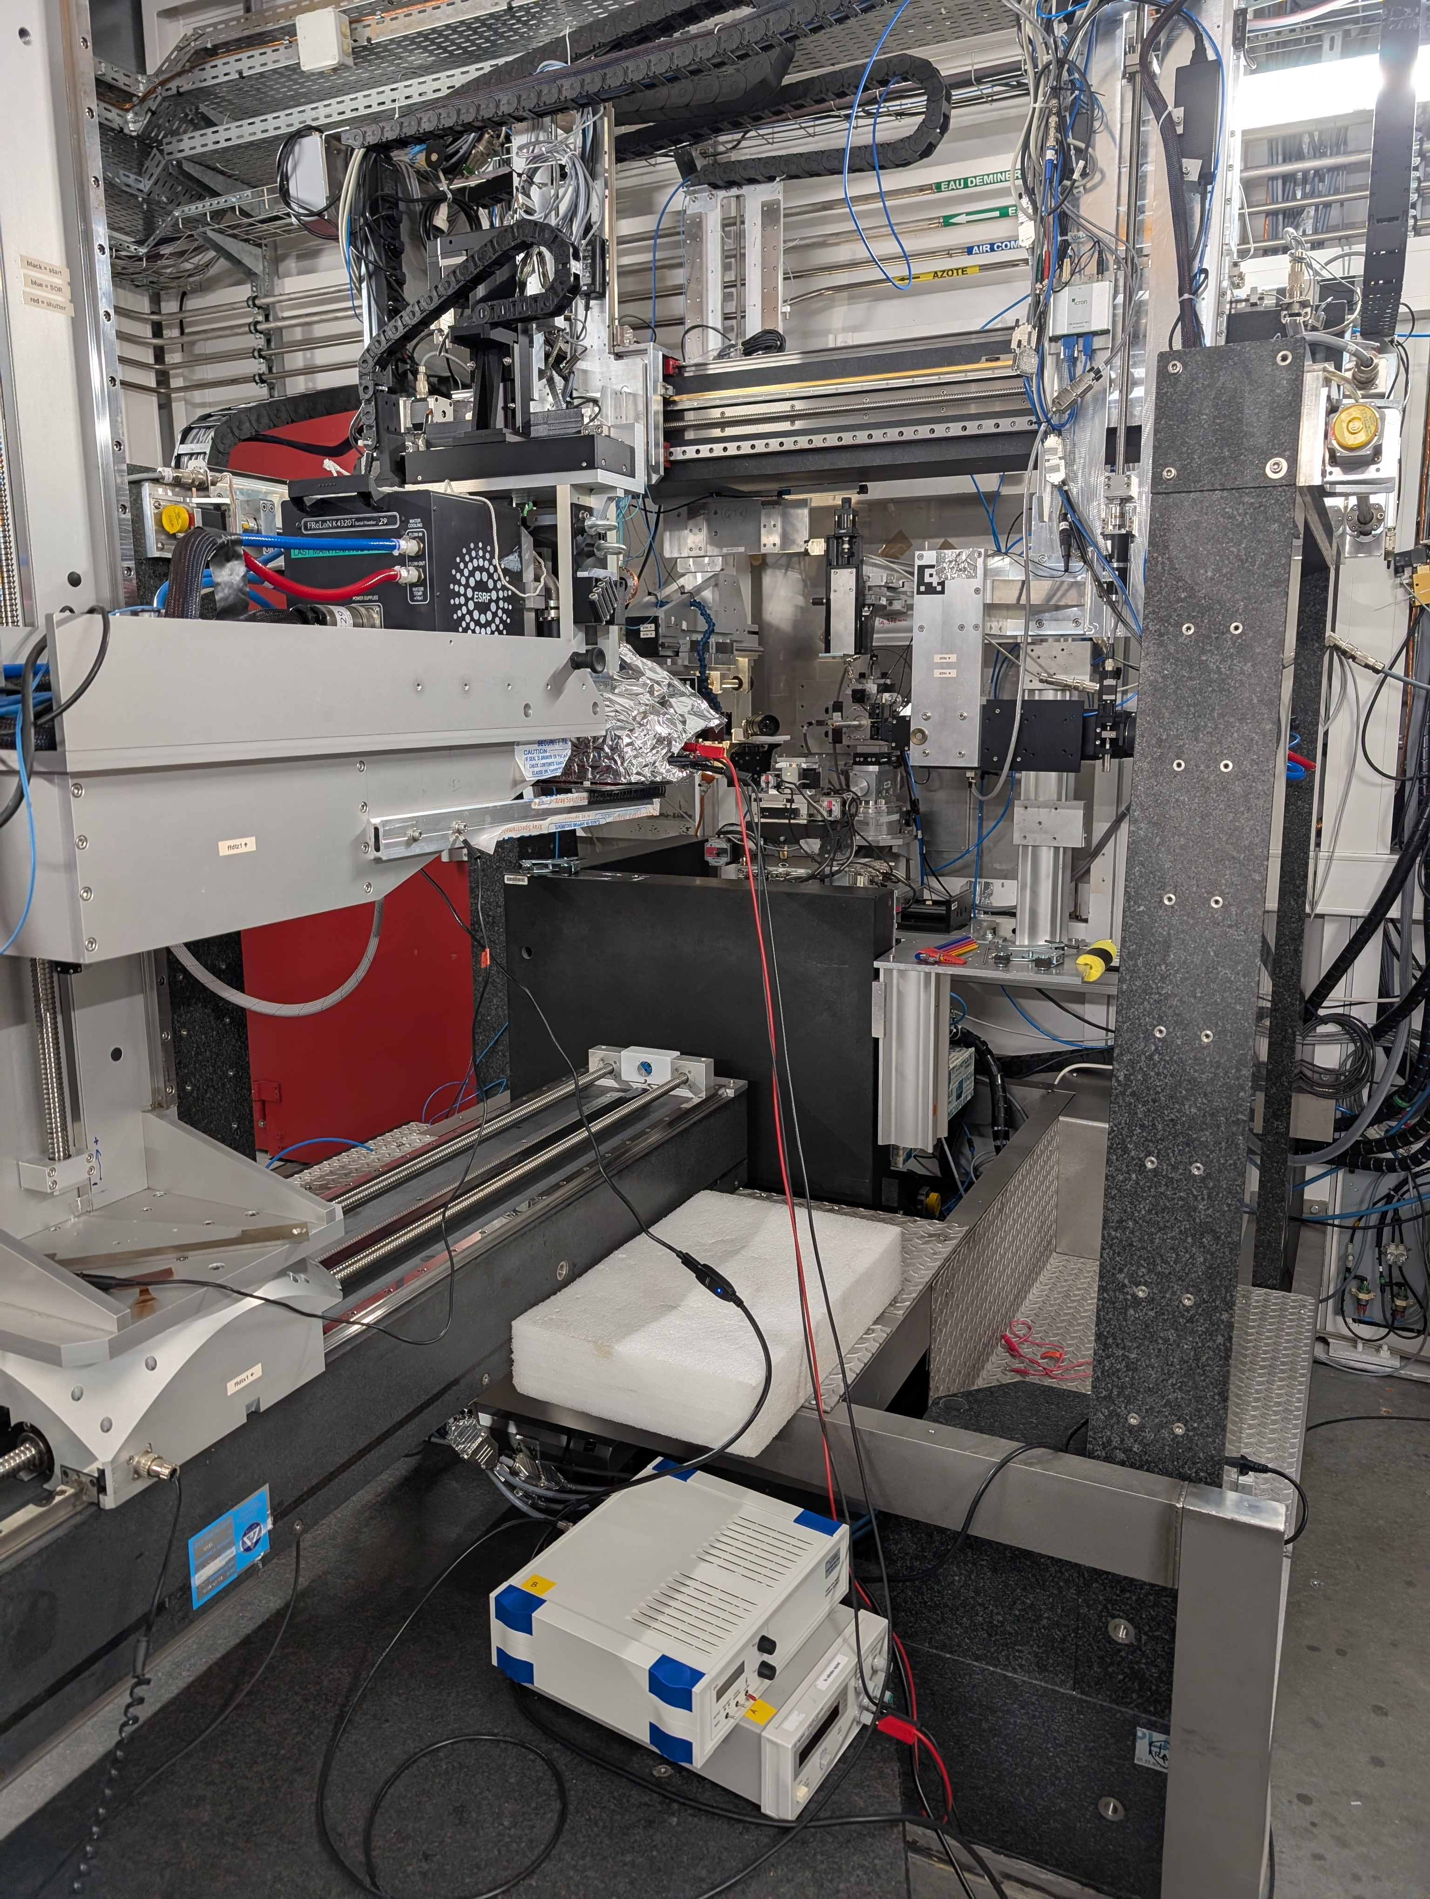
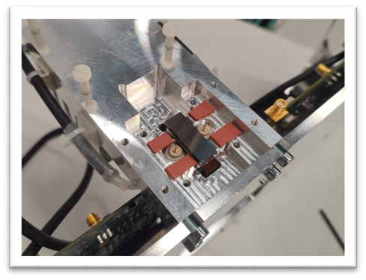
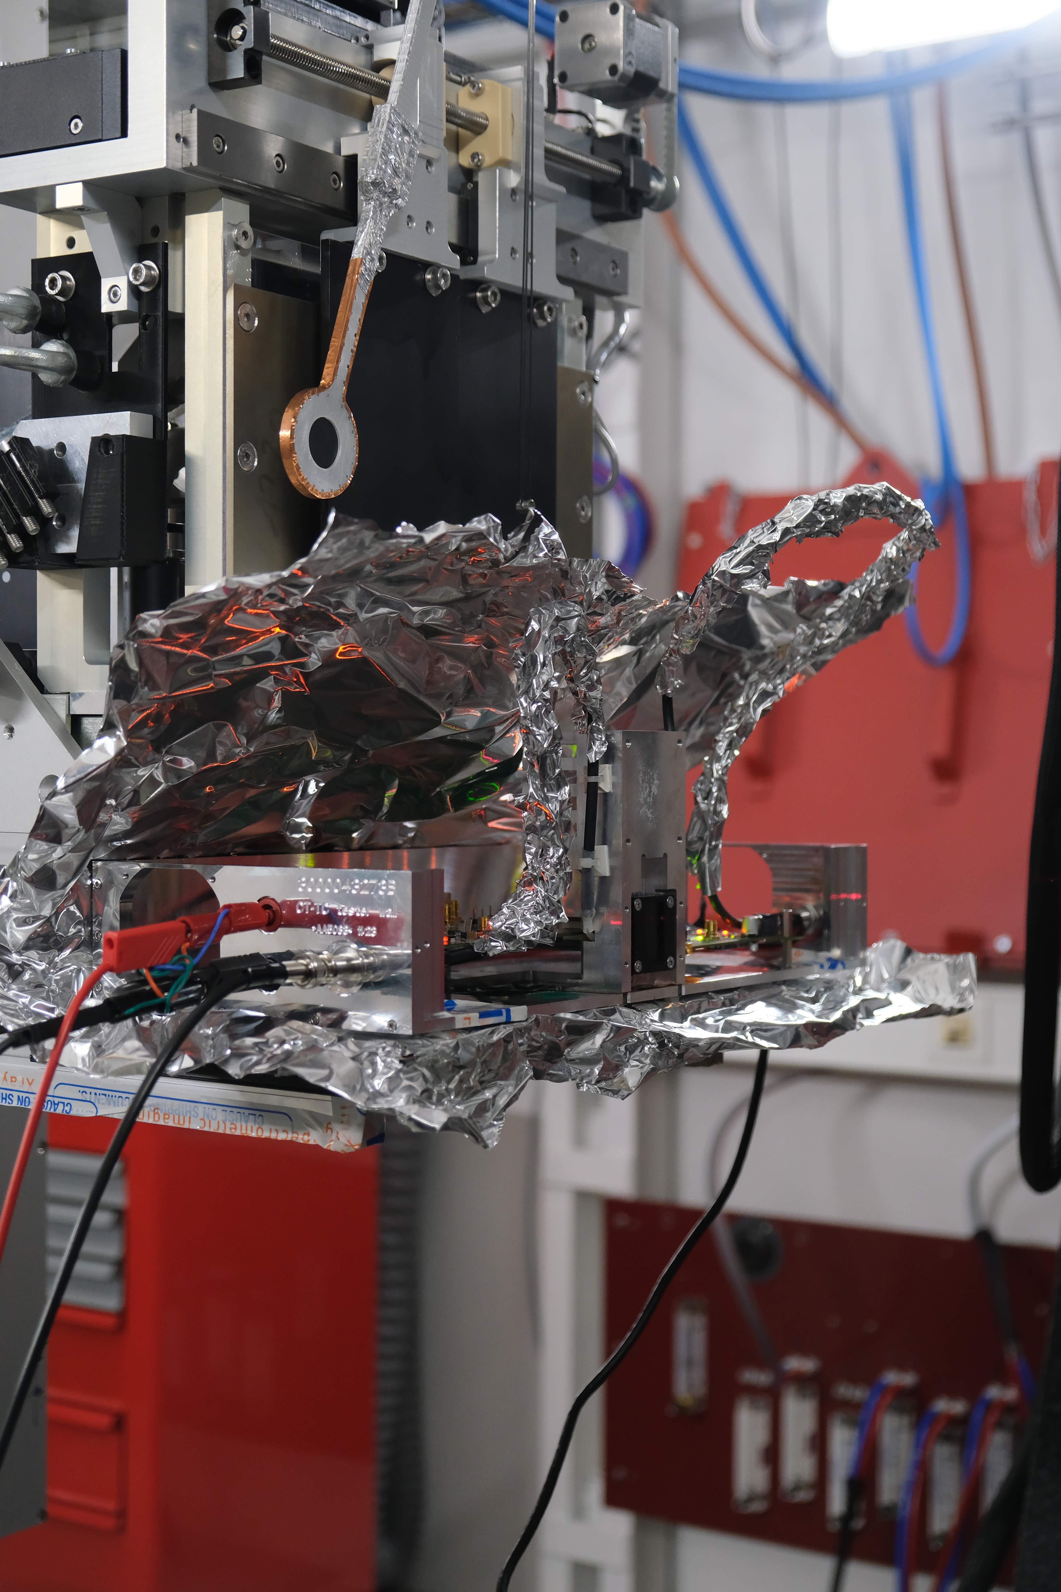

4 - Validation case 2: DT demonstrator
ID11 source
10 x 10 µm² fine beam 59.5 keV / 74.9 keV
  a. ESRF ID11 experimental set-up
Beamtime (5 days allocated):
Characterize the prototype developed by DT and acquired experimental data to validate and refine detector simulation
Y. Boursier et al. (2026), “2D-CdZnTe detector prototype characterization for simulation validation,”Experimental report, Proposal MI-1525,Beamline ID11, ESRF, DOI: 10.15151/ESRF-ES-2266935027
Tile
z
y
Incident beam
z
z
x
y
x
y

Slide 17
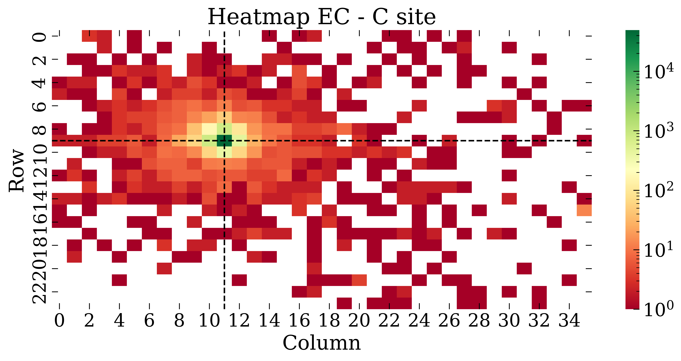
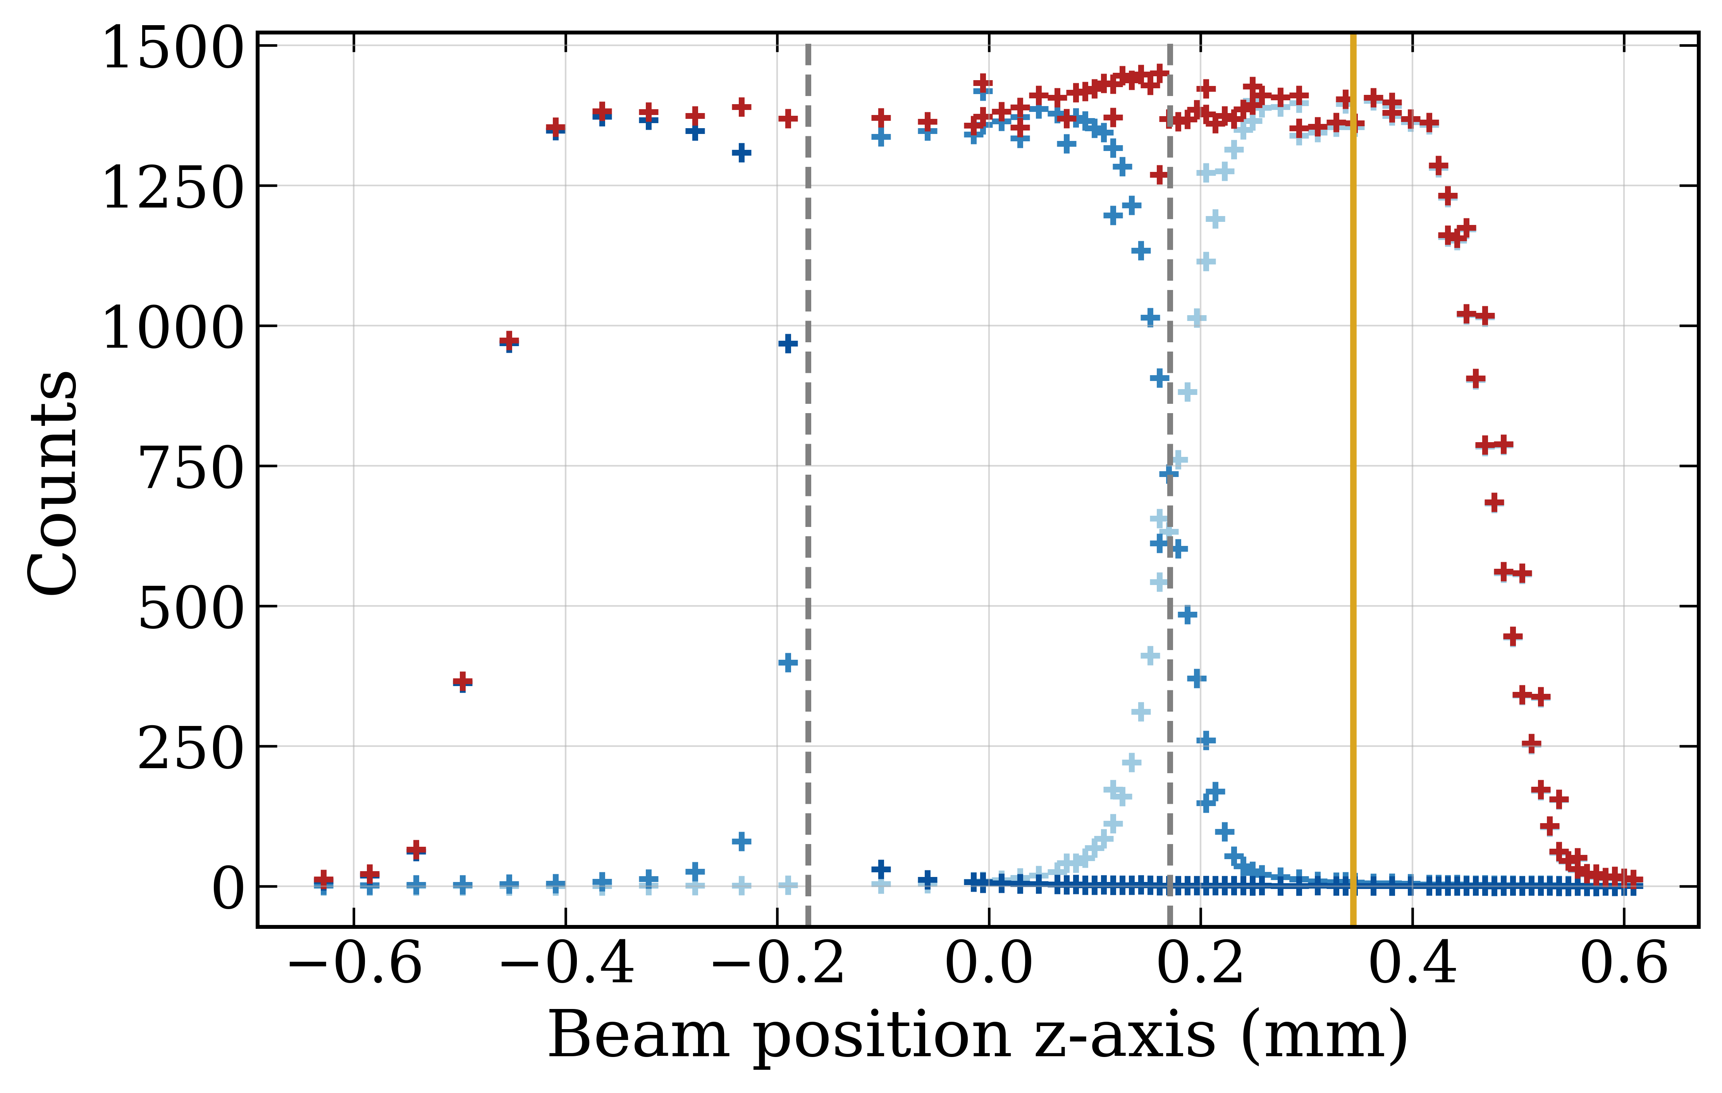
4 - Validation case 2: DT demonstrator
Heatmap of the matrix
Counts recorded for 3 adjacent pixels vs beam position beam position
Spectra of the target pixel and its neighbour
  b. Spot scans and spectral measurements

Slide 18
4 - Validation case 2: DT demonstrator
  c. Spectral measurements vs simulation
Good agreement between simulated and measured spectra.
Accurate reproduction of the full-energy and fluorescence peaks.

Slide 19
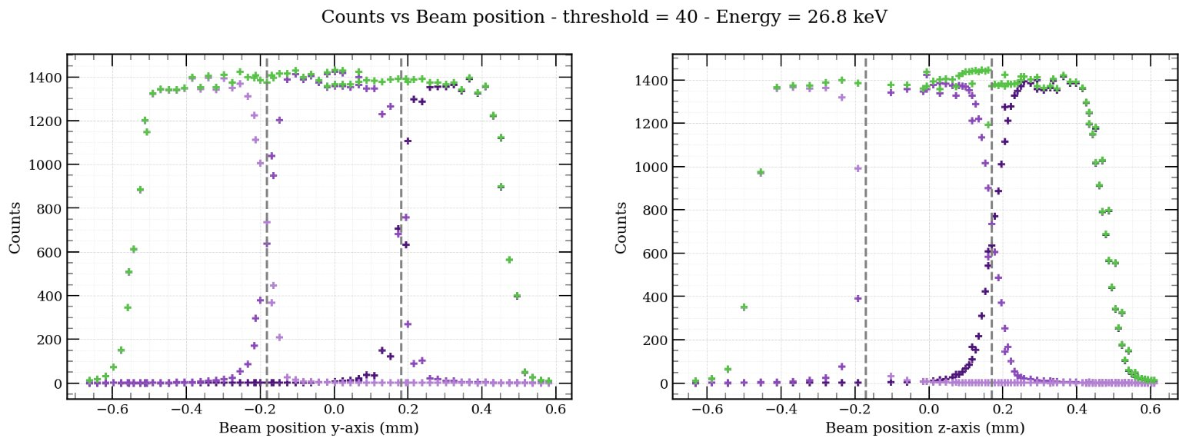
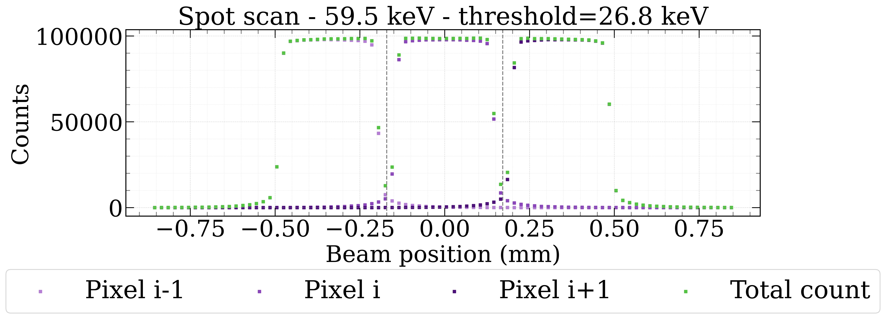
4 - Validation case 2: DT demonstrator
  d. Spot scans measurements vs simulation
MESUREMENT
ONGOING WORK
SIMULATION

Slide 20
5 - Conclusion
Goals of the study:
Simulation of high Z semiconductor pixel detectors response
Focus on the simulation of fluorescence escape and charge sharing
Method:
Simulation integrates charge carriers' generation and dynamics
Study of 2 charge transport models, essential to reproduce accurately charge sharing
Processing of XPAD3.2-S/CdTe measurement performed in synchrotron
Measurement campaign spot beam performed with DT CdTe/CZT based prototype in Dec. 2025
Results:
Good agreement
Behavior at this interpixel needs to be refined – ongoing work
Prospects:
Integration of signal induction on electrodes
Comparison with other simulation tools
Continue measurements analysis to refine the model

Slide 21
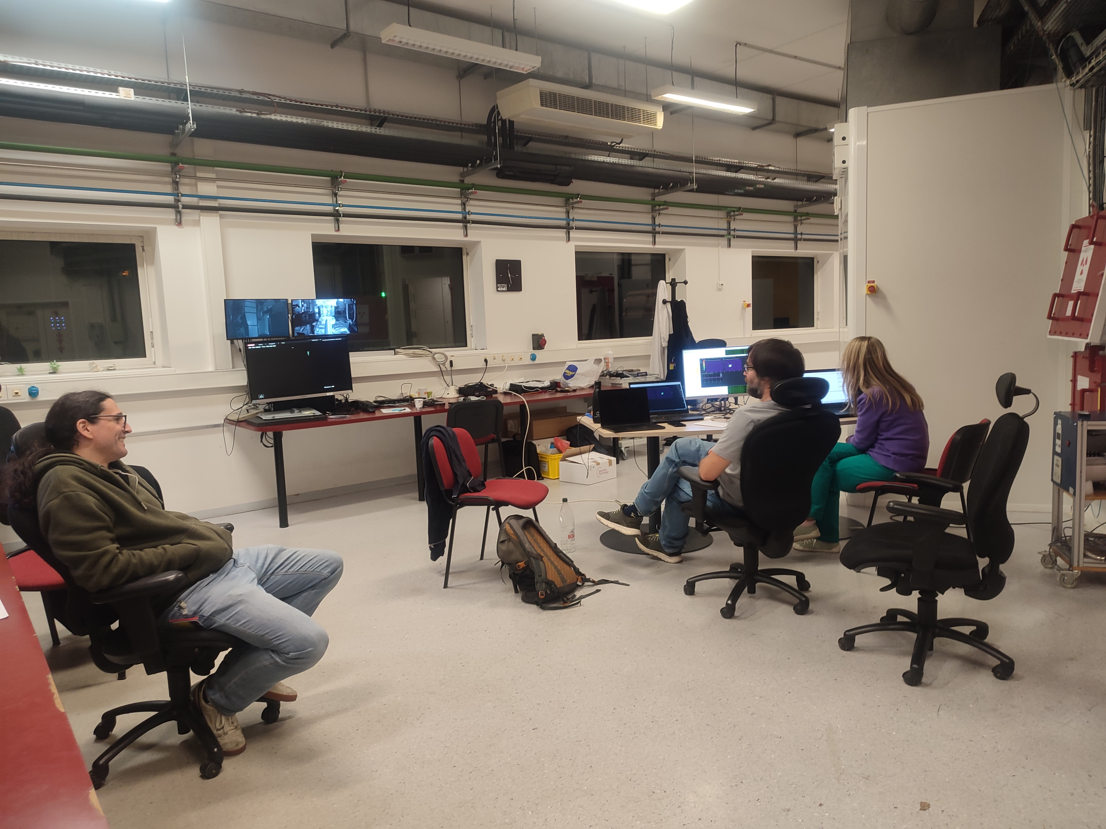
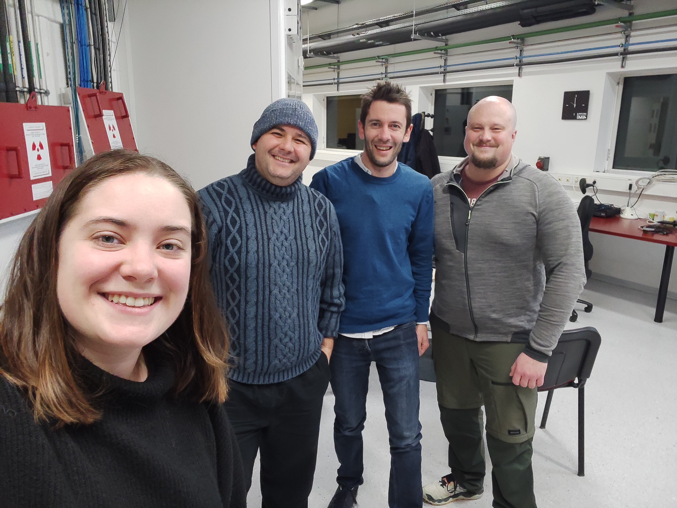
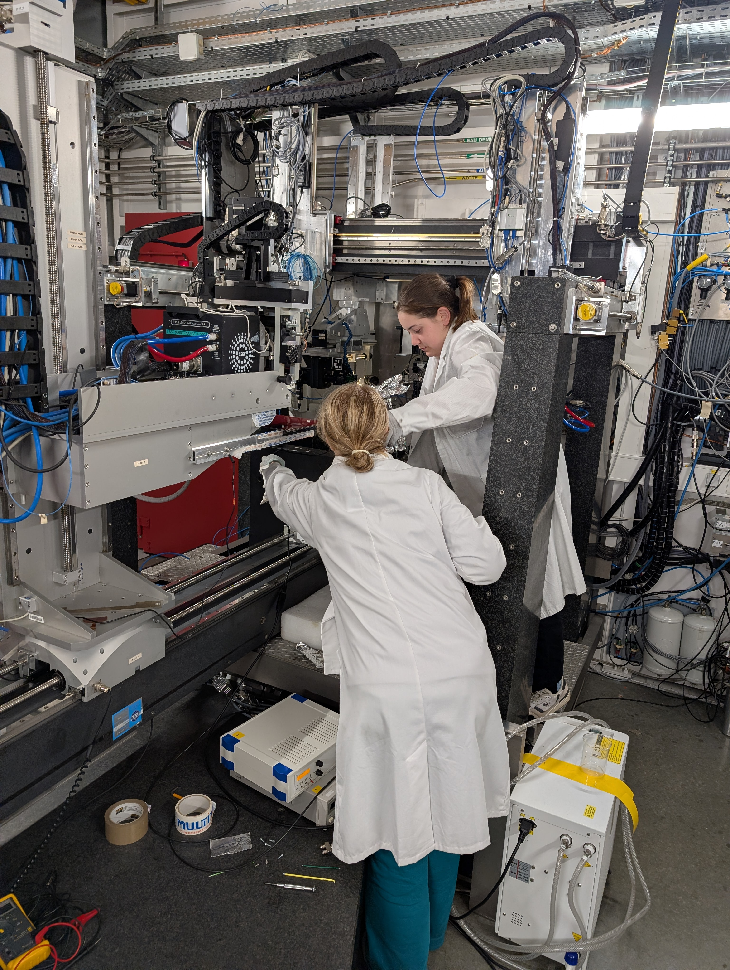
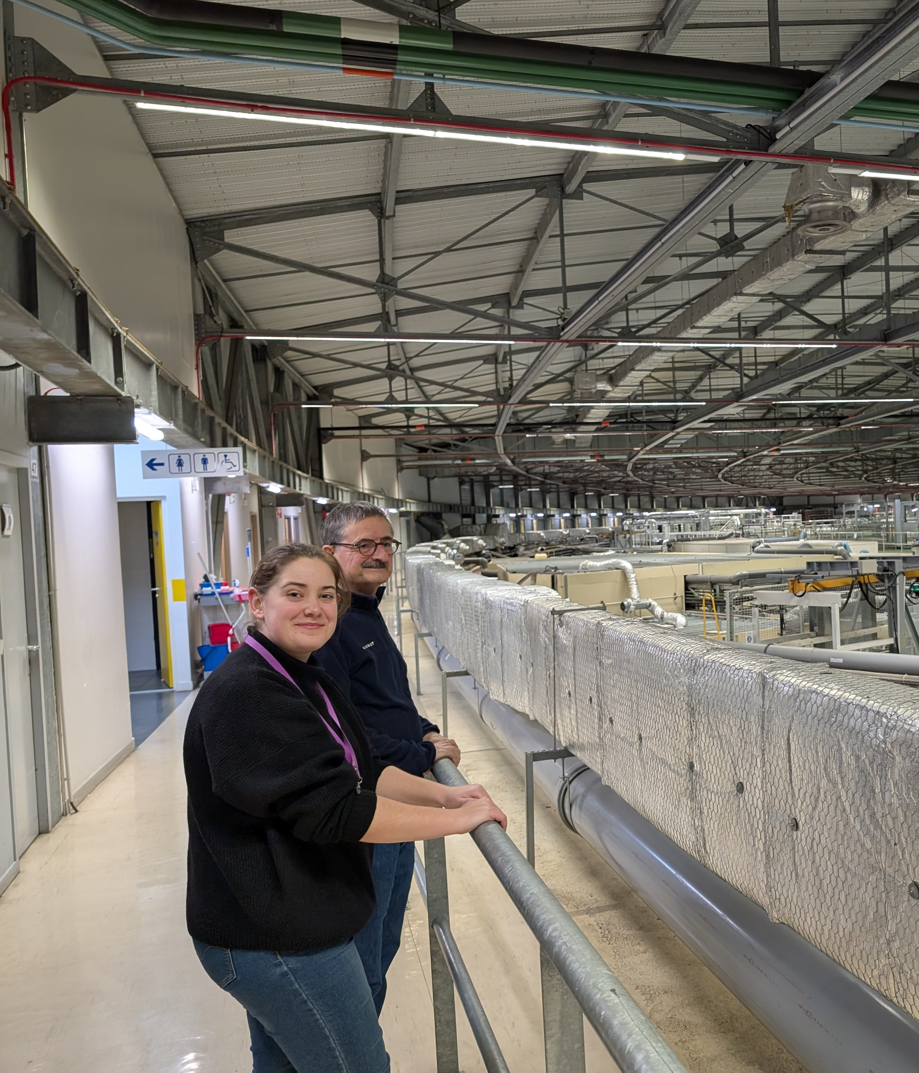
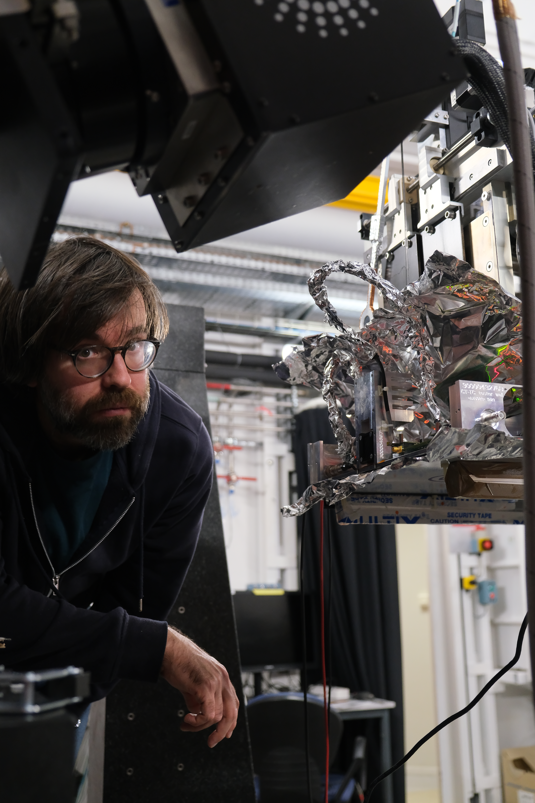
Thank you for your attention
Questions ?
AG GDR, Mi2b
Marseille, le 29.06.2026
Acknowledgement:
→ We acknowledge the European Synchrotron Radiation Facility (ESRF) for the provision of synchrotron radiation facilities under proposal ID MI-1525 and on beamline ID11. We thank Loic Jegou and the beamline staff for assistance and support during the beamtime.
→ We thank G. Gey, M.Plainemaison, T.Pierson, A. Winkler and M. Matikkala from Detection Technology for their support during data acquisition and experimental preparation.

Slide 22
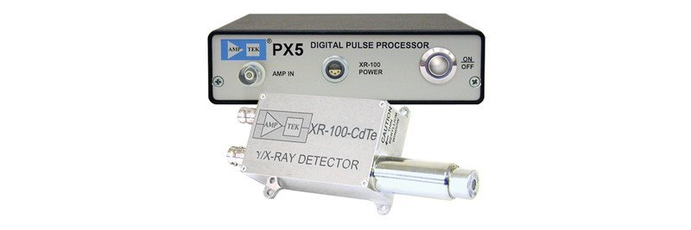
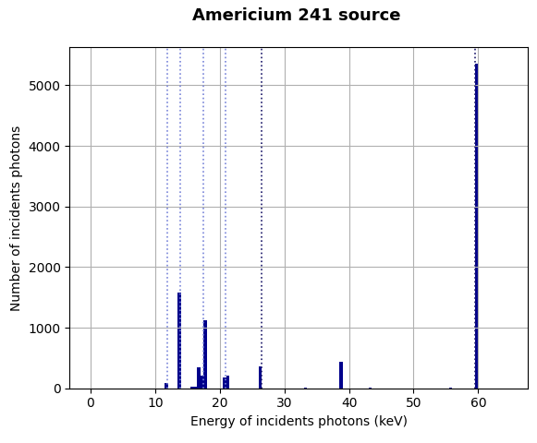
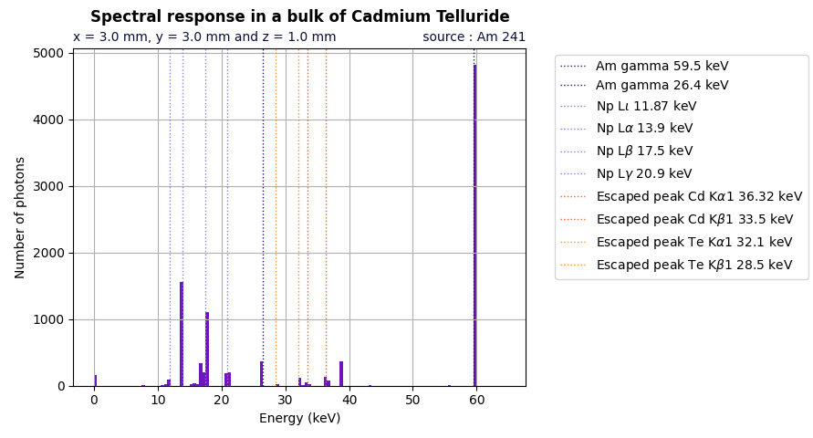
3 - Simulation pipeline
X-ray interactions
Carrier generation and recombination
Charge carriers dynamics
Charge carriers
collection
  b. X-ray interactions with Geant4
Amptek : XR-100T-CdTe
 | Mono-pixel detector CdTe 3 mm pitch 1 mm thickness
Tracking of particles in the sensor, their position and energy loss
Photoelectric effect, Compton scattering
CdTe : fluorescence escape photon
1 mm
3 mm
Americium 241
CdTe
3 mm

Slide 23
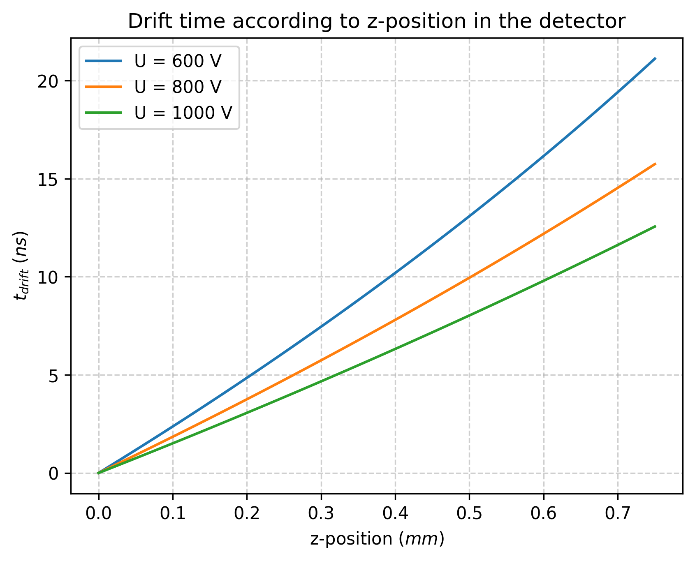





3 - Simulation pipeline
X-ray interactions
Carrier generation and recombination
Charge carriers dynamics
Charge carriers
collection
  c. Charge carriers dynamics
Charges drift toward the electrodes under the influence of electric field
Drift time is deduced from the position of the interaction z and a linear electric field
Anode
$$t_{0}$$
$$z$$
+
+
+
+
+
+
$$E$$
+
$$v_{drift}\left(z\right)=\frac{dz}{dt}=µ{E(z)}$$
$$t_{drift}(z)=\frac{1}{µk}\ln\left(\frac{E(z)}{E_{0}}\right)$$
Cathode

Slide 24
2. Simulation framework
X-ray interactions
Carrier generation and recombination
Charge carriers dynamics
Charge carriers
collection
  c. Charge carrier dynamics
Diffusion and repulsion cause a spontaneous spread of charge carriers
Diffusion
Electrons/Holes
Repulsion
Holes
+
+
+
+
+
+
High concentration
+
+
Low concentration
An inhomogeneous distribution induce a spontaneous Brownian motion
Charges of same sign repel each other due to electrostatic forces

Slide 25
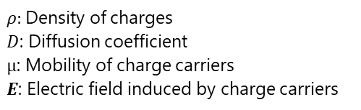

3 - Simulation framework
X-ray interactions
Carrier generation and recombination
Charge carriers dynamics
Charge carriers
collection
  c. Charge carriers dynamics
Diffusion and repulsion cause a spontaneous spread of charge carriers
Charge continuity equation
Describes the concentration of charge carrier evolution with respect to space and time
Neglecting generation and recombination at t > 0:
$$\frac{∂ρ}{∂t}={D∇}^{2}ρ−μ∇.(ρE)$$
$ρ$: Density of charges
$D$: Diffusion coefficient
$µ$: Mobility of charge carriers
$E$: Electric field induced by charge carriers
Diffusion
Electrostatic repulsion
Equation solving
Complex + time consuming in simulation: approximation of the solution using models
The 2 models studied :
  Repulsion and diffusion are independent
E. Gatti et al., NIMA, 253 (1987) 393-399, DOI: 10.1016/0168-9002(87)90522-5.
- Repulsion and diffusion are dependent
M.Benoit et al., NIMA, 606 (2009) 508-516, DOI: 10.1016/j.nima.2009.04.019.

Slide 26






2. Simulation framework
X-ray interactions
Carrier generation and recombination
Charge carriers dynamics
Charge carriers
collection
  c. Charge carriers dynamics
Model 1: Decoupling repulsion and diffusion
$$\frac{∂ρ}{∂t}={D∇}^{2}ρ−μ∇.(ρE)$$
Diffusion
Electrostatic repulsion
Diffusion-only equation:
Repulsion-only equation:
$$\frac{∂ρ}{∂t}={D∇}^{2}ρ−μ∇.(ρE)$$
$$\frac{∂ρ}{∂t}=−μ∇.\left(ρE\right)$$
$$\frac{∂ρ}{∂t}={D∇}^{2}ρ$$
$$\frac{∂ρ}{∂t}={D∇}^{2}ρ−μ∇.(ρE)$$
$$\frac{∂ρ}{∂t}={D∇}^{2}ρ−μ∇.(ρE)$$

Slide 27
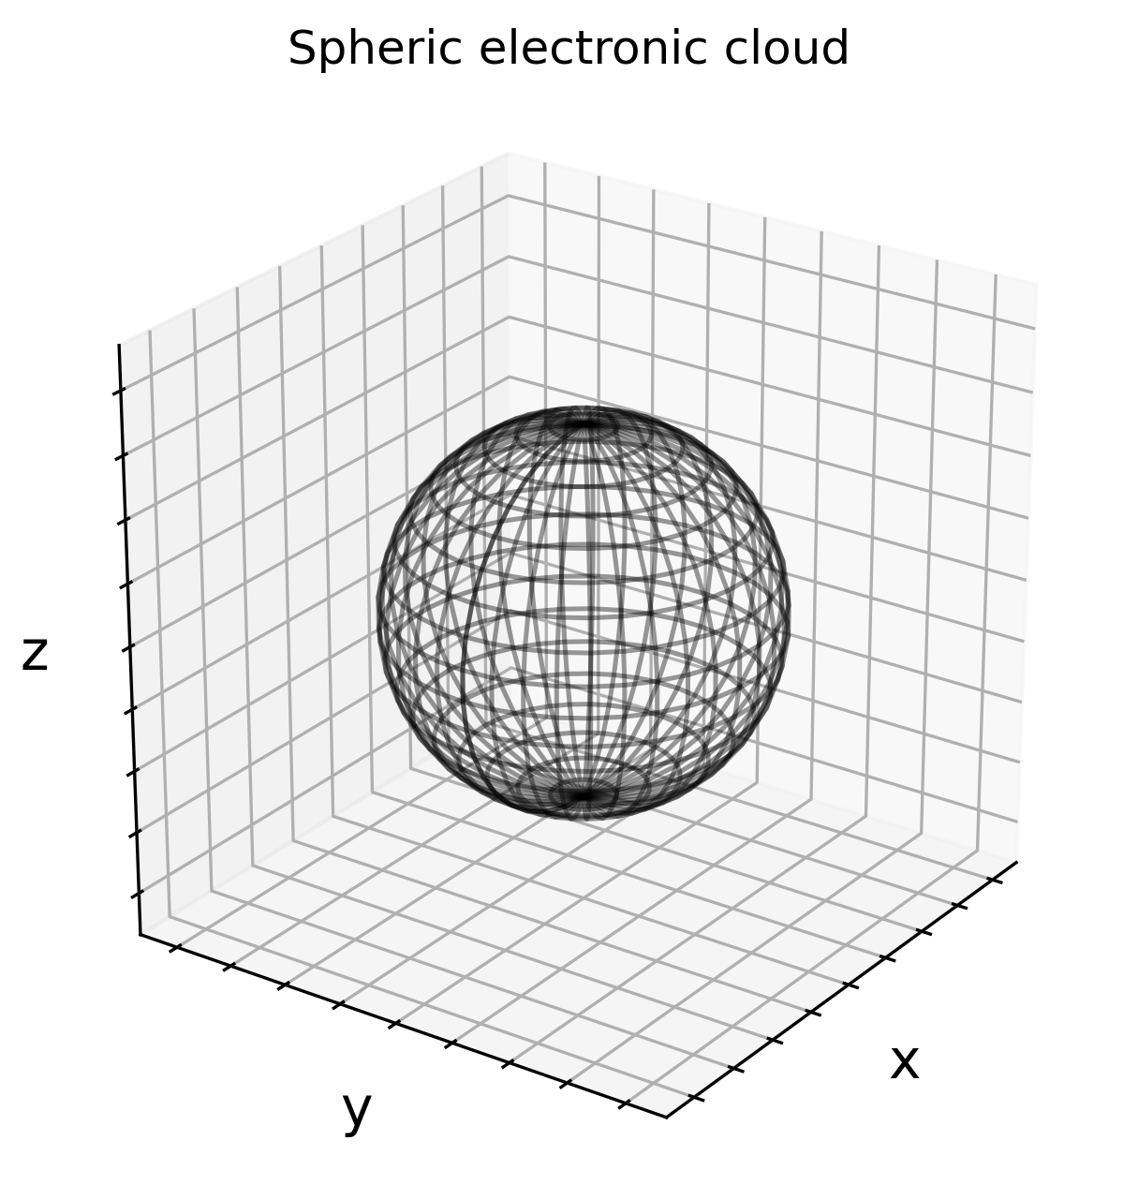
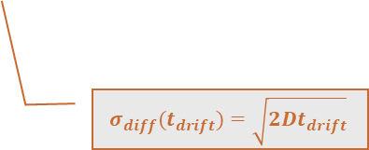
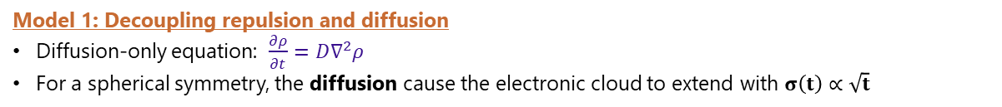
2. Simulation framework
X-ray interactions
Carrier generation and recombination
Charge carriers dynamics
Charge carriers
collection
  c. Charge carriers dynamics
Model 1: Decoupling repulsion and diffusion
Diffusion-only equation: $\frac{∂ρ}{∂t}={D∇}^{2}ρ$
For a spherical symmetry, the diffusion cause the electronic cloud to extend with $σ\left(t\right)∝\sqrt{t}$
At t = 0, charges are concentered in a point
Charges density follows 3D gaussian distribution
$$σ_{diff}(t_{drift})=\sqrt{2Dt_{drift}}$$

Slide 28
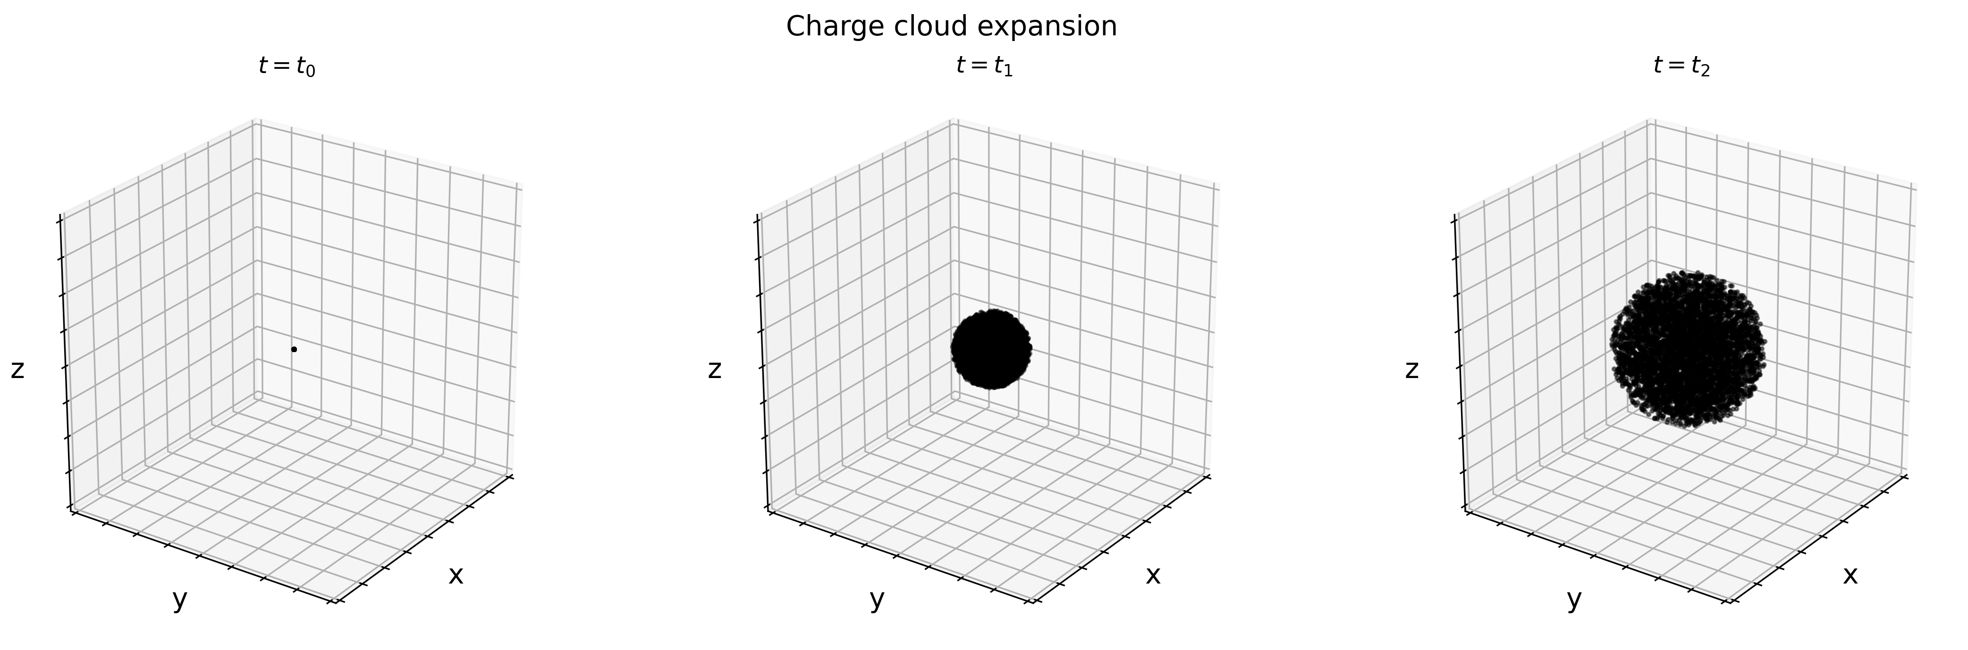
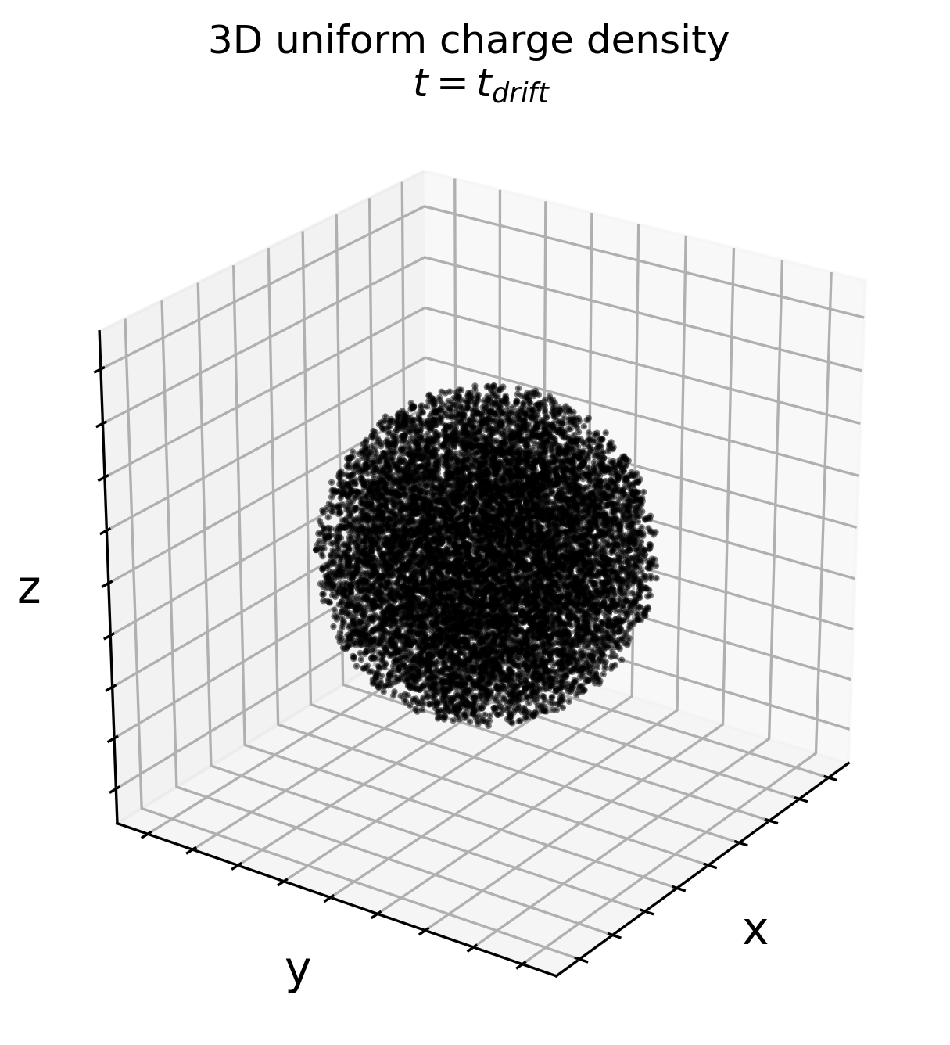
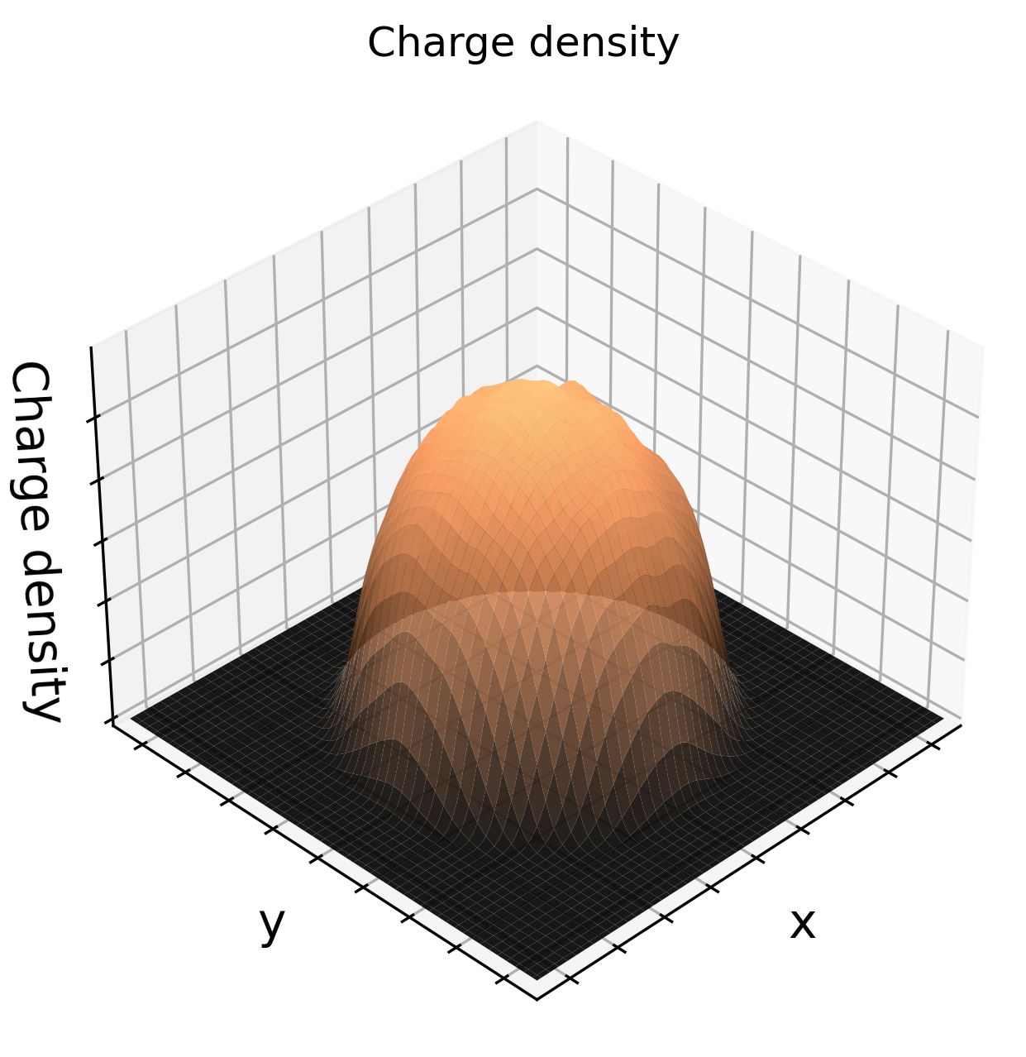
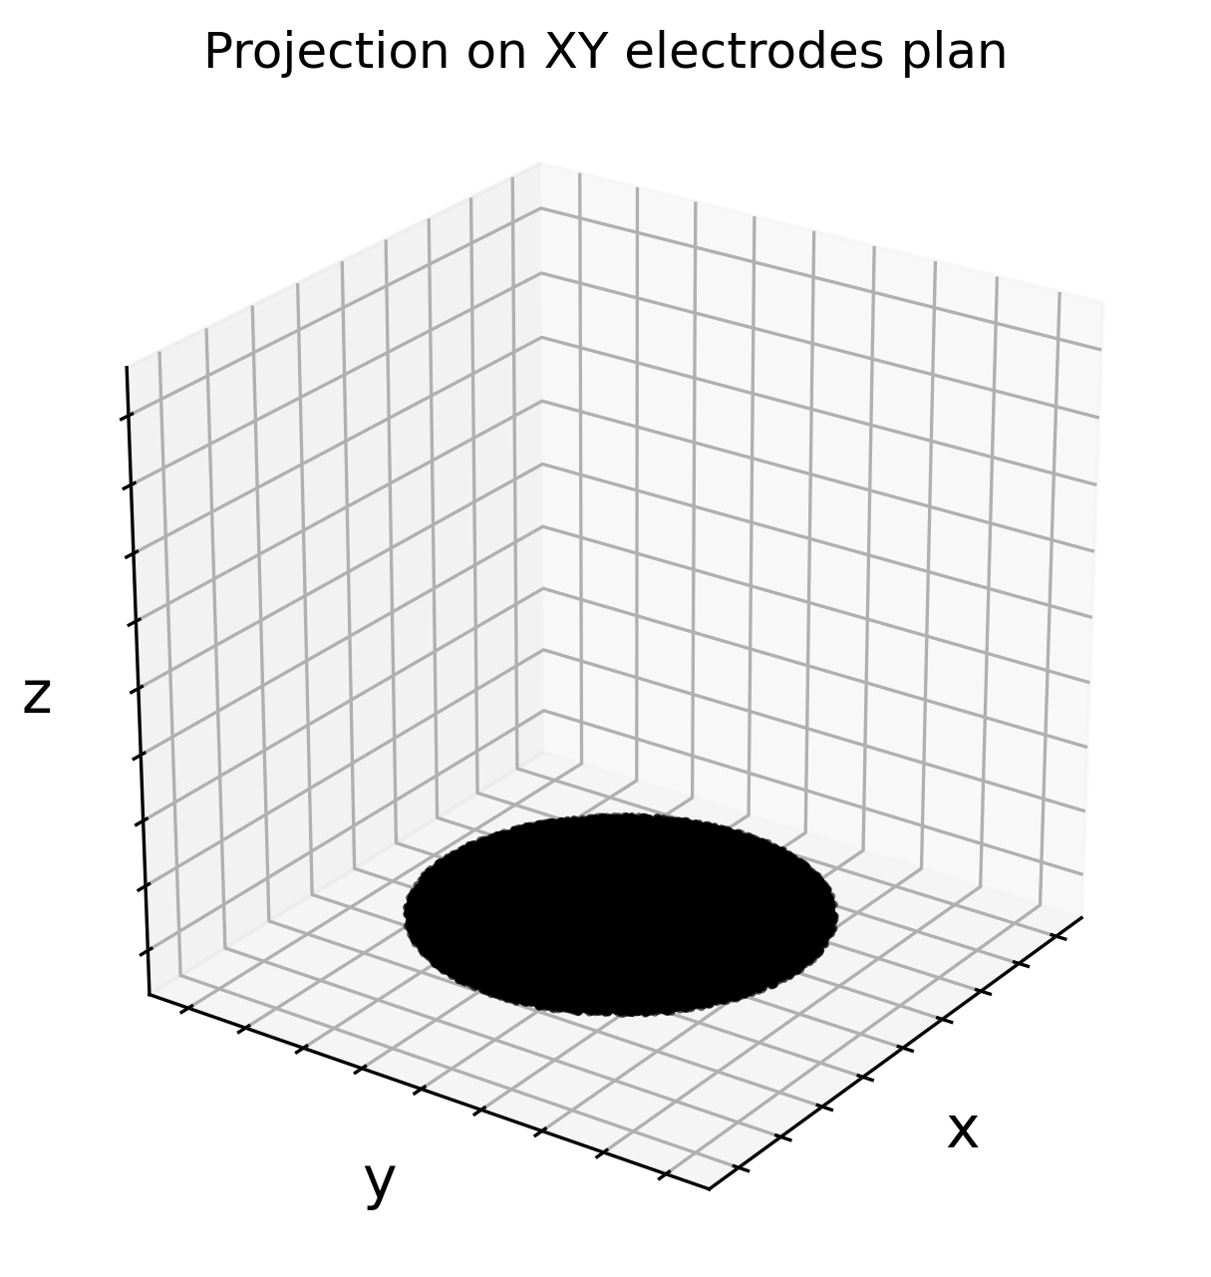
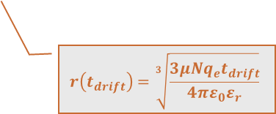

2. Simulation framework
X-ray interactions
Carrier generation and recombination
Charge carriers dynamics
Charge carriers
collection
  c. Charge carriers dynamics
Model 1: Decoupling repulsion and diffusion
Repulsion-only equation: $\frac{∂ρ}{∂t}=−μ∇.(ρE)$
For a spherical symmetry, the repulsion cause the electronic cloud to extend and $r\left(t\right)∝\sqrt[3]{t}$
Does not stand for energy deposition higher than 10 keV
At t = t₀, charges are concentered in a point
$$r\left(t_{drift}\right)=\sqrt[3]{\frac{3μNq_{e}t_{drift}}{4πε_{0}ε_{r}}}$$
Charges density follows a uniform distribution

Slide 29





2. Simulation framework
X-ray interactions
Carrier generation and recombination
Charge carriers dynamics
Charge carriers
collection
  c. Charge carriers dynamics
Model 1: Decoupling repulsion and diffusion
For a cylindric symmetry, the repulsion cause the electronic cloud to extend and $r\left(t\right)∝\sqrt[2]{t}$
Charges density follows a uniform distribution
$$r\left(t_{drift}\right)=\sqrt{q_{e}\frac{s_{LOSS}μ_{0}t_{drift}}{E_{eh}πε}}$$

Slide 30




2. Simulation framework
X-ray interactions
Carrier generation and recombination
Charge carriers dynamics
Charge carriers
collection
  c. Charge carriers dynamics
Model 2: Coupling repulsion and diffusion
$$\frac{∂ρ}{∂t}={D∇}^{2}ρ−μ∇.(ρE)$$
Diffusion
Electrostatic repulsion
$$\frac{ⅆσ^{2}(t)}{ⅆt}=2\left(D+\frac{μNq_{e}}{24π^{3/2}ε_{0}ε_{r}σ\left(t\right)}\right)=2D_{eff}$$
At t = t0, charges are distributed
Charges density follows 3D gaussian distribution
$$D_{eff}$$

Slide 31


4 - Validation case 1: XPAD3.2-S/CdTe
  b. Simulation
Electronic noise approximated by a convolution with a gaussian
Simulation parameters
$$E_{e˗̵­h}^{CdTe} (eV)$$ | $$4.43$$
h mobility ($cm^{2}/(Vs)$ | $$100$$
h lifetime $(μs)$ | $$2$$
Fano factor | $$0.24$$
Incident beam energy $(keV)$ | $$52$$
Fluorescence escape peaks are visible on the spectrum
The full energy peak is shifted due to an incomplete collection of charges
Activation of diffusion and repulsion increase the size of the electronic cloud and so the charge sharing

Slide 32



ESRF set-up additional pictures

Slide 33


ESRF set-up additional pictures

Slide 34


4 - Validation case 2: DT demonstrator
  b. Spectral Detector Response - Simulation vs Measurements
Selection pixels with counts > 30

Slide 35


Back-up. sigma vs energy: thresholds
Réponse spectrale d'un pixel pour un faisceau de 59.5 keV (droite) à et 79.5 keV (gauche)

