Slide 1




Hypoxia-induced radioresistance and cell state dynamics: Experimental analysis, compartmental modeling, and density dependence
Supervised by Mathilde Badoual and Angélique Stéphanou
Botao Dai
IJCLab / TIMC
01/07/2026
1

Slide 2
Contents
1
Introduction
Hypoxia, radioresistance, and hidden cell states
2
Experimental & analysis workflow
Seeding · hypoxia · irradiation · detection
3
Experimental results
Field-level curves · single experiment average · dose comparison
4
Modeling results
Compartment model · fits · dose trends · final fates
5
Discussion & next steps
Heterogeneity · detection limits · lucky cells · reoxygenation experiment
2

Slide 3
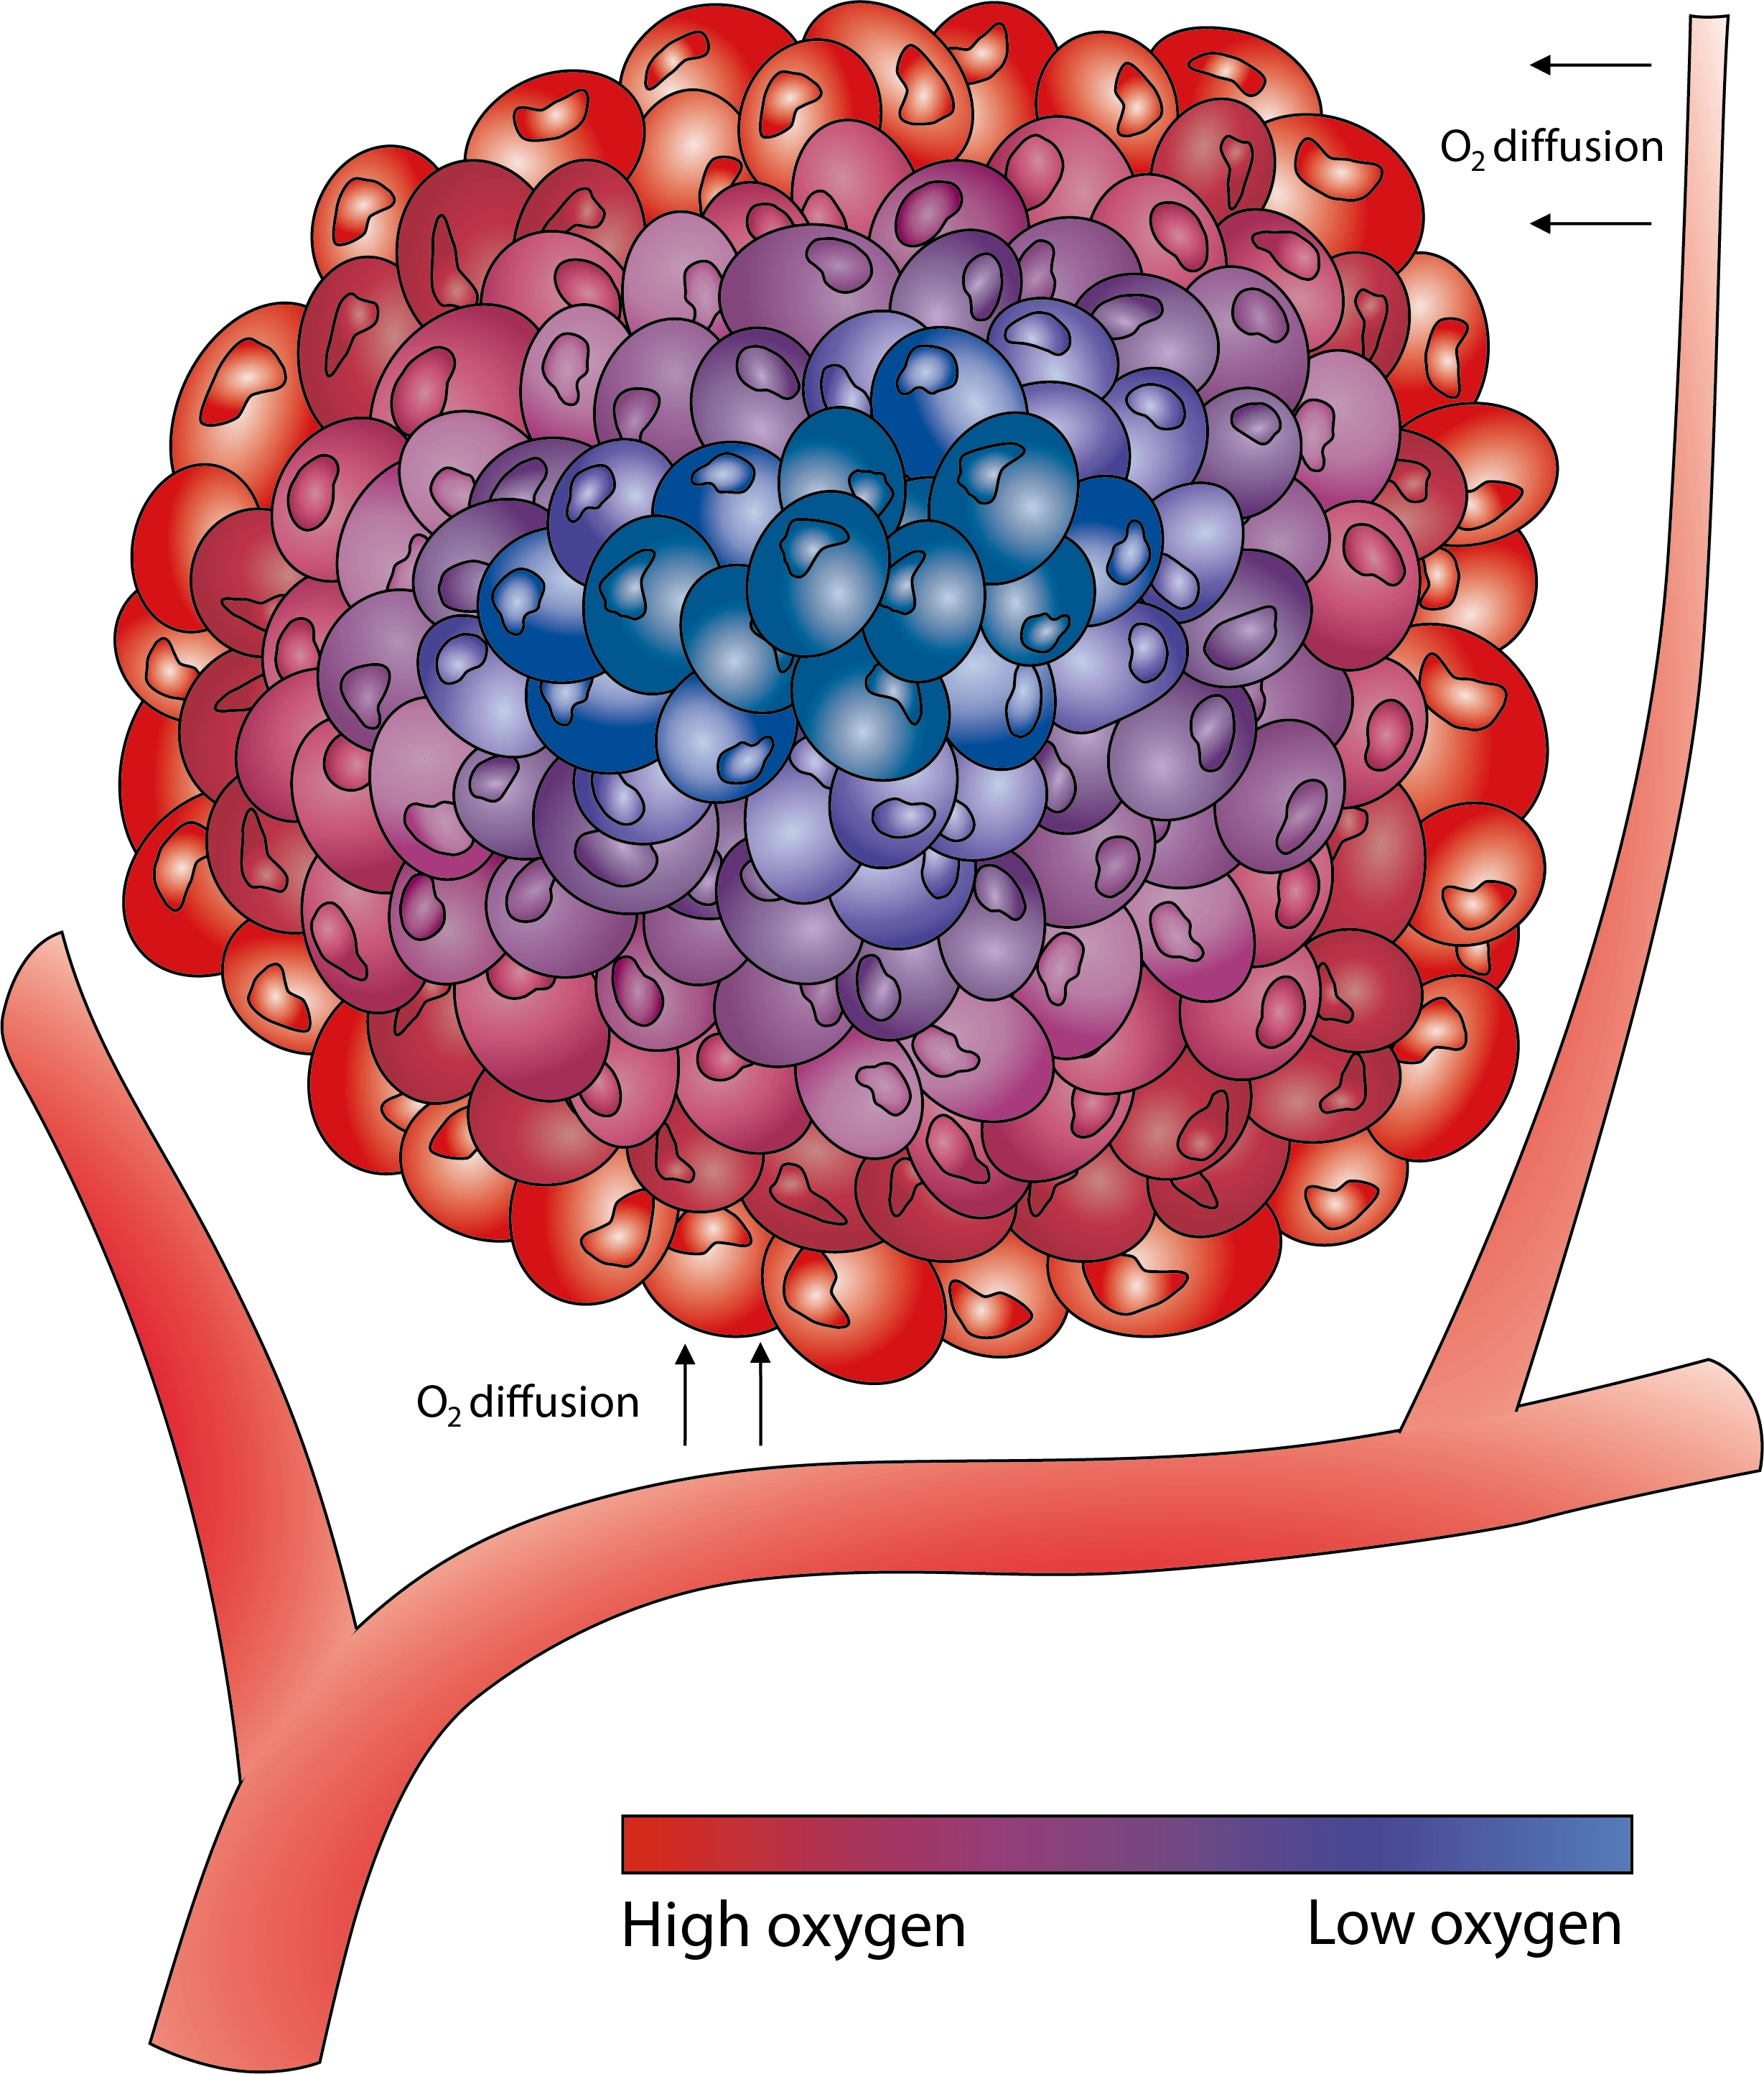
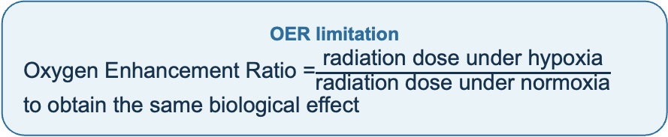
1. Introduction
2. Workflow
3. Results
4. Modeling
5. Discussion
Section 1/5 · Why model hypoxia?
Why study hypoxia in radiobiology?
•
Hypoxia is common in solid tumors
•
Hypoxic cells are often more radioresistant
Hidden mechanism
Beyond oxygen-mediated radical damage, hypoxia-induced quiescence can also increase radioresistance.
•
Oxygen changes radiation-induced damage
•
Population curves show only global behavior
•
Need to infer hidden cellular mechanisms
Central question
•
Why are cells more resistant to irradiation under hypoxic conditions?
And how does the initial cell density influence this effect?
References: Gardner et al., 2024, Modelling radiobiology; Menegakis et al., 2021, Cells.
3

Slide 4
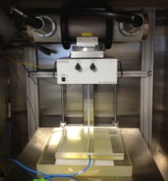
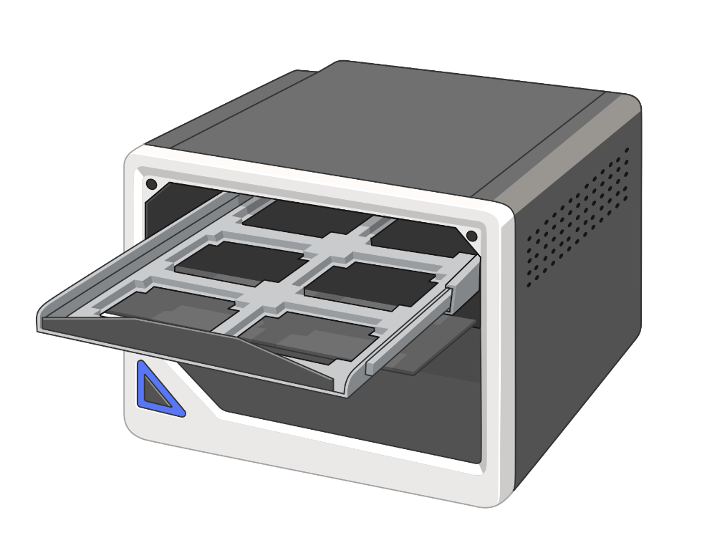
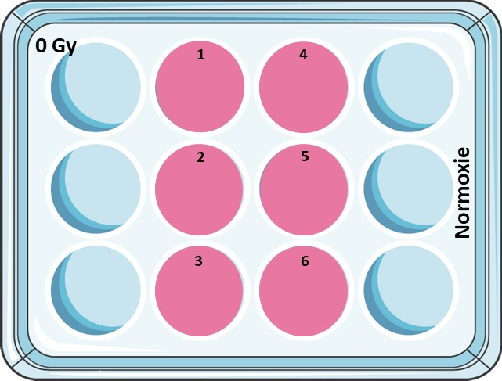
1. Introduction
2. Workflow
3. Results
4. Modeling
5. Discussion
Section 2/5 · Experimental & analysis workflow
Experimental workflow
Step-by-step overview
1
Cell seeding
2
Oxygen conditioning
3
Irradiation
4
Live imaging
5
Quantification
F98 NLS-red
6 densities
Normoxia / Hypoxia
Pre-irradiation
Control / irradiated
X-ray exposure
Incucyte
BF + fluorescence
Detection
Curves + model
D0 ~16:00
Seeding
D1 15:00
O₂ ↓ slowly
0.5% after ~15 h
Total exposure ≈19 h
D+2 11:00
Irradiation
≈4 h before imaging
D+2 15:00
Imaging start
Observation ≈240 h
After imaging
Detection
Curves + model
4

Slide 5
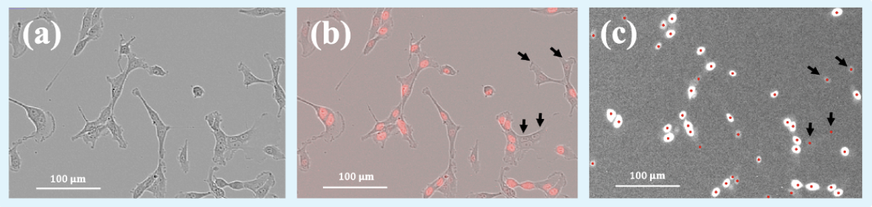
1. Introduction
2. Workflow
3. Results
4. Modeling
5. Discussion
Section 2/5 · Experimental & analysis workflow
Cell detection and counting
From fluorescence images to cell number over time
•
Nuclei detected from fluorescence images
•
One detected maximum = one cell
•
Automatic counting for each field
•
Output: cell number vs time
5

Slide 6
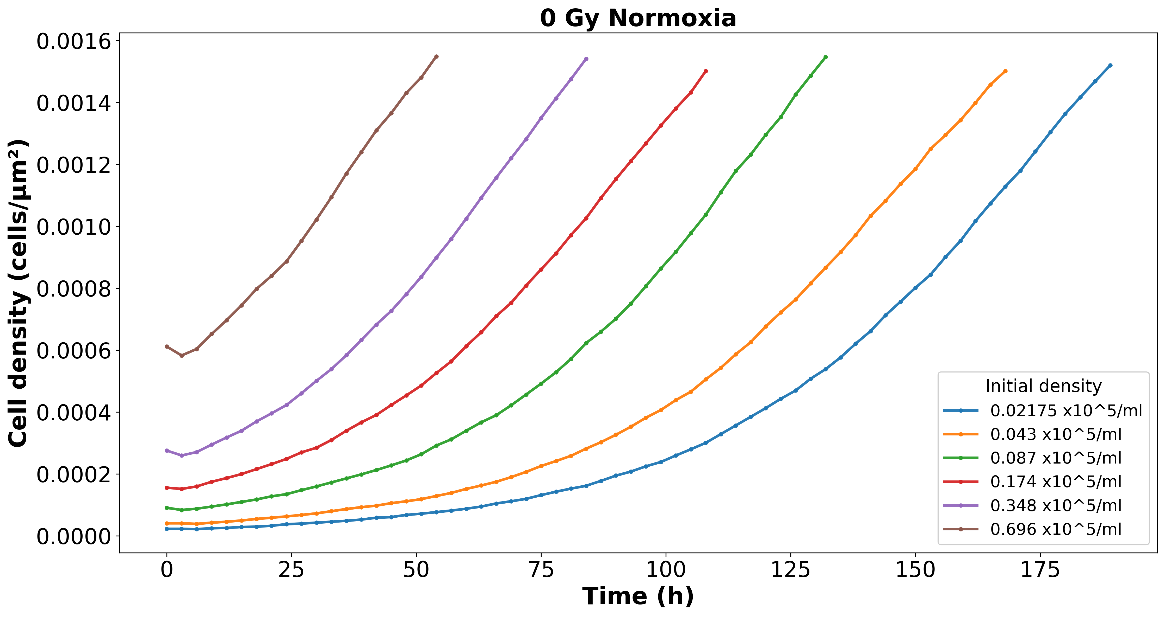
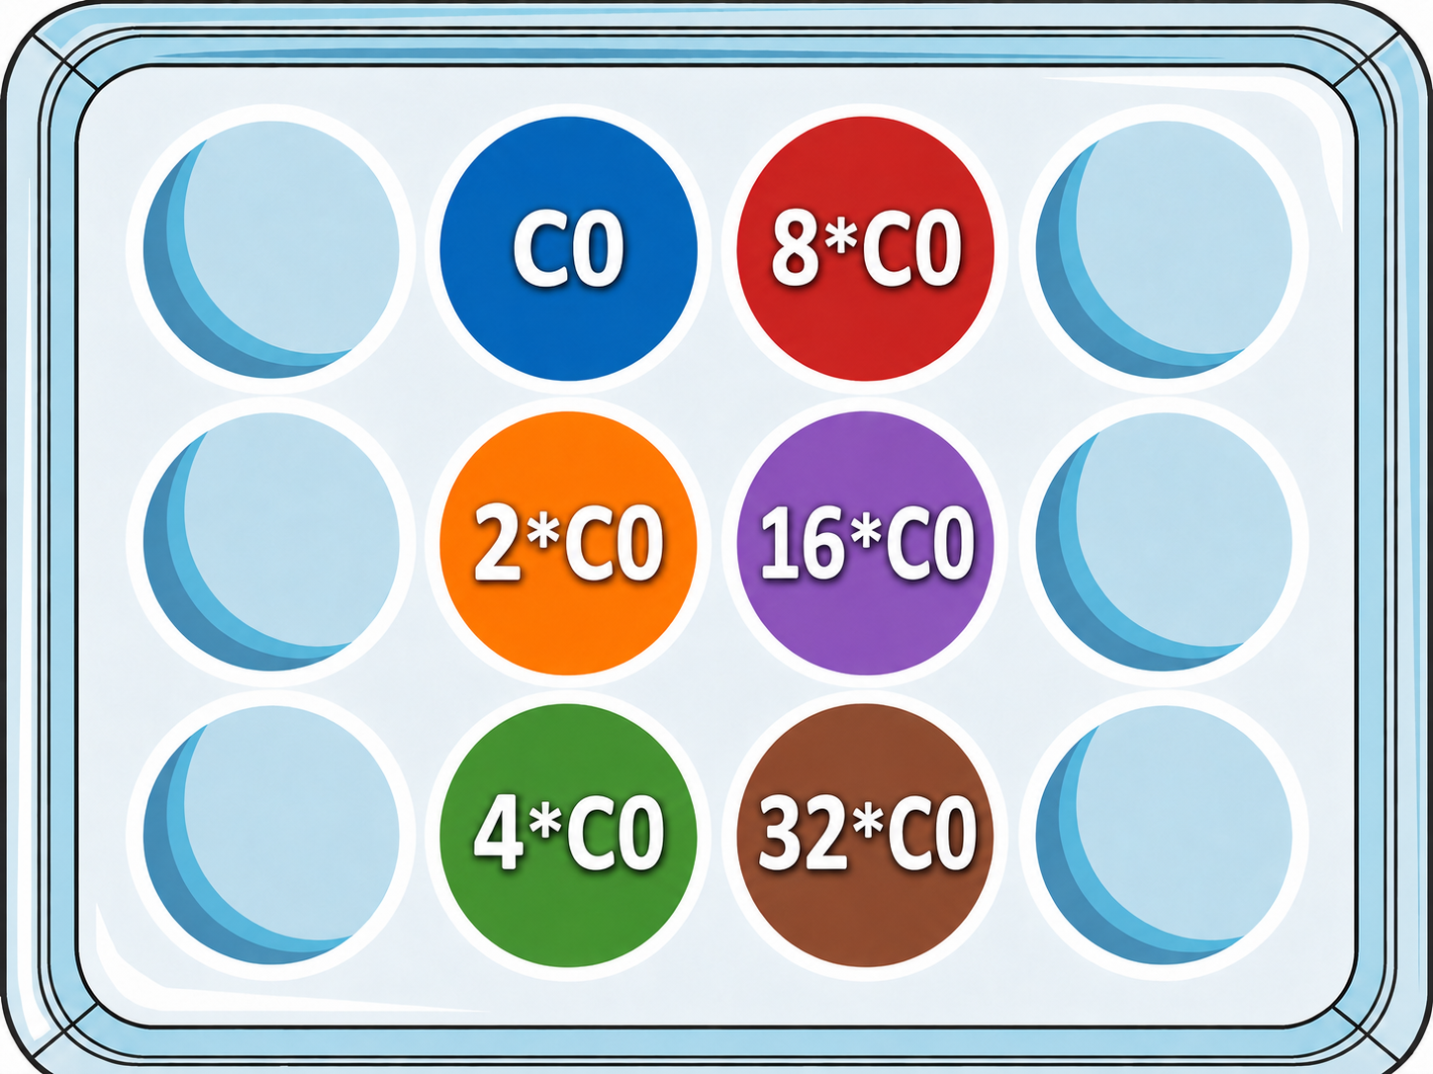
1 Introduction
2. Workflow
3. Results
4. Modeling
5. Discussion
Section 3/5 · Experimental results
Results – Control group : 0 Gy normoxia
A clearer comparison between oxygen conditions
•
Normoxia group
Experimental structure
• 2 plates for one dose: normoxia and hypoxia
• 6 wells per plate
6

Slide 7
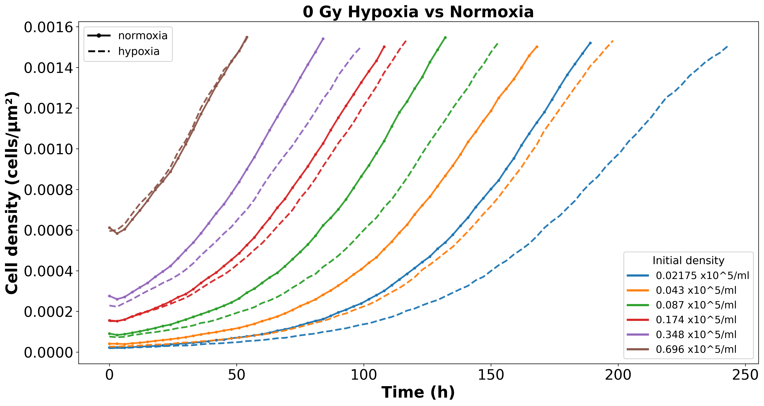
1 Introduction
2. Workflow
3. Results
4. Modeling
5. Discussion
Section 3/5 · Experimental results
Results – Control group : 0 Gy normoxia vs hypoxia
A clearer comparison between oxygen conditions
•
Normoxia vs hypoxia comparison
Experimental structure
• 2 plates for one dose: normoxia and hypoxia
• 6 wells per plate
• Solid = normoxia; dashed = hypoxia
6

Slide 8
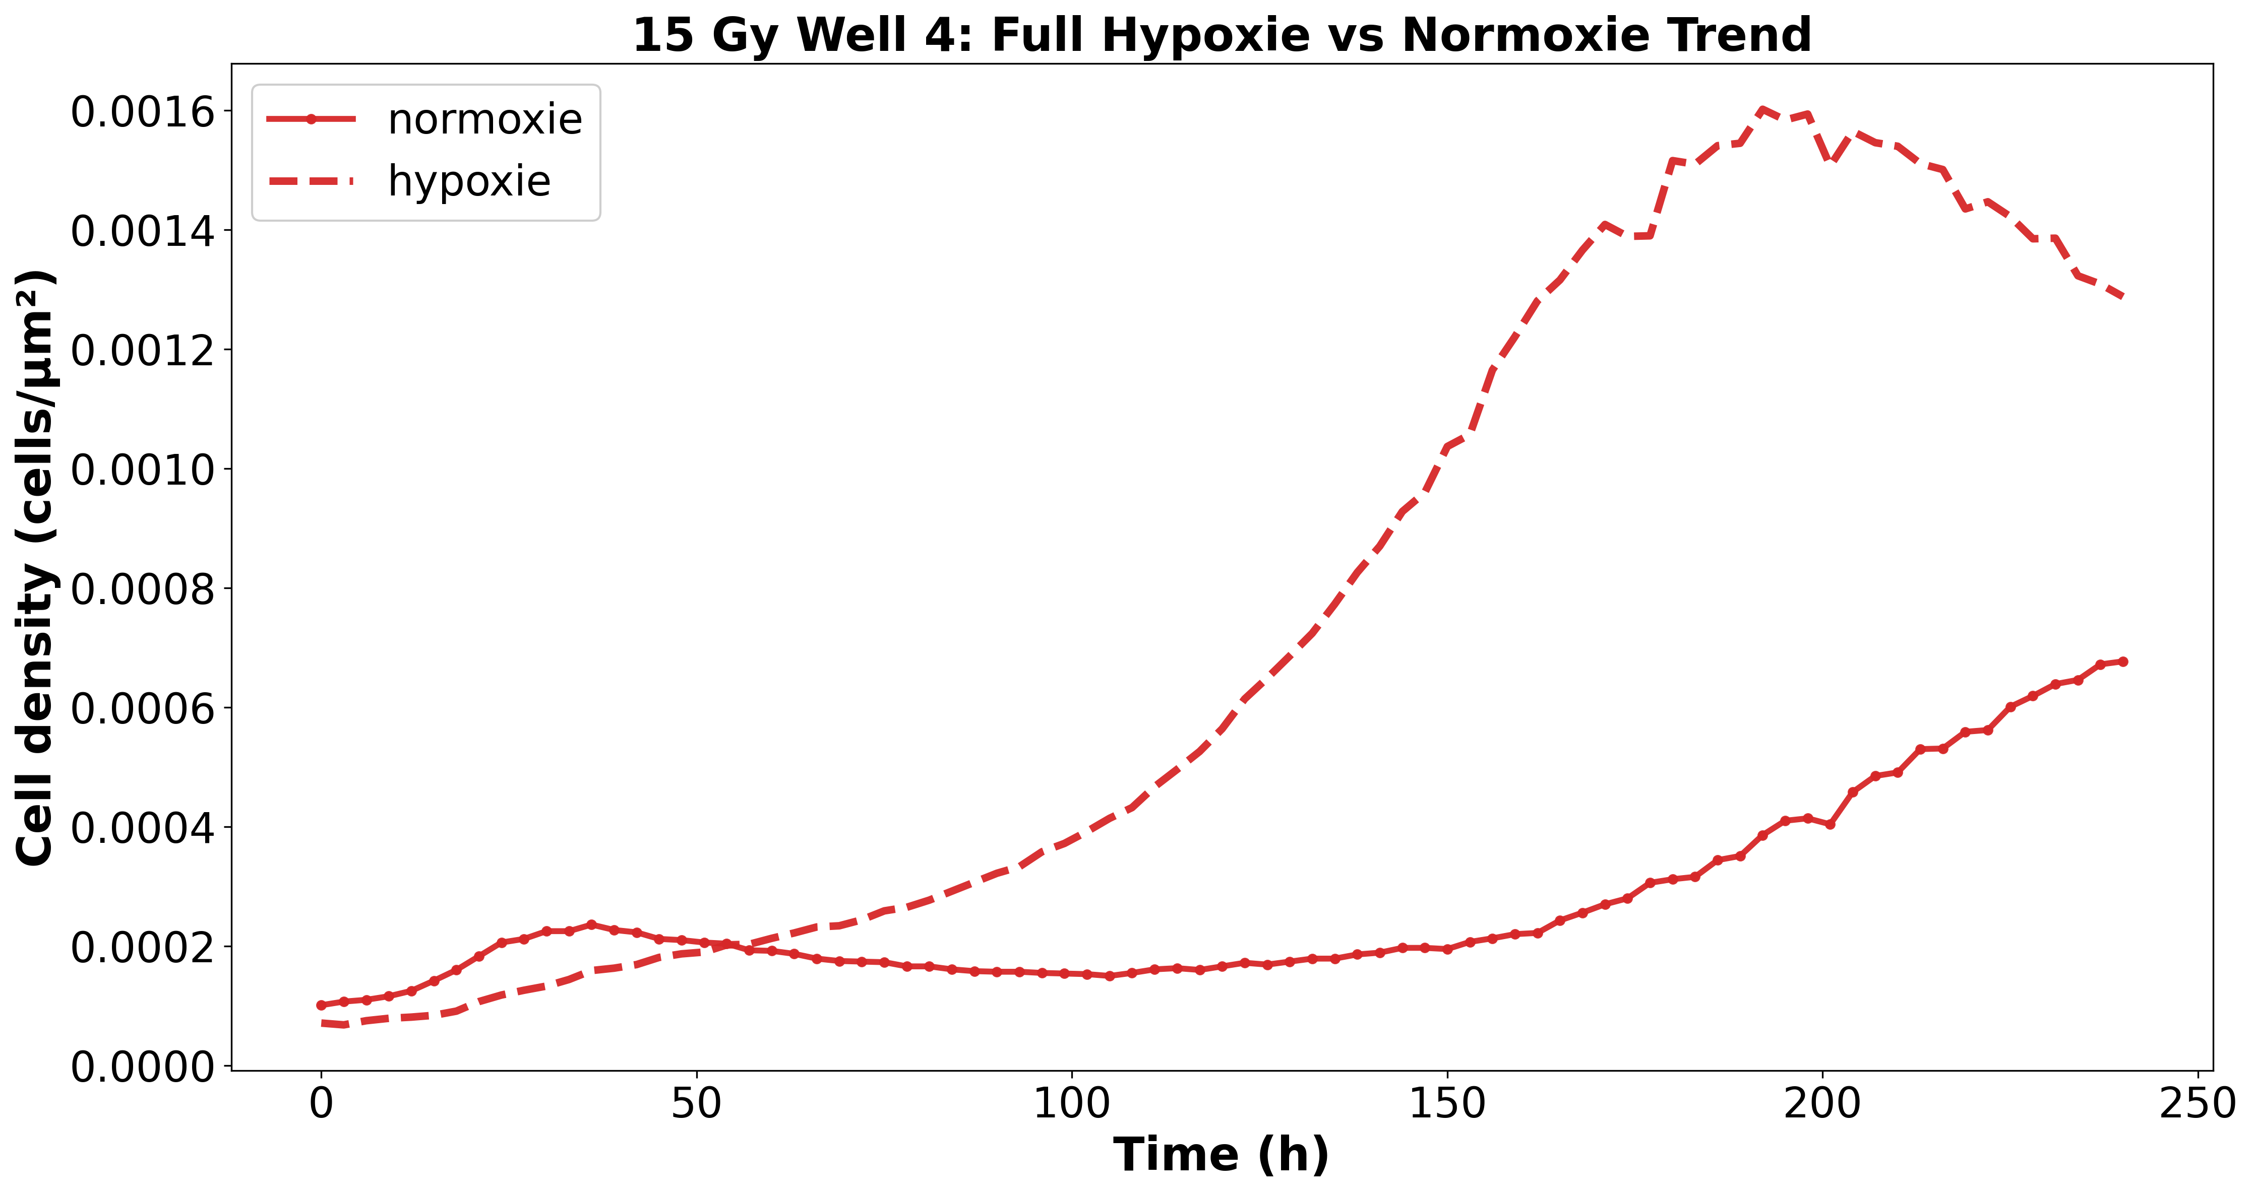
1 Introduction
2. Workflow
3. Results
4. Modeling
5. Discussion
Section 3/5 · Experimental results
Results – 15 Gy, single initial density, early window
7

Slide 9
1 Introduction
2. Workflow
3. Results
4. Modeling
5. Discussion
Section 3/5 · Experimental results
Results – 15 Gy, same initial density, full time course
8

Slide 10
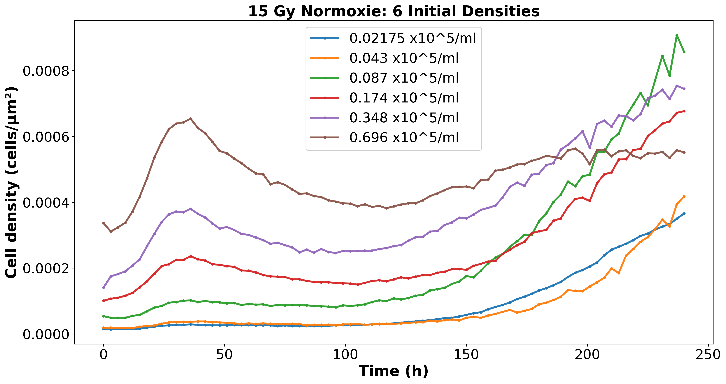
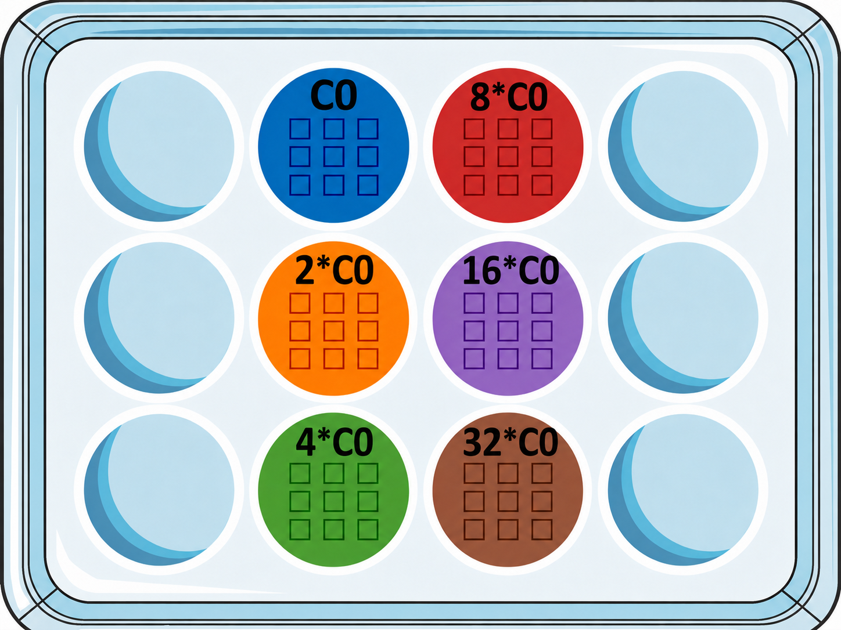
1 Introduction
2. Workflow
3. Results
4. Modeling
5. Discussion
Section 3/5 · Experimental results
Results – 15 Gy normoxia
Truncated view to highlight proliferation differences
•
Six curves = six initial densities
Different colors = different wells / initial densities
9

Slide 11
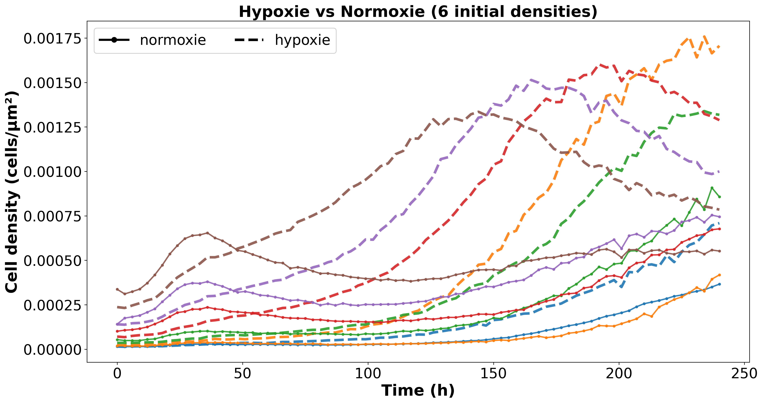
1 Introduction
2. Workflow
3. Results
4. Modeling
5. Discussion
Section 3/5 · Experimental results
Results – 15 Gy normoxia vs hypoxia
Oxygen condition changes the apparent regrowth dynamics
•
Triangles = hypoxia
•
Hypoxia restarts faster after irradiation
Interpretation
• At the beginning, the hypoxia curves have fewer cells.
• This may reflect slower proliferation or more cell death before irradiation;
• After irradiation, the hypoxia curves recover faster, supporting a hypoxia-associated radioresistance effect.
10

Slide 12
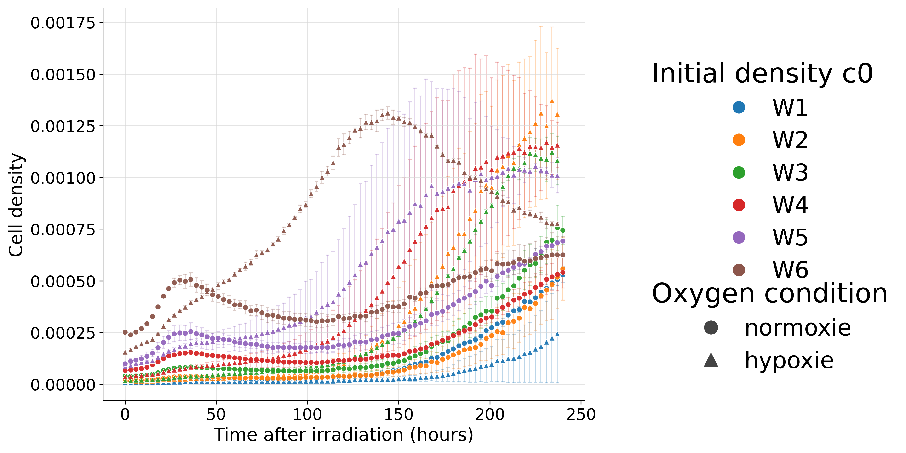
1 Introduction
2. Workflow
3. Results
4. Modeling
5. Discussion
Section 3/5 · Experimental results
Results – 15 Gy 3 experiments full time course
Late-time maximum and limits of cell counting
•
Six wells = six initial densities
•
Colors identify the wells
Different colors = different wells / initial densities
11

Slide 13
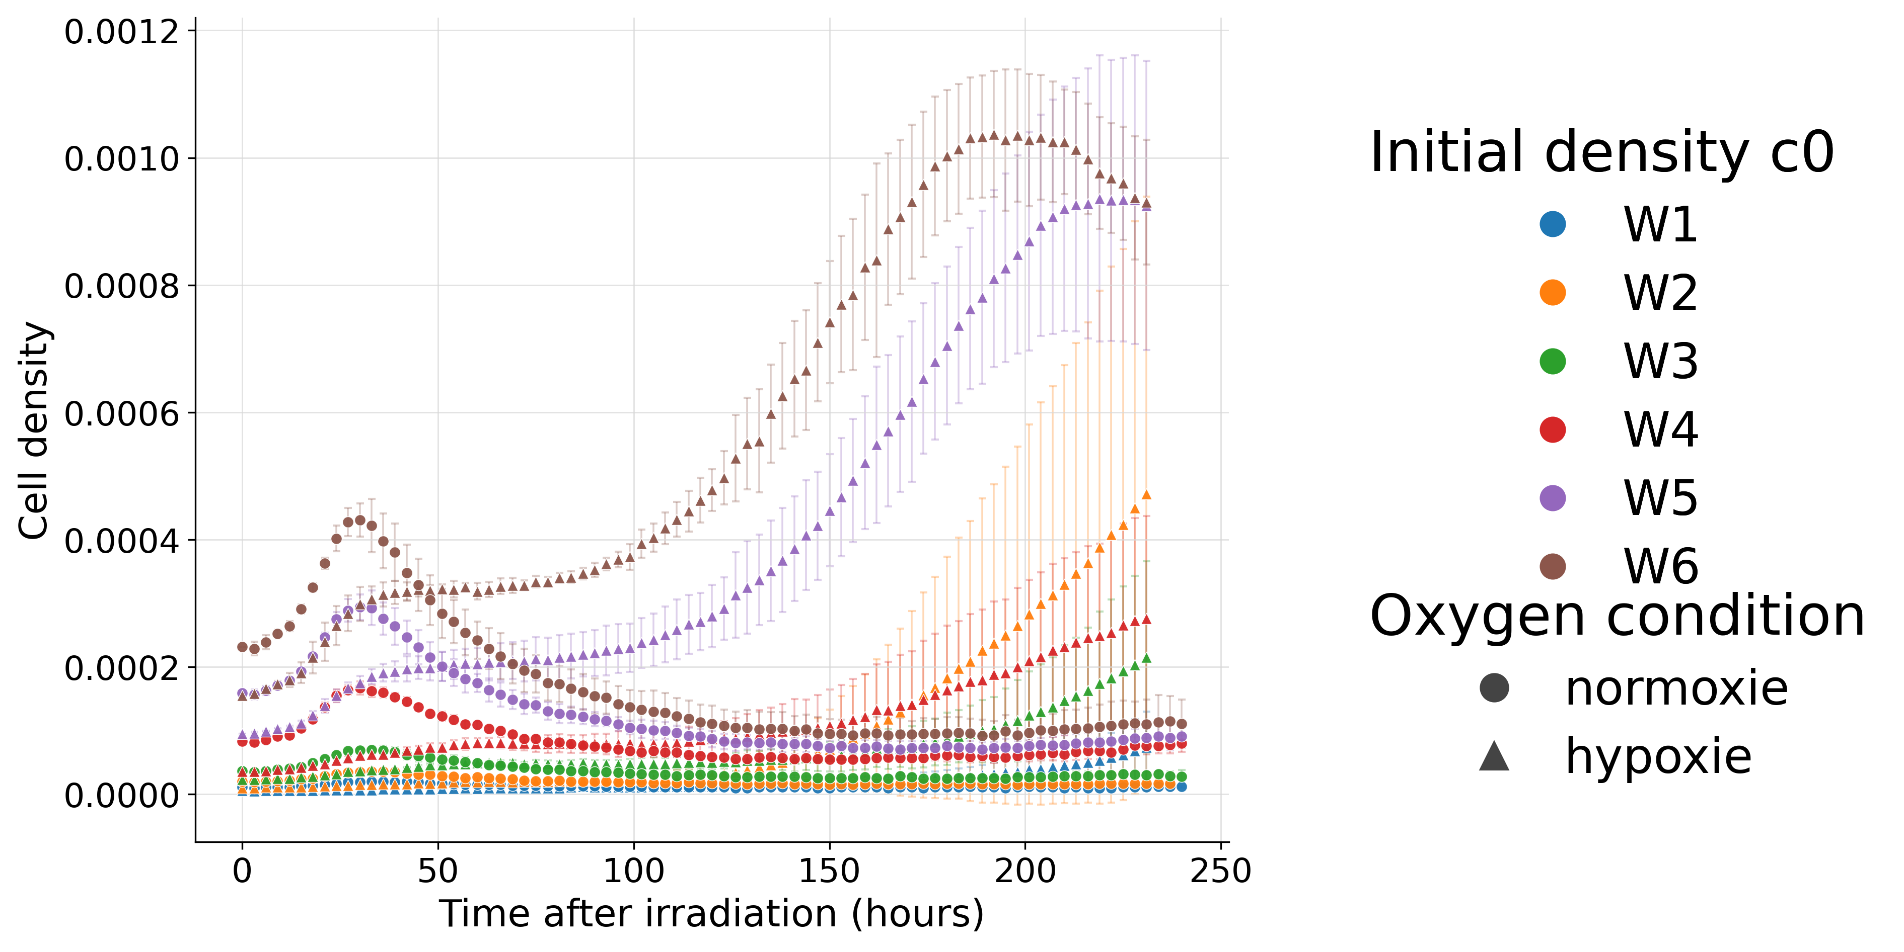
1 Introduction
2. Workflow
3. Results
4. Modeling
5. Discussion
Section 3/5 · Experimental results
Results – 20 Gy 3 experiments full time course
Full response at the highest dose
12

Slide 14
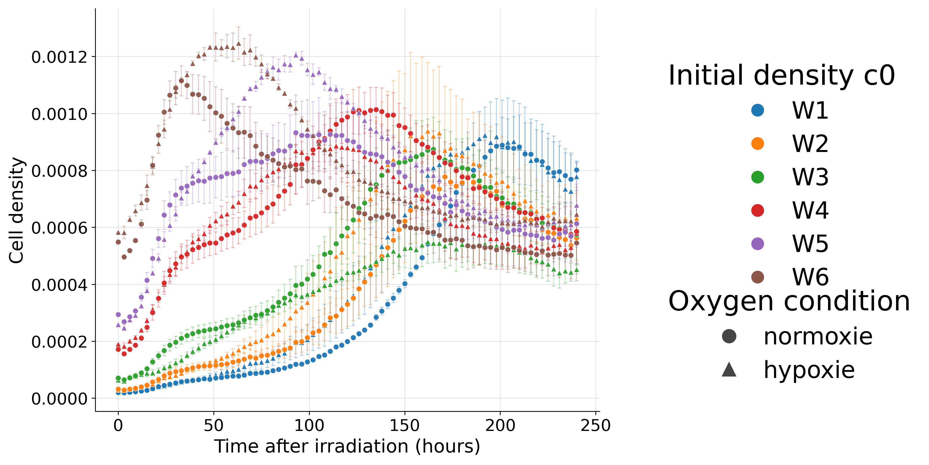
1 Introduction
2. Workflow
3. Results
4. Modeling
5. Discussion
Section 3/5 · Experimental results
Results – 10 Gy 3 experiments full time course
Lower dose response for comparison with 15 Gy and 20 Gy
13

Slide 15
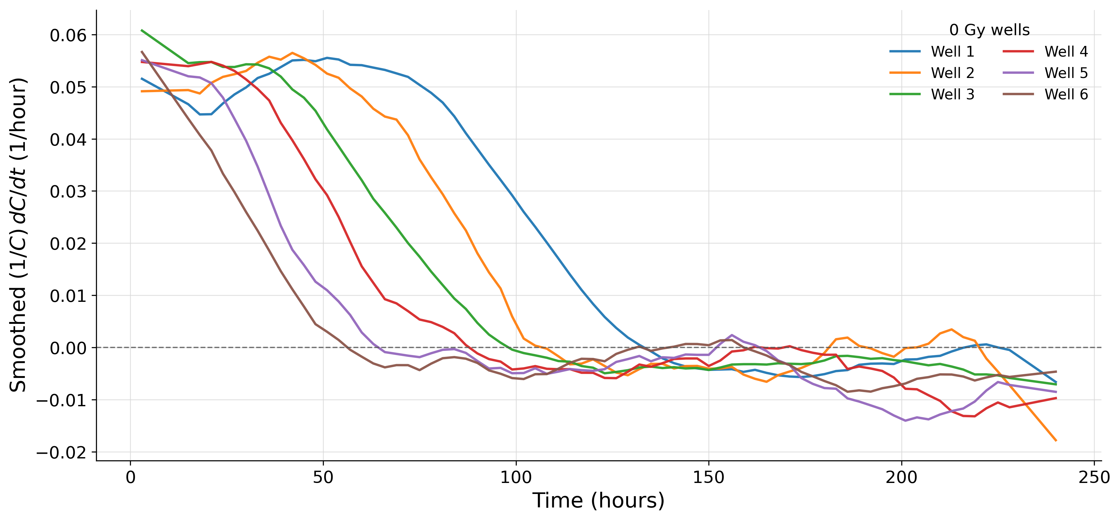
1. Introduction
2. Workflow
3. Results
4. Modeling
5. Discussion
Section 4/5 · Modeling results
Model fitting – 0 Gy control
Estimate the basal proliferation parameter k0
•
Proliferation rate was similar for cells with different initial densities
Cell proliferation rate versus time
14

Slide 16

1. Introduction
2. Workflow
3. Results
4. Modeling
5. Discussion
Section 4/5 · Modeling results
Model fitting – 0 Gy control
Estimate the basal proliferation parameter k0
•
Estimate k0: normal proliferation rate
•
Use k0 as a baseline for irradiated fits
•
Estimate different k0 for normoxia and hypoxia
•
Logistic function :
15

Slide 17
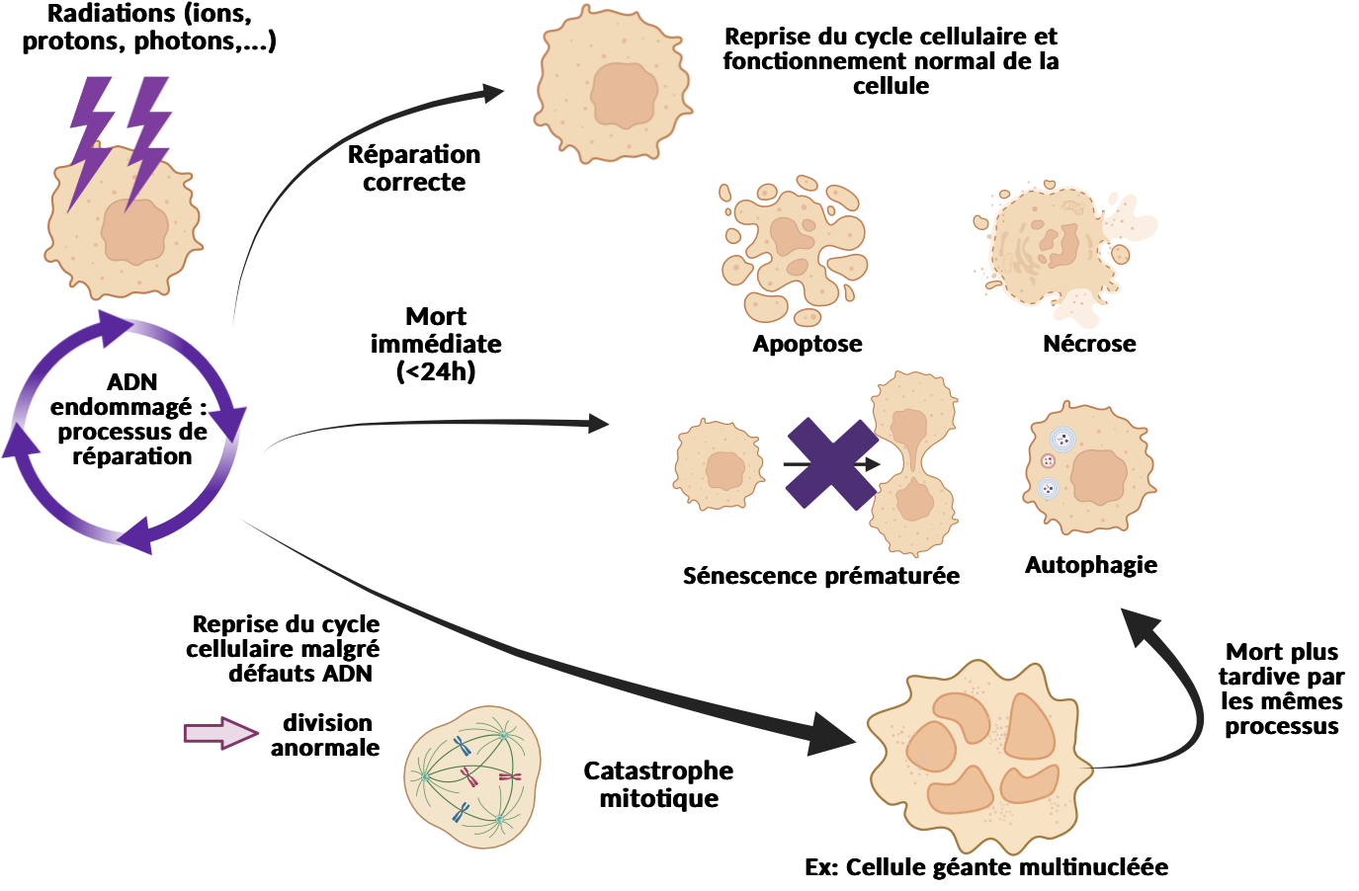
1. Introduction
2. Workflow
3. Results
4. Modeling
5. Discussion
Section 1/5 · Why model hypoxia?
Effect of irradiation on cells
Time-resolved response of glioma cells after irradiation in normoxie
•
Time-lapse fluorescence microscopy
•
Cell density measured over time
•
Single-dose irradiation response
•
Compartmental model of cell fate
Model can estimate
–
Repaired cells
–
Unrepaired cells
–
Senescent cells
–
Dead cells
16

Slide 18
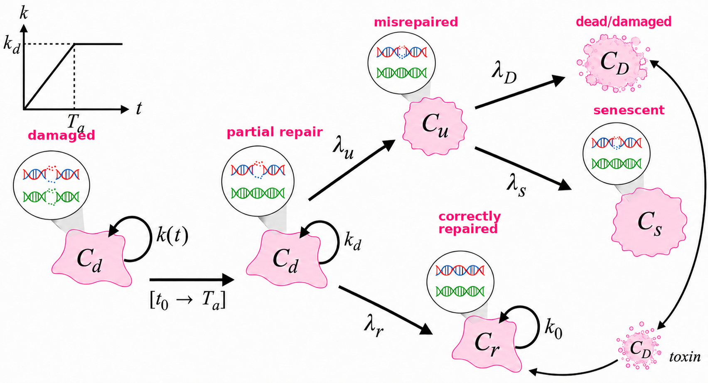
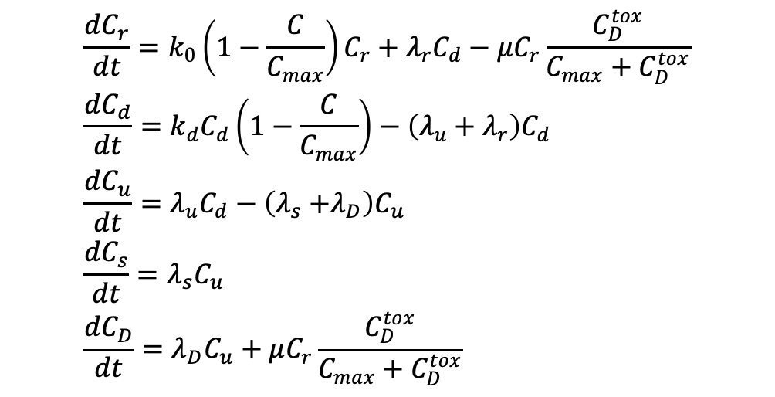
1. Introduction
2. Workflow
3. Results
4. Modeling
5. Discussion
Section 4/5 · Modeling results
Compartmental model
Hidden cell states after irradiation
ODE structure
17

Slide 19
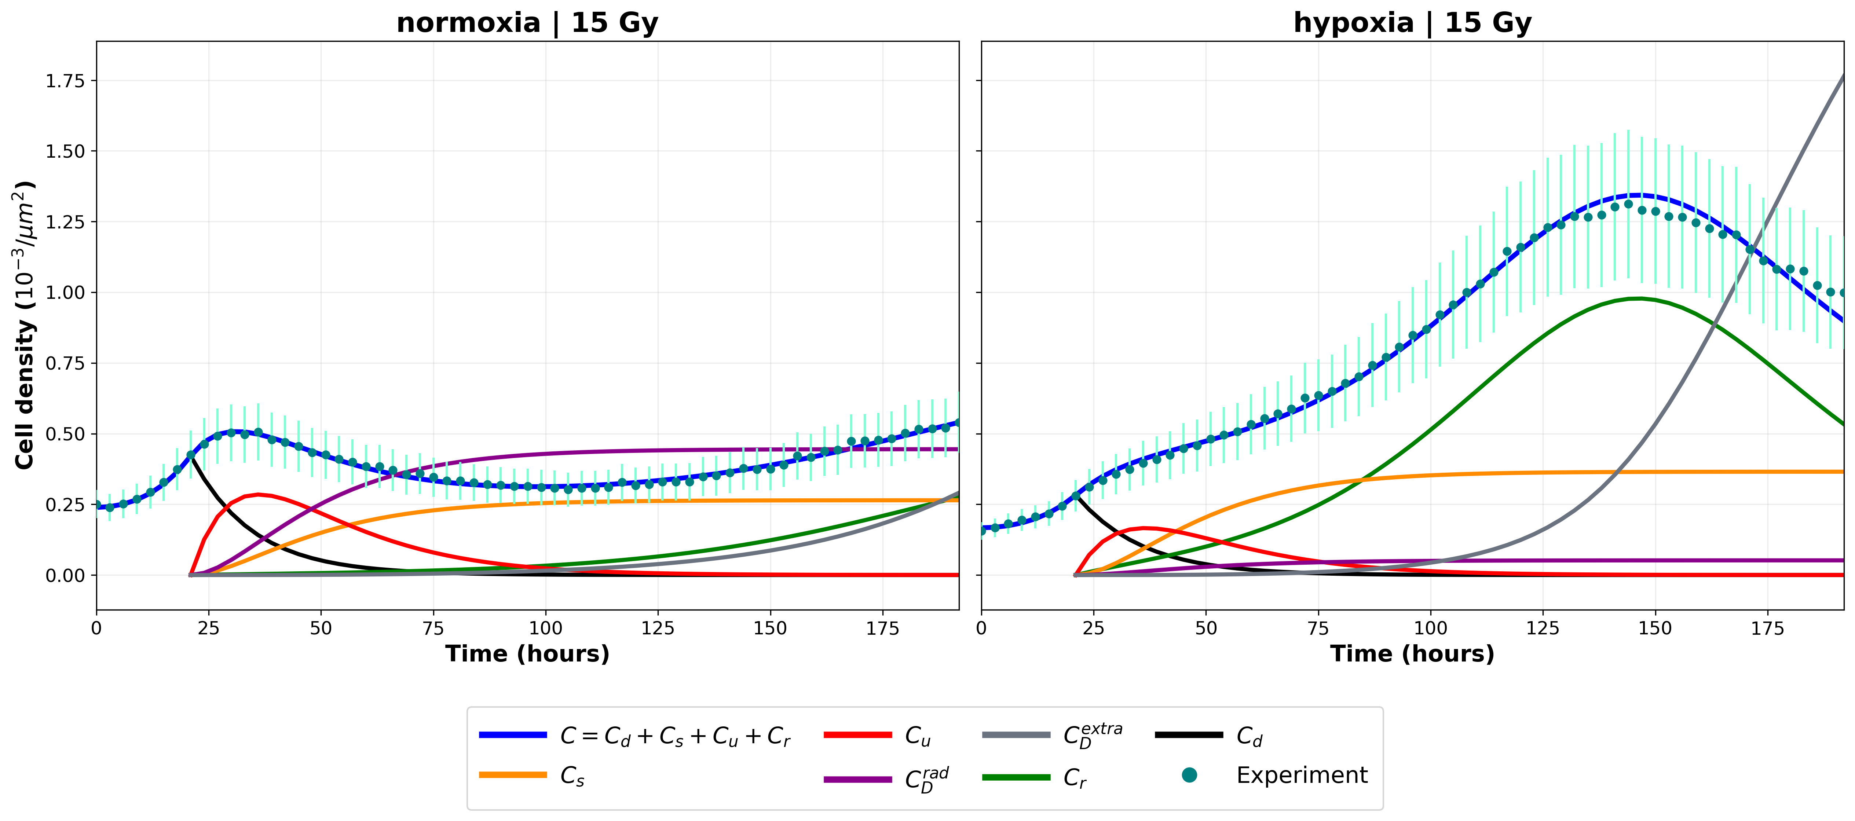
1. Introduction
2. Workflow
3. Results
4. Modeling
5. Discussion
Section 4/5 · Modeling results
Compartmental model
Hidden cell states after irradiation
Compartments
•
Ctot: all detected cells
•
Cd: damaged cells
•
Cr: repaired cells
•
Cu: unrepaired cells
•
Cs: senescent cells
•
CD rad: dead cells
•
CD extra toxin generated by dead cells
Two phases
•
Repair phase
•
Regrow-or-die phase
18

Slide 20
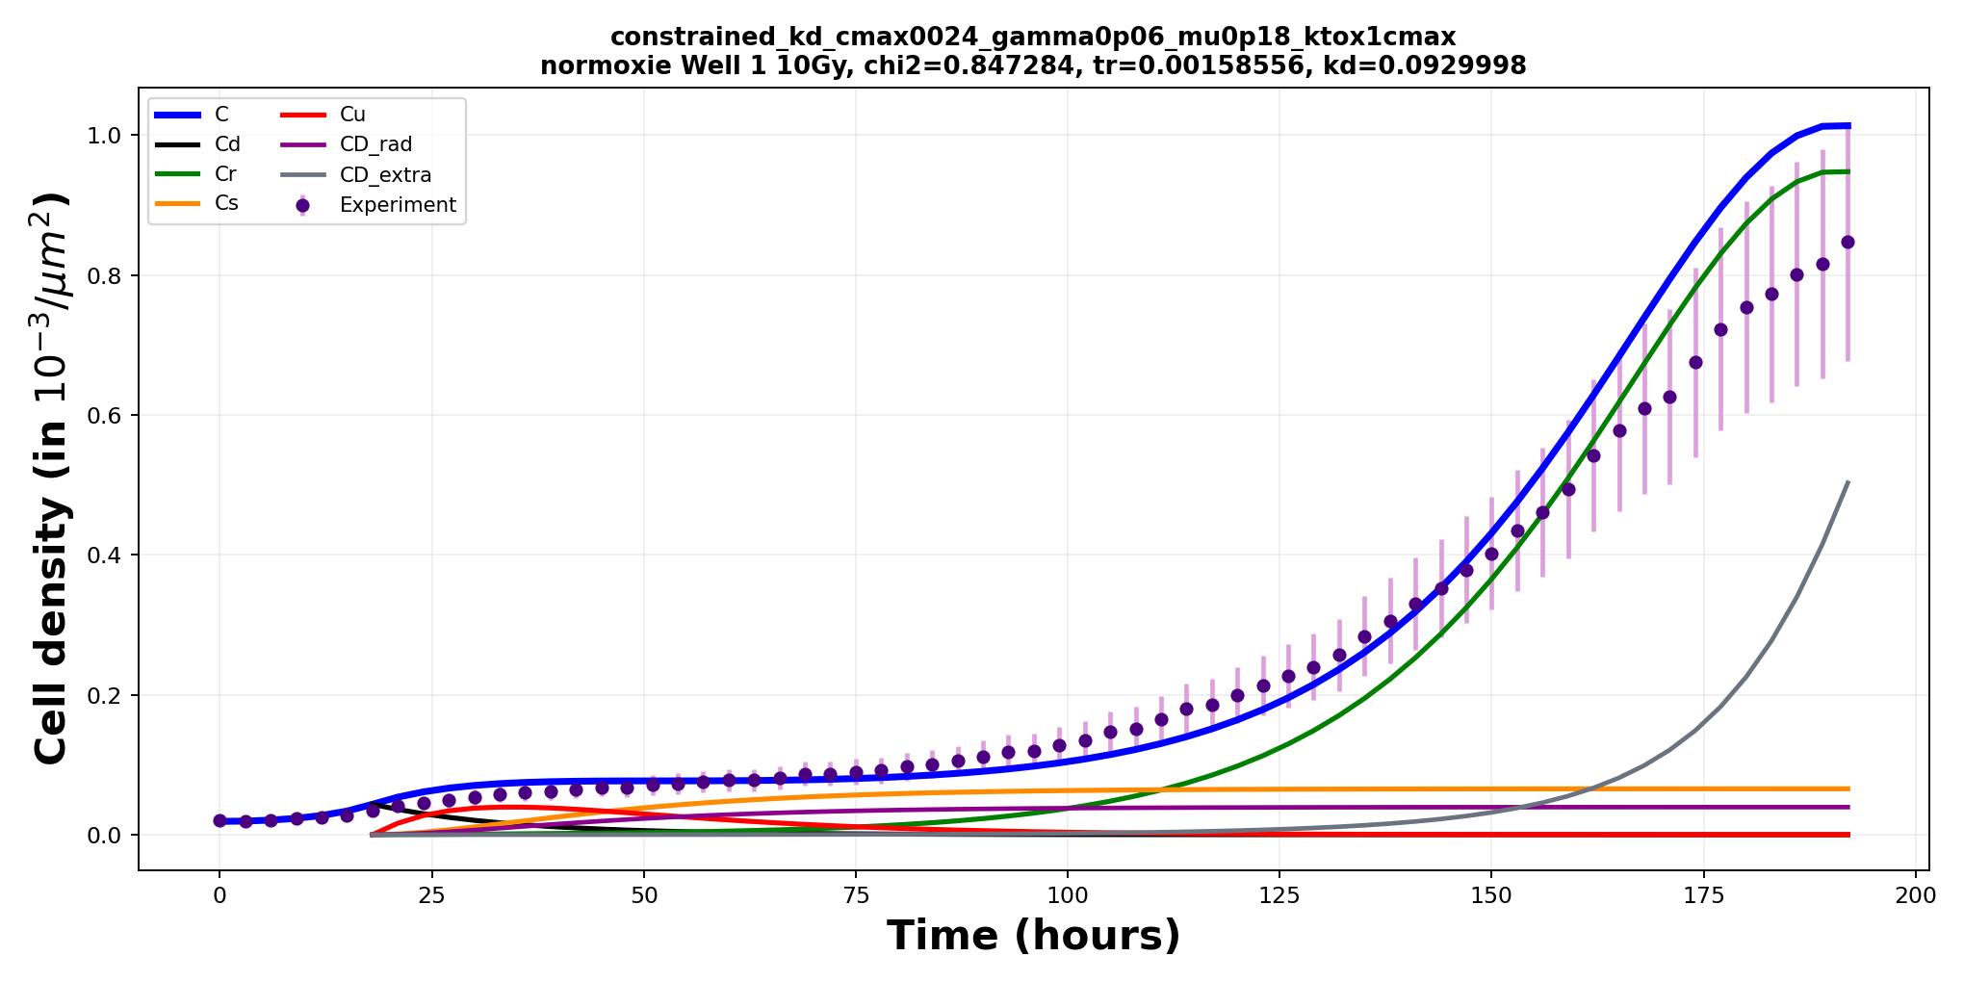
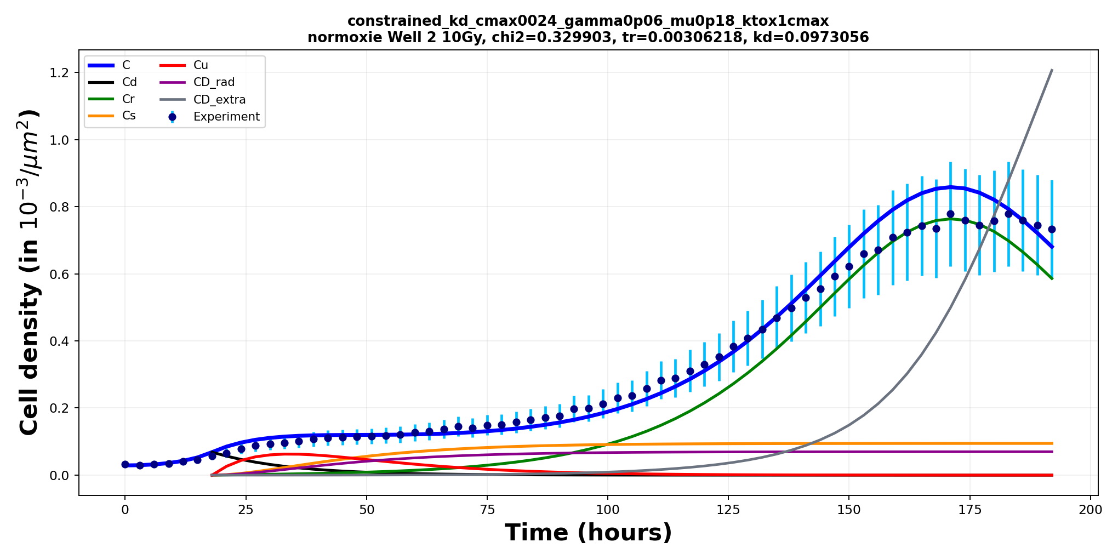
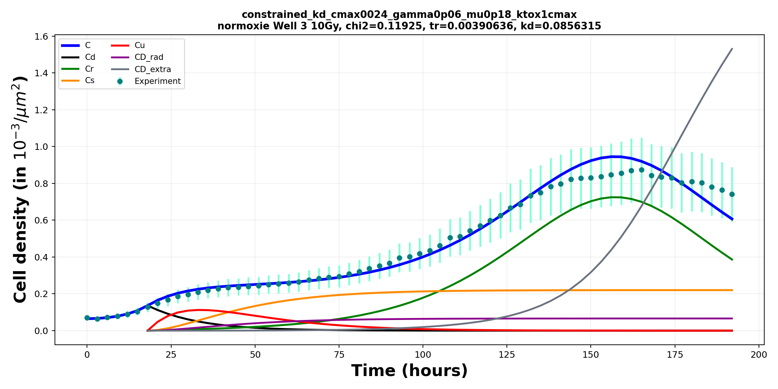
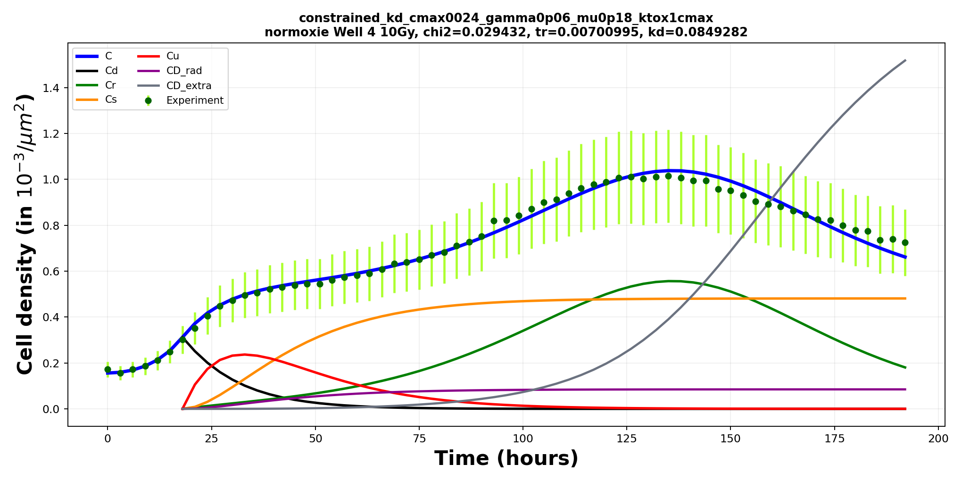
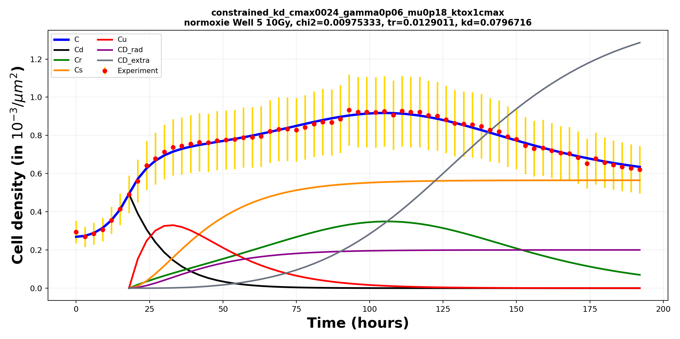
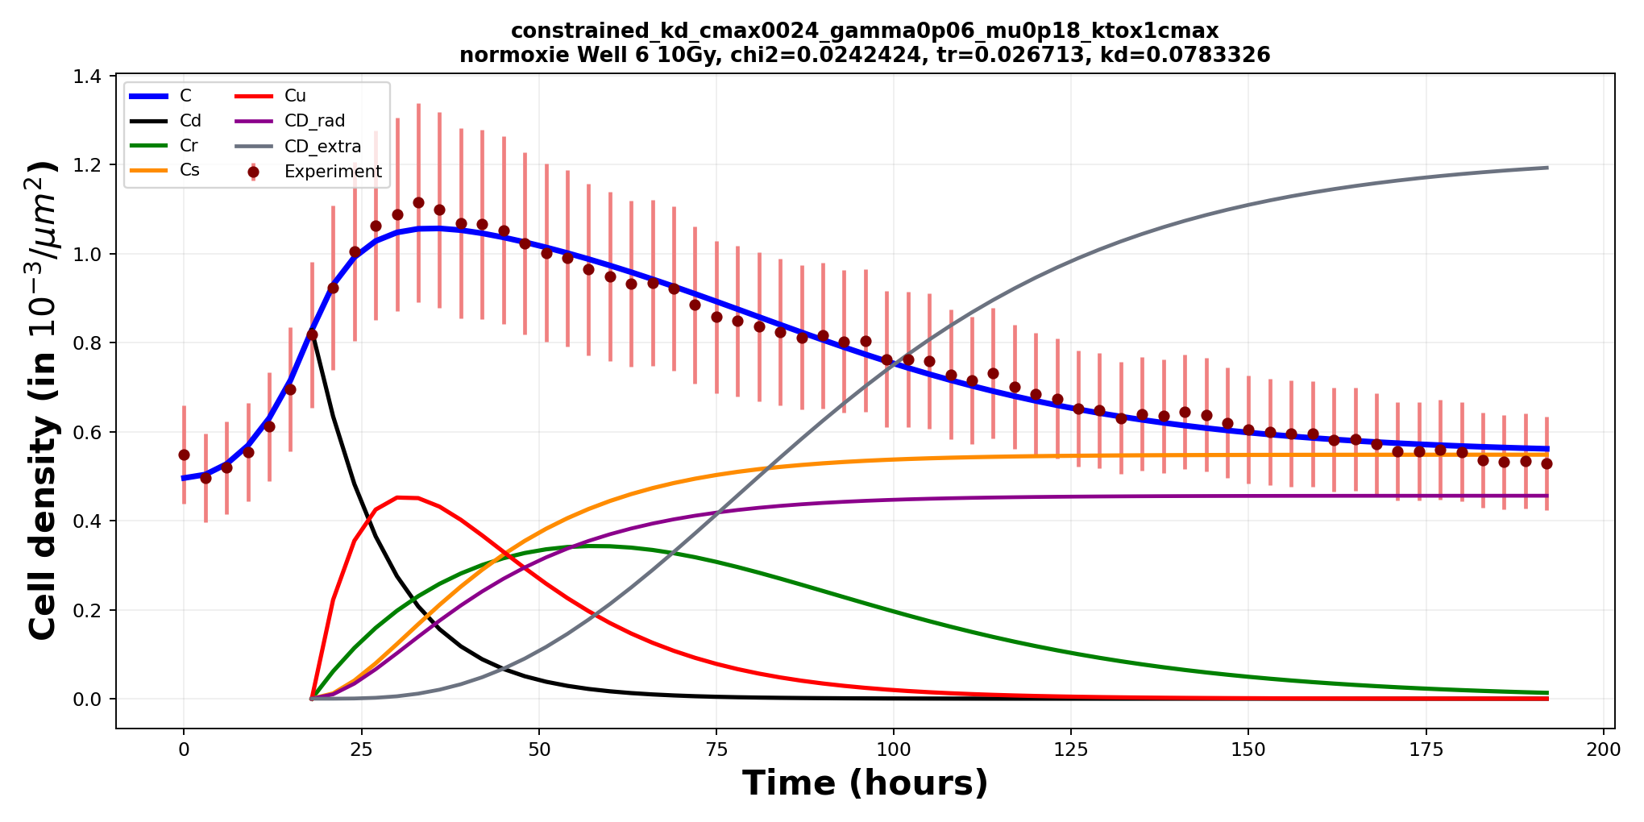
1. Introduction
2. Workflow
3. Results
4. Modeling
5. Discussion
Section 4/5 · Modeling results
Model fitting – 10 Gy, normoxia
19

Slide 21
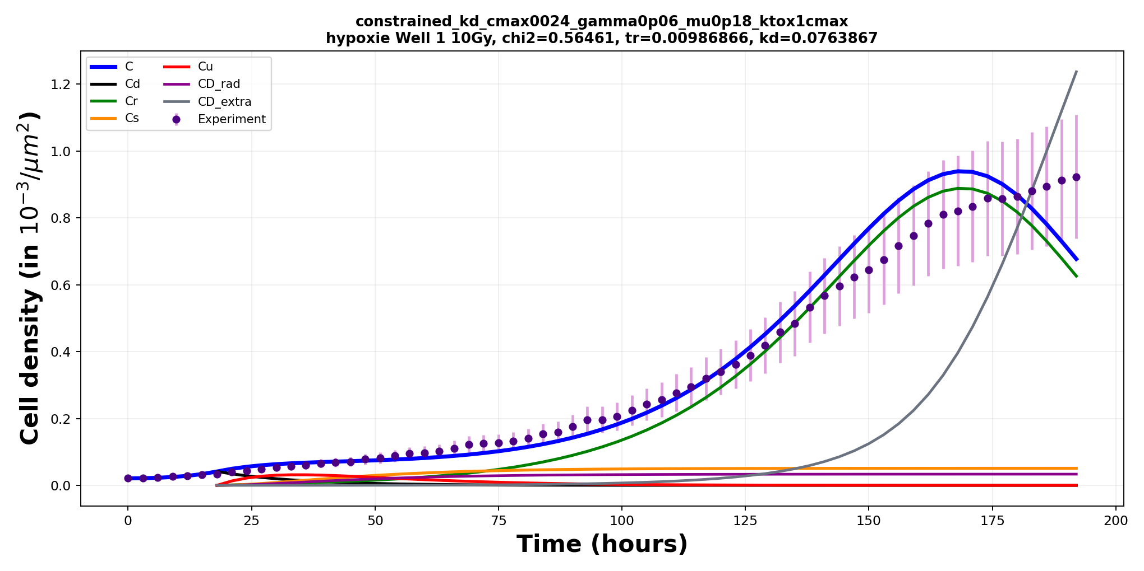
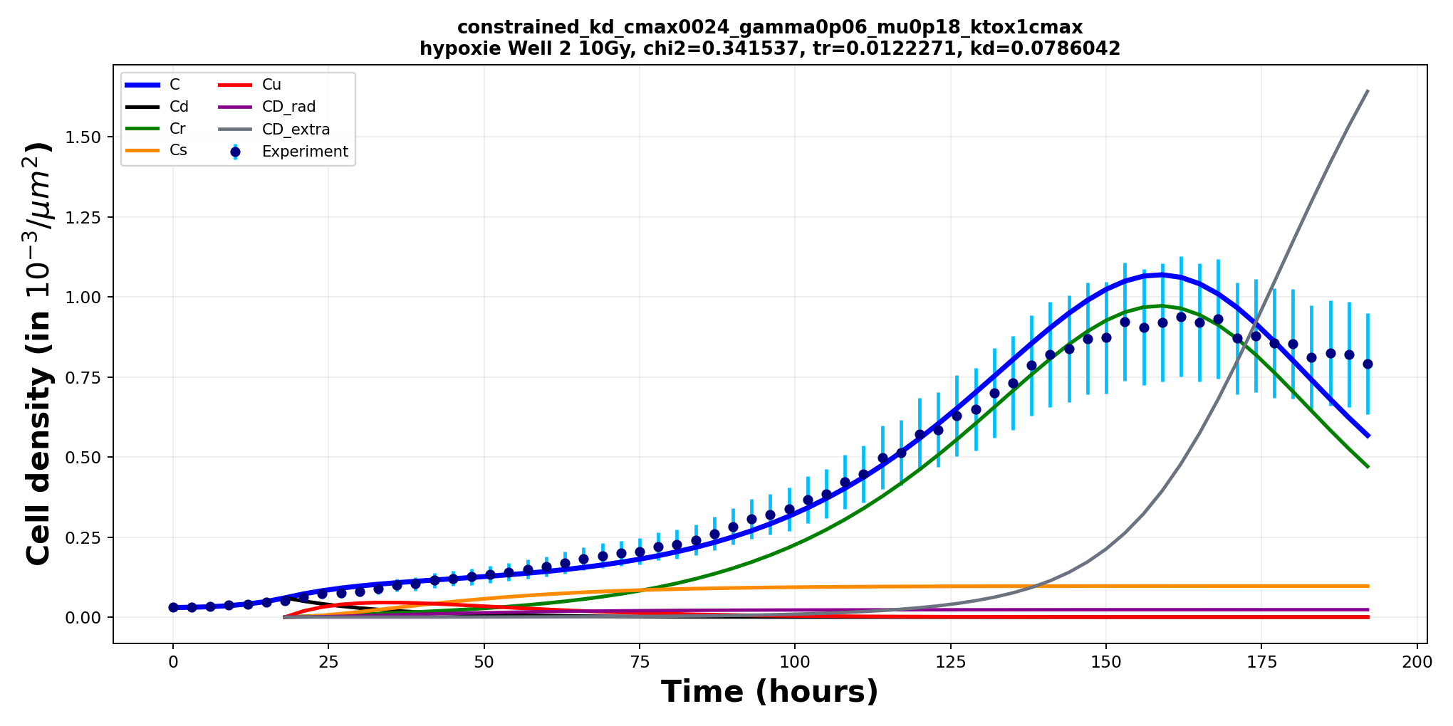
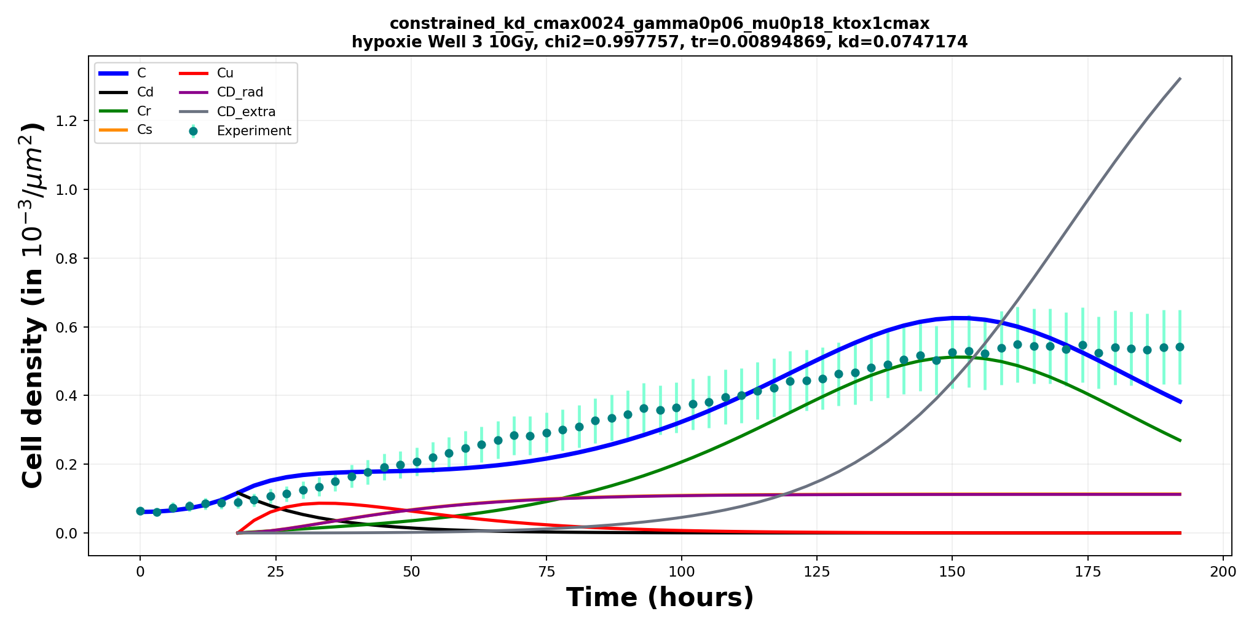
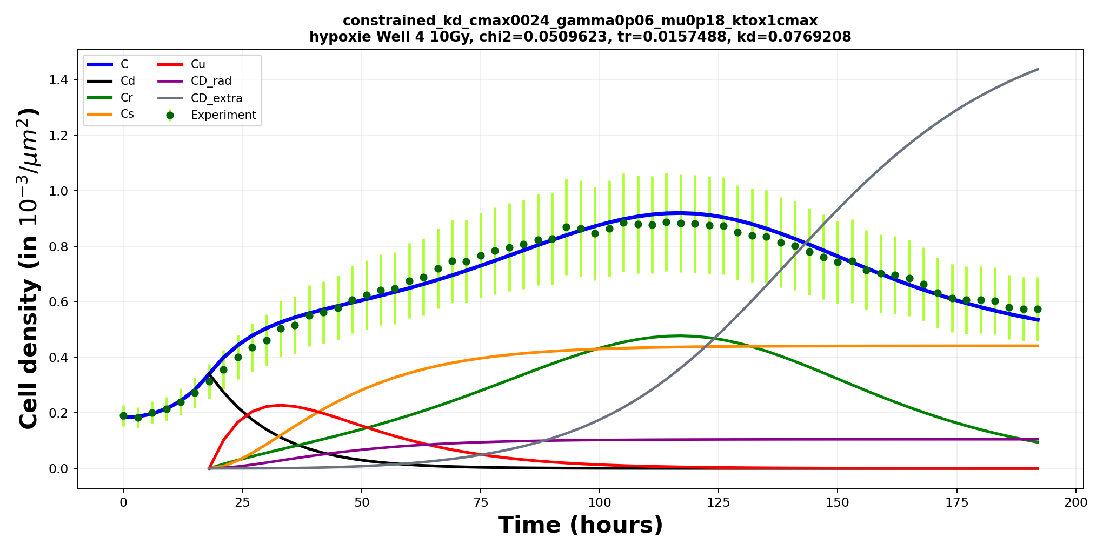
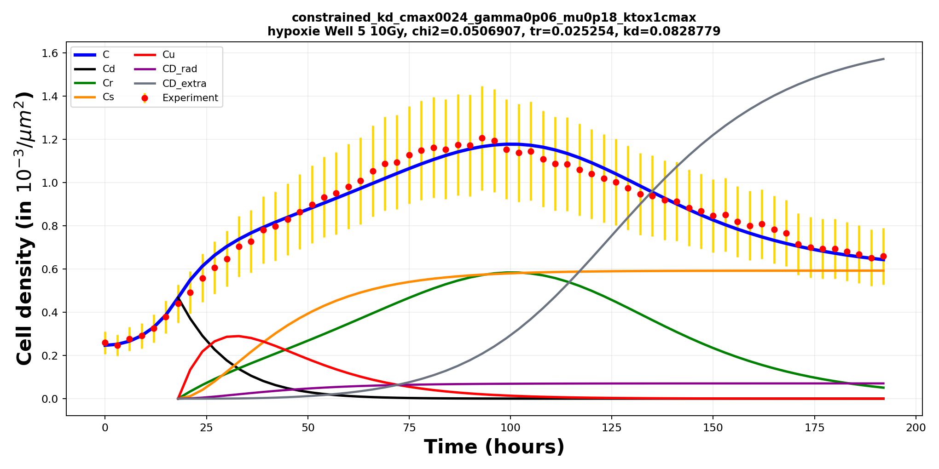
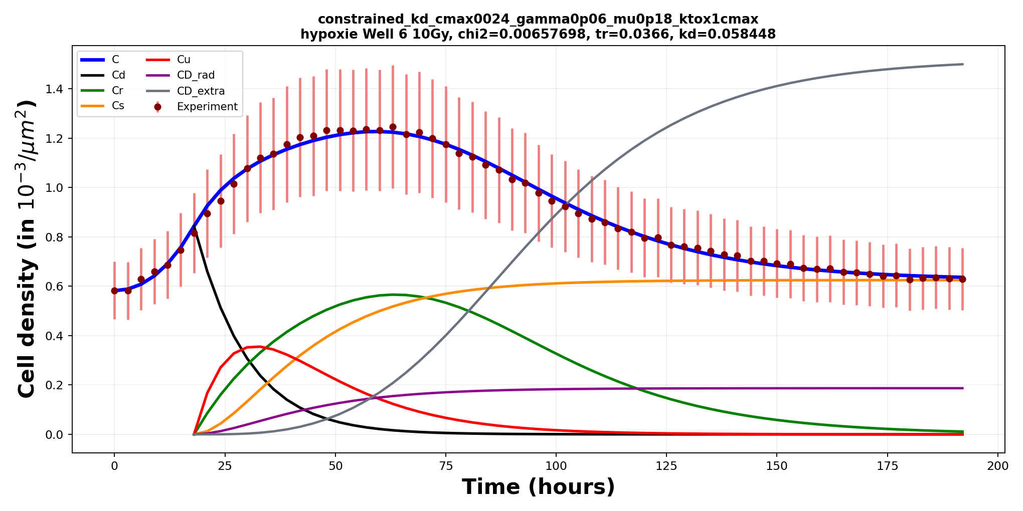
1. Introduction
2. Workflow
3. Results
4. Modeling
5. Discussion
Section 4/5 · Modeling results
Model fitting – 10 Gy, hypoxia
20

Slide 22
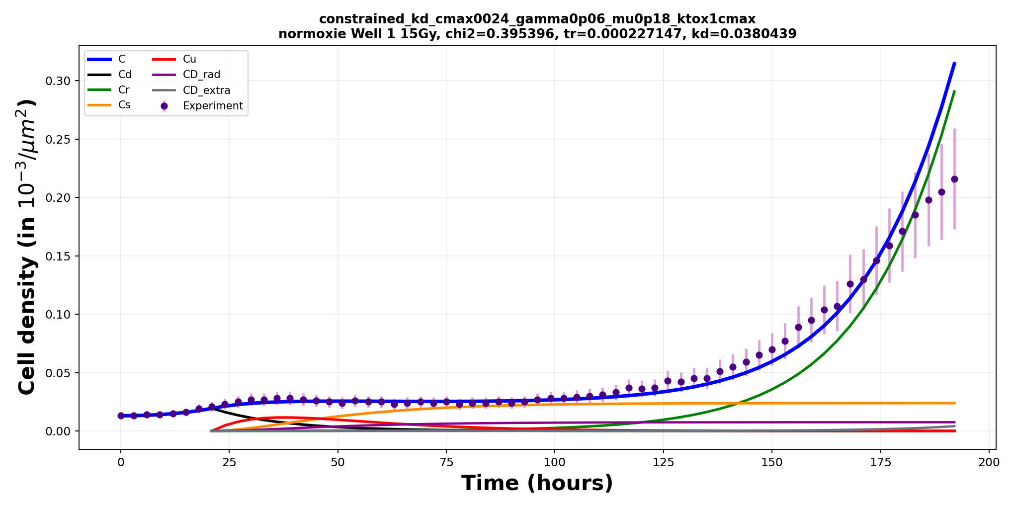
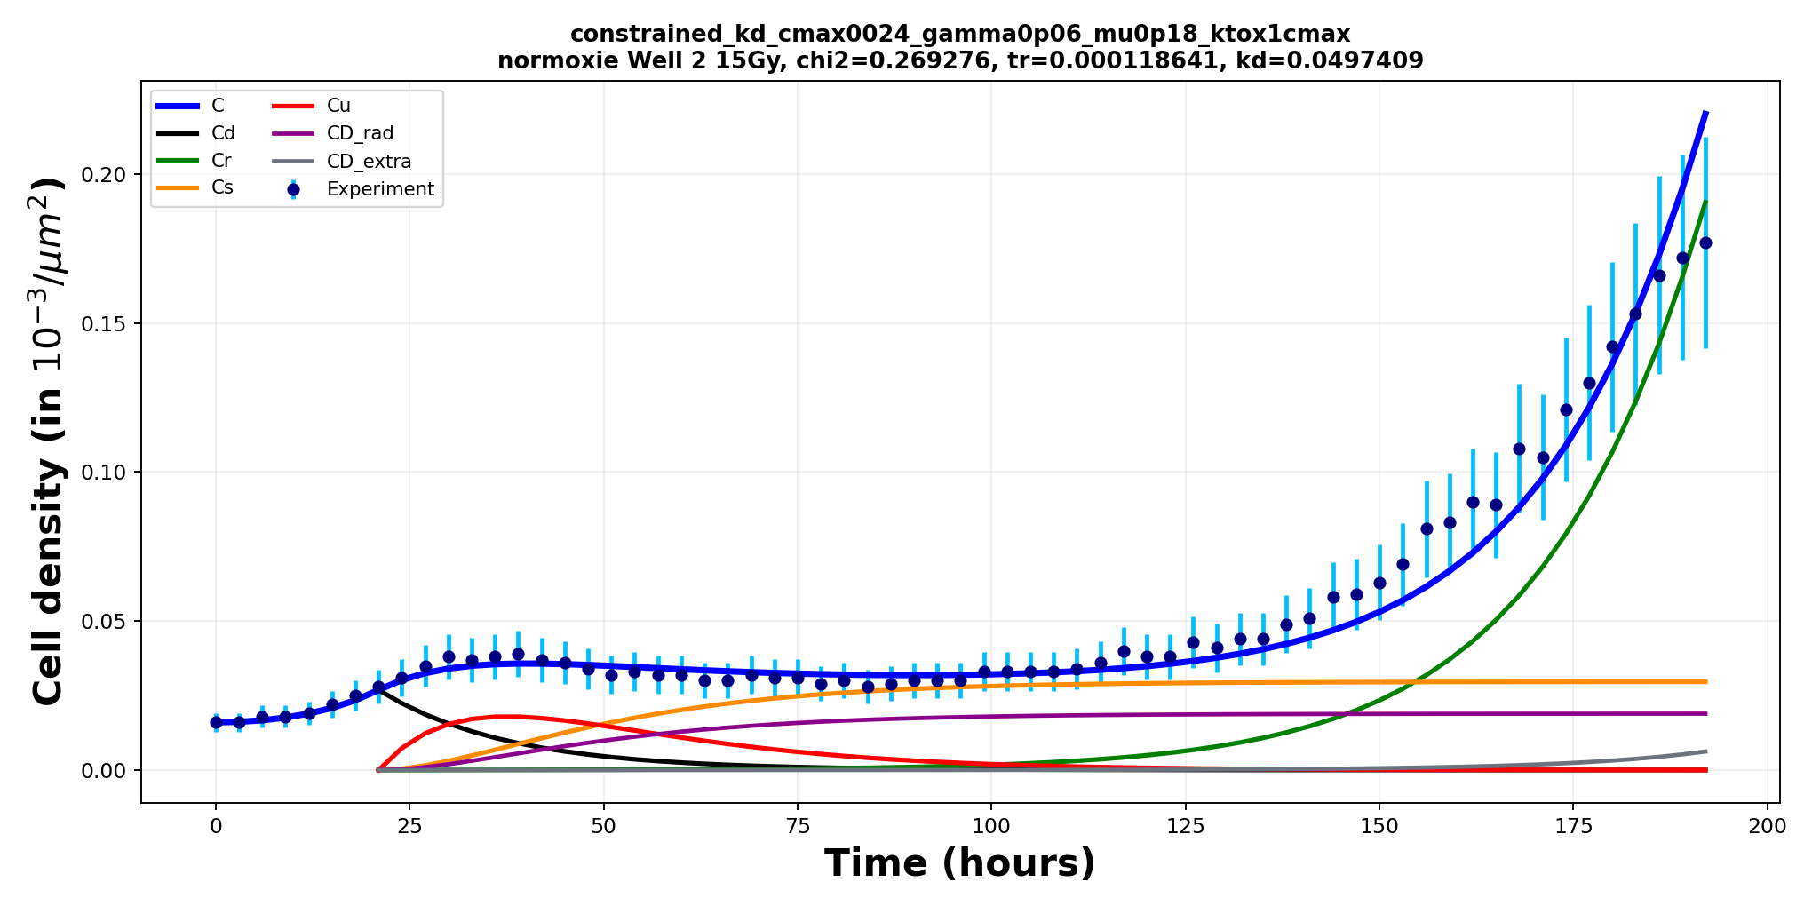
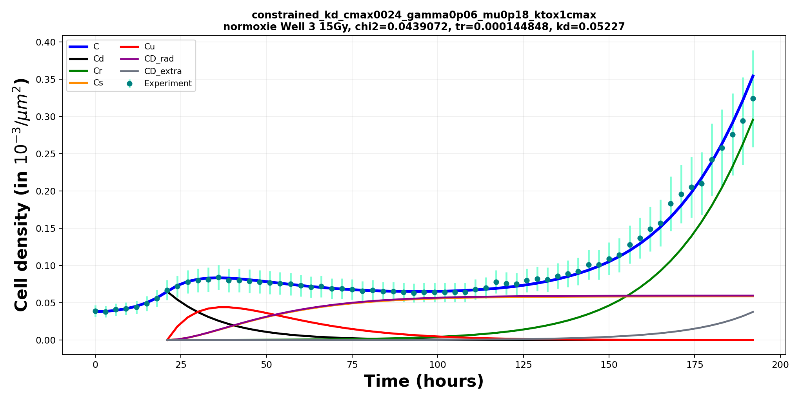
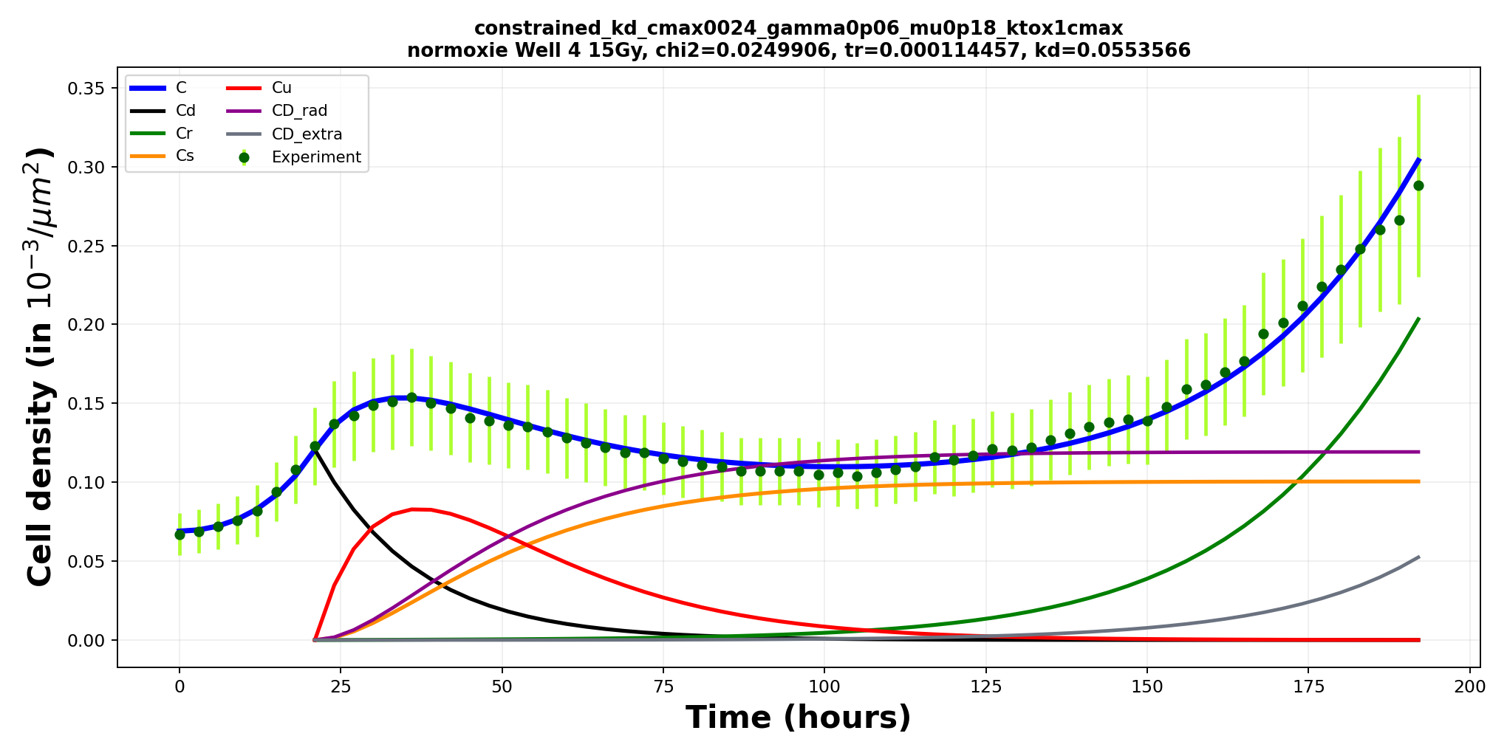
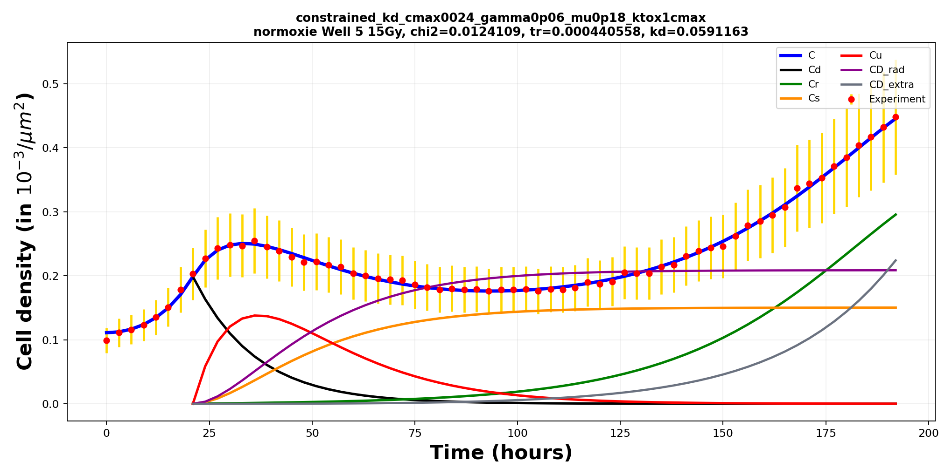
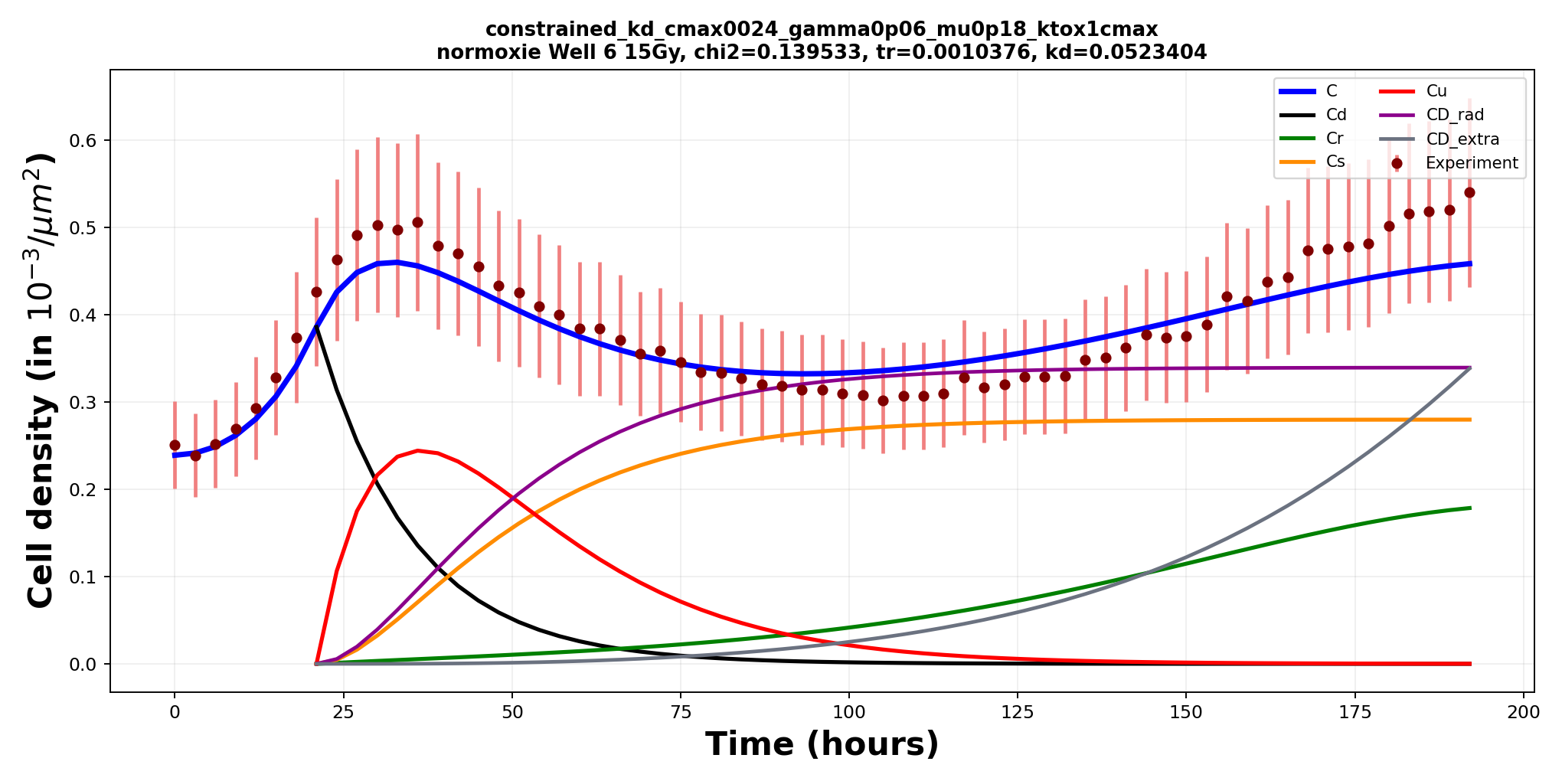
1. Introduction
2. Workflow
3. Results
4. Modeling
5. Discussion
Section 4/5 · Modeling results
Model fitting – 15 Gy, normoxia
21

Slide 23
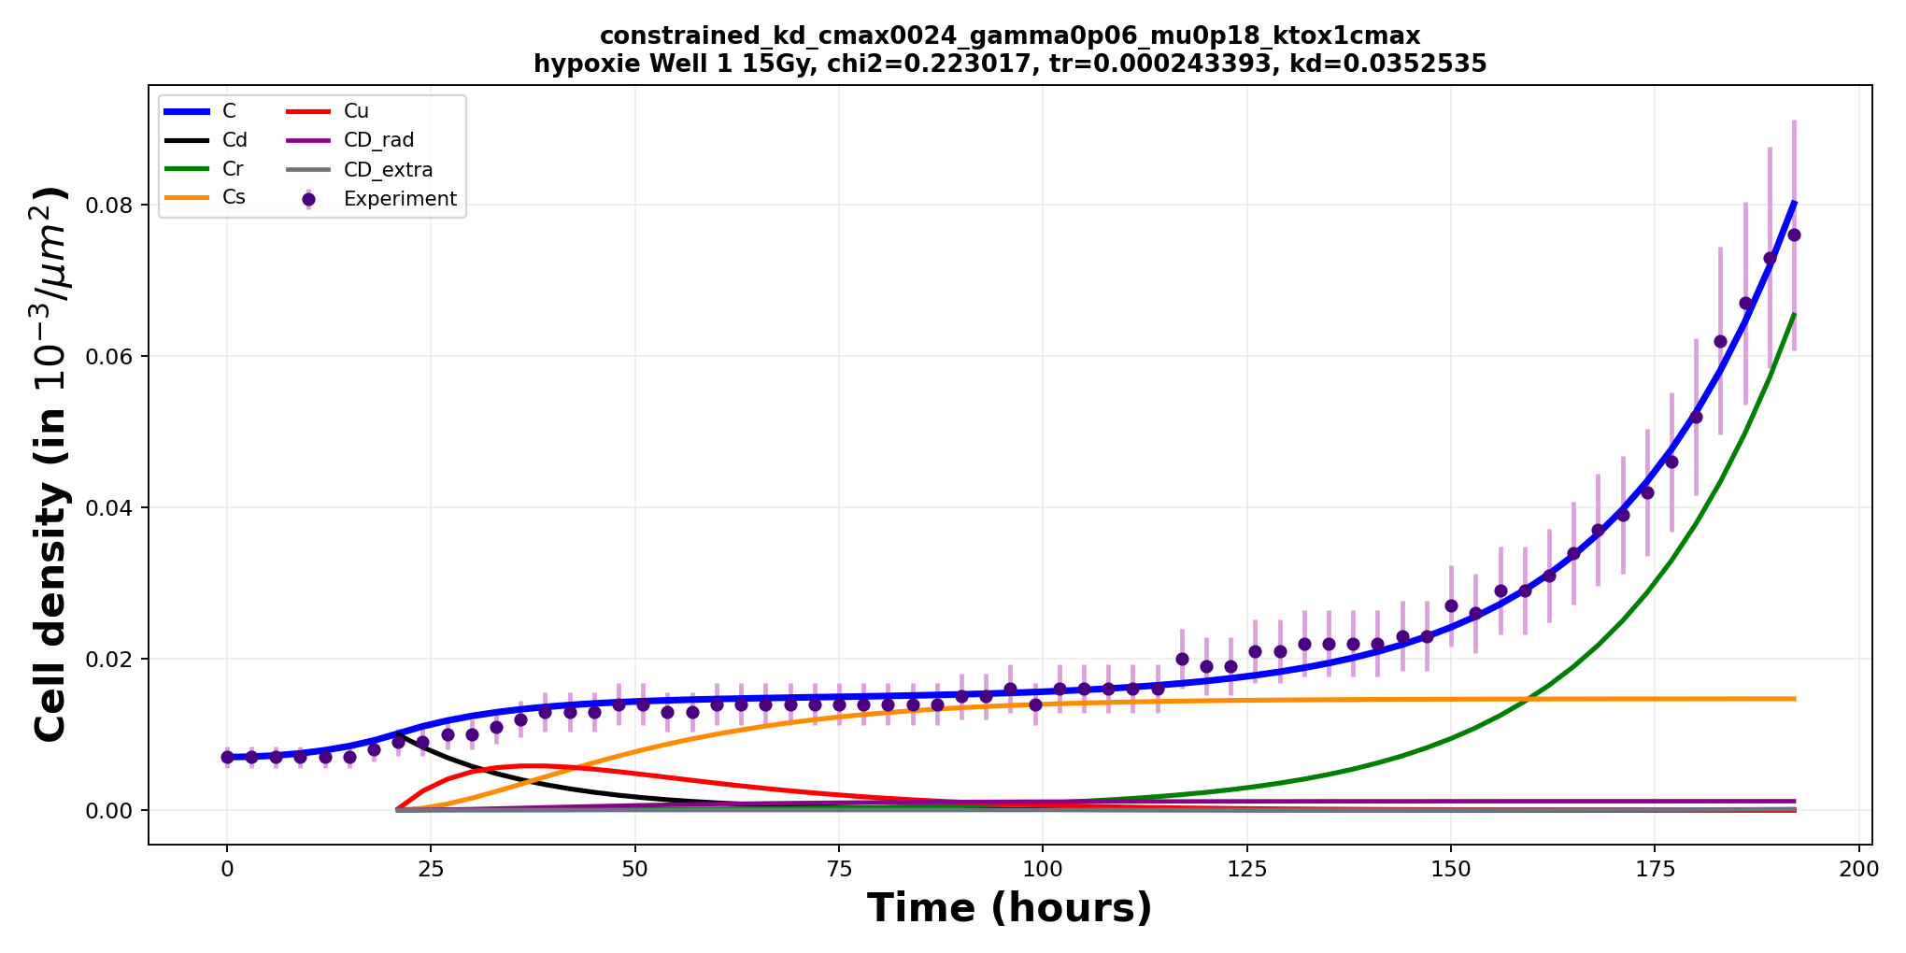
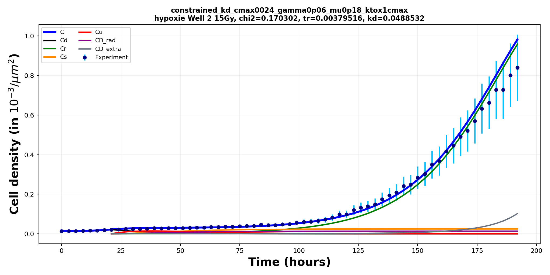
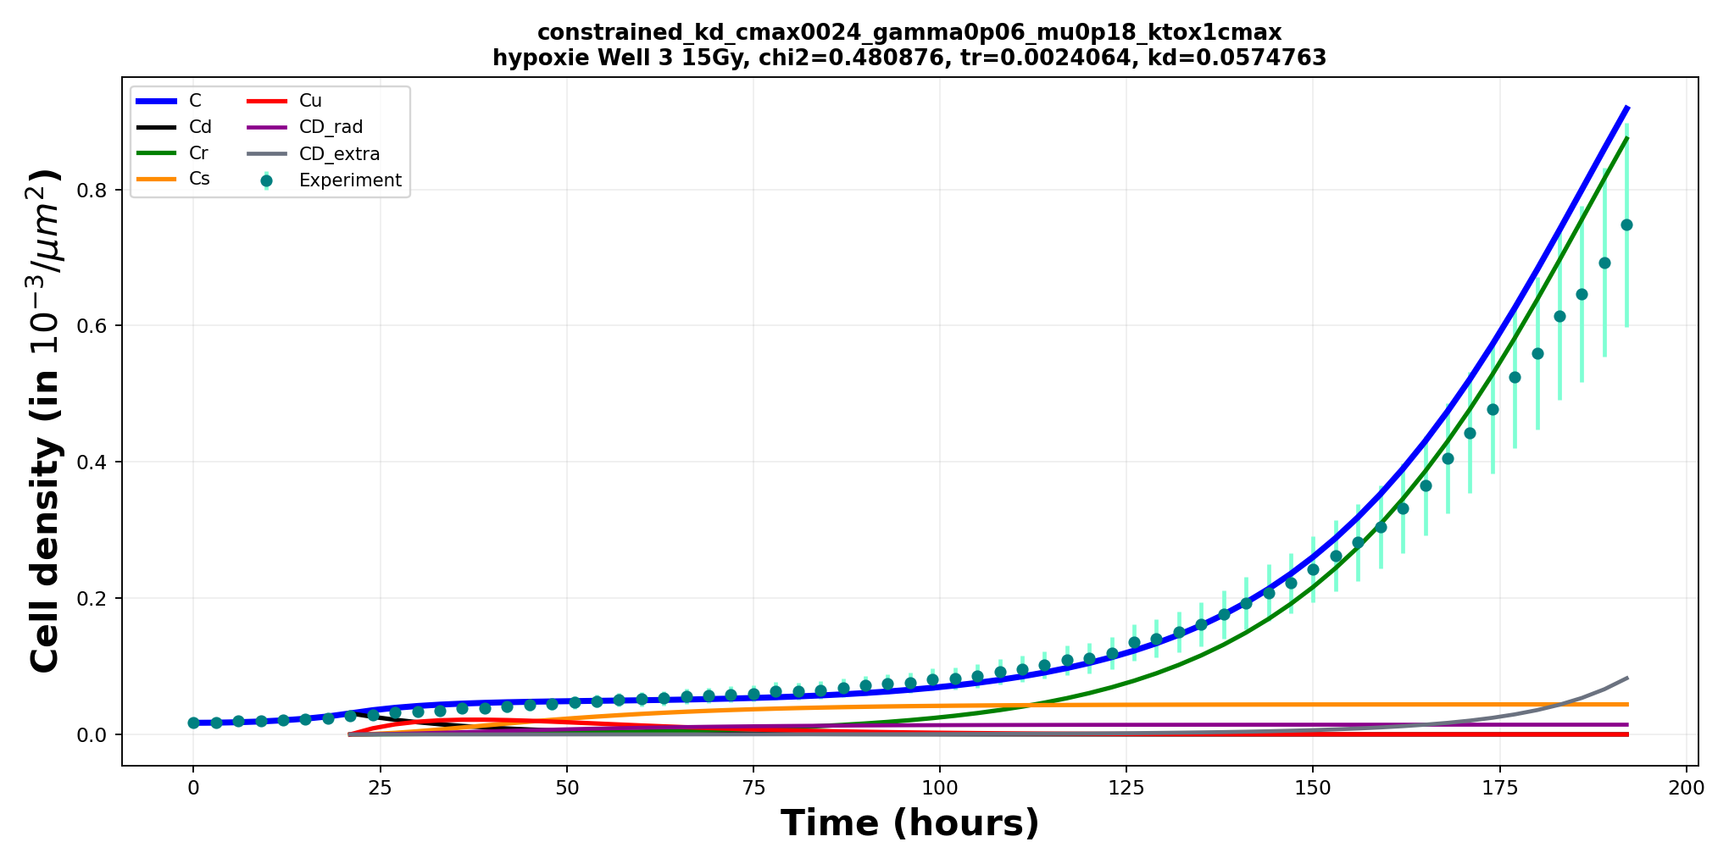
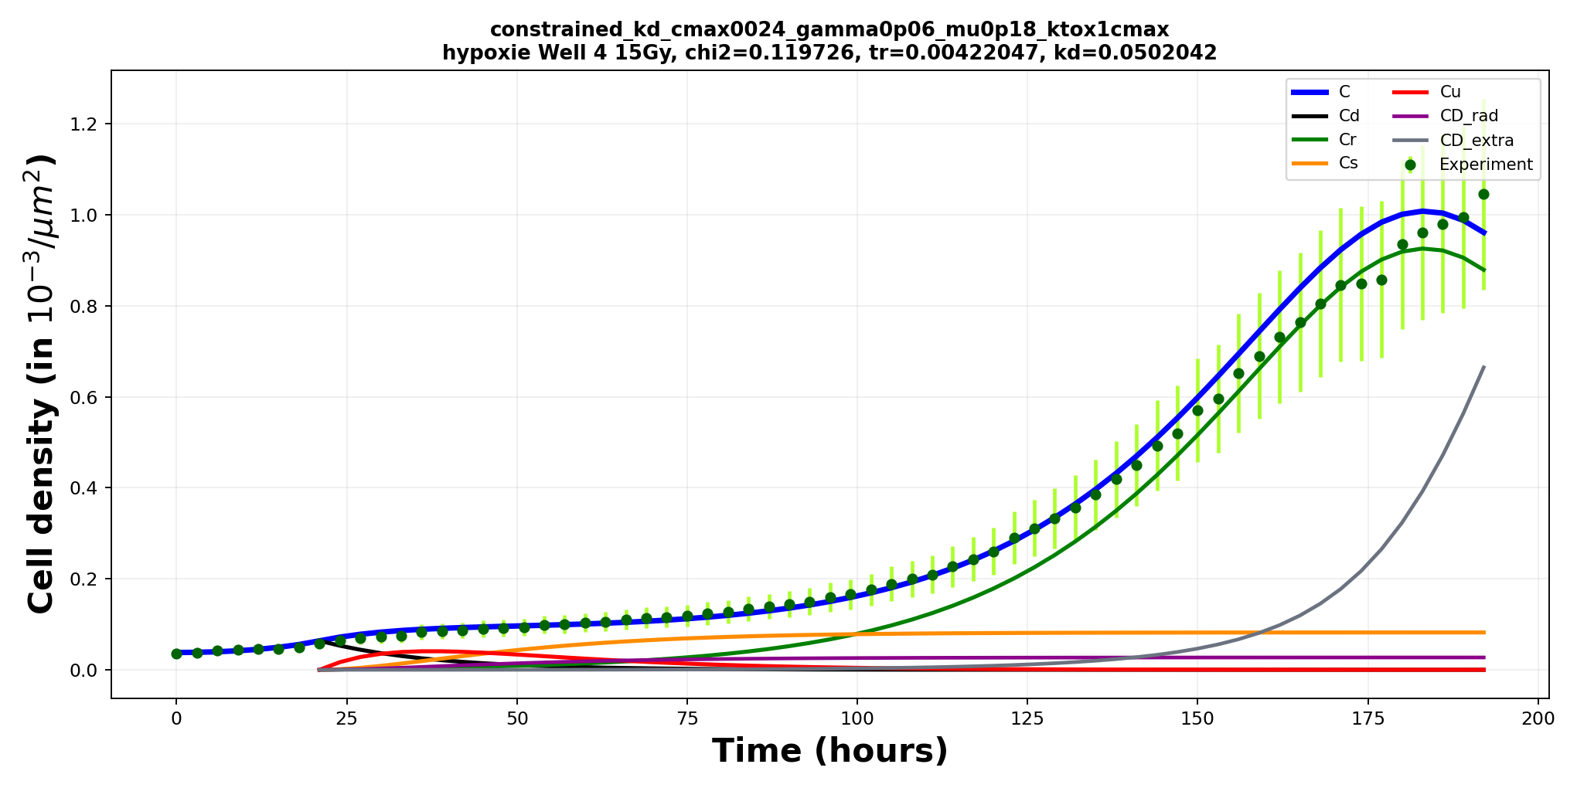
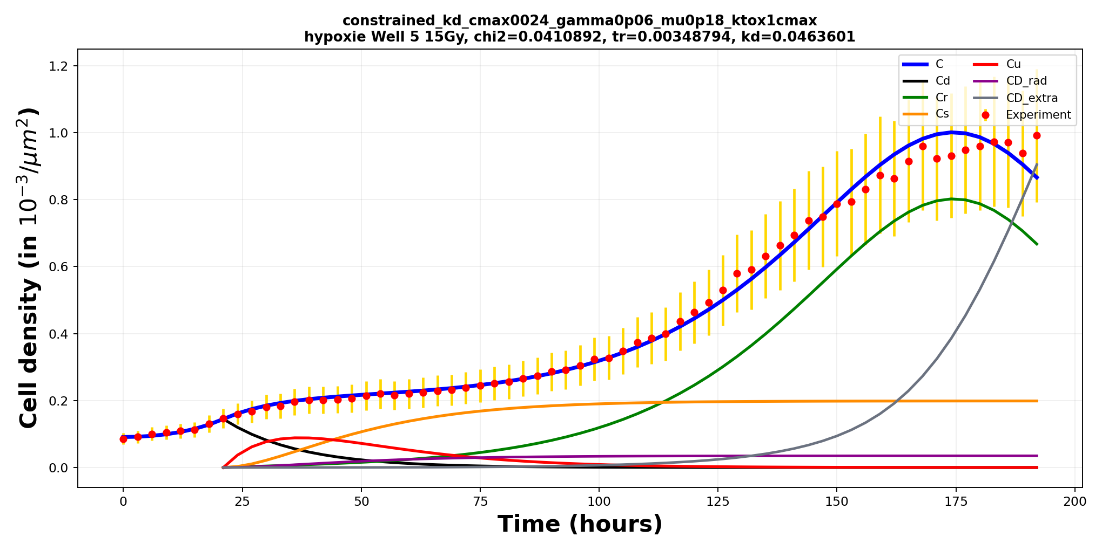
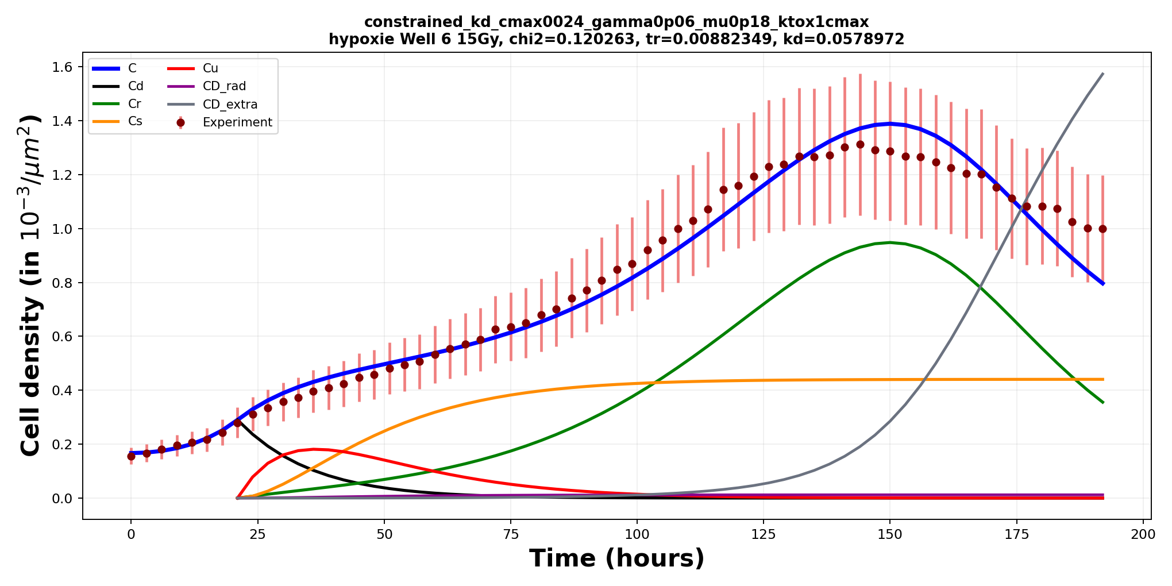
1. Introduction
2. Workflow
3. Results
4. Modeling
5. Discussion
Section 4/5 · Modeling results
Model fitting – 15 Gy, hypoxia
22

Slide 24
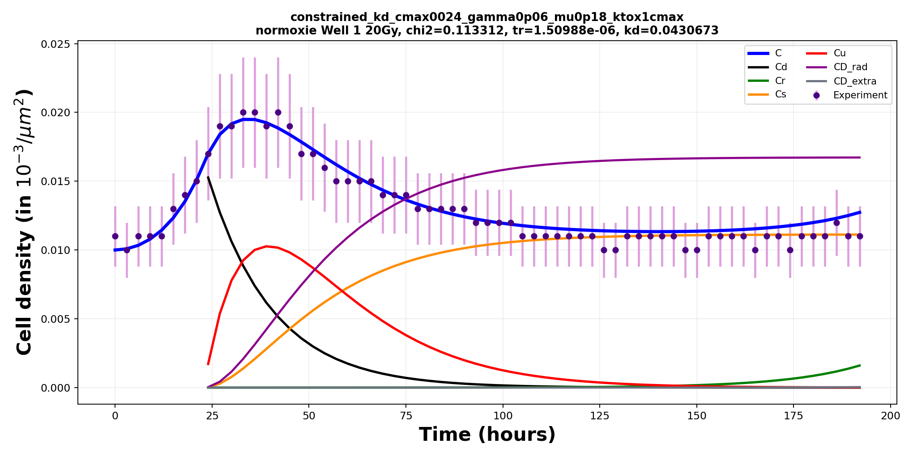
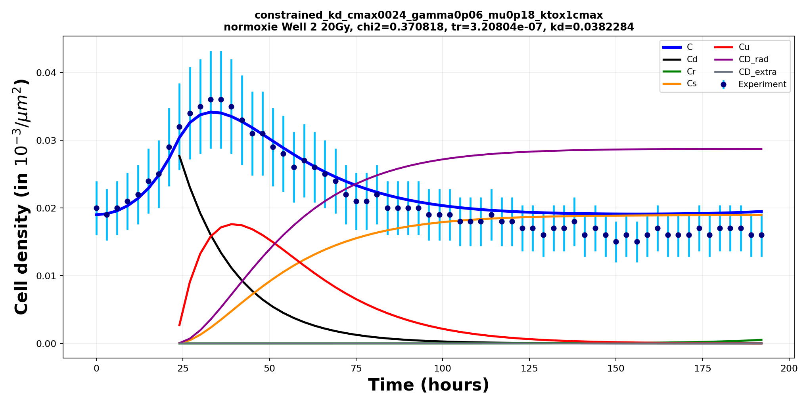
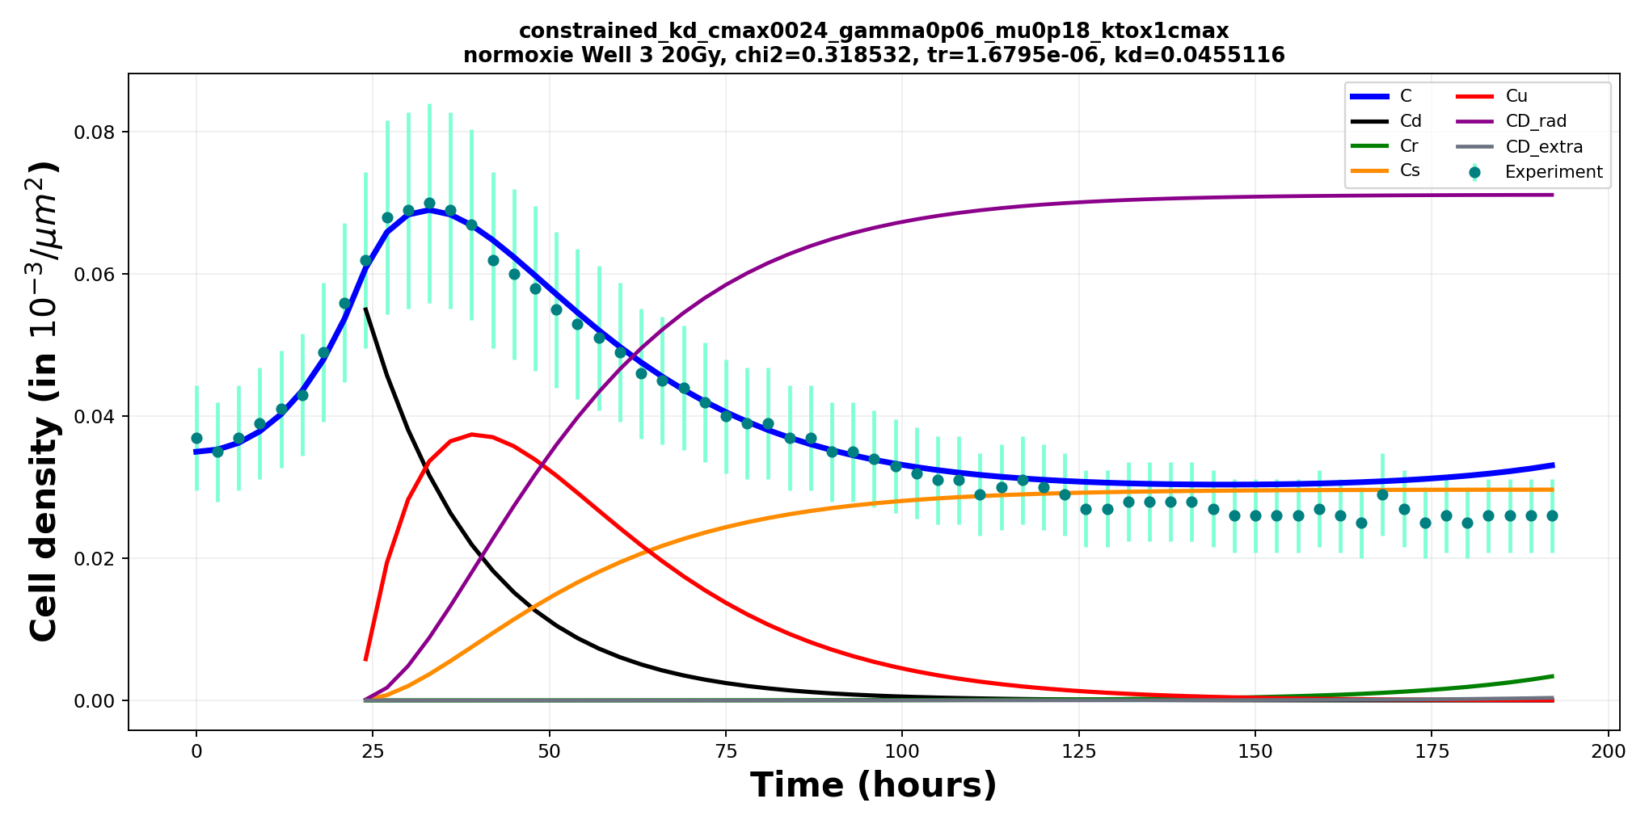
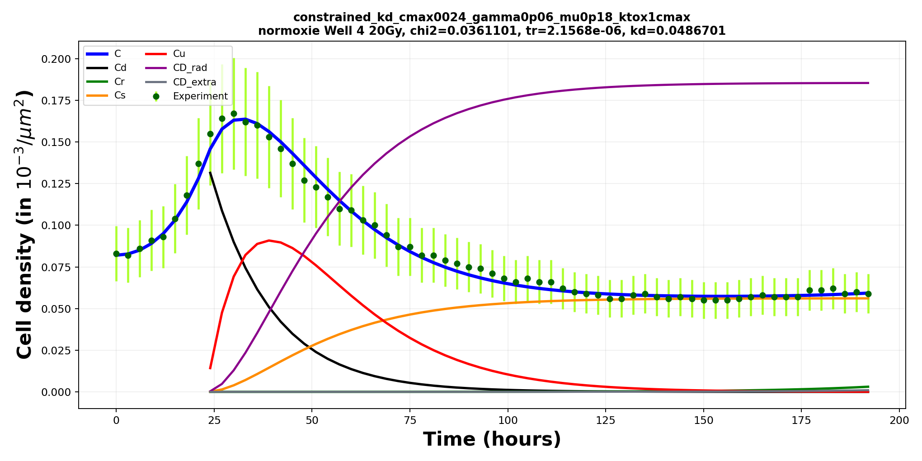
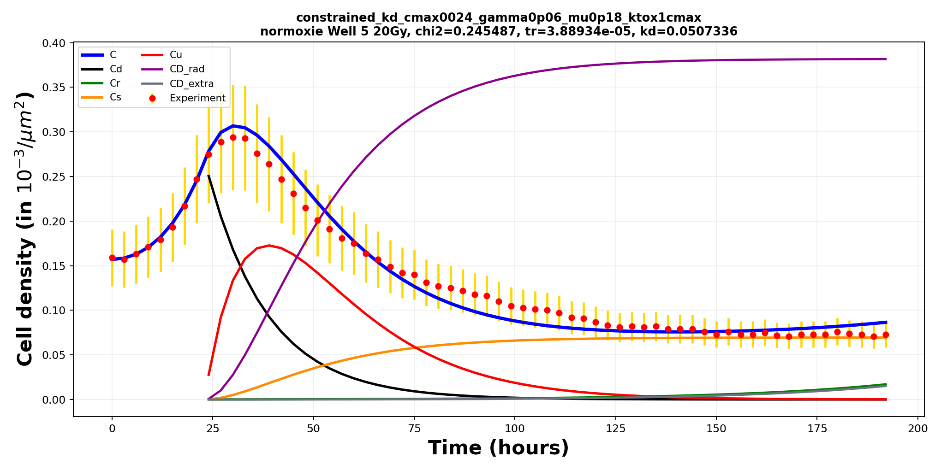

1. Introduction
2. Workflow
3. Results
4. Modeling
5. Discussion
Section 4/5 · Modeling results
Model fitting – 20 Gy, normoxia
23

Slide 25






1. Introduction
2. Workflow
3. Results
4. Modeling
5. Discussion
Section 4/5 · Modeling results
Model fitting – 20 Gy, hypoxia
24

Slide 26

1. Introduction
2. Workflow
3. Results
4. Modeling
5. Discussion
Section 4/5 · Modeling results
Surviving fraction S = λr / (λu + λr)
25

Slide 27
1. Introduction
2. Workflow
3. Results
4. Modeling
5. Discussion
Section 5/5 · Discussion & next steps
Discussion – Detection limitations
Late-time images become difficult to quantify
•
Late nuclei become larger
•
Fluorescence becomes heterogeneous
•
Several maxima may appear in one nucleus
•
Cell counting becomes less reliable
•
BF + fluorescence may still be ambiguous
•
Living / dying status difficult to decide
•
Observed across all initial densities
26

Slide 28
1. Introduction
2. Workflow
3. Results
4. Modeling
5. Discussion
Section 5/5 · Discussion & next steps
Discussion – Next experimental step
Separate oxygen-radical effect from cell-state effect
•
Hypoxia appears to increase radioresistance
•
Possible explanations:
–
less oxygen-mediated radical damage
–
quiescence / metabolic adaptation
–
altered repair or fate transitions
Planned experiment
•
Reoxygenate cells before irradiation and compare response with continuous hypoxia
27

Slide 29
Thank you for your attention!
28

Slide 30
Backup
29

Slide 31

1. Introduction
2. Workflow
3. Results
4. Modeling
5. Discussion
Section 2/5 · Experimental & analysis workflow
Experimental design
Conditions and measurements
Cell line: F98 NLS-red (red nuclear fluorescence enables automatic nucleus/cell counting)
•
•
Oxygen conditions: normoxia / hypoxia
•
Control and irradiated groups
•
6 wells / 6 initial densities
(each density = 2× previous)
•
9 windows for each well
•
Brightfield + red fluorescence
•
Follow-up over 10 days
•
Images every 3 h
30

Slide 32
1. Introduction
2. Workflow
3. Results
4. Modeling
5. Discussion
Section 2/5 · Experimental & analysis workflow
Raw imaging data
Time-lapse observation of cell population dynamics
Cells expressed red fluorescence in the nucleus via transfection of an NLS-mScarlet fusion construct
•
Brightfield: morphology / confluence
•
Fluorescence: labeled nuclei
•
Dynamic response after irradiation
31

Slide 33


1. Introduction
2. Workflow
3. Results
4. Modeling
5. Discussion
Section 2/5 · Experimental & analysis workflow
Raw imaging data (0 Gy normoxia)
Time-lapse observation of cell population dynamics
Bright field image
Fluorescence image
32

Slide 34


1. Introduction
2. Workflow
3. Results
4. Modeling
5. Discussion
Section 2/5 · Experimental & analysis workflow
Raw imaging data (15 Gy normoxia)
Time-lapse observation of cell population dynamics
Bright field 15 Gy normoxia
Bright field 15 Gy hypoxia
33

Slide 35

1. Introduction
2. Workflow
3. Results
4. Modeling
5. Discussion
Section 3/5 · Experimental results
Results – Single experiment, field-by-field
Within-well variability and temporal trend
•
One representative experiment
•
6 wells / 6 initial densities
10 Gy normoxia· 15 oct 2025
•
9 fields per well
Different colors = different fields
( same initial densities)
34

Slide 36


1. Introduction
2. Workflow
3. Results
4. Modeling
5. Discussion
Section 5/5 · Discussion & next steps
Discussion – Detection limitations
Late-time images become difficult to quantify
35

