Slide 1
EICROC monthly 9 apr 2026
XIII FRONT-END ELECTRONICS
for Particle Physics, Photon Science
and Related Applications
Paris, France | 18–22 May 2026

Slide 2
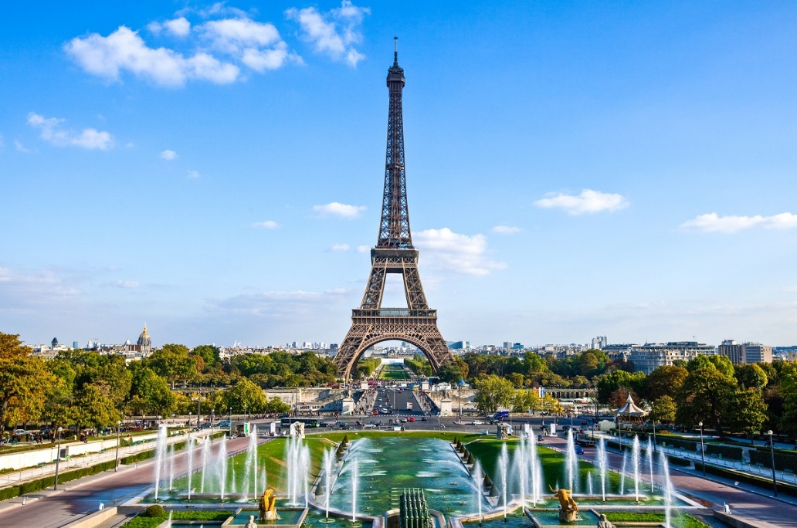
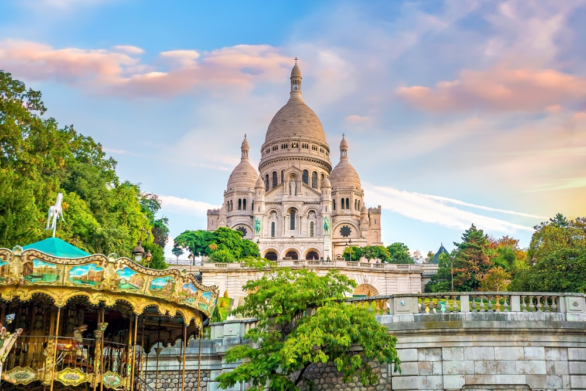
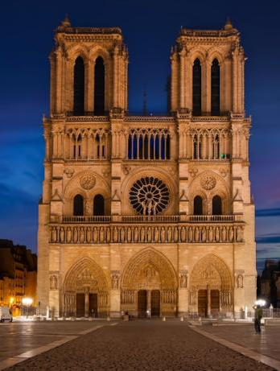
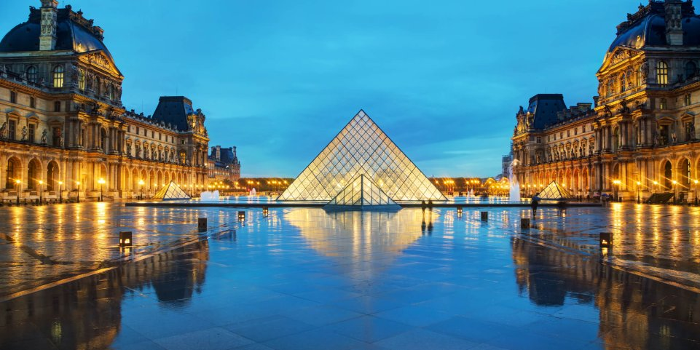
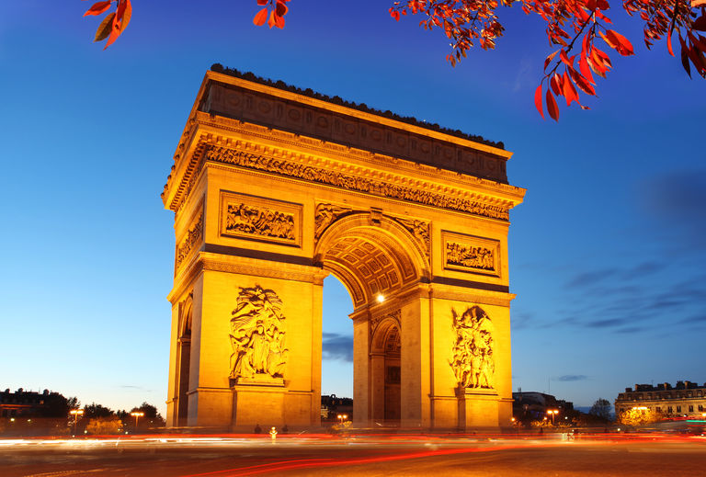
Welcome to PARIS !

Slide 3
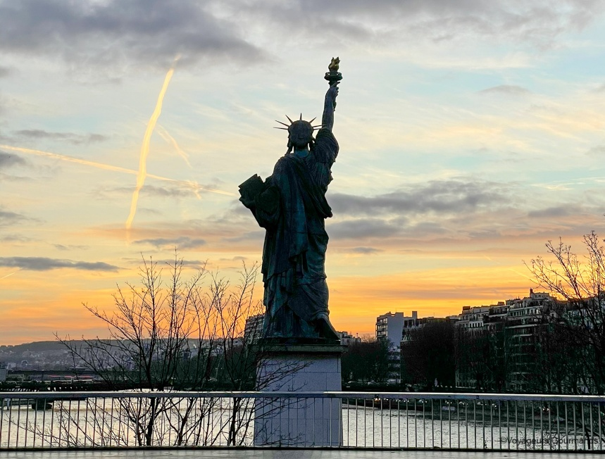
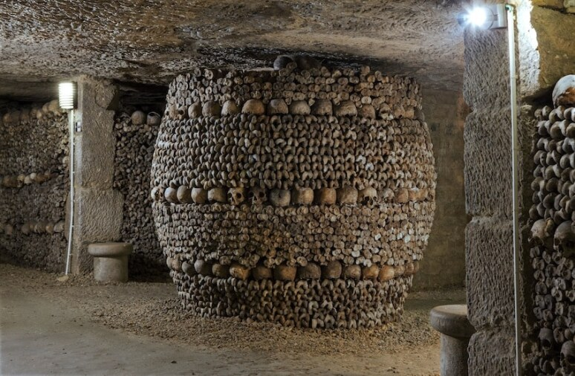

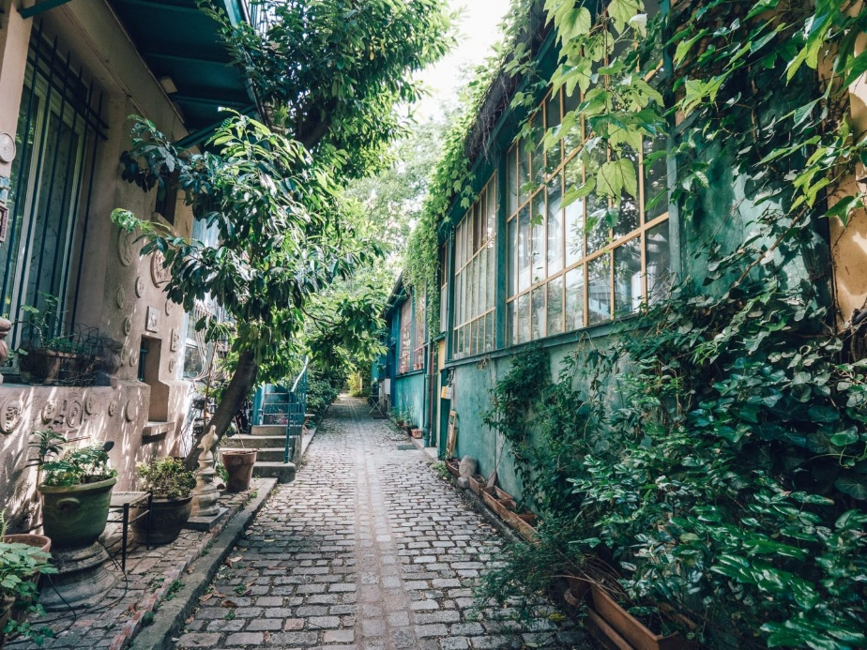
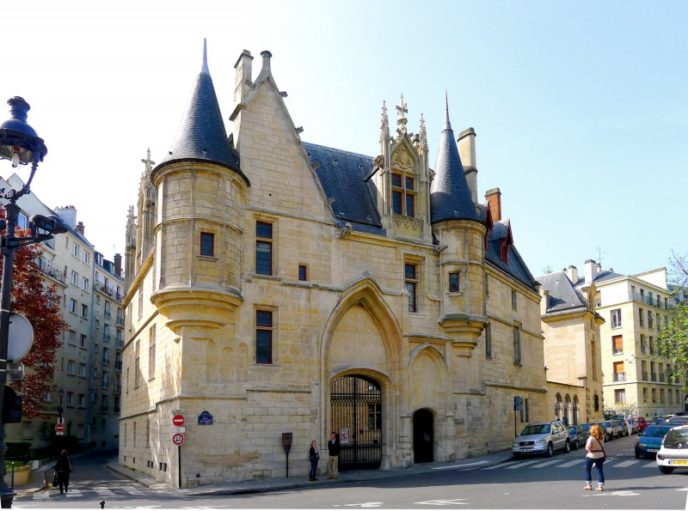
Welcome also to PARIS insolite!

Slide 4
XII(I) Front-End meeting on (Integrated) Front-End Electronics for Particle Physics, Photon Science and related applications
Tradition started in Perugia and Yellowstone
Continued every 3 (2) years
With a break for the pandemic
Only in person
By invitation only
Presentations longer than in usual conference
To allow you to go in detail…
…in a friendly and informal environment
Coffee breaks can be as productive as the talks!
Minimize the overhead: no proceedings. Only slides on a public website
Angelo’s slide from FEE 2023 Torino

Slide 5
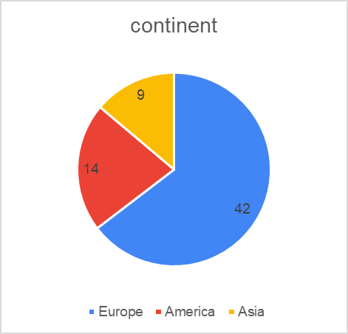
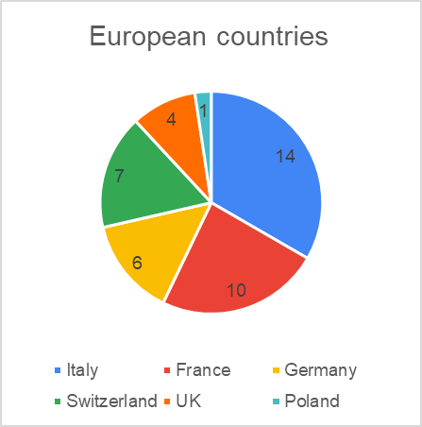
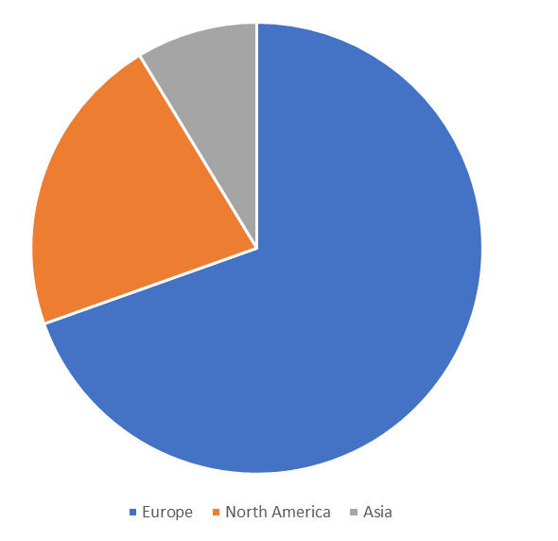
Some numbers
49 talks in 15 sessions
FEE 2023 Torino

Slide 6
Recommendations for talks
Talk duration is supposed to be 25 minutes talks + 5 minutes for discussion
Use coffee breaks and lunches for additional questions and discussions!
From time to time looks also at your session chair ☺
Please upload on indico your slides before the session
In case you have issues come with a USB pen during the coffee breaks before your session
Upload also a pdf version, just in case
Coffee breaks are served outside the amphi (no food/drinks in amphi please)

Slide 7
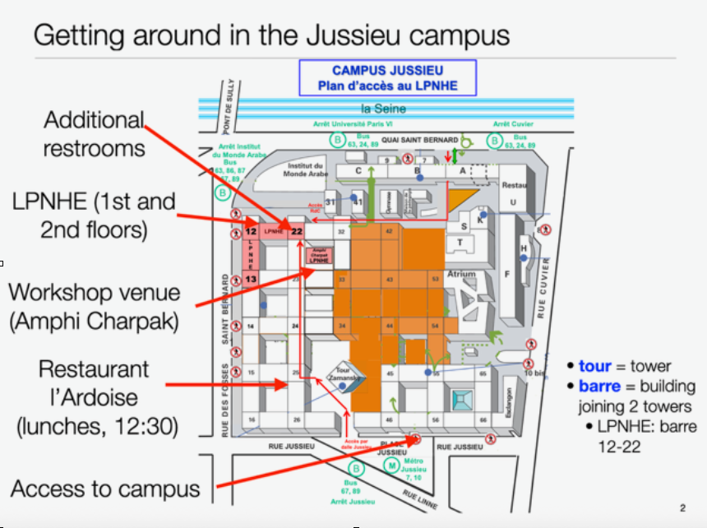
lunches
Monday and Tuesday at restaurant l’Ardoise
Wednesday : sandwiches before catching the bus
Thursday : buffet in front of the amphitheater
Friday : on your own in quartier Latin
Metro station

Slide 8
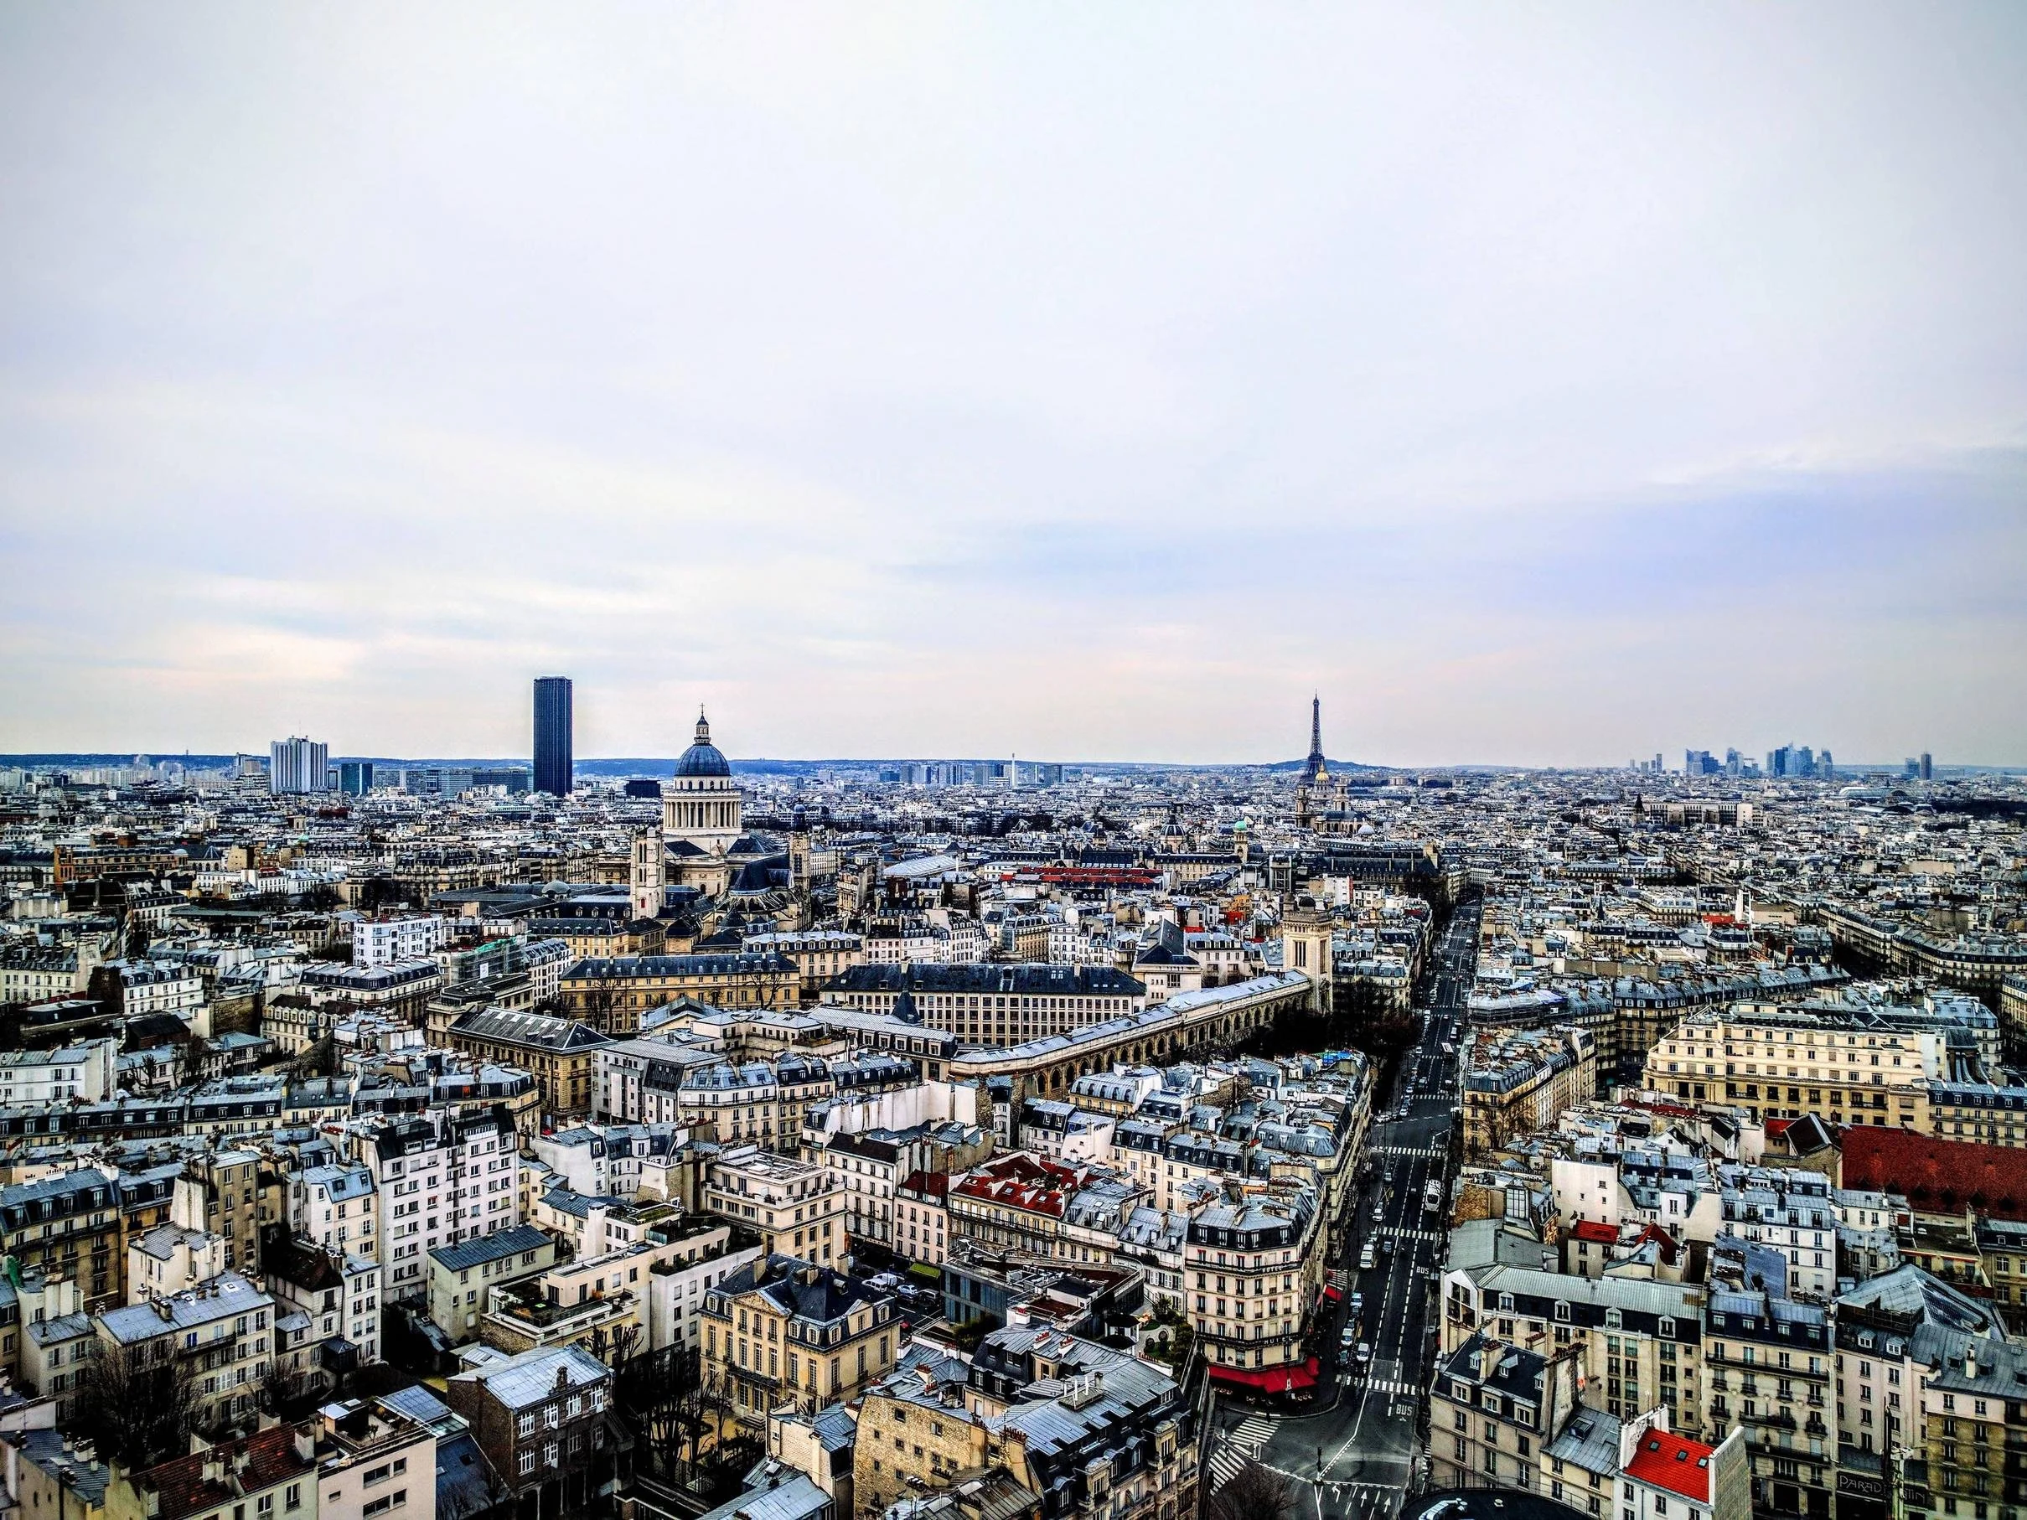
Social/networking events : welcome drink
Tour Zamanski closed last week for safety reasons
Sorry you’ll miss the view !
You will also get a nice(r) view from Montmartre on wednesday
Welcome drink in couvent des Cordeliers instead
a sweet reminder for TWEPP 2009 attendees….

Slide 9
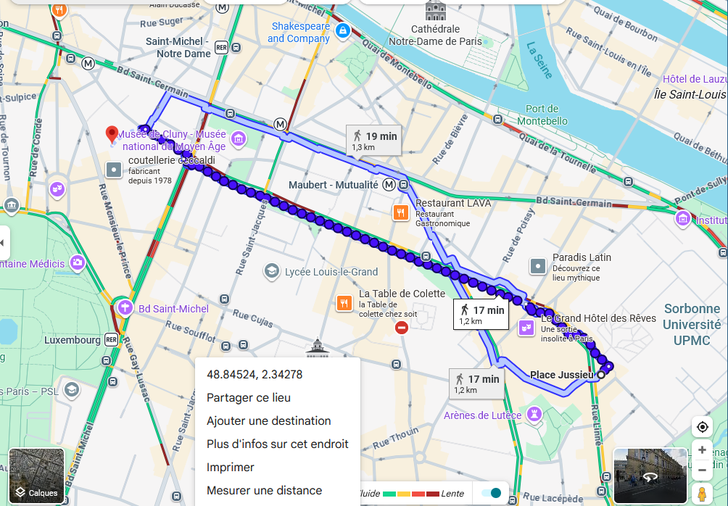
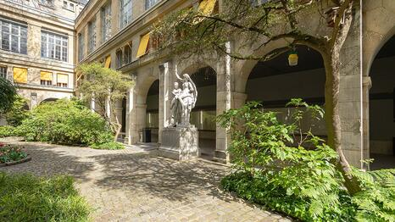
Welcome drink @ campus des Cordeliers
15-21 rue de l’Ecole de Médecine
17mn (straight) walk from Jussieu
12 mn by metro :direct on line 10, stop at Odeon (4 stops)

Slide 10
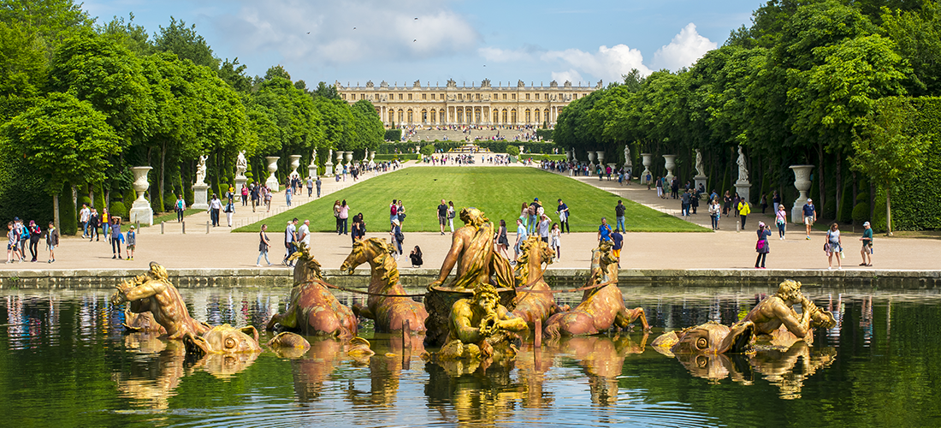
Social/networking : visit of Versailles Palace
Wednesday afternoon immediately after lunch
Meeting at 12:45, bus leaves at 13:00, guided tour starts at 14:20
Bus returns to Paris at 17:30, should arrive ~18:30-19:00.
If you miss the bus trains or RER C connect Jussieu to Versailles RG/RD every ~15mn

Slide 11
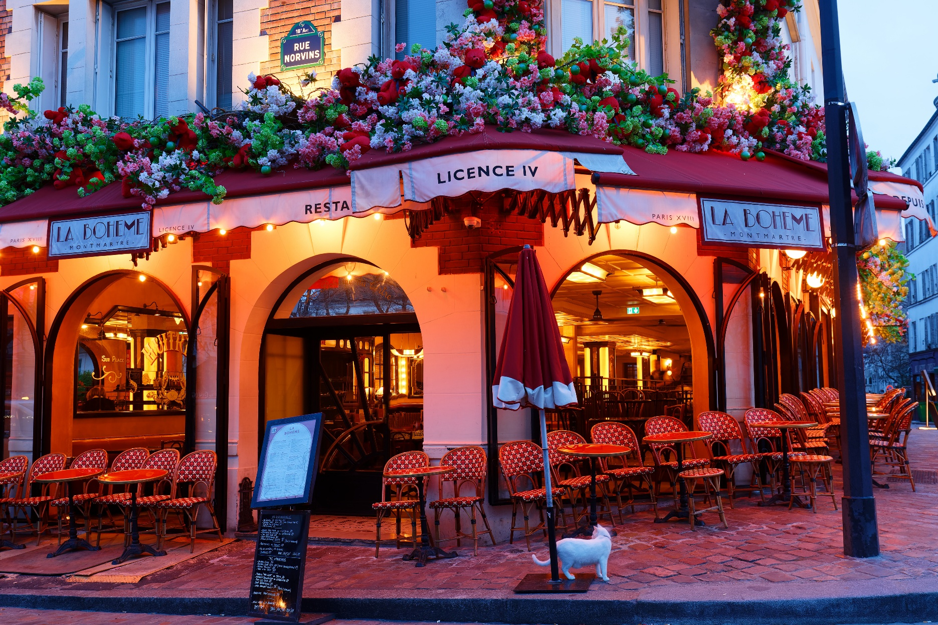
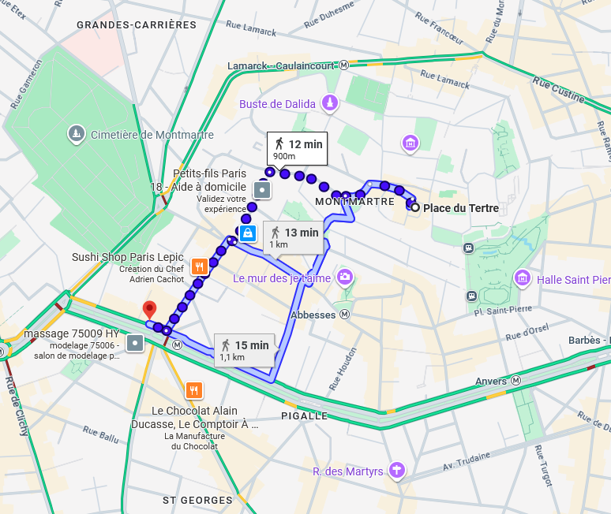
Social/networking : social dinner on Montmartre
Restaurant La Bohème, 2 place du Tertre 19:30
Shuttle at 18:45 in front of Moulin Rouge, near metro Pigalle

Slide 12
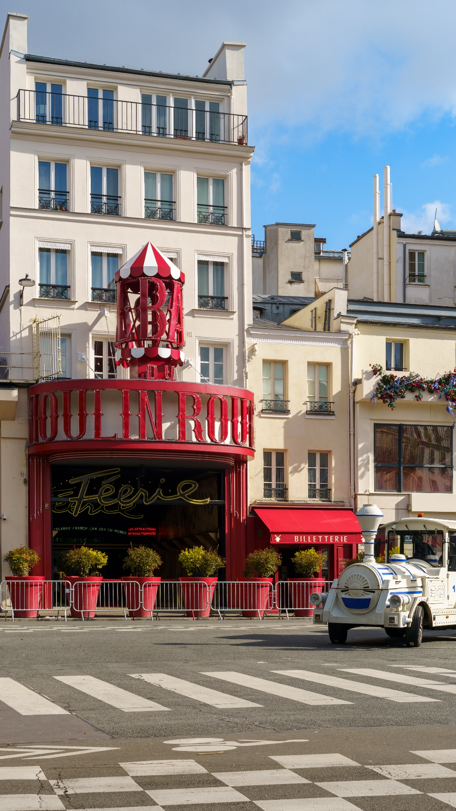
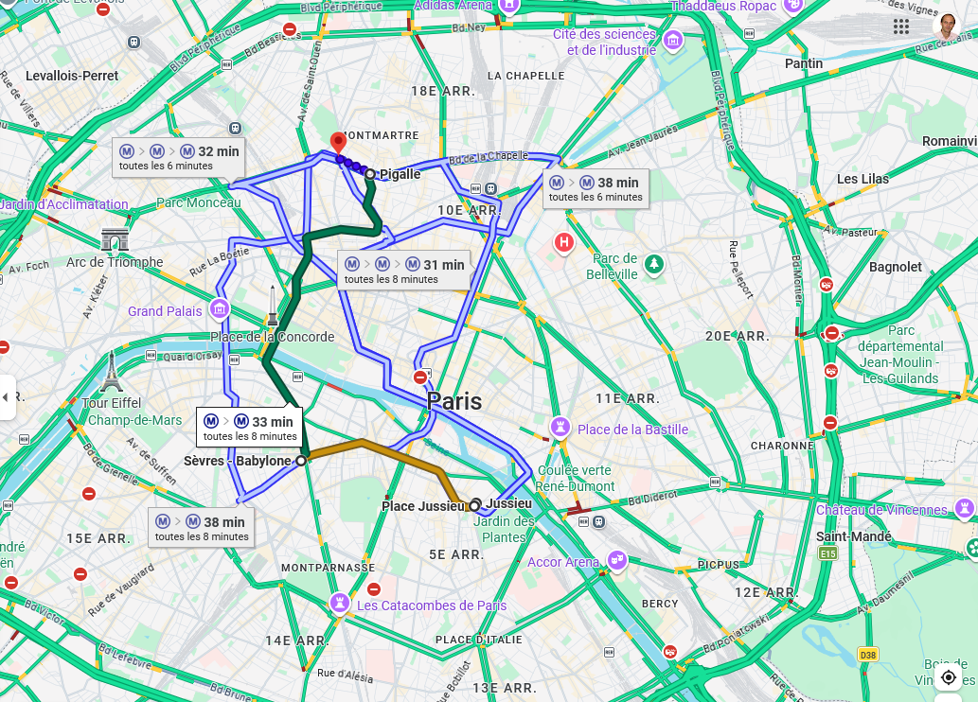
Getting to Place du Tertre
Shuttle (« petit train ») at 18:45 (leaves at 19:00) in front of Moulin Rouge, near metro Pigalle
If you miss the train, you can walk up rue Lepic : 900 m (12 mn)
From Jussieu to Pigalle take line 10, change at Sevres Babylon and take line 7 (takes ~30 mn)

Slide 13
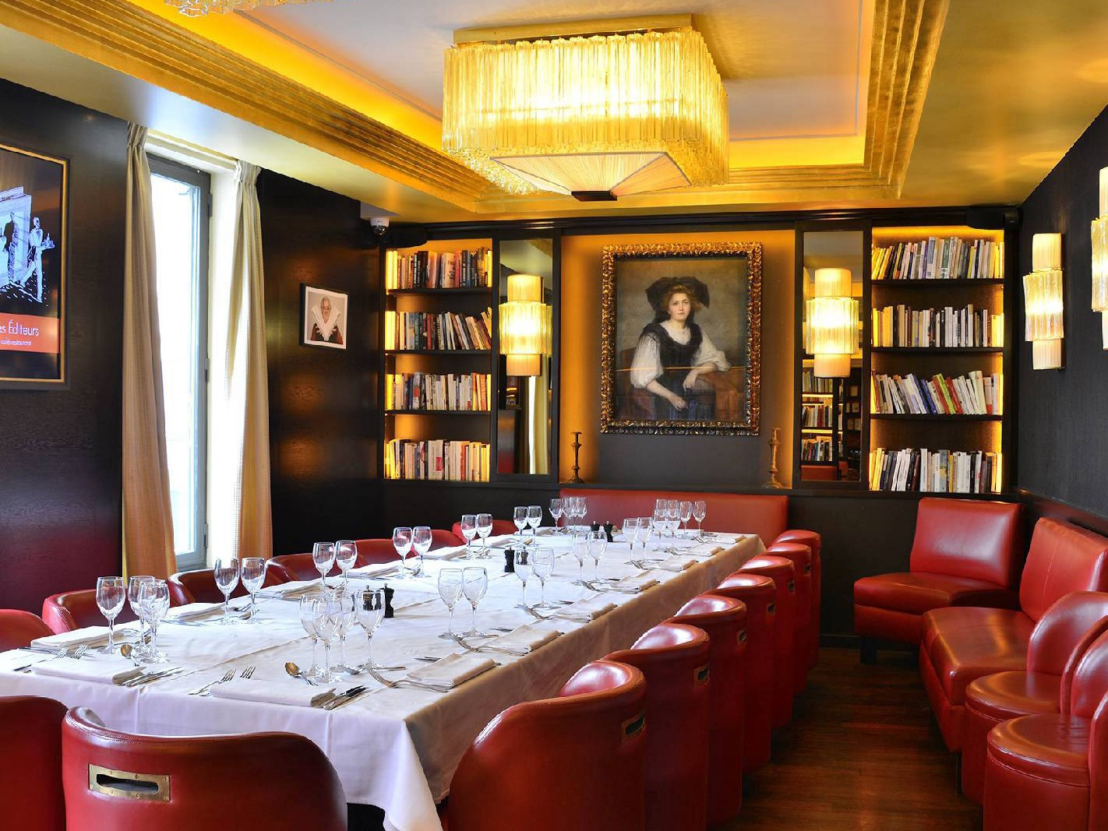
Committee dinner : Thursday evening
Restaurant Les Editeurs
Restricted to committee members :
Christophe de LA TAILLE
Grzegorz DEPTUCH
Thomas GARDINER
Zhen An LIU
Xavier LLOPART
Patrick PANGAUD
Valerio RE
Angelo RIVETTI
Lorenzo ROTA
Wei WEI
Convey your feedback/wishes to any member before thursday

Slide 14
XIII FRONT-END ELECTRONICS
for Particle Physics, Photon Science
and Related Applications
Paris, France | 18–22 May 2026
Enjoy an interesting and productive workshop!

