Slide 1
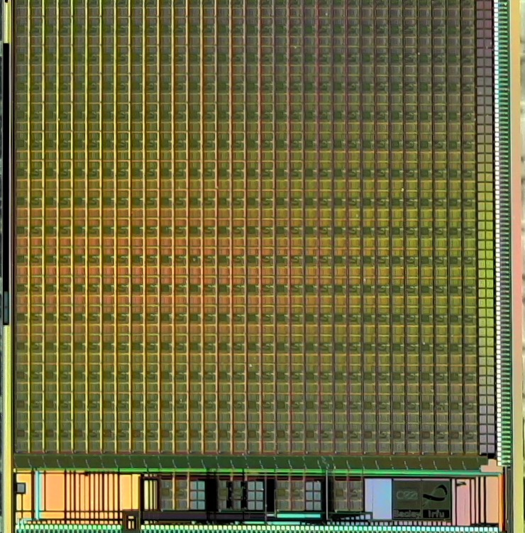
Microelectronics at IRFU Saclay
Olivier Gevin

Slide 2
Microelectronics Lab at Saclay
Fields of application, technical and human resources
Domain of expertise
Muti-channel for particle detectors, radiation hard, low noise…
Families of ASICs
Preamp-shaper, TDC, CRASICs, MAPS…

Slide 3
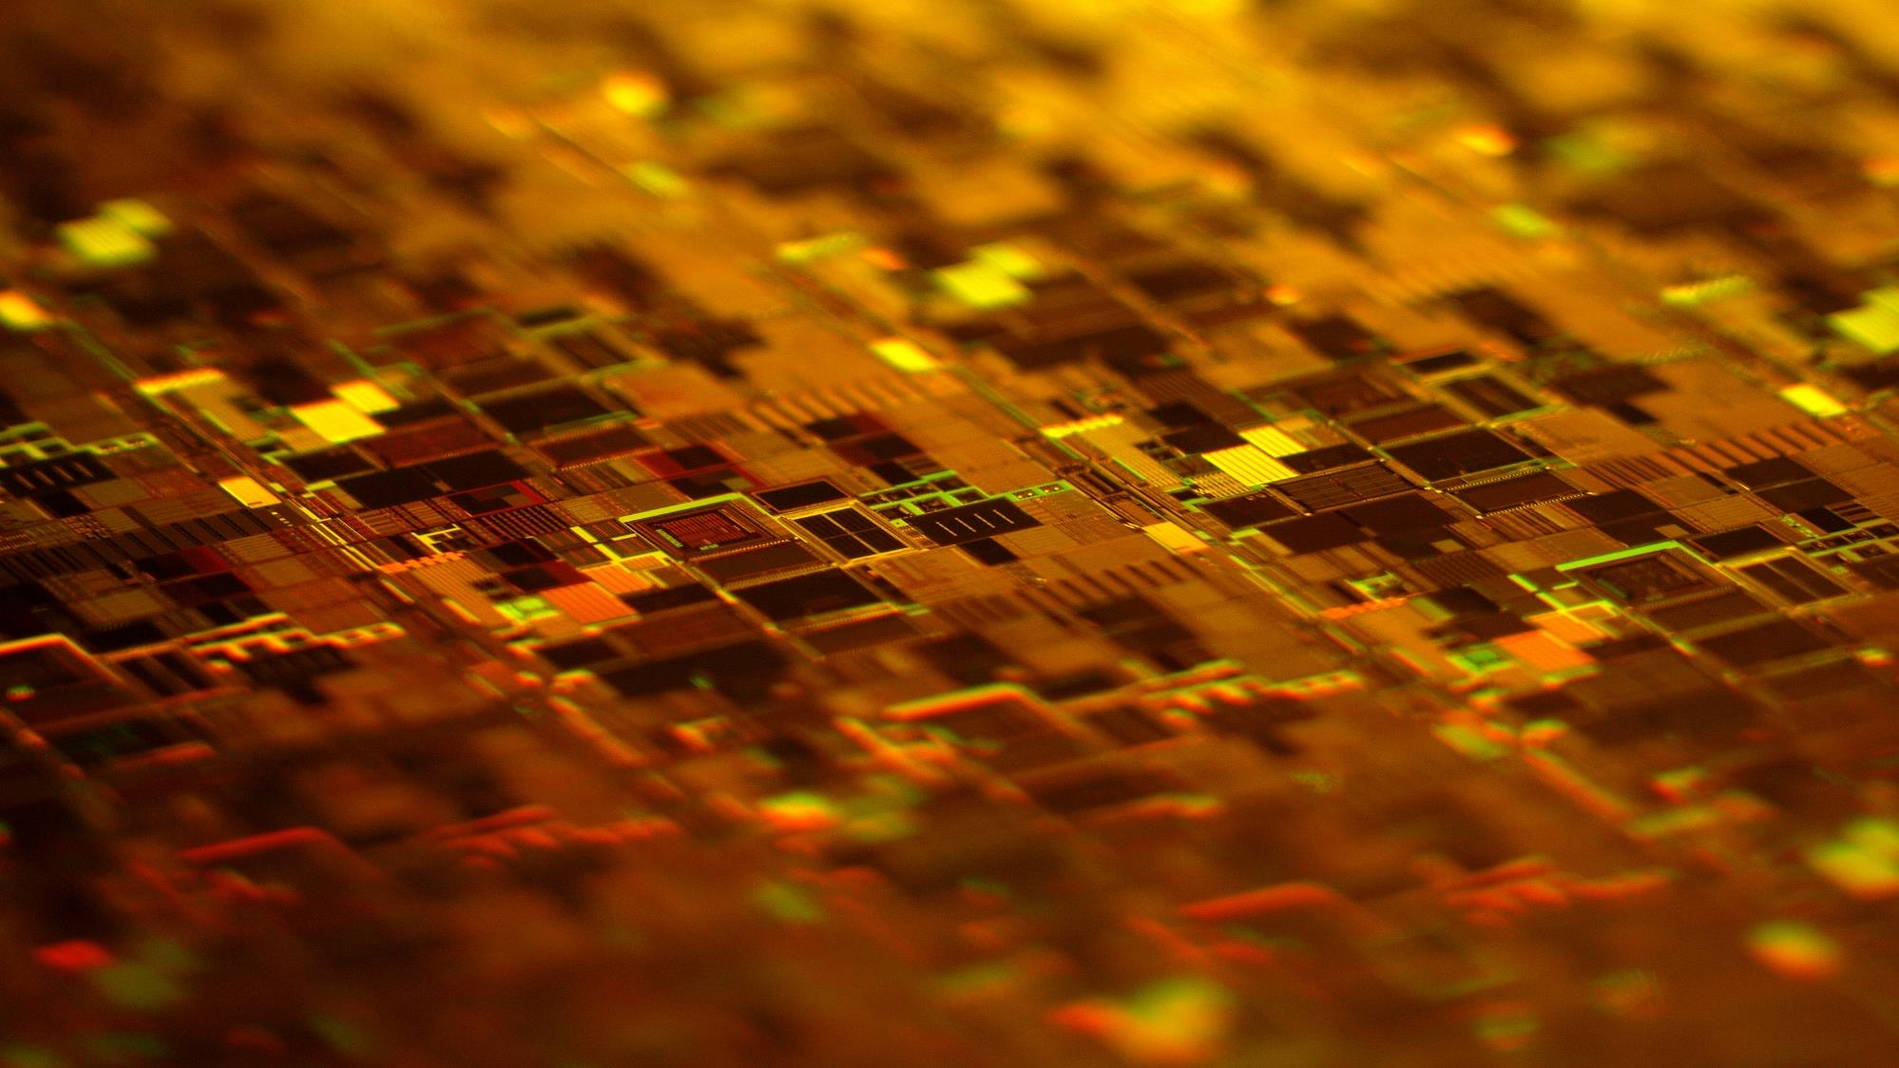
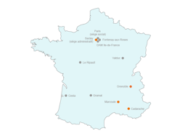
French Alternative and Atomic Energy Commision (CEA)
Defense and security, low carbon energies, technological research for industry, fundamental research in the physical sciences and life sciences. (17000 permanent people)
Fundamental research
Biology, Chemistery, Energy, health, physics, nano sciences, Instruments and technology, climate and environment. (6000)
Centre de Saclay
25 km from Paris
7000 people.
IRFU
Astrophysics, High Energy Physics, Nuclear Physics and associated instrumentations Institute
F Sabatié(675)
Technical divisions
Physics divisions
GANIL
DIS
DACM
DEDIP
DPhP
DPhN
DAp
Heavy ion accelerator at CAEN
Accelerators and cryogeny and magnetism
Detectors, Computing, Electronics
J. Bobin(~150)
Astrophysics
and Instrumentation
Mechanical engineering
Nuclear Physics
Particle Physics
9 other labs
STREAM
All the skills to think, build, and operate a complete instrument
Real time and Mircroelectronics
Lab, O. Gevin (18)

Slide 4
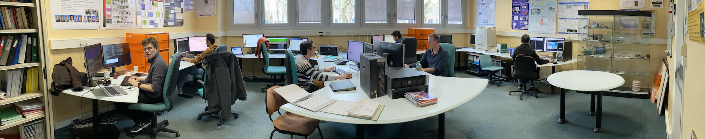
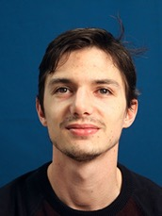
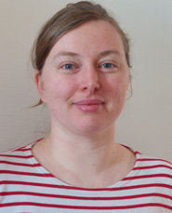
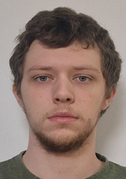
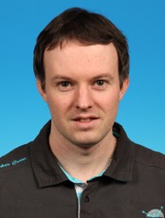
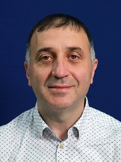
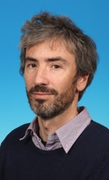
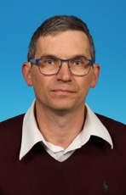
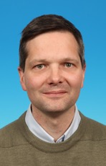
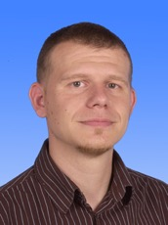
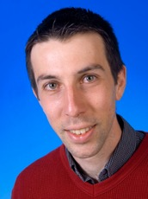
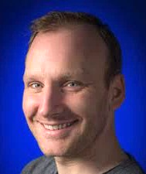
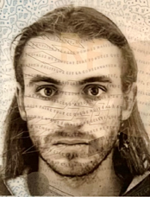
Design Lab
Talk on chip for Space
Talk on Chip for EIC
Microelectronics Lab was created in the 90’s for LHC
First designs in the radhard DMILL 0.8 µm homemade technology. Initially for CERN: the HAMAC analog memory sampler chip in 1998. But rapidly also for Space Applications
Today: team of 12 designers
6 analog and mixed-signal designers
4 digital & verif designers (DoT, UVM)
2 analog designers for CRASICs (cryo ASICs down to 50 mK)

Slide 5
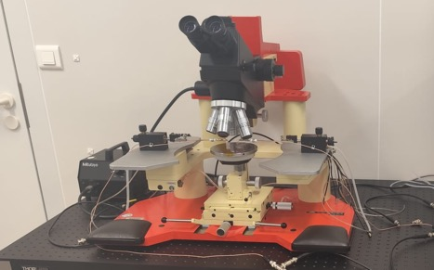
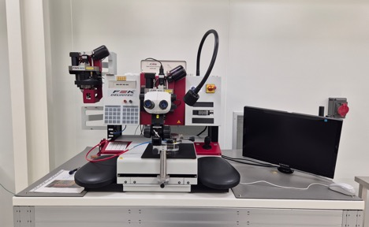
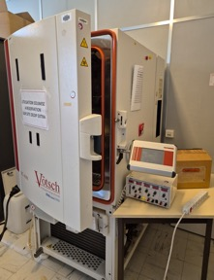
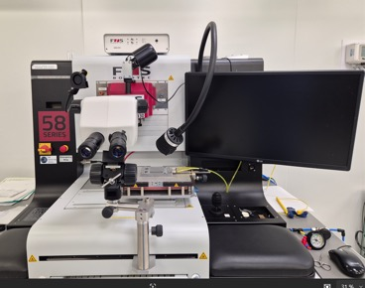
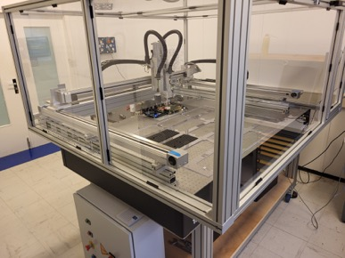
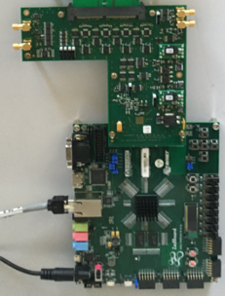
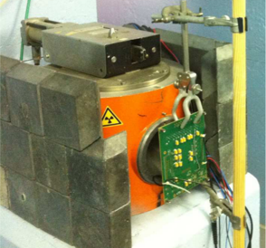
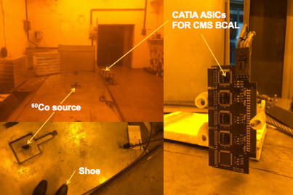
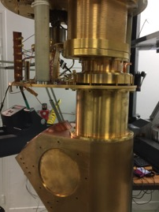
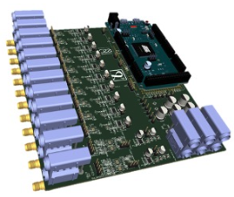
Microscope with chip/wafer probing
Wire bonding Machines (wedge)
Climatic chamber
Bonding machine for ATLAS ITK
2 Mass production test facilities (here for Coluta ADC validation)
Microelectronics lab as part of SACLAY site benefits from several local platforms and testing facilities for :
Packaging : semi-automatic wire bonding machine for prototyping and production packaging
Testing: Multi-ASIC Testing setup (MATIS), automatic testing machines for mass production characterization
Cooling: Climatic chamber and cryostat
Irradiadiation : ⁶⁰Co at COCASE(1.5=>1500 rad/h for space qualification) and at PAGURE (3k=>50krad/h)
Cryostat: 50 mK stage
MATIS: Multi-ASIC test setup
Multi domain power supply
domain Latchup analyser
COCASE: low dose rate ⁶⁰CO source irradiation facility
PAGURE: medium dose rate ⁶⁰CO source irradiation facility

Slide 6
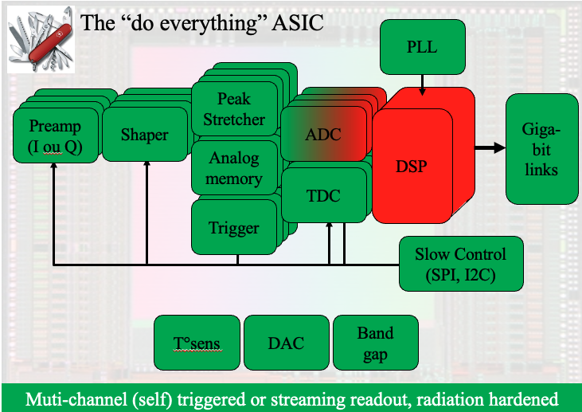
Microelectronics: domain of expertise
We design ASICs for Particle Physics, Nuclear Physics and Astrophysics and for some exotic applications (medical, beam diagnostic, homeland security…).
99% of our ASICs are multi-channel ASICs to read particle detectors
Almost all of our ASIC architectures consist of a set of modules and can be represented by this generic diagram:
Scaled Charge Sensitive Amplifiers
Patented architecture
Optimized for detectors from 300 fF to 1nF
Dynamic range from 1 fC to 50 pC, both polarities
IDeF-X for Solar Orbiter
MONACAL for CMS
Trans Impedance Amplifier
Very low input impedance
Dynamic range of few mA.
CATIA for CMS
Tunable shapers
Peaking time from 25 ns to 15 µs
Versatile: lots of programmable values
DREAM for CLAS12 (Jlab)
IDeF-X for SVOM (ESA)
Analog memories/digitizers
Ultra fast low depth (200ps, 64 cells)
Fast-high depth (0.5-10ns, 512-1024 cells)
Multi-channel (2-72)
Radiation hard (TID, SEU, Latchup)
NECTAR for CTA
TDC
25ps online,
5ps offline (DLL + pulse replicator or sampling)
In HGCROC for CMS
SAMPIC
ADC
// Boosted-Wilkinson: 1 MHz, 12 bits, 32 channel
Pipeline: 20 MHz, 12 bits
SAR-TDC hybrid, 50MHz, 12 bits
OWB1
DRD7
Radiation hard Services
Low jitter PLL, TMR-I²C, DACs, T°@TID probes, Fast Drivers...

Slide 7
Microelectronics: domain of expertise
We design ASICs for Particle Physics, Nuclear Physics and Astrophysics and for some exotic applications (medical, beam diagnostic…).
99% of our ASICs are multi-channel ASICs to read particle detectors
Almost all of our ASIC architectures consist of a set of modules and can be represented by this generic diagram:
Monolithic Active Pixel Sensor (MAPS)
HV, Hres, gain layer
Tracker, timing
CACTUS for timing
CRASICs (Cryogenic ASICs)
Very low power
FE for bolometers, amplifiers, MUX circuits
ECLIPSE for SPICA (ESA)
Digital
Serializer, SPI, I2C ...
Multi-channel (2-72)
Radiation hard (TID, SEU, Latchup)

Slide 8
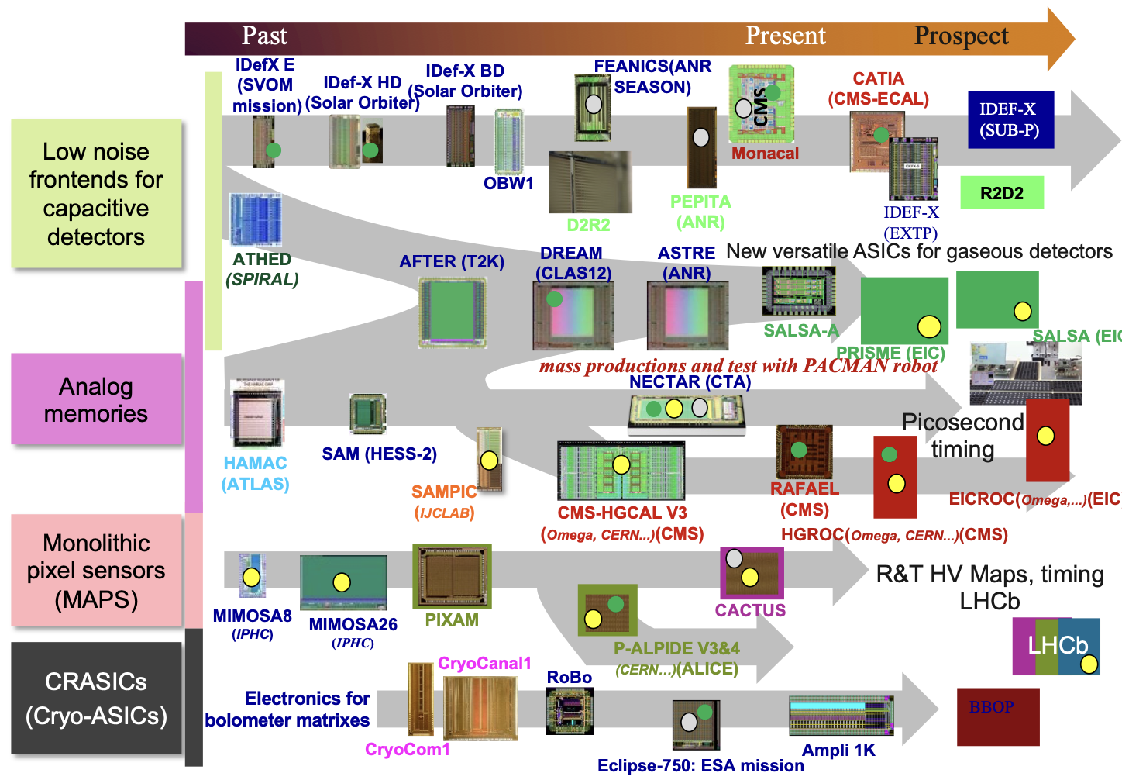
Roadmap: too many technologies, more and more collaborations
Technologies
DMILL 800
AMS 350 SiGe
AMS 350
AMS 180
X-FAB 180
Tower Jazz 180
Lfoundry 150
TSMC 130
TSMC 65nm
Still used
Collaboration
Prod
Under test
CHIPNAME(collaboration) (Experiment)

Slide 9
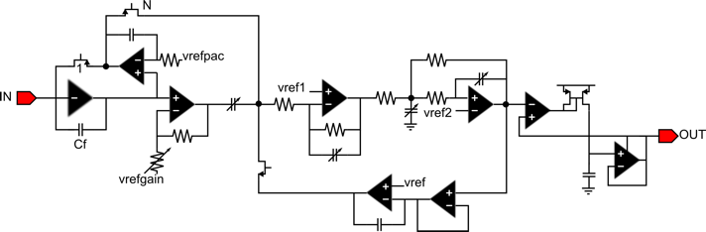

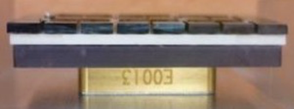
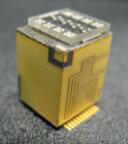
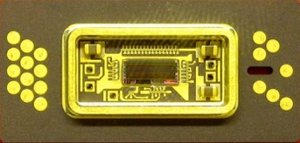
Some of our ASIC families
Low noise front-ends for low capacitor detectors for space
Multichannel space-proof ASICs made of Charge Sensitive Amplifier + Shapers
Typical architecture: IDeF-X HD
Different flavors
Analog output readout: Mux or //
Geometry: 1D or 2D
Anode, cathode or both electrodes readout optimized
Technology: all CMOS (AMS 0.35, AMS 0.18, XFAB 0.18)
Typical applications
Readout of Cd(Zn)Te and Si detectors for space applications
IDeF-X ECLAIRs with CdTe from ACRORAD. ECLAIRs, SVOM mission. Launched in 2024
IDeF-X HD in CALISTE spectro-imager Solar Orbiter mission launched in 2020

Slide 10

Some of our ASIC families
Low noise front-ends for low capacitor detectors for space
Multichannel space-proof ASICs made of Charge Sensitive Amplifier + Shapers
Typical architecture: IDeF-X HD
Different flavors:
Analog output readout: Mux or //
Geometry: 1D or 2D
Anode, cathode or both electrodes readout optimized
Technology: all CMOS (AMS 0.35, AMS 0.18, XFAB 0.18)
Typical applications:
Readout of Cd(Zn)Te and Si detectors for space applications:
IDeF-X ECLAIRs with CdTe from ACRORAD. ECLAIRs, SVOM mission. Launched in 2024
IDeF-X HD in CALISTE spectro-imager Solar Orbiter mission launched in 2020

Slide 11

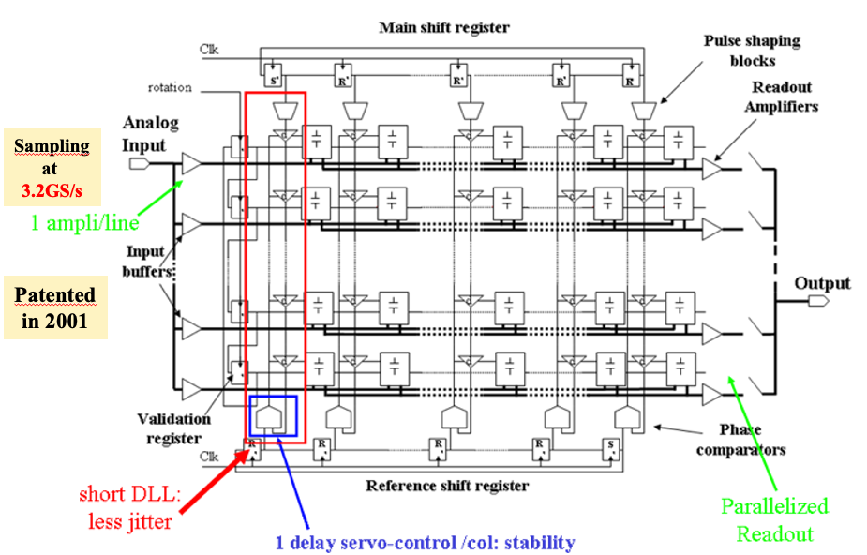

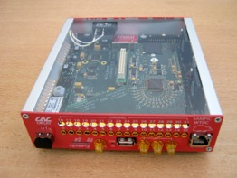

Some of our ASIC families
Fast analog memories (high speed photodetectors)
Single or Multi-channel analog memories with or without ADC.
Based on the patented circular analog memories made of sampling capacitor array (SCA):
Different flavors
Output format: analog or digital (ADC included)
Depth of the memory (64 to 1024)
Sampling frequency (400M-10GHz)
Readout frequency: 100 MHz/sample max
Dead time free
Technology: all CMOS (DMILL, AMS 0.8, AMS 0.35, AMS 0.18)
Typical applications
Readout of fast detectors, generic sampler
MATACQ (heart
of the Caen V1729)
NECTAR for the CTA telescope
SAMPIC, Picosecond multi-channel
TDC (collaboration IN2P3)

Slide 12
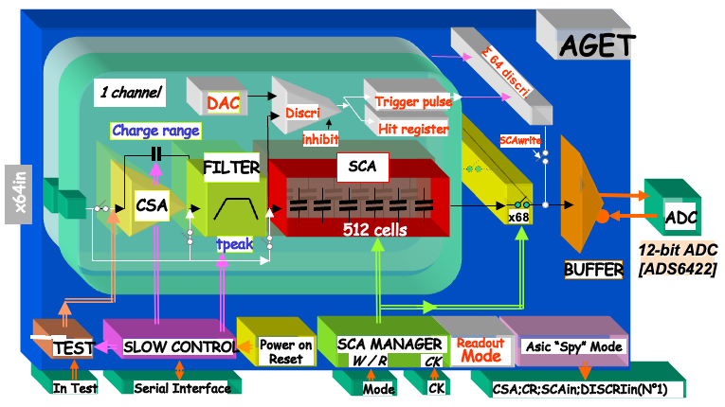
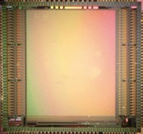
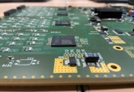
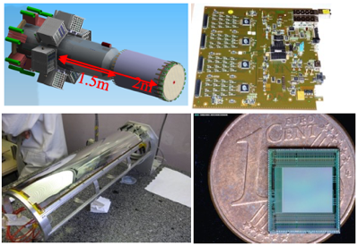
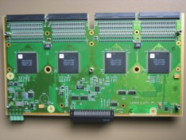
Some of our ASIC families
FE-SCA type ASIC: designed for gaseous detectors and semi-conductor detector for high dynamic range.
Typical architecture
Multi-channel architecture with, for each channel:
CSA (multi-gain) + Filter (multi peaking time) + Sampling Capacitor Array (analog memory)
This architecture memorizes for each event (validated by internal or external trigger) the waveform of the output of the filter:
Different flavors
Dynamic range (10 pC max)
Peaking time range (50ns-8µs)
Scaling for detectors
External/internal trigger
Dead time
Technology: all CMOS (AMS 350, TSMC 65)
Typical applications
Readout of gaseous detectors and silicon detectors for trackers or TPCs
AFTER ASIC for T2K
DREAM ASIC for CLAS12 at JLAB

Slide 13
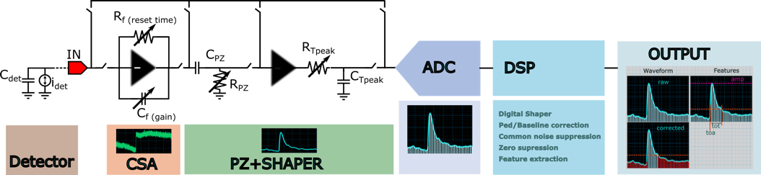
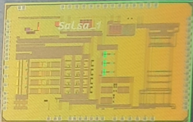
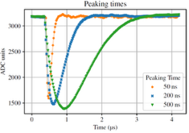
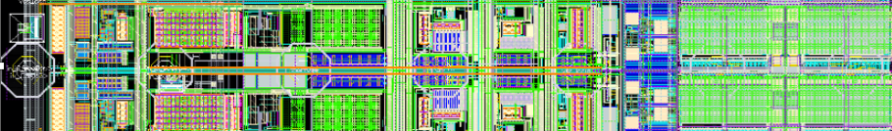
Some of our ASIC families
FE-SCA type ASIC: designed for gaseous detectors and semi-conductor detector for high dynamic range.
Typical architecture
Multi-channel architecture with, for each channel:
CSA (multi-gain) + Filter (multi peaking time) + Sampling Capacitor Array (analog memory)
This architecture memorizes for each event (validated by internal or external trigger) the waveform of the output of the filter.
Now replaced by :
CSA (multi-gain) + Filter (multi peaking time) + Sampling Capacitor Array (analog memory) ADC + DSP and streaming readout
Different flavors
Dynamic range (10 pC max)
Peaking time range (50ns-8µs)
Scaling for detectors
External/internal trigger
Dead time
Technology: all CMOS (AMS 350, TSMC 65)
Typical applications
Readout of gaseous detectors and silicon detectors for trackers or TPCs
AFTER ASIC for T2K
DREAM ASIC for CLAS12 at JLAB
SALSA for EIC

Slide 14

Some of our ASIC families
FE-SCA type ASIC: designed for gaseous detectors and semi-conductor detector for high dynamic range.
Typical architecture
Multi-channel architecture with, for each channel:
CSA (multi-gain) + Filter (multi peaking time) + Sampling Capacitor Array (analog memory)
This architecture memorizes for each event (validated by internal or external trigger) the waveform of the output of the filter.
Now replaced by :
CSA (multi-gain) + Filter (multi peaking time) + Sampling Capacitor Array (analog memory) ADC + DSP and streaming readout
Different flavors
Dynamic range (10 pC max)
Peaking time range (50ns-8µs)
Scaling for detectors
External/internal trigger
Dead time
Technology: all CMOS (AMS 350, TSMC 65)
Typical applications
Readout of gaseous detectors and silicon detectors for trackers or TPCs
AFTER ASIC for T2K
DREAM ASIC for CLAS12 at JLAB
SALSA for EIC

Slide 15
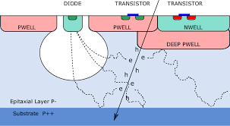
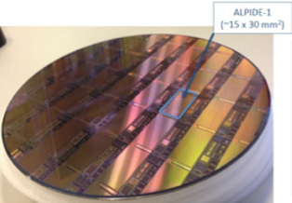
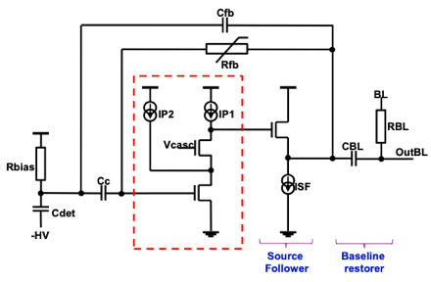
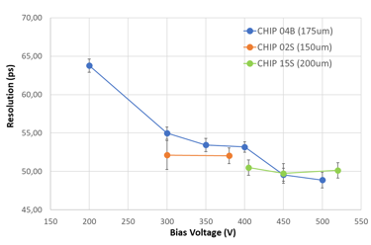
Some of our ASIC families
Monolithic Active Pixel Sensors
Typical architecture
The ASIC is the detector and the readout. Based on (almost) the same technologies as for visible imaging but readout optimized for particle tracking.
High scale matrix (Mpixel) with single conversion stages and digital output
Source follower or Charge (filtering) preamplifier + Discriminator
Different flavors
Size of the pixel from 30 x 30 µm² to 1 mm²
Technology node (AMS350, TJ180, LF150)
Technology option: Hres, HV, gain layer
Event buffers
In-pixel or column discrimination
Technology: all CMOS (AMS 350, TSMC 65)
Typical applications
Trackers, timing. Us today: LHCB and Cactus
IRFU Designs
Analog DAC
Readout Management
Power On Reset
Monitoring ADC
CACTUS, HV MAPS for timing LF 150nm, 50 ps rms (FEE 2018, Degerli)
Participation to ALPIDE chip with CERN for the Muon Forward Tracker in ALICE experiment

Slide 16
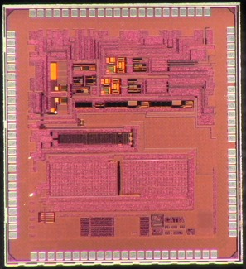
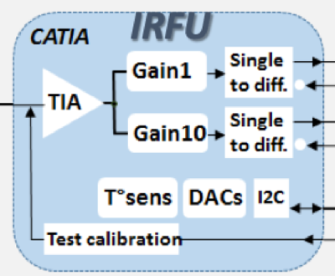
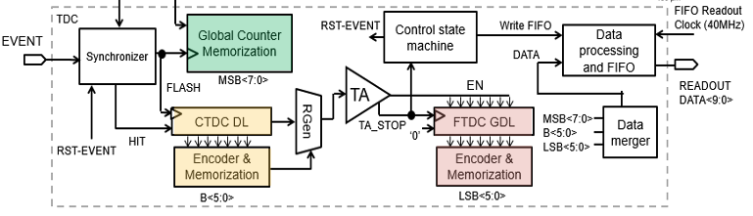




Some of our ASIC families
And many other chips
CATIA for CMS BCAL
TSMC 130nm, 80K produced and almost tested for HLLHC (FEE 2023, Guilloux)
TOA and ToT of HGCROC
TSMC 130nm, 100K produced and almost tested for HLLHC (FEE 2023, Bouyjou)
LF-MONOPIX proto for ATLAS, MAPS for tracking LF150nm, (FEE 2018, Hemperek)
SAMPIC 16-channel TDC
AMS 180nm, 5ps waveform tdc (FEE 2014, Gevin)

Slide 17

Today at Saclay
Design of the SALSA2 chip for ePiC MPGD detectors for the Electron Ion Collider (TSMC65) : talk on Tuesday
Design of the RADPIX maps for LHCB tracker (LF150)
Design of the CESAR ASIC for spectro imaging modules with CdTe detectors (XFAB180) : talk on Friday
Design of the tdc of EICROC for AC-LGAD detectors for ePIC (TSMC130)
Design of CRASICs (AMS350) for space applications

