Slide 1
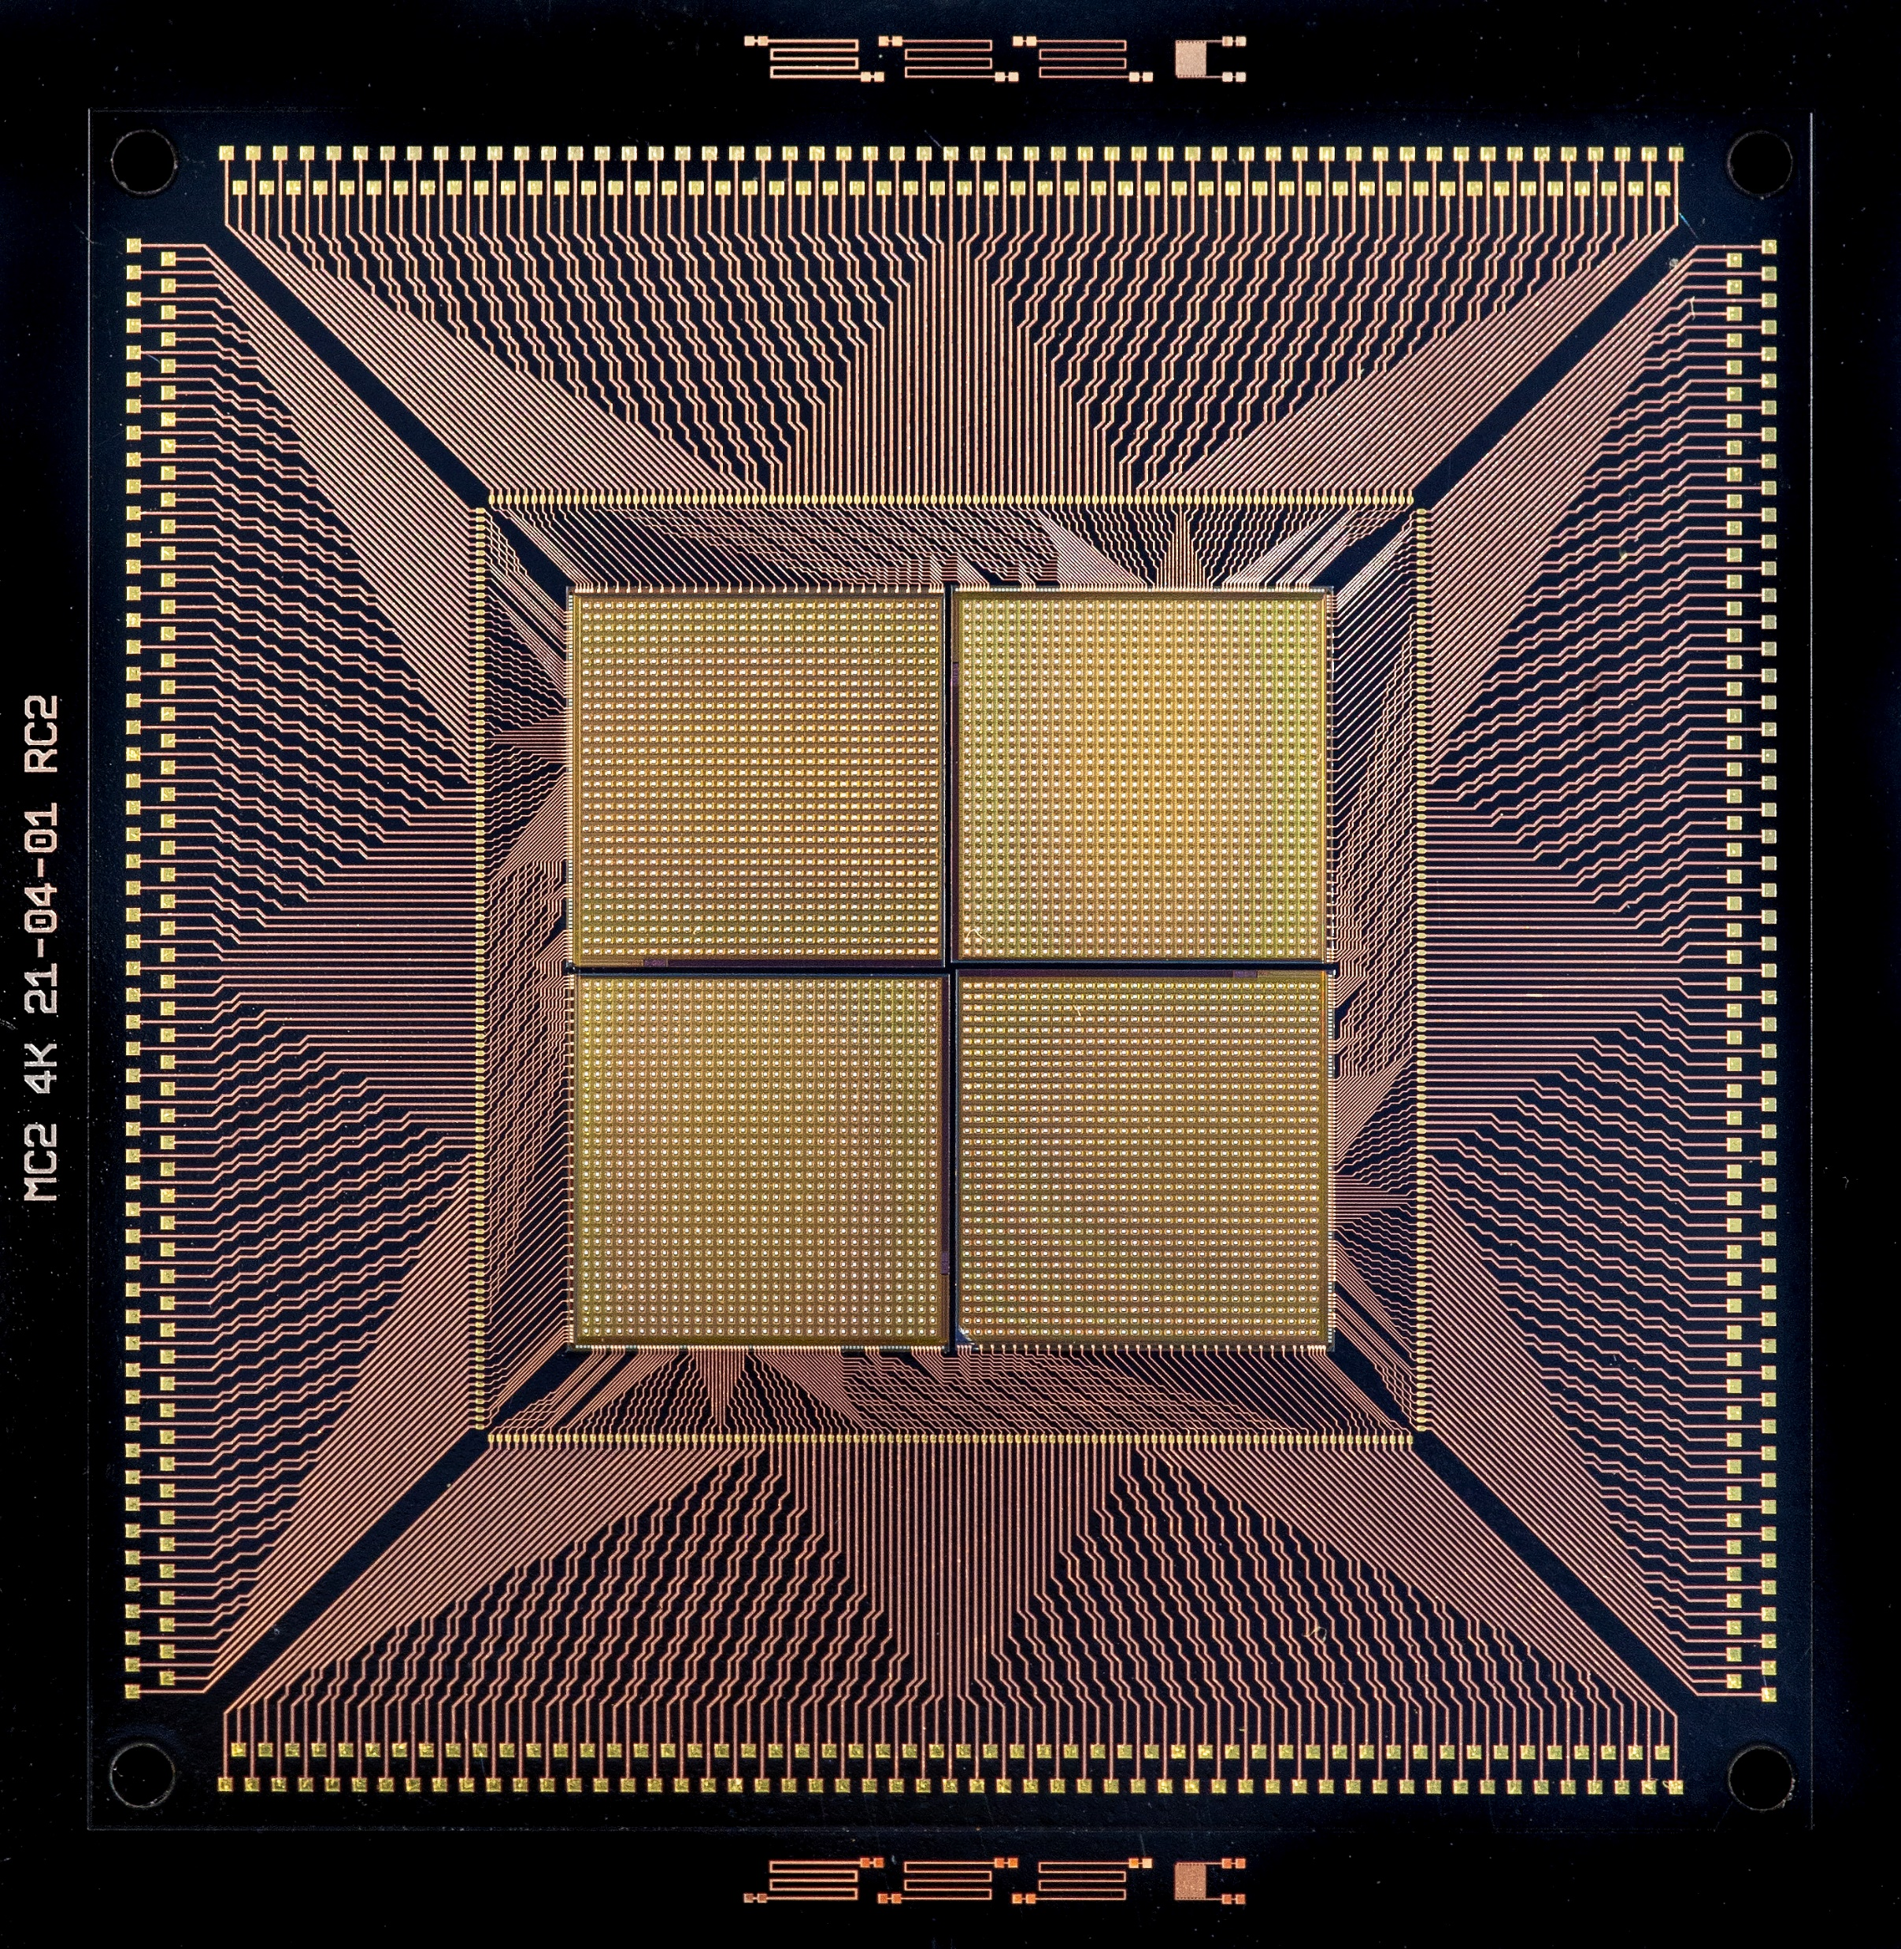


Front-end ASICs for high resolution imaging spectroscopy in space
David Baudin et.al.

Slide 2
Summary
Astrophysic Context: Existing missions and future needs
Noise optimisation for high resolution
CMOS Amplifier
Non Stationnary Noise Suppressor
Matrix based optimisation
Double CR-RC stage
AC link with low noise leakage current generation
Packaging and interconnexion
Results and conclusion

Slide 3
Astrophysic Context: Existing missions and future needs
1

Slide 4
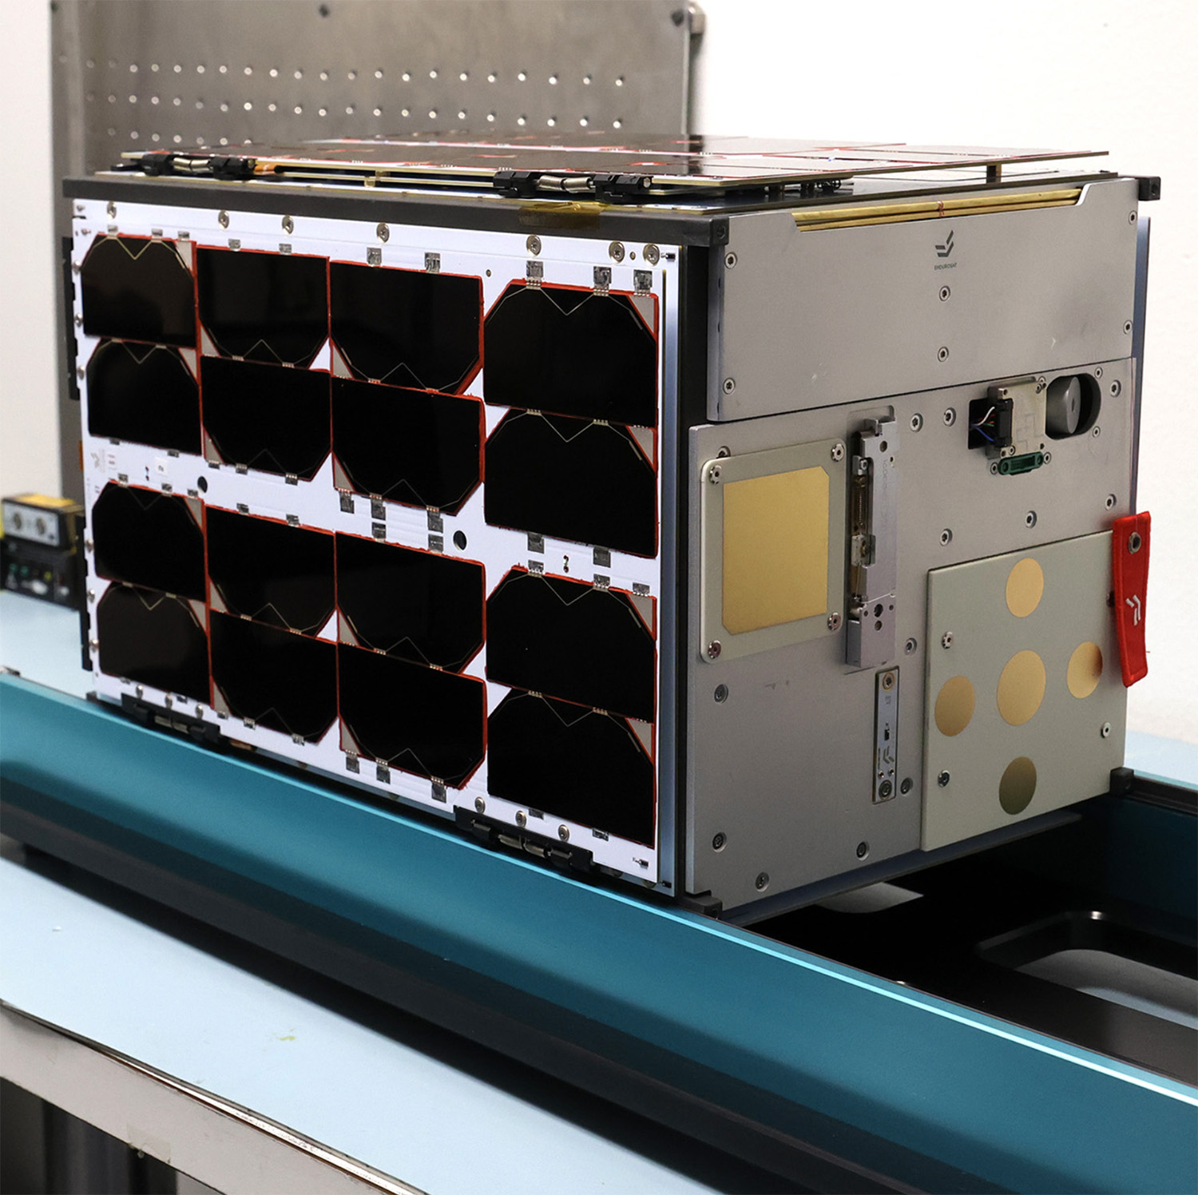
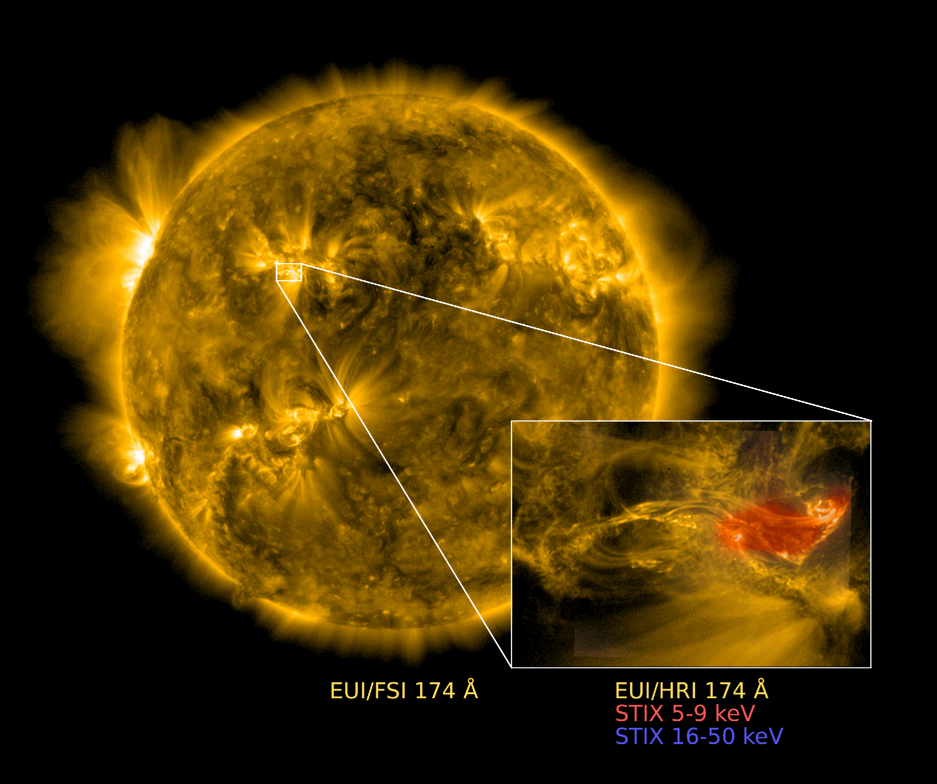
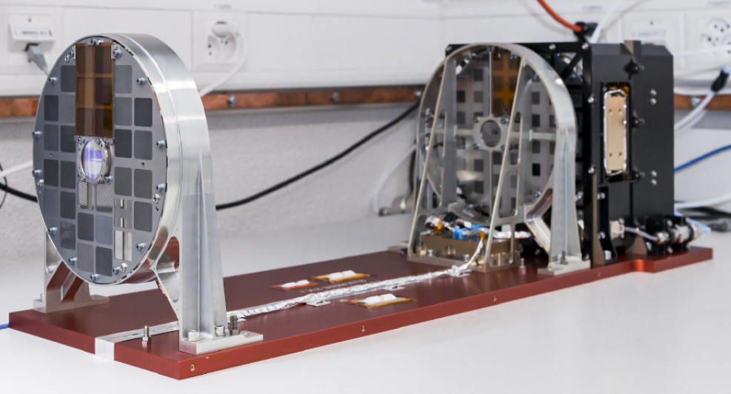
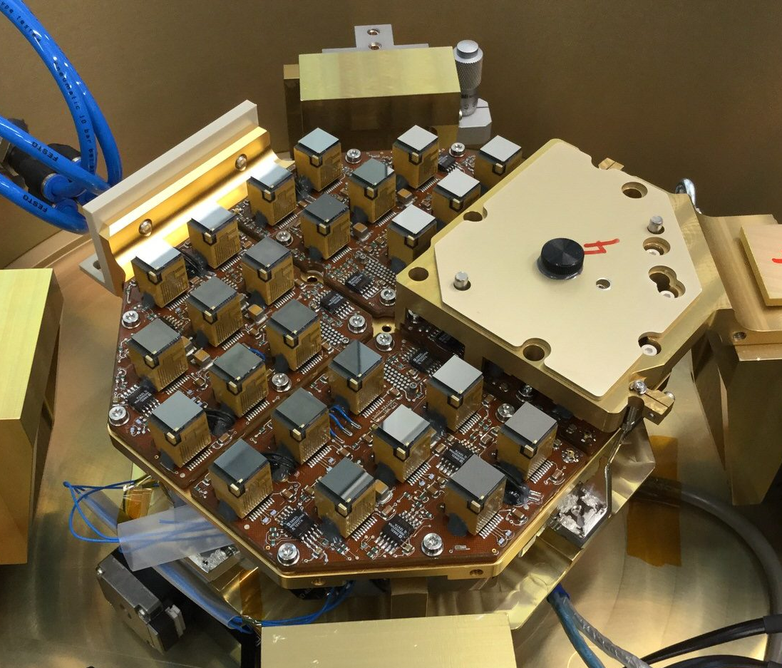
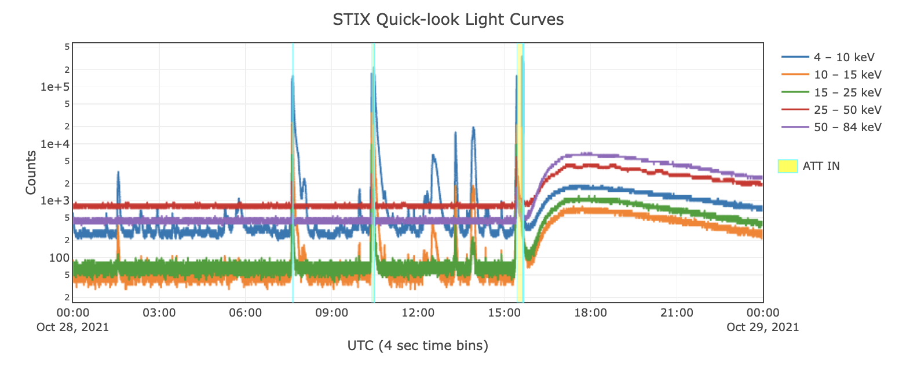
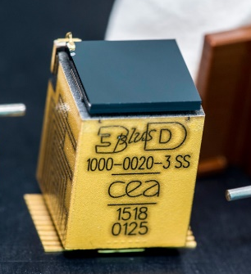
Summary of astrophysic context: Solar physics
Padre:
Direct measurement
4 modules – Caliste-SO
IDEF-X HD ASICs
Science Case:
Study the electron acceleration in coronal emission (Solar Orbiter)
Measure the electron distribution and polarisation
Flux and transient phenomena measurements
Fig 2: Padre nano satellite
Future Needs:
Highly pixelated integrated circuit:
< 250 x 250 µm²
> 32 x 32 pixels
Energy resolution < 2 keV @ 30 keV
< 40 el.rms
Flux: ~200 kHz/mm²
Fig1: Sum picture in UV and X-Ray taken by Solar Orbiter
Space missions (on-flight):
Solar orbiter:
Fourier-transform imaging
Stackup of CdTe – ASIC – Supplies
12 Pixels per modules
30 modules – Caliste-SO
IDEF-X HD ASICs (one per module)
Fig 3: Solar orbiter imaging system, focal plane, flux variation with time, Caliste So module

Slide 5
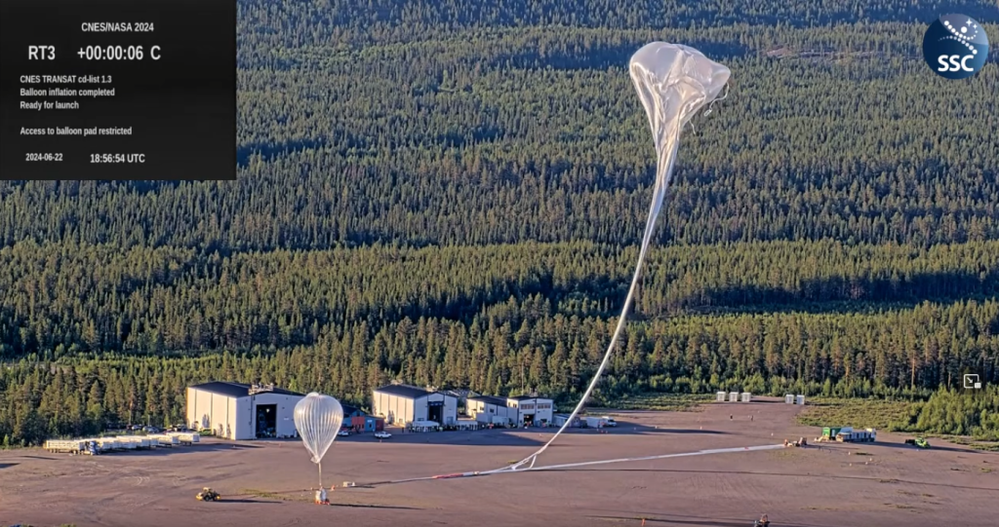
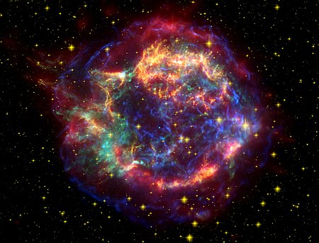
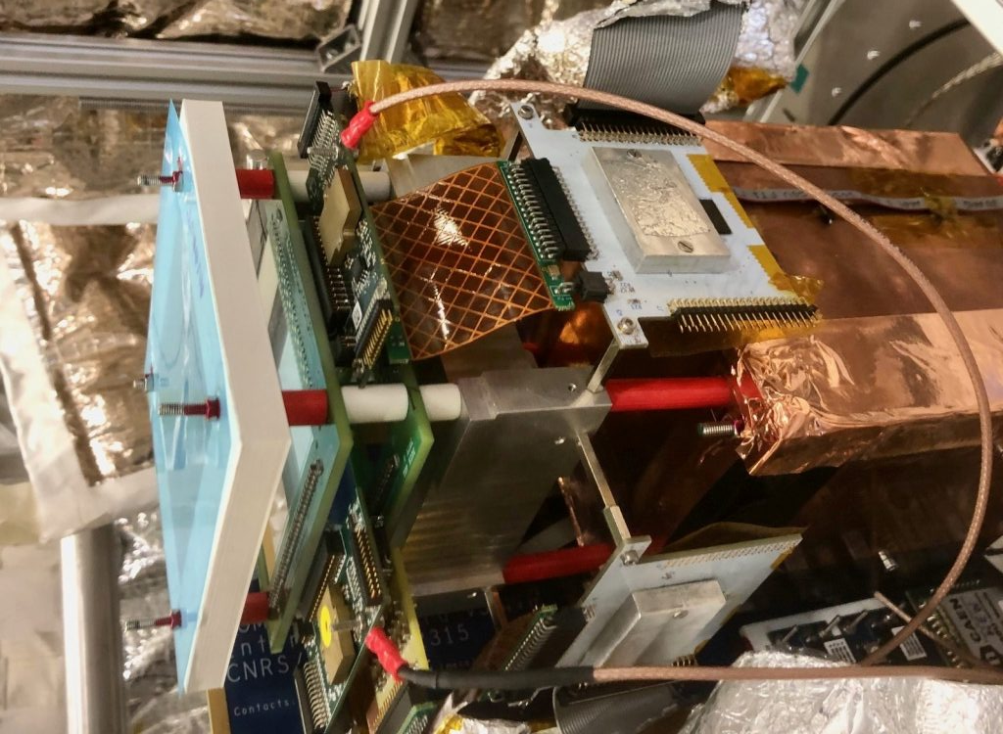
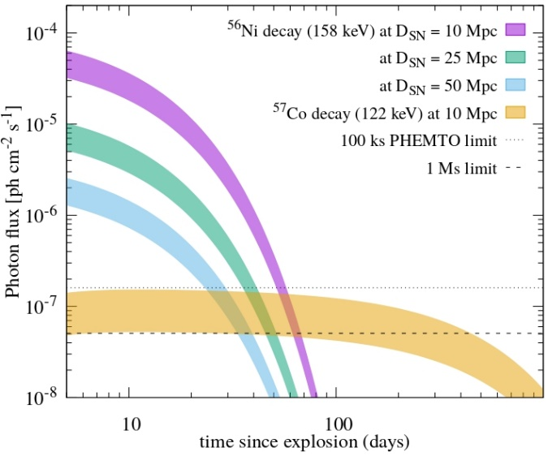
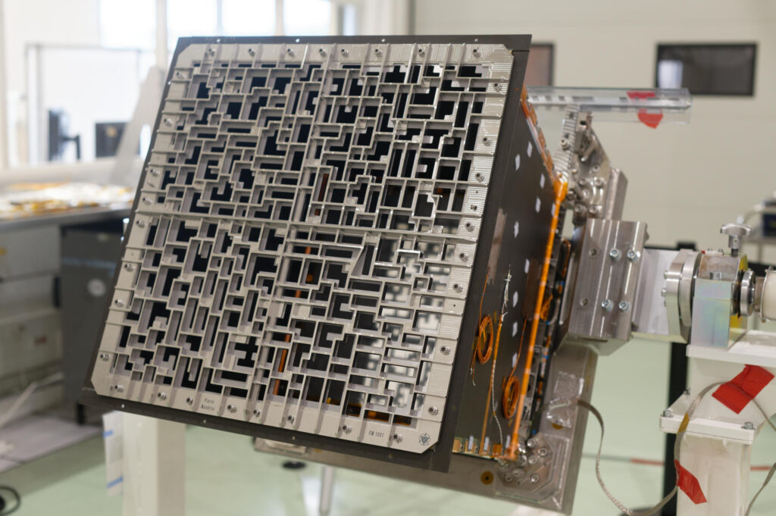
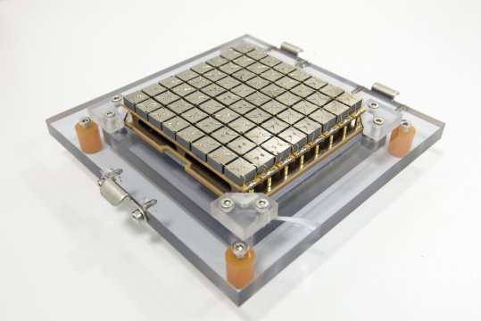
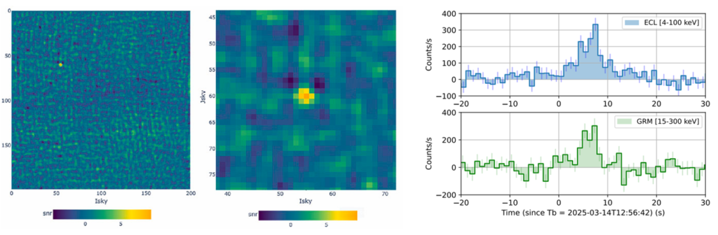
Summary of astrophysic context: Extra galactic [SNR, Gamma ray burst]
Science Case:
Comcube:
Coded mask imaging
SDD detector
Constellation of 27 nano-satelittes
4 ASICs
IDEF-X HDBD
Study the metal generation on stellar generation
⁵⁶Ni → ⁵⁶Co at 156 keV
⁵⁷Co → ⁵⁷Fe at 122 keV
Study polarization and energy distribution of Gamma ray bursts
Fig 4: Cas-A picture (chandra-X)
Fig 6: Comcube ballon launch and payload
Fig 5: Simulated flux from SNR
Future Needs:
Highly pixelated integrated circuit (for polarisation):
< 250 x 250 µm²
> 32 x 32 pixels
Energy resolution < 1 keV @ 30 keV < 20 el.rms
Space missions (on-flight):
SVOM:
Coded mask imaging
Stackup of CdTe – ASIC – Supplies
32 Pixels per modules
25 modules
IDEF-X Eclairs
Fig 7: SVOM eclair coded mask aperture, focal plane, image of GRB

Slide 6
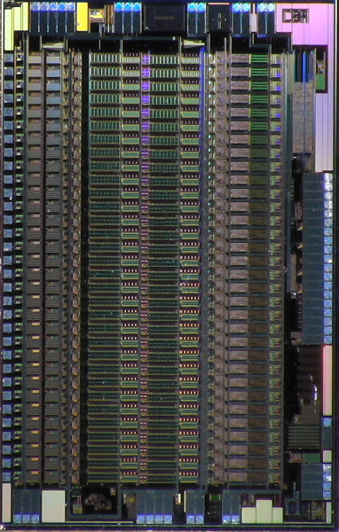
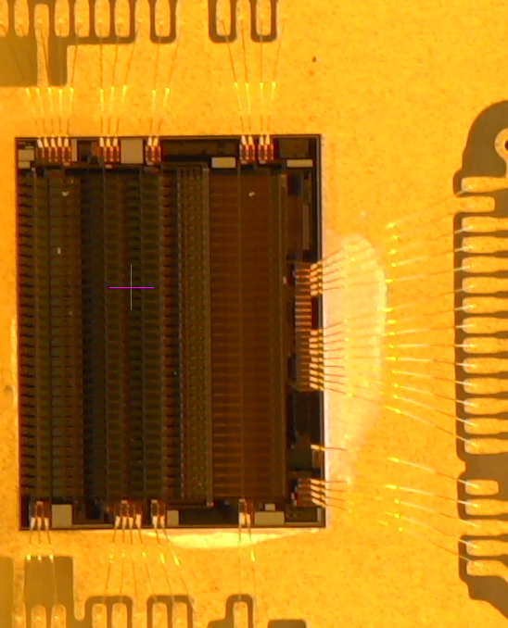
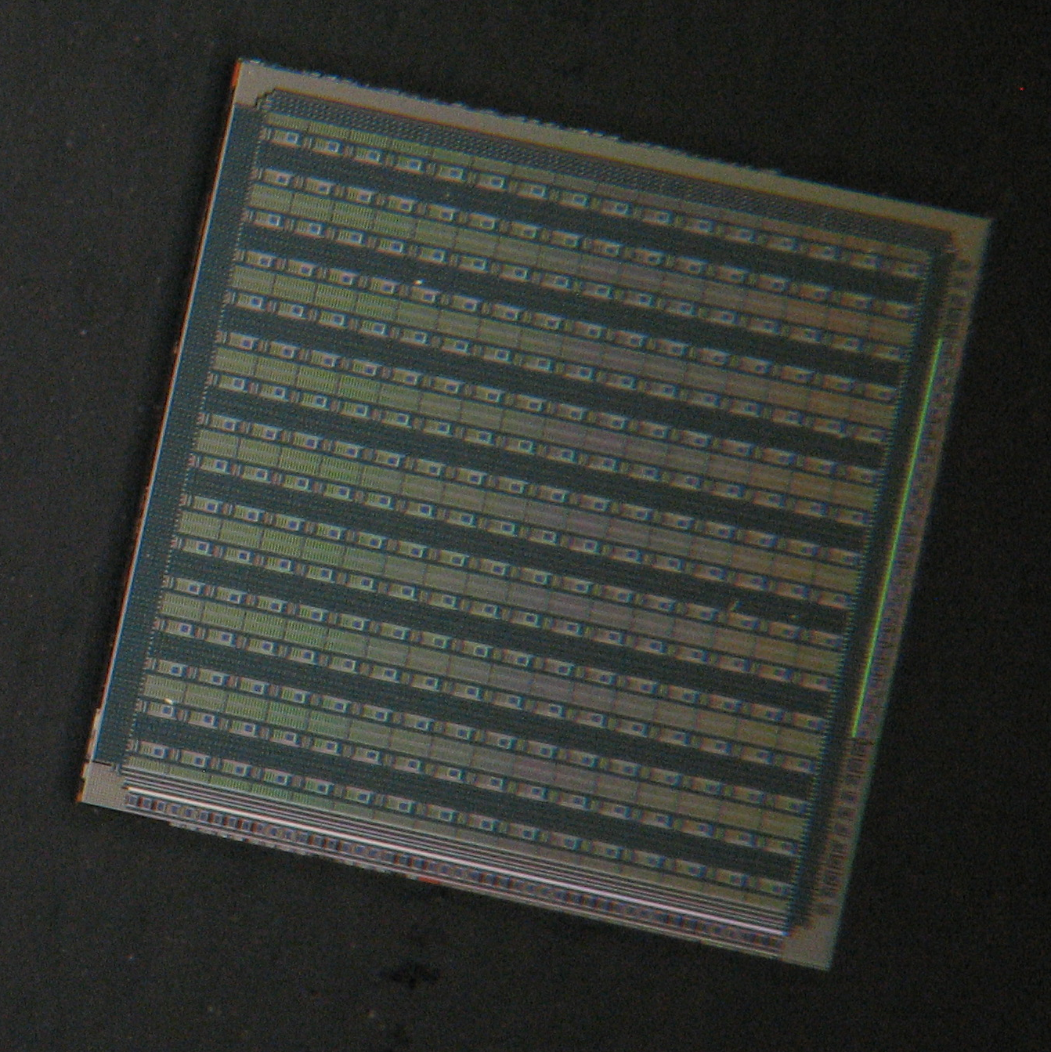
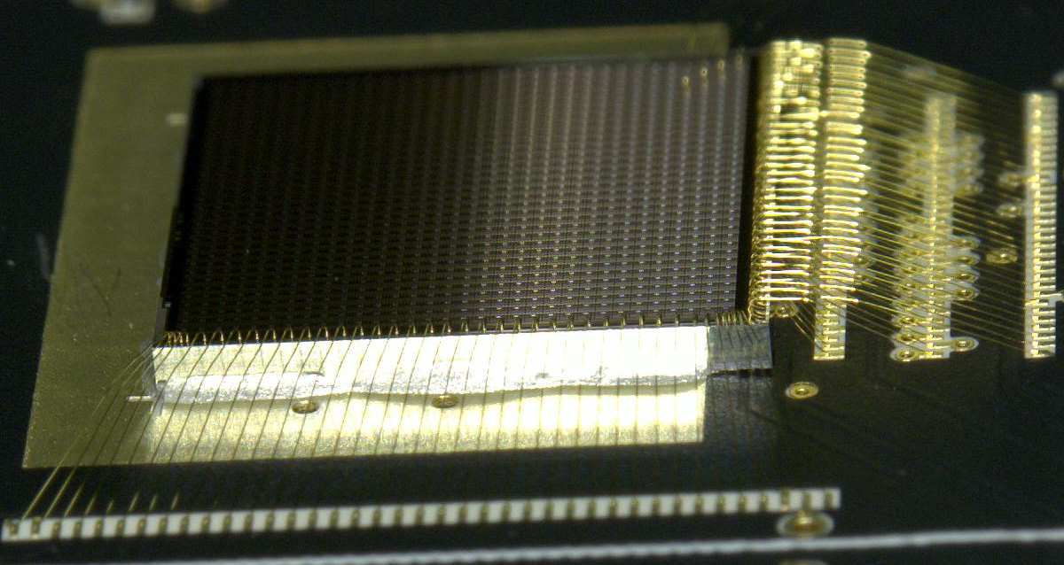
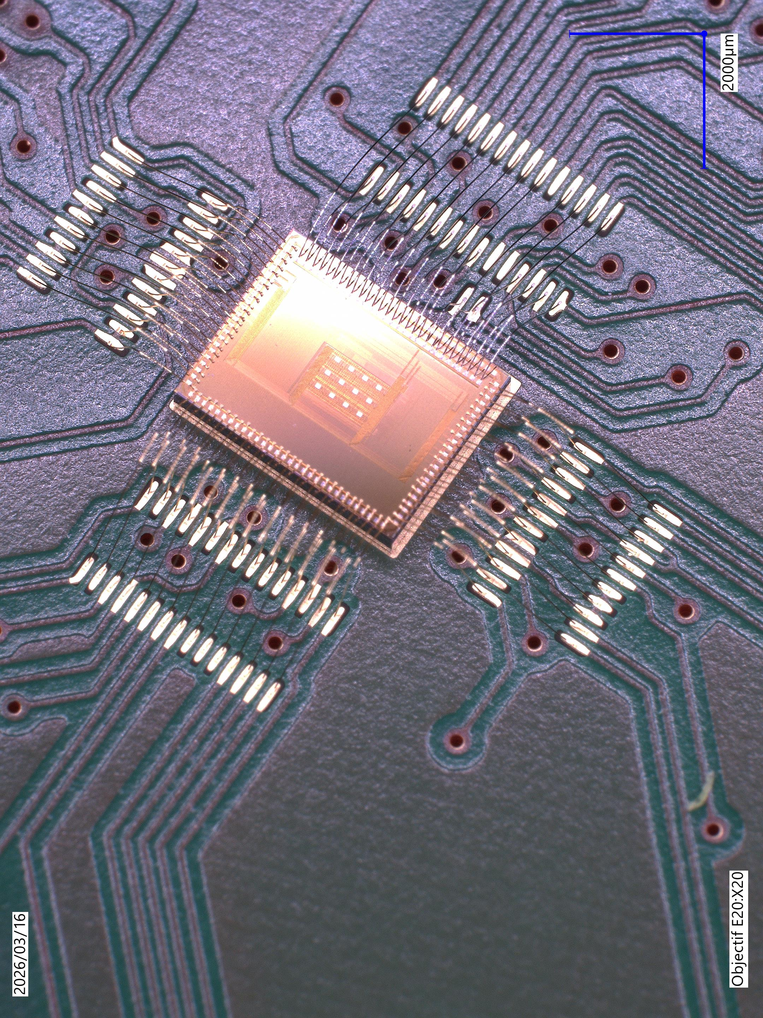
ASICs Developped at Saclay List and Specification
ASIC | Energy resolution eV @ 60 keV | Number of Pixels / channels | Size of pixels / channels (µm x µm) | Power density (mW/mm²) (mW/channel) | Options / Technology
IDeF-X HDBD | 526 [17 el.rms] | 32 | 150 x 2000 | 2,7 0,8 | Bidirectionnal AMS 0.35 µm
IDeF-X S | 474 [10 el.rms] | 32 | 150 x 2500 | 2,2 0,8 | Common mode rejection AMS 0.35 µm
D2R1 | 666 [29 el.rms] | 16 x 16 | 300 x 300 | 2,7 0,25 | CDS XFAB 0.18 µm
D2R2 | 910 [54 el.rms] | 32 x 32 | 250 x 250 | 4,8 0,3 | XFAB 0.18 µm
ANAQIN-X | NA [17 el.rms] | 4 x 4 | 250 x 250 | 4,8 0,3 | Prototype XFAB 0.18 µm
Fig 8: ASICs Developped at Saclay

Slide 7
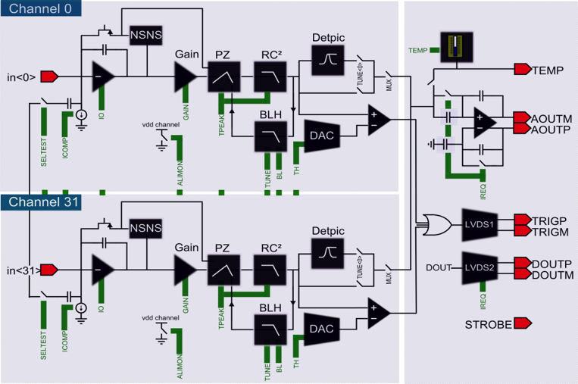
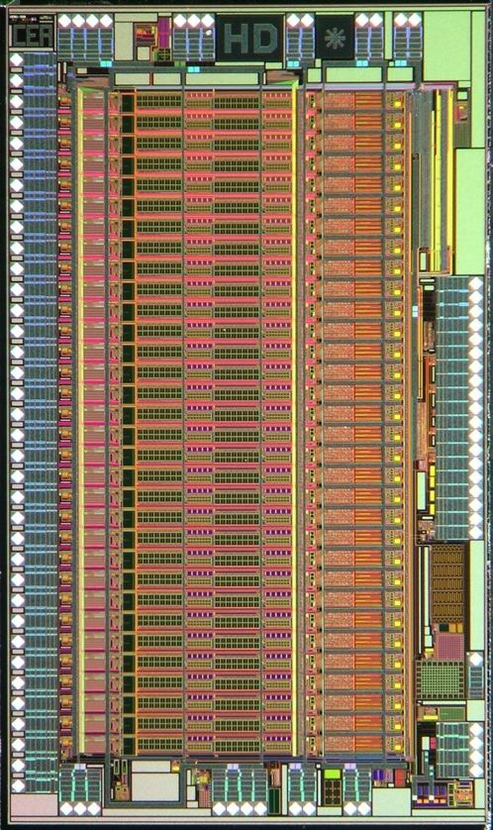
General structure of our ASICs
Amplification:
CSA with continuous reset
Filtering:
Analog CR-RC^{n} filter with transistors copy
Maximum detection:
Peak detector with or without pileup detection
Triggering:
Tunable threshold with baseline rejection
Fig 10: General spectroscopic instrumentation chain schematic
Fig 9: IDEFX-HD picture
Some options used in some designs:
Non stationnary noise suppressor
Multi-Stage CR-RC
CMOS amplifier

Slide 8
Noise optimisation for high resolution
2

Slide 9
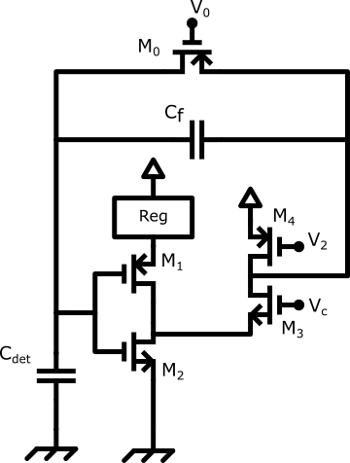

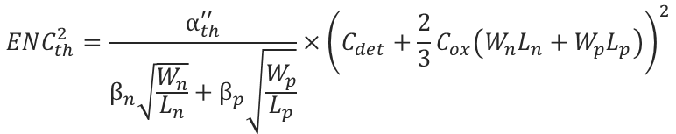



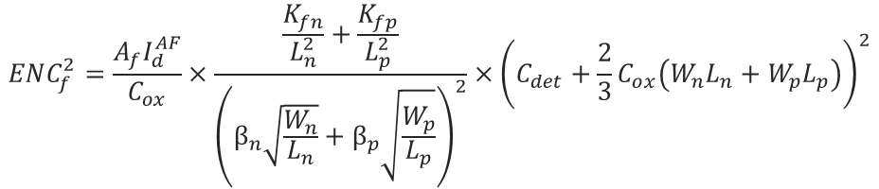

A- CMOS architecture for Charge Sensitive Amplifier
Circuit:
Classical folded cascode architecture
Both P and N mosfet are connected together
A current regulation set the current state
In our case its a « mirror » version of the CSA that generate voltage reference for « current regulation »
Fig 11: CMOS CSA
Hypothesis: - Strong Inversion region
- L_{n} = L_{p} = L_{min}
Thermal Noise optimization
Flicker Noise optimization
$$ENC_{th}^{2}=\frac{α_{th}^{′′}}{β_{n}\sqrt{\frac{W_{n}}{L_{n}}}+β_{p}\sqrt{\frac{W_{p}}{L_{p}}}}×{\left(C_{det}+\frac{2}{3}C_{ox}\left(W_{n}L_{n}+W_{p}L_{p}\right)\right)}^{2}$$
$$ENC_{f}^{2}=\frac{A_{f}I_{d}^{AF}}{C_{ox}}×\frac{\frac{K_{fn}}{L_{n}^{2}}+\frac{K_{fp}}{L_{p}^{2}}}{{\left(β_{n}\sqrt{\frac{W_{n}}{L_{n}}}+β_{p}\sqrt{\frac{W_{p}}{L_{p}}}\right)}^{2}}×{\left(C_{det}+\frac{2}{3}C_{ox}\left(W_{n}L_{n}+W_{p}L_{p}\right)\right)}^{2}$$
$$With: α_{th}^{′′}=\frac{8kTA_{th}}{3T_{peak}}$$
Optimum for:
$$β_{n}= \sqrt{2k_{n}^{′}I_{d}}$$
Optimum for:
$$C_{Csa}=\frac{C_{det}}{3}$$
$$β_{p}= \sqrt{2k_{p}^{′}I_{d}}$$
$$C_{Csa}=C_{det}$$

Slide 10

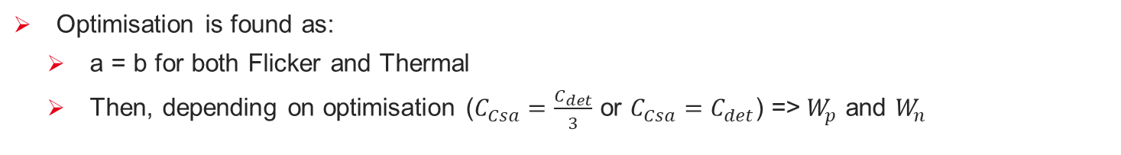
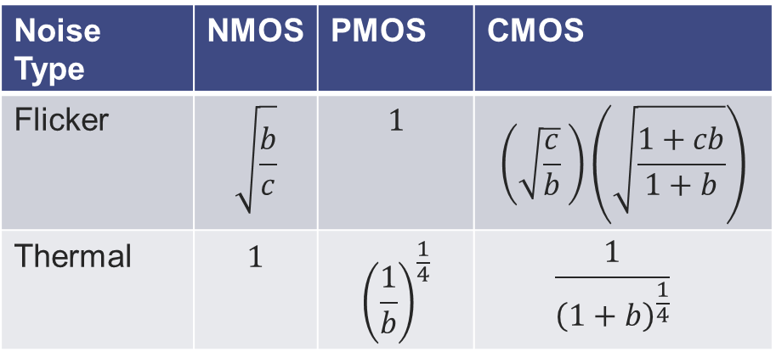


A- CMOS architecture for Charge Sensitive Amplifier
We can fix some parameter to help us identify noise ratios
$$a=\frac{W_{p}}{W_{n}}$$
$$b=\frac{k_{p}^{′}}{k_{n}^{′}}$$
$$c=\frac{KFp}{KFn}$$
Optimisation is found as:
a = b for both Flicker and Thermal
Then, depending on optimisation ($C_{Csa}=\frac{C_{det}}{3}$ or $C_{Csa}=C_{det}$) =>$W_{p}$ and $W_{n}$
Noise ratio with respect to NMOS for thermal and Flicker for PMOS can be found as:
Noise Type | NMOS | PMOS | CMOS
Flicker | $$\sqrt{\frac{b}{c}}$$ | $$1$$ | $$\left(\sqrt{\frac{c}{b}} \right)\left(\sqrt{\frac{1+cb}{1+b}}\right)$$
Thermal | $$1$$ | $${\left(\frac{1}{b}\right)}^{\frac{1}{4}}$$ | $$\frac{1}{{\left(1+b\right)}^{\frac{1}{4}}}$$
Technology | NMOS | PMOS | CMOS
Thermal AMS035 | 1 | 1,3 | 0,93
Thermal AMS018 | 1 | 0,5 | 0,95
Thermal XFAB018 | 1 | 1,5 | 0,95
Thermal TSMC0065 | 1 | 1,1 | 0,89
Noise Type | NMOS | PMOS | CMOS
Thermal AMS035 | 1 | 1,3 | 0,93
Flicker AMS035 | 1,1 | 1 | 0,95

Slide 11
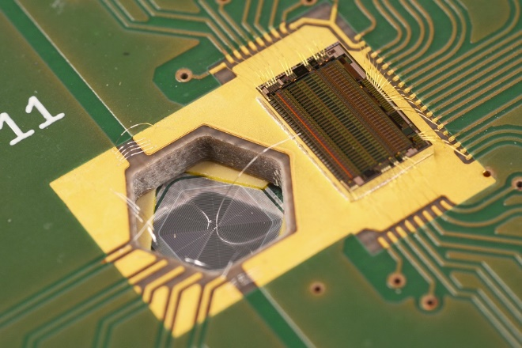
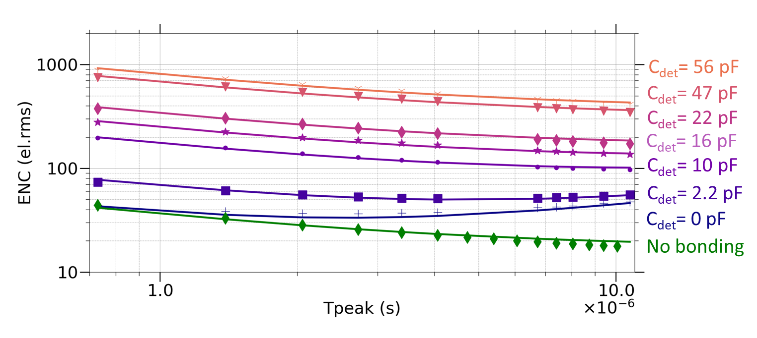
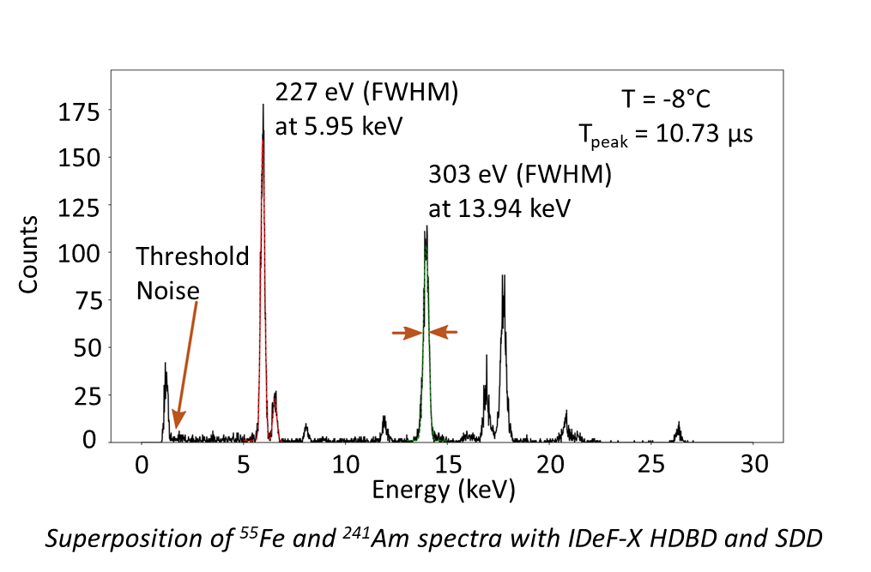
A- CMOS architecture for Charge Sensitive Amplifier
Several ASIC have been done with this circuit, one of the latest is:
IDEF-X HDBD:
Fig 12: IDEF-X HDBD noise variation with peaking time and capacitance
Fig 13: IDEF-X HDBD picture mounted with INAF-Triestre & Roma SDD
Coupled with a Silicon drift detector (C_{det} = 120 fF)
Resolution: 227 eV @ 5,9 keV
Threshold: 1,2 keV
Power: 26 mW
Channel: 32
Fig 14:

Slide 12
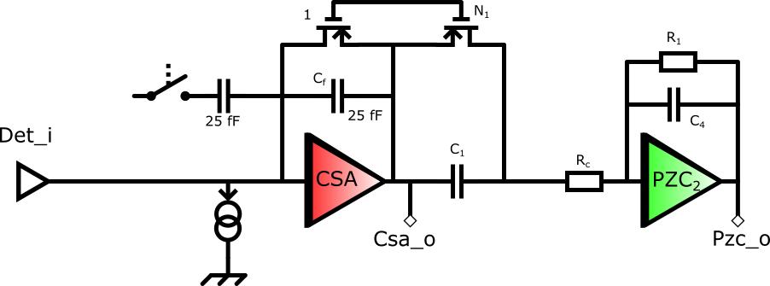
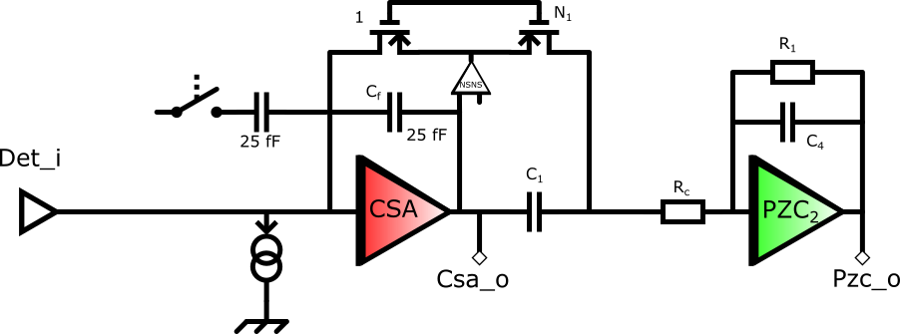
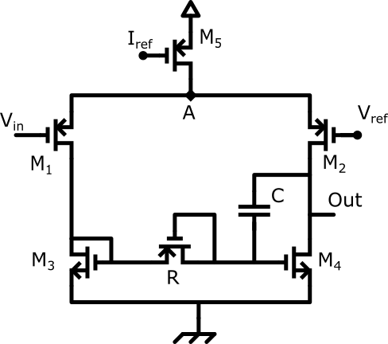
B- Non stationnary noise suppressor
[Geronimo et.al], “A CMOS fully compensated continuous reset system,” IEEE Transactions on Nuclear Science, vol. 47, no. 4, pp. 1458–1462, Aug. 2000
Our design are often base on a continuous reset done with a MOS transistor in subthreshold region.
When signal amplifies high value charges:
CSA output increases
Source voltage increase
Reset transistor is non longer in subthreshold region during that time
Consequences:
Reset goes faster (could generates ballistic deficit)
Noise increase temporarily
Fig 15: Single stage CR-RC in continuous reset
We implemented a special filter at CSA’s output
Advantages:
Supress gm variation with charges
Drawbacks:
Increase Reset time
Generates oscillation when Ileak increases if low pass)
Fig 16: Double Stage CR-RC in continuous reset

Slide 13
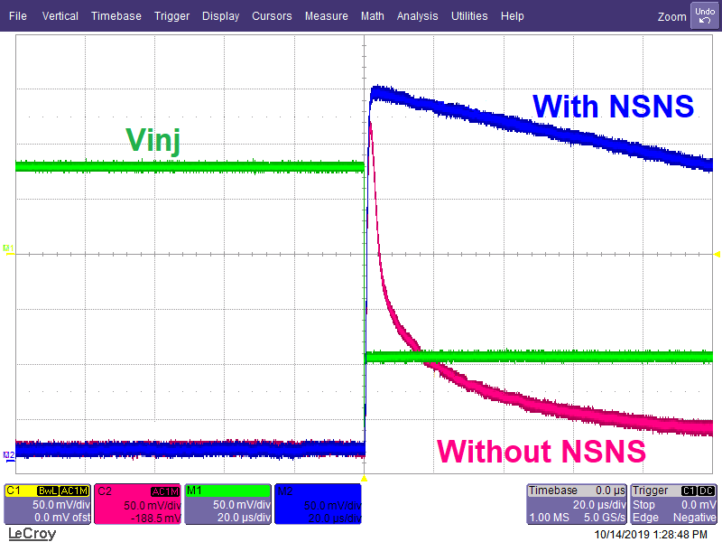
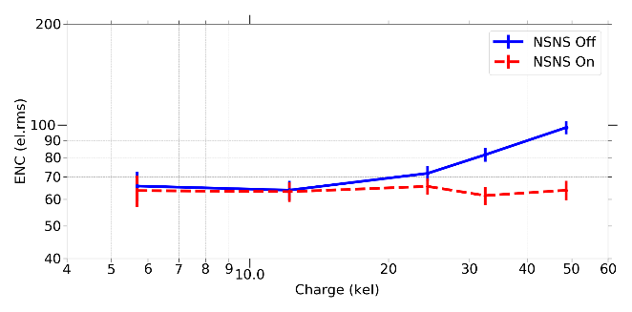
B- Non stationnary noise suppressor
Filter is based on a small differential pair with a zero and pole path done with « R » and « C ».
R is based on an inverted diode with small potential accross in order to reach Tohms values
Avoids having oscillation a high leakage, if design with a correct pole and zero, one can be always stable (if Ileak < 10 fA).
Fig 17: NSNS Structure
One ASIC has implemented a version where we can turn on / off this features: D2R2
Fig 18: Oscilloscope output of a 27 kel equivalent pulse
Fig 19: ENC variation with injected charge

Slide 14
Matrix based optimisation
3

Slide 15
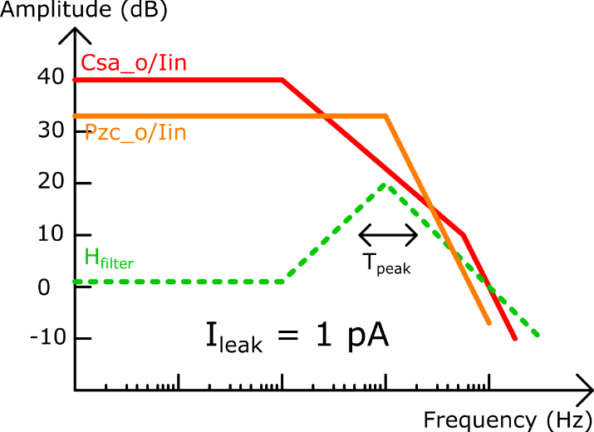
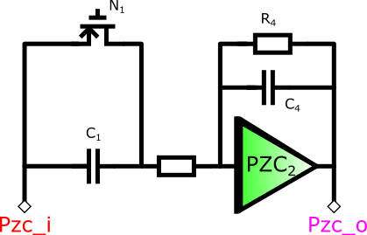
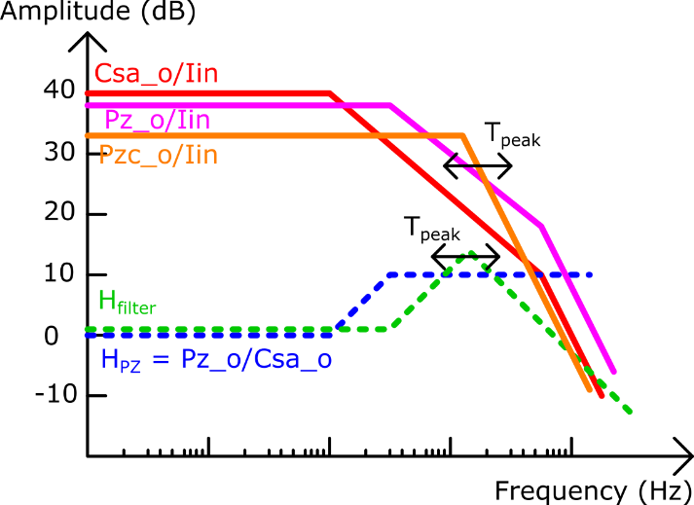
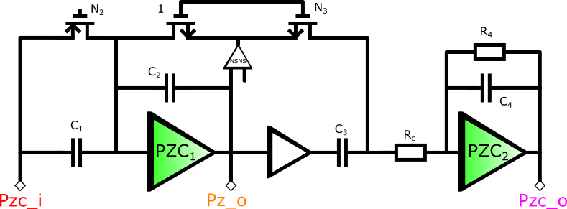

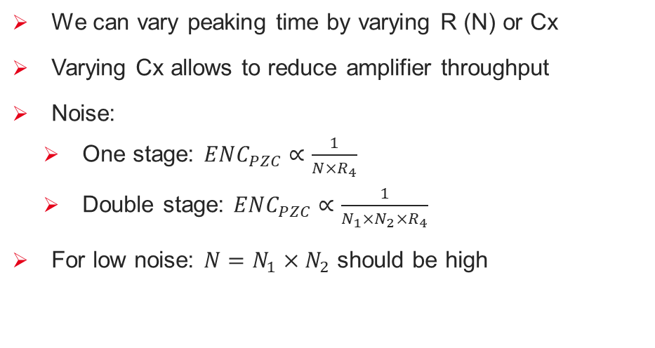


A- Double CR-RC stage
One Stage CR-RC
We add a resistor to add a « free pole »:
$$H_{tot}\left(s\right)=\frac{NR_{4}s}{{\left(1+R_{4}C_{4}s\right)}^{2}}$$
$$R_{c}≪\frac{1}{N_{1}gm_{1}}$$
$$Hypothesis:$$
We can vary peaking time by varying R (N) or Cx
Varying Cx allows to reduce amplifier throughput
Noise:
One stage: $ENC_{PZC}∝\frac{1}{{N×R}_{4}}$
Double stage: $ENC_{PZC}∝\frac{1}{N_{1}×N_{2}×R_{4}}$
For low noise: $N=N_{1}{×N}_{2}$ should be high
Double Stage CR-RC
Fig 20: Schematic of single stage and double stage continuous reset architecture (left) and resulting AC bode diagram (right)

Slide 16
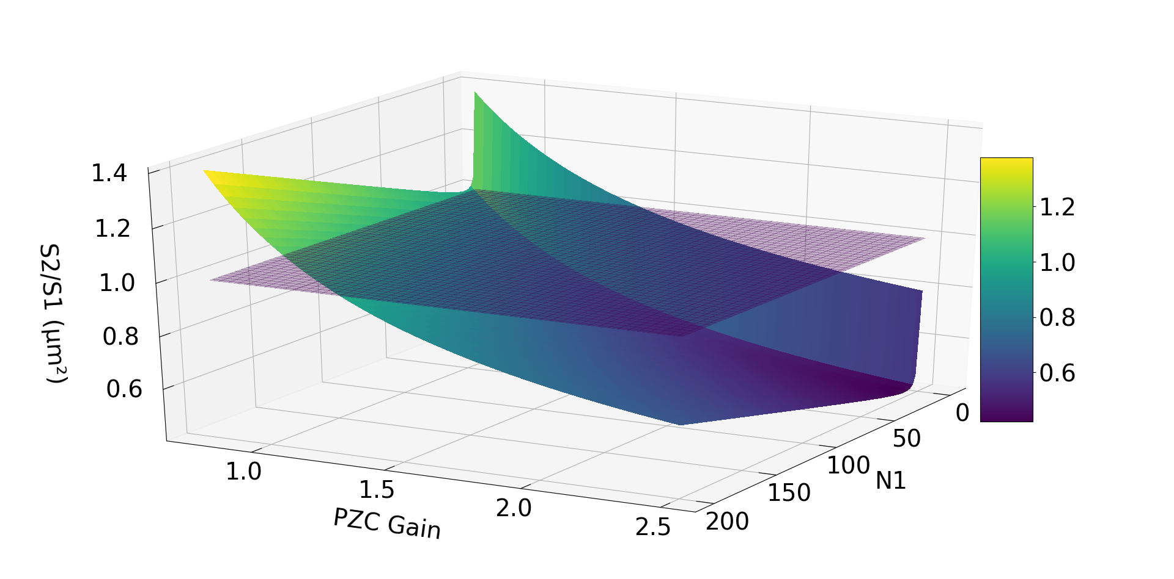
A- Double CR-RC stage
Fig 21: Plot of the mathematical representation of area ratio between two architecture, taking into acount transistors area together with capacitance area for C_{density} = 2,35 fF/µm²

Slide 17
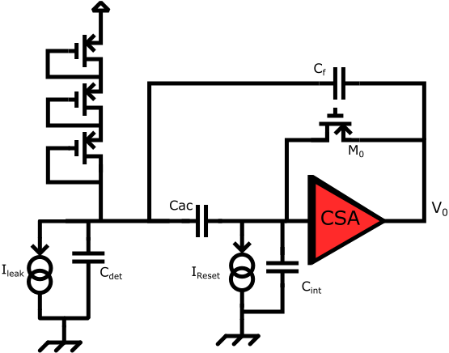

AC link with low noise leakage current generation
With Continuous reset circuit:
If I_{leak} increases, noise will increase both due to schot noise in detector but also with thermal noise produced by the reset
With radiation, detectors (Silicon) tends to have increasing leakage current
We wanted to decouple inside the ASIC (for matrix connection) reset and detector bias => AC link
Feedback capacitance outside of AC link loops helps to provide
And amplification of Cac to be able to have 30 pF
with only 1 pF internal capacitance
Reset can be done with N transistor in diode which allows:
$Noise_{reset}=\frac{Noise_{reset}\left(1 Transistor\right)}{\sqrt{Nb_{diodes}}}$
[Perić, Ivan et.al.] « High-voltage pixel detectors in commercial CMOS technologies for ATLAS, CLIC and Mu3e experiments ». Nuclear Instruments and Methods in Physics Research Section A: Accelerators, Spectrometers, Detectors and Associated Equipment, PIXEL 2012, vol. 731 (décembre 2013): 131‑36. https://doi.org/10.1016/j.nima.2013.05.006.
Fig 22: Semi-AC reset architecture.

Slide 18
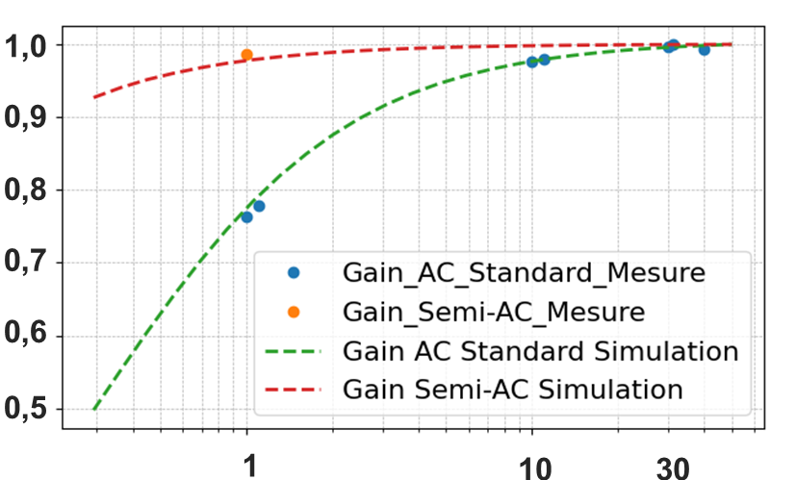
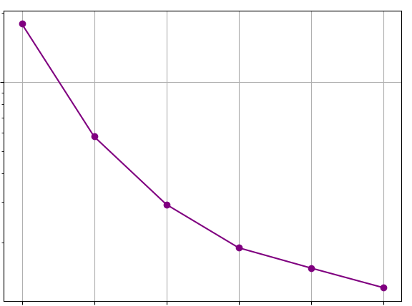
AC link with low noise leakage current generation
We implemented this on two pixels of ANAQIN chip with possibility to change number of diodes
Optimum point for 3 diodes
100
50
55 pA
Normalised Gain
Ileak (pA)
Optimum point for 7 diodes
20
12.7 pA
2
3
4
5
6
7
Number of Diodes
Capacitance (pF)
Fig 24: Simulated optimal point by variying both Tpeak and number of diode in series
Fig 23: Gain measured with or without « semi - AC » architecture
Leakage current is controlled with voltage reference
We have seen an improvement with 1 – 2 transistors
Larger number of transistors have shown issues in the leakage current generation
We reach with 1 pF and equivalent gain of 30 pF

Slide 19
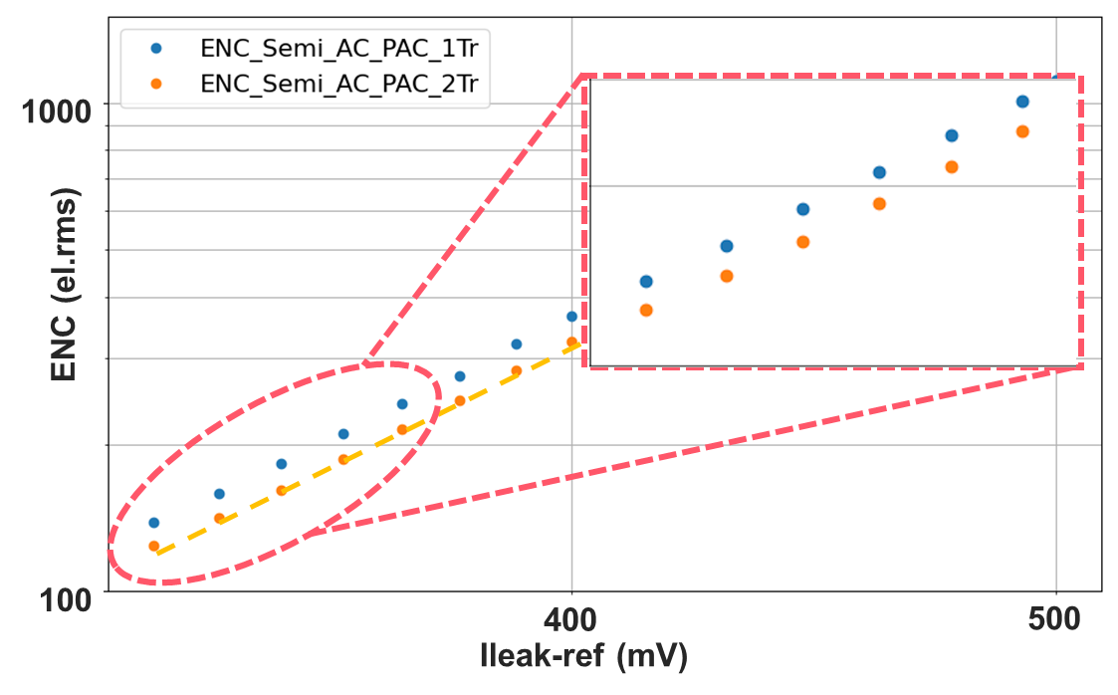
AC link with low noise leakage current generation
We implemented this on two pixels of ANAQIN chip with possibility to change number of diodes
$${ENC}_{//} \left(semi−AC\right)∝\sqrt{I_{leak}}.\sqrt{(N+1)/N}$$
Normalised Gain
Fig 25: Measure of total noise with Varying Leakage current
Capacitance (pF)
Fig 23: Gain measured with or without « semi - AC » architecture
Leakage current is controlled with voltage reference
We have seen an improvement with 1 – 2 transistors
Larger number of transistors have shown issues in the leakage current generation
We reach with 1 pF and equivalent gain of 30 pF

Slide 20
Packaging and interconnection
4

Slide 21
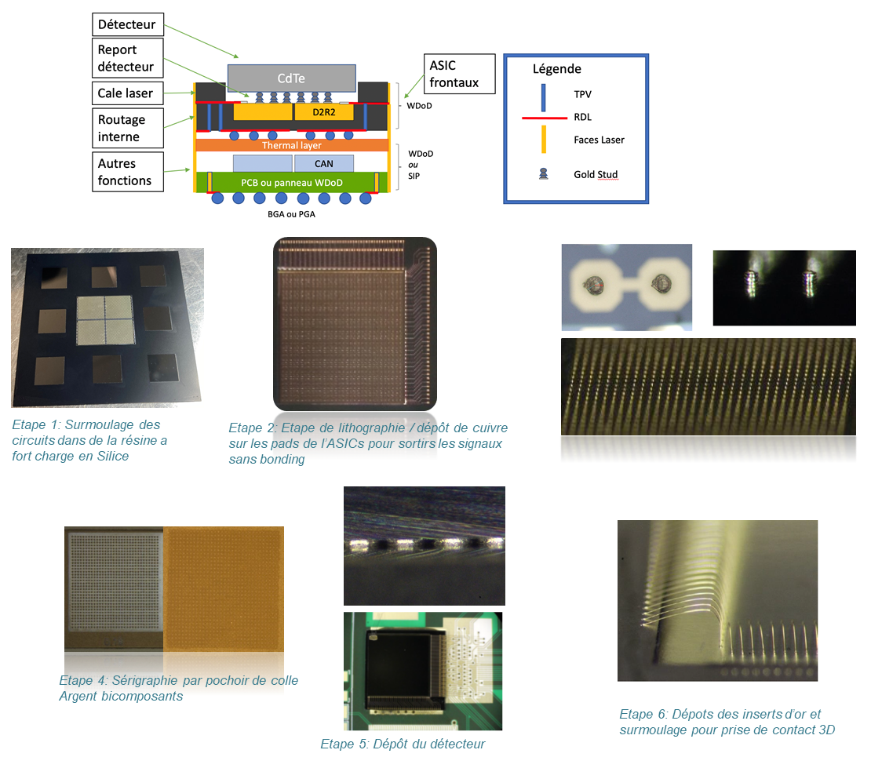
A- Packaging and interconnexion From 3D interconnection to 2D
Detector
Interconnection
Molding
Laser routing
Detector
IDeF-X HD
Power supply / decoupling
Step 1: chip molded in siliciced resin
Step 2: copper deposition and lithography
Step 3: gold stud deposition
PGA outputs
Fig 26: X-Ray Photography of a Caliste - HD
Step 4: serigraphy with stencil and Ag epoxy
Step 6: Gold wire insertion for « TPV »
Step 5: detector deposition
Fig 27: 2D interconnection process steps

Slide 22
Results and conclusion
5

Slide 23
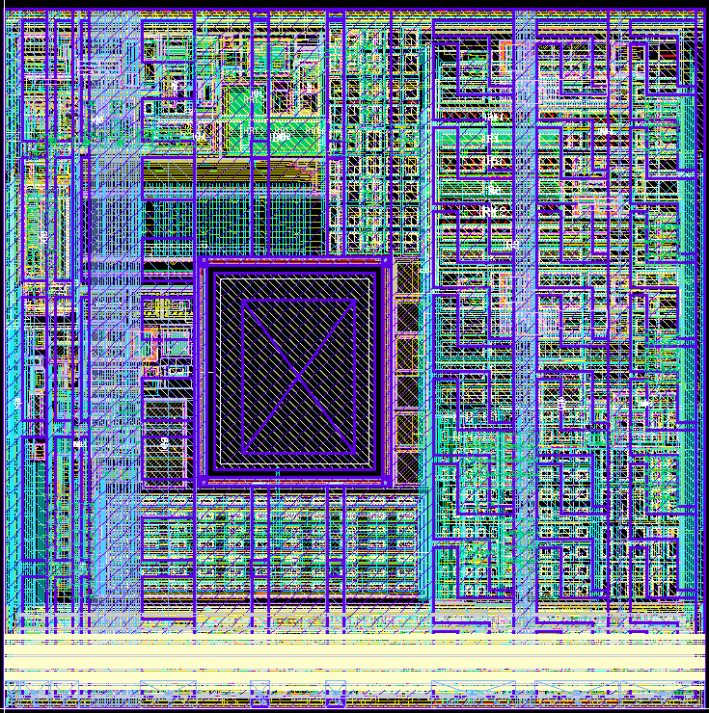
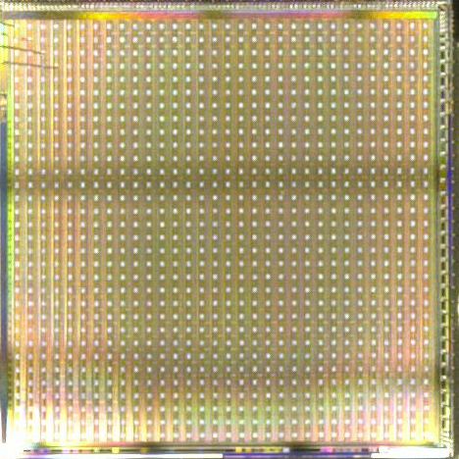
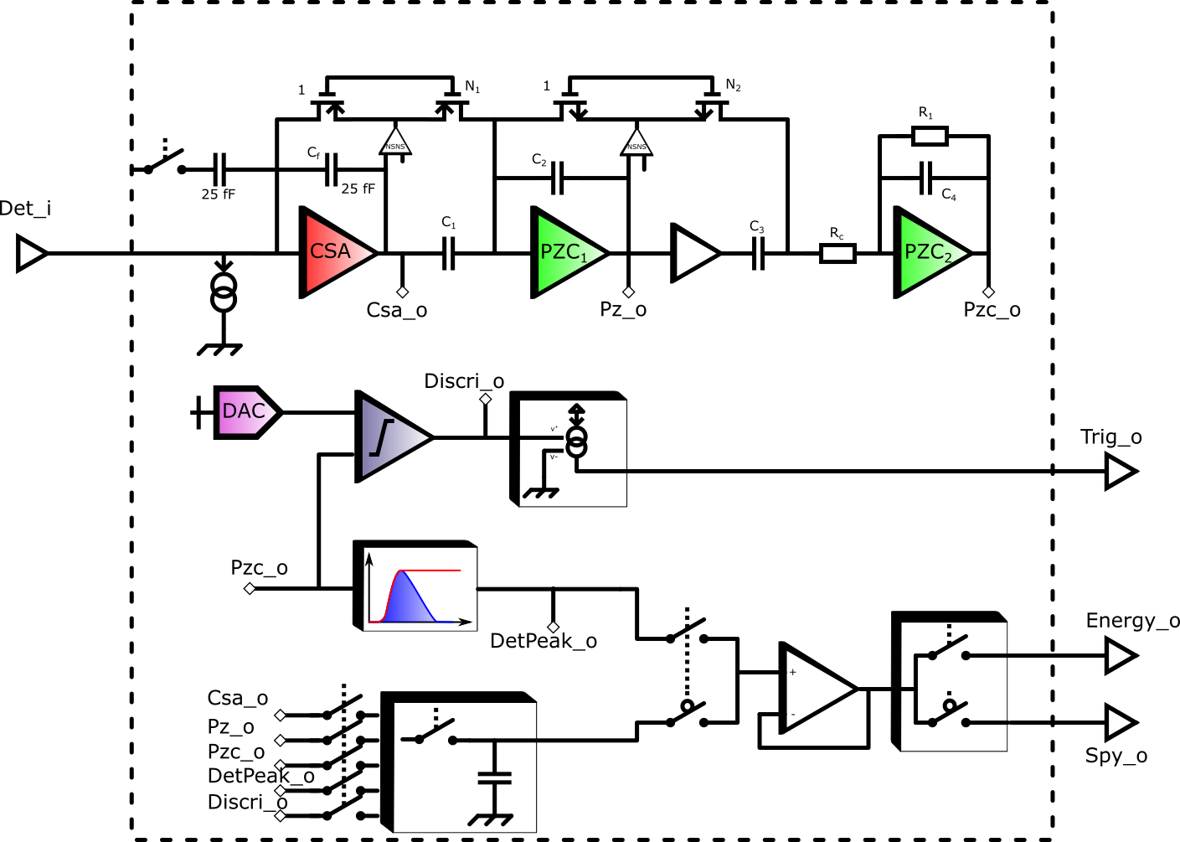
A- D2R2 ASIC
250 µm
8500 µm
250 µm
8500 µm
Fig 28: Schematic of one pixel
Fig 29: IDeF-X D²R₂ Pixel Layout
Fig 30: IDeF-X D²R₂ picture

Slide 24
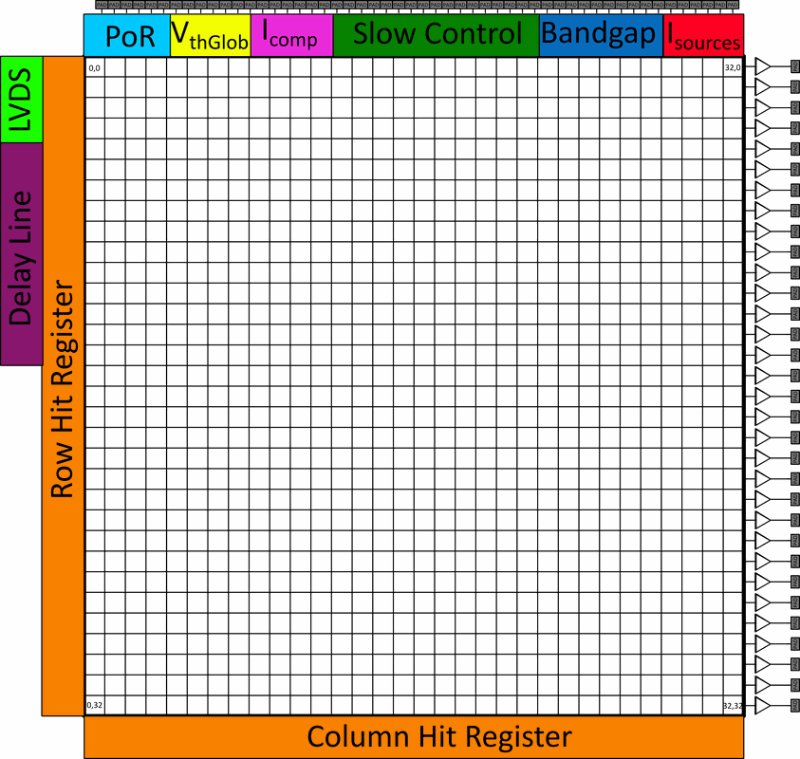
A- D2R2 ASIC
Fig 31: Readout Strategy

Slide 25


B- D2R2 ASIC results
Fig 32: Gain Map
Fig 33: ENC Map
Mean value: 31 µV/el
Standard deviation: 271 nV/el
Mean value: 74 el.rms [12 expected]
Minimum: 42 el.rms
Standard deviation: 21 el.rms
[CSA + Internal shaper / All pixels]

Slide 26





C- Packaging and interconnexion
Fig 34: Hybrid made « inhouse », and count map.
Noise with detector is similar than without (77 vs 74).
Issue with excess of noise in the circuit (74 vs 14)
Custom interconnects still needs improvement:
Not 100 % of full connection
Different gain seen in the pixels (not seen with IMAGIN-X hybrids)
Normalised intensity
Energy (keV)
Fig 33: Hybrid made by Imagine-X Japan, hit map above threshold, and sum spectrum

Slide 27



C- ANAQIN ASIC results
Reference pixel (nelna)
PMOS Base CSA
Nelna with 300 µm length
NMOS standard
AC-Based CSA
Fig 35: Picture of ANAQIN-X ASIC
Fig 36: ENC versus peaking time for PMOS based CSA (top) and NMOS based CSA (bottom)

Slide 28

Conclusion
I tried to show the different solutions we developped for reduction of:
Noise: CMOS amplifier, NSNS, semi-AC link
Interconnexion: packaging with custom WDoD
Space: Double stage CR-RC
With ANAQIN-X we managed to find a pixel with a correct working point
Future Matrix « CESAR » is planned to be taped out on july 2026
Pixel selected from ANAQIN-X measurements
Reduction of interfaces (136 pads to 64)
DACs for reference
Serialized mode for output
In parallel, module is beeing built
Fig 37: Layout of CESAR ASIC

Slide 29
Thank You and thanks to the team
Xavier Coppolani, Pascal Couderc, Olivier Gevin, Olivier Limousin, Florent Bouyjou, Hugo Allaire, Diana Renaud, Marin Prieur, Aline Meuris, Fabrice Soufflet, Jean-Michel Guinet, Eric Tan, Noemie Belin, Jérémy Chauveau, Olivier Garel, Hervé Bervas, Denis Chesnais,…

Slide 30
Backups

Slide 31




Oscillations with low pass NSNS
If Low pass:
I_{leak} ↑ ⬄ oscillation
Solution:

Slide 32




Simulation optimisation with XFAB018 and nelna
XFAB 0.18 µm:
$b=\frac{k_{p}^{′}}{k_{n}^{′}}$ = 0.23
G_{OL} = 8000 V/V
G_{CL} = 6.2 µV/el
T_{rise} = 50 ns
W = 90 µm
L = 180 nm
ENC_{Floor} = 14 el.rms with Ideal CR-RC filter
$c=\frac{KFp}{KFn}$ = 1.55
Noise | NMOS | PMOS | CMOS
Flicker | 0.38 | 1 | 0.5
Thermal | 1 | 1.44 | 0.94

Slide 33





Measurement D2R2
CSA + External Shaper
Gain: 6.3 µV/el
ENC_{floor}: 36 el.rms at T_{peak} = 9.5 µs [CSA + External filter]
(14 el.rms expected)
Variation with capacitance: 300 el/pF at T_{peak} = 4 µs
(20 el/pF expected)
C_{det} = 0 pF
C_{det} = 1.5 pF
C_{det} = 3.4 pF
C_{det} = 5.2 pF
C_{det} = 7 pF
C_{det} = 8.8 pF
T_{peak} = 12 µs
T_{peak} = 18 µs
T_{peak} = 54 µs
T_{peak} = 12 µs
T_{peak} = 18 µs
T_{peak} = 54 µs
T_{peak} = 153 µs
T_{peak} = 1200 µs
T_{peak} = 153 µs
T_{peak} = 1200 µs
« Flat » slope
C_{det}
1/f noise ?
Vary with I_{csa}

Slide 34




Measurement D2R2
Linearity
2.6 % [For all range high gain]
0.24 % [For 0-110 keV range high gain]

Slide 35

Measurement D2R2

Slide 36

Measurement D2R2
Discriminator
Minimum threshold:
1.5 keV
Noise contribution
From Discriminator:
< 30 el.rms

Slide 37

Measurement D2R2
Noise Distribution

Slide 38


















Measurement D2R2
Filter Function
$$R_{c}≪\frac{1}{N_{2}gm_{2}}$$
$$N=N_{1}×N_{2}$$
$$H_{Csa}\left(s\right)=\frac{V_{out_{Csa}}}{Q_{in}}=\frac{\frac{s}{gm_{1}}}{1+\frac{C_{f}}{gm_{1}}s}$$
$$C_{1}=N_{1}C_{f}$$
$$C_{3}=N_{2}C_{2}$$
$$H_{PZC_{TwoStages}}\left(s\right)=s×\frac{R_{4}N}{{\left(1+R_{4}C_{4}s\right)}^{2}}$$
$$C_{3}=3C_{4}$$
$$H_{Stage_{1}}\left(s\right)=\frac{V_{out_{Stage_{1}}}}{V_{out_{Csa}}}=\frac{−\frac{N_{1}gm_{1}}{gm_{2}}\left(1+\frac{C_{1}s}{N_{1}gm_{1}}\right)}{1+\frac{C_{2}s}{gm_{2}}}$$
$$R_{c}=\frac{R_{4}}{3}$$
$$H_{PZC_{TwoStages}}\left(s\right)=\frac{\frac{s}{gm_{1}}}{1+\frac{C_{f}}{gm_{1}}s}×\frac{\frac{R_{4}N_{2}N_{1}gm_{1}gm_{2}}{gm_{2}}\left(1+\frac{C_{1}s}{N_{1}gm_{1}}\right)\left(1+\frac{C_{3}s}{N_{2}gm_{2}}\right)}{\left(1+\frac{C_{2}s}{gm_{2}}\right)\left(1+R_{4}C_{4}s\right)\left(1+R_{c}N_{2}gm_{2}+R_{c}C_{3}s\right)}$$
$$H_{Stage_{2}}\left(s\right)=\frac{V_{out_{Stage_{2}}}}{V_{out_{Stage_{1}}}}=\frac{−R_{4}N_{2}gm_{2}\left(1+\frac{C_{3}s}{N_{2}gm_{2}}\right)}{(1+R_{4}C_{4}s)(1+R_{c}N_{2}gm_{2}+R_{c}C_{3}s)}$$
Filter Area
$$S_{1}=\frac{1}{ε}\left(C_{f}\left(1+N\right)+\frac{Nq}{3G_{tot}}\right)+\frac{1}{γ}\left(\frac{4}{3}R_{4}\right)+W_{reset}L_{reset}\left(1+N\right)$$
$$S_{2}=\frac{1}{ε}\left(C_{f}\left(1+N_{1}\right)+\frac{N_{1}C_{f}}{Gain_{PZ}}\left(1+\frac{N}{N_{1}}\right)+\frac{Nq}{3Gain_{tot}}\right)+\frac{1}{γ}\left(\frac{4}{3}R_{4}\right)+W_{reset}L_{reset}\left(1+N_{1}+\frac{N}{N_{1}}\right)$$
$$C_{f} and C_{1}$$
$$C_{4}$$
$$R_{4} and R_{c}$$
$$transistors$$
$$C_{f} and C_{1}$$
$$C_{4}$$
$$transistors$$
$$C_{2} and C_{3}$$
$$R_{4} and R_{c}$$

Slide 39








Measurement D2R2
Why?:
Parallel noise:
How?:
Low pass:
How?:
3rd Order system:
$$\frac{V_{A}}{Q_{in}}=\frac{R_{f}\left(1+p_{1}s\right)}{H_{0}+R_{f}C_{f}s+p_{1}R_{f}C_{f}s^{2}}$$
$$\frac{V_{A}}{Q_{in}}=\frac{R_{f}}{H_{0}}\frac{1+\left(p_{1}+p_{2}\right)s+p_{1}p_{2}s^{2}}{1+\left(z_{1}+\frac{R_{f}C_{f}}{H_{0}}\right)s+\frac{R_{f}C_{f}}{H_{0}}\left(p_{1}+p_{2}\right)s^{2}+\frac{R_{f}C_{f}}{H_{0}}p_{1}p_{2}s^{3}}$$
$$ENC_{para}^{2}=2qI_{leak}T_{peak}+4kTgm$$
$$gm_{WI}=\frac{qI_{leak}}{nkT}$$
$$p_{1}<\frac{0.25R_{f}C_{f}}{H_{0}}$$
WI:
Stability:
Stability:
$$gm_{SI}=\sqrt{2k_{n}^{′}I_{leak}.\frac{W}{L}}$$
SI:

Slide 40

Technology validation
For finding appropriate technology we have done several test matrices of CSA’s in:
AMS 0,18 µm
Pmos
Nmos
XFAB 0,18 µm
Pmos
Nmos
Nmos « low noise »
Pmos 3,3V
Pmos « low noise »
Conclusion:
AMS 0,18 µm have shown better results
Both chip have been irradiated up to 1 Mrad and 300 krad (see next)
We unfortunately have been forced to stop ams 0.18 (OSRAM has reserved the foundry)

Slide 41


C- Technlogy validation
Irradiation: With a ⁶⁰Co source
XFAB
AMS
XFAB:
We followed the previous development to characterize different types of transistor in a chip: ANAQIN

