Slide 1
LArPix & LightPix Scalable, cryogenic-compatible pixelated readout for noble liquid detectors
Brooke Russell on behalf of the LArPix and LightPix Teams
XIII Front-End Electronics Workshop
May 22, 2026

Slide 2
Outline
LArPix
DUNE NDLAr Implementation
Prospective DUNE Far Detector
LightPix
Scale-able cryo-compatible SiPM readout

Slide 3
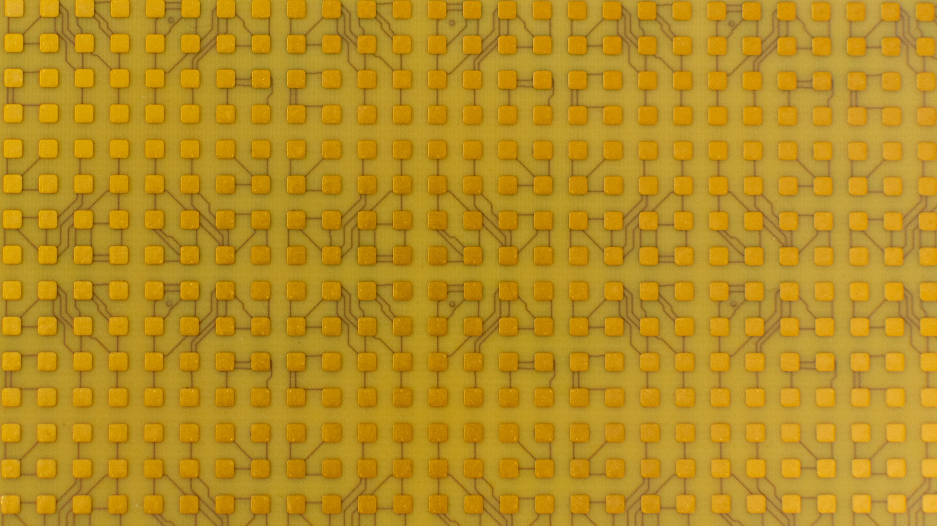
Outline
LArPix
DUNE NDLAr Implementation
Prospective DUNE Far Detector
LightPix
Scale-able cryo-compatible SiPM readout

Slide 4
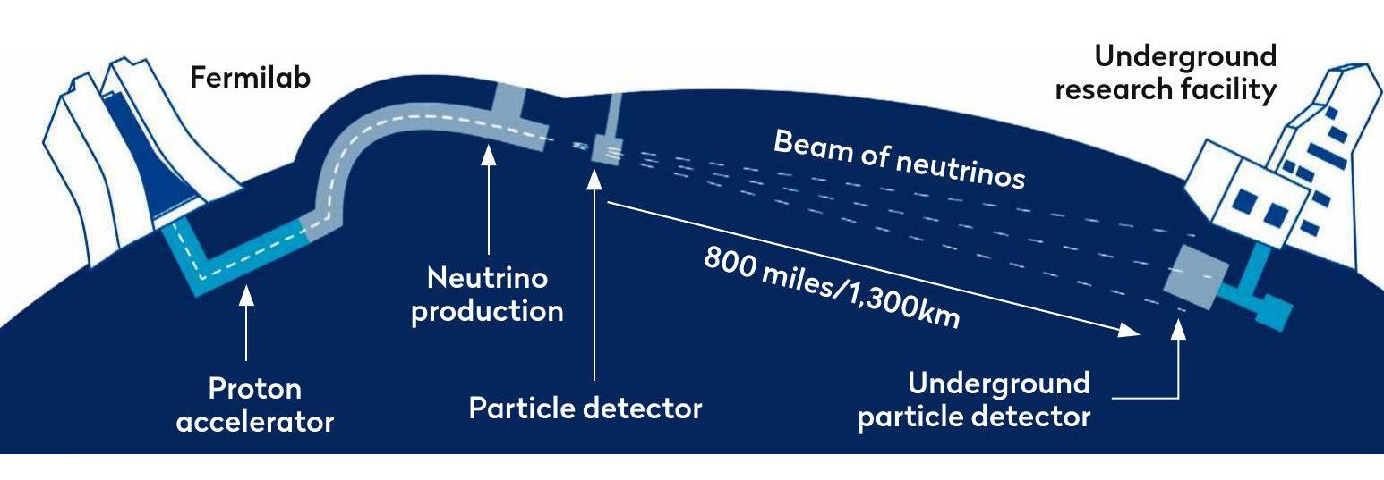
Deep Underground Neutrino Experiment (DUNE)
1.2 MW (upgradeable to 2.4 MW) LBNF (anti-)neutrino beam
LArTPC charge signal:
inherently slow & sparse
millimeter-scale charged particle tracking
O(100) keV charge signal threshold

Slide 5
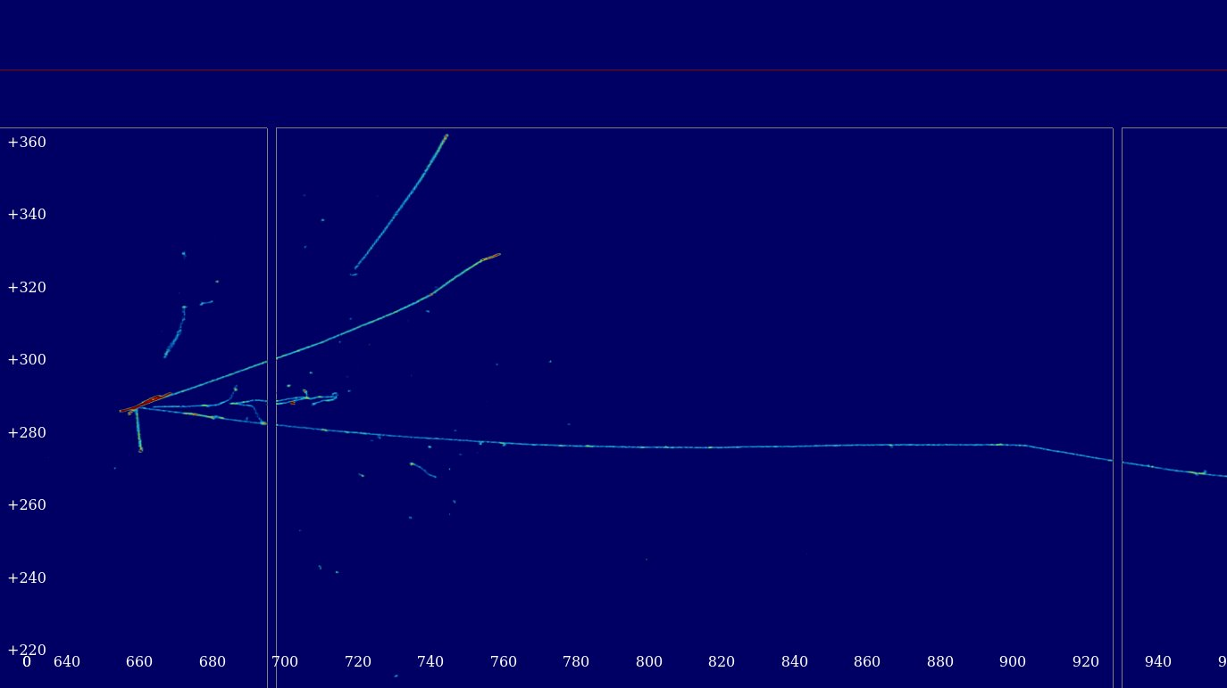
DUNE Far Detectors 1 & 2
Wire and strip continuous readout with in-situ cryogenic readout electronics
LArASIC front-end amplifier
==> See next talk on CHARMS by P. Mukim
ColdADC digitization
COLDATA manage data & fast commands-
Time
Channel
DUNE FD will collect ~30 neutrino interactions per week

Slide 6
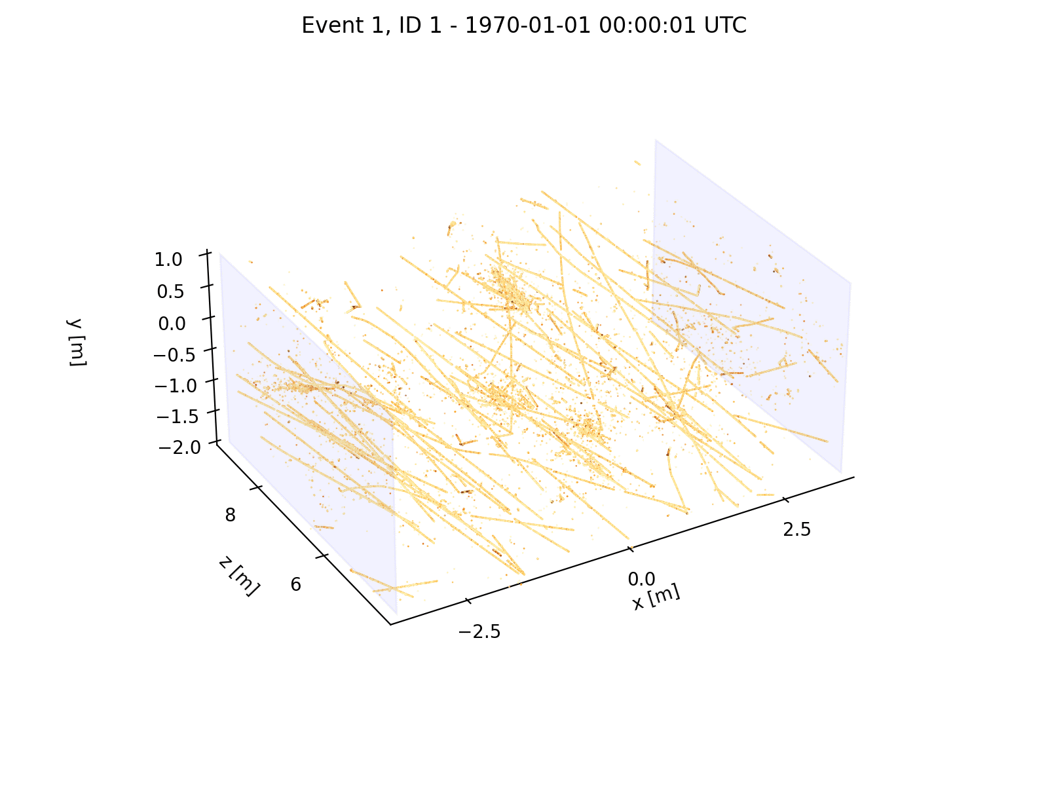
DUNE LAr Near Detector
Anticipate O(100) interactions per 10µs beam spill
70 optically-segmented LArTPCs with pixelated readout charge sensing in NDLAr
200 m² active anode area
224k LArPix ASICs
14.3M channels at 3.7 mm pixel pitch
DUNE ND will collect ~1.5 million neutrino interactions per week

Slide 7
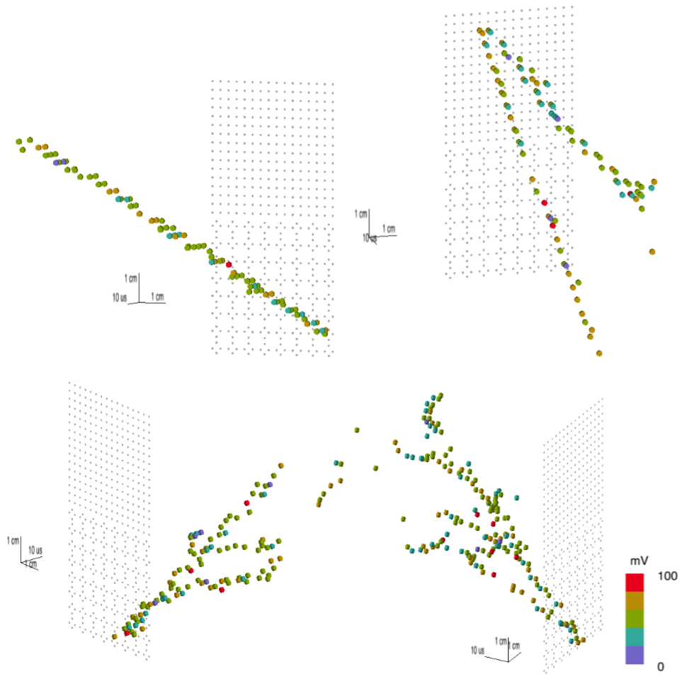
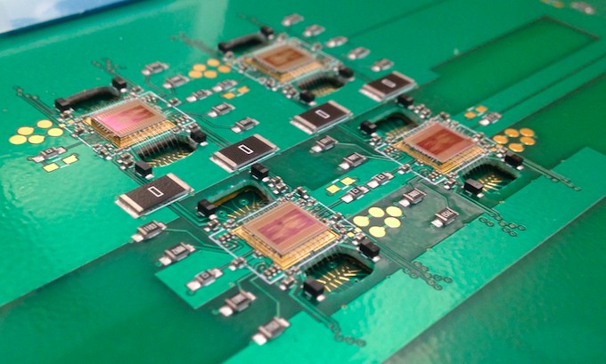
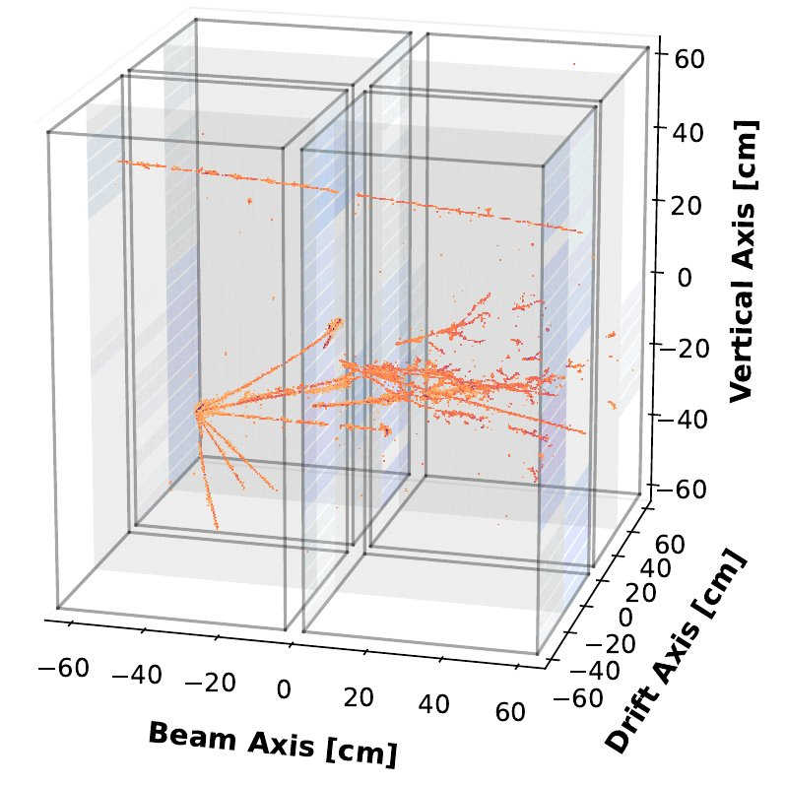
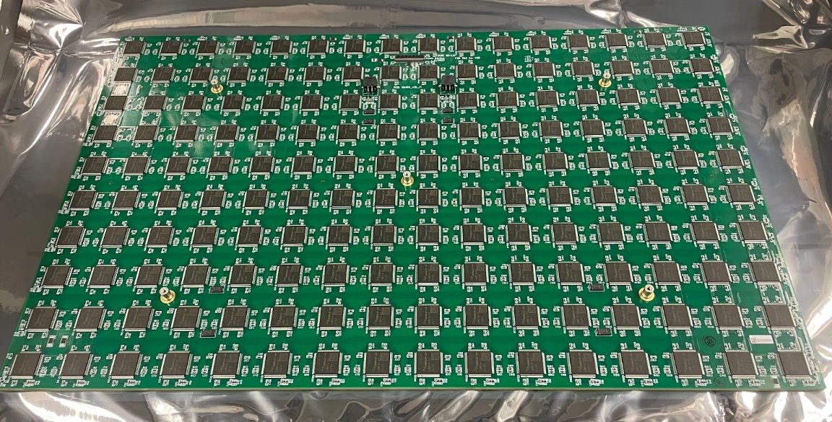
LArPix Evolution
LArPix-v1, 2016-2018
LArPix-v2, 2019-2024
LArPix-v3, 2025-
32 channel inputs
275 e- ENC @ 87K
O(10³) channel readout via 2 wires demonstrated technical feasibility
O(10⁵) channel prototypes demonstrated industry-produced, scalable system architecture
64 channel inputs
>10k digital multiplexing
800 e- ENC @ 87K
Improved data integrity (v3c)
350 e- ENC @ 87K
Differential buffer (v3c)
Differential, asynchronous 10-bit ADC (v3a)

Slide 8
LArPix-v3 ASIC Overview
Specification | Value
Analog Inputs | 64
Gain | 3.4 µV/e-
Noise | 350 ENC
Power | <170 µW/channel
Dynamic Range | 340 ke-
AFE Settling Time | <200 ns
Minimum Resampling Time | 1.4 µs
Timestamp Precision | 100 ns
Linearity | 0.9%
ADC Resolution | 10 bits
Operating Temperature | 77 K to 300 K
Cryo-compatible, low-power mixed-signal ASIC (TSMC 130 nm) designed for pixelated, true 3D readout of LArTPC detectors
Continuous self-triggered pixelated free streaming readout, ~100% uptime
Principal component of the end-to-end LArPix readout system: $0.10/channel ($10k/m²)

Slide 9
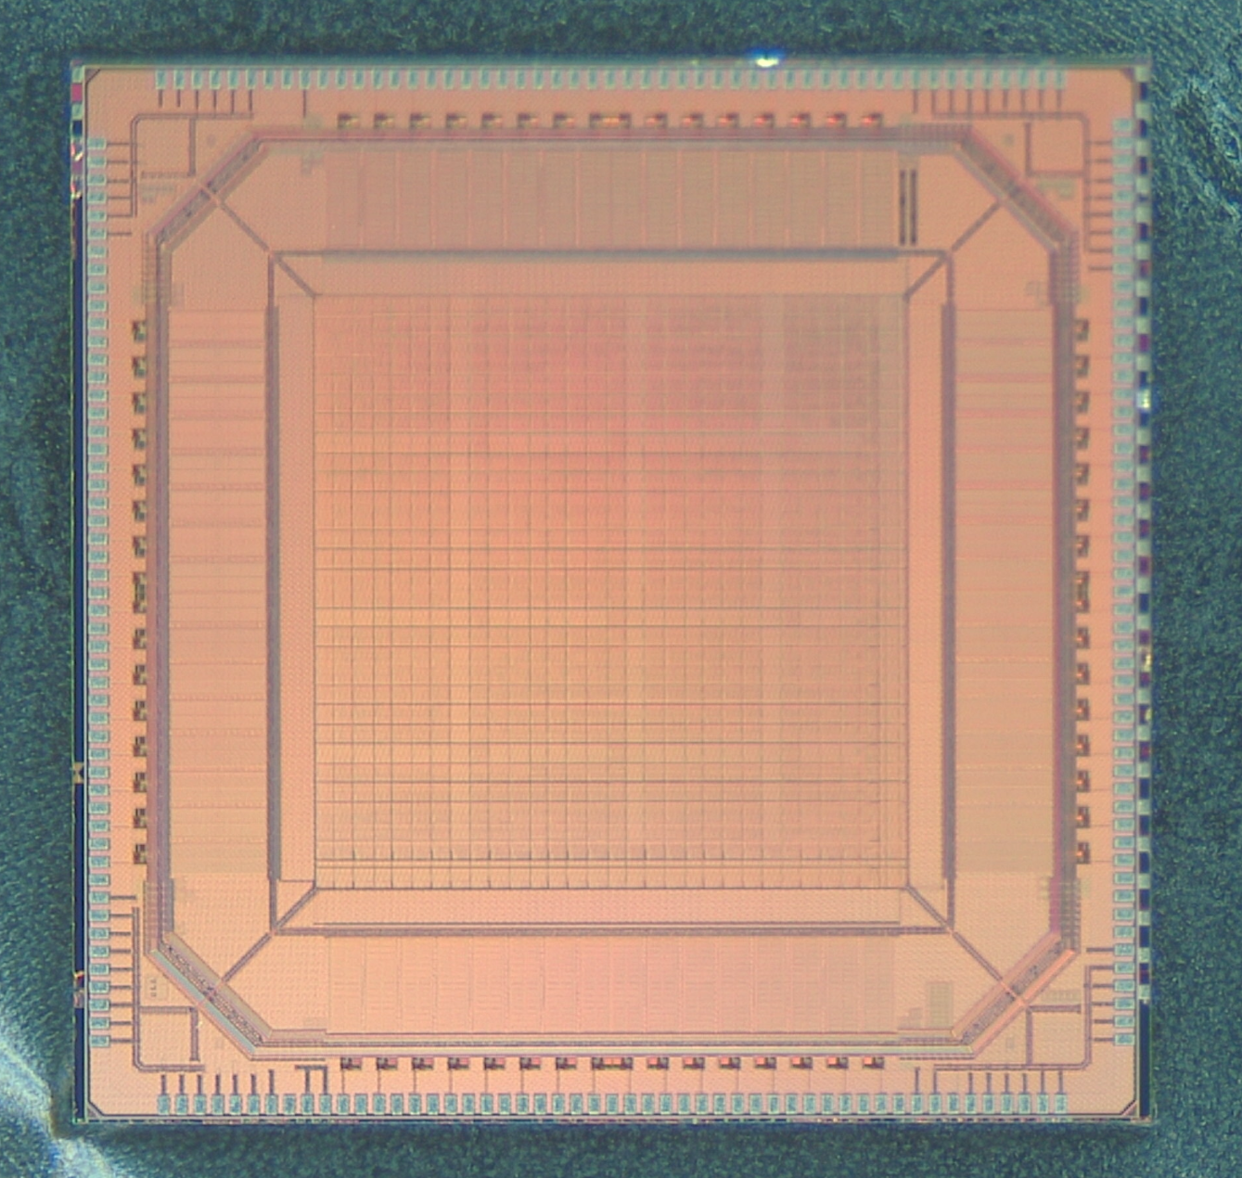
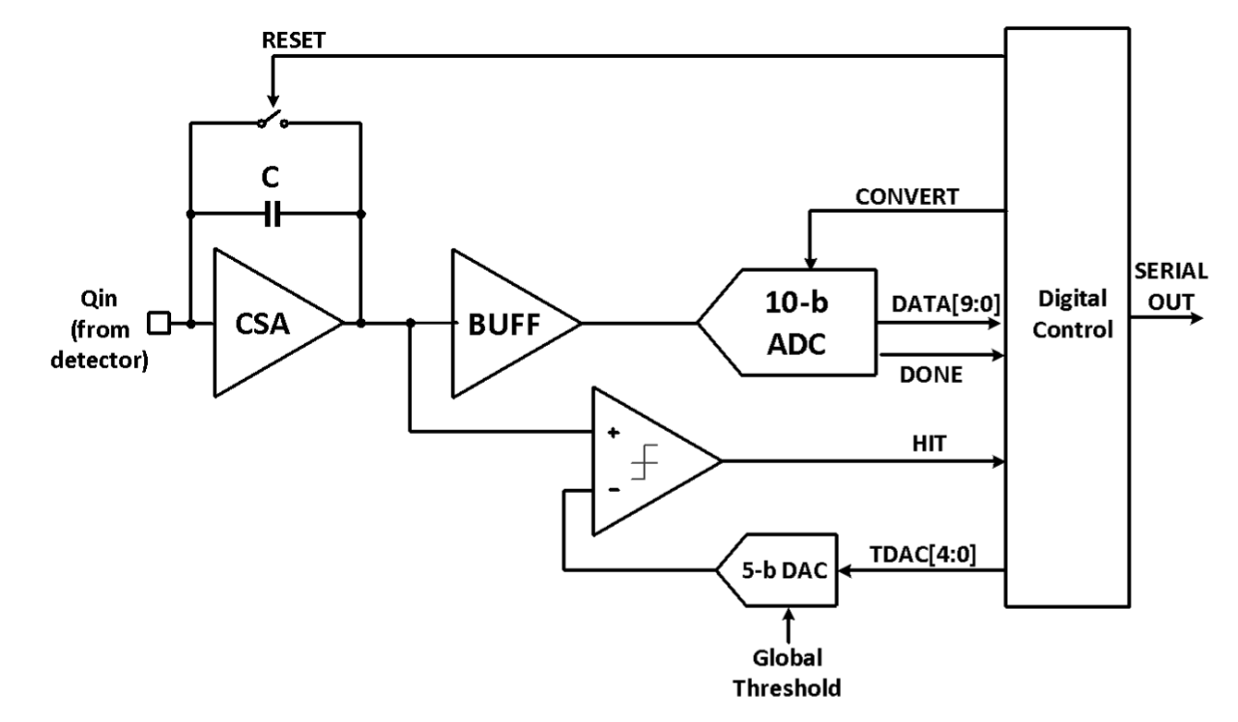
LArPix Analog Front-End
64-channel SoC, in 130nm
SAR Digitizer
5.4mm
Front-end Amplifier
Self-triggering Discriminator
Charge sensing: per-pixel integrating amplifier with self-triggered digitization and readout

Slide 10
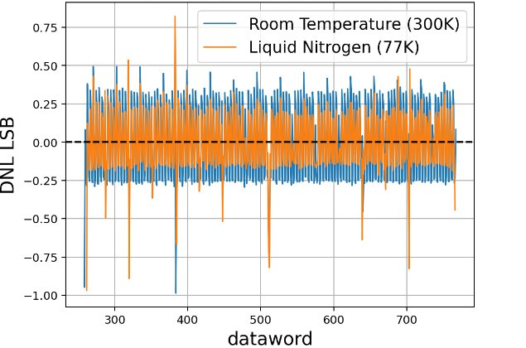
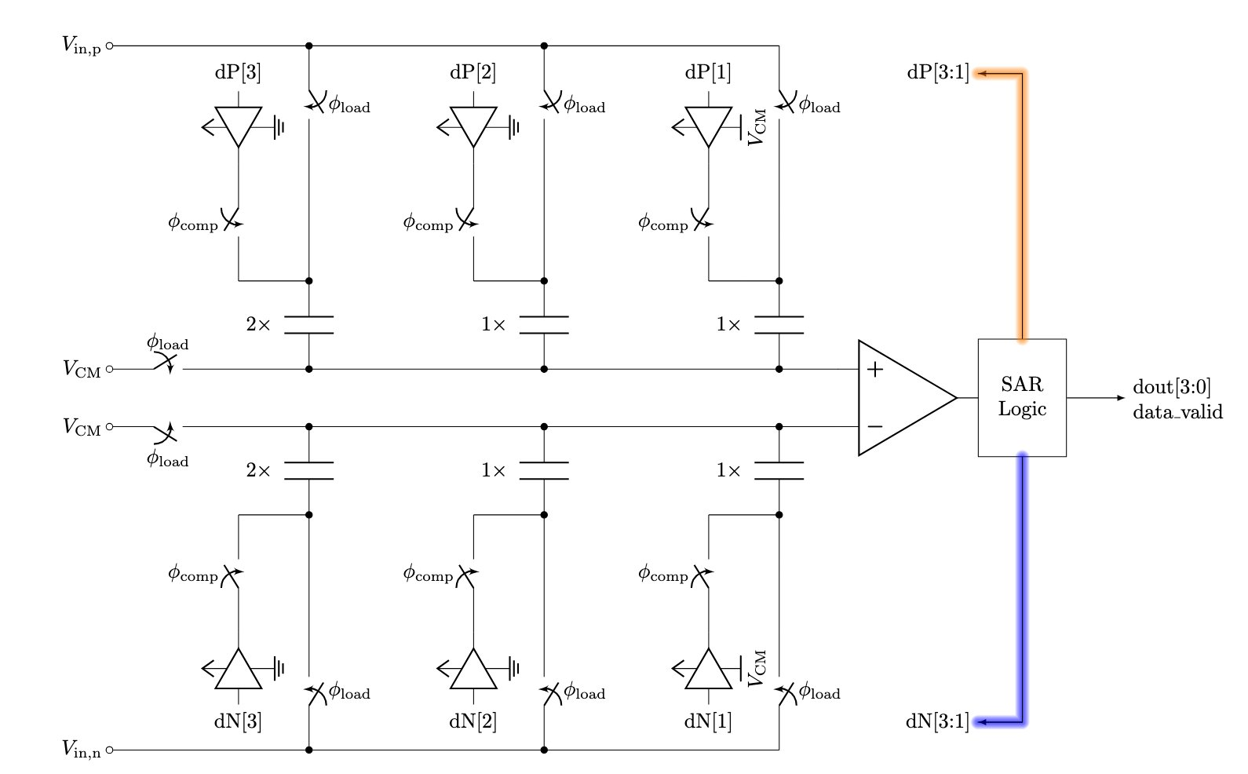
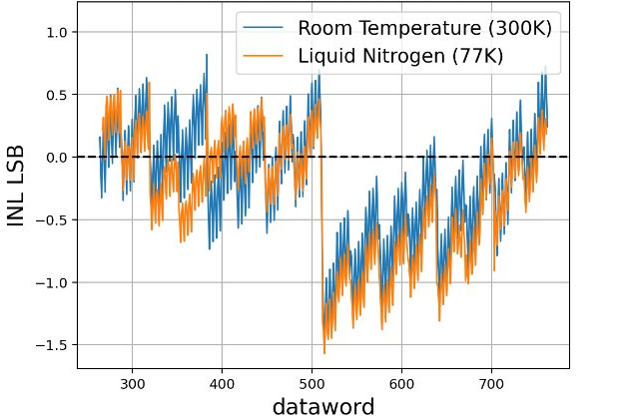
Asynchronous 10-bit SAR ADC
DNL <1 LSB
INL <1.6 LSB
(512 is a missing code attributed to a layout artifact)
Design and implementation by Panos Zarkos (LBNL)
Differential design with bi-directional switching, reduces area and power
Asynchronous logic: internally-generated clock speeds ADC conversion

Slide 11
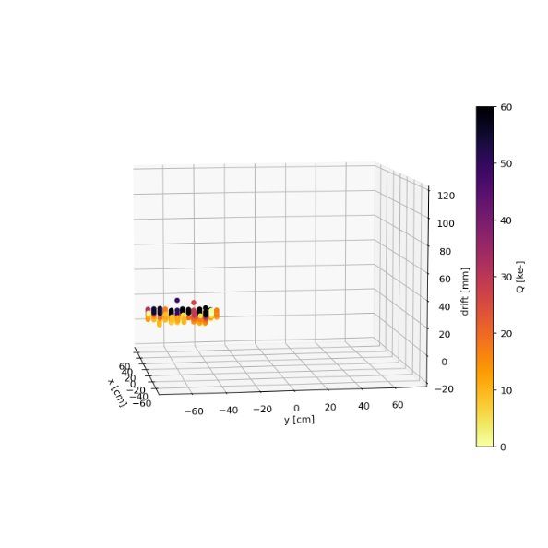
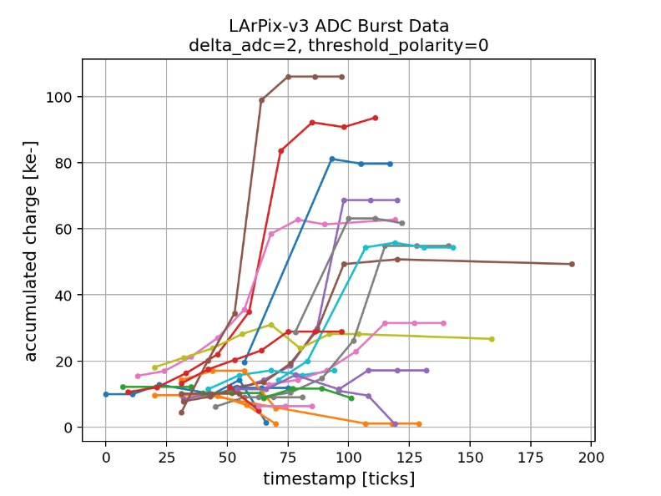
Triggering Schemes
MIP track ~parallel to anode
Self-trigger reset (nominal operating mode): digitize and drain charge after threshold crossed
Cross-trigger reset: digitize and drain sub-threshold charge based on self-trigger of another pixel
External-trigger reset: digitize and drain sub-threshold charge based on external signal
Periodic-trigger reset: periodically digitize and drain sub-threshold charge at fixed cadence on a channel rolling or chip-synchronous basis
Optional burst modes
Fixed burst: process N hit cycles for each self-trigger
ADC threshold: continue to process hit cycle until an ADC dataword ceiling (or floor) is exceeded
ADC settle: continue to process hit cycles until change in ADC value is below set value
ADC settle triggering scheme

Slide 12
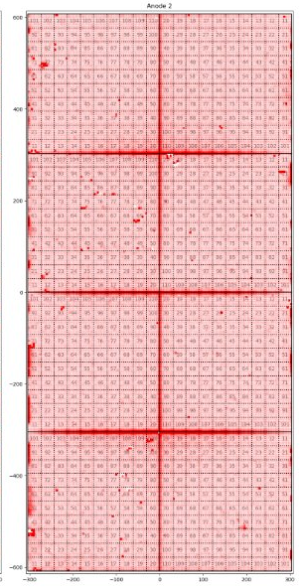
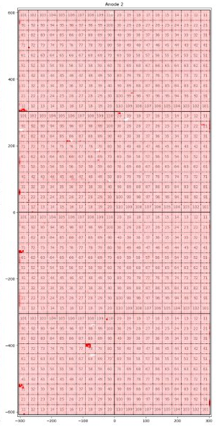
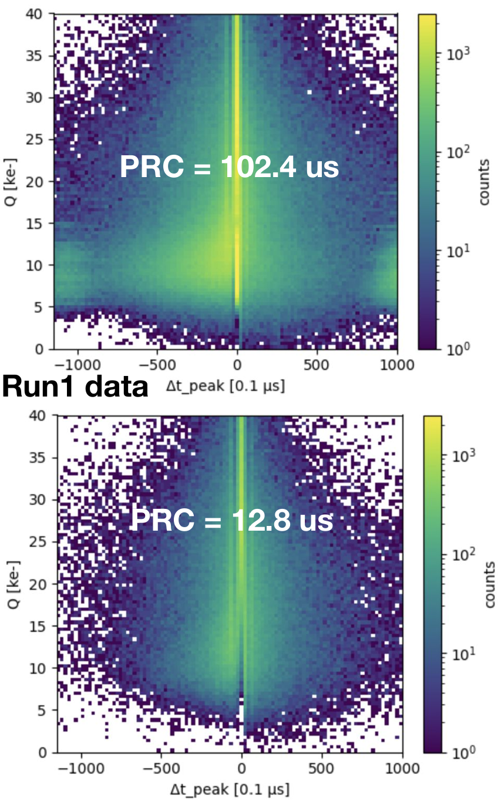
Reset Schemes
Pixel pedestal RMS (50k channels)
Front-end periodic reset at a configurable cadence on a channel rolling or chip-synchronous basis
Highly effective in mitigating detector environment noise
Microphonics
Cryocooler power cycling
Long-range induction mitigation
100 ns AFE deadtime incurred with each reset
Reset at 2.4 Hz
Reset at 2.4 kHz

Slide 13
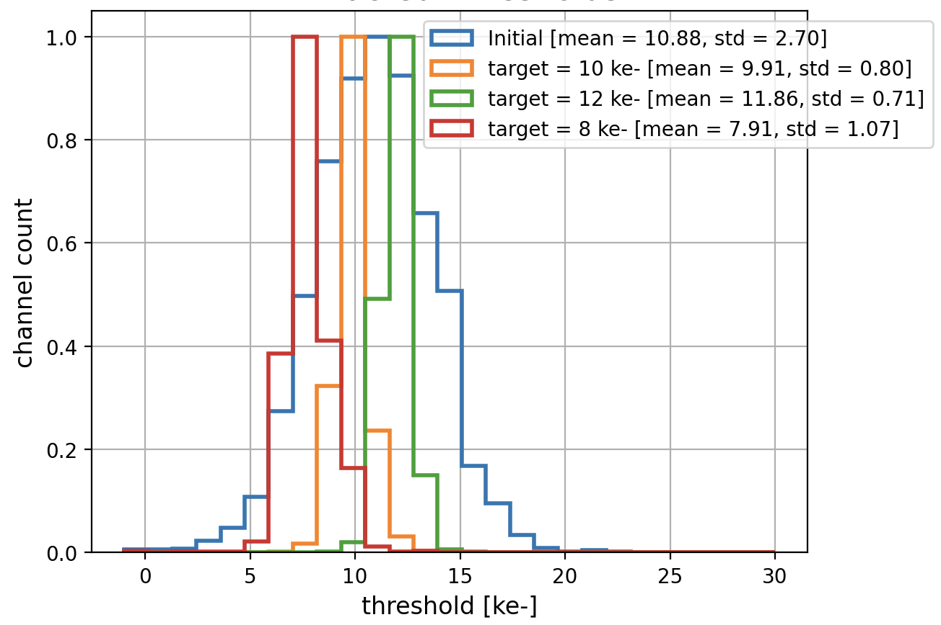
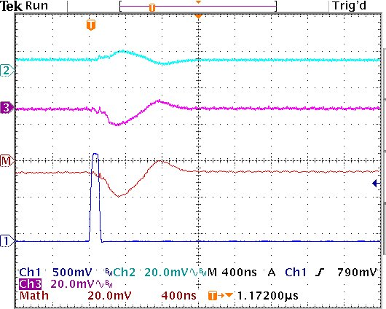
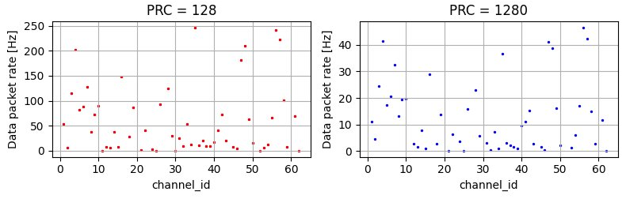
Operating Thresholds
Channel thresholds are highly configurable
Ability to dynamically set/change thresholds during operation
Investigating channel reset-induced pickup
Results in spurious triggers at ~3000 e- threshold level
PRELIMINARY
AFE monitor output
Digital reset signal

Slide 14
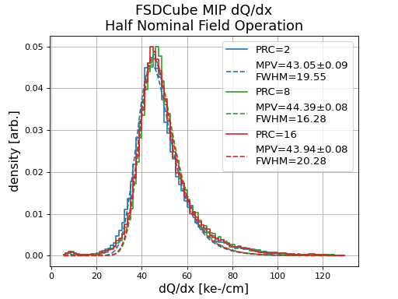
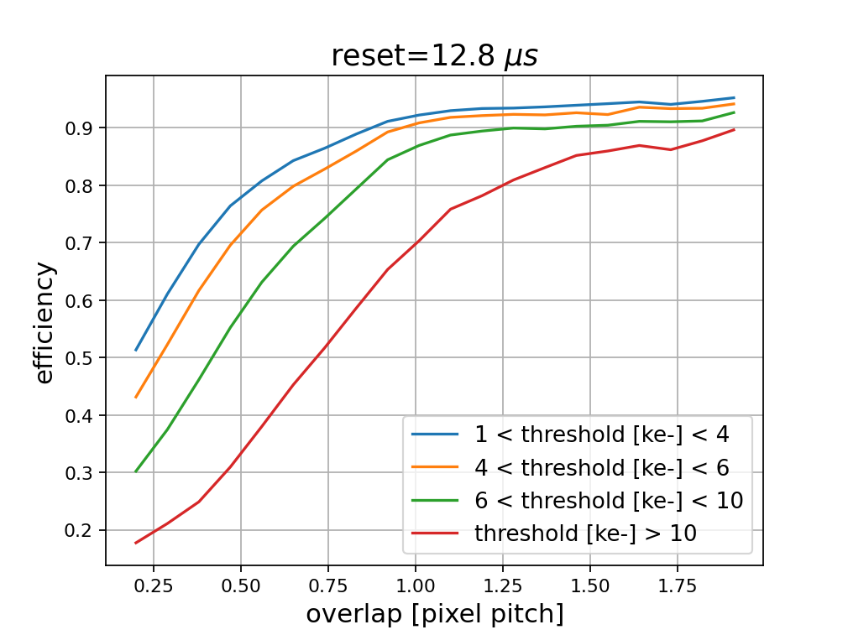
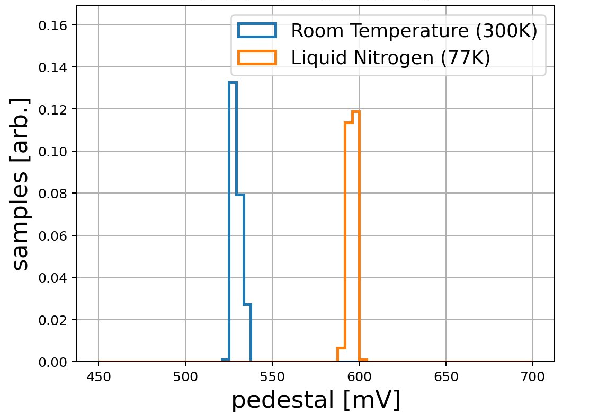
Analog Front-End
Key design changes:
Super source follower front-end buffer
Asynchronous 10-bit SAR ADC
Correlated-double sampling
Performance benchmarked in small-scale LArTPC
Known bug in management of memory buffer causes few percent data loss

Slide 15
LArPix Digital Back-End
64-channel SoC, in 130nm
5.4mm
Digital control: data aggregation, amplifier configuration, inter-chip communication
Data transmitted on every rising clock edge (10 Mbit at 10 MHz CLK)

Slide 16
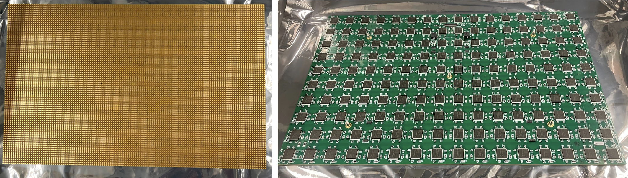
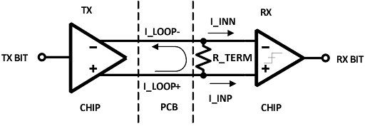
Digital I/O
Custom tunable low-voltage digital transmitter and receiver
Similar to LVDS in concept, but much lower power: O(10 µW) per transmitter & receiver
Highly-tunable loop current and termination resistance supports multiple modes of operation (chip-to-chip, chip-to-controller)
Optional mode for automatic transmitter power-down when no data
off-tile I/O

Slide 17
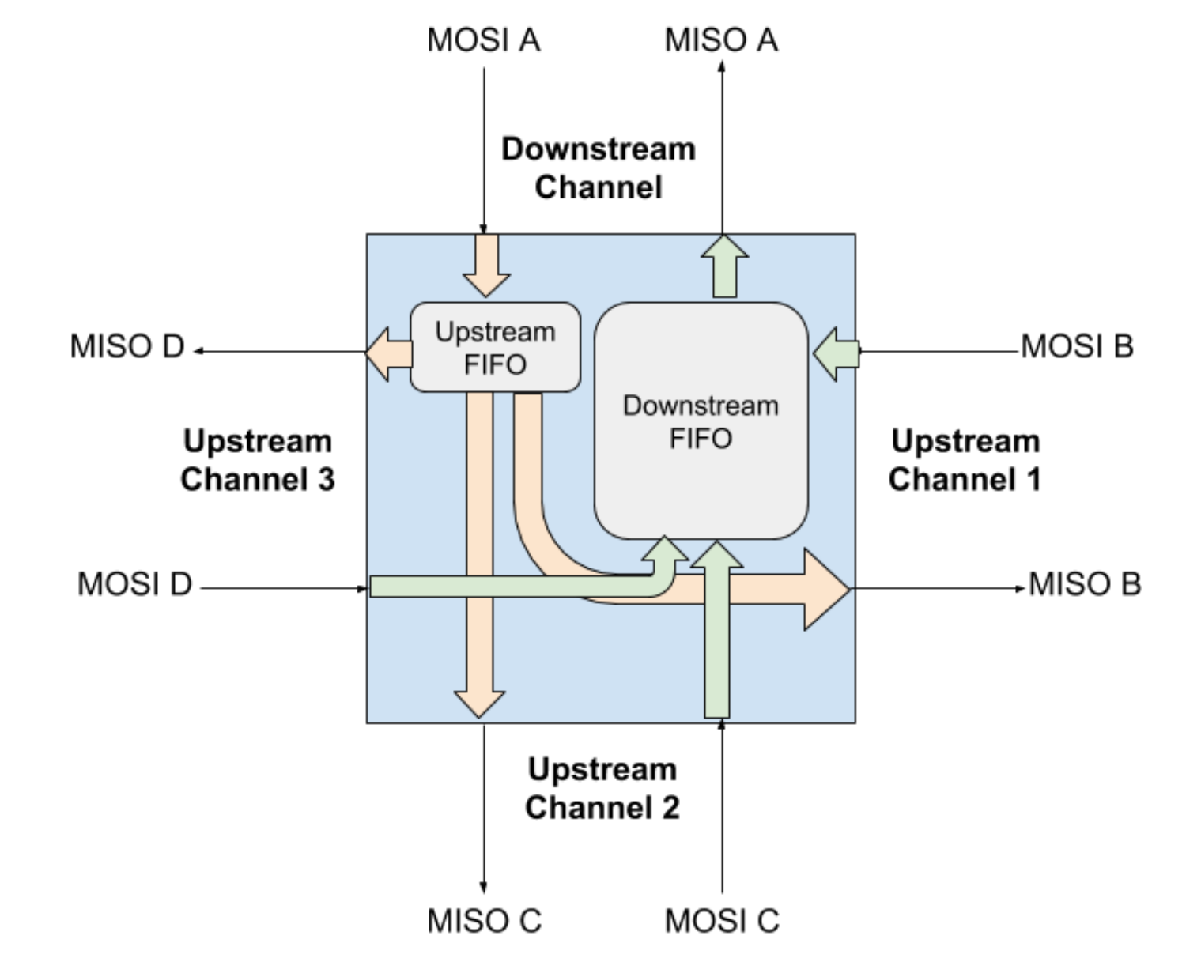
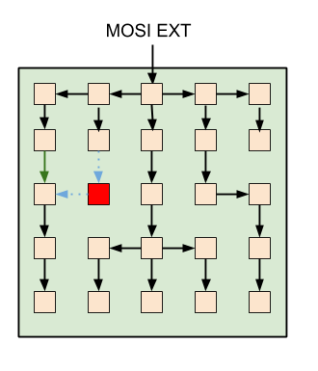
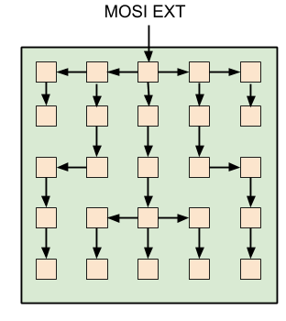
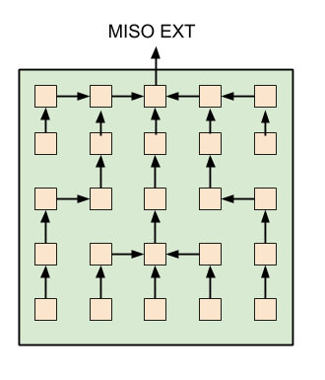
Hydra I/O
Each ASIC capable of configurable I/O in any cardinal direction
I/O can occur between any neighboring chips on pixel tile
ASIC network constructed by explicit configurable connection between neighboring ASICs in a determined fashion
Example 5x5 pixel tile network
Example failed chip

Slide 18
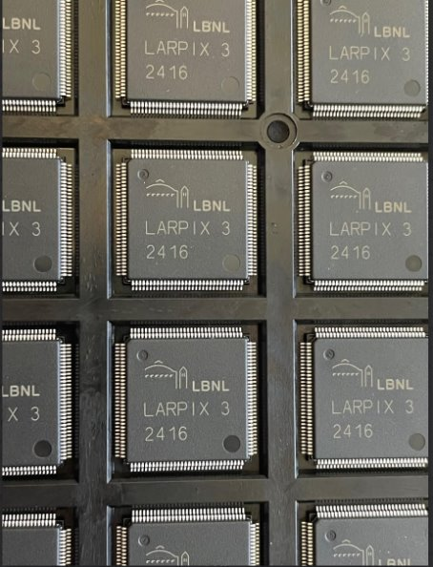
Power
Power dissipation is reduced with:
Low voltage supplies (VDDA 2.2 V, VDDD 1.2 V)
Low data rates
Channel power is lowered by avoiding digitization and readout of mostly quiescent data
Minimizing the number of active components in the cryogenic environment
Use a standard TQFP128-EP package
==> ground pad serves as a heat sink to aid thermalization and mitigate localized heat density

Slide 19
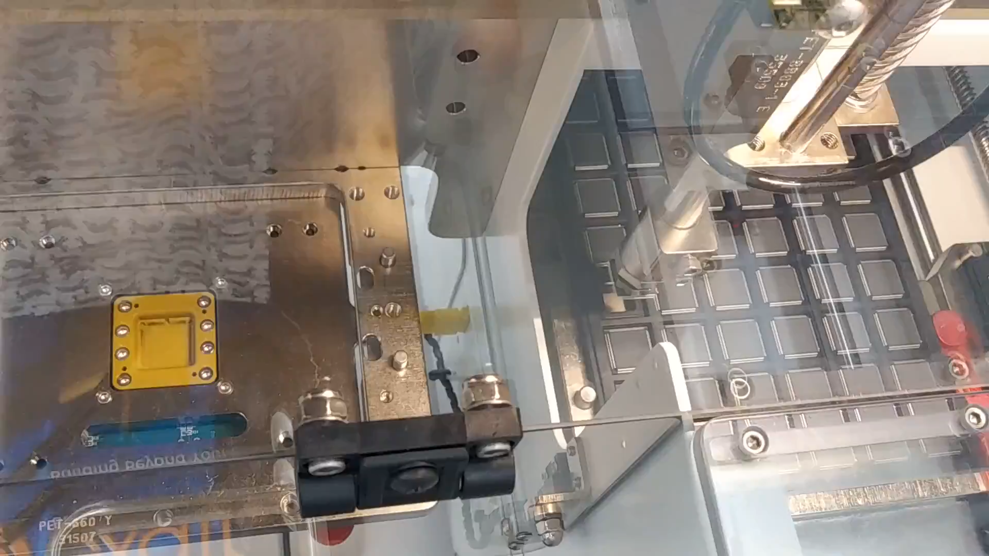
ASIC Yield
6457 LArPix-v3 ASICs screening:
94.7% good
2.6% fail due to high noise/leakage
2.7% fail due to I/O fail (includes DOA)
<<1% fail due to bit flips
900 chips/day testing throughput with 1 robot
Robotic chip testing @ Caltech

Slide 20
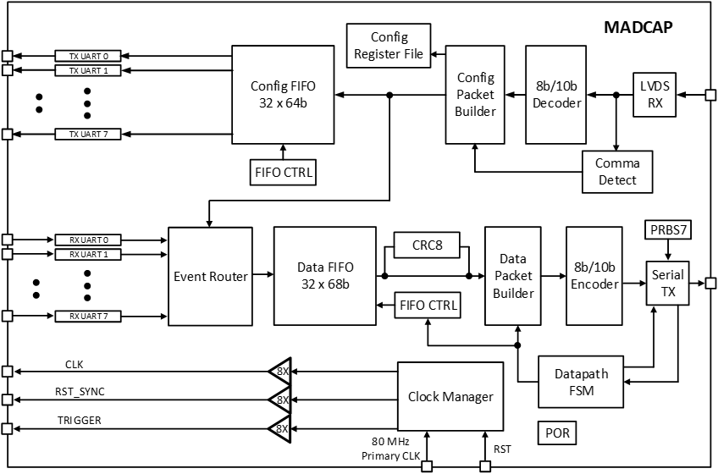
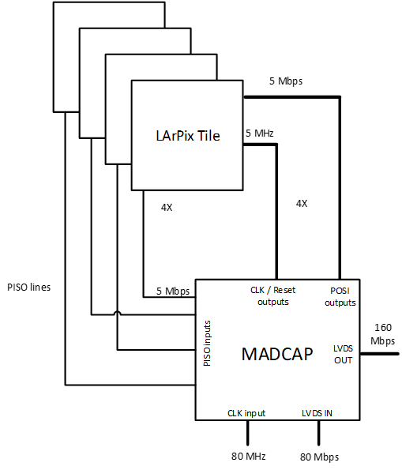
Prospective DUNE Far Detector
To reach O(10⁸) pixel system scale, need to reduce the number of cables/feedthroughs
Aggregate data I/O from multiple pixels to reach O(10⁵) pixels per data channel
MADCAP (multiplexer ASIC for data and clock aggregation) in development as a cryo-compatible digital multiplexer
130 nm TSCM MPW tapeout next month

Slide 21
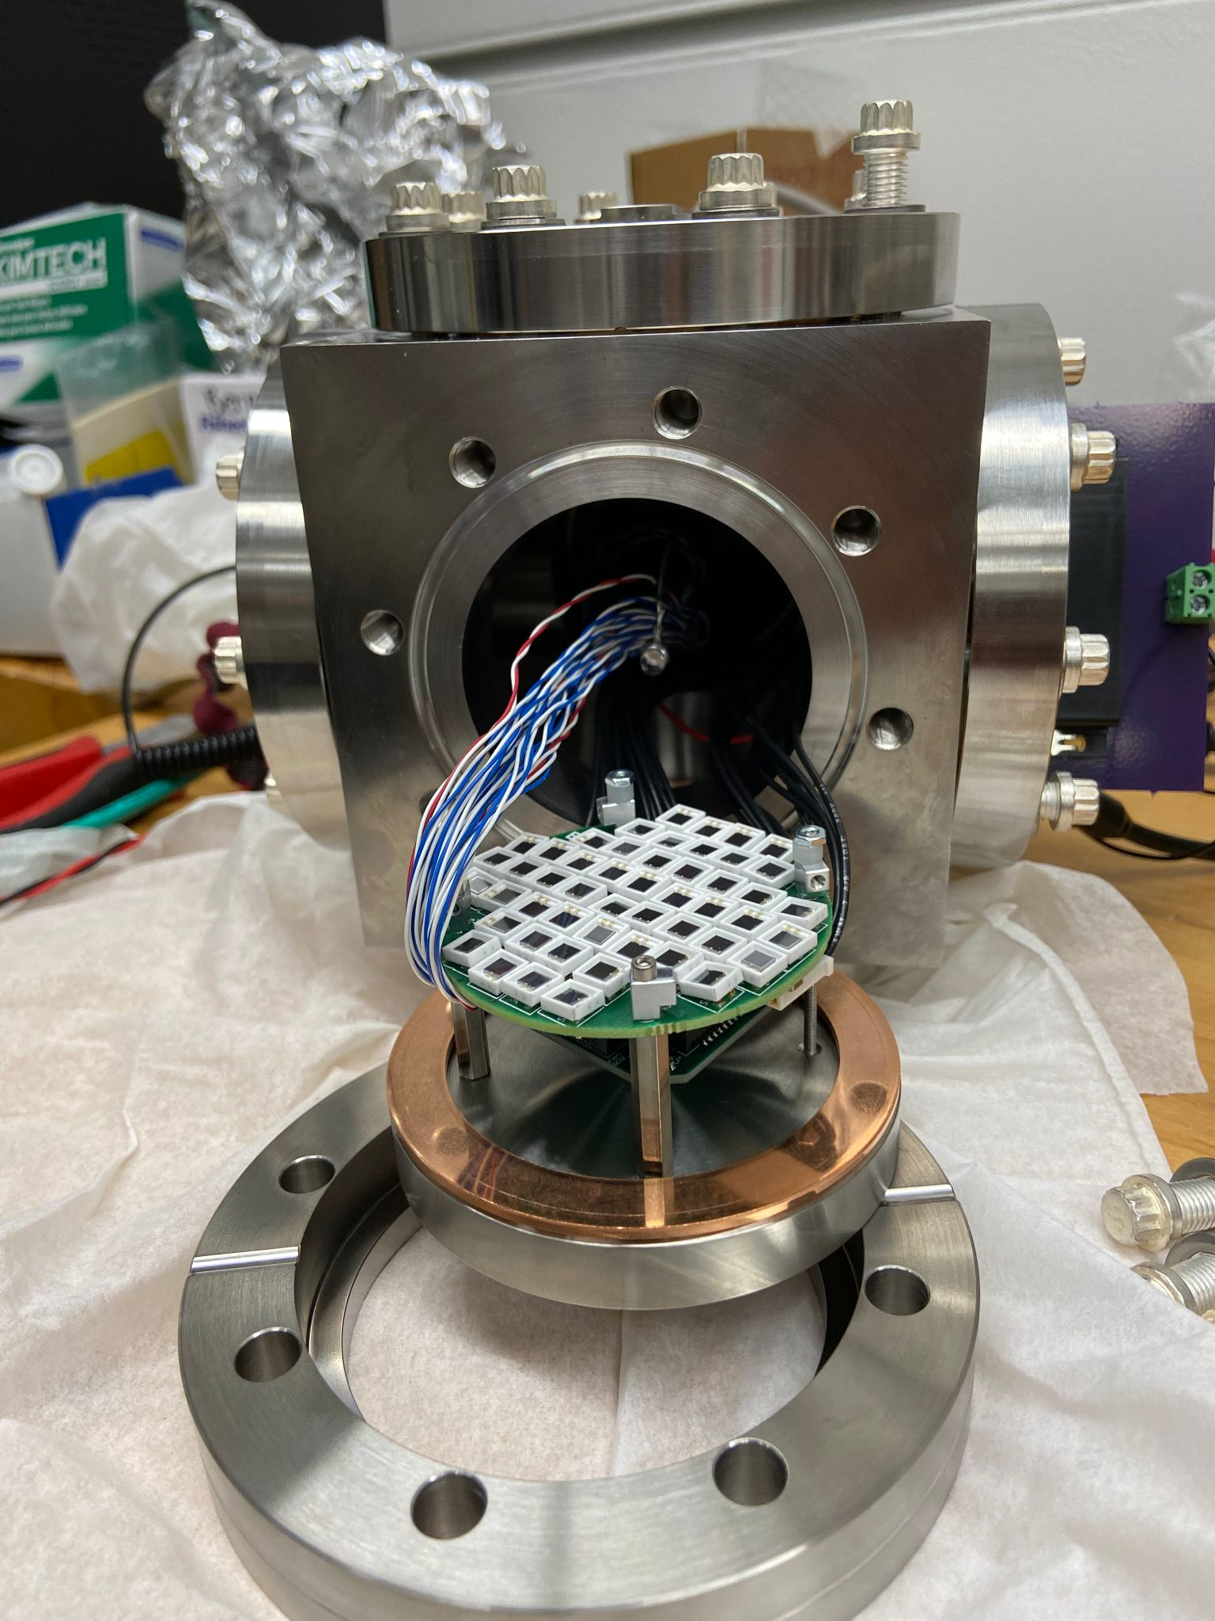
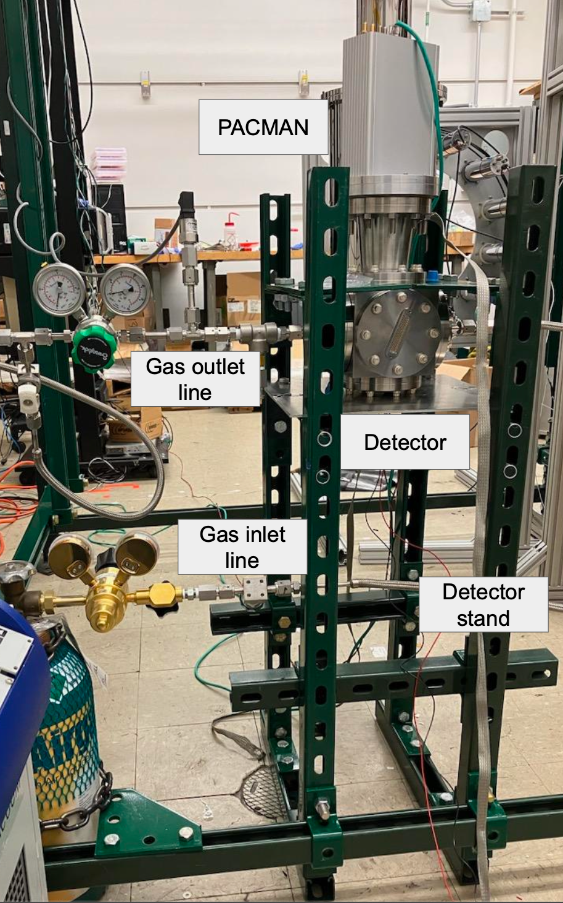
Outline
LArPix
DUNE NDLAr Implementation
Prospective DUNE Far Detector
LightPix
Scale-able cryo-compatible SiPM readout
LightPix-v1 readout system for GHe applications at UC Berkeley: 50x 3 mm by 3 mm VUV SiPMs with single cable power, I/O

Slide 22
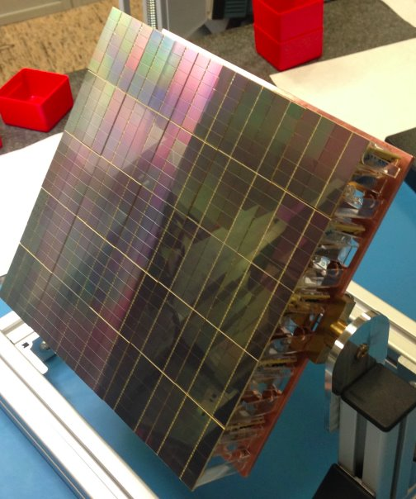
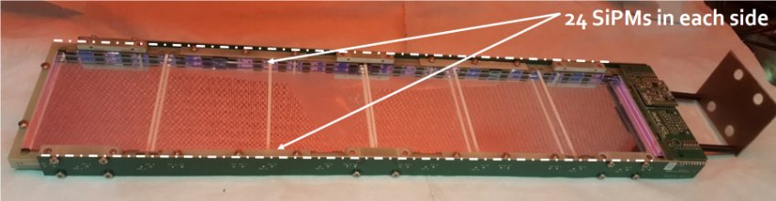
Motivation
Example of direct SiPM detector format from DarkSide-20k prototype
Traditional tradeoff for SiPM-based applications requiring high photocoverage: sacrifice spatial resolution for collection efficiency
Design considerations driving multiplexing requirements:
Cost
Power dissipation
Technical need for scalabe (high collection efficiency, high channel count), low-power SiPM readout without ganging signals and operating 77 K to 300 K
Example of large area light trap with X-ARAPUCA

Slide 23
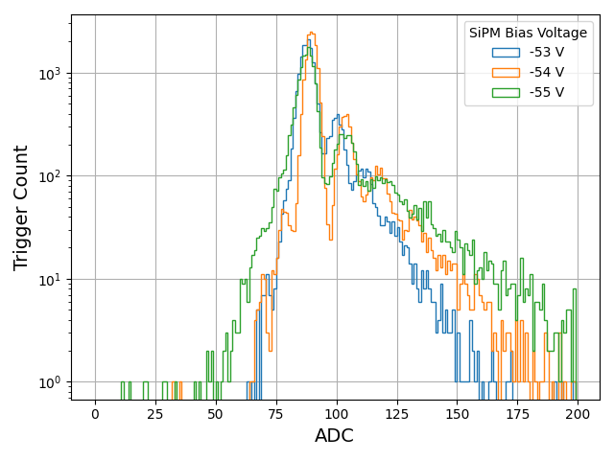
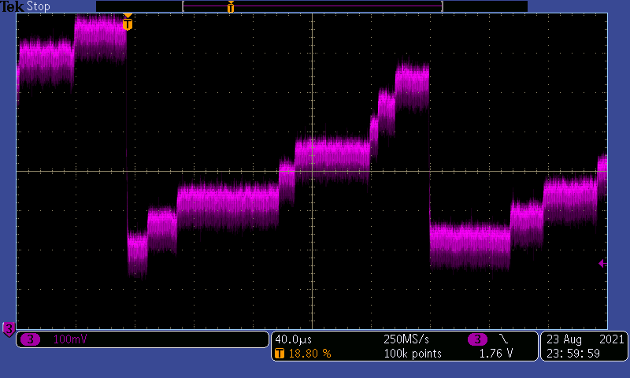
SiPM Dark Counts on LArPix-v2 AFE
1 PE
2 PE
3PE
23

Slide 24
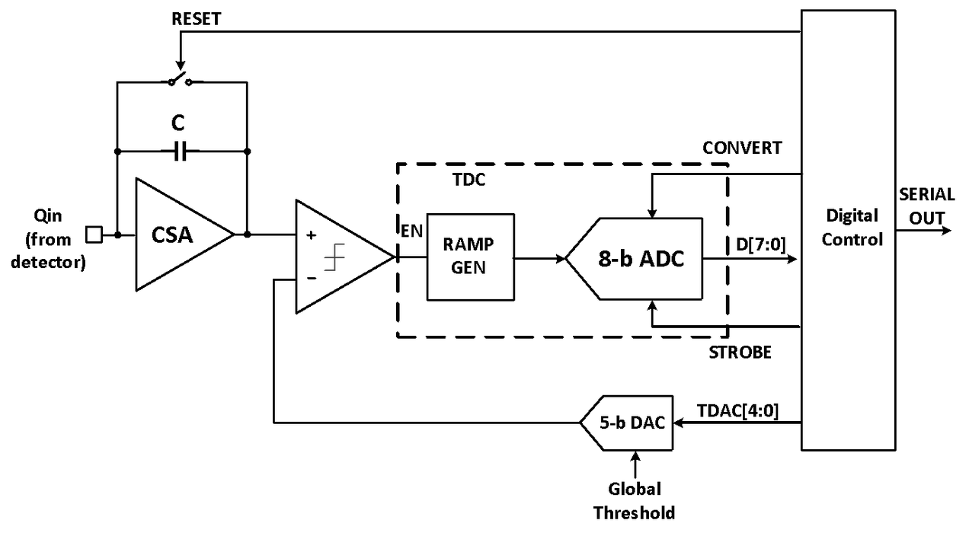
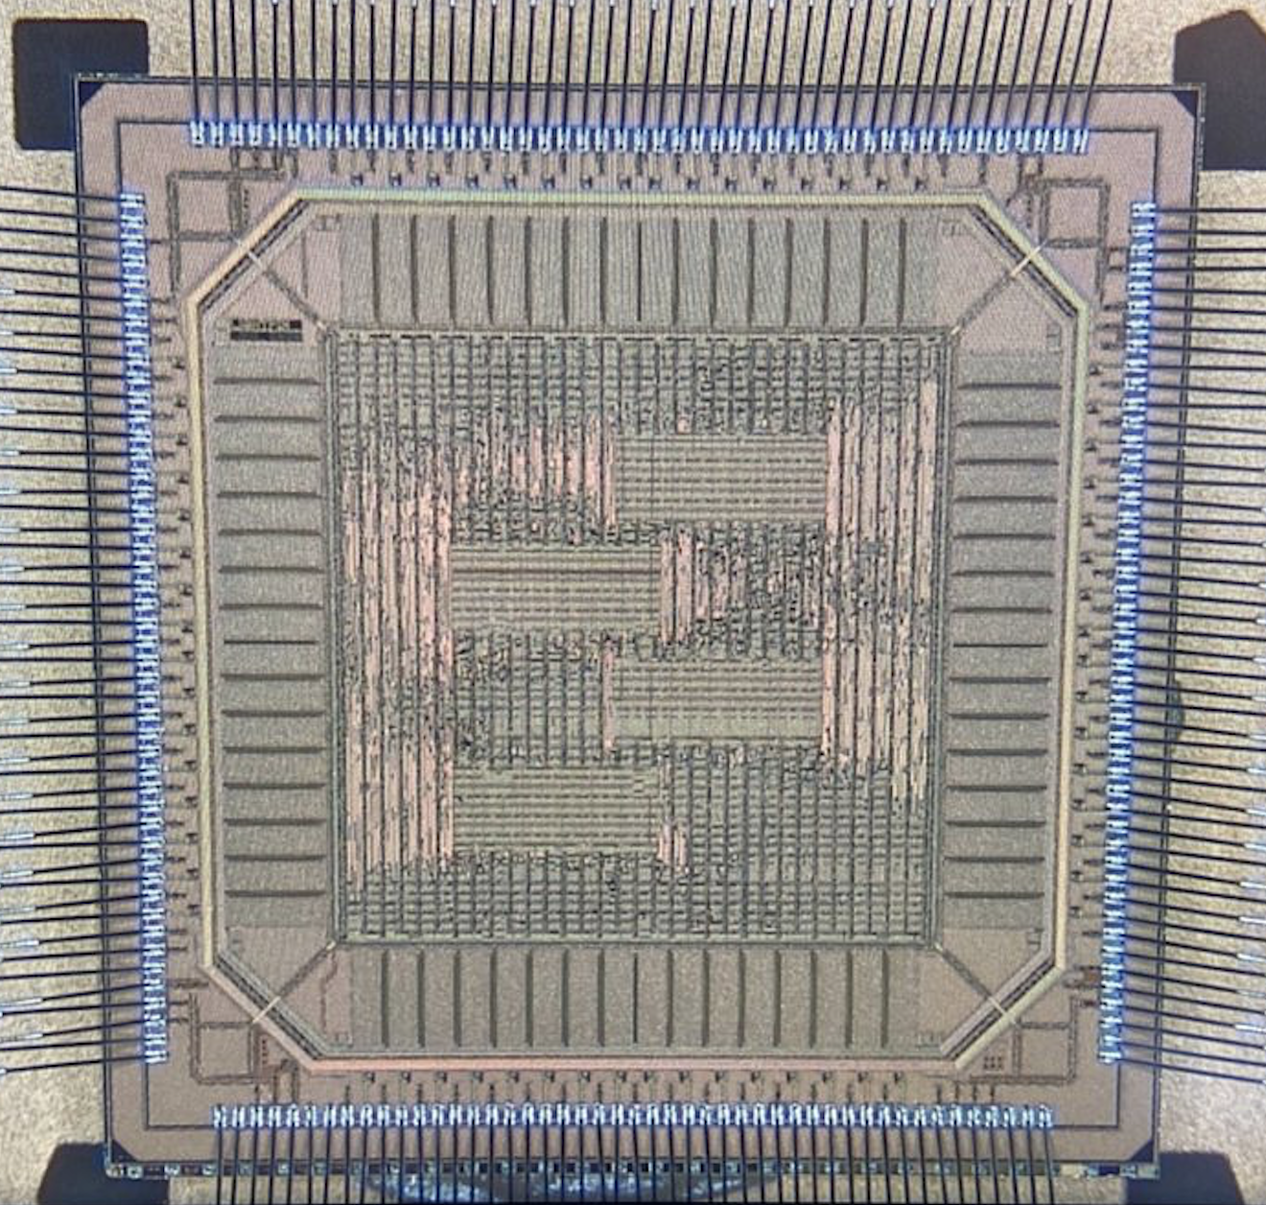
LightPix-v1
Unique channel input for each SiPM
A single photoelectron discriminator with a TDC for fine-timing
Designed for very-high-channel-count systems with low occupancy, where the typical number of photons per channel is less than one
Calorimetry and pulse-shape discrimination achieved through the aggregate distribution of photon arrival times across many SiPMs
"LightPix-mode": tuneable multi-channel coincidence triggering mode to suppress excess data from dark noise
1-64 channels over threshold in 100 ns to 13 µs window
LightPix-v1 produced in
180 nm TSCM

Slide 25
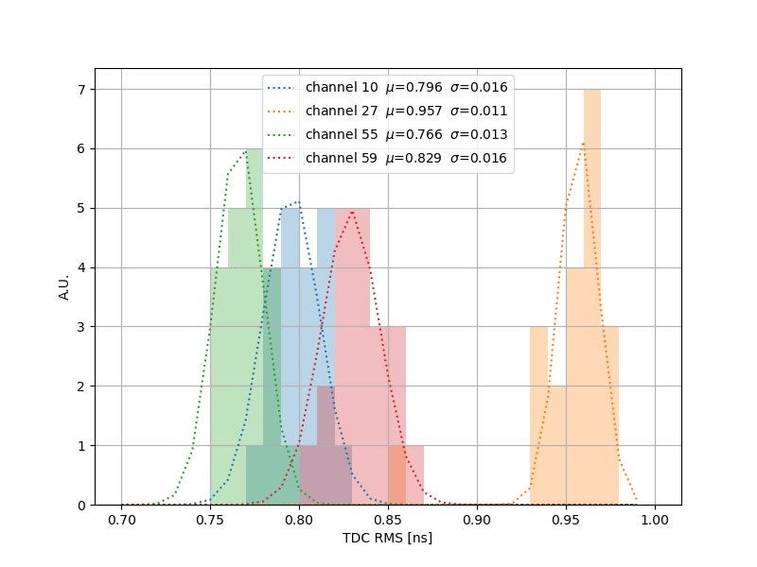
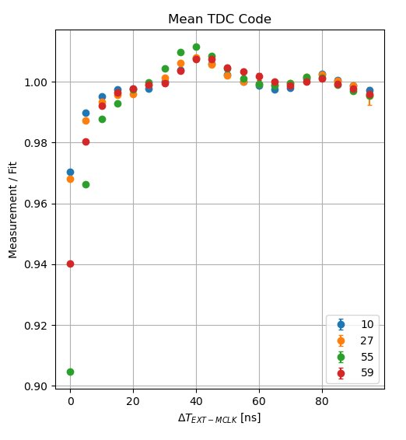
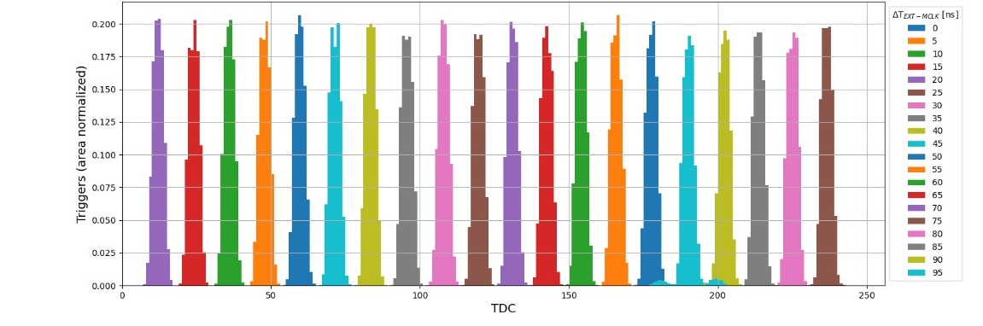
LightPix-v1 Performance
TDC evaluation for O(1) PE inputs:
TDC linear to <10% within 10 ns of ramp generator start
< 1 ns jitter
< 2 ns time-walk bias
<1 ns RMS global timing accuracy
Dark count suppression logic validated

Slide 26
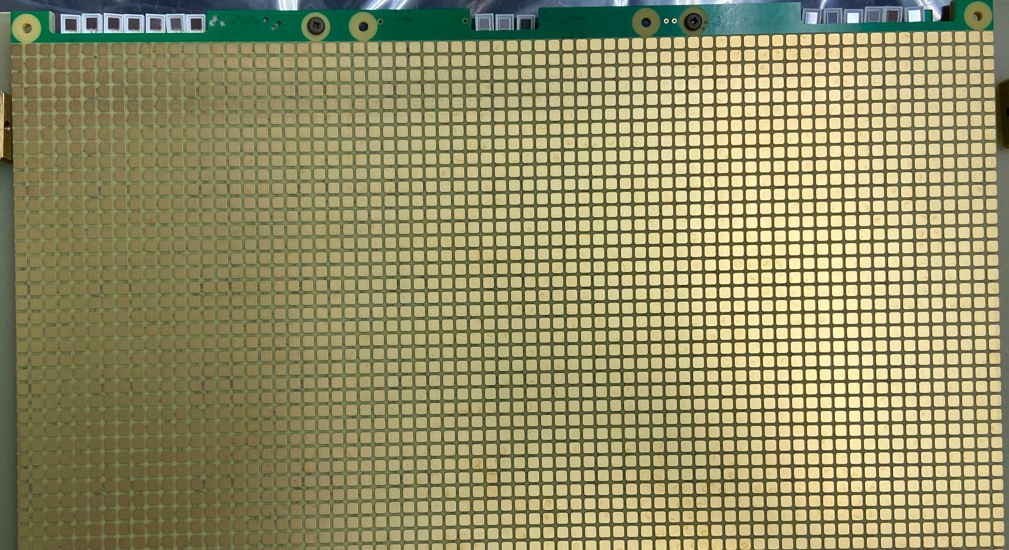
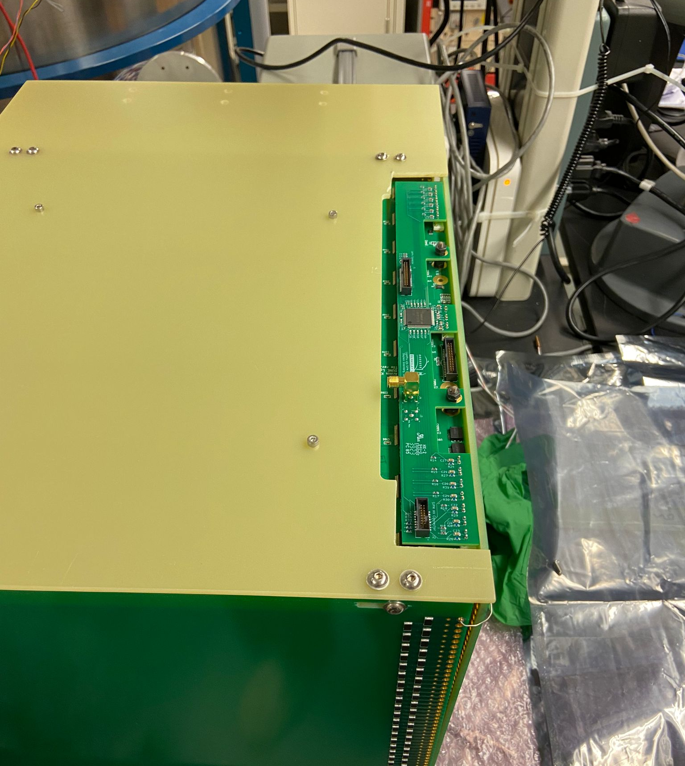
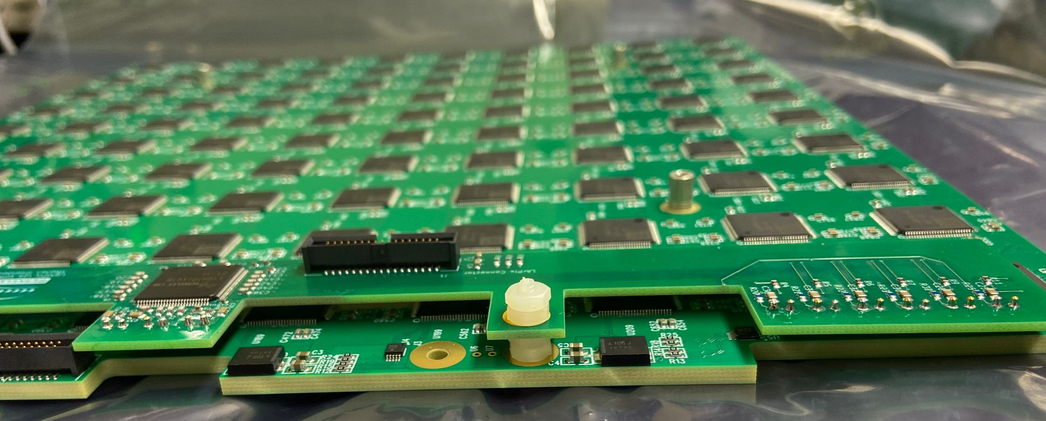
16 HPK Direct VUV 3mm x 3 mm SiPMs
LArPix-LightPix Dual TPC Readout
Proof of concept for joint charge/light readout with direct VUV light detection in LArTPC
SiPM PCB attaches directly to LArPix anode tile
Single PACMAN controller, two shared data/power cables

Slide 27
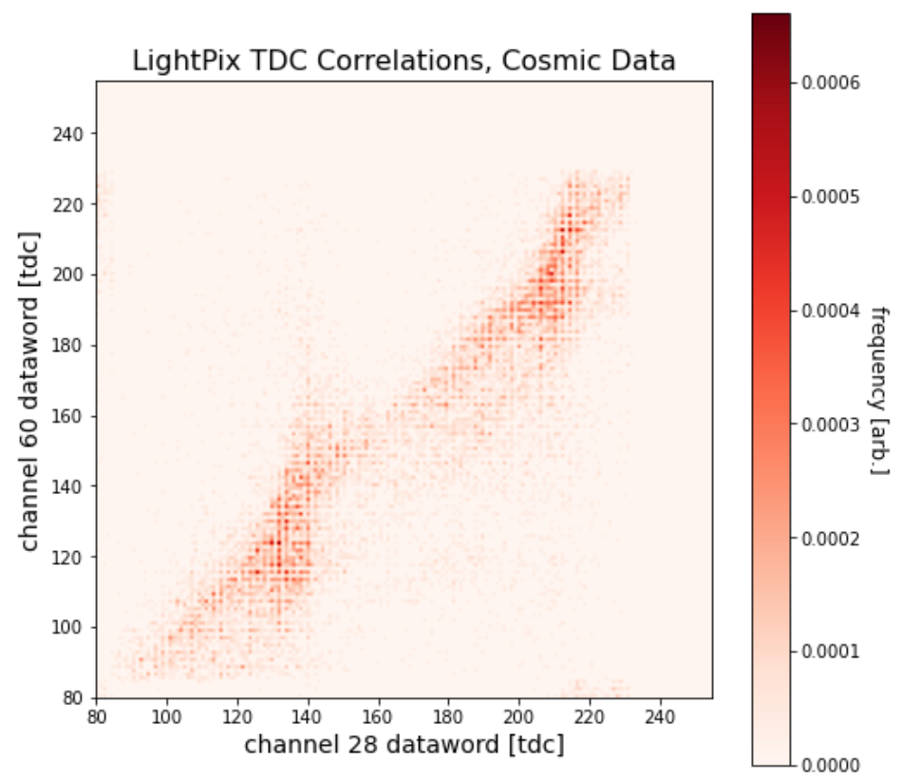
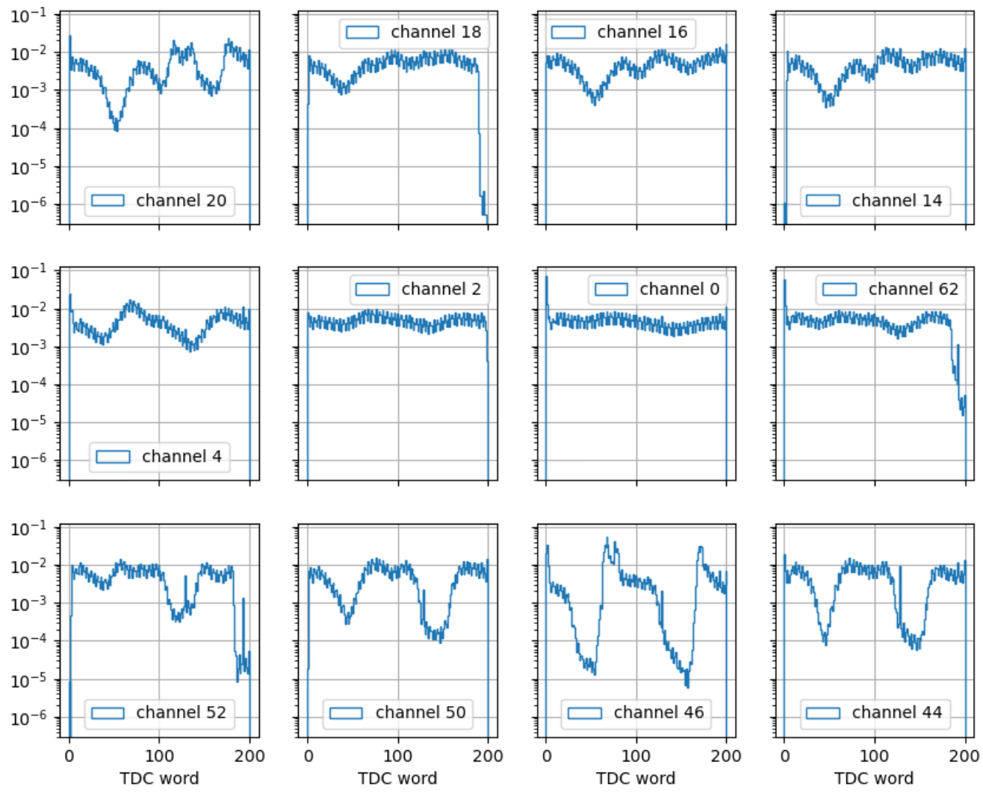

LightPix TPC Performance
Issue: significant cross-talk from LArPix-v2a single-ended I/O
Per-event timing correlations slewed by pickup from single-ended clock & digital I/O

Slide 28


LightPix-v3
Design changes relative to version 1:
Replaced CSA with TIA optimized for larger SiPM capacitance (6 mm x 6 mm or larger)
Added ADC in parallel with TDC for use in higher-occupancy detectors
Fully differential, low-swing clock and digital I/O
32 "super channels" with sub-ns timing +multi-PE calorimetry
LightPix-v3 produced in
180 nm TSCM

Slide 29


LightPix-v3 TDC
TDC resolution and linearity < 1 ns

Slide 30

Adjusted channel trigger threshold
LightPix-v3 ADC
Demonstrated multi-PE discrimination and single-PE self-trigger efficiency
Flexible application:
Channel threshold tunability for single-channel dark count rejection
Chip-level dark count rejection
Initial studies (without optimization) demonstrate ~20 PE dynamic range
Triggers (area normalized)
ADC word

Slide 31
Summary & Outlook
LArPix has demonstrated continuous self-triggered pixelated free streaming readout at the O(10⁵) channel scale
Targeted improvements to be incorporated into the next ASIC tapeout (v3c in Summer '26)
Fully-differential front-end buffer
Remediate data loss from FIFO event contention
Remediate reset correlated front-end pickup
Further system channel scaling requires implementation and system integration of a digital multiplexer (MADCAP)
LightPix is a low-power, cryo-compatible, scale-able readout ASIC for targeting a general multipurpose, high-channel-count SiPM systems
Multiple development threads in progress:
LightPix+SiPM timing-energy correlation evaluation in progress
LightPix-specific system controller architecture
In-situ detector format implementation

