Slide 1






Development of the COFFEE Chip for Particle Tracking
— A MAPS in 55 nm HVCMOS process for CEPC ITK and LHCb UP
  Yang ZHOU (IHEP)
  On behalf of the HV-CMOS pixel sensors in 55nm process collaboration
The XIII FRONT-END ELECTRONICS WORKSHOP, Paris, France, 18-22 May, 2026

Slide 2
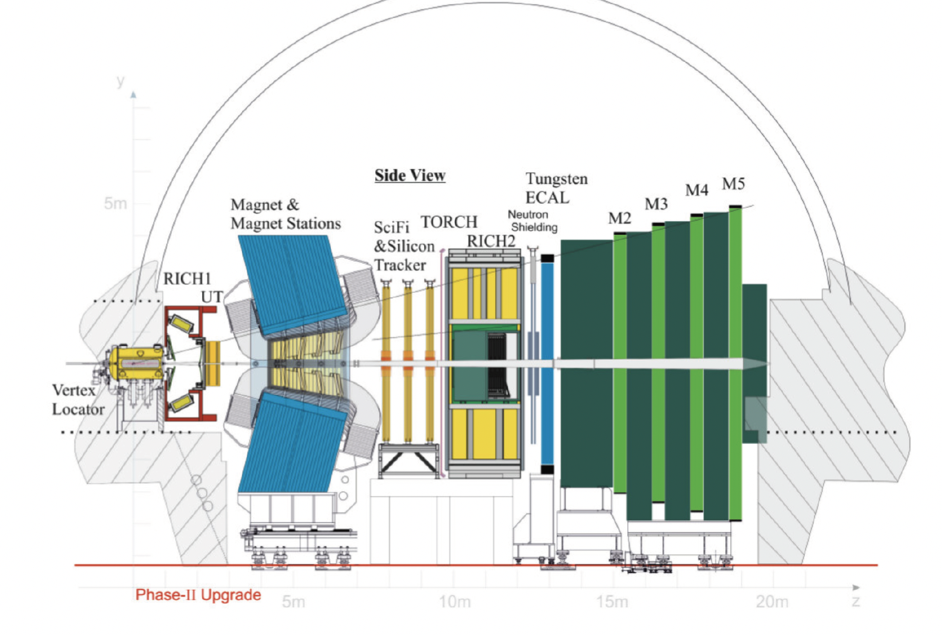
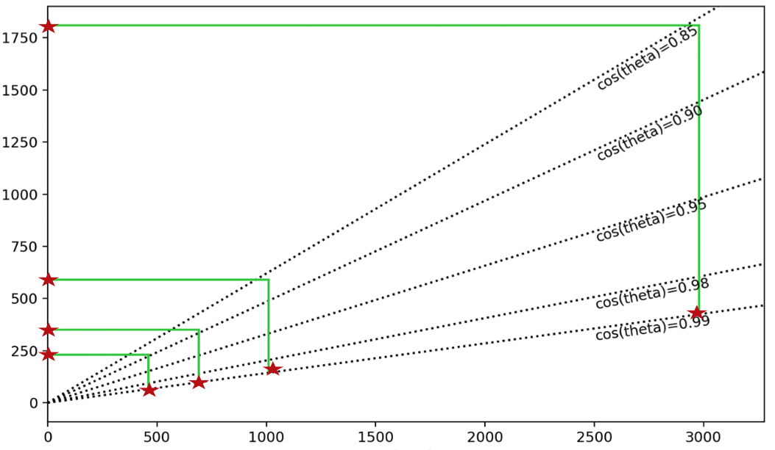
Background & Motivation
Current R&D targets for two applications：
OTK with precision timing
TPC
R [mm]
ITK
Vertex
Z [mm]
The CEPC Inner Tracker (ITK)
LHCb Upstream tracker upgrade II (UP)
Yang ZHOU – The FEE 2026, Paris, France, 18-22 May, 2026

Slide 3
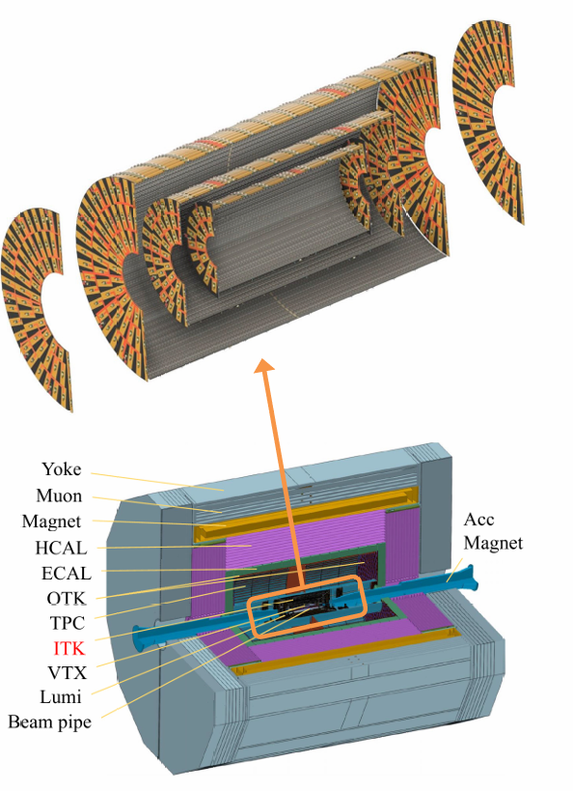
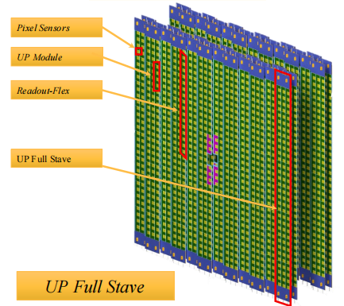
Key Performance Metrics for Both Applications
  Time resolution: ~ 3 － 5 ns for precise tagging of bunch crossing (~23 ns for CEPC, 25ns for LHCb);
  Spatial resolution: Spatial resolution: ~8 μm in the R‑φ (bending) direction for CEPC, with less stringent requirements for LHCb;
  Power dissipation: < 200 mW/cm² ;
  Max hit rate: ~100 MHz/cm² for LHCb UP；
  Radiation tolerance: 250 Mrad & 4×10¹⁵n_{eq}/cm²；
  Sensor thickness： < 200 μm;
CEPC ITK：3 barrels layers + 4 pairs of endcap disks
LHCb UP：4 layers of endcap
Yang ZHOU – The FEE 2026, Paris, France, 18-22 May, 2026

Slide 4
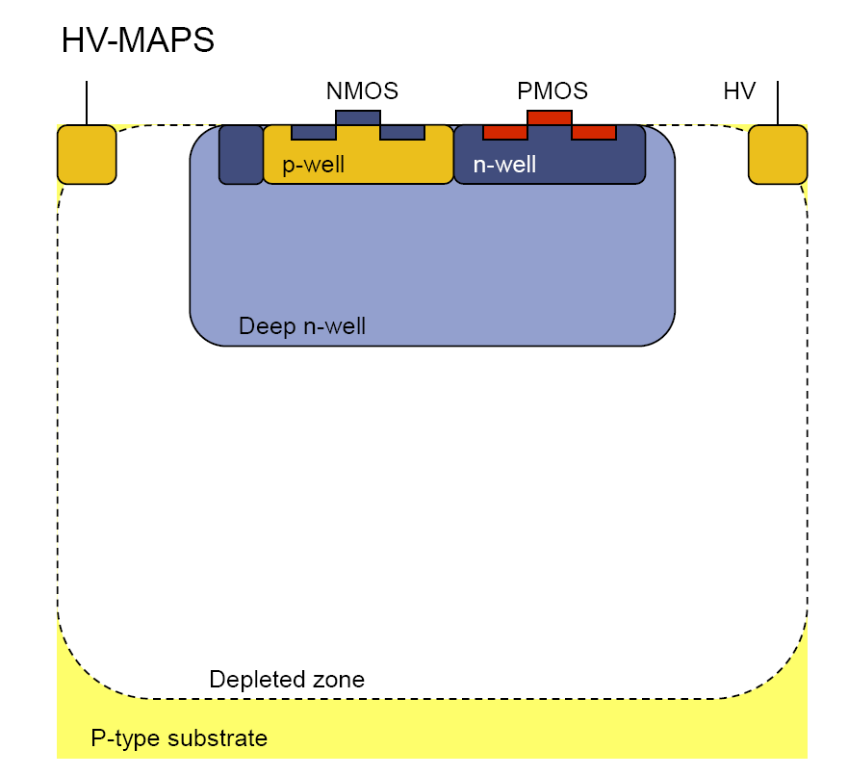
HV-CMOS Pixel Sensor：a promising candidate for both applications
Target specifications for design
Performance Metrics | Sensor Design Specifications
Time resolution | ~3–5 ns
Spatial resolution (Pixel size） | ~ 30 μm × 150 μm
Power dissipation | < 200 mW/cm²
Max hit rate | ~100 MHz/cm²
Radiation tolerance | 250 Mrad & 4×10¹⁵ neq/cm²
Sensor thickness | < 200 μm
Sensor dimension | ~2cm×2cm，~90% sensitive area
Charge collection node
Cross‑section of a typical HV‑CMOS pixel sensor.
The sensor can be fully depleted, featuring fast signal collection and good radiation tolerance.
Since this technology was first developed in the early 2000s. A wide range of chips have been designed, exhibiting outstanding performance. Such as ATLASPix， MuPix， LF-MonoPix，RD50-MPW series , RadPix，MightyPix …….. (All fabricated using the 180 nm/150 nm process).
Starting from the 55 nm process, we intend to meet the overall performance demands of both applications, while expanding available MAPS process possibilities for the high‑energy physics community.
Yang ZHOU – The FEE 2026, Paris, France, 18-22 May, 2026

Slide 5
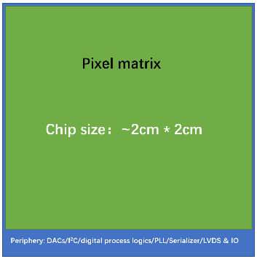
Main Tasks Carried Out in Parallel
Verify the technical principles in 55 nm process
Investigate the commercial standard process
ASIC design and validation on standard process.
Performance Optimization Combining modified Process and Validated ASIC.
Pursue possibility of process modifications for enhanced sensor performance.
Now we are here
Yang ZHOU – The FEE 2026, Paris, France, 18-22 May, 2026

Slide 6
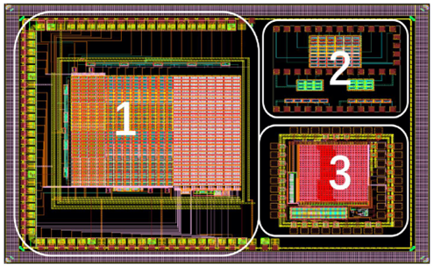
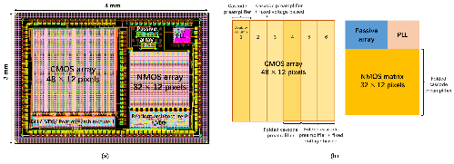
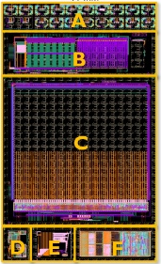
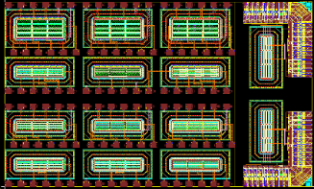


COFFEE Series Development Roadmap
COFFEE1
COFFEE2
COFFEE3
CHiR 1.0
CHiR_x
Final version
……
0.5cm $×$ 2cm
……
2cm $×$ 2cm
55nm LL-CMOS process
55nm HV-CMOS process
Small prototype
Process modification and validation
¼ full size sensor
Full size sensor
2022.10
2023.08
2025.01
2026.01
2027
Key progress:
- Verified the technical principles
- ASIC design architecture verification
- Process modification and verification
Yang ZHOU – The FEE 2026, Paris, France, 18-22 May, 2026

Slide 7
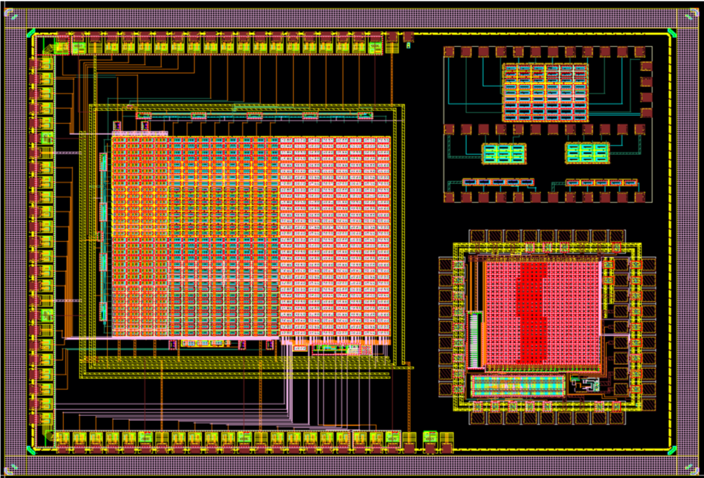
Design Overview of COFFEE2
Three independent regions in COFFEE2：
  Passive diode arrays：
    Various sensing structures: DNW size, distances, with/without P-stop ；
  An active pixel matrix including 3 variations of pixel design：
    To quantitatively evaluate the “cross-talk" issue of HV-CMOS pixel sensor technology in the new process and guide the overall design of the future detector chip
  An active pixel matrix with a new readout architecture：
    Very small pixel size 25×25μm² (for a HV-CMOS pixel sensor)；
    New matrix readout architecture;
    Digital peripheral data processing included；
For the commercial process characteristics study
1
2
For charge sensing diode + in-pixel AFE study
3
For new architectures in 55nm process @ Designed by KIT
The COFFEE2 design includes three independent regions.
Published paper: 1. NIMA Volume 1069 P169905 (2024) https://doi.org/10.1016/j.nima.2024.169905;
2. 2025 JINST 20 C03023 . https://doi.org/10.1088/1748-0221/20/03/C03023;
3. 2025 JINST 20 C10011. https://doi.org/10.1088/1748-0221/20/10/C10011;
Yang ZHOU – The FEE 2026, Paris, France, 18-22 May, 2026

Slide 8
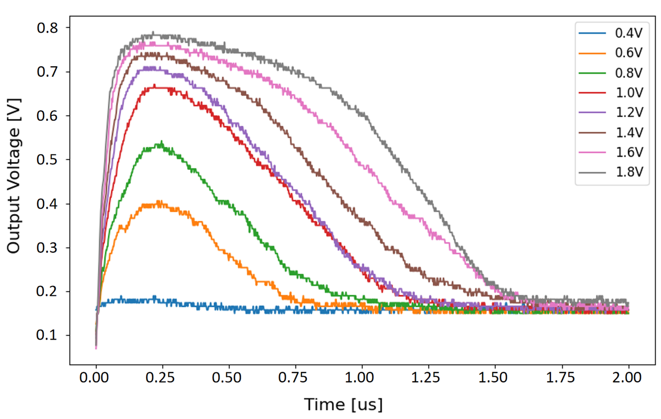
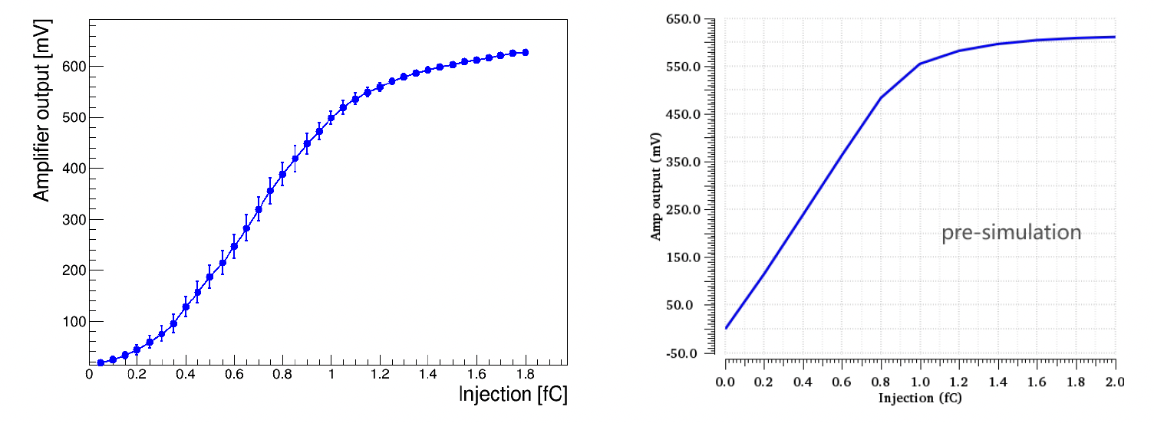
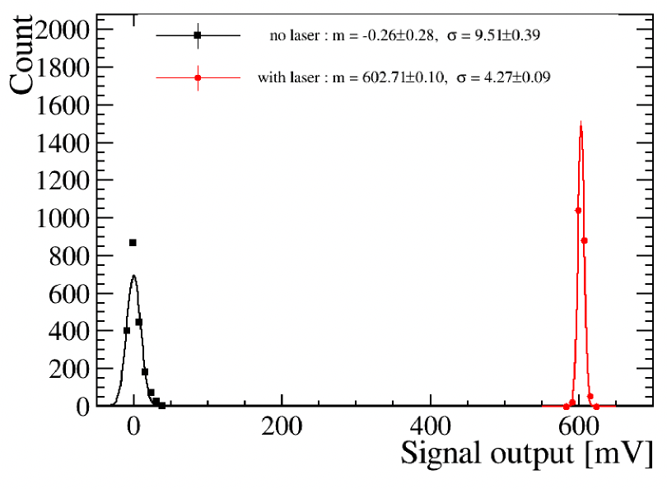
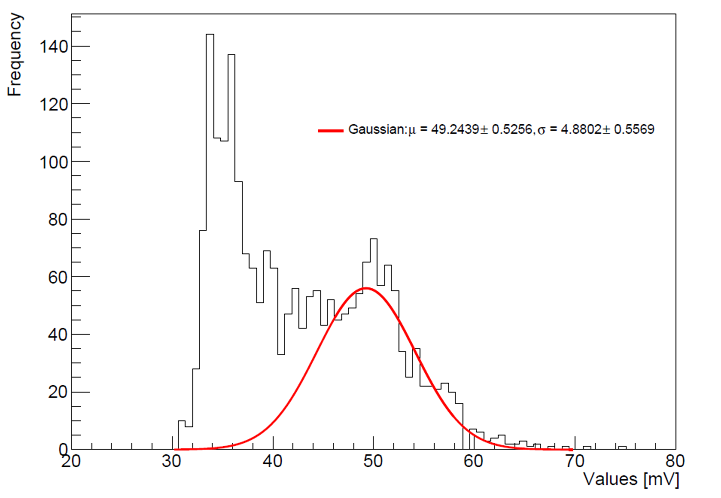
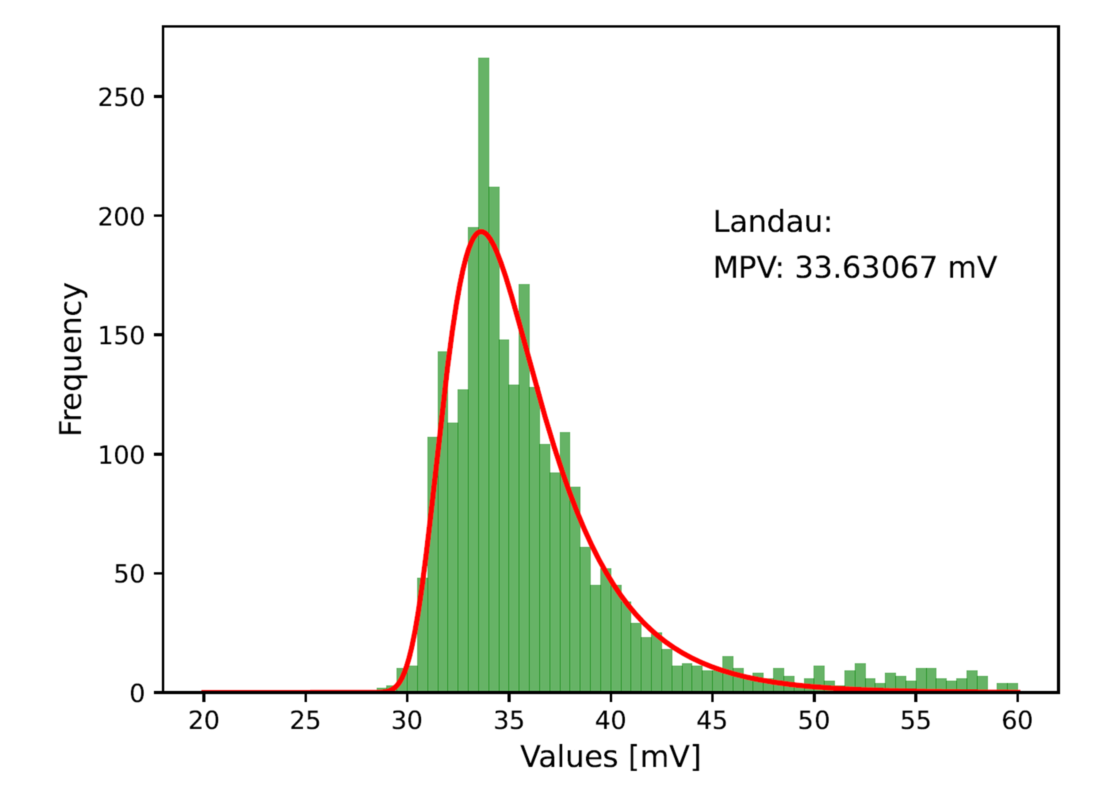
Investigation of the Commercial Standard Process: results from COFFEE2
The in-pixel amplifier & comparators work as the simulation predicts
Measurement
Simulation
The CSA output versus different injection voltages
CSA output as function of charge injection
Clear response to laser/ ⁵⁵Fe / ⁹⁰Sr sources:
depleted depth ~ 10 μm @ sensor bias -30V
laser
⁵⁵Fe
⁹⁰Sr
Yang ZHOU – The FEE 2026, Paris, France, 18-22 May, 2026

Slide 9
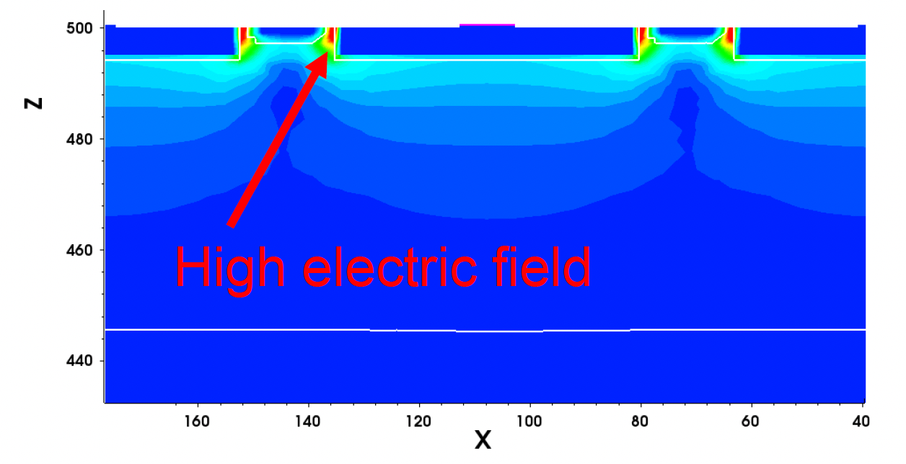
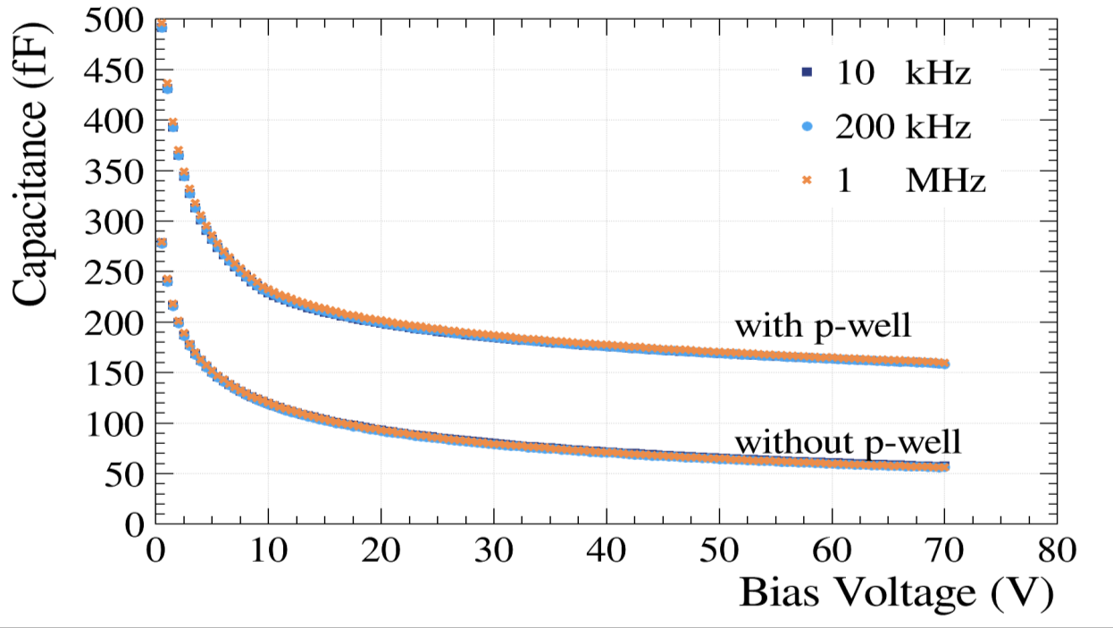
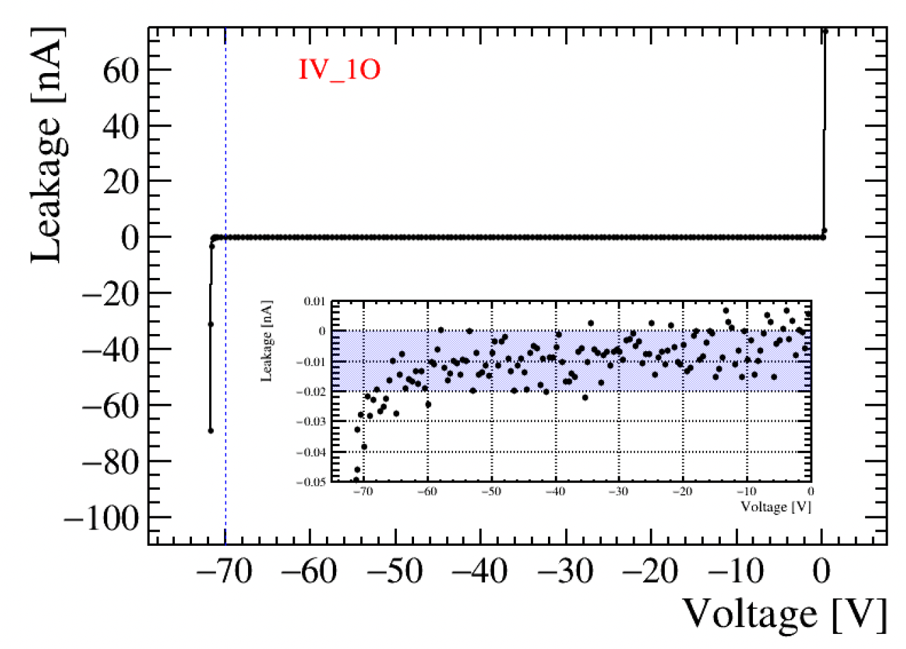
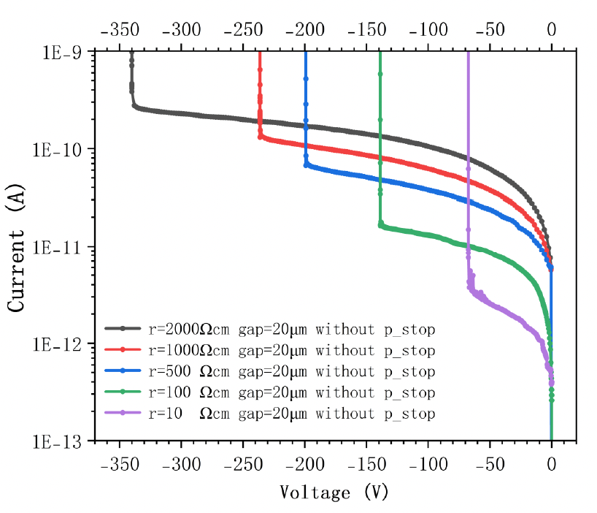

Investigation of the Commercial Standard Process: results from COFFEE2
Breakdown voltage： ~ -70V for regular resistivity wafer (10 Ω·cm).
Leakage current: ~10pA/pixel
CV test results of a pixel with or without P-well inside.
Pixel layout size:40×145 μm²
P-WELL inside version cover ~50% area of the pixel
IV curve test result
Simulated
IV curve
Breakdown takes place between DNW and p‑type surface. Lowering p‑type concentration at DNW edge (using high‑resistivity wafers) improves breakdown voltage.
C_{diode} is ~ 200 fF，dominated by P‑well‑to‑DNW capacitance.
Charge collection node
TCAD simulation
Yang ZHOU – The FEE 2026, Paris, France, 18-22 May, 2026

Slide 10
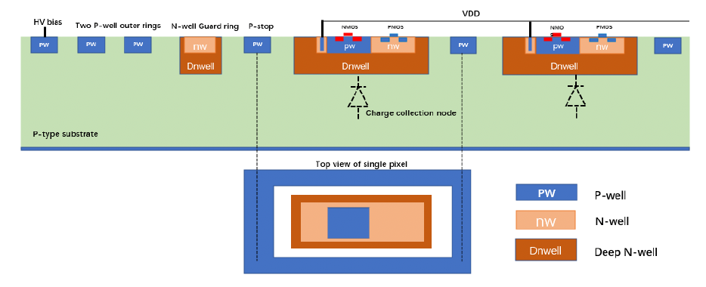
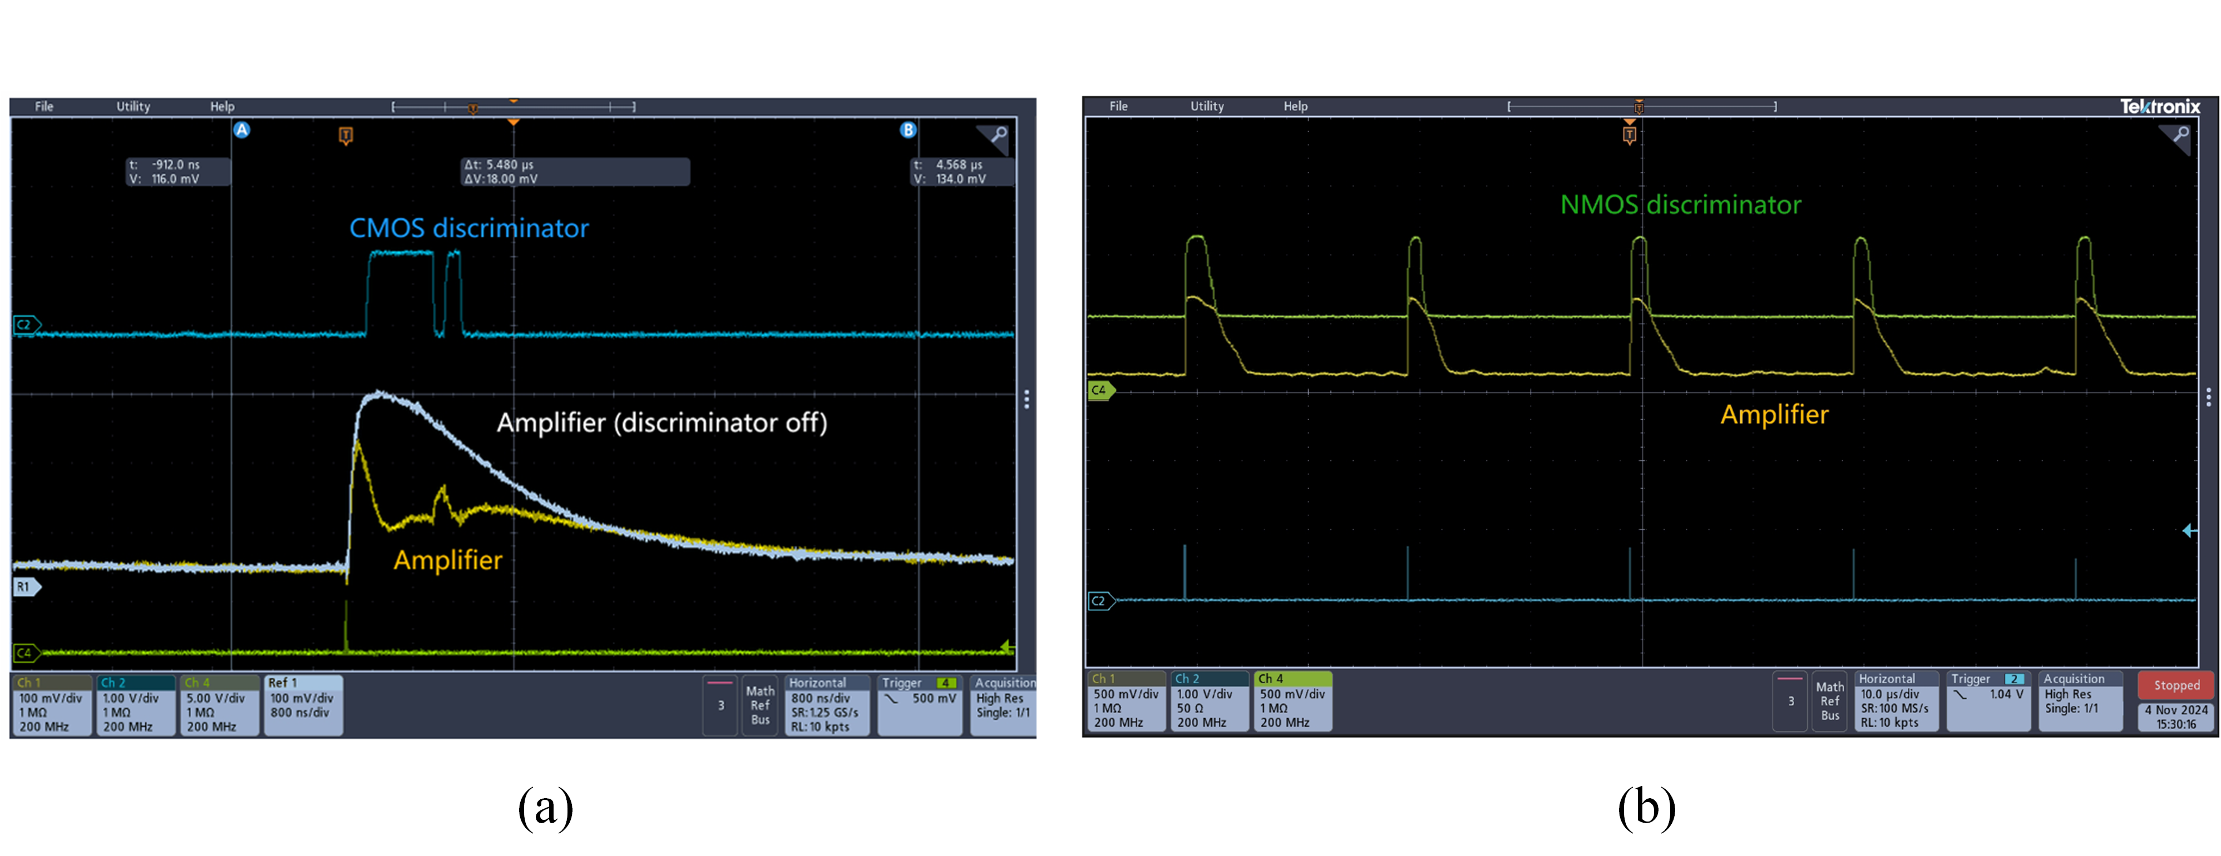
Investigation of the Commercial Standard Process: results from COFFEE2
Process limitation: in-pixel design
In‑pixel digital signal may cause parasitic charge injection throw NW into sensing DNW. (cross-talk)
In-pixel CMOS comparator design
In-pixel NMOS comparator design
Test results of cross-talk issue:
  (a) CSA output when the CMOS discriminator on (yellow) and off (white) with the corresponding CMOS discriminator output (blue);
  (b) CSA output (yellow) when the NMOS discriminator on (green).
Yang ZHOU – The FEE 2026, Paris, France, 18-22 May, 2026

Slide 11
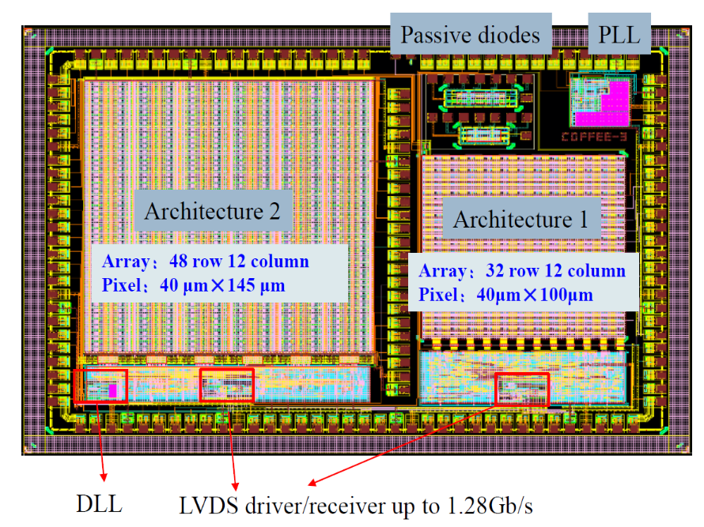
Layout and Targets of COFFEE3
Architecture 1：In-pixel NMOS design to avoid cross-talk risk.
Architecture 2：In‑pixel CMOS design for Potential Future Process Modifications
DLL
LVDS driver/receiver
COFFEE3 layout，3×4 mm².
Main design:
  Two independent readout architecture, both could be scaled to large sensor (~2×2 cm²);
  Necessary digital and analogue Peripheral Function Modules;
To answer:
  If it possible to meet（Time resolution ~ ns；Spatial resolution ~10 μm; Hit rate ~ 100MHz/cm², Power dissipation < 200mW/cm²） at the same time?
  What’s more can 55 nm process bring to HV-MAPS?
Yang ZHOU – The FEE 2026, Paris, France, 18-22 May, 2026

Slide 12
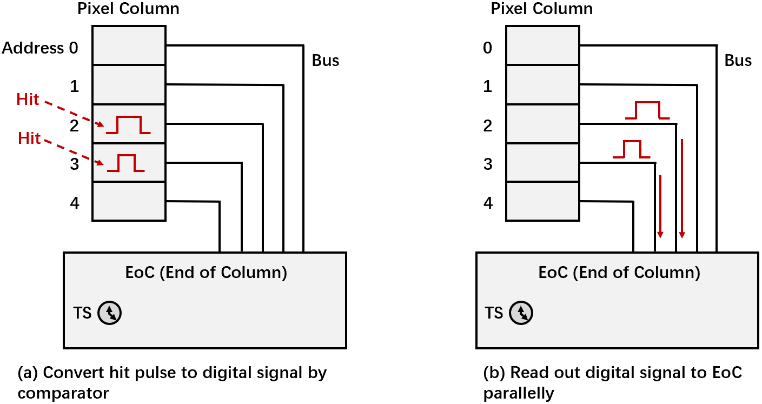
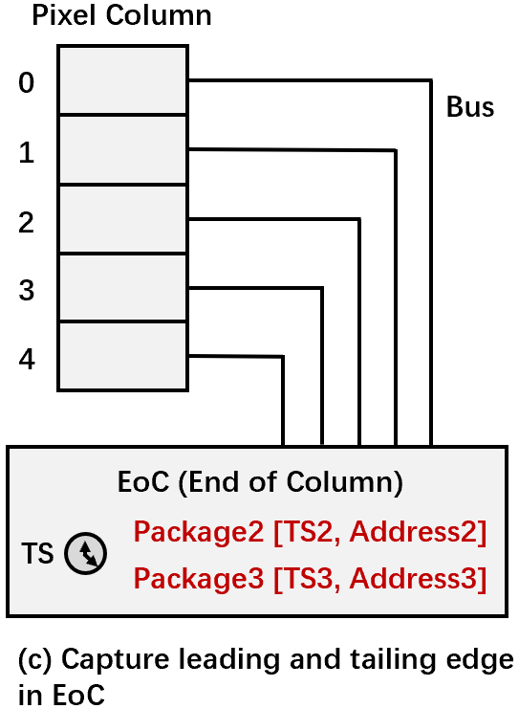
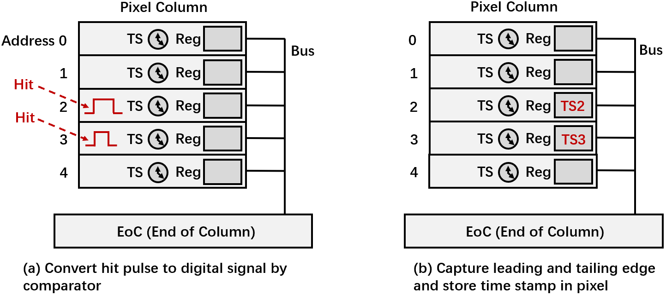
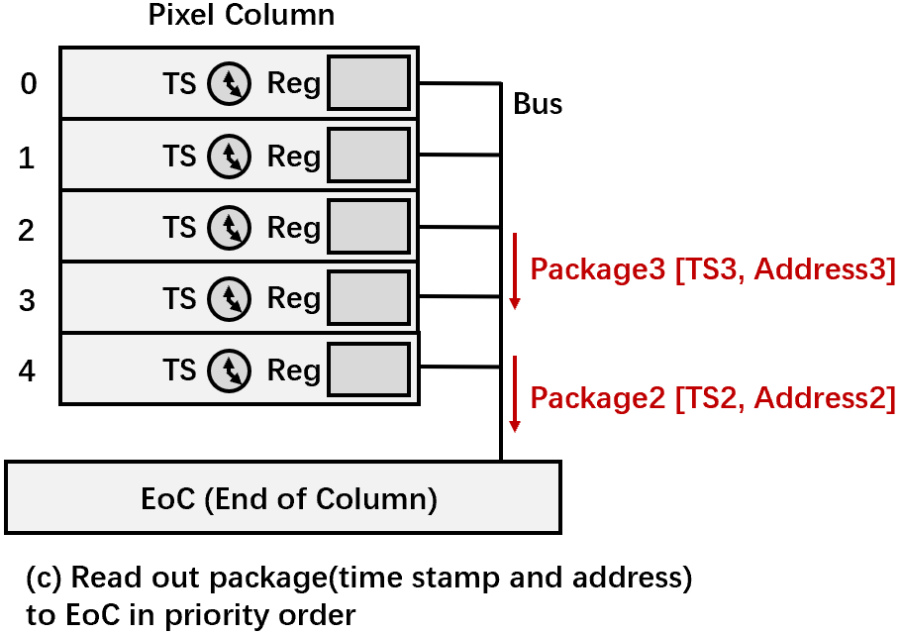
Readout Architectures
Architecture 1：In-pixel NMOS design, after digitization, each pixel data is transmitted in parallel to the bottom of the array, where time stamps are added.
Architecture 2：employs a TDC within each pixel. Particle hit information (arrival time, end time) is recorded locally in each pixel and then read out to the bottom of the array in priority order.
Readout concept of Architecture 1, similar with ATLASPix, MightyPix, MuPix, etc
Readout concept of Architecture 2, similar with RadPix, MonoPix, Timepix (hybrid), etc.
Targets:
Potential for Low power consumption or high position accuracy
More possibilities & High hit density processing capability
Yang ZHOU – The FEE 2026, Paris, France, 18-22 May, 2026

Slide 13
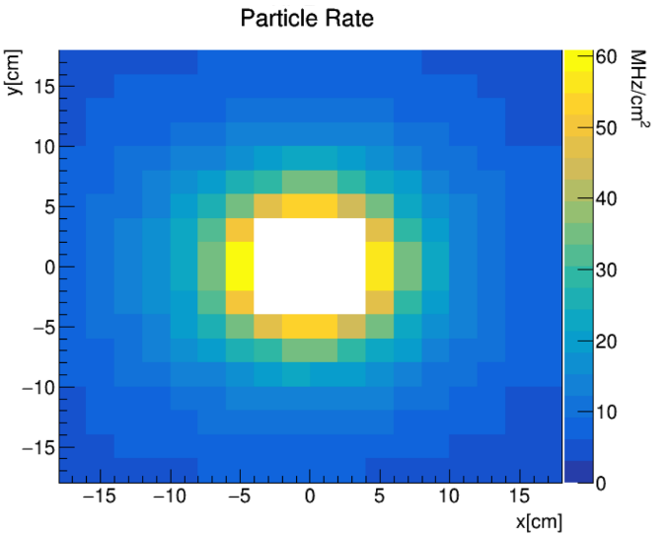
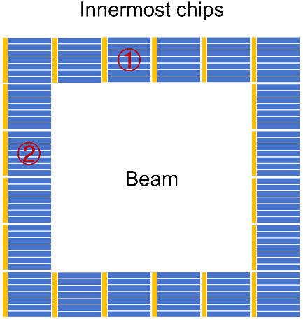
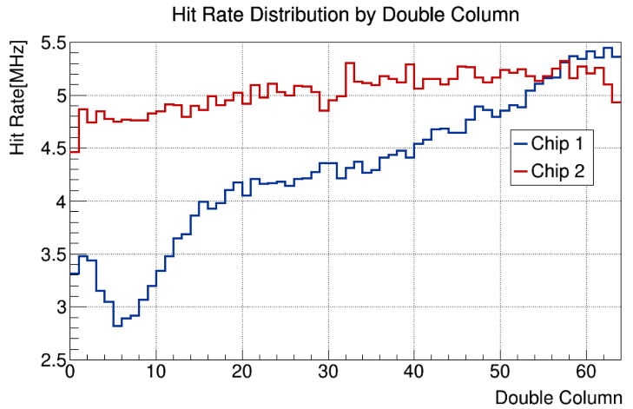
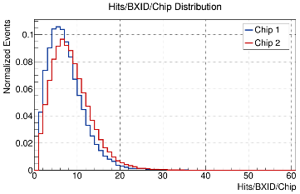
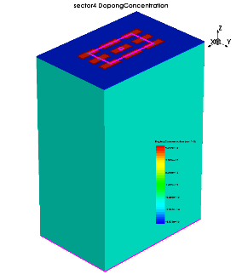
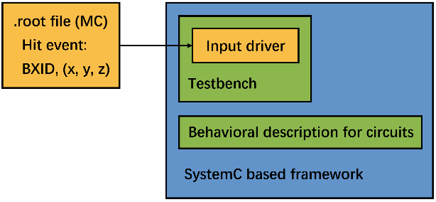
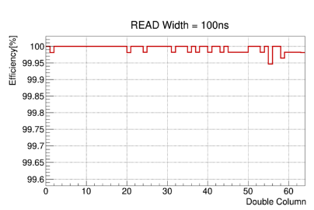
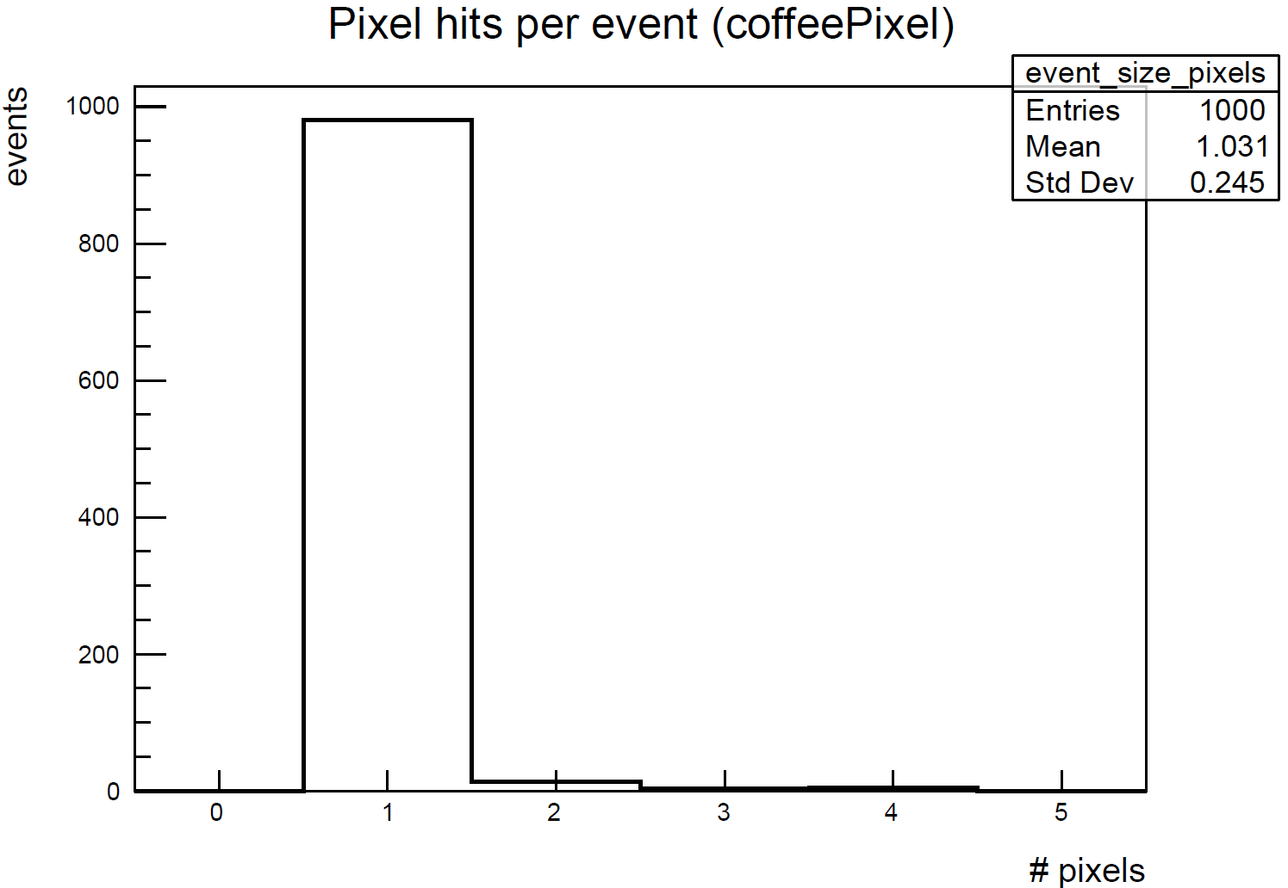
Design Specifications：Chip System‑Level Simulation
50 000 Bunch crossing physics simulation data at LHCb UP for future LHC upgrades.
The final chip arrangement on the detector.
Hit‑rate Variation of Pixels Inside Extreme‑Position Chips
• Analogue pile-up: Analogue signal width;
• Digital pile-up: Data processing speed and FIFO depth;
• Output Link Num. and speed and on chip Data Compression Algorithm;
…….
Electric field conditions obtained from TCAD.
Signal collection information provided by Allpix².
System C based ASIC behavioral description framework, to guarantee >99% detection efficiency.
Yang ZHOU – The FEE 2026, Paris, France, 18-22 May, 2026

Slide 14
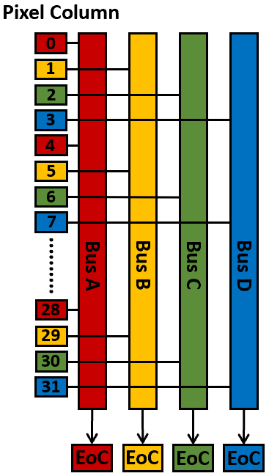
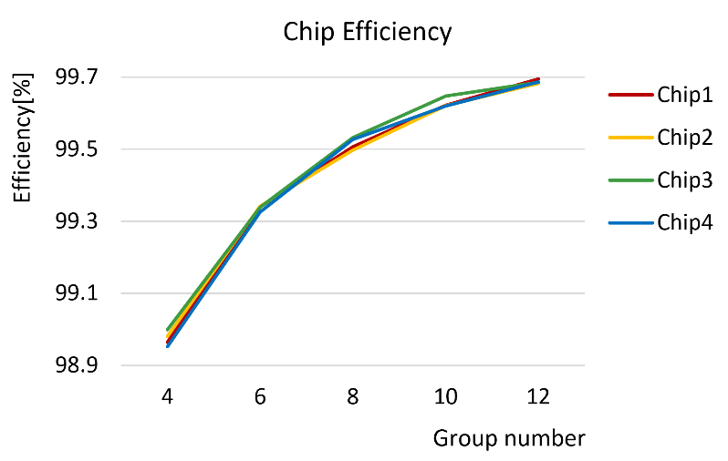
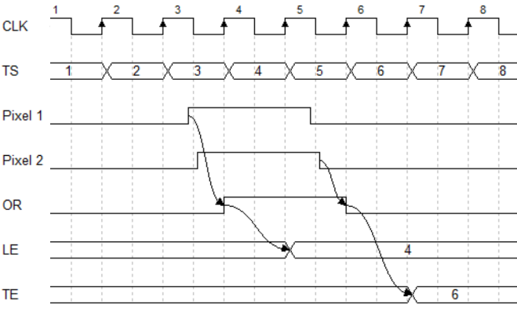
Architecture 1: design for Higher Hit Density Processing Capability
Architecture 1: Pixel Hit Parallel Transmission to Array Bottom
Each column shares an EoC module
At UP extreme positions, digital logic induced efficiency loss is ~1%.
One pixel column architecture in COFFEE3.
TOT last 100 ns -1.6 μs
Limitation: while hit density increase (eg. > several tens of Mhz/cm²)
  Timestamp information inaccurate;
  Efficiency loss;
Can not provide independent time stamp counter for each pixel at EoC
To handle higher hit rates: 4 EoC modules for each column, and two FSMs for each Eoc in COFFEE3. The area of the peripheral digital circuits does not significantly increase (still much less than 10% of the whole sensor).
This concept with 1 EoC for each column, while hit density increase, the timestamp information maybe inaccurate.
Yang ZHOU – The FEE 2026, Paris, France, 18-22 May, 2026

Slide 15
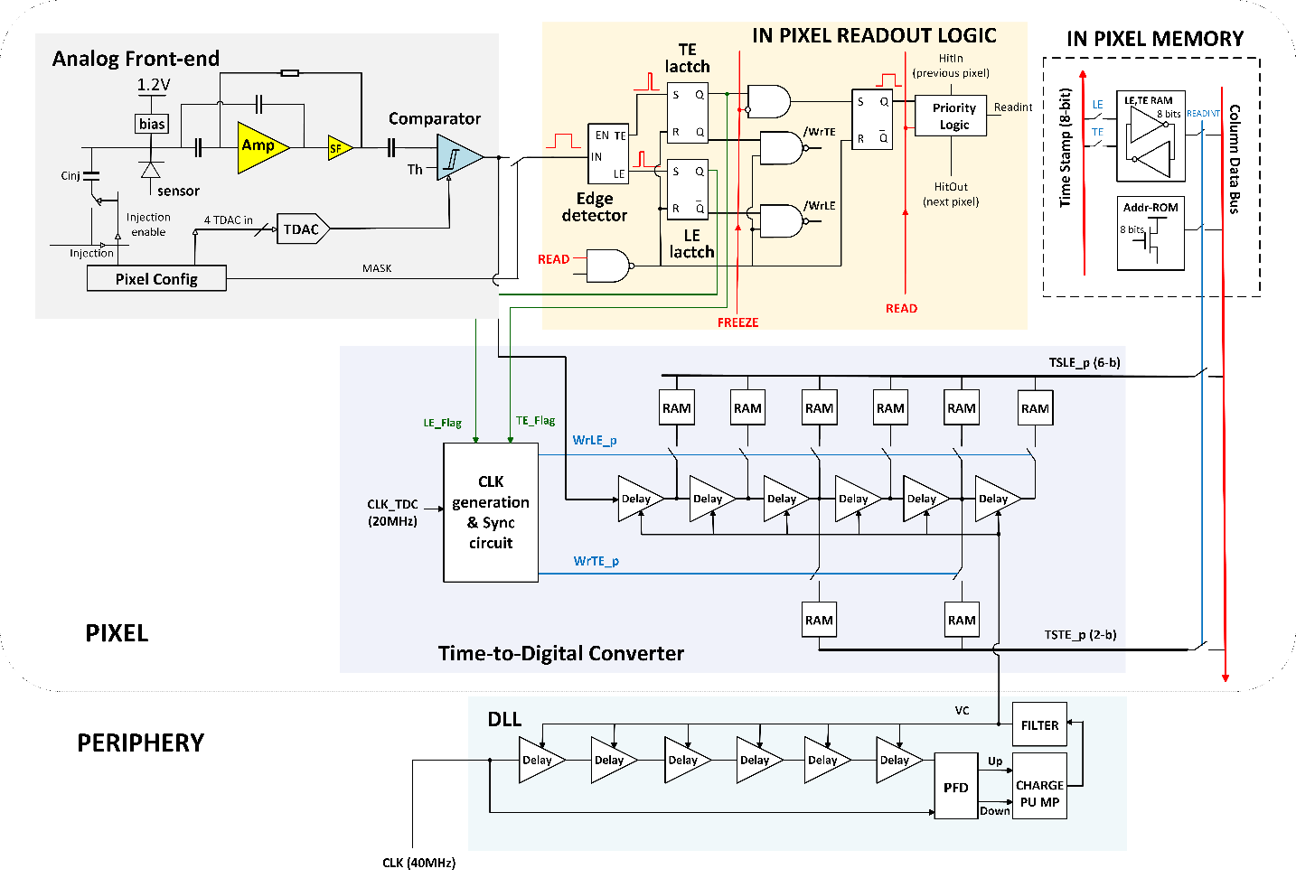
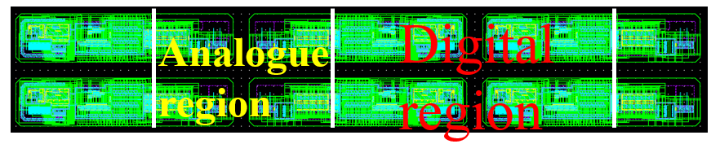
Architecture 2: for more possibilities & High hit density processing capability
Architecture 2: the event time information are recorded within each pixel. Then read out to the bottom of the array in order of priority
(Efficiency > 99.9% @ UP while READ ≤ 100 ns).
No limitations like Architecture 1, time information is accurate.
Layout of 2×3 pixels，signal pixel size is 40×145 μm²
*The actual manufacturing size will be scaled down to 0.9 times the layout size.
More integration in-pixel: The analog front-end, comparators, in-pixel DACs, priority readout structure, memories, and TDCs have all been integrated within a limited pixel area. This further enhances the capability of HV-MAPS to provide high-precision hit information in high hit density applications.
Yang ZHOU – The FEE 2026, Paris, France, 18-22 May, 2026

Slide 16
Architecture 2: Low-Power Design Considerations
Peripheral DLL and duplicated in-pixel VCDL
The comparator output is used for VCDL
6 phases are used for Leading edge and 2 of them are used for tailing edge.
Deign of in-pixel Coarse-fine TDC: for lower power dissipation
  Only a small VCDL block in-pixel (DLL is at the Peripheral);
  Almost no static power consumption for in-pixel TDC: only works while pixels are fired;
  Low power for Coarse time-stamp distribution into pixel matrix: 20 Mhz (Convert to 40 MHz, within the pixel);
  One delay line for both Leading edge and Tailing edge information.
4.16ns fine timestamp for LE
Yang ZHOU – The FEE 2026, Paris, France, 18-22 May, 2026

Slide 17
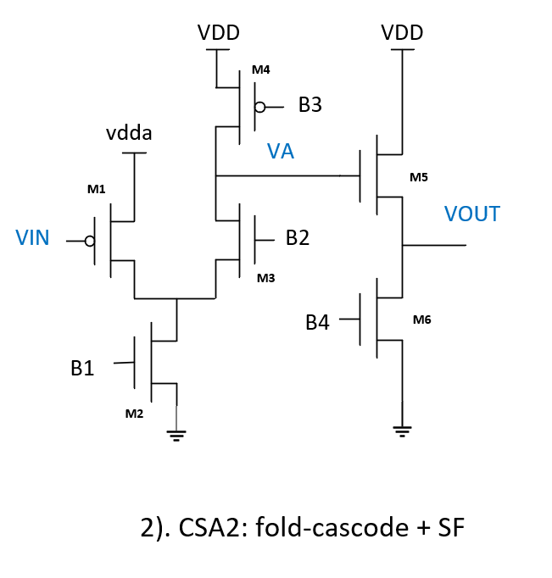
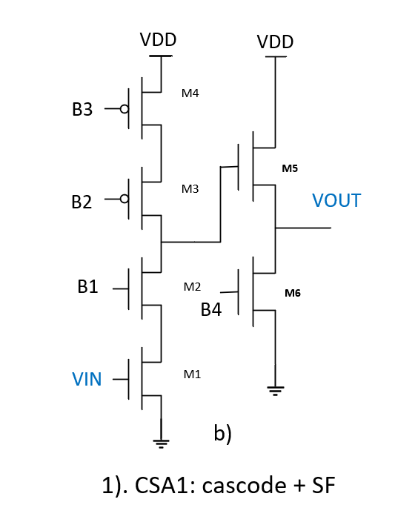
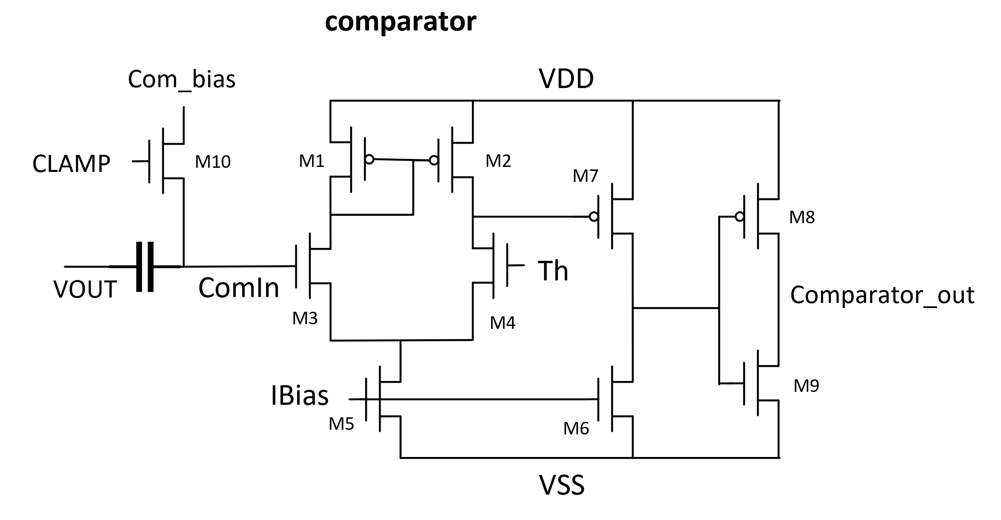
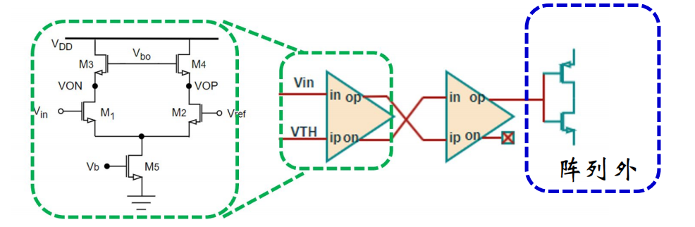
Common design: In-pixel Analogue Front-end
CSA+NMOS comparator in Architecture1
CSA+CMOS comparator in Architecture 2
In-pixel
End of Column
Simulation based on the expectation of using high-resistivity wafers in the future.
C_{diode} | ~200 fF （Estimated）
Signal distribution | 2k - 20ke- （Assuming high-resistivity wafer）
Threshold set | 5 times of noise values
Key design performances:
  Response time: one contribution to time resolution;
  Power dissipation：main contribution to total power;
  Time Over Threshold：analogue pile-ups in high hit density applications;
  Noise：one contribution to time resolution, also affect detection efficiency and fake hit rate;
Yang ZHOU – The FEE 2026, Paris, France, 18-22 May, 2026

Slide 18
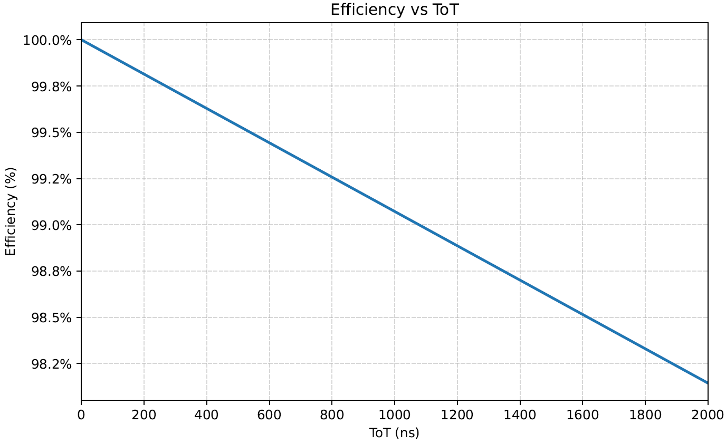
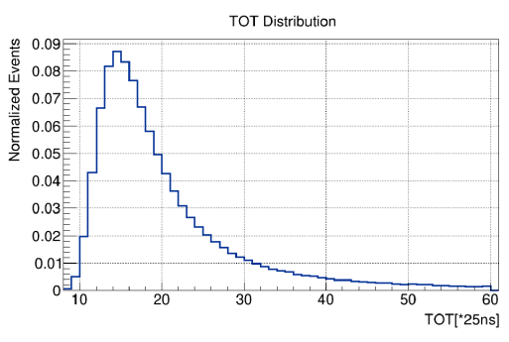
Common design: In-pixel Analogue Front-end
Time over Threshold:
Pixel：40 * 145 um²
Efficiency vs ToT while the hit density @ 100 Mhz/cm² (only analogue part)
Simulation results of ToT distribution of a MIP in HV-CMOS pixel sensor (2ke- --> 20ke-).
The maximum ToT (for MIP) is limited to ~1μs, ensuring far less than 1% efficiency loss due to analogue pile-up while the hit density reaches 100Mhz/cm².
Yang ZHOU – The FEE 2026, Paris, France, 18-22 May, 2026

Slide 19
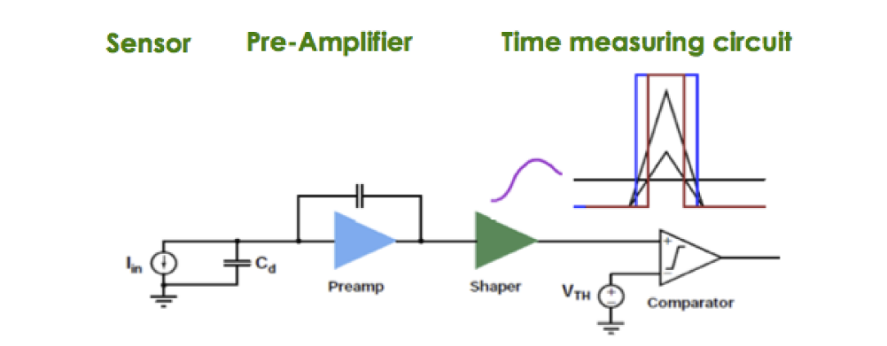

Timing Resolution Budget
（TOT compensation not included）
Typical time measurement detector structure.
Electronics noise、threshold inconsistency from pixel to pixel, etc.
TDC quantization noise：
Time stamp bin size/√12
Signal charge distribution、analog front-end design、comparator threshold setting, etc.
<（4 ns）²
<（2 ns）²
<（2 ns）²
Time resolution < 5 ns
The current analysis does not incorporate TOT compensation, clock delay (~1ns, compensable), or clock jitter (ps-level) effects. The final performance highly depends on the final process condition we could access.
Yang ZHOU – The FEE 2026, Paris, France, 18-22 May, 2026

Slide 20
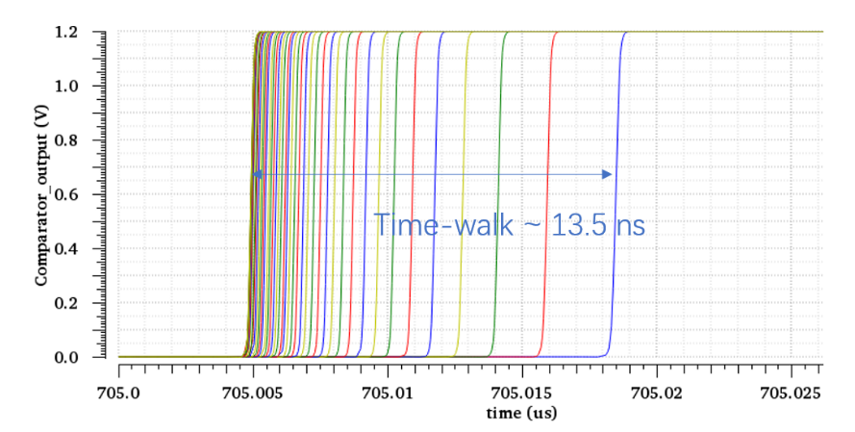
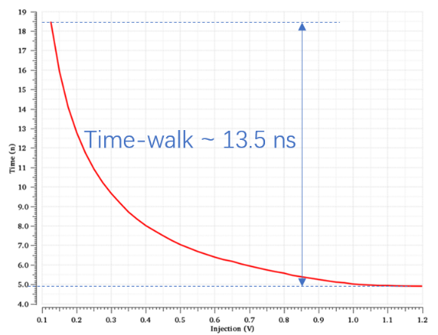
Common design: In-pixel Analogue Front-end
The time-walk: simulations for MIP in fully depleted 200 μm thick sensor.
Time walk: 13.5 ns
Time of Arrive: 5 ns - > 20 ns
Power: ~ 10 μW/pixel for in pixel CSA + Comparator
Noise: ~120 e⁻ (in test results section)
Yang ZHOU – The FEE 2026, Paris, France, 18-22 May, 2026

Slide 21
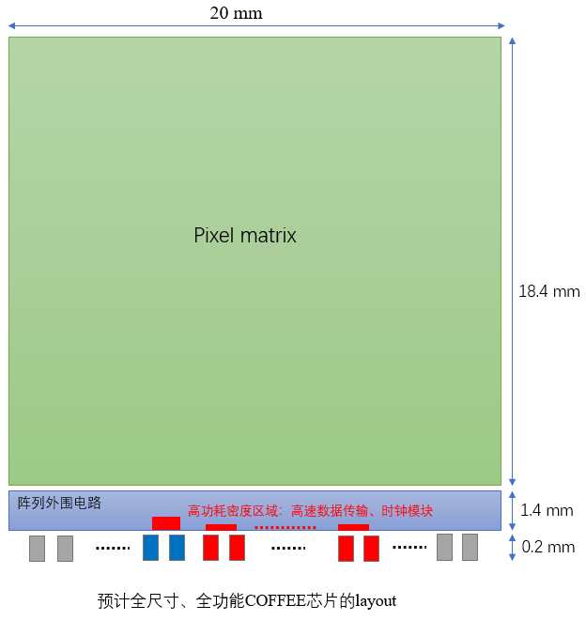
Preliminary Estimation of Chip Power Consumption and Area
Estimated overall power consumption and area (based on architecture 2)
--- on the expectation of using high-resistivity wafers in the future.
 | Pixel matrix | Peripheral | Overall
Area | 20 × 18.4 mm² | 20 × 1.6 mm² | 20 × 20 mm²
Total power consumption | ~580 mW | ~ 22 mW (may overly optimistic) | ~ 602 mW
Power density | ~158 mW/cm² | ~123 mW/cm² （estimate one data Transmitter channel） | ~ 150 mW/cm² （hit density related dynamic power not included yet）
A very rough estimation
Estimated layout of a full size HV-CMOS sensor.
Yang ZHOU – The FEE 2026, Paris, France, 18-22 May, 2026

Slide 22

The Preliminary Test Results of COFFEE3
Yang ZHOU – The FEE 2026, Paris, France, 18-22 May, 2026

Slide 23



Response of Full Readout Chain with Laser Test
Architecture 2: in-pixel TDC
Architecture 1: in-pixel NMOS design
DLL
LVDS driver/receiver
Layout of COFFEE3
The full readout chain works for both of the two readout architectures.
Sensing diode → in-pixel (CSA\comparator\TDC) → EOC (digital peripheral) -> data link-> DAQ
Yang ZHOU – The FEE 2026, Paris, France, 18-22 May, 2026

Slide 24







Test Results of Functional Modules
All the functional modules designed in COFFEE3 work:
PLL works ups to 640Mhz
LVDS driver/receiver works at 640 Mhz support 1.28 Gbps data link
Delay line for in-pixel TDC works as expected
No delay
Test results
Simulation results
640MHz
Delay by $π$
Yang ZHOU – The FEE 2026, Paris, France, 18-22 May, 2026

Slide 25



In Pixel Analog Front-End Test Results
⁵⁵Fe Source Test Results
No significant calibration peak (1640e⁻ for 5.9 keV X-ray) is observed.
Measured TOT-threshold relationship matches simulation results.
Yang ZHOU – The FEE 2026, Paris, France, 18-22 May, 2026

Slide 26





In Pixel Analog Front-End Test Results
S-curve results of the In-pixel TDC version: Each pixel integrates a 4-bit DAC for threshold tunning
Before threshold tunning
After threshold tunning
Threshold Variation Noise: 34.7mV
Threshold Variation Noise: 4.6 mV
Temporal Noise:5.5 mV
If we take 0.1V as the calibration peak of ⁵⁵Fe, noise after tunning would be ~ 120 e⁻ (results are just obtained, very preliminary and need further confirmation.)
Yang ZHOU – The FEE 2026, Paris, France, 18-22 May, 2026

Slide 27

Laser Response of Dual-Column Pixels
2column×48 rows pixel
Laser response test of pixel array:
1000 laser injections per position with a 200 μm moving step, covering an equivalent pixel interval of ~5 pixels (180 μm, pixel size = 36 μm).
Yang ZHOU – The FEE 2026, Paris, France, 18-22 May, 2026

Slide 28
The preliminary test results are positive
However, standard commercial 55nm HV-CMOS process is by no means the ideal MAPS process
  Triple-well process → cross-talk risks between sensor (deep-n) and PMOS transistors； → Restrict the flexibility of in-pixel design;
  Break down at ~-70V;
  No access of high-resistivity wafers;
→ Extremely limits the SNR.
In collaboration with the Foundry, some process modifications have just been made
for better sensor performances
Yang ZHOU – The FEE 2026, Paris, France, 18-22 May, 2026

Slide 29




Process Modifications for better Sensor Performances
Modifications ：
Breakdown V: 70 --> > 400V
Capacitance of VDNW/p-sub: ~ hundreds fF --> ~ tens of fF
Add layers: Deep-PW & Very-deep-NW;
Change doping rules affecting breakdown voltage;
Replace wafer: from 10 Ω·cm --> >1k/2k/4k Ω·cm;
Depletion depth: ~10 μm → >200 μm
Huge S/N gain : Signal increase >10 times, while C_{diode} reduce
Yang ZHOU – The FEE 2026, Paris, France, 18-22 May, 2026

Slide 30

First Design based on Modified Process: CHiR 1.0
*CHiR (COFFEE-HiRes)
20 times the layout size of COFFEE3, can be diced into a number of chips serving various goals:
11 mm
~2 mm
A
Guard rings & Passive sensor design validation:
  (A) 20 arrays of 3x4 passive pixels with diff guard ring designs, each can be diced into individual 1x1 mm² chip;
In-pixel FE and Active pixel matrix design validation:
  (B) 9 variations of in-pixel FE designs & 12 variations of pixel sizes;
  (C) A 256 × 64 pixel matrix (pixel size 38 μm x 150 μm) with digital periphery;
Analogue IP & Digital modules and transistors validations
  (D) necessary analog IPs: PLL, DAC, LVDS, SLDO …
  (E) alternative small pixel arrays and SLDO versions
  (F) digital modules and transistors for TID and SEE studies
4 mm
B
C
~22 mm
12.7 mm
3 mm
D
E
F
The chip is expected to be returned next month.
Answers to many key questions can be expected!
2 mm
3 mm
5.5 mm
Layout of CHiR1.0, submitted Jan. 24, 2026
Yang ZHOU – The FEE 2026, Paris, France, 18-22 May, 2026

Slide 31


Summary and Outlook
We have complete the design of COFFEE2/3 in a commercial 55nm HV-CMOS process；The preliminary test results are positive, more performance tests are in progress;
The first design CHiR 1.0, based on the modified process has been submitted; answers to many key questions can be expected! If everything goes well, the design optimization will be implemented based on the modified process.
Hopefully, we could have the full-function and full-size chip at the end of 2027.
Time line
Several MPWs to reach the full-size full-function sensor
2027
2023.8
2025.1
2026.1
¼ of the full size
COFFEE2
COFFEE3
Full functional design
Process modification
Target: Time resolution ~ ns；Spatial resolution ~10 μm; Power dissipation < 200mW/cm² ；
Yang ZHOU – The FEE 2026, Paris, France, 18-22 May, 2026

Slide 32




Acknowledgements
  Name list: Random ranking
    Leyi Li, Xiaoxu ZHANG, XiaoMin WEI, Weiguo LU, Pengxu LI, Mei ZHAO, Yang ZHOU, Bingchen Yan, Anqi WANG, Yuanhong JIAO, Yang CHEN，Yujie WANG, Huimin Wu, Zexuan ZHAO, Yu ZHAO, Zheng Wei, Jianpeng DENG, Zhan SHI, Kunyu XIE, Xinhao XIE, Xiaolong WANG, Ziying ZHANG, He HUANG, Junyuan YAN, Shenyao TANG, Hui ZHANG, Ruoshi DONG, Yang CHEN, Xuekang LI，Xinyang GUO, Zhuojun CHEN, Hui ZHANG, Zhiyu XIANG, Zijun XU, Zeng CHENG, Kang LIU, Menke CAI, Boxing WANG, Yuman CAI, Mingjie FENG, Lei ZHANG, Meng WANG, Hongbo ZHU, Yiming Li, Jianchun WANG ……..
    & Independent KIT design in COFFEE2: Hui ZHANG, Ruoshi DONG, Ivan PERIC；
Yang ZHOU – The FEE 2026, Paris, France, 18-22 May, 2026

Slide 33
Thanks for your attention!

Slide 34
Power Dissipation
Architecture 1：
  in pixel matrix: ~10μW/pixel
Architecture 2：
  in pixel matrix：
    Two analogue FE design：~10 μW/pixel；
    Power for time-stamp distribution：~ 20 mW/cm²;
    Fine time TDC：only work in fired pixel;
    Hit density related dynamic power consumption：not yet evaluated；
  Layout area and simulated power consumption of the peripheral functional modules
Peripheral modules | area | Frequency | Power consumption
Digital module | ~ 1.2mm ×18 mm | 40 Mhz | ~ 40 mW/cm² (estimated)
PLL | 360×360 μm² | 160/320/640 Mhz | 0.98/1.76/2.66 mW
LVDS Receiver | 70×140 μm² | 40/160/320/640 Mhz/ | 1.13/1.58/2.18/3.38 mW
LVDS Transmitter | 112×250μm² | 40/160/320/640 Mhz | 4.87/5.04/5.27/5.73 mW

Slide 35



Architecture 1: a simple in-pixel design leads a small C_{diode}
The power consumption:
$τ_{CSA} ∝ \frac{1}{g_{m}}\frac{C_{d}}{C_{f}}$
Charge collection node
  $TW ∝ τ_{CSA}\frac{V_{TH}}{V_{sig,min}}$
TCAD simulation of the CV for one pixel.
For a determined temporal response, a smaller C_{d} and larger signal are crucial to reduce the power consumption of the in-pixel amplifier.
Architecture 1: only a CSA and a comparator in pixel → very compact in-pixel ASIC layout.
--》potential for low power or small pixel size (high position accuracy)
CV test results of a pixel with or without P-well inside.

