Slide 1
Cryogenic CMOS Design for Scalable Qubit Control and Readout
2026-05-21 |Dennis Nielinger, Jonas Bühler, Phanish Chava, Carsten Degenhardt, Andre Kruth, Sabitha Kusuma, Daniel Liebau, Jonas Mair, Lea Schreckenberg, Patrick Vliex, Stefan van Waasen

Slide 2
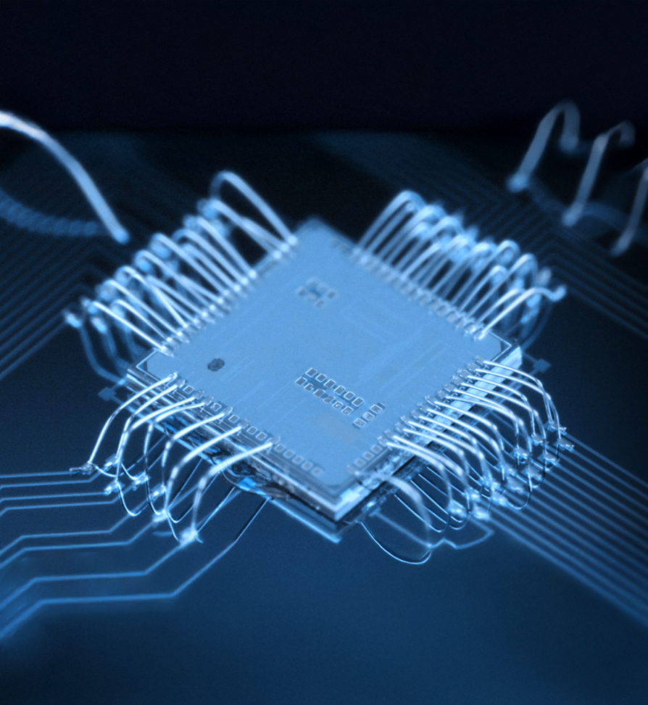
CONTENT
Designs in 65nm bulk and 22 nm FD-SOI
Cryogenic measurement results
Lessons learned (what to watch out for)
Co-integration experiment with qubits at mK
Thermal management
Other activities at ICA for QC:
Cryogenic device measurement and modelling
Cryogenic photonic link (for superconducting qubits and cryo. electronics)

Slide 3
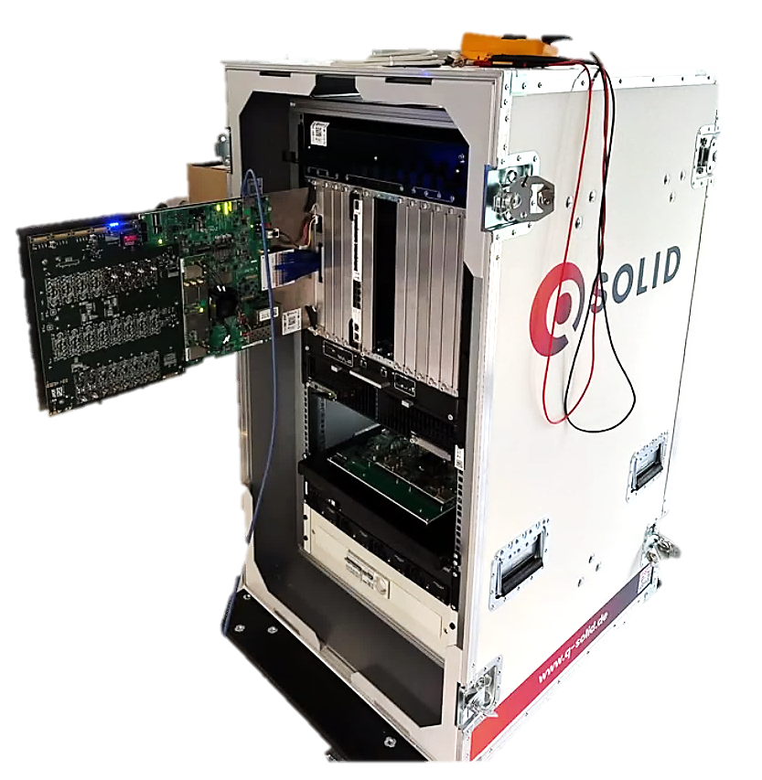
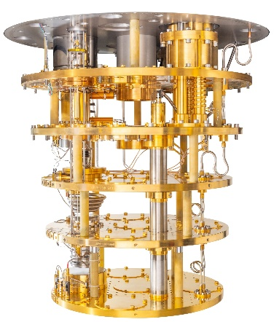
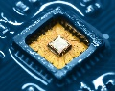
Cryogenic CMOS Design
Move (parts) of classical control & readout electronics closer to the qubit
Consequence → operate at cryogenic temperature
Cryogenic CMOS enables high-integration
Comply to ultra strict cooling power budget
Qubits are evolving quickly → modular IC framework

Slide 4
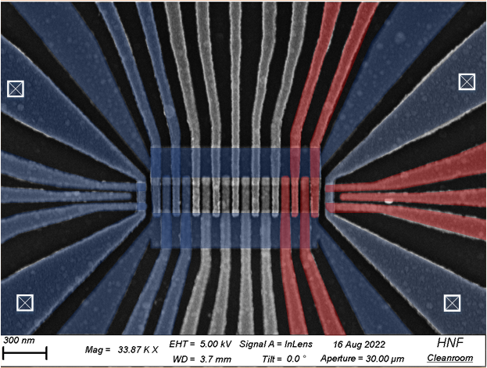
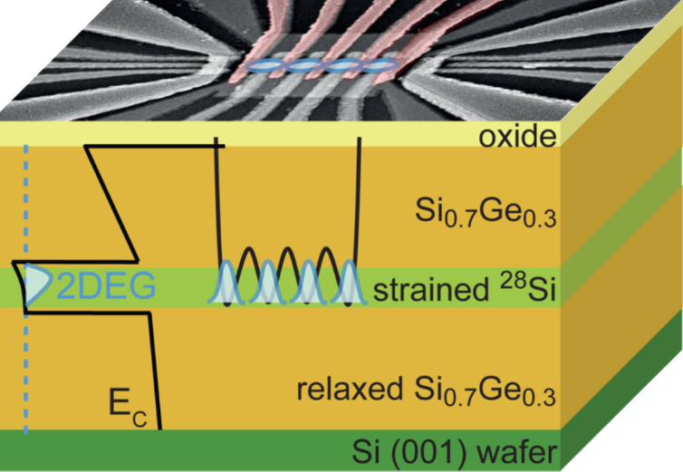
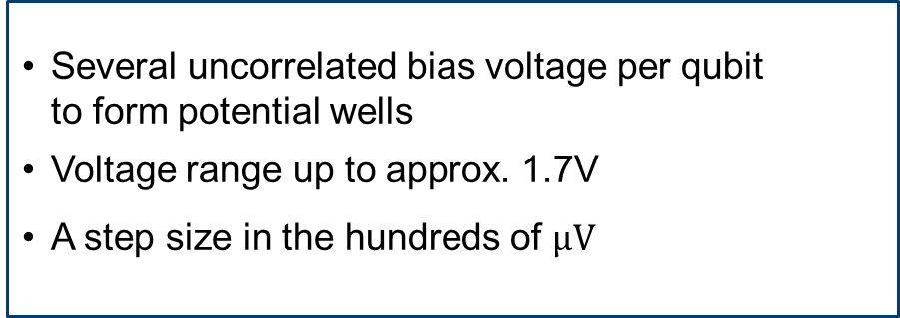
DC Bias
Specification
Specification for DC Bias via DAC
Si/SiGe Architecture^{[3]}
Several uncorrelated bias voltage per qubit to form potential wells
Voltage range up to approx. 1.7V
A step size in the hundreds of $μV$
[3] I. Seidler, T. Struck, R. Xue et al., ”Conveyor-mode single-electron shuttling in Si/SiGe for a scalable quantum computing architecture,” npj Quantum Inf 8, 100, 2022.

Slide 5
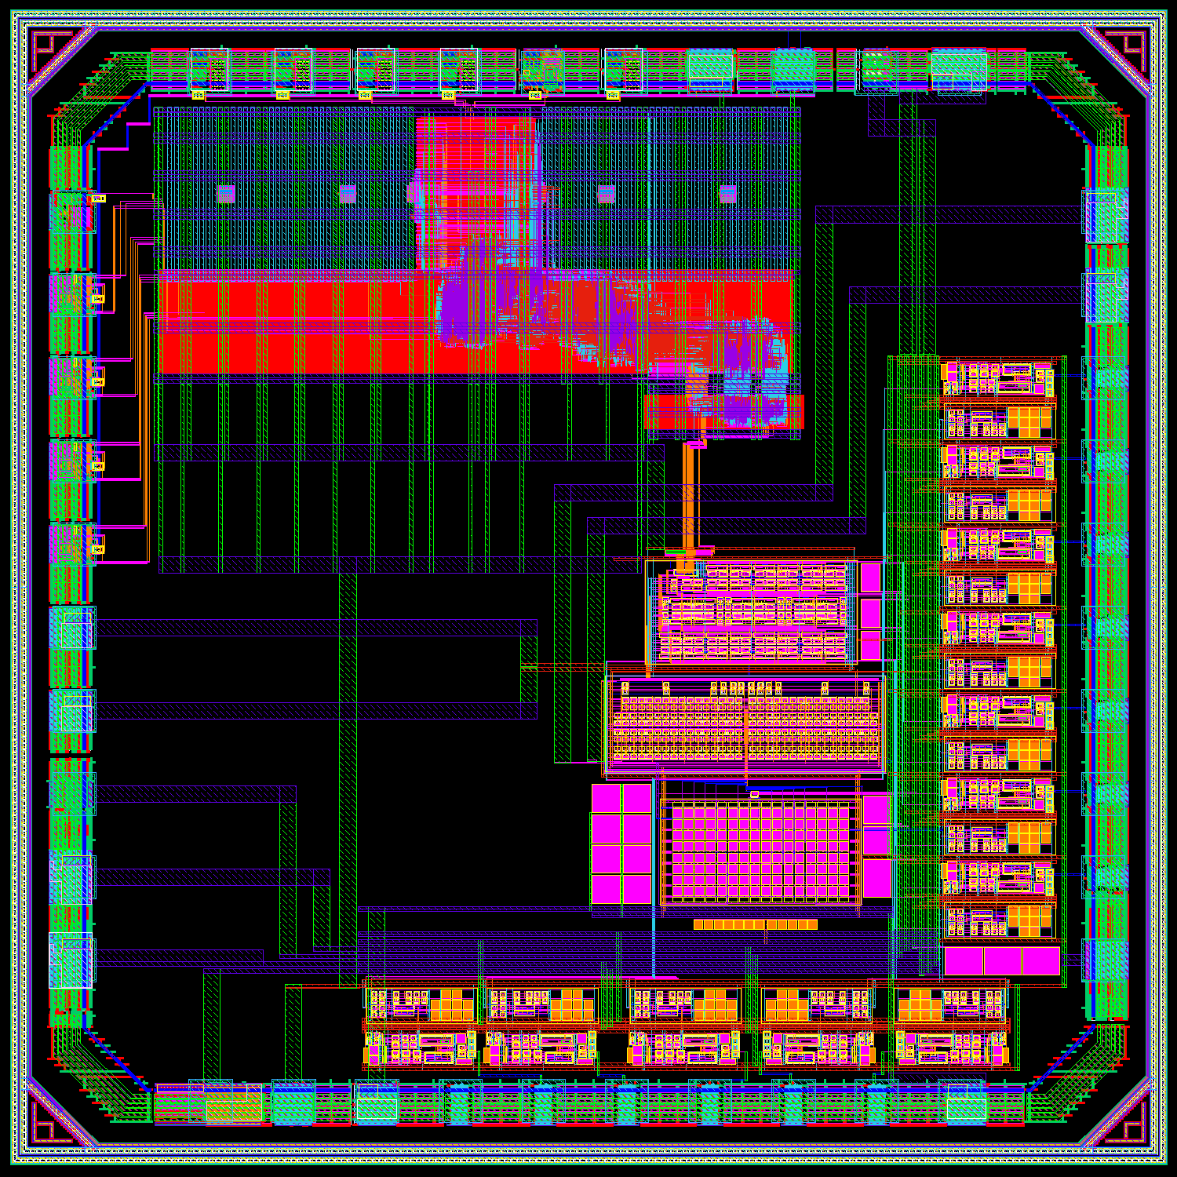
DC Bias
QUOCCA
Digital
Digital^{[4]}:
JTAG Interface
RISC-V Processor
DAC FSM
Bias DAC:
Charge-redistribution topology
Negligible static power
DAC
Sample & Hold Output Channel:
S&H & OPA
Individual refreshable
Testing amplifier

Slide 6
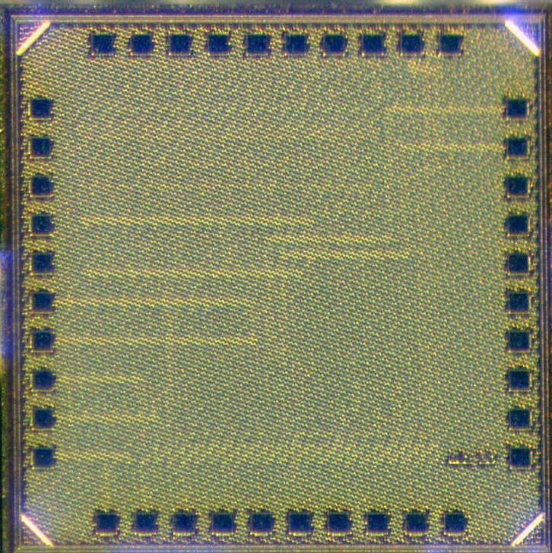
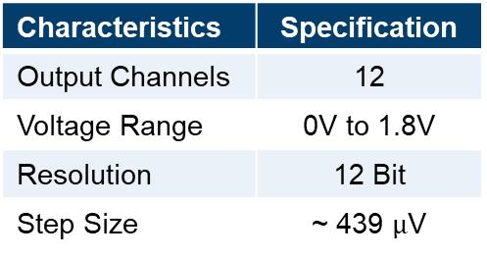
DC Bias
CMOS Bias DAC
JTAG
Digital
1.25 mm
DAC
Voltage Outputs
1.25 mm
Characteristics | Specification
Output Channels | 12
Voltage Range | 0V to 1.8V
Resolution | 12 Bit
Step Size | ~ 439 $μ$V
No output buffer needed due to low leakage
Reduce power and noise
Defined control of the DAC refresh
Internal or external trigger signal

Slide 7
DC Bias
DAC Output
506 skipped input words → 11.81 Bit

Slide 8
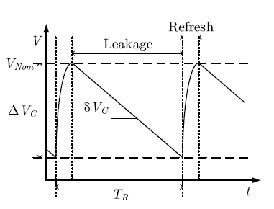
Measurements
Defined hold trigger for qubit operation between refresh
Defined hold trigger for qubit operation between refresh
Periodical refresh due to leakage in S&H channels
Refresh increases noise at qubit gates
Low temperature makes long hold time possible
[5]
Voltage drift: 746 ${μV}/s$

Slide 9
DC Bias
Power Consumption And Noise
Component | Power Consumption @ 5 MHz Clock
Analog DAC | 0.96 $μW$
Analog DAC reference | 0.86 $μW$
Analog DAC total | 1.8 $μW$ (152 $nW$ per channel)
Digital IO | 24.9 $μW$
Digital Core | 26.4$μW$
Total | 53.1 $μW$
12 Channel running at 24 kHz channel refresh rate at 5 MHz Clock
Integrated noise added by DAC @ 1MHz Clock $≈119 {μV}_{rms}$
Notes:
10 Hz to 300kHz noise bandwidth

Slide 10
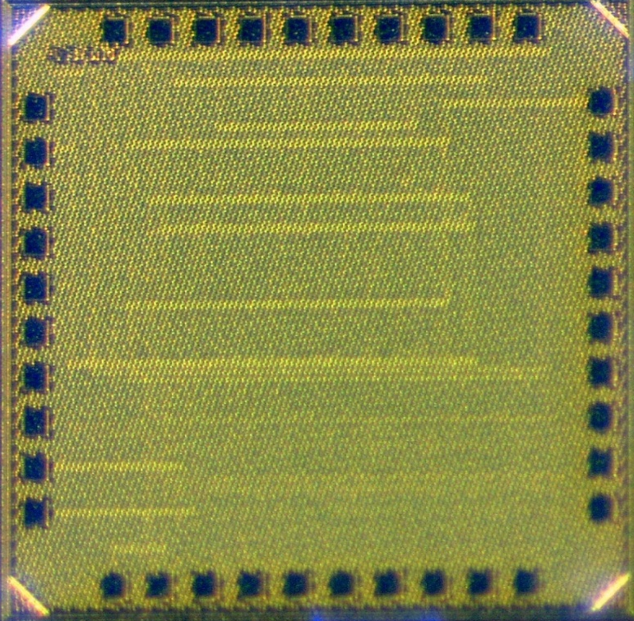
Power draw in padframe
Padframe IP Considerations
Padframe IP is not made for cryo. temperature
Analog pads are good
Typically less leakage in ESD structures
Digital pads:
Functionality (mostly fine)
even with complex internal circuitry
Power (every µW counts at mK)
Consider internal power OK generation
May generate internal bias voltages (e.g. for IO ↔ core voltage levelshifter)

Slide 11
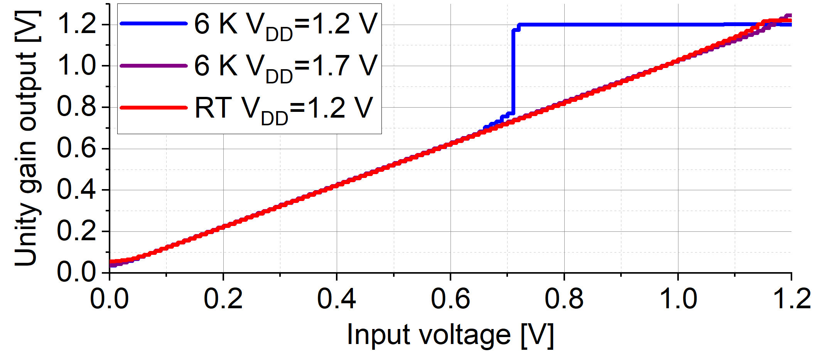
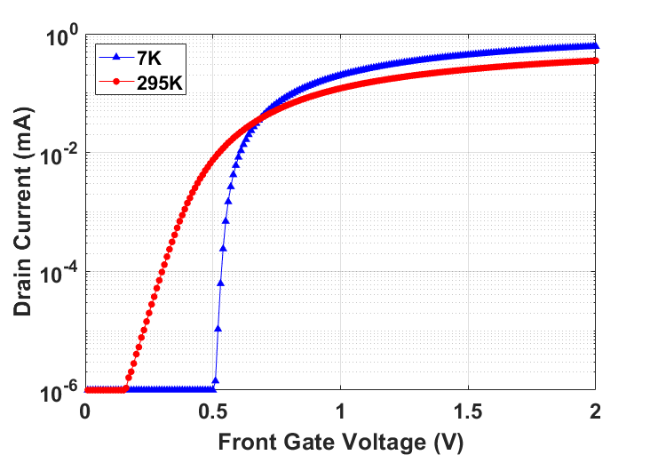
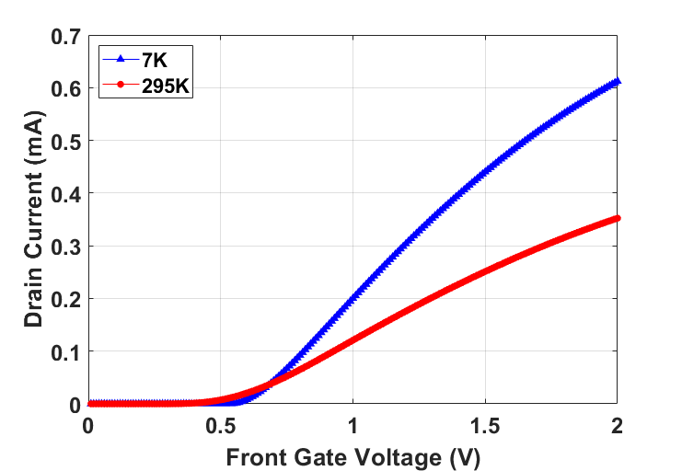
OPAMP
Clipping of Opamp output at cryo temp.
Subthreshold operation problemetic
Due to steep SS
Increase supply for extra headroom
Use low supply circuit topologies
Pay extra attention to stay in strong inversion
Compensate or be aware of V_{TH} shift
V_{TH}↑
Steep SS

Slide 12
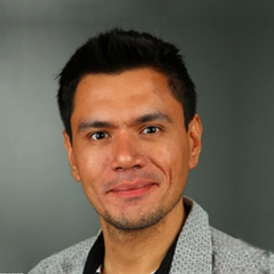
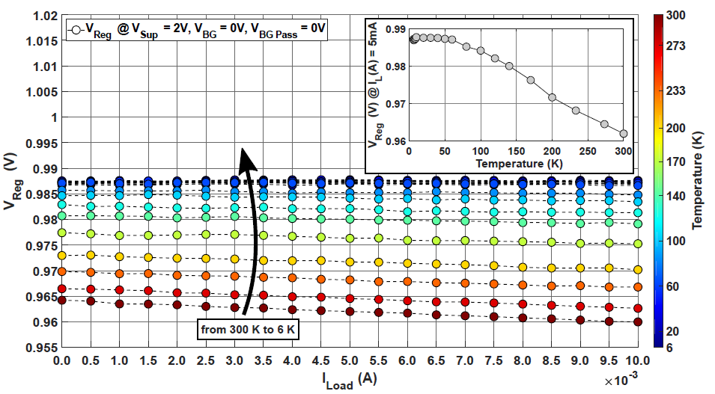
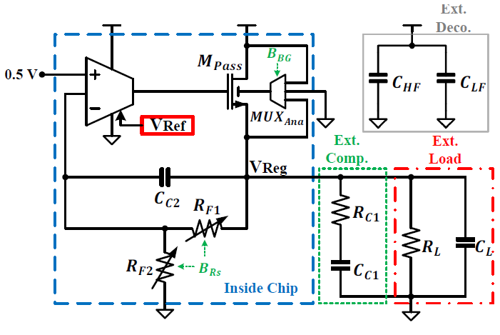
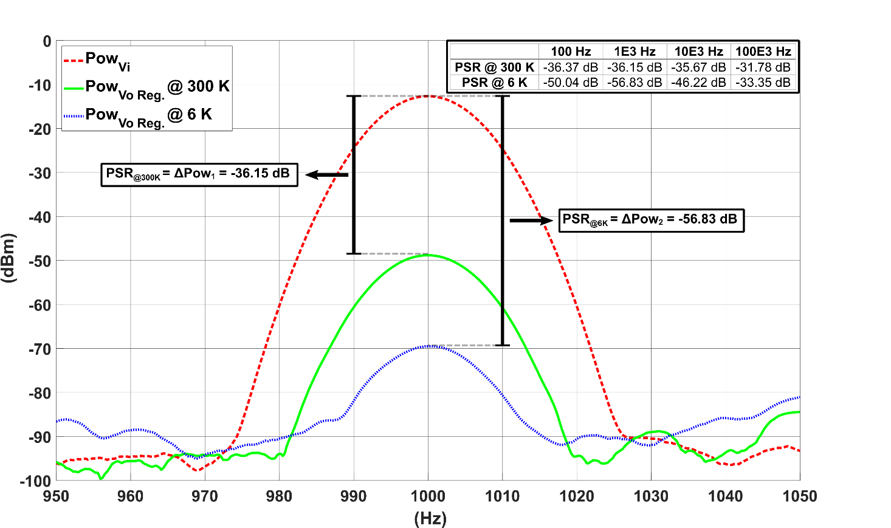
Voltage references
Voltage Reference and Regulator Circuit in 22nm FD-SOI
[2] A. R. Cabrera-Galicia, et.al, "Voltage Reference and Voltage Regulator for the Cryogenic Performance Evaluation of the 22nm FDSOI Technology," in IEEE Open Journal of Circuits and Systems, vol. 5, pp. 377-386, 2024, doi: 10.1109/OJCAS.2024.3466395

Slide 13
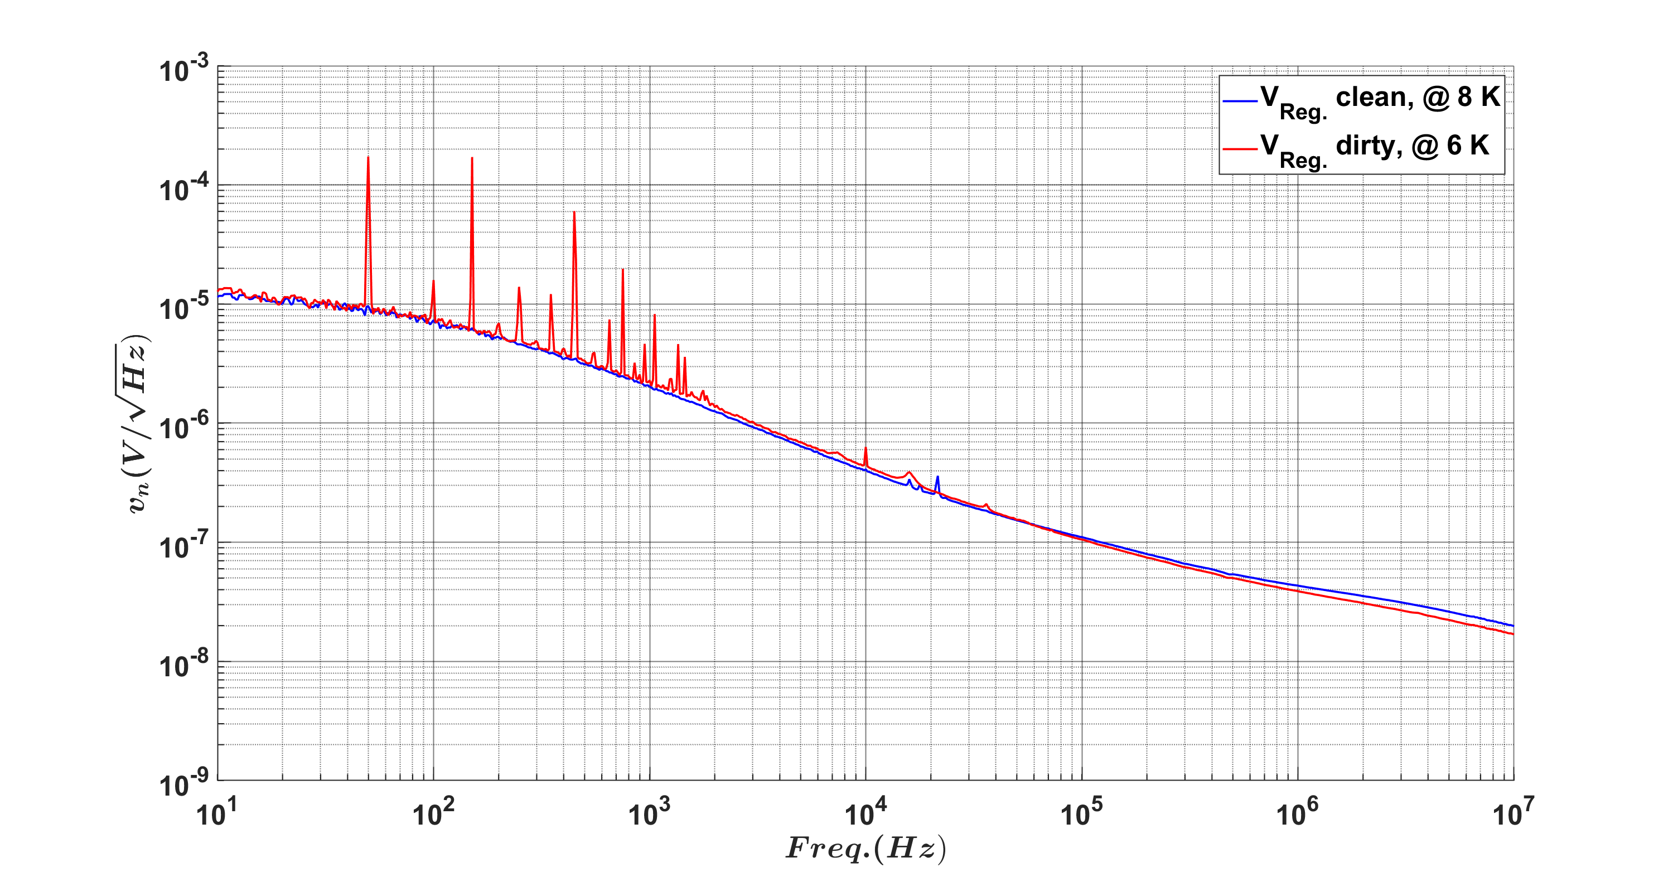
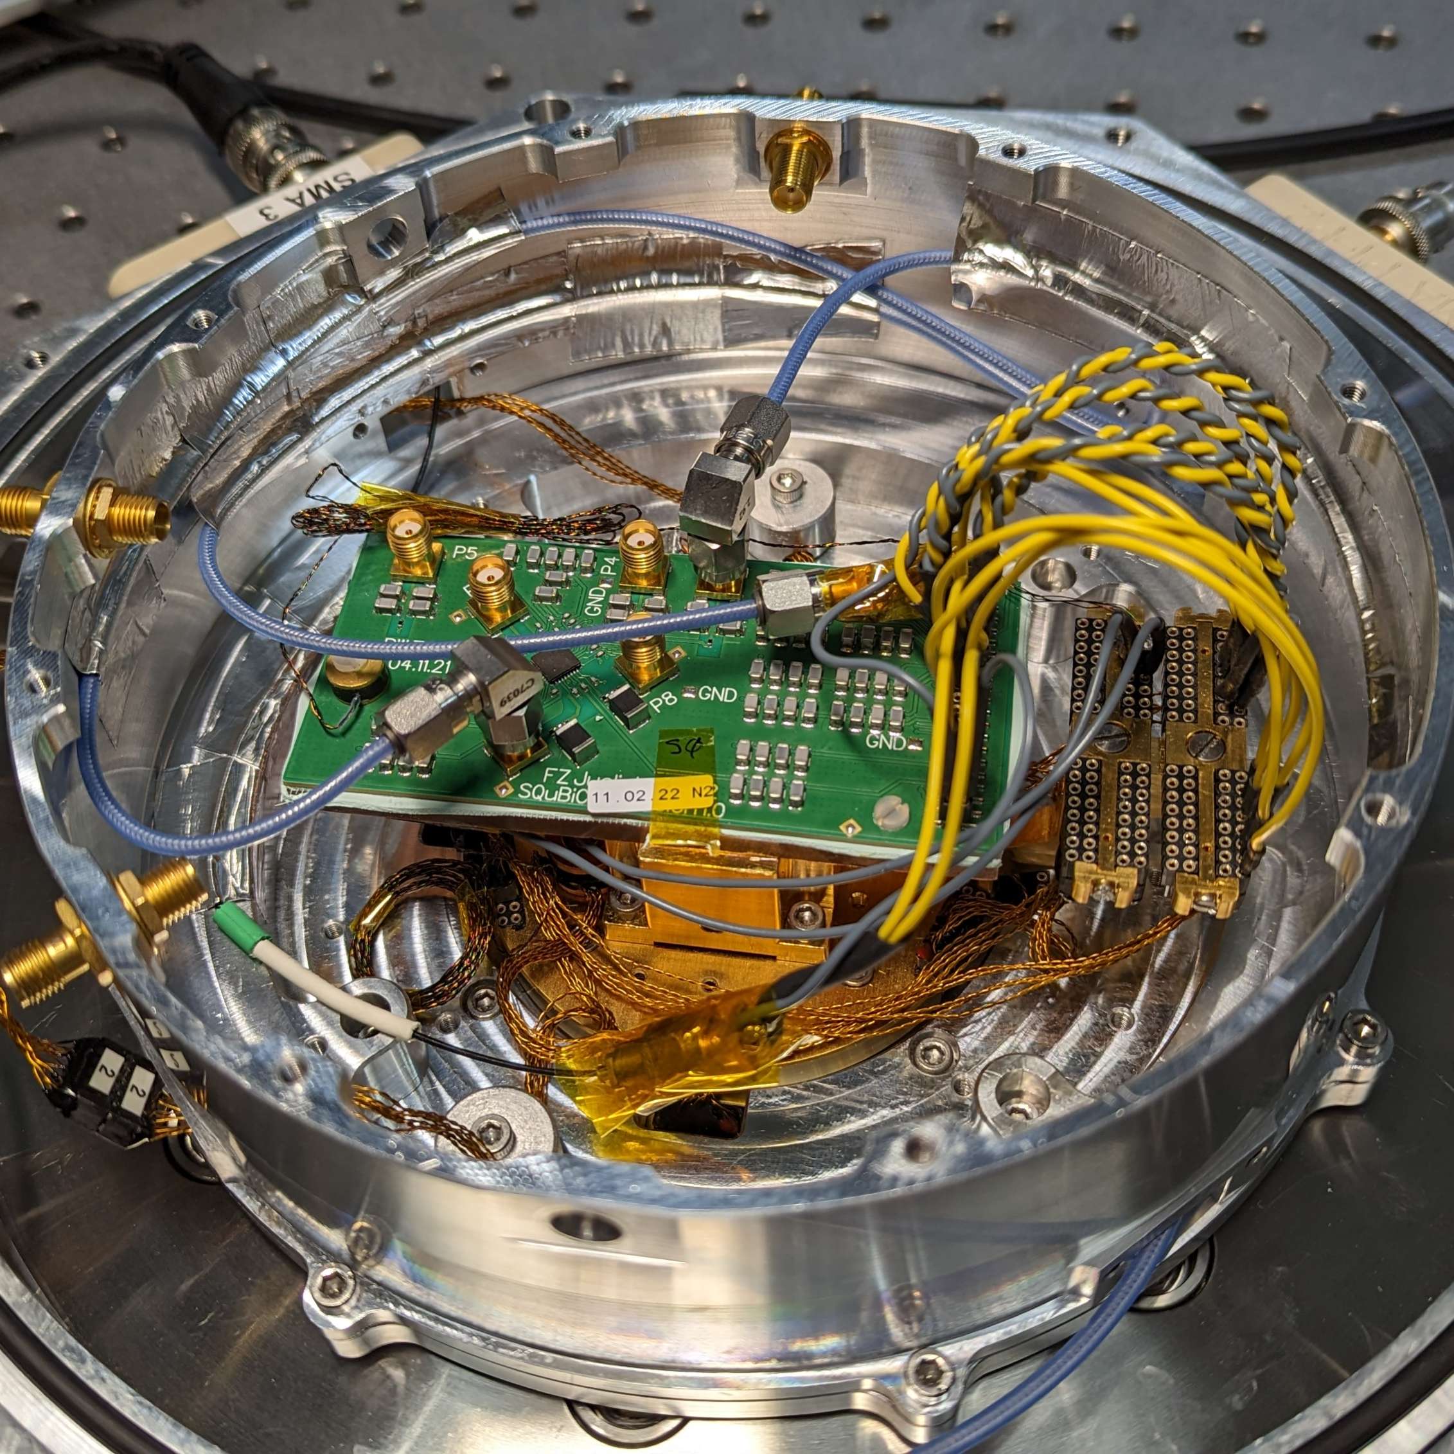
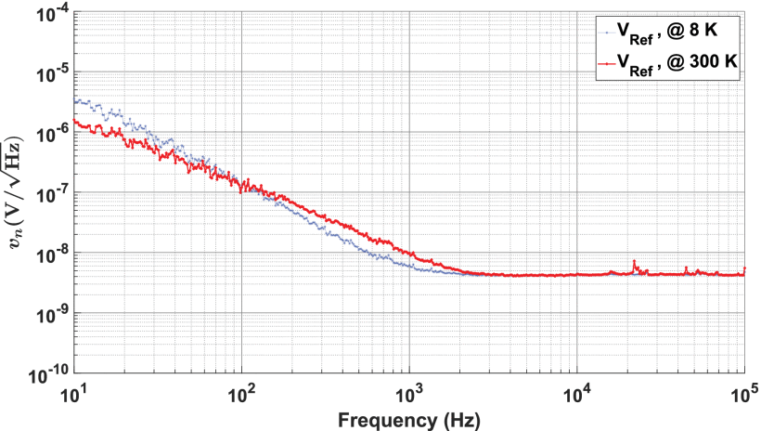
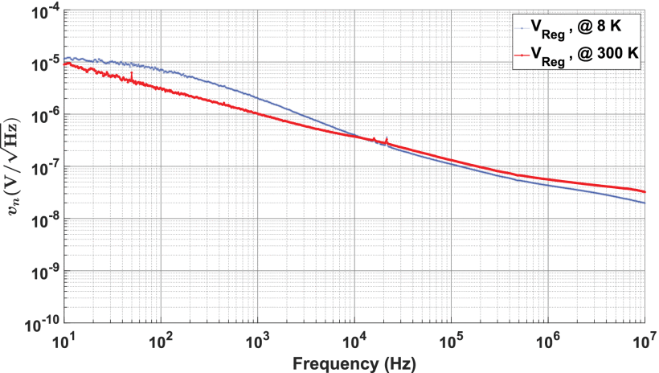
NOISE
Ground loop noise is removed by electrically detaching the regulator from the cold plate.
Cryostat and Voltage Reference & Regulator
Ground loop noise is coupled to regulator output via cold plate.
Avoid GND loops in the cryostat
Counteracting the wish to thermal couple
Increased 1/f noise; decreased thermal noise
Higher temp. due to thermal pad and imperfect thermalization of cables; improvement on progress.
Voltage reference noise
Voltage regulator noise
[2] A. R. Cabrera-Galicia, et.al, "Voltage Reference and Voltage Regulator for the Cryogenic Performance Evaluation of the 22nm FDSOI Technology," in IEEE Open Journal of Circuits and Systems, vol. 5, pp. 377-386, 2024, doi: 10.1109/OJCAS.2024.3466395
Notes:
Triboelectric effect (vibration induced)
Gap Pad 500S35 (for space applications)
Shorter connections (through shroud)
Break GND loops (also USB isolators)
RLC low-pass filters
EMC electro magnetic compatibility

Slide 14

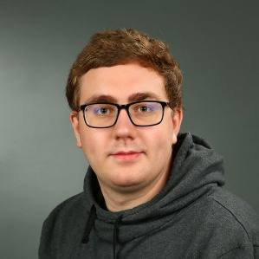
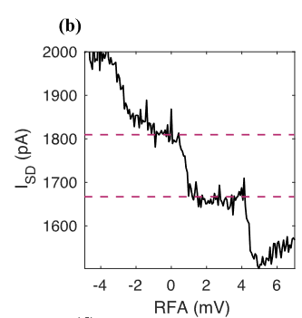
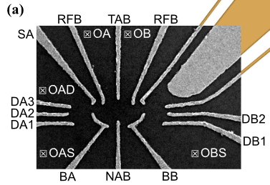
Qubit Readout
Qubit Readout - QUOCCA.SET: A Scalable Readout IC for Semiconductor Quantum Dots
Target: Current readout of quantum dots
Pauli spin blockade to convert spin to charge
Single electron transistor (SET) to convert charge to current (signal ca. 250 pA)
1,25 mm
[3] J.Buehler et al., "QUOCCA.SET: A Scalable Readout IC for Semiconductor Quantum Dots", Global Physics Summit 2025, MAR-G19/4
[[10] Kammerloher, E. (2022) Improving the output signal of charge readout for quantum computing in electrostatically defined quantum dots with a new sensing dot concept.

Slide 15
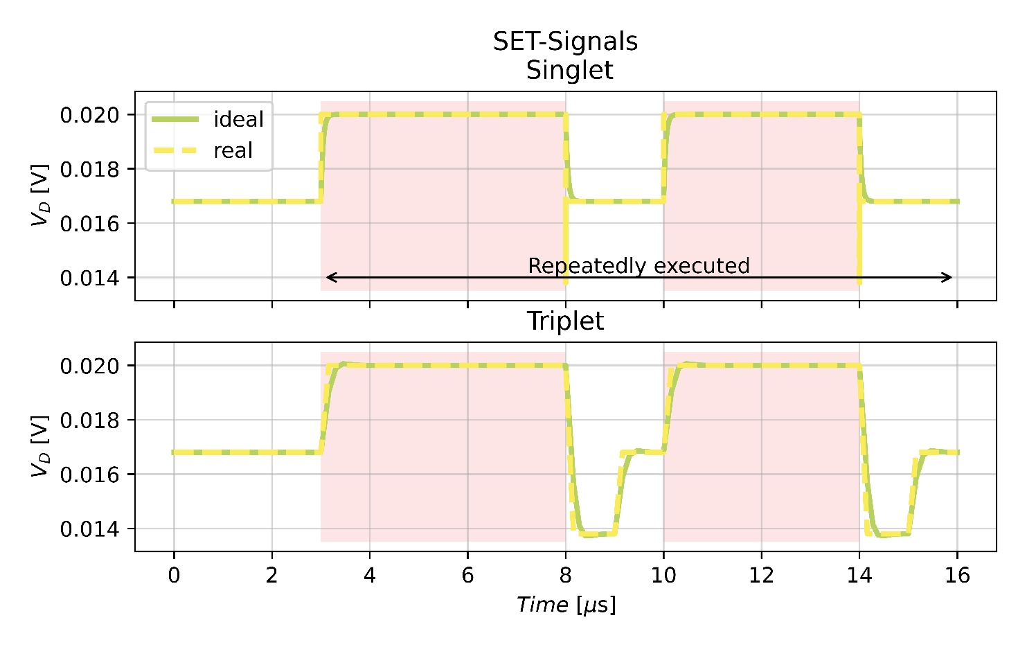
Qubit Readout
Qubit Readout - QUOCCA.SET: A Scalable Readout IC for Semiconductor Quantum Dots
Correlated Double Sampling (CDS)
1st sample after qubit initialization
2nd sample after qubit operation
Cancellation of low frequency noise
IN
S/H1
OUT
Signal
S/H2
SET-Signals Singlet
SET drain current for $\left|1\right\rangle$
Real Ideal
Signal (a.u.)
SET drain current for $\left|0\right\rangle$
Triplet
Signal (a.u.)
Signal
Time (a.u.)
[3] J.Buehler et al., "QUOCCA.SET: A Scalable Readout IC for Semiconductor Quantum Dots", Global Physics Summit 2025, MAR-G19/4

Slide 16
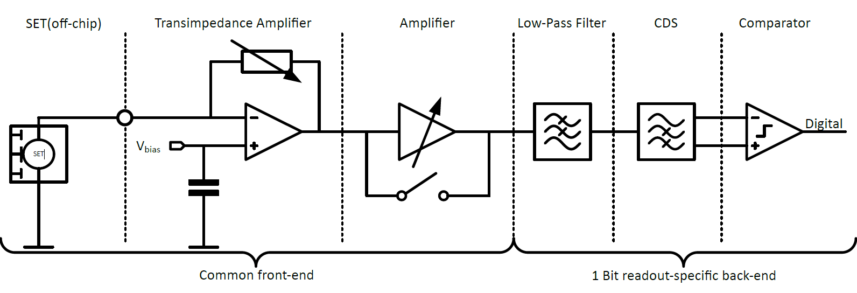
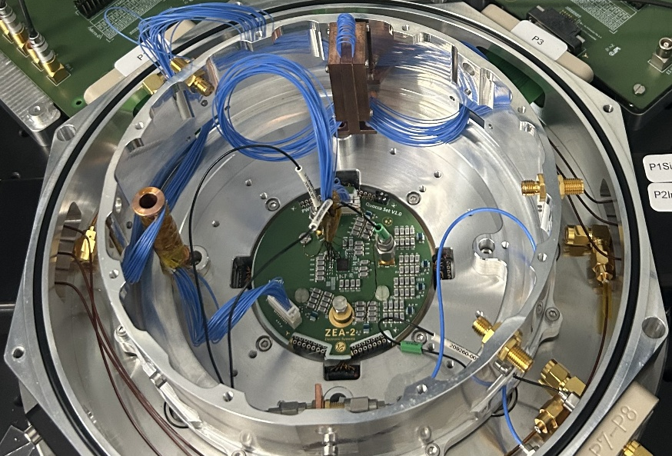
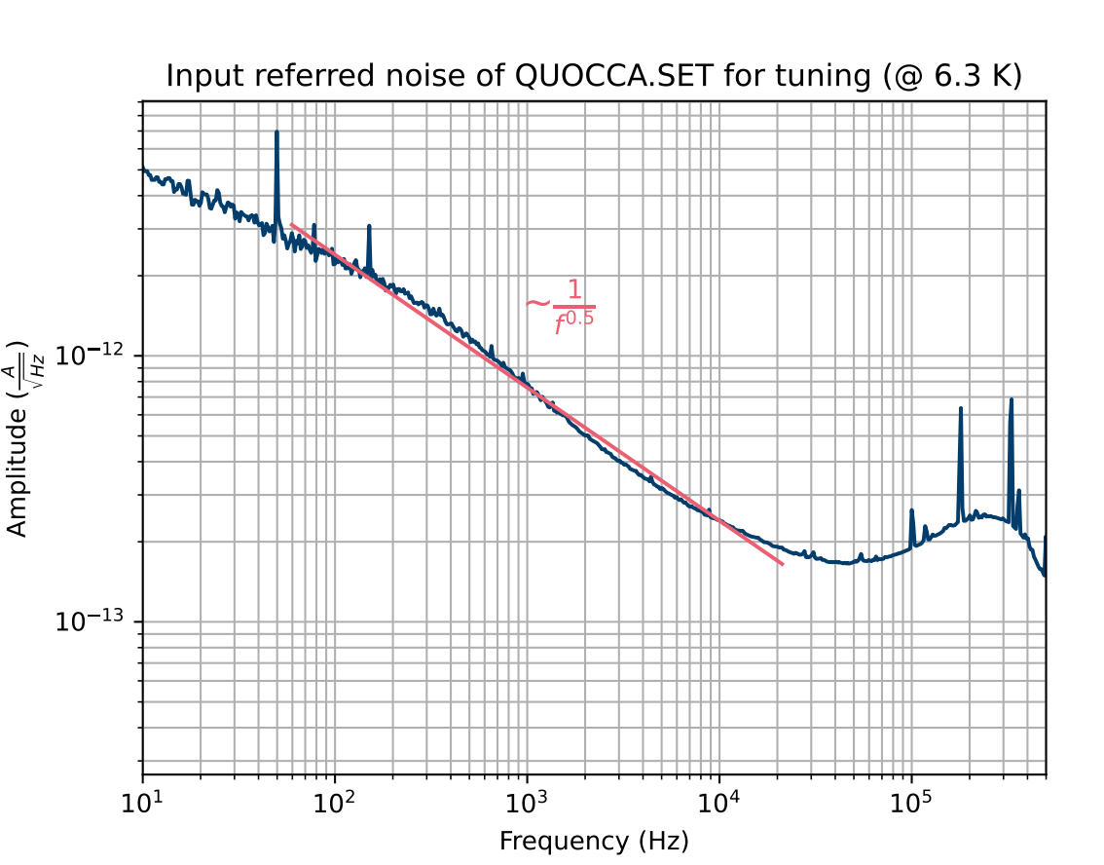
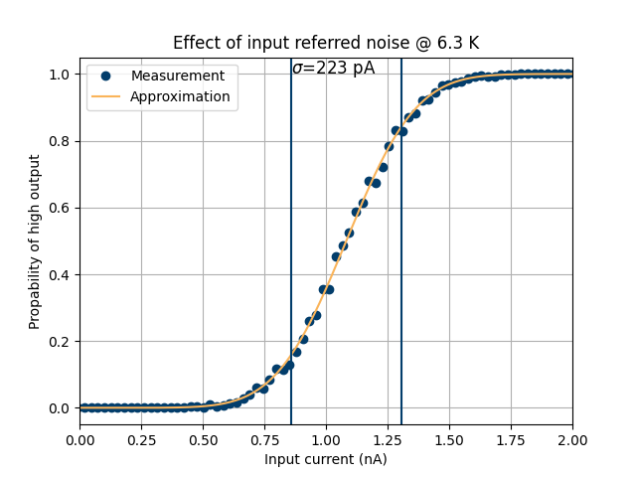
Qubit Readout
Qubit Readout - QUOCCA.SET: A Scalable Readout IC for Semiconductor Quantum Dots
223 pA RMS @ 1 µs, max. BW
111 pA RMS @ 1 µs, 1 kHz BW
Digital Power: 41 µW
Analog Power: 33.6 µW/SET
[3] J.Buehler et al., "QUOCCA.SET: A Scalable Readout IC for Semiconductor Quantum Dots", Global Physics Summit 2025, MAR-G19/4

Slide 17

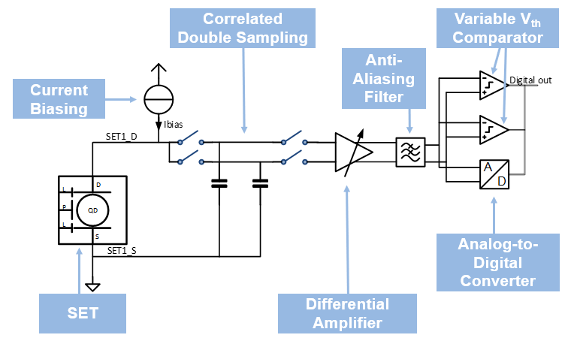
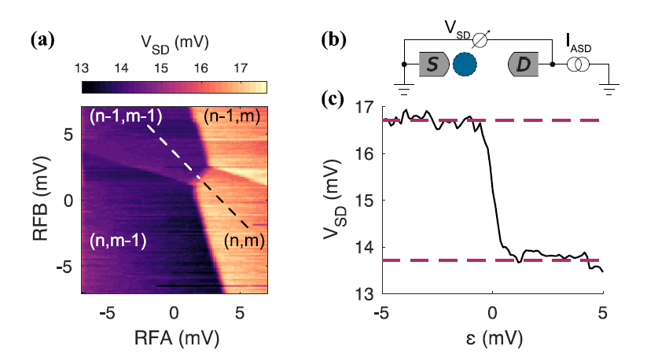
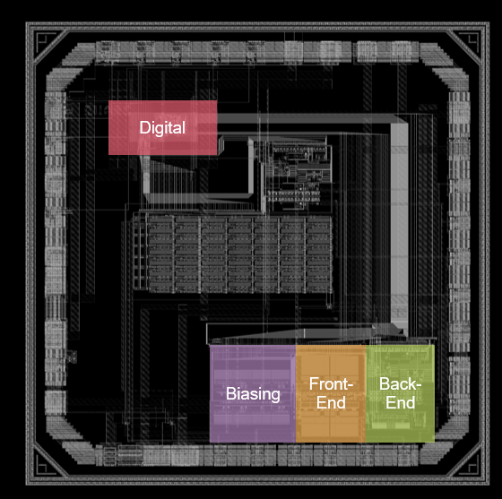
Qubit Readout
Qubit Readout - QUOCCA.SET: A Scalable Readout IC for Semiconductor Quantum Dots
Target: Voltage readout of quantum dots
Pauli spin blockade to convert spin to charge
Single electron transistor to convert charge to voltage
Signal: ≈ 3 mV ^{[5]}
Digital
Front-End
Triggerd FSM
JTAG and UART
Current-mirror bank
S/H with variable Capacitances
Dynamic Comperator
7 bit SAR ADC
Biasing
Back-End
1 mm
[4] J.Buehler et al., "Scalable integrated readout of semiconductor quantum dots using current biasinG", Global Physics Summit 2026
https://summit.aps.org/smt/2026/events/MAR-Z17/15
10] Kammerloher, E. (2022) Improving the output signal of charge readout for quantum computing in electrostatically defined quantum dots with a new sensing dot concept.

Slide 18
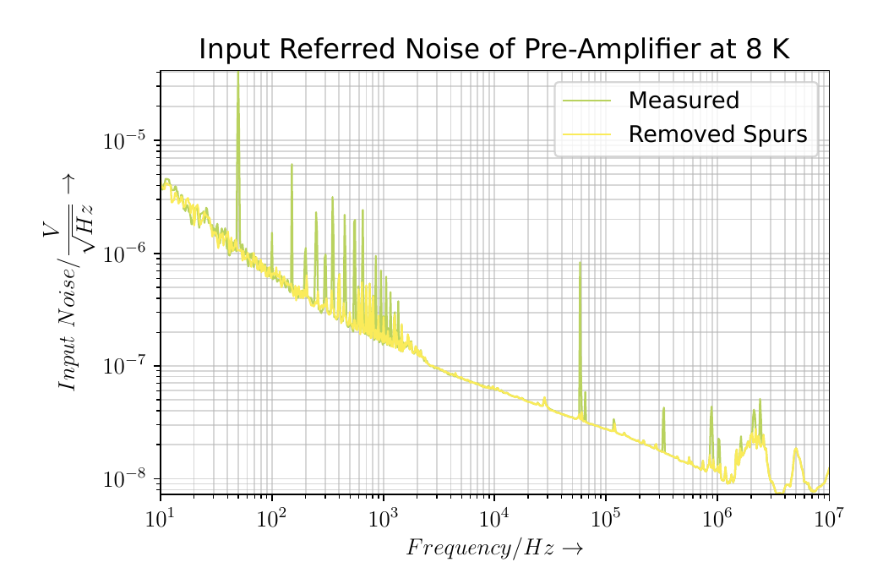
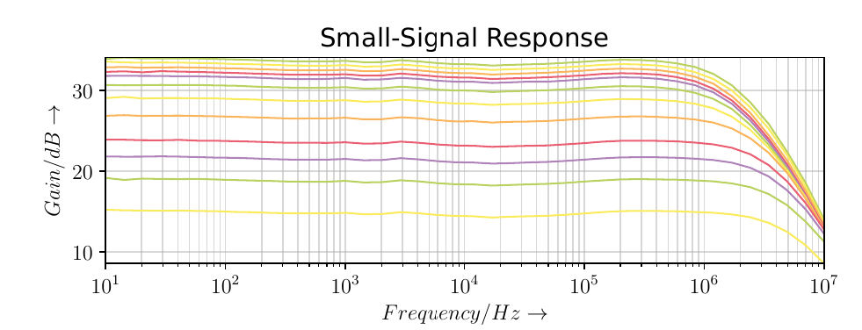
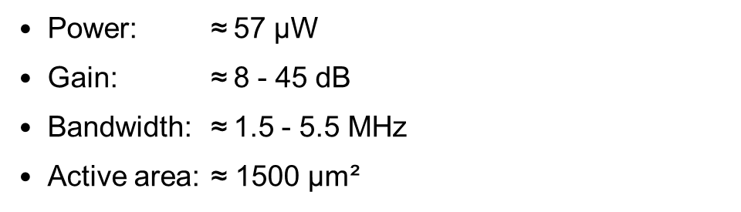
Qubit Readout
Amplifier Measurements at 8 K
Power: $\text{≈}$57 µW
Gain: $\text{≈}$8 - 45 dB
Bandwidth: $\text{≈}$1.5 - 5.5 MHz
Active area: $\text{≈}$ 1500 µm²
[4] J.Buehler et al., "Scalable integrated readout of semiconductor quantum dots using current biasinG", Global Physics Summit 2026
https://summit.aps.org/smt/2026/events/MAR-Z17/15

Slide 19
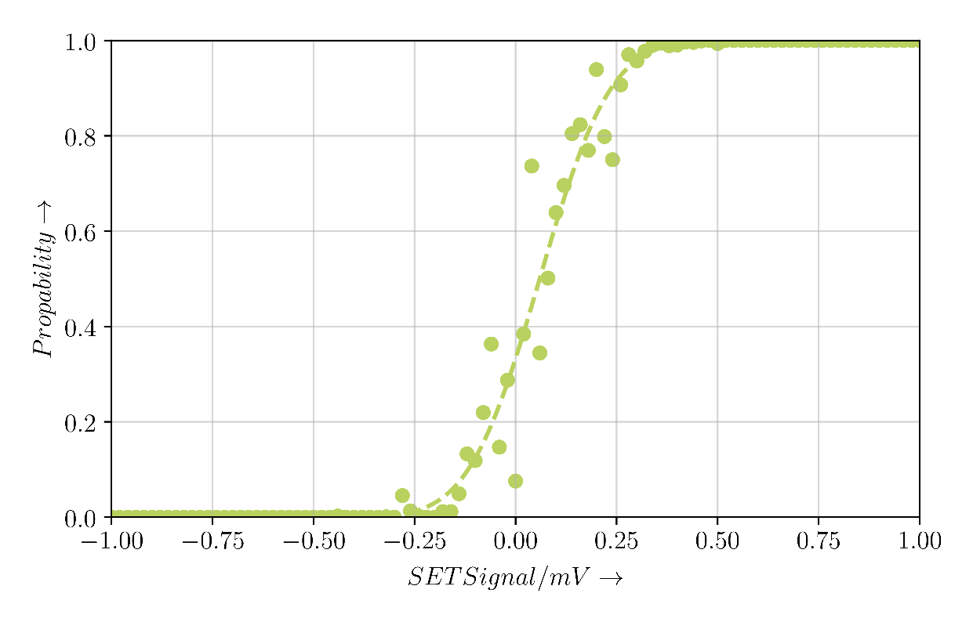
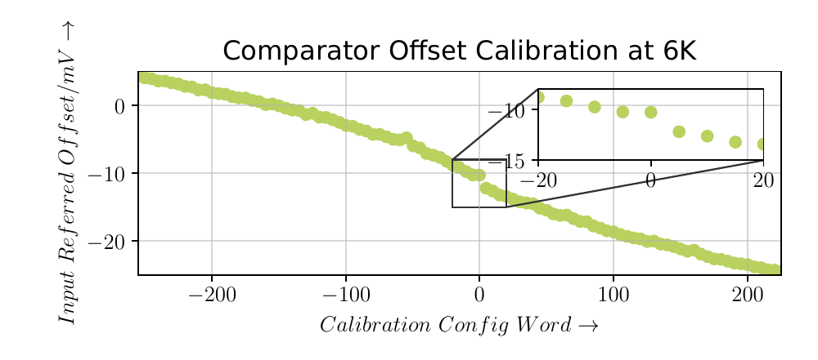
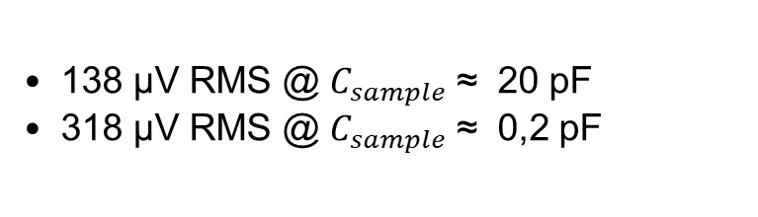
Qubit Readout
Performance of 1-Bit readout
500 ns Sampling Time
138 µV RMS @ $C_{sample} \text{≈}$ 20 pF
318 µV RMS @ $C_{sample} \text{≈}$ 0,2 pF
Power:
Digital Power: 8.5 µW
Analog Power: 115 µW
43] J.Buehler et al., "Scalable integrated readout of semiconductor quantum dots using current biasinG", Global Physics Summit 2026
https://summit.aps.org/smt/2026/events/MAR-Z17/15

Slide 20
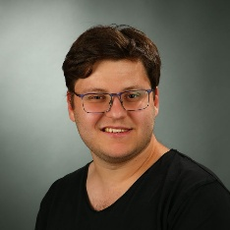
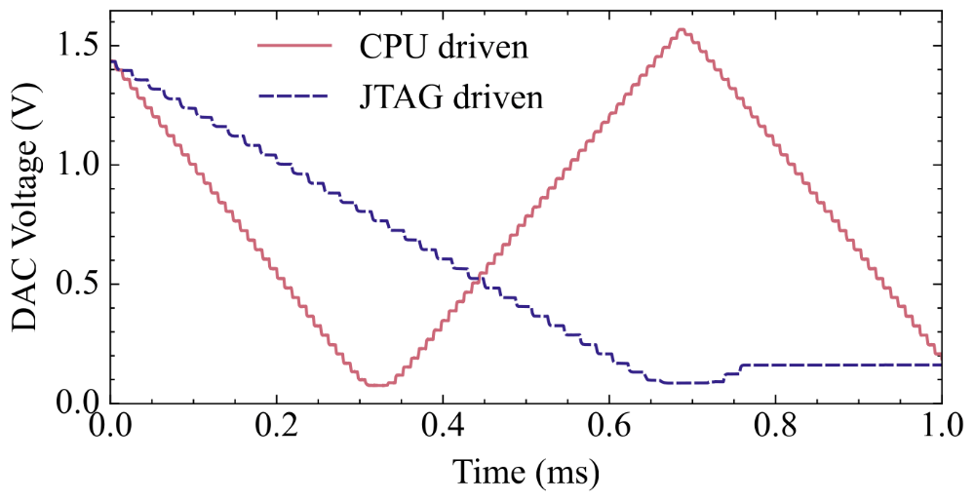
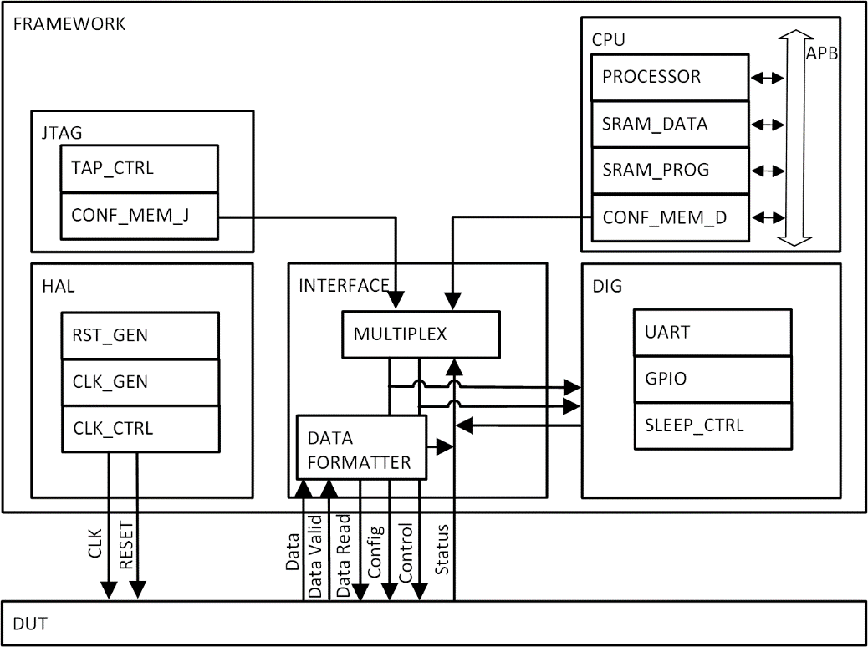
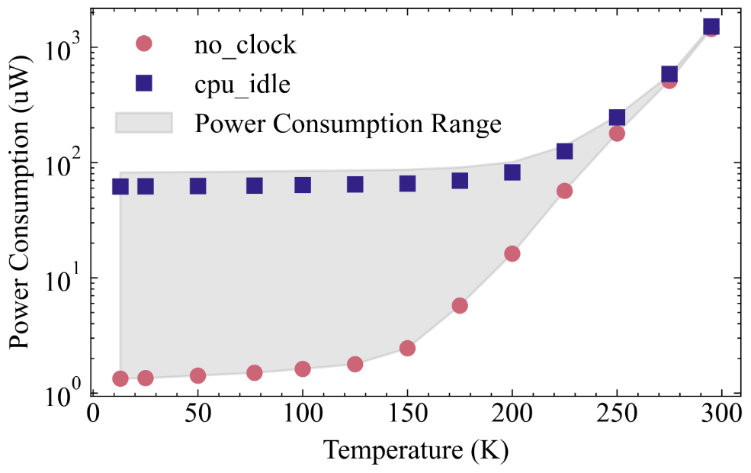
Integrated RISC-V
Rapid Prototyping Platform for Integrated Circuits for Quantum Computing
RISC-V with SRAM and APB
Enables flexibility in control (algorithms)
Leakage negligible at cryo
[5] J. Mair et al., "Rapid Prototyping Platform for Integrated Circuits for Quantum Computing," 2024 20th International Conference on Synthesis, Modeling, Analysis and Simulation Methods and Applications to Circuit Design (SMACD), Volos, Greece, 2024, pp. 1-4, doi: 10.1109/SMACD61181.2024.10745395.
Notes:
32-Bit RISCV with 3 Pipeline Stages
2x32kB SRAM (Data and Instructions)
Single Clock Access Over (modified) APB
Area:
700 µm x 300 µm
Gate Count:
19628
Dynamic Power @25°C:
0.13 mW (5MHz, 0.8V)
Leakage Power @25°C:
0.70 mW (0.8V)

Slide 21
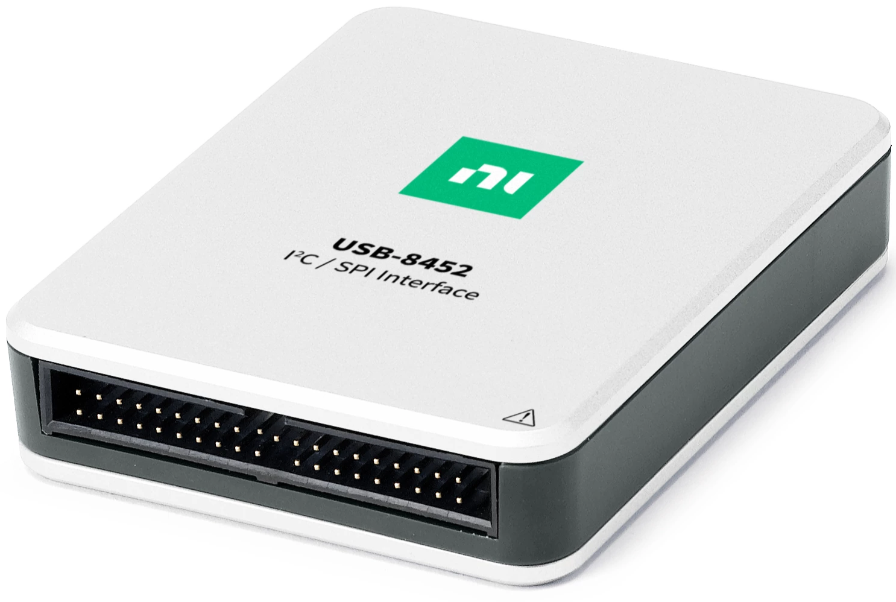
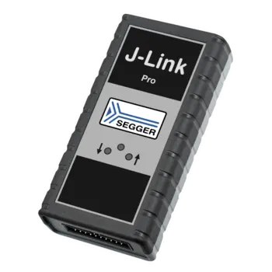
Digital Interface
Comparison of Industry Standard Protocols
Protocol | Pro ☺ | Cons ☹
UART | 2-wire interface (RX TX) No pull-up/down | Requires sync.
I²C | 2-wire interface (SDA SCL) | Pull-ups
SPI | No pull-up/down | 3[4]-wire interface (SCLK MOSI MISO [CE])
JTAG | No pull-up/down | 4-wire interface (TCK TMS TDI TDO) Complex state-machine
cJTAG | 2-wire interface (TCKC TMSC) | Complex state-machine Less established Optional Pull-ups/downs
Write & read IC config regs
Configuration of IC blocks

Slide 22
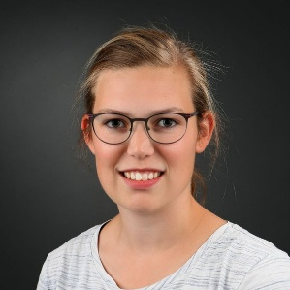
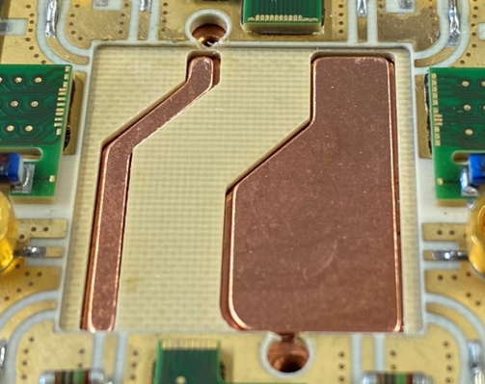
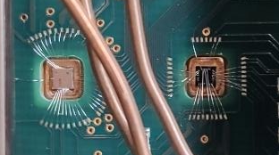
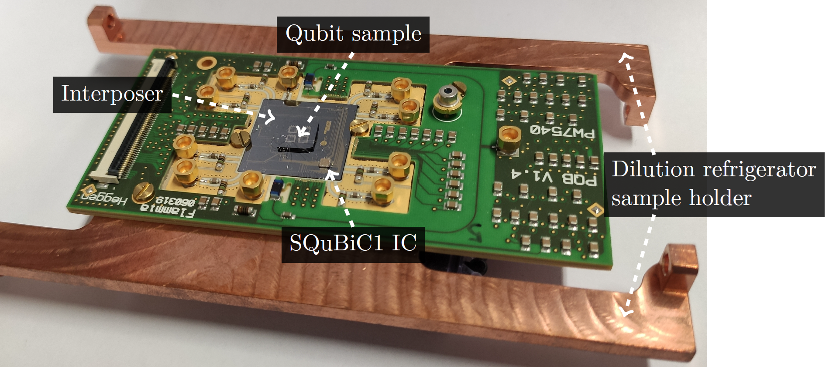



Cryogenic co-integration
Multiple Approaches
IC
Qubit
IC
Qubit
Interposer
Interposer
Interposer
IC
Qubit
PCB Material
Copper
Copper
Copper
Divided Interposer
IC and Qubit:
Same Interposer
IC and Qubit:
Two Interposer
IC and Qubit:
Direct Copper
Electron Temperature Qubit: ca. 2-3K
Electron Temperature Qubit: ca. 0.5-1K
Electron Temperature Qubit: < 0.4K
[6] L. Schreckenberg et al., "SiGe Qubit Biasing with a Cryogenic CMOS DAC at mK Temperature," ESSCIRC 2023

Slide 23




Cryogenic co-integration
Ultra-low Leakage Currents
Bias DAC cycling through 7 metal electrodes
SET used as measurement amplifier
Visible cross-talk depending on location
Leakage rates on metal electrodes meas.
2 pF on-chip cap.; ca. 300 fF off-chip cap.
Ultra-low voltage drift of <1 µV/s
Cryo Bias-DAC
RT DAC
[6] L. Schreckenberg et al., "SiGe Qubit Biasing with a Cryogenic CMOS DAC at mK Temperature," ESSCIRC 2023

Slide 24




Cryogenic co-integration
Qubit DC Biasing
Co-integration bias DAC with Si / SiGe qubit
Cryo setup
at mK stage
[5]
Charge sensing of single and double quantum dot
[3]
[6]
[7] P. Vliex et al., "Bias Voltage DAC Operating at Cryogenic Temperatures for Solid-State Qubit Applications," IEEE Solid-State Circuits Letters, 2020
[6] L. Schreckenberg et al., "SiGe Qubit Biasing with a Cryogenic CMOS DAC at mK Temperature," ESSCIRC 2023

Slide 25

















Cryogenic Measurements
Inputs for a Cryo-PDK for 22 nm CMOS
Short-Channel I-V-Curves [8]
Setup @ ICA | FZJ: T_{min} ~ 7 K
Transistor Arrays
60 K Stage
I_{D} [a.u.]
7 K
7 K
Analyzer
300 K Stage
Input Data for BSIM-IMG Based Modeling
done by AdMOS GmbH
Cryogenic Model Library
DUT
[8] Chava, Phanish, et al. "Evaluation of cryogenic models for FDSOI CMOS transistors." 16th IEEE Workshop on Low Temperature electronics. No. FZJ-2024-05369. Zentralinstitut für Elektronik, 2024.
The QSolid project acknowledges the support of the Federal Ministry of Education and Research (BMBF) within the framework programme “Quantum technologies – from basic research to market” (Grant No. 13N16149).

Slide 26




Qsolid – Photonic link
Optical Data and Power Link to Cryo
Passive optical photodiode link as alternative approach
Significantly improved bandwidth & dark currents at cryo
Purely passive operation, no bias needed
Power and data communication envisioned
Measurement with SC Qubit in Munich ongoing
[9] S.Mutum, et. Al, "A Photonic Link at 4.7K with >1 GHz bandwidth towards an Optical Quantum Computing Interface", IEEE MTT-S International Microwave Symposium (IMS) 15-20 June 2025, Moscone Center, San Francisco, CA
The QSolid project acknowledges the support of the Federal Ministry of Education and Research (BMBF) within the framework programme “Quantum technologies – from basic research to market” (Grant No. 13N16149).

Slide 27










Summary
Cryo-CMOS readout shown with current and voltage biasing.
DC qubit biasing demonstrated in 22 nm and 65 nm, at cryo and with qubits
Cryogenic Pitfalls:
Hidden IP power
Cryo model shifts
Ground loops in the cryostat
Steep subthreshold slope
Thermal anchoring
System Modeling
Cryogenic IC Design
Cryo Measurement
System Engineering

Slide 28




Follow Us!
Jobs & Social Media Accounts @ ICA
Current Vacancies:
LinkedIn:
Mastodon:
Threads:
www.ica.fz-juelich.de
www.linkedin.com/showcase/ica-pgi4
https://social.fz-juelich.de/@fzj_ica
www.threads.com/@fzj_ica

Slide 29
References
[1] H. Banba et al. “A CMOS bandgap reference circuit with sub-1-V operation”. In: IEEE Journal of Solid-State Circuits 34.5 (May 1999), pp. 670–674. doi: 10.1109/4.760378.
[2] A. R. Cabrera-Galicia, et.al, "Voltage Reference and Voltage Regulator for the Cryogenic Performance Evaluation of the 22nm FDSOI Technology," in IEEE Open Journal of Circuits and Systems, vol. 5, pp. 377-386, 2024, doi: 10.1109/OJCAS.2024.3466395
[3] J.Buehler et al., "QUOCCA.SET: A Scalable Readout IC for Semiconductor Quantum Dots", Global Physics Summit 2025, MAR-G19/4
[4] J.Buehler et al., "Scalable integrated readout of semiconductor quantum dots using current biasinG", Global Physics Summit 2026 https://summit.aps.org/smt/2026/events/MAR-Z17/15
[5] J. Mair et al., "Rapid Prototyping Platform for Integrated Circuits for Quantum Computing," 2024 20th International Conference on Synthesis, Modeling, Analysis and Simulation Methods and Applications to Circuit Design (SMACD), Volos, Greece, 2024, pp. 1-4, doi: 10.1109/SMACD61181.2024.10745395.
[6] L. Schreckenberg et al., "SiGe Qubit Biasing with a Cryogenic CMOS DAC at mK Temperature," ESSCIRC 2023
[7] P. Vliex et al., "Bias Voltage DAC Operating at Cryogenic Temperatures for Solid-State Qubit Applications," IEEE Solid-State Circuits Letters, 2020
[8] Chava, Phanish, et al. "Evaluation of cryogenic models for FDSOI CMOS transistors." 16th IEEE Workshop on Low Temperature electronics. No. FZJ-2024-05369. Zentralinstitut für Elektronik, 2024.
[9] S.Mutum, et. Al, "A Photonic Link at 4.7K with >1 GHz bandwidth towards an Optical Quantum Computing Interface", IEEE MTT-S International Microwave Symposium (IMS) 15-20 June 2025, Moscone Center, San Francisco, CA
[10] Kammerloher, E. (2022) Improving the output signal of charge readout for quantum computing in electrostatically defined quantum dots with a new sensing dot concept. Dissertation/PhD thesis. Aachen: RWTH Aachen University. DOI: 10.18154/RWTH-2022-01567.

Slide 30


New Spin-Off:
IceCirc is a spin-off of the Institute for Integrated Computing Architectures at Research Center Jülich which:
Has 10 years of experience in cryogenic IC design
Employs state of the art semiconductor technology
Has demonstrated integration of cryogenic electronics with qubits
Provides electronic design service for cryogenic integrated electronics
Visit us at icecirc.com

