Slide 1


Cryogenic modeling and Process Design Kit for a CMOS 28-nm bulk technology
Luca castellani – FEE 2026 Paris

Slide 2
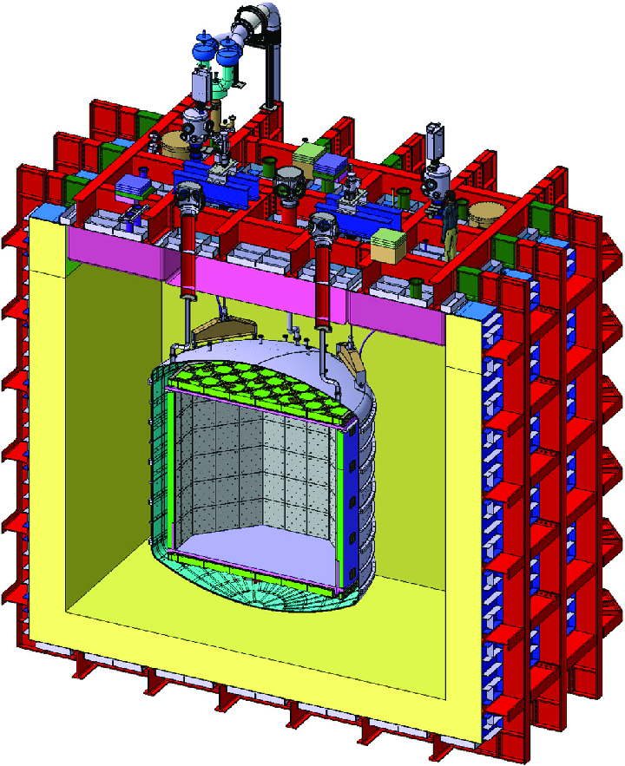
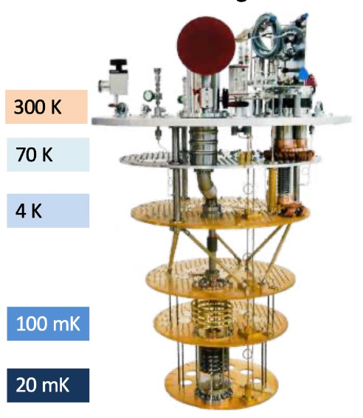
Reason for cryogenic pdk development
Thesis Goal
Cryogenic ICs → cryogenic particle detectors readout and quantum computing control
Dark matter/neutrino detectors → scalability
quantum processors → interconnect
Si Foundries → PDK (Process Design Kits) for a CMOS tech node.
Valid only down to -40° C
Cryogenic Designs → custom models
Darkside20k liquid Ar cryo-TPC
in construction @LNGS, Italy
[1]
Example of fixed cryo-T dilution cryostat for quantum computing prototypes
Goal :
establish a cryo characterization and extraction methodology for a 28nm bulk CMOS technology → partial cryo-PDK
[1] DarkSide-20k sensitivity to light dark matter particles, Acerbi et al. 2024

Slide 3
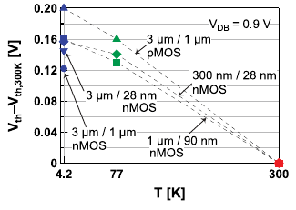
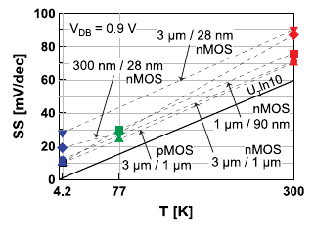
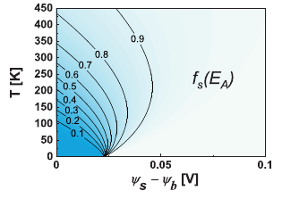
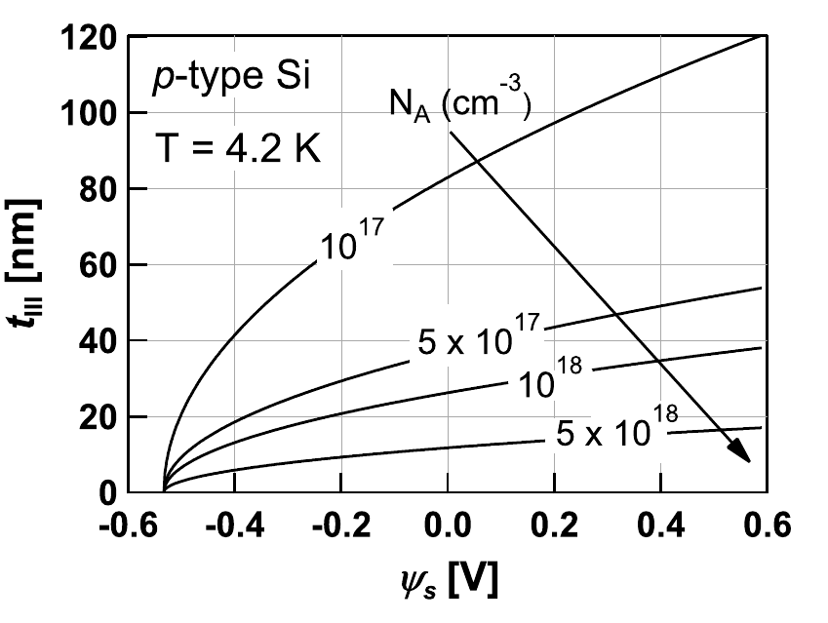
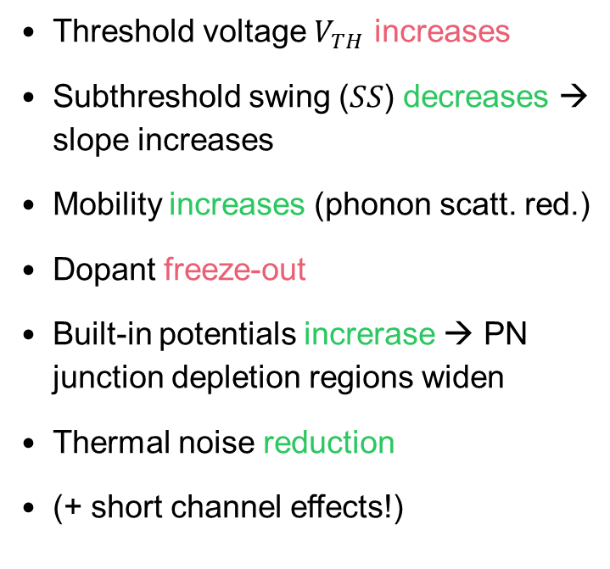
cryogenic phenomena - cmos electronics
Threshold voltage $V_{TH}$ increases
Subthreshold swing ($SS$) decreases → slope increases
Mobility increases (phonon scatt. red.)
Dopant freeze-out
Built-in potentials increrase → PN junction depletion regions widen
Thermal noise reduction
(+ short channel effects!)
[1]
[1]
[1]
[1]
[1] “Characterization and Modeling of 28 nm Bulk CMOS Technology down to 4.2K” Beckers et al., 2018

Slide 4
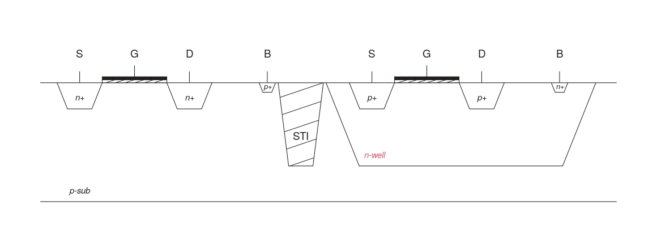
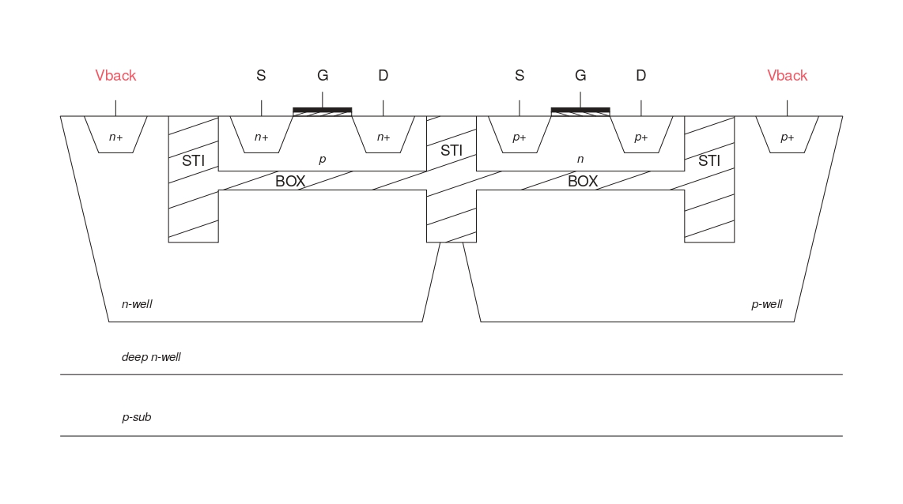
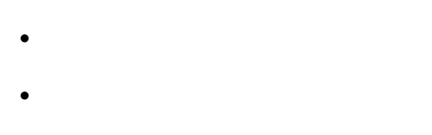
28-nm Bulk CMOS
Bulk CMOS schematic
Technology Overview @cryo T
Mature commercial tech, 2011
Balance of cost, power consumption and performance
Dominant in many applications (Detector ASICs, Analog/Mixed-Signal Ics, scientific R&D)
One of the last av. planar CMOS nodes
FD-SOI CMOS schematic
BULK vs FD-SOI @CRYO:
Cost effective
Less self heating
No $V_{TH}$ control ($V_{back}$)
Freeze out

Slide 5
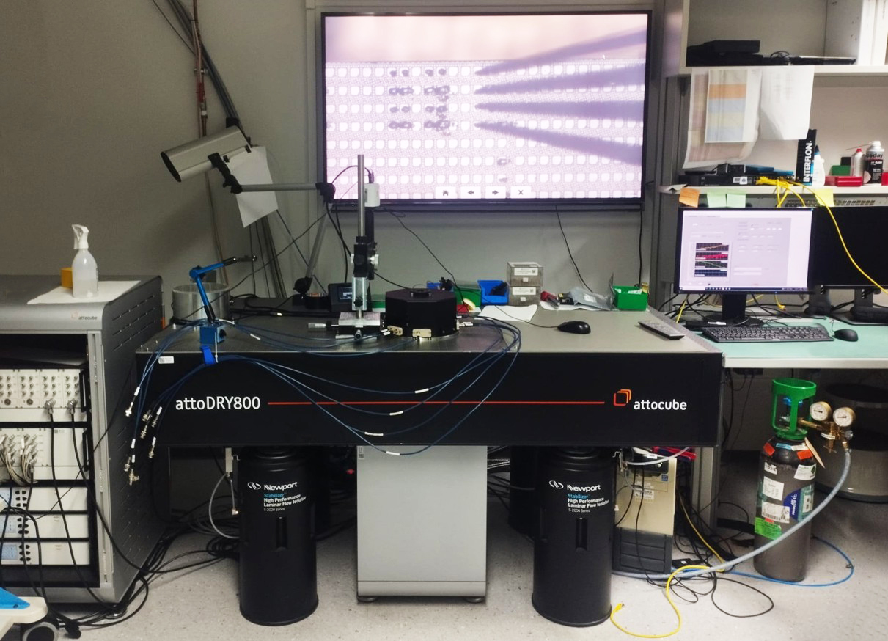
Cryogenic measurement setup
Forschungszentrum juelich

Slide 6
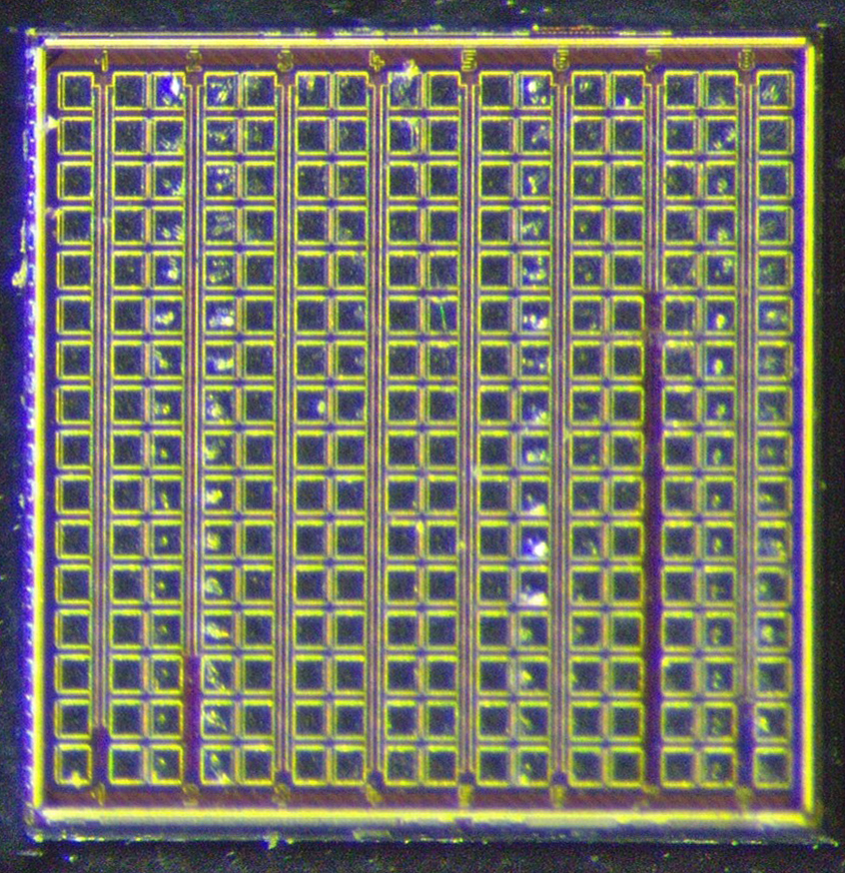
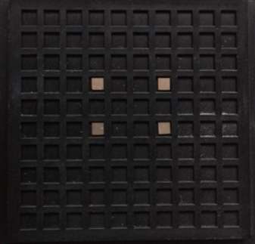
sample DUT
28-nm CMOS multi-geometry chip for needle probing
Courtesy of Giulio Borghello – DRD7, CERN
pMOS and nMOS Test-transistors on p-sub
Intended for Total Ionizing Dose (TID) tests
28-nm, 16 pads per Column
1 mm

Slide 7
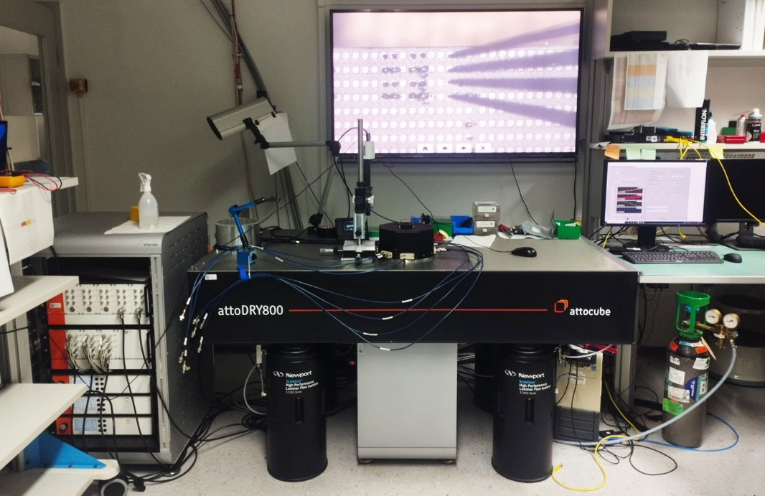
Attodry800 dry cryostat workstation
Probing Screen
Control PC
Microscope
Cryostat
Fischer Lines
N2 Bottle
Piezo Modules
Vacuum Circuit

Slide 8
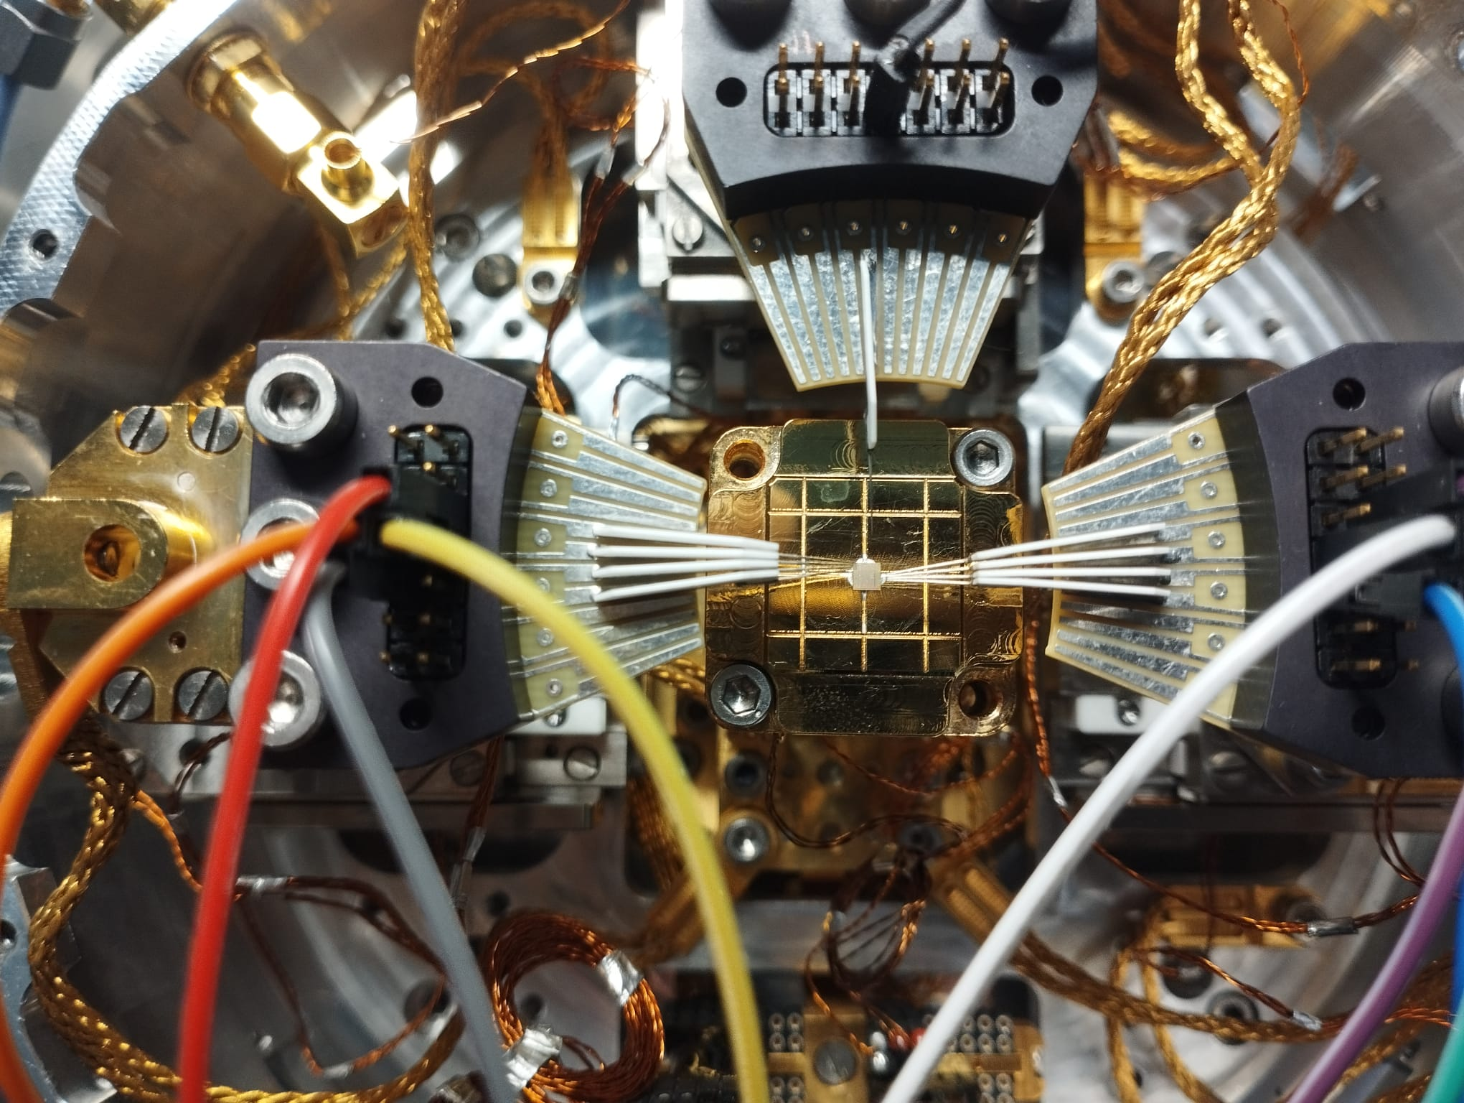
attodry800 cryostat setup
Needle Probing Configuration
AttoDRY800 dry cryostat @FZJ
Configuration with 3 Piezo Positioners,
mounting a needle probe
DC signal through Fischer Lines
Outer shield: thermalized at 60K
Probes, Fischer slots and sample chip
thermalized @8K
Heater and T sensor under sample base
DUT Chip
3 Probes used:
  Left and right Probe: 4 Needles
  Upper Probe: 1 Needle
Thermal Contact w/ Cold Plate
Cold Plate

Slide 9
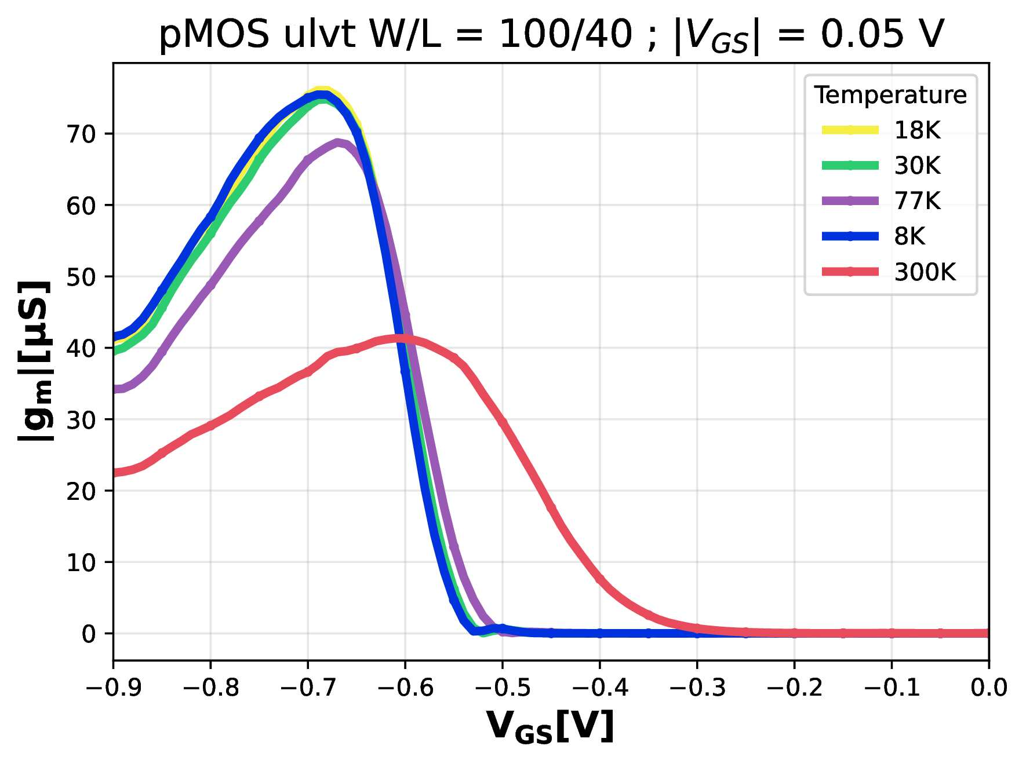
Cryogenic temperature dependence characterization
Forschungszentrum juelich

Slide 10
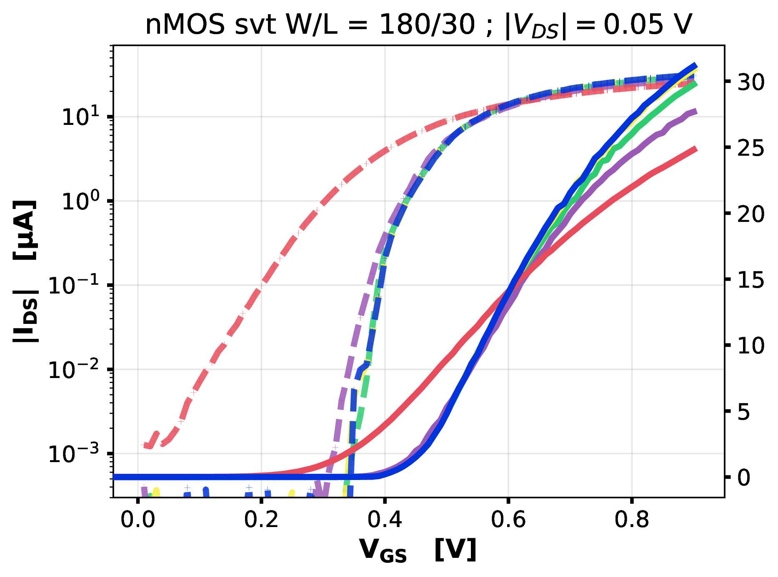
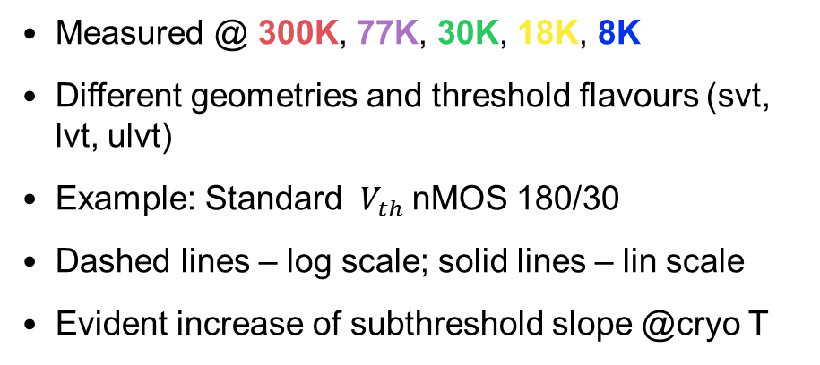
Transfer currents
Measured @ 300K, 77K, 30K, 18K, 8K
Different geometries and threshold flavours (svt, lvt, ulvt)
Example: Standard $V_{th}$nMOS 180/30
Dashed lines – log scale; solid lines – lin scale
Evident increase of subthreshold slope @cryo T
T
T

Slide 11
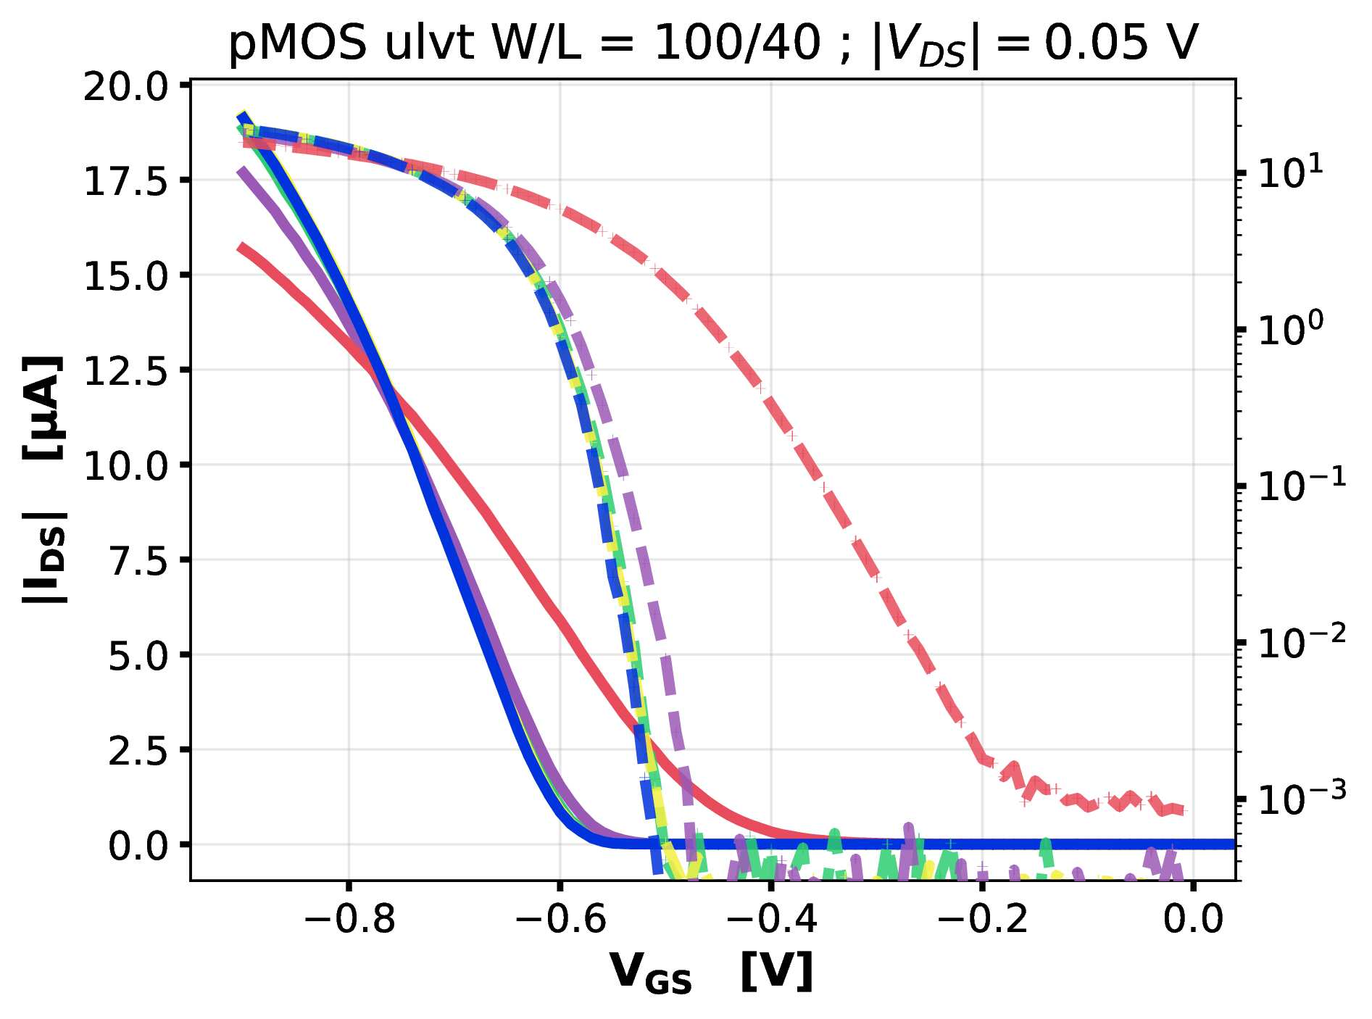

Transfer currents
Measured @ 300K, 77K, 30K, 18K, 8K
Different geometries and threshold flavours (svt, lvt, ulvt)
Example: Ultra-low $V_{th} p$MOS 100/40
Dashed lines – log scale; solid lines – lin scale
Evident increase of subthreshold slope @cryo T
T

Slide 12
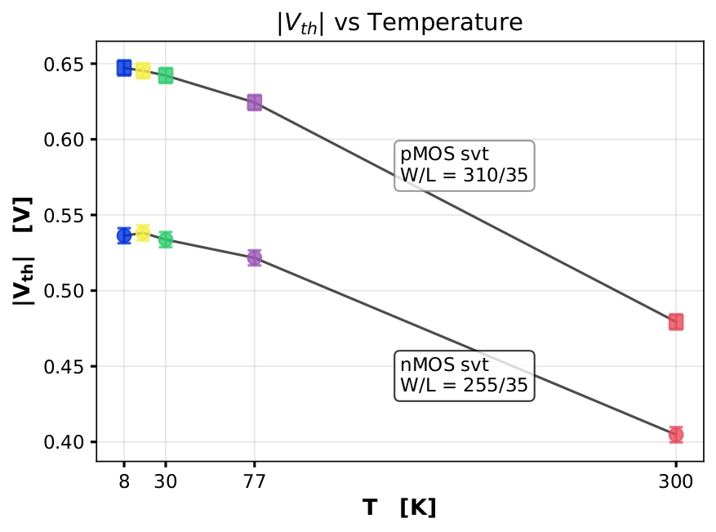
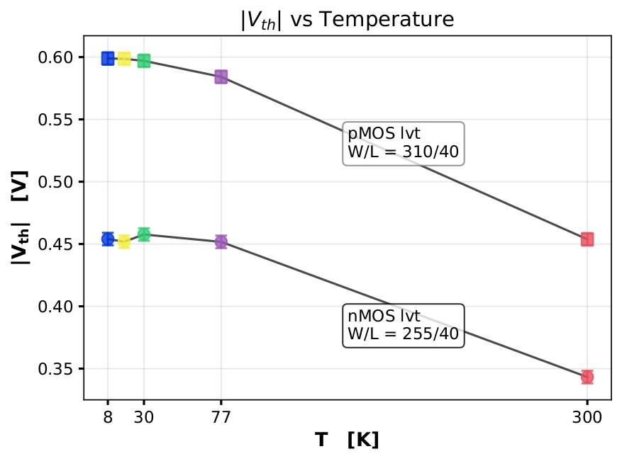
Thresholds
[1]
LE (Linear Extrapolation) Method
Threshold increase of more than 100mV @cryo T observed for every device
[1] “Revisiting MOSFET threshold voltage extraction methods” Ortiz-Conde et al., 2013

Slide 13
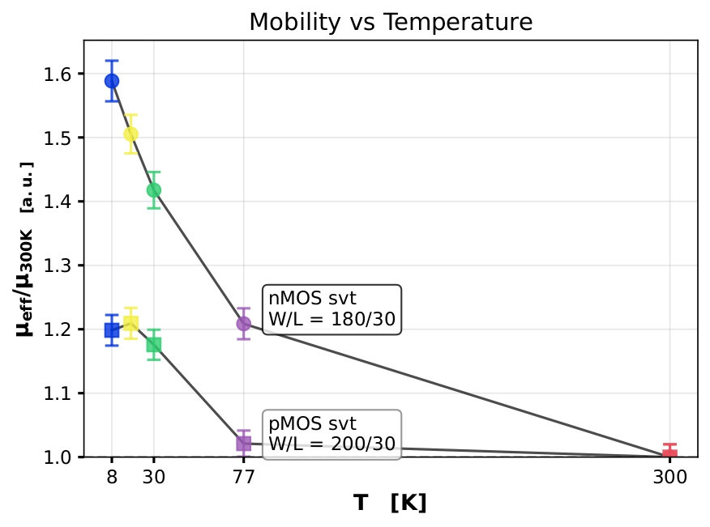
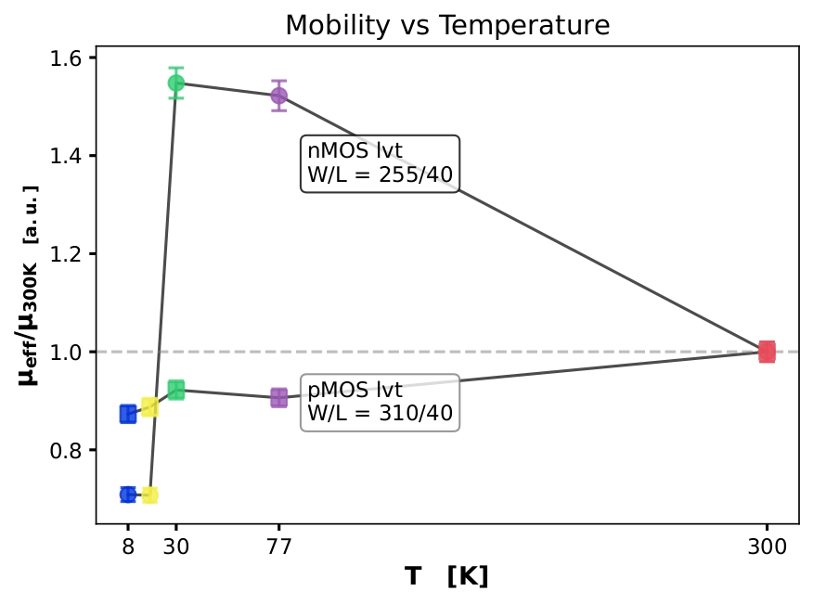
Free-carrier mobilities
[1]
Jazaeri $g_{ds}$ method
$μ_{eff}≅−2∙\frac{L}{W}∙\frac{1}{C_{ox}}∙\frac{∂g_{ds}}{∂V_{DS}}$ where $C_{ox}$ is the gate-oxide capacitance and $\frac{∂g_{ds}}{∂V_{DS}}$is fitted at $\left|V_{GS}\right|=900mV$ (strong inversion) $\left|V_{DS}\right|=50mV$ (linear region)
[1] „Free Carrier Mobility Extraction in FETs”, F. Jazaeri et al., 2017

Slide 14
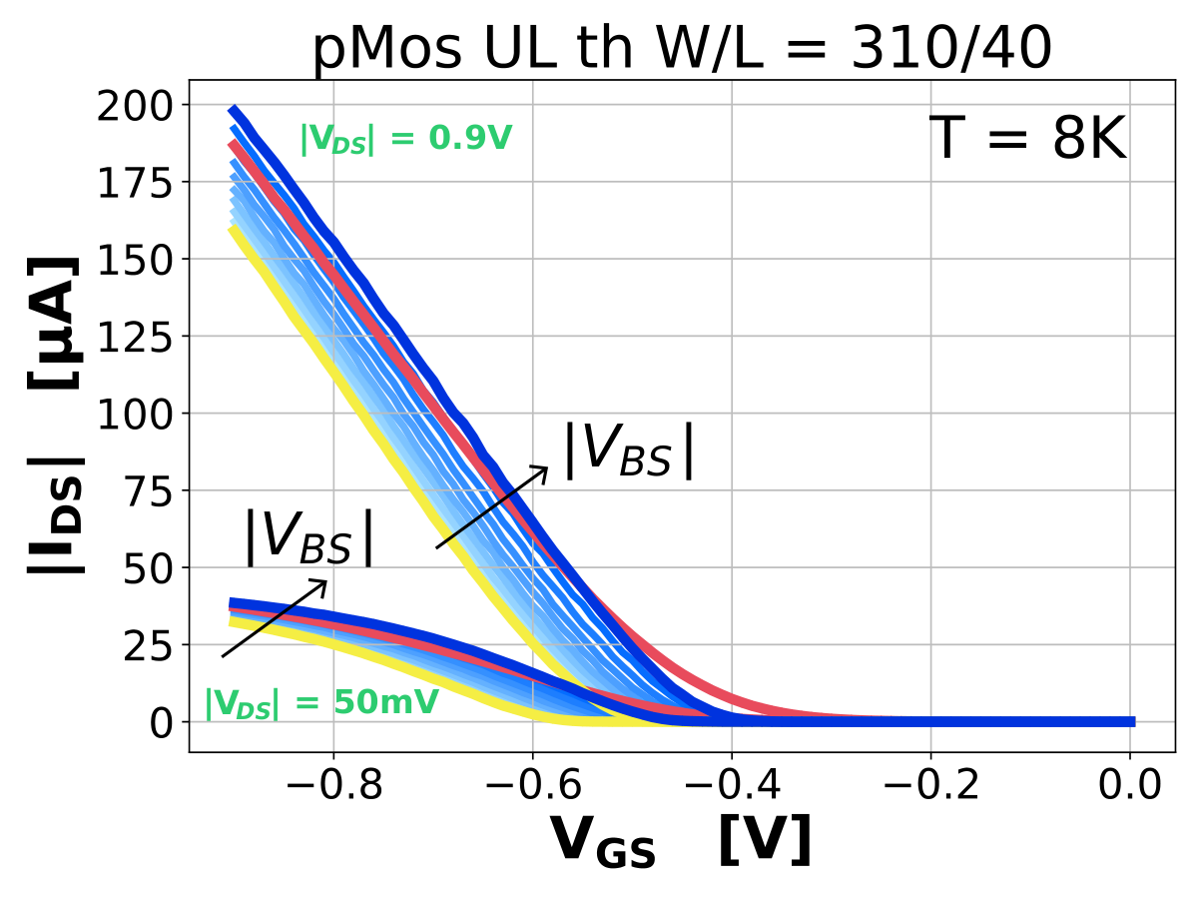
Threshold adjustment in bulk technology
Forschungszentrum juelich

Slide 15
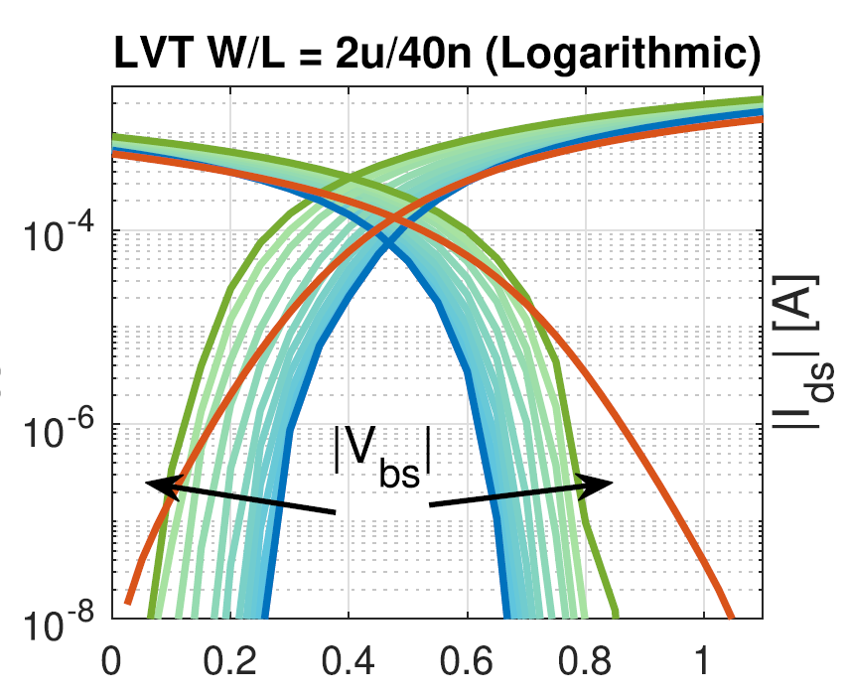
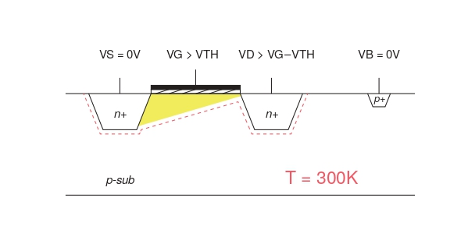
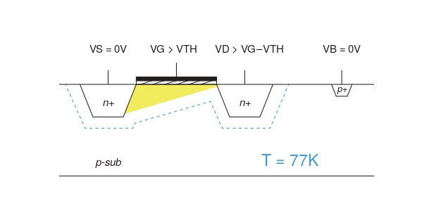


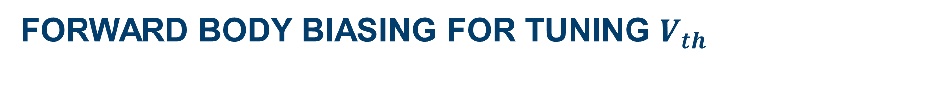
Forward body biasing for TUNING $V_{th}$
In a Bulk Tech: increasing the Source-Bulk potential: Forward body biasing (FBB) →Compensation of $V_{th }$(bigger tech nodes)
$$V_{th, n/p}∝\sqrt{V_{SB}}$$
Demonstrated in 40 nm Tech → possible because of increasing built-in potentials and depletion regions at cryo T ^{[1]}
First time test on 28-nm, only pMOS FBB
[1]
$$V_{G}$$
[1] TU Delft : Cryogenic-Aware Forward Body Biasing in Bulk CMOS, Overwater et al. 2024

Slide 16
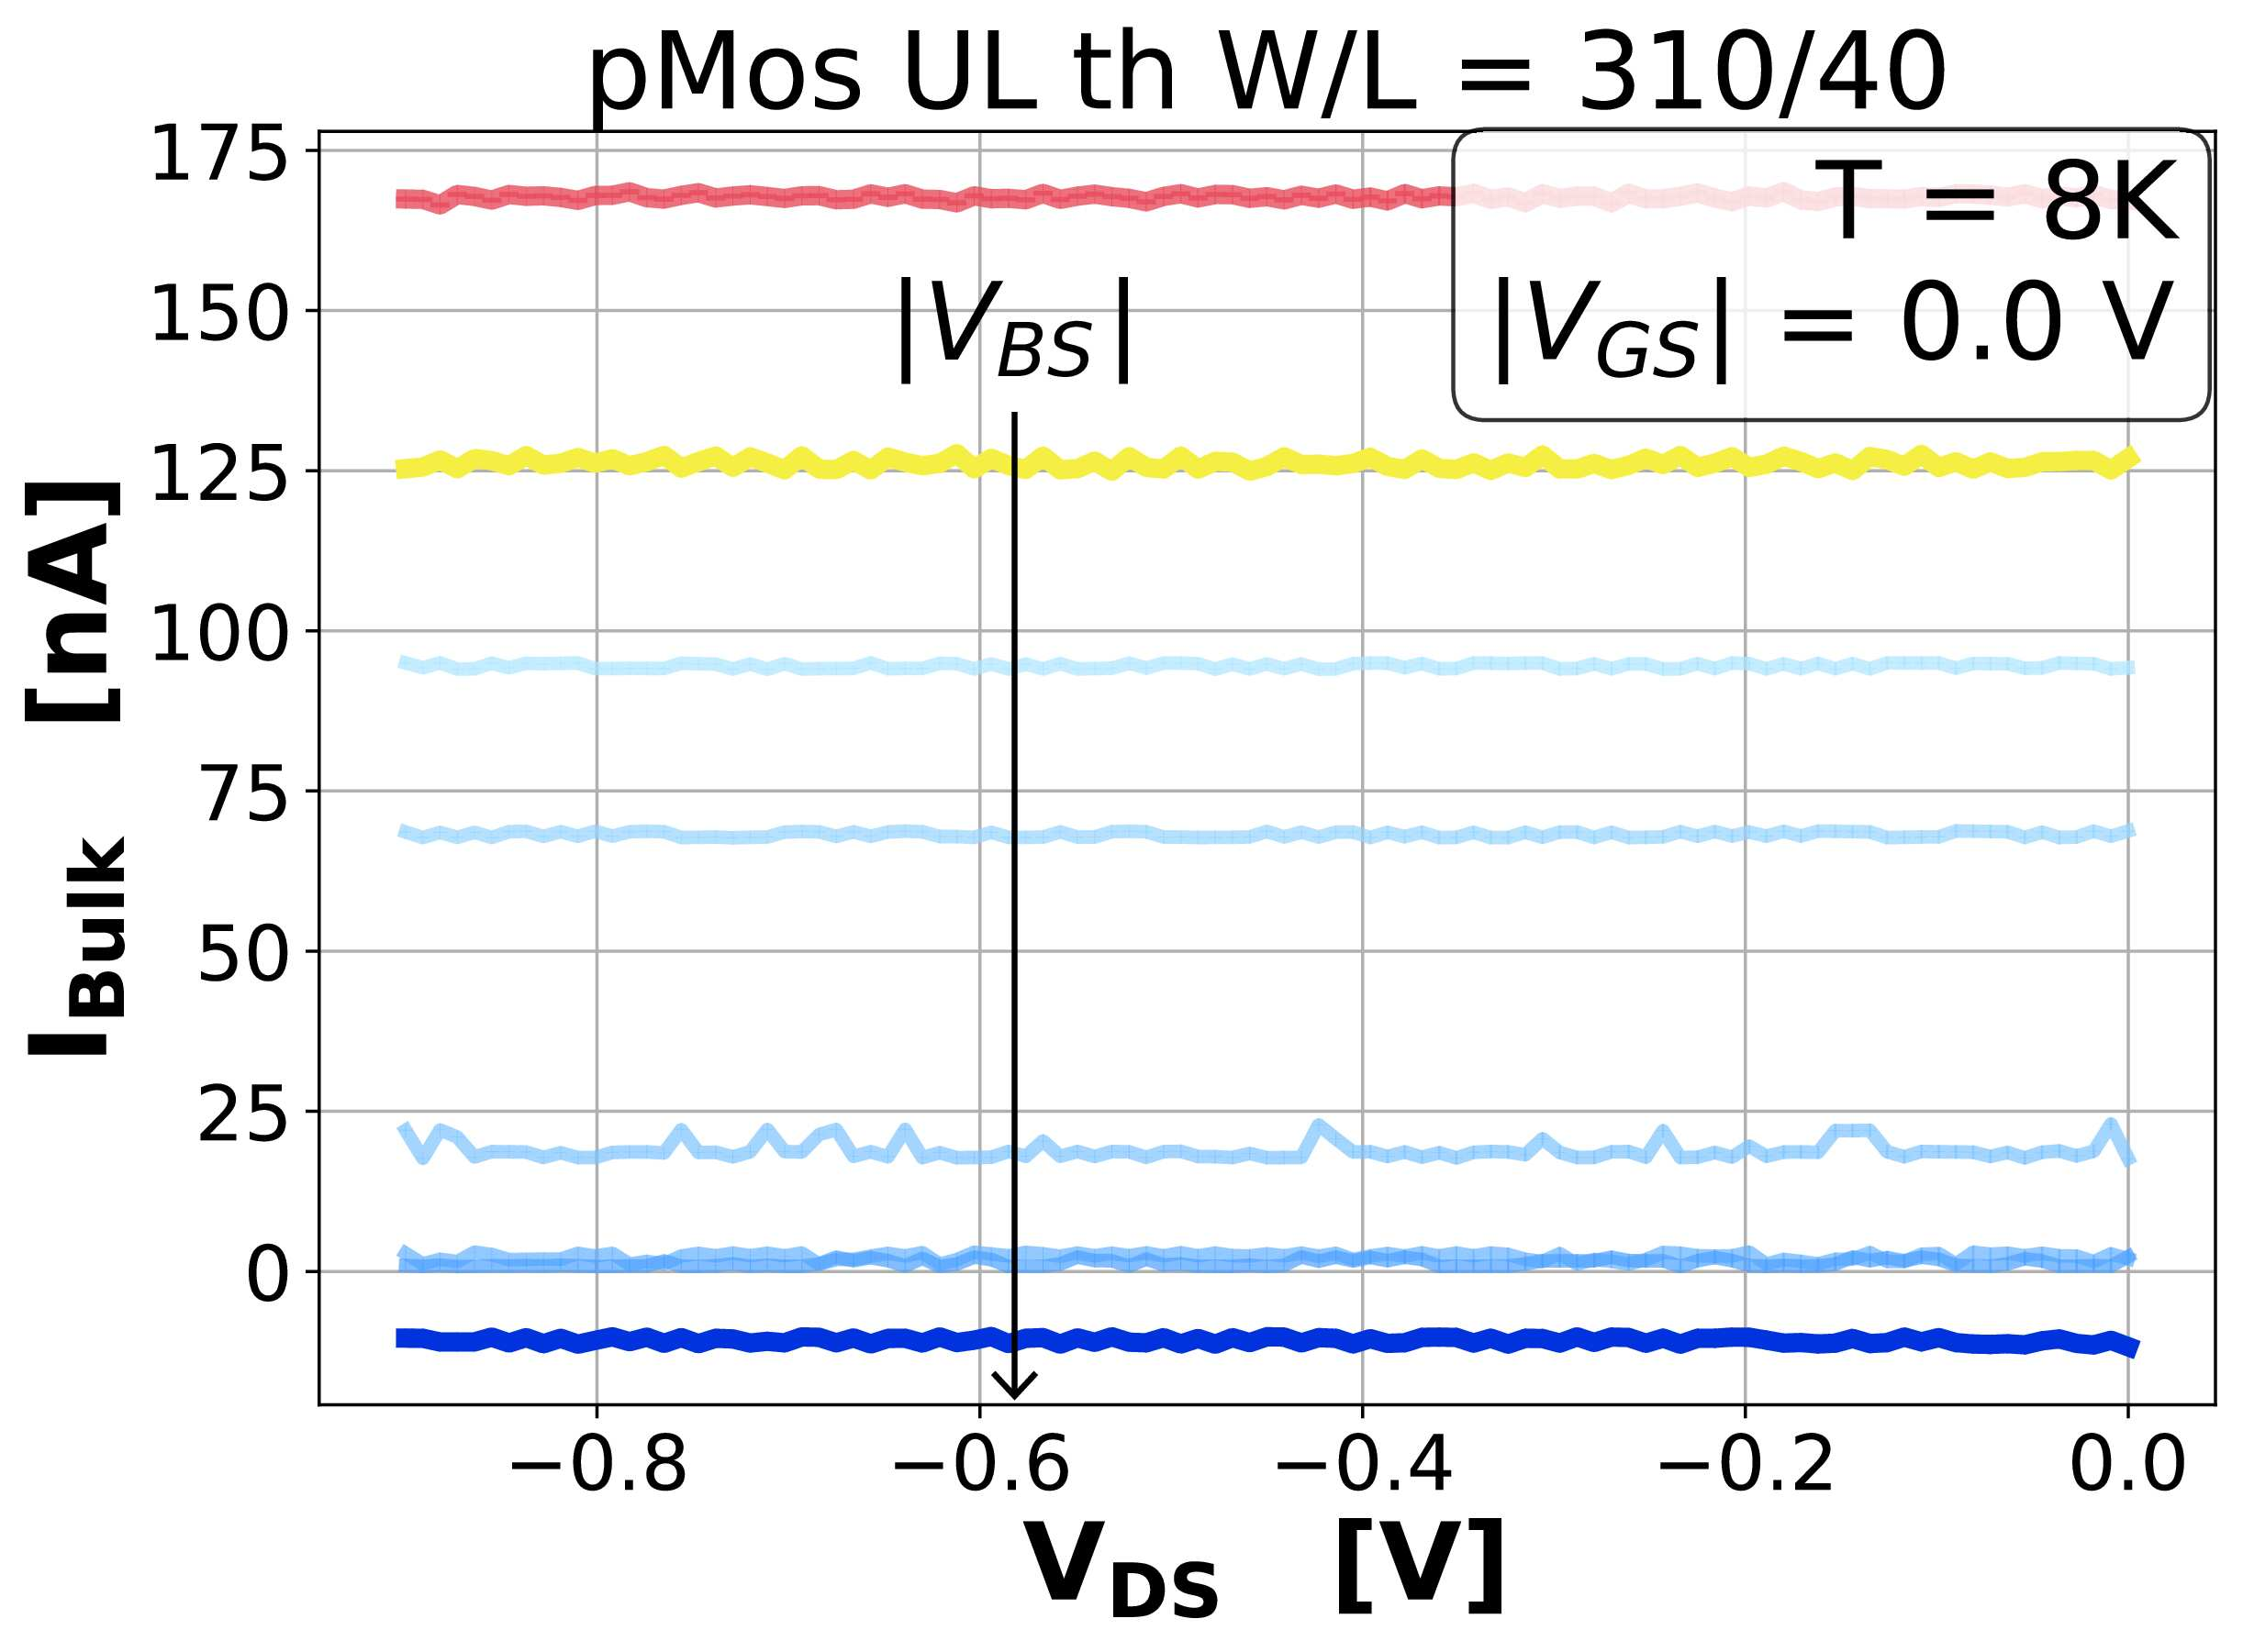
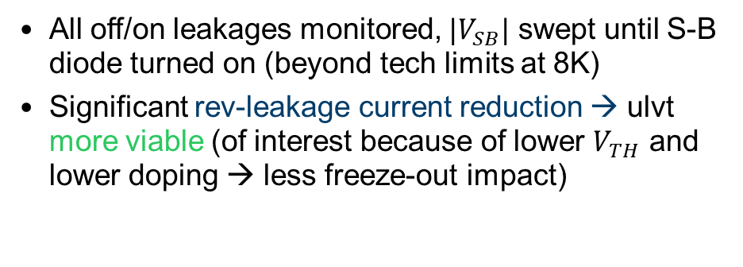
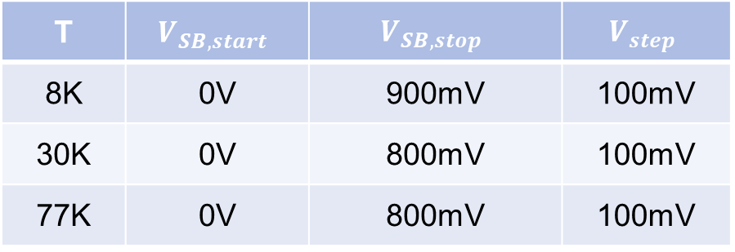
Forward Body biasing limits and leakages
Example UL threshold pMOS 310/40 @T=8K
T | $$V_{SB,start}$$ | $$V_{SB,stop}$$ | $$V_{step}$$
8K | 0V | 900mV | 100mV
30K | 0V | 800mV | 100mV
77K | 0V | 800mV | 100mV
All off/on leakages monitored, $|V_{SB}|$ swept until S-B diode turned on (beyond tech limits at 8K)
Significant rev-leakage current reduction → ulvt more viable (of interest because of lower $V_{TH}$ and lower doping → less freeze-out impact)

Slide 17
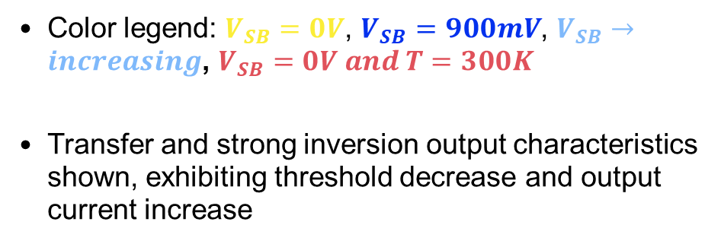
Forward Body biasing results
Example UL threshold pMOS 310/40 @T=8K
Color legend: $V_{SB}=0V$, $V_{SB}=900mV$, $V_{SB}→increasing$, $V_{SB}=0V and T=300K$
Transfer and strong inversion output characteristics shown, exhibiting threshold decrease and output current increase

Slide 18
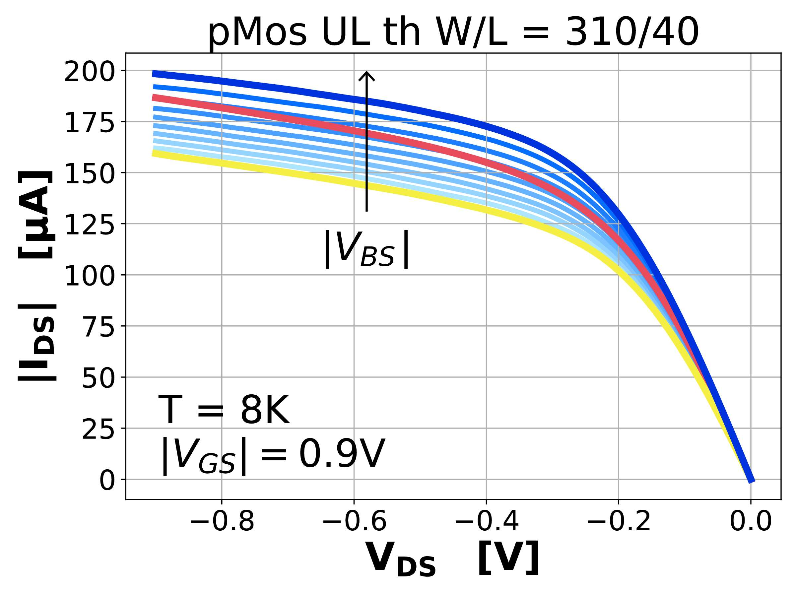
Forward Body biasing results
Example UL threshold pMOS 310/40 @T=8K
Color legend: $V_{SB}=0V$, $V_{SB}=900mV$, $V_{SB}→increasing$, $V_{SB}=0V and T=300K$
Transfer and strong inversion output characteristics shown, exhibiting threshold decrease and output current increase

Slide 19
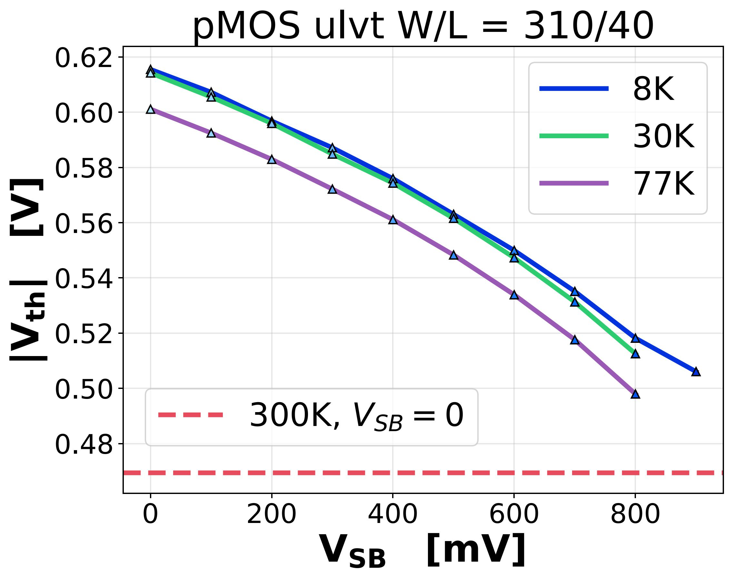
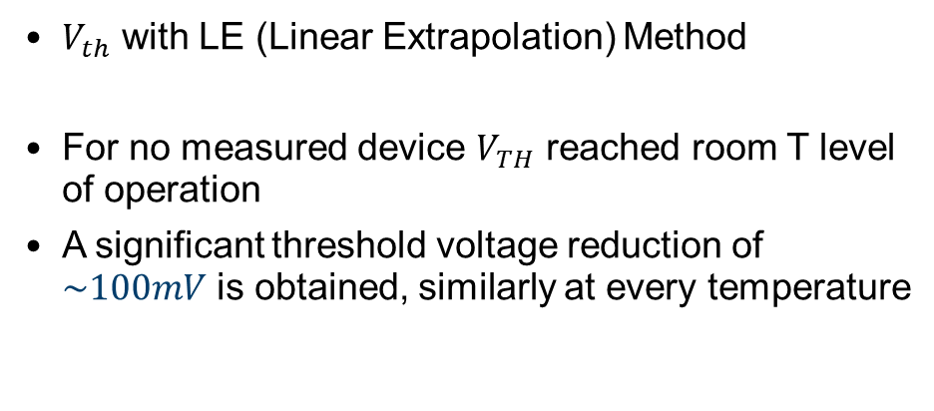
Forward Body biasing $V_{TH}$ tuning
Example UL threshold pMOS 310/40
[1]
$V_{th}$ with LE (Linear Extrapolation) Method
For no measured device $V_{TH}$ reached room T level of operation
A significant threshold voltage reduction of $\sim 100mV$ is obtained, similarly at every temperature
Vth @ T=300K, Vsb = 0
[1] “Revisiting MOSFET threshold voltage extraction methods” Ortiz-Conde et al., 2013

Slide 20
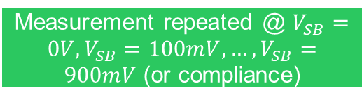
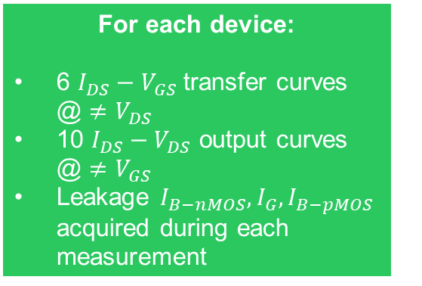
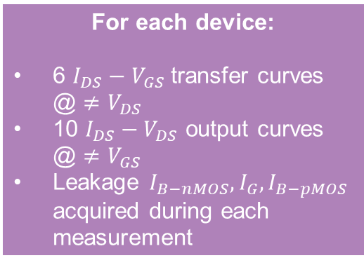
Experimental Data – in a nutshell
For each device:
6 $I_{DS}−V_{GS}$ transfer curves @ $≠V_{DS}$
10 $I_{DS}−V_{DS}$ output curves @ $≠V_{GS}$
Leakage $I_{B−nMOS}, I_{G}, I_{B−pMOS}$ acquired during each measurement
Measurement repeated at 8K, 18K, 30K 77K and 300K
Measured short-channel devices:
9 nMOS and 9 pMOS svt
8 nMOS and 8 pMOS lvt
8 nMOS and 8 pMOS ulvt
Different W/L
T Characterization Data
FBB Data
For each device:
6 $I_{DS}−V_{GS}$ transfer curves @ $≠V_{DS}$
10 $I_{DS}−V_{DS}$ output curves @ $≠V_{GS}$
Leakage $I_{B−nMOS}, I_{G}, I_{B−pMOS}$ acquired during each measurement
Measured short-channel devices:
4 pMOS lvt
4 pMOS ulvt
Different W/L
Measurement repeated @ $V_{SB}=0V, V_{SB}=100mV, …, V_{SB}=900mV$(or compliance)
Measurement repeated at 8K, 30K and 77K

Slide 21
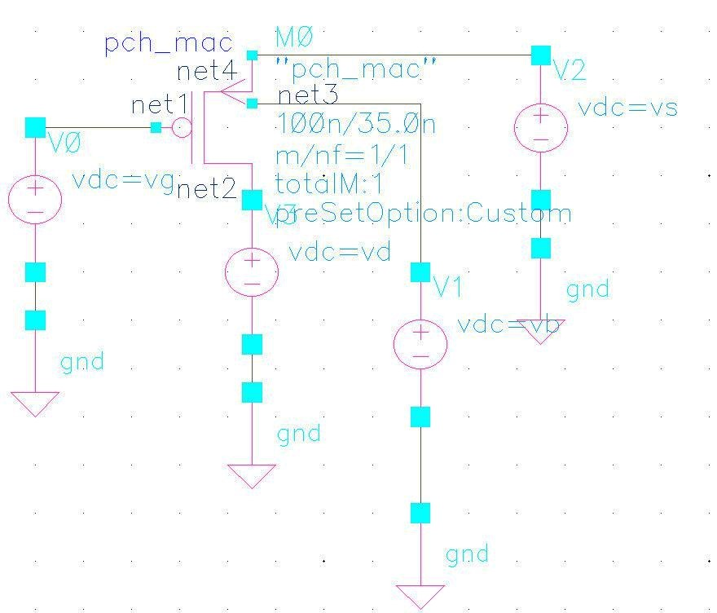
Method for cryogenic cmos model extension
INFN TORINO

Slide 22
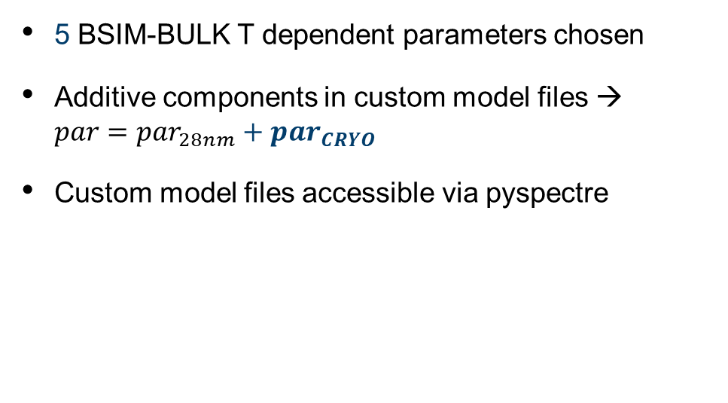
The partial cryo-PDK procedure
Software Setup
Goal: partial PDK
establish a procedure to create cryo-corners in 28-nm, valid at fixed thermal states
SW Setup: Cadence Spectre + Python possible thanks to pyspectre interface
Model: BSIM-BULK (former BSIM-6)
Workspace was tested @ FZJ and setup @ INFN Torino
5 BSIM-BULK T dependent parameters chosen
Additive components in custom model files → $par=par_{28nm}+par_{CRYO}$
Custom model files accessible via pyspectre
[1]
[2]
[1] “PySpectre: Python interface for Cadence Spectre” GitHub repository. Y. Uhlmann., Version 1.2.0. 2024
[2] “BSIM-BULK 107.2.1 MOSFET Compact Model”. Berkeley, CA, 2025

Slide 23
The Parameter extraction PROCESS
Pyspectre flow
|Ids| vs Vgs simulation @ different Vds
Measured vs simulated metric check
Netlist loaded
Metric unsatisfied
START
Netlist loaded
Metric satisfied
Algorithm changes 5 additive parameters in model files
Parameters

Slide 24
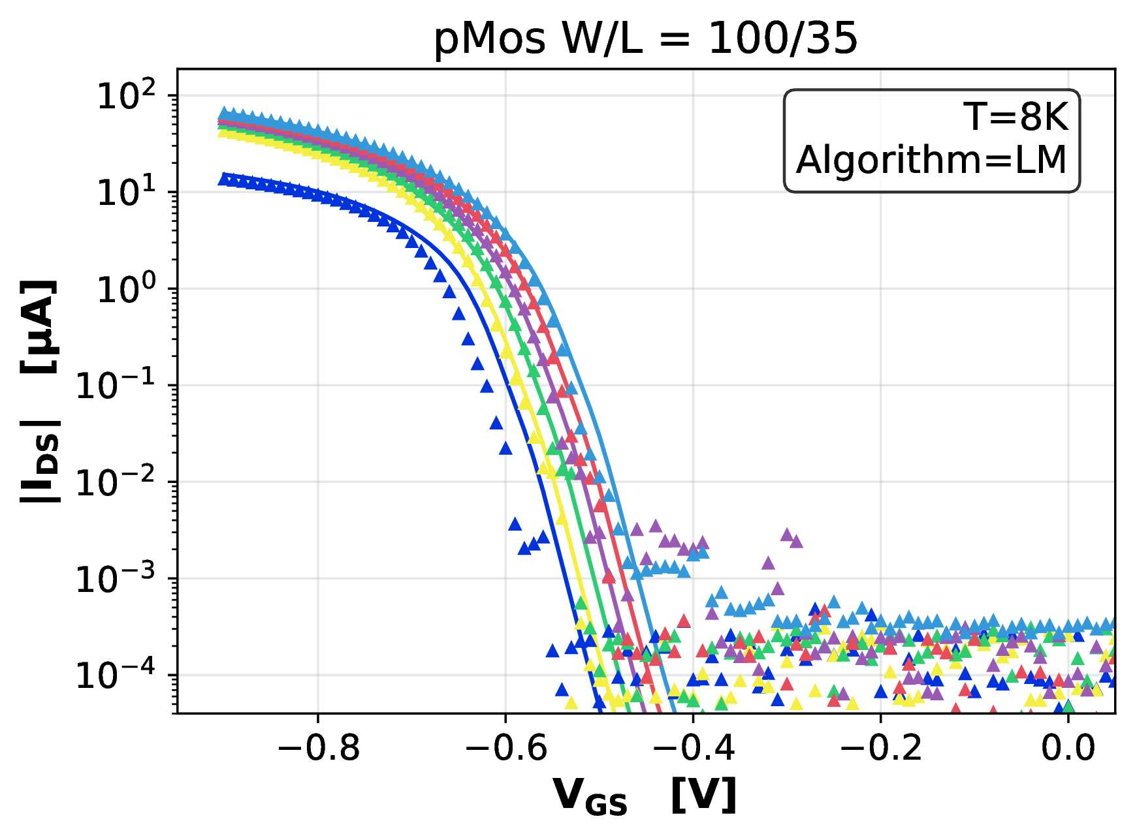

Metric and multiple fitting algorithm
svt pMOS W/L = 100/35
Procedure tested on a single svt pMOS W/L = 100/35
Chosen metric → mean square error sum $[A^{2}]$ with weightintg: moderate (50x) in strong inversion, heavy (150x) in sharp moderate inversion, light (0.5x) for sub-threshold noise
Algorithms → two multidim tested: Levenberg-Marquardt and Nelder-Mead

Slide 25
Metric and multiple fitting algorithm
svt pMOS W/L = 100/35
Procedure tested on a single svt pMOS W/L = 100/35
Chosen metric → mean square error sum $[A^{2}]$ with weightintg: moderate (50x) in strong inversion, heavy (150x) in sharp moderate inversion, light (0.5x) for sub-threshold noise
Algorithms → two multidim tested: Levenberg-Marquardt and Nelder-Mead
Freeze-out kinks

Slide 26
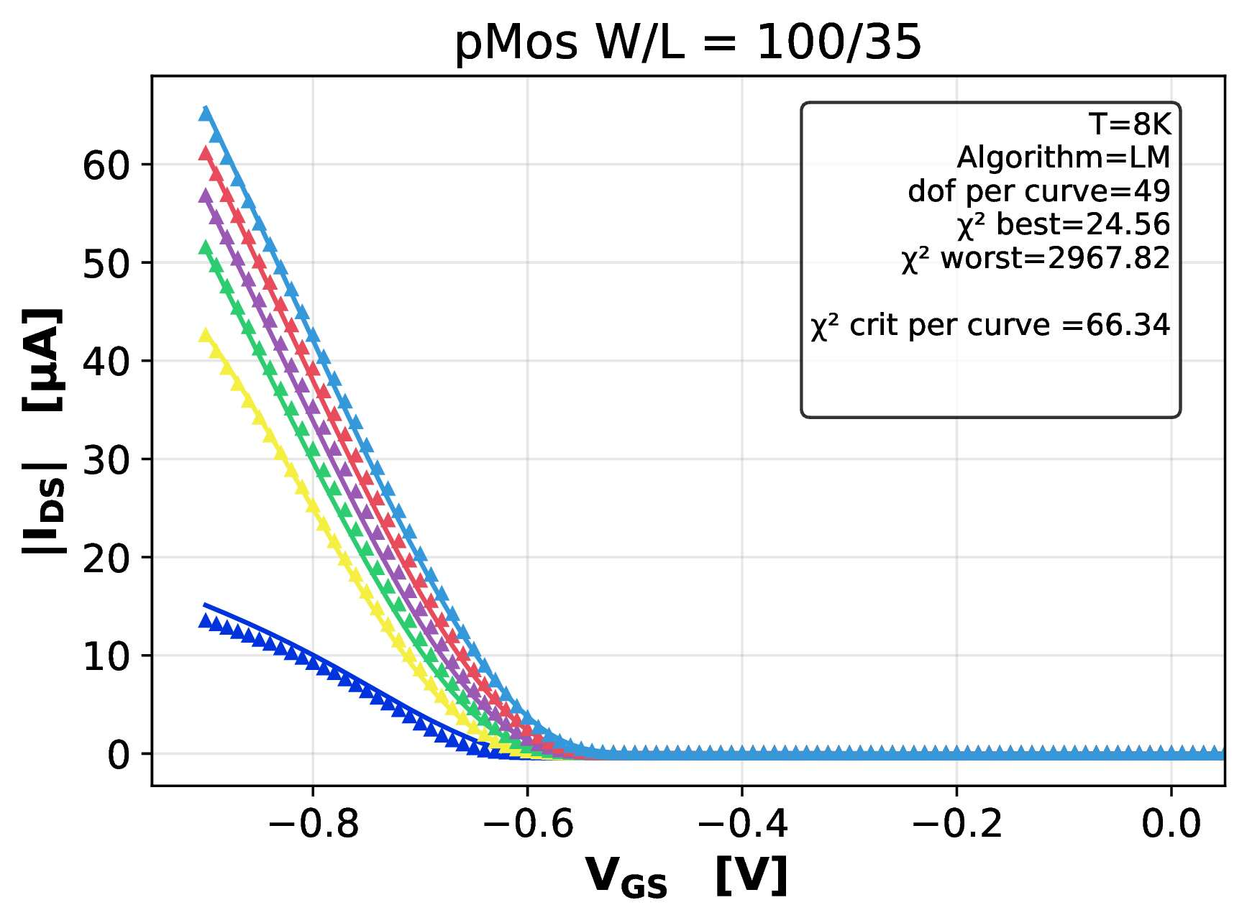
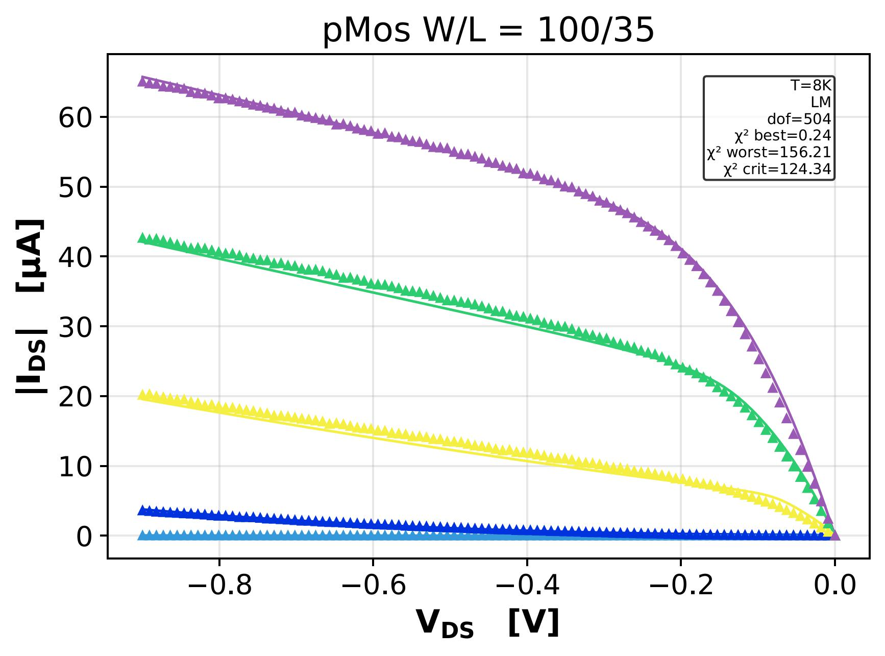
Sim vs meas data – 8K
svt pMOS W/L = 100/35

Slide 27




PARTIAL CRYO-PDK – in a nutshell
Foundry BSIM complete model (.scs) files
Custom BSIM transistor model (.scs) files with $par=par_{28nm}+par_{CRYO}$
Custom BSIM transistor model (.scs) files with $par=par_{28nm}+par_{CRYO}$
Enhance the PDK to cover continuous T ranges
Transistor netlist (.scs)
$par_{CRYO}$ OBTAINED
INCLUDED
INCLUDED
Cryo CMOS IP libraries
Repeated @ $≠$ W/L of nMOS-pMOS
Experimental data
Multiple fitting procedure run
(python scripts)
Partial cryo-PDK files valid @ fixed T
pyspectre interface

Slide 28
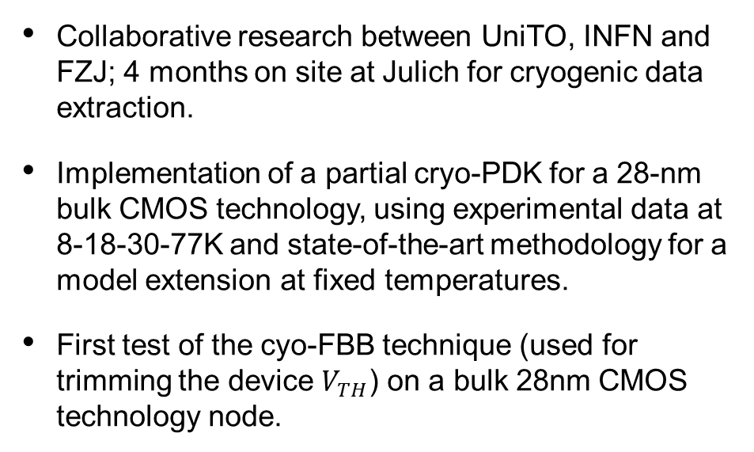
Conclusions and outlook
Conclusions
Outlook
Collaborative research between UniTO, INFN and FZJ; 4 months on site at Julich for cryogenic data extraction.
Implementation of a partial cryo-PDK for a 28-nm bulk CMOS technology, using experimental data at 8-18-30-77K and state-of-the-art methodology for a model extension at fixed temperatures.
First test of the cyo-FBB technique (used for trimming the device $V_{TH}$) on a bulk 28nm CMOS technology node.
Development of a new cryogenic device model allowing for simulation over a continuous temperature range (instead of fixed thermal states), in collaboration with TU Graz (Austria).
Design of a new DUT (bulk-28nm, other techs) optimised for cryogenic measurements – current measurement campaign used a DUT developed for radiation hardness studies.
Design of a cryo-IP (bulk 28-nm) prototype using the partial PDK developed and available for the complete demonstration of the cryo-PDK.

Slide 29
REFERENCEs
Presentation references
“DarkSide-20k sensitivity to light dark matter particles” Acerbi et al. 2024
“Characterization and Modeling of 28 nm Bulk CMOS Technology down to 4.2K” Beckers et al., 2018
“Revisiting MOSFET threshold voltage extraction methods” Ortiz-Conde et al., 2013
“BSIM-BULK 107.2.1 MOSFET Compact Model”. Berkeley, CA, 2025.
“PySpectre: Python interface for Cadence Spectre” GitHub repository. Y. Uhlmann., Version 1.2.0. 2024
“Free Carrier Mobility Extraction in FETs”, F. Jazaeri et al., 2017
“Characterization and modeling of 28-nm FDSOI CMOS technology down to cryogenic temperatures” Beckers et al. 2019
“Cryogenic-Aware Forward Body Biasing in Bulk CMOS” Overwater et al. 2024

Slide 30
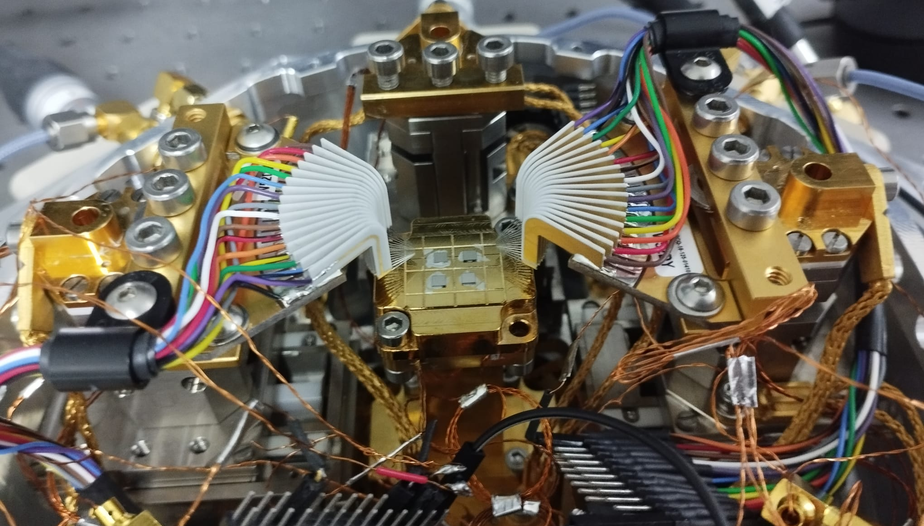

Backup - discarded setup
Tried but discarded:
Hard repeated contacts @cryo
Vertical bending @cryo
Lack of cryostat feedthroughs
Heavy T load
16L + 16R Needle Probes
TID damage live monitoring:
many devices contacted on the same cycle
Contact @CERN: 2 entire columns sim. !!

Slide 31

Backup - transconductances

Slide 32



Backup - Mobilities
[1]
[1] “Characterization and Modeling of 28 nm Bulk CMOS Technology down to 4.2K” Beckers et al., 2018

Slide 33


Backup – short channel effects
Drain-induced barrier lowering
Halo dopings

Slide 34




BACKUP - FD-SOI backgate tuning of $V_{th}$
Increase of $V_{th}$ in cryo
Adjusted with $V_{back}$
One of the advantages of SOI for cryo ICs
[1]
[1] Characterization and modeling of 28-nm FDSOI CMOS technology down to cryogenic temperatures, Beckers et al. 2019

Slide 35


backup - PMOS FBB
Ag Glue
Only pMOS FBB because:
Substrate in contact with the cold plate
CERN Chip: no triple well nMOS devices
$V_{B, nMOS}$ → Ground Loop
$V_{S,nMOS}$ → $V_{S}<V_{SS}$ -> ESD Diode on S
DUT Chip
Cu Alloy Cold Plate

Slide 36


Backup – Statystical testing
svt pMOS W/L = 100/35, Levenberg Marquardt algorithm
$σ=max⁡\{10\% ∙I_{DS} , 0.1 μA\}$

Slide 37

Backup – Statystical testing
svt pMOS W/L = 100/35, Levenberg Marquardt algorithm
$σ=max⁡\{10\% ∙I_{DS} , 0.1 μA\}$
$χ^{2}$ not passed → model extension weakness in linear region

Slide 38

Backup – Statystical testing
svt pMOS W/L = 100/35, Levenberg Marquardt algorithm
$σ=max⁡\{10\% ∙I_{DS} , 0.1 μA\}$
$χ^{2}$ passed, or barely not (low ${|V}_{DS}|$ regime)

Slide 39



Backup – Statystical testing
Freeze-out kinks
Max noise levels
$$\sim 3∙{10}^{−10}A$$

Slide 40


Backup - Algorithms comparison
8K optimization 5 parameters
Same initial guess, same 5 pars
Same target RMS → adherence sim-meas
Levenberg-Marquardt
Total time: 30.43 s
Function evals: 29
Time per eval: 1.05 s
Final cost: 9.4e-07 $A^{2}$
Final RMS: 3.5e-05 $A$
Quadratic
Faster but more sensitive to loc. min. and initial guess
Nelder-Mead
Total time: 113.50 s
Function evals: 149
Time per eval: 0.46 s
Final cost: 9.4e-07 $A^{2}$
Final RMS: 3.5e-05 $A$
Linear
Less sensitive to loc. min. and initial guess but slower

