Slide 1




XIDyn
High Flux, High Dynamic-range Hard X-ray detector full-reticle ASIC for 4th generation synchrotrons
Luke Mallett (RAL STFC)
On behalf of the XIDyn Collaboration

Slide 2
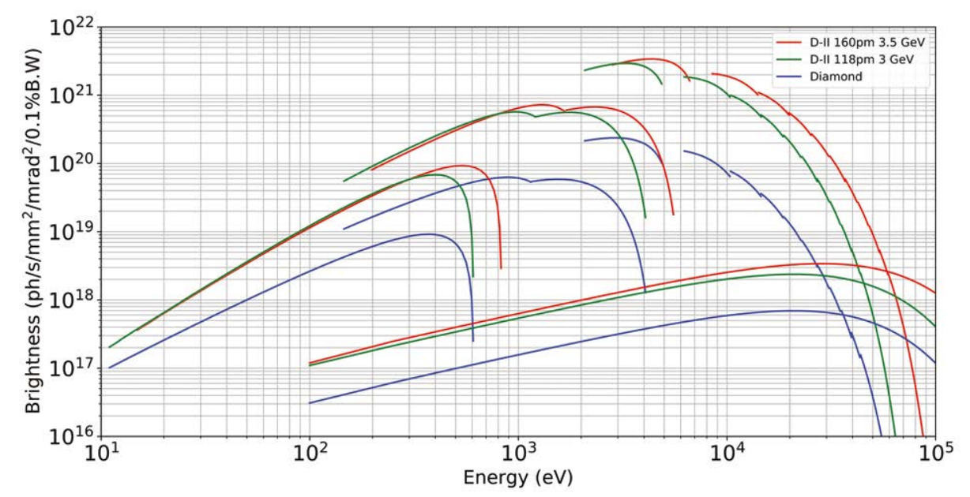
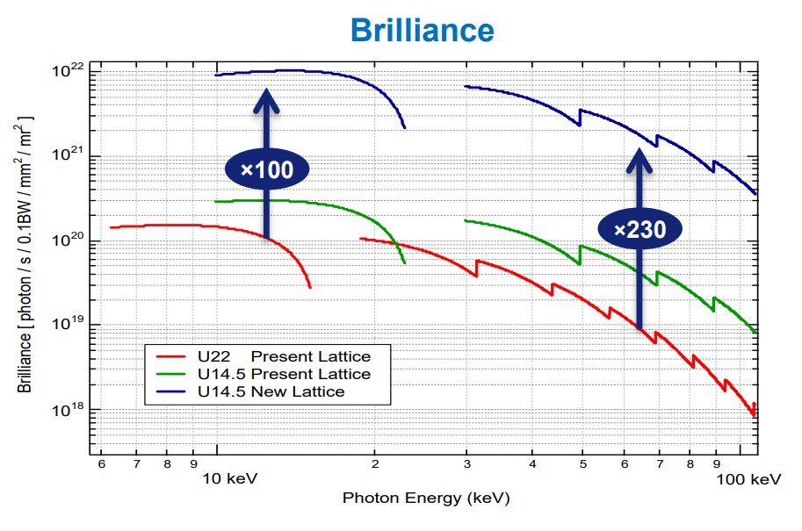

Introduction
New generation of synchrotrons operate at significantly higher flux and higher energy photons
Faster high flux detector systems required
Must use higher Z materials (CZT)
Diamond II
ESRF
Up to ${10}^{12}$ photons/s/$mm^{2}$

Slide 3
Specification
Parameter | Continuous | Burst Timing
Operation | Constant with tolerable deadtimes | 256 Frame capture and slower readout
Master Clock Frequency [MHz] | Up to 684.5 | 500
Energy Range [keV] | 25keV typical | 30-100keV
Resolution [photon] | 0.25-1 | 1
Noise [e] | <1200 (1/4 photon) | <1200 (1/4 photon)
Flux [ph/pixel/s] | ~10¹⁰ | -
Pixel Size [µm] | 110 | 110
Frame Rate [kHz] | ~10-150 | 5700 for 16 bunch mode
Instantaneous Flux [photons] | ~100 | ~200
Power [W/cm²] | 5 | 5
Notes:
110um pitch – compromise between resolution and data output

Slide 4
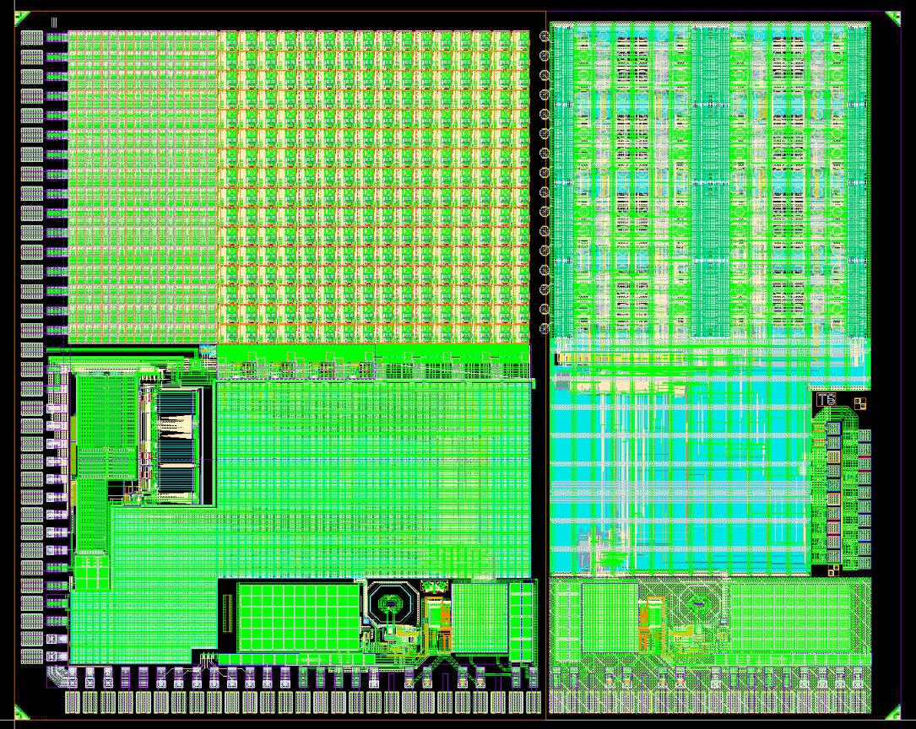
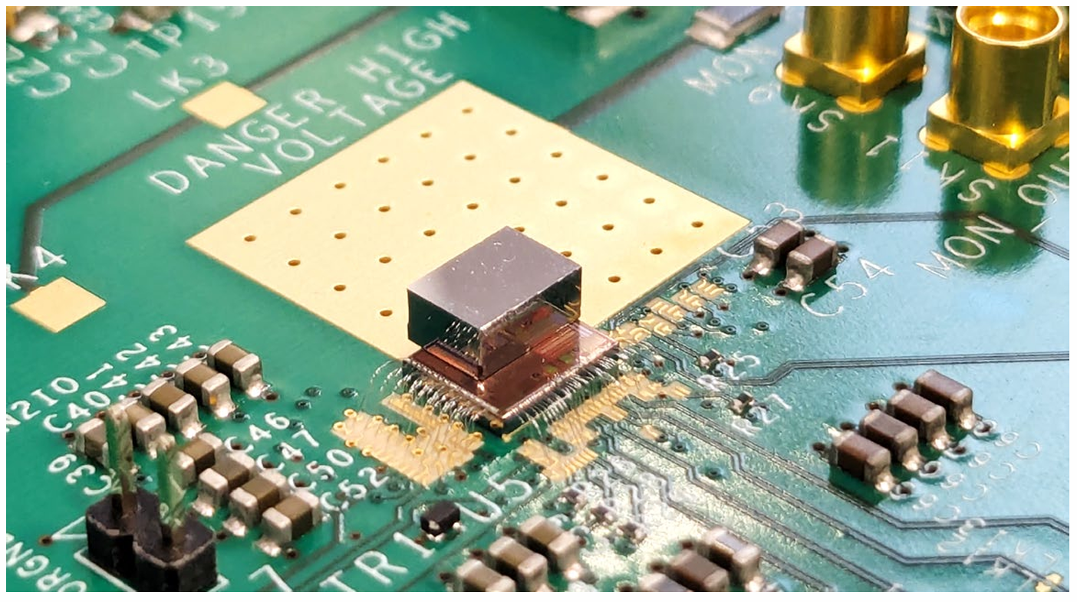
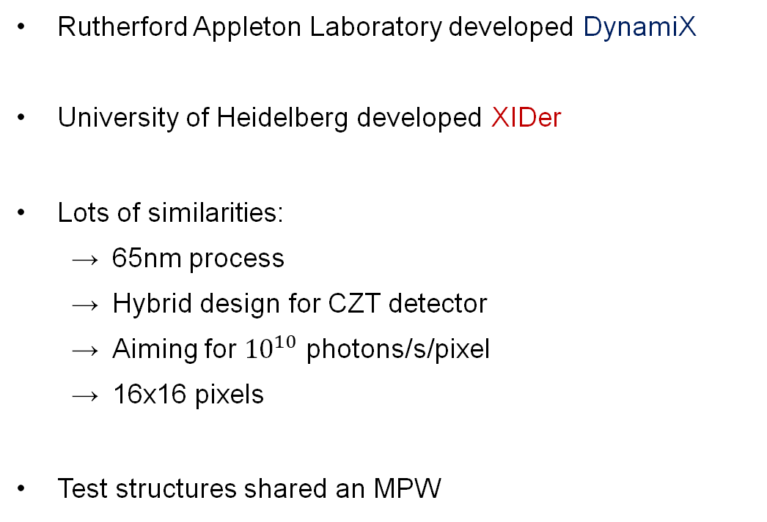
BabyDynamiX
XIDer T6
Introduction
Rutherford Appleton Laboratory developed DynamiX
University of Heidelberg developed XIDer
Lots of similarities:
65nm process
Hybrid design for CZT detector
Aiming for ${10}^{10}$ photons/s/pixel
16x16 pixels
Test structures shared an MPW
Both shown at
FEE 2023
2mm Redlen HF-CZT
Notes:
BOTH PRESENTED AT FEE 2023

Slide 5
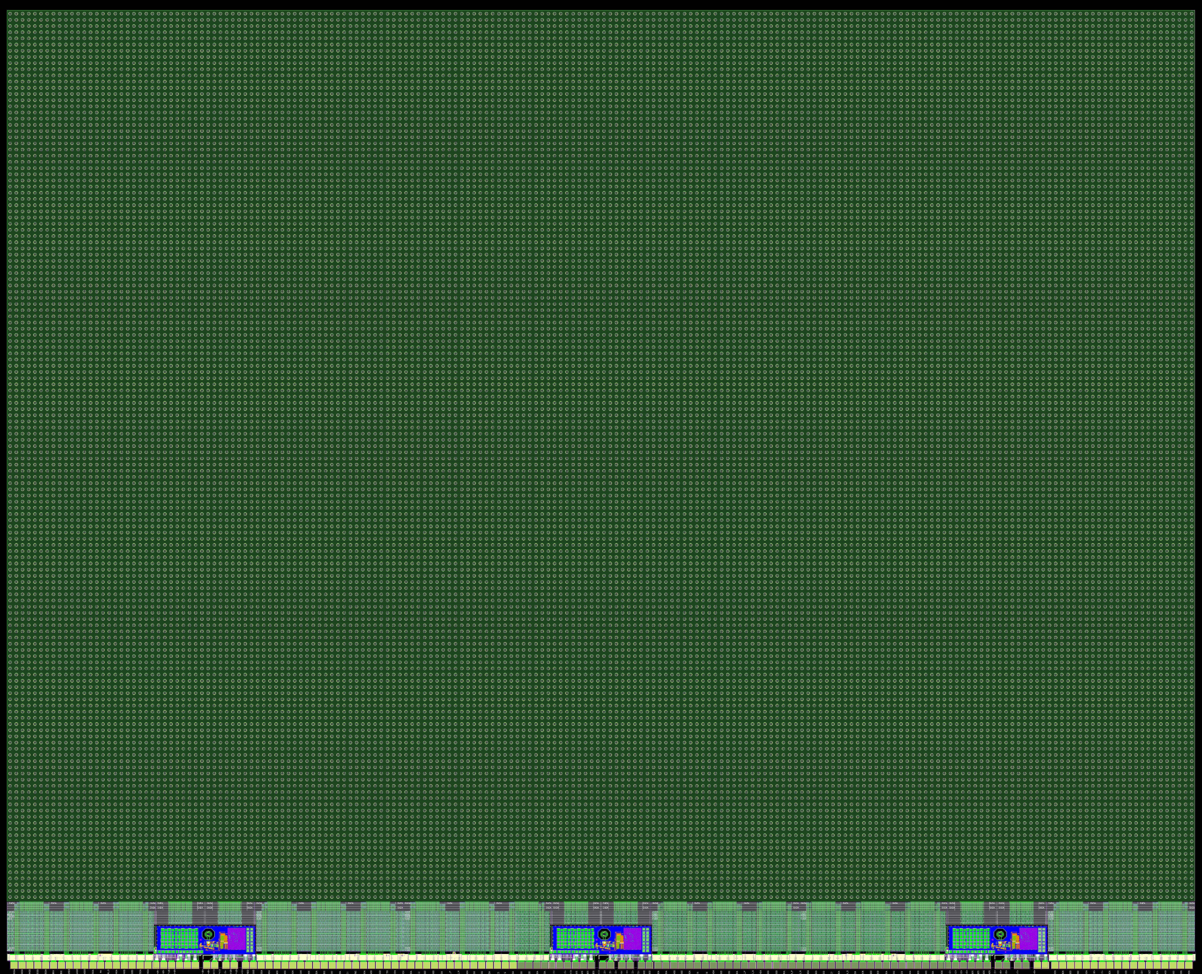
21mm
Introduction
XIDyn
Efforts combined to XIDyn (XIDer + DynamiX)
192x144 pixels reticle scale ASIC
Pads only on one edge for tiling
Using RAM in pixel from XIDER
Maximum of 20W
17mm
Notes:
144 rows as 192 rows too large – IR drop/timing

Slide 6

ASIC Architecture
Large pixel array controlled by global digital logic
3 Dual lane 14.1Gbps serializers
Using 4x4 super pixels
Digital-on-top approach
Design challenges:
IR drop up columns
Pixel mismatch
PIXEL ARRAY
GLOBAL DIGITAL LOGIC | FIFO | GLOBAL DIGITAL LOGIC | FIFO | GLOBAL DIGITAL LOGIC | FIFO | GLOBAL DIGITAL LOGIC
 | SERIALISER |  | SERIALISER |  | SERIALISER
PADS

Slide 7
ASIC Architecture
PIXEL ARRAY
GLOBAL DIGITAL LOGIC | FIFO | GLOBAL DIGITAL LOGIC | FIFO | GLOBAL DIGITAL LOGIC | FIFO | GLOBAL DIGITAL LOGIC
 | SERIALISER |  | SERIALISER |  | SERIALISER
16 Analogue Channels
16 RAMs
(256x16b)
Digital logic
PADS

Slide 8
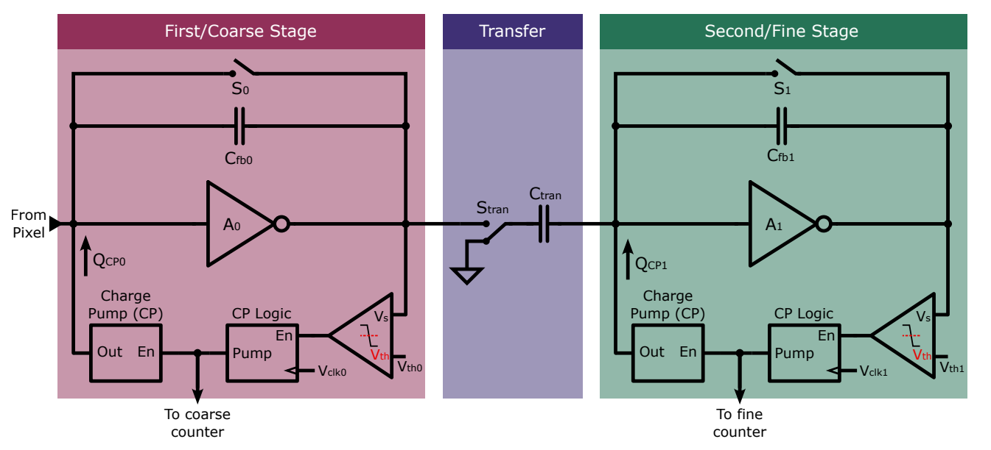

Analogue Channel
Charge cancellation
Charge is integrated and removed when amount exceeds threshold
Allows for constant charge removal from Cf to prevent saturation
Removes charge in known packet sizes and directly provides digital output (no ADC)
With the high flux, cannot achieve photon counting with a single stage

Slide 9
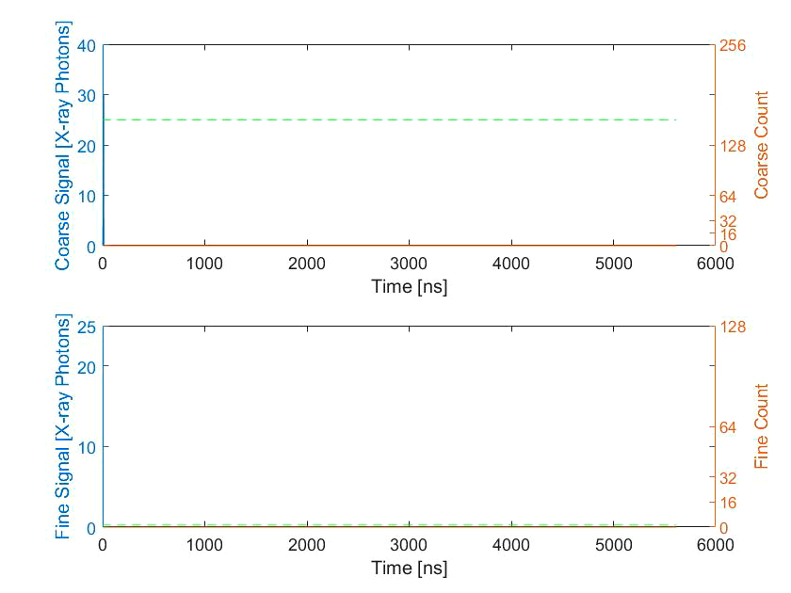
Analogue Channel
Frame 1
Frame 2
Frame 3

Slide 10
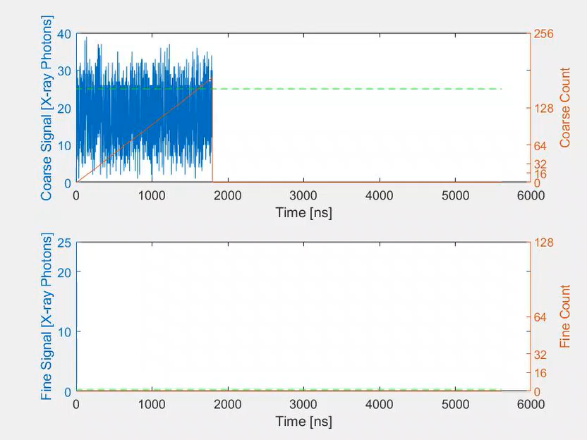
Analogue Channel
Frame 1
Frame 2
Frame 3

Slide 11
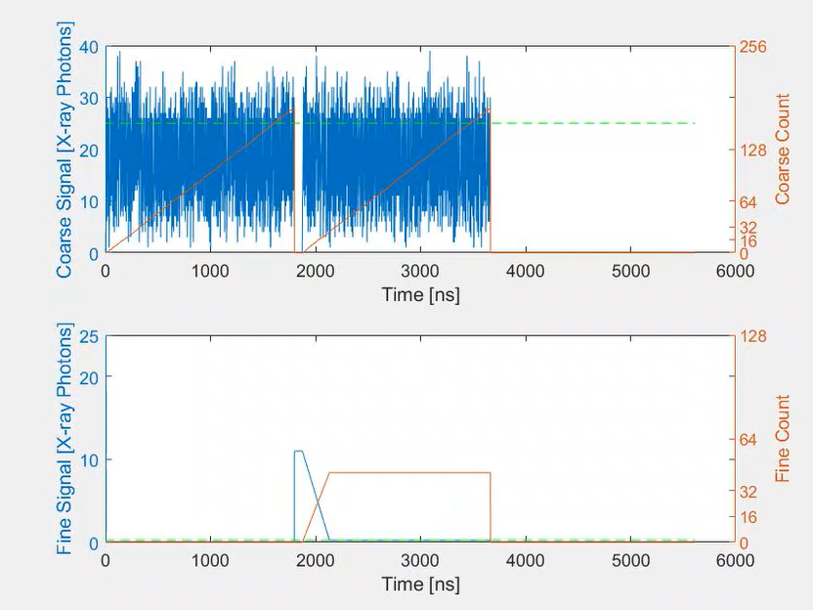
Analogue Channel
Frame 1
Frame 2
Frame 3

Slide 12
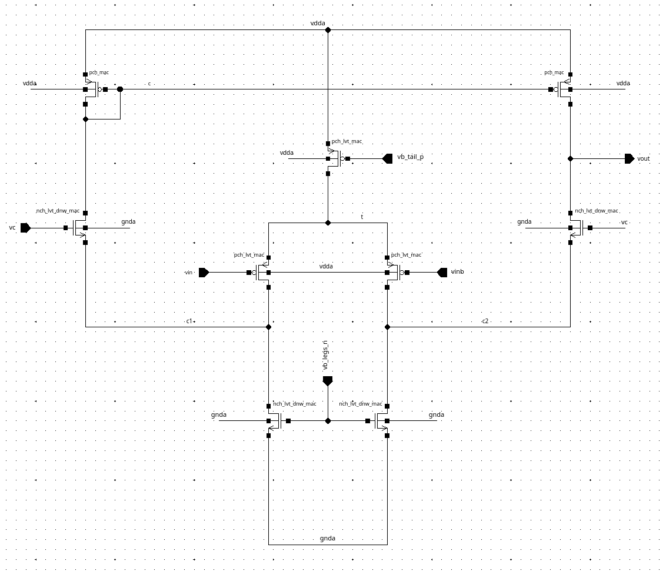
Analogue Channel
Amplifier
Folded cascode design
High open loop gain
Fast response time
Baseline voltage 400mV
Generated at global level
Coarse stage has 3x higher bias current and different transistor sizing
Increased response time to handle larger charge
Coarse stage has 3x higher bias current WHY

Slide 13
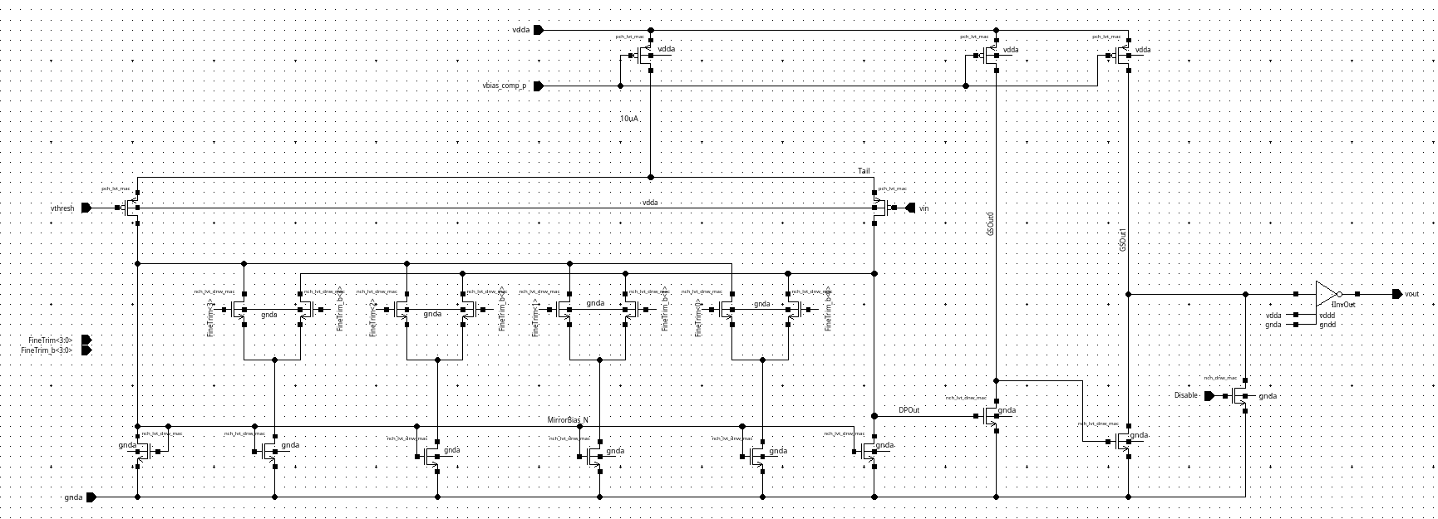
Analogue Channel
Comparator
Differential pair with 2 gain stages
Additional gain stage improves current balancing
Improved response time
4-bit trim to minimise offset voltage
Coarse comparator sized for improved speed

Slide 14
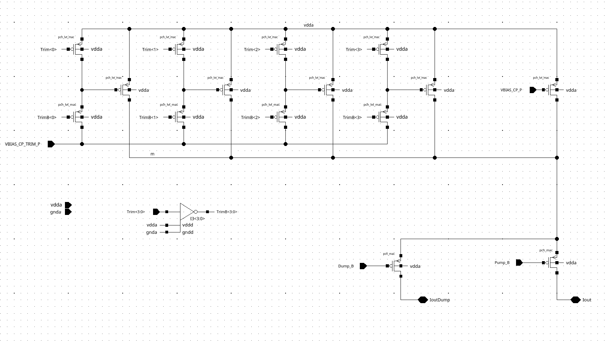
Analogue Channel
Charge pump
Bias voltages set globally
Calibrated to match number of photons
4-bit trim on pump current
Trim circuit uses separate bias for increased flexibility
Maximum cancellation in course stage is 48 ph @ 25keV
Pump time in multiples of Master Clock period
Current either pumped into channel or dumped to ground

Slide 15
Pixel biasing
…
…
Bias voltages generated from DACs globally then buffered to channels
DAC codes set via JTAG
Set in initial calibration
Generated from 1mA current bandgap
CHANNEL GROUP
CHANNEL
CHANNEL GROUP
CHANNEL
CHANNEL GROUP
CHANNEL
CHANNEL GROUP
CHANNEL
GLOBAL DACS
COLUMN END
COLUMN END
…

Slide 16
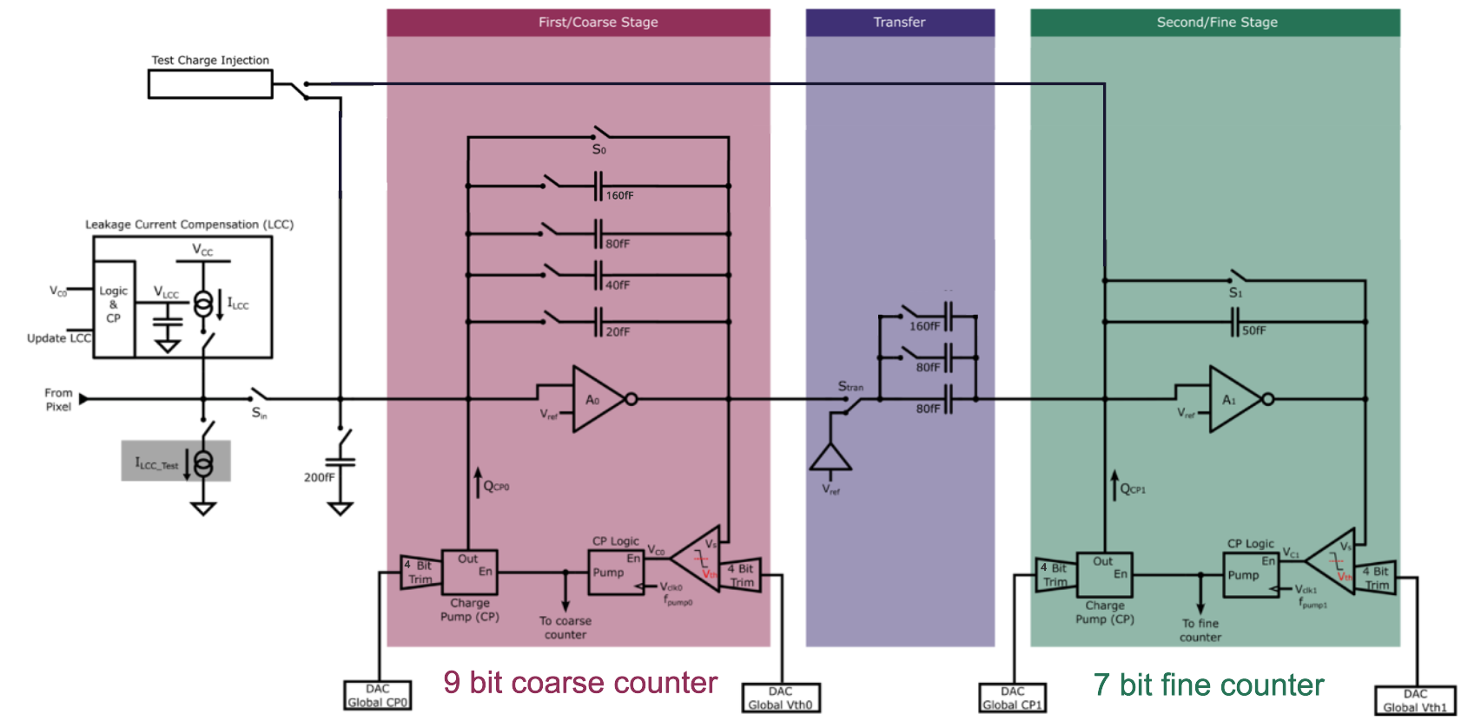
Analogue Channel
Configurable capacitance
Array of capacitors to suit operating mode
Coarse Cf: 20 – 300 fF
Transfer C: 80 - 320 fF
Fine Cf: Fixed 50 fF
Power consumption
Each analogue channel consumes 220uA
264 uW per channel
7.3 W total

Slide 17
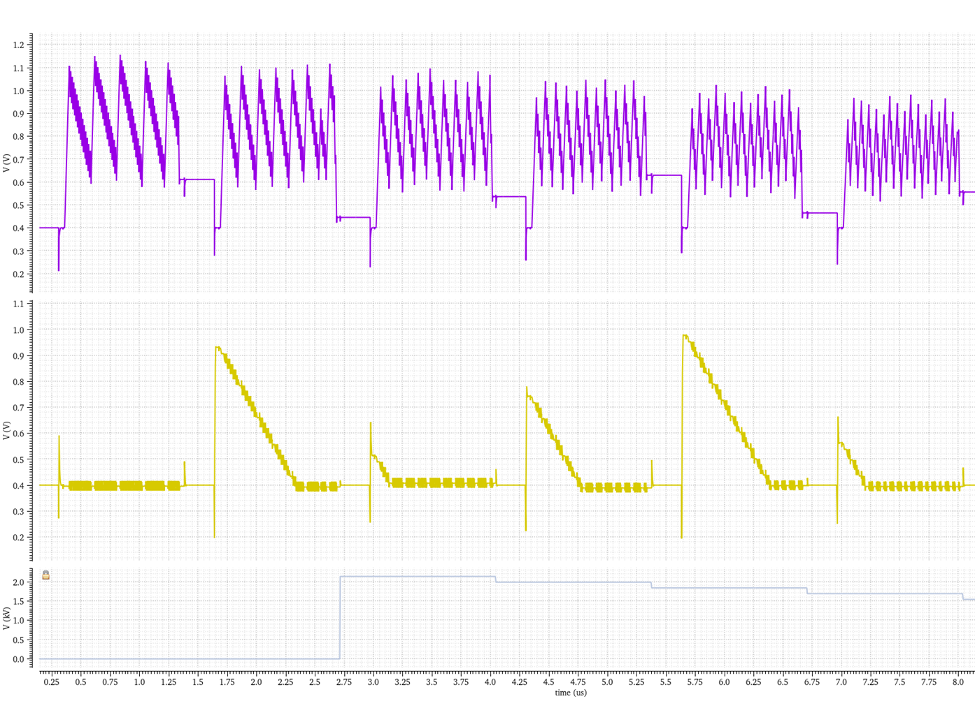
Analogue Channel
Coarse CSA output
Fine CSA output
Combined count

Slide 18
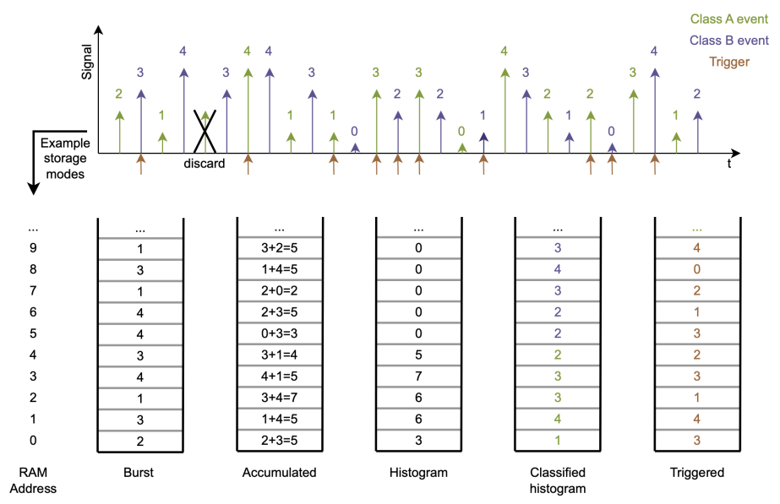
In-pixel RAM
Each pixel has a 256x16bit RAM
Uses foundry provided 6T SRAM bit cell
Full custom periphery
Enables increased functionality:
Storing count values
Accumulating values across frames
Histograms
Estimated RAM will contribute ~60% of digital power for the pixel
16-bit register available to bypass RAM

Slide 19
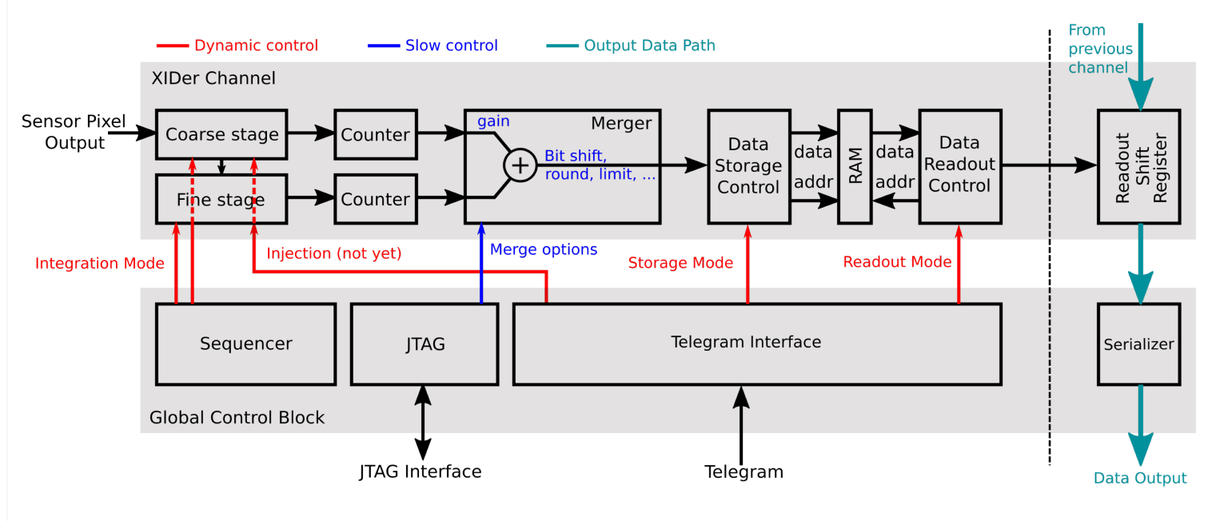
Digital Control
Telegram
Operational commands sent through the external Telegram Interface on the fly
Determines what is done with the pixel value
Begins readout from pixels
Simple commands can be generated on-chip
Telegram encoded in 8b10b
Clocked at 68.45 MHz and synchronised to external interface

Slide 20
Digital Control
Sequencer
Dynamic digital control signals generated by Sequencer on chip
Configured through JTAG at start up
Controls:
Reset
Charge pump enable
Charge transfer from Coarse to Fine
Clocked at 684.5 MHz and synchronised to start of Telegram Commands

Slide 21
Long column mitigations
Maximised power tracks up columns for minimal IR drop (on M9 and M8)
Mirroring bias currents and buffer voltages per column
Channel simulated at 0.96 V for IR drop
Accounting for a 120 mV drop along VDD and GND tracks
Sequencer signals generated per two columns to meet timing
Top pixels can be turned off

Slide 22
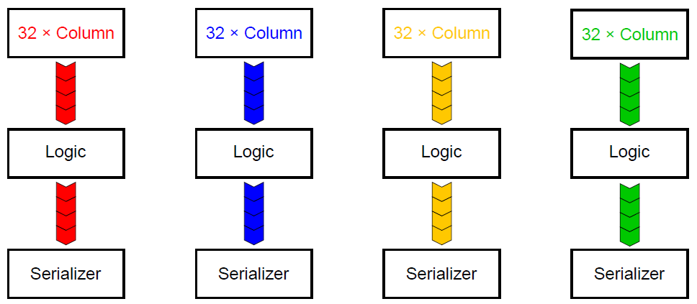
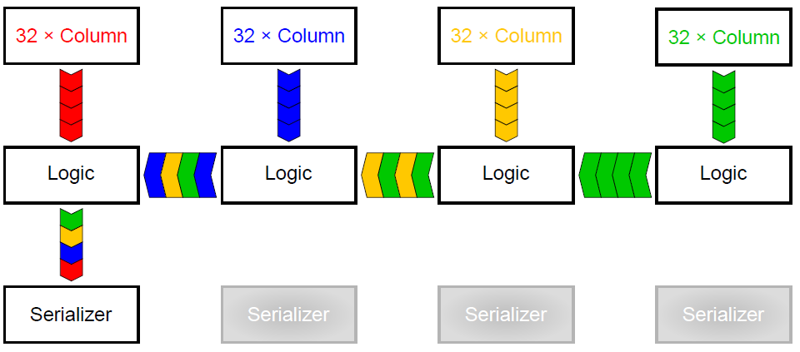
Readout
Pixel values are shifted down columns into global logic at the bottom
Option for 2x2 pixel binning
Readout has up to 6 14.1Gbps serializer links available
Used on previous test structures
Can operate with 1, 2, 3, or 6 active
All serializers active
Left-most serializer active

Slide 23
Design flow
Digital-on-top approach
Pixels built in super pixel Channel Groups
Channel Groups form Double Columns
Double Columns form Pixel Matrix
Global Circuitry added to Pixel Matrix
16 Analogue Channels
16 RAMs
(256x16b)
Digital logic

Slide 24
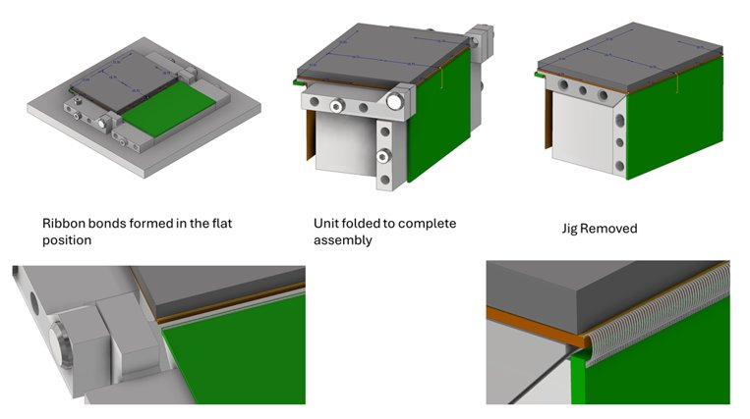
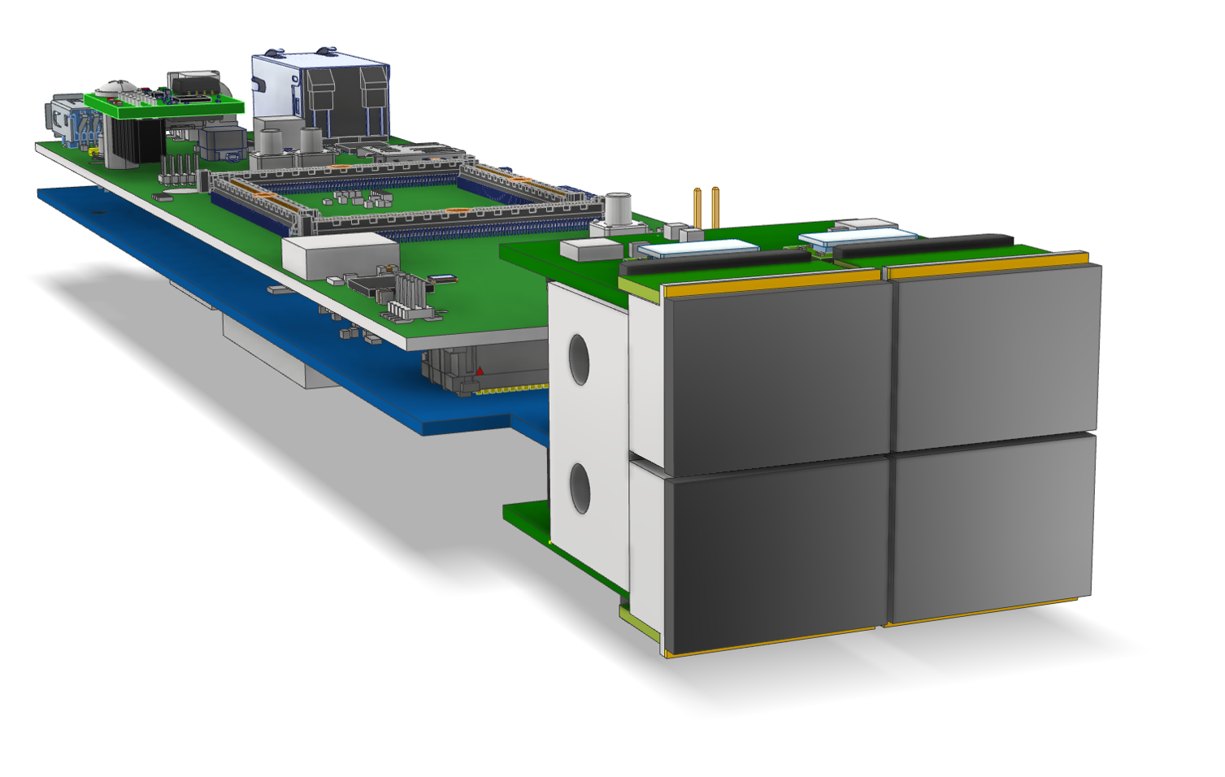
Detector System
CZT detector bump bonded onto ASIC
Ribbon bonds to connect to PCB
PCB folded underneath ASIC using jig
Full detector system will tile 4 ASICs together
Expected to reach 85-90% fill of image area
Utilising existing STFC LOKI control boards
LOKI Control Boards

Slide 25
Summary
Tape-out scheduled for end of June 2026
Initial X-ray tests scheduled for Winter 2026
Beamtime characterisation to follow
Test detector system in development with plans to scale up to Quad and 1 MP systems
Calibration
Laser drilled tungsten mask
Software method removing charge sharing events

Slide 26




Notes:
The abstract pattern can be removed or repositioned if required. Be careful to ‘Send to Back’ so that it does not obscure any important information.

Slide 27






Science and Technology Facilities Council
@STFC_matters
Science and Technology Facilities Council
Notes:
The abstract pattern can be removed or repositioned if required. Be careful to ‘Send to Back’ so that it does not obscure any important information.

Slide 28
Backup

Slide 29
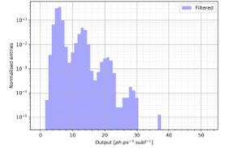
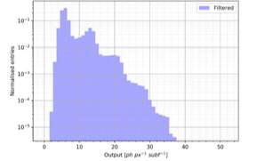
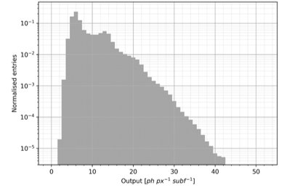
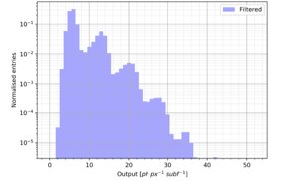
Simple Software Extraction
Still some charge loss where E lost < Th
Low Flux < 1 ph/frame
Raw 500k frames
Some correction to do?
Decreasing threshold
if neighbours > threshold charge sharing →discard
else 0 or 1 photon in
central pixel → keep
1% of events
PUBLICATION IN PROGRESS

Slide 30
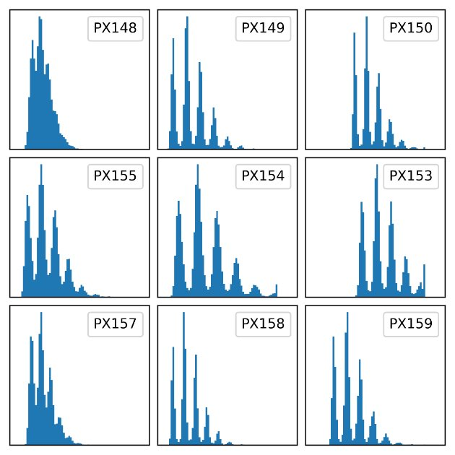
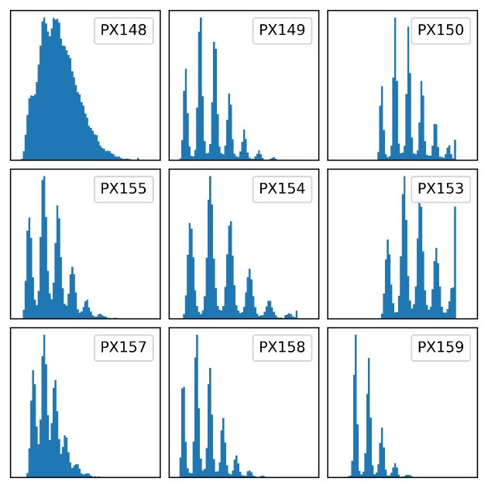
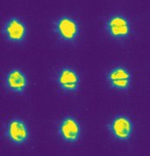
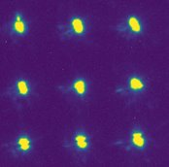
Physical Mask
Known Bad Pixel
40 µm
20 µm
Laser drilled array of holes on 110 µm pitch (16x16 trial)
No trim on test ASIC
Works fine…
Probably not practical for deployment
But maybe a way to get correction for software method?
40 µm
20 µm
Spacing of holes most important
Holes just need to be small enough
PUBLICATION IN PROGRESS

