Slide 1





EICROC : AC-LGAD readout chip for EIC FEE workshop 21 may 2026
F. Bouyjou, H. Chanal, F. Dulucq, M. El Berni, S. Extier, M. Firlej, T. Fiutowski, K. Guillossou, F. Guilloux, M. Idzik, N. Kachkachi, B.-Y. Ki, C. de La Taille, J. Moron, D. Marchand, L. Royer, N. Seguin-Moreau, L. Serin, A. Shama, A. Soulier, K. Swientek, D. Thienpont, A. Verplancke

Slide 2
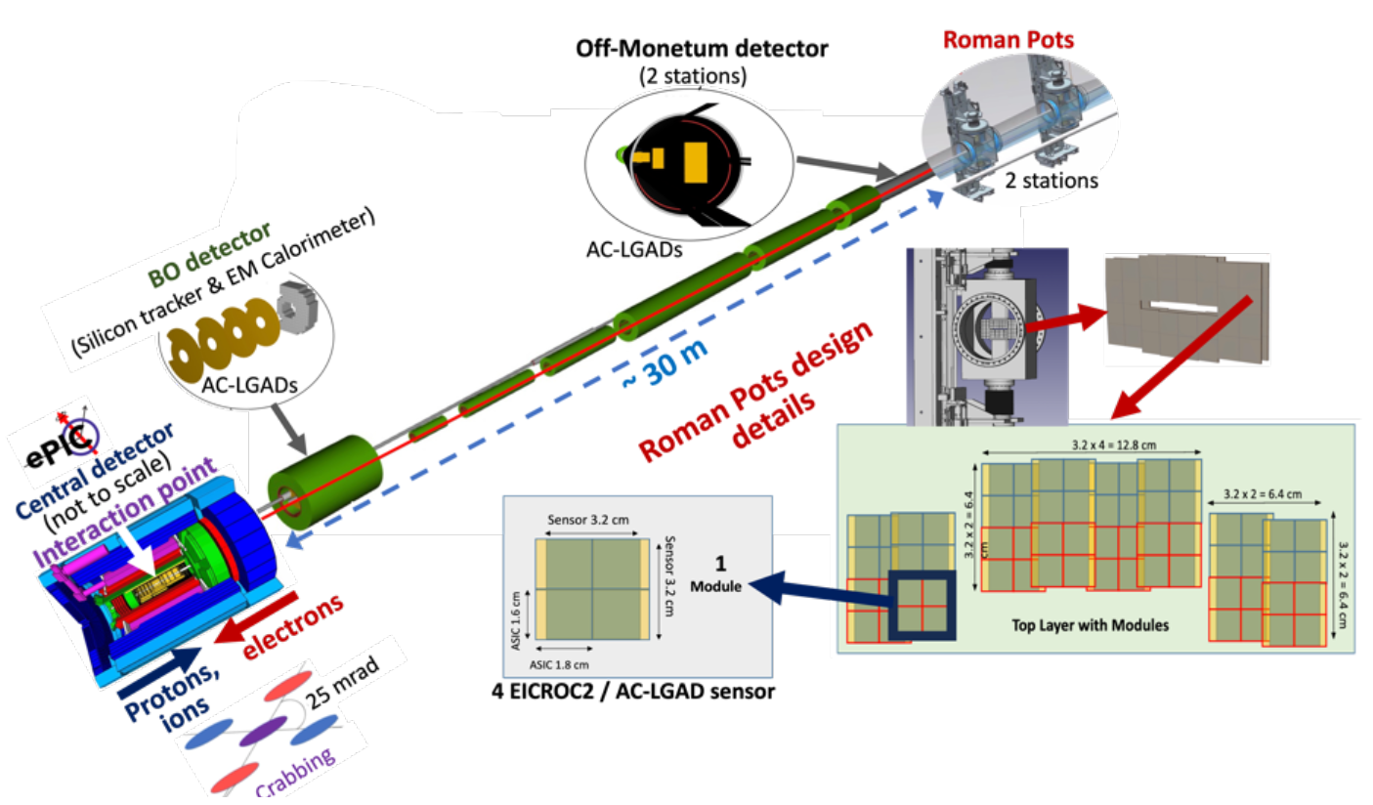
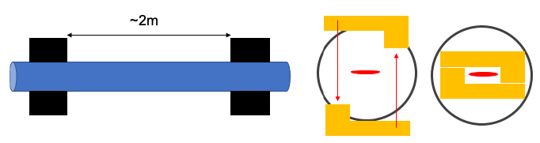
ePIC experiment far-forward region
Roman Pots for ePIC experiment
Used in the far forward tracking of particle collisions, mandatory for exclusive reactions
2 stations ~2m apart
2-3 layers of sensors per station
Square pixels of (500µm)²
Stringent requirements
AC-LGAD sensors will be used because of their capability to provide excellent resolution in timing and spatial resolution.
EIC Conceptual Design Report, 2021

Slide 3
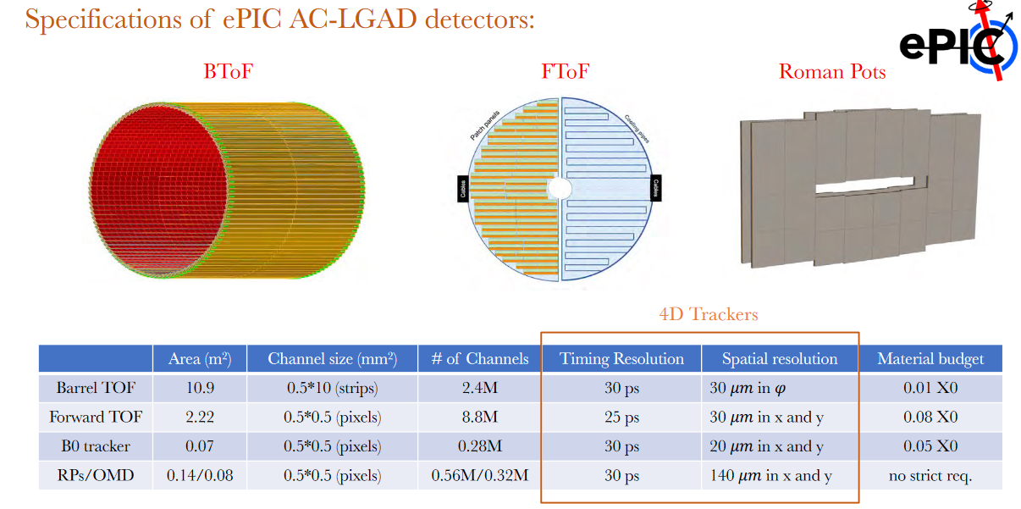
ePIC AC-LGAD detectors

Slide 4
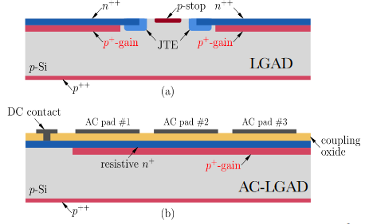
DC LGAD and AC LGAD
From S. Nanda : https://indico.cern.ch/event/1232761/contributions/5321425/
MIP timing detectors (HGTD, ETL) use DC LGAD sensors
~10 fC/MIP
Area : (1.3 mm)²
Good timing resolution : 30-50 ps
Poor position resolution : ~400 µm
« dead zone » between pixels
AC LGADs for EIC
Resistive layer to get signal sharing
Area (500 µm)²
Good position resolution : < 50 µm
No dead area
Good timing resolution (as DC LGAD)

Slide 5
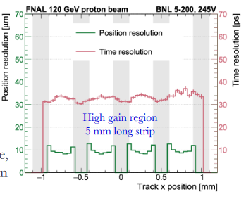
AC LGAD performance [FNAL]
From S. Nanda : https://indico.cern.ch/event/1232761/contributions/5321425/
Here for strips : 500 µm x 5 mm
~30-35 ps timing resolution
~10 µm position resolution
Oscilloscope readout
Still preliminary results and improvements underway on gain uniformity
Chosen as baseline for several EIC detectors
New and promising detector
Need readout chip
Strips (see next talk by A. Apresyan)
Pixels 500 µm x 500 µm : EICROC

Slide 6






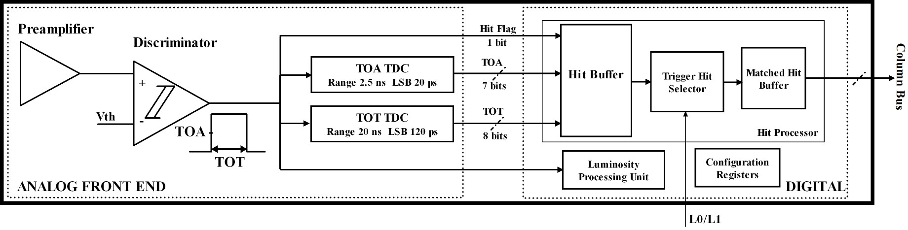
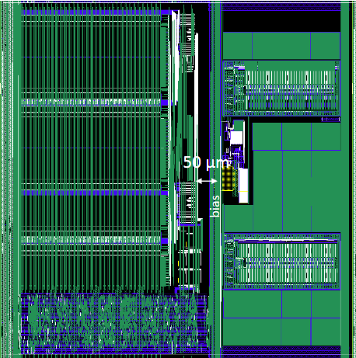
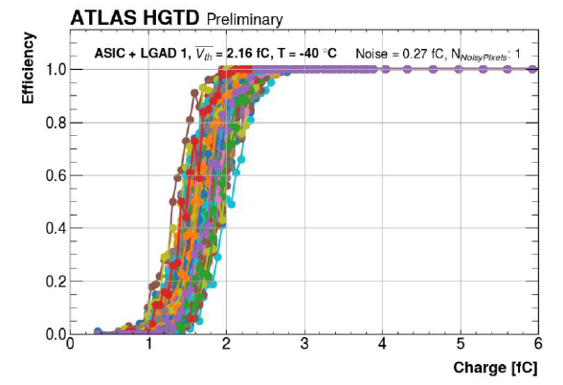
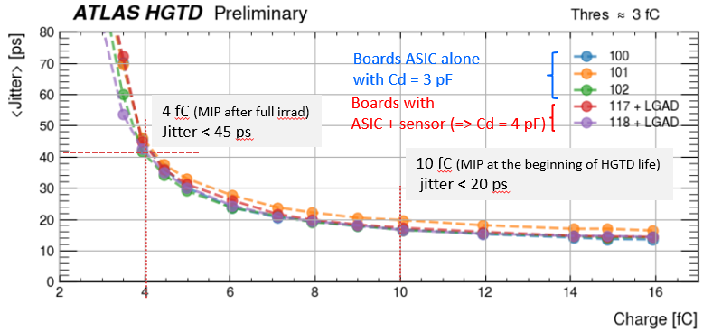
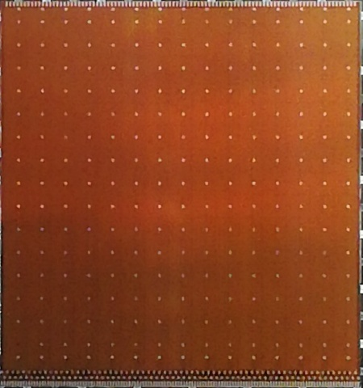
ALTIROC : DC-LGAD readout chip
1 GHz preamplifier and discriminator
2 vernier TDCs for ToA and ToT
Hit buffer: SRAM 1536 x 19 bit (38 µs latenccy)
One pixel : 1.3x1.3mm²
15 x 15 pixels
2 x 2 cm²

Slide 7
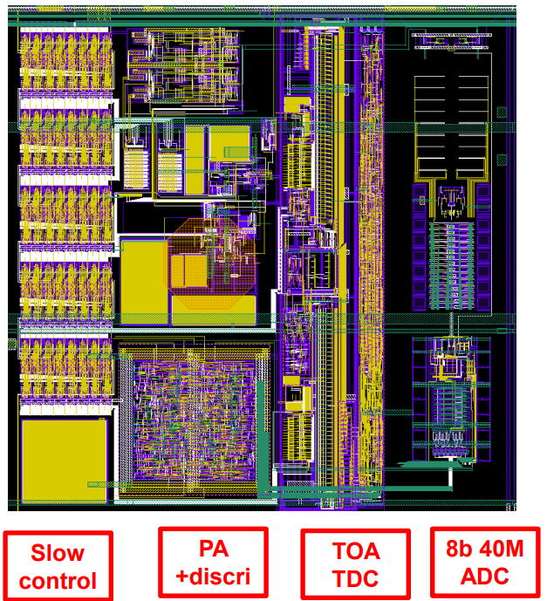
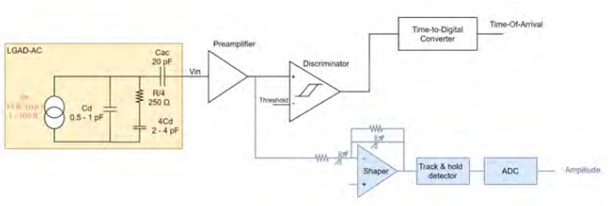

EICROC0
Analog frontend similar to ATLAS ALTIROC
Cd = 1 pF (max 3 pF)
Need ADC instead of ToT for charge measurement : 8bit 40 MHz from AGH Krakow
TDC taken from HGCROC by CEA Saclay
Simple digital readout but SEE-proof I²C slow control
~2 mW/pixel
Fabricated in spring 2022 in TSMC 130nm

Slide 8
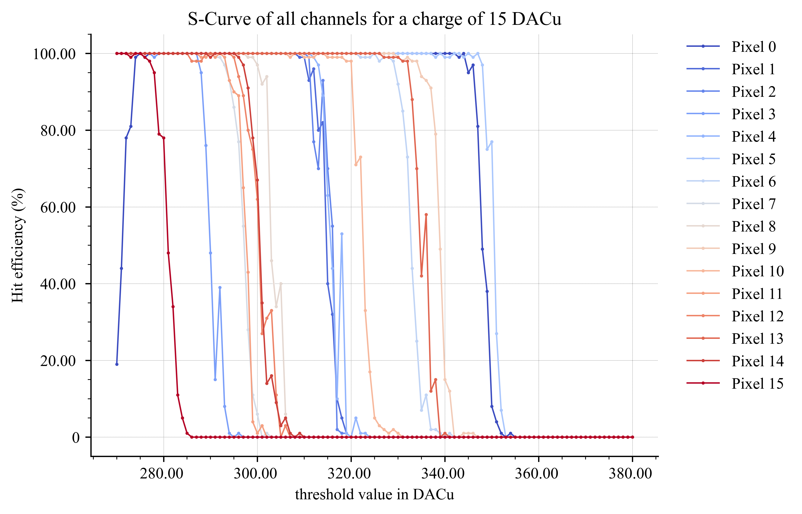
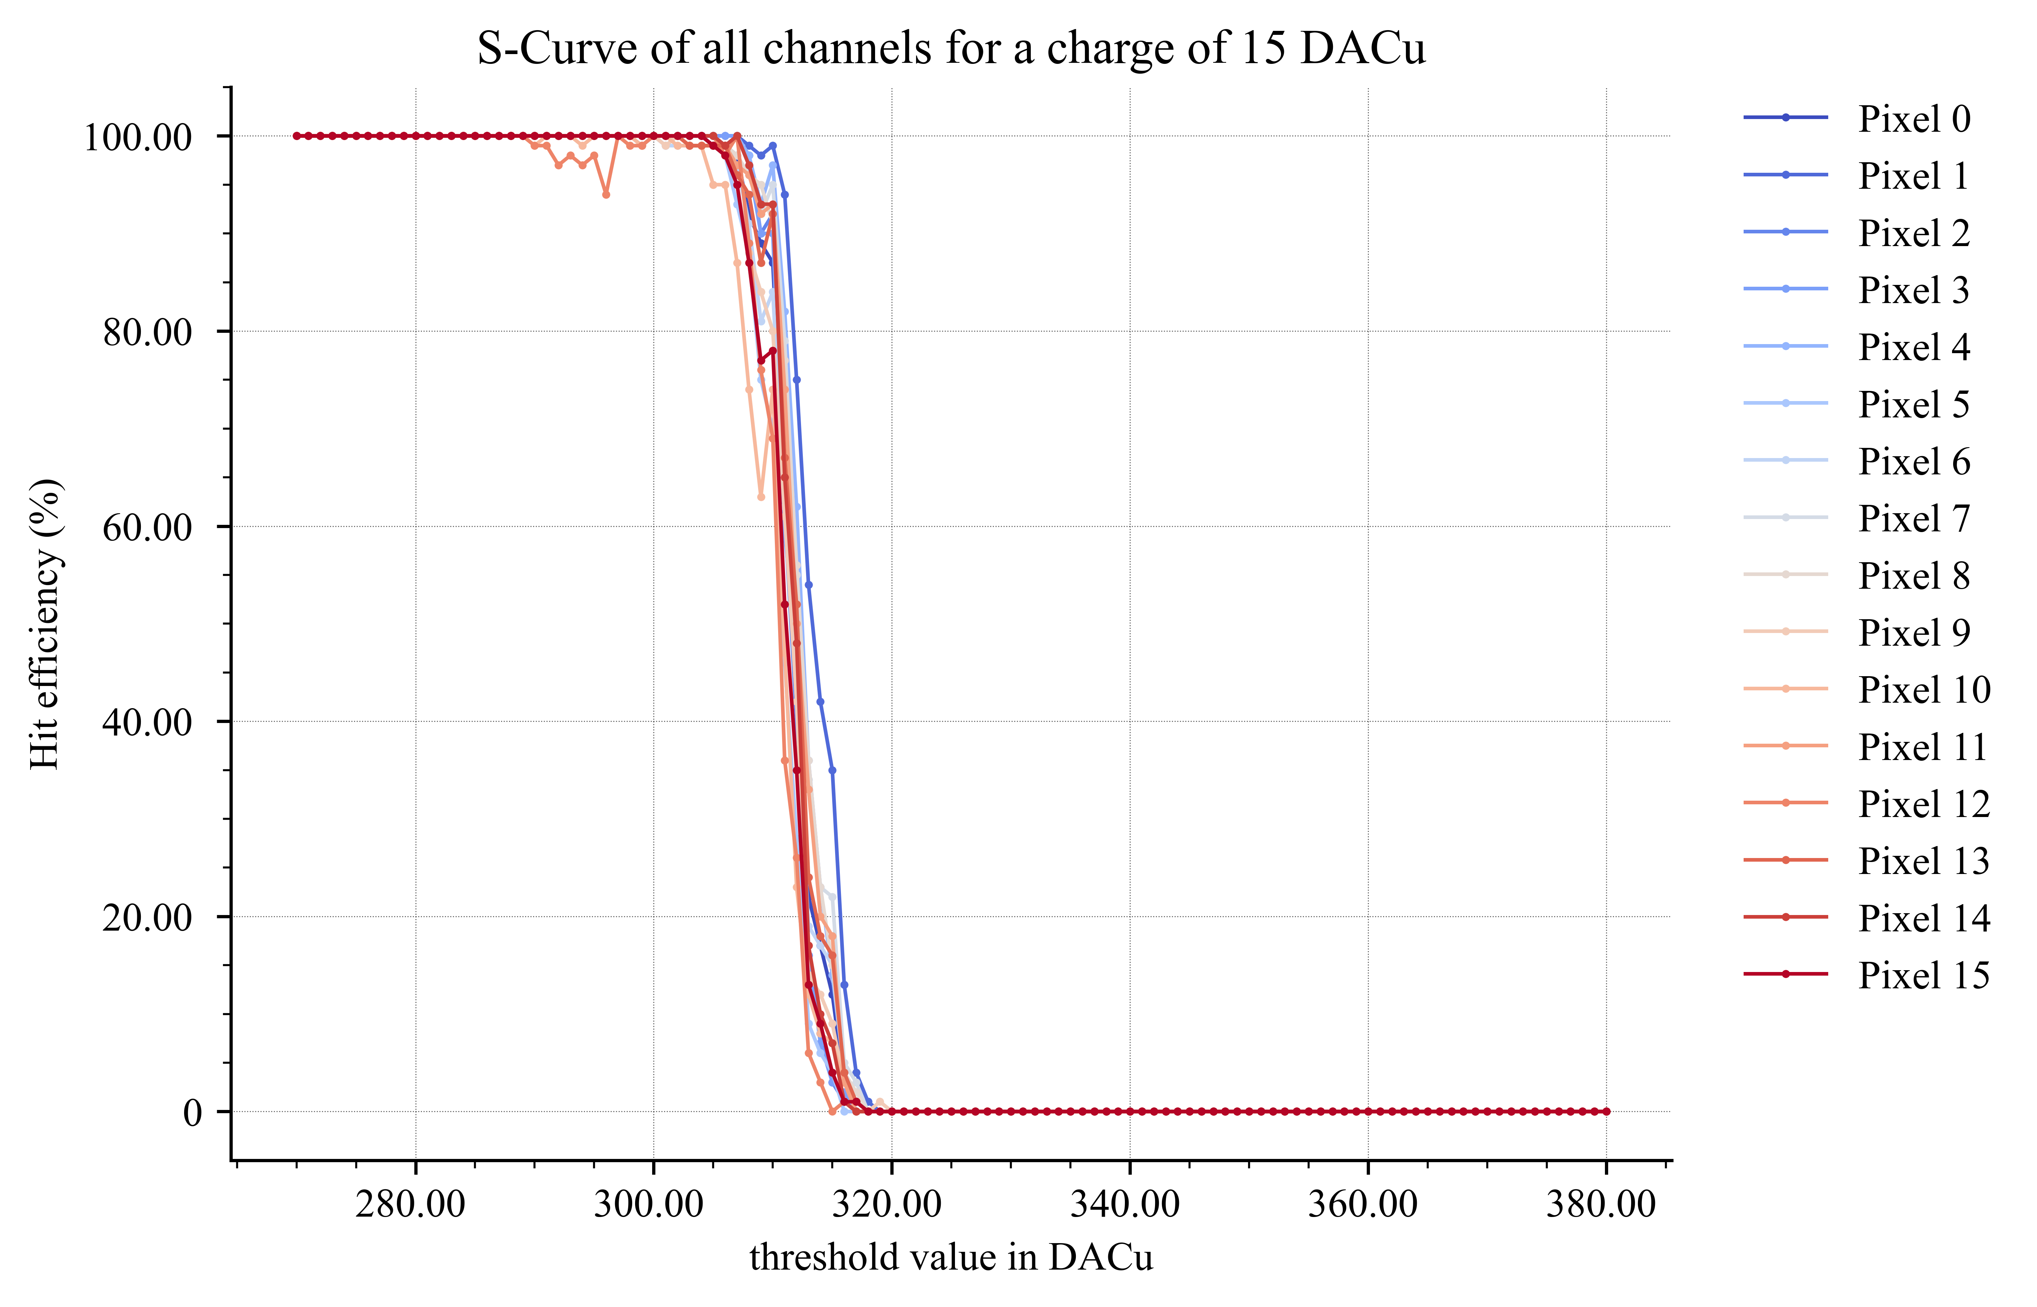
EICROC0 measurements : S-Curves
6-bit DAC for channel-wise threshold alignement
Correction of channels for a charge of 5 fC (ASIC alond)

Slide 9
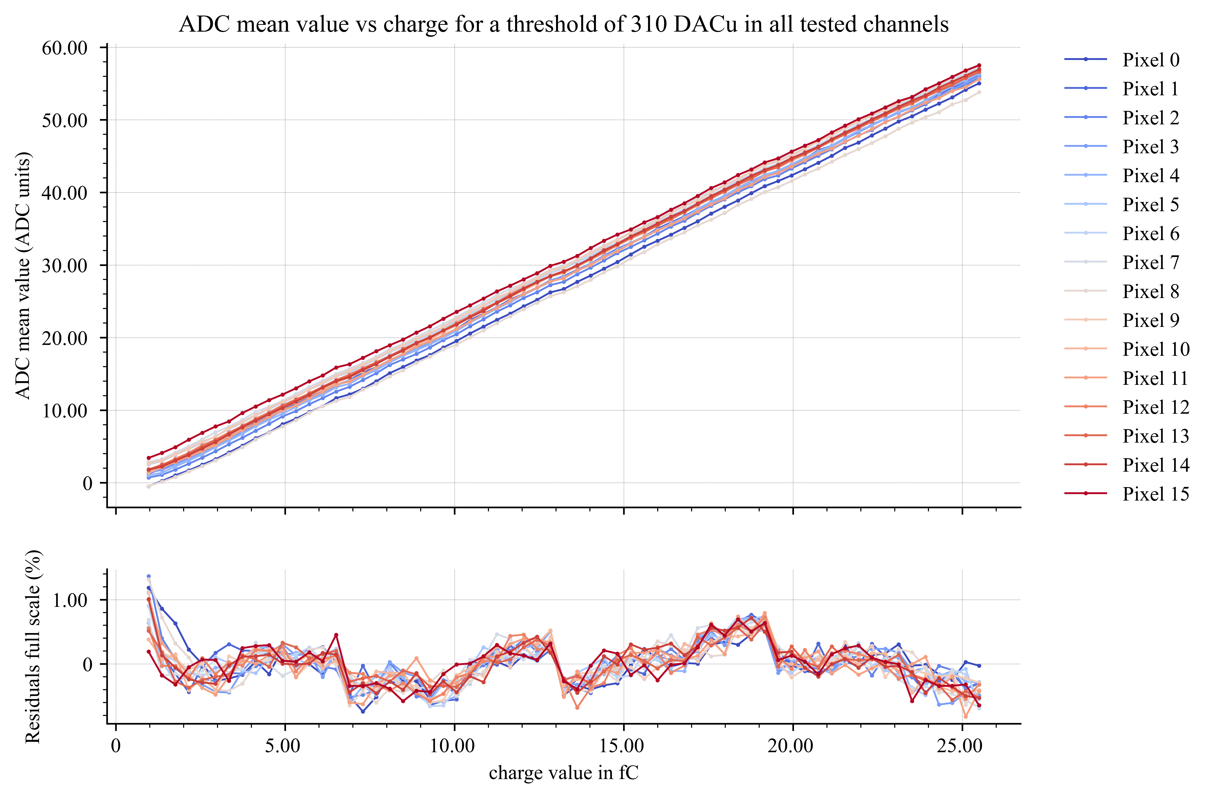
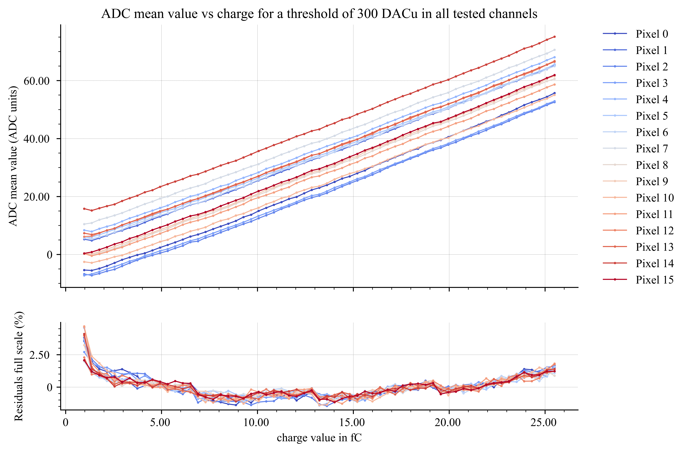
EICROC0 measurements : ADC linearity
8 bit 40 MHz SAR ADC [Krakow]
Noise ~1 UADC but large common mode noise (here substracted)
Signal 50 UADC ~500 um => 1 UADC ~10 um
ADC mean & residuals – no sensor
ADC mean & residuals – BNL Flipchip sensor

Slide 10
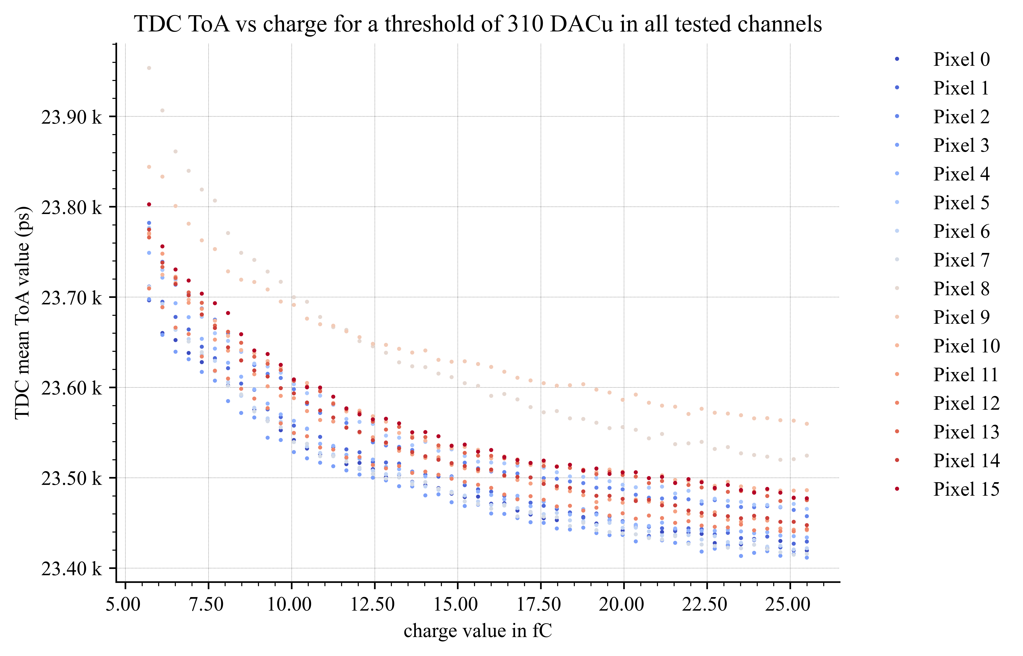
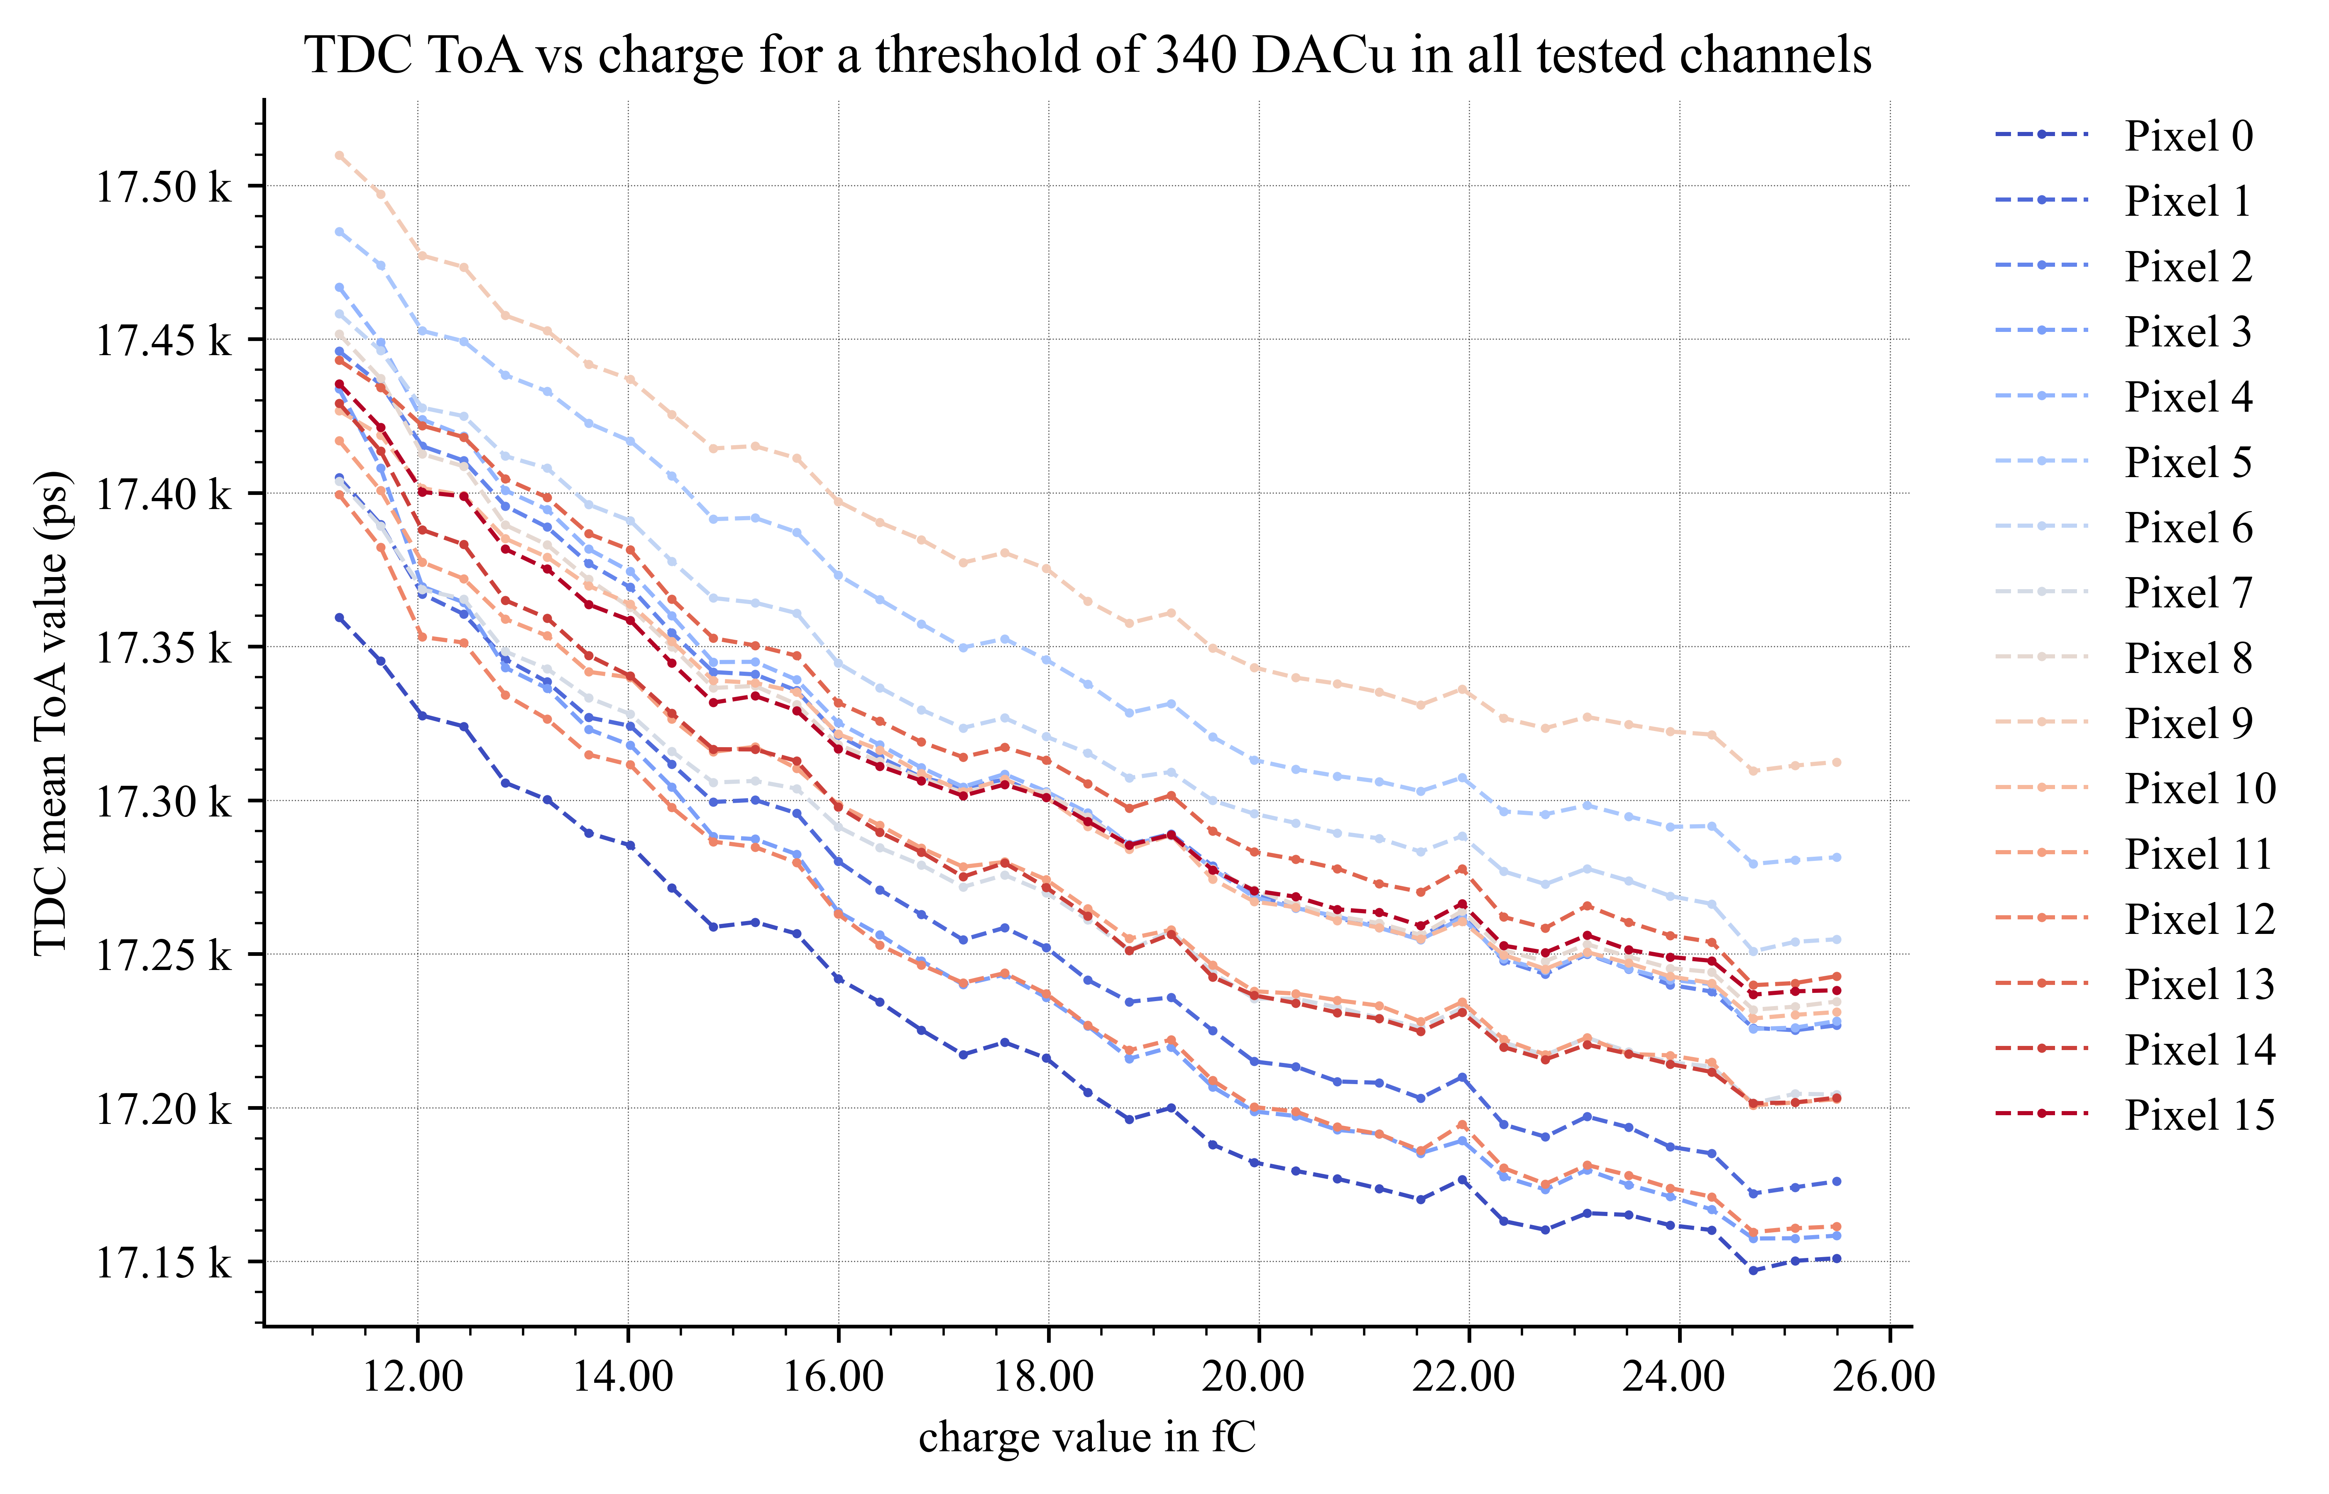
EICROC0 measurements : TDC ToA
Time walk measurement :~400 ps
TDC ToA – no sensor
TDC ToA – BNL Flipchip sensor
500 ps

Slide 11
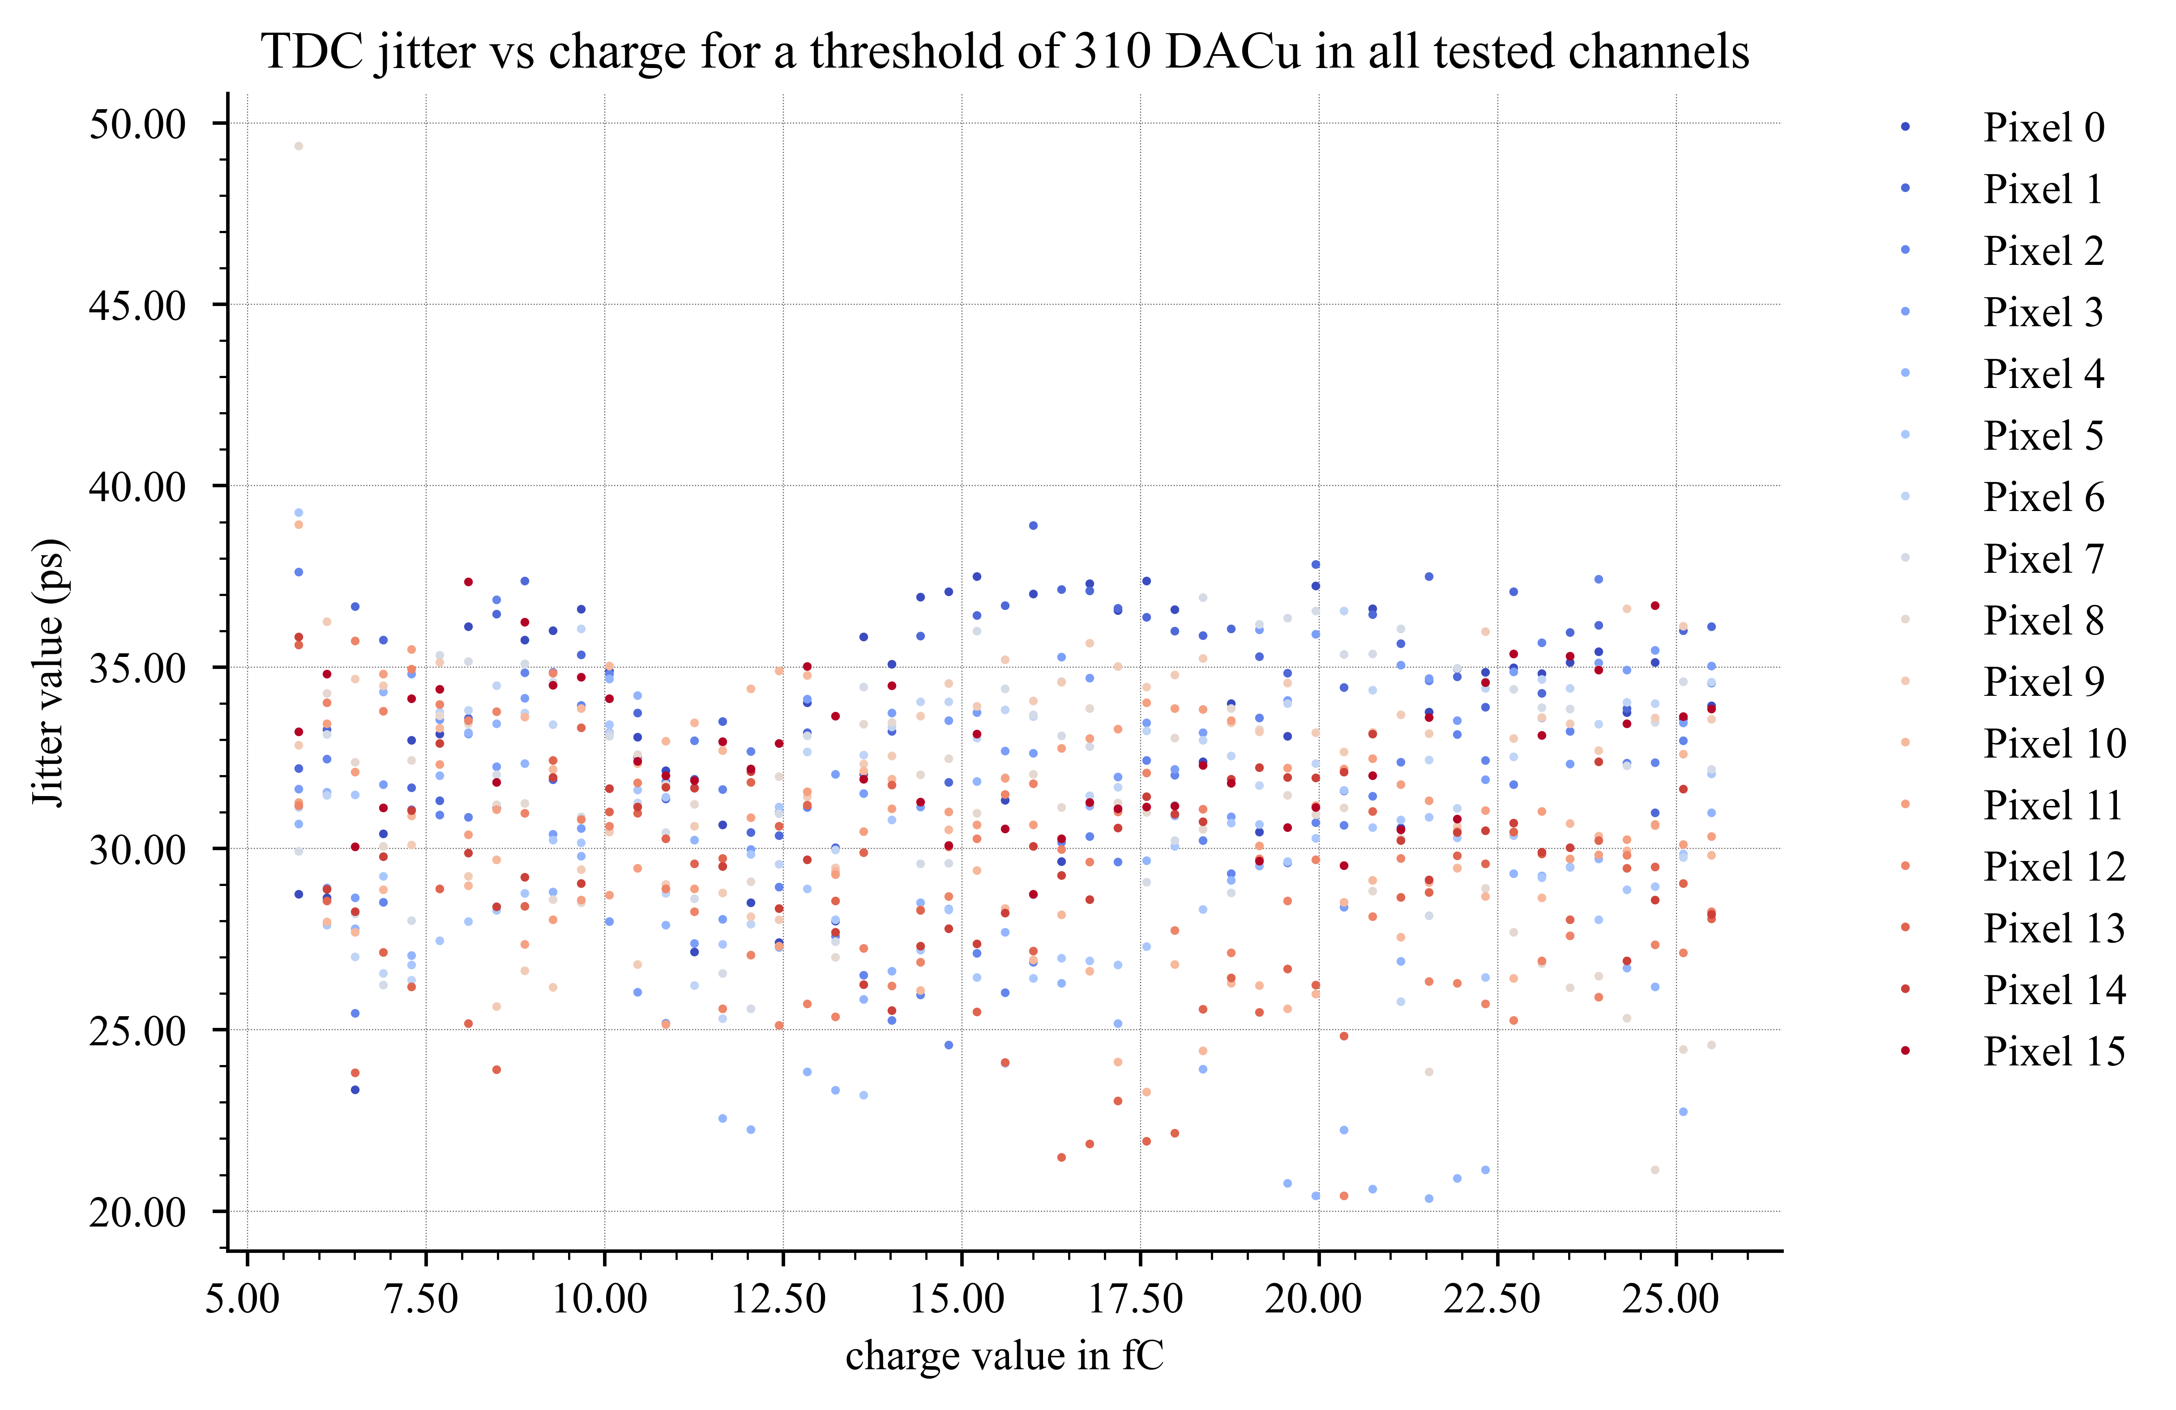
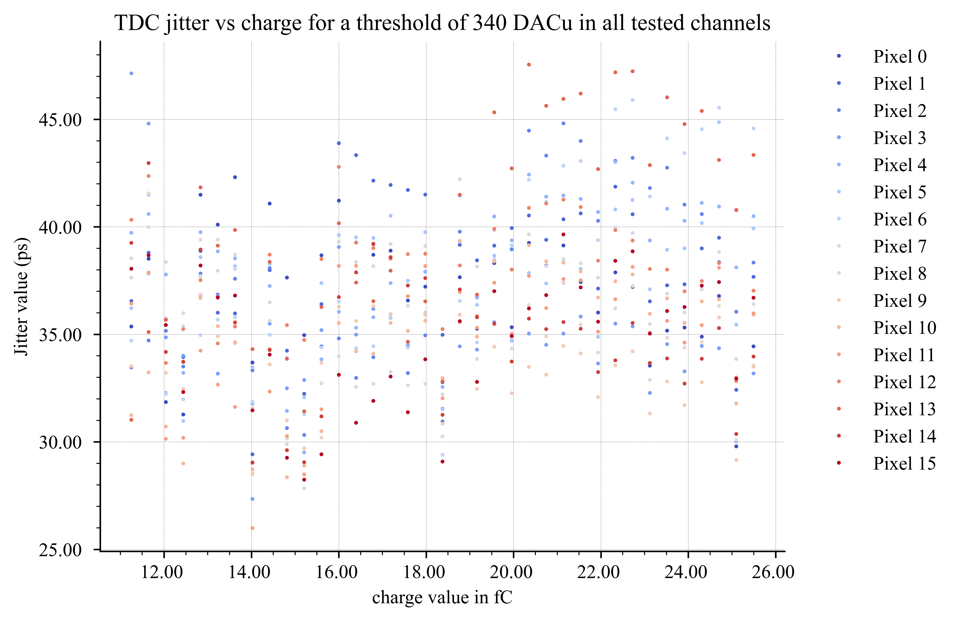
EICROC0 measurements : TDC jitter
TDC jitter – no sensor
TDC jitter – BNL Flipchip sensor
Charge range degraded with sensor, still need to properly calibrate the TDC for each channel and remove correlated noise

Slide 12



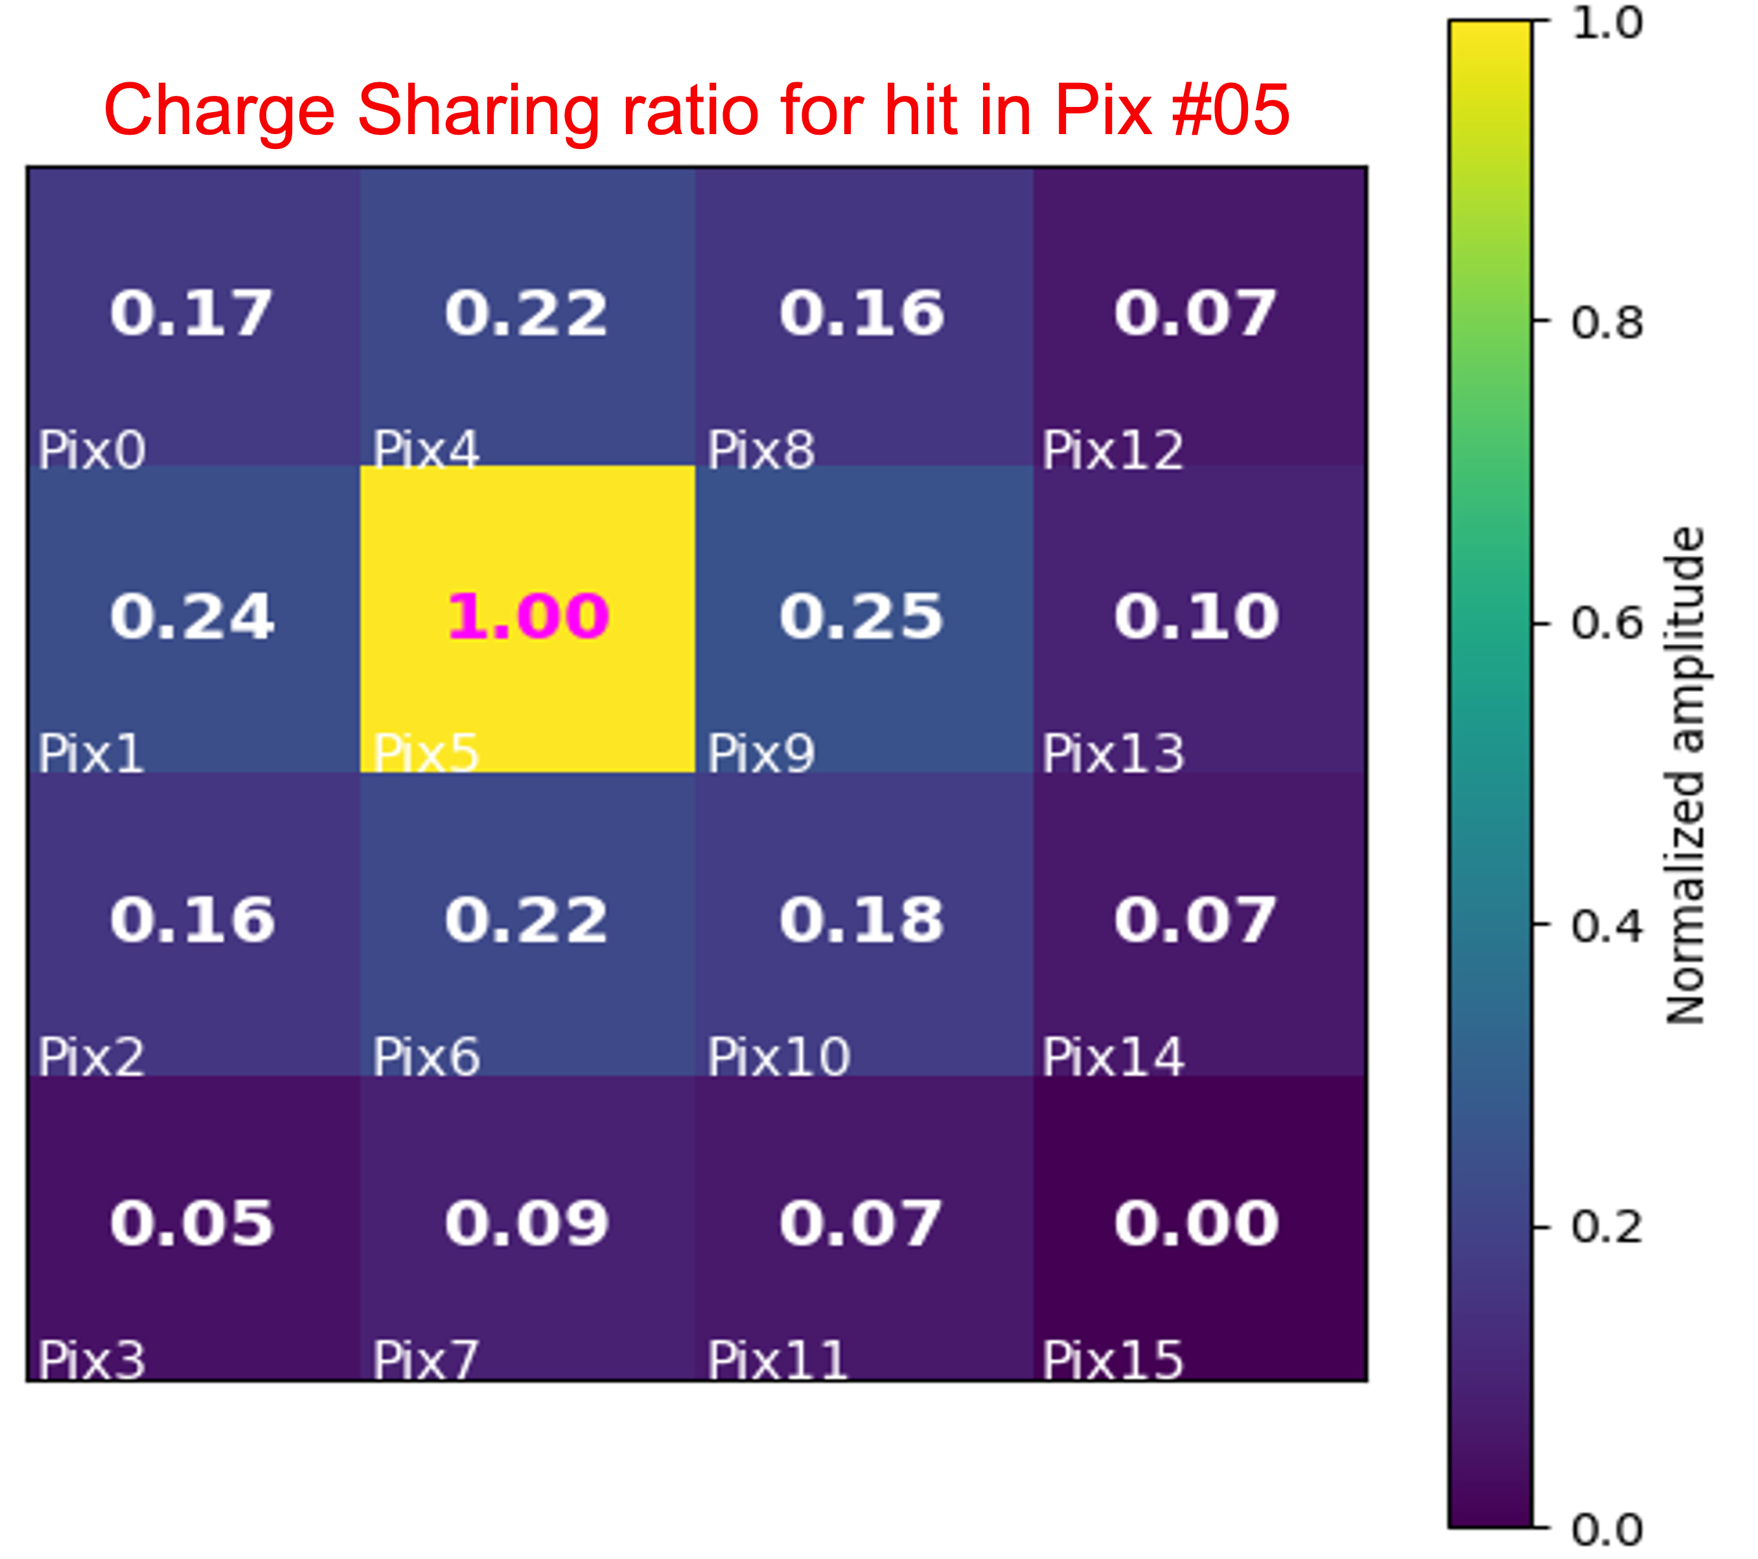
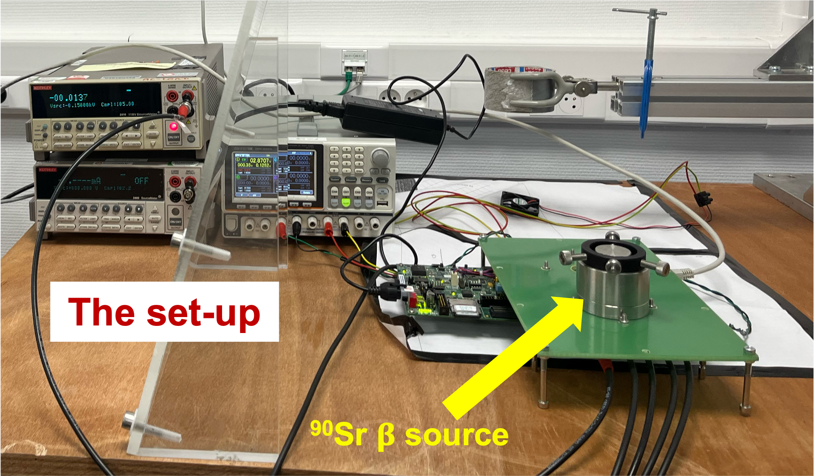
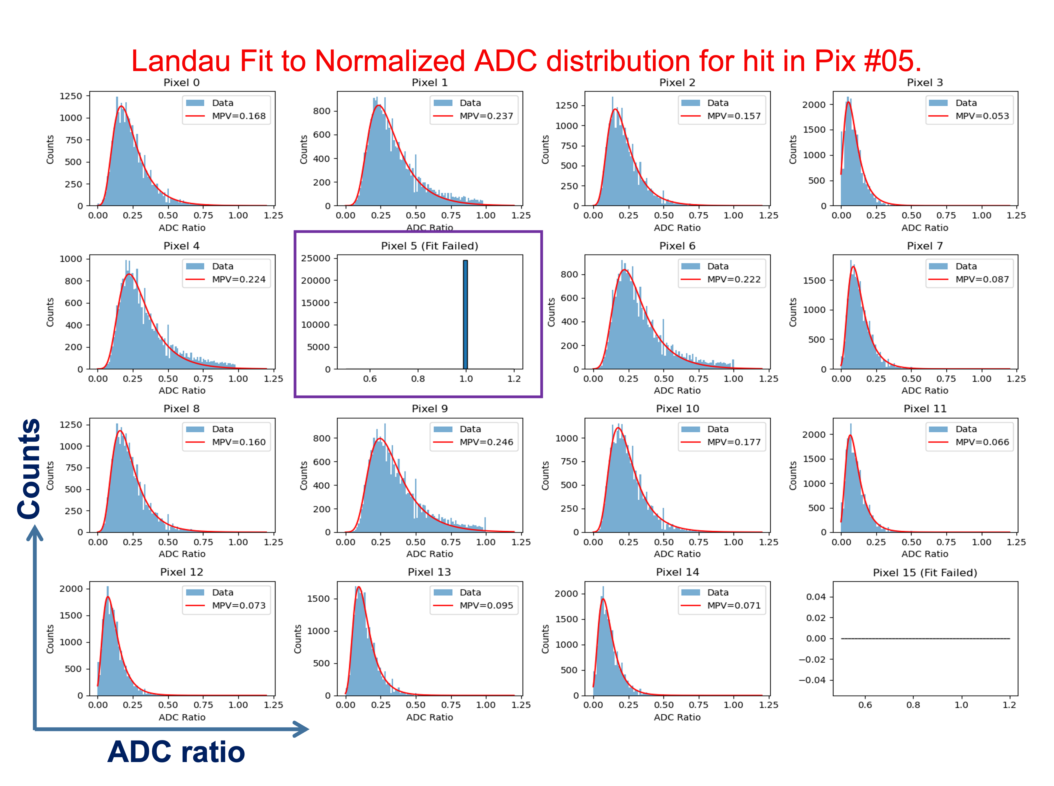
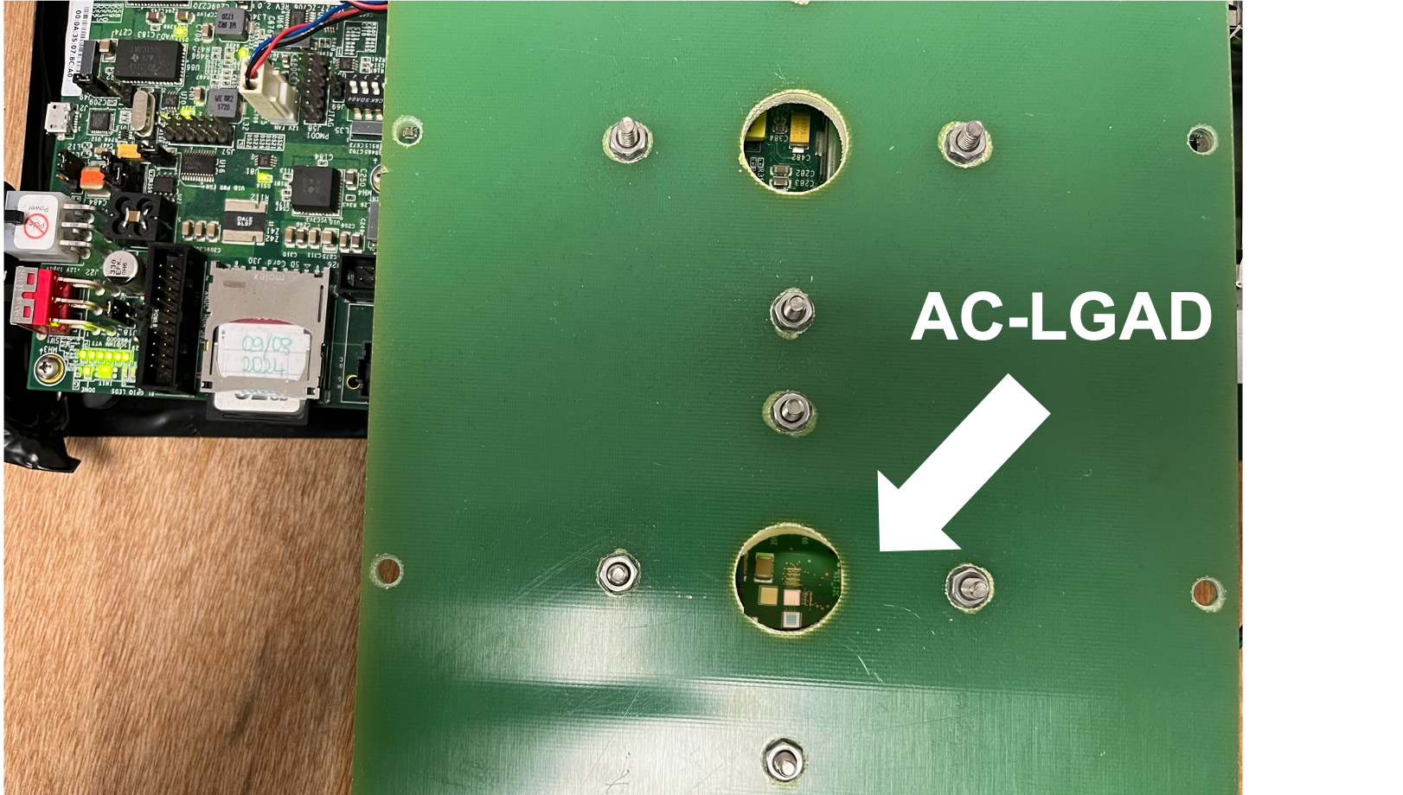
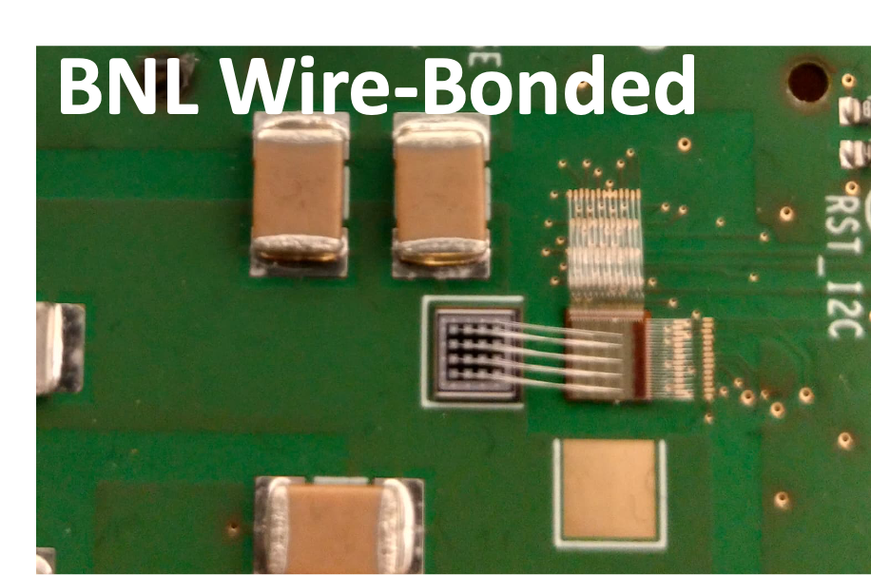
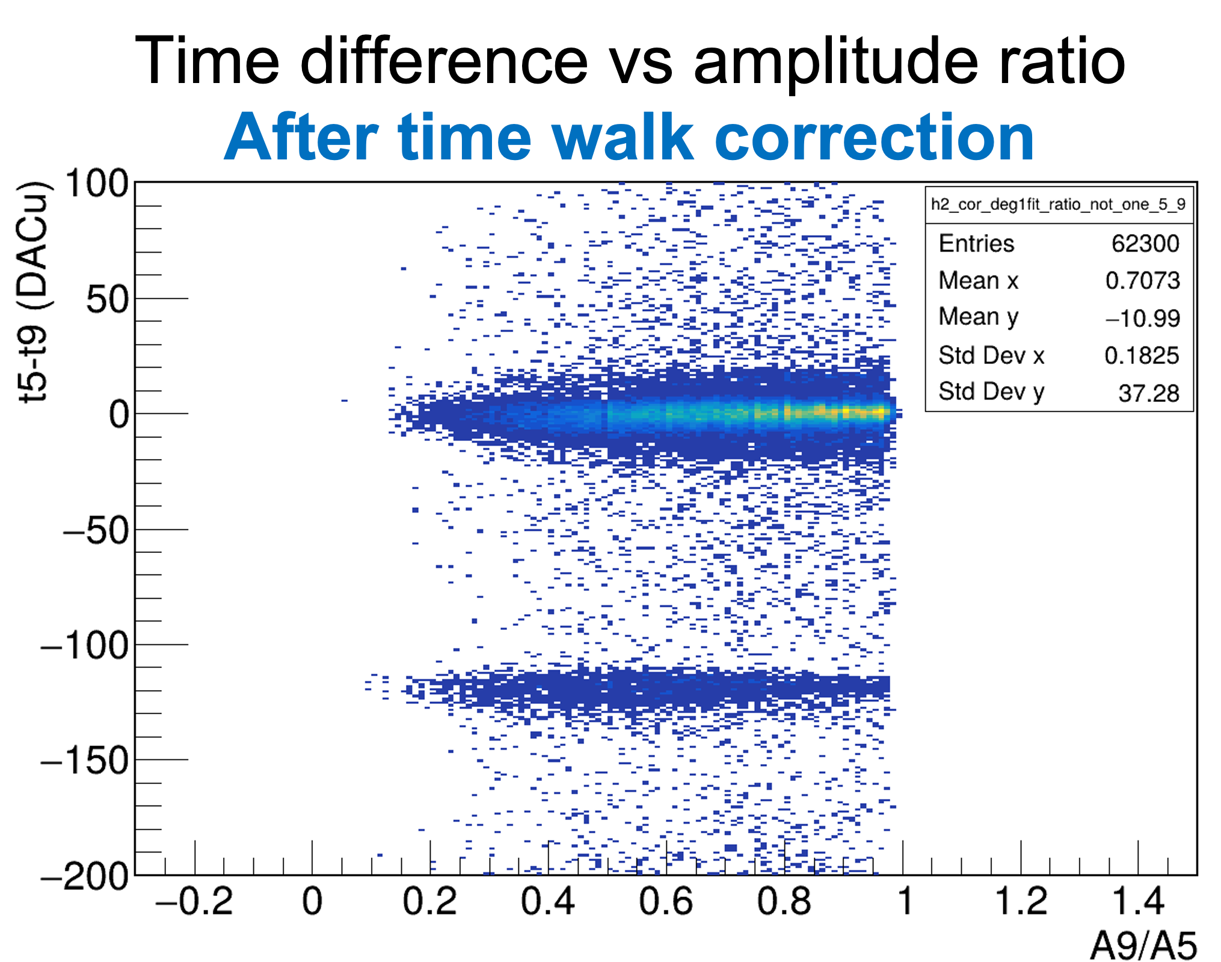
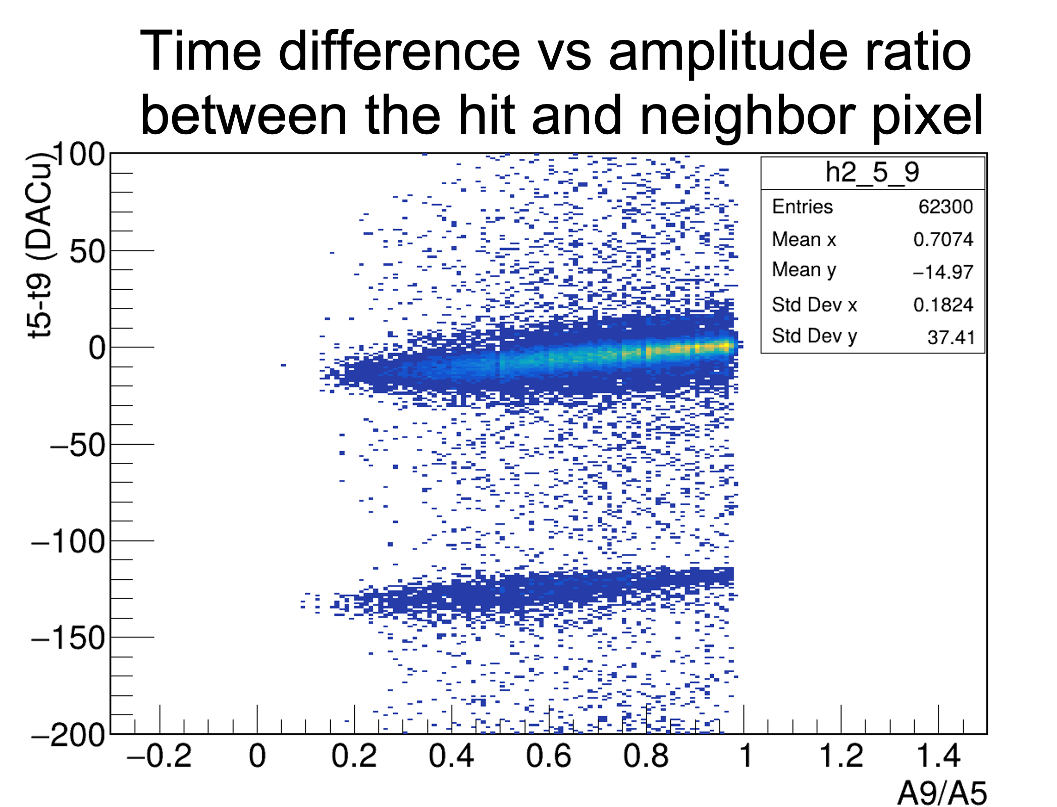

Pixelated AC-LGAD read-out characterization
Measurements with ⁹⁰Sr 𝛃 source at IJCLab PSI platform (July ‘25)
1) digital data stored when the PreAmp signal amplitude of at least 1 channel among the 16 is passing the discriminator threshold
From ADC data
ADC pedestal subtraction computed from “far” pixel
More charge sharing (~23%) for adjacent neighbors
Time walk correction applied successfully to TDC data
EICROC0 (4 x 4 channels) CMOS 130 nm
A. Sharma, B.-Y. Ky, D. Marchand, L. Serin

Slide 13
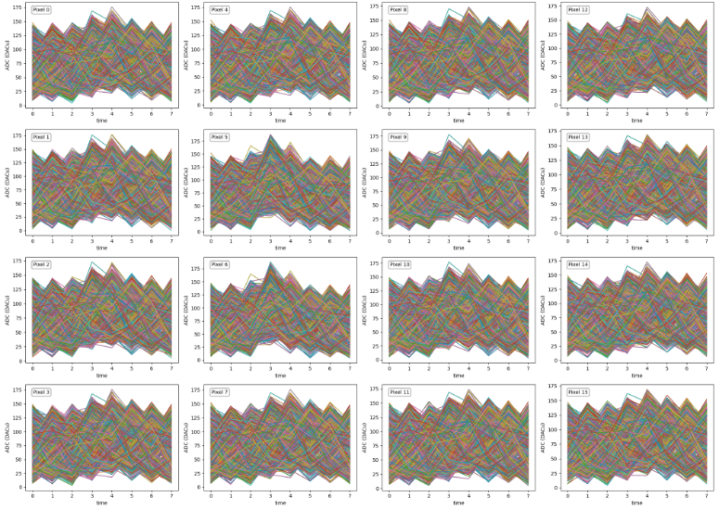
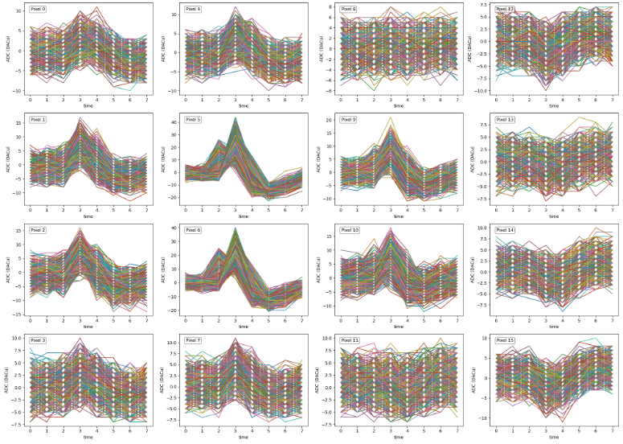
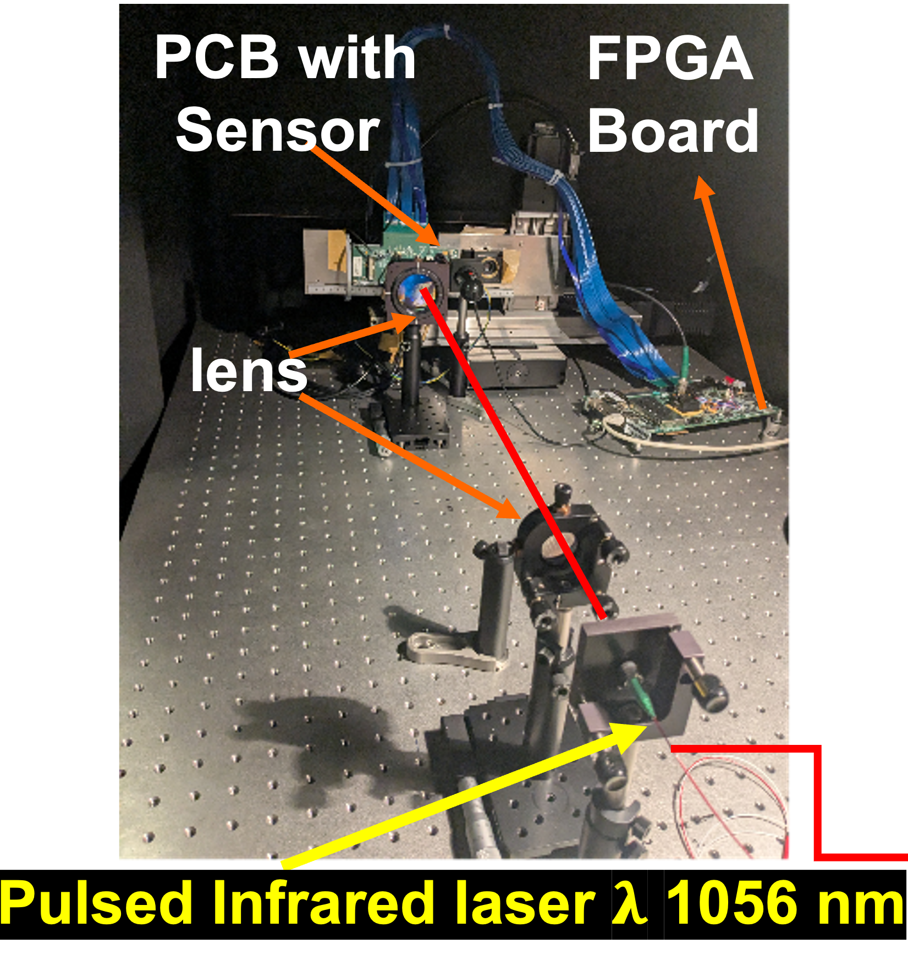
Pixelated AC-LGAD read-out characterization
Preliminary results with Infrared Laser (1/2)
ADC waveforms (8 time samples = 8 points/event): BEFORE & AFTER pedestal subtraction (based on « far » pixel evt by evt)
A. Sharma & D. Marchand

Slide 14
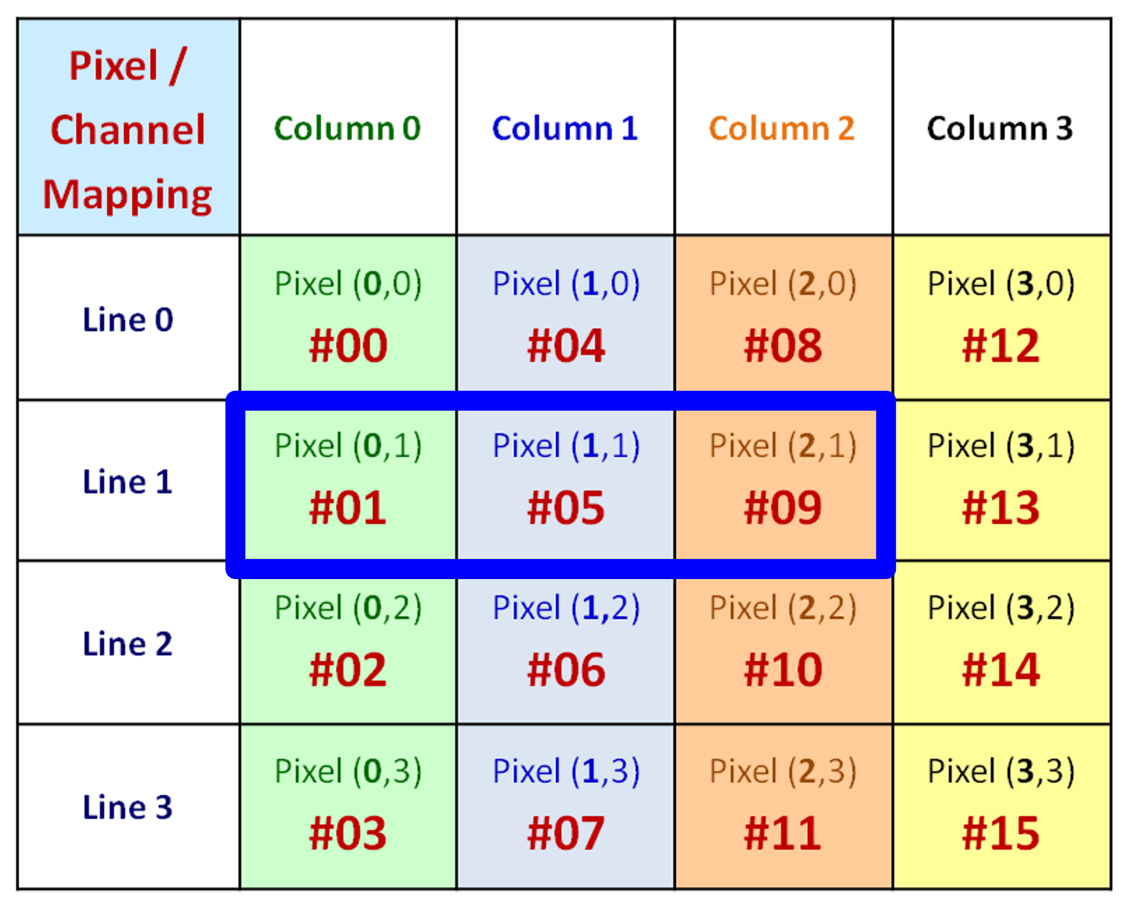
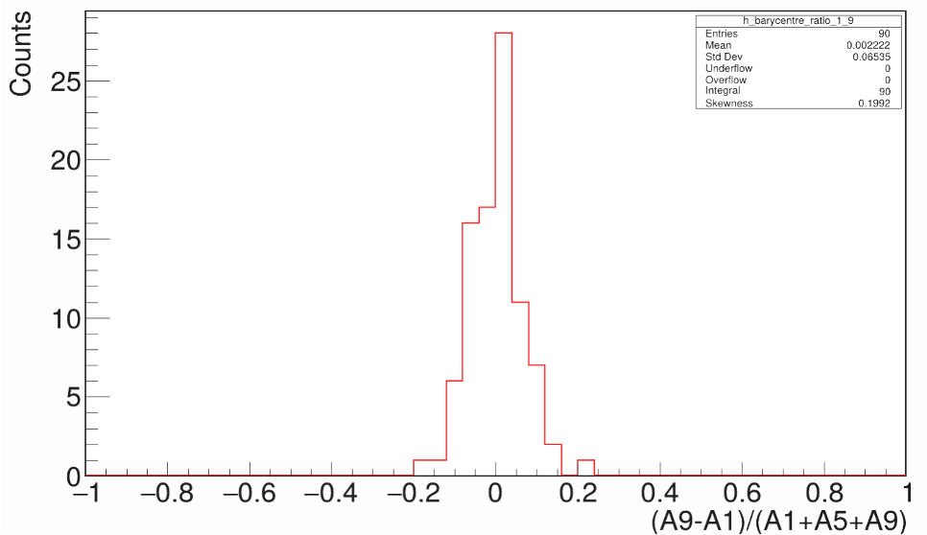
Pixelated AC-LGAD read-out characterization
Preliminary results with Infrared Laser
Barycenter calculation from ADC data
Considering pixels #01, #05 & #09
Horizontally the laser is shooting the center of pixel #05
Mean = 0.0022
RMS = 0.065 = 33 µm
Amplitude Ratio = (A9-A1)/(A1+A5+A9)
A. Sharma, D. Marchand & L. Serin

Slide 15
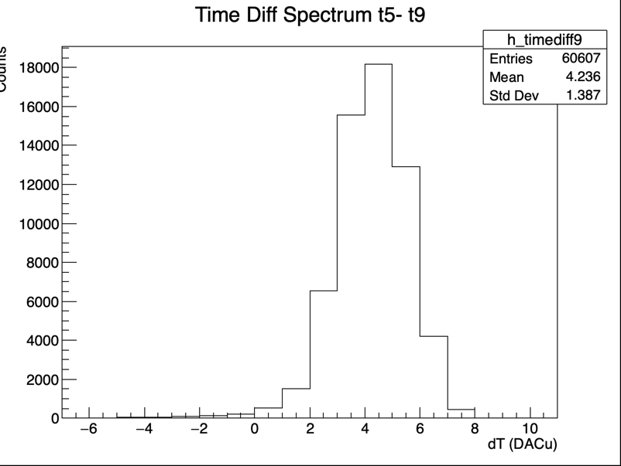
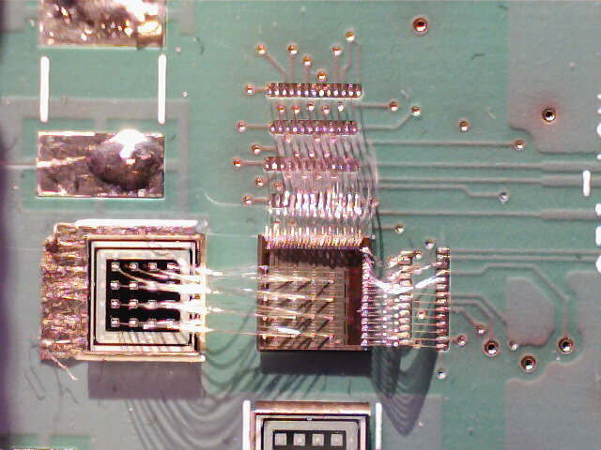
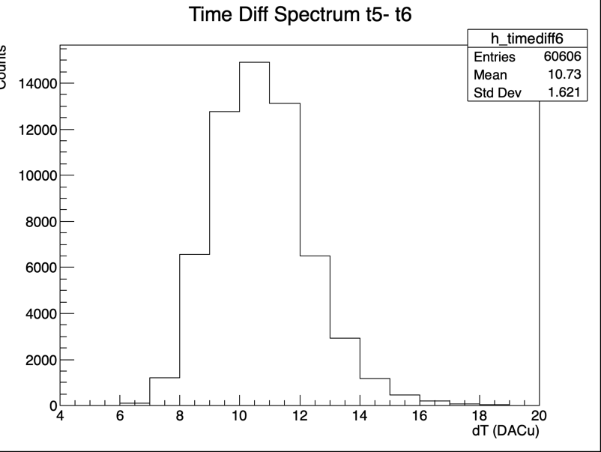
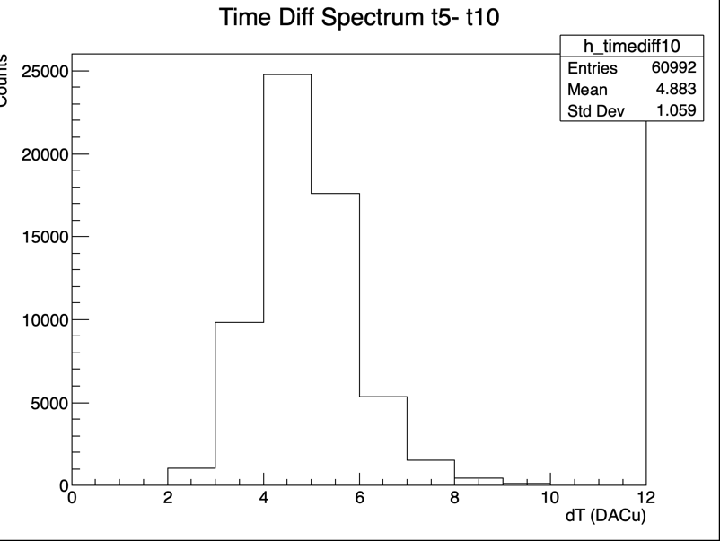
Pixelated AC-LGAD read-out characterization
With Infrared Laser
TDC values difference [DACu] between hit pixels w.r.t. pixel #05
TDC differences between 2 hit neighboring pixels
𝜎 [pix05 – pix09]_{DACu} = 1.387 ➜ TDC jitter for individual pixel [= 𝜎 / √2]: 24.5 ps
BNL sensor biased at HV = -190V
𝜎 [pix05 – pix10]_{DACu} = 1.059 ➜ TDC jitter for individual pixel [= 𝜎 / √2]: 18.7 ps
𝜎 [pix05 – pix06]_{DACu} = 1.623 ➜ TDC jitter for individual pixel [= 𝜎 / √2]: 28.7 ps
Individual Pixel jitter from 19 ps up to 29 ps

Slide 16
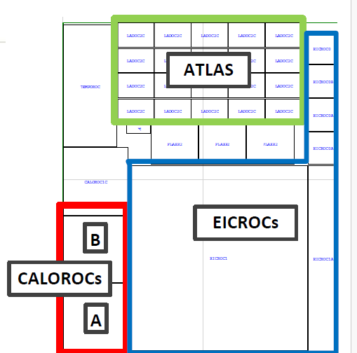
EICROC prototypes
EICROC0 : 4x4 pixels with simple readout (2022)
EICROC OA/0B 1/1B fabricated in 2025 « ATLAS/ EIC » engineering run TSMC 130n
EICROC0A/B : 4x4 with improved blocks and testability
EICROC1/1A : 32x32 and 4x32
EICROC2 will be fabricated Q1 2027
Should be the final chip…

Slide 17
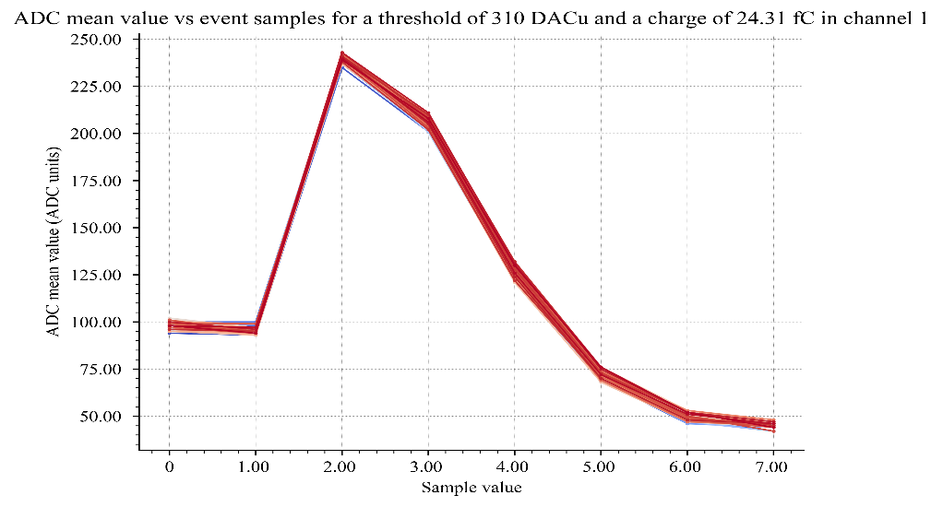
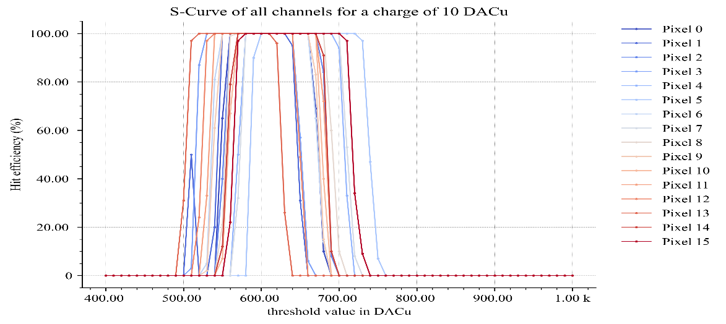
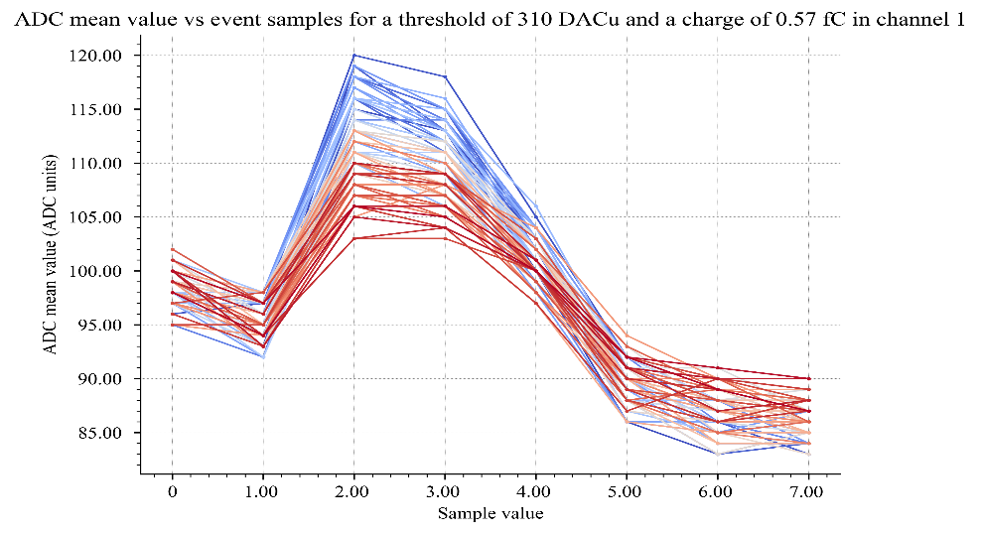
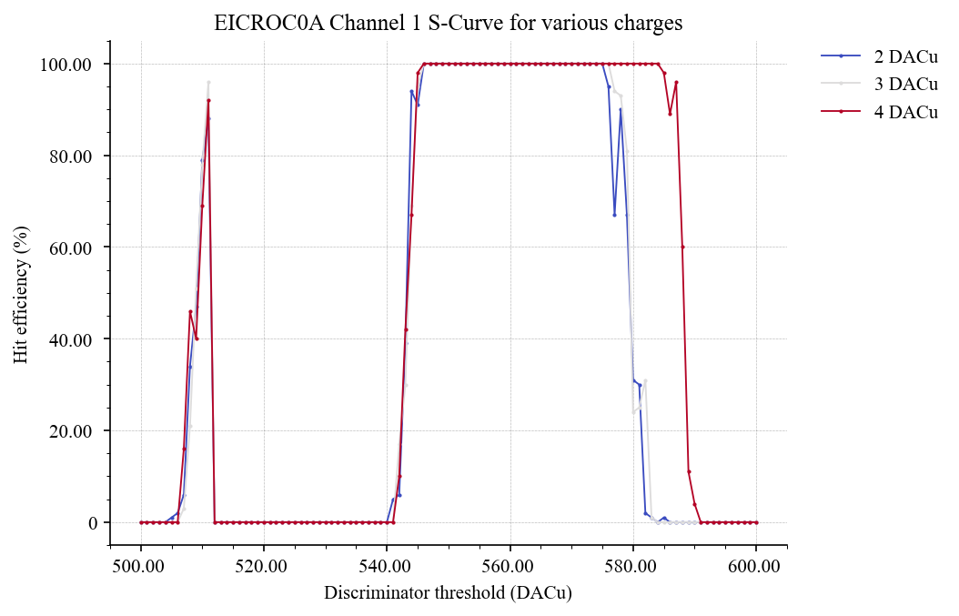
First measurements of EICROC0A
Only partial configuration is possible : look at ADC data and s-curves
Improved ADC baseline, similar minimum threshold (3 fC)

Slide 18
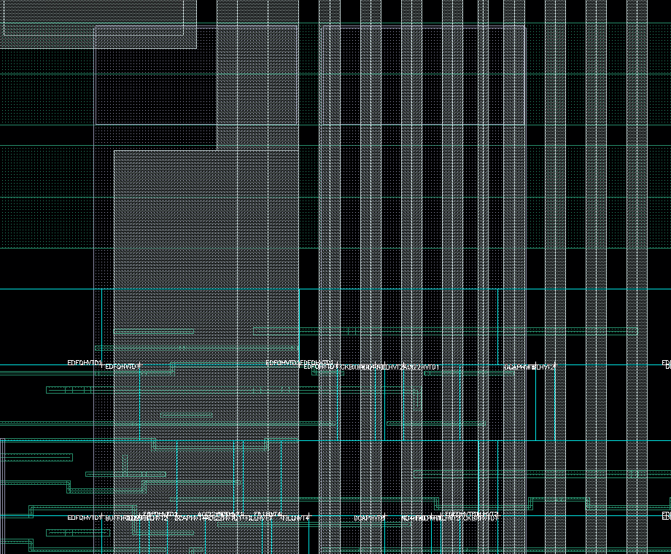
EICROC0 Coupling investigation
Large coupling seen on the ADC data which was completely hiding the signal up to 20 fC
Large coupling capacitance between local (pixel) digital block and preamp / shaper bias lines
Layout improved by adding exclusion zones and a shield between bias lines and digital
Bias / digital block layout in new EICROC ASICs

Slide 19
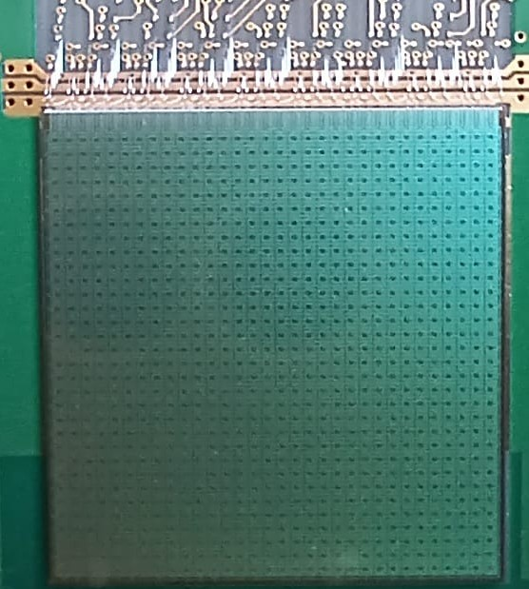
EICROC1
32x32 chip : final dimensions
Goal :
test full-scale chip analog performance (IR drops)
Allow final sensor characterization
Test interface with DAQ : fast commands and 320 Mb/s data output
Progress on module/front-end boards
Caveats :
Not (yet) zero-suppressed data
Still 2mW/ch
Still analog-on-top

Slide 20

EICROC1 description
Designed as 8 blocks of 4x32
Read out sequentially, like EICROC0
Pixel similar to EICROC0A
8 CLPS outputs at 40 MHz
Clock tree for isochronous calib_pulse distribution
Common balcony (End of column)
Biases and slow control
New : fast command decoder (clock, calib_pulse, enable_acquisition, start_readout)
Backup clock and cmd_pulse inputs available
New : 320 MHz serializer for 1 CLPS output

Slide 21
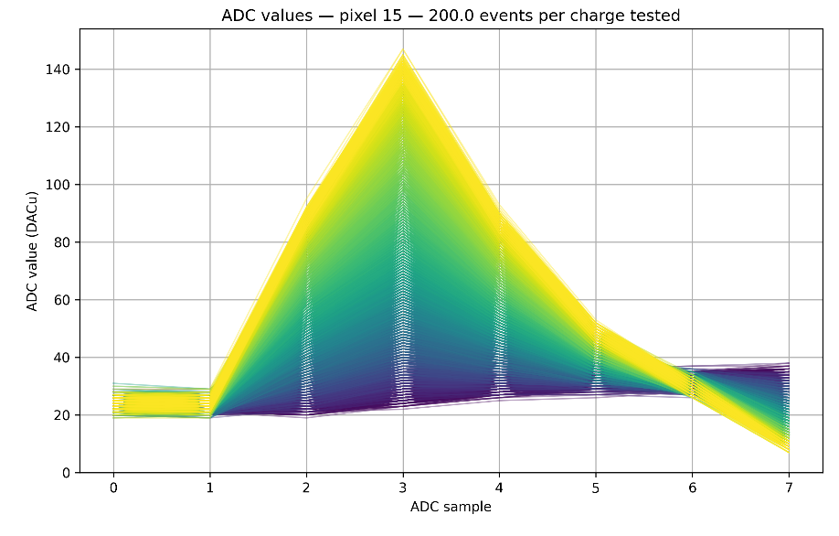
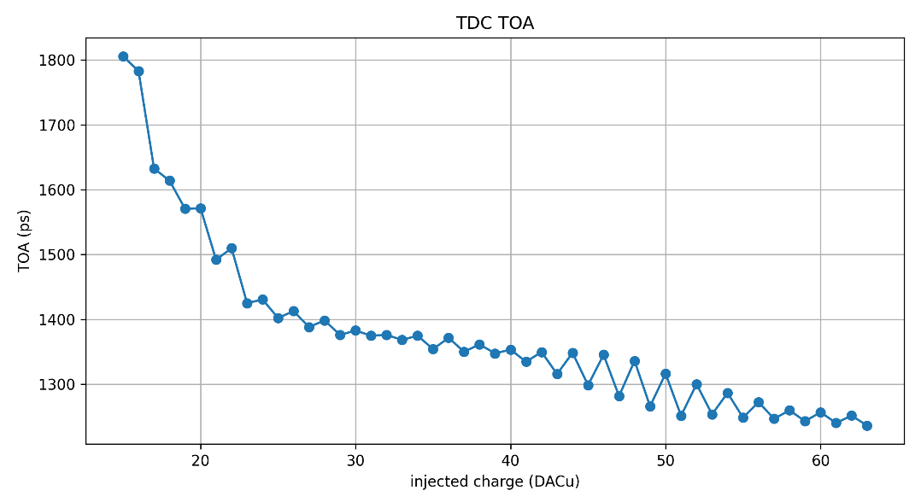
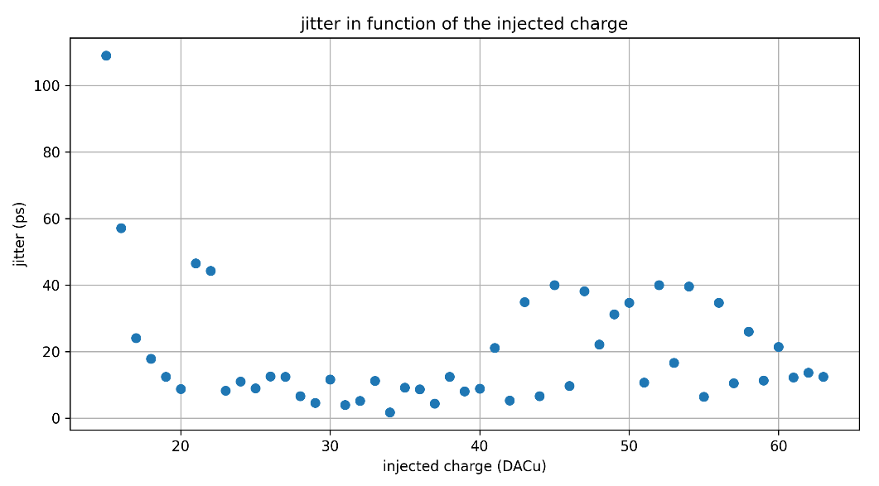
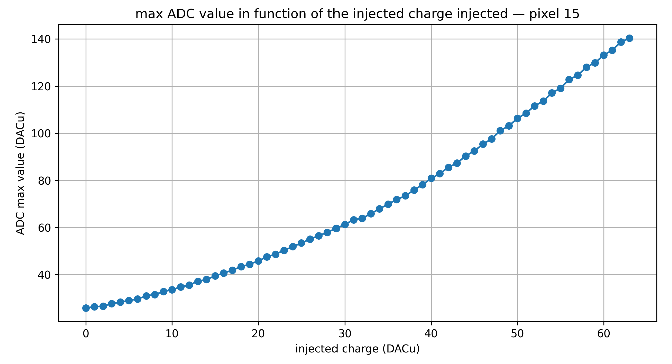
First measurements of EICROC1 ADC&TDC

Slide 22
next EICROC2 (2027)
What is missing in EICROC1 ?
Larger rate compatibility ?
Derandomizer for successive events (how many ?)
Digital on Top (DoT) design for digital power reduction and timing verification on large area : more powerful tools available (UVM)
Auto-trigger and zero_suppressed data
Power reduction if possible below 2 mW/ch
Clermont Ferrand lab has joined to take responsibility for the DoT
Already participated in ATLAS ALTIROC
The design and verification should take ~9 months from now
Technology choice
Seems to converge to 130n provided rate remains low enough

Slide 23

Architecture proposal [A. Soulier et al.]
Goals
Less digital logic possible inside pixel/matrix
Less signals possible between matrix and periphery
Triplication of sensitive circuits (configuration registers for example)
No triplication on data path
Complexity on periphery side, simple logic inside pixel
Proposal : Based on clusters of 4 pixels, controlled by the periphery
Some logic shared at cluster level
Shared data bus between 2 columns
First iteration of this architecture is ready at RTL level, some debug in progress
➔ Physical implementation can reveal new constraints, architecture may change
Triggered Pixel (TP)
Neighbor pixel (TL1)
Busy cluster
Cluster waiting for hit

Slide 24

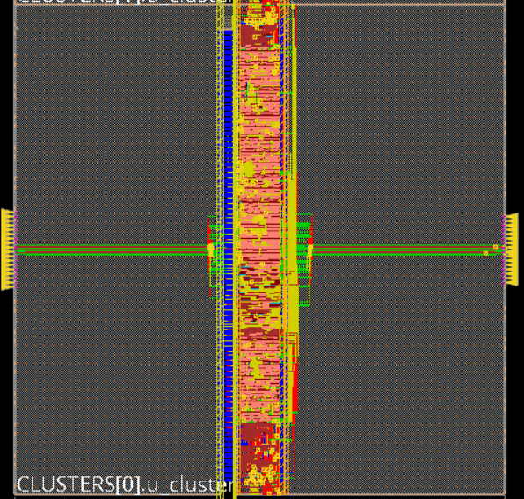
Physical implementation
First physical implementation done in 130nm
Check if we manage to fit digital readout inside pixel
Preliminary layout of the cluster of 4 pixels and the column
Triplication of cluster (probably need some refinement)
Using a pixel_analog_dummy macro, not the real analog front-end
Need more time to validate that this architecture can fit using 130nm technology
Cluster of 4 pixels
Double column

Slide 25
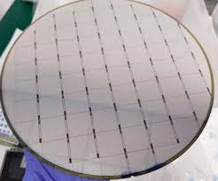
Path towards production and QC
For roman pots ~500 chips would be needed (500 k ch) = 6 wafers
For FToF 10k chips ~100 wafers
EICROC2 should be a final version (all features implemented)
Schedule accomodates a possible EICROC3 to fix bugs in EICROC2
~1 year after EICROC2 tests and system tests complete
Wafer probing station and test setup will be needed
Can be inspired from ALTIROC setup

Slide 26
summary
EICROC now reached full scale 32x32 with EICROC1
Important for analog performance and sensor test
Also allows to progress on system design
Small scale EICROC0s 4x4 still under test to improve performance and reduce power
Tests to start soon with sensors
EICROC2 now needs its digital design DoT : ~6 months design time from now
Responsibility of Clermont Ferrand lab
Main driving specification is power minimization and low hit rate (< 100 Hz/pixel)
Submission in Engineering run in TSMC130n Q1 2027
System tests will be (as always) an important input for chip(s) finalization

Slide 27
backup

Slide 28
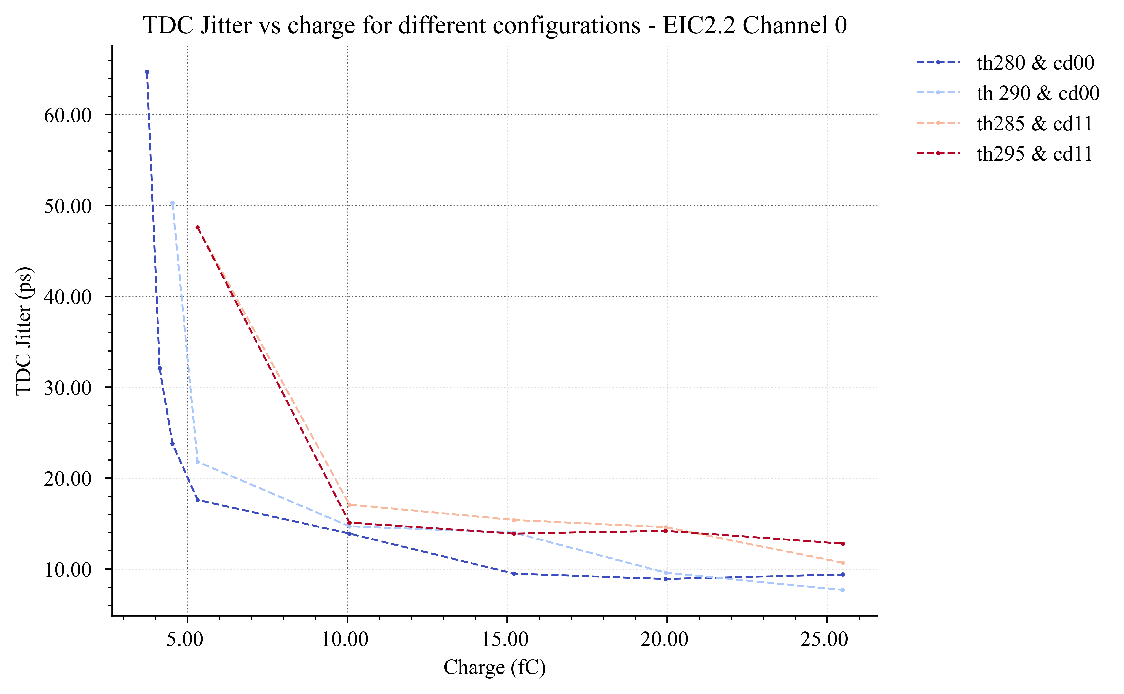

EICROC0 : discriminator jitter measured on probe
Measurements done with the oscilloscope

Slide 29


ePIC Detectors & Far-Forward Region
electron beam
Zero Degree Calorimeter
p/A beam
Luminosity
System
Low-Q2 Taggers
B0 Magnet
Spectrometer
Off-Momentum Detectors (OMDs)
Roman Pots (RPs)
Far-Forward Region
Far-Forward detectors are essential to measure exclusive processes, as Deep Virtual Compton Scattering (DVCS) ➜ Generalized Parton Distributions (GPDs)
Roman pots (RP)
Detect particles scattered at very small angle (< 5 mrad)
Required to measure exlusive processes on proton targets
DVCS, DVMP…
All the channels relevant to GPDs of quarks and gluons
Off-Momentum Detectors (OMD)
Detect small angle particles with a different rigidity than the beam
Access angles down to 0 for rigidity < 0.65
Necessary for all tagged measurements
Study of nuclear effects
Effective neutron target

