Slide 1





XIII FEE Workshop 2026 - Paris
A Low-Power Fully Depleted Monolithic CMOS Pixel Detector with Time and Charge Measurement
for Space-Based Compton Imaging
Matteo Barbagiovanni^{(1,2)} on behalf of the Space it Up! collaboration
Politecnico di Torino⁽¹⁾ / INFN Sezione di Torino⁽²⁾

Slide 2
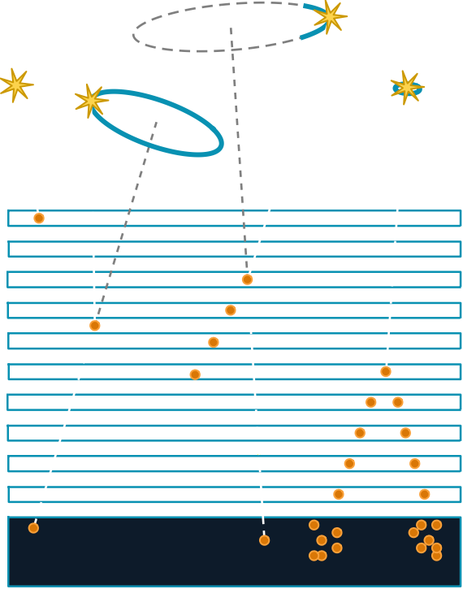
MOTIVATION & CONTEXT
Space Compton Telescope
Science Driver
MeV Gap
Target the MeV gap (100 keV – 1 GeV) currently invisible to Fermi-LAT (20 MeV – 300 GeV) → AMEGO-X
Needed for studying extreme accelerators and multimessenger sources, including supermassive black hole jets (blazars), binary neutron star mergers (gravitational wave counterparts), and Galactic supernovae
Detection Principle
Characterize gamma-rays:
Single-site (< 100 keV)
Increases sensitivity for low-energy transients, just triggers one pixel (Photo-electric effect)
Compton Scattering (< 10 MeV)
Measures the energy and position of the interaction to determine the initial scatter angle (ϑ)
Pairs Production (> 10 MeV)
Tracks the electron-positron pair to reconstruct the incident photon's direction
Single-Site event
Untracked Compton
event
Tracking Planes
Tracked Compton
event
Pair event
Calorimeter
1

Slide 3
MOTIVATION & CONTEXT
Space Compton Telescope
Science Driver
MeV Gap
Target the MeV gap (100 keV – 1 GeV) currently invisible to Fermi-LAT (20 MeV – 300 GeV)) → AMEGO-X
Needed for studying extreme accelerators and multimessenger sources, including supermassive black hole jets (blazars), binary neutron star mergers (gravitational wave counterparts), and Galactic supernovae
Requirements:
Low power consumption < 10 mW/cm²
6.25 μW/channel @ pitch 250 μm
High input energy dynamic range [10¹, 10⁹] keV
Low rate 10 Hz/cm²
Low noise SNR > 10 & ENC < 200 e⁻
Timing Resolution 200 ns rms
Energy Resolution 10% @ 60 keV
Space graded working range [-35, 50]°C
Single-Site event
Untracked Compton
event
Tracking Planes
Tracked Compton
event
Pair event
Calorimeter
2

Slide 4
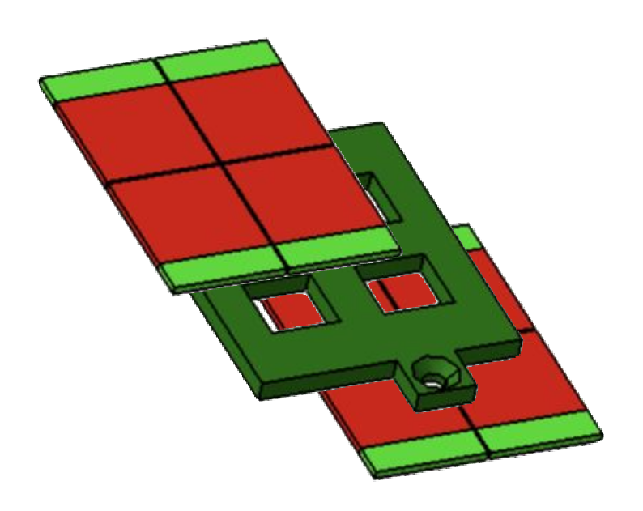
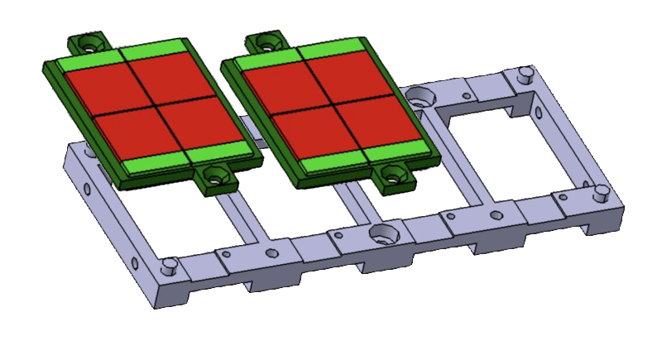
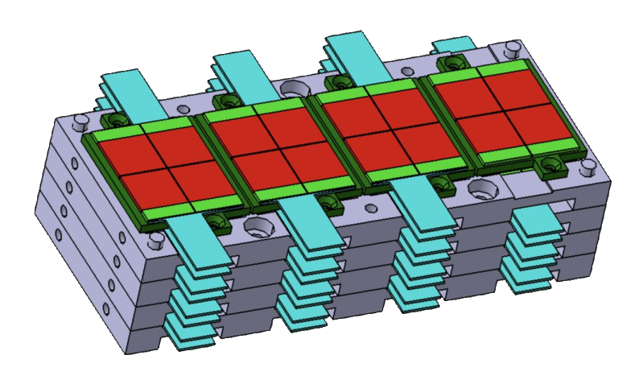
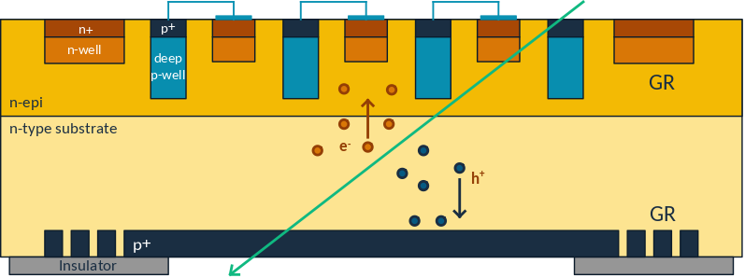
MOTIVATION & CONTEXT
Why a MAPS for space-borne γ-ray detection?
ARCADIA FD-MAPS
Monolithic integration
Sensor + Readout on same wafer
Electronics buried in deep p-wells
ARCADIA heritage
110 nm CMOS custom process (LFoundry)
N-type high resistivity active region
Backside reverse biased juction
Fully Depleted (FD)
Depletion grows up to the top
N-type epitaxial layer to limit punch-through current
Proven up to 400 µm FD substrates
>500 µm - thick FD-MAPS
Increase the interaction probability (stopping power)
Maintain low power consumption
Pixel Matrix
Chip Tiling
Pixel
MIP
Multi-plane HICs
3

Slide 5
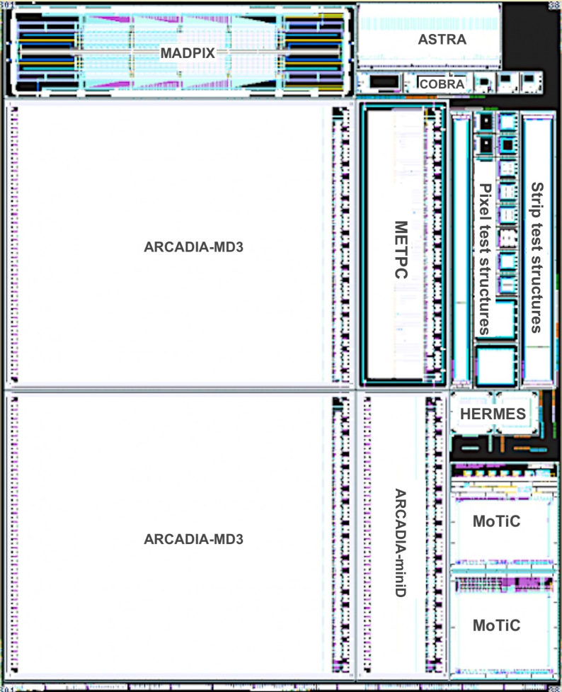
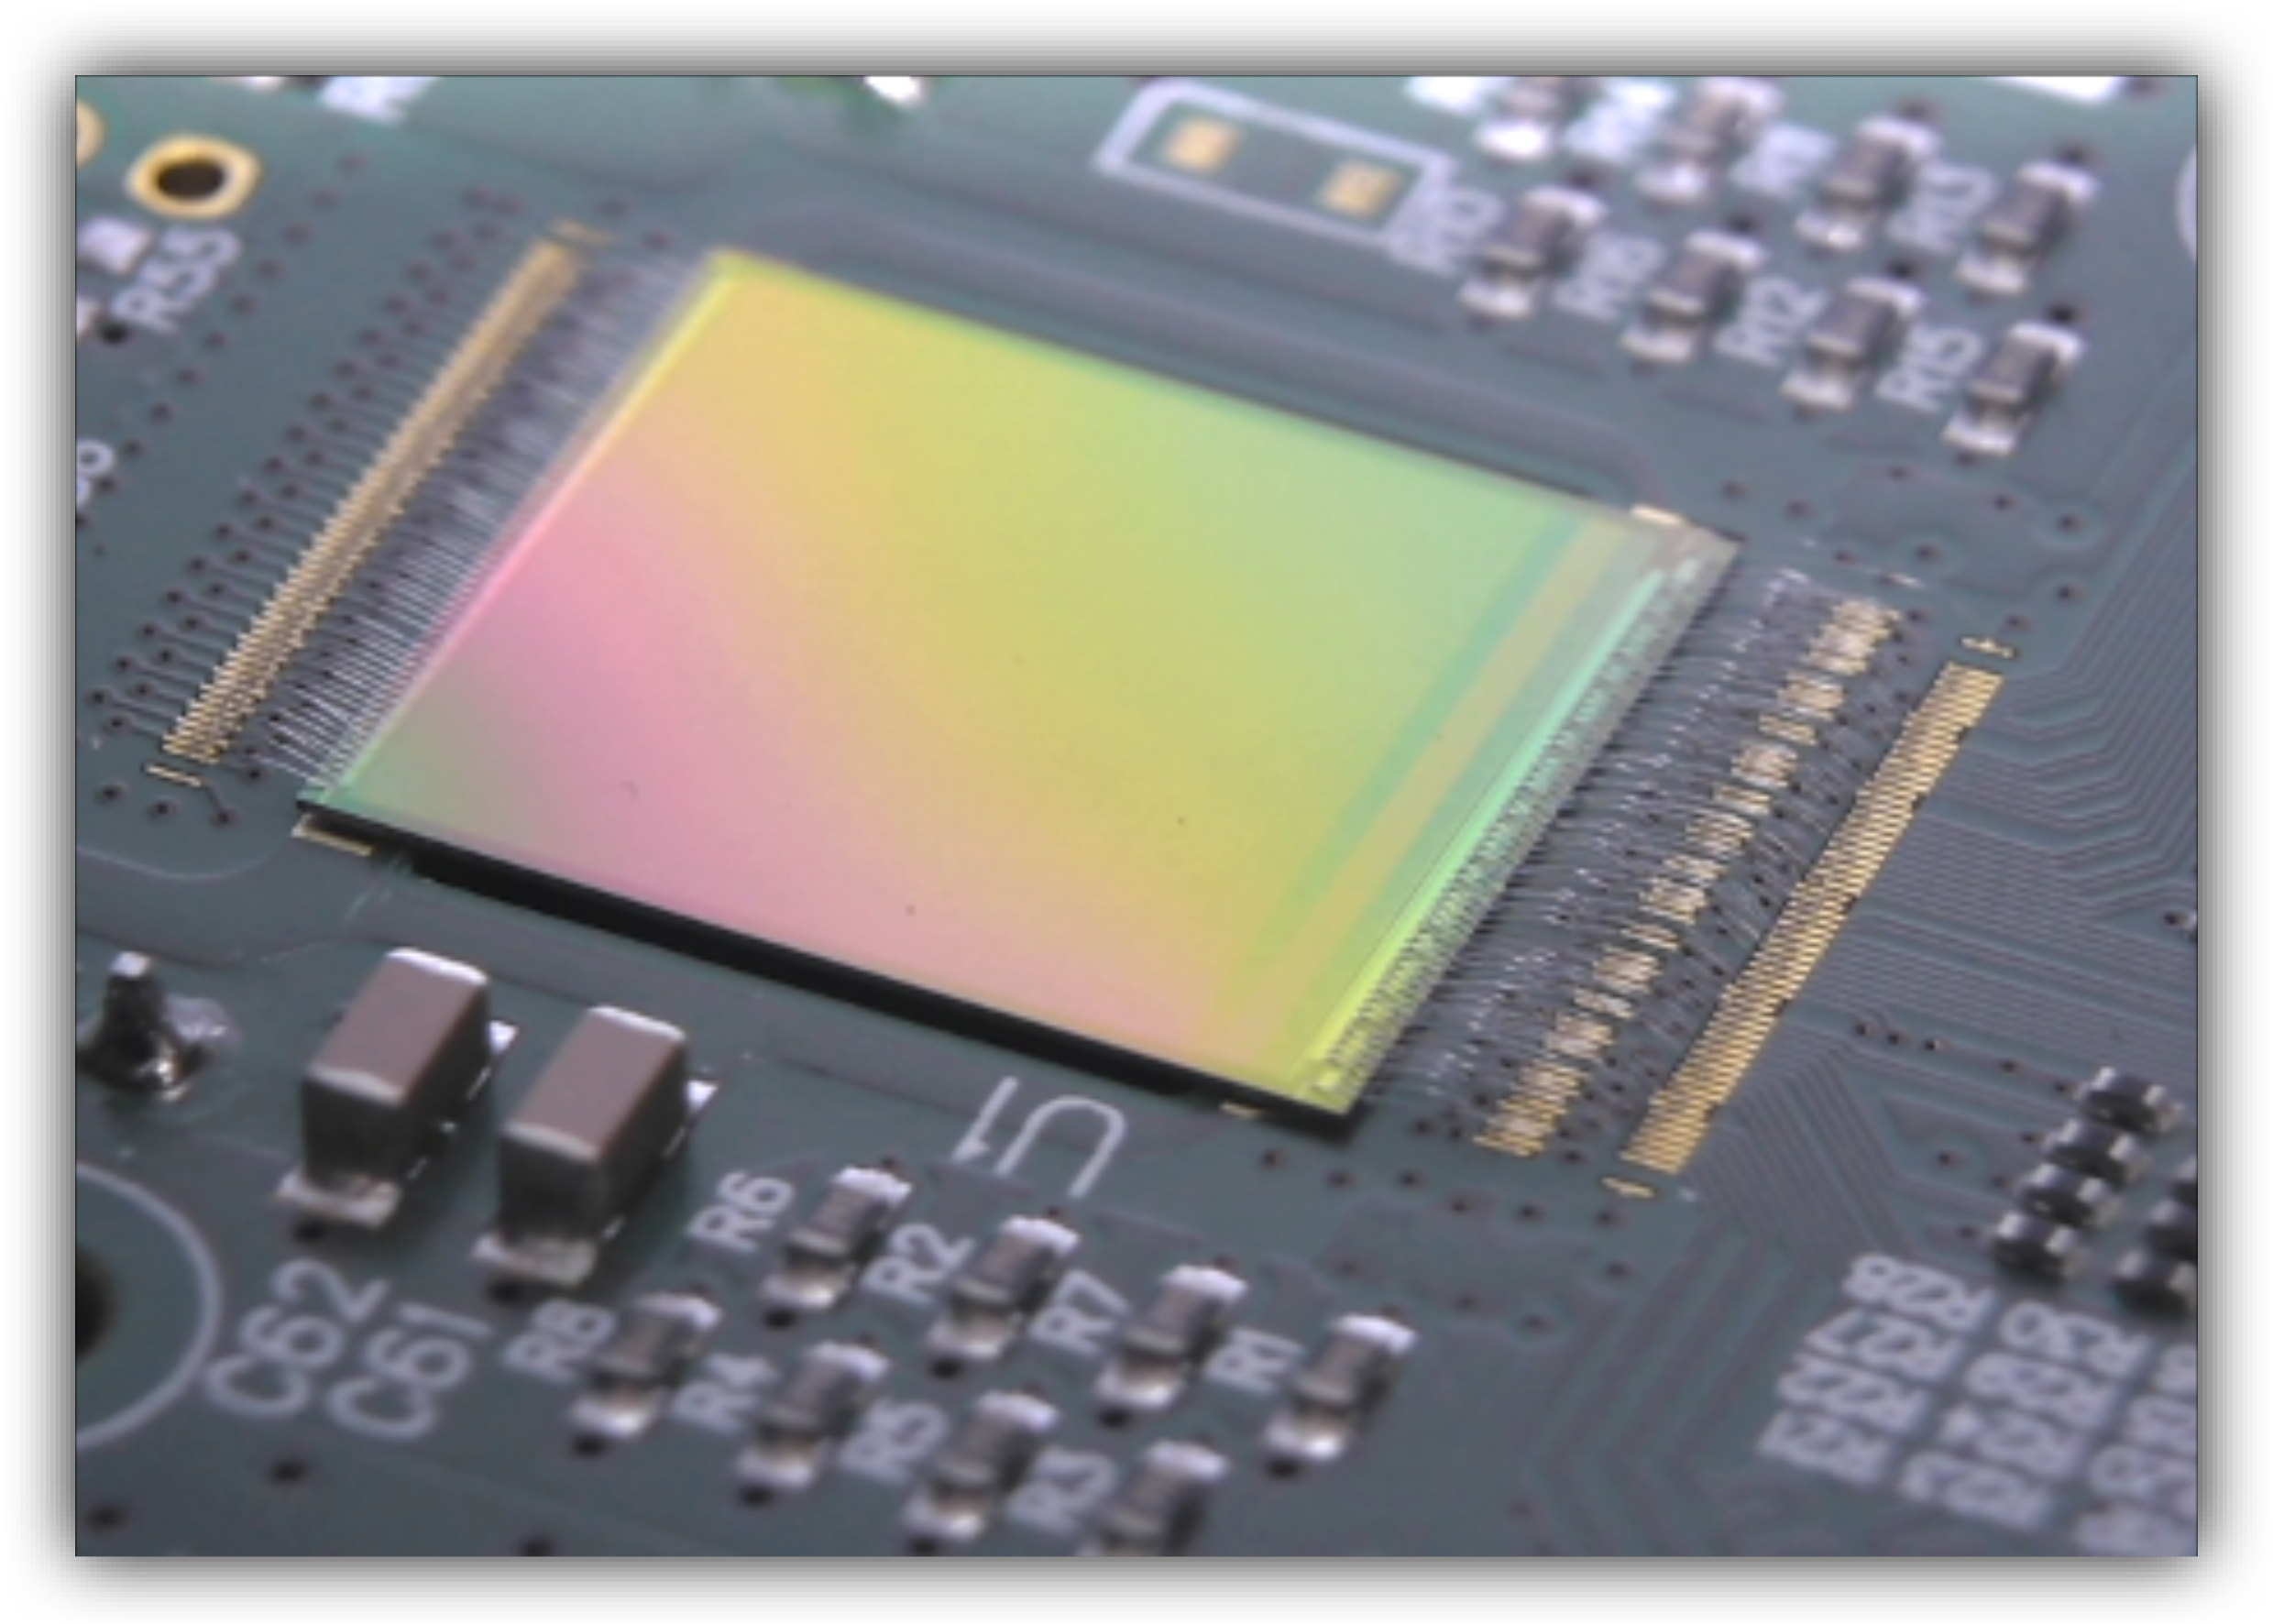
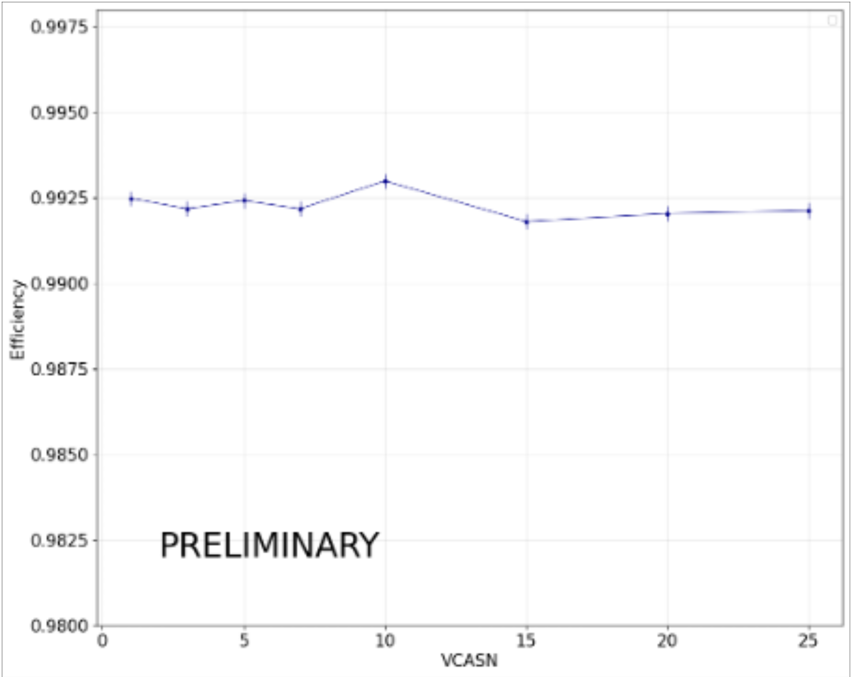
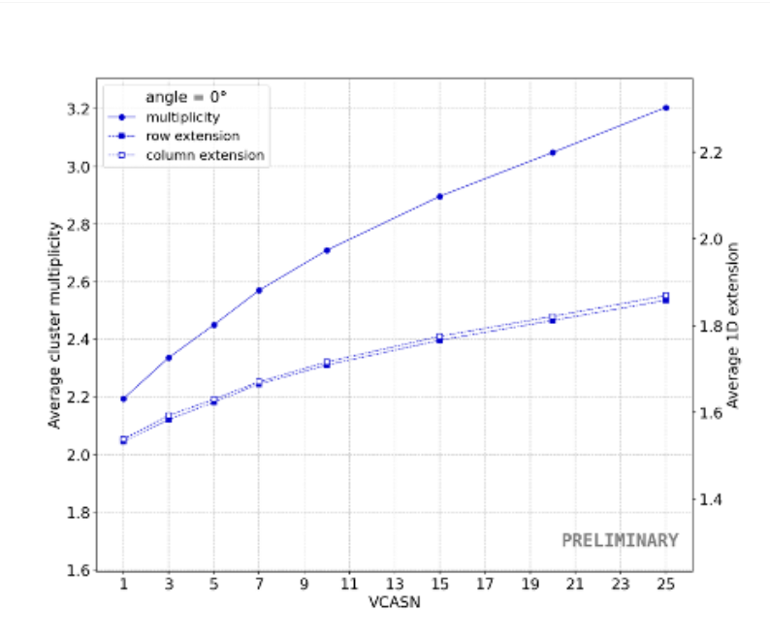
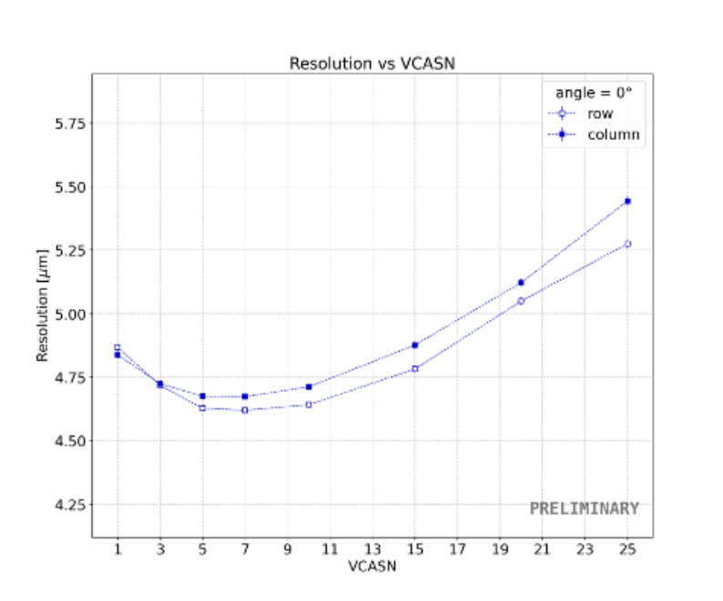
MOTIVATION & CONTEXT
ARCADIA Collaboration
Advanced Readout CMOS Architectures with Depleted Integrated sensor Arrays · INFN CSN5
Technology Platform
R&D in semiconductor sensor technology IP-core design,
mixed-signal ASICs, and advanced DAQ systems
all on the INFN-LFoundry 110 nm CIS process
Applications
High-energy particle physics (vertex & tracking), astroparticle physics in space, medical instruments, nuclear imaging & dosimetry
Key Achievements
High-granularity MAPS down to 5 µm spatial resolution
System-ready MD3 demonstrator
512×512 pixels, 1.64 cm²,
17 mW/cm² in low-rate mode
CMOS LGAD targeting timing performances better than 20 ps rms
Monolithic strip sensors with embedded electronics for space-borne applications
MD3
Test beam at FNAL with 120 GeV protons
Single-point resolution ~ 4.7 μm
average efficiency 99.23%
Detection Efficiency
Cluster Size
Resolution
V_{th}
V_{th}
V_{th}
4

Slide 6
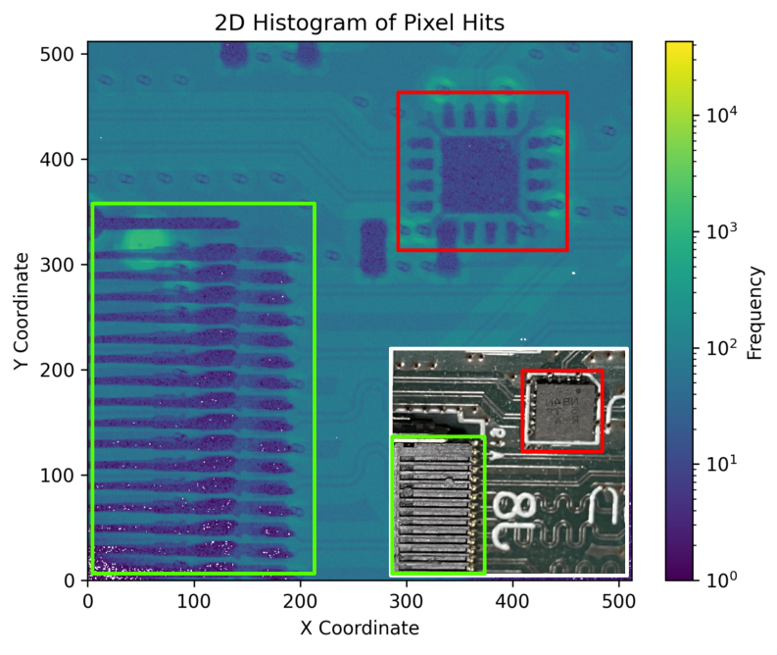
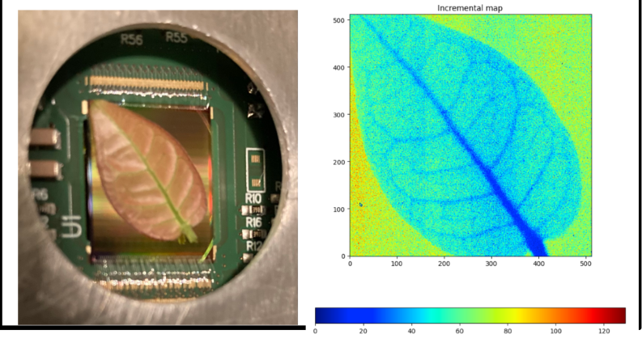
MOTIVATION & CONTEXT
ARCADIA Collaboration
Advanced Readout CMOS Architectures with Depleted Integrated sensor Arrays · INFN CSN5
Technology Platform
R&D in semiconductor sensor technology IP-core design,
mixed-signal ASICs, and advanced DAQ systems
all on the INFN-LFoundry 110 nm CIS process
Applications
High-energy particle physics (vertex & tracking), astroparticle physics in space, medical instruments, nuclear imaging & dosimetry
Key Achievements
High-granularity MAPS down to 5 µm spatial resolution
System-ready MD3 demonstrator
512×512 pixels, 1.64 cm²,
17 mW/cm² in low-rate mode
CMOS LGAD targeting timing performances better than 20 ps rms
Monolithic strip sensors with embedded electronics for space-borne applications
MD3
Molybdenum K_{α1} and K_{α2} X-rays (17 keV)
X-ray microfocus (up to 140 keV) for radiography and CT setups
5

Slide 7
System Architecture

Slide 8
SYSTEM ARCHITECTURE
Top-level block diagram
Grouping
Macropixels composed of 2x2 pixels
Low Hit occupancy
Cluster size
Resource sharing
Wilkinson ADC
Common Logic
EOC
Sparse Readout
Timestamping
Global coarse timestamp
Local fine-time
Final data 24 bit words
Address
Fine Time
Energy Value
MacroPixel
Pixel
Addr
Addr+Energy
32x32
▶
▶
Energy
Config
ADC
▶
Serializer
▶
EOC
TimeFlag
Addr+Time
▶
▶
16×16
Pixel
MacroPixel
Serializer
EOC
250×250 µm²
CSA
PDH
Discriminator
▶
2×2 pixels
Shared ADC
FE Logic
*Serializer
▶
24-bit words
DDR - 12 CLK
16 ser./chip
▶
Time reconstruction
Sparse readout
Configuration
Data flow →
← Configuration (token ring)
▶
6

Slide 9
DIGITAL WORKING PRINCIPLES
Macropixel Event Handling
Word Transmission
24-bit words in DDR, same line for charge and time
Async trigger storage
Event fires → pixel stores arrival word position (0-11) and word counter at arrival (0-5), pixel is immediately blocked
Round Robin scan
Two indipendent pointers scan all 4 pixel registers looking for valid events
Priority TIme > Charge
Pixel release
After both time and charge are transmitted the pixel is unblocked and ready for the next hit
Pixel Register State
Time Path
Pixel | Arr. word pos. | Word Ctr. | Time | Charge
00 | bbbb | bbb | 1 | 1
01 | bbbb | bbb | 1 | 1
10 | bbbb | bbb | 1 | 1
11 | bbbb | bbb | 1 | 1
12 clk cycles per word
Transmit counter (0-11) encodes sub-word phase
Word counter (0-5) encodes inter word delay
Charge Path
Time and charge information
are processed in parallel if present
↓
Round Robin Processing
ADC digitizes pixel analog memory
Up to 256 cycles ADC conversion
Up to 256 clk cycles
Charge
ADC
12 clk cycles
Time
Serializer
7

Slide 10
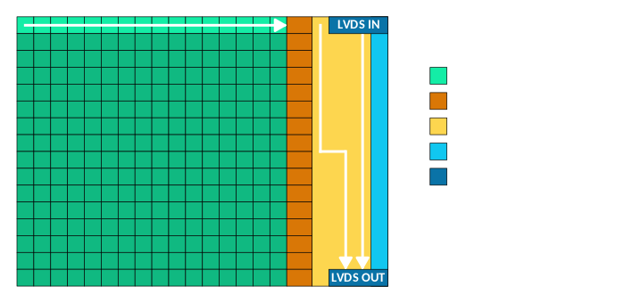
DIGITAL WORKING PRINCIPLES
Timing Reconstruction in EOC
EOC timing reconstruction
T_event = T_global − (N_words_waited + 1) × T_word − (12 − transmit_counter)
Word arrives with fixed delay (calibration routine at startup) on a dedicated wire (Macropixel to EOC)
Global timestamp is latched at EOC on time word arrival
Transmit count track position within the current word
Word counter counts how many words elapsed since event
IDLE
OTHER
OTHER
TIME WORD
IDLE
Time to subtract
Event Arrival
EOC receives event time word
8

Slide 11
Sensor Design

Slide 12
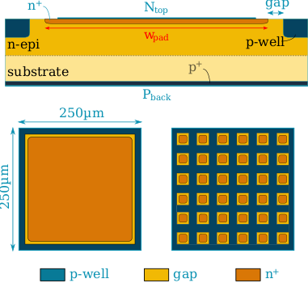
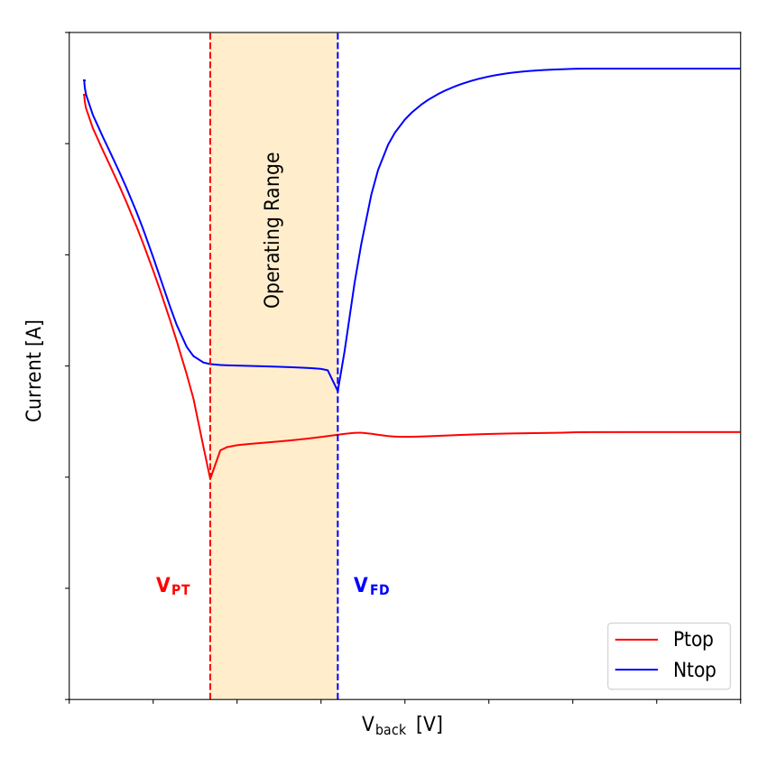
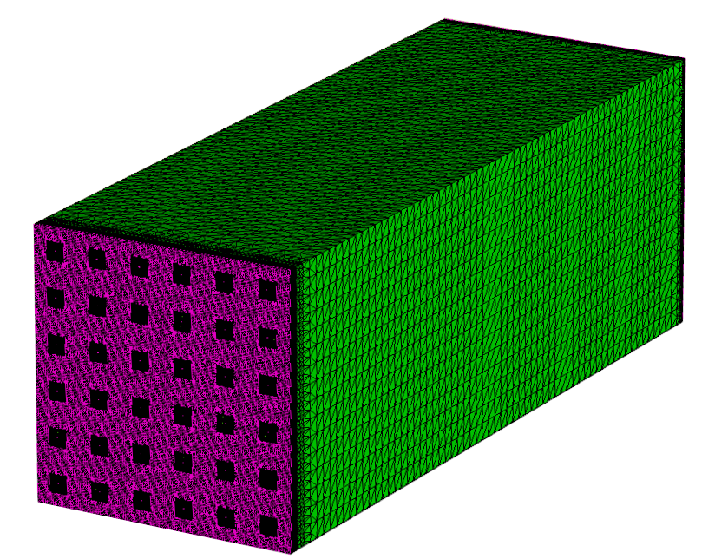
SENSOR DESIGN
Fully depleted n-on-n sensor structure
Synopsys TCAD Sentaurus simulations — 110 nm LFoundry process
Cross-section schematic
Design choices
Pitch → 250 μm → 6.25 μW/channel
Limit the number of channels for power constraints
No sacrifice on reconstruction capabilities
Thickness → 715 μm
Electrical Characterization
On going tests on new substrates
Capacitance → < 250 fF
gap optimization
p-well/n⁺ ratio
Pixel Layout
Single pad
Subpixels
9

Slide 13
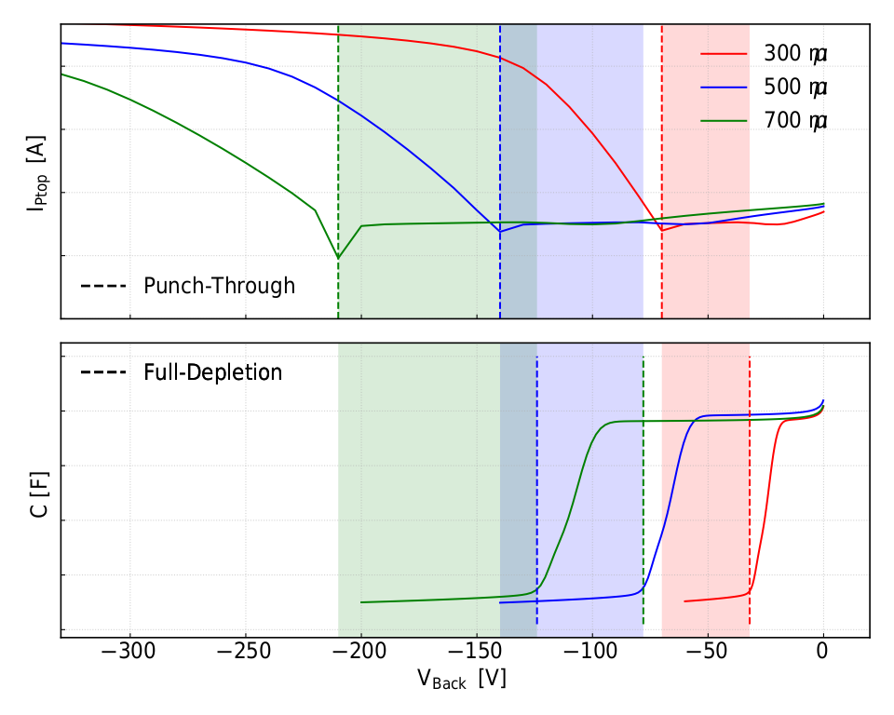
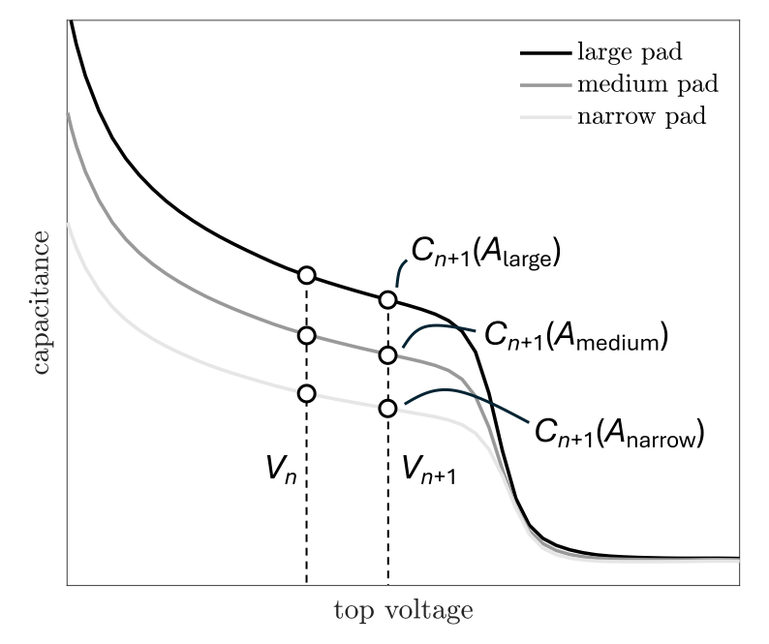
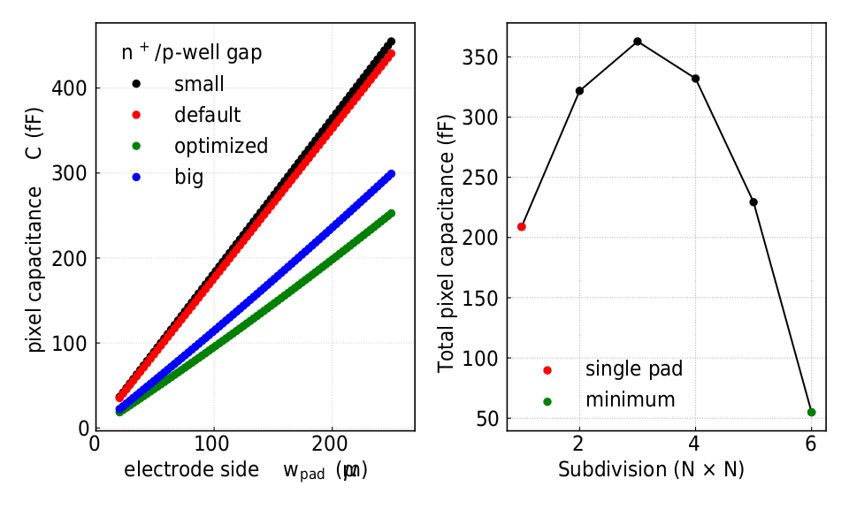
SENSOR DESIGN
Sensor Layout Optimization
Key figure of merit: lateral n⁺/p-well junction capacitance
Electrical Characterization
PT shifts with thickness but remains accessible across 300-700 μm.
C(V) identified FD as capacitance plateau; well-defined working range also for 700 μm.
Thickness [μm] | V_{Full Depletion} [V] | V_{Punch-Through} [V]
300 | 30 | 70
500 | 80 | 140
700 | 125 | 210
Predictive Capacitance Modeling
Developed geometry-based models to accelerate layout optimization
Main capacitance contribution is the lateral one for the
n⁺/p-well junction
Gap optimization leads to half of the capacitance wrt default value
Segmented pixels increase perimeter capacitance until 6×6 sub-pixel layouts improve scaling — but routing complexity and parasitic capacitance grows
10
Key findings
Segmented pixels increase perimeter capacitance until 6×6 sub-pixel layouts improve scaling — but routing complexity grows
Single-pad selected: superior field uniformity, simpler routing, space for MIM decoupling capacitor
C(V) sweep identifies full depletion as capacitance plateau; working range well-defined for all thicknesses up to 700 µm
Punch-through sets upper bias limit — shifts with thickness but remains accessible across 300–700 µm range

Slide 14
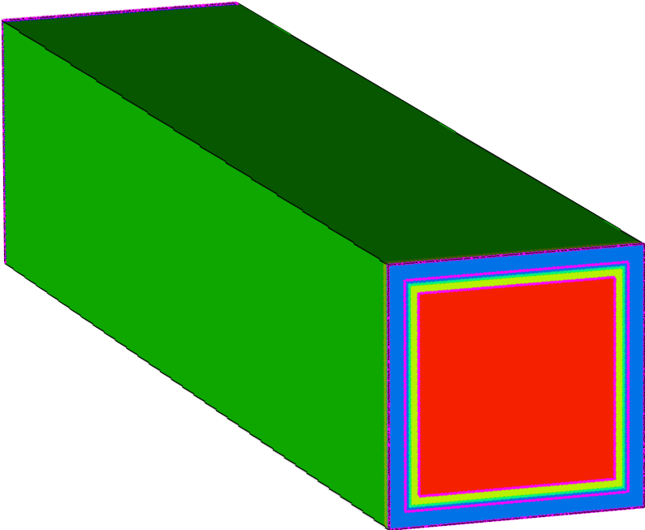
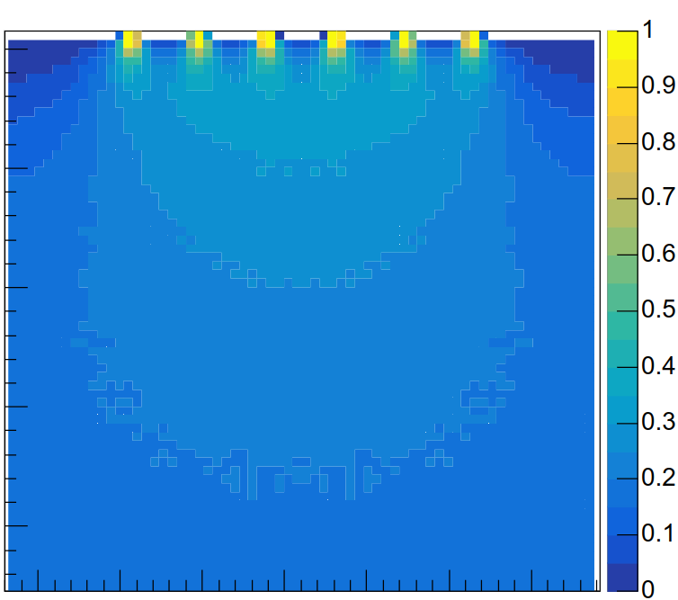
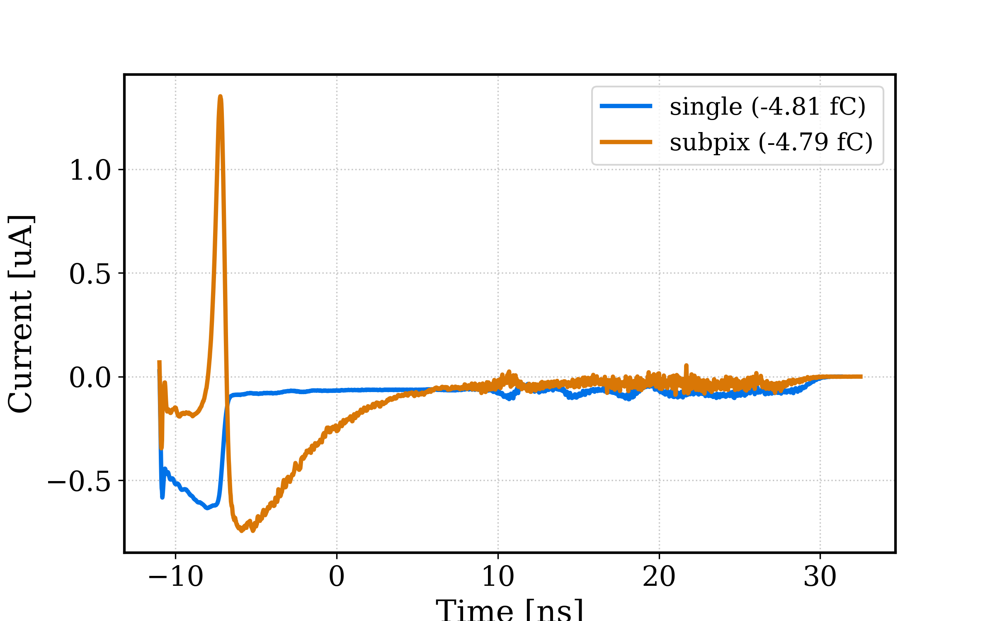
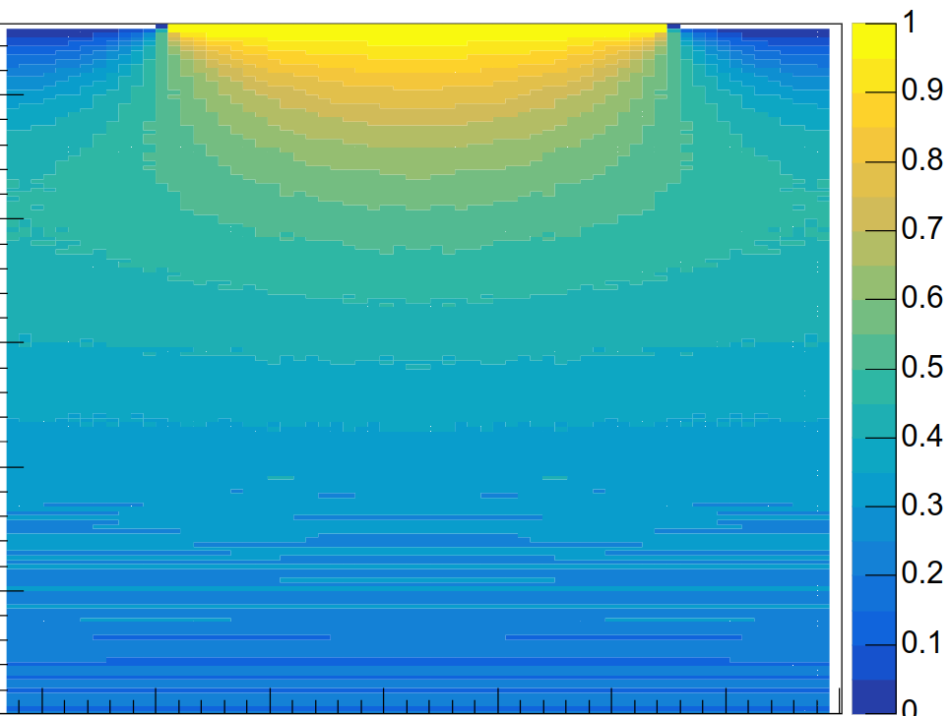
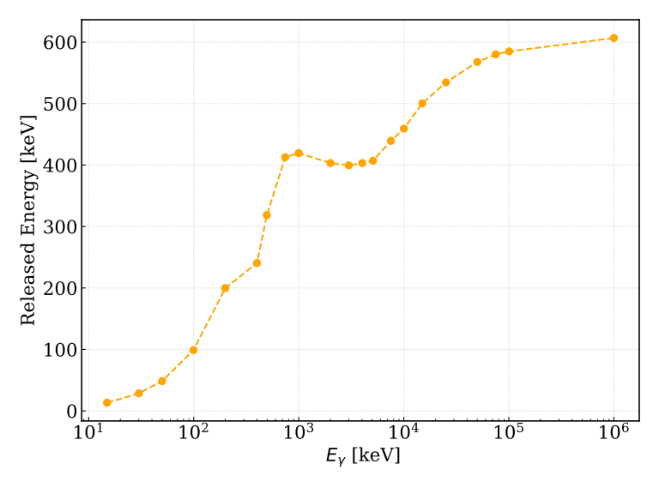
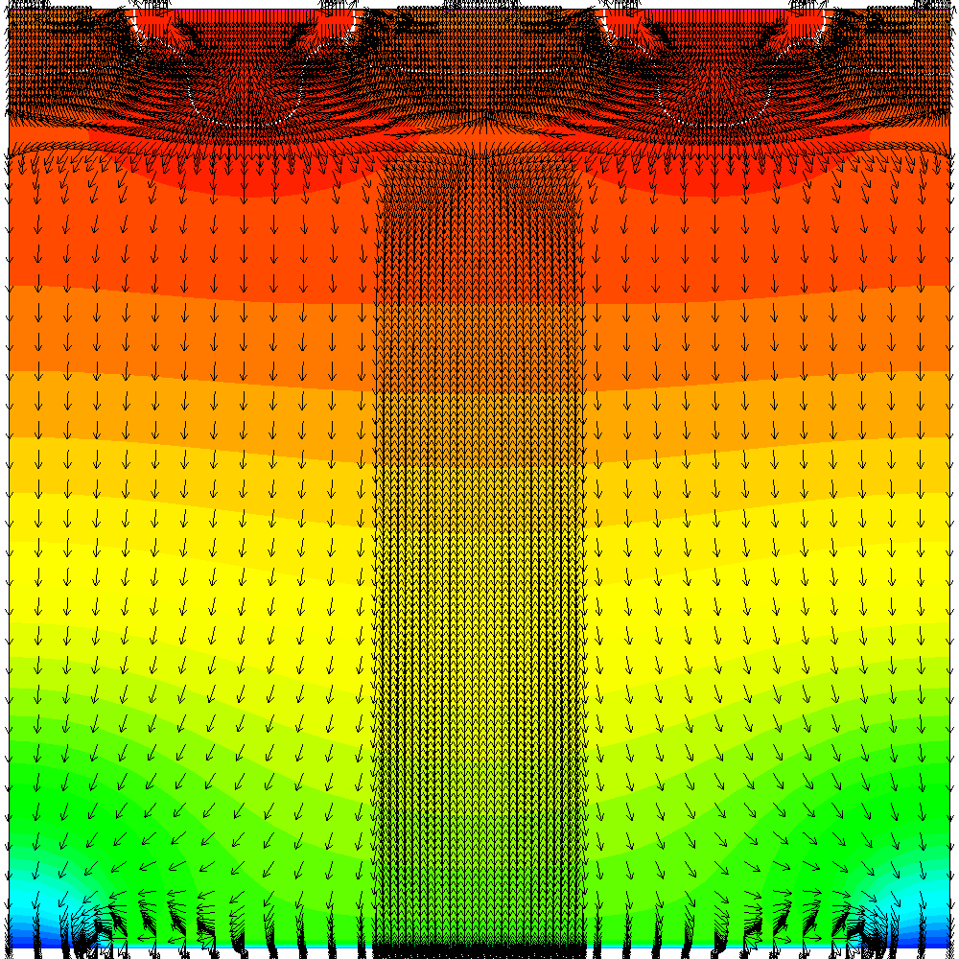
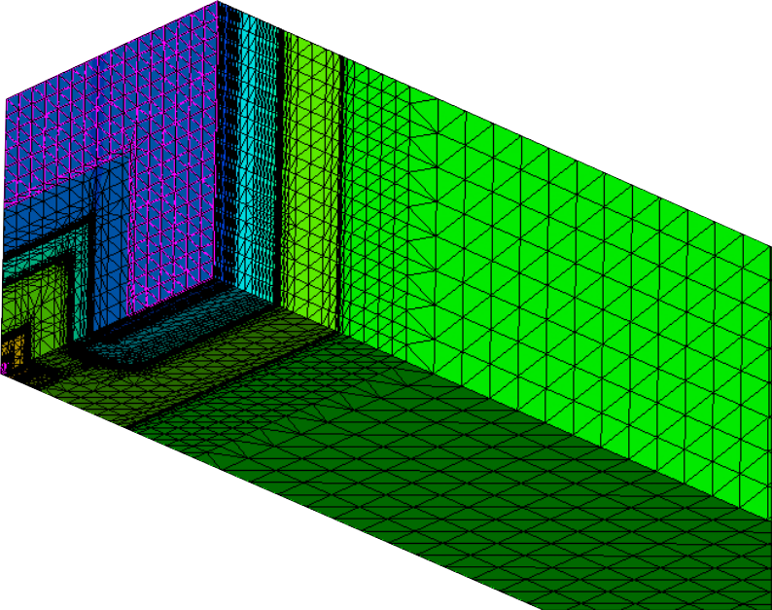
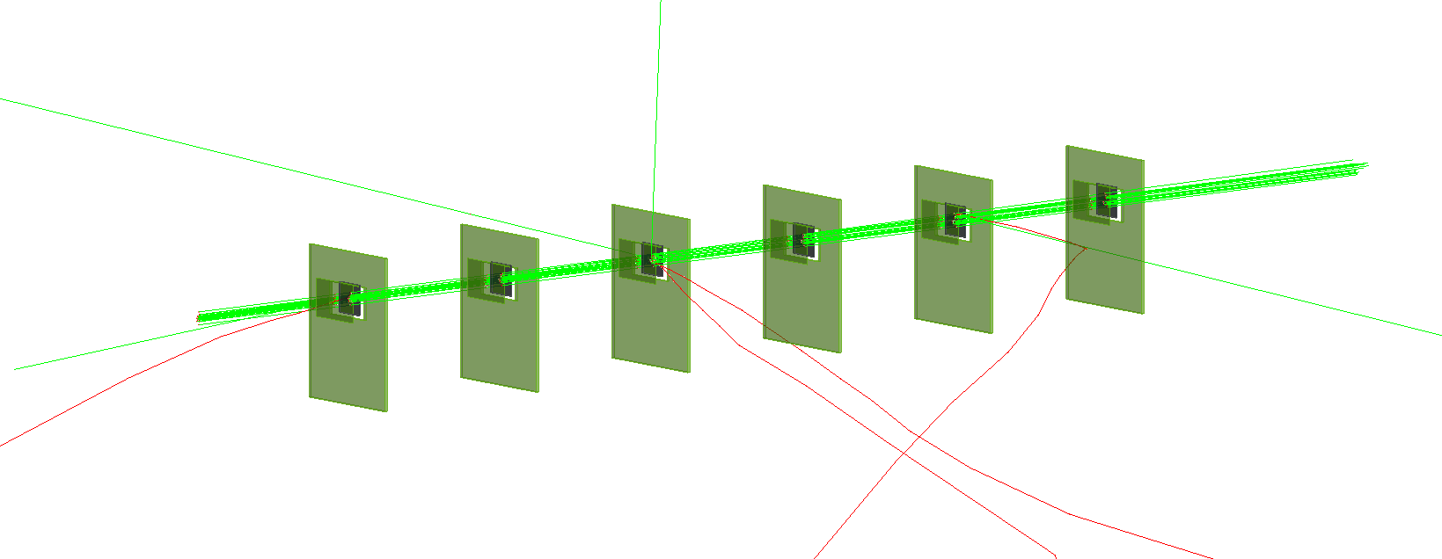
SENSOR DESIGN
Sensor MC Testing
Allpix signals for 30 ke⁻ released at 100 μm
Depth at the center of one pixel
TCAD
Device layout and simulation → export following maps
Doping Concentration
Electrostatic Potential → Weigthing Potential
Electric Field
Monte Carlo Framework
Particle transport and interactions simulations
Energy deposition and ionization modeling
Charge carrier drift and signal induciton computations
50 fF
200 fF
99th percentile of Energy released in one pixel
E_{γ} [keV] | 99th percentile [keV]
1e1 | 10 → 3k e⁻
1e3 | 400 → 110k e⁻
1e4 | 450 → 125k e⁻
1e5 | 570 → 160k e-
11
Key findings
Signal Integrity
Unipolar signals ensure full charge collection without cancellation effects from bipolar induction — critical for accurate energy and timing measurements
Weighting Potential Uniformity
More uniform weighting potential across the pixel area means the induced signal is less dependent on the track hit position, giving consistent response over the full 250 µm pitch
Charge Collection Equivalence
Since integrated collected charge is identical between the two layouts, the capacitance penalty (200 fF vs 50 fF) is the only real drawback of the single pad — and it is a known, manageable trade-off
Simpler Signal Processing
Unipolar pulses are easier to threshold, integrate, and time-stamp; bipolar signals require more careful shaping and can cause baseline shifts or undershoot at high rates
Reduced Risk of Partial Signal Loss
In bipolar signals, if the negative lobe is clipped or the shaping time is poorly matched, net collected charge is underestimated; the single pad avoids this risk entirely
Design Simplicity & Yield
A single large pad has no inter-subpad routing, fewer lithographic constraints, and is more robust against process variation in a thick fully-depleted substrate
Thickness [μm] | V_{Full Depletion} [V] | V_{Punch-Through} [V]
300 | 30 | 70
500 | 80 | 140
700 | 125 | 210

Slide 15
Front-End Implementation

Slide 16
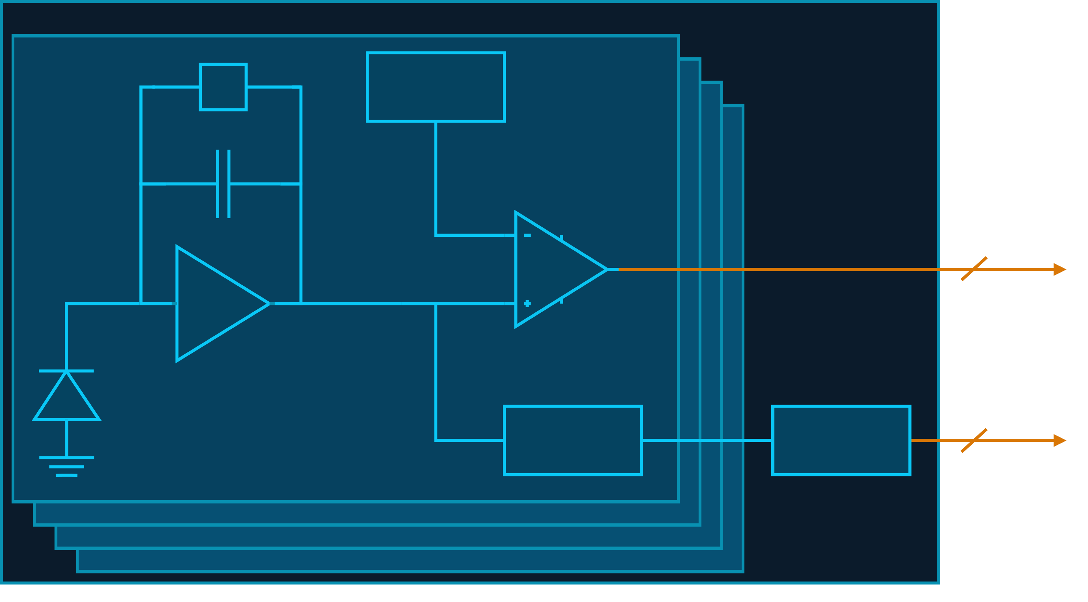
FONRT-END IMPLEMENTATION
Pixel Architecture Overview
MacroPixel
Sensor Capacitance
Single pad layout → 200 fF
Dynamic Range
3k - 160k electrons in sensor
Focus on 3k - 100k electrons
Temperature Range
Space grading → [-35,50] °C
PreAmplifier
CSA
TP injection
Energy Branch
Peak Detector and Hold circuit
Shared Wilkinson ADC
Time Branch
Timing Discriminator
Pixel
Rf
DAC
Cf
Time Flag
CSA
Discriminator
Energy
PDH
ADC
Pixel
MacroPixel
Serializer
EOC
250×250 µm²
CSA
PDH
Discriminator
▶
2×2 pixels
Shared ADC
FE Logic
*Serializer
▶
24-bit words
DDR - 12 CLK
32 ser./chip
▶
Time reconstruction
Sparse readout
Configuration
Data flow →
← Configuration (token ring)
▶
12

Slide 17
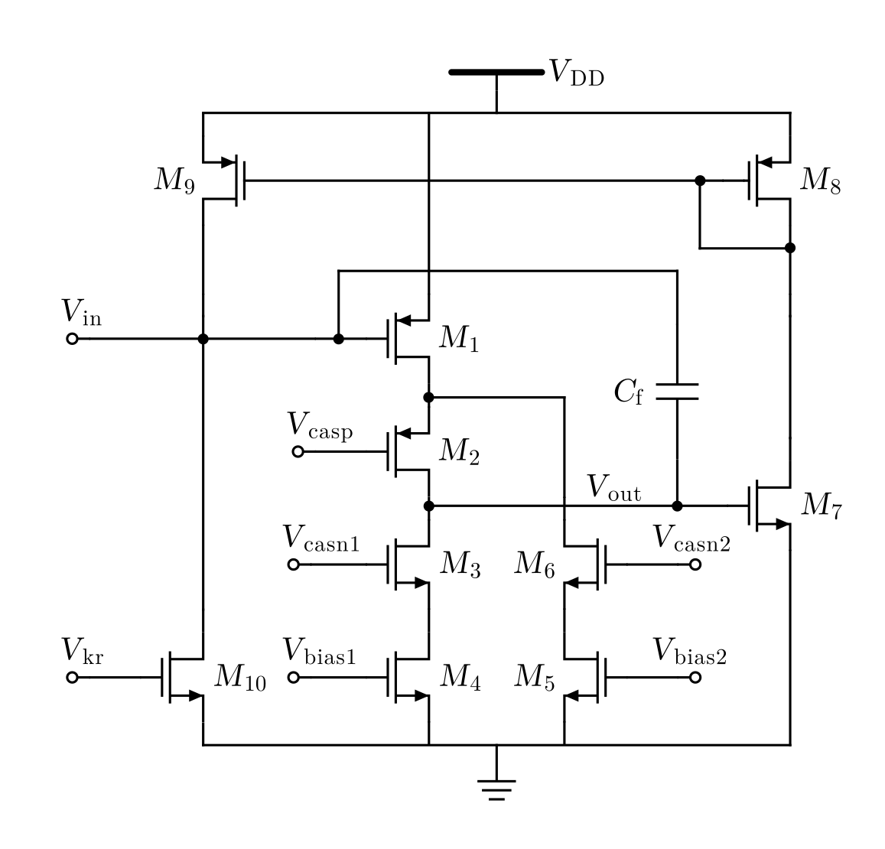

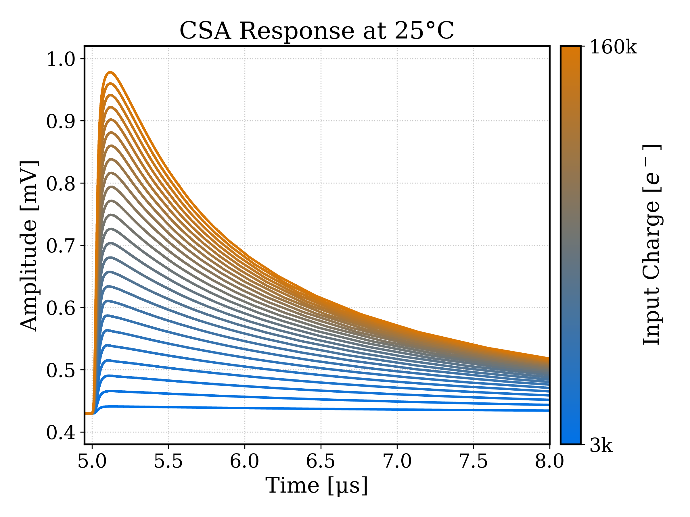
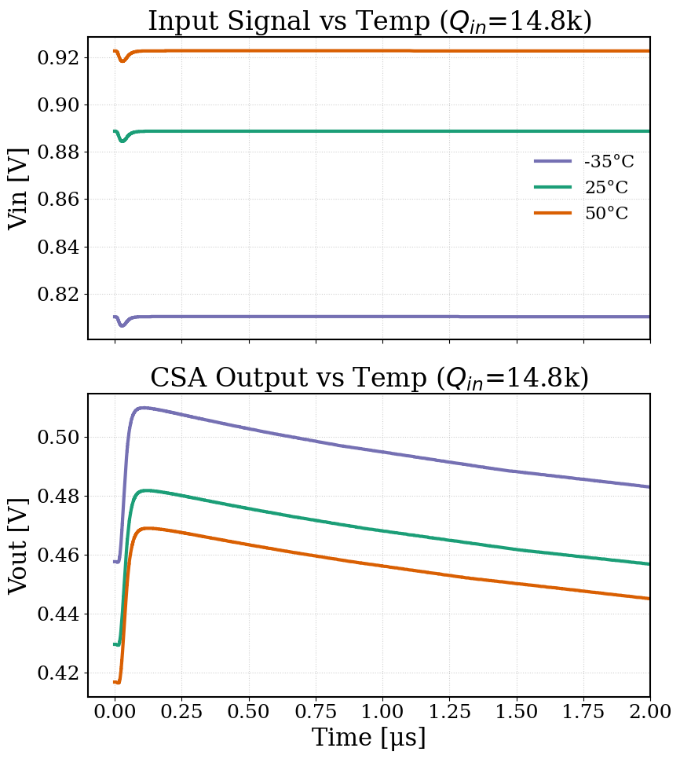
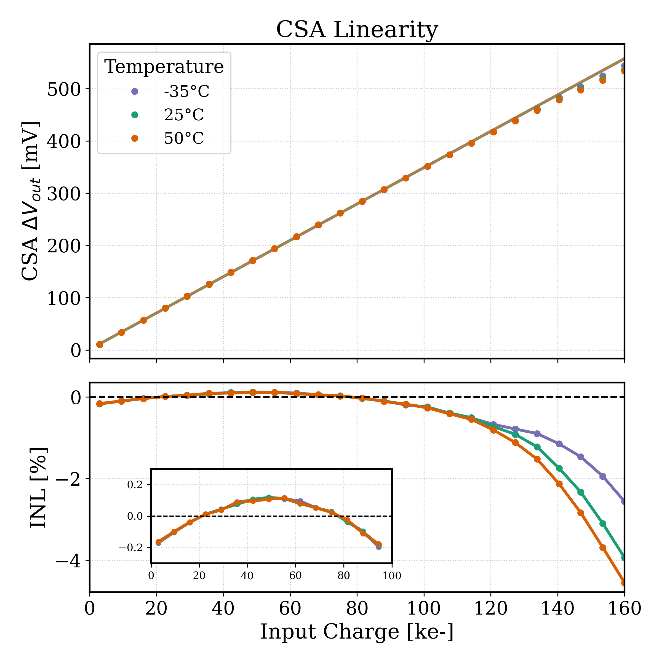
FRONT-END IMPLEMENTATION
Charge Sensitive Amplifier
1.2 μW
CSA Features
Telescopic cascode with split bias current branch and PMOS input transistor
C_{Detector} = 200 fF
C_{Feedback}= 45 fF → expected gain 22 mV/fC
[3, 160] kelectrons input → [10, 570] mV output swing
Sensor cathode needs at least 0.7 V bias
Active feedback network to give enough room for the output
τ_{RC} = 3.5 μs
Peaking Time = 150 ns
CSA Simulations
DC Levels:
V_{in} > 0.8 V
V_{out} ~ 450 mV
V_{out} ~ 40 mV change
Need for baseline holder
Linearity:
21.8 mV/fC measured gain
INL ± 0.2% @ [3-100] ke⁻
13

Slide 18
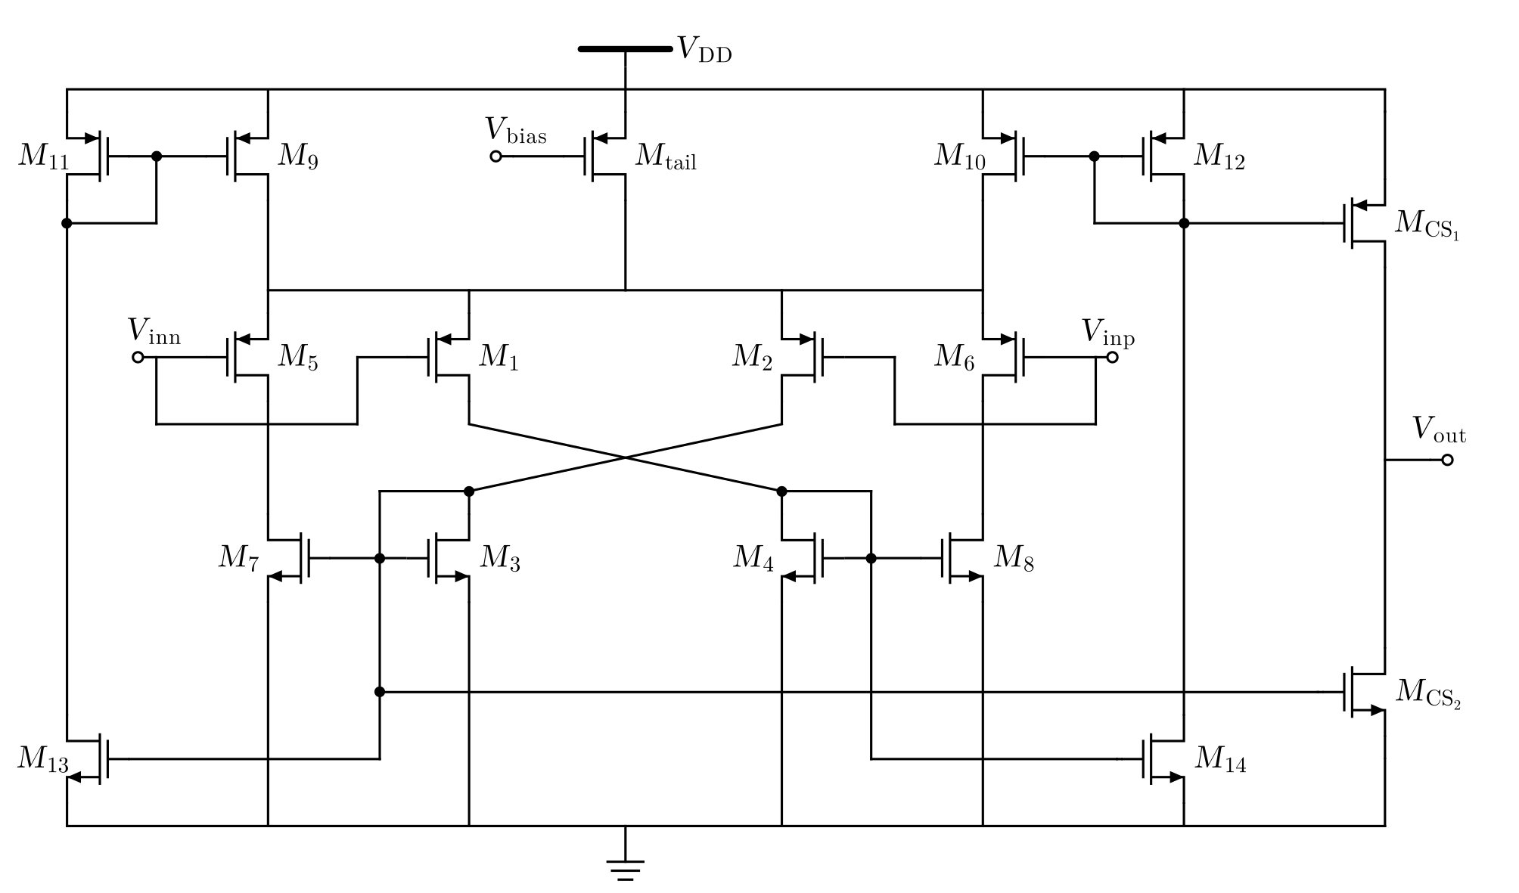
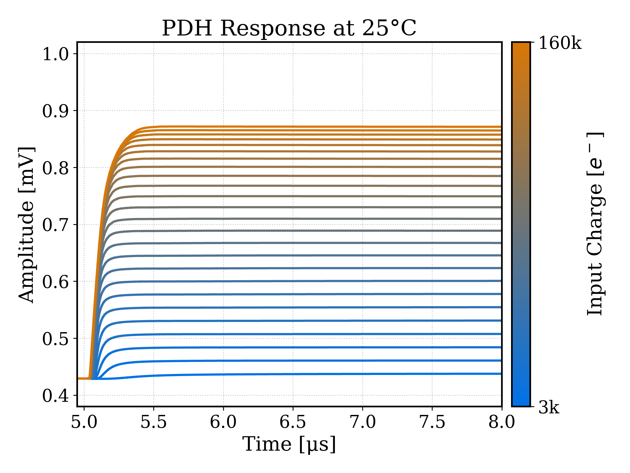
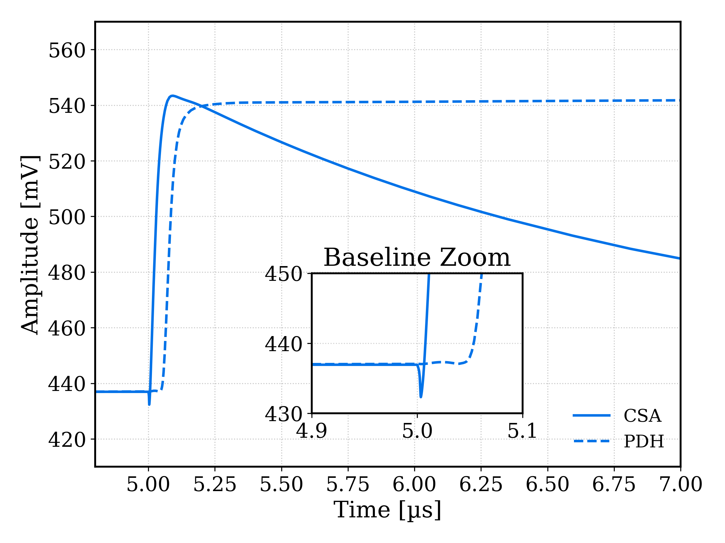
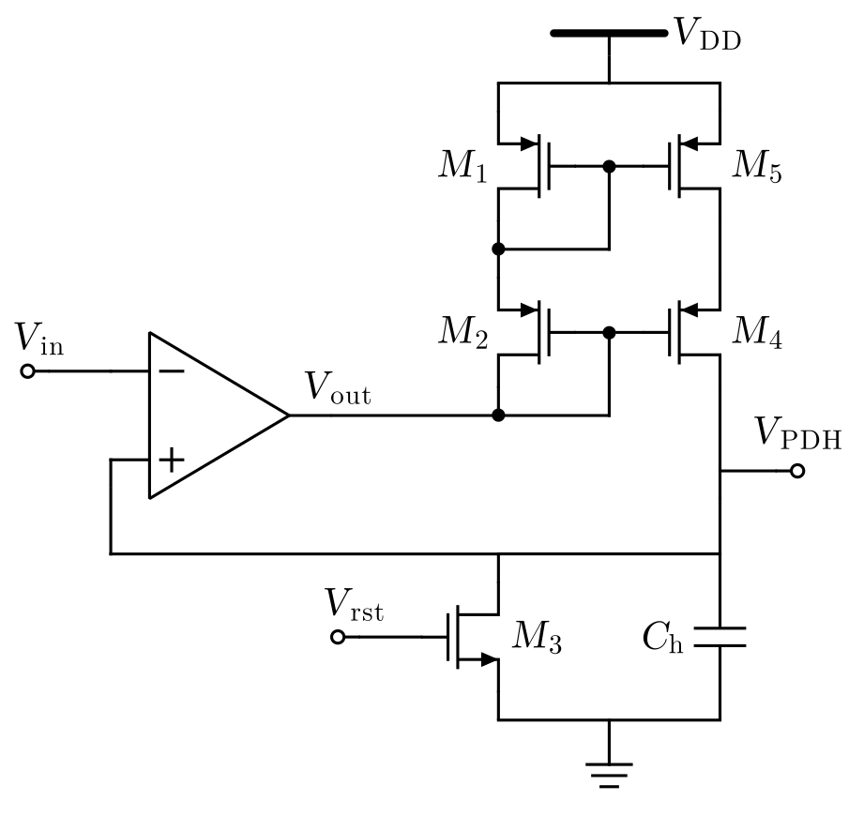
FRONT-END IMPLEMENTATION
Peak Detector and Hold
1.8 μW
PDH Features
Class AB OTA
Adaptive Biasing via Positive Feedback
Boost current during pulse edges
Enhanced Slew-Rate/Power Ratio
Weak-Inversion Quiescent Operation
Cascoded rectifing current mirror
Prevent voltage drop and leakage
Limit baseline pedestal
[1] Ah-Reum Kim et al. "Low-power class-AB CMOS OTA with high slew-rate," 2009 International SoC Design Conference (ISOCC), Busan, 2009, pp. 313-316, doi: 10.1109/SOCDC.2009.5423790
14

Slide 19
FRONT-END IMPLEMENTATION
Peak Detector and Hold
1.8 μW
PDH Features
Class AB OTA
Adaptive Biasing via Positive Feedback
Boost current during pulse edges
Enhanced Slew-Rate/Power Ratio
Weak-Inversion Quiescent Operation
Cascoded rectifing current mirror
Prevent voltage drop and leakage
Limit baseline pedestal
PDH Simulations
I_{tail} = 40 nA
C_{h} = 300 fF
Pedestal < 2 mV
Settling time ~ 0.5 μs
Linearity
PDH/CSA ± 3% @ [3, 100] ke⁻
Strong dependence on temperature for more energetic events
[1] Ah-Reum Kim et al. "Low-power class-AB CMOS OTA with high slew-rate," 2009 International SoC Design Conference (ISOCC), Busan, 2009, pp. 313-316, doi: 10.1109/SOCDC.2009.5423790
15

Slide 20
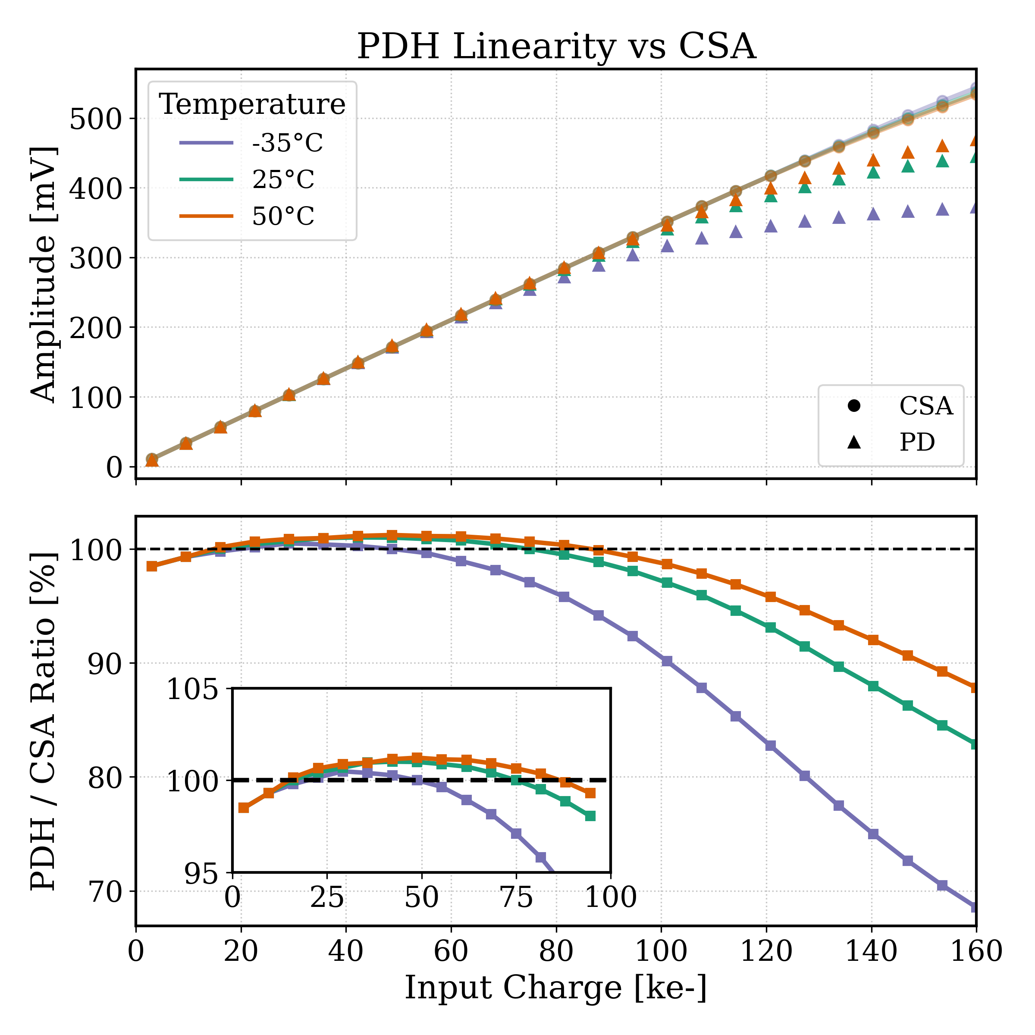
FRONT-END IMPLEMENTATION
Peak Detector and Hold
1.8 μW
PDH Features
Class AB OTA
Adaptive Biasing via Positive Feedback
Boost current during pulse edges
Enhanced Slew-Rate/Power Ratio
Weak-Inversion Quiescent Operation
Cascoded rectifing current mirror
Prevent voltage drop and leakage
Limit baseline pedestal
PDH Simulations
I_{tail} = 40 nA
C_{h} = 300 fF
Pedestal < 2 mV
Settling time ~ 0.5 μs
Linearity
PDH/CSA ± 3% @ [3, 100] ke⁻
Strong dependence on temperature for more energetic events
[1] Ah-Reum Kim et al. "Low-power class-AB CMOS OTA with high slew-rate," 2009 International SoC Design Conference (ISOCC), Busan, 2009, pp. 313-316, doi: 10.1109/SOCDC.2009.5423790
16

Slide 21
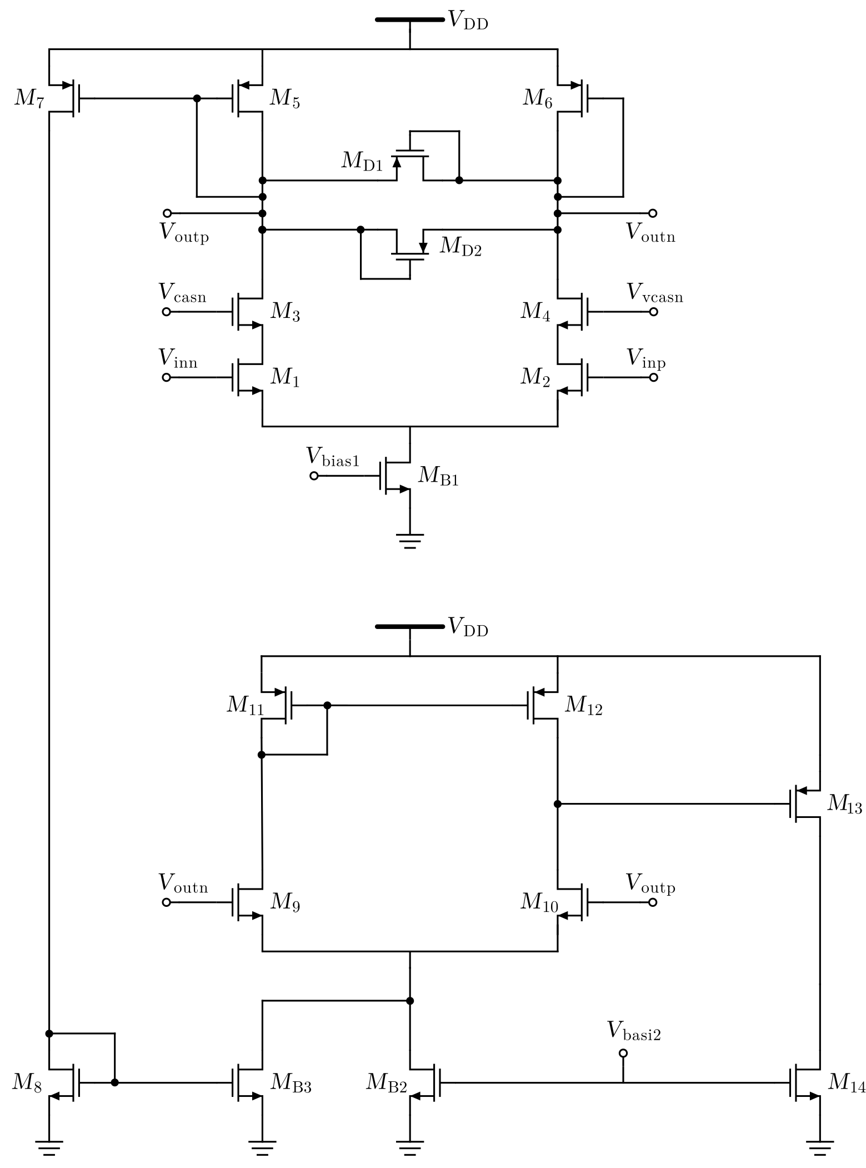
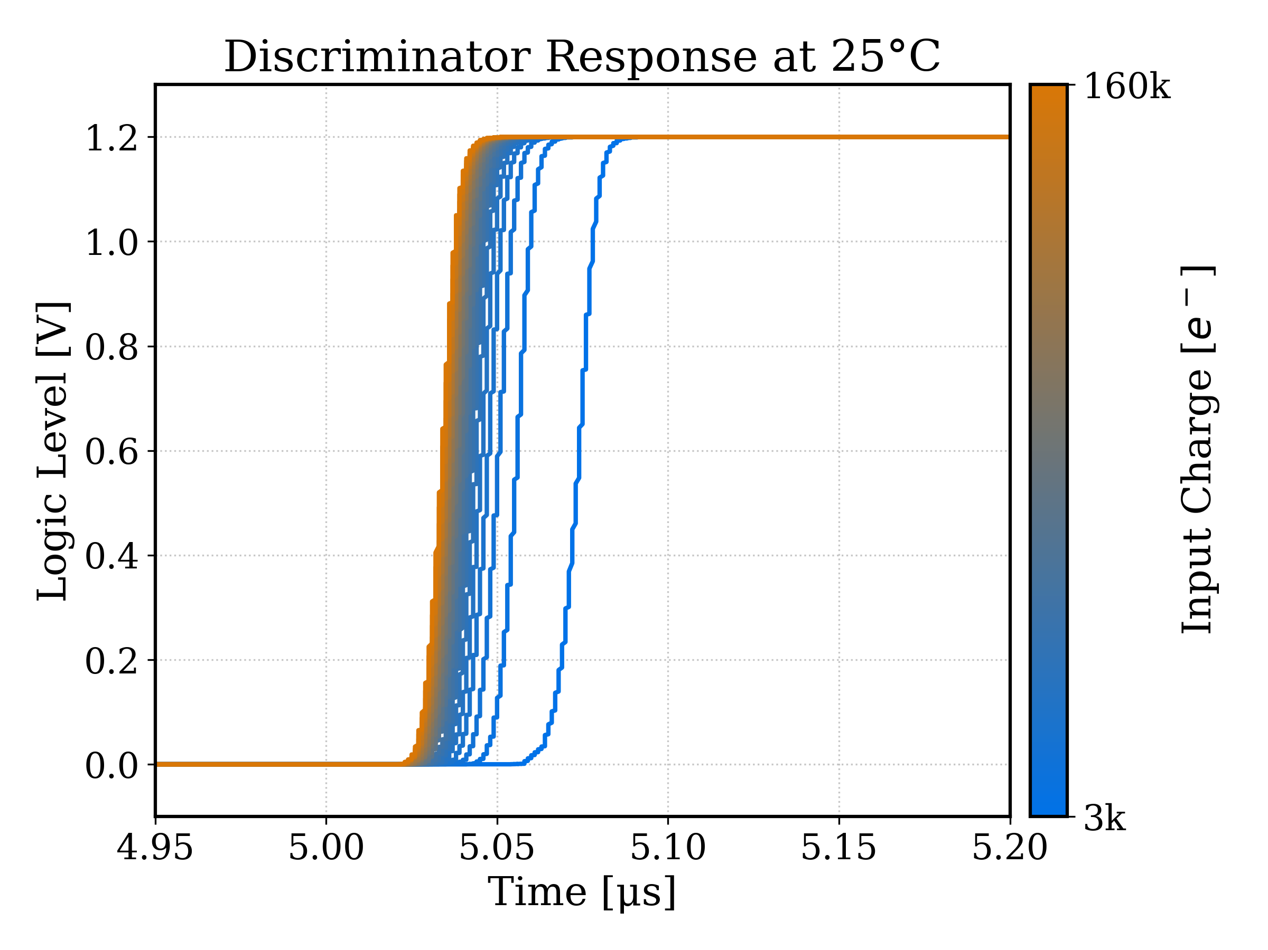
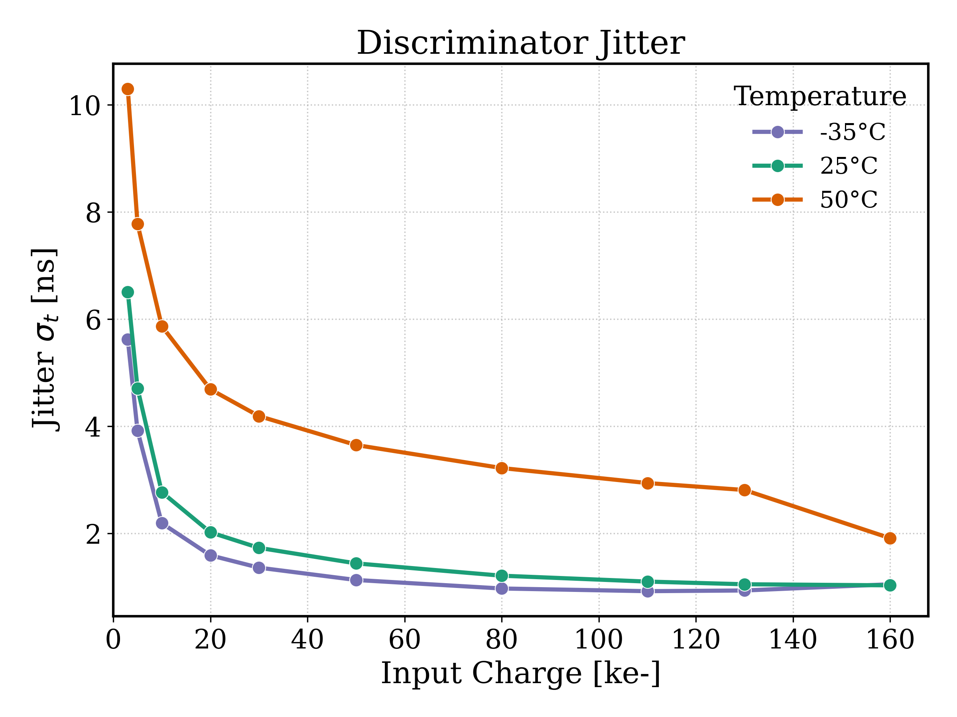
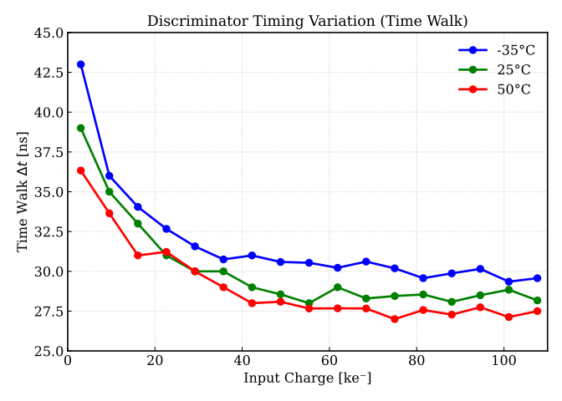
FRONT-END IMPLEMENTATION
Timing Discriminator
1.5 μW
DiscirminatorFeatures
Dual stage cascoded leading-edge discriminator
Cells connected with active biasing network
Minimal quiescent current
Boost tail current of the second stage
Fast recovery limiting voltage swing
Discriminator Simulations
Jitter < 10 ns
Timewalk < 45 ns
17
[2] Menouni, Mohsine. “Low Power Discriminator for ATLAS Pixel Chip,” 2009. doi:10.5170/CERN-2009-006.606.

Slide 22
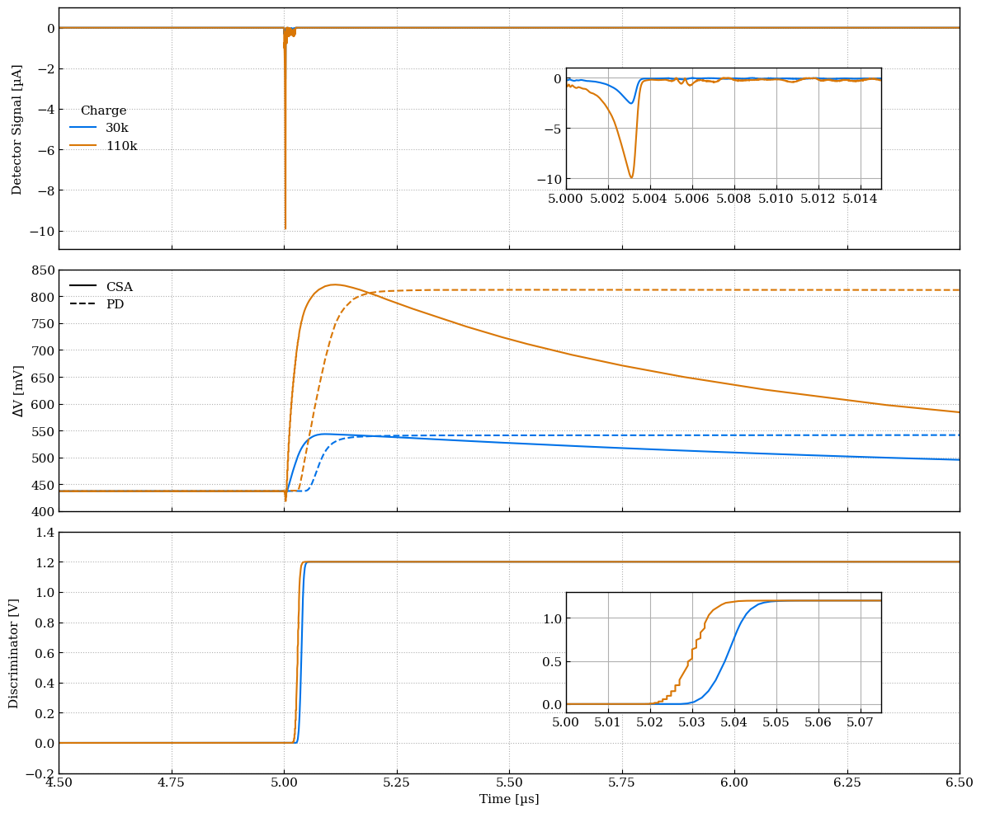
FRONT-END IMPLEMENTATION
Front-end simulated results
Front end response to Allpix² signals
Power Consumption:
10 mW/cm²
250 μm pitch
→ 6.25 μW/channel
Temperature Range
Space Application
→ [-35, 50]°C
Timing Resolution:
200 ns r.m.s.
Dynamic Range
Main focus on 3k - 100k electrons
Technology | LFoundry 110 nm CIS
Power Supply | 1.2 V
N_{Channels} | 32 x 32 Pixels / 16 x 16 MP
Input Polarity | Negative
C_{Sensor} | 200 fF
ENC | < 200 e⁻
SNR @ 3 ke⁻ | 17
FE Power Consumption | 4.5 μW/channel
18

Slide 23
Substrates Characterisation

Slide 24
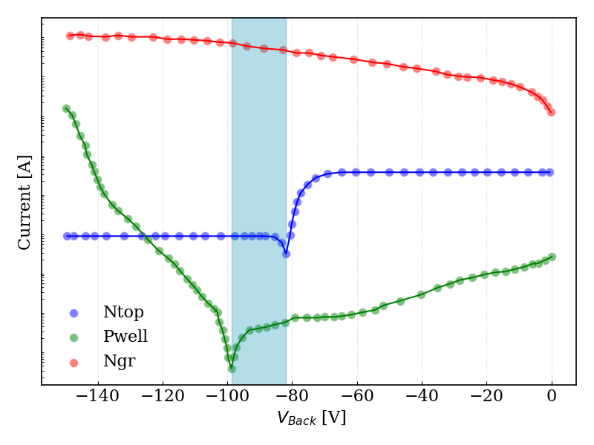
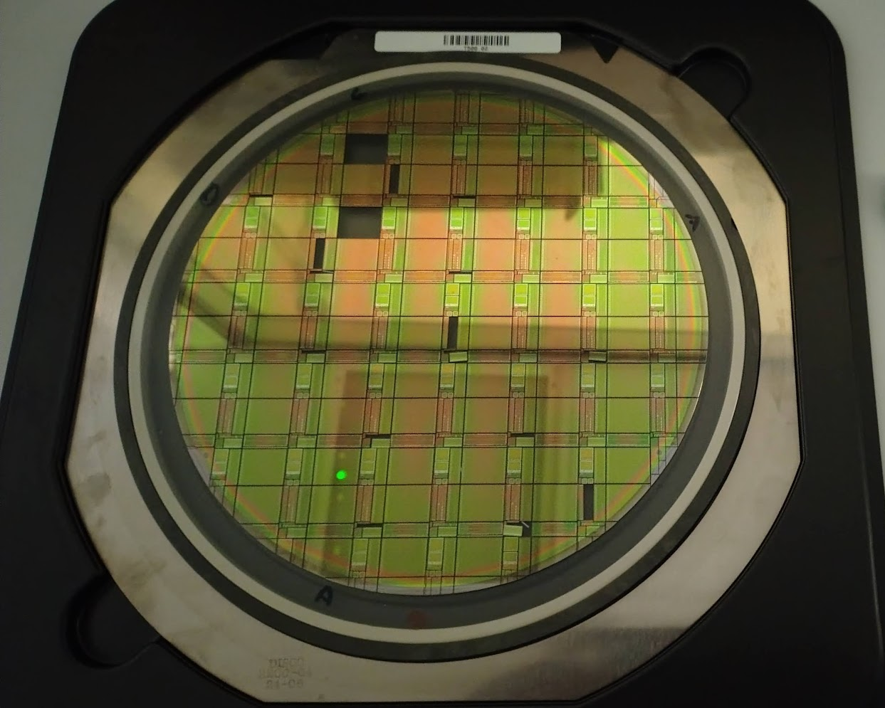
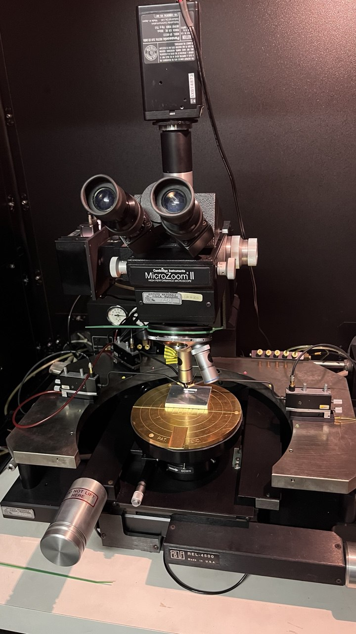
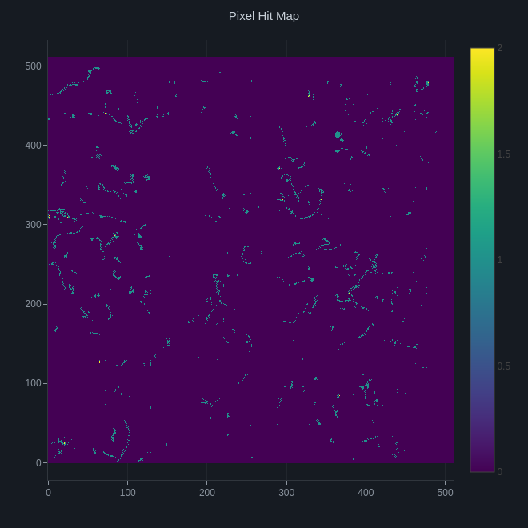
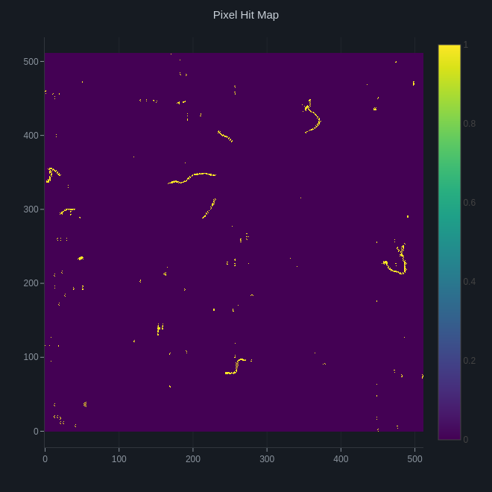
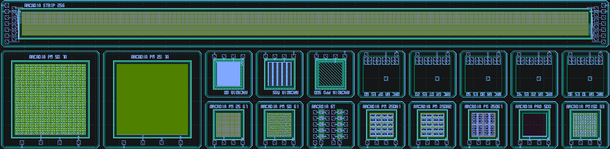
SUBSTRATES CHARACTERISATION
First test results
Substrate Characterisation
IV Characterisation at the MicroProbing station (passive structures)
500 μm – thick substrates
700 μm – thick substrates
Testing of ARCADIA MD3 on thicker substrates
PRELIMINARY
500 μm
700 μm
Uranium cup used as source
Hitmaps: number of hits showed relatively to the 512x512 pixels MD3 matrix
19

Slide 25
Status and Outlook

Slide 26
STATUS AND OUTLOOK
A Low-Power FD-MAPS for Space Compton Imaging
Sensor
700 µm n-on-n TCAD pixel optimised at 250 µm pitch
single-pad layout selected for field uniformity
200 fF capacitance achieved
full depletion at ~80 V on real 700 µm substrates
Digital
MacroPixel async event storage
time-priority round-robin arbitration
EOC sub-word timestamp reconstruction validated in simulation
24-bit DDR serialisation implemented
Front-End
CSA
150 ns peaking
Output swing 10 - 600 mV
±0.2% INL
PDH
0.5 us settling time
2 mV pedestal
Time Discriminator
timewalk < 45 ns
Jitter < 10 ns
-35 to 50 °C
4.5 μW
Ongoing work
Wilkinson ADC design: ramp linearity and power optimisation in progress
Full analog–digital integration: floor-planning and mixed-signal verification upcoming
Complete thick substrate qualification on 700 µm samples under way
Module integration with multiple HIC options under study (PCB, FPC, FLEX)

Slide 27
Thank you for your time!
Design, Simulation and Test Group
M. Barbagiovanni, L. Baldini, M. Da Rocha Rolo, A. Di Salvo,
E. Posteraro, A. Frassà, L. Latronico, M. Mandurrino,
U. Savino, C. Sgrò, E. Trossarello

Slide 28
Backup Slides

Slide 29
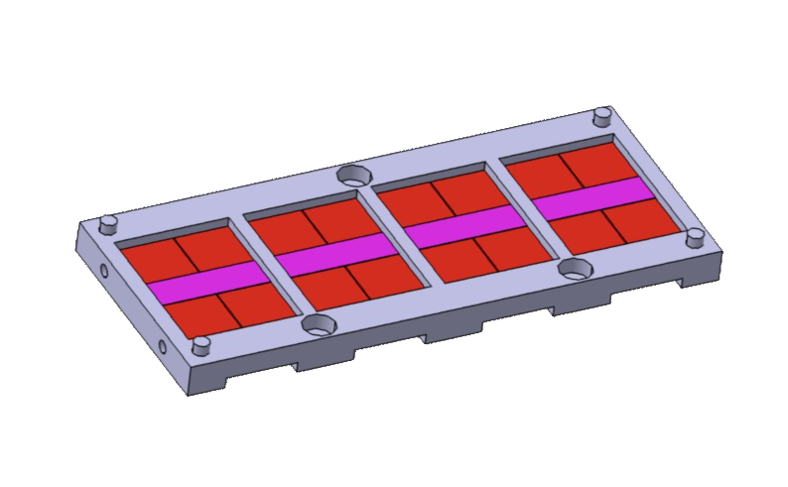
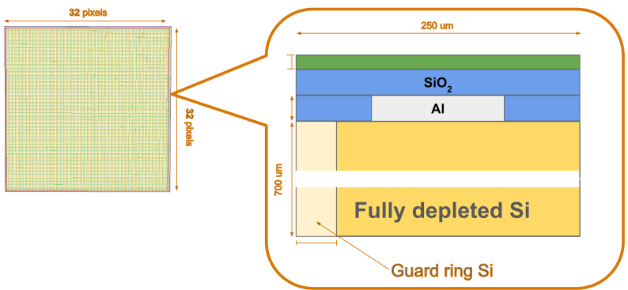

BACKUP
Courtesy of A. Frassà
GEANT Simulations
Tracker simulation details
Detector
simulated with worst case single block of all metallization on top of sensor
32x32 pixels
EOC
Hybrid Integrated Circuit
Multiplane tracker
1 m² chip planes
Monocromatic source
100 keV - 1 GeV

Slide 30

BACKUP
Courtesy of A. Frassà
GEANT - E_{γ} = 100 keV, E_{thr} = 5 keV

Slide 31

BACKUP
Courtesy of A. Frassà
GEANT - E_{γ} = 100 MeV, E_{thr} = 5 keV

Slide 32






BACKUP
PRELIMINARY
Courtesy of U. Savino
Module assembly options
PCB
Printed circuit board
Thermal Performances
Steady-state thermal simulation
32 chips (16 per side)
Dissipated power/chip 13mW
ideal thermal contact and a wall temperature fixed at 15°C
Maximum global variations:
PCB → 4.5°C
FPC → 2.5°C
Higher thermal drain for FPC
2x2 chips layout
Hybrid Integrated Circuit
HICs on Al Frame
FPC
PCB
Al flexible printed circuit
Flex embed
FBK flex demonstator
spTab bonded to ALPIDE chip
FPC
Al Chip embedded in flex printed circuit

