Slide 1
MightyPix: A HV-CMOS Pixel Chip for LHCb’s Mighty Tracker
Nicolas Striebig, Richard Leys, Lucas Dittmann, Toko Hirono
Ivan Peric*

Slide 2
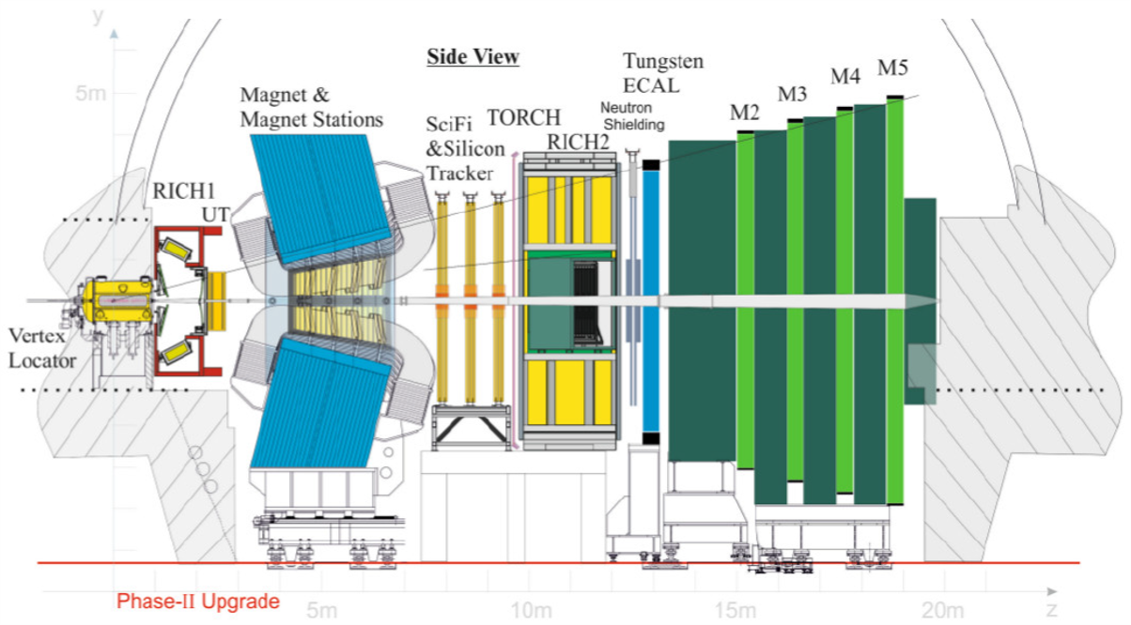
LHCb Experiment
LHCb Experiment
Forward-arm spectrometer at the LHC
Precision flavour physics:
CP violation
beauty and charm decays
hadron spectroscopy
rare decays
~9 fb⁻¹ recorded in Run 1 and Run 2
IP
Tracking Stations
Schematic side view of the Upgrade II LHCb detector. [1]
Notes:
The LHCb experiment is a forward-arm spectrometer at CERN designed for precision flavour physics.
Its physics program includes studies of CP violation, beauty and charm decays, hadron spectroscopy, and rare decays that are sensitive to physics beyond the Standard Model.
During Run 1 and Run 2, LHCb recorded approximately 9 inverse femtobarns of data.
Yes, the inverse femtobarn (\(fb^{-1}\)) is a standard unit used in particle physics to measure integrated luminosity. [1, 2]
Here is a breakdown of what that means:
What it Measures: It represents the total amount of data collected by a particle accelerator (like the LHC) over a specific period, essentially measuring the potential number of collisions.
The "Barn": A "barn" (\(b\)) is a unit of area, used in nuclear and particle physics to express the cross-section (the likelihood) of a particle interaction. It is equal to \(10^{-28}\) square meters or 100 square femtometers (\(\text{fm}^{2}\)).
Femtobarn (\(fb\)): A femtobarn is \(10^{-15}\) barns.
Inverse Femtobarn (\(fb^{-1}\)): Because luminosity is defined as collisions per unit area per unit time, integrating this over time creates a unit of "inverse area." One inverse femtobarn (\(1\text{ fb}^{-1}\)) corresponds to roughly 100 million million (\(10^{14}\)) proton-proton collisions. [1, 2, 3, 4, 5]
Why it matters: If a specific particle process (like Higgs boson production) has a cross-section of \(1\text{ fb}\), then a detector that has accumulated an integrated luminosity of \(100\text{ fb}^{-1}\) would expect to record roughly 100 of those events

Slide 3
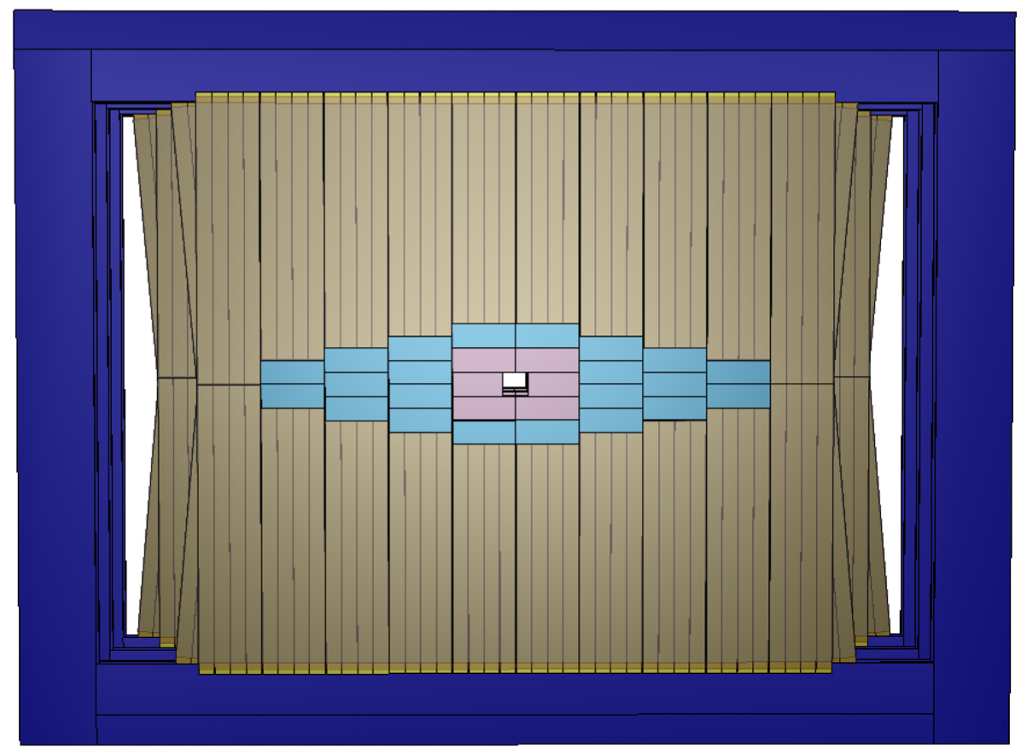
Upgrade
LHCb Upgrade II
Higher luminosity operation
Increased:
radiation dose
particle multiplicities
hit rates
Upgrade of downstream tracker:
Mighty Tracker
SciFi
MT
IT
1 m
~ 4 m
Schematic of one layer of the Mighty Tracker. [1]
Notes:
The main challenges of Upgrade II are significantly higher radiation levels, increased particle multiplicities, and much higher hit rates.
To cope with the operating conditions of Upgrade II, the LHCb detector requires substantial upgrades.
The upgrade of the downstream tracking detector is called the Mighty Tracker.

Slide 4
Mighty Tracker Concept
Mighty Tracker
Hybrid tracking detector:
SciFi Tracker
Inner Tracker
Middle Tracker
Technology:
Scintillating fibres + HV-MAPS
Advantages:
High granularity
Fast timing
Radiation hardness
SciFi
MT
IT
1 m
~ 4 m
Schematic of one layer of the Mighty Tracker. [1]
Notes:
The Mighty Tracker is a hybrid detector concept combining scintillating fibre technology with HV-MAPS pixel sensors.
The detector consists of the SciFi tracker together with the Inner and Middle Tracker regions instrumented with pixel sensors.
This hybrid solution provides a good balance between cost and detector performance, while delivering high granularity, excellent timing resolution, and strong radiation hardness.

Slide 5
MightyPix Detector Scale
MightyPix Detector Scale
Baseline technology:
HV-CMOS pixel chip MightyPix
46,000 silicon sensors
Total silicon area:
~18 m²
SciFi
MT
IT
1 m
~ 4 m
Schematic of one layer of the Mighty Tracker. [1]
Notes:
The baseline for the pixel region is the HV-CMOS chip called MightyPix.
In total, more than 46 thousand silicon sensors are required to instrument an active area of approximately 18 square meters.

Slide 6
Module Structure
Module structure:
28 modules/layer, 6 layers
Module size: 20 cm × 54 cm
Mighty Tracker Module
HV-MAPS mounted on both sides
Cooling pipes integrated into support structure
Continuous active coverage
Notes:
Each of 6 tracking layer is divided into 28 modules, where each module covers an area of 20 by 54 centimeters. (252 chips)
This slide shows the top view and cross section of one detector module.
The blue regions correspond to the silicon sensors.
The HV-MAPS chips are mounted on both sides of the mechanical support structure, while cooling pipes are integrated inside the module.
This arrangement provides continuous active coverage over the entire module area.

Slide 7
MightyPix Requirements
MightyPix Requirements
Pixel size:
< 100 µm × 300 µm
Hit-rate capability:
30 MHz/cm²
In-time efficiency:
99% in 25 ns
Radiation hardness:
6 × 10¹⁴ neq/cm²
Power:
< 150 mW/cm²
4 × 1.28 Gbps data links
Notes:
The requirements for MightyPix are quite demanding.
The chip must support hit rates above 30 megahits per square centimeter while maintaining an in-time efficiency above 99 percent within the 25 nanosecond bunch crossing interval.
In addition, the detector must tolerate high radiation levels and remain power efficient.
The chip also needs to integrate fully into the LHCb readout system and provide four high-speed data links operating at 1.28 gigabits per second.

Slide 8
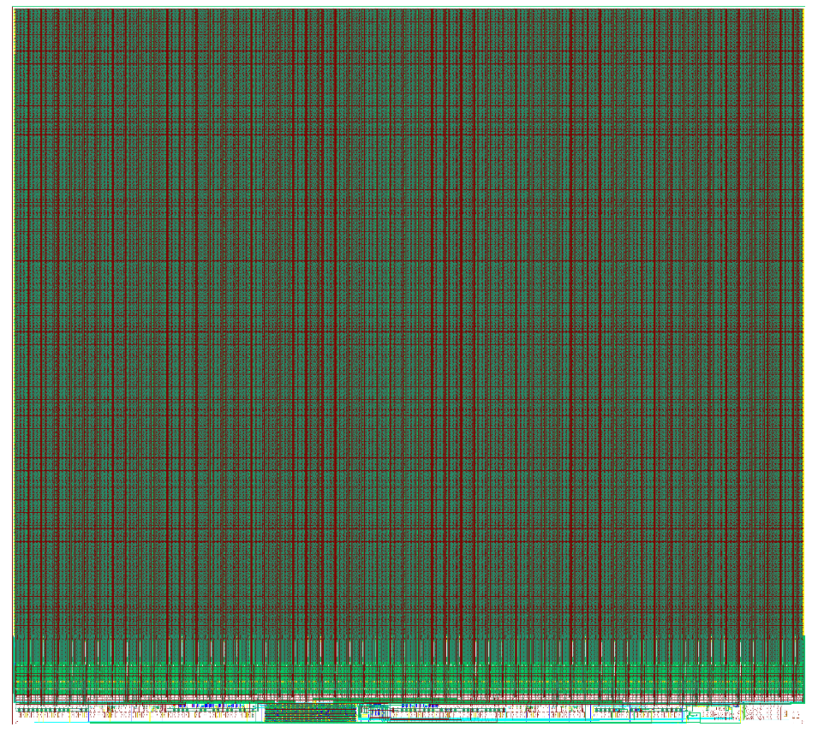
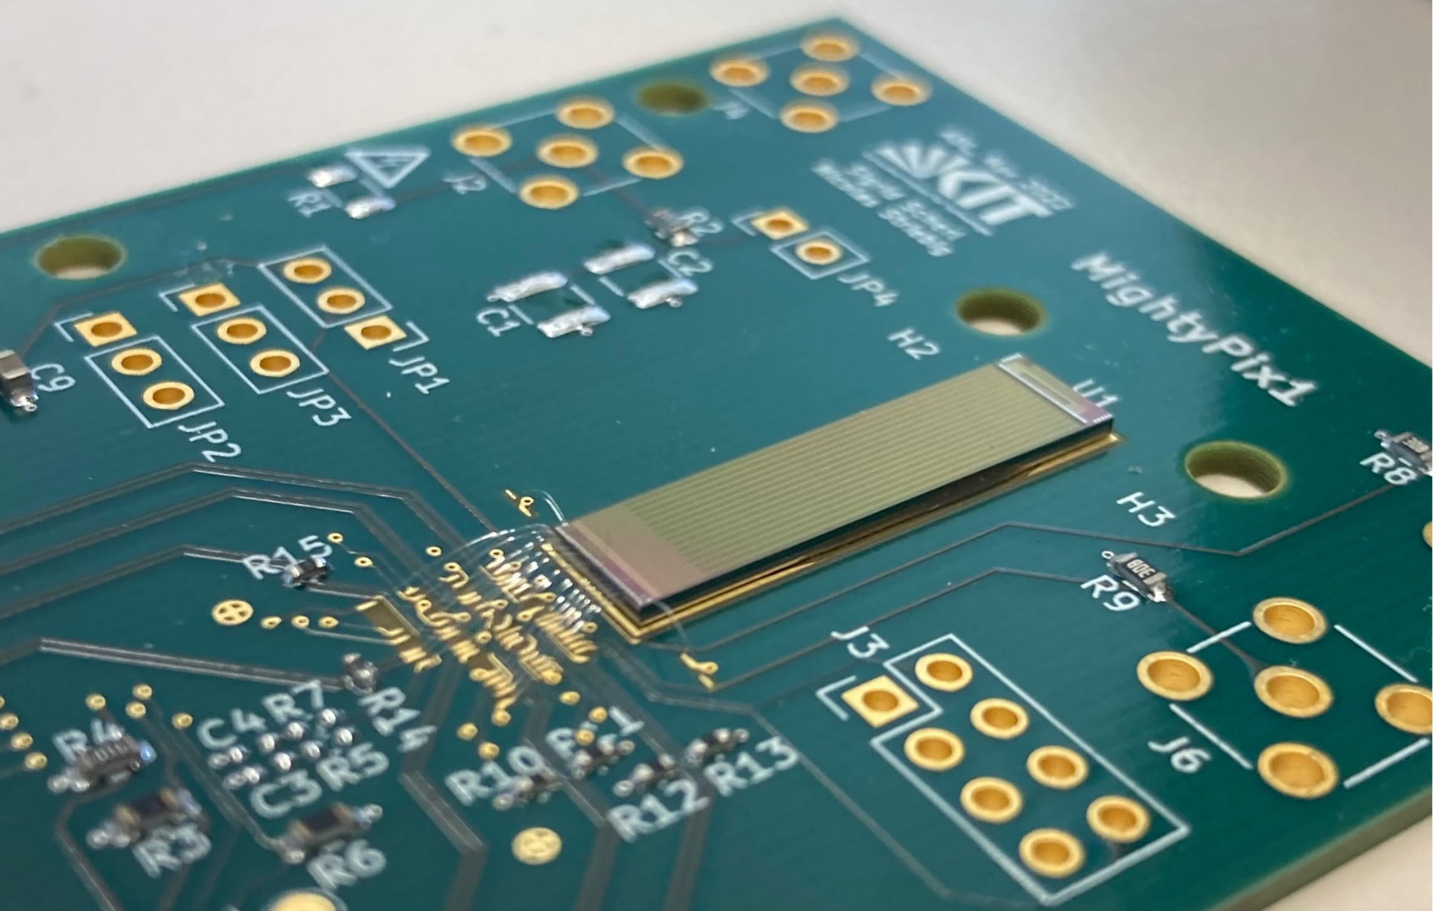
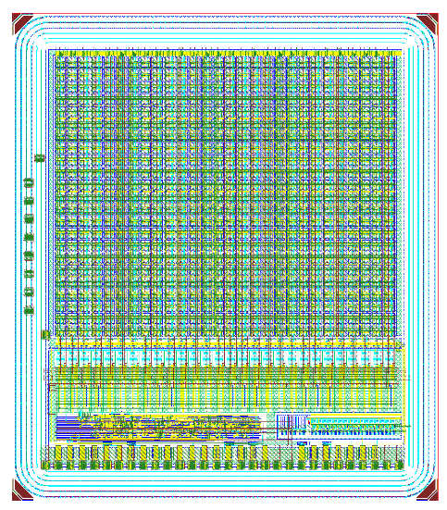
Development
MightyPix Development
MightyPix1
first prototype
MightyPix2
near-full functionality
MightyPix3
final prototype
Parallel development:
LF-MightyPix
150 nm CMOS backup technology
MightyPix2
LFMightyPix
MightyPix1
Notes:
Our development follows a stepwise prototype strategy.
We started with MightyPix1 as the first prototype, followed by MightyPix2, which integrates almost the complete functionality planned for the final chip.
MightyPix3 will serve as the final pre-production prototype.
In parallel, we developed LF-MightyPix in a 150 nanometer CMOS technology as a backup option and to reduce long-term technology risks.

Slide 9
MightyPix Chip Architecture
MightyPix Chip Architecture
122 double columns
2 × 194 pixels per double column
Chip periphery includes:
Hit buffers
End-of-Column (EoC) circuits
Readout Control Unit (RCU)
DACs
I/O pads
Config. register
EOC
EOC
EOC
EOC
EOC
regulator
RCU
DAC
VDAC
pads
Notes:
MightyPix consists of 122 double columns, where each double column contains two rows of 194 pixels.
The central part of the chip is occupied by the pixel matrix, while the chip periphery contains the supporting readout and control circuitry.
This includes the hit buffers, the End-of-Column circuits, the Readout Control Unit, DACs for bias and threshold generation, as well as the interface and I/O pads.

Slide 10
MightyPix: Analogue Part
Working principle:
1. Charge collected by pixel n-well
2. Converted to voltage signal by Charge Sensitive Amplifier
3. Analog voltage pulse shaped and converted to digital signal by comparator
4. Hit information stored in hit buffer
1.8V
BL
Pixel
Bias resistance
Amplifier
Tout
Th
Comparator
C_{inj}
AnalogOut
Sensor
Offset
EnInjection_row_i
VMinus
-HV
RAM
Q(0:2)
TDAC
Injection
Data transfer line
WrRAM(0:2)_row_i
3
Injection
RAM in
AmpOut
row control (in pixel control reg)
column control(in pixel control reg)
Hit buffer
Source: Ivan Perić
Notes:
Each pixel integrates the complete front-end chain, including the sensor diode,

Slide 11
MightyPix: Analogue Part
Working principle:
1. Charge collected by pixel n-well
2. Converted to voltage signal by Charge Sensitive Amplifier
3. Analog voltage pulse shaped and converted to digital signal by comparator
4. Hit information stored in hit buffer
1.8V
BL
Pixel
Bias resistance
Amplifier
Tout
Th
Comparator
C_{inj}
AnalogOut
Sensor
Offset
EnInjection_row_i
VMinus
-HV
RAM
Q(0:2)
TDAC
Injection
Data transfer line
WrRAM(0:2)_row_i
3
Injection
RAM in
AmpOut
row control (in pixel control reg)
column control(in pixel control reg)
Hit buffer
Source: Ivan Perić
Notes:
a charge sensitive amplifier,

Slide 12
MightyPix: Analogue Part
Working principle:
1. Charge collected by pixel n-well
2. Converted to voltage signal by Charge Sensitive Amplifier
3. Analog voltage pulse shaped and converted to digital signal by comparator
4. Hit information stored in hit buffer
1.8V
BL
Pixel
Bias resistance
Amplifier
Tout
Th
Comparator
C_{inj}
AnalogOut
Sensor
Offset
EnInjection_row_i
VMinus
-HV
RAM
Q(0:2)
TDAC
Injection
Data transfer line
WrRAM(0:2)_row_i
3
Injection
RAM in
AmpOut
row control (in pixel control reg)
column control(in pixel control reg)
Hit buffer
Source: Ivan Perić
Notes:
a comparator, a threshold tuning DAC, and local RAM used for storing the tuning bits

Slide 13
MightyPix: Analogue Part
Working principle:
1. Charge collected by pixel n-well
2. Converted to voltage signal by Charge Sensitive Amplifier
3. Analog voltage pulse shaped and converted to digital signal by comparator
4. Hit information stored in hit buffer
1.8V
BL
Pixel
Bias resistance
Amplifier
Tout
Th
Comparator
C_{inj}
AnalogOut
Sensor
Offset
EnInjection_row_i
VMinus
-HV
RAM
Q(0:2)
TDAC
Injection
Data transfer line
WrRAM(0:2)_row_i
3
Injection
RAM in
AmpOut
row control (in pixel control reg)
column control(in pixel control reg)
Hit buffer
Source: Ivan Perić

Slide 14
Sensor
Deep n-well in high-resistivity substrate
Reverse bias up to ~260 V
Depletion depth:
~90 µm
Charge collection by drift
260V
V_{bias}
n-well
p-well
n-well
p-well
Deep n-well
p-type substrate
Notes:
The sensing element is a pn diode formed by a deep n-well implanted in a high-resistivity substrate.
The diode is reverse biased up to approximately 260 volts, creating a depletion region of about 90 micrometers.
Charge generated by incident particles is collected by drift toward the deep n-well.

Slide 15
Sensor Biasing
Sensor Biasing
Deep n-well biased through high-ohmic device
Maintains correct DC potential
Avoids low-impedance path for signal charge
PMOS transistor
NMOS transistor
n-well
p-well
Deep n-well
260V
V_{bias}
n-well
p-well
n-well
p-well
Deep n-well
p-type substrate
Notes:
To avoid signal loss, we bias the deep n-well through a high-ohmic device.
This resistor keeps the deep n-well at the correct DC potential while avoiding a low-impedance path that could drain away the collected signal charge.

Slide 16
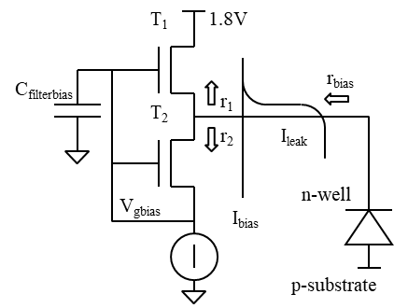
Sensor Biasing
Bias device implementation:
Operation:
T2 provides bias resistance
T1 carries leakage current
Notes:
The bias device is realized by a MOSFET.
Circuit maintains a nearly constant small-signal AC resistance even in the presence of sensor leakage current.
In this implementation, transistor T2 provides the effective bias resistance, while transistor T1 carries the leakage current component.

Slide 17
Charge Sensitive Amplifier
Charge Sensitive Amplifier
Cascode amplifier architecture
Combined:
NFET input
PFET input
Enhanced transconductance:
gm = gm,NMOS + gm,PMOS
VDD
V_{p}
T_{scp}
T_{load}
V_{pload}
VSS
outamp
T_{sf}
T_{inp}
T_{casc}
V_{casc}
outampsf
in
V_{sf}
T_{scsf}
T_{inn}
Notes:
The CSA uses a cascode architecture with both NFET and PFET input transistors in order to increase the effective transconductance.
Effectively, the transconductances of both devices are added, improving speed and timing performance.

Slide 18
Charge Sensitive Amplifier
CSA Operating Principle
NMOS gate controlled by DC feedback
Current source defines bias current
PMOS and NMOS share same current
VSS node:
large capacitance
AC ground behavior
AC currents add constructively
Increased effective gm
VDD
V_{p}
T_{scp}
T_{load}
V_{pload}
Other pixel amplifiers
VSS
outamp
T_{sf}
T_{inp}
T_{casc}
V_{casc}
outampsf
in
V_{sf}
T_{scsf}
T_{inn}
Notes:
The gate-source voltage of the NMOS transistor is controlled by the DC feedback loop, while the current source defines the bias current.
The PMOS input transistor is connected in series with the NMOS device, meaning that both transistors share the same bias current.
The source of PMOS is common to all pixels and has a large capacitance. Therefore, for AC signals, this node behaves approximately as an AC ground.
As a result, the AC currents of the NMOS and PMOS transistors add, so the amplifier behaves like two parallel transistors with combined transconductance.
To improve bandwidth and reduce the amplifier time constant, we use a source follower stage.
The entire analog front-end is optimized for low timing jitter at the discriminator threshold crossing.

Slide 19
Feedback Capacitance (C_{f})
Feedback Capacitance (C_{f}) Realized using parasitic drain diffusion capacitance of a MOSFET
R_{f}
nwell
VDD
VDD
in
VDD
V_{p}
V_{pload}
outamp
T_{scp}
T_{load}
C_{f}
nwell
VSS
outamp
Tin
Tload
C_{f}
T_{sf}
n-well
T_{inp}
T_{casc}
V_{casc}
outampsf
nwell
in
V_{sf}
T_{scsf}
Deep n-well
T_{inn}
Notes:
Feedback Capacitance (C_{f}):
C_{f} is realized using the parasitic drain diffusion capacitance of a MOSFET.

Slide 20
Feedback Resistor Implementation
Feedback Resistor Implementation
Feedback resistor Rf implemented using MOSFET
Simple implementation:
Common gate bias generated off-matrix
T_{fb}
VDD
V_{p}
T_{scp}
T_{load}
V_{pload}
nwell
VSS
outamp
C_{f}
T_{sf}
T_{inp}
T_{casc}
V_{casc}
outampsf
nwell
in
V_{sf}
T_{scsf}
T_{inn}
Notes:
The feedback resistor Rf​ is implemented using a MOSFET
In the simplest implementation, the gate voltage controlling the feedback transistor, labeled Tfb, is generated outside the pixel matrix and distributed globally to all pixels.
However, in this configuration the conductivity of the feedback transistor depends strongly on the local VDD value.
Since the power rails carry substantial current, the local VDD voltage can vary significantly across the matrix.
These voltage variations can therefore affect the effective feedback resistance and influence the analog front-end behavior.

Slide 21
Feedback Resistor Implementation
Improved Feedback Biasing
Local bias-current generation using Tbias
Tbias generates small current:
~100 pA
Current generates gate voltage for Tfb
PFB generated off-matrix by bias DAC
VDDFB
PFB
T_{bias}
T_{fb}
VDD
V_{p}
T_{scp}
T_{load}
V_{pload}
nwell
VSS
outamp
C_{f}
T_{sf}
T_{inp}
T_{casc}
V_{casc}
outampsf
nwell
in
V_{sf}
T_{scsf}
T_{inn}
Notes:
The solution shown here avoids the dependence of the feedback resistance on local VDD variations.
A dedicated transistor, labeled Tbias, generates a very small bias current, typically around 100 picoamperes.
This current produces the gate voltage for the feedback transistor Tfb locally inside the pixel.
As a result, the operating point of the feedback transistor becomes significantly less sensitive to variations of the supply voltage across the matrix.
The global control voltage PFB is generated off-matrix using a bias DAC, allowing programmable adjustment of the feedback operating point

Slide 22

Optimizing Amplifier Rise Time for Minimum Time Jitter
Time Jitter Formula:
$\text{TJ}≈T_{r}⋅\frac{N}{V_{\text{sig}}−V_{\text{TH}}},$
Noise dependence:
$N=\frac{A}{\sqrt{T_{r}}}$ where $A=\frac{1}{2}⋅\frac{C_{det}}{C_{f}}\sqrt{\frac{4kTγn}{g_{m}}}$
Threshold dependence:
$V_{\text{TH}}=m N$ = $\frac{m A}{\sqrt{T_{r}}}$
Combined Expression:
$\text{TJ}≈T_{r}⋅\frac{N}{V_{\text{sig}}−m N}=T_{r}⋅\frac{\frac{A}{\sqrt{T_{r}}}}{V_{\text{sig}}−\frac{m A}{\sqrt{T_{r}}}}$
Time jitter depends nonlinearly on Tr.
Small Tr → higher noise. Large Tr → slower signal.
Optimal Tr minimizes TJ: trade-off between noise and signal timing.
Notes:
We start from the formula for time jitter $\text{TJ}≈T_{r}⋅\frac{N}{V_{sig}−V_{TH}}$
Here, Tr is the rise time of the amplifier, N is the noise, Vsig is the signal amplitude, and VTH is the threshold voltage. Both the noise N and the threshold voltage VTH depend on Tr.
We write simplified formula for noise in a charge-sensitive amplifier (we take into account only thermal noise of the input transistor):
$$N=\frac{A}{\sqrt{T_{r}}}$$
Where A is a constant that includes detector and feedback capacitances, temperature, and transistor parameters. Specifically:
$$A=\frac{1}{2}⋅\frac{C_{det}}{C_{f}}\sqrt{\frac{4kTγn}{g_{m}}}$$
Next, we assume that the threshold voltage VTH is set proportionally to the noise level. That is:
$$V_{\text{TH}}=m N$$
with m being some empirical constant, typically around 10.
Now we substitute these expressions into our formula for time jitter:
$$\text{TJ}≈T_{r}⋅\frac{N}{V_{\text{sig}}−m N}=T_{r}⋅\frac{\frac{A}{\sqrt{T_{r}}}}{V_{\text{sig}}−\frac{m A}{\sqrt{T_{r}}}}$$
This gives us an expression that explicitly shows how time jitter depends on the amplifier rise time Tr, and on the detector and electronics parameters embedded in A.
This equation helps us search for an optimal Tr that minimizes time jitter. If Tr is too small, noise increases. If Tr is too large, the signal becomes slow, worsening jitter. So, there is a trade-off.

Slide 23

Optimizing Amplifier Rise Time for Minimum Time Jitter
Optimal Rise Time:
$T_{r}={\left(\frac{2 m A}{V_{\text{sig}}}\right)}^{2}$; $A=\frac{1}{2}⋅\frac{C_{det}}{C_{f}}\sqrt{\frac{4kTγn}{\frac{I_{bias}}{nU_{T}}}}=nU_{T}\frac{C_{det}}{C_{f}}\sqrt{\frac{eγ}{I_{bias}}}$
At optimum:
$N=\frac{V_{\text{sig}}}{2 m}=> SNR=\frac{V_{\text{sig}}}{N}=2m=> \text{TJ}≈\frac{T_{r}}{m}$
Notes:
By taking the derivative with respect to Tr​ and setting it to zero, we find the optimal rise time:
$$T_{r}={\left(\frac{2 m A}{V_{\text{sig}}}\right)}^{2}$$
At this optimum, the noise voltage becomes:
$$N=\frac{V_{\text{sig}}}{2 m}$$
which means the signal-to-noise ratio, SNR, is:
$$SNR=\frac{V_{\text{sig}}}{N}=2m$$
Finally, the timing jitter at this minimum simplifies to:
$$\text{TJ}≈\frac{T_{r}}{m}$$
Now, to evaluate A more explicitly, let's assume the transistor operates in the weak inversion region, where the transconductance is:
$$g_{m}=\frac{I_{bias}}{nU_{T}}$$
Here, Ibias​ is the bias current, n is the subthreshold slope factor, and UT​ is the thermal voltage, approximately 25 millivolts at room temperature.
Substituting this into the expression for A, we get:
$$A=\frac{1}{2}⋅\frac{C_{det}}{C_{f}}\sqrt{\frac{4kTγn}{\frac{I_{bias}}{nU_{T}}}}=nU_{T}\frac{C_{det}}{C_{f}}\sqrt{\frac{eγ}{I_{bias}}}$$
Putting all these together, the timing jitter can be approximated as:
$$\text{TJ}≈\frac{T_{r}}{m}=\frac{1}{m}{\left(\frac{2m n U_{T}}{V_{sig}}\frac{C_{det}}{C_{f}}\right)}^{2}\frac{eγ}{I_{bias}}$$
To see what this means in practice, consider these realistic values:
m = 10, C_{det} = 100fF, C_{f} = 2.5fF, V_{sig} = 0.1V (Q_{sig} = C_{f} V_{sig} ~ 1500e), I_{bias} = 10µA, n = 1.25, $γ$ = 2/3
Substituting these into the formula, the timing jitter is approximately:
TJ∼66.75 ps
This small timing jitter highlights how effective the design can be when these parameters are carefully optimized.

Slide 24
Optimizing Amplifier Rise Time for Minimum Time Jitter
Step 1: First, we scale down C_{f} until the R_{f} - noise contribution becomes small enough.
Step 2: Adjust rise time Tr​ (via output capacitance Co) to achieve SNR = 2m
Step 3: Multiply transistors to increase bias current Ibias​
Keeps SNR optimal
Decreases Tr ​ → reduces timing jitter
Trade-off: Increasing Ibias​ raises power consumption → balance time resolution vs. power efficiency
Assumption: Charge collection time ≪ Tr​
Achieves SNR
Reduces jitter
smaller R_{F} noise
1
2
3
Notes:
How to optimize timing performance in HVCMOS sensors?
We assume that we reduced the detector capacitance as much as possible.
Let us start with the "minimum size" C_{f} (e.g. 10 fF) and with a small transistor and small transistor current (e.g. 10 µA).
First, we scale down C_{f} until the R_{f} - noise contribution becomes small enough.
First, we adjust the rise time, Tr ​, by varying the output capacitance Co ​ so that we achieve a target signal-to-noise ratio—specifically, an SNR of 2m, where m is our empirical factor, often around 10.
Once this optimal SNR is achieved, the next step involves transistor multiplication—that is, increasing the number of parallel transistors to raise the bias current Ibias​. This increase in Ibias​ allows us to reduce Tr​, since higher current improves the speed of the amplifier.
By doing this, we keep the SNR optimal while pushing the timing jitter down. However, this comes at a cost: multiplying transistors and raising Ibias​ increases power consumption.

Slide 25
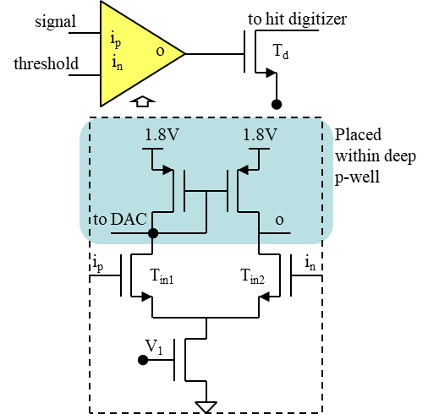
Comparator Design
Comparator Architecture
Challenge:
Large signals on PMOS diffusion contacts can cause parasitic charge injection into sensing deep n-well
Solution: Isolated n-well
Isolated n-well available in:
AMS aH18
TSI 180 nm HV-CMOS
LFoundry 150 nm
VDD
PMOS transistor
(isolated) n-well
Deep p-well
Deep n-well
Notes:
The comparator converts the small analog signal from the front-end amplifier into a digital signal suitable for the readout logic.
One challenge is that large fast signals appearing on PMOS diffusion contacts can produce parasitic charge injection into the sensing deep n-well.
For this reason, the comparator architecture strongly depends on the availability of isolated PMOS transistors.
An isolated n-well means that the PMOS n-well is electrically isolated from the sensing deep n-well.
This option was available in older AMS aH18 technologies, in the TSI 180 nanometer HV-CMOS process, and also in the LFoundry 150 nanometer process.

Slide 26
Comparator Design
MightyPix2:
no isolated PMOS option available
VDD
PMOS transistor
Deep p-well
Deep n-well
Notes:
Unfortunately, the production version of the AMS technology used for MightyPix2 does not provide isolated PMOS devices.

Slide 27
Comparator Design
MightyPix2:
fully NMOS-based comparator
Three-stage cascade
NFET differential amplifiers, NFET loads
No PFET loads:
avoid parasitic charge injection
VDD
PMOS transistor
Deep p-well
Deep n-well
CP
2.1V
1.8V
1.8V
inp
1.0V
inn
Notes:
The comparator consists of a cascade of three NFET differential amplifier stages with NFET loads.
The cascade structure is necessary because the gain of a single stage is relatively small, approximately given by the ratio of the transconductance of the input transistor to the load transconductance.
PFET load transistors are avoided in order to suppress parasitic charge injection and signal coupling into the sensing deep n-well caused by fast digital transitions.

Slide 28
Readout
N. Striebig et al 2026 JINST 21 C04059
pixel
pixel
pixel
Hit buffers
0
RCU
EOCs
Notes:
Let me now move to the digital part located at the chip periphery.
The digital architecture consists of three main blocks.
First, we have the matrix of hit buffers located below the pixel matrix, with one hit buffer assigned to each pixel. Two columns of hit buffers share one End-of-Column, or EoC, block. The hit buffers and EoCs are implemented as full custom designs, while the Readout Control Unit, or RCU, is synthesized from RTL code.

Slide 29
…
&
Prio. Logic
TSRam
CompIn
PrioIn
Hit buffer
pixel
HitFlag1
LdPix
RdPix
TS
PrioOut
Data bus
3
HitFlag2
RdPix
PrioOut
Data
TS
LdPix
HitFlag and prio. logic
3
LdCol
PrioOut
PrioIn
RdCol
Data bus
EOC buffer
Data latch
Notes:
The output of each comparator is connected directly to a hit buffer. The hit buffer contains hit flags, synchronization logic, and priority selection circuitry.
At the leading edge of the discriminator pulse, a 12-bit time-of-arrival timestamp is stored in DRAM cells. In LF-MightyPix, a 13-bit timestamp is used.

Slide 30
…
5
3
5
State
Machine
RCU
Notes:
At the trailing edge, an additional 4-bit timestamp is captured in order to determine the time-over-threshold, which is later used for time-walk compensation.

Slide 31
…
5
3
8
A
9
B
B
State
Machine
RCU
Notes:
next hits entering the hit buffer.

Slide 32
…
5
3
8
A
9
B
B
State
Machine
State
Machine
RCU
Notes:
The hit buffer is loaded asynchronously by the hit signal, while the readout itself is synchronized.
Ldpix signal is important for synchronizing the hit acquisition and readout process.

Slide 33
…
5
3
8
A
9
B
B
State
Machine
State
Machine
RCU
Notes:
HitFlag2 is set.

Slide 34
…
5
3
8
A
9
B
B
State
Machine
State
Machine
RCU

Slide 35
…
5
3
8
A
9
B
B
State
Machine
State
Machine
RCU
Notes:
Priority logic is used to select the highest-priority full buffer within the column.

Slide 36
…
5
3
8
A
9
B
B
State
Machine
State
Machine
RCU
Notes:
Priority logic is used to select the highest-priority full buffer within the column.

Slide 37
…
5
3
8
A
9
B
B
State
Machine
State
Machine
RCU
Notes:
Priority logic is used to select the highest-priority full buffer within the column.

Slide 38
…
5
3
8
A
9
B
B
State
Machine
State
Machine
RCU
Notes:
Outputs of all hit buffers in one column are connected to a shared data bus, or bitline.

Slide 39
…
&
Prio. Logic
TSRam
CompIn
PrioIn
Hit buffer
HitFlag1
LdPix
RdPix
TS
PrioOut
Data bus
5
3
HitFlag2
RdPix
PrioOut
Data
8
A
TS
9
B
LdPix
HitFlag and prio. logic
B
LdCol
PrioIn
PrioOut
RdCol
Data bus
EOC buffer
Notes:
In the lower part of the slide we see the End-of-Column buffer.
Its structure is similar to the hit buffer, but it operates at the column level and temporarily stores the selected hit data before readout by the FSM.

Slide 40
…
5
3
8
A
9
B
B
State
Machine
State
Machine
RCU
Notes:
An AND function between PrioOut and LdCol generates the signal RdPixel.
The data are then stored in the first EoC (preload) latch. Preloading flag is set.

Slide 41
…
5
3
8
A
9
B
B
State
Machine
State
Machine
RCU
5,3,row0,col0
A,B,row1,col2

Slide 42
…
5
3
8
A
9
B
B
State
Machine
State
Machine
RCU
5,3,row0,col0
A,B,row1,col2
Notes:
At the same time, the read operation clears HitFlag1 and HitFlag2 inside the hit buffer.
However, an internal latch, not shown here, keeps the Select signal active until RdPixel returns to zero.

Slide 43
…
5
3
8
A
9
B
B
State
Machine
State
Machine
RCU
5,3,row0,col0
A,B,row1,col2

Slide 44
…
5
3
8
A
9
B
B
State
Machine
State
Machine
RCU
5,3,row0,col0
A,B,row1,col2
5,3,row0,col0
A,B,row1,col2
Notes:
Ldpix signal transfers the data from the preload latch into the main latch and sets the corresponding main hit flag.
The preloaded hit becomes available for the normal End-of-Column readout process.

Slide 45
…
5
3
8
A
9
B
B
State
Machine
State
Machine
RCU
5,3,row0,col0
A,B,row1,col2
5,3,row0,col0
A,B,row1,col2

Slide 46
…
5
3
8
A
9
B
B
State
Machine
State
Machine
RCU
5,3,row0,col0
A,B,row1,col2
5,3,row0,col0
A,B,row1,col2
Notes:
The state machine receives this PrioOut signal, which indicates that valid hit data are now stored in the End-of-Column buffer.

Slide 47
…
5
3
8
A
9
B
B
State
Machine
State
Machine
RCU
5,3,row0,col0
A,B,row1,col2
5,3,row0,col0
A,B,row1,col2
Notes:
The state machine then generates the signal RdCol to read out the data stored in the End-of-Column buffer.

Slide 48
…
N. Striebig et al 2026 JINST 21 C04059
5
3
8
A
9
B
B
State
Machine
State
Machine
RCU
5,3,row0,col0
A,B,row1,col2
5,3,row0,col0
A,B,row1,col2

Slide 49
…
N. Striebig et al 2026 JINST 21 C04059
5
3
8
A
9
B
B
State
Machine
State
Machine
RCU
9,8,row1,col0
A,B,row1,col2
5,3,row0,col0
A,B,row1,col2
Notes:
Now we come to the preloading operation.
At the same time that the current EoC data are being read out, a new RdPix signal is already generated for the next hit.
As a result, the next hit data are transferred from the hit buffer and stored into the preload latch of the first EoC stage.
In this way, the next readout cycle is prepared in parallel with the current one, which significantly improves the readout efficiency.

Slide 50
…
5
3
8
A
9
B
B
State
Machine
State
Machine
RCU
9,8,row1,col0
A,B,row1,col2
5,3,row0,col0
A,B,row1,col2

Slide 51
…
5
3
8
A
9
B
B
State
Machine
State
Machine
RCU
9,8,row1,col0
A,B,row1,col2
5,3,row0,col0
A,B,row1,col2

Slide 52
…
5
3
8
A
9
B
B
State
Machine
State
Machine
RCU
9,8,row1,col0
A,B,row1,col2
5,3,row0,col0
A,B,row1,col2

Slide 53
…
5
3
8
A
9
B
B
State
Machine
State
Machine
RCU
9,8,row1,col0
A,B,row1,col2
5,3,row0,col0
A,B,row1,col2

Slide 54
…
5
3
8
A
9
B
B
State
Machine
9,8,row1,col0
A,B,row1,col2
5,3,row0,col0
A,B,row1,col2

Slide 55
…
5
3
8
A
9
B
B
State
Machine
9,8,row1,col0
A,B,row1,col2
5,3,row0,col0
A,B,row1,col2

Slide 56
…
5
3
8
A
9
B
B
State
Machine
9,8,row1,col0
A,B,row1,col2
9,8,row1,col0
A,B,row1,col2
Notes:
Now the signal LdPix is generated again.
This signal LdPix transfers the data from the first, or preload, latch into the second main latch and sets the corresponding main hit flag.
As a result, the preloaded hit becomes fully available for the standard End-of-Column readout process.

Slide 57
…
5
3
8
A
9
B
B
State
Machine
9,8,row1,col0
A,B,row1,col2
9,8,row1,col0
A,B,row1,col2

Slide 58
…
5
3
8
A
9
B
B
State
Machine
9,8,row1,col0
A,B,row1,col2
9,8,row1,col0
A,B,row1,col2

Slide 59
…
5
3
8
A
9
B
B
State
Machine
9,8,row1,col0
A,B,row1,col2
9,8,row1,col0
A,B,row1,col2
Notes:
The last data word is transferred to the readout bus.

Slide 60
…
5
3
8
A
9
B
B
State
Machine
9,8,row1,col0
A,B,row1,col2
9,8,row1,col0
A,B,row1,col2

Slide 61
…
5
3
8
A
9
B
B
State
Machine
9,8,row1,col0
A,B,row1,col2
9,8,row1,col0
A,B,row1,col2

Slide 62
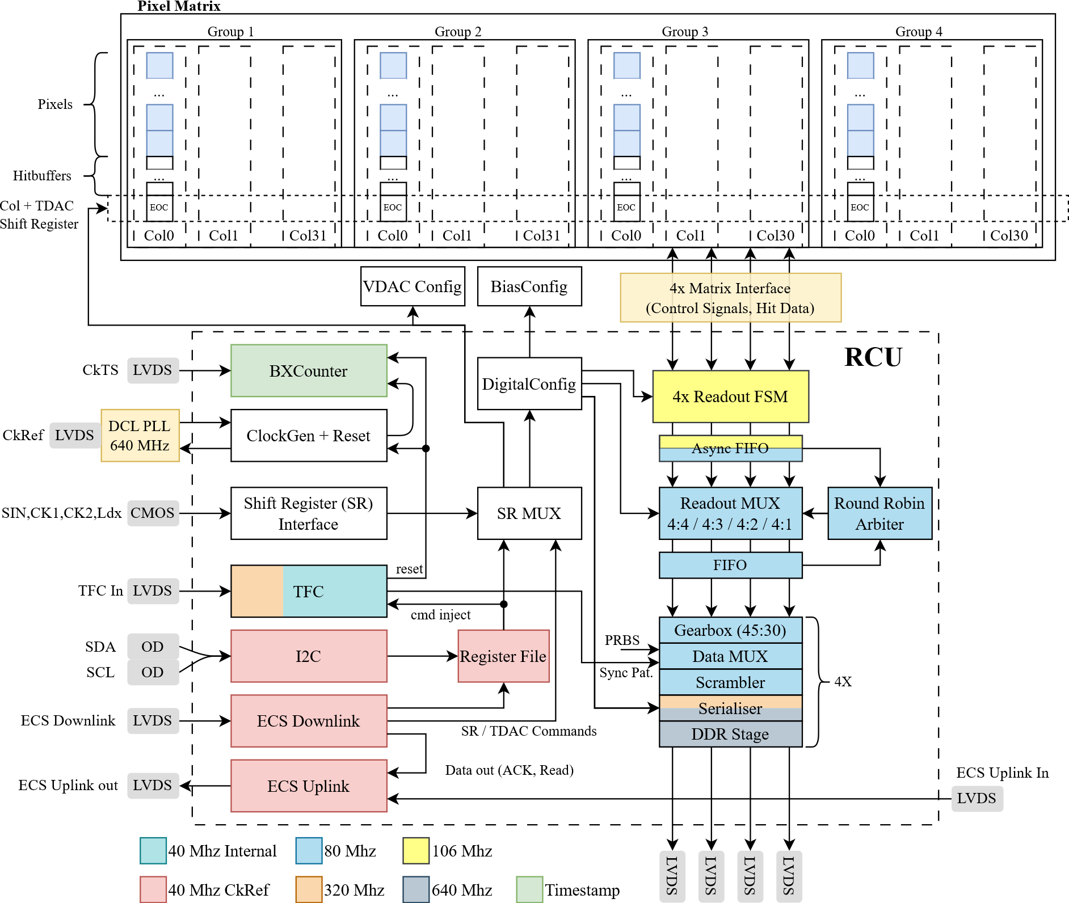
Readout Control Unit (RCU)
N. Striebig et al 2026 JINST 21 C04059
Readout Control Unit (RCU)
Main digital readout block
Contains:
Readout FSMs
Asynchronous FIFOs
Readout multiplexer
Round-robin arbiter
Gearbox
Scrambler
Serializer
DDR output stage
Slow Control Interfaces
Used for:
Chip configuration
Monitoring
Status register readback
On-chip ADC readout
Main interface:
ECS downlink
10 Mbps serial link
8b/10b encoded
Notes:
The Readout Control Unit, or RCU, is a relatively complex digital block responsible for controlling the complete chip readout.
It contains the readout finite state machines, asynchronous FIFOs, multiplexers, arbitration logic, gearbox circuits, scramblers, serializers, and the final DDR output stage.
The chip also incorporates several slow-control interfaces that are primarily used for device configuration, monitoring, status register readback, and access to on-chip ADC data.
The main control interface is the ECS downlink operating at 10 megabits per second.

Slide 63
Test Results
Test Results
Measured prototypes:
MightyPix1
LF-MightyPix
Focus:
Radiation hardness
Hit efficiency
Timing performance
Notes:
Finally, I would like to show some measurement results.
So far, we have tested both MightyPix1 and LF-MightyPix.
In the following slides, I will highlight several important results related to radiation hardness, hit efficiency, and timing performance.

Slide 64
DESY Test Beam
DESY Test Beam
Measurements performed after irradiation
Scans:
Threshold scans
Bias voltage scans
Conditions:
Up to 3 × 10¹⁵ neq/cm²
High-voltage operation up to 480 V
Notes:
These are preliminary results from our recent DESY test beam campaign investigating the radiation hardness of LF-MightyPix.
We performed threshold scans at 190 volts = the full unirradiated depletion voltage, and the maximum safe operating voltage, for each irradiation fluence.
For fluences of 5 x 10¹⁴ and 10¹⁵ n_{eq} /cm², additional scans of the bias voltage were performed at constant threshold.

Slide 65
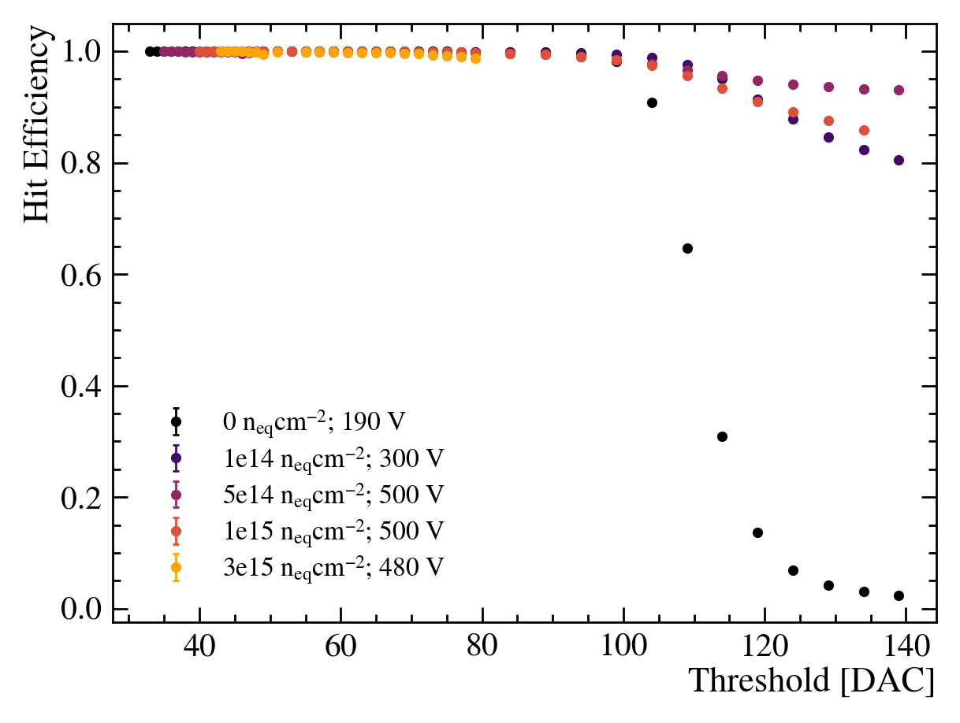
Radiation Hardness
Radiation Hardness
LF-MightyPix achieves:
99% hit efficiency
up to 3 × 10¹⁵ neq/cm²
Operation voltage:
up to 480 V
Measurements: Lucas Dittmann (U. Heidelberg)
Notes:
LF-MightyPix achieves hit efficiencies above 99 % up to fluences of 3 x 10¹⁵ n_{eq} /cm².
This was achieved at bias voltages up to 480 volts.
These results demonstrate radiation hardness and significantly exceed the original detector requirements.

Slide 66
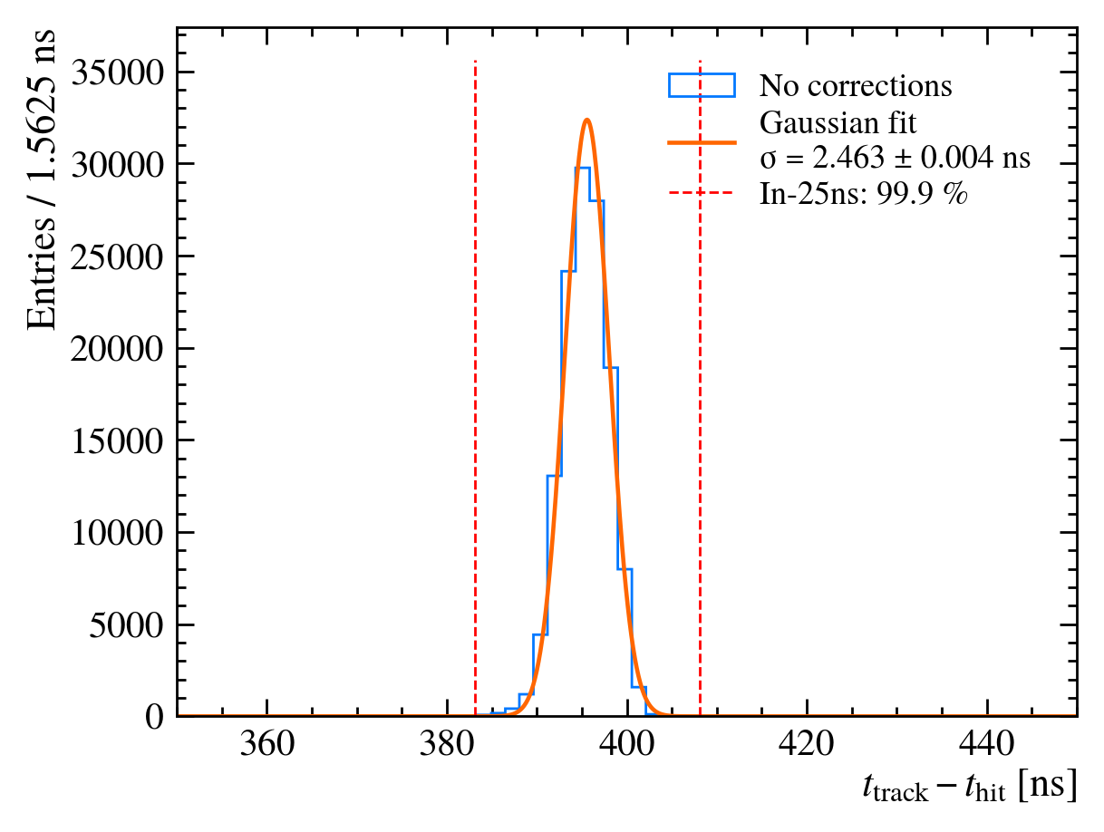
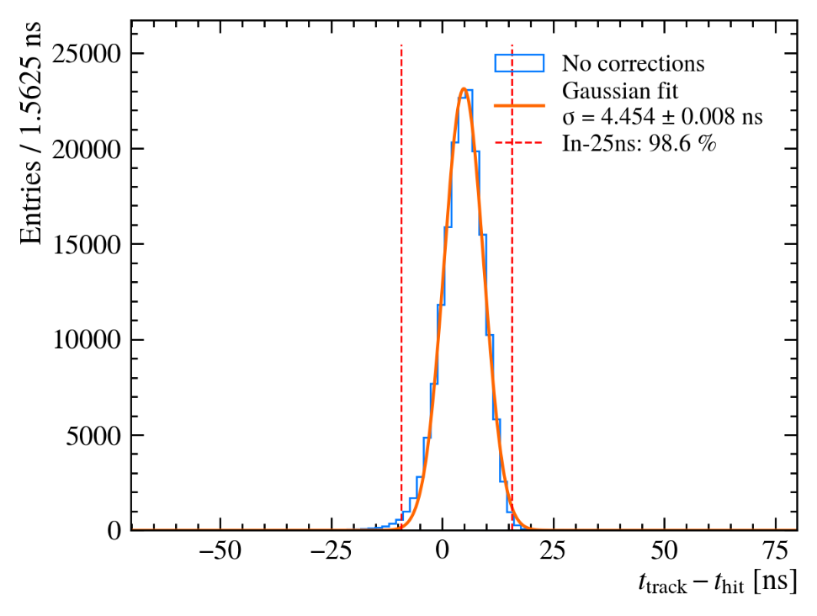
Timing Resolution
Timing Resolution
Without timewalk correction:
~2.5 ns
up to 1 × 10¹⁵ neq/cm²
~4.5 ns
at 3 × 10¹⁵ neq/cm²
In-Time Efficiency
LHCb requirement:
99% within 25 ns
Measured:
fulfilled up to 1 × 10¹⁵ neq/cm²
98.6% at 3 × 10¹⁵ neq/cm²
Measurements: Lucas Dittmann (U. Heidelberg)
Notes:
At high bias voltages, the measured time resolution is approximately 2.5 nanoseconds up to fluences of 10¹⁵ n_{eq} /cm², even without applying timewalk correction.
At the highest tested fluence of 3 x 10¹⁵ n_{eq} /cm², the timing resolution degrades to approximately 4.5 nanoseconds.
We also evaluated the in-time efficiency within the 25 nanosecond bunch-crossing interval.
The LHCb requirement of 99 % efficiency within 25 nanoseconds is fulfilled up to fluences of 10¹⁵ n_{eq} /cm².
Even at the highest fluence, we still measure 98.6 % in-time efficiency.

Slide 67
Conclusion
Conclusion
MightyPix demonstrates:
high-rate capability
fast timing
strong radiation hardness
HV-CMOS is a strong candidate for:
LHCb Mighty Tracker
Next steps:
MightyPix2 measurements
MightyPix3 development
Notes:
In conclusion, MightyPix demonstrates that HV-CMOS technology is a strong candidate for the LHCb Mighty Tracker.
The prototypes achieve high-rate capability, fast timing performance, and excellent radiation hardness.
The next steps are the measurement campaign for MightyPix2 and the further optimization towards MightyPix3.
Thank you for your attention.

