Slide 1

Smartpixels: In-pixel AI for on-sensor data filtering
May 20th 2026
Benjamin Parpillon
FEE2026

Slide 2
Agenda
Physics Motivation
Filtering Machine Learning
Front-End Implementation
Test Result
Status And Next Steps

Slide 3
Physics Motivation
01

Slide 4
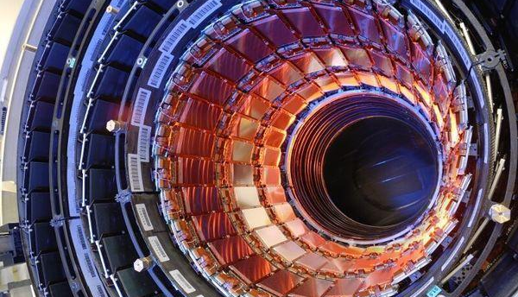
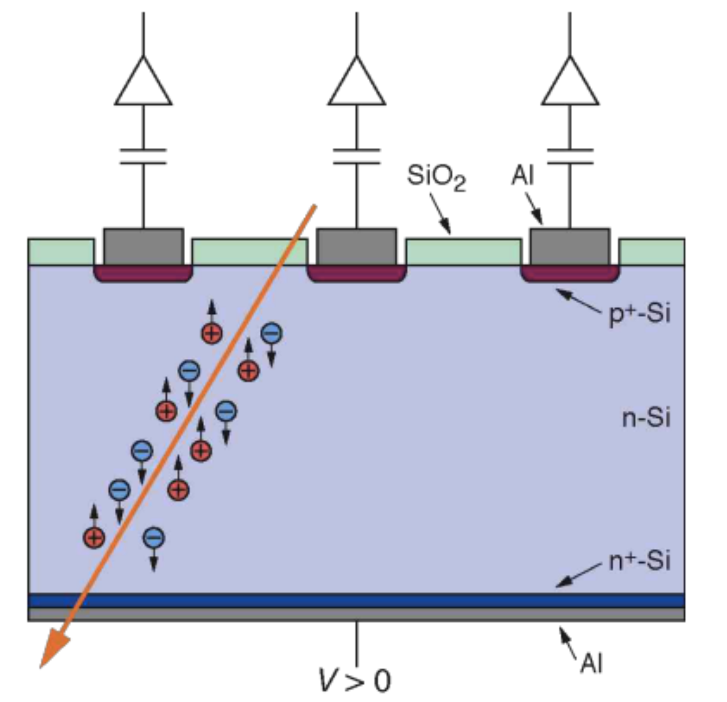
Silicon Pixel Detectors
Experiments at colliders typically have a silicon pixel detector at the center
Concentric rings tiled with sensors
Silicon sensors are depleted of charge carriers by high voltage
When a charged particle from a collision passes through, it creates e/h pairs
Charge is read out and transferred off-detector
Charge cluster information is used for physics analysis offline
Silicon Pixel Detector at CMS (LHC, CERN)

Slide 5

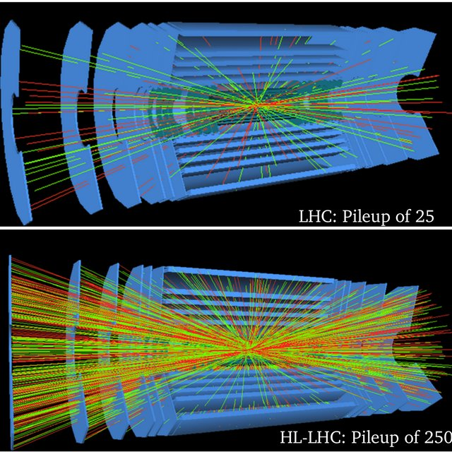
Case Study
CMS Phase-2
Exploratory R&D
> 90% of detector data originates from silicon pixels
Pixel detector data rates continue to scale aggressively
In 2018, CMS saw ~40 simultaneous pp collisions
The High Luminosity LHC will increase this to ~200
5 times improved luminosity (radiation)
7 times higher interaction rate (~3Ghit/cm2)
Technology | 65nm | 28nm
Pixel size | 100x25 | 50x12.5 𝛍m²
Pixels # | 157.6k | 0.63M
Trigger rate | 750KHz | 40MHz
Readout data rate | 1-4 links @ 1.28Gbps | Photonic link @ 30-100 Gbps
Radiation tolerance | 500Mrad | 1Grad
Power density | 1 W /cm² | 1 W /cm²

Slide 6

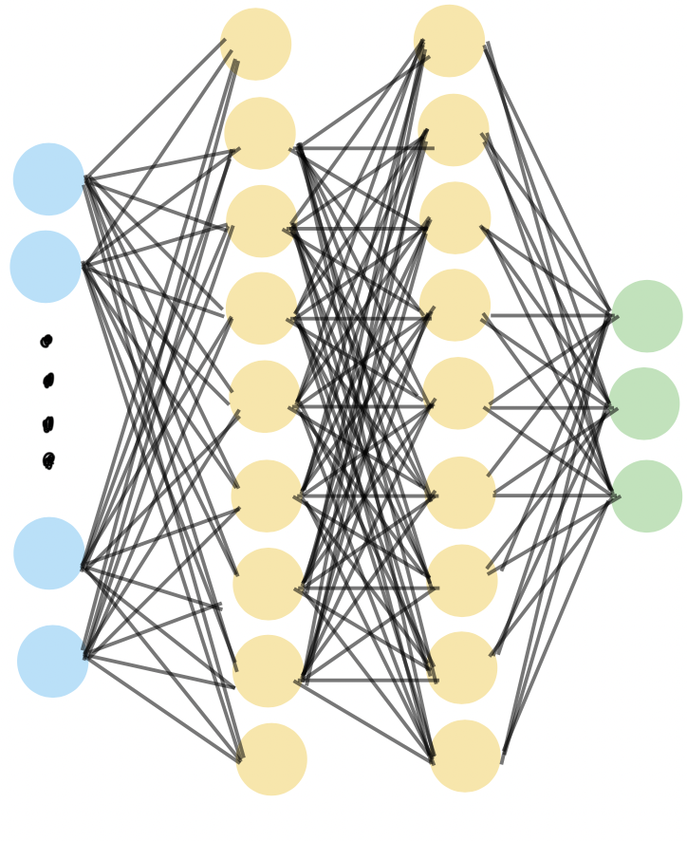
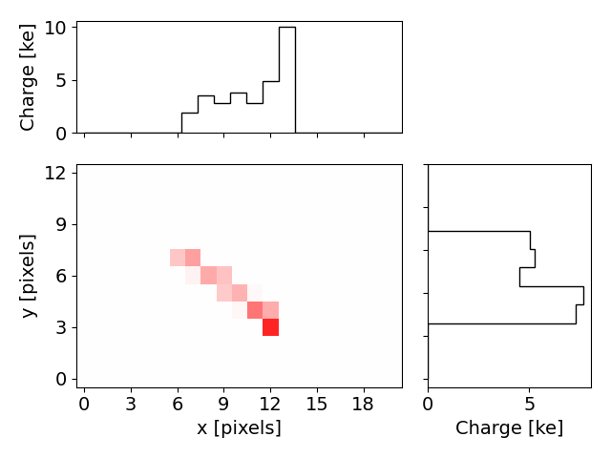
High Level Proposed System
4. ML model
5. Decision
1. Collision
2. Sensor
3. Cluster
No physics value
Physics
value
AI on chip

Slide 7
Filtering Machine Learning
02

Slide 8
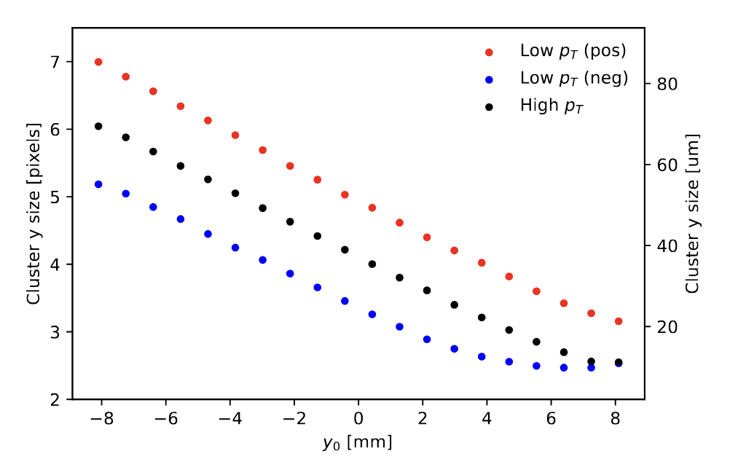
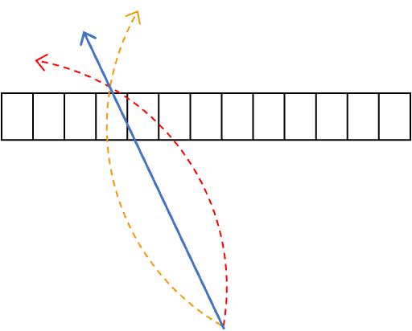
Clusters Properties
https://iopscience.iop.org/article/10.1088/2632-2153/ad6a00
Incident charge particle → deposits cluster of charge in pixel array
High pT
B=(3.8,0,0)T
Lorenz drift
low pT
-ve charge
low pT
+ve charge
Global Y-coordinate [mm] *y-direction - along the bending plane of magnetic field
Cluster information across the y-direction can be used to infer the momentum of the track
Predicting pT from cluster morphology is not easily reducible to LUT logic

Slide 9
Filtering Neural Network
High pT
B=(3.8,0,0)T
low pT
-ve charge
low pT
+ve charge
∑
Quantity of interest: Cluster profile along Y (sum of charge values over pixel rows after 4 ns) Correlated with:
y-position
incident particle’s pT
∑
Sample event display at 4 ns
16 input values
3 output classes
16 X-projected cluster values
+ve charge, pT < 0.2 GeV
-ve charge, pT < 0.2 GeV
pT > 0.2 GeV
*The cluster shapes are dependent on global y-position of pixel sensors. Separate weights and biases are trained for different y-local regions
Training hyper-parameter

Slide 10
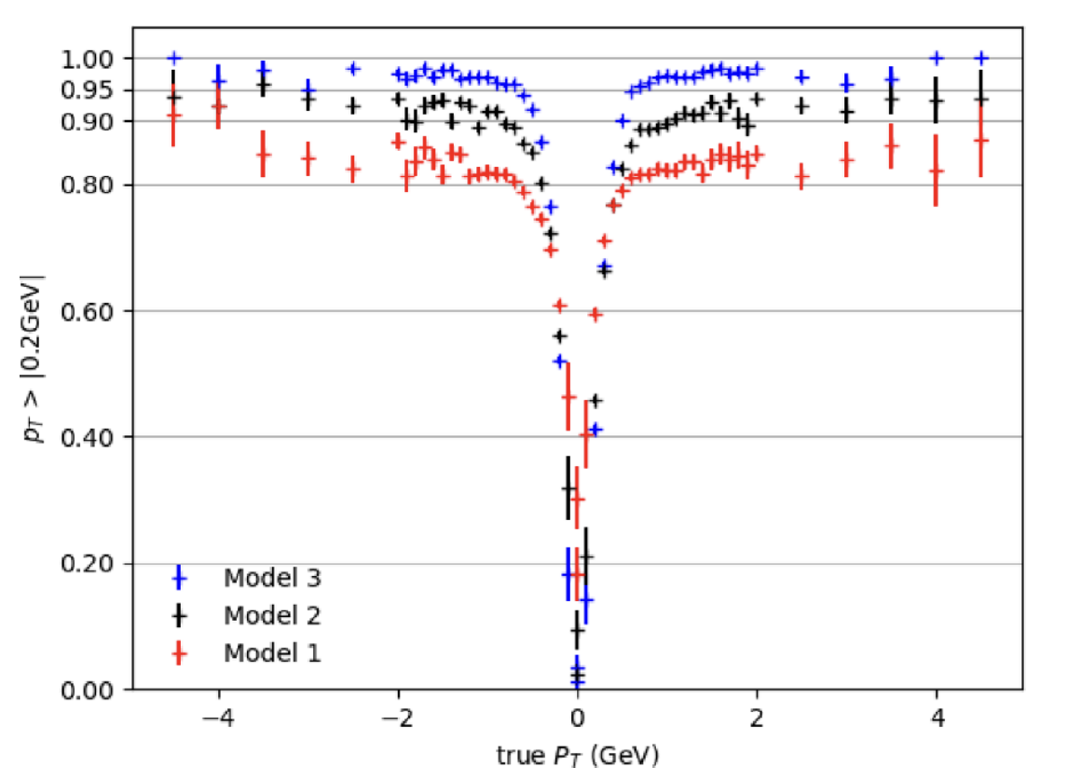
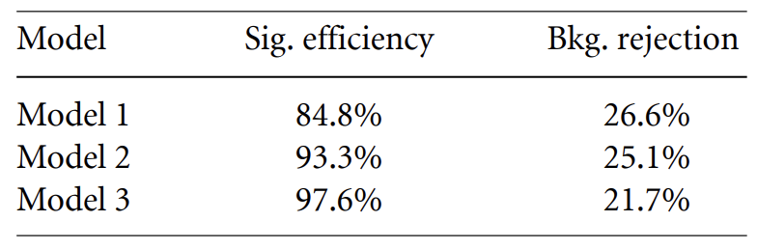
First Step: p_{T} Filter at Full Precision
Train fully-connected, feed-forward network
Test selection of input features
Cluster size (in bending direction) only
Projected cluster shape, integrated over 4 ns
Eight temporal “snapshots” of cluster shape in 200 ps intervals, showing evolution of cluster
Key metrics:
Efficiency (tracks with true p_{T} > 2 GeV correctly identified as high p_{T})
Background rejection (tracks with true p_{T} < 2 GeV correctly identified as low p_{T})
Data reduction (all tracks classified as low p_{T})
*
*
Model 2 selected as benchmark for compromise between performance and simplicity
* Produced in 2024 with preliminary dataset

Slide 11
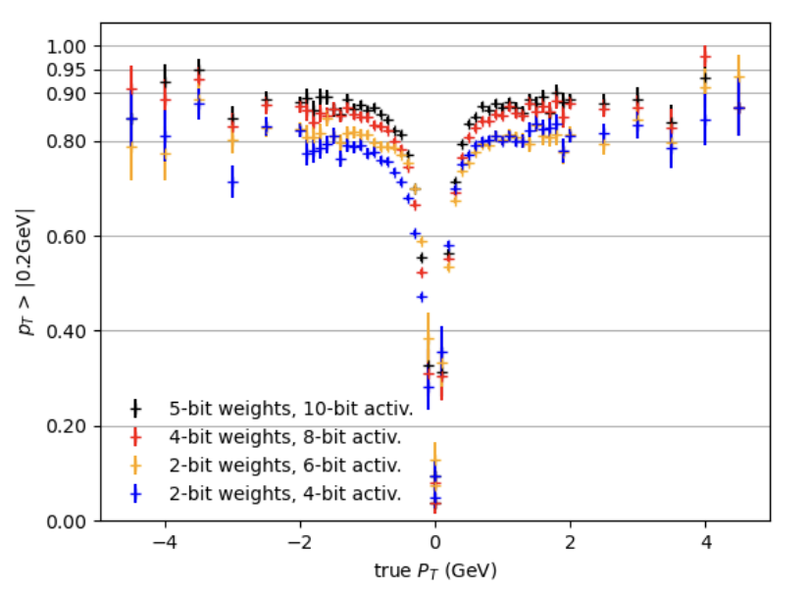
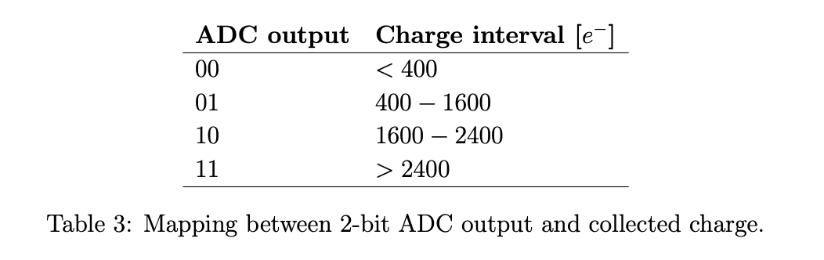
Digitization And Simulated Performance
Charge digitalization: 2-bit “flash” ADC
Weight/activation quantized to 4-bit and 8-bit respectively
$$Data reduction=0.4×bkg reduction+0.6× untracked data reduction$$
Untracked data reduction (single-pixel hits (noise), loopers) estimated between 61to 100%
Bkg. reduction > 20%
Total data reduction estimated between 54 to 75%
https://iopscience.iop.org/article/10.1088/2632-2153/ad6a00

Slide 12
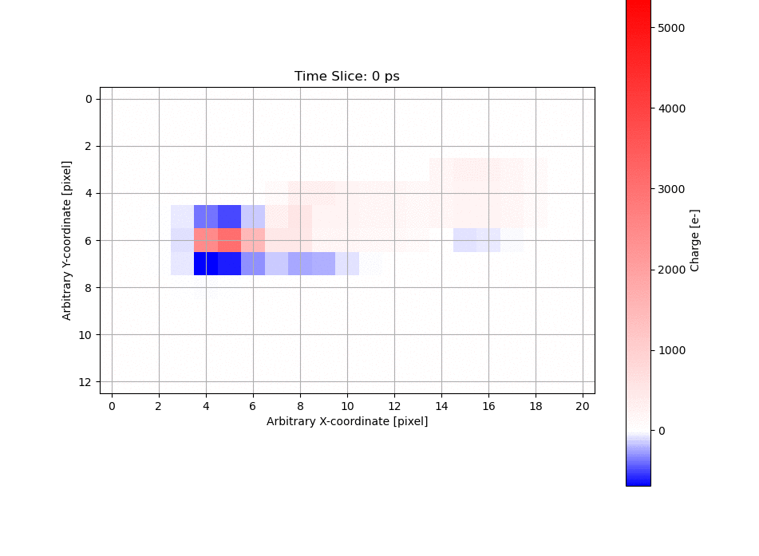
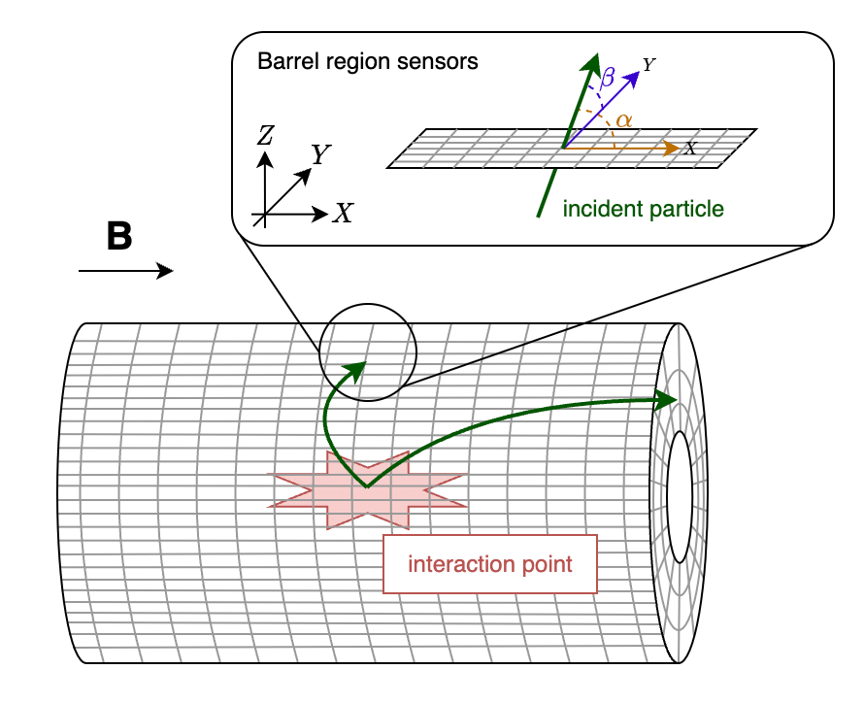
Training Data: Simulation
50 x 12.5 μm² pitch pixels (100 μm thickness)
Dataset extracted for 16x16 pixel array.
Electric field maps of pixel sensor are generated using TCAD simulation.
Field maps are imported into PixelAV
Provide realistic detector response
200ps time slice
Public dataset !
Charge deposited in pixel array for an incident particle
A detailed simulation tool for silicon detectors
Datasets now made available publicly on zenodo! https://zenodo.org/records/17180303
https://zenodo.org/records/18472791
image credits: Danush Shekar

Slide 13
Front-End Implementation
03

Slide 14
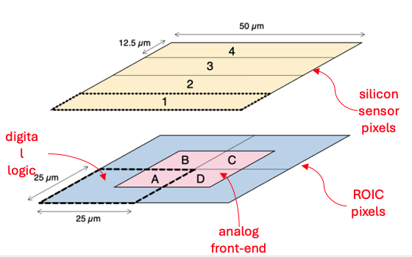
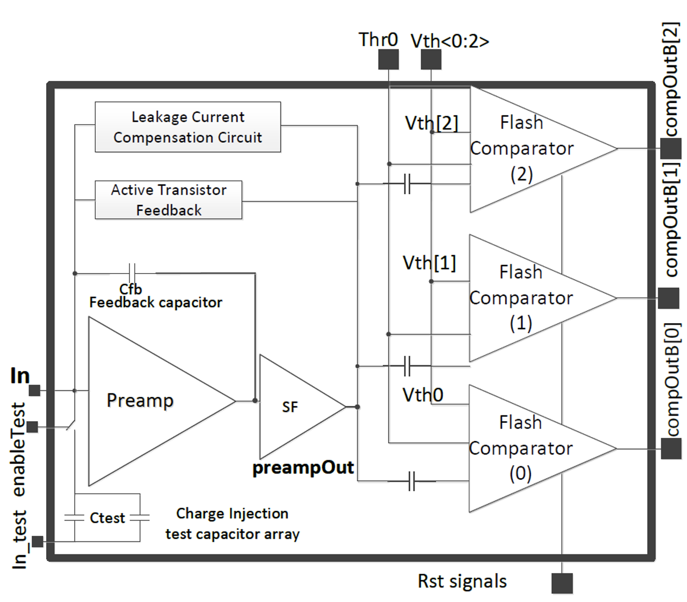
Front-End Pixel Architecture: Synchronous ADC
25µm × 25µm pixel sizes
<1W/cm² Power density
CSA architecture inspired by FCP130 (not Krummenacher)
AC coupled 40MSPS in-pixel 2-bit flash ADC
Auto-Zero (AZ) in every pixel for threshold correction
Insensitive to pile-up
2 architectures tested
Global charge injection site with programmable capacitive array
No sensor bonded to this prototype
Comparison study here
Detail design here

Slide 15
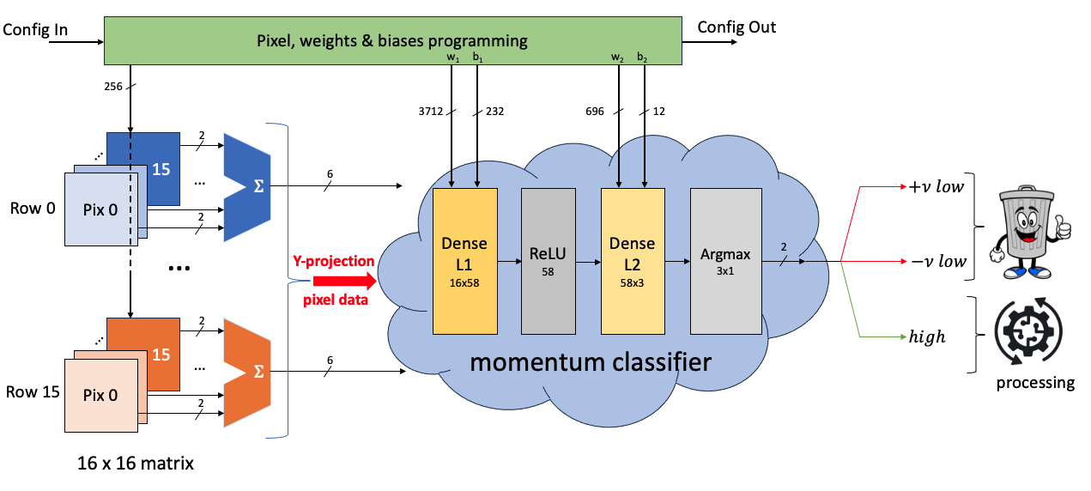
Implementable Network
Key Take-Away:
Reprogrammable Network
Region specific training
Improve resilience against faulty pixels
Retrain after radiation damage
Classifier fully combinatorial
Power proportional to hit density

Slide 16
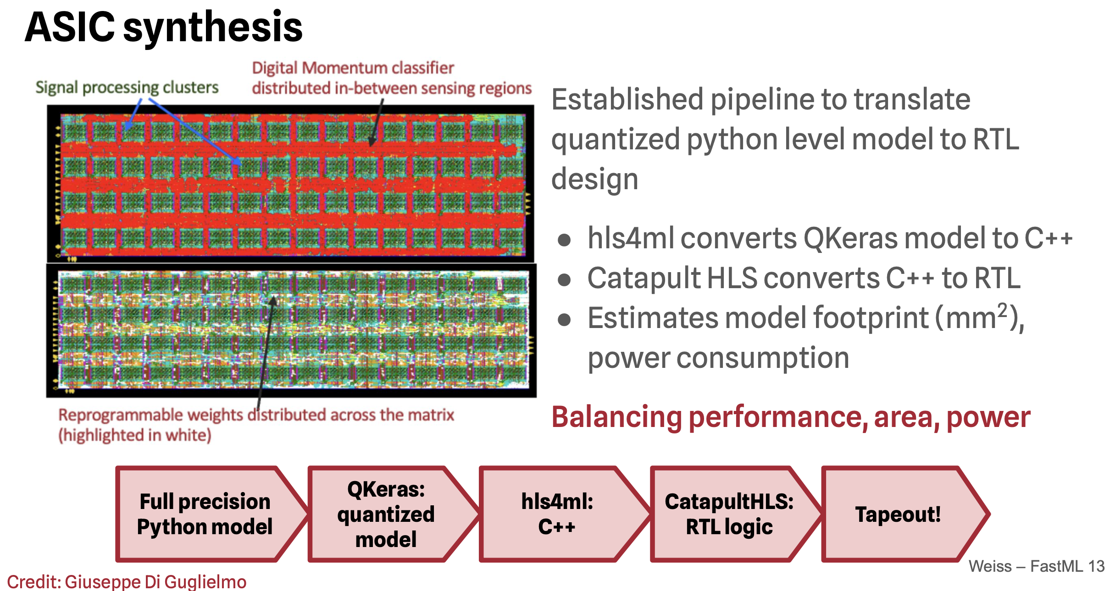
First Smartpixels Tapeout With Network

Slide 17
Test Result
04

Slide 18
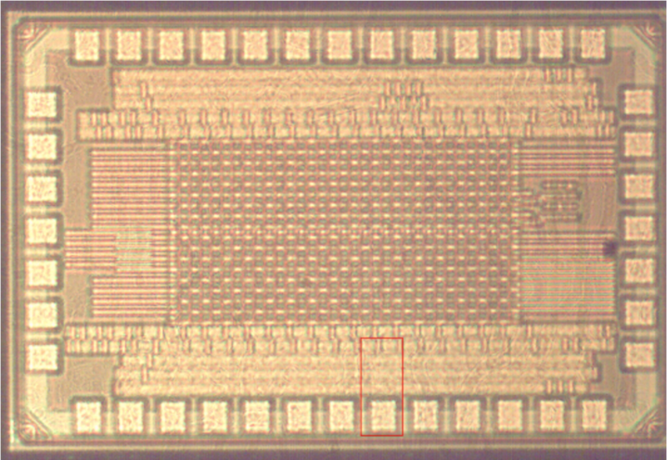
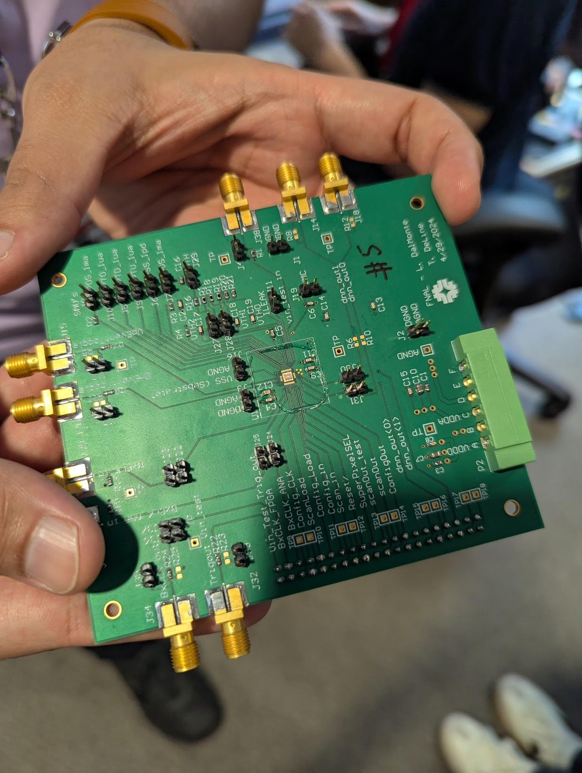
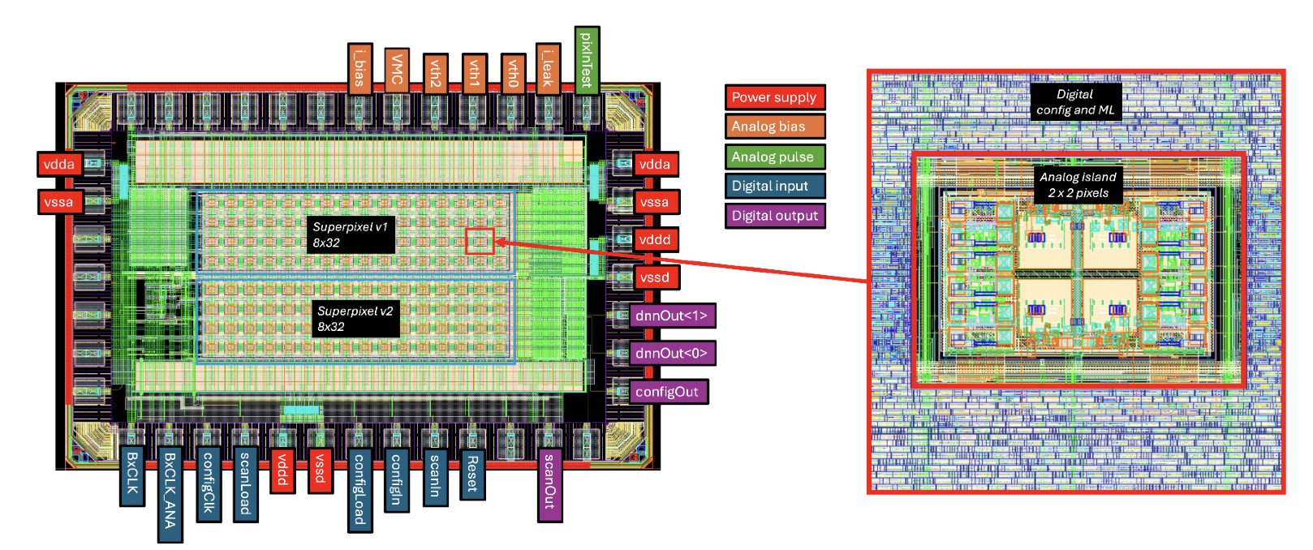
First Prototype
1.5mm² die – tsmc28
Pixel Analog Front End Prototype v1 with digital ML Filter
two16x16 (sensor side) superpixel variants
Mixed signal implementation but still analog on top

Slide 19
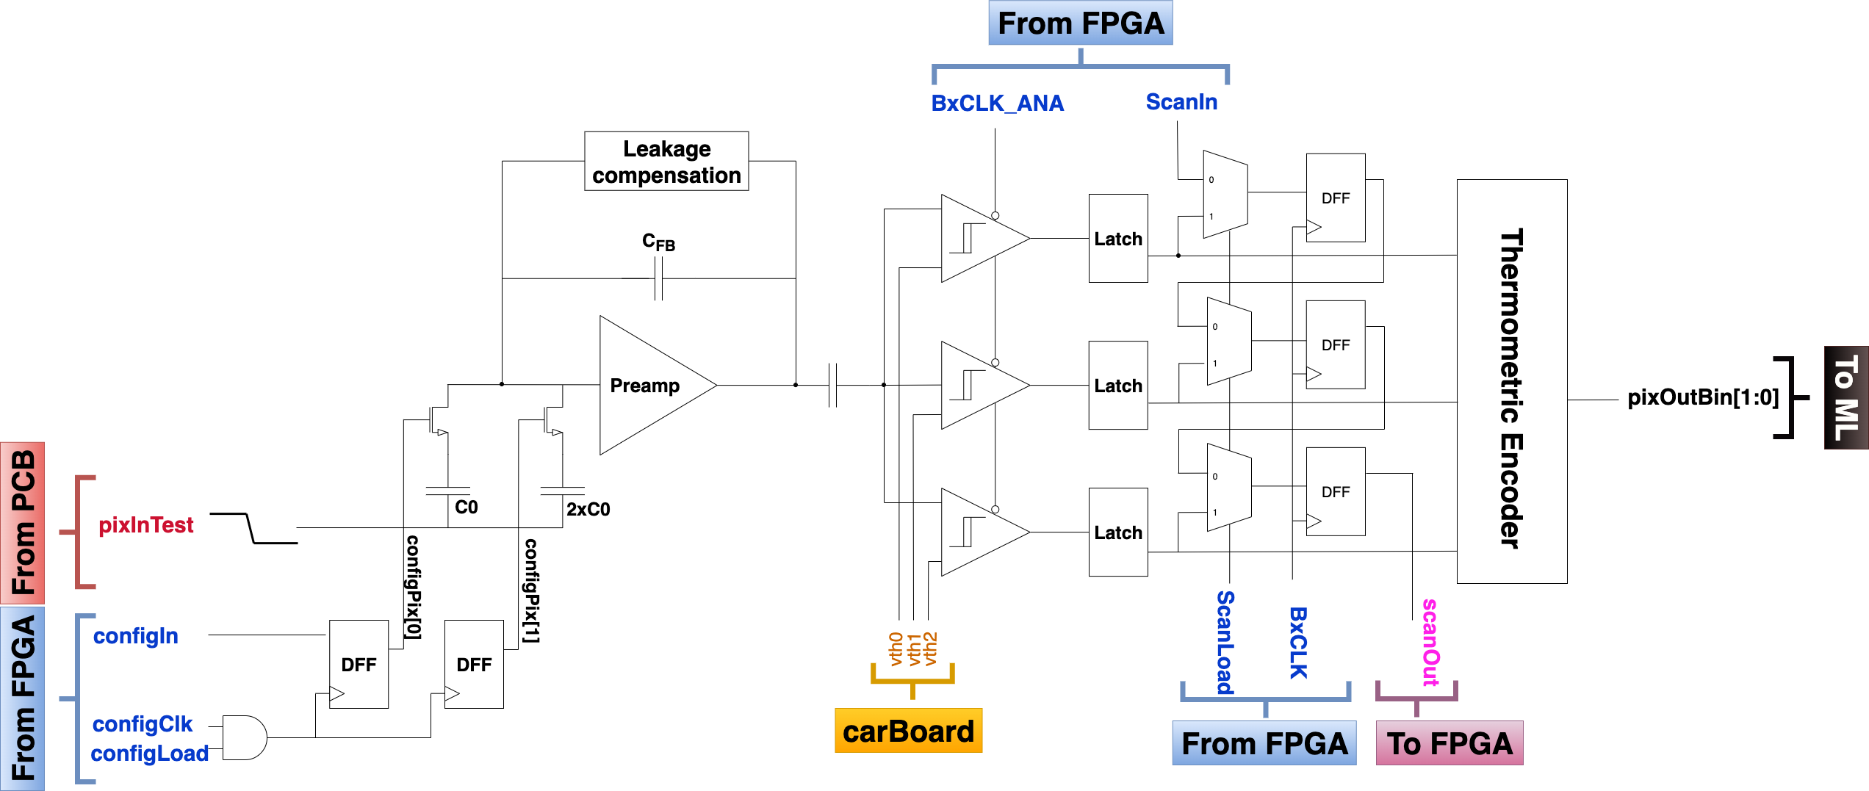
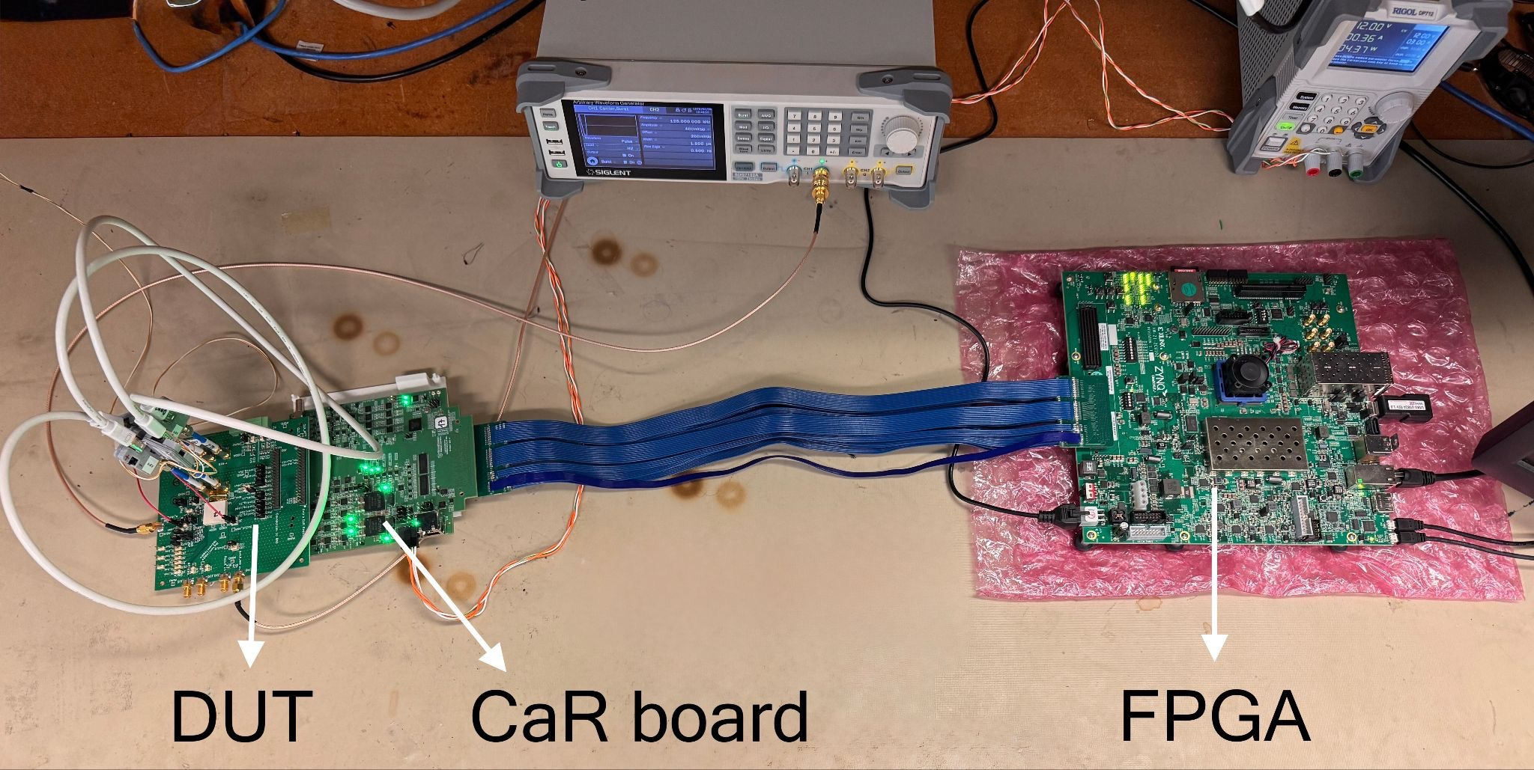
ASIC Test Stand
https://arxiv.org/abs/2510.07485
Scurve on 3 bit
Lightweight test stand duplicated at 3 universities
Pixel interface with DAQ and FPGA validated
Three comparators implement 2-bit flash ADC
Per-pixel S-curves extracted across matrix
Threshold and ENC characterization

Slide 20
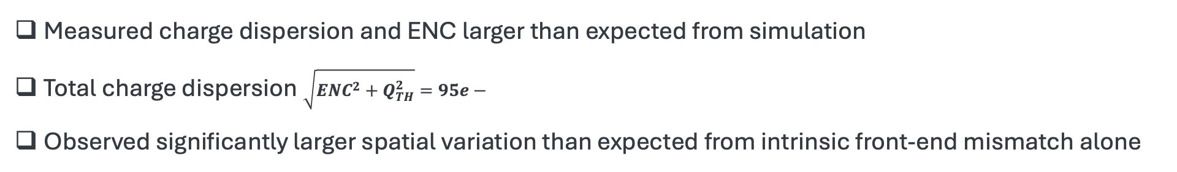
Threshold Dispersion Characterization
Threshold Dispersion
Threshold heat map
Q_{TH} = 77.5 e-
ENC = ~55 e-
768 bits
Room Temp
Measured charge dispersion and ENC larger than expected from simulation
Total charge dispersion $\sqrt{{ENC}^{2}+Q_{TH}^{2}}=95e−$
Observed significantly larger spatial variation than expected from intrinsic front-end mismatch alone

Slide 21
Characterization Non-Idealities Identified
Threshold Dispersion
Global injection network effect
Distributed RC degradation on global injection grid
Spatially varying injected charge amplitude
Artificial shift in extracted thresholds
Q_{TH} = 77.5 e-
ENC = ~55 e-
Threshold dispersion Q_{TH} across pixels
Global Injection connected to 512 pixels
Threshold heat map

Slide 22
Characterization Non-Idealities Identified
Threshold Dispersion
Global injection network effect
Distributed RC degradation on global injection grid
Spatially varying injected charge amplitude
Artificial shift in extracted thresholds
Threshold-bias sensitivity
Shared VTH bias grid affected by high leakage (>uA)
Leakage creates systematic offsets across both matrices
Spatial pattern likely reflects combined injection + bias-grid effects
Effect dominated by characterization infrastructure
Fix implemented in future ASIC iteration
Q_{TH} = 77.5 e-
ENC = ~55 e-
Threshold dispersion Q_{TH} across pixels
Threshold heat map
Key question:
How much do these front-end non-idealities affect ML inference?

Slide 23
Measured Classification Performance
Comparison of software, quantized, and measured ASIC inference
On-chip classifier evaluated using measured front-end response
Region-specific weights trained for y-local range [0.0, 1.35) mm
 | Sig. efficiency | Bkg rejection
Full precision model | ~92 | 42
Quantized model | ~92 | 40
Key metrics:
Signal Efficiency (tracks with true p_{T} > 2 GeV correctly identified as high p_{T})
Bkg rejection (tracks with true p_{T} < 2 GeV correctly identified as low p_{T})
160K event

Slide 24
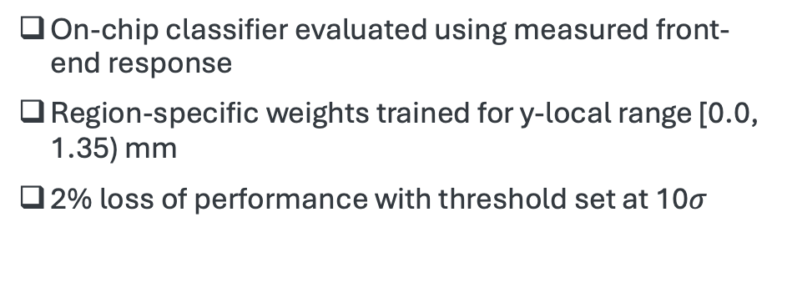
Measured Classification Performance
Comparison of software, quantized, and measured ASIC inference
On-chip classifier evaluated using measured front-end response
Region-specific weights trained for y-local range [0.0, 1.35) mm
2% loss of performance with threshold set at 10$σ$
 | Sig. efficiency | Bkg rejection
Full precision model | ~92 | 43
Quantized model | ~92 | 38
ASIC @1000e- | ~90 | 36
160K event

Slide 25
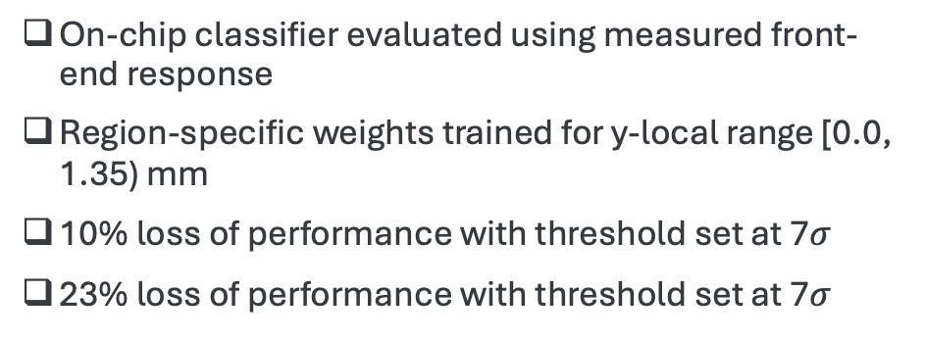
Measured Classification Performance
Comparison of software, quantized, and measured ASIC inference
On-chip classifier evaluated using measured front-end response
Region-specific weights trained for y-local range [0.0, 1.35) mm
10% loss of performance with threshold set at 7$σ$
23% loss of performance with threshold set at 7$σ$
 | Sig. efficiency | Bkg rejection
Full precision model | ~94 | 42
Quantized model | ~94 | 40
ASIC @ 700e- | ~84 | 44
ASIC @ 400e- | ~71 | 33
Noise level directly impact the signal efficiency
160K event

Slide 26
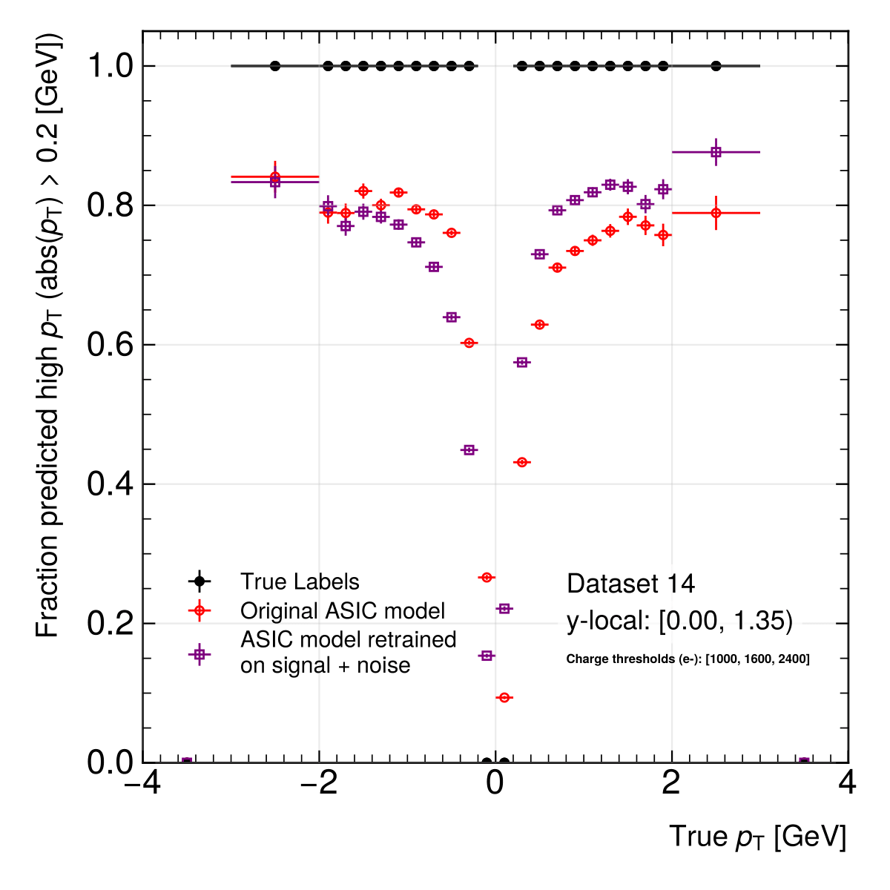
Promises On Noise Retraining
smartpixel CPAD 2025
The model was re-trained with noise-injected simulation data
Retraining with realistic noise recovers substantial efficiency
Same Hardware, updated weights and biases
Flow is complex and mostly manual pipeline is a work in progress
Training Model In ASIC @1000e- | Sig. efficiency | bkg rejection
signal | 78.91 % | 45.42 %
signal & noise | 87.64 % | 45.33 %

Slide 27
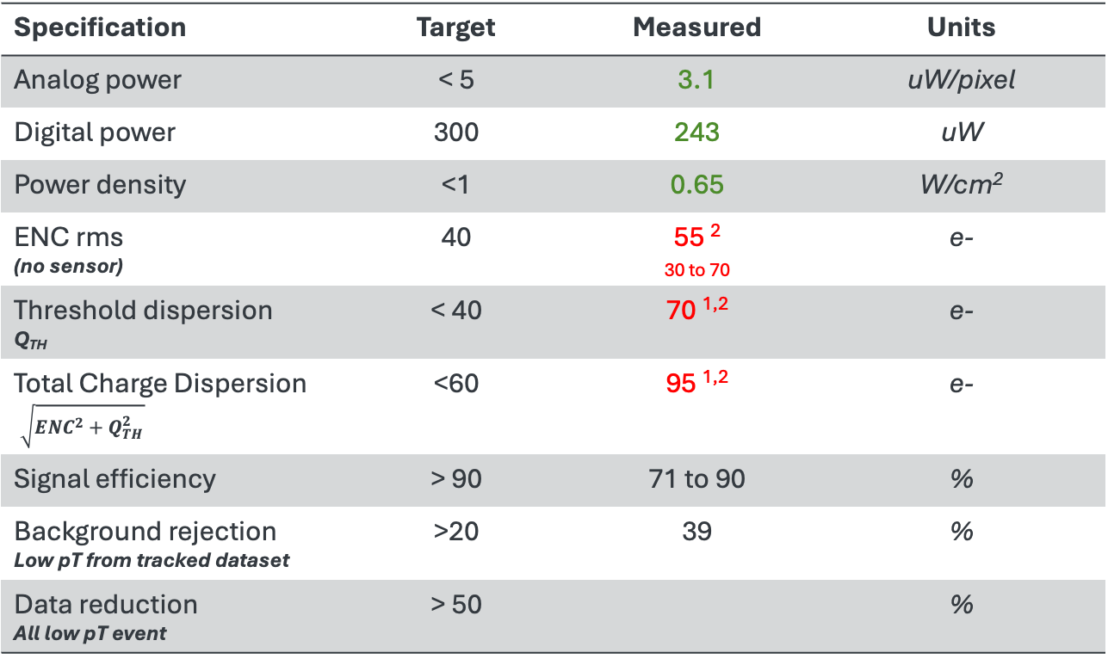
Performance at Room Temperature
Specification | Target | Measured | Units
Analog power | < 5 | 3.1 | uW/pixel
Digital power | 300 | 243 | uW
Power density | <1 | 0.65 | W/cm²
ENC rms (no sensor) | 40 | 55 ² _{30 to 70} | e-
Threshold dispersion Q_{TH} | < 40 | 70 ^{1,2} | e-
Total Charge Dispersion $\sqrt{{ENC}^{2}+Q_{TH}^{2}}$ | <60 | 95 ^{1,2} | e-
Signal efficiency | > 90 | 71 to 90 | %
Background rejection Low pT from tracked dataset | >20 | 39 | %
Data reduction All low pT event | > 50 |  | %
Leakage on bias grid
Global Charge injection

Slide 28
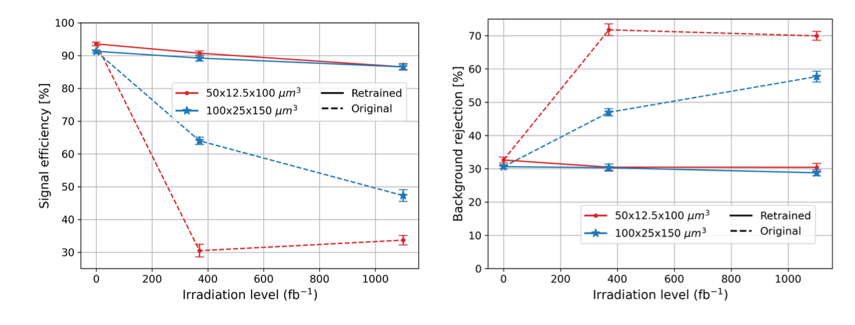
Incoming Test: Radiation Damage Correction
HL-LHC will reach unprecedented radiation levels, highest in barrel pixel layer 1, 3 cm from collisions
Generate datasets with simulated radiation damage (models from PixelAV)
3.3 x 10¹⁵ n_{eq}/cm² (370 fb⁻¹ (Run 3) at Layer 1)
1.0 x 10¹⁶ n_{eq}/cm² (1100 fb⁻¹ (half of HL-LHC) at Layer 1)
Retraining (new weights, same structure) recovers most performance for both benchmark and HL-LHC sensor geometry, and will be possible for an eventual detector
Next step: leverage leakage current injection to mimic effect of radiation and retrain the ASIC to recover performance
https://arxiv.org/abs/2510.06588
Under review NIM-A

Slide 29
Status And Next Steps
05

Slide 30
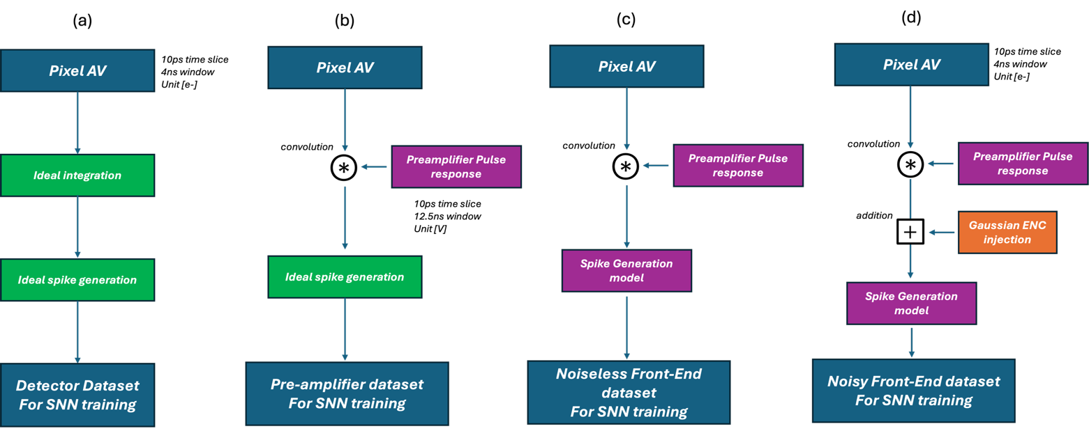
Future Dataset Productions
Current filtering network is mostly time-agnostic
Regression and neuromorphic ML need accurate timing modeling
We are upgrading our dataset flow
CSA model ready and predicts rise time and saturation behavior correctly
ADC and spike generation timing modeling is a work in progress
ENC noise injection is next to train our ML with realistic ASIC conditions
New
In progress
Envisioned dataset production flow
30

Slide 31
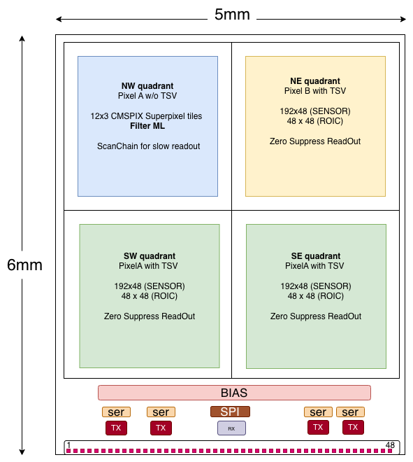

VIZARD 2026
Status
Tapeout: End 2026
Engineer run with CERN
Chip delivery: Early 2027
Overview
Two 30mm2 chips
VIZARD_v0a - backside sensor connection (TSVs)
VIZARD_v0b – frontside sensor connection (Bump bond)
Improved and novel AFE architecture
Zero suppress readout on three 192x48 pixel matrices quadrant
Implementation of 36 digital filter ML (NW quadrant)
SPI interface for configuration and slow readout
High Speed RX/TX interface (1.28Gbps)

Slide 32
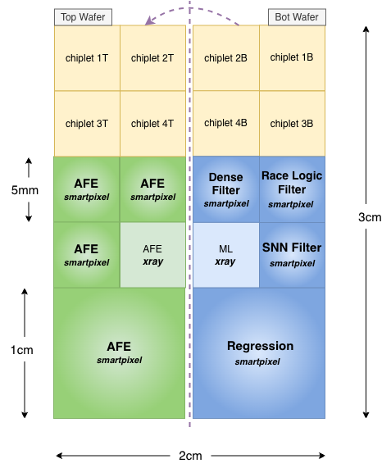
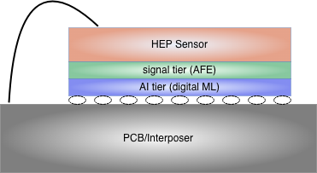
3D chip tapeout
3D integration planned in January 2027
8 chiplets design dedicated for smartpixels
Improved and novel AFE architecture
Smarter digital auto zero cycle control
Explore novel Filter ML architectures (race logic, SNN)
Regression algorithms for real-time physics feature extraction
Fabrication and test planned for 2027-2028
https://arxiv.org/abs/2602.15946
3D detector product

Slide 33
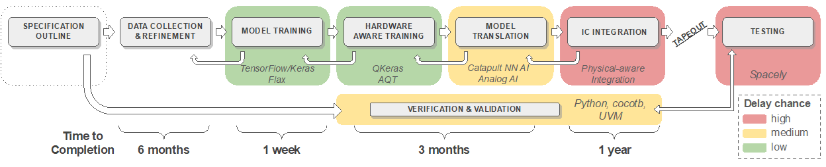
Codesign Flow
1 week
weeks
Dataset production accelerated dramatically
Silicon Realistic Dataset including AFE timing and noise modeling
ML-to-ASIC flow improved Reduced HLS4M
Tight integration of HLS4ML with siemens catapult
We produced with siemens a more automatized flow that works for ASIC
Hardware iteration remains the bottleneck
A chip result is worth a thousand simulations

Slide 34














The Smartpixels Team
Fermi National Accelerator Laboratory: Abhijith Gandrakota, Benjamin Parpillon, Chinar Syal, Douglas Berry, Farah Fahim, Gauri Pradhan, Giuseppe Di Guglielmo, James Hirschauer, Jennet Dickinson, Lindsey Gray, Nhan Tran, Ron Lipton
Cornell University: Jennet Dickinson, Ben Weiss
Johns Hopkins University: Dahai Wen, Morris Swartz, Petar Maksimovic
Northeastern University: Nick Manganelli
Northwestern University: Manuel Blanco Valentin
Oak Ridge National Laboratory: Aaron Young, Shruti R. Kulkarni
Purdue University: Mia Liu, Arghya Das
University of Chicago: Karri DiPetrillo, Anthony Badea, Carissa Kumar, Emily Pan, Rachel Kovach-Fuentes, Aidan Nicholas, Eliza Howard, Eric You
University of Colorado Boulder: Jannicke Pearkes, Ricardo Silvestre
University of Illinois Chicago: Corrinne Mills, Danush Shekar, Jieun Yoo, Mohammad Abrar Wadud
University of Illinois Urbana-Champaign: Mark S. Neubauer, David Jiang
University of Kansas: Alice Bean

Slide 35
Backup
06

Slide 36
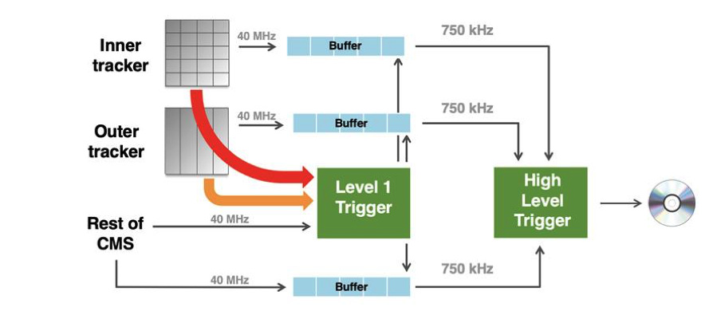
Smartpixel In The Trigger

Slide 37
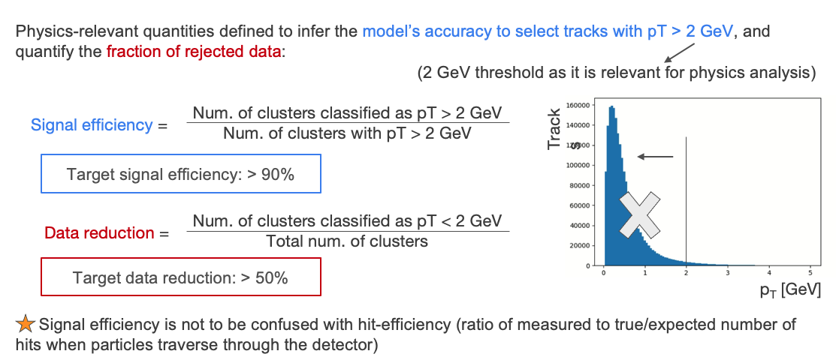
Filtering neural network: performance metrics

Slide 38
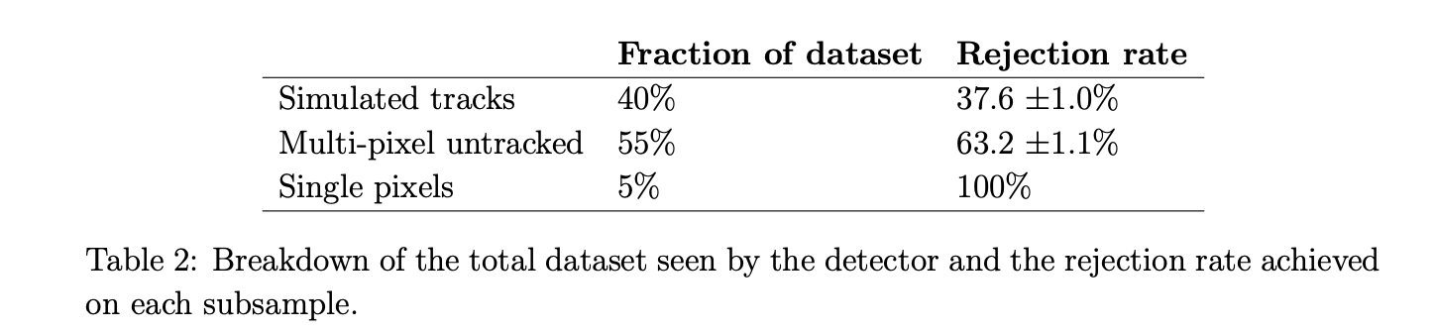
Data reduction
Dataset breakdown seen in the detector
https://arxiv.org/abs/2310.02474

Slide 39
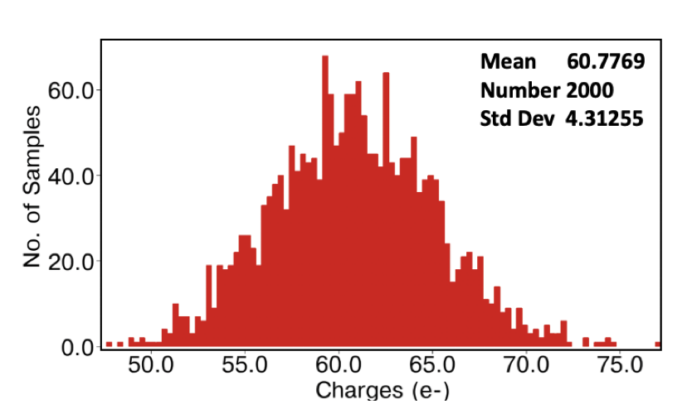
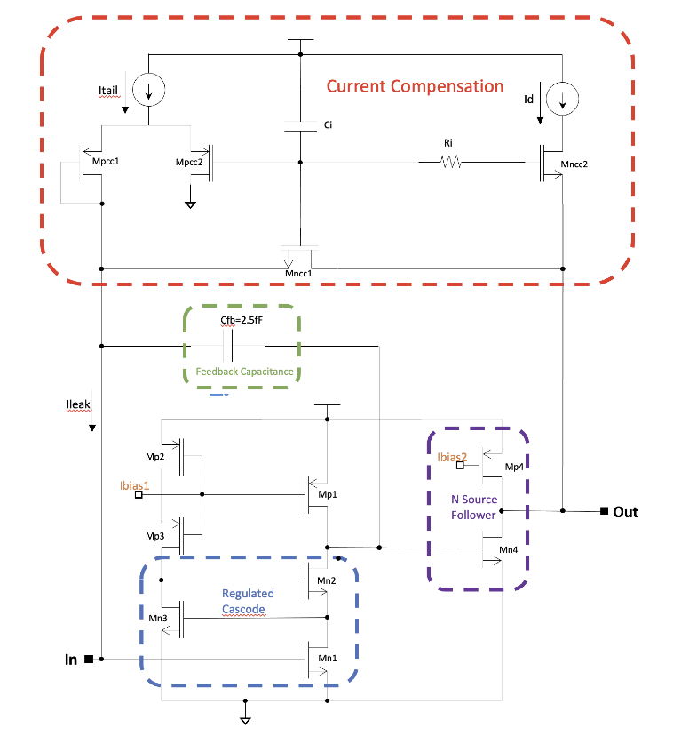
CSA schematic
ENC + MC
Csensor = 30fF
ENC simulation with 30fF sensor capacitor

Slide 40
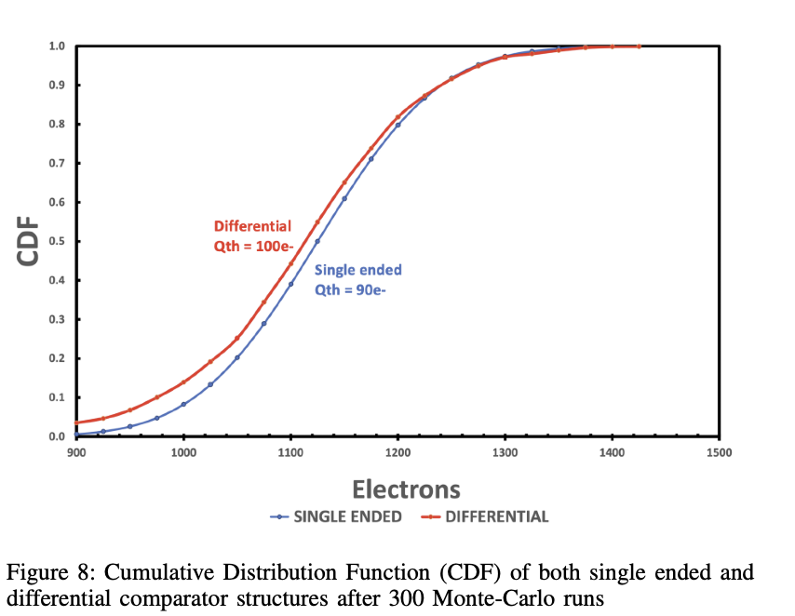
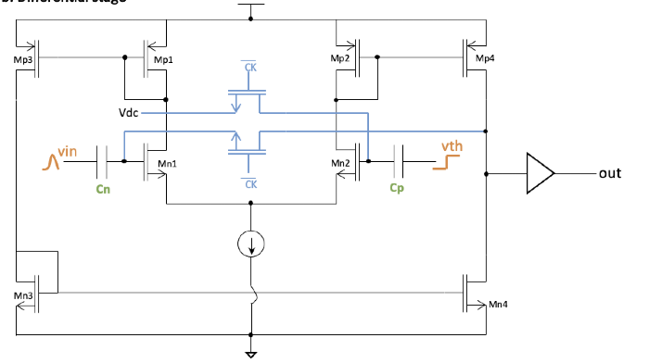
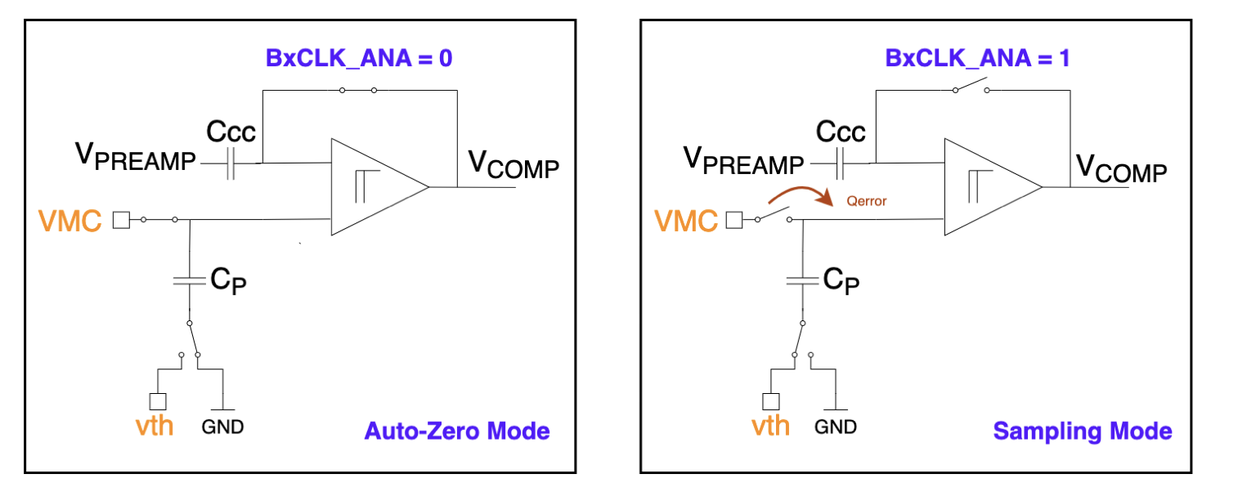
Comparator Schematic and AZ Modes
ENC + MC
Csensor = 30fF

Slide 41
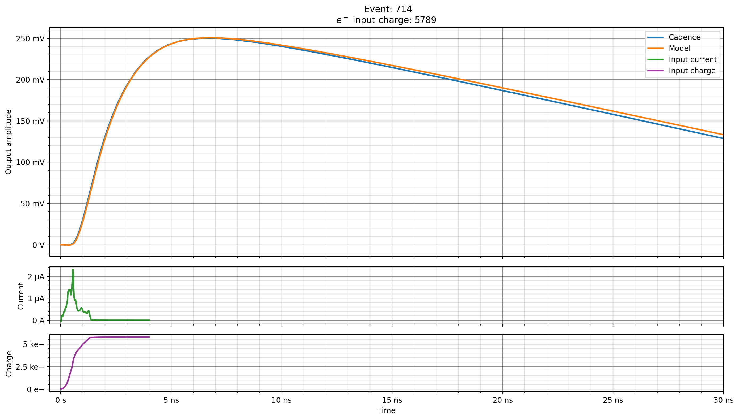
Future Dataset productions
CSA model
Cadence plot
Ideal integration (used in Filter ML)
pixelAV dataset
41

Slide 42
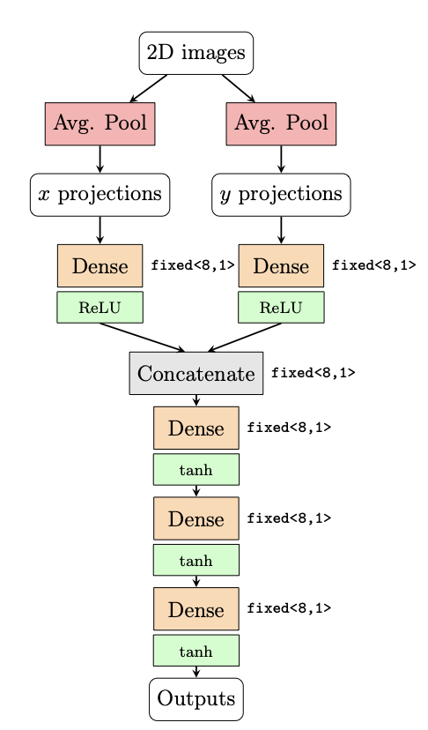
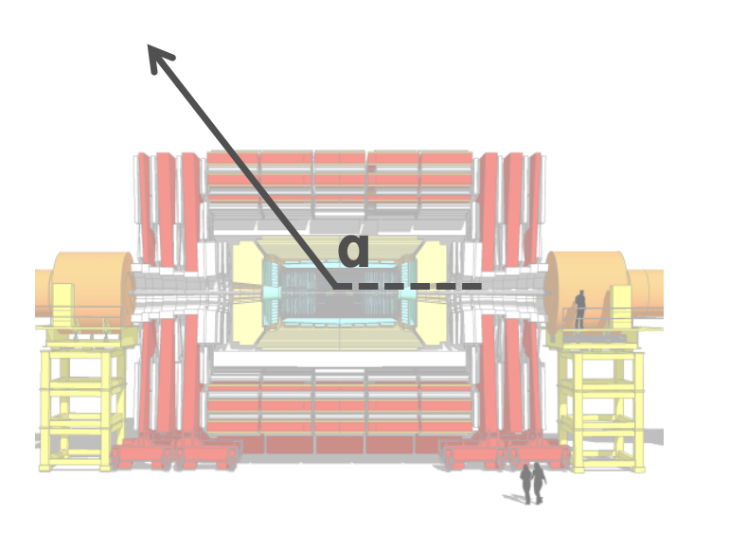
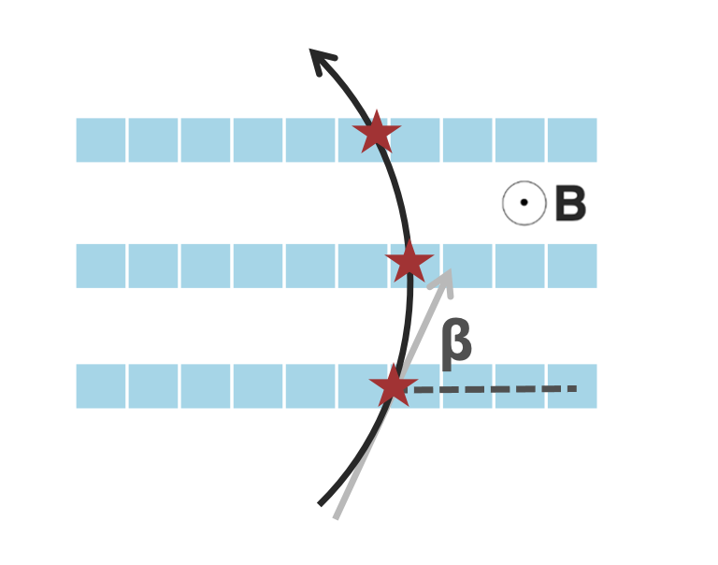
CNN approach - Feature Regression Network
Treat the charge deposited in the pixel array as 2D image
Convolutional layers are powerful for image processing
Each 200 ps time slice is treated as a channel
Predict and read out the traversing particle’s hit position (x, y) and incidence angle (cot ɑ)
https://arxiv.org/abs/2602.15946

Slide 43
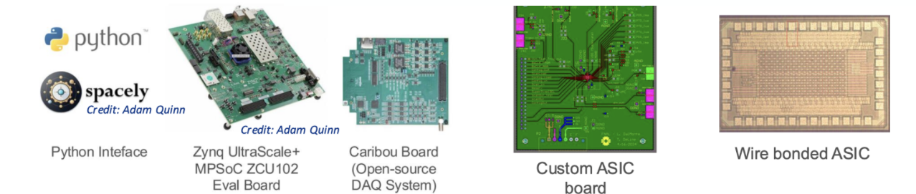
Test Setup Flow

