Slide 1
Event-Driven MAPS for Large-Area Vertex and Tracking Detectors aiming at Intelligent 3D Stacks
Dominik Górni, Grzegorz Deptuch, Piotr Maj
(dgorni@bnl.gov)
XIII FRONT-END ELECTRONICS WORKSHOP
May 19, 2026

Slide 2


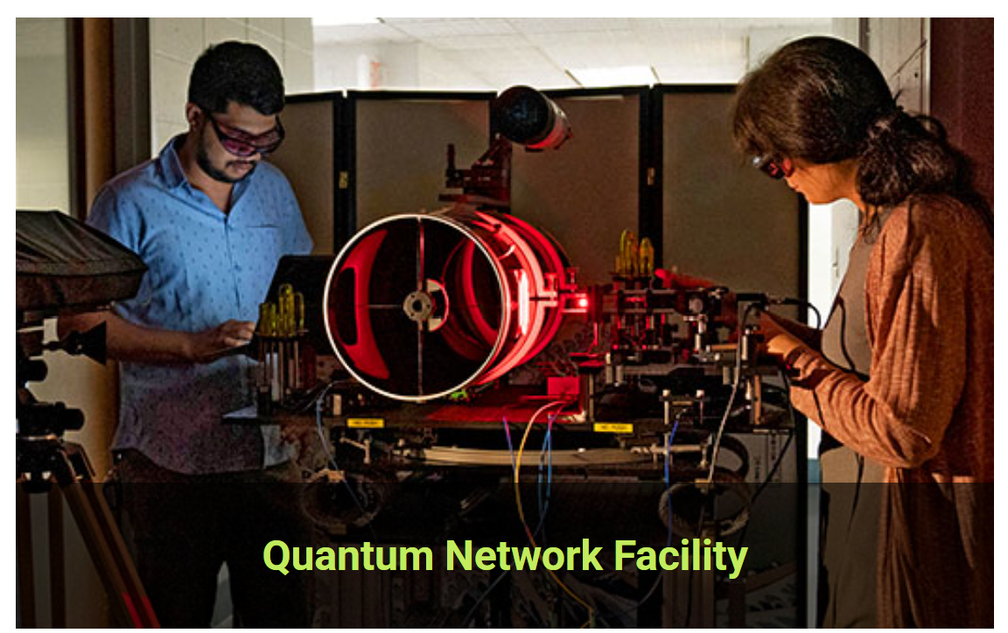

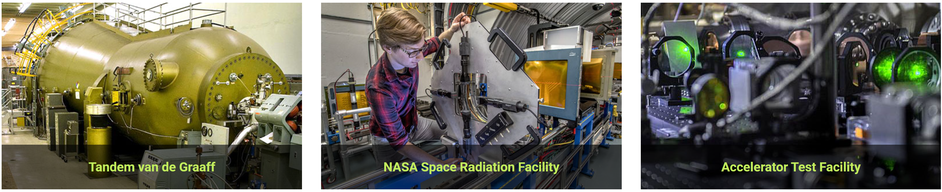

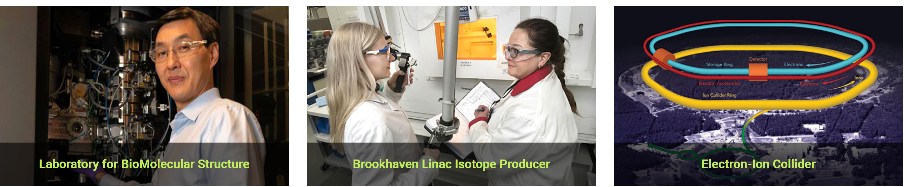
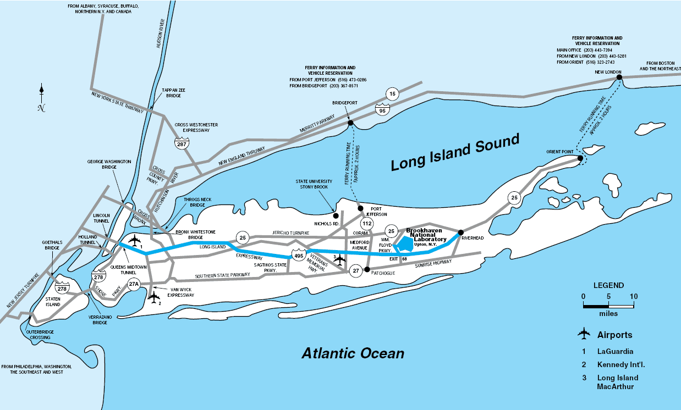
Brookhaven National Laboratory
Notes:
Zderzacz ciezkich jonow
Moderinizacja zderzacz electron-jon 4km

Slide 3
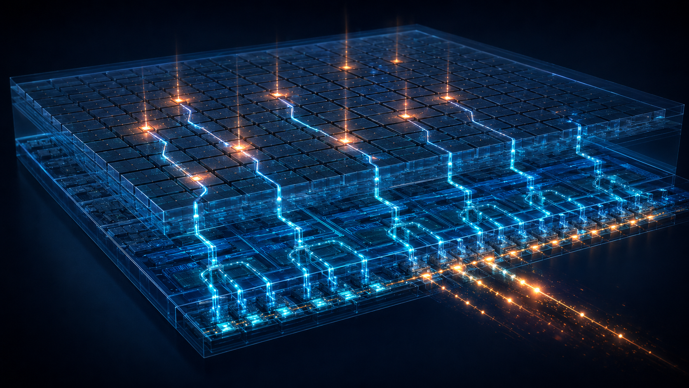
Event driven readout

Slide 4
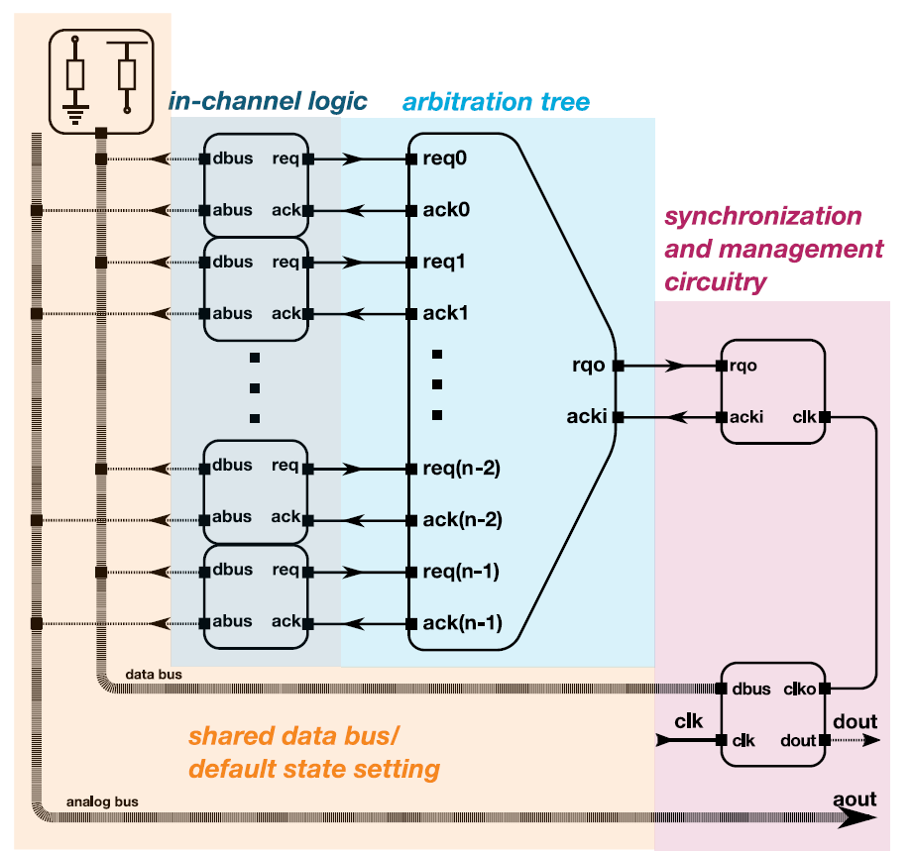
Event driven readout
Block diagram of EDWARD readout architecture
AFE interface

Slide 5

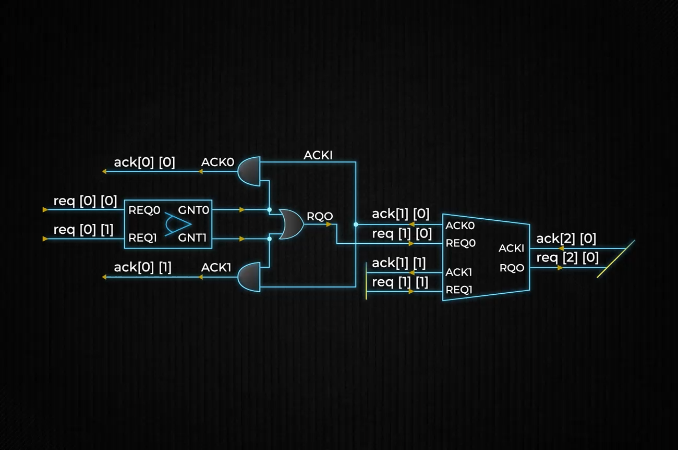
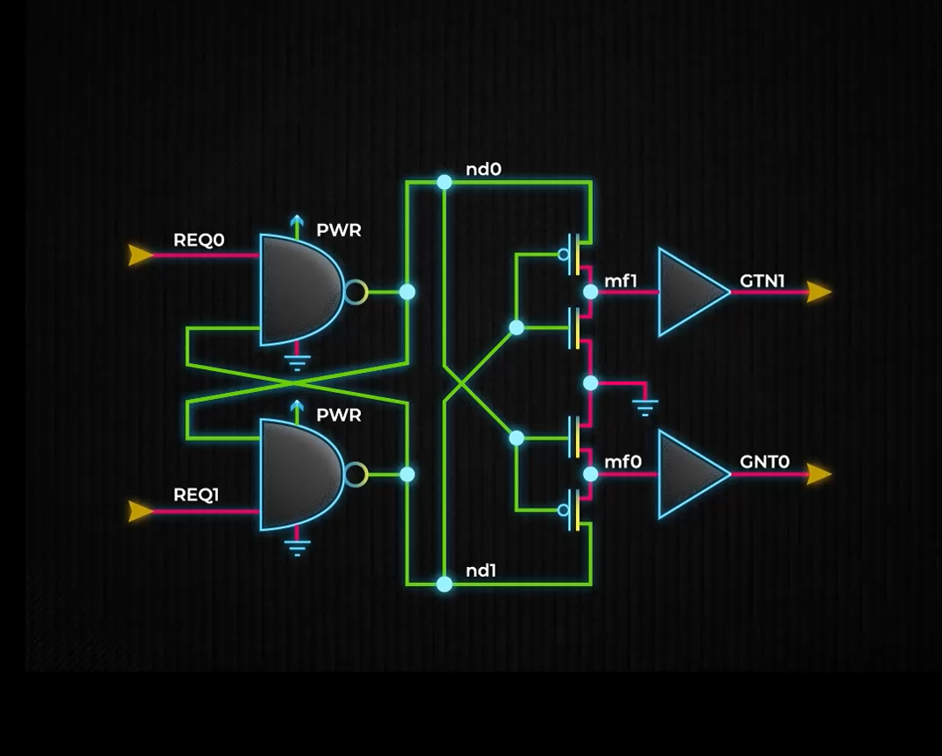
Building block – arbiter cell
Additional logic builds a path back for acknowledge signal and generates request for next stage. However, this structure suffer from race condition
Arbiter based on Seitz’ arbiter provides mutual exclusion. Especially useful for asynchronous signals

Slide 6
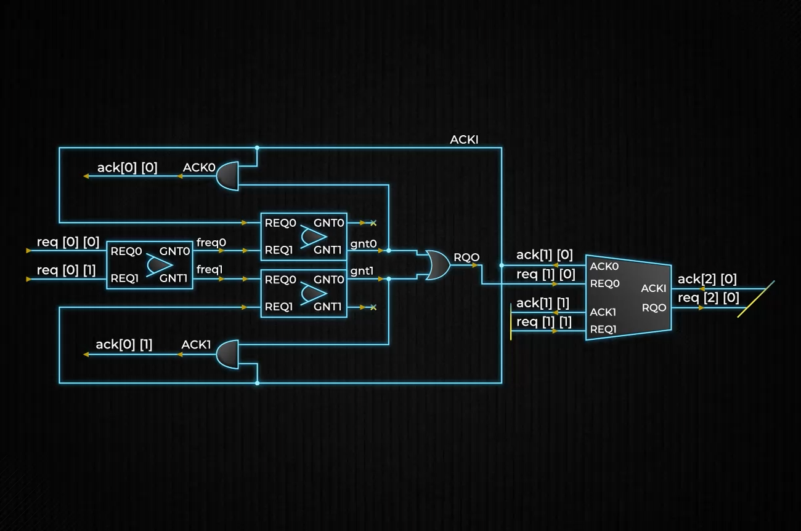
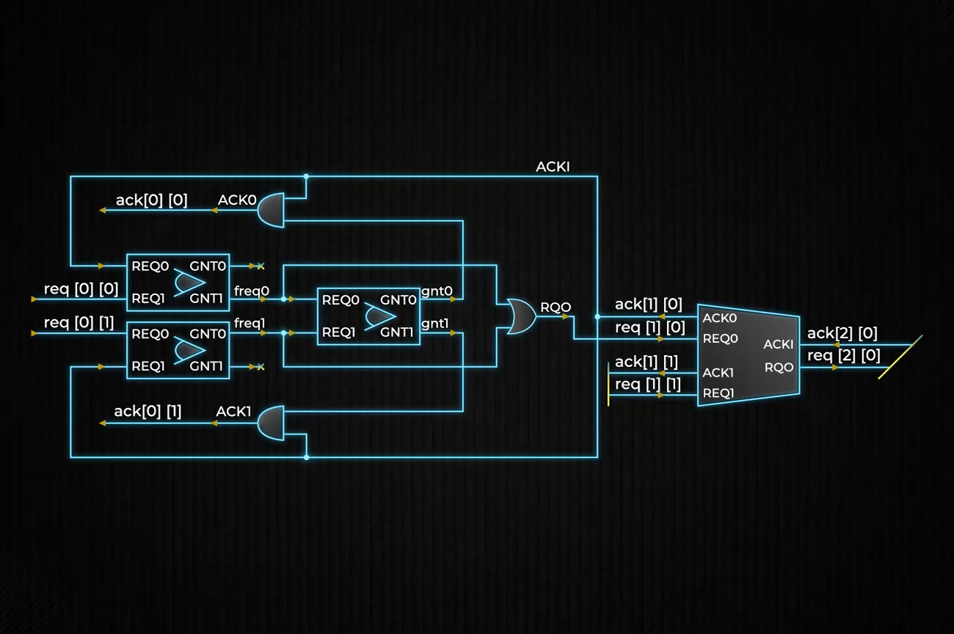
Resolving race condition
Fair arbitration blocks propagation of second request until cell is cleared – it forces ack signal to be cleared up to the top of the tree
Unfair arbitration blocks ack until both requests are cleared – it switches locally up to the next closest stage with active request

Slide 7
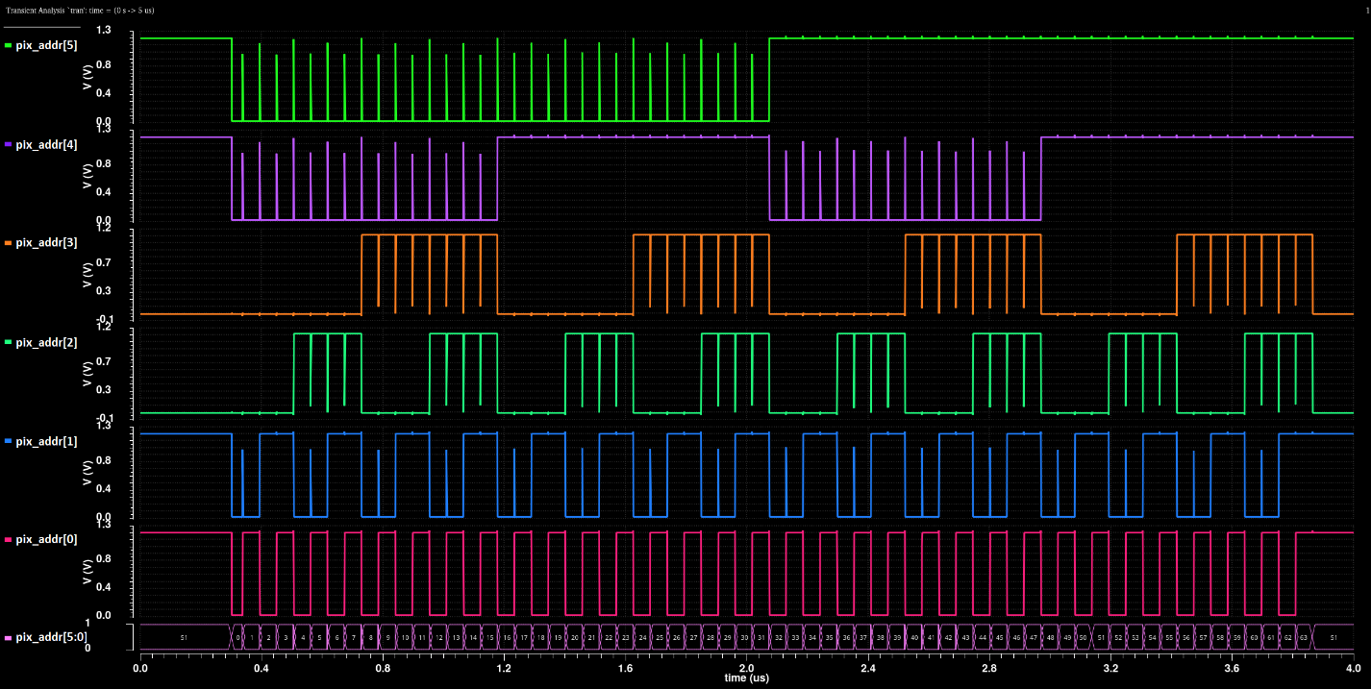
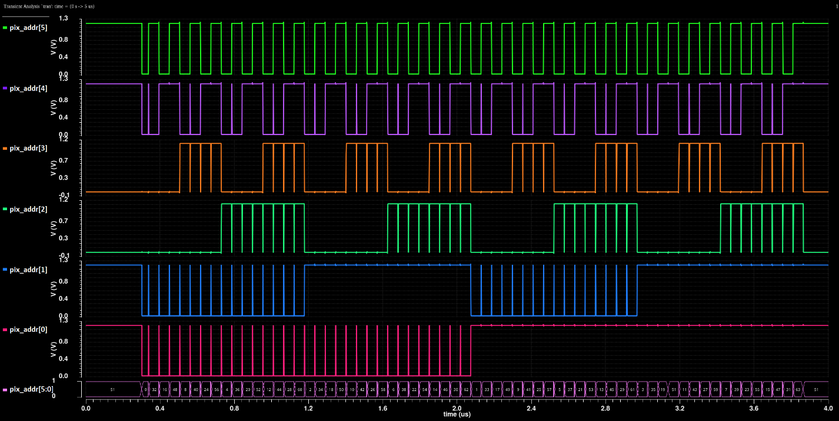
Readout order of unfair arbiter
Readout order of fair arbiter

Slide 8
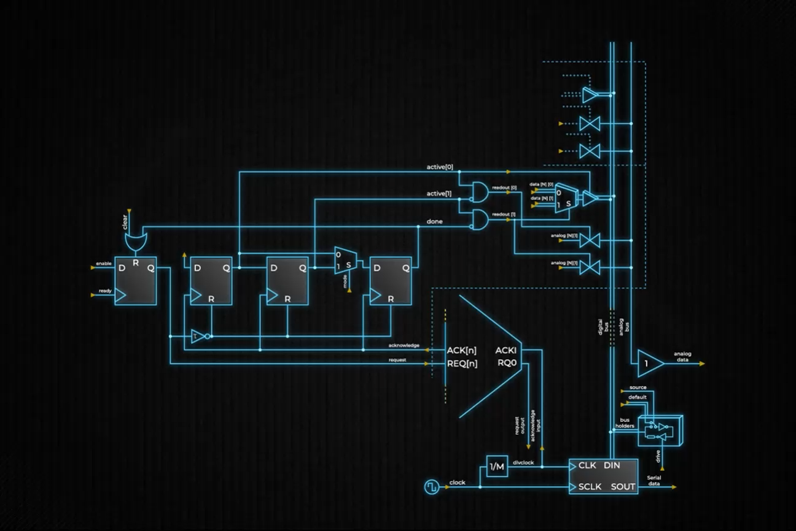
Full operation flow

Slide 9
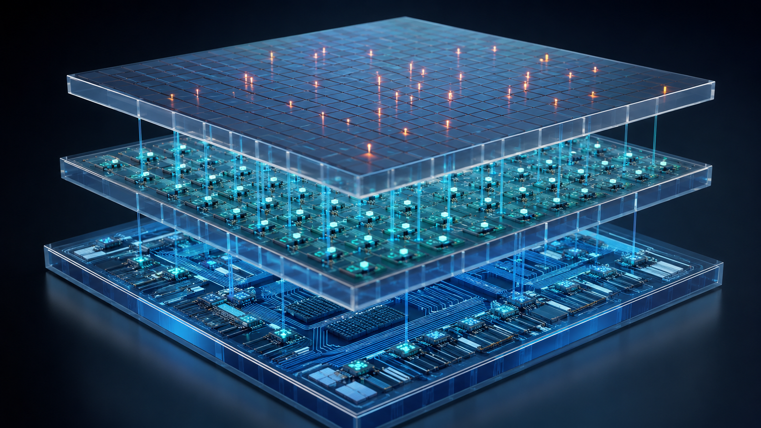
Previous work with hybrid pixel detectors

Slide 10
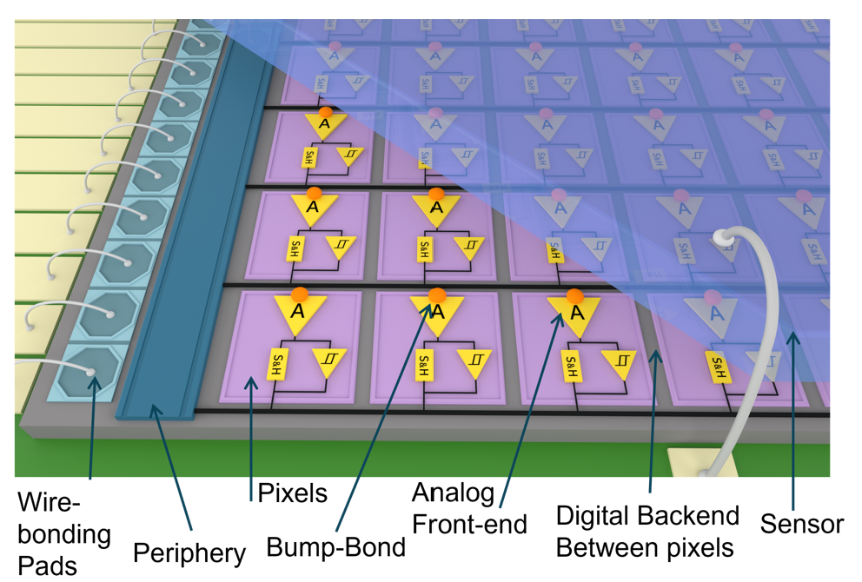
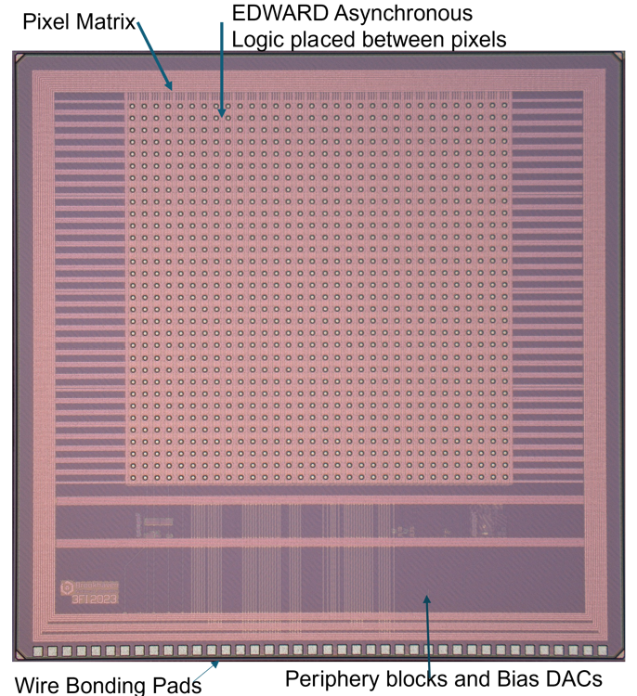
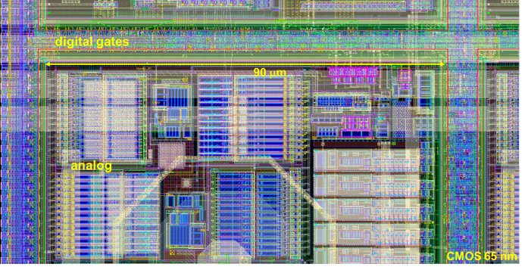
Full-field fluorescence imaging chip
General hybrid detector
pixel structure
Image of 3FI65P1
Notes:
The detector is built around the 3FI chip. It has a classical structure of hybrid detector. Each individual pixels contain their own functionality having analog front end and digital back end. The supporting biasing is located in the periphery. Chip is connected to a PCB using wire bonding and the sensor is integrated using bum pads. The microscopic photos of the cheap from the top view is shown on a picture on the right. We can clearly distinguish here pixel matrix area and peripheral circuitry

Slide 11
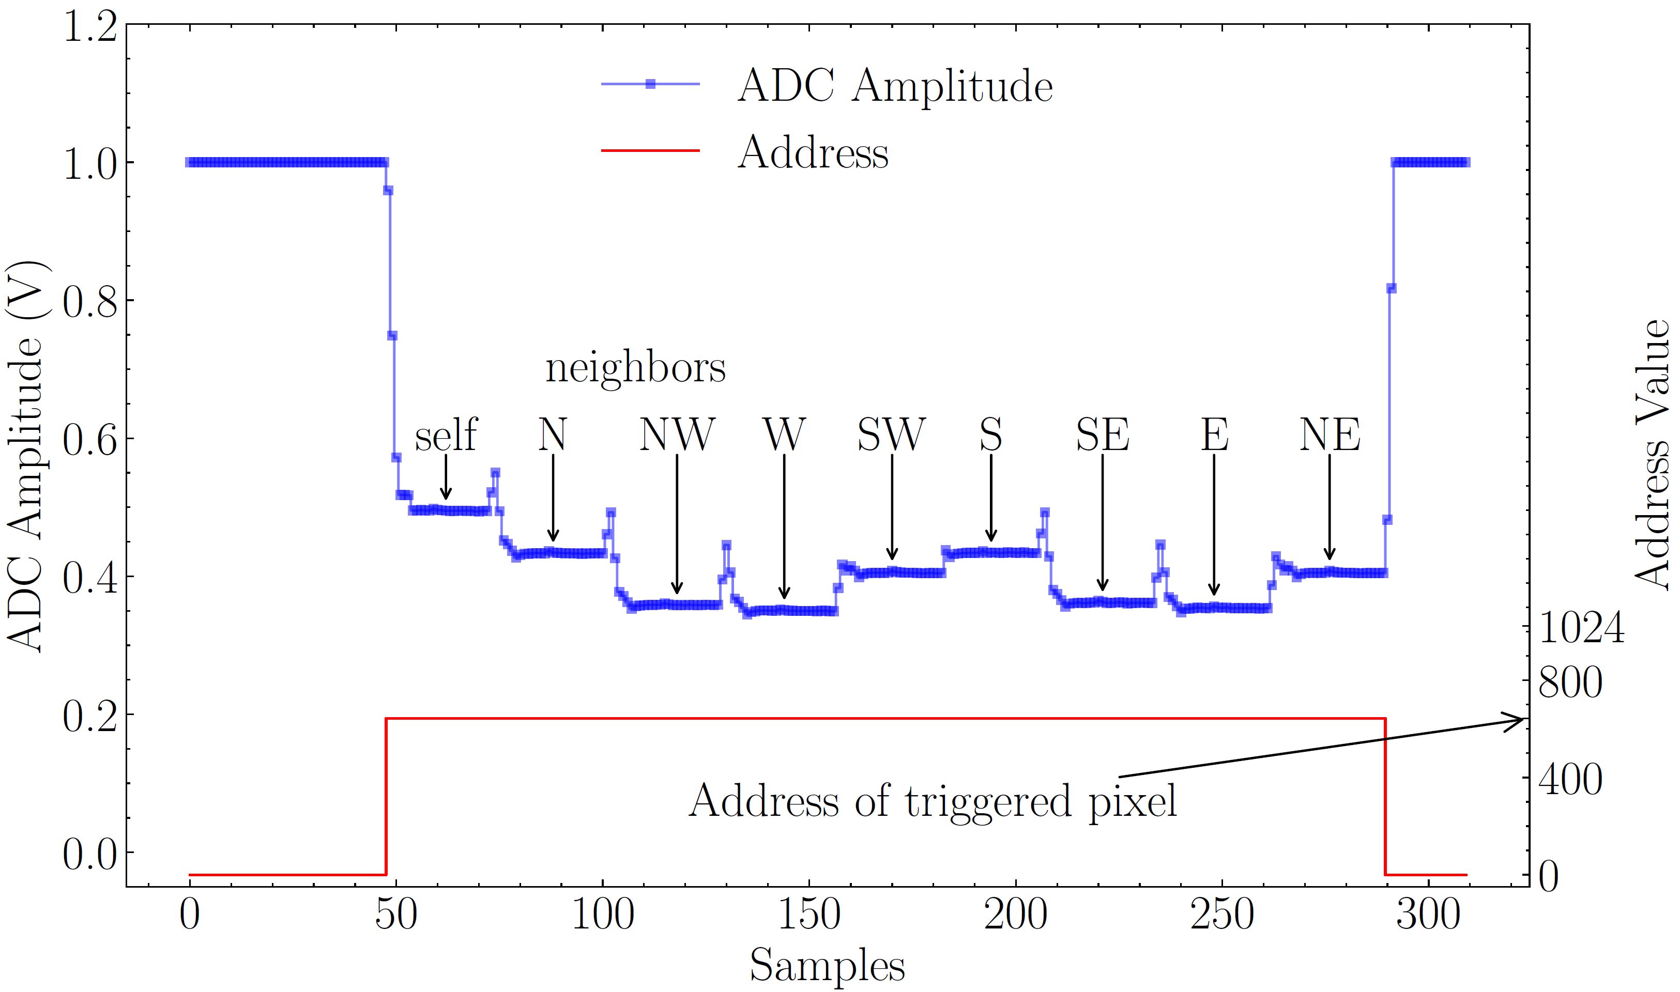
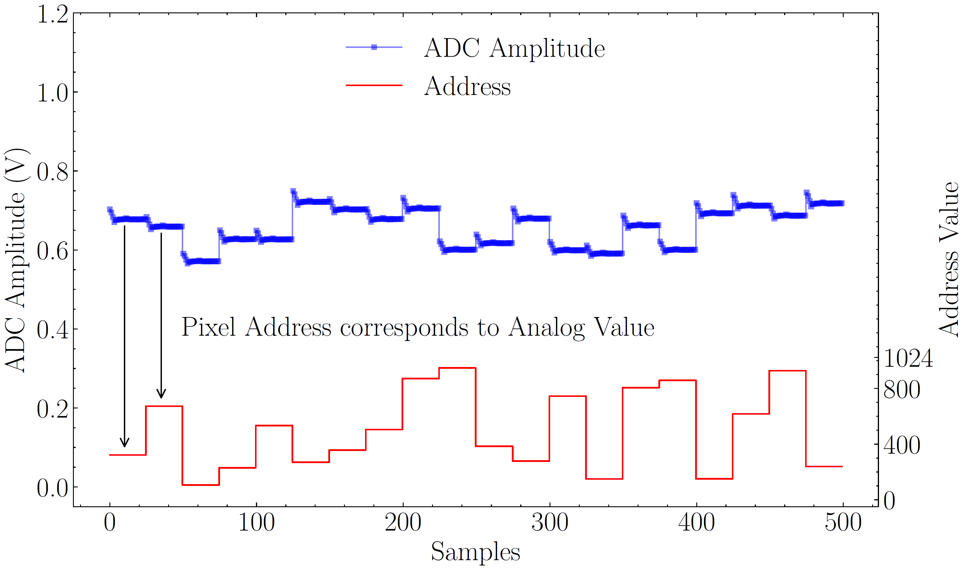
Two modes of operation
Charge sharing compensation mode
High Throughput Mode

Slide 12
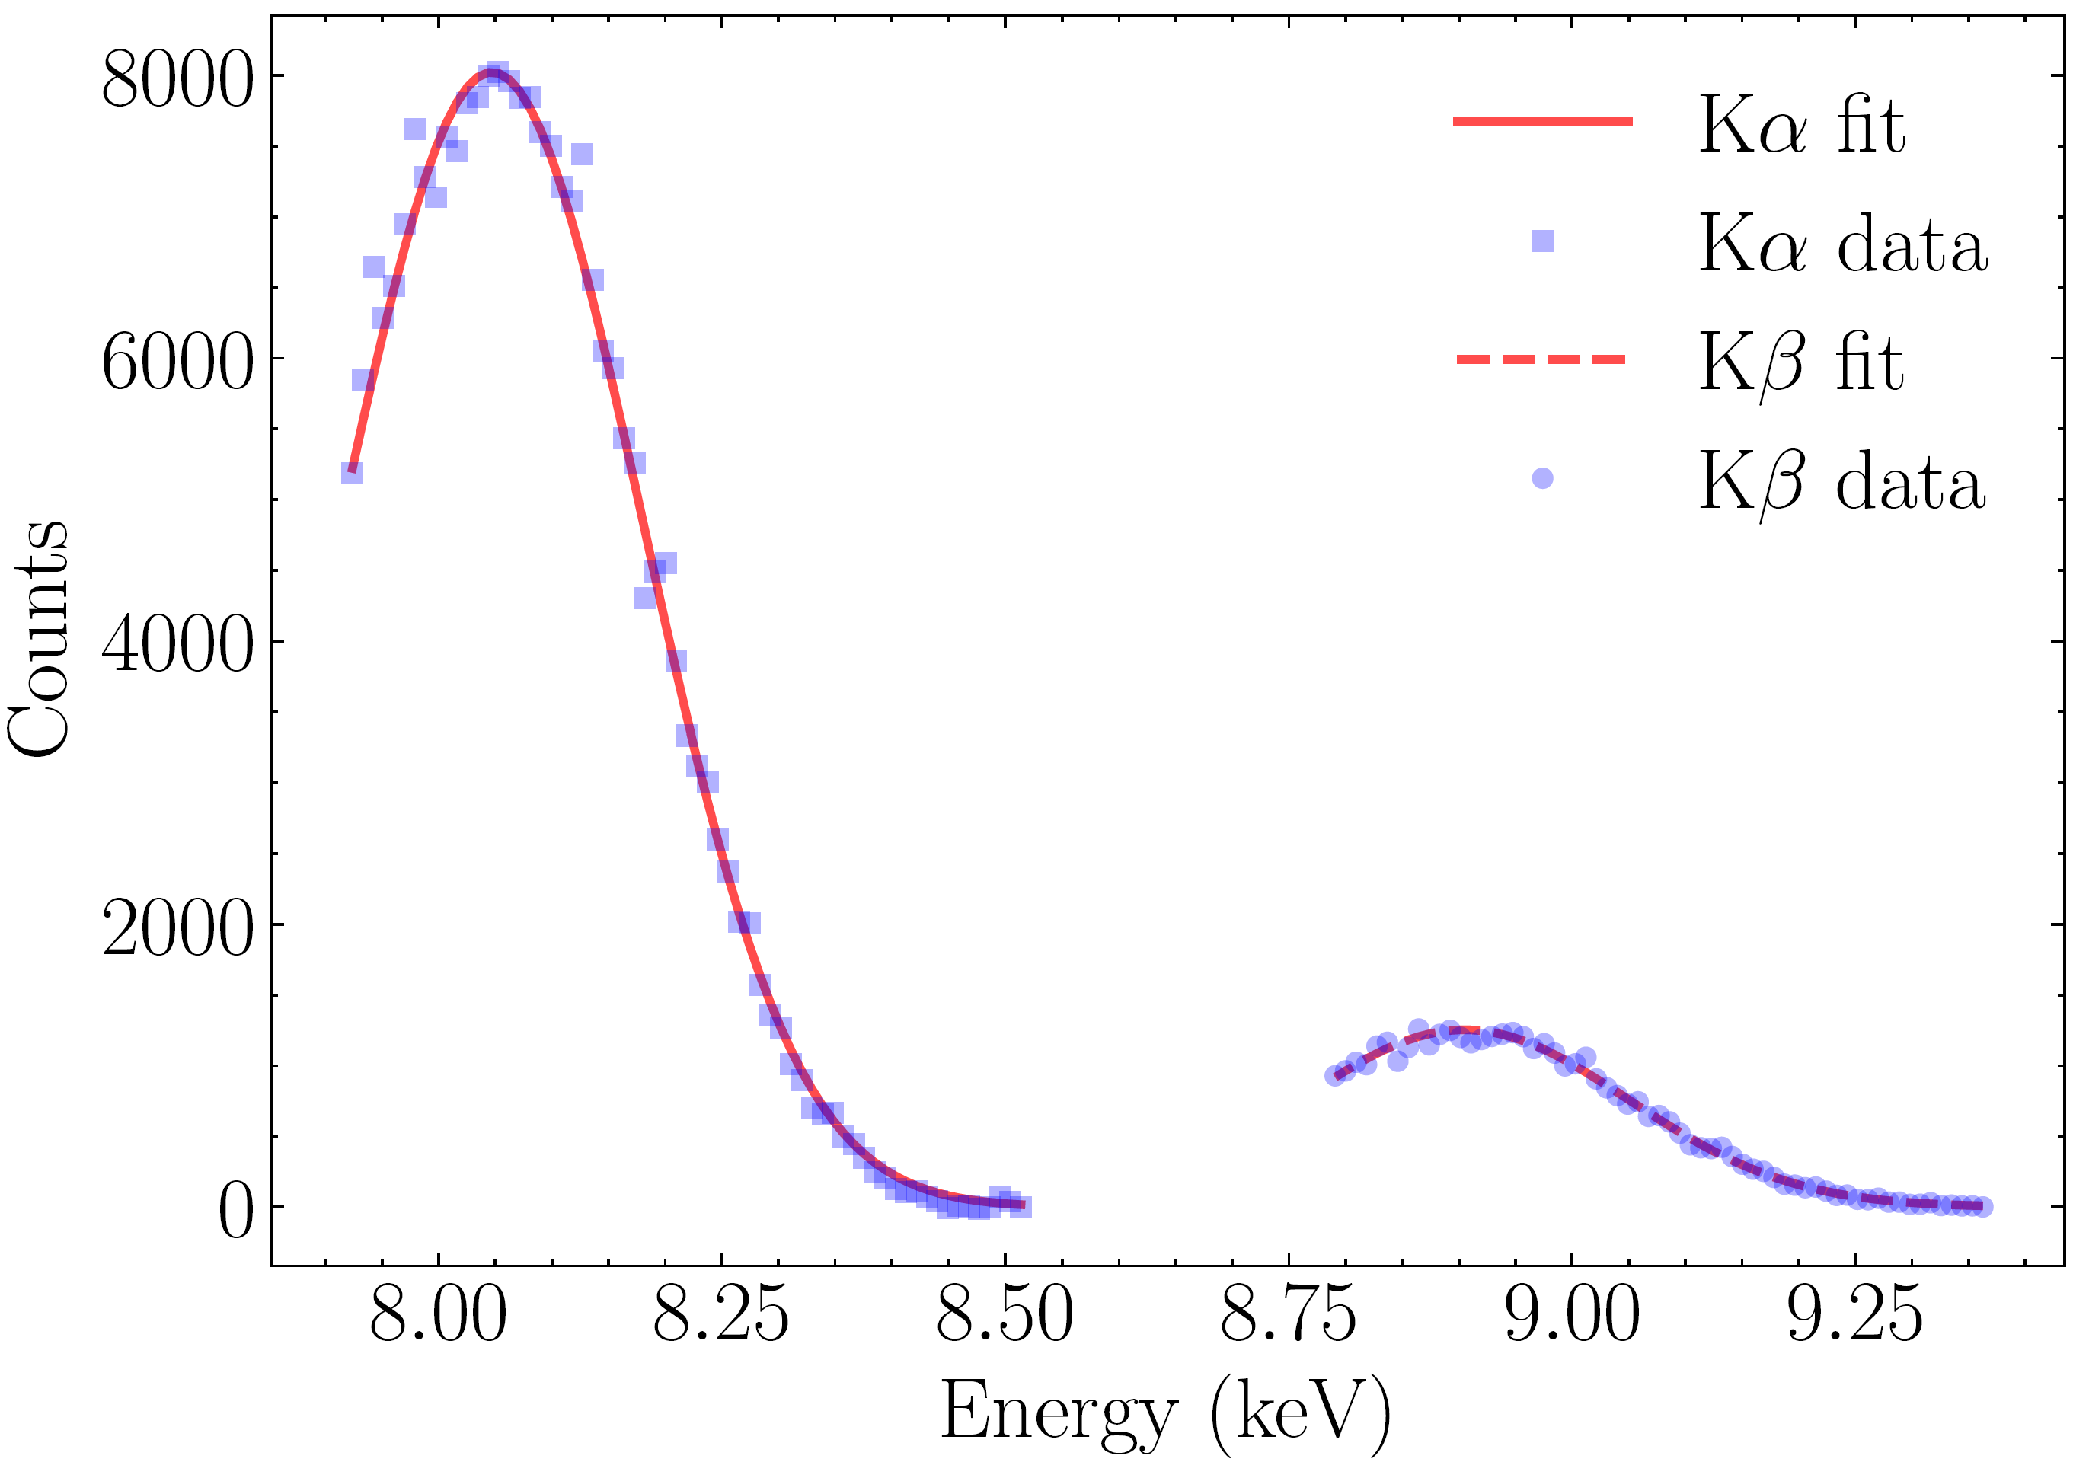
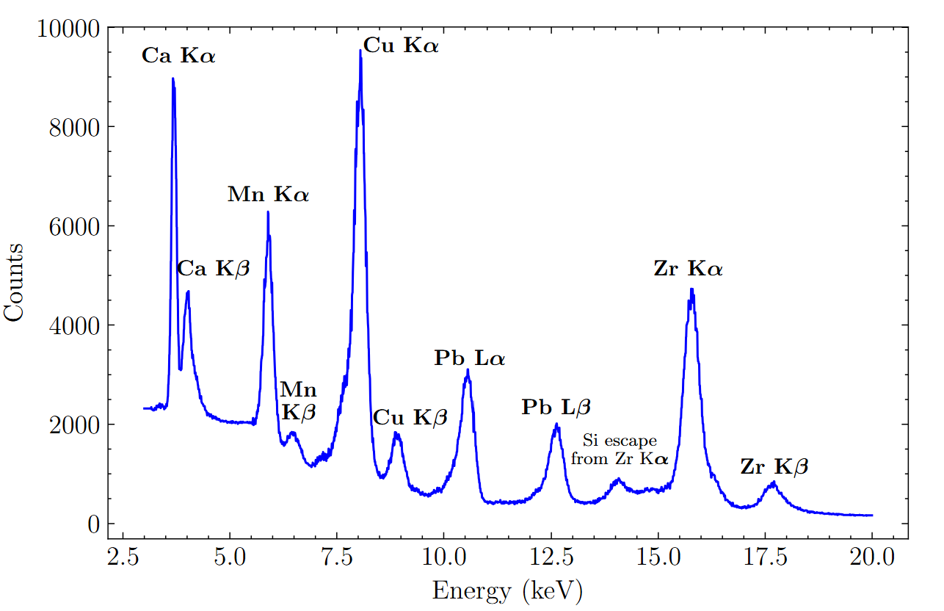
Results
Characteristic X-ray Lines and Measured Energy Resolutions
Element | Line | Energy (keV) | Energy Resolution (FWHM, eV)
Calcium (Ca) | Kα | 3.691 | 138
Manganese (Mn) | Kα | 5.898 | 249
Copper (Cu) | Kα | 8.047 | 308
Lead (Pb) | Lα | 10.551 | 339
Zirconium (Zr) | Kα | 15.775 | 469
Spectrum combined for several samples and measurements
Gain calibration across the entire range from 2.5 keV to 20 keV. The energy resolution obtained from the Ca Kα and Cu Kα peaks reached 138 eV and 308 eV FWHM.

Slide 13

Toward bidirectional communication

Slide 14
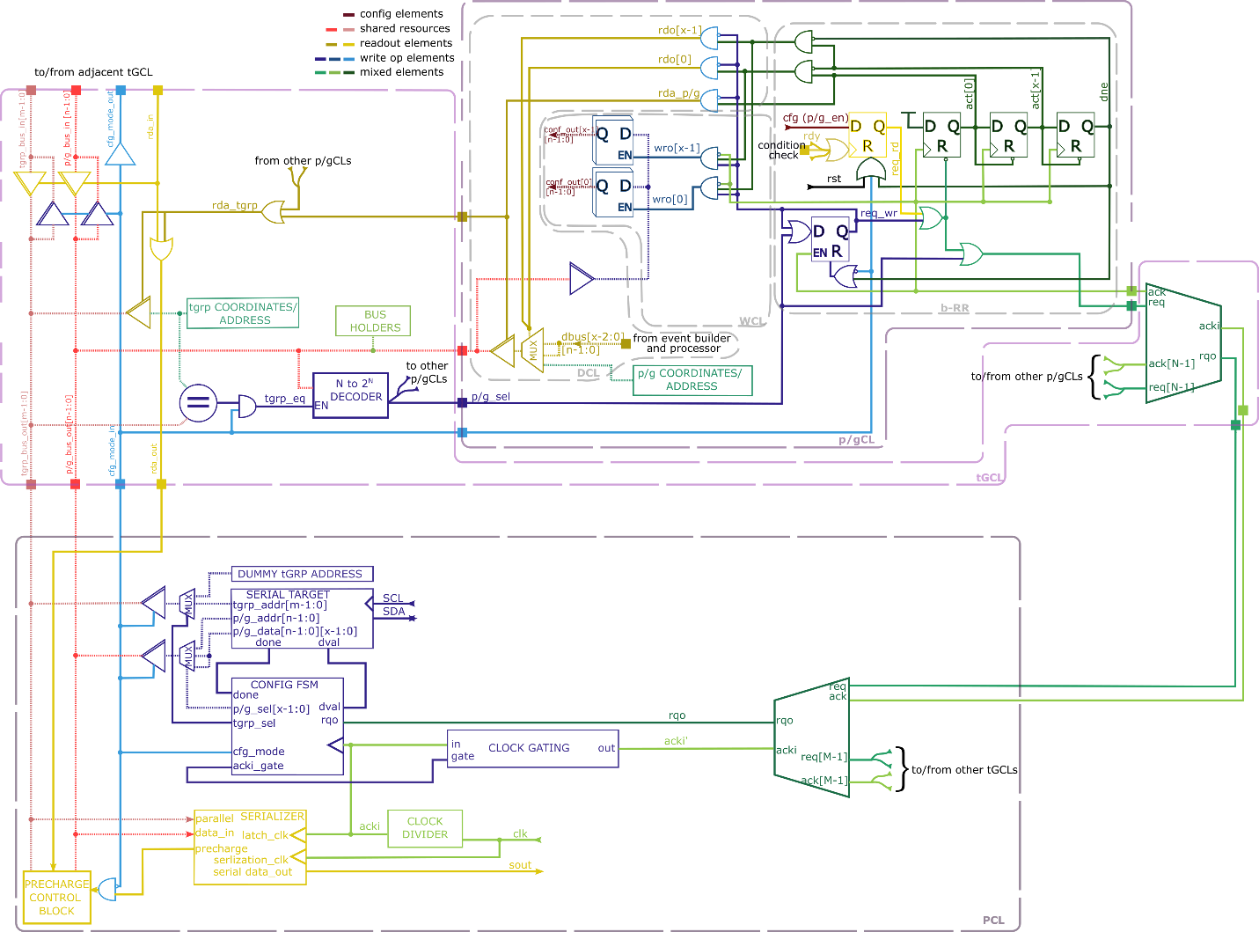
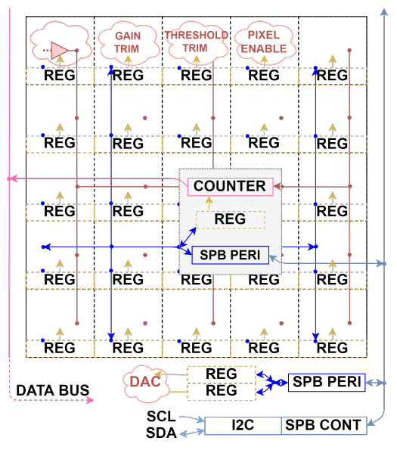
Bidirectional structure
From separate config logic to shared resources with readout

Slide 15
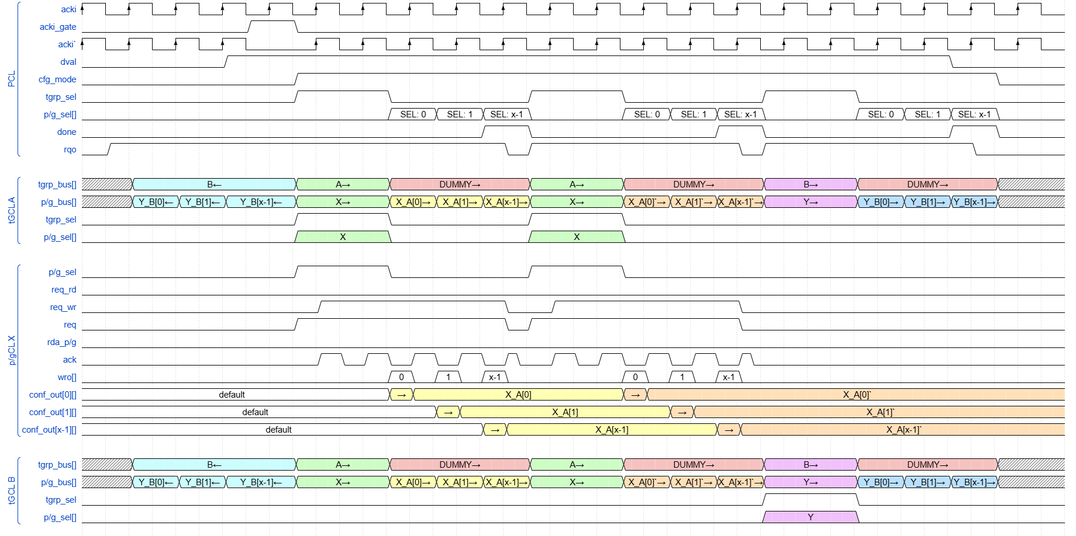
Example waveforms

Slide 16
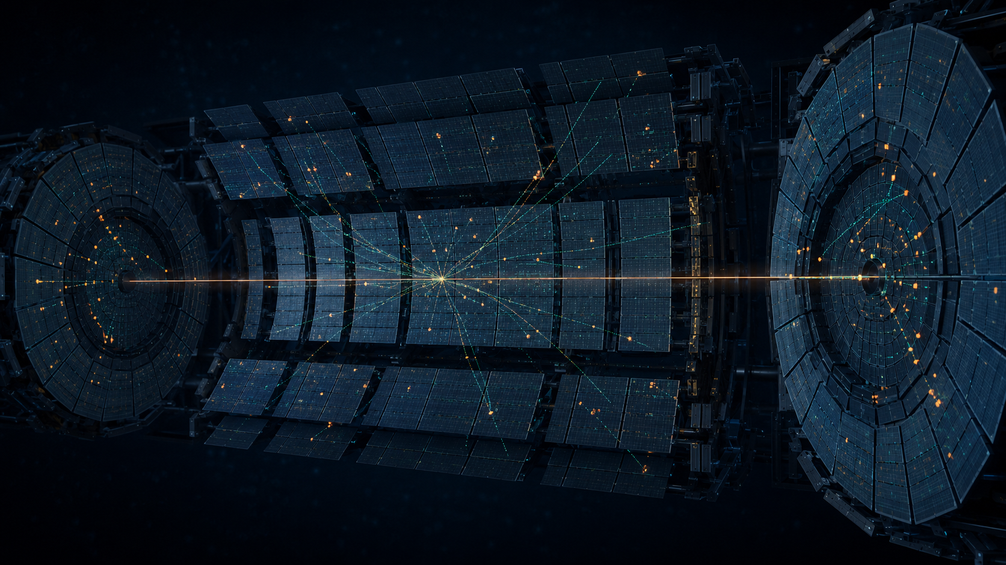
MAPS implementation

Slide 17
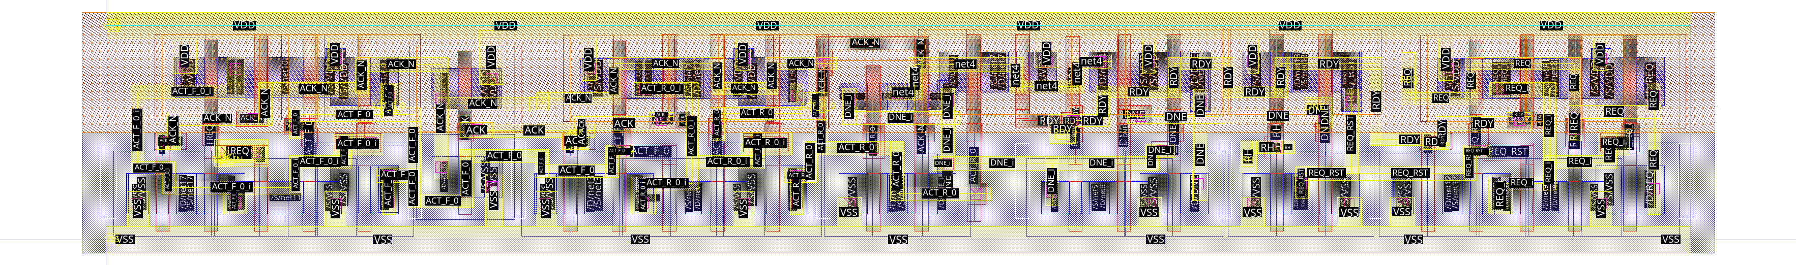
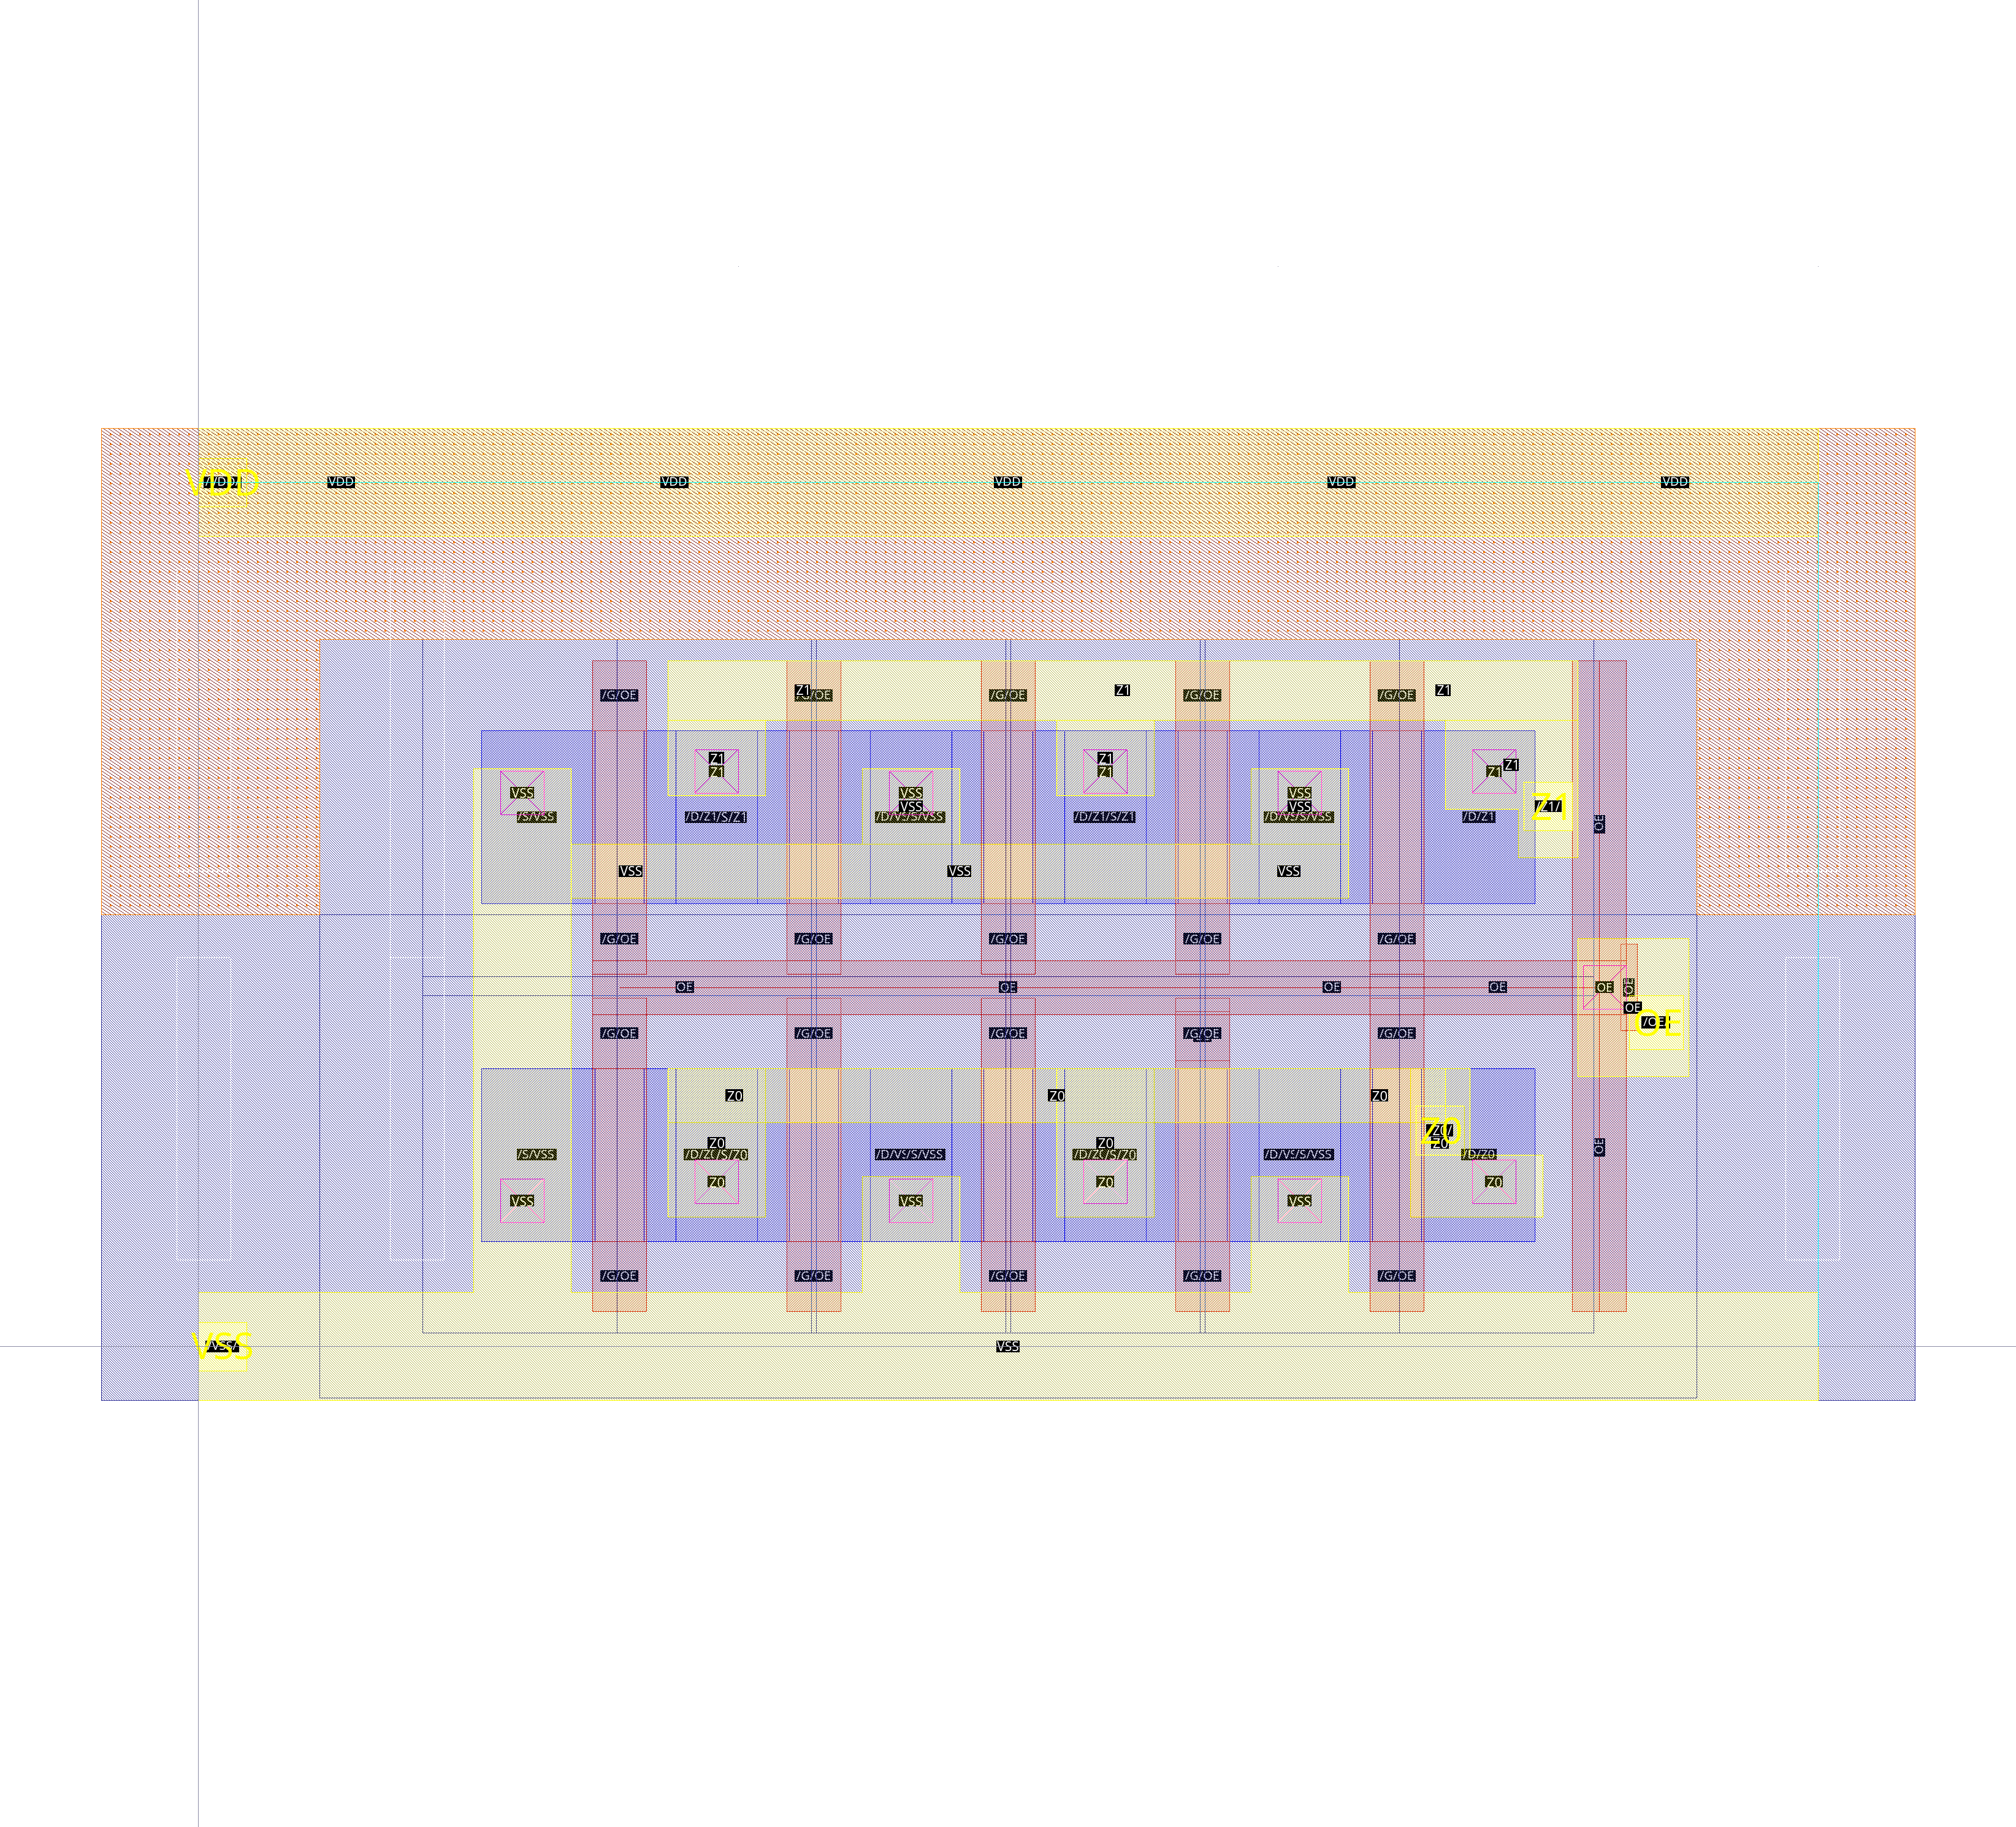
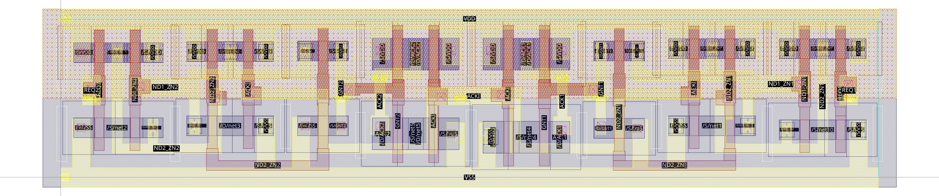
Digital library
TPSCo 65nm
Set of 8T standard cells provided by CERN got expanded
Integrated in-pix readout controller
Fair arbiter cell
Fixed value 2-bit BUFT
Characterized with the use of Liberate (5 corners x2 PWELL voltages)

Slide 18
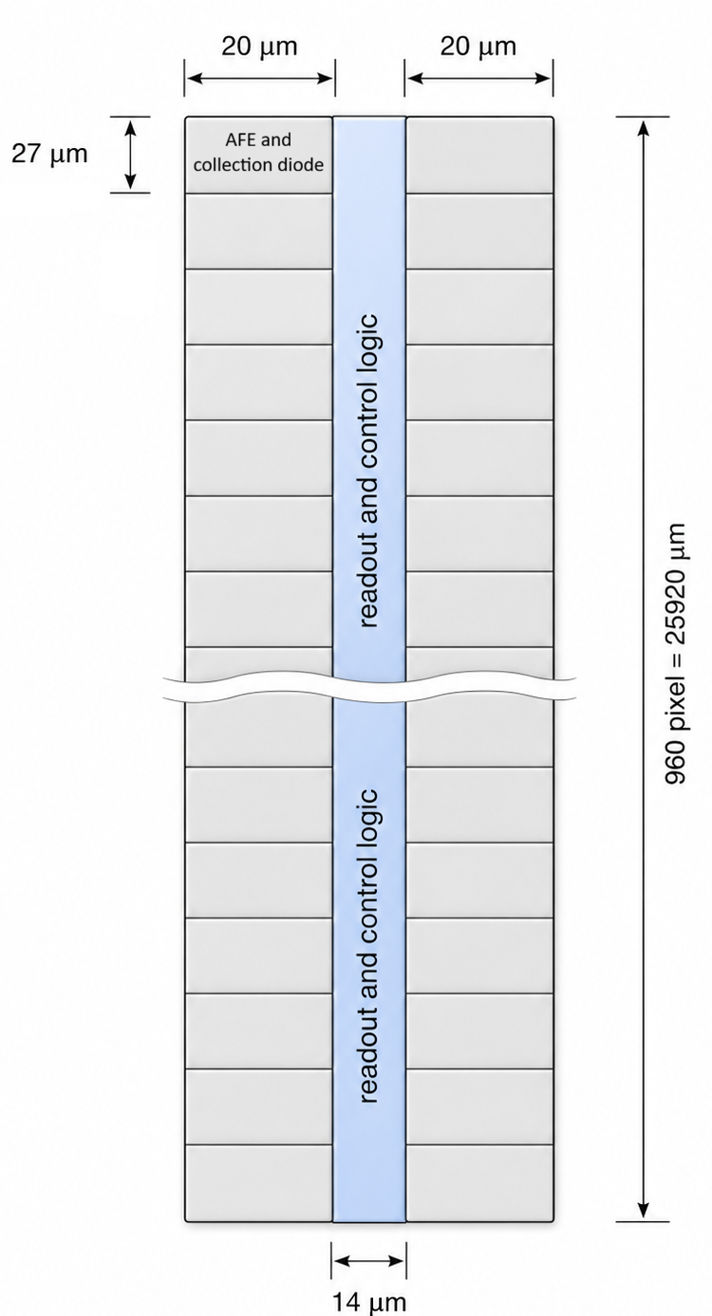
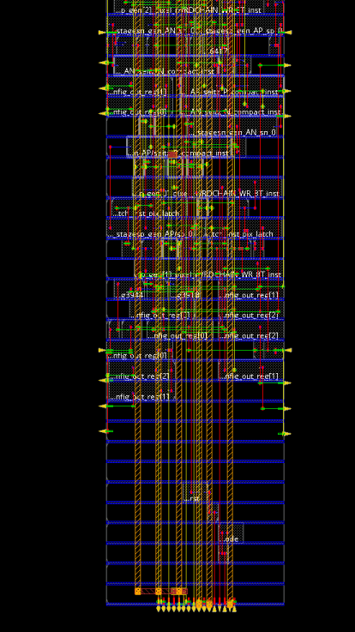
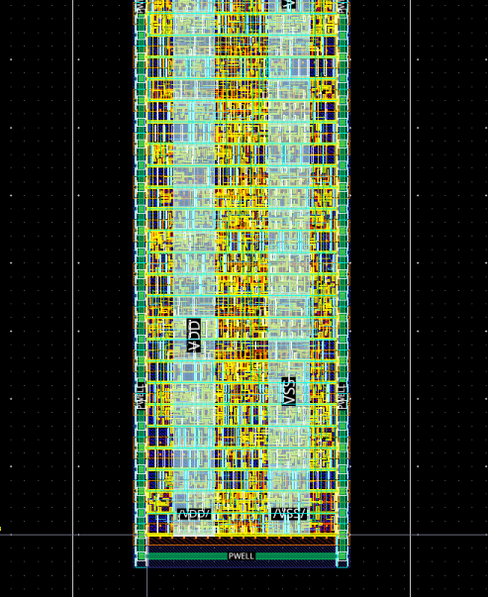
Implementation
~80% density

Slide 19
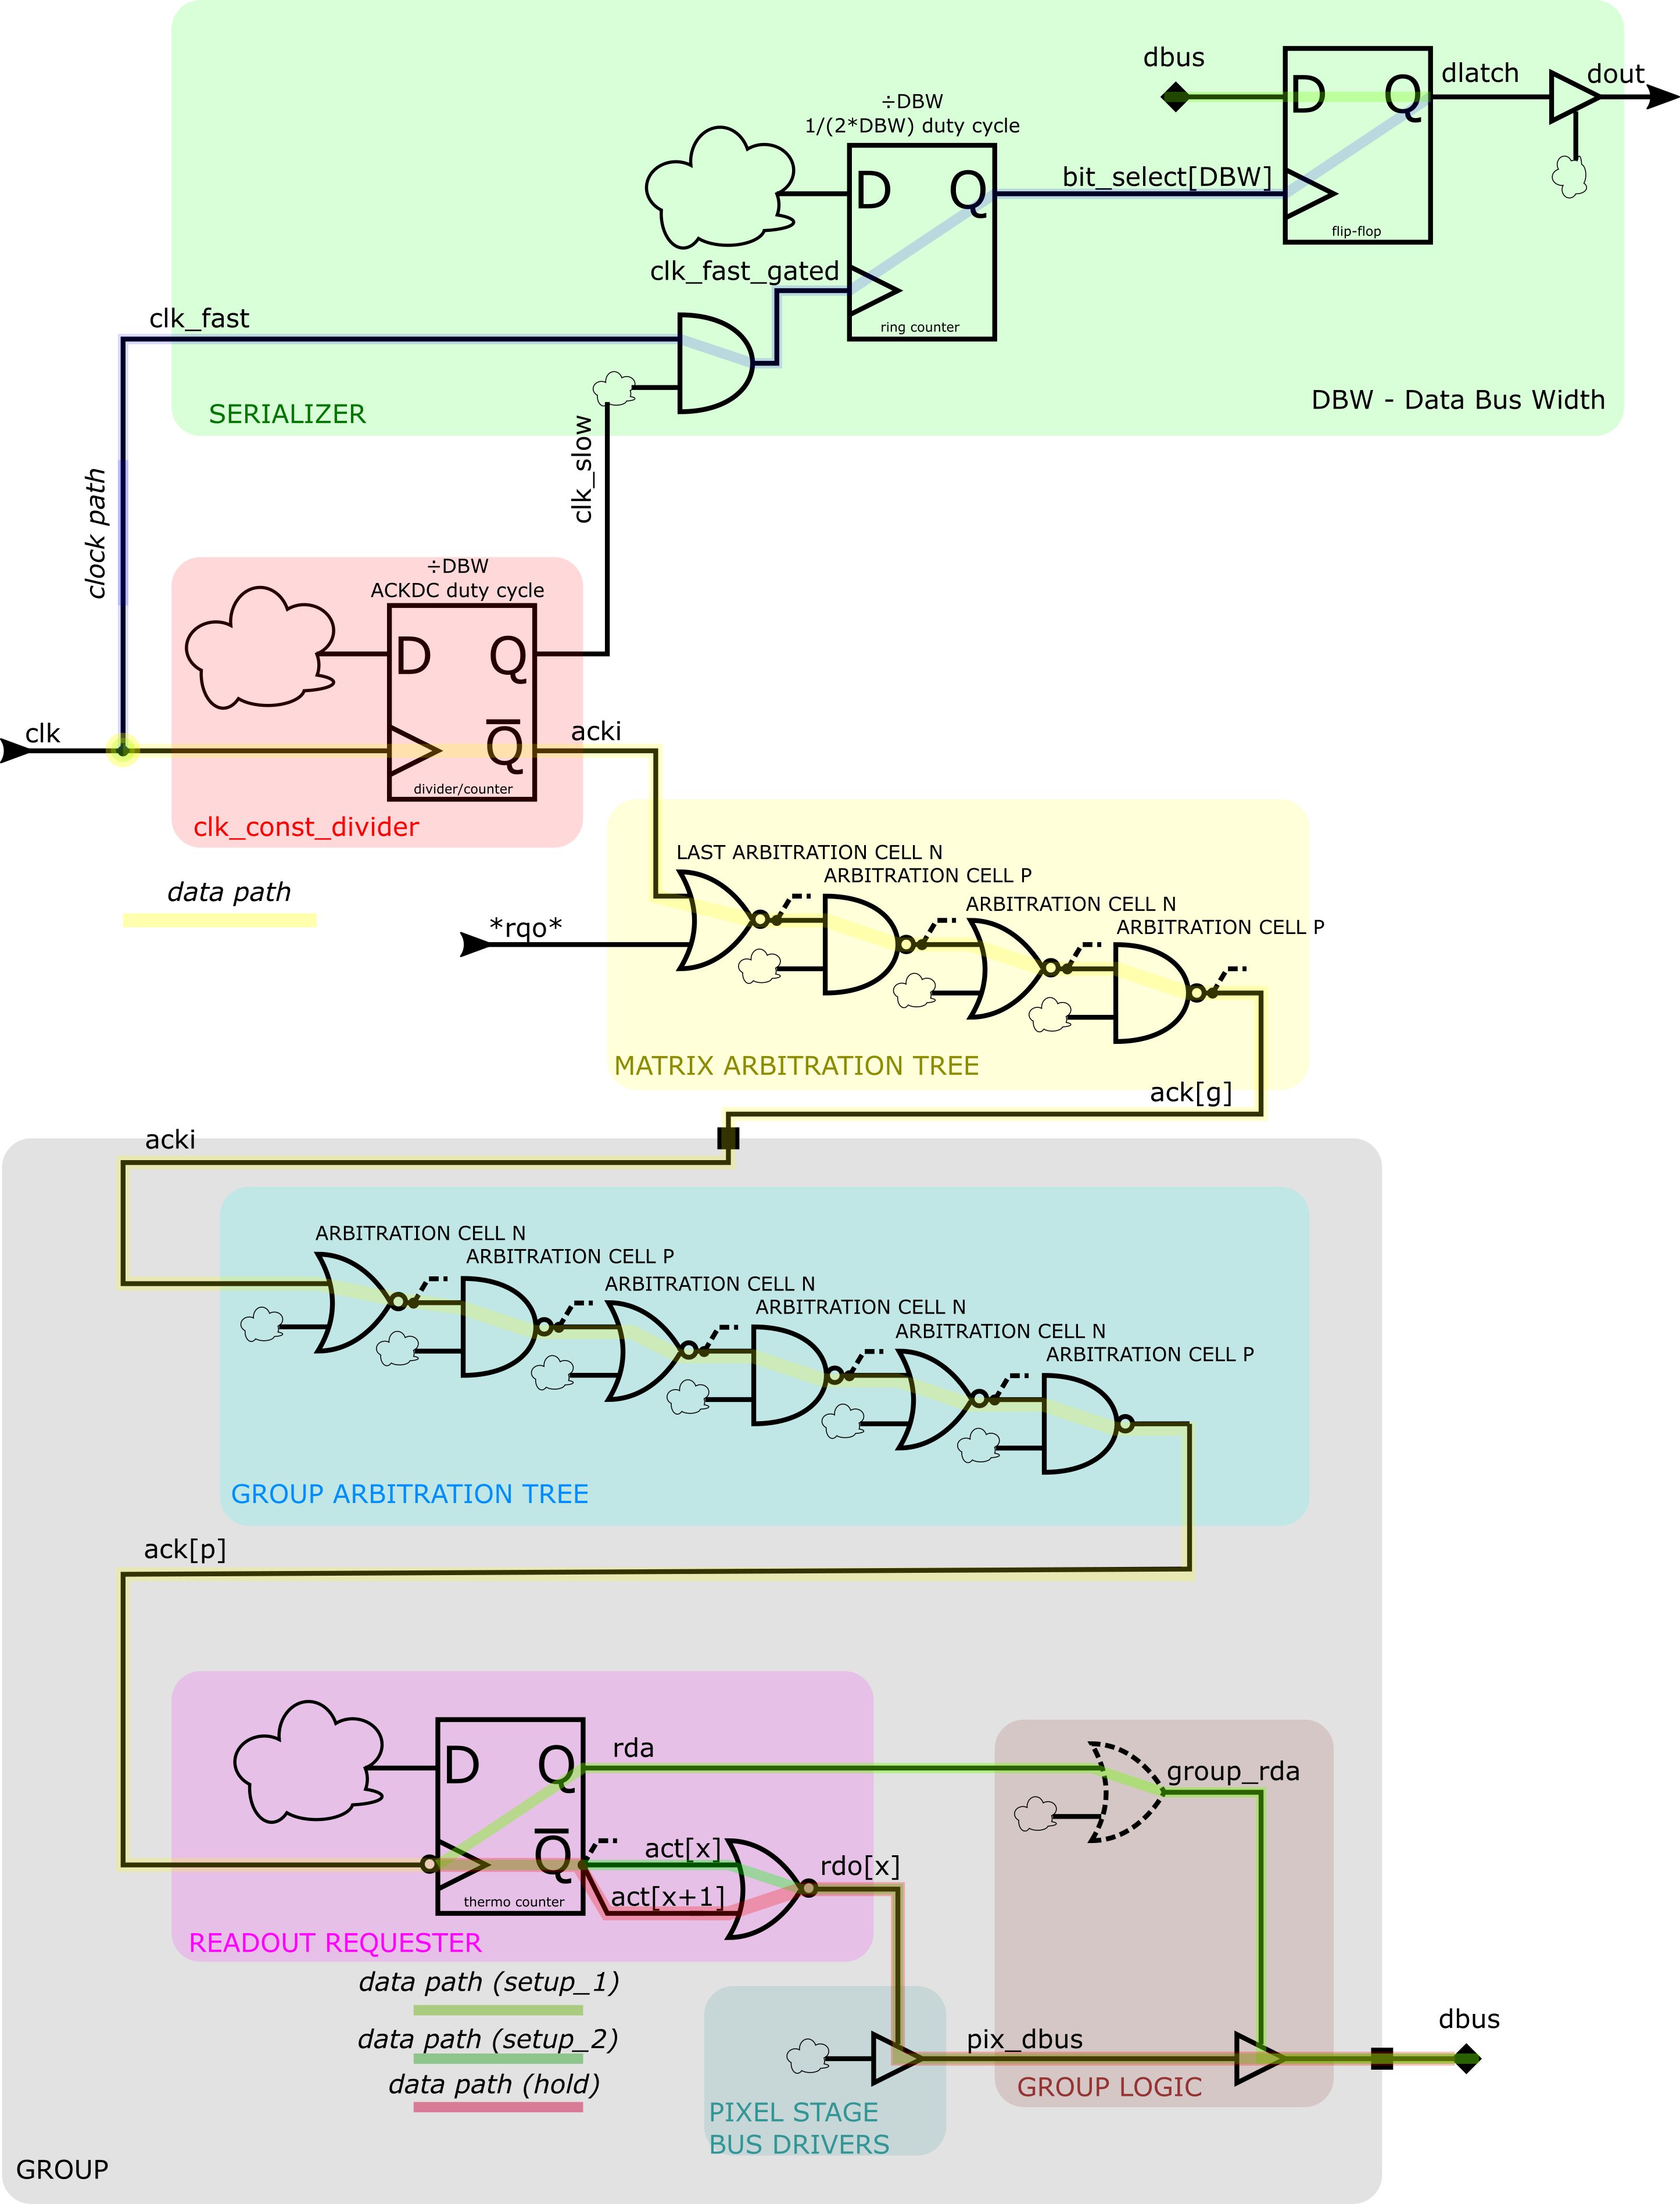
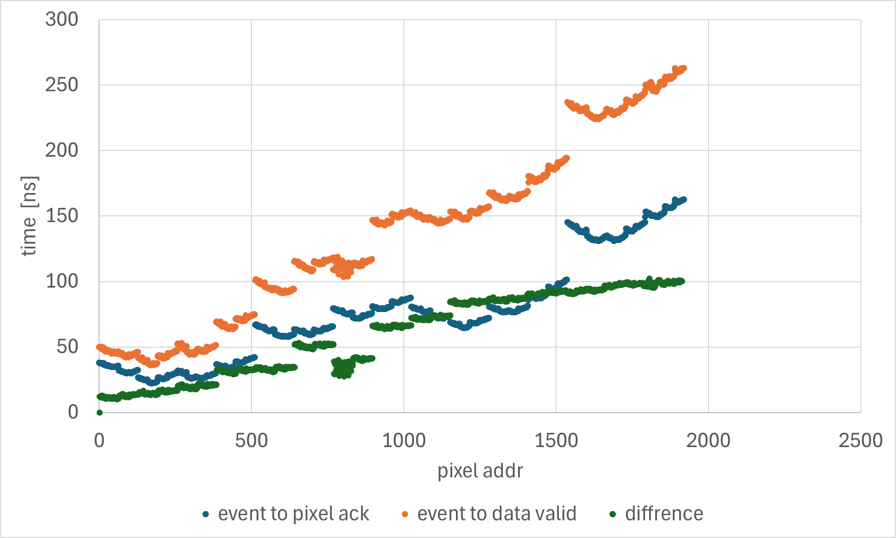
Problem
Time between event and valid data is too high – needs to speed up the “clock tree”. Also, either parasitics of data bus must be lower or stronger buffers must be used.
Worst case RC, ss corner and PWELL = -6V

Slide 20
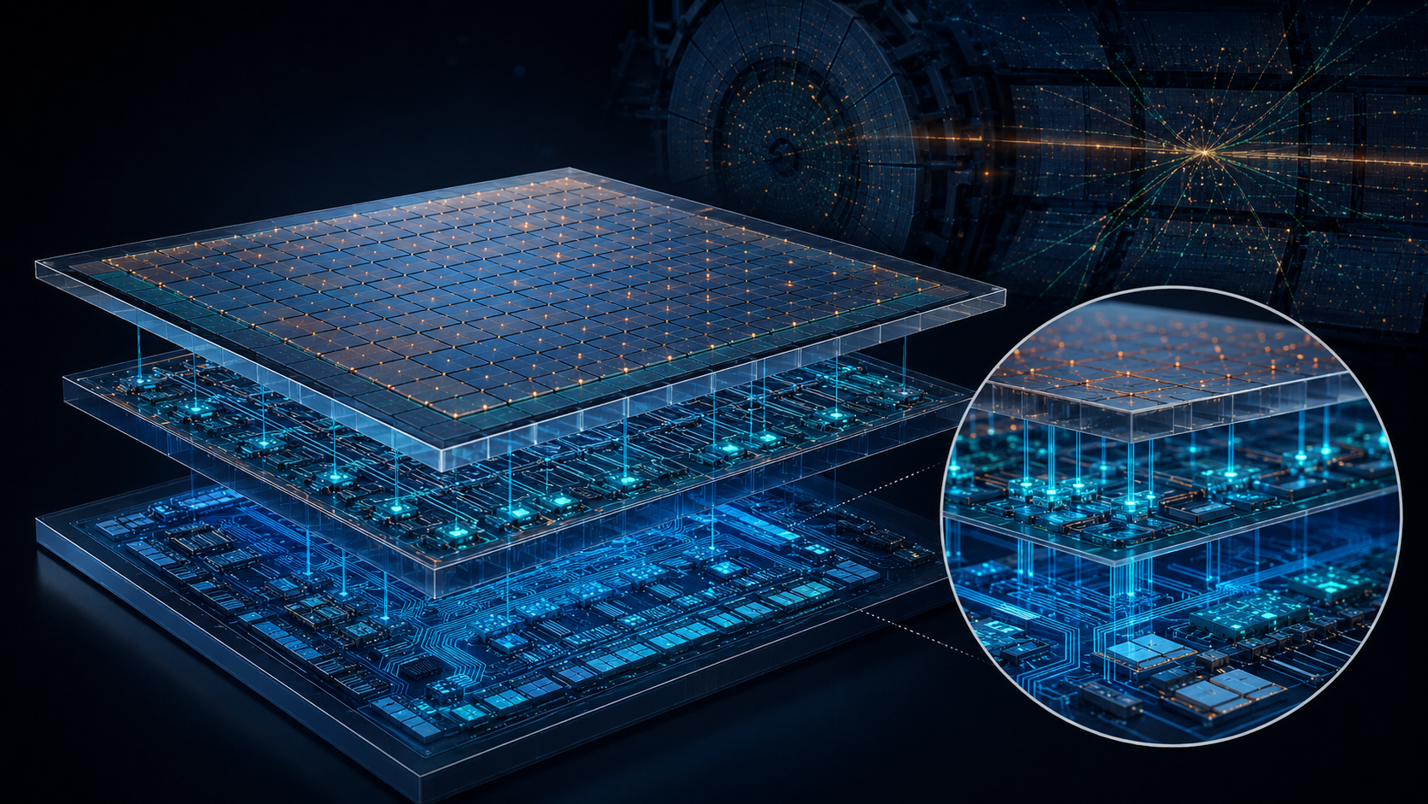
Intelligent 3D Stacks

Slide 21

3D stacking of MAPS
Rehak’s convention:
n-type – green, p-type – red
Thin, 3D-stacked, large-area MAPS detector, providing in-situ x-ray background rejection and generating tracking primitives (x, y, local direction, time, quality flags) ð AI-ready vertexing and tracking
reduction of data
reduction of combinatorics in reconstruction / tracking
no data generated
(x, y, $\vec{r}$) data generated
Notes:
An X-ray usually produces a localized, single-layer hit, while a charged particle produces correlated hits across multiple layers.
The proposed Intelligent 3D Stack is different because it embeds compact AI inference directly inside a vertically integrated MAPS stack, where it can access low-level, uncompressed information from multiple closely coupled sensing layers before data are compressed or sent off chip. This enables cross-layer filtering, feature extraction, and early tracklet reconstruction at the source.

Slide 22
Backup

Slide 23
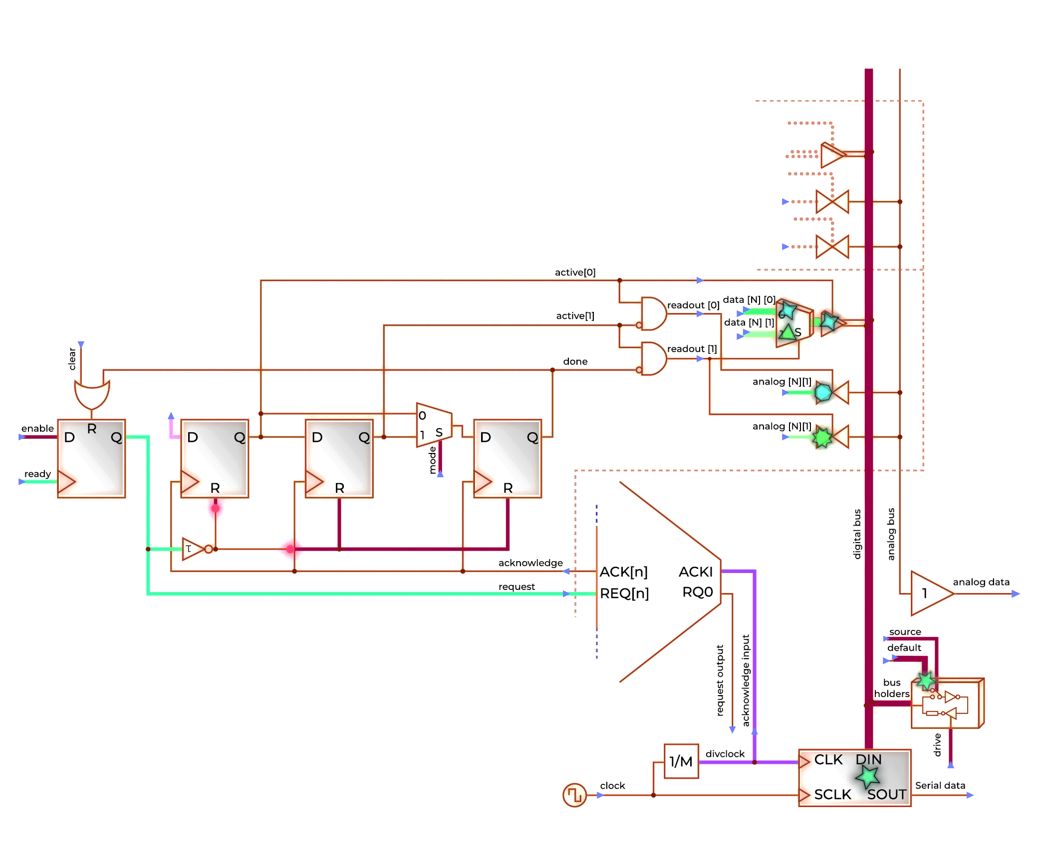
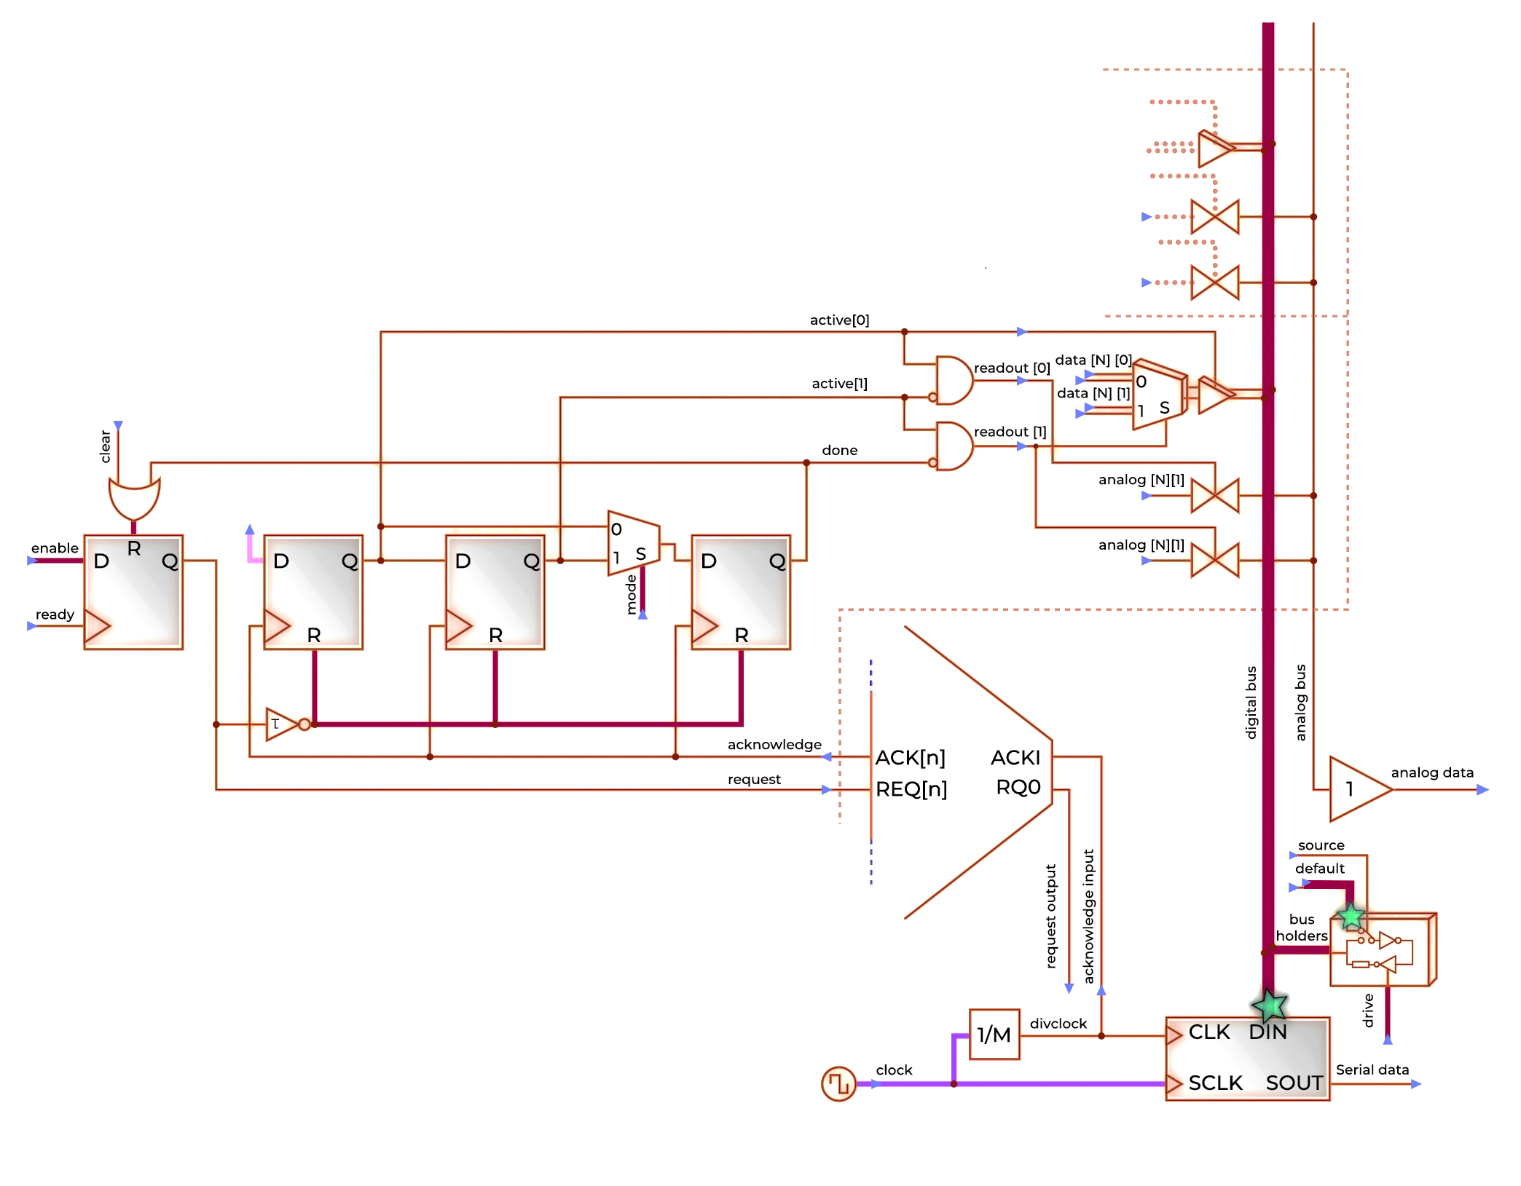
Operation flow 1/3
Idle / Reset State
No active requests. The in-pixel logic is in reset, outputs are inactive, and buses remain in default condition (digital bus driven from periphery, analog bus in high-Z). The acquisition system clock is active only in the periphery.
Request Generation
An event is detected and converted into a readout request. The request propagates through the arbitration tree toward the periphery, while the in-pixel logic waits for the acknowledge signal.

Slide 24
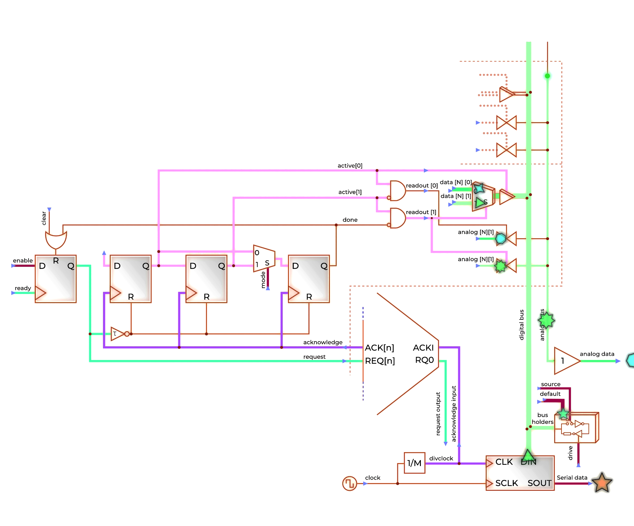
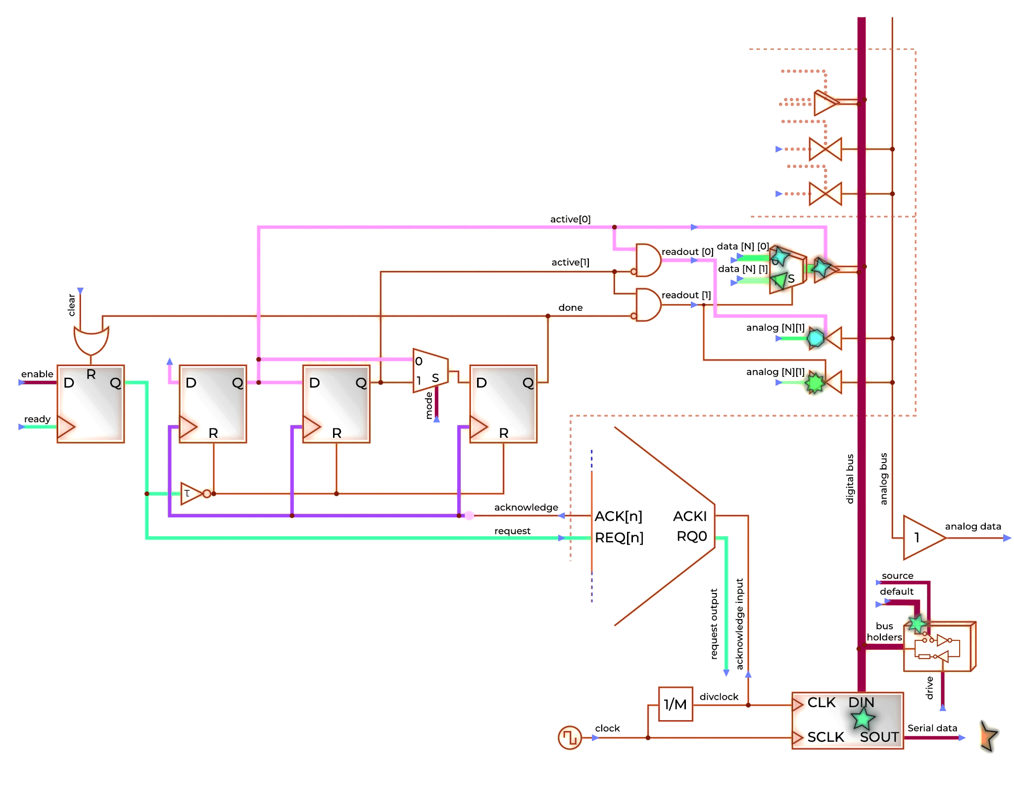
Operation flow 2/3
First Acknowledge – Data Transmission Start
The acknowledge signal arrives, granting the pixel exclusive access to the shared bus. The first data packet (e.g., pixel address and peak level) is transmitted over both the digital and analog lines.
Second Acknowledge – Next Data Packet
The next acknowledge edge triggers transmission of the second data packet (e.g., information about charge sharing). The handshake continues without the need for a change in the request state.

Slide 25

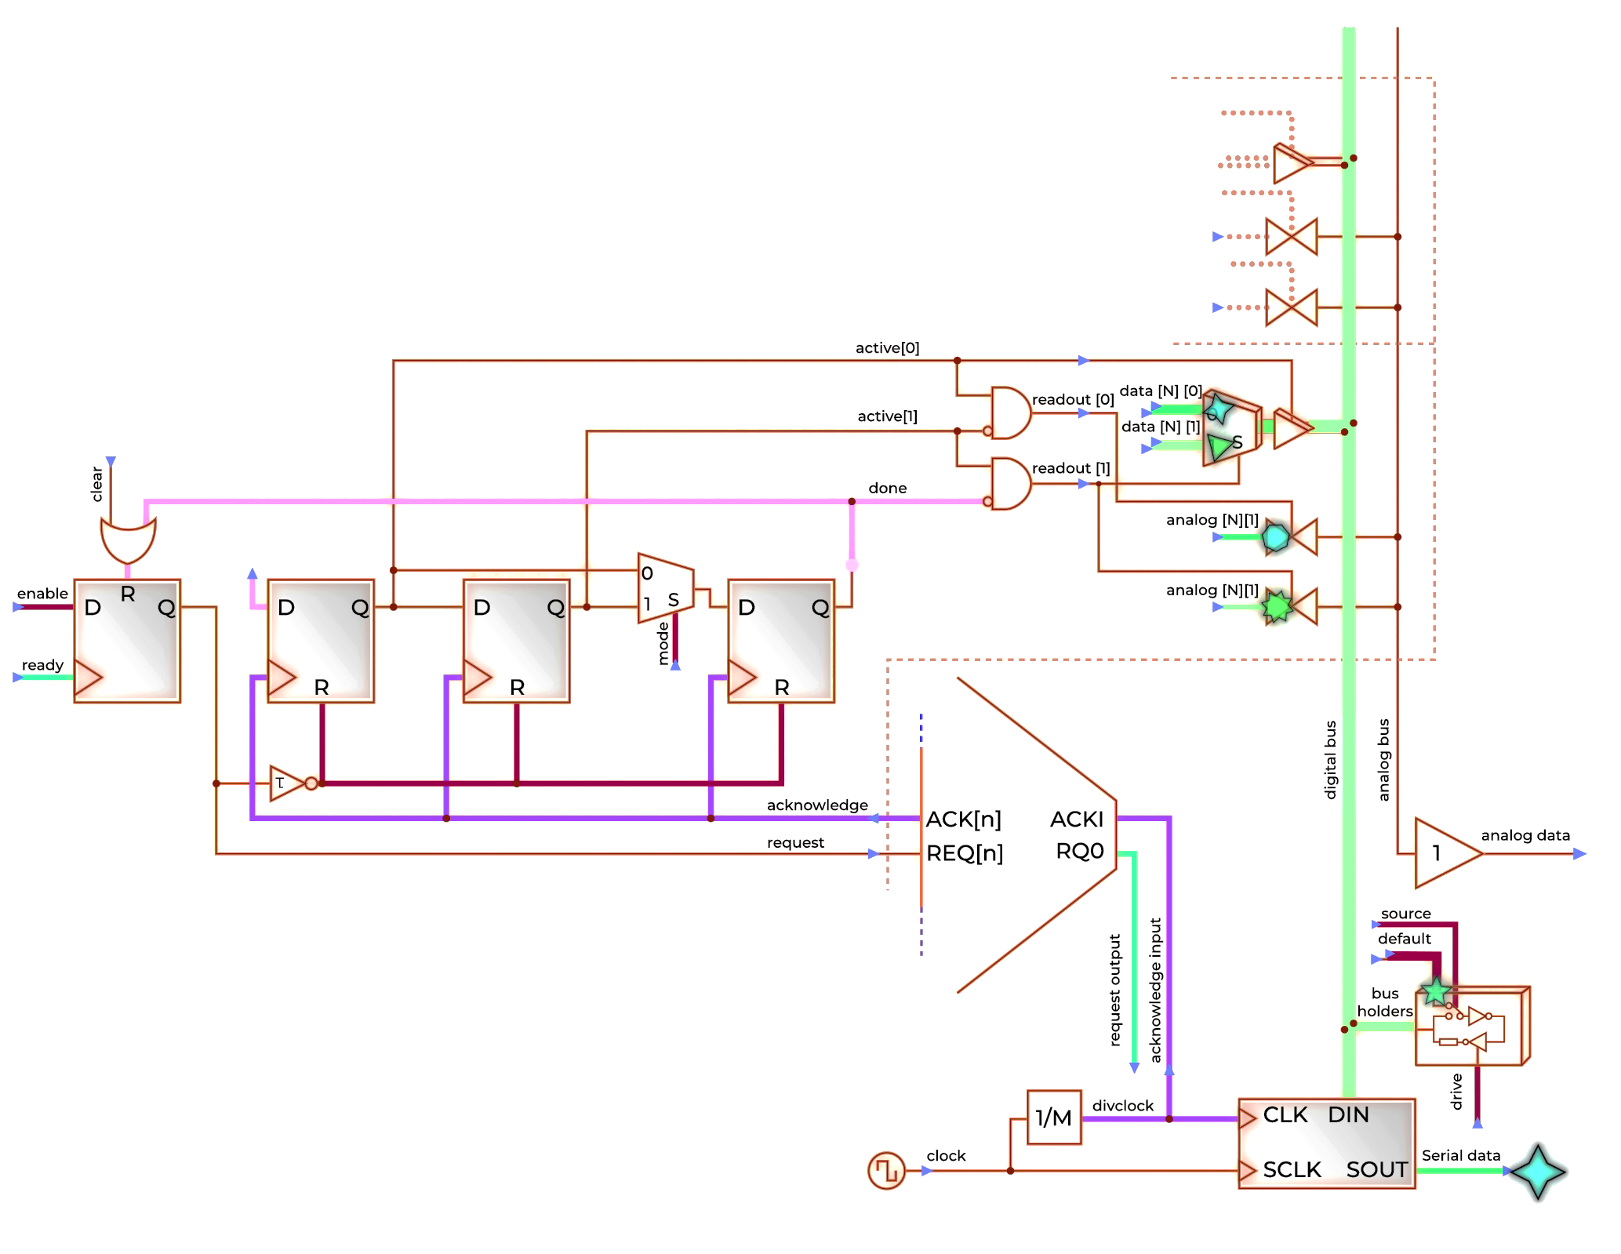
Operation flow 3/3
Third Acknowledge – Readout Completion
The third acknowledge completes the transaction. The in-pixel logic asserts the done signal, clearing the request and automatically resetting internal flip-flops to prepare for the next event. The acknowledge can be rerouted to other requesting pixel without incurring any dead time.
Return to Idle State or next readout
The pixel returns to its default idle state. The buses are released, the digital output resumes its default logic level, and the analog output returns to high-Z.

Slide 26
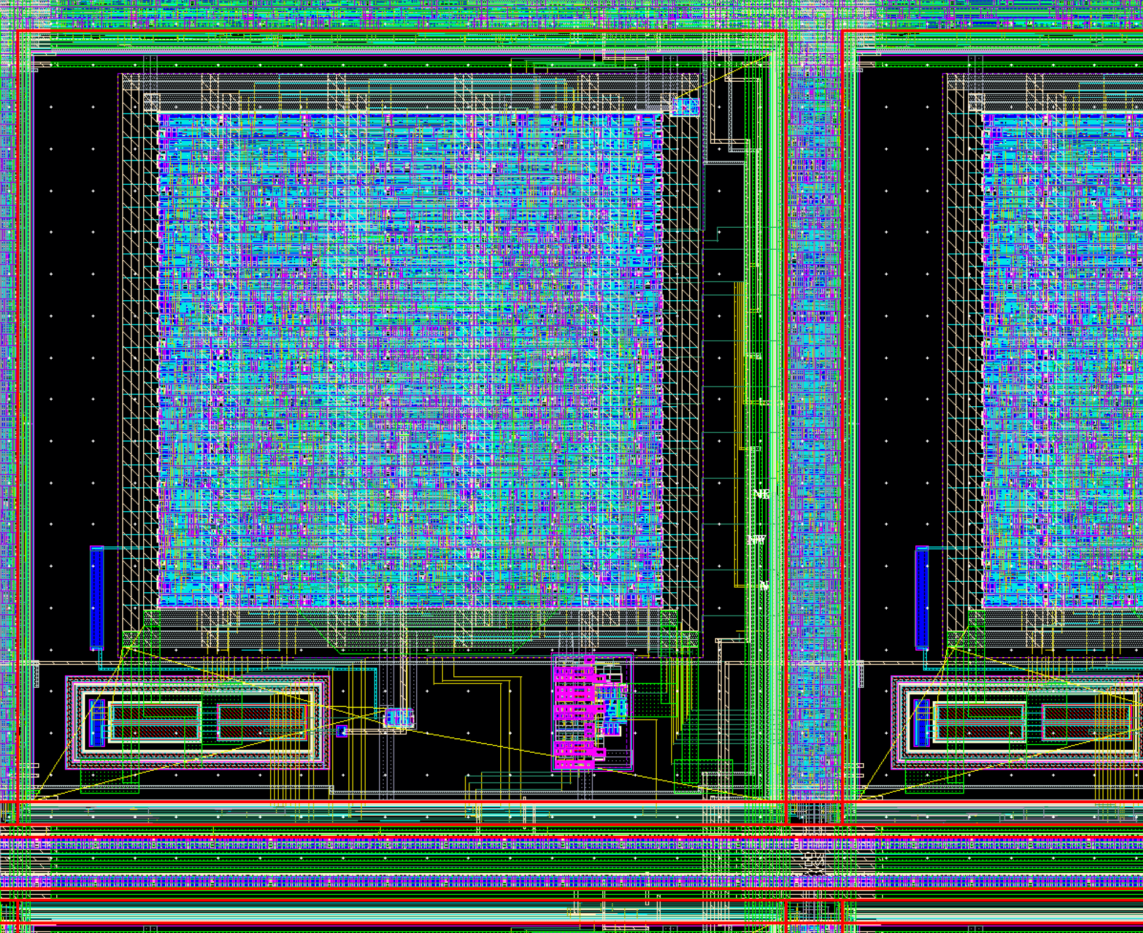
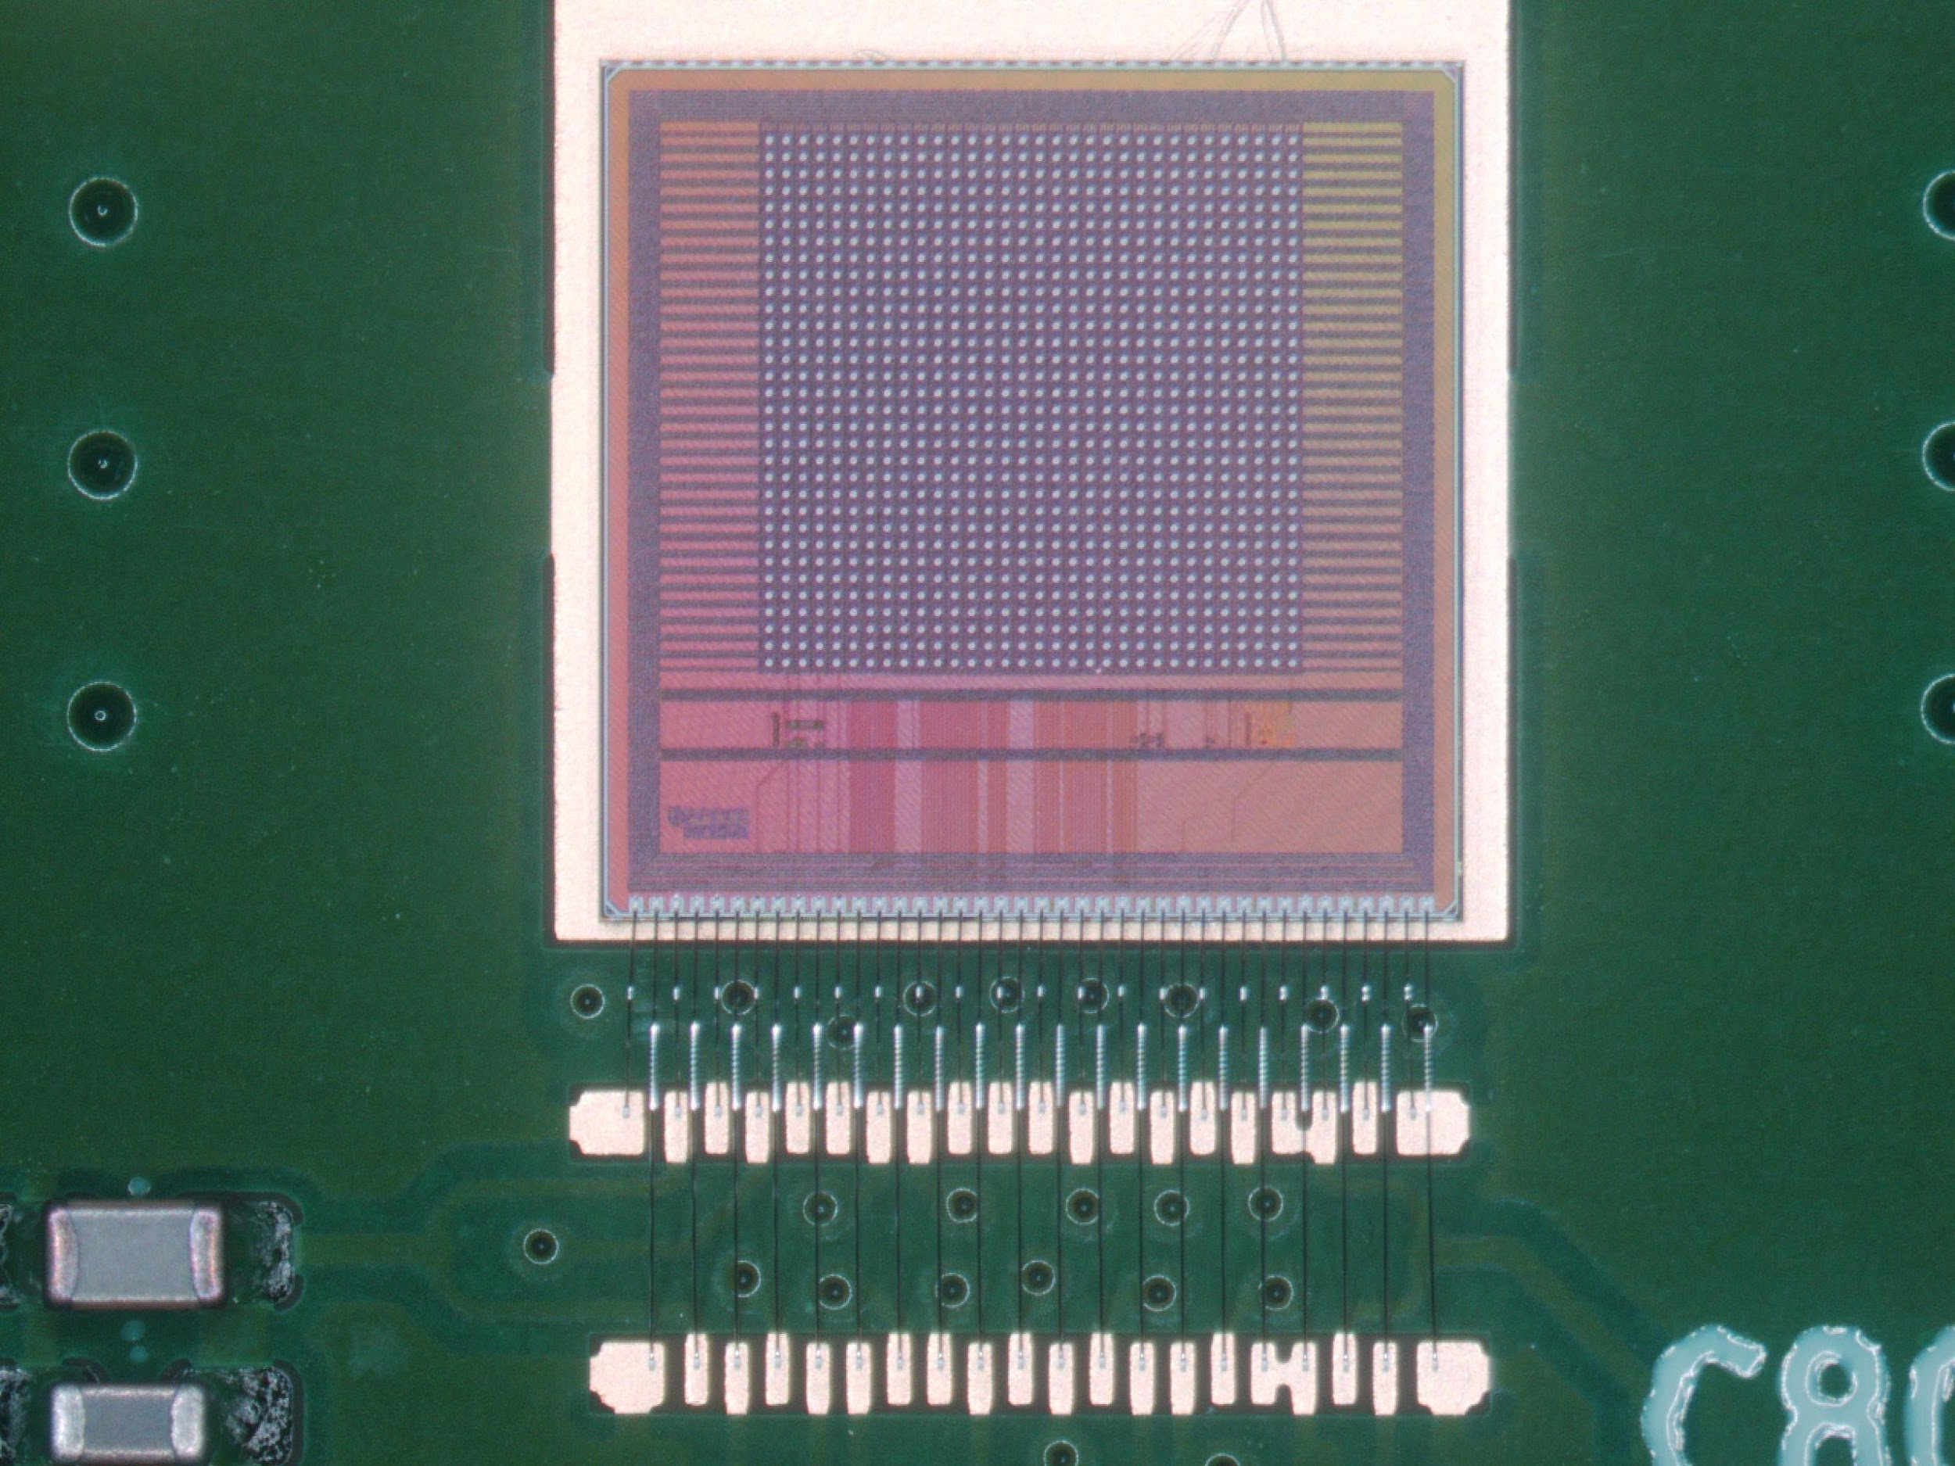
EDWARD65P1 chip
matrix of pixels
32x32
peripherals
AFE replaced with an event generator operating as a Poisson process, with exponentially distributed inter-event times.
Objective: to more accurately study the timing and functional properties of the EDWARD architecture in a laboratory environment without the need for physical radiation signal sources.
Full control over the rate of generated events.
D. Gorni, G. Deptuch, P. Maj, S. Mandal, G. Pinaroli, „Event-driven readout development: testing of the EDWARD65P1 chip with integrated event generators”, Journal of Instrumentation, 20(03), C03009 (2025), DOI: 10.1088/1748- 0221/20/03/C03009.
Notes:
Aby jeszcze dokładniej zbadać architekturę EDWARD powstał drugi, siostrzany chip EDWARD65P1, w którym analogowy tor przetwarzania zamieniłem na generator zdarzeń jak w procesie Poissona. Dzięki czemu uzyskano układ, który może generować zdarzenia o zmiennym natężeniu w warunkach laboratoryjnych.

Slide 27
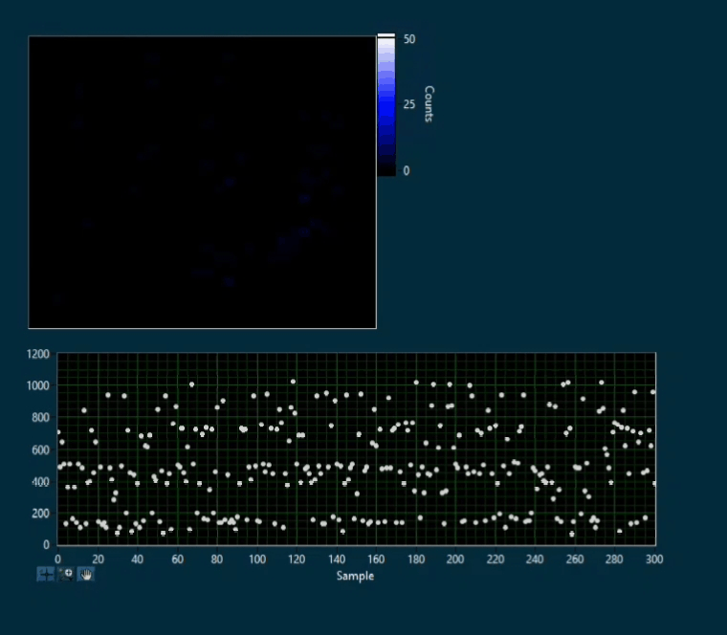
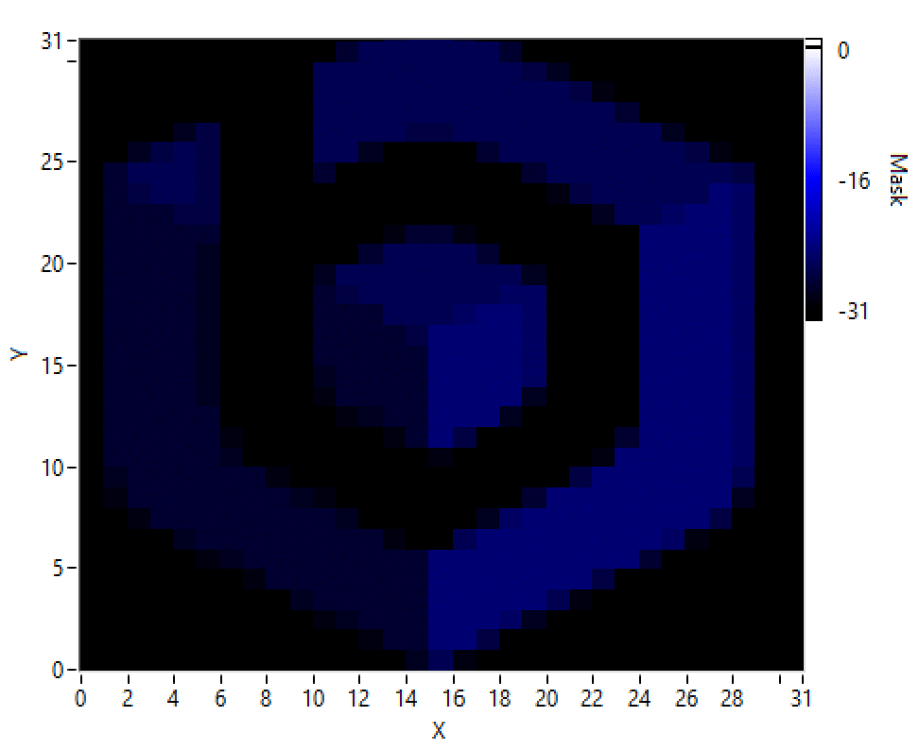
Examples of BNL systems - EDWARD

Slide 28
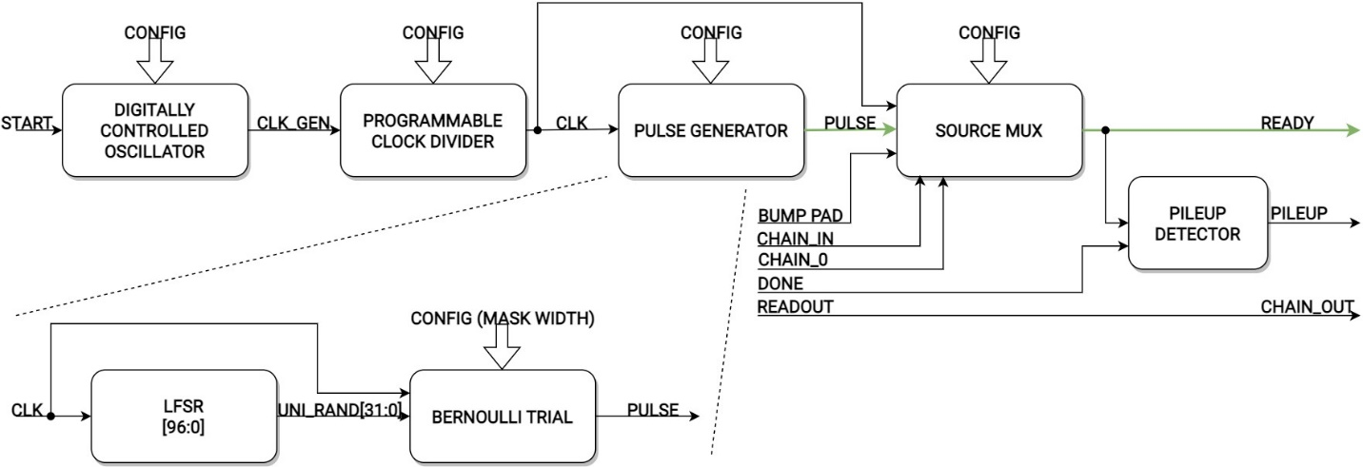
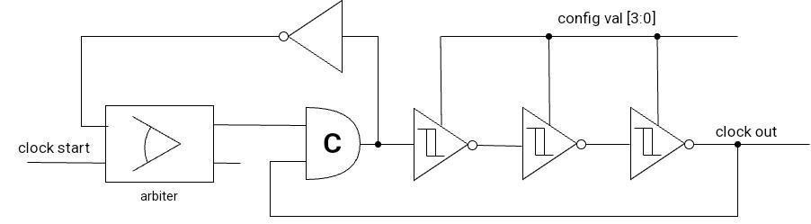
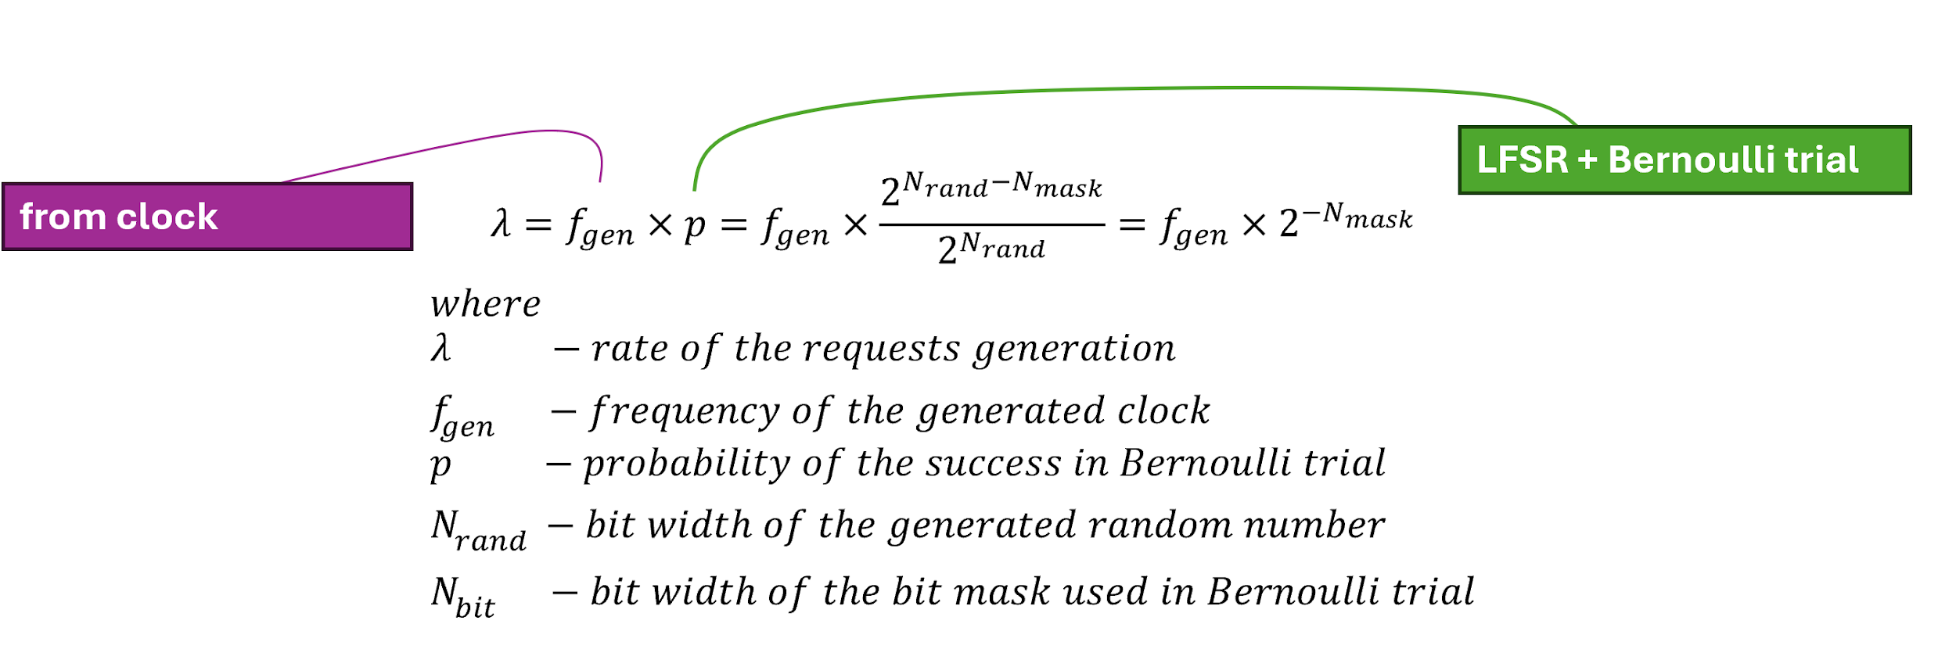
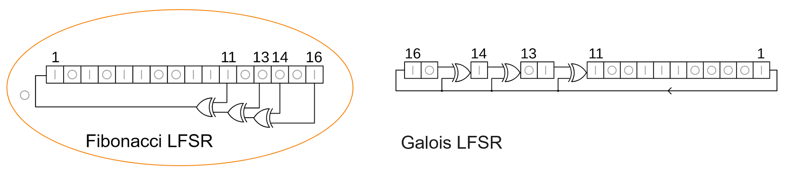
Per-pixel Poissona process generator
The use of a generator with a pause capability allows the dissipated power to be reduced and enables simulation of the absence of digital activity in a pixel.
Based on: A. Veiga and E. Spinelli, „A pulse generator with poisson-exponential distribution for emulation of radioactive decay events”, in 2016 IEEE 7th Latin American Symposium on Circuits & Systems (LASCAS), 2016.
The use of an LFSR in the Fibonacci configuration enables generation of a 32-bit pseudorandom variable with a uniform distribution in a single clock cycle by parallelizing the feedback computation.
Notes:
Generator wytarza sygnał, w którym odstępy pomiędzy kolejnymi wystąpieniami stanu aktywnego mają rozkład wykładniczy i działa w oparciu o lokalny oscylator, generator liczb pseudolosowych, które następnie poddawane są próbie Bernoullego.
Rejestr przesuwający z liniowym sprzężeniem zwrotnym
linear feedback shift register, LFSR

Slide 29
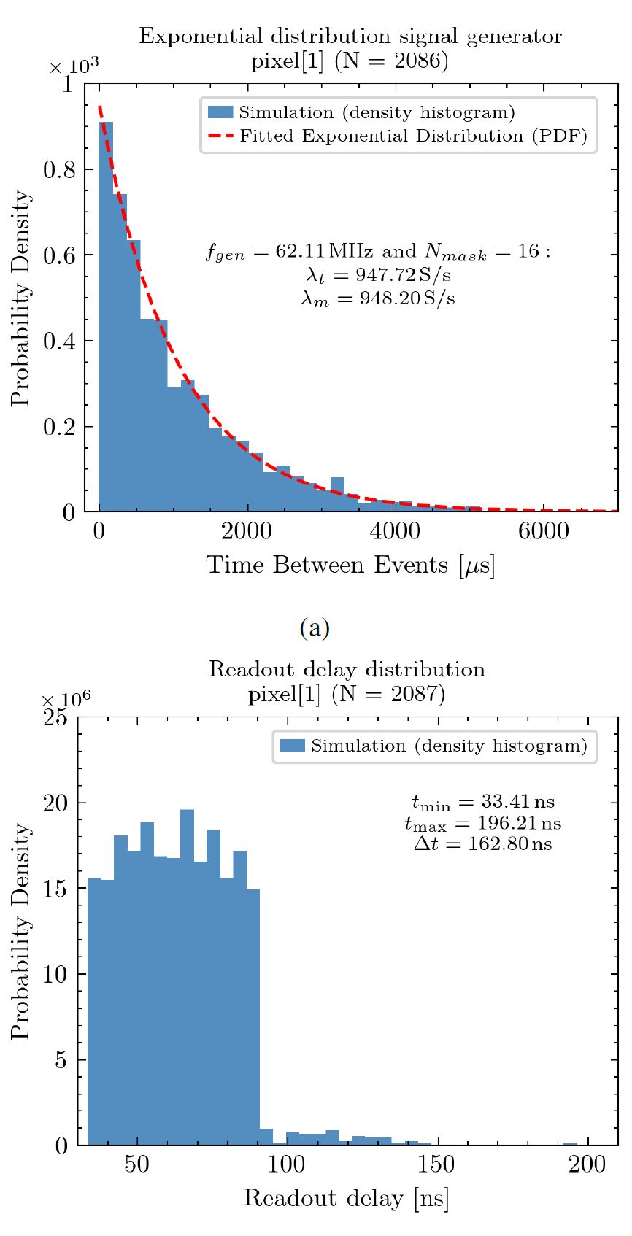
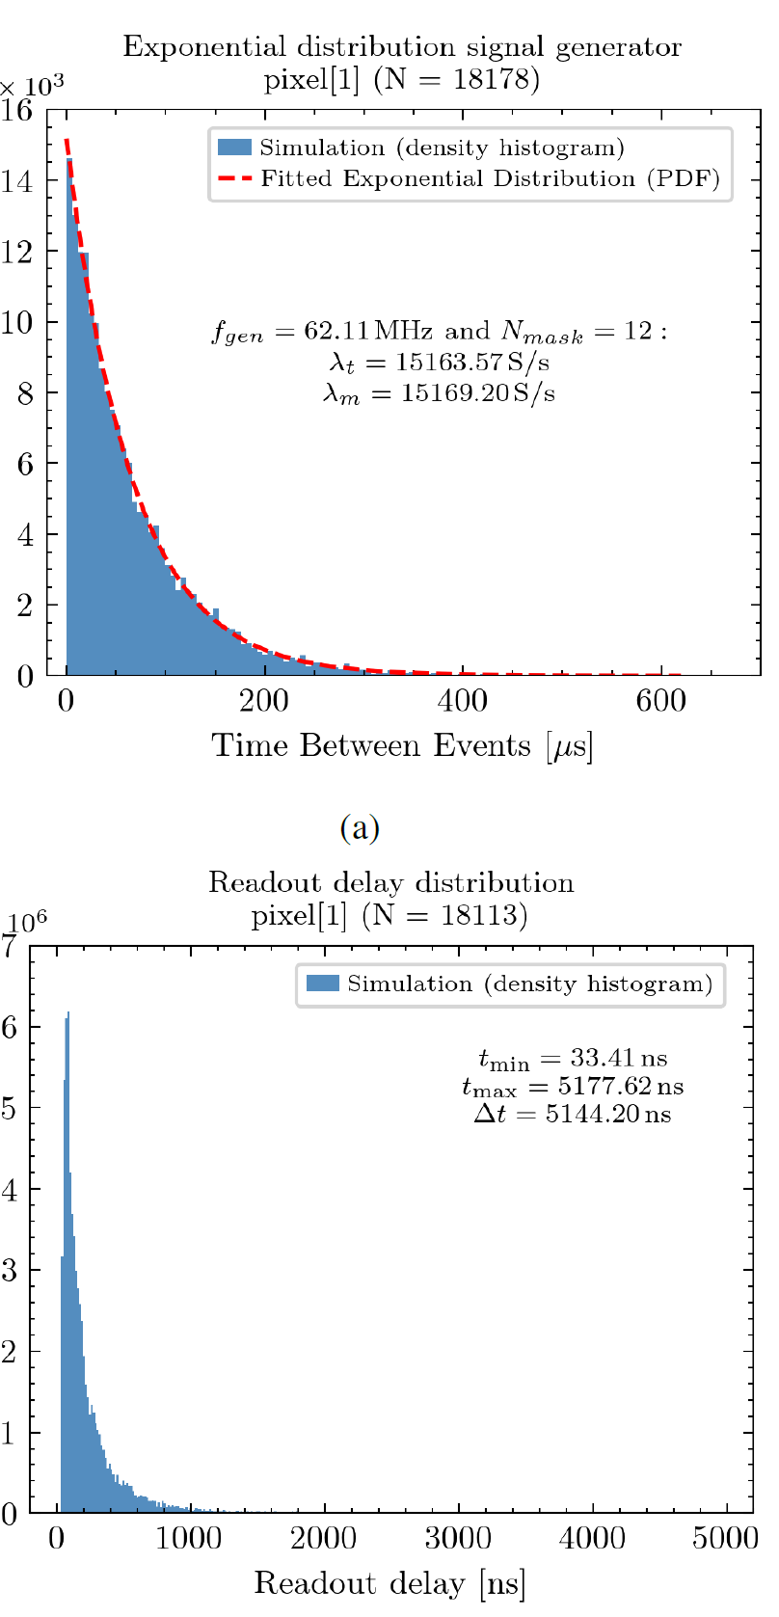
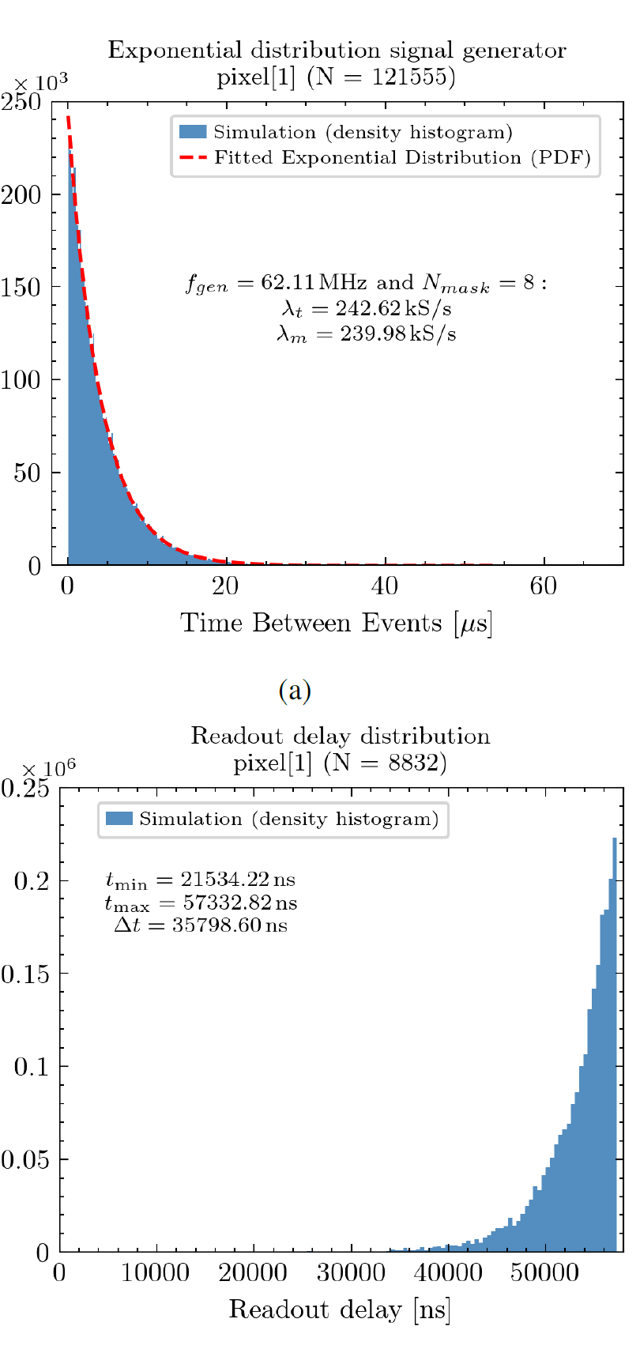
Digital-domain simulation results – dependence on event rate
At a low generation rate, considered effectively over the entire matrix, compared with the rate of acknowledge signals, most pixels are read out immediately by the first available acknowledge signal. Occasionally, however, a pixel must wait until earlier requests from other pixels have been served.
As the generation rate increases, the average waiting time for readout also increases, because more pixels compete for service at the same time.
When the event generation rate exceeds the acknowledge-signal rate, the latency approaches a limiting value corresponding to the time required to read out the entire matrix, analogous to frame-based readout. In this regime, each pixel must effectively wait for all other pixels to be read out.
T_{ack} = 56 ns
Notes:
Z wykorzystaniem samego modelu generatora przeprowadzono symulacje mające na celu zbadanie zależności zachowania odczytu od częstości zdarzeń. U góry pokazano rozkład międzyczasów generowanych zdarzeń w pikselu dla różnych konfiguracji
zaś na dole latencję odczytu mierzoną jako czas od wystąpienia żądania odczytu do ustalenia się danych na magistrali danych.
W przypadku małego tempa generacji większość zdarzeń odczytywana jest już przez pierwszy dostępny sygnał potwierdzenia. Wraz ze wzrostem tempa generacji czas oczekiwania wzrasta aż napotykamy na barierę kiedy tempo generacji jest większe niż tempo generacji potwierdzeń. W tej sytuacji piksel musi oczekiwać na odczyt wszystkich pozostałych pikseli zanim zostanie odczytany ponownie ale gwarantuje się, że żaden z innych pikseli nie będzie odczytany w tym czasie dwukrotnie.

Slide 30



Digital simulation results – dependence on event rate
System
utilization factor
ρ ~ T_{ack} x λ_{eff}
0.05
0.87
1.00
Average probability
of event overlap (pile-up):
μ ≈ 0%
μ ≈ 0.3%
μ ≈ 92.7%
Average readout latency:
μ ≈ 63 ns
μ ≈ 220 ns
μ ≈ 53.5 μs
Notes:
Gdy spojrzymy na te same dane z innej perspektywy widzimy, że wraz ze wzrostem tempa odczytu rośnie prawdopodobieństwo nakładania się zdarzeń jednak mimo wszystko każdy piksel jest odczytywany sprawiedliwie z podobną latencją.

Slide 31

Measured generator characteristics
Objective: to verify whether the obtained results agree with theory, both for the generator itself and for the EDWARD architecture.
The limit on the number of read out events reaches the theoretical limit imposed by the clock cycle used to generate acknowledge signals when the event rate from the matrix exceeds the acknowledge generation rate.
Notes:
Pomiary laboratoryjne potwierdziły wyniki symulacji – zaobserwowany rozkład generowanych zdarzeń zgodny jest z teorią i limitami nałożonymi przez architekturę odczytową

Slide 32


Measured generator characteristics cont.
As the event rate generated by the matrix increases, the readout rate increases linearly up to the limit set by the acknowledge-generation frequency.
The system exhibits non-paralyzable behavior.
The generator stops emulating a Poisson process when the success probability p becomes too large.
Notes:
Należy również pamiętać, że generowany rozkład tylko przybliża faktyczny proces Poissona – gdy prawdopodobieństwo sukcesu jest zbyt duże zaczynamy generować zdarzenia niemal w każdym cyklu lokalnego oscylatora.
Ale co najważniejsze wraz ze wzrostem częstości zdarzeń generowanych przez matrycę rośnie liniowo częstość odczytów aż do limitu wynikającego z częstości generowania potwierdzeń co jest pożądaną cechą.
Dodatkowo układ ma charakter nieparaliżujący – liczba odczytywanych zdarzeń pozostaje na stałym poziomie po przekroczeniu limitu.

Slide 33




Analytical model

Slide 34

Analytical results

