Slide 1

FEE 2026 · PARIS
Verification of Complex ASICs
Adithya Pulli
EP-ESE-ME, CERN
Front-End Electronics Workshop · May 2026

Slide 2
CONTEXT
Why Verification Matters?
Recent High Energy Physics (HEP) ASICs have far more digital complexity
Highly optimized readout architectures
On-chip processing, RISC-V, AI/ML
e.g. RD53, FastRICH, PicoPix
Cost of engineering runs increase as we move to smaller technology nodes
65nm → 28nm: engineering runs >2× more expensive
A re-spin that was manageable at 130nm or 65nm can become financially prohibitive at 28nm
Source: CERN ASIC support
Verification is a key enabler for first time silicon success

Slide 3
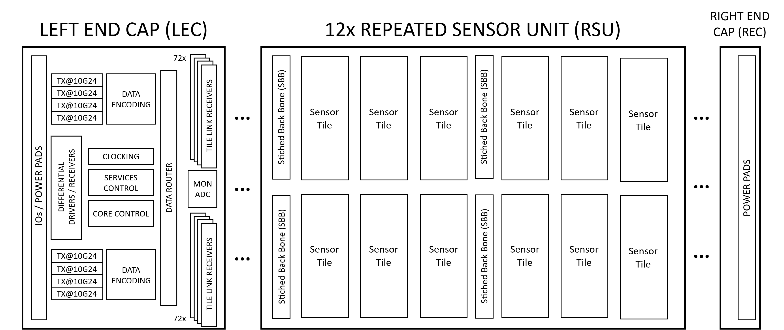
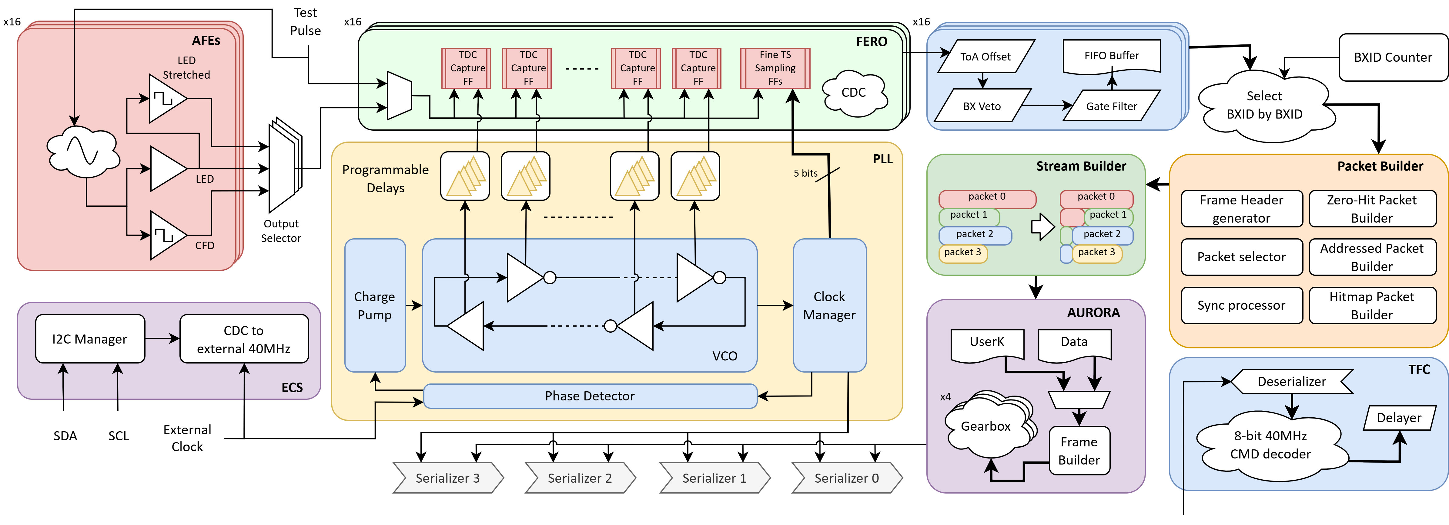
CONTEXT
The Chips We'll Use as Examples
FASTRICH
MOSAIX
What | 16-channel front-end readout ASIC for timing detectors
Technology | TSMC 65 nm CMOS
Scale | 5 × 5.25 mm, 16 channels
Features | 25 ps ToA, 4× 1.28 Gbps Aurora, SEE-tolerant
Challenge | High precision TDC, readout optimized for wide range of detector occupancies
What | Monolithic stitched pixel sensor for tracking
Technology | TPSCo 65 nm CMOS imaging process
Scale | 265 × 19.6 mm, ~10M pixels
Features | Sync-based readout, 8× 10.24 Gbps, SEE-tolerant
Challenge | Massive scale — hierarchy & reuse from day one

Slide 4
SECTION 1
The Verification Process
Illustrated with FastRICH and MOSAIX ASICs
Strategize
→
Plan
→
Implement
→
Sign-off

Slide 5
STRATEGIZE
Defining the Verification Strategy
Aligns goals, methods, resources, and sign-off criteria

Slide 6
STRATEGIZE
Defining the Verification Strategy
Aligns goals, methods, resources, and sign-off criteria
Identify requirements & goals — functional, performance, SEE robustness
FASTRICH — VERIFICATION GOALS
Control Interface
Command Interface
● I2C compliance
● 100 kHz – 1 MHz operation
● All RW registers verified
● Lock to fast-command frame
● All command combinations
● Constant command latency
Readout Interface
Data Integrity
● Aurora compliance
● 1, 2, 4 links @ 320/640/1280 Mbps
● Recovery after link saturation
● ToA accuracy <25 ps – TDC linearity
● No hit losses / ghost hits
● Test pulse covers all timing bins
SEE Robustness
● Configuration is not corrupted
● Commands are always responded to
● Command latency is always constant
● Automatic link recovery

Slide 7
STRATEGIZE
Defining the Verification Strategy
Aligns goals, methods, resources, and sign-off criteria
Identify requirements & goals — functional, performance, SEE robustness
Pick methodologies — simulation vs. formal, RTL vs. netlist, mixed-signal, power-aware
FASTRICH — VERIFICATION METHODOLOGIES
Formal
● Model checking for critical controllers
● Auto formal checks: connectivity, linting, CDC
● Triple Modular Redundancy (TMR) correctness
Simulation — Coverage Driven Constrained Random Verification (CDCRV)
● RTL: protocol compliance, functional correctness, performance analysis
● Netlist: Clock domain crossings, asynchronous paths in TDC
Mixed-signal
● PLL simulations
● AFE + TDC co-simulation

Slide 8
STRATEGIZE
Defining the Verification Strategy
Aligns goals, methods, resources, and sign-off criteria
Identify requirements & goals — functional, performance, SEE robustness
Pick methodologies — simulation vs. formal, RTL vs. netlist, mixed-signal, power-aware
Conceptualise application — languages and libraries (SV, UVM, Python, cocotb), testbench hierarchies, content reuse
MOSAIX VERIFICATION HIERARCHIES

Slide 9
STRATEGIZE
Defining the Verification Strategy
Aligns goals, methods, resources, and sign-off criteria
Identify requirements & goals — functional, performance, SEE robustness
Pick methodologies — simulation vs. formal, RTL vs. netlist, mixed-signal, power-aware
Conceptualise application — languages and libraries (SV, UVM, Python, cocotb), testbench hierarchies, content reuse
Identify bottlenecks — compute, licenses, time, people

Slide 10
STRATEGIZE
Defining the Verification Strategy
Aligns goals, methods, resources, and sign-off criteria
Identify requirements & goals — functional, performance, SEE robustness
Pick methodologies — simulation vs. formal, RTL vs. netlist, mixed-signal, power-aware
Conceptualise application — languages and libraries (SV, UVM, Python, cocotb), testbench hierarchies, content reuse
Identify bottlenecks — compute, licenses, time, people
Define sign-off strategy — checklist of tasks and metrics to declare the chip verified
MOSAIX SIGN-OFF CHECKLIST — 41 TASKS
Category | Hierarchies | Metric
RTL regression | All testbench hierarchies | vPlan score (coverage + pass-rate)
TMR regressions | All testbench hierarchies | vPlan score (coverage + pass-rate)
Netlist regressions (min/typ/max) | All testbench hierarchies | vPlan score (functional coverage + pass-rate)
Power-aware regressions (typ) | All testbench hierarchies | Pass-rate
Performance analysis | Sensor Tile | Efficiency plots
Quality checks | All testbench hierarchies | Warning counts, SDF annotation percentage, waiver review
Formal analysis | Sensor Tile, Left End Cap | Super lint and connectivity checks pass without errors

Slide 11
SECTION 1
The Verification Process
Illustrated with FastRICH and MOSAIX ASICs
Strategize
→
Plan
→
Implement
→
Sign-off

Slide 12
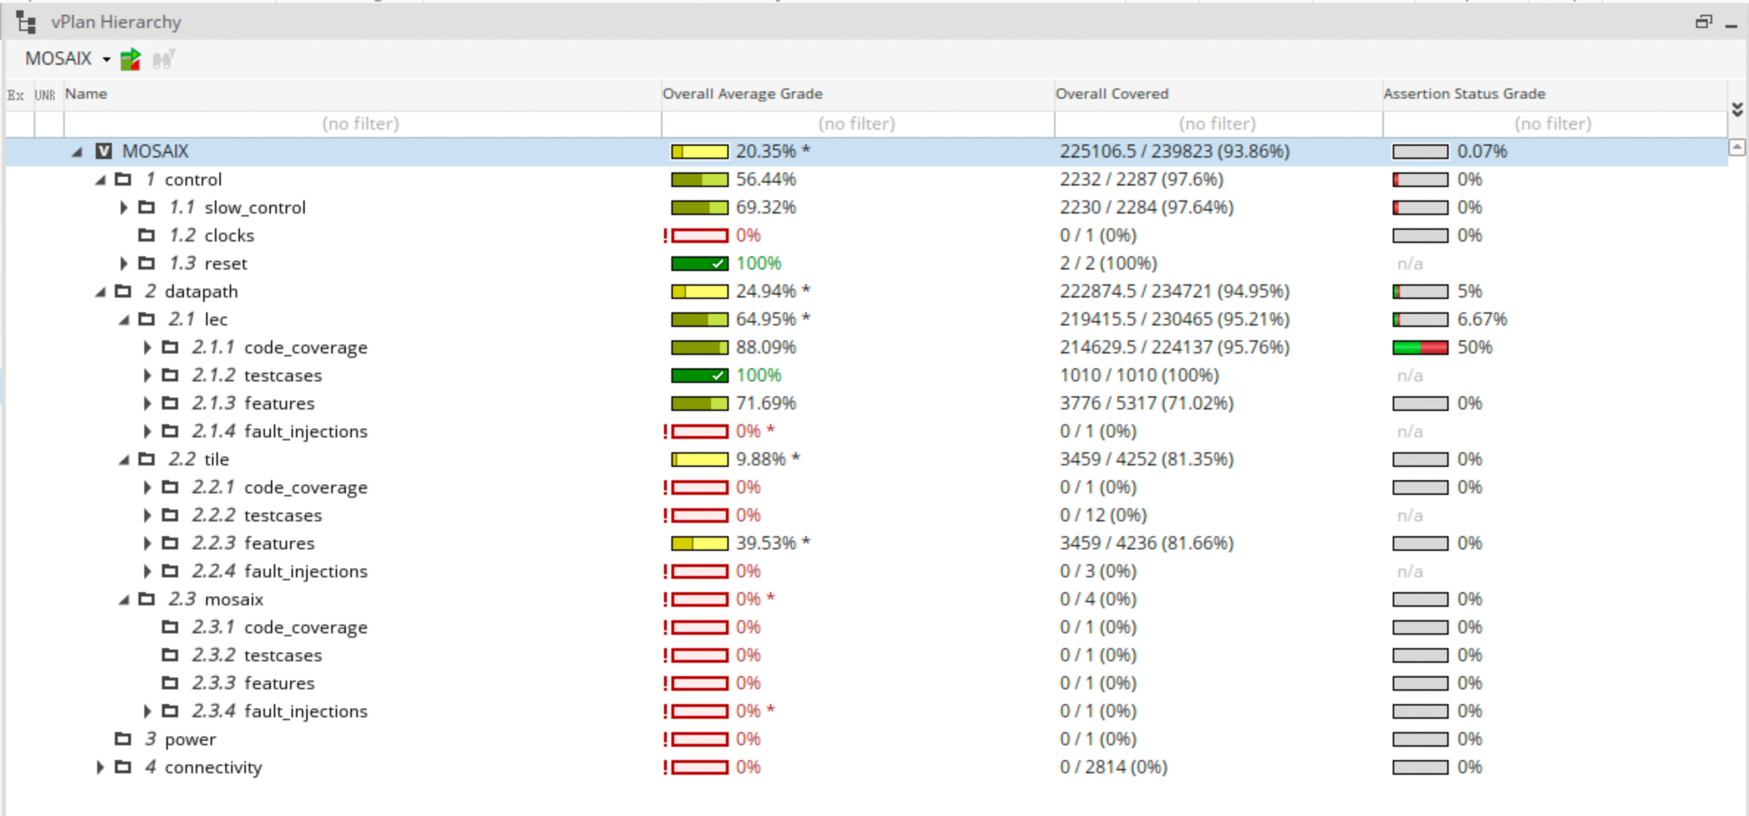
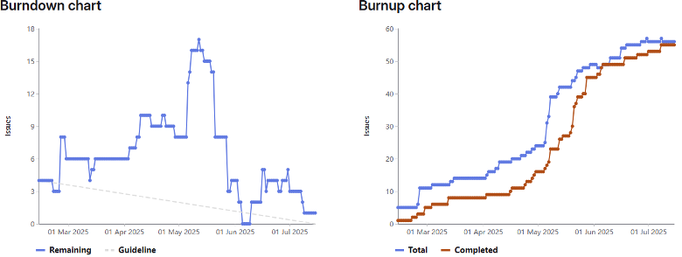
PLAN
Verification Plan & Project Plan
Cadence vManager — vPlan
Verification Plan
● Test cases — what to verify
● Coverage — how to measure completeness
● Tracked in Cadence vManager or spreadsheet
GitLab Milestone Progress Tracking
Project Plan
● Implementation of verification environment
● Implementation of test cases and coverage
● Timeline for various regressions and coverage closure
● Tracked on GitLab — issues and milestones

Slide 13
SECTION 1
The Verification Process
Illustrated with FastRICH and MOSAIX ASICs
Strategize
→
Plan
→
Implement
→
Sign-off

Slide 14
IMPLEMENT
Testbench Architecture — Reuse First, Build What's Unique
Reuse what is already available — don't rebuild testbench components
Using a standardized methodology, such as UVM enables content reuse across projects through UVM Verification Components (UVCs)
Several commonly used UVCs are available through CHIPS gitlab project
Focus effort on what is unique to the ASIC — checker, readout protocol decoders, coverage model
FASTRICH TESTBENCH ARCHITECTURE
tests
hits_uvc
FastRICHDUT
RTL / TMR / Netlist
checker
pin_uvc
aurora_uvc
clk_gen_uvc
frame decoder
control_uvc
i2c_cfg_uvc
RAL
see_uvc
Reference: Reusable verification components for High-Energy Physics readout ASICs, M. Lupi et al 2025 JINST 20 C02002

Slide 15
IMPLEMENT
Verification Activities
Constrained Random Tests
Regressions
● Random hit timing, occupancy, ToT
● Random commands and command sequences
● Random register access tests
● RTL regressions
● Netlist regressions
● Sign-off regression suites
Semi-directed Tests
Continuous Integration
● ToA scan across full timing range
● Test-pulse & TDC dead-time scan
● Readout efficiency vs. occupancy
● Smoke regressions on every commit
● Ensures no bugs introduced
● Critical with >2 engineers on a project
Tests are rerun several times with different seeds until a coverage goal is achieved. Hundreds of jobs in parallel on the batch farm.
Bug Tracking
● GitLab issues for every bug
● Steps to reproduce + debug notes
● Reproducibility is essential

Slide 16
SECTION 1
The Verification Process
Illustrated with FastRICH and MOSAIX ASICs
Strategize
→
Plan
→
Implement
→
Sign-off

Slide 17
SIGN-OFF
Sign-off: A Rubber Stamp on a Clean Process
Run all sign-off checks (defined early in the project) on sign-off database
A sign-off report:
Typically documented in a Gitlab issue
Steps to reproduce the results
Waivers and their justification
If the process is followed well, sign-off is the easiest part of the project
Project | Tape-out | Bugs found | Bugs escaped
lpGBT | Q1 2021 | 60 | 1
Altiroc | Q3 2022 | No data | 1
MOSS | Q4 2022 | 76 | 0
ECON-D | Q4 2022 | 373 | 0
ECON-T | Q4 2023 | 75 | 0
RD53 | Q3 2023 | 169 | 1
FastRICH | Q1 2025 | 247 | 0
MOSAIX | Q2 2025 | 592 | 1
PicoPix |  | 434

Slide 18
SECTION 2
Challenges & Path Forward

Slide 19
CHALLENGE 1
The Process and Methodology Scales — Human Resources Don't
Coverage Driven Constrained Random Verification (CDCRV) and the other verification practices discussed here scale well for complex HEP ASICs
Challenges:
Verification expertise is not immediately available
Onboarding to full productivity takes ~12-18 months (one project cycle)
Personnel often leave before this investment fully pays off (as observed at CERN)
Knowledge continuity is fragile, with expertise effectively resetting between personnel generations
CERN's strategy:
Treat verification as an independent discipline – significant investment in verification personnel and tools over the past 5 years
Development of a robust verification methodology and process to ensure long-term continuity

Slide 20
CHALLENGE 2
The EDA Licensing Bottleneck — and a Path Around It
Current verification throughput is gated by EDA license availability, not compute
As GenAI raises engineer throughput, license availability becomes the binding constraint even faster
OUVERT — Open-source Universal VERification Technologies
Exploratory project to develop, validate, and document a fully open-source digital verification methodology as a credible alternative to the current methodology
Goal is not to replace the current commercial stack, but to merely explore alternatives which can scale well for most of the verification process
Capability | Open-source alternative
Simulator | Verilator + Icarus Verilog
Testbench framework | cocotb + AVL (Python)
Regression management | pytest + pytest-xdist
Functional coverage | cocotb-coverage (from AVL)
Fault list generation | Based on yosys
Python lowers the barrier to entry — new contributors reach productive output faster than with UVM SystemVerilog

Slide 21
THE HONEST BLIND SPOT
Analog and Mixed Signal Verification
Verification process discussed today mainly applies to digital logic
HEP ASICs have complex analog and mixed signal IP blocks – AFEs, PLLs, ADCs, DACs etc.
Many recent bugs found in silicon are in analog blocks
Methodical AMS verification is largely unsolved in HEP
Calls for another round of strategic investment into this topic to ensure first time silicon success
We have not cracked this!

Slide 22
SUMMARY
Verification Techniques for Complex ASICs
The Process Works
Challenges
Path Forward
Strategize → Plan → Execute → Sign-off
Reuse concentrates effort
Well established process assures continuity in verification effort
Proficiency takes 12–18 months
EDA licensing wall
AMS verification — unsolved
OUVERT: open-source stack
GenAI improves verification throughput
Promote common verification practices
Invest in AMS verification expertise

Slide 23
Thank you
Questions?
Adithya Pulli
EP-ESE-ME, CERN
adithya.pulli@cern.ch
ACKNOWLEDGEMENTS
Matteo Lupi · Simone Scarfi
Co-verification engineers on FastRICH, MOSAIX & PicoPix — EP-ESE-ME, CERN

Slide 24
SECTION 3
Backup

Slide 25
IMPLEMENT
The FastRICH Checker
CANONICAL CHECKER ARCHITECTURE
FASTRICH CHECKER — APPROXIMATE SCOREBOARD
Stimulus drives both DUT and reference model
Scoreboard compares outputs exactly
Works when output is fully deterministic
DUT
Readout to hits
Hits UVC
Readout UVC
Hit Classifier (match/mismatch/lost/ghost)
DUT
Scoreboard
Hits UVC
Readout UVC
Exact prediction infeasible: clock phase uncertainty, metastability, ±1 bin ambiguity
Classify each hit: matched / mismatched / ghost / lost
Handles edge cases: bunch-crossing veto, gate filtering, ToT mismatch
Reference model
Reference: Challenges and strategies in verification of FastRICH ASIC for the LHCb RICH detector, M. Lupi et al 2026 JINST 21 C03008

Slide 26
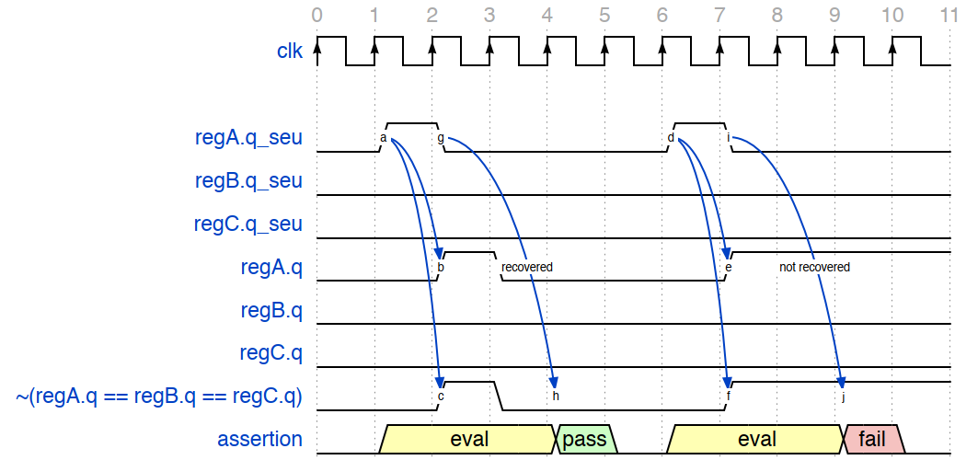
IMPLEMENT
SEE Verification: Simulation & Formal
SIMULATION TRACK
FORMAL TRACK
TMR campaign: two parallel simulations with same seed - compare all DUT output strobes. Mismatch = incorrect triplication
Non-TMR campaign: inject faults in unprotected nodes, check fault-tolerance goals are preserved
Random fault + recovery: random SEE injection across full test; verify chip recovers via soft reset
SVA assertions auto-generated from netlist - one per TMR triplet
Proves exhaustively that voter always outputs majority - no simulation seeds
Catches triplication errors which takes much longer in simulation
Proof times: 90 sec → 36 hrs depending on block complexity
Reference Simulation
strobe.vcd
Design
Strobe comparison
Fault Simulation
strobe.vcd
References:
A simulation methodology for verification of transient fault tolerance of ASICs designed for high-energy physics experiments, A. Pulli and M. Lupi 2023 JINST 18 C01038
SEU injection framework for radiation-tolerant ASICs, a formal veriﬁcation approach, M. Lupi and A. Pulli 2023 JINST 18 C02023

