Slide 1
ALCOR: A mixed-signal ASIC for the DRICH detector of the ePIC experiment at the EIC
19 May 2026
Giulio Dellacasa (INFN Torino) on behalf of EPIC dRICH Collaboration

Slide 2
Outline
ePIC-dRICH detector at EIC
ALCOR architecture overview
Main results from ALCOR-32
ALCOR-64: design upgrades and BGA packaging
Summary

Slide 3
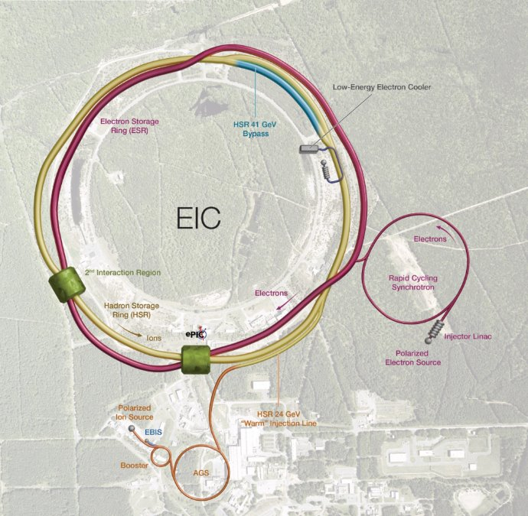
The ePIC experiment at the EIC
Electron-Ion Collider (EIC) at BNL: major US project in nuclear physics, one of the most important future facilities in the field
Collision of e⁻ and ions (from proton to uranium)
Center-of-mass energy from 20 to 140 GeV
Highly polarised beams: ~70%
High luminosity: 10³³ cm⁻²s⁻¹
One approved experiment: ePIC
Start of operations in the early 2030s
Physics goals:
Precise measurements in non-perturbative QCD
Origin of mass & spin of the nucleons
3D imaging of the nuclear structure

Slide 4
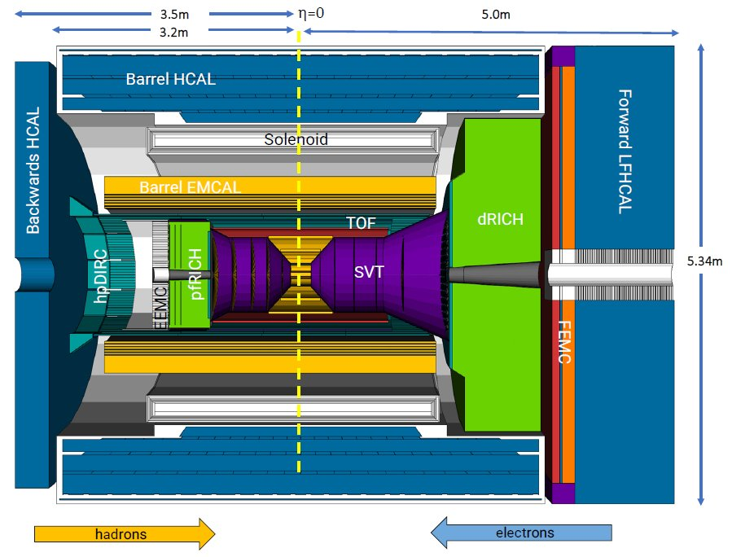
The ePIC experiment at the EIC
Tracking
1.7 T magnet
Si MAPS Tracker
MPGDs (μRWELL / MicroMegas)
PID
high performance DIRC
proximity focusing RICH
dual-radiator RICH
TOF (AC-LGAD)
Calorimetry
barrel: imaging EMCal
backward: PbWO₄ EMCal
forward: finely segmented
outer barrel + backward HCal

Slide 5
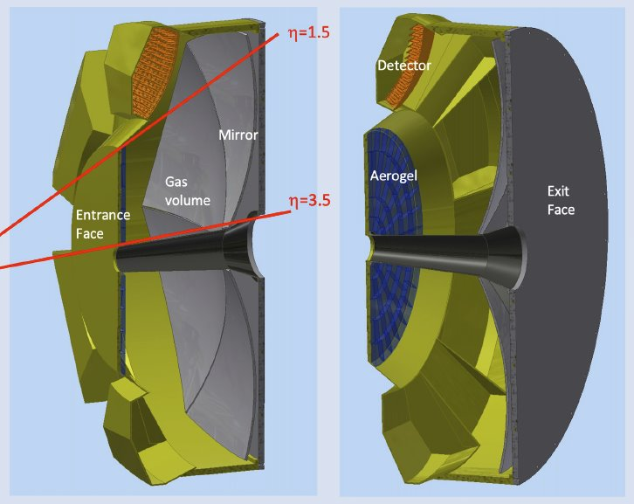
The dual-radiator RICH (dRICH) for forward PID
Compact and cost-effective solution for broad momentum coverage (3-50 GeV/c) at forward rapidity (1.5-3.5)​
Radiators: aerogel (n ~ 1.026) and C₂F₆ (n ~ 1.00086)
Mirrors: large outward-reflecting, 6 sectors
Photosensors: 3x3 mm² SiPMs, 0.5 m² per sector, in 1 T magnetic field and radioactive environment (10¹⁰-10¹¹ n_{eq}/cm² total exposure 10 y operation)
SiPM based readout
  Single Photon sensitivity ~ 30 phs per Cherenkov event
  Good timing performance < 100 ps
  Cheap and insensitive to magnetic fields
  High DCR and high radiation sensitivity requires:
    cooling → T = -30/-40°C
    annealing → in-situ temperature cycles
    timing → fast electronics

Slide 6
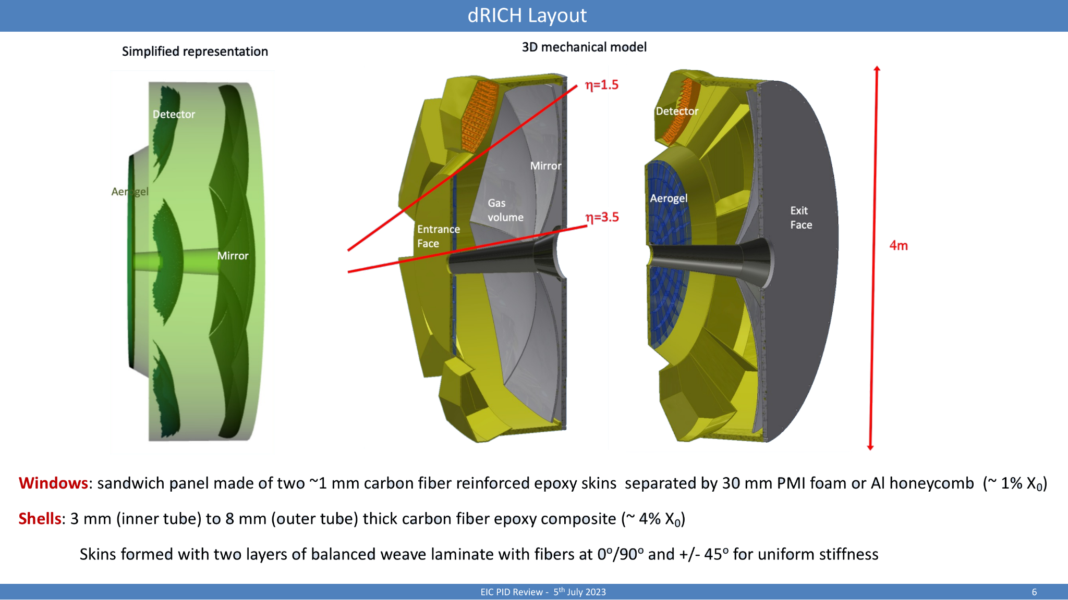
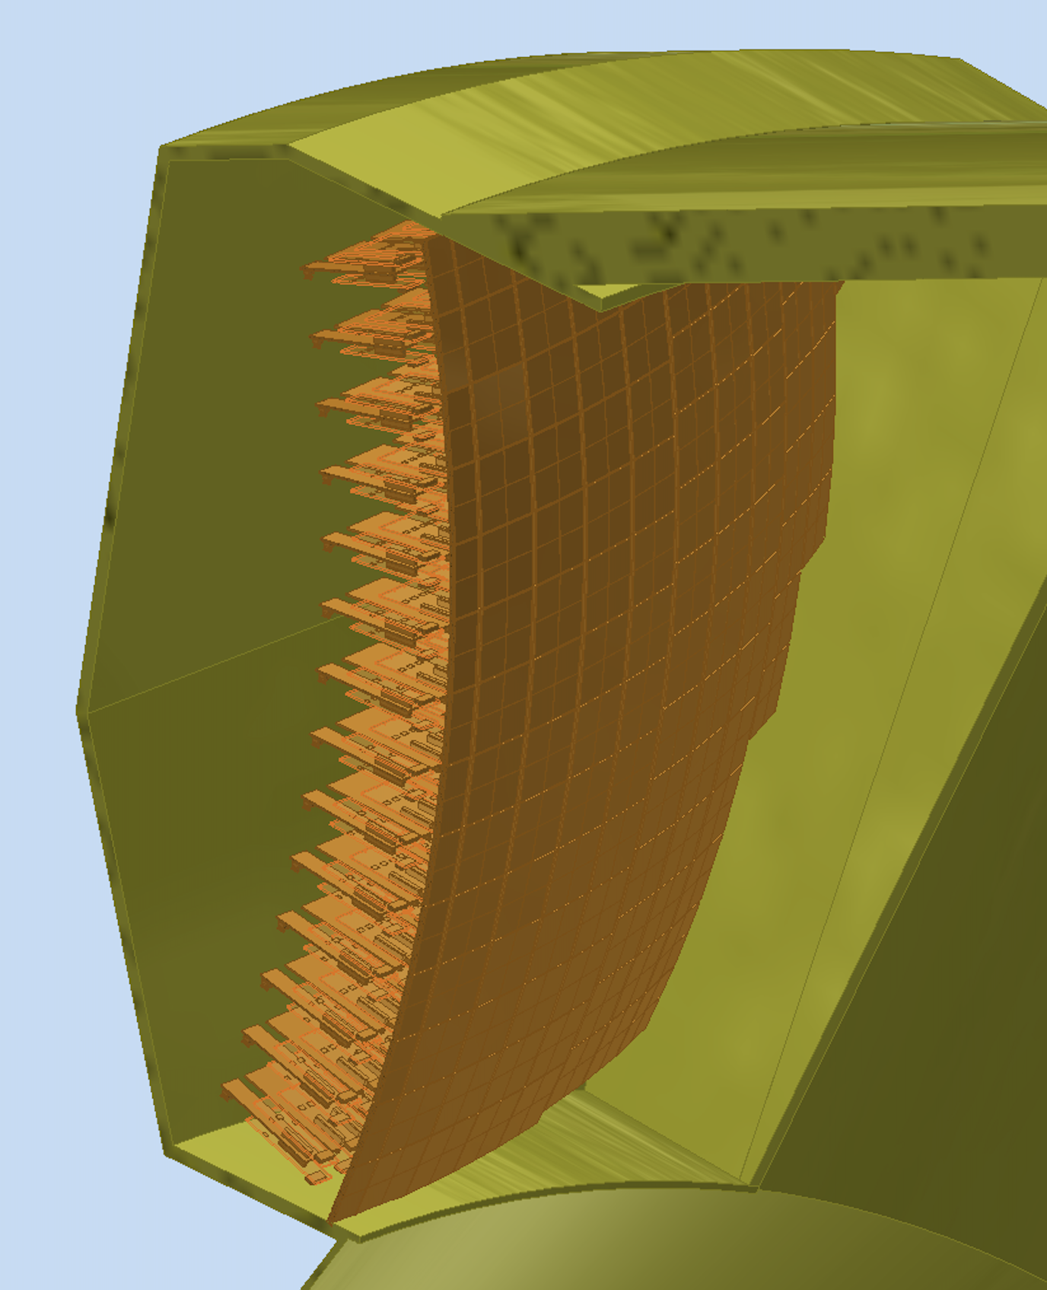
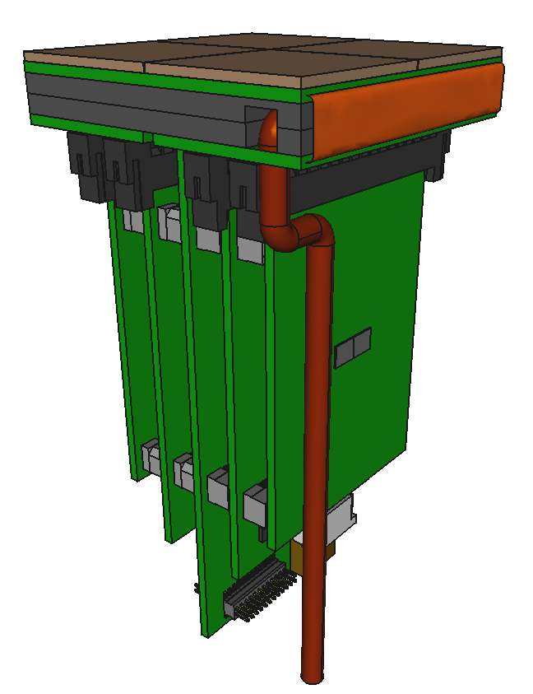
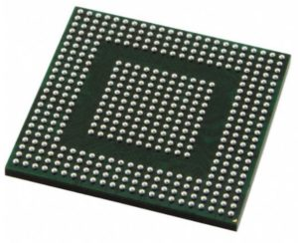
dRICH electronics overview
PDUs inside dRICH sector “detector box” (INFN Ferrara)​
cold plate / heat exchanger
SiPM sensors
SiPM matrix array
(INFN Bologna)
flex PCB
back-side connectors
~ 14 cm
FEB
ALCOR ASIC
(64-channel, BGA)
1 PDU: 4x64 SiPM array device (256 channels), 4 FEBs, 1 RDO​
1 ALCOR (64 channels) per FEB: 8x8 SiPM matrix readout​
6 sectors: 208 PDUs/sector → 1248 PDUs for full dRICH readout​
4992 FEBs → 4992 ALCOR-64​
319488 readout channels​
RDO
connections to services
HV, LV, DAQ, …
(INFN Bologna)

Slide 7
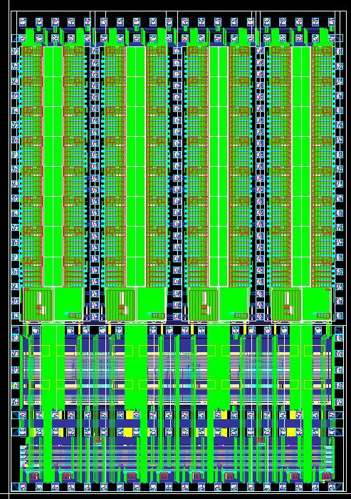
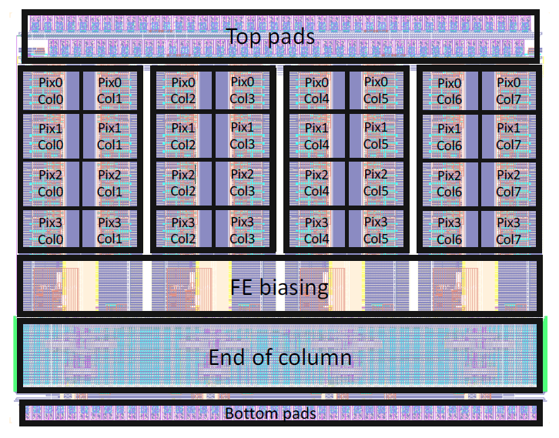
ALCOR: A Low power Chip for Optical sensor Readout
Main requirements for the ePIC dRICH detector
Provide single-photon time tagging of signals coming from SiPM sensors
Cope with SiPM DCR: 300 kHz/channel (at max SiPM radiation damage)
32 or 64-pixel matrix mixed-signal ASIC with on-chip signal amplification, conditioning and digitization
ToA + ToT or Slew-Rate measurements for time walk compensation
Triggerless readout, fully digital output
Power consumption ~12 mW/channel
110 nm CMOS technology
ALCOR-64
ALCOR-32
New version (ALCORv3) with specific EIC-driven features
64-channel, FC-BGA package
Increased amplifier bandwidth to improve time resolution
Hardware shutter to inhibit events digitization (asynchronous with ns time window) and suppress out-of-time SiPM DCR hits
394 MHz clock frequency
8 LVDS 394 MHz DDR Tx links
ALCORv1: Developed for the DarkSide Experiment for SiPM readout at cryogenic temperature
32-channel, wire-bond
320 MHz clock frequency
4 LVDS 320 MHz DDR Tx links
Extensively used within the ePIC-dRICH Collaboration since 2021 and validated with multiple successful beam tests (ALCORv2)
3.78 mm
7.02 mm
4.95 mm
4.95 mm

Slide 8
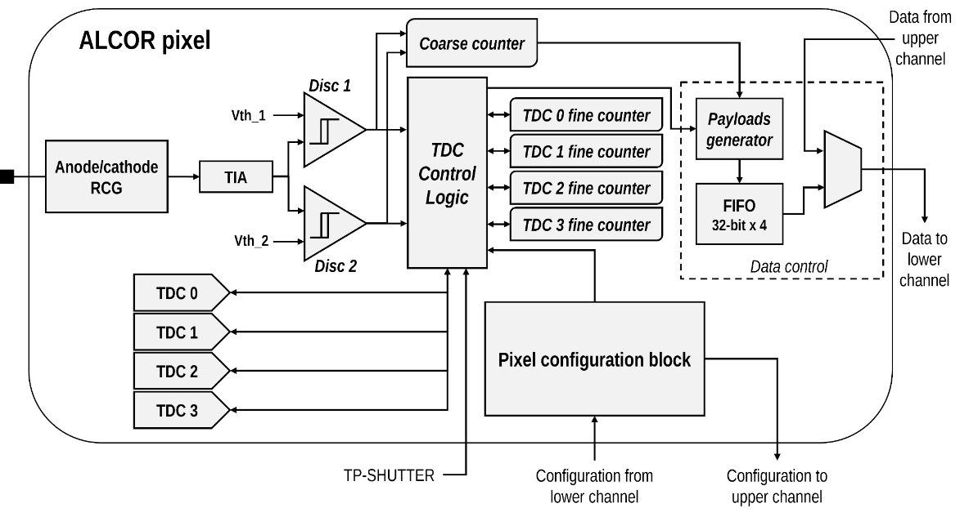
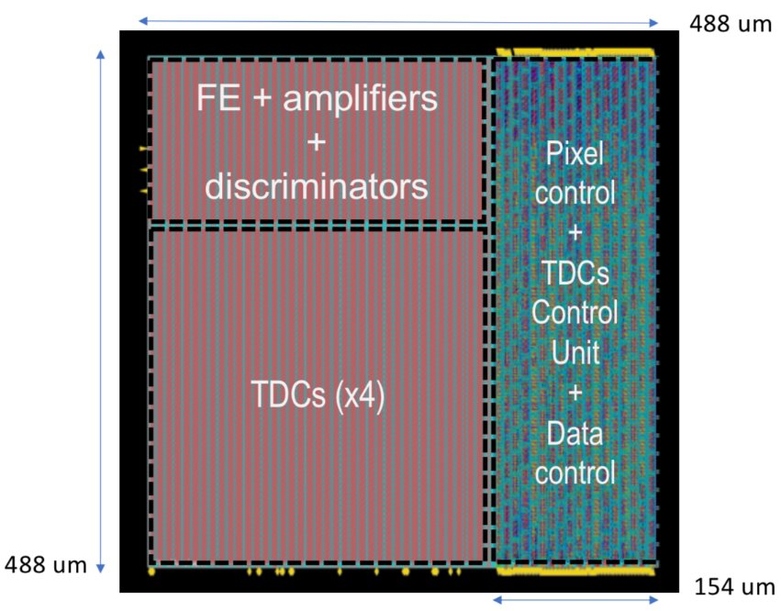
ALCOR pixel architecture
pixel size: 440 x 440 μm²
Dual-polarity RCG input stage current conveyor (Z_{in}= 10-20 Ω) + TIA with 4 gain settings
2 leading edge discriminators with independent (and per pixel) threshold settings (6-bit DAC) → V_{th} = 0.5 p.e.
4 TDCs based on analogue interpolation with 20-40 ps time-bin (at 394 MHz clock frequency)
Pixel control logic handles TDC operation, pixel configuration, operating mode and data transmission
Test pulse injection into the analog FE or TDC + Shutter to inhibit events digitization and suppress out-of-time SiPM DCR hits

Slide 9
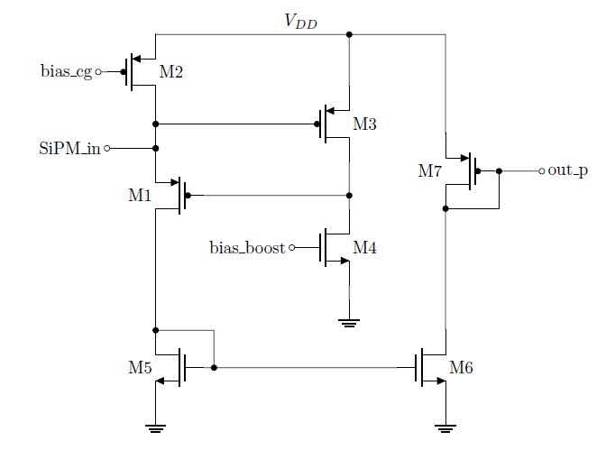
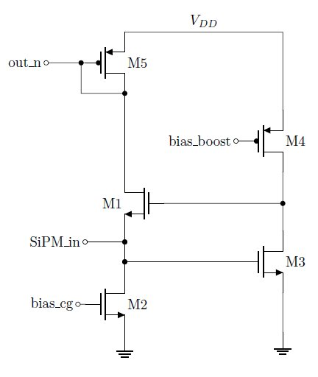
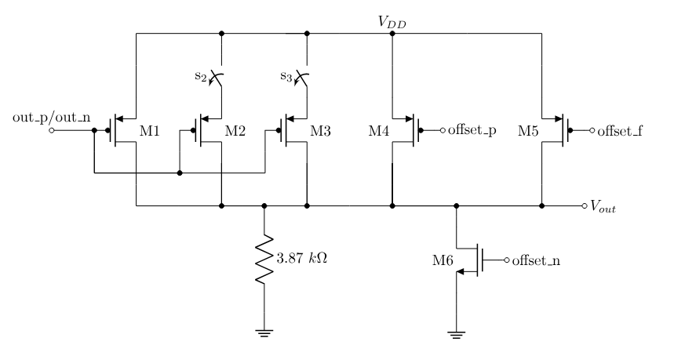
ALCOR Front-End
Input stage
Dual-polarity RCG current conveyor
Programmable bias currents: CG (30-100 μA) and BOOST (1-4 mA)
Z_{in} ~ 10-20 Ω
Output stage
TIA gain: 3.87 kΩ
4 gain settings: 1/3, 4/3, 7/3 and 10/3
DC coupled: baseline compensation based on gain and CG bias current settings + fine offset adjustment (3-bit)

Slide 10
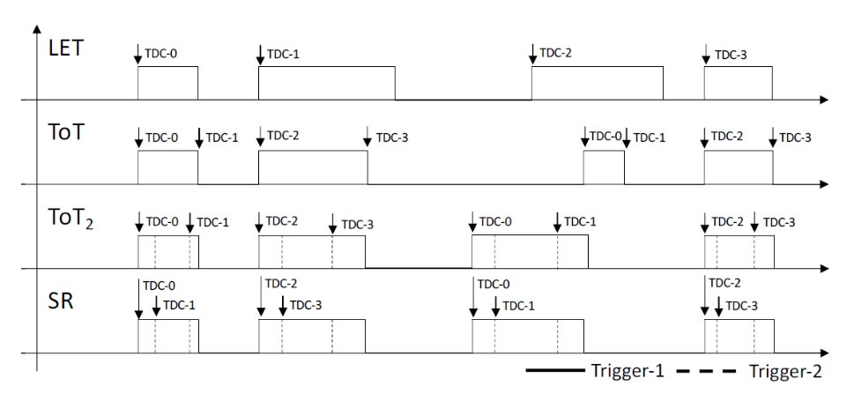
ALCOR pixel operating modes
4 operating modes:
LET: leading edge measurement
ToT: Time-over-Threshold measurement using the first discriminator for both edges
ToT2: Time-over-Threshold measurement using both discriminators
SR: slew-rate measurement
Each mode can be set to:
FE: normal operation mode
FE_TP: send test-pulse to analogue front-end
TDC_TP: send test-pulse to pixel control logic to test and calibrate TDCs (bypass front-end)
Each pixel can also be disabled

Slide 11
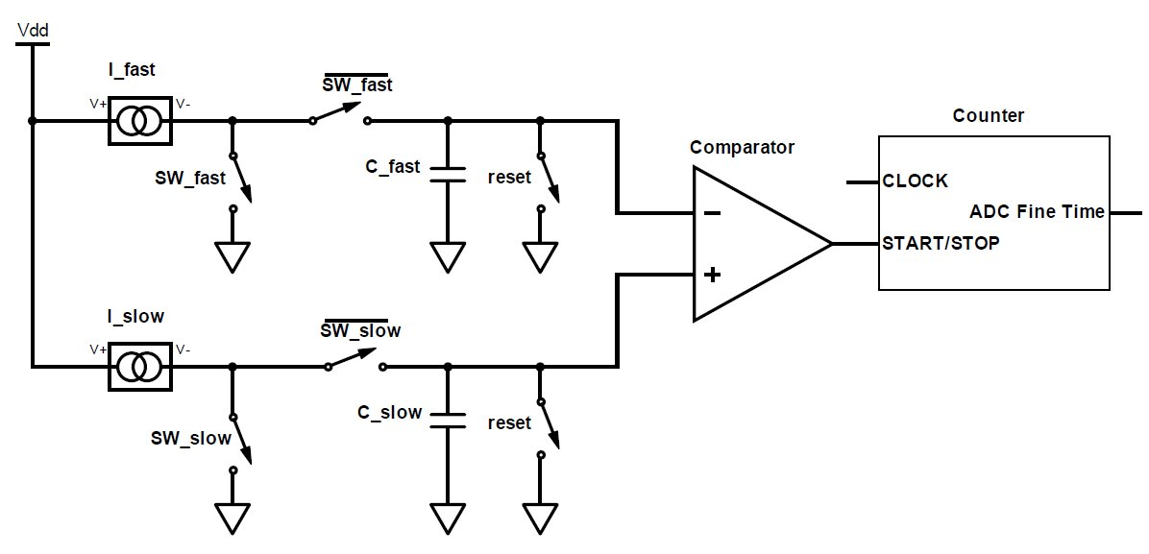
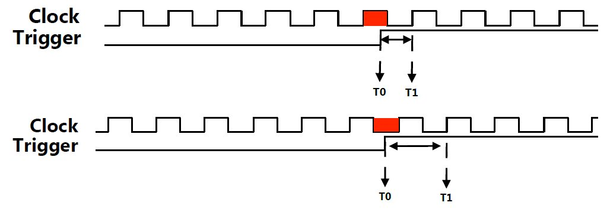
Time to Digital Conversion
Coarse time: 15-bit clock counter
Time conversion performed by TDC based on analogue interpolation (9-bit fine time):
  fast ramp: constant current to charge C_{fast} → measure phase between event trigger and clock
  slow ramp: smaller constant current to charge C_{slow} → counts clock cycles until C_{slow} and C_{fast} are equal
I.F. 64 or 128 → LSB = 20-40 ps @394 MHz
Measured time interval: 0.5 - 1.5 clk period
TDC conversion time: [170, 500] ns
4 TDCs per pixel for event derandomization

Slide 12
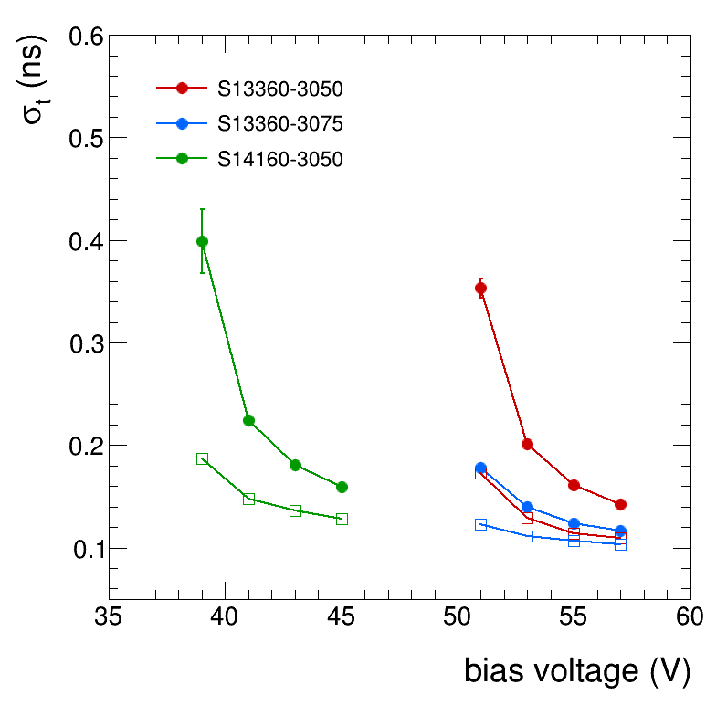
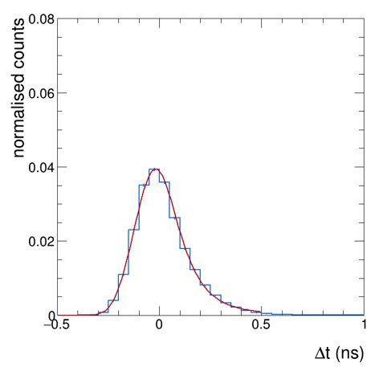
ALCOR-32 Laser timing measurements
includes contributions
σ_{sync} = 30 ps
σ_{start} = 27 ps
FWHM < 300 ps
gaussian core σ ~ 100 ps
time-walk corrected
FE bias = MIN
300 ps
FE bias = MAX
Better time resolution with 75 μm SPADs
Comfortably below σ_{t} = 150 ps also at low Vbias
includes contribution for laser-ALCOR synchronization (σ_{sync} = 30 ps) and reference time resolution (σ_{start} = 27 ps)

Slide 13
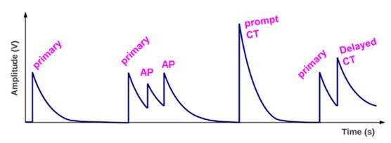
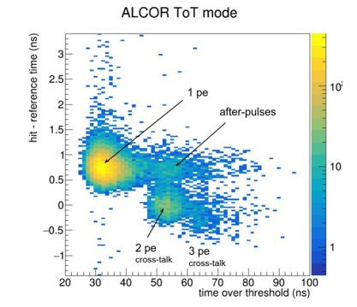
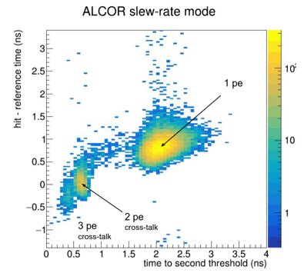
Time walk correction
Time walk correction needed to improve overall time resolution
→ studies with laser setup using ToT and Slew Rate measurements
ToT mode cannot distinguish between afterpulses (slow-rise time, large ToT) and cross-talk (fast rise-time, large ToT)
SR mode provides better separation

Slide 14
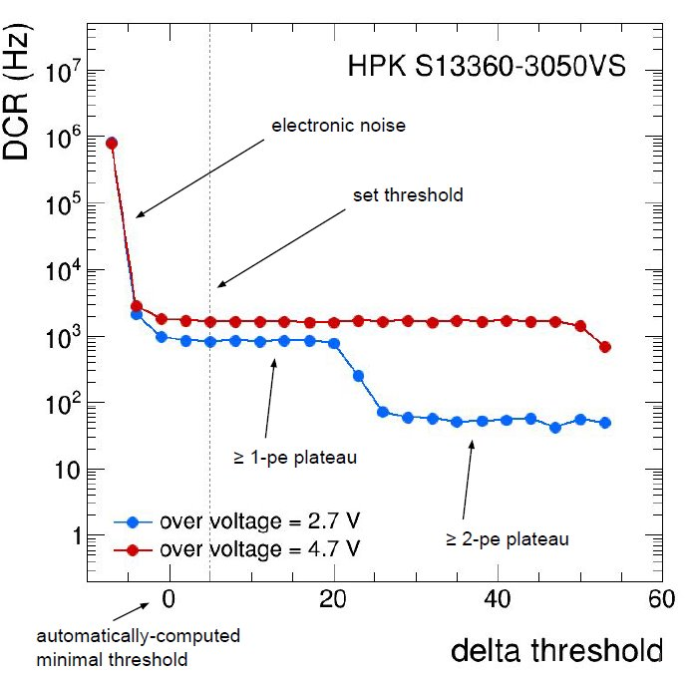
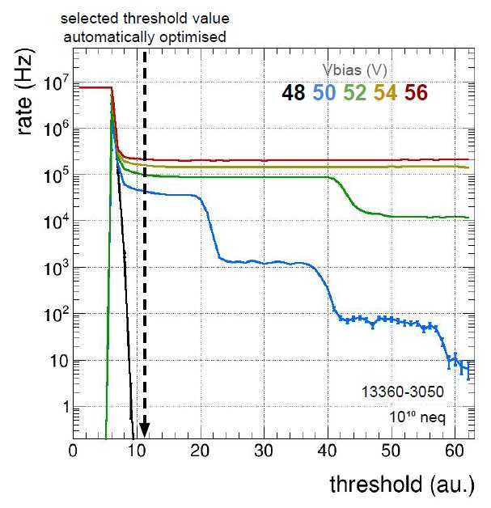
ALCOR-32 threshold scan

Slide 15
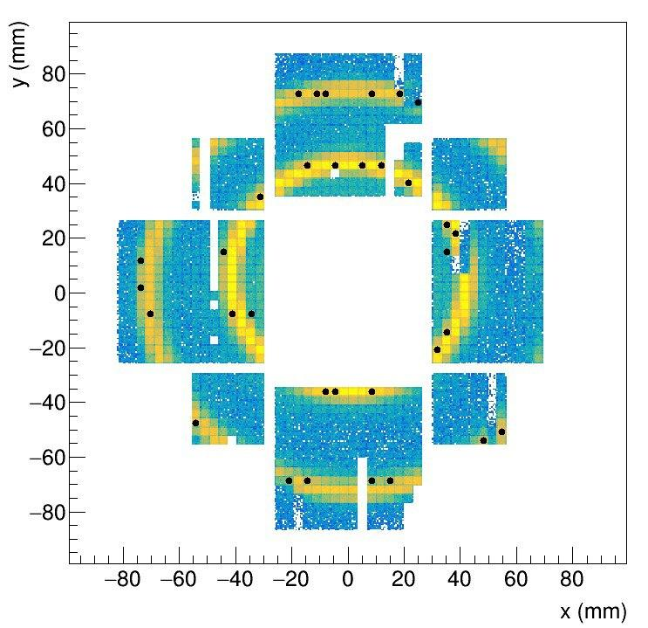
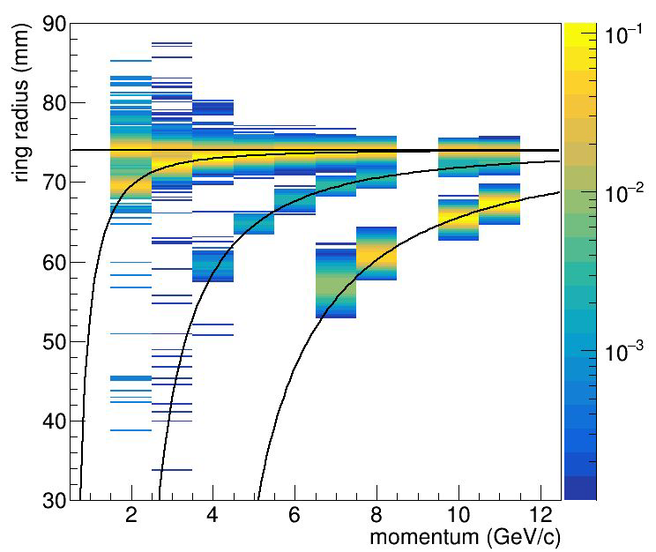
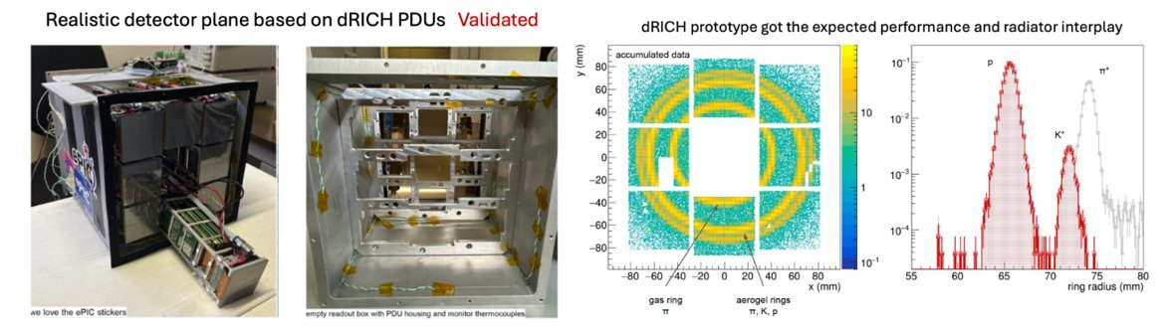
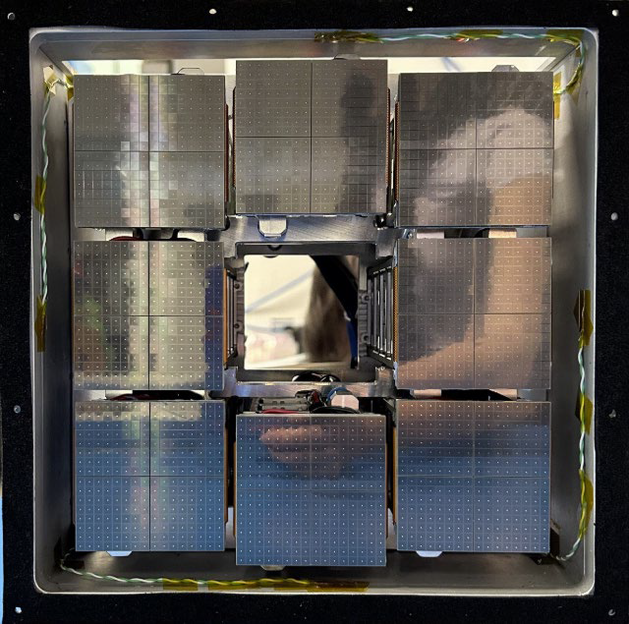
ALCOR-32 beam tests at CERN-PS
Successful beam tests with prototype dRICH and PDUs (CERN-PS, October 2023, May 2024)
HPK S13360-3050 and S13360-3075 (3x3 mm², T lower than -30°C)
32 FE-DUAL (64 ALCOR-32, 2048 channels)
DAQ: Xilinx Kintex 7 KC705
10 GeV negative beam
dual radiator configuration
Reconstructed radii vs. beam momentum
hits from
one event
e⁺
π⁺
C₂F₆ gas
K⁺
p
aerogel
20 x 20 x 20 cm³

Slide 16
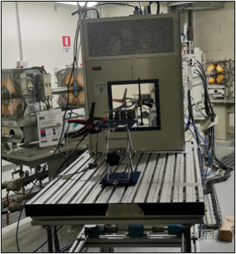
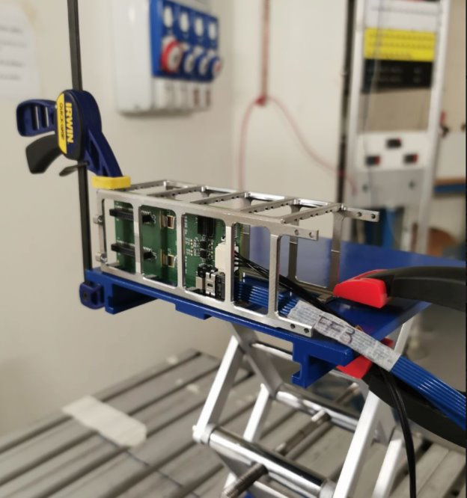
Radiation tolerance
The dRICH-PDUs are in a moderately hostile radiation environment
Φ (p+n > 20 MeV) = 700 Hz/cm²
TID ≅ 2.3 krad (for 1000 fb⁻¹)
Irradiation tests campaign: SEU/SEL and TID tests at Centro of Proton-Therapy in Trento with ALCOR-32 in Jul 2024 and Dec 2024
  Beam: 100 MeV proton
  Intensity: 10 - 100 nA
  Runs: typically 600 s
  Fluence collected per run: 10¹¹ - 10¹² p/cm²
Total fluence: 4.64 ⋅ 10¹² p/cm² (Jul 2024) and 3.2 ⋅ 10¹² p/cm² (Dec 2024)
Total TID: 436 krad
Technology is sufficiently radiation tolerant to be used in the ePIC dRICH environment
SEU rate is within the expected manageable levels: in ALCOR-64 TMR SEU protection added also for periphery registers, Hamming code SEU protection for FSMs
safety factor of 5 included
Detailed results presented at the 29th Jan 2025 dRICH Meeting: https://indico.bnl.gov/event/26313/

Slide 17
ALCOR-64 (V3)
64-pixel matrix (8x8) mixed-signal ASIC
Single-photon time tagging + Time-over-Threshold or Slew-Rate measurements for time walk correction
On-chip signal amplification, conditioning and digitization, 32-bit event word
Shutter to inhibit events digitization (asynchronous with ns time window) and suppress out-of-time SiPM DCR hits
Trigger-less readout with fully digital output: 8 LVDS 394 MHz DDR Tx links with 8b10b encoding
  2.4 Mhits per pixel in LE mode
  1.2 Mhits per pixel in TOT/SR mode
"New orbit" command through reset signal:
  Data encapsulated in frames every coarse counter rollover
  New orbit forces a rollover condition (ALCOR rollover = 2¹⁵ clk cycles ≈ 83 μs, EIC orbit period ≈ 12.8 µs)
Flip-chip BGA package (no RDL was available)
Improved SEU protection (TMR with autocorrection or Hamming encoding)
Power consumption ~12 mW/channel
0.11 µm CMOS technology
7.02 mm
4.95 mm

Slide 18
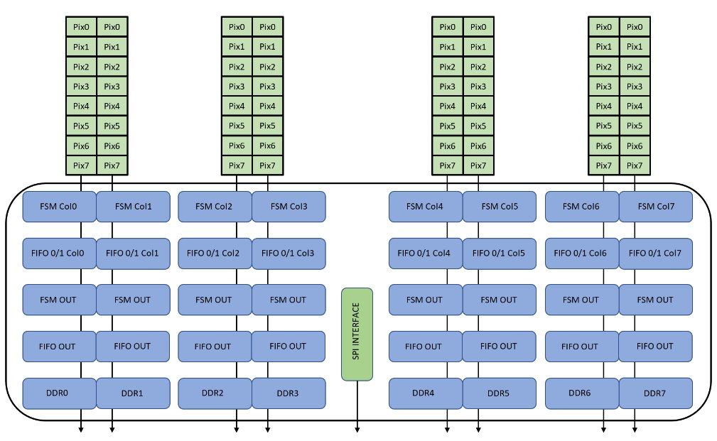
Block diagram

Slide 19
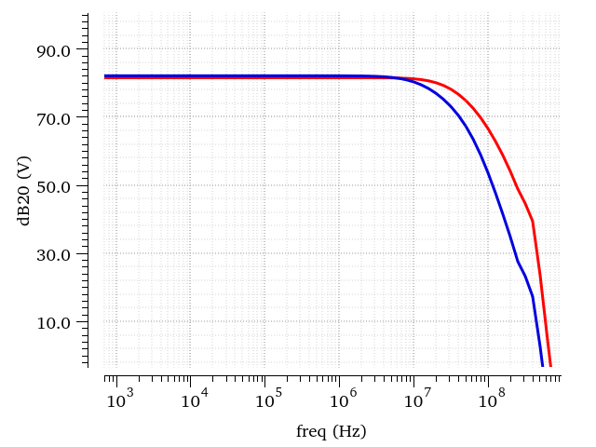
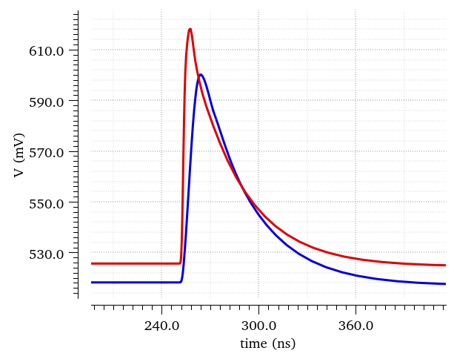
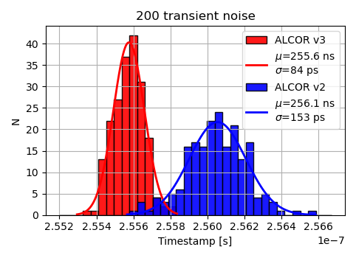
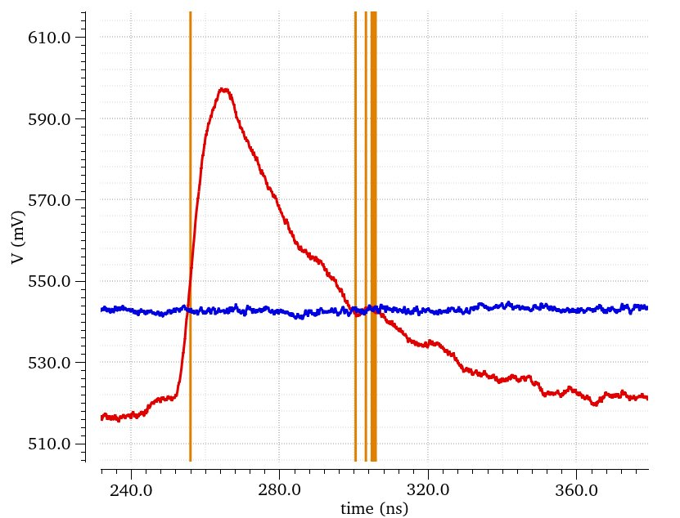
ALCOR-64 frontend
Small revisions on ALCOR FE design
Increased amplifier bandwidth to improve time resolution
  transient noise simulations
  Vth = 0.5 p.e.
  jitter: 153 ps → 84 ps
Discriminator with programmable hysteresis to avoid re-triggering on slow tail with low thresholds
ALCORv3
S13360-3050, OV=3V
ALCORv2
ALCORv2
C_{in} = 320 pF
ALCORv3
S13360-3050, OV=3V
ALCORv2 transient noise sim​

Slide 20
Digital shutter
Expected DCR below 300 kHz (with online annealing cycles on SiPM)
Digital Shutter “inhibit” pixel digital logic to suppress out-of-gate DCR hits and reduce data throughput (~10.2 ns bunch crossing, ~300 ps bunch length)
The external Test-Pulse is used as enable for the analogue trigger
The minimum width of this timing window can be of the order 2-3 ns
Each pixel implements a programmable delay chain to set the proper shutter timing window
4 configuration bits allow you to choose 16 steps from 0 to 15 delays
Each delay step is approximately 350 ps (TYP corner)
Additionally, the End of Column circuits allow you to choose a programmable delay, on the shutter signal, to adjust the skew between columns (16 steps from 0 to 15, each step approximately 100 ps)
Shutter needed only when DCR becomes higher due to SiPMs taking radiation damage over time. Use first period of ePIC data taking to optimize shutter calibration
Two complementary off-chip data throughput reduction approaches are being considered to perform online data filtering at sub-detector level against pure dark-count events:
  INFN Roma: Online AI-based distributed data reduction (more details in C. Rossi talk at RICH2025)
  INFN Genova: SciFi Interaction Tagger (more details in S. Vallarino talk at the 2025 EICUG EC Workshop)

Slide 21
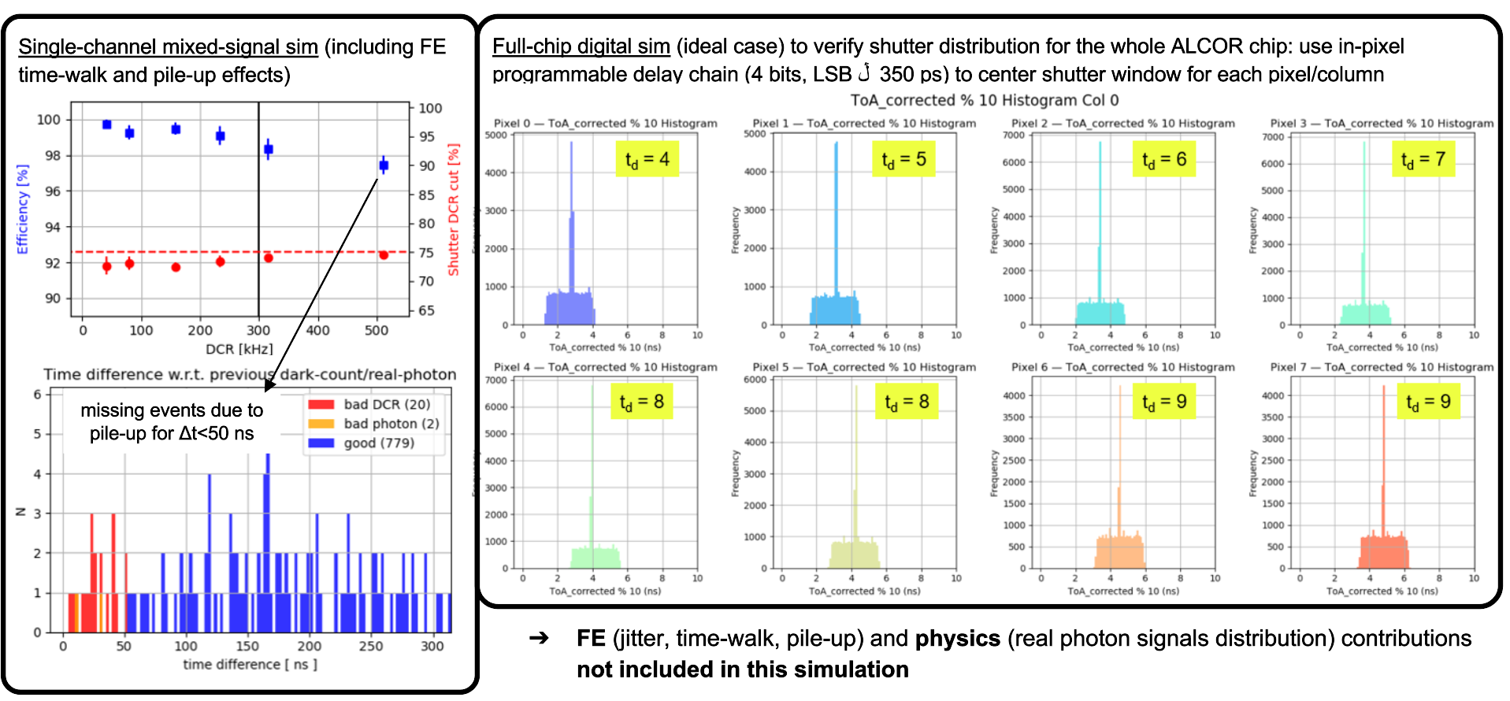
Digital shutter simulations

Slide 22
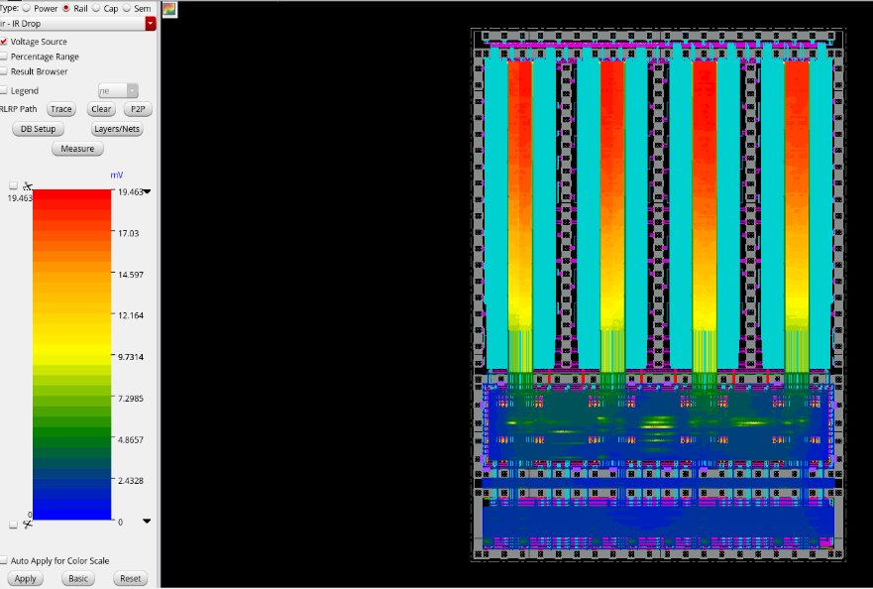
Power analysis IR drop (digital)
Analysis done with VCD file form post pnr simulation at 400 MHz clock (expected total power 1.2 W: digital + analogue + bias)

Slide 23
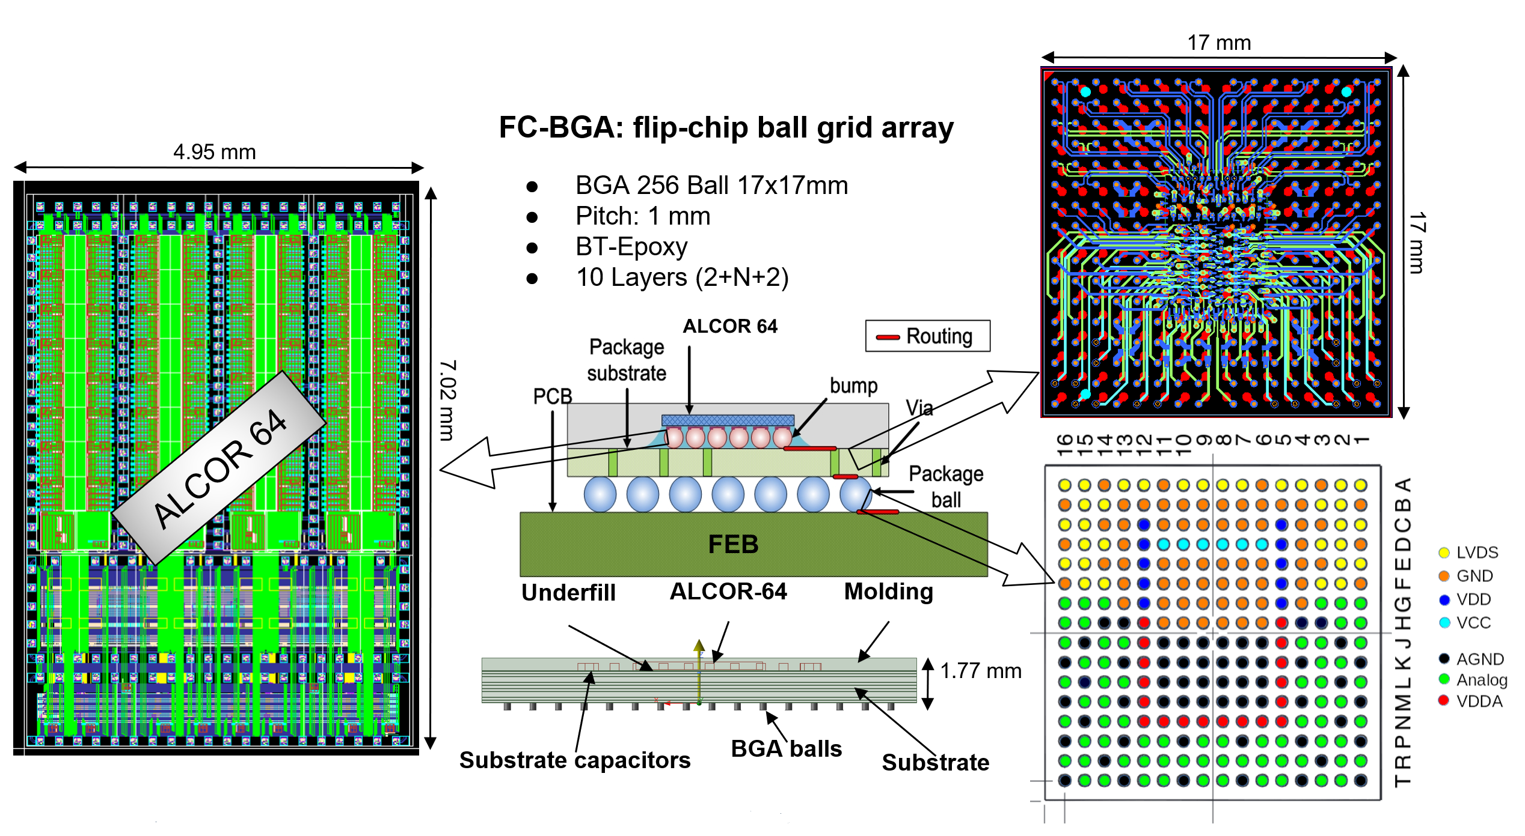
ALCOR-64 BGA package

Slide 24
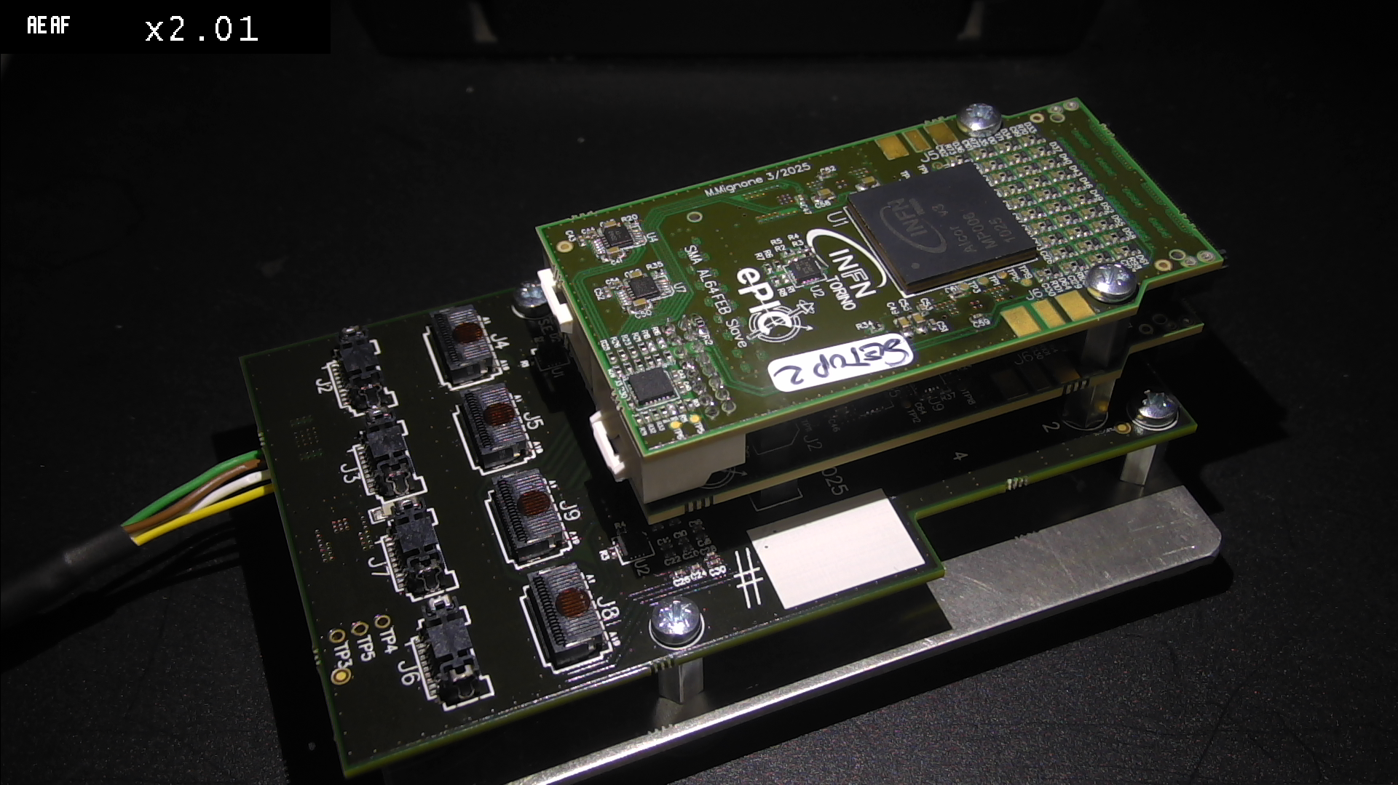
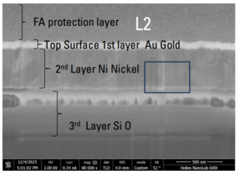
ALCOR-64 status
Nov 2025: 1st Run flip-chip die attach failed due to solder overflow causing short circuits between bump pads
FIB dissection + SEM-EDX analysis (Dec 2025) on one die showed that UBM layers extend beyond the bump pads, covering additional areas of the chip surface above the passivation layer
This metallization creates a wetting surface that facilitates solder migration from the substrate-side bumps to the die, leading to short circuits between adjacent pads
UBM process managed by packaging vendor (via different subcontractor)
Testing on four chips confirmed the presence of short circuits
Exploring alternatives for UBM and bumping process:
  IMEC informed us that new Flip-Chip TLR has been introduced by the foundry this year
  UBM and bumping process can be done on single dies via IMEC subcontractor

Slide 25
Summary
ALCOR is a 64-channel mixed-signal ASIC adopted for the readout of the SiPM sensors for the ePIC dRICH detector
ALCOR-32 has been extensively used within the dRICH Collaboration in the last 5 years: several laboratory and beam tests demonstrated the ALCOR-based readout capability to measure single photons with good time resolution and rate capability
ALCOR-64 includes all features and specifications required for the ePIC dRICH:
  64 channels, BGA package, shutter, 394.08 MHz clock frequency
  Packaging issues introduce an important delay in our schedule
  Discussions ongoing to find alternative UBM process and preparation for new MPW run
Exploring alternatives for UBM and bumping process to be still on schedule for the installation planned in 2032

Slide 26
Backup

Slide 27
SEU/SEL results (July 2024)
ECCR/BCR/PCR registers checked against SEU (every second)
ECCR σ = (9.4 ± 1.8) ⋅ 10⁻¹⁴ cm²/bit periphery register → no TMR in ALCOR v2.1
BCR σ = (7.6 ± 1.1) ⋅ 10⁻¹⁴ cm²/bit periphery register → no TMR in ALCOR v2.1
PCR σ = (3.3 ± 0.5) ⋅ 10⁻¹⁵ cm²/bit pixel register → TMR (accumulating bit flips due to auto-correction bug in triplicated registers)
SEU rate in ePIC:
dRICH Flux = 140 (h > 20 MeV) / (cm² s)
ALCOR bits: (2048 + 192) = 2240 → ALCOR-64 bits will be 4480
Total ALCOR: 4992
Total bits: 4992 ⋅ 4480 = 2.2 ⋅ 10⁷ bits
σ = 3.3 ⋅ 10⁻¹⁵ cm²/bit → MTBF = 9.8 ⋅ 10⁴ seconds → every 27 hours
No latchup events (from power supply currents monitoring)
SEU rate is within the expected manageable levels

Slide 28
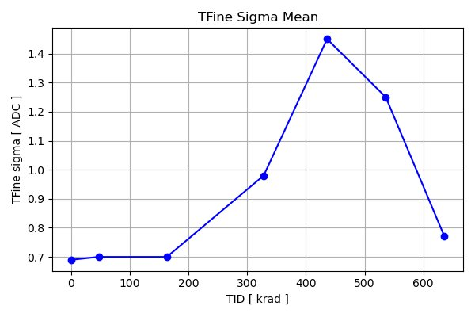
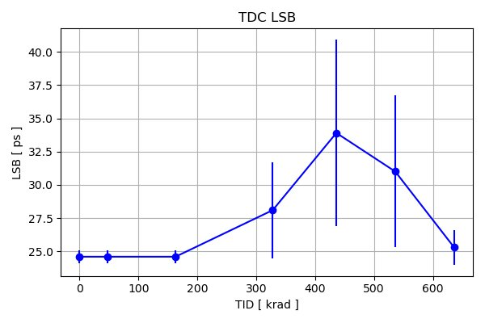
TID results - TDC error & LSB
*last two points = 436 krad after 10 hours and 5 months
Technology is sufficiently radiation tolerant to be used in the ePIC dRICH environment
Similar results w.r.t. irradiation tests performed on another ASIC with same technology [1]
Also other FEB components will be tested and validated

