Slide 1
A sub-5 ps jitter time-to-digital converter ASIC with back-gate delay tuning in 22 nm CMOS
Adam Quinn
May 18, 2026
FERMILAB-SLIDES-26-0065-ETD
Notes:
ABSTRACT:
Novel sensor technologies can unlock new ways of learning about the world and open up new ways to probe challenging problems in physics. But a new sensor is only as good as the electronics chain that digitizes and stores the data collected from it. Modern scientific ASICs (Application-Specific Integrated Circuits) can deliver picosecond single-shot resolution, but integrating this technology in extreme environments involves engineering trade-offs of power, resolution, and noise which directly impact the physics reach of an experiment. In this talk, I will give an introduction to the applications (and challenges) of picosecond timing in science, and review several cryogenic timing ASICs which are currently under development at the Fermilab Microelectronics Division.

Slide 2
Agenda
Introduction and Motivation
Time-to-Digital Converter ASIC Design and Measurement Results
Further Developments
Microelectronics at Fermilab
Applications for Picosecond Timing
Notes:
Introduction + Motivation = 5 minutes total
TDC ASIC Design = 18 minutes
Further Developments = 2 minutes

Slide 3
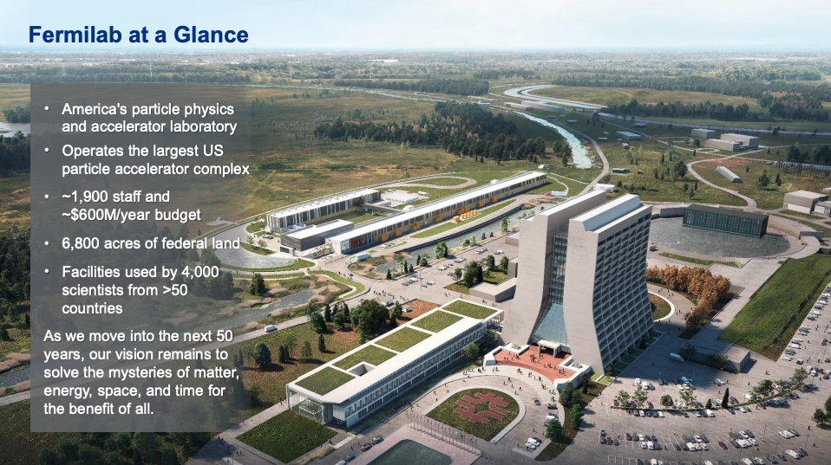
Fermilab

Slide 4
Integrated Circuit Design Over ~ 5 Decades at Fermilab
A diverse portfolio of microelectronics expertise surrounding low-noise, low-power readout of novel detectors operating in extreme environments.
Since 1980's
Ionizing Radiation (> 1 Grad, 1,000x higher than outer space)
Collider Experiments (FCC, HL-LHC)
Since 2010’s
LAr Cryogenic Electronics (77K-100K)
Neutrino Experiments (DUNE), Dark Matter Experiments (Skipper-CCDs)
See Ben Parpillon’s Talk
Weds @ 11:00 am
Since 2019
LHe Cryogenic Electronics (4K)
Cryo Detectors (SNSPDs, TES, etc.), Quantum Information Science
Since 2022
Superconducting Electronics (~100mK)
TWPAs, JPAs (ADMX), QIS for HEP
Since 2024
Silicon Photonics
Micro-Ring Modulators, readout for quantum sensing/computing

Slide 5
Applications for Picosecond Timing
Notes:
Time check: 2 minutes

Slide 6
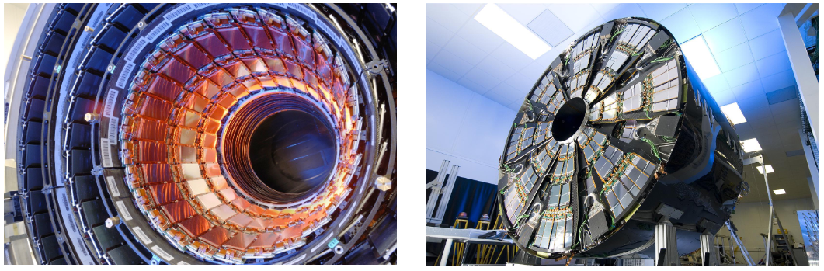
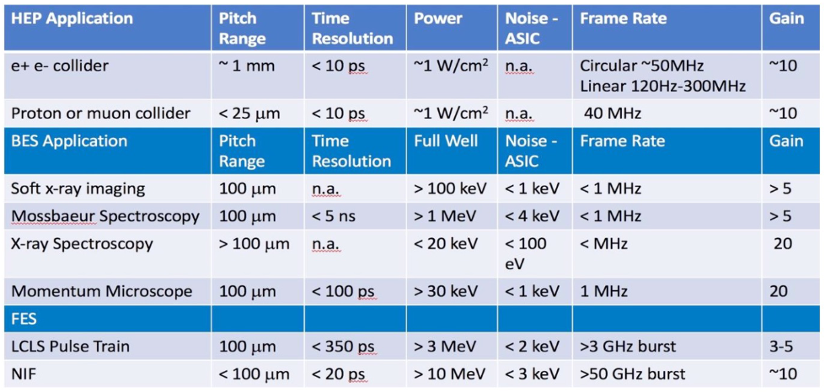
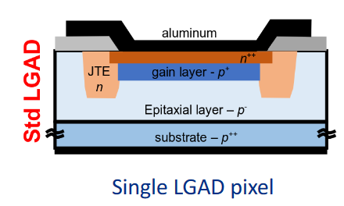
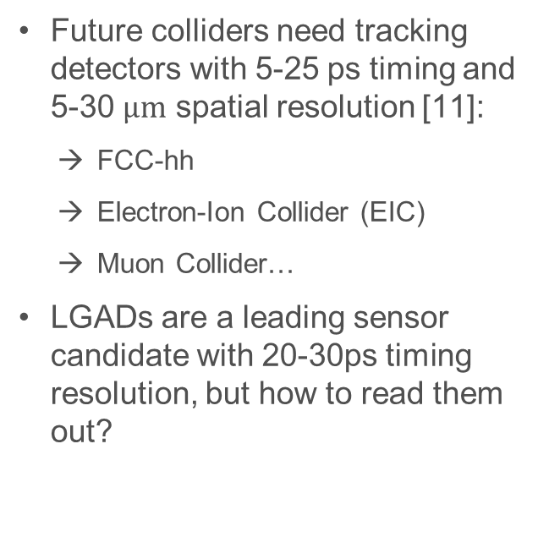
LGAD Tracking Detectors
Future colliders need tracking detectors with 5-25 ps timing and 5-30 $μm$ spatial resolution [11]:
FCC-hh
Electron-Ion Collider (EIC)
Muon Collider…
LGADs are a leading sensor candidate with 20-30ps timing resolution, but how to read them out?
Notes:
Silicon Low Gain Avalanche Detector (LGAD) is the technology used for the
HGTD sensors. It is based on the PiN diode structure and it consists of N-P junc-
tion over highly doped p-type (p+), this will creat a high electric ﬁeld region Figure
3(a). It is operated in high reversed bias voltage to get as wide depletion region as
possible. Whenever a charged particle passes through the detector, an electron hole
pair is created in the depletion region, which causes to generate a large current by
drifting of the holes to the p+ region. Standard PiN diodes are seriously aﬀected
by thermal and electronic noise. Moreover, Exposing them to high irradiation causes
irrecoverable damage (Acceptors removal) and decrease in signal-to-noise ratio.
LGAD provide a moderate multiplication (gain ≈20) on the collected charge, which
leads to a signiﬁcant increase in the signal to noise ratio

Slide 7
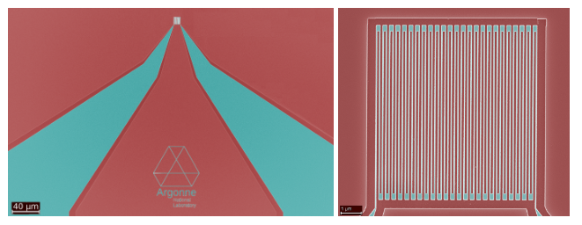
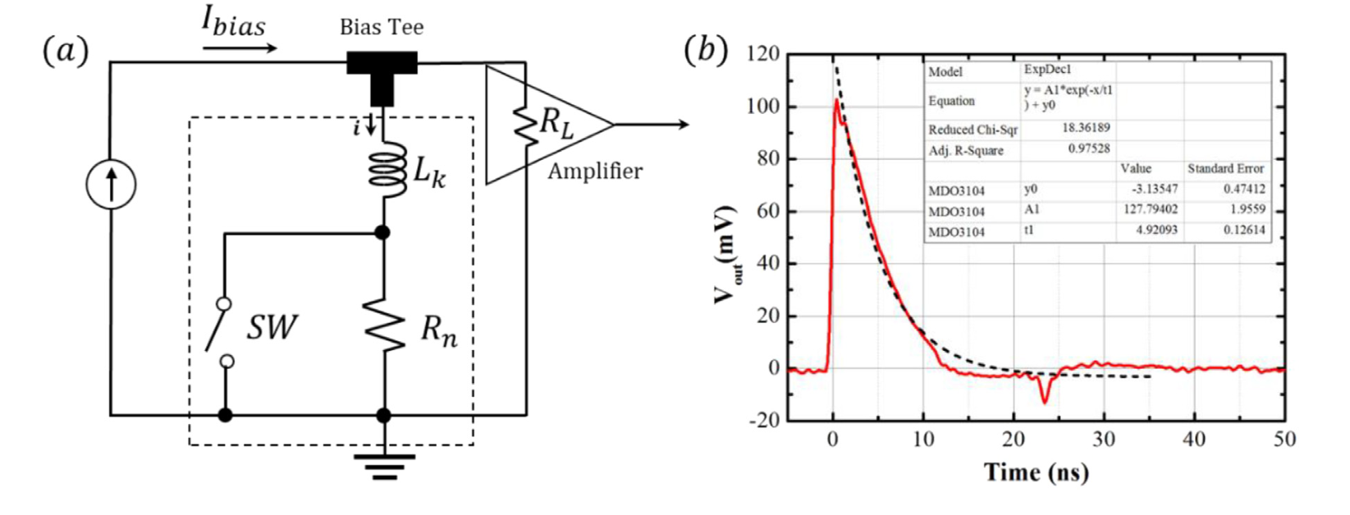
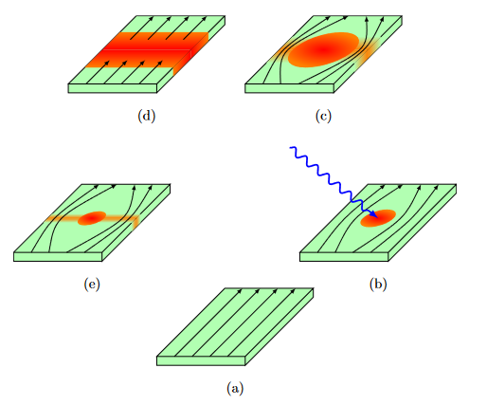
Superconducting Nanowire Single-Particle Detectors (SNSPDs)
SNSPDs are fast, and fast-timing ASICs are needed to preserve that resolution.
Cryogenic readout designs are key to reduce heat load.
Ideal inductors when superconducting
Resistive when heated by a photon/particle
Motivation:
Risetime ~Lk/(Rn+RL) ~100’s ps
FallTime ~Lk/RL ~10’s ns

Slide 8
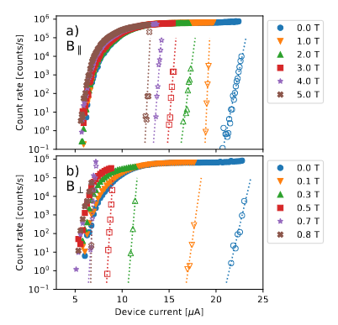
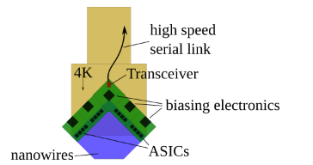
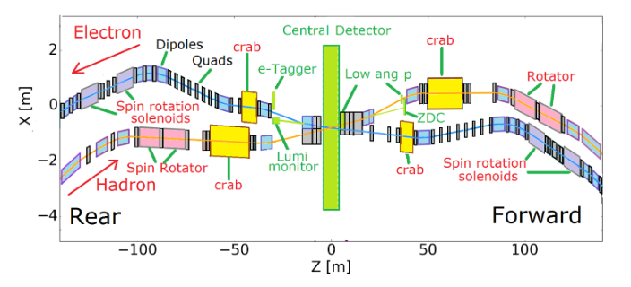
SNSPDs at the EIC
Electron-Ion Collider: Novel accelerator under development at BNL to probe proton mass, other challenges.
SNSPD operation at cryo + high magnetic fields can help increase acceptance by instrumenting difficult regions of the machine.
Radiation hardness under investigation.
Integration concept with SNSPDs, ASICs, and high-speed readout links.
SNSPD operation at high B-field; zero dark counts.
Electron-Ion Collider Diagram
Notes:
n electron–ion collider (EIC) is a type of particle accelerator collider designed to collide spin-polarized beams of electrons and ions, in order to study the properties of nuclear matter in detail via deep inelastic scattering.
In 2020, The United States Department of Energy announced that an EIC will be built over the next ten years at Brookhaven National Laboratory (BNL) in Upton, New York, at an estimated cost of $1.6 to $2.6 billion.^{[3]}
Polarization
In order to allow understanding of spin dependence of the electron-nucleon collisions, both the ion beam and the electron beam must be polarized. Achieving and maintaining high levels of polarization is challenging. Nucleons and electrons pose different issues. Electron polarization is affected by synchrotron radiation. This gives rise to both self polarization via the Sokolov–Ternov effect and depolarization due to the effects of quantum fluctuations. Ignoring the effects of synchrotron radiation, the motion of the spin follows the Thomas BMT equation.

Slide 9
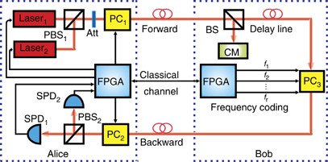
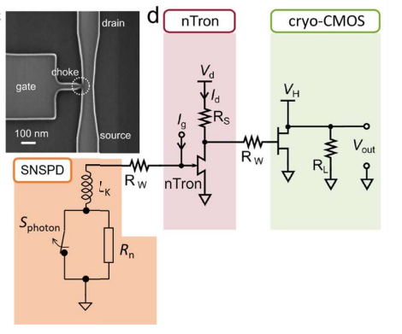
SNSPDs in Quantum Communication
The Challenge: High-bandwidth time-correlated single photon counting in a cryogenic environment.
A Quantum Secure Direct Communications System (Hu [10])
Integration with superconducting electronics:
DOE NASA RFI 86 FR6315 [4]
Notes:
Cryogenic challenges:
Low temp / low power dissipation
Vt increase, variability issues
BUT: Better achievable SNR.

Slide 10
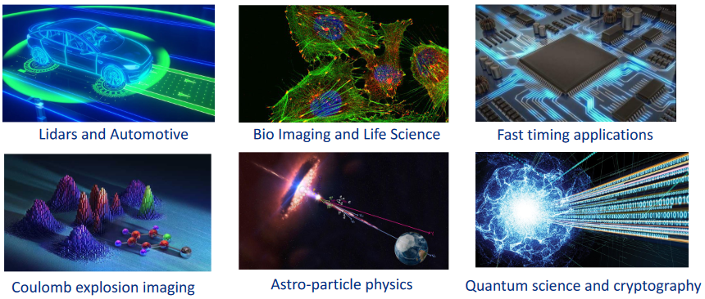
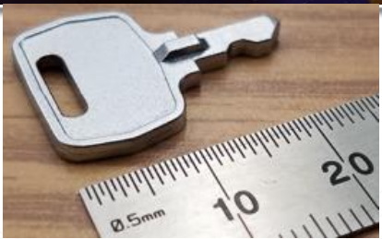
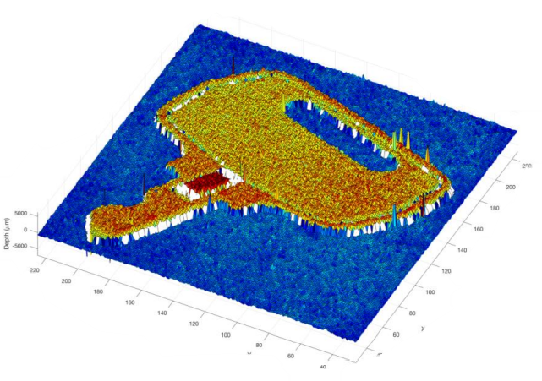

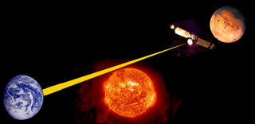
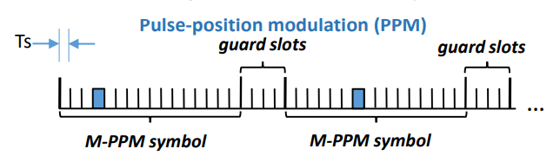
Diverse Other Applications
Rangefinding / 3D Modeling
Optical Space Communication

Slide 11
Picosecond Timing ASIC Development
Notes:
Time check: 7~8 minutes

Slide 12
Picosecond Timing ASIC Development
Design Objectives:
→ 5-10 ps resolution
→ 3-6 ps jitter
2-10 ns dynamic range
Operation at cryogenic (4K) and room temperature.
~ few 100 uW per channel
ASIC Versions:
Nov 2021 – CryoTDC v1: Single-channel TDC Demonstrator
Oct 2023 – SUNROCK: 32-channel Prototype w/ Peripheral Circuits

Slide 13
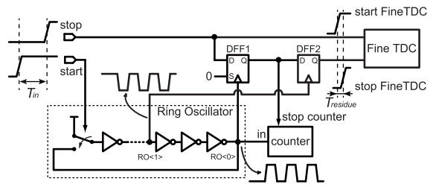
CryoTDC v1 Channel Block Diagram
VTUNE_P_FAST
Total Pins: 22
6 analog inputs
7 digital inputs
3 digital outputs
6 power pins
Not Shown:
* RO1, HALT, INCR, and STOP_FINE are mux’d to two digital outputs with the select done by 4 shift register bits.
* RESET pin
VTUNE_N_FAST
VTUNE_P_SLOW
VTUNE_N_SLOW
STOP
Back-Gate Tuned Fine Vernier TDC
START
D Q
S
D Q
CAL1
CAL0
READY
STOP_FINE
RO1
Decoder
HALT
00
1X
01
(3x)
(5x)
10-bit Counter
INCR
QFINE<6:0>
QCOARSE<9:0>
S_DIN
S_DOUT
S_LOAD
Shift Register
S_CLK
VTUNE_P_RO
VTUNE_N_RO
Enomoto et al. [2]
Notes:
Delay-Cell Based Vernier TDC

Slide 14
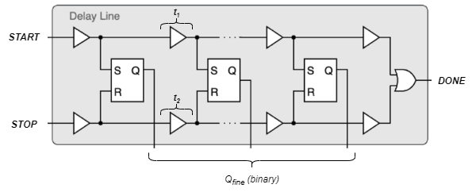
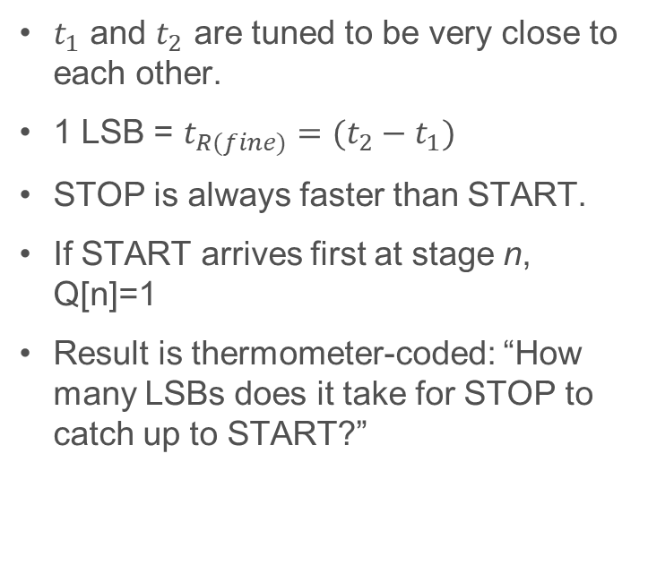
Fine Vernier TDC
$t_{1}$ and $t_{2}$ are tuned to be very close to each other.
1 LSB = $t_{R(fine)}=(t_{2}−t_{1})$
STOP is always faster than START.
If START arrives first at stage n, Q[n]=1
Result is thermometer-coded: “How many LSBs does it take for STOP to catch up to START?”

Slide 15
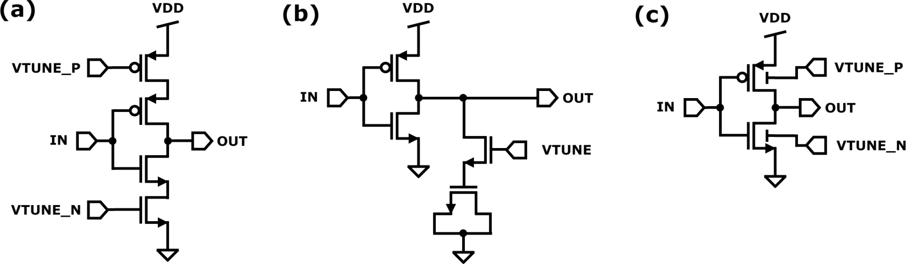
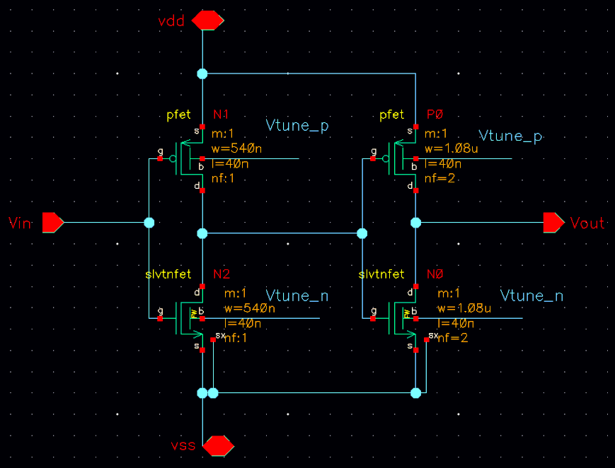
Delay Tuning with Back-Gate Bias
Comparison between back-gate tuning and conventional approaches.
Fine TDC delay cells and RO delay cells are same architecture (different sizing)
Speed is tuned by FDSOI back-gate biasing
Low complexity
Small footprint
No noise contribution from bias circuits
6 separate tuning voltages (all 0~2V w.r.t. VSS)
Fine TDC fast chain, slow chain, and coarse TDC ring oscillator (NMOS and PMOS separately).
Fine TDC Delay Stage

Slide 16
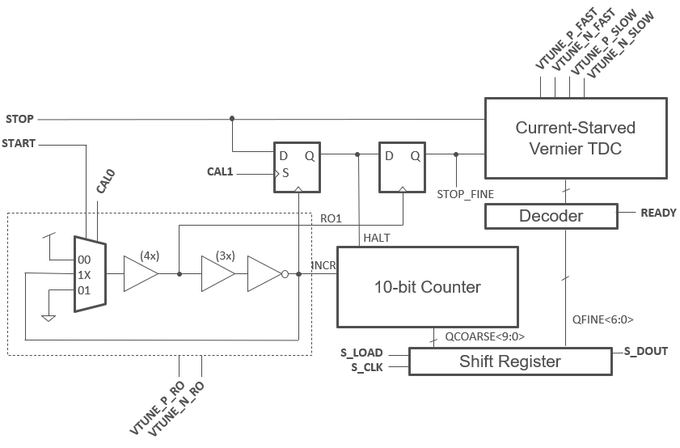
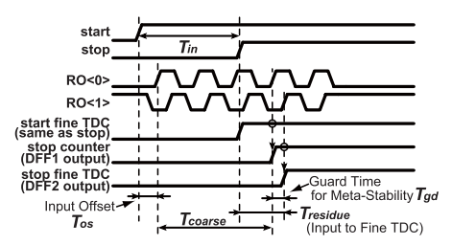
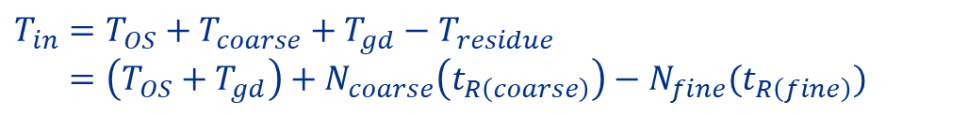
Coarse TDC
INCR
Enomoto et al. [2]
START starts the ring oscillator. The counter counts up until STOP, and the residue is encoded by the fine TDC:
$$T_{in}=T_{OS}+T_{coarse}+T_{gd}−T_{residue}$$
$$=\left(T_{OS}+T_{gd}\right)+N_{coarse}\left(t_{R\left(coarse\right)}\right)−N_{fine}(t_{R\left(fine\right)})$$
Notes:
Coarse counter runs longer than Tin, gives an overestimate.

Slide 17
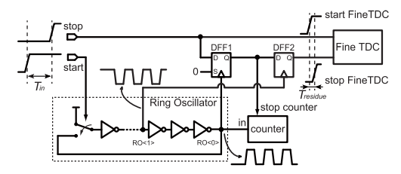
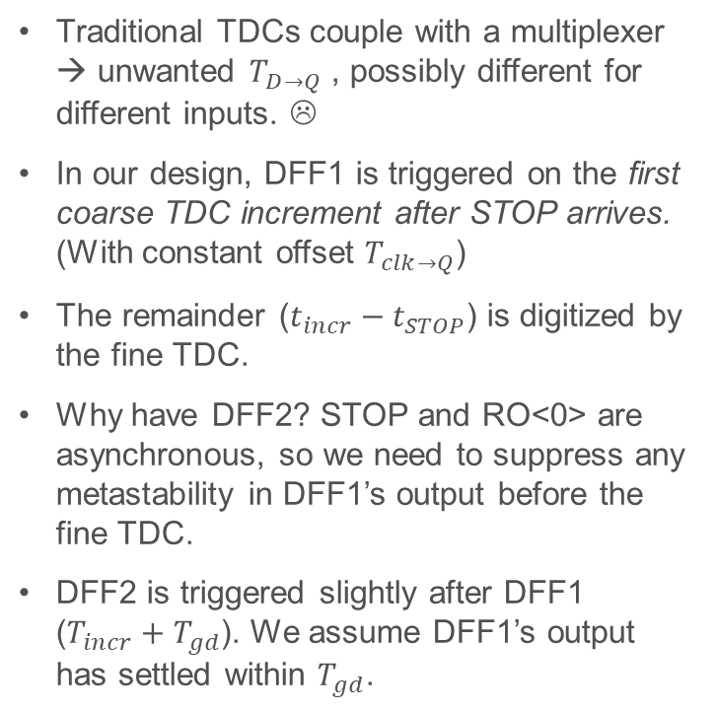
Coarse-to-Fine Coupling with DFFs
Traditional TDCs couple with a multiplexer → unwanted $T_{D→Q}$ , possibly different for different inputs. ☹
In our design, DFF1 is triggered on the first coarse TDC increment after STOP arrives. (With constant offset $T_{clk→Q}$)
The remainder ($t_{incr}−t_{STOP}$) is digitized by the fine TDC.
Why have DFF2? STOP and RO<0> are asynchronous, so we need to suppress any metastability in DFF1’s output before the fine TDC.
DFF2 is triggered slightly after DFF1 ($T_{incr}+T_{gd}$). We assume DFF1’s output has settled within $T_{gd}$.
Enomoto, et al. [2]

Slide 18
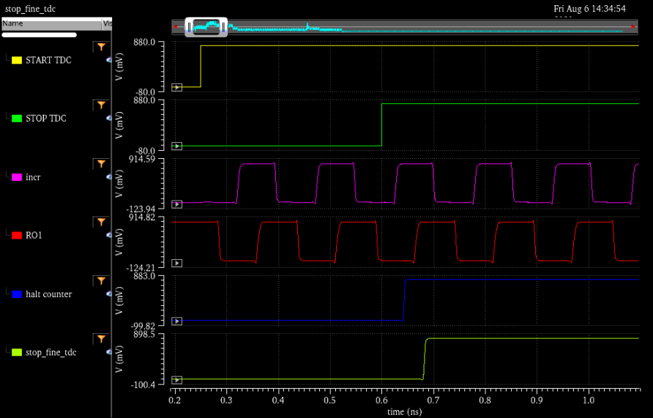

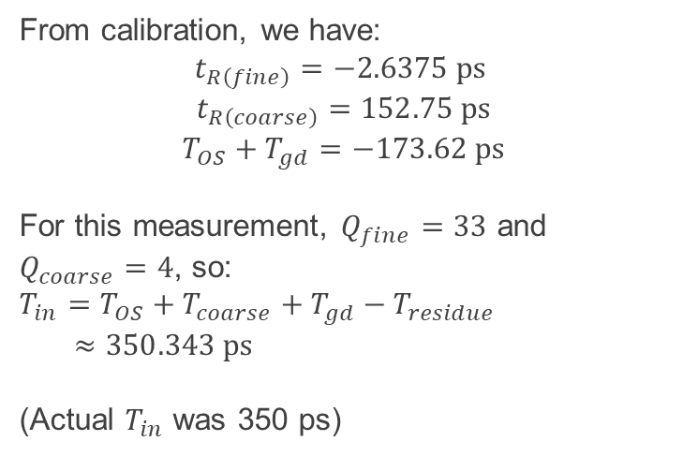



Simulation of an Example Measurement
From calibration, we have:
$$t_{R\left(fine\right)}=−2.6375 ps$$
$$t_{R\left(coarse\right)}=152.75 ps$$
$$T_{OS}+T_{gd}=−173.62 ps$$
For this measurement, $Q_{fine}=33$ and $Q_{coarse}=4$, so:
$$T_{in}=T_{OS}+T_{coarse}+T_{gd}−T_{residue}$$
$$≈350.343 ps$$
(Actual $T_{in}$ was 350 ps)
$$T_{in}$$
$$T_{coarse}$$
$$T_{gd}$$
$$T_{residue}$$

Slide 19
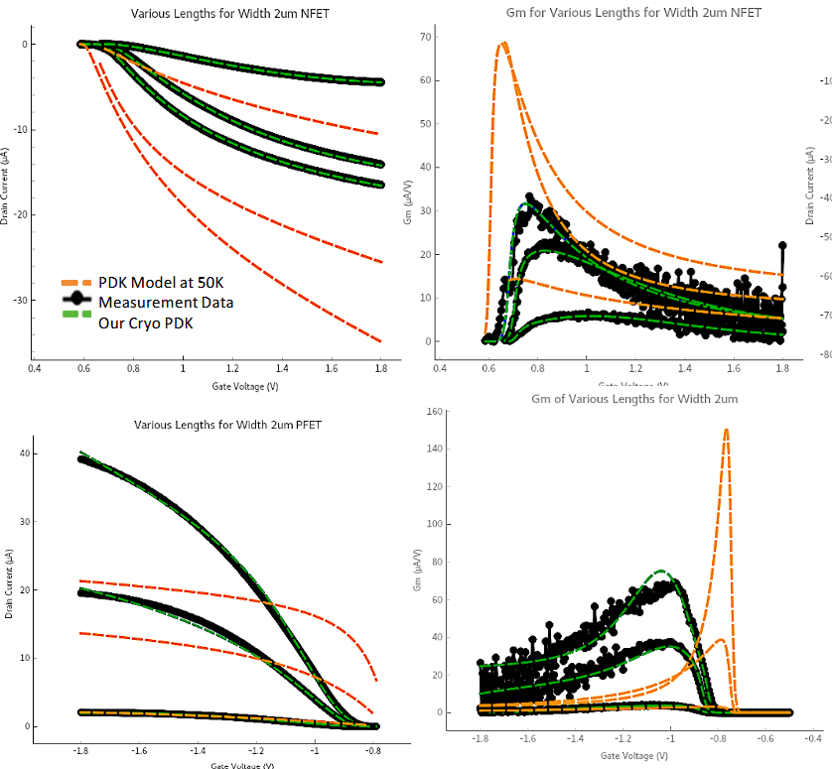
A Note on Cryomodels
Fermilab is developing cryogenic models for GF 22FDX in collaboration with EPFL, Synopsys, and GlobalFoundries.
At present, models cover SLVT and EGLVT FETs at 3.8K
Unfortunately, these models were not available at design time for the cryoTDC – and do not match the flavors used in the cryoTDC core.
For more information, see: https://doi.org/10.2172/2426440 (Olivia Seidel, IceQubes 2024)

Slide 20
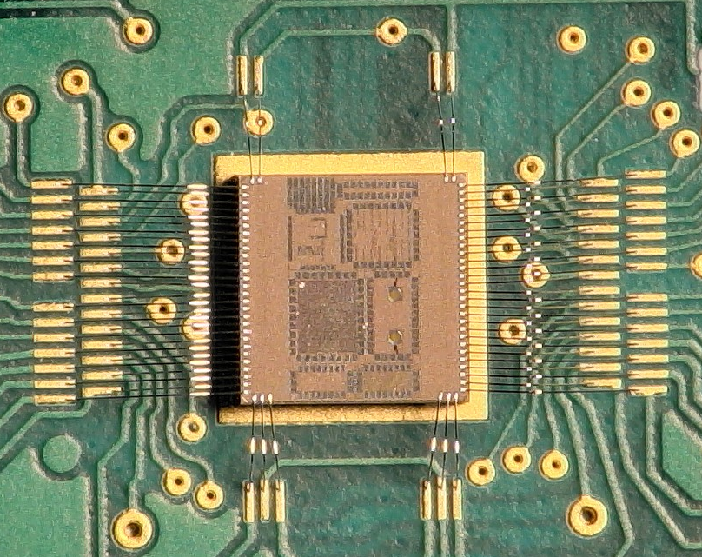
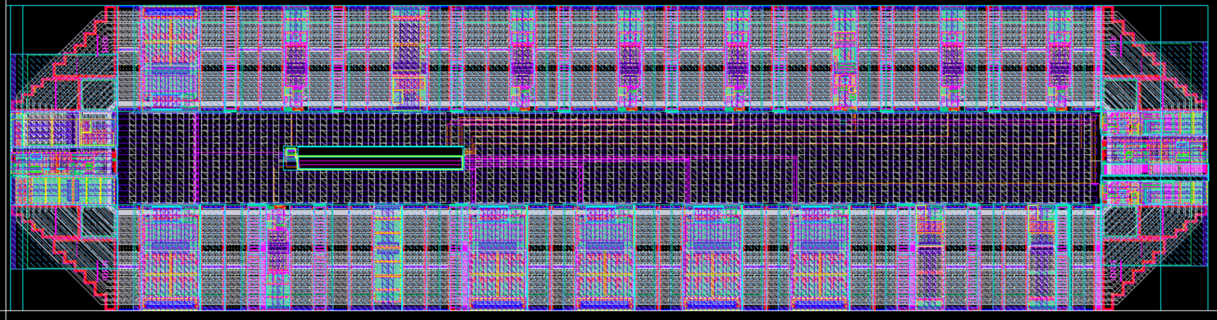
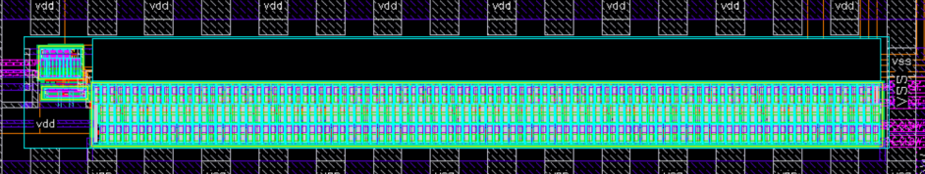




Test Chip
TDC
$$≈250 μm$$
$$≈1000 μm$$
[Digital Readout and Control]
$$≈20 μm$$
[Fine TDC]
$$≈150 μm$$
Notes:
Time Check: ~17 mins

Slide 21
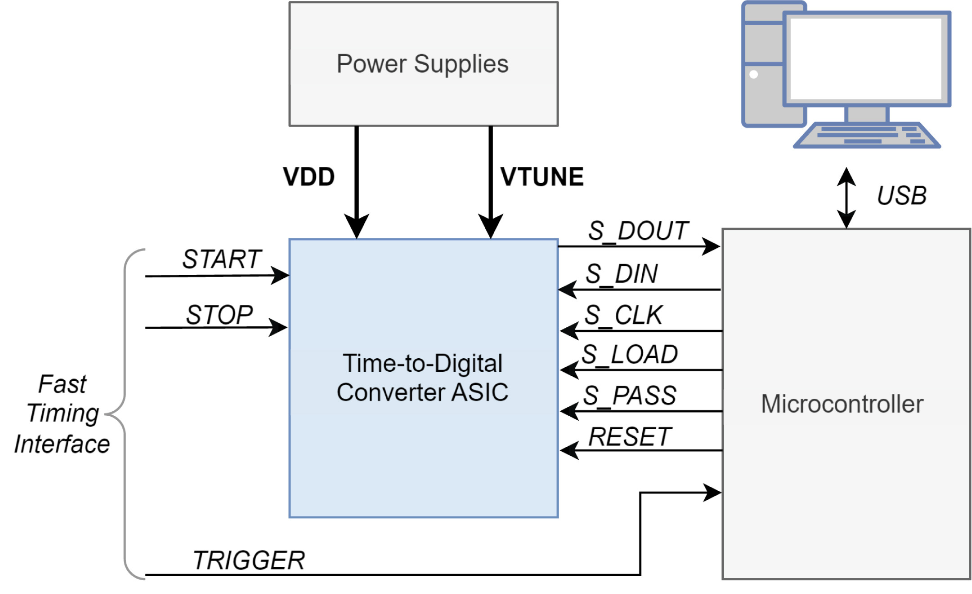
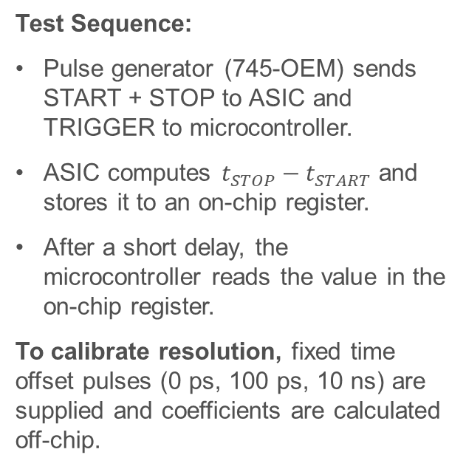
Testing the CryoTDC
Test Sequence:
Pulse generator (745-OEM) sends START + STOP to ASIC and TRIGGER to microcontroller.
ASIC computes $t_{STOP}−t_{START}$ and stores it to an on-chip register.
After a short delay, the microcontroller reads the value in the on-chip register.
To calibrate resolution, fixed time offset pulses (0 ps, 100 ps, 10 ns) are supplied and coefficients are calculated off-chip.

Slide 22
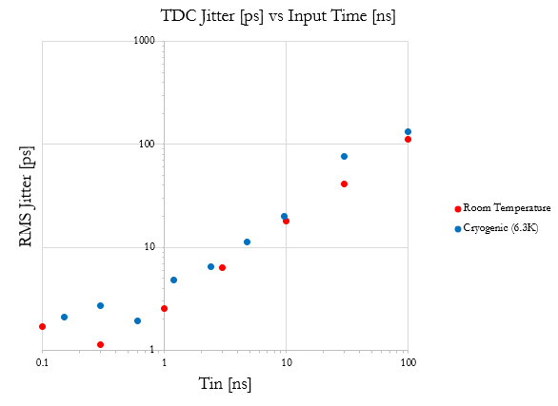

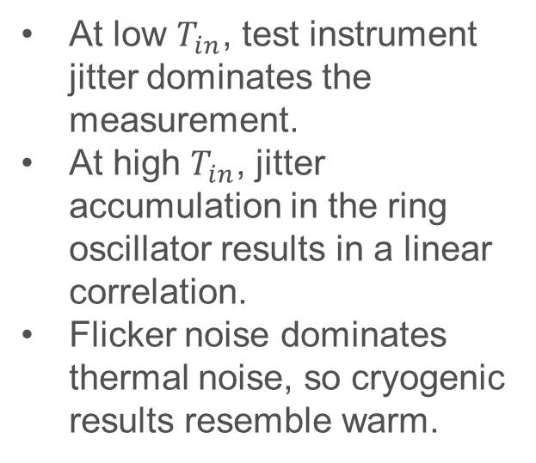
Result: Jitter vs $T_{in}$
At low $T_{in}$, test instrument jitter dominates the measurement.
At high $T_{in}$, jitter accumulation in the ring oscillator results in a linear correlation.
Flicker noise dominates thermal noise, so cryogenic results resemble warm.
$$σ\left(T_{in}\right)=0.001T_{in}$$

Slide 23
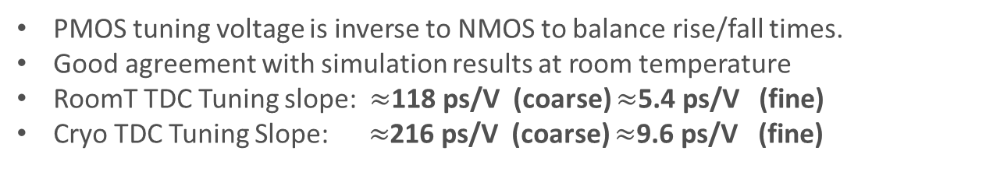
Back-Gate Tuning
PMOS tuning voltage is inverse to NMOS to balance rise/fall times.
Good agreement with simulation results at room temperature
RoomT TDC Tuning slope: $≈$118 ps/V (coarse) $≈$5.4 ps/V (fine)
Cryo TDC Tuning Slope: $≈$216 ps/V (coarse) $≈$9.6 ps/V (fine)
Notes:
NOTES:
Ring Oscillator tuning was swept over the full nominal range of the back-gate bias (0~2V)
Fine TDC was swept until the resolution became so small that (1) the LSB is well below the jitter floor and (2) the dynamic range of the fine TDC became so small that 100x fine LSBs << 1 coarse LSB, so calibration doesn’t work properly.

Slide 24
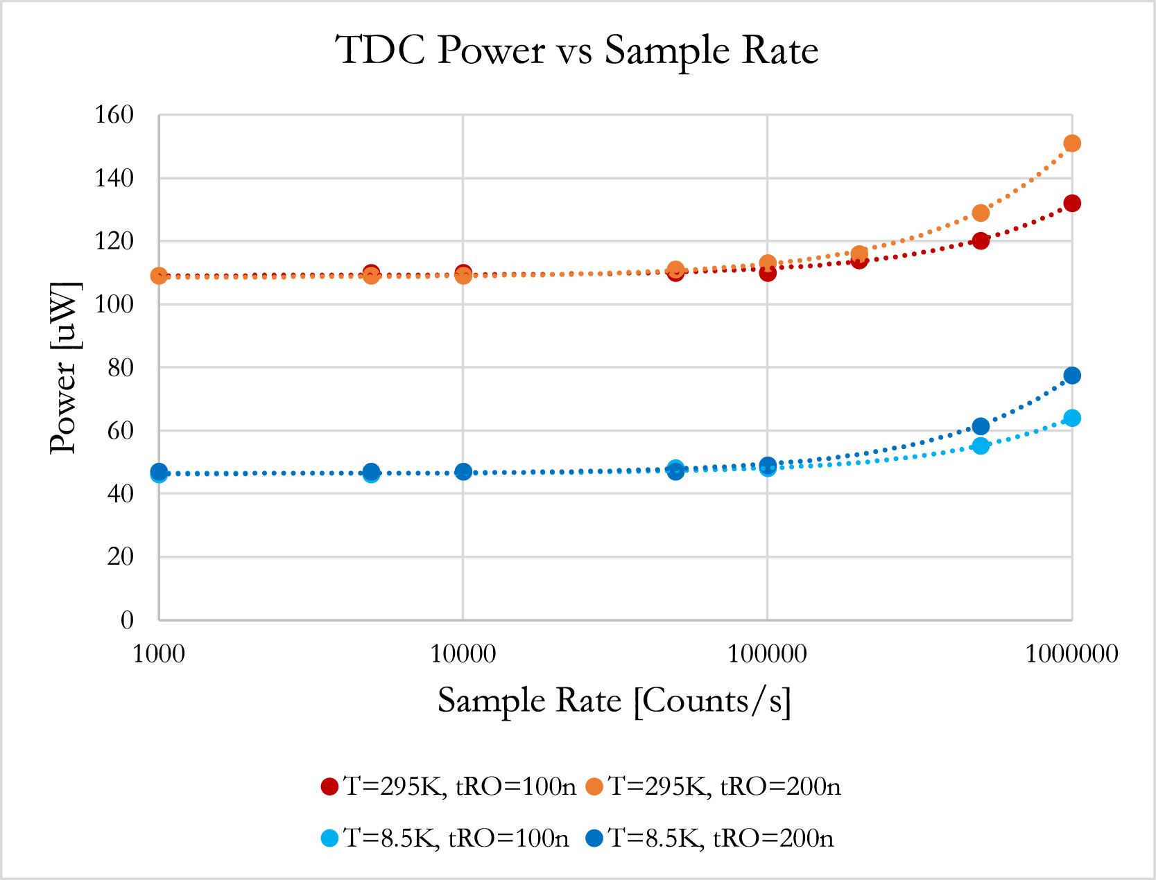
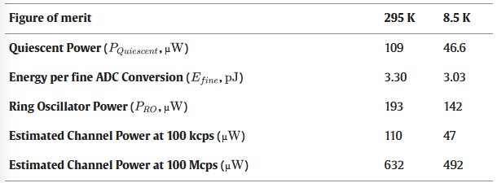
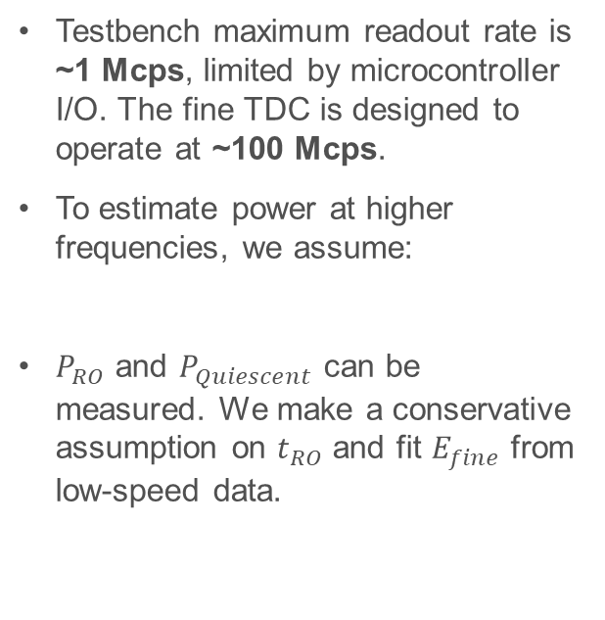
Power and Operation Speed
Testbench maximum readout rate is ~1 Mcps, limited by microcontroller I/O. The fine TDC is designed to operate at ~100 Mcps.
To estimate power at higher frequencies, we assume:
$P_{RO}$ and $P_{Quiescent}$ can be measured. We make a conservative assumption on $t_{RO}$ and fit $E_{fine}$ from low-speed data.

Slide 25
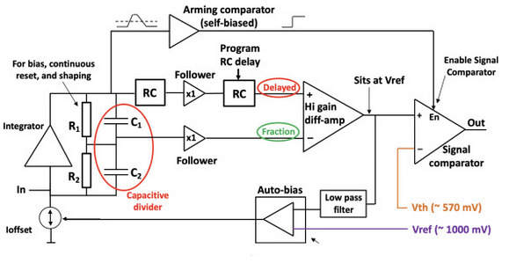
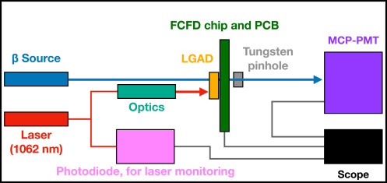
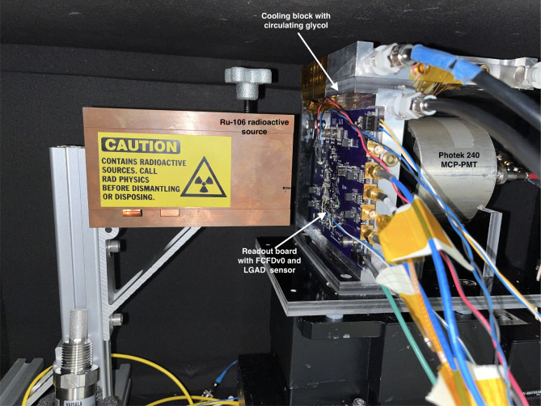
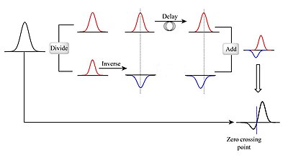
The Fermilab Constant-Fraction Discriminator (FCFD)
FCFDv0 is a front-end readout chip for LGADs which uses CFD to locally compensate for input signal time walk.
The FCFD includes pulse injection (5~26 fC) which mimics LGAD signals for easy characterization.
Images from [11]

Slide 26
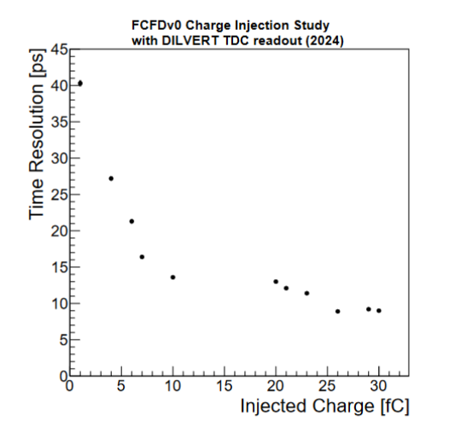
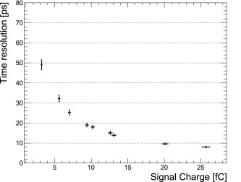
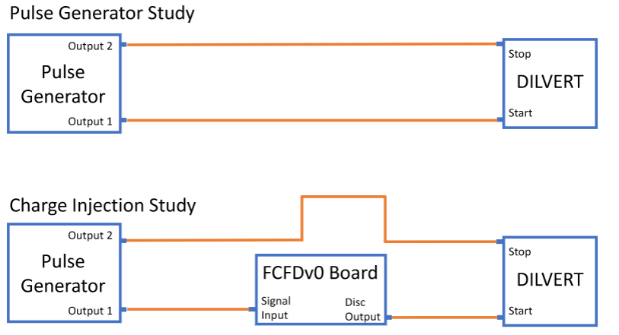
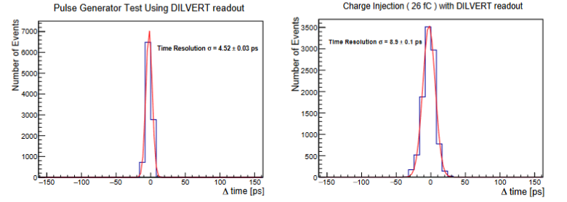
Readout Results with FCFD
Time Resolution vs Injected Charge Measured with an Oscilloscope (reference) [11]
Time Resolution vs Injected Charge Digitized with CryoTDC v1
CryoTDC v1 achieves sensor-limited readout fidelity with FCFDv0.
Intrinsic readout RMS noise O(5ps).
RMS Noise (Pulse Generator → CryoTDC v1)
RMS Noise (FCFD (26 fC) → CryoTDC v1)
CryoTDC
CryoTDC

Slide 27

Summary of Figures of Merit
Notes:
Unique cryogenic TDC result
Good balance of rate, resolution, power, and area.

Slide 28
Further Developments
Notes:
Time Check: 23 mins

Slide 29


SUNROCK
32x channels, a shared clock and readout architecture, and DC biasing for SNSPDs.

Slide 30

SUNROCK TDC Architecture
Fine TDC design essentially identical to CryoTDC v1.
Coarse counter is clocked by hsclk
hsclk (10.0 GHz) is produced on-chip by a novel cryogenic sampling PLL with ~10fs rms jitter.
hsclk

Slide 31

SUNROCK Test Chip
Successfully taped out.
Testing has been significantly delayed due to engineering resources but is currently underway.

Slide 32

Thank you for your attention!
Please direct any questions or feedback to:
aquinn [at] fnal [dot] gov
More Fermilab Talks this Week:
“Smart Pixels: In-Pixel AI for on-sensor data filtering”
Benjamin Parpillon – Weds @ 11:00 am
“Constant Fraction Discriminator Readout Chip for ePIC”
Artur Apresyan – Thurs @ 11:30 am
For more technical info, check out our NIM-A Paper:

Slide 33
Backup
Notes:
Time check: 42 minutes

Slide 34
References
[1] Harbaugh, J. (2017, May 22). Deep Space Optical Communications (DSOC). NASA. Retrieved October 3, 2021, from https://www.nasa.gov/mission_pages/tdm/dsoc/index.html.
[2] Jet Propulsion Laboratory, California Institute of Technology. (2018). Superconducting Nanowire Single Photon Detectors For Deep Space Optical Communication.
[3] Ho, R., Mai, K., & Horowitz, M. (2001). The future of wires. Proc. IEEE, 89, 490-504.
[4] Fermi National Accelerator Laboratory. (2021). Joint DOE-NASA development of custom readout electronics for Superconducting Nanowire Single Photon Detector (p. 1).
[5] SLAC National Accelerator Laboratory. TDC development for future detectors: Initial technology evaluation. U.S. Department of Energy Office of Science.
[6] P. Dudek, S. Szczepanski and J. V. Hatfield, "A high-resolution CMOS time-to-digital converter utilizing a Vernier delay line," in IEEE Journal of Solid-State Circuits, vol. 35, no. 2, pp. 240-247, Feb. 2000, doi: 10.1109/4.823449.
[7] R. Enomoto, T. Iizuka, T. Koga, T. Nakura and K. Asada, "A 16-bit 2.0-ps Resolution Two-Step TDC in 0.18- μm CMOS Utilizing Pulse-Shrinking Fine Stage With Built-In Coarse Gain Calibration," in IEEE Transactions on Very Large Scale Integration (VLSI) Systems, vol. 27, no. 1, pp. 11-19, Jan. 2019, doi: 10.1109/TVLSI.2018.2867505.
[8] B. V. Bockel, P. Leroux and J. Prinzie, "Tradeoffs in Time-to-Digital Converter Architectures for Harsh Radiation Environments," in IEEE Transactions on Instrumentation and Measurement, vol. 70, pp. 1-10, 2021, Art no. 2005710, doi: 10.1109/TIM.2021.3100355.
[9] Global Foundries. 22FDX Design Kit and Technology Training Book. TTM-000022 Revision 9.
[10] Hu, Jianyong & Yu, Bo & Jing, Ming-Yong & Xiao, Liantuan & Jia, Suotang & Qin, Guo-Qing & Long, Gui. (2016). Experimental quantum secure direct communication with single photons. Light: Science & Applications. 5. e16144. 10.1038/lsa.2016.144.

Slide 35
References, Cont’d
[11] Si Xie, Artur Apresyan, Ryan Heller, Christopher Madrid, Irene Dutta, Aram Hayrapetyan, Sergey Los, Cristián Peña, Tom Zimmerman, Design and performance of the Fermilab Constant Fraction Discriminator ASIC, Nuclear Instruments and Methods in Physics Research Section A: Accelerators, Spectrometers, Detectors and Associated Equipment, Volume 1056, 2023, 168655, ISSN 0168-9002, https://doi.org/10.1016/j.nima.2023.168655. (https://www.sciencedirect.com/science/article/pii/S0168900223006459)

Slide 36



Traditional Tuning Methods
$$Delay∝\frac{I}{C}$$
Tuning is important!
Small PVT variation in $t_{1}$, $t_{2}$ → big variation in $t_{R}$
But comes with a lot of side-effects:
Parasitic R, C even at maximum $V_{ctrl}$
Die area doubled (or more)
Tuning FET noise contribution
What if we could tune $t_{1}$, $t_{2}$ without adding any FETs?
SLAC [5]
Notes:
(Note these points also apply to the capacitive method of tuning.

Slide 37



22FDX Back-Gate Biasing
Back-gate biasing modulates $V_{Th}$, changing drive strength and thus delay.
DILVERT has six independent bias voltages:
$$V_{tune_p_fast}, V_{tune_n_fast}$$
$$V_{tune_p_slow}, V_{tune_n_slow}$$
$$V_{tune_p_RO}, V_{tune_n_RO}$$
GF 22FDX Training Manual [9]
Notes:
*wide tuning range overcomes PVT variations.

Slide 38

TDC Characteristic Equation Derivation

Slide 39




Flicker Noise Contribution
For a free-running RO, $σ_{ΔT}$ is dominated by thermal noise at low $ΔT$, flicker at high $ΔT$.
Our TDC shows $σ_{ΔT}∝ΔT$ which is characteristic of flicker noise.
Empirical models give $t_{c}≈\frac{1}{36f_{c}}$. For the inverters in DILVERT RO, $f_{c}≈10 MHz$, so $t_{c}≈2.7 ns$. (From measurement, $t_{c}≈0.5 to 5 ns$, limited by Meas. Floor)
C. Liu and J. McNeill, “Jitter in oscillators with 1/f noise sources,” in Proc. IEEE Int. Symp. Circuits and Systems (ISCAS), 2004, pp. 773–776.

Slide 40
(Update 2/7/2023) Splitter Noise Measurements
Goal: Estimate the jitter performance possible from DILVERT fine TDC.
Eliminate instrumentation noise by using a cable delta + splitter to generate START/STOP.
Circumvent issues with calibration + course counts by examining fine counts.
Delta/Temp | Avg Qfine | RMS Noise [LSB] | For LSB=6ps | For LSB=12ps
6in 6K | 21.73046 | 0.364787008 | 2.19 | 4.38
9in 6K | 41.91884 | 0.419846533 | 2.52 | 5.04
24in 6K | 72.61523 | 0.912814773 | 5.48 | 10.95
40in 6K | 69.48798 | 1.215260398 | 7.29 | 14.58
49in 6K | 65.08617 | 1.218580317 | 7.31 | 14.62
9in 296K | 53.37575 | 0.466708555 | 2.8 | 5.6
24in 296K | 44.07214 | 0.901775747 | 5.41 | 10.82
40in 296K | 94.71844 | 1.197597789 | 7.19 | 14.37
49in 296K | 74.44589 | 1.387048054 | 8.32 | 16.64
Notes:
This is a good result. This confirms that even with the various bugs, we’re in the right range of jitter.
For full data, see Splitter_Noise_Measurements.xlsx

Slide 41


Slide 42

Design Goals for the next 20 years: Enable Smart Sensors
Novel sensors; CMOS sensors
Low power, low noise, ultra-sensitive analog for sensor signals
Advanced digital architectures and verification methods
AI-on-chip, Quantum cryoelectronics, 6G and beyond
Integrated high speed communication between modules and off-detector
Extremely important to work with industry to leverage production-scale processing

Slide 43

Microelectronics at Fermilab: Quantum/Cryo Analog
Advances in HEP, DM detection, quantum imaging demand better detectors:
Extreme spatial/temporal resolution
Extreme environments (cryo, rad-hard)
Extremely low noise (< 1 e-)
Beyond CMOS technology demonstration:
Cryo silicon photonics
Superconducting readout
Quantum instrumentation

Slide 44


Microelectronics at Fermilab: Digital & ML
FoMs for Science vs Industry ML
Ever-higher luminosity and event rates in particle trackers create a “data deluge”
Need data compression at the edge, or valuable physics data will be lost.

Slide 45

Technology Transfer at National Labs

Slide 46


All You Need to Know
Flip-Flop
Gate
Clock→
Data (D) is captured at the rising edge of clock.
Delays a signal by a few (~20) ps

Slide 47
Time-to-Digital Converter Design Trade-offs
Dynamic Range
Linearity
Resolution
(Bin Size)
Jitter
Power/Area
Notes:
Resolution as small as possible → fast, min-length devices → but we need large devices to minimize jitter
Dynamic range as big as possible (no voltage headroom constraints) → many unit devices → lots of delays to balance, need to keep linear/low-area

Slide 48





Time-to-Digital Converter = A Counter?
Dynamic Range: $Q_{MAX}∝2^{N}$ 😀
Resolution: $T_{CLK}$☹️
Other Issues:
Clock generator?
FO4 scaling (TT, low $V_{DD}$, high temp)
$$\overline{STOP}$$
EN
Counter
$$CLK$$
CLK
Q
$$Q_{TDC}$$
Ho, et al. [3]

Slide 49

Gate-Level Resolution (Flash TDC)
Dynamic Range: $Q_{MAX}∝N$ ☹️
Resolution: $τ_{gate}$ 😐
Other Issues:
Linearity & Mismatch
Thermometer decode
Delay on the STOP line?
From Bockel [8]

Slide 50


Sub-Gate Resolution (Vernier TDC)
Dynamic Range: $Q_{MAX}∝N$ ☹️
Resolution: $≪τ_{gate}$, limited by jitter 😀
Other Issues:
Linearity & Mismatch
Need tunable delay elements
Thermometer decode
Processing time may be > Dynamic Range
START
STOP
Enomoto [7]

Slide 51




Loop the TDC?
$$Start$$
EN
Counter
CLK
Q
$$Q_{COARSE}$$
Issues:
Jitter accumulation
Pulse shrinking?
Non-linearity ($C_{parasitic}$ on the CLK line?)
$$Q_{FINE}$$

Slide 52


Two-Step TDC?
Big Idea: Fine TDC for resolution, Coarse TDC for dynamic range.
Two “Steps”:
START propagates through coarse TDC.
When STOP arrives, START is coupled to fine TDC to digitize residual.
Enomoto [7]
Routing complexity $∝N_{coarse}$
Area still grows linearly with dynamic range…
What about MUX/logic delay?
Notes:
So called because the “two steps” are sequential. Only one of the two TDCs is evaluating at once.

Slide 53


DFF Interlock?
DFF1 aligns STOP_FINE_TDC to the next clock edge.
Now:
$$T_{in}=T_{coarse}−T_{residue}$$
Signal path is always the same → no variable delay.
Enomoto [7]
* But what’s the timing relationship between RO<0> and STOP?

Slide 54
A Better DFF Interlock
DFF1 has the same function as before.
DFF2 suppresses metastability of the halt signal.
Doesn’t this introduce delay?
→ Constant, can be calibrated.
Enomoto [7]

Slide 55


An Aside: Delta-Sigma TDCs
Measure delay offset between clocks:
One clock signal is delayed, depending on feedback from output.
Resulting phase difference is integrated.
Excellent resolution, but requires oversampling → not very applicable to our application.

