Slide 1
Matterhorn, a single photon counting detector for high flux synchrotrons applications
Roberto Dinapoli, Aldo Mozzanica, Anna Bergamaschi, Bernd Schmitt, Carlos Lopez Cuenca, Christian Rueder,Davide Mezza, Dhanya Thattil, Dominic Greiffenberg, Erik Fröjdh, Jiaguo Zhang, Jonathan Mulvey, Khalil Daniel Ferjaoui, Konstantinos Moustakas, Mar Carulla Areste, Martin Brückner, Martin Mueller, Saverio Silletta, Shuqui Li, Simon Ebner, Thomas King, Vadym Kedych, Viktoria Hinger, Viveka Gautam, Xiangyu Xie.
13th FEE workshop, Paris France, 18-22 May 2026

Slide 2
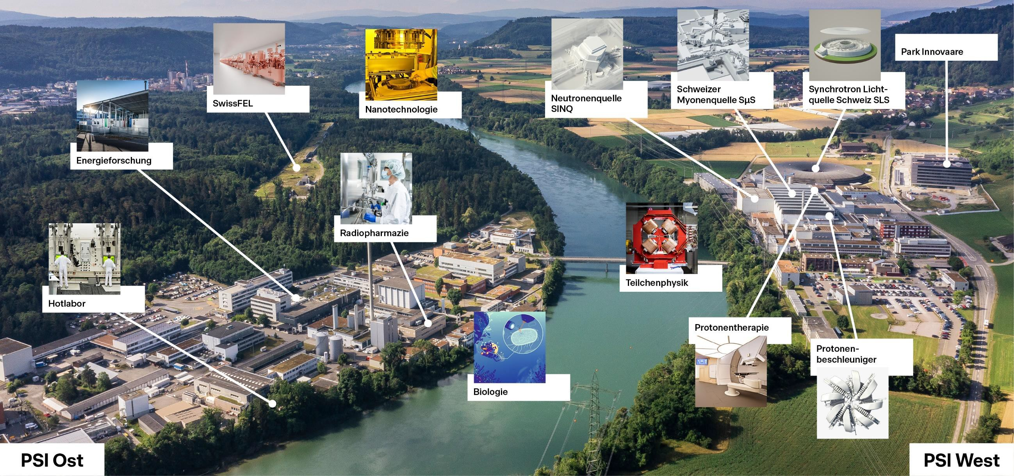
Paul Scherrer Institute
Park Innovaare
X-ray Free Electron
Laser SwissFEL
Muon source
SµS
Synchrotron source
SLS
Neutron source
SINQ
Nanotechnology
Energy research
Radiopharmaceuticals
Particle physics
Hot lab
Proton Therapy
Proton
Accelerator
Biology
Notes:
Energy, radio pharma, biology, proton therapy.
-SINQ: neutrons
- Sus: muons
- Protons
- Synchrotron
- XFEL

Slide 3
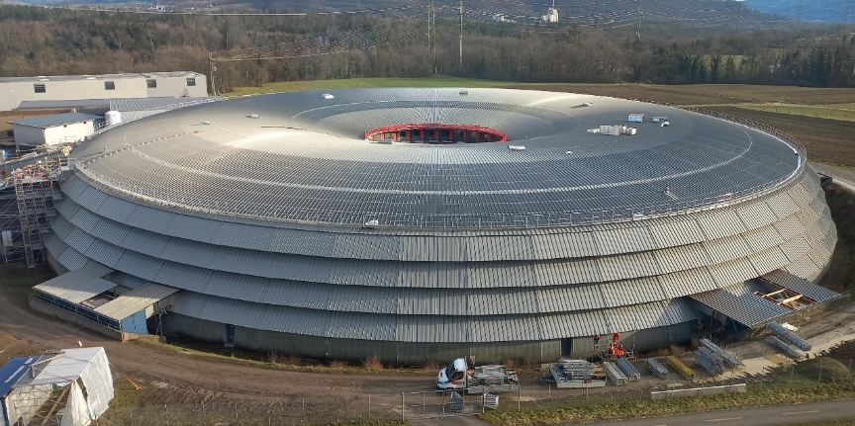
SLS 2.0 – a 4th generation synchrotron
Increased coherent flux [1]:
>100x at 10 keV
Up to 1000x at 20 keV
Increased electron energy (2.4 → 2.7 GeV)
Higher energy photons (80 keV)
[1] SLS 2.0 Storage Ring Technical Design Report PSI Bericht Nr. 21-02 November 2021

Slide 4
SLS 2.0 – a 4th generation synchrotron
Increased coherent flux [1]:
>100x at 10 keV
Up to 1000x at 20 keV
Increased electron energy (2.4 → 2.7 GeV)
Higher energy photons (80 keV)
For the detector this means:
Faster count rate
Higher frame rate
Wider energy range
[1] SLS 2.0 Storage Ring Technical Design Report PSI Bericht Nr. 21-02 November 2021

Slide 5
SLS 2.0 – a 4th generation synchrotron
Increased coherent flux [1]:
>100x at 10 keV
Up to 1000x at 20 keV
Increased electron energy (2.4 → 2.7 GeV)
Higher energy photons (80 keV)
For the detector this means:
Faster count rate
Higher frame rate
Wider energy range
- 15-20 M photons/pixel/second
- 20 kHz continuous frame rate
- 250 eV – 80 keV
[1] SLS 2.0 Storage Ring Technical Design Report PSI Bericht Nr. 21-02 November 2021

Slide 6

SLS 2.0 – a 4th generation synchrotron
Increased coherent flux [1]:
>100x at 10 keV
Up to 1000x at 20 keV
Increased electron energy (2.4 → 2.7 GeV)
Higher energy photons (80 keV)
For the detector this means:
Faster count rate
Higher frame rate
Wider energy range
- 15-20 M photons/pixel/second
- 20 kHz continuous frame rate
- 250 eV – 80 keV
LGADs
High Z
[1] SLS 2.0 Storage Ring Technical Design Report PSI Bericht Nr. 21-02 November 2021

Slide 7
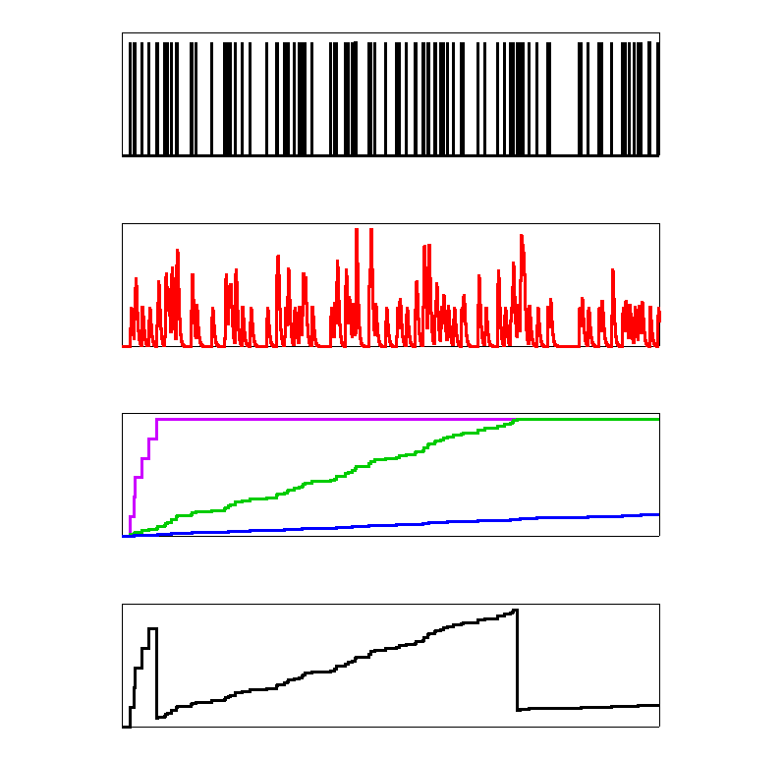
SLS 2.0 – a 4th generation synchrotron
Increased coherent flux [1]:
>100x at 10 keV
Up to 1000x at 20 keV
Increased electron energy (2.4 → 2.7 GeV)
Higher energy photons (80 keV)
For the detector this means:
Faster count rate
Higher frame rate
- 15-20 M photons/pixel/second
- 20 kHz continuous frame rate
Charge integration
Single Photon Counting
[1] SLS 2.0 Storage Ring Technical Design Report PSI Bericht Nr. 21-02 November 2021

Slide 8
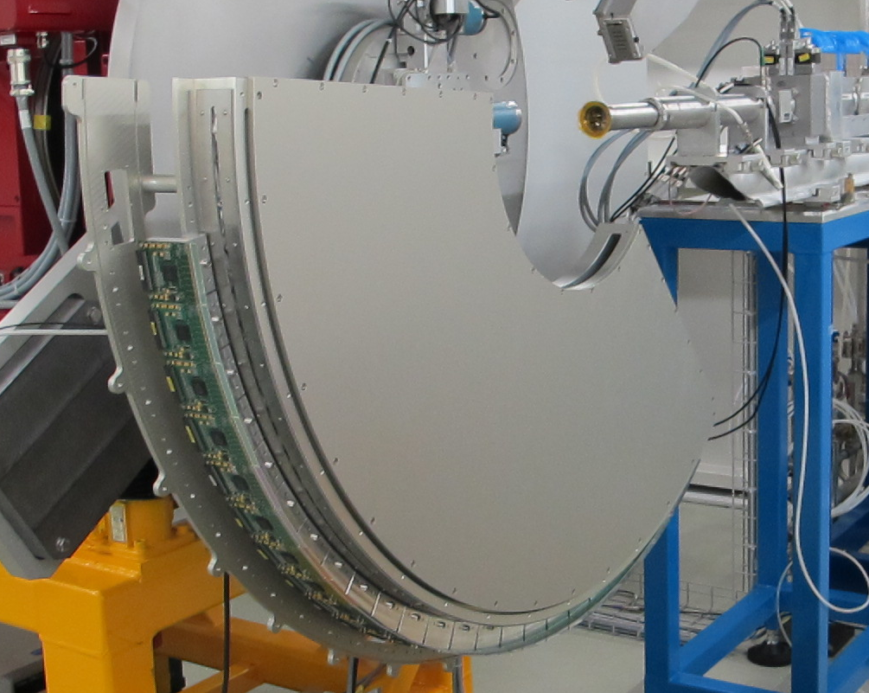
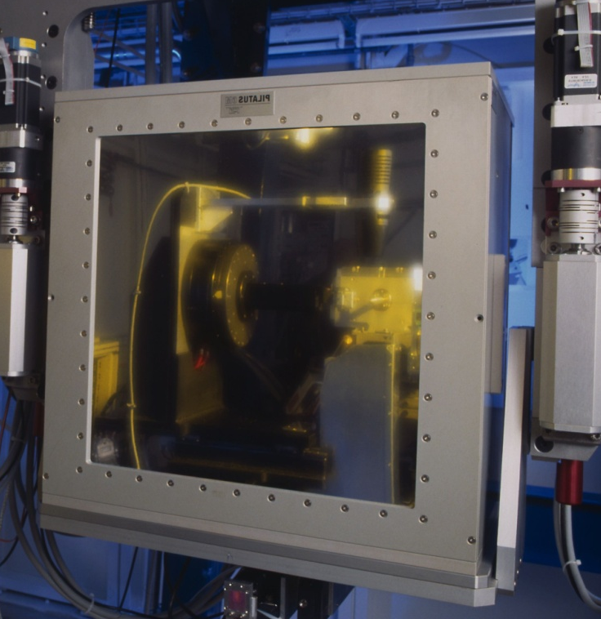
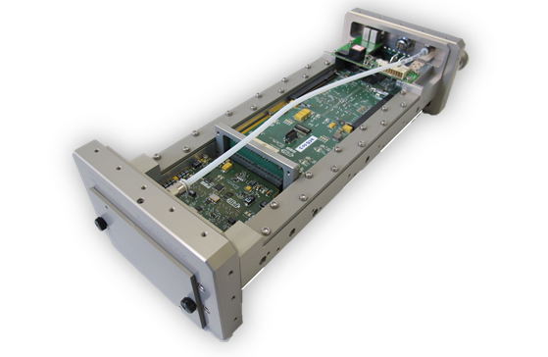
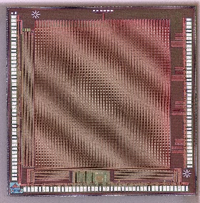
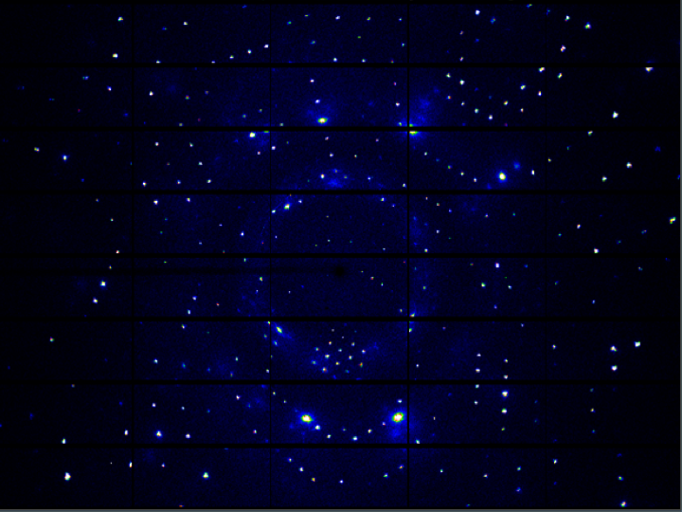
(Historical) detector portfolio: Single photon counting
 | MYTHENI-II-III | PILATUSI-II | EIGER | MATTERHORN
Technology | UMC 250/110 nm | DMILL800/UMC 250 nm | UMC 250 nm | UMC 110 nm
Status | Modules available | Modules available | Modules available | Prototyping phase
Channel size | 50 µm (Strips) | 172 x 172 µm² | 75 x 75 µm² | 75 x 75 µm²
New

Slide 9
(Historical) detector portfolio: Single photon counting
 | MYTHEN III | PILATUS | EIGER | MATTERHORN
Technology | UMC 110 nm | UMC 250 nm | UMC 250 nm | UMC 110 nm
Status | Modules available | Modules available | Modules available | Prototyping phase
Channel size | 50 µm (Strips) | 172 x 172 µm² | 75 x 75 µm² | 75 x 75 µm²
New
Phased out
(DECRTIS)
Phasing out

Slide 10
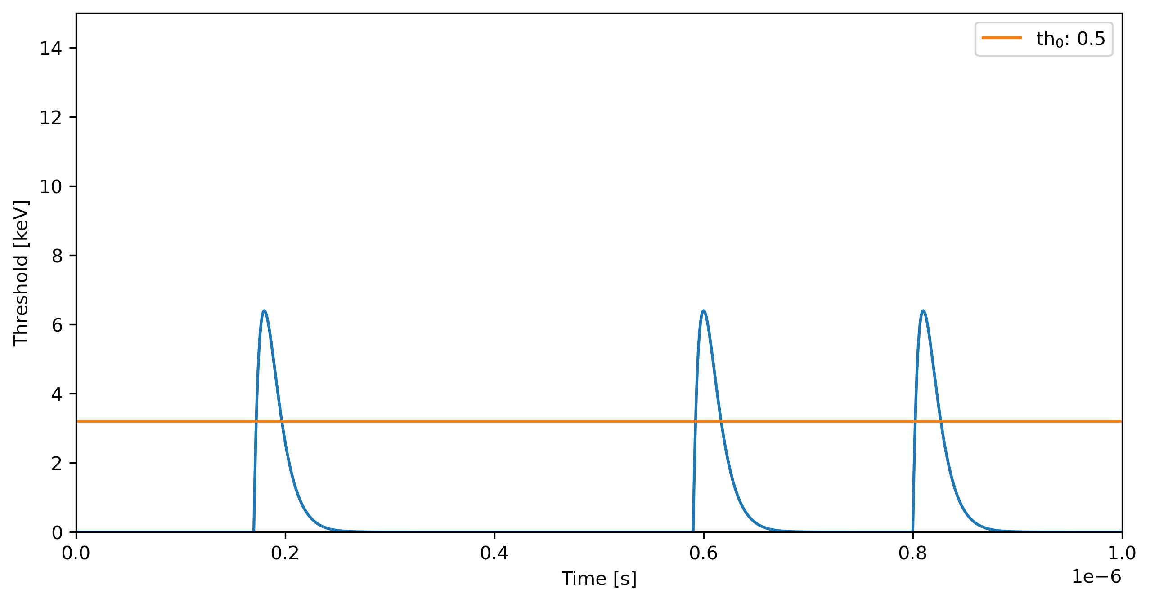
The “speed challenge”: high photon flux
Single photon counting works extremely well if the incoming photon rate is reasonable low

Slide 11
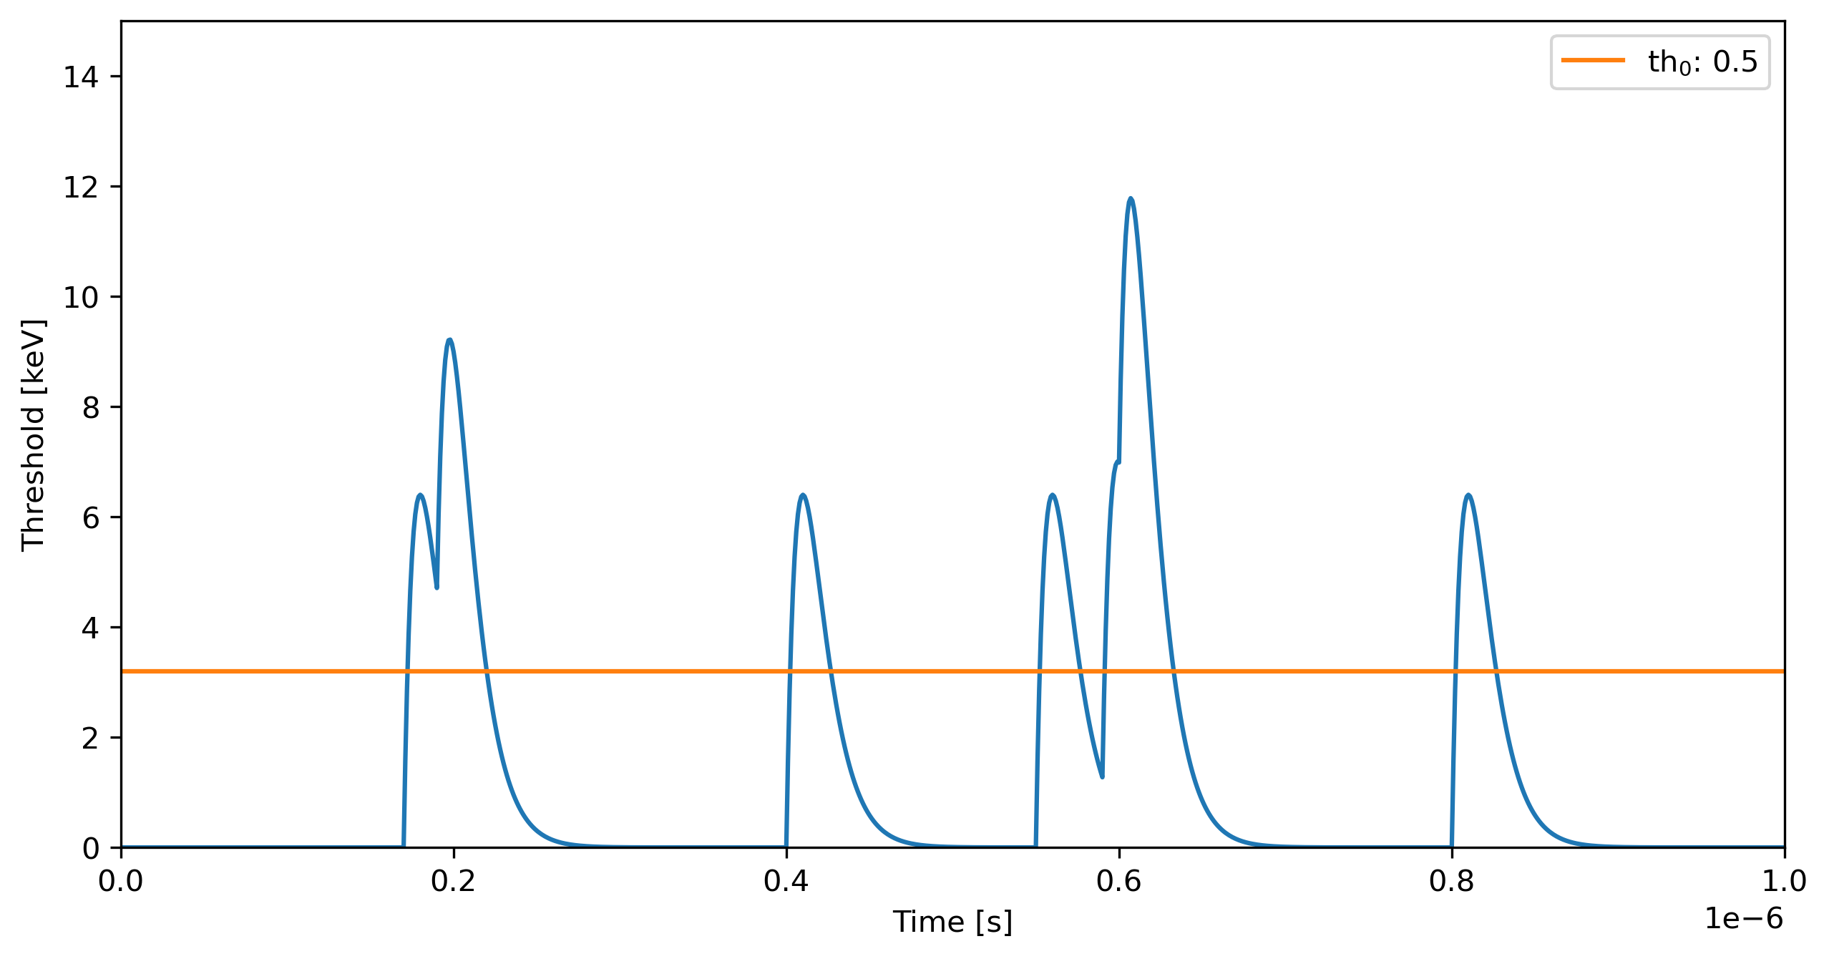
The “speed challenge”: high photon flux
Single photon counting works extremely well if the incoming photon rate is reasonable low
But as the rate increases we lose efficiency due to pulse pileup

Slide 12
The “speed challenge”: high photon flux
Single photon counting works extremely well if the incoming photon rate is reasonable low
But as the rate increases we lose efficiency due to pulse pileup
Pile-up mitigation techniques for SPC:
Time over threshold
Retriggering
…

Slide 13
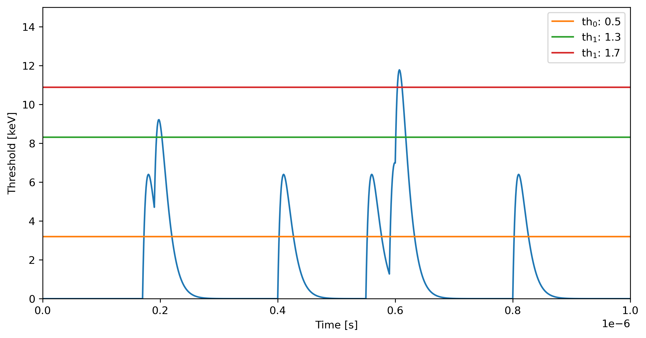
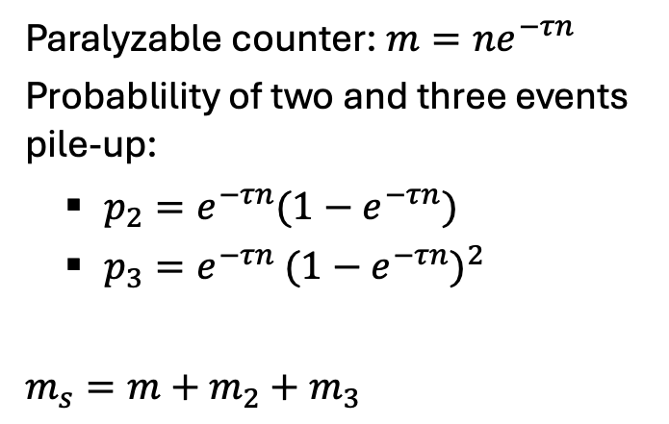
Pile-up counting with multiple thresholds
Th as fraction of photon energy
Paralyzable counter: $m=ne^{−τn}$
Probablility of two and three events pile-up:
$p_{2}=e^{−τn}(1−e^{−τn})$
$p_{3}=e^{−τn}$ ${(1−e^{−τn})}^{2}$
$m_{s}=m+$ $m_{2}+m_{3}$
Counter 2
170%
Counter 1
130%
100%
Counter 0
50%
[1] Glenn F. Knoll, Radiation Detector and Measurement 4th Edition, Wiley
[2] M. Andrae The MYTHEN III Detector System - A single photon counting microstrip detector for powder diffraction experiments ETHZ Doctoral Thesis
100%: Energy of the monochromatic incoming photons

Slide 14
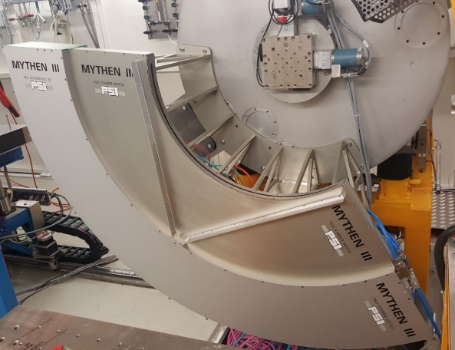
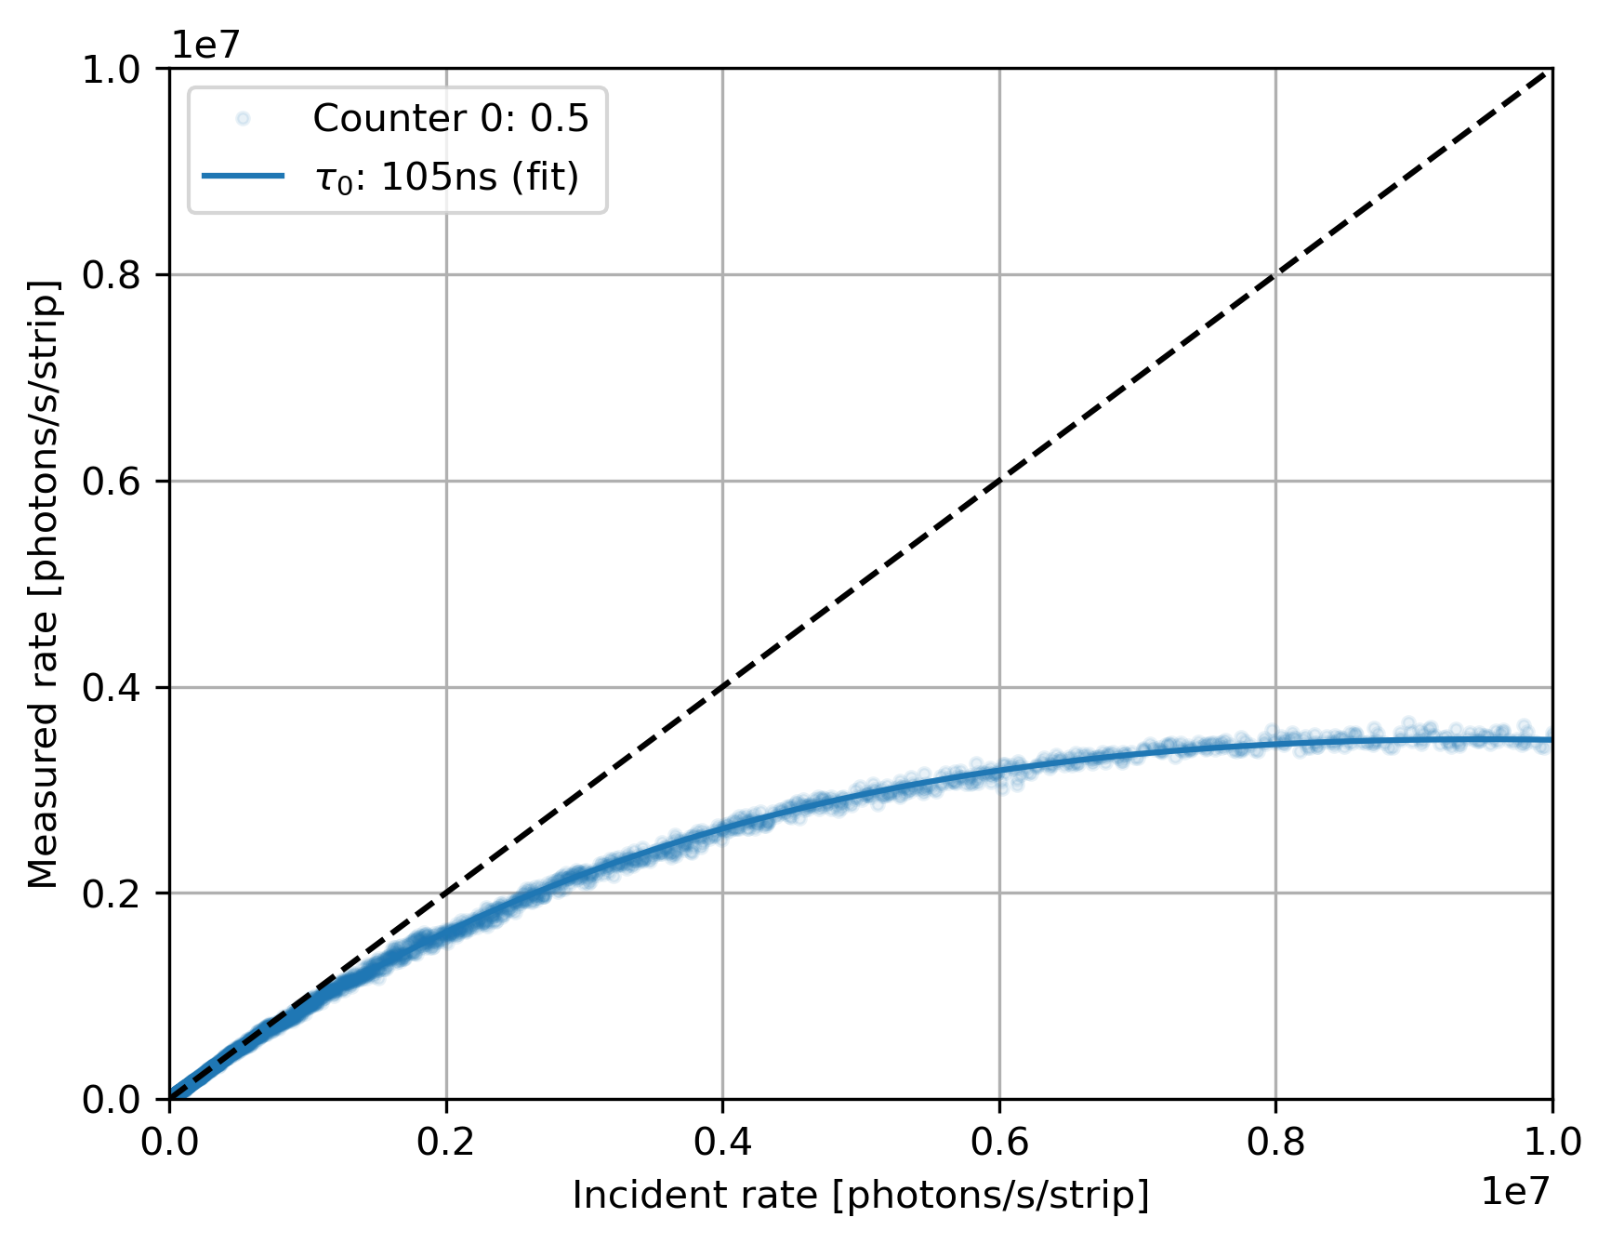

Multi-thresholding : proof of concept with Mythen3.02 (1D)
MS Beamline @ SLS
Settings: standard
Energy: 15 keV
90% efficiency at:
Single counter : 1.03Mcps
$m=ne^{−τn}$

Slide 15
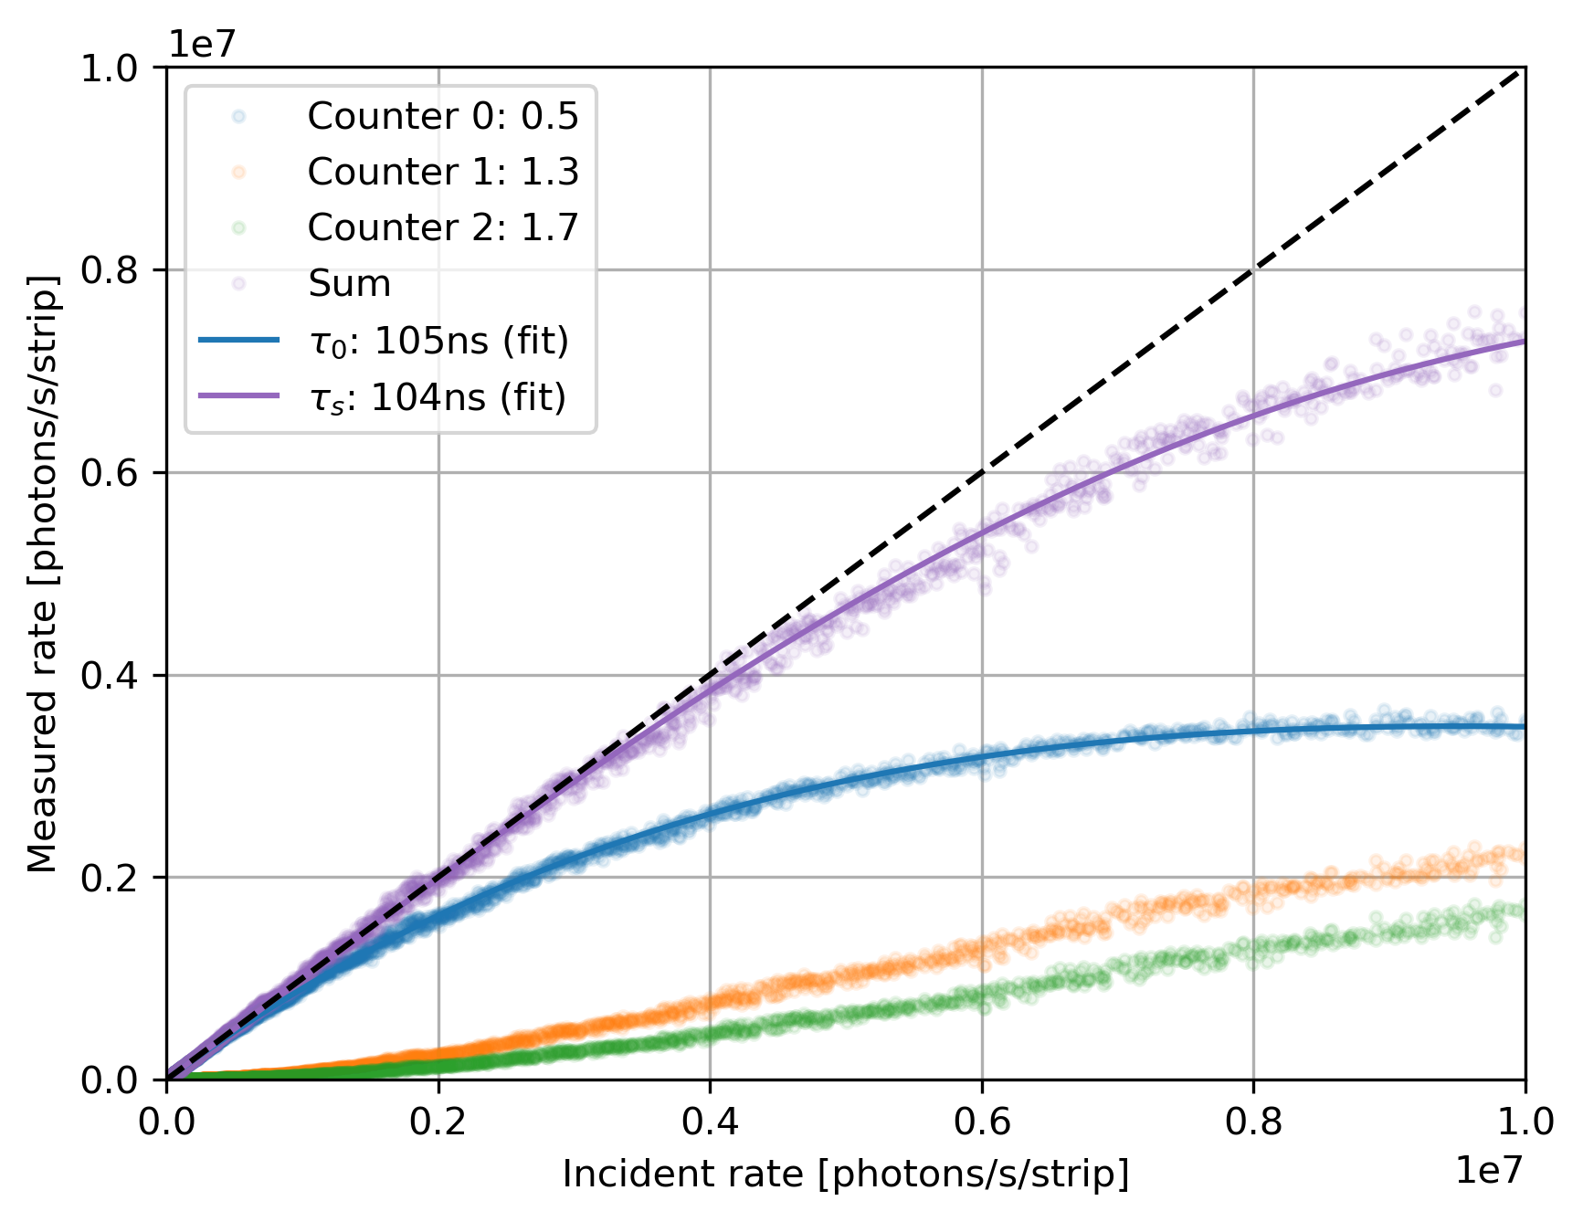



Multi-thresholding : proof of concept with Mythen3.02 (1D)
MS Beamline @ SLS
Settings: standard
Energy: 15 keV
90% efficiency at:
Single counter : 1.03Mcps
Three counters : 6 Mcps
Noise: 175e- RMS
$m_{s}=m+$ $m_{2}+m_{3}$
$m=ne^{−τn}$
$p_{3}=e^{−τn}$ ${(1−e^{−τn})}^{2}$
$$p_{2}=e^{−τn}(1−e^{−τn})$$

Slide 16
Multi-thresholding : proof of concept with Mythen3.02 (1D)
MS Beamline @ SLS
Settings: standard
Energy: 15 keV
90% efficiency at:
Single counter : 1.03Mcps
Three counters : 6 Mcps
Noise: 175e- RMS
x6
Settings: Fast [1]
Single counter 3.52 Mcps
Three counters 20.87 Mcps
Noise:~250e-
x6
[1] M Andrä The MYTHEN III Detector System - A single photon-counting microstrip detector for powder diffraction experiments ETHZ PhD Thesis 2021

Slide 17

Matterhorn – a new single photon counter for SLS2.0
 | EIGER | MATTERHORN
Technology | UMC 250 nm | UMC 110 nm
Pixel size | 75 x 75 um² | 75 x 75 um²
Thresholds | 1 | 4
Counter depth | 12 bit (3x4) | 4x16 bit
90% efficiency | 350k counts/pixel/s* | 15-20M counts/pixel/s
Module size | 4x8cm² | 4x8cm²
HighZ/LGAD | No | Yes
*DECTRIS EIGER2 90% efficiency at ~2 Mcps (UMC 110nm)
T. Donath et. al. EIGER2 hybrid-photon-counting X-ray detectors for advanced synchrotron diffraction experiments J. Synchrotron Rad. (2023). 30, 723-738

Slide 18
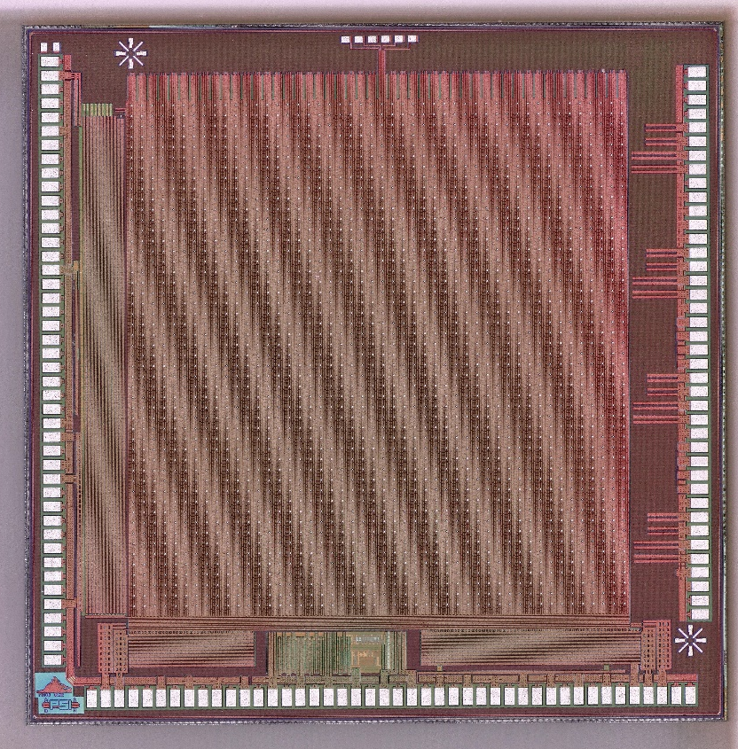
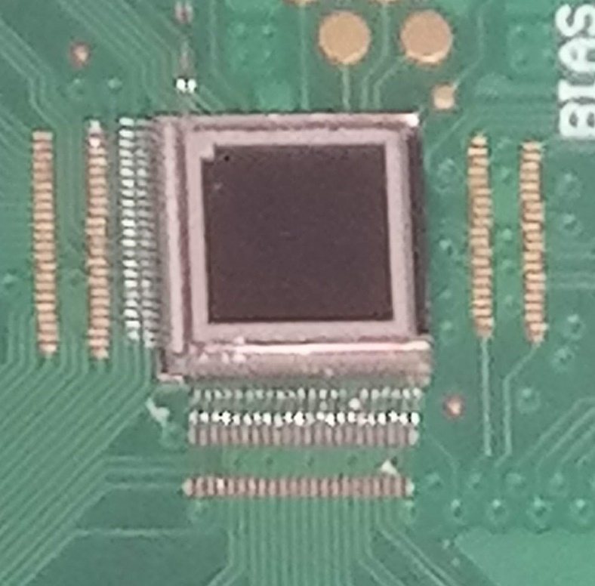
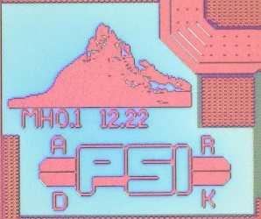
Matterhorn 0.1, 12.2022
Matterhorn prototypes
Matterhorn 0.2,10.2023
ASICs: ~5x5 mm² (3.6x3.6 active=48x48=2304 pixels)
MPW chips bump-bonded to sensor (XR-Nanotech)
2 Pre/shaper variations
2 Comparator variations
2x 1.6 GHz serializers
1.6 GHz CML driver (with pre-emphasis)
One pixel version only
2x 3.125 GHz serializers
3.125 GHz CML driver
Internal DACs for biasing
Some “features” fixed
Analog variations
“Slow” readout
One version only
Fast readout

Slide 19
Matterhorn 0.3, 12.2024 new digital periphery features
Matterhorn prototypes

Slide 20
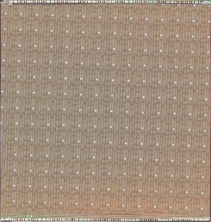

Matterhorn 0.3, 12.2024 new digital periphery features
Matterhorn prototypes
Matterhorn 1.0,t.o. 08.2025 Delivered: 01.2026
MH 1.0
~2 cm
MH0.2

Slide 21
Matterhorn 1, the full-size chip
MH 1.0
~2 cm
Same pixel as Matterhorn 0.2
MH0.2
 | MATTERHORN 1
Technology | 110 nm
Chip active area | 1.92x1.92 cm² 256x256 pixels
Pixel size | 75 x 75 um²
Thresholds | 4
Counter depth | 4x16 bit
Trim bits/compar. | 6
Static power/pixel (4 comparators) | 9.6μW
HighZ/LGAD | Yes
New features
Pixel data transfer:
Current mode signal distribution (to pixel periphery)
New periphery, additional features:
Global signals distribution (RES,STO,EN<0:3>)
Counter summing mode
4 bit mode
64b/66b encoder for serializers
SPI interface for configuration/slow control
Gating (4 independent EN) <20ns
No active circuitry on the chip sides (less dead area)

Slide 22
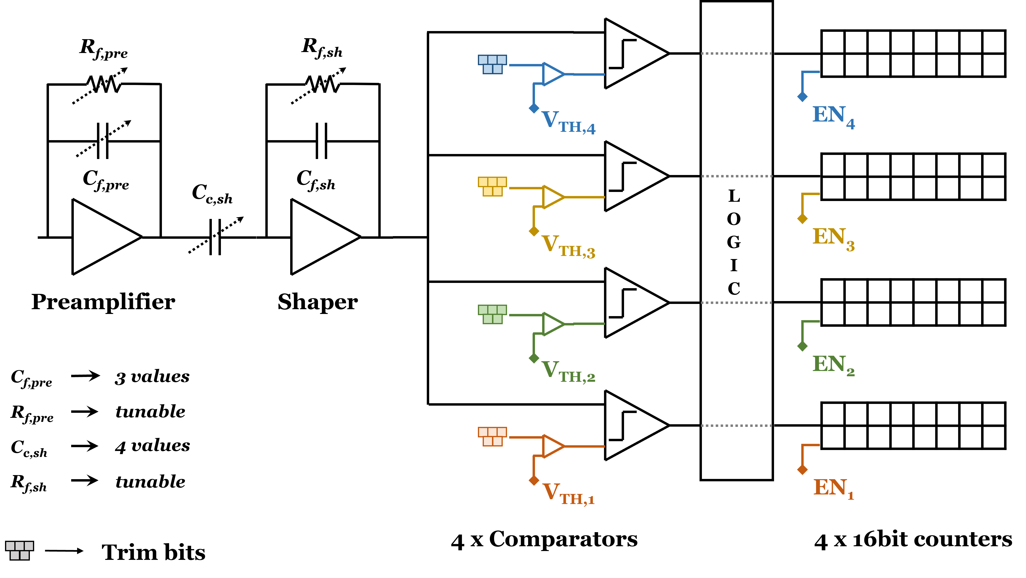
Matterhorn pixel architecture
1)
1)
(Vrf voltage)
Pixel
(Vrfsh voltage)
1)
¹⁾ Both e⁻ and h⁺ readout possible
Static power/pixel (4 comparators) | 9.6μW

Slide 23
Matterhorn pixel architecture
We had problems in UMC110 with small MIMCAPS
We moved to MOMCAPS where possible
1)
1)
(Vrf voltage)
(Vrfsh voltage)
1)
¹⁾ Both e⁻ and h⁺ readout possible
Static power/pixel (4 comparators) | 9.6μW

Slide 24
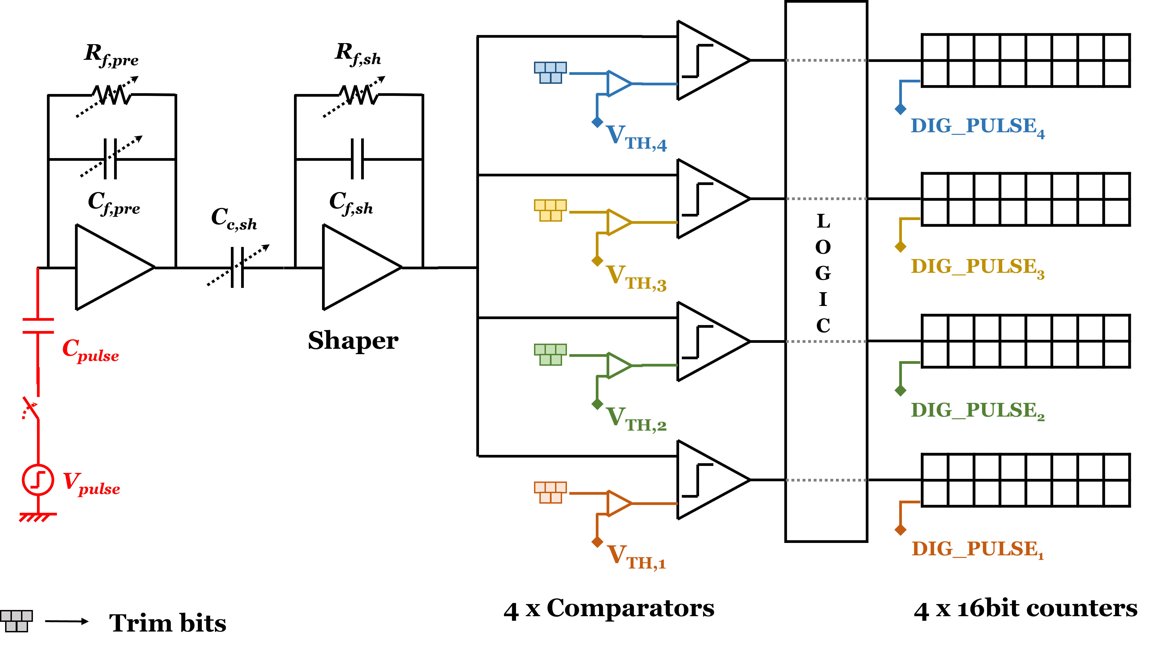
Pixel testability, charge injection
OLD, MH0.2
5)
Cinj
5)
(Vrf voltage)
(Vrfsh voltage)
1)
BOC pulser
⁵⁾ The preamp can be pulsed with a programmable voltage step

Slide 25
Pixel testability, charge injection
NEW, MH1.0
6)
PIX pulser
Cinj
1)
1)
(Vrf voltage)
(Vrfsh voltage)
1)
BOC control
⁵⁾ The preamp can be pulsed with a programmable voltage step
⁶⁾ Each counter can individually be pulsed

Slide 26
Pixel testability, analog out
Differences wrt EIGER:
No per-pixel analog out
Very good buffers
Comp2
Pre
Count2
Shaper
Pre
Shaper
Comp2
Count2
(255,255)

Slide 27
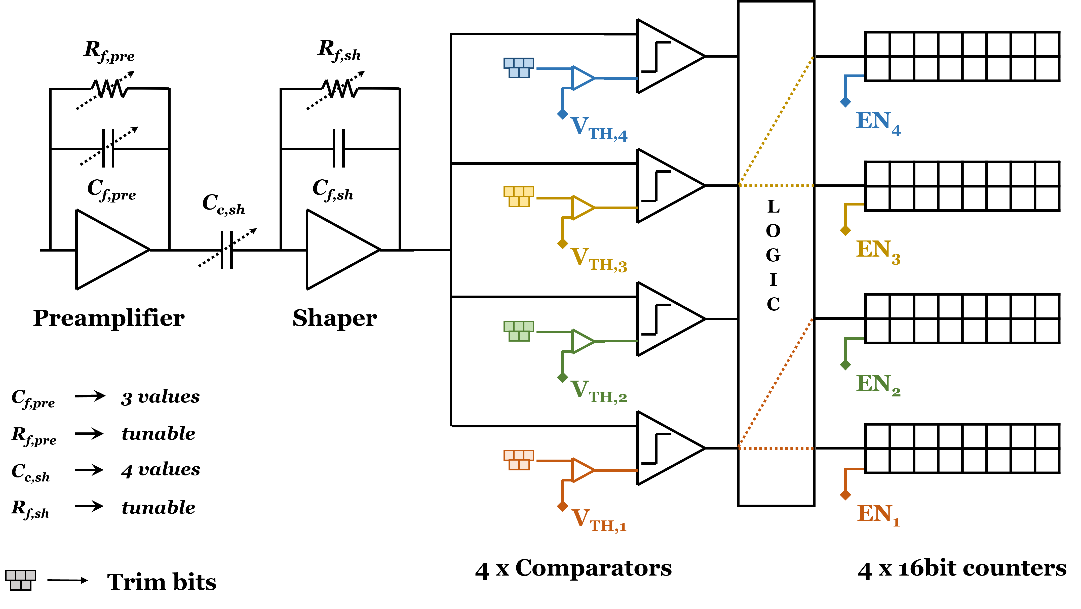
Matterhorn pixel architecture
2)
Pixel
²⁾ One comparator can be connected to two counters (pump-probe)

Slide 28
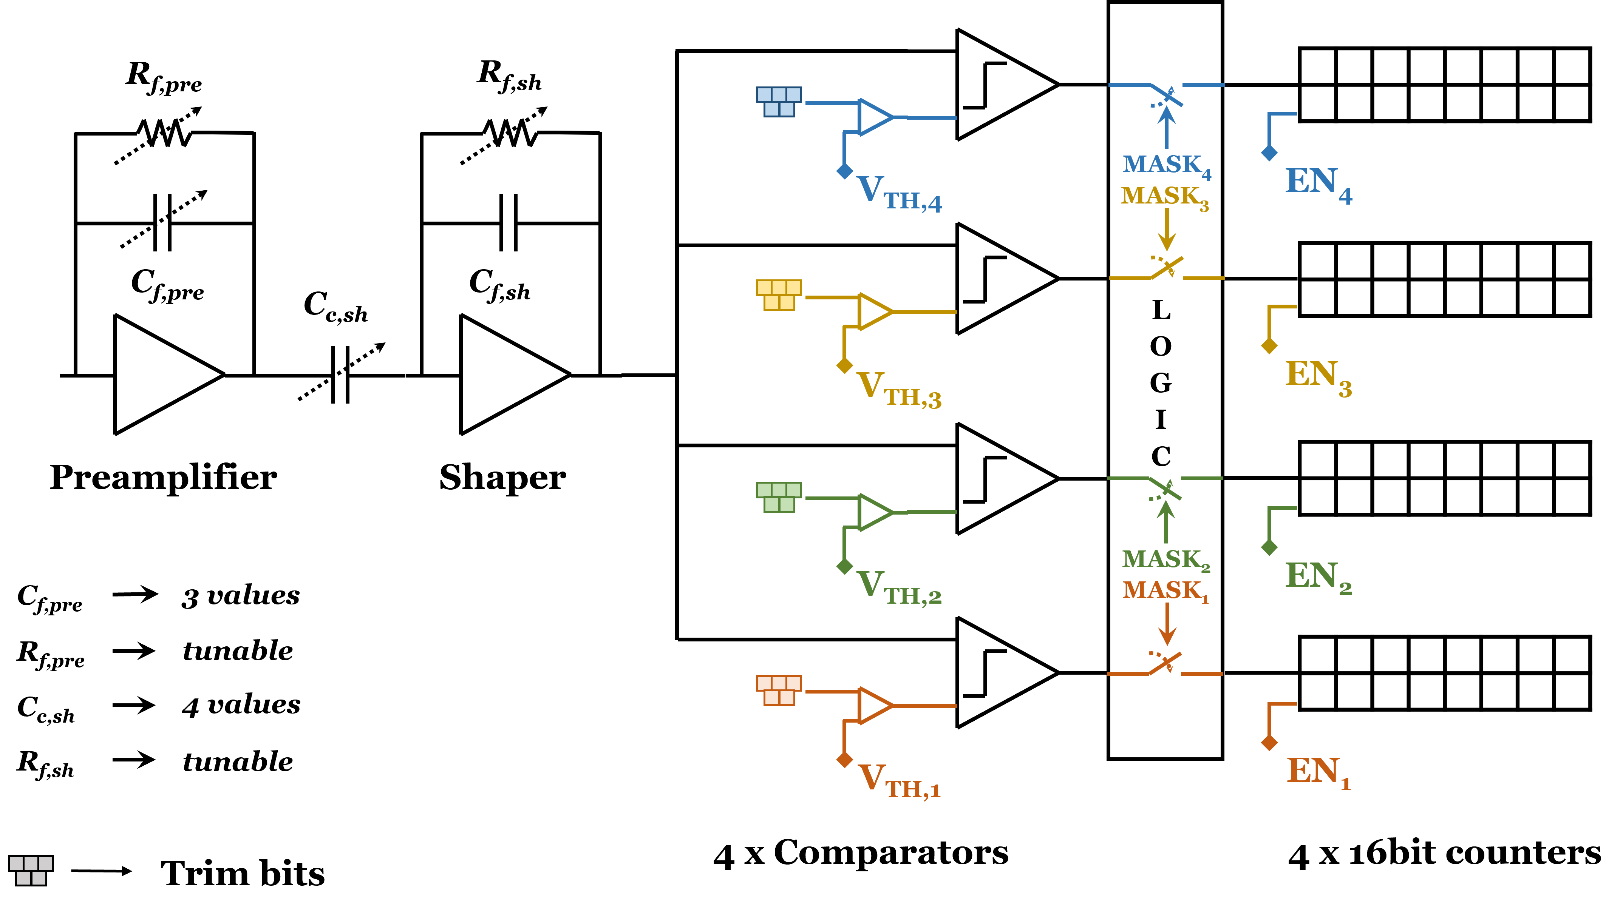
Matterhorn pixel architecture
3)
Pixel
³⁾ Each comparator can individually be ‘masked’ (disconnected from the counter)
→ reduce switching for noisy channels

Slide 29
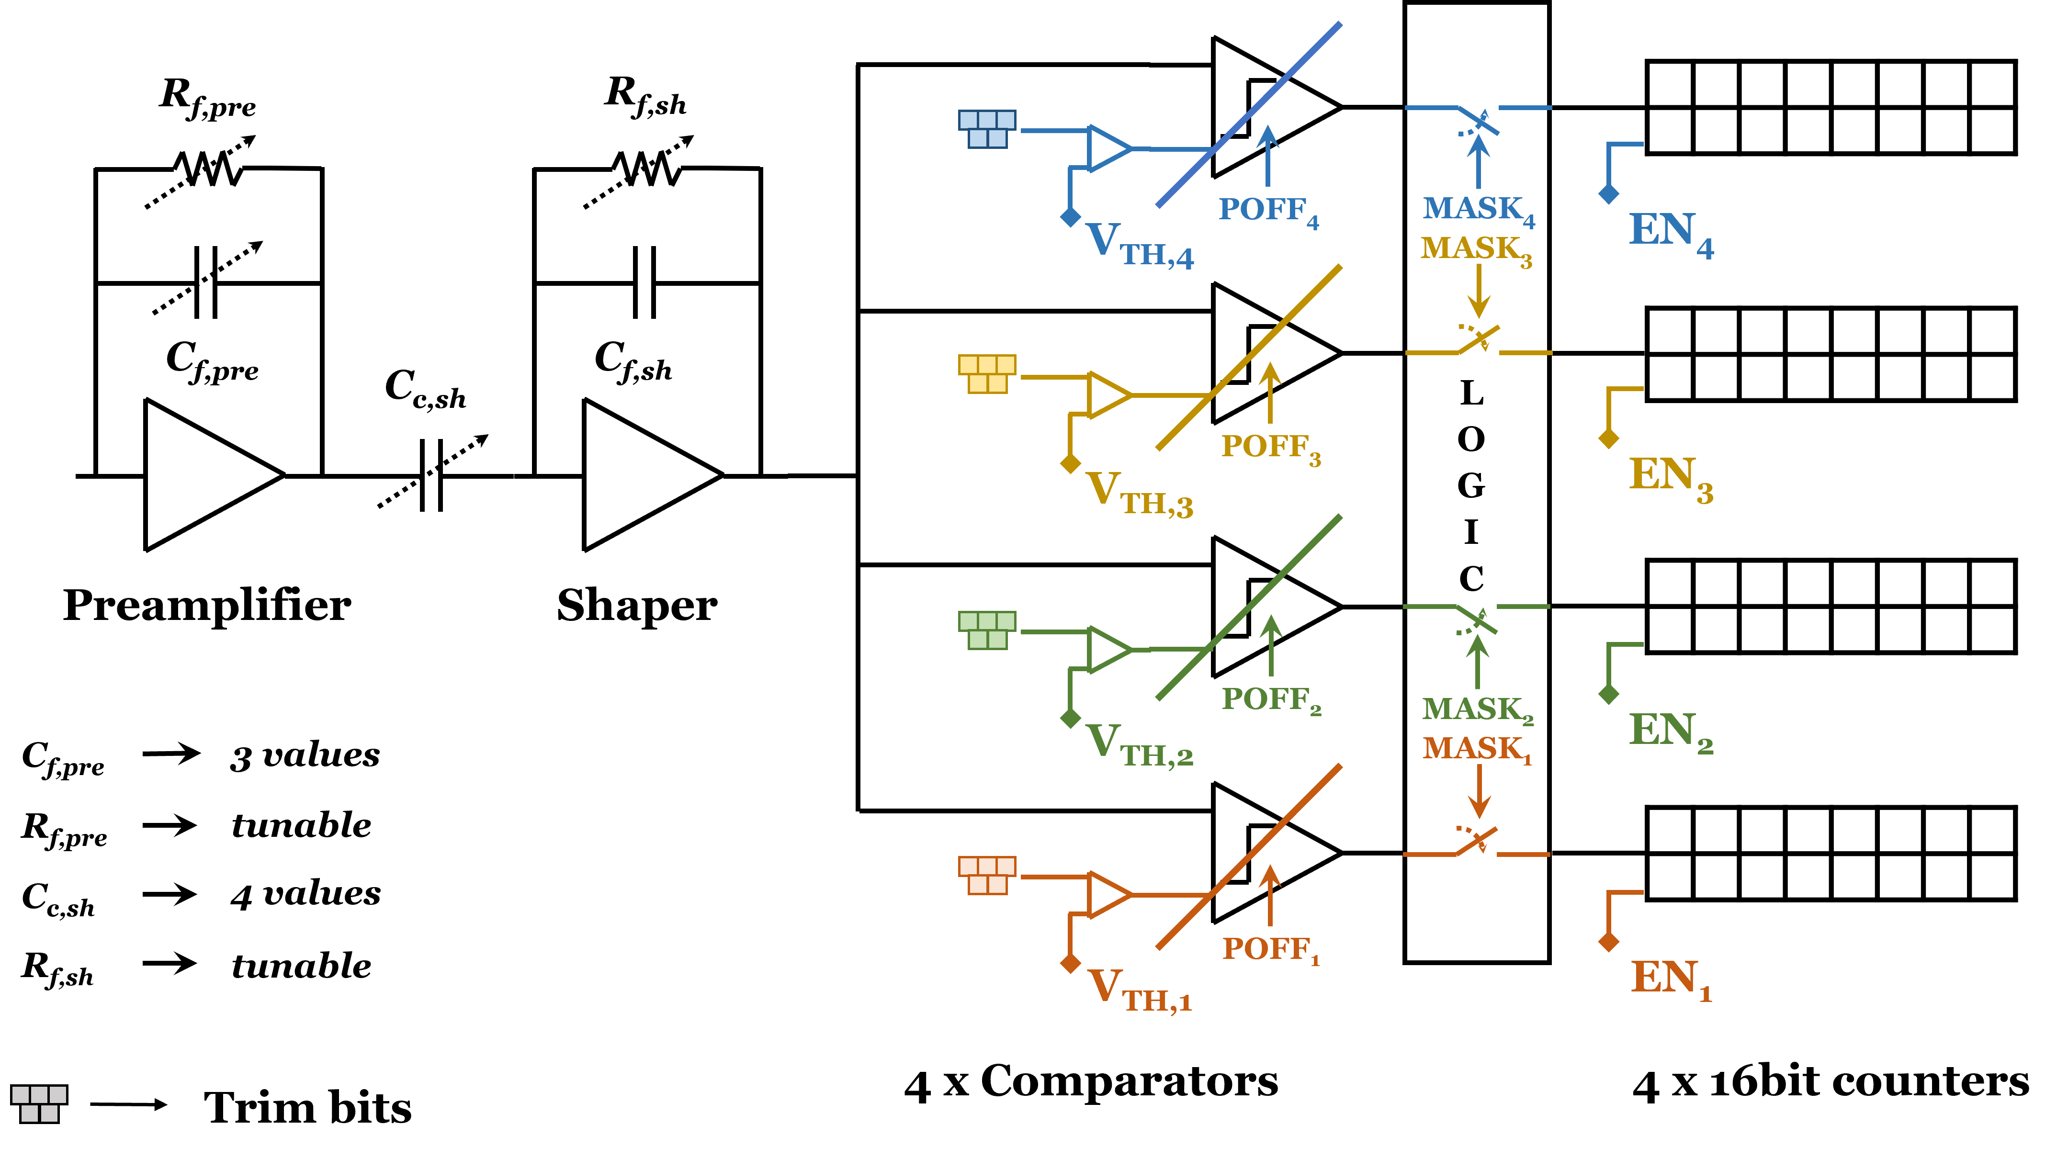
Matterhorn pixel architecture
Pixel
4)
⁴⁾ Each comparator can individually be powered-off when noisy or not used

Slide 30
Matterhorn counters
Counter T- flip-flops
RESET
RESET
T
T
Enable
D
D
STORE
STORE
D- latches for continuous R/W
Very dense full custom layout with 0.87 transistors/um2 (physical dimensions)
(EIGER: storage on MIMCAPs to save silicon area)
All logic on Triple Well to reduce D/A crosstalk

Slide 31
Matterhorn 1.0 counters readout
D- latches for continuous R/W
I_{pixel}
Column Data Bus
16 lines
D
STORE
ROW SELECT
Same concept as EIGER but:
Tunable I_{pixel}
New current comparator
1024x Current comparators
MH0.2: Voltage readout
MH1.0: current readout
Chip digital periphery

Slide 32
Periphery blocks
PLL
Locking range: 930 MHz ÷ 2600 MHz
Power: 18 mW
Jitter < 5 ps
All biases available on internal DACs (or self bias)
Transistor threshold monitor
Ring oscillator
Some critical biases also available from on-board DACs
4 separated comparator biases

Slide 33
Periphery blocks
Pixel & counter selector
Counter summing mode
SPI interface for configuration/slow control
RESET, STORE flexible global distribution
Very high speed ENABLE (gating) distribution
CML driver
Main driver and pre-emphasis current tunable (3 bits): 3 mA ÷ 15 mA
Pre-emphasis delay tunable (2 bits)
Pixel/counter readout logic (includes 16,8, 4 bit mode)
64/66b Aurora encoding
4xHigh speed serializers @3.125MHz
NO logic on the chip sides
How many columns at the same time and delay are selectable
Targeting 20ns distribution delay for pump-probe/hybrid SLS mode
All periphery logic synthesized with digital tools for the first time!

Slide 34
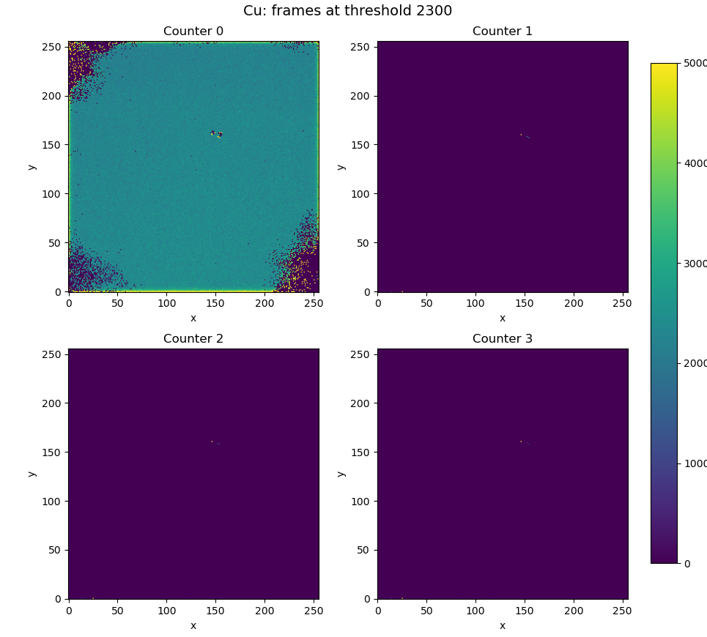
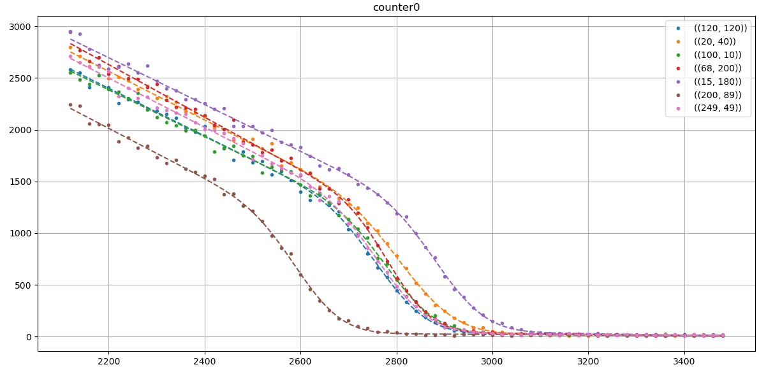
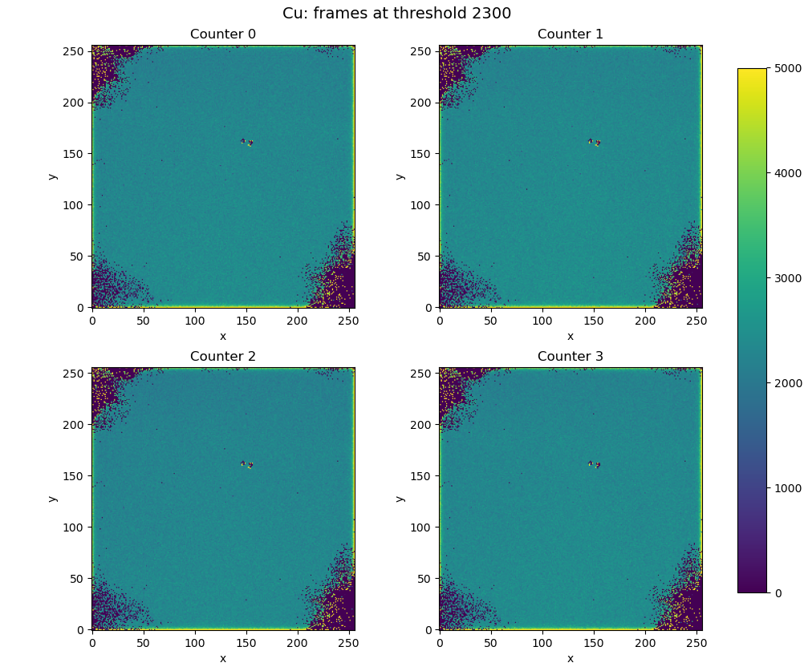
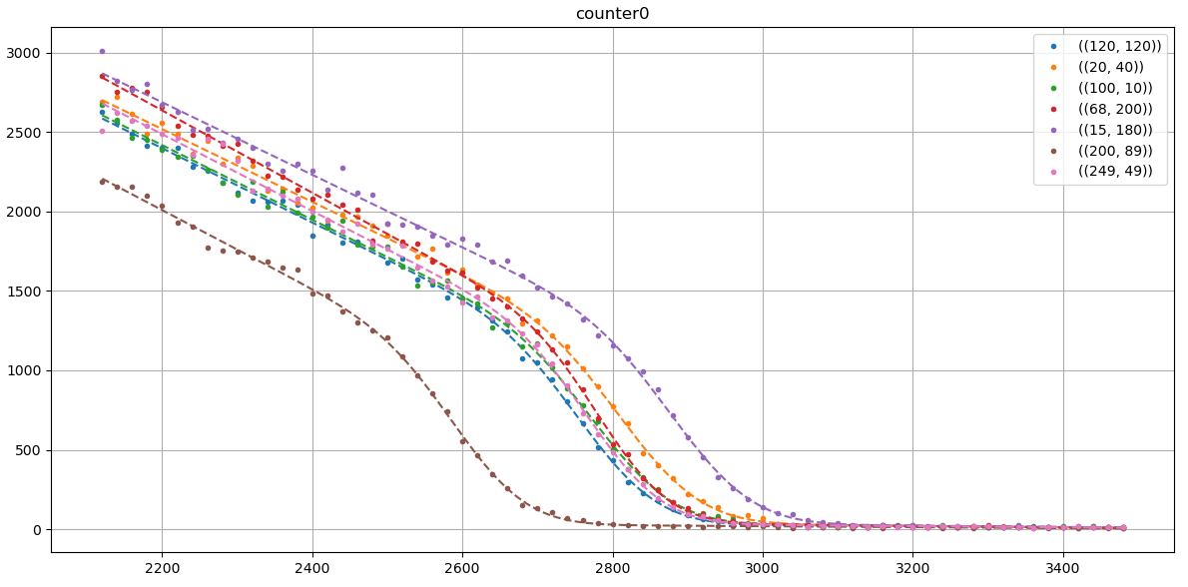
Single pixel S-curves
MH1.0
Counter0
Default settings
(Vrf=990DAC#)
Cu fluorescence
All counters enabled but cnt1,2,3 at 4095 DAC
All counters scanned

Slide 35
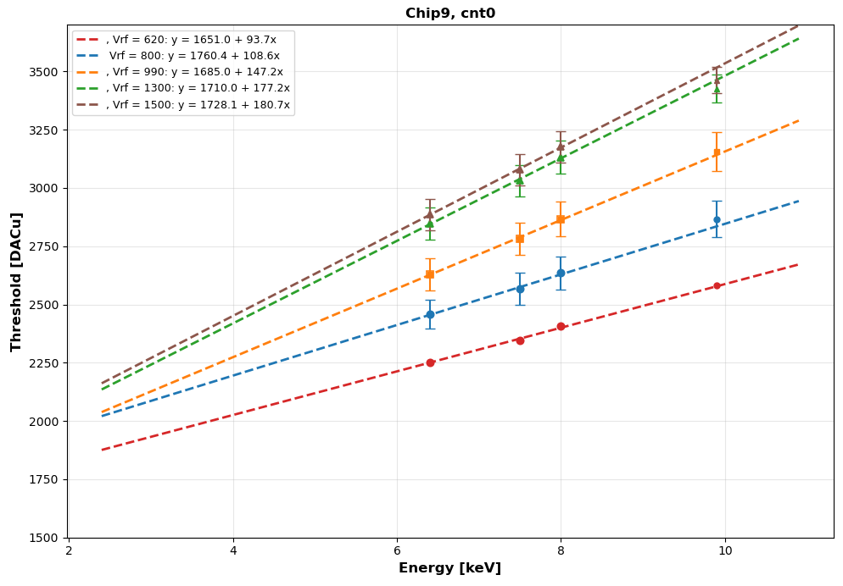
Threshold energy calibration
MH1.0
Counter0
Default settings
(Vrf=990DAC#)
Multiple fluorescence targets
All counters scanned

Slide 36
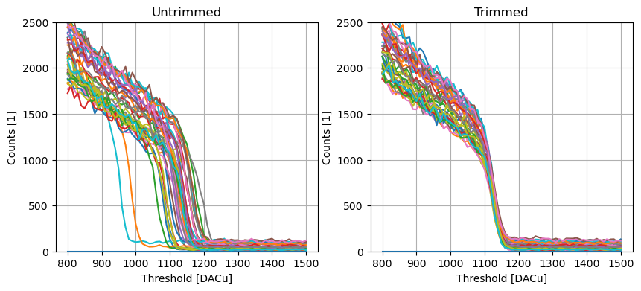
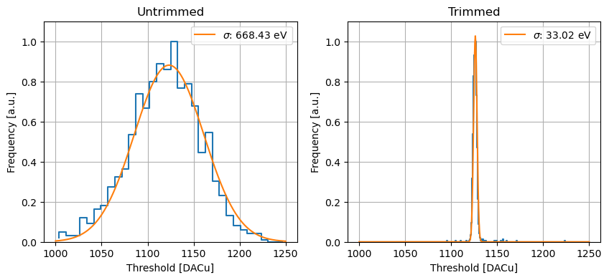
Threshold dispersion at 9 keV
MH0.2
vrf | Untrimmed [eV] | Trimmed [eV]
200 | 998 | 59
300 | 905 | 43
400 | 668 | 33
500 | 477 | 29
130e-
8e-
:16 to 20
Small chip (48x48 pixels)
Non optimized trimming procedure
Trimming on inflection point

Slide 37
Threshold distribution
MH1.0
Defective columns
Sigma before trimming:
~130e-
Default settings
Low- noise
settings

Slide 38
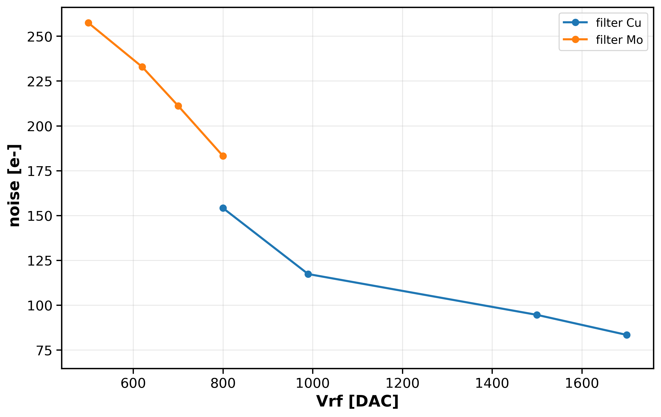
Noise performance
MH1.0
Counter0
Default settings
(but Vrf scanned)
Cu+Mo fluorescence
Molybdenum fluorescence
Copper fluorescence
fast - slow
DAC units are different in MH1.0 and MH0.2

Slide 39
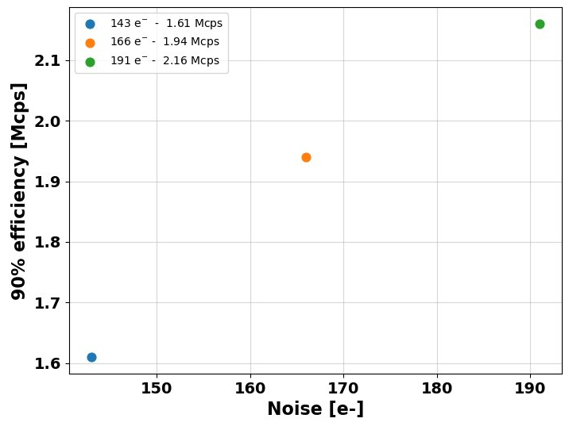
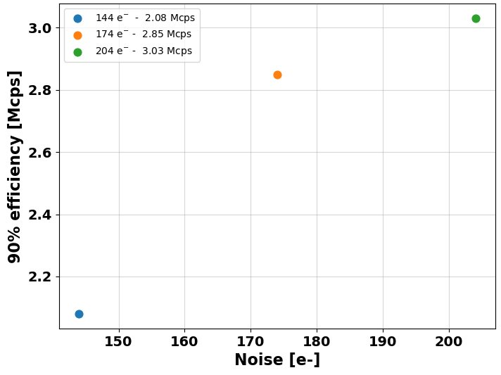
Effect of Icomp on detected incoming rate
MH0.2
Single counter
Counter0
Default settings
(but Vrf scanned)
Beamtime at PSI
Icomp Default (1200 DAC)
Icomp 3x (2495 DAC)
1.4x
τ=18.7ns
1.45x
1.3x

Slide 40
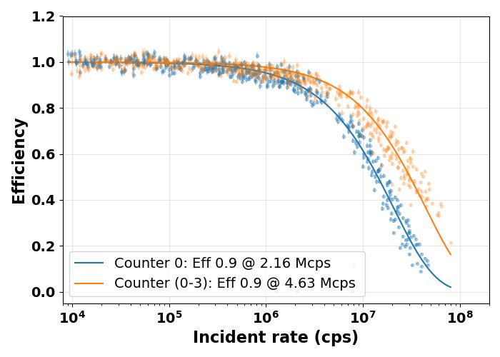
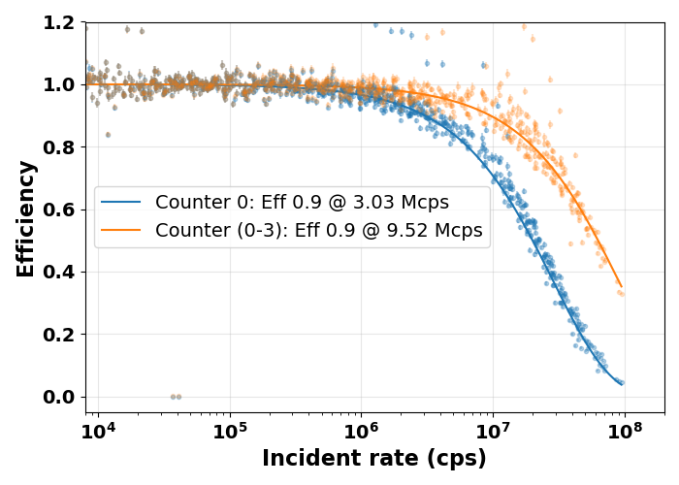
Multi-threshold rate tests at PSI with MH02
MH0.2
E=12 keV
Vicomp 1200 DAC (1x current)
Vrf 200 DAC
Vicomp 2495 DAC (3x current)
Vrf 200 DAC
x3.1
Fits: paralyzable model
Fits: paralyzable model
x2.1

Slide 41
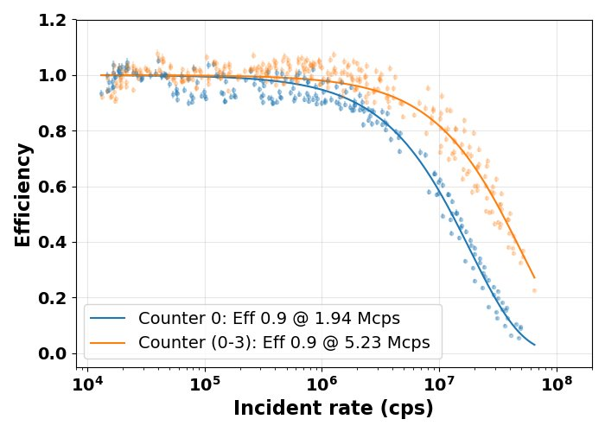
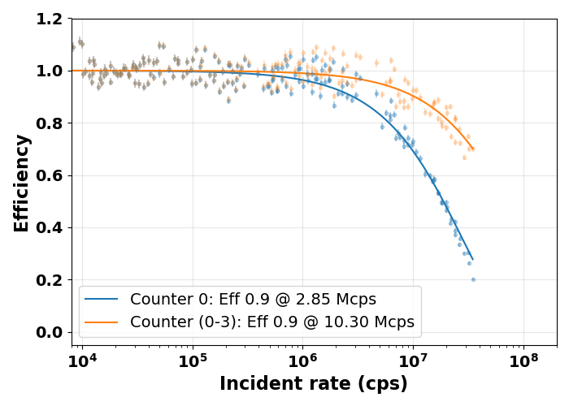
Multi-threshold rate tests at PSI with MH02
MH0.2
E=12 keV
Vicomp 1200 DAC (1x current)
Vrf 300 DAC
Vicomp 2495 DAC (3x current)
Vrf 300 DAC
Fits: paralyzable model
Fits: paralyzable model
x2.7
x3.6

Slide 42
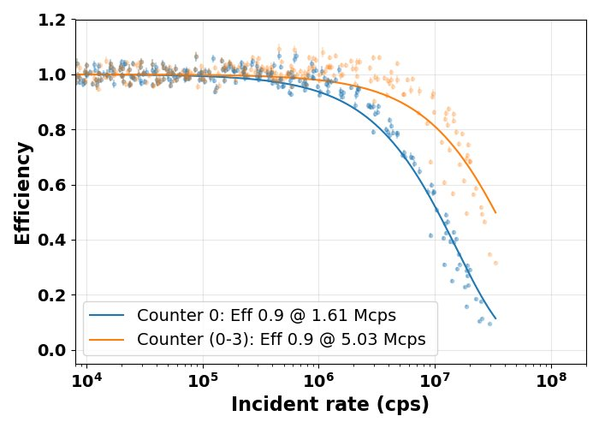
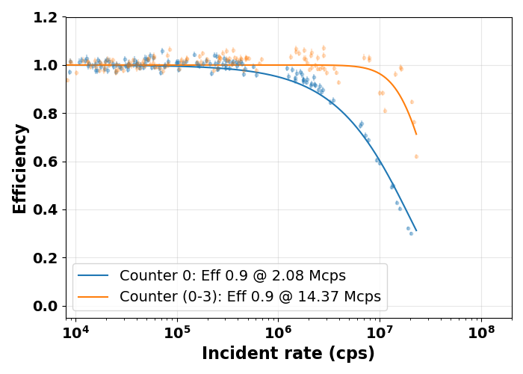
Multi-threshold rate tests at PSI with MH02
MH0.2
E=12 keV
Vicomp 1200 DAC (1x current)
Vrf 400 DAC
Vicomp 2495 DAC (3x current)
Vrf 400 DAC
Fit: paral. model
Fit: paral. model
Fit: paral. model
Fit: sum model
x3.1
x6.9

Slide 43
The “speed challenge”: high frame rate
 | EIGER | MATTERHORN 1
Technology | 250 nm | 110 nm
Chip outputs | 32xCMOS, 200 Mb/s | 4xCML, 3.125 Gb/s
Single chip | 6.4 Gb/s | 12.5 Gb/s
Module (8 chips) | 51.2 Gb/s | 100 Gb/s
Readout channels/module | 2x10Gbit/s | 1x100Gbit/s
Frame rate | ~10 kHz 8bit (burst) | ~20 kHz 8bit (continuous)
Continuous R/W | Yes | Yes

Slide 44

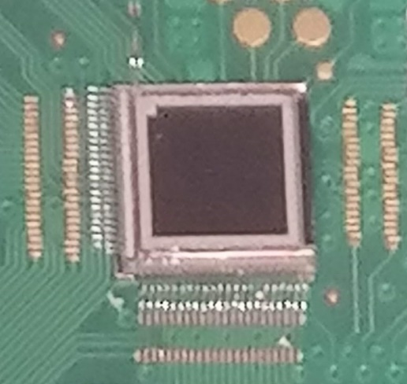
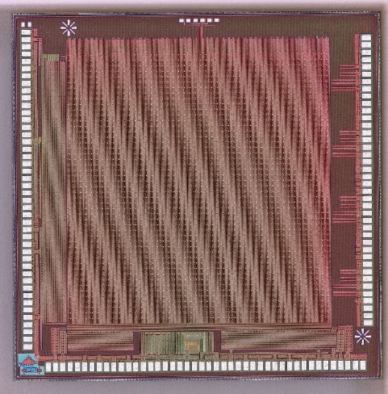

Summary
Matterhorn is a new SPC detector for SLS2.0 targeting:
15-20Mcps count rate with 10% loss of efficiency
250 eV – 80 keV energy range (with LGADs and HighZ)
20kHz frame rate; <20 ns gating
Results from MH01, MH02 and full-size chip MH1.0:
Noise down to <~80e- in slow settings
Demonstrated ~14.4 Mcps at 90% efficiency using multiple thresholds with MH0.2
Tau <20ns in single counter mode
Digital periphery and high speed links working
MH 1.0
~2 cm
MH0.2

Slide 45
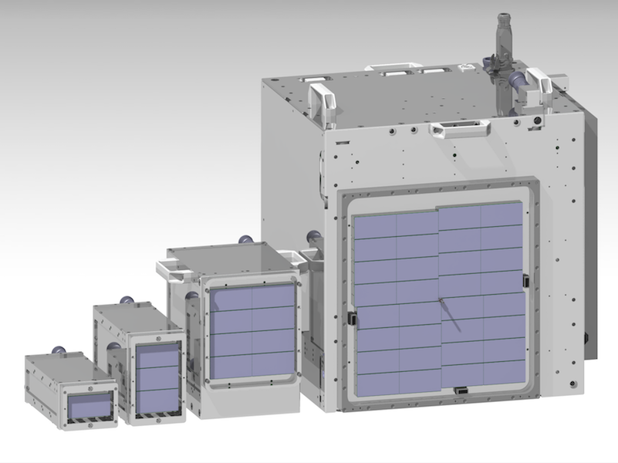
Outlook
Detailed characterization of MH1.0
Rate tests
Parameters optimization
Maximize speed with pile-up counting
I/O speed
Radiation tolerance
High-Z and LGAD integration
Full detector development
Module Q1 2027?
1.5M
4M
16M
500k
JUNGFRAU detectors of different size

Slide 46
THANKS!

Slide 47
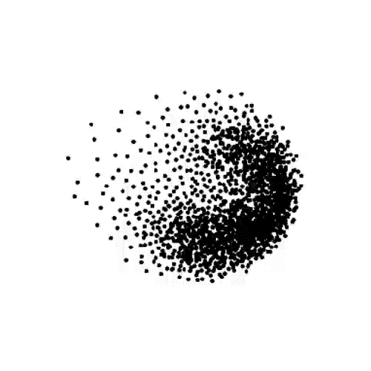

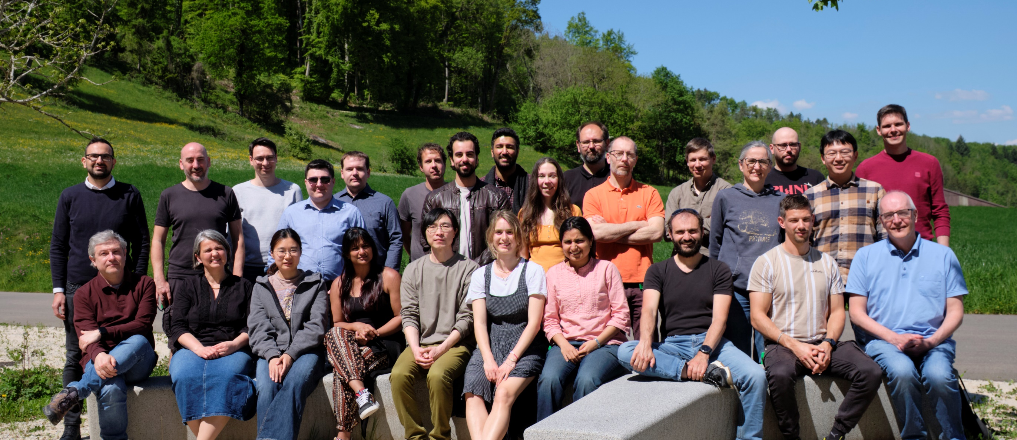
THANKS!
V. Kedych, M. Müller, P. Sieberer, K. Ferjaoui, M. Brückner, E. Fröjdh, J. Heymes, C. Lopez-Cuenca,
K. Moustakas, C. Ruder, J. Mulvey, S. Silletta, V. Hinger, A. Mozzanica, M. Carulla, X. Xie,
R. Dinapoli, A. Bergamaschi, S. Li, D. Thattil, J. Zhang, A. Mazzoleni, V. Gautam, D. Mezza, T. King, B. Schmitt.
Missing: S. Ebner, D. Greiffenberg, S. Hasanaj, S. Emiliani, L. Lunid, S. Moses, M. Anastasi, I. Giannopoulos, M. Huerst

Slide 48
Backup slides

Slide 49
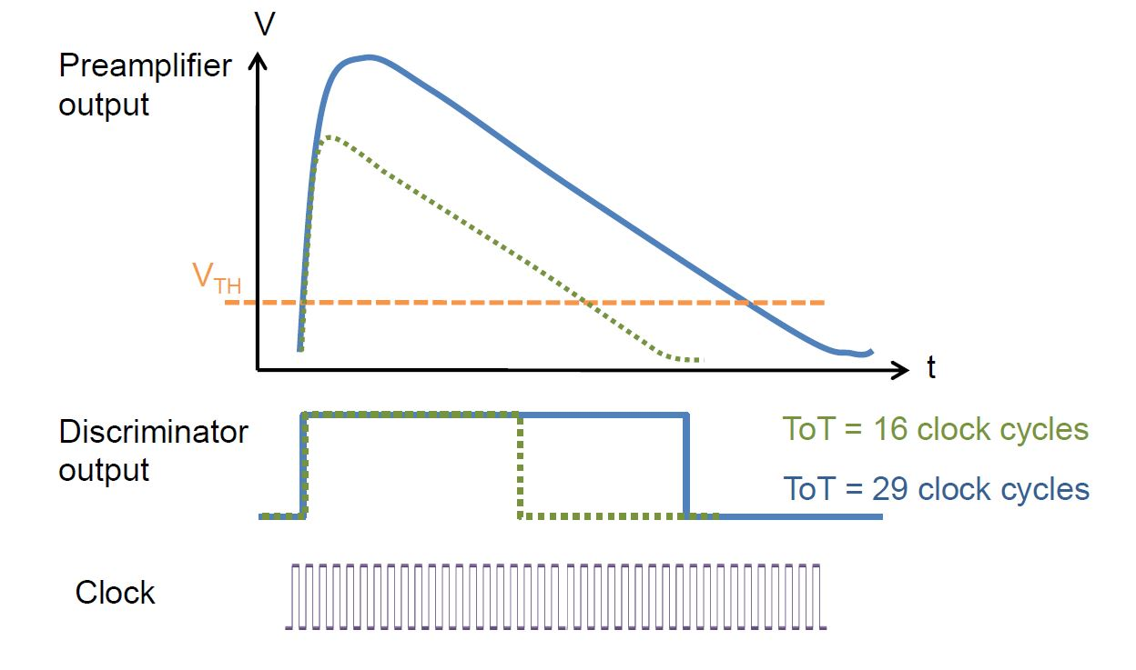
Pile-up mitigation techniques
Use charge integration with dynamic gain switching (Jungfrau, Jungfrau 2)
Time over threshold/retriggering
Credit: R. Ballabriga

Slide 50
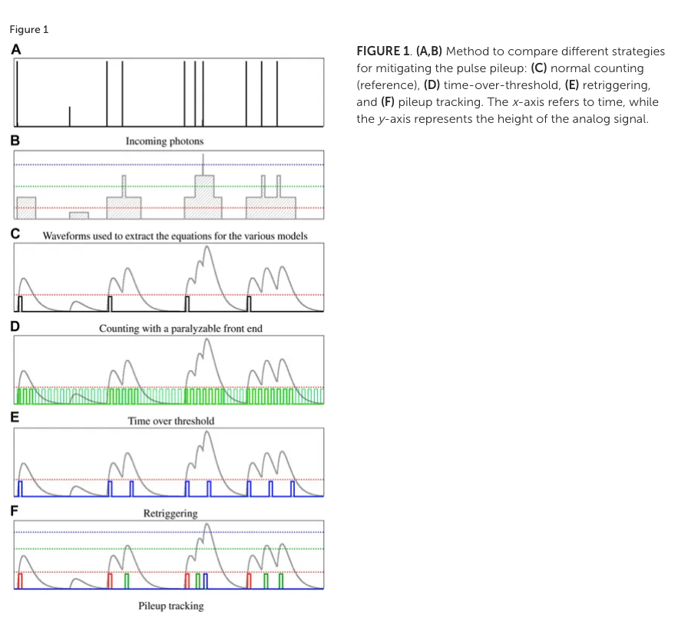
Operating modes of a single photon “counter”

Slide 51
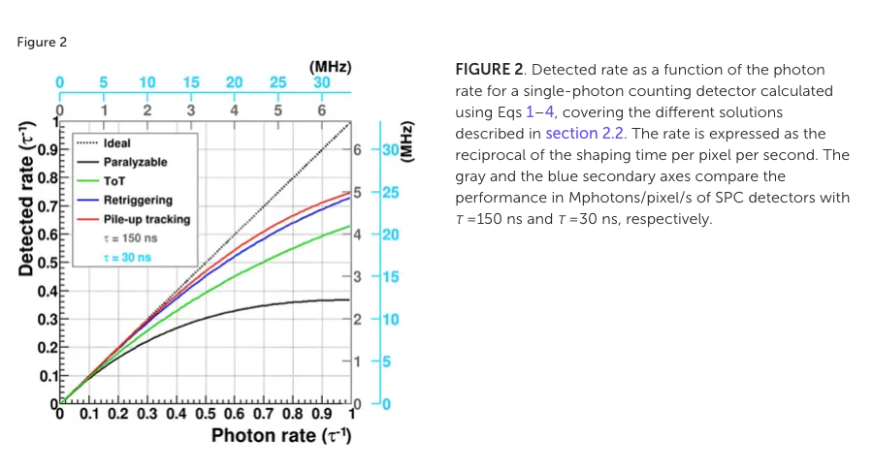
Comparison of pileup mitigation
[1] A. Bergamaschi et. al. Time-over-threshold readout to enhance the high flux capabilities of single-photon-counting detectors J. Synchrotron Rad. 18, 923-929. 2011
[2] P. Zambon, Dead time model for X-ray photon counting detectors with retrigger capability, NIMA 2021

Slide 52
Pixel testability
Pre
Count2
Shaper
Comp2
6)
6)
6)
5)
Pixel
6)
⁵⁾ The preamp can be pulsed with a programmable voltage step
Preamp and shaper outputs of pixel 0,0 can be monitored
⁶⁾ Each counter can individually be pulsed
Comparator and “count” outputs of pixel 0,47 can be monitored

Slide 53
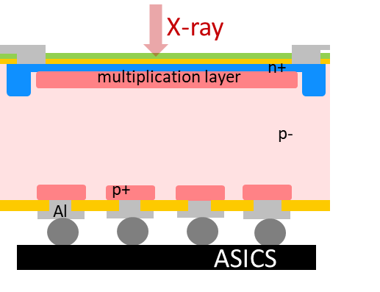
The «energy challenge»: low photon energies
Soft X-ray applications at SwissFEL and SLS (250 eV – 2 keV)
Low quantum efficiency (QE):
Development of “thin entrance window” sensor
Low signal-to-noise ratio (SNR):
Increase the signal with inverse Low Gain Avalanche Diodes (iLGADs) with a multiplication factor 5-20
Results: 80 % QE for a planar pin diode @250eV
Results: nominal noise of 35 e⁻ with standard sensor at RT down to 3.7 e⁻ at -22 ºC with Moench

Slide 54
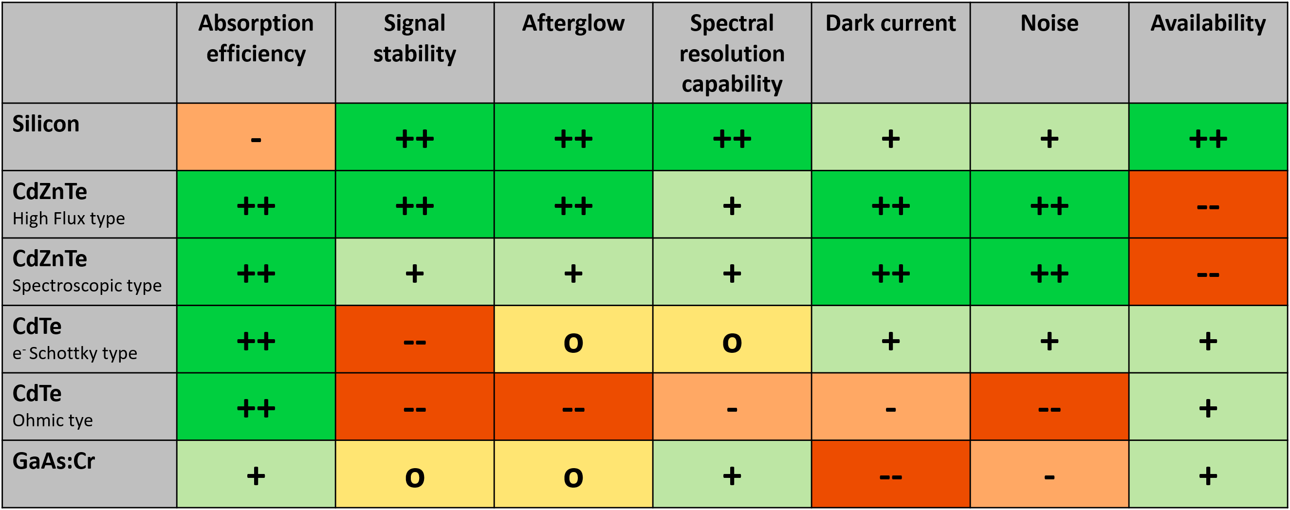

The «energy challenge»: high photon energies
Hard x-ray applications at Synchrotrons, 15-80keV
CdZnTe is the material of choice above 15 keV
4×4 cm² sensor commercially available
Dynamic behavior (signal stability, afterglow) close to silicon sensors
Higher photon energies need to be studied
Crystal defects influence sensor uniformity
Fluorescence photons with long absorption range
GaAs:Cr is promising, but doesn‘t perform as well as CdZnTe
Two European suppliers, 8×4 cm² sensors available
○ Afterglow acceptable up to photon fluxes
 Continuous: <10⁽⁸⁻⁹⁾ ph/mm²·s  Pulsed: <10⁽⁶⁻⁷⁾ ph/mm² ·pulse
Some signal loss at photon fluxes above > 3×10¹⁰ ph/mm²·s
Crystal defects influence sensor uniformity, variation of effective pixel size + Short hole lifetime  Craters
High dark current  For long exposure times: ideally SPC

Slide 55




Timeline
Move to new building
SLS2.0
Second prototype (MPW) Submitted
Single module detectors?
Matterhorn
Full ASIC submission
Multi module
detectors
First prototype submitted (MPW)
First prototype back!
Planned submission
of third prototype
Second prototype back!

Slide 56


Slide 57
Default settings:
For Mh02 , external DACs: 400 DAC. For Mh10, internal DACs: 990 DAC

Slide 58




Basic characterization of MH02
Metrologie beamline at SOLEIL with help from: Marie Andrä and Arkadiusz Dawiec
Calibration at: 7, 9, 12, 15 keV
Threshold scans fitted with analytical model:
$f\left(x\right)=\left(p_{0}+p_{1}x\right)+0.5\left(1+Erf\left(\frac{x−μ}{\sqrt{2}∙σ}\right)\right)\left(A+C\left(x−μ\right)\right)$
Single pixel data

Slide 59

Four counters scan
MH 0.2
Scanned at the same time

Slide 60


Noise performance of MH02
Preamplifier feedback voltage
(gain)
fast - slow

Slide 61


Single counter rate tests at MS beamline - MH01
Measurement
Predicted rate capability using analytical model

Slide 62


Single counter rate tests at MS beamline – MH01
Note: slightly over estimated due to kB peak

Slide 63

Single counter rate tests at MS beamline – MH01
Noise vs. rate capability
E=12 keV

Slide 64

Multi threshold rate tests at SOLEIL with MH02
Counter 0
x6
Sum counter 0-3

Slide 65

Multi threshold rate tests at SOLEIL with MH02
Counter 0
x6
Counter 0
x3
Sum counter 0-3
Sum counter 0-3
Note: fitted with simple paralyzable function

Slide 66
Multi threshold rate tests at SOLEIL with MH02
Counter 0
x6
Counter 0
x3
Sum counter 0-3
Sum counter 0-3
Comparator biased in “low power” mode
Vrf can be set even lower (100-150)
Preamp/shaper biases can be further tuned

Slide 67

Trimming with noise (very preliminary)
counts
MH1.0
Default settings
(Vrf 990 DAC#)
Noise peak, NOT threshold distribution
Noise peak moves quite linearly with TB value

Slide 68

Trimming with noise (very preliminary)
MH1.0
counts
~110e-
:9
Default settings
(Vrf 990 DAC#)
~12e-
130/9<15e-
Noise peak, NOT threshold distribution
Full chip (256x256 pixels)
Non optimized trimming procedure
Trimming on noise

