Slide 1
Radiation Hard Embedded Field Programmable Arrays
Are eFPGAs of any Use for High-Energy Physics?
21th of May 2026 XIII Front-end Electronics Workshop Paris
Michael Karagounis Department of Electrical Engineering University of Applied Sciences and Arts Dortmund

Slide 2
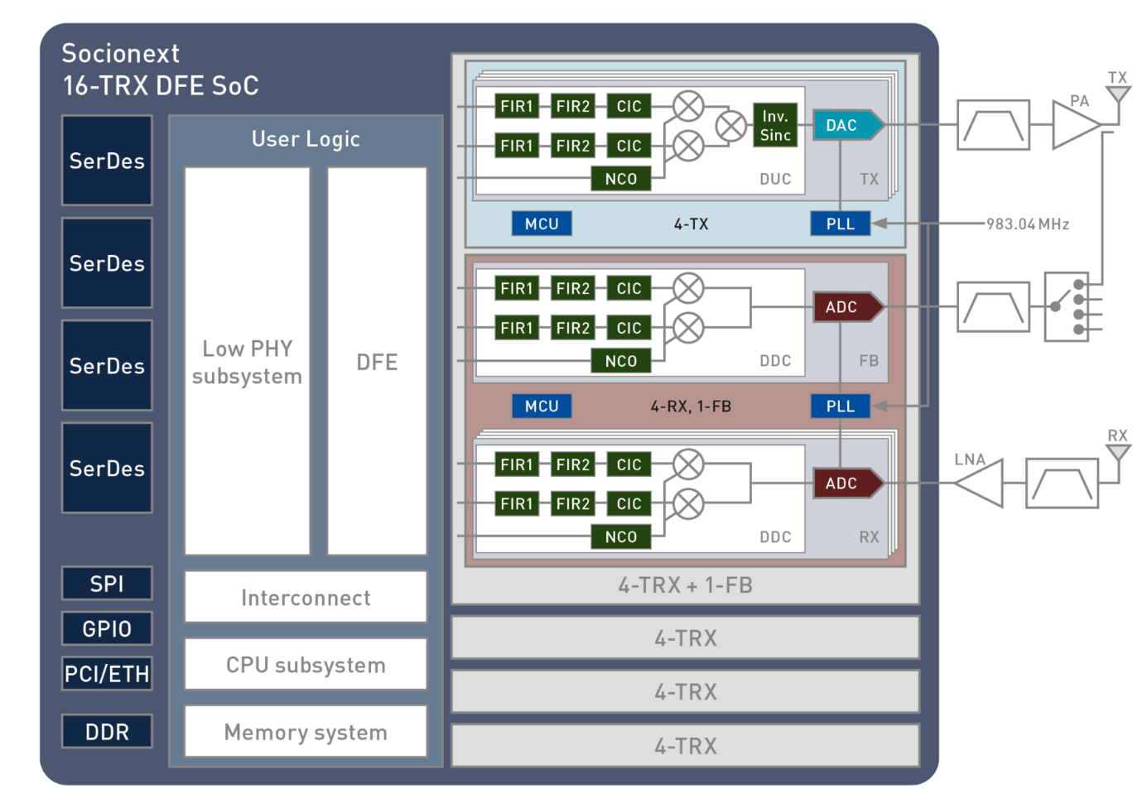
Exemplary commercial chip with integrated eFPGA
Socionext 7nm ASIC
5G wireless base‑station chip
eFPGA replaces discrete FPGA
Allows for system complexity reduction
Less power consumption by getting rid of high-swing off-chip communication
Allows adaption to new standards and protocols
Meet high throughput requirements by massively parallel deterministic hardware data paths

Slide 3
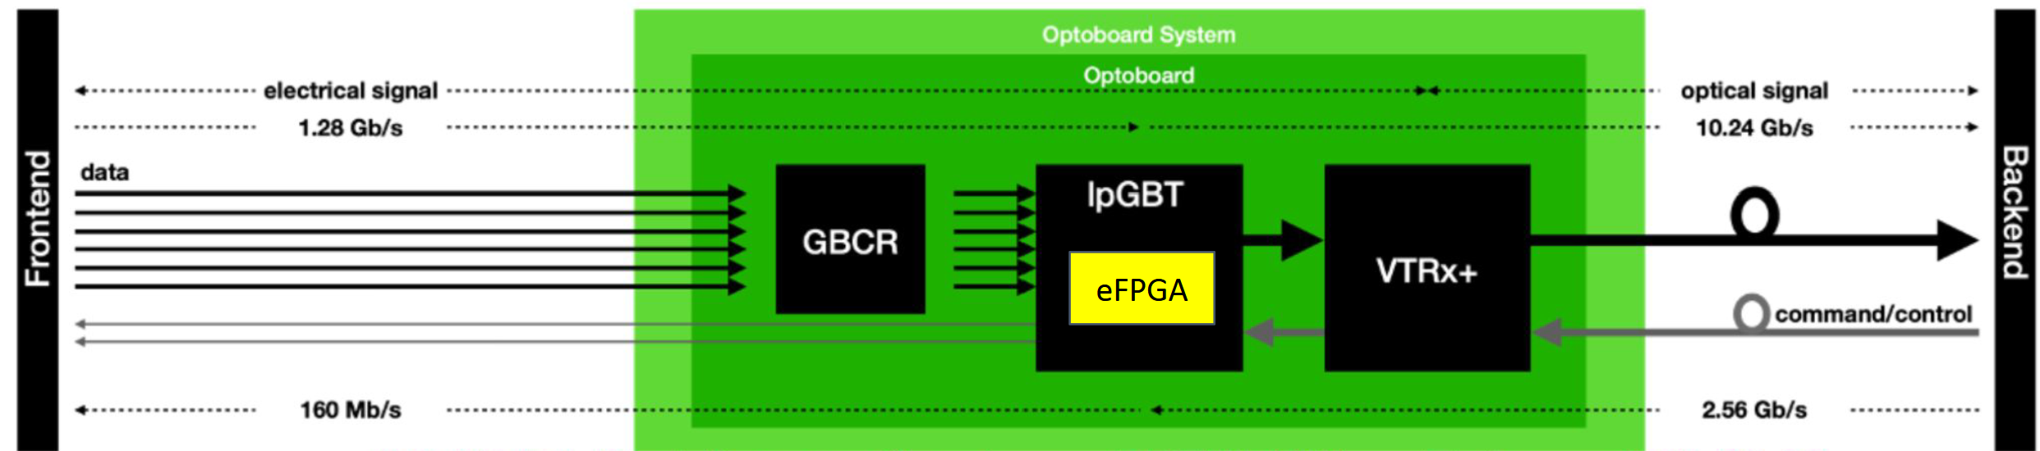
Potential Applications of eFPGA in HEP
Joram, Christian, et al. Extension of the R&D; Programme on Technologies for Future Experiments. No. CERN-EP-RDET-2023-001. 2023
„Possible applications for such a technology might lie within reconfigurable trigger and data processing ASICs and in the domain of communications, data concentrator chips comparable to the current lpGBT ASIC“
J. Gonski, R. Bartoldus, R. Herbst, H. Kim, L. Ruckman, C. Grace, J. Johnson, K. Hatakeyama, J. Wilson, J. Hoff, N. Kharwadkar, K. Yoshihara, J. Zhu, Embedded FPGAs for Reconfigurable ML in Future HEP Detectors, FCC EOI, 2025
Applications of eFPGAs range from front-end readout, where machine learning at the data source can enable compression or feature extraction to mitigate the transferred data rate, to their use as hardware accelerators, which can significantly reduce the power consumption and cost associated with large offline processing tasks.

Slide 4
General Motivation
State of the art methodology in HEP is based on hardwired non-programmable logic
Advantage
optimized hardware for specific application case
High resource efficiency in terms of power and area consumption
Disadvantage
time consuming
Verification always the bottleneck in academic design projets
no flexibility
bug fixes require design iteration
reuse of chips in different projects and applications difficult
Microcontroller Cores
Allow more complex and more flexible on chip routines than FSM
(Embedded) FPGA / Programmable Logic Array IP
allow reprogramming/reconfiguration of logic for bugfixes and project adaption

Slide 5
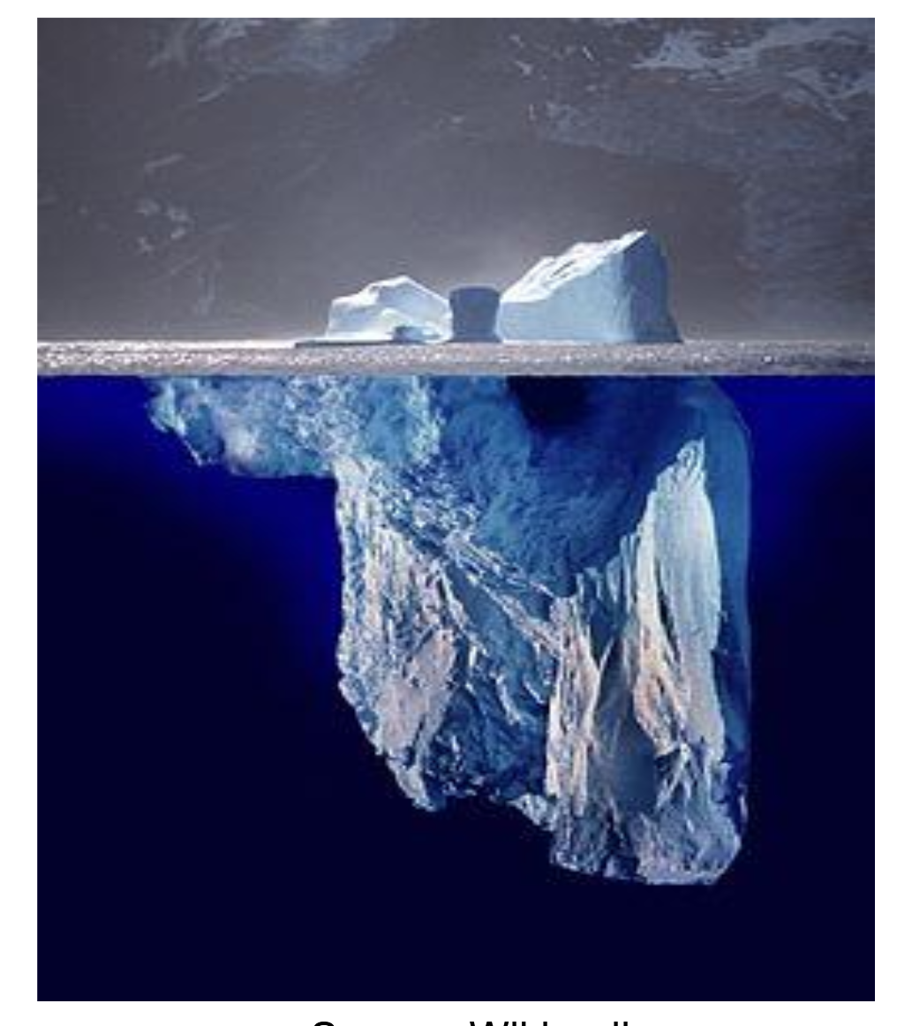
Reconfiguration Overhead
Reconfigurability in FPGAs introduces substantial overhead compared to ASIC implementations typically
10–40 × in area
10–100 × in power
3–10 × in delay
(I. Kuon and J. Rose, “Measuring the Gap Between FPGAs and ASICs,” in Proc. ACM/SIGDA Int. Symp. on Field Programmable Gate Arrays, Monterey, CA, USA, 2006, pp. 21–30)
Dirk Koch: “You think you buy logic,
... but you pay for the routing”

Slide 6
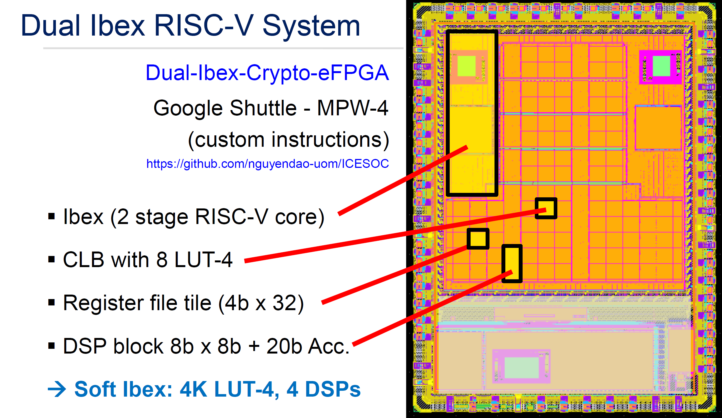
Example Design generated with Faboulous
Courtesy from Dirk Koch

Slide 7
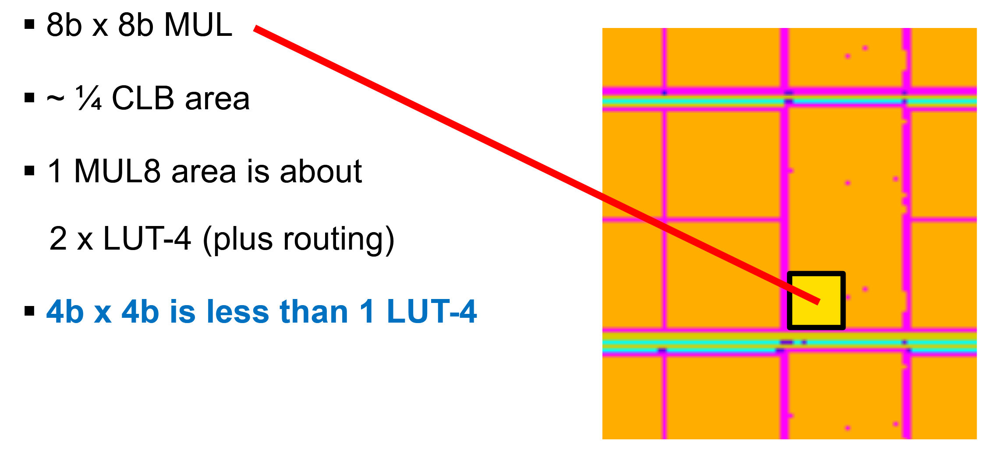
Area Efficiency Increase by DSP block
Implementing an 8x8 multiplier in the FPGA fabric would consume 25-80 of the 4-LUT blocks depending on FPGA architecture and design optimization grade
Courtesy from Dirk Koch

Slide 8

Look-Up Table Implementation
A Look-Up Table (LUT) is a memory array with a word width of 1 bit
Configuration writes a bit pattern into the memory array to implement a logic function
The LUT input is used as an address to readout the respective bit by means of multiplexer
LUTs with k inputs have $2^{k}$ bits which can store $2^{k^{k}}$ different bit patterns/logic functions
Trade-off between number of required LUTs and efficient LUT usage
Config Bus
Logic Element
0
0
0
0
0
0
0
1
AND3
A | B | C | Y
0 | 0 | 0 | 0
0 | 0 | 1 | 0
0 | 1 | 0 | 0
0 | 1 | 1 | 0
1 | 0 | 0 | 0
1 | 0 | 1 | 0
1 | 1 | 0 | 0
1 | 1 | 1 | 1

Slide 9
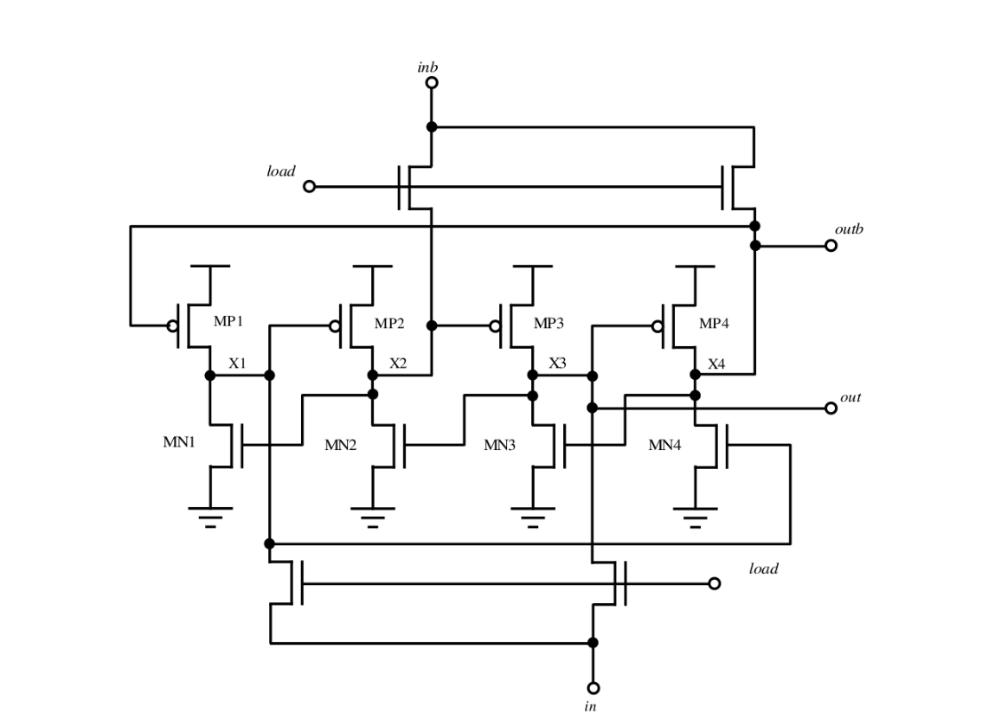
Measure for Radiation Hardness Dual Interlocked Storage Cell (DICE)
Usage of DICE cells in LUT memory
0
0
1
1

Slide 10
SEE Mitigtation: Dual Interlocked Storage Cell (DICE)
1
1
0
0

Slide 11

SEE Mitigtation: Dual Interlocked Storage Cell (DICE)
1
0
0
0

Slide 12
SEE Mitigtation: Dual Interlocked Storage Cell (DICE)
Limitations
Nodes need sufficient spacing ~ µm
Cell requires careful “analog” design
Integration of custom cell into digital flow
1
0
0
1

Slide 13
SEE mitigation: TMR protection of LUT memory
Limitations
Instances need sufficient spacing ~ µm
LUT memory overhead by 5
Nees feedback path to avoid bit error accumulation
No protection in user logic

Slide 14
SEE mitigtation: LE with hard wired Full Scale TMR
Advantage
Protects config memory and user logic
Limitations:
Overall overhead increase by factor 5x
Errors in LUT memory may accumulate

Slide 15
SEE mitigation: ECC of LUT memory in user path
Advantage
Less area overhead than TMR
Limitations:
additional time delay in user path
access to all LUT memory bits required
Nees feedback path to avoid bit error accumulation
No protection in user logic
Parity bits

Slide 16
SEE mitigation: ECC of LUT memory in config path
Advantage
No additional delay in user path
Less area overhead than TMR
scrubbing mitigates error accumulation
Limitations:
Bidirectional config bus required
(also of for partial reconfiguration)
Continuous scrubbing increases power consumption
No protection in user logic

Slide 17
Routing Architecture
Most common approaches:
hierachical tolpology
improves local speed but introduces mapping inefficiency and significant delay penalties when signals cross hierarchy levels.
island topology with switching and connection boxes
avoids mapping constraints and delay penalties across levels, but pays with a larger and more power-hungry routing fabric
Connection box with Wilton topology
maps tracks using direction-dependent cyclic index permutations i,i+1,i−1 mod(W) to improve routability.(W number of channels)
enables full directional flexibility when signals traverse multiple switch boxes.

Slide 18
Routing Circuits and Wires
routing switches are implemented as:
Transmission Gates
enable dense and flexible routing
suffer from accumulation of RC delay
Tristate Buffers
Improve signal integrity and long-distance driving performance
have increased area and power.
routing is implemented with a variaty of wire length
short wires
Increase granularity and flexibility
incur high delay due to many switch elements in series
increases the overall probability of radiation-induced failures.
long wires
reduce delay
limit routing flexibility

Slide 19
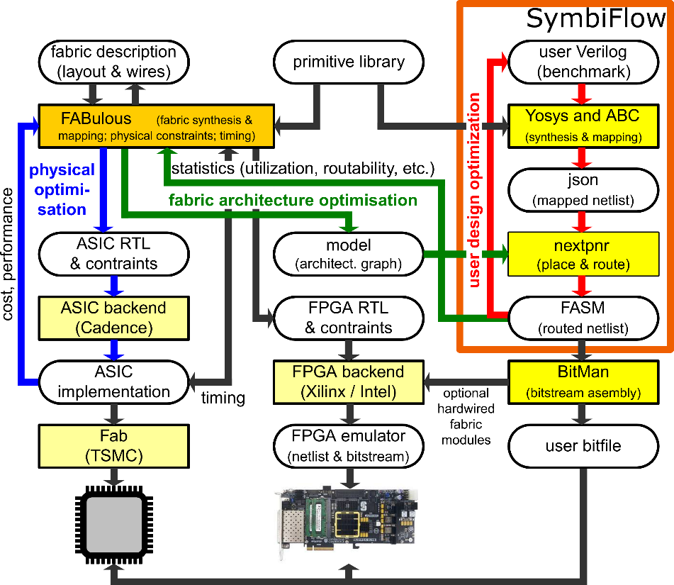
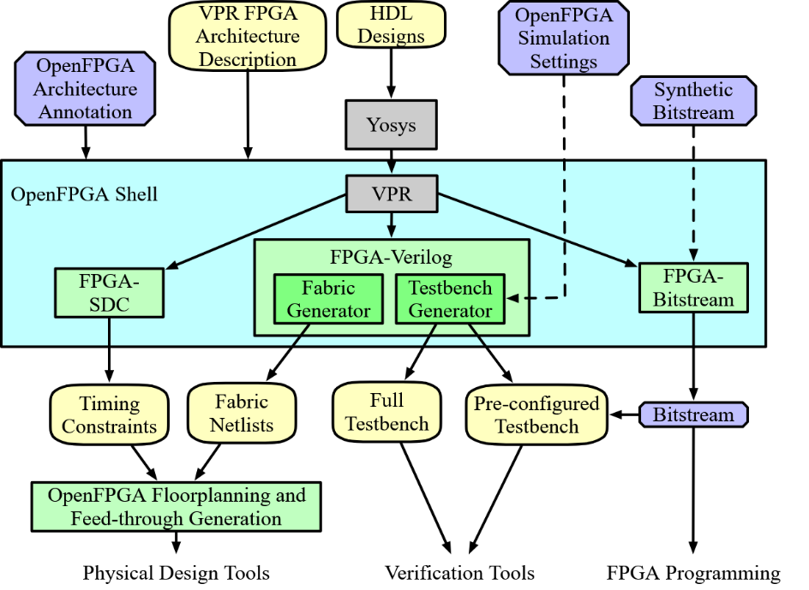


Open Source eFPGA flows
openFPGA
Fabulous
Pierre-Emmanuel Gaillardon
Dirk Koch

Slide 20
Comparison between OpenFPGA and FABulous
OpenFPGA
Defines FPGA architecture in XML
Automatically generates HDL for FPGA fabric
Better suited to architectural studies
FABulous
FPGA is predefined in different HDL templates
New FPGA architecture requires manually crafting new HDL templates
Composition of FPGA fabric with predefined templates defined in CSV Files
Has a stronger end-to-end / out-of-the box eFPGA IP generation focus
Both do not target inherently radiation-hardening aspects

Slide 21
Conclusion
Are eFPGAs of any use for HEP Detector Electronics?
We will see!
Reconfigurability
Flexibility, bug fixing, adaptability
Significant overhead
~10–40× area, ~10–100× power, ~3–10× delay
Routing dominates cost
Radiation challenge
SEU sensitivity of configuration memory
Trade-offs: DICE / TMR / ECC + scrubbing
Implementation of radiation hard eFPGA seems feasible
“You don’t pay for logic — you pay for routing. “
The question is whether the flexibility is worth it

