Slide 1



What is the 650 GeV resonance made of ?

Slide 2
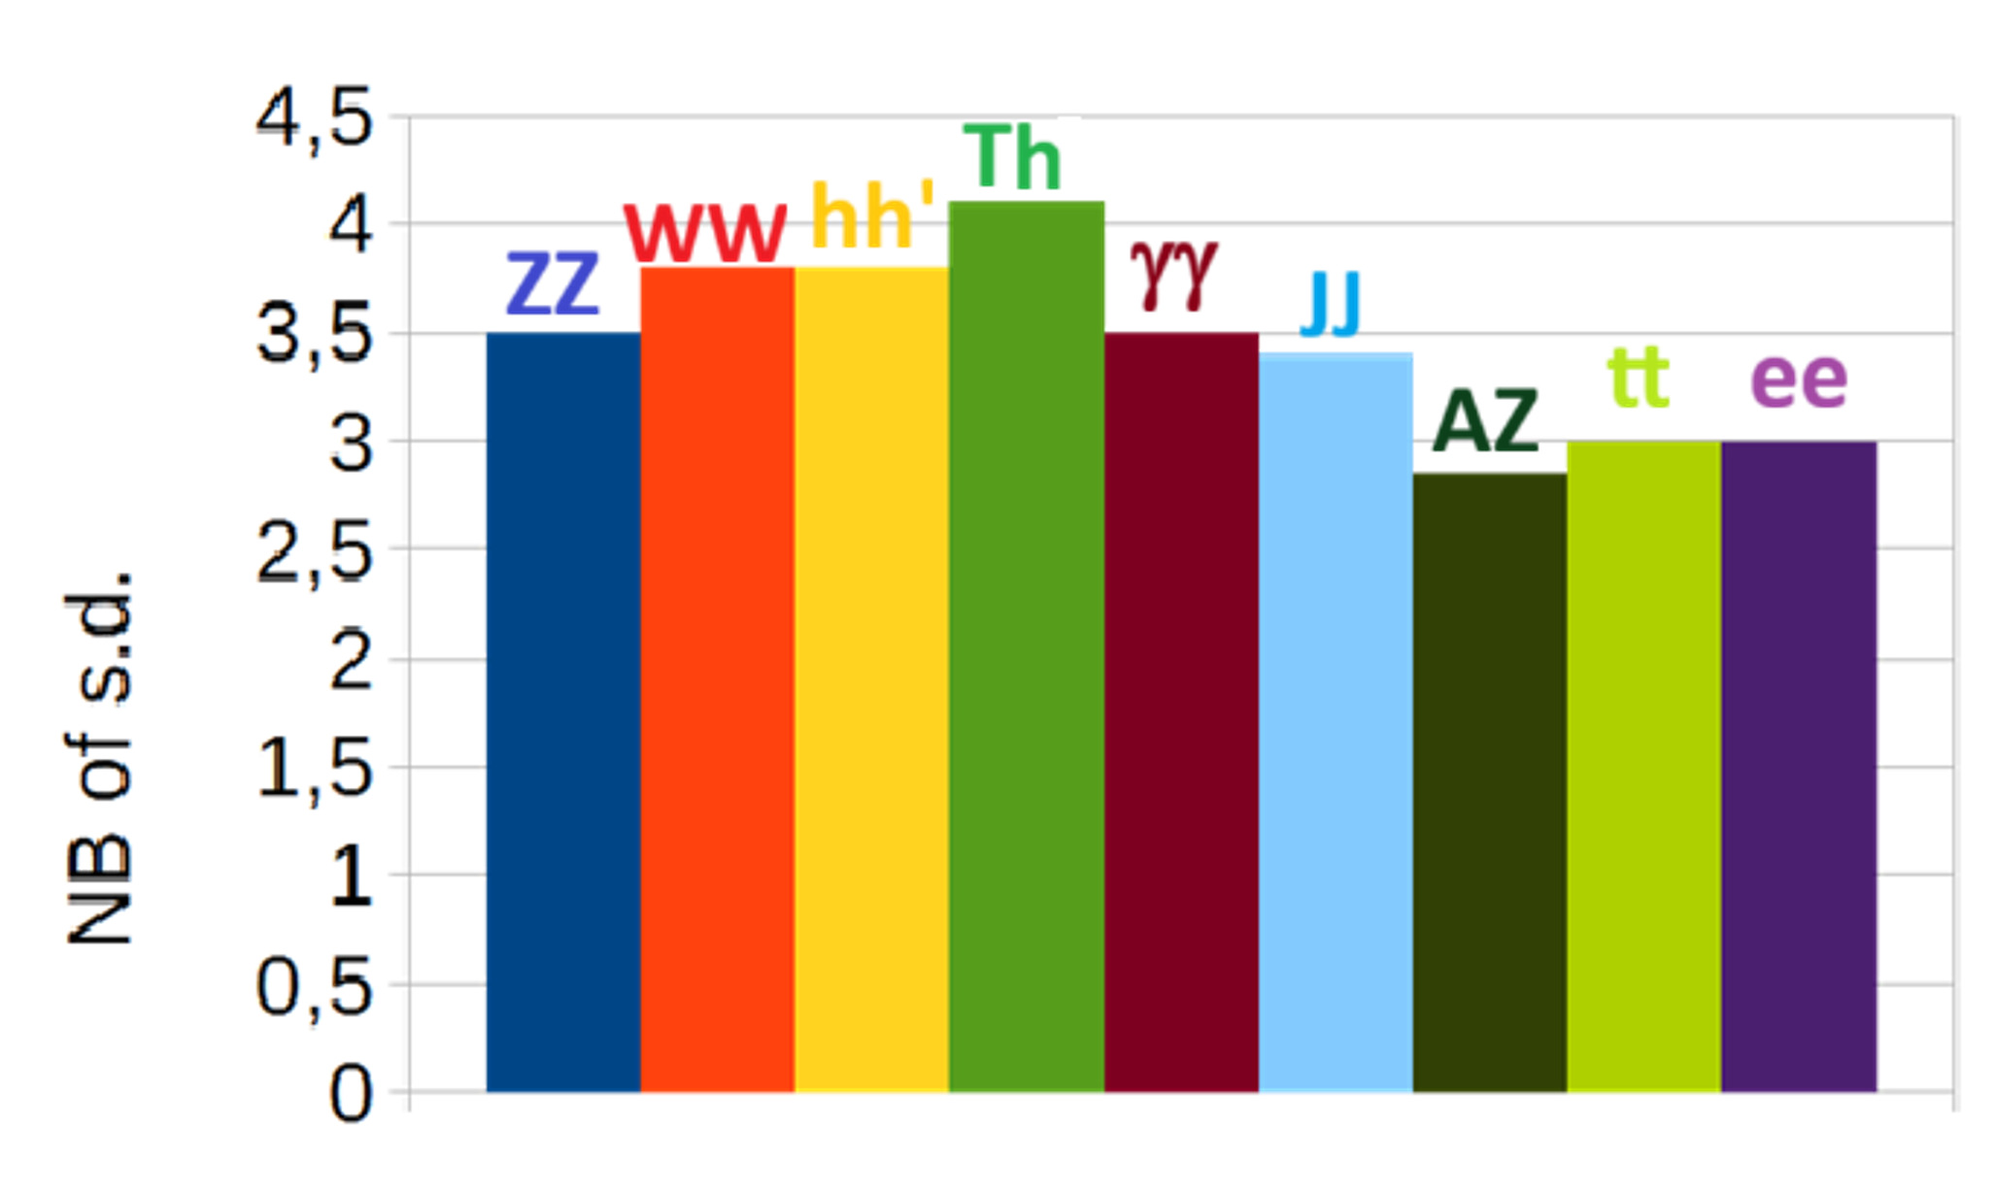
INTRODUCTION
For many years there has been growing evidence for indications around 650 GeV both in ATLAS and CMS
Presently there are 9 such indications, each reaching ~3 sd. When statistically combined they give a global evidence ~6 sd ! RUN3 should allow to reach individually 5 sd for some of them
Coming after the 750 GeV episode, they provoke, at best, polite skepticism
Today we come to the conclusion that the alleged 750 GeV in 2 photons first seen by ATLAS belongs to the same family, the shift in mass being presumably due to a mis-calibrated detector + an initial positive fluctuation in the ATLAS sample

Slide 3
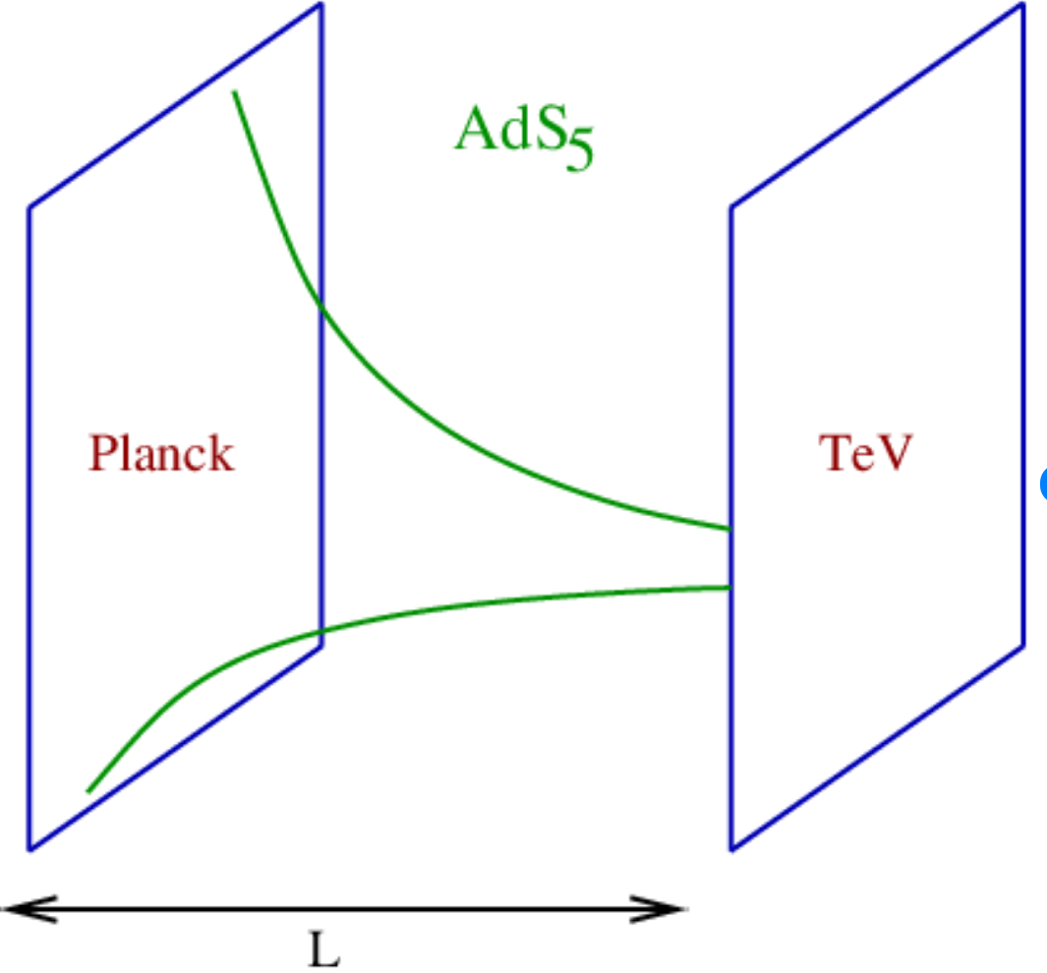
What is it ?
Interpretations of this effect went through different phases but, at
present, the best interpretation of these indications is given by the
Randall Sundrum model
However it is fair to add that various observations do not coincide with the strict predictions of this model, in particular the absence of coupling to gluons which considerably reduces the production rate for this resonance and explains that it takes so long to reach a full confirmation in spite of its low mass
We understand the reason for this absence, invoking the classical dual picture where the RS 5D is dual to a 4D world where resonances are composite objects. In this picture the SM Higgs is itself made of colorless partons which therefore do not couple directly to gluons. The same would be true for KK gravitons which can only couple to gluons through top loops

Slide 4
References
[1]New resonances at LHC
Alain Le Yaouanc(IJCLab, Orsay), François Richard(IJCLab, Orsay) (Jun 11, 2025) e-Print: 2506.09490
[2]X650->ZZ/WW/H125H95/A450Z -- scalar, tensor or both ?
Alain Le Yaouanc(IJCLab, Orsay), (IJCLab, Orsay), François Richard(IJCLab, Orsay(Aug 22, 2024
Contribution to: 3rd ECFA workshop on e+e- Higgs, Electroweak and Top Factories e-Print: 2408.12178
[3]Triple Higgs coupling
Alain Le Yaouanc(IJCLab, Orsay), (IJCLab, Orsay), François Richard(IJCLab, Orsay)(Apr 15, 2024)
Contribution to LCWS24 e-Print: 2404.09827
[4]As a consequence of H(650)->W+W-/ZZ, one predicts H++->W+W+ and H+->ZW+, as indicated by LHC data
Alain Le Yaouanc(IJCLab, Orsay), François Richard(IJCLab, Orsay) (Aug 23, 2023)
Contribution to: 2nd ECFA Workshop on e+e- Higgs/EW/Top Factories e-Print: 2308.12180
[5] Searches for scalars at LHC and interpretation of the findings Anirban Kundu (Calcutta U.),
Alain Le Yaouanc (IJCLab, Orsay), Poulami Mondal (Calcutta U.), François Richard (IJCLab, Orsay)
Contribution to 2022 ECFA Workshop on e+e- Higgs/EW/TOP factories e-Print: 2211.11723

Slide 5
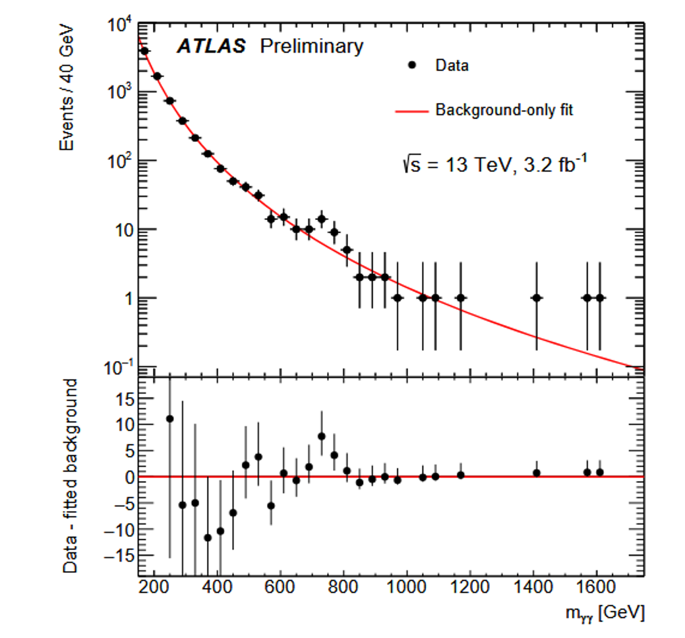
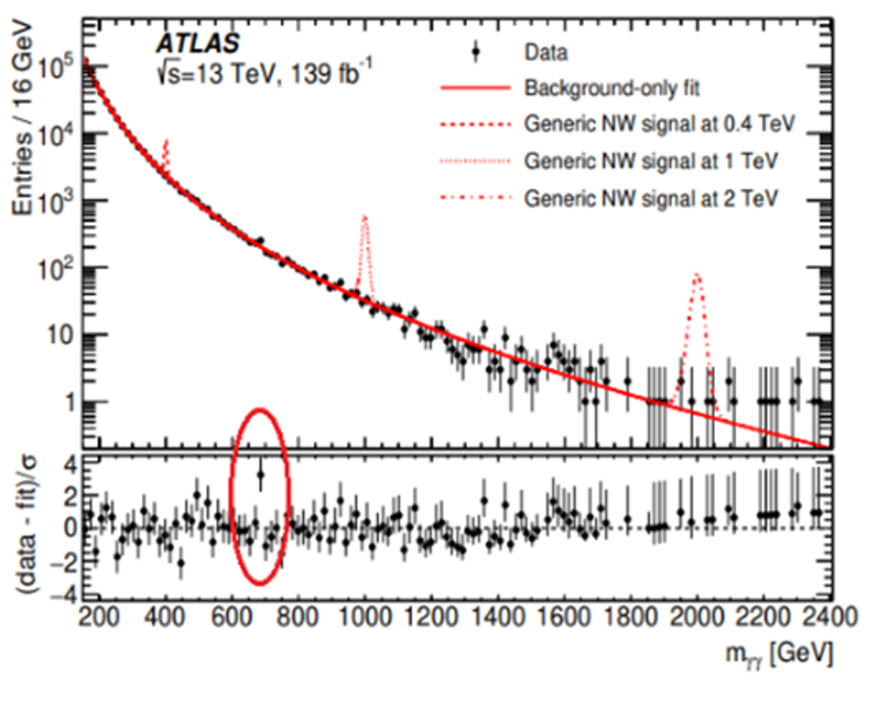
The two photon story
Yesterday: 750 GeV wide
Today: 690 GeV narrow
ATLAS-CONF-2015-081
2102.13405

Slide 6
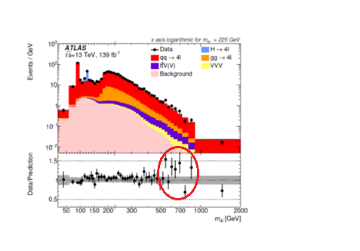
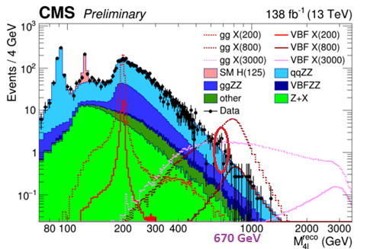
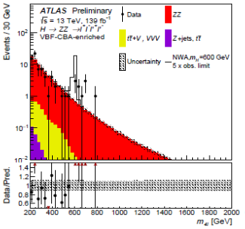
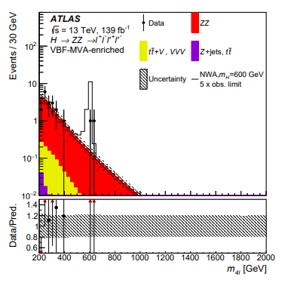
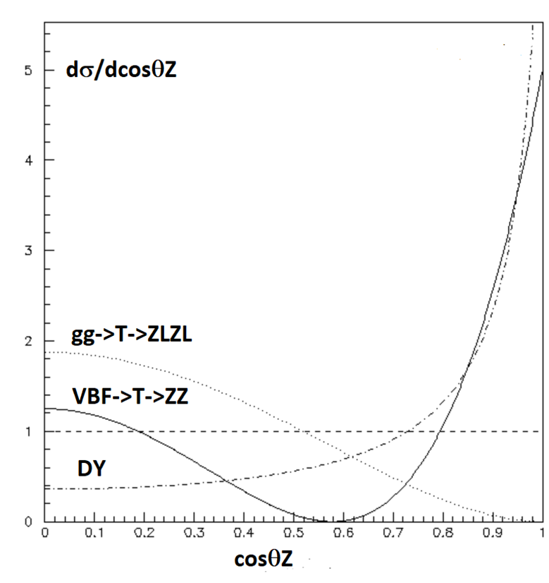
X650->ZZ-> ℓ⁺ℓ⁻ ℓ^{’+}ℓ^{’-} J=2 or J=0 ?
Naive cut based analysis
Selecting a scalar against DY
ggF+VBF
VBF

Slide 7
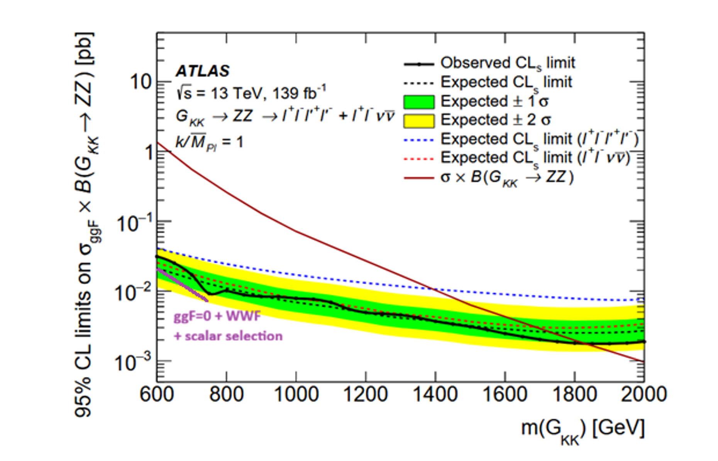
Only produced through VBF
2009.14791
Both ATLAS and CMS loose the ZZ channel with scalar selections even w/o the VBF selection
ggF should not suffer from a scalar selection !
Same observation in the WW channel by CMS which concludes that this signal comes mainly from VBF and not from ggF
Goes against RS standard predictions !
Invalidates mass limit from ATLAS
Explains why we need so much luminosity to observe a sub-TeV resonance

Slide 8
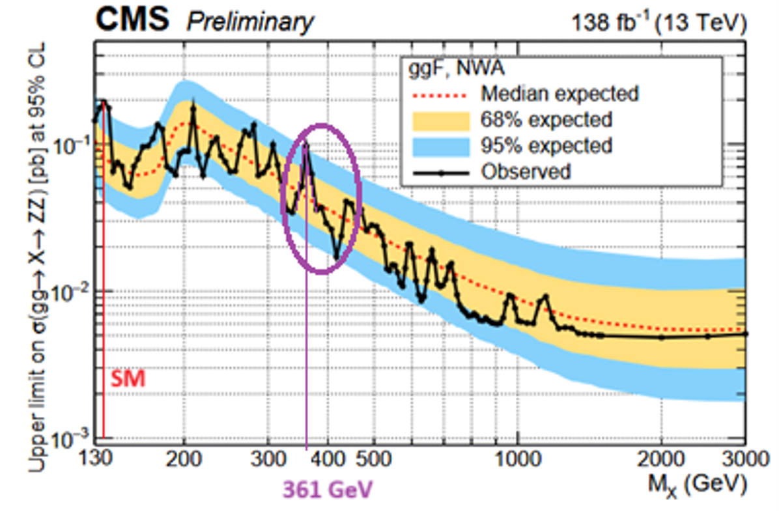
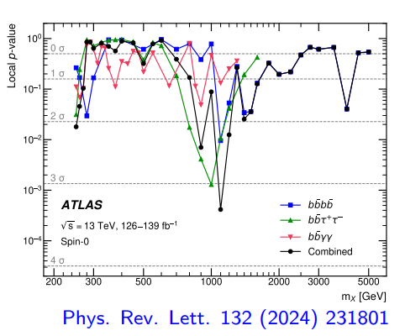
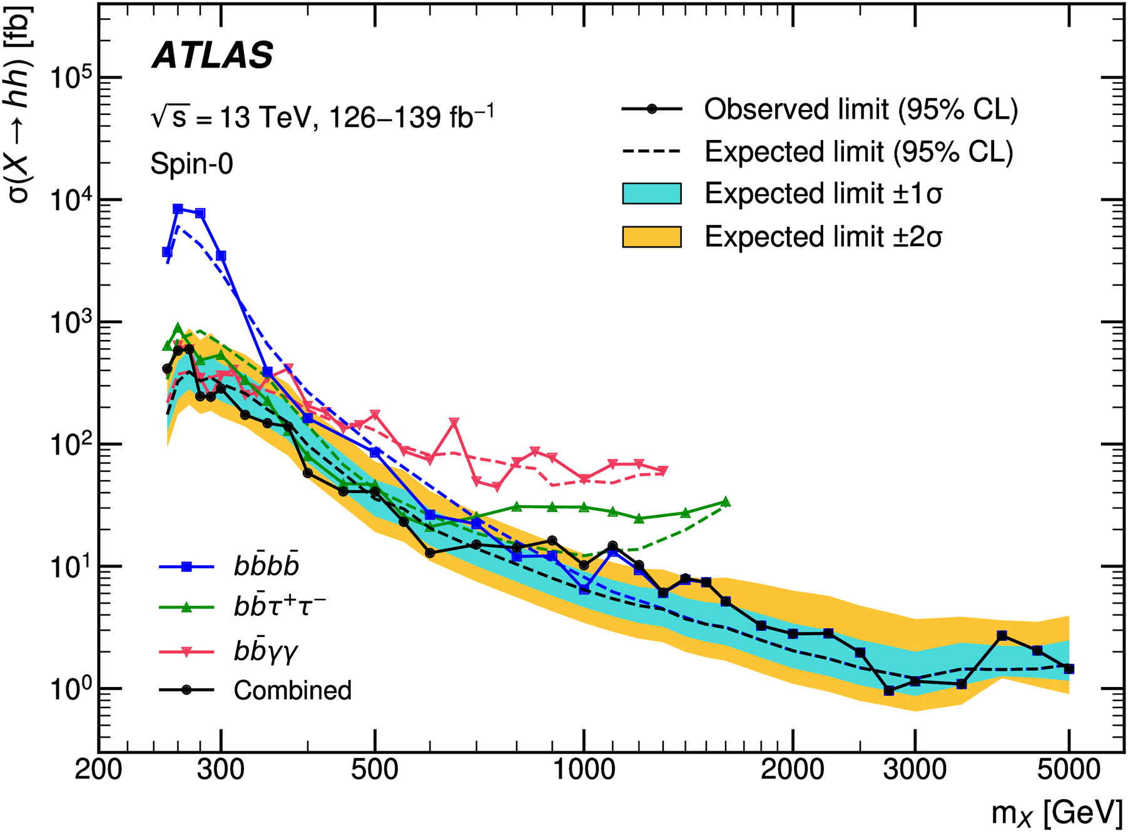
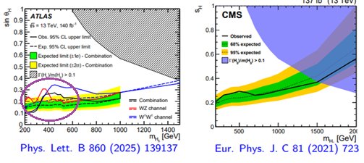
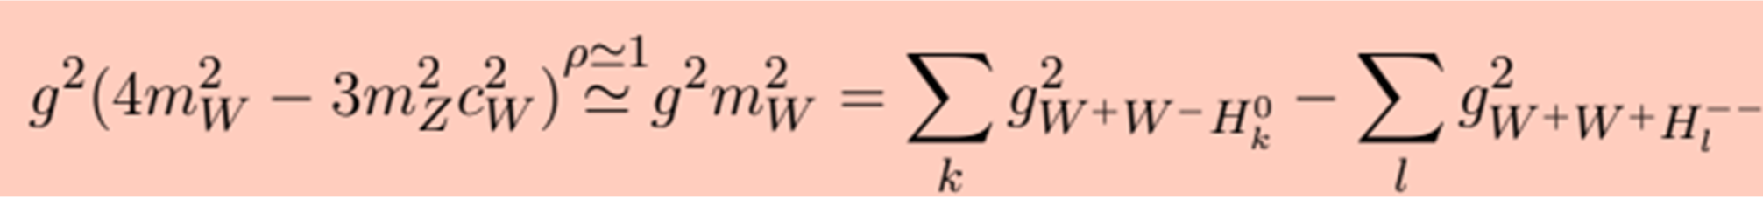
RS predictions
RS predicts: T376 T690 T1100 GeV given by zeros of Bessel function (geometry)
We have 5 indications compatible with T376 hence a significance of ~4 s.d.
Explains the width of T690 ~20 GeV instead of ~3 GeV for T376
Indication in hh at 1000 GeV from ATLAS
Perturbative unitarity predicts that there could be W⁺W⁺ and ZW resonances to avoid early violation which seems true for the first sequence T376

Slide 9
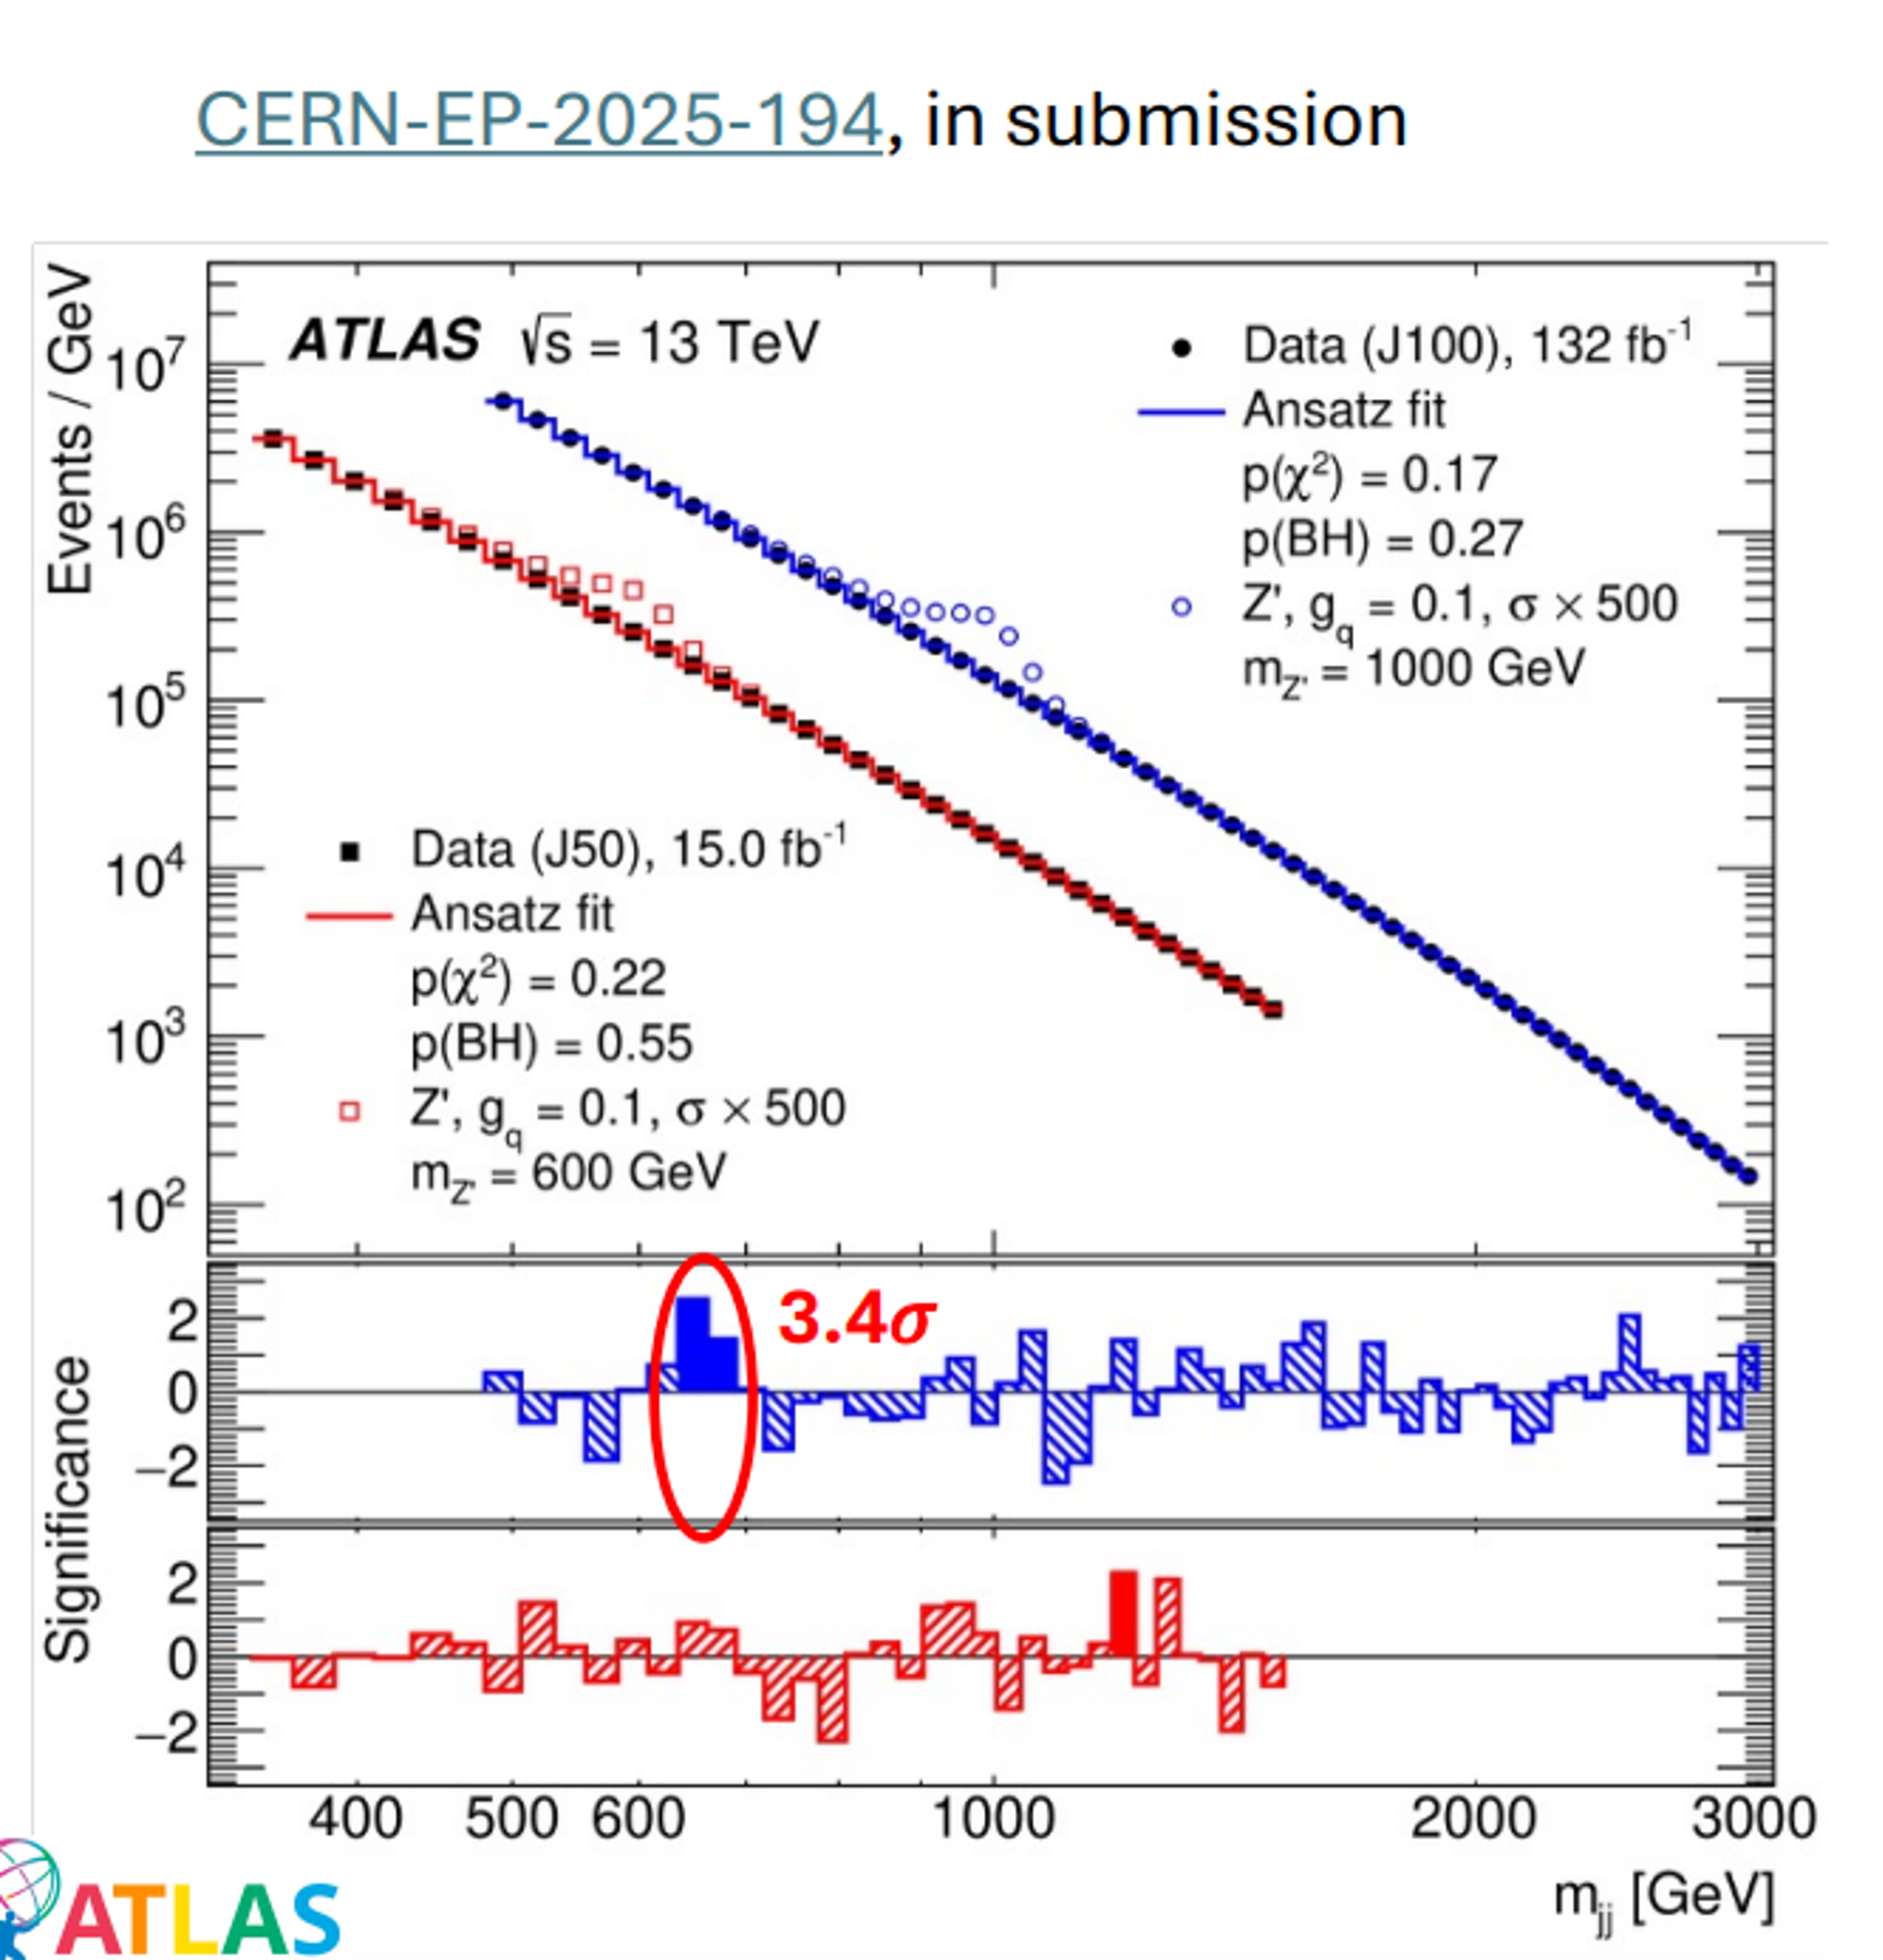
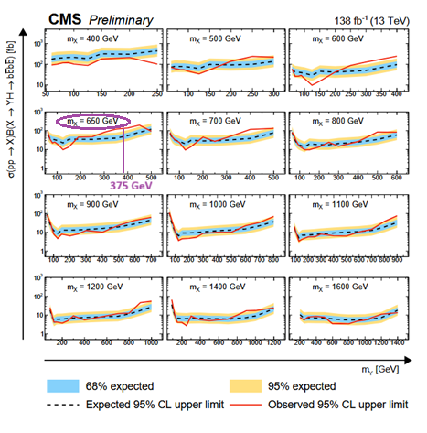
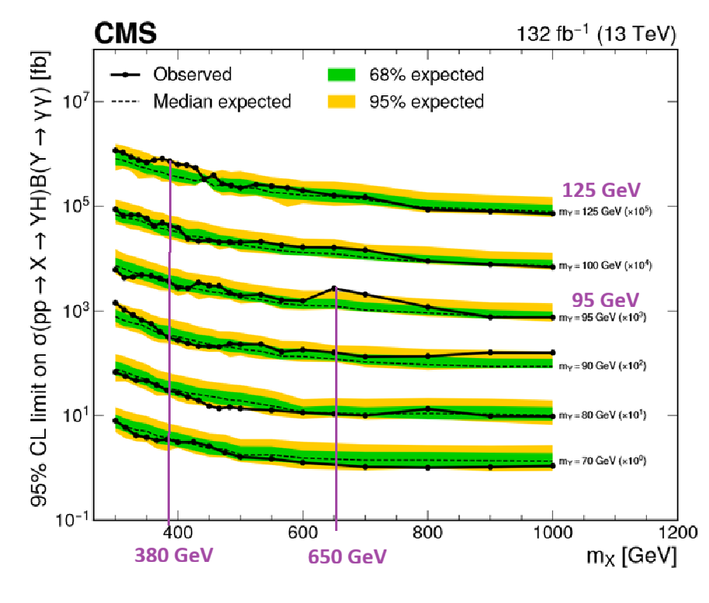
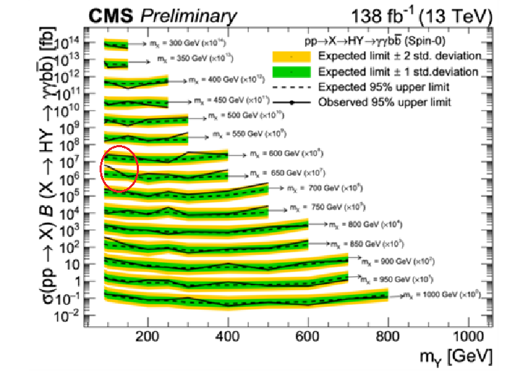
Other evidences for 650 GeV
2509.01219
CMS-PAS-HIG-20-012
2310.01643
2505.23012
X650->2 Jets
X650->Y375+h125->bb+bb
X650-> h125h95 -> γγ +bb
X650-> h125h95 -> γγ+ττ
T376-> h125h125->γγ+ττ

Slide 10
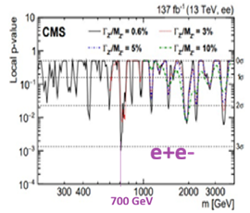
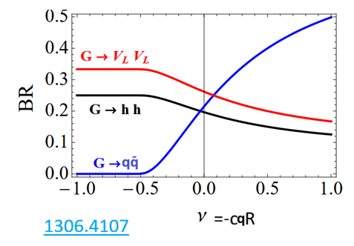
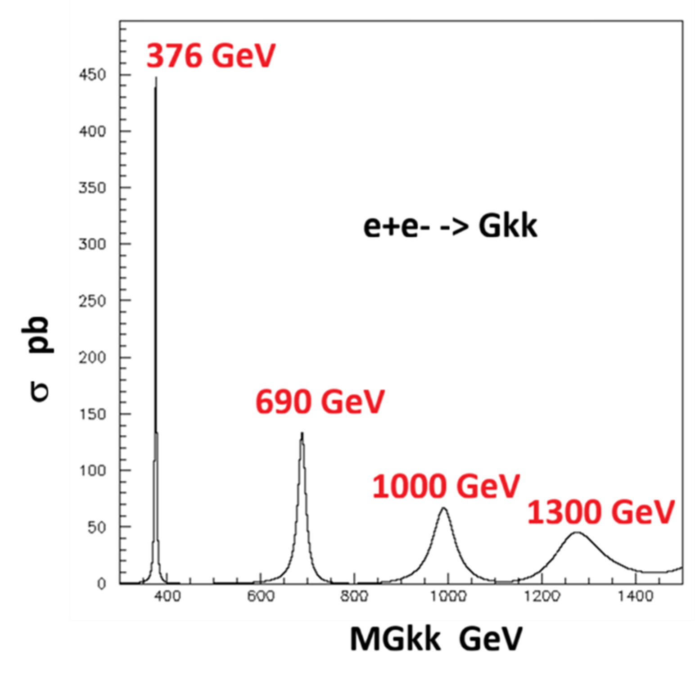
Open questions
2103.02708
Where are the other KK states like Z_{KK} etc… ?
Two mechanisms are proposed to explain why
G_{KK} could be the lightest KK state 1603.06980 2506.09490
Is it coupled to e+e- ? BR(G_{KK} ->ee)=0.25% from ATLAS/CMS is compatible with sin²θ_{eff} from LEP/SLD if Z_{KK} is much heavier than G_{KK}
Essential point: BR(ee)~0.25% would predict Giga graviton factories at e+e- colliders

Slide 11
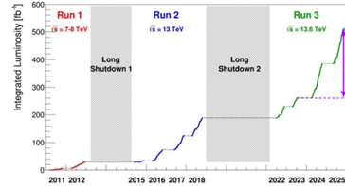
SUMMARY
‘650’ and ‘750’ are probably not distinct !
ZZ and WW suggest a J=2 state produced by VBF with seven more indications
This resonance is accompanied by two other indications which suggest the RS sequence T376 T690 T1000 which provides an explanation for the width and strengthen our interpretation
Absence of coupling to gluons suggest G_{KK} is a composite particle made of colorless partons similarly to the Higgs boson
T376, accompanied by T++ and T+, allows to push perturbative unitarity limit > 29 TeV
To interpret LEP precision measurements and BR(ee)~0.25% KK gravitons should be much lighter than KK Z
Implies Gigafactories for e+e- colliders with ECM>400 GeV
RUN2+RUN3 should provide enough data to confirm/reject this signal and its interpretations

Slide 12
Acknowledgements
Thanks to Andreas Höcker and Gautier Hamel de Monchenault for their encouragements in this task
Useful and pleasant exchanges with Abdelhak Djouadi, Ulrich Ellwanger, Adam Falkowski and Gilbert Moultaka are gratefully acknowledged
Thanks to Roman Poeschl, Guillaume Unal and Louis Fayard for useful exchanges
Thanks to Kaustub Agashe and Severin Lüst experts on the RS model

Slide 13
Additional slides

Slide 14
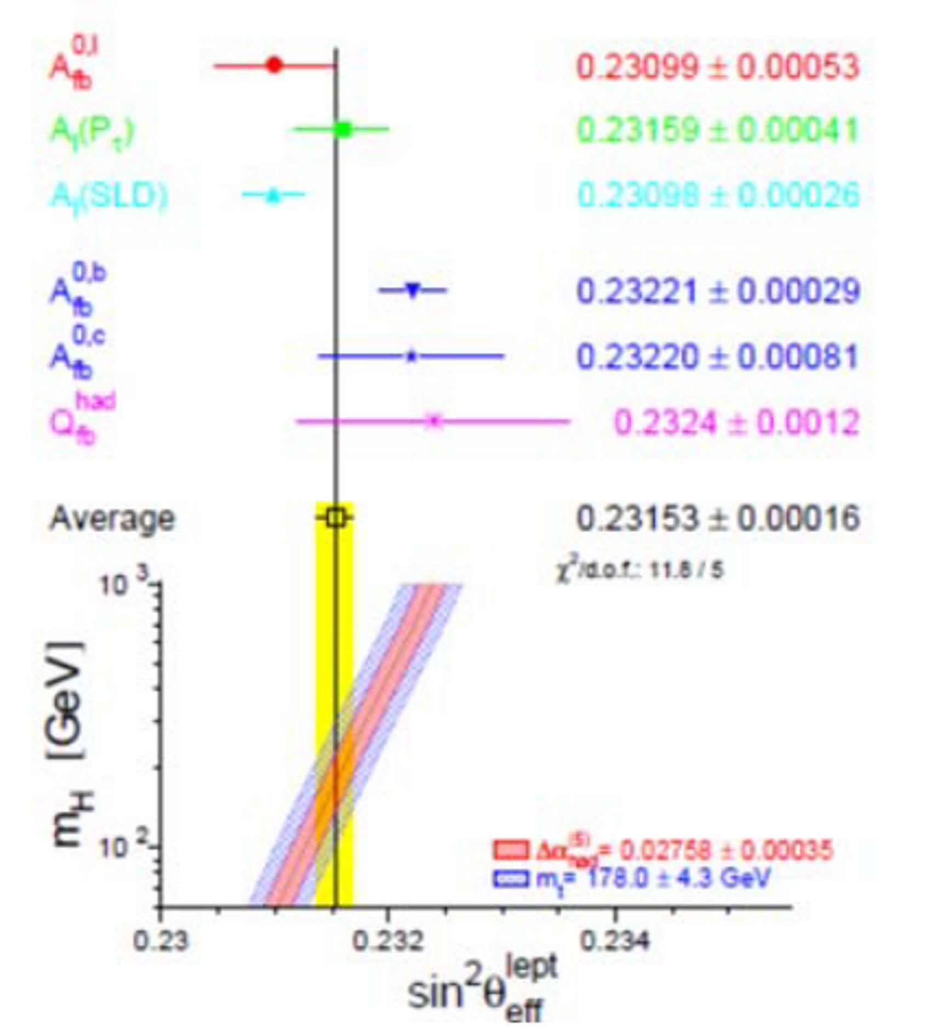
LEP precision measurements
In the RS model Z_{KK} can influence LEP PM
AFBb, ALR show signs of deviations which can be fixed within a LR extension of the RS model
So far a KK mass of 0.3TeV/sinθ’ was assumed, with sinθ’>0.1, see 0610173, hence ceR=0.56 which gives a negligible BR(G_{KK}->ee)
If this mass is of order 2.5TeV/sinθ’, ALR implies that ceR=0.45
This implies BR(ee)~0.25% compatible with ATLAS and CMS as suggested by the figure from 1306.4107

Slide 15
Why is G_{KK} much lighter than Z_{KK} ?
In 1603.06980 a mechanism is recalled where bulk fields develop localized corrections to the kinetic terms which can modify the phenomenological predictions
Large brane kinetic terms allows to create a hierarchy between the diverse KK families
A more radical way out is to invoke an analogue of the Higgs mechanism. As longitudinal degrees of freedom of Z and W come from the SM Higgs doublet, the additional degrees of freedom for the massive graviton KK modes (5 in the massive vs 2 in the massless case) would come from one vector and one scalar KK mode. Experimentally, these “eaten” vectors and scalar degrees of freedom are not visible as individual particles. The same thing could also happen for the fermionic KK modes in a SUSY theory. They can become the missing degrees of freedom of the massive gravitino KK modes.
We are indebted towards Severin Lüst for suggesting this mechanism.

Slide 16
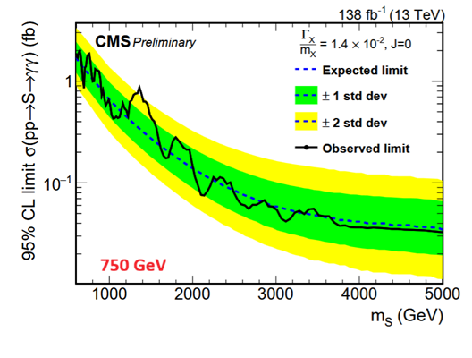
CMS on G_{KK}->2γ
ATLAS has found a xsection of ~2 fb at ~700 GeV
This result is not incompatible with the limit given by CMS in EXO-22-024

Slide 17
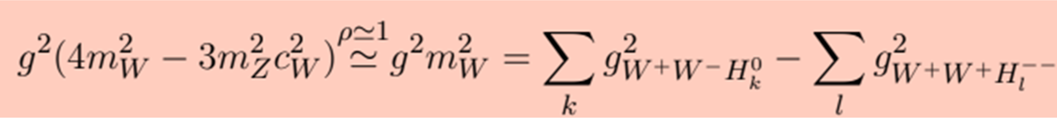
Sum Rules
Perturbative Unitarity requirements predict sum rules for scalar couplings
W_{L}⁺ W_{L}⁻ -> W_{L}⁺ W_{L}⁻ Haber et al. in P.R.D 43 (1991) 904-912
They are satisfied by the SM and heavy scalar doublet (decoupling) contributions
In the Georgi Machacek model one has compensation due to H⁺⁺ (u exchange term)
KK J=2 gravitons have a different angular distribution but could be compensated by doubly charged tensors T⁺⁺->W⁺W⁺ giving u exchange contributions
In the same way ZZ->WW forces us to expect T->ZW
They are indicated by LHC data for the first KK recurrence at 376 GeV
They could also appear at 690 GeV for the second KK recurrence

Slide 18
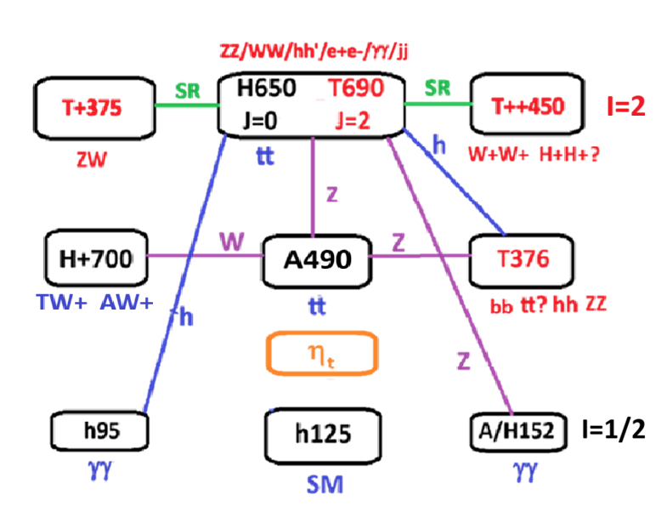
Summary diagram

Slide 19
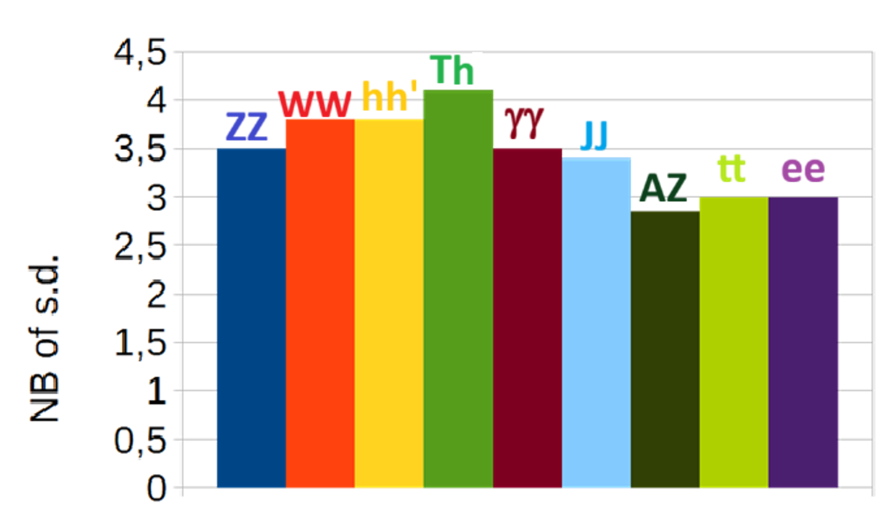
Evidences for ~650 GeV resonance(s)
Channel | Significance s.d. | Reference
ZZ 4 leptons | 3.8 ggF+VBF 2.8 VBF | ATLAS 2009.14791
WW 2leptons | 3.8 VBF | CMS-PAS-HIG-20-016
h95h125 bb/tt gg | 3.8 | CMS 2310.01643 CMS 2506.23012
T376h125 bbbb | 4.1 | CMS-PAS-HIG-20-012
gg | 3.5 | ATLAS 2102.13405
JJ | 3.4 | ATLAS 2509.01219
AZ tt 2leptons | 2.85 | ATLAS 2311
e+e- | 3 | ATLAS 1903.06248 CMS 2103.02708
tt | 3 | ATLAS 2404.18986 CMS 2507.05119
~ 6 sd global significance

Slide 20
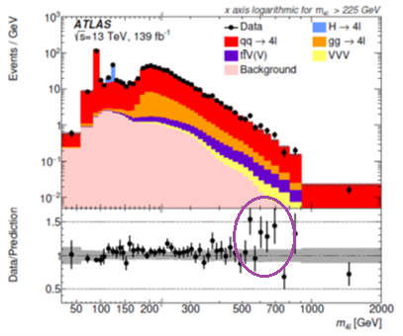
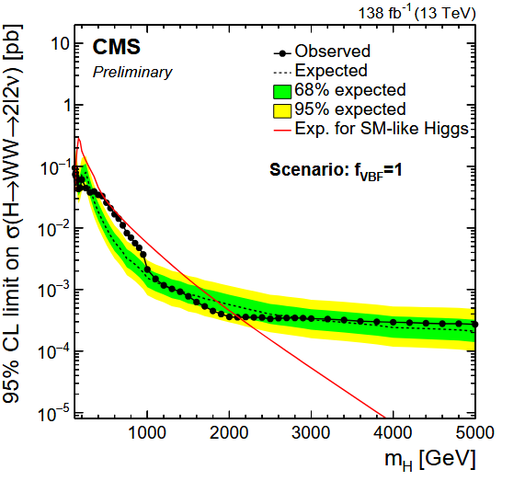
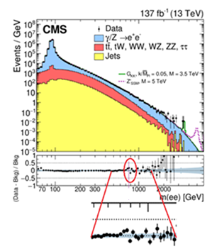
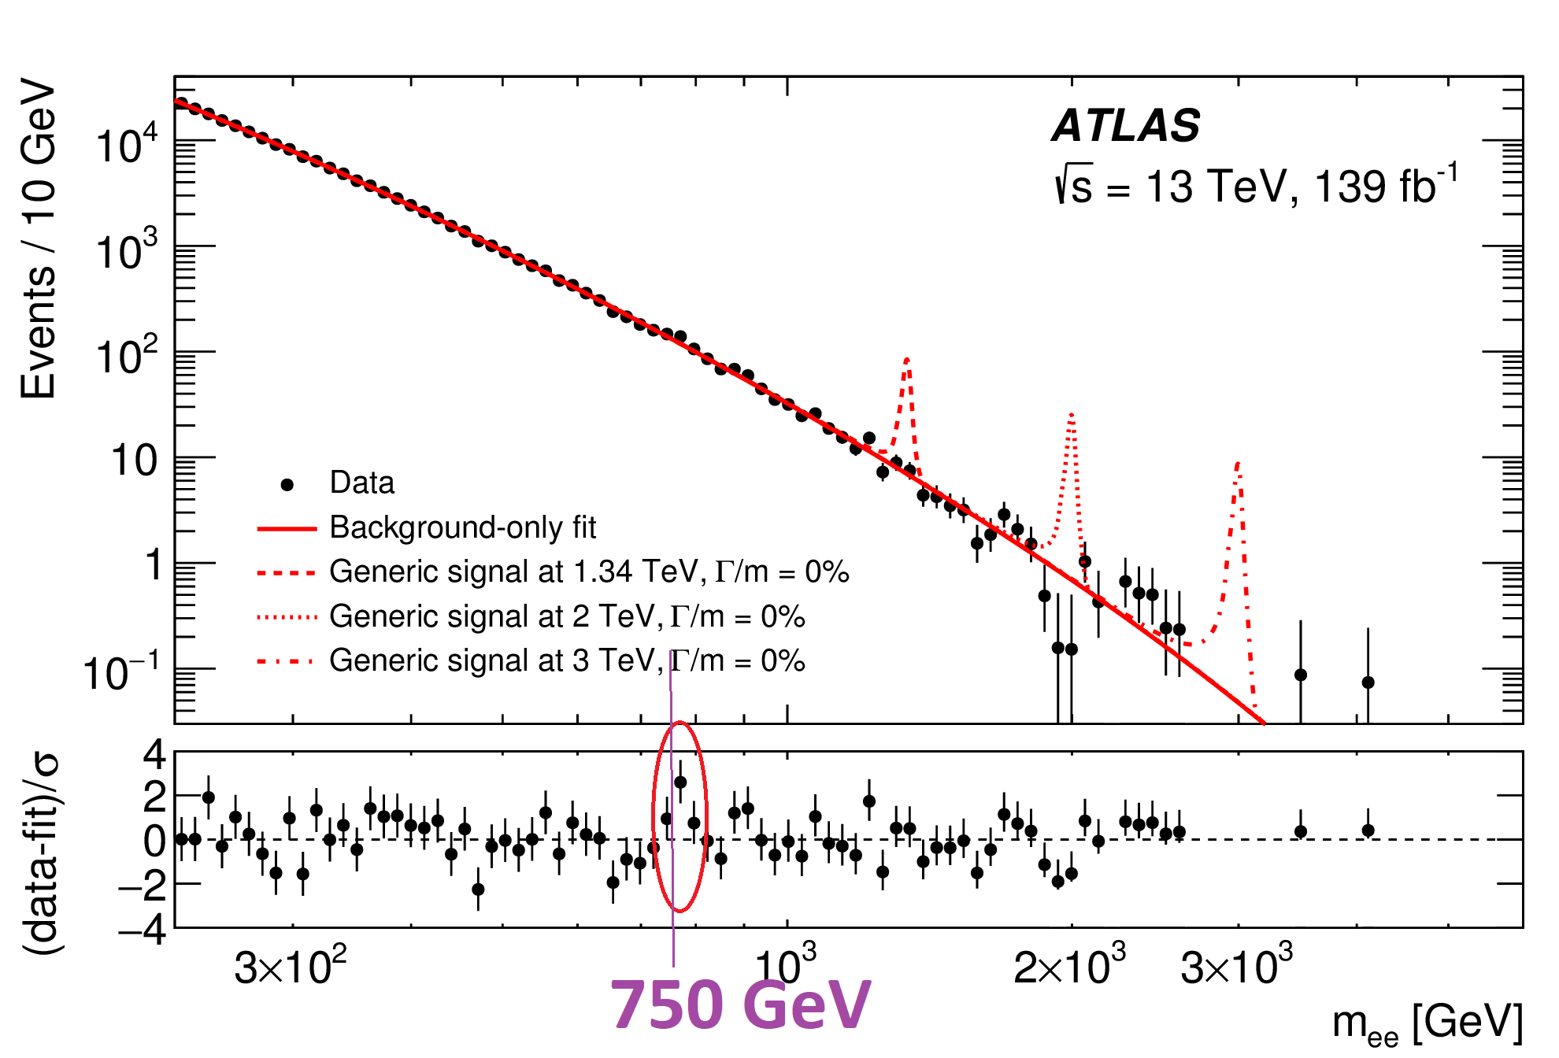
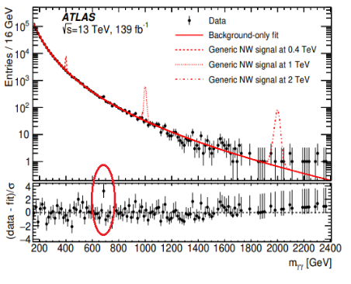
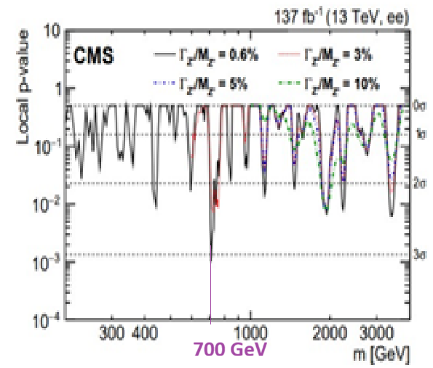
CMS-PAS-HIG-20-016
2009.14791
2103.02708
1903.06248
2102.13405

Slide 21
Complex modes
2505.23012
2509.01219
CMS-PAS-HIG-20-012
2310.01643
X650->2 Jets
X650->Y375+h125->bb+bb
X650-> h125h95 -> γγ +bb
X650-> h125h95 -> γγ+ττ
T376-> h125h125->γγ+ττ

Slide 22
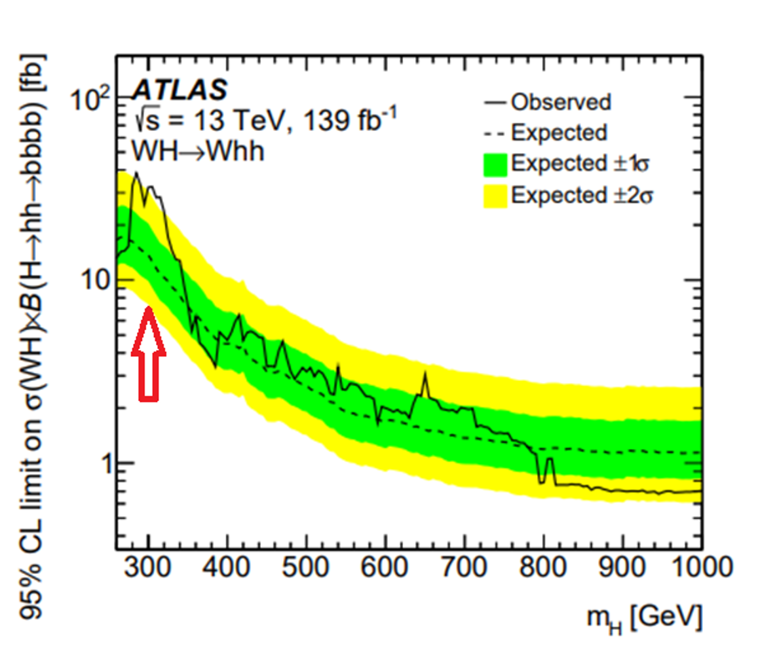
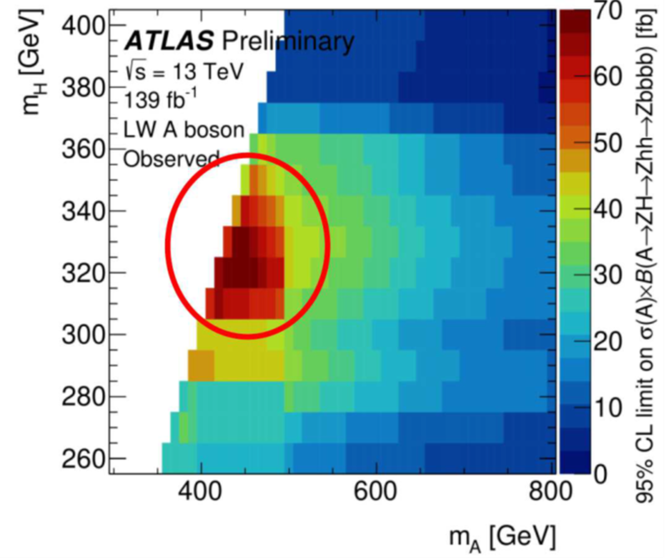
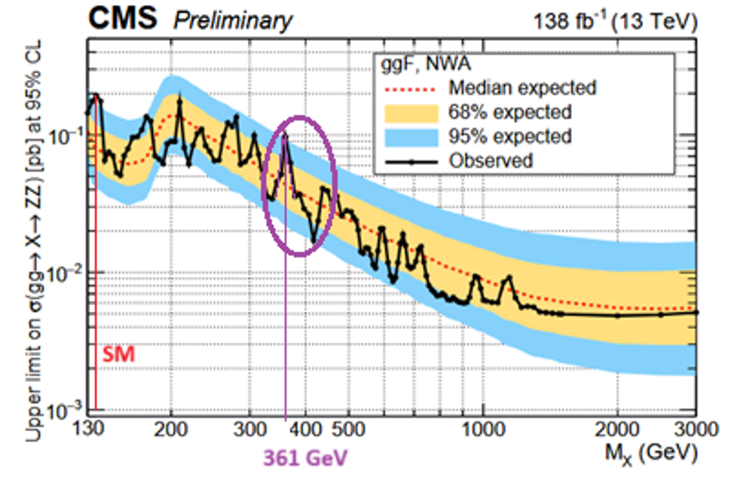
Next best candidate to T690 ?
2210.05415
CMS 2506.23012
2210.05415
H+→T376+W→hh+W->bbbb+W
A490->T376Z->bbbbZ
T376→ hh→ t⁺t⁻ +gg
T690→ T375h → bb+bb
CMS-PAS-HIG-20-012
T376->ZZ->l⁺l⁻ l’⁺l’⁻
CMS-PAS-HIG-24-002

Slide 23
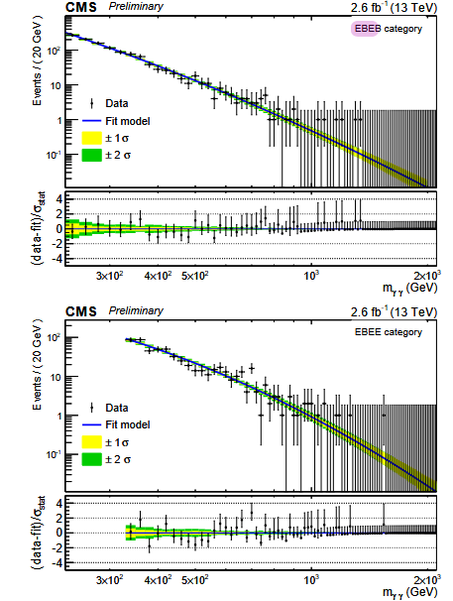
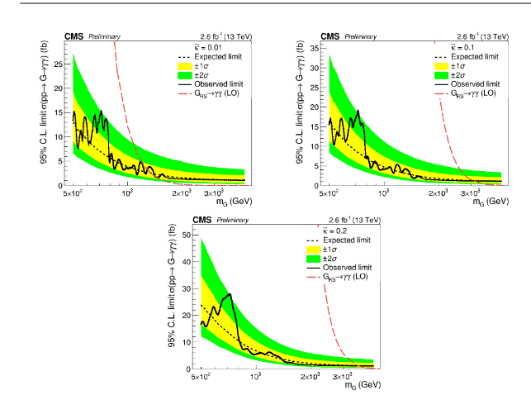
CMS results
https://cds.cern.ch/record/2114808/files/EXO-15-004-pas.pdf

Slide 24
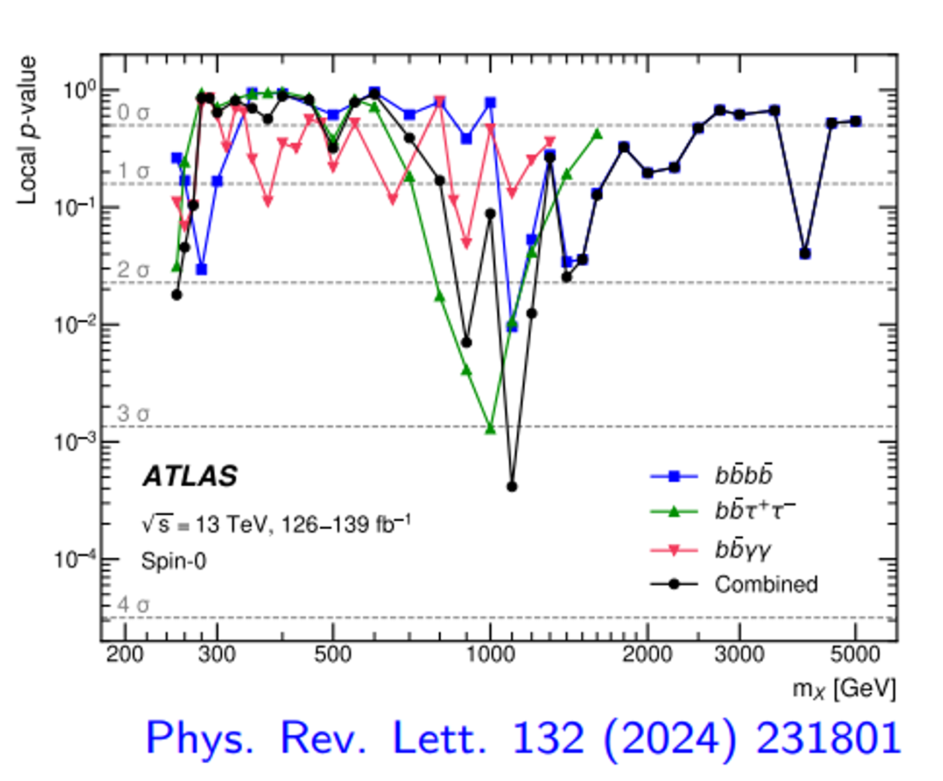
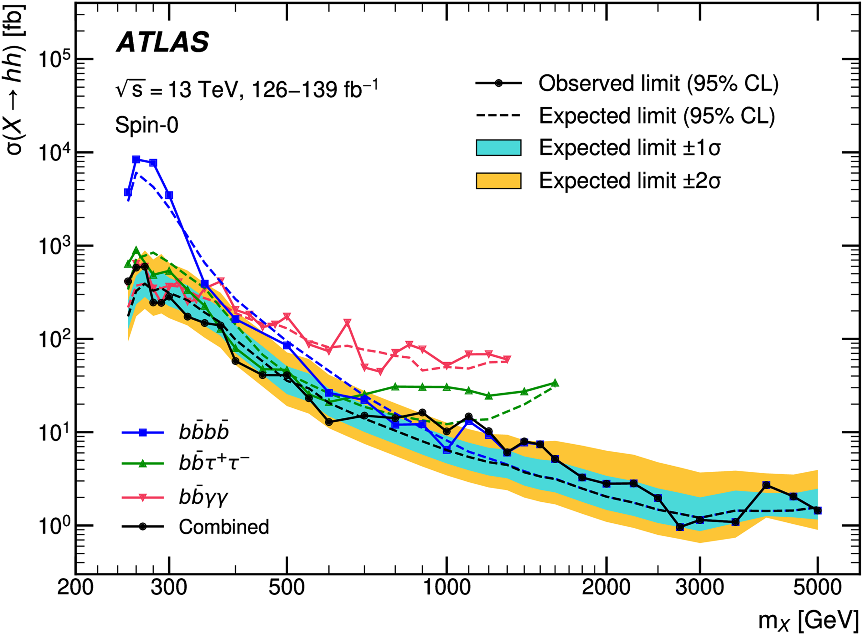
Graviton recurrences ?
T690 seems a valid tensor candidate
In the Randall Sundrum (RS) model, graviton KK resonances G_{iKK} have masses which go like mi~100x^{G}_{i} in GeV, where x^{G}_{i}=3.8,7.0,10.2,13.3... and widths which go like Γ~0.06(x^{G}_{i} )³
These numbers which govern the RS model are of geometric origin, simply given by the zeros of the Bessel function J₁(x)
Assuming that T690 is the second KK resonance, one predicts T376 as the first one, as observed and the third one T1000 , which seems indicated by ATLAS searches for h125h125
The next one should be T1300

Slide 25
A preliminary interpretation of these indications
J=0
I=1/2
J=2
I=2
HD1 | h125→ SM | WL | ZL
HD2 | h95->2g | t→H⁺130 b→bcb | A152→ 2g+Z/W
HD3 | H650->A490Z->ttZ | H⁺700→A490W⁺ | A490→T376Z->hhZ
TQ1 | T⁺⁺450->W⁺W⁺ | T⁺375→ZW⁺ | T376→hh,bb,tt
TQ2 | T690→ZZ/WW/h125h95/tt/2g/e+e-
TQ3 | T1000→ZZ/WW/h125h125
Weinberg Model
Gauge Theory of CP violation, Phys. Rev. Lett, 37 (1976) 657.
Randall Sundrum
MTQ1=376
MTQ2=690
MTQ3=1000

Slide 26
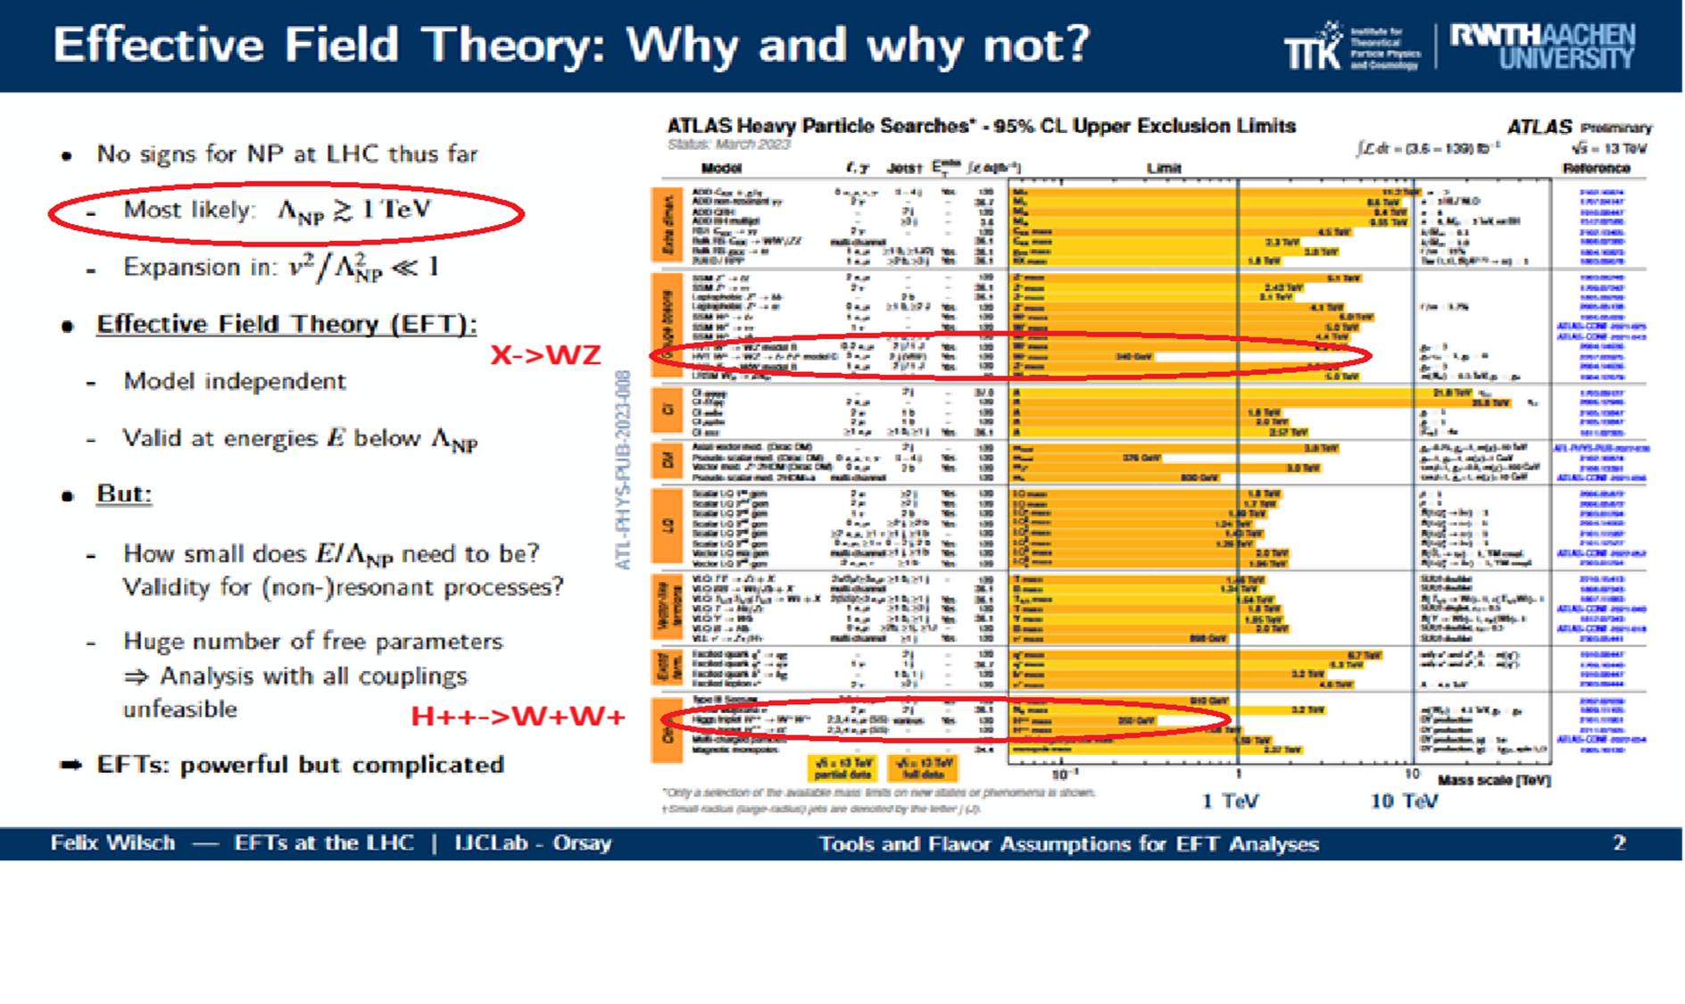
https://indico.ijclab.in2p3.fr/event/12138/contributions/39316/

Slide 27
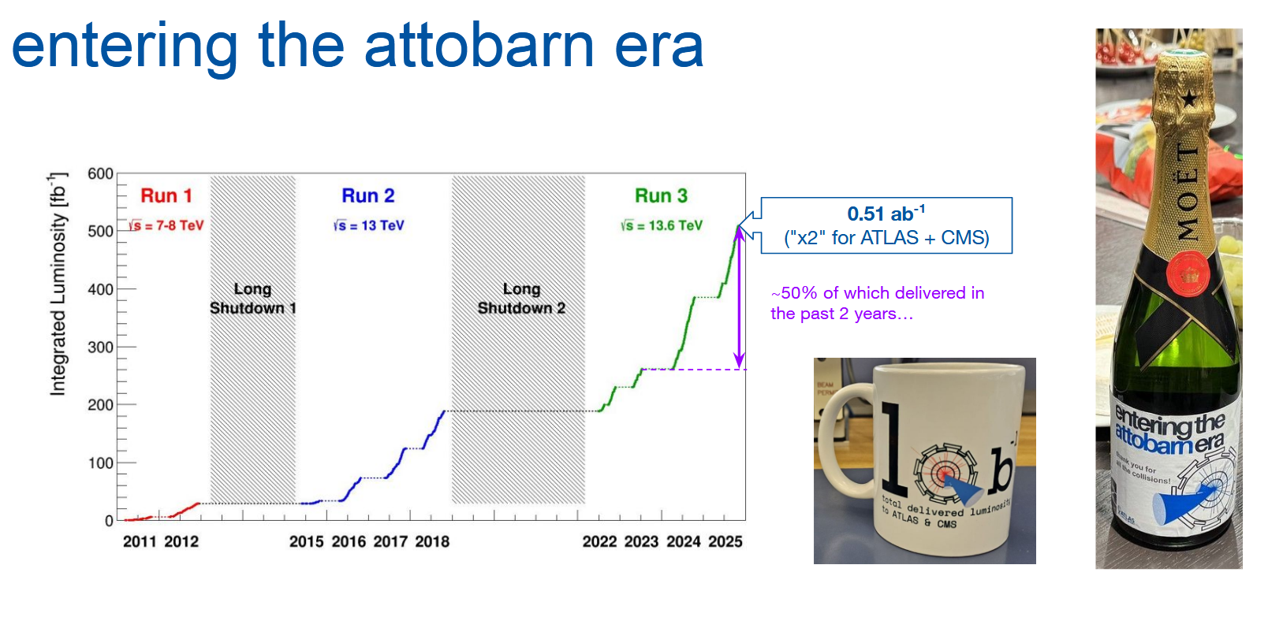
Michi Hostettler Moriond 2026
+30 fb-1 in 2026

