Slide 1
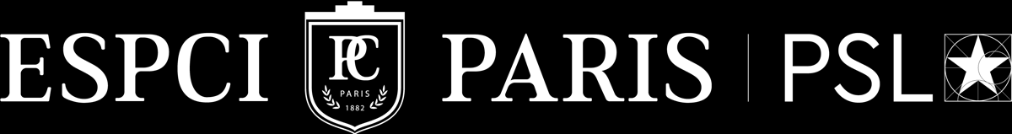



Experimental Test of the Axion Paradigm using Quantum Sensing
Phase-Resolved Haloscope with Magnetic Tunability
Jeanne BALLY
PhD student in HQC’s group, LPENS - LPEM
Exp : C. Fruy, K. Kodama, D. Diez, A. Théry, B. Hue, T. Fauvet, L. Jarjat, T. Philippe Kagan, M.R. Delbecq, T. Kontos
Theory : A. Cottet
RADES Collaboration : I. Irastorza, S. Paraonau, W. Wernsdorfer (Dark Quantum) + B. Döbrich, A. Lindner…
22/04/2026

Slide 2

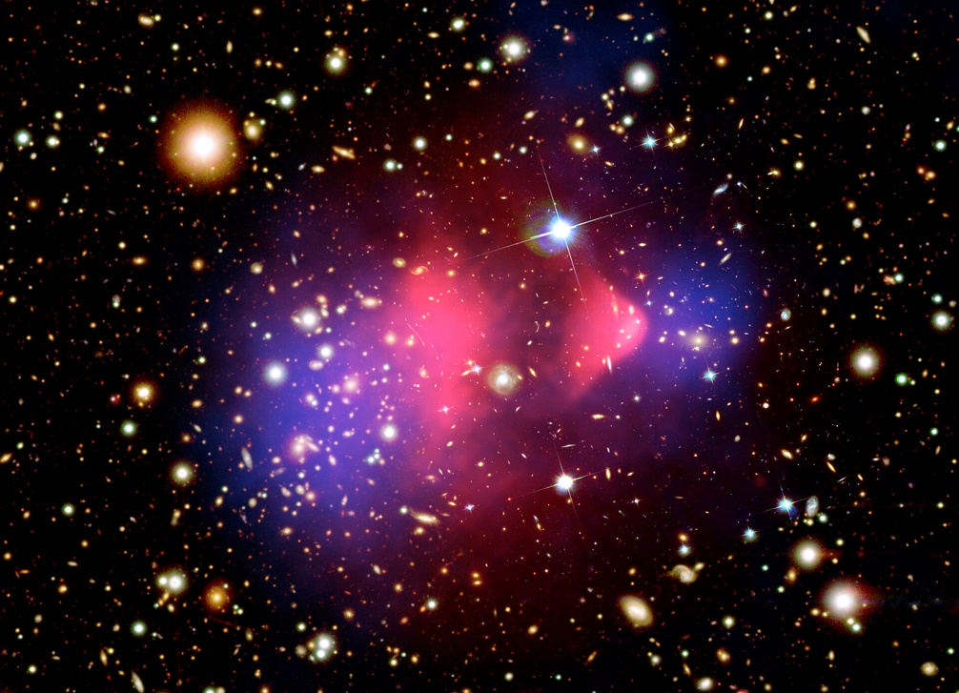
The Dark Universe
Dark matter: hypothetical matter that interacts weakly ordinary matter.
Estimated matter-energy content of the Universe :
DARK ENERGY
DARK MATTER
The bullet cluster (ESA)
BARYONIC (ORDINARY) MATTER
X-ray: NASA/CXC/CfA/M.Markevitch
Optical and lensing map: NASA/STScI, Magellan/U.Arizona/D.Clowe
Lensing map: ESO WFI
Non-zero local dark matter density, with extremely weak interactions with standard matter
Hot intracluster gas detected in X-ray (contains most of the baryonic matter)
Gravitational lensing detected mass
The AXION particle
good Dark Matter candidate
2

Slide 3
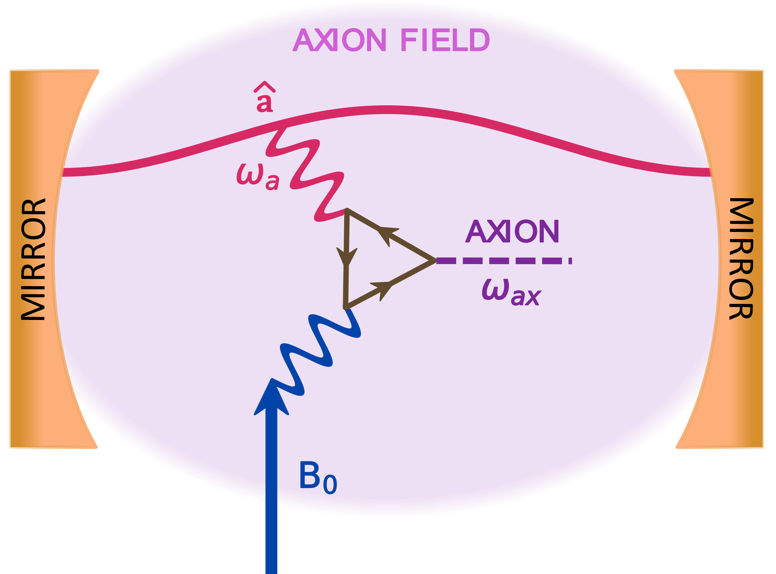
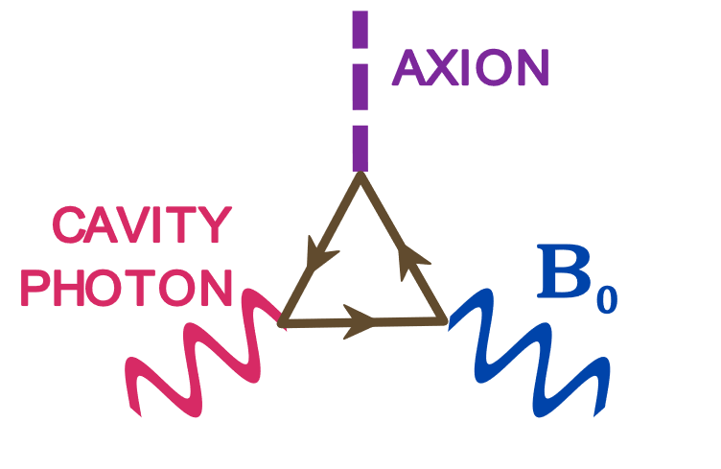
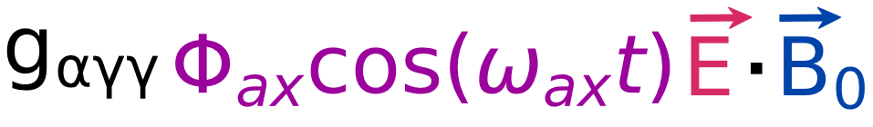

The Axion Particle
Solve the strong charge-parity (CP) problem
Peccei-Quinn solution: spontaneous breaking of symetry
R.D. Peccei and H.R. Quinn, PRL’77, Weinberg, PRL’78, Wilczek, PRL’78…
Laboratory searches via electromagnetic conversion experiments: HALOSCOPES
Primakoff effect
Lagrangian axion–photon interaction term:
P. Sikivie, PRL 51, 1415 (1983)
$$ω_{a}=ω_{ax}$$
3

Slide 4
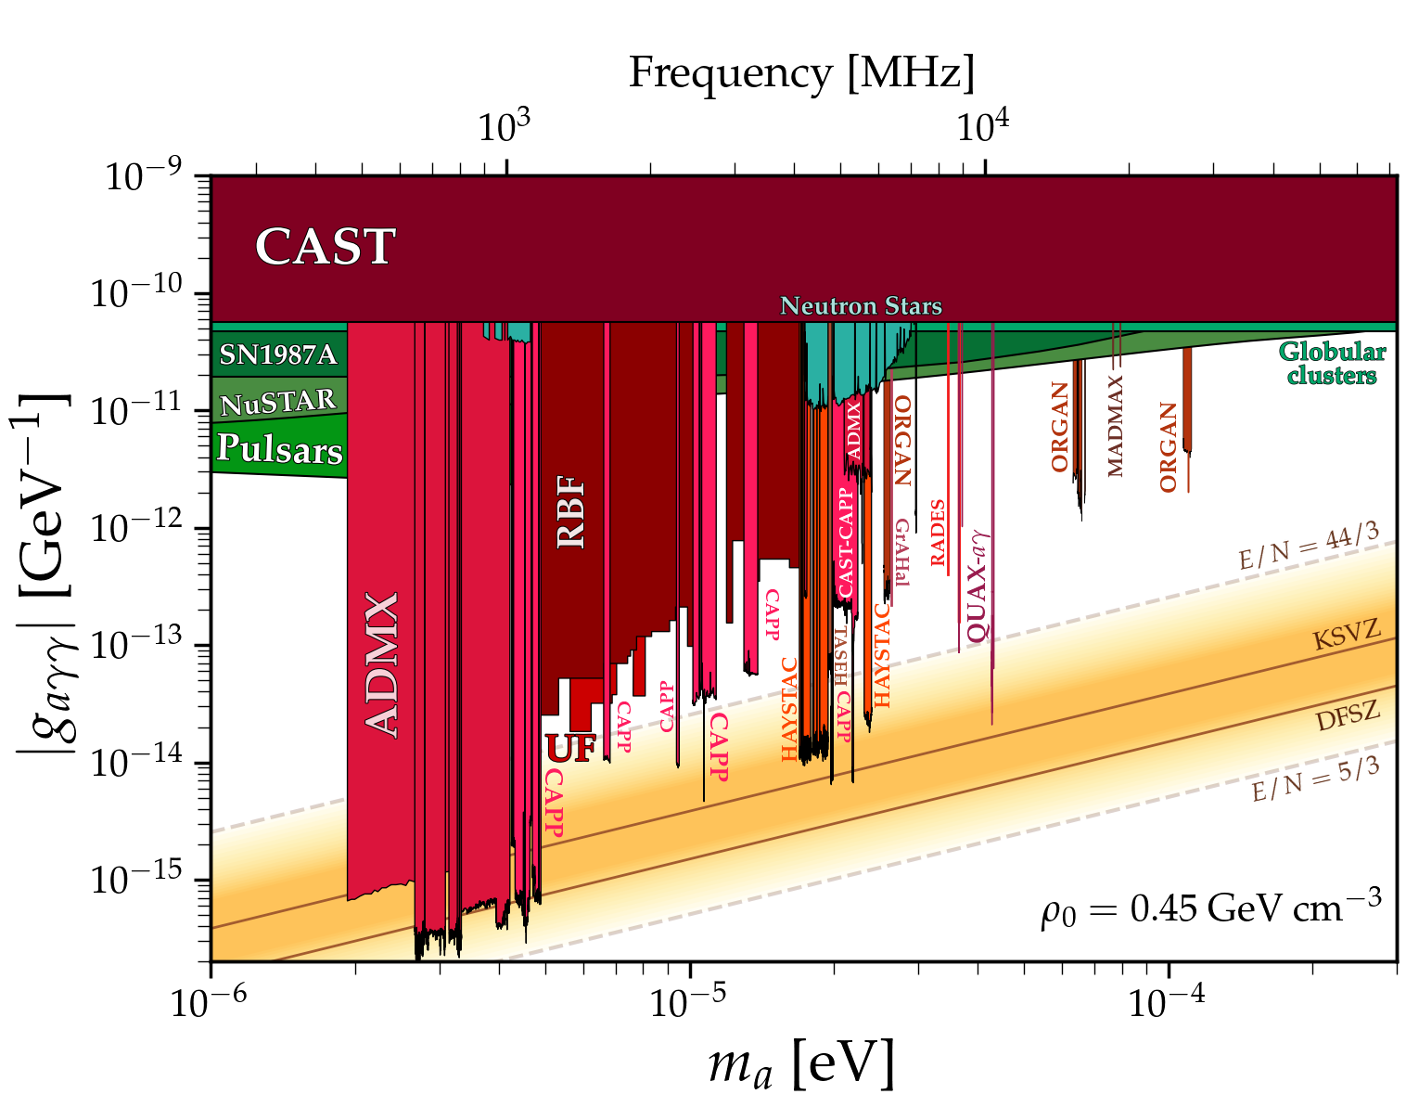
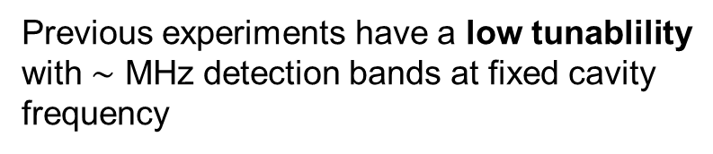
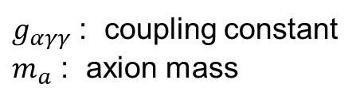
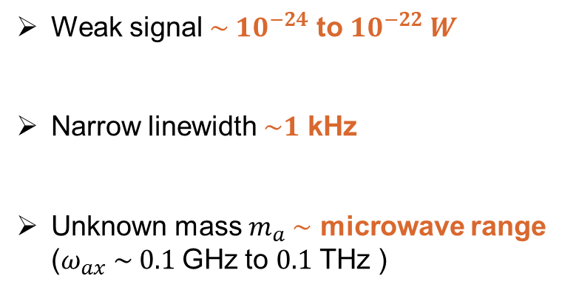
The Axion Search
Parameter space explored by axion experiments benchmarked by KSVZ and DFSZ predicted axion mass and coupling strength
Challenges in axion searches:
Weak signal ${\sim 10}^{−24}$ to ${10}^{−22} W$
Narrow linewidth $\sim 1$ kHz
Unknown mass $m_{a} \sim$ microwave range ($ω_{ax} \sim 0.1$ GHz to $0.1$ THz )
Previous experiments have a low tunablility with $\sim$ MHz detection bands at fixed cavity frequency
$g_{αγγ}$ : coupling constant
$m_{a}$ : axion mass
4

Slide 5
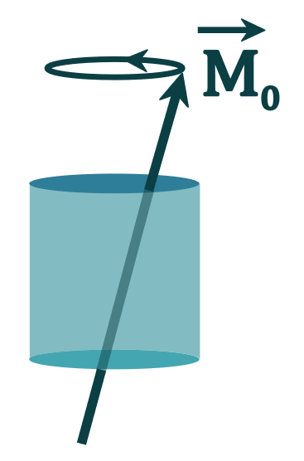

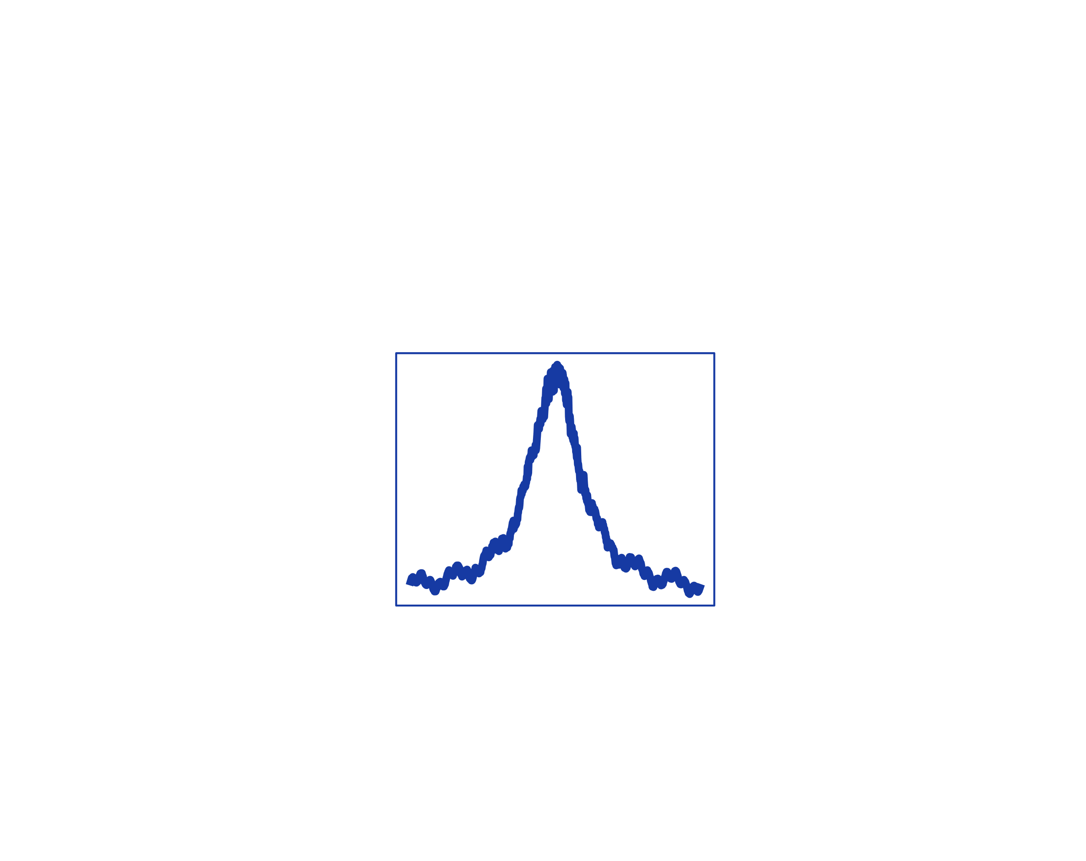
Research Project Goals
Key goals of AXION sensing:
Expand the mass scanning range
Boost the detection sensitivity
Simulate a fake axion signal
Magnetic materials in
resonant cavities
Non-linear coupling
Phase-jammed signal
5

Slide 6
Research Project Goals
Key goals of AXION sensing:
Expand the mass scanning range
Boost the detection sensitivity
Simulate a fake axion signal
Magnetic materials in
resonant cavities
Non-linear coupling
Phase-jammed signal
6

Slide 7
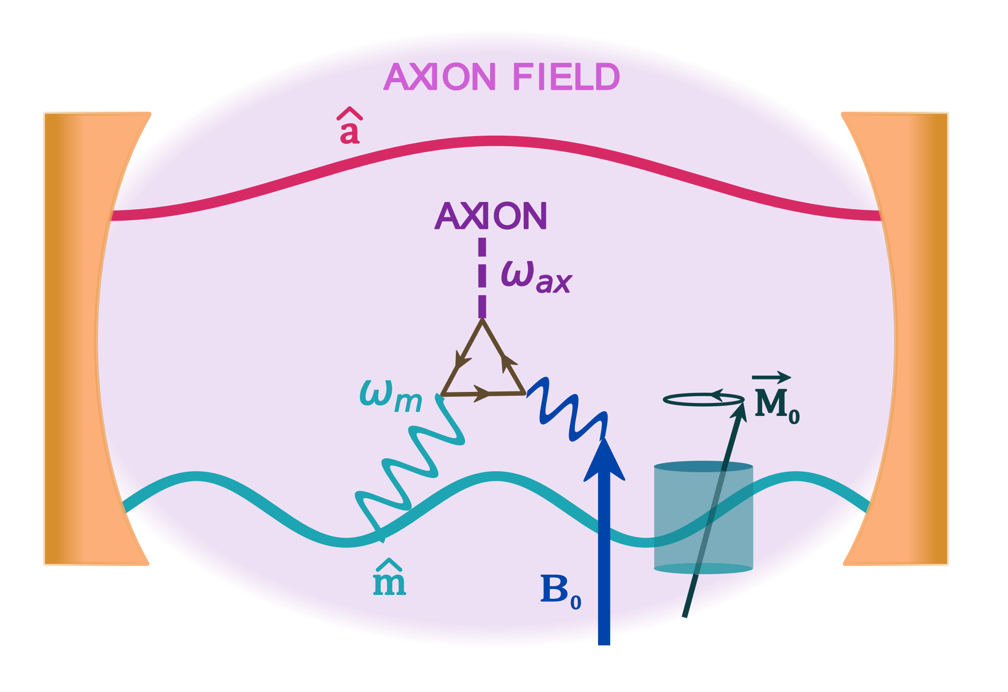
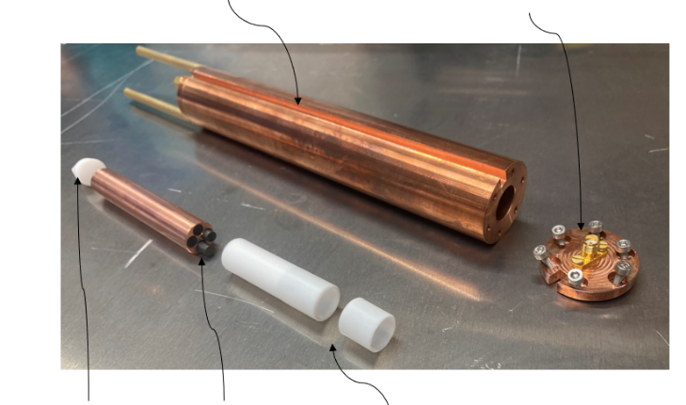

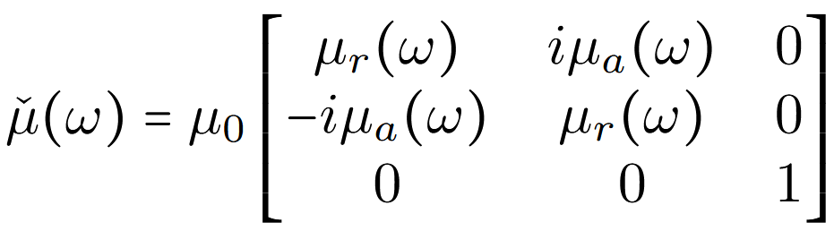
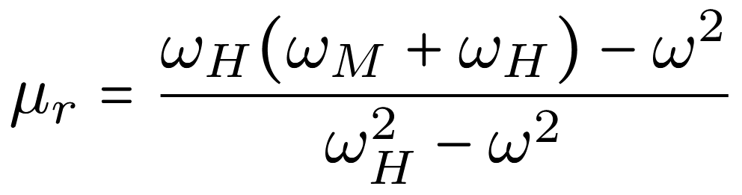
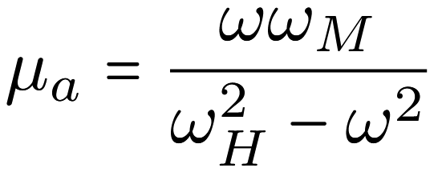

Magnetic Tunability
Ferromagnetic cavity
Copper cavity
Cavity’s hat
$$ω_{a}=ω_{ax}$$
Teflon support
YIG rods
Teflon support
YIG crystals permeability tensor : frequency and magnetic resonnance dependence
Landau-Lischitz-
Gilbert equation
,
A. Cottet and T. Kontos: New J Phys 28 024504 (2026), Gurevich and Melnikov (1996)
7

Slide 8
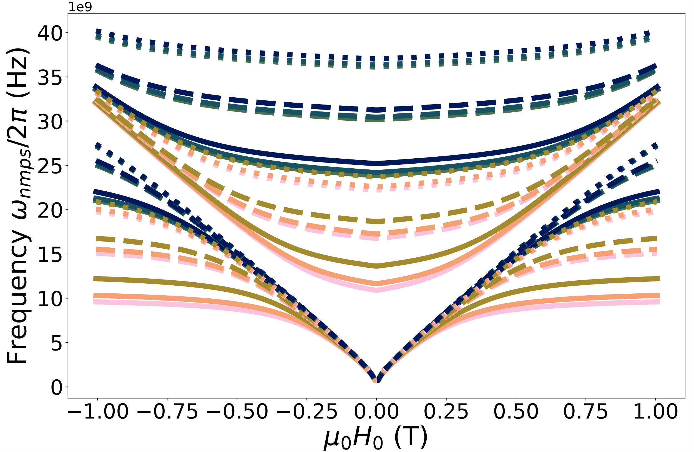
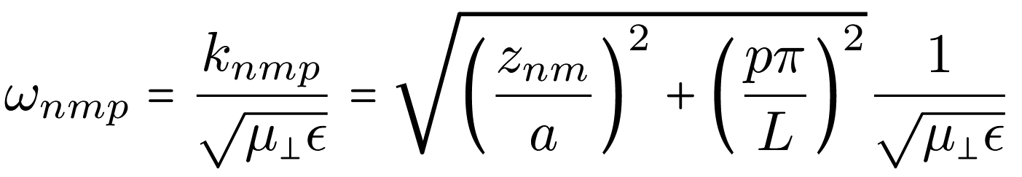
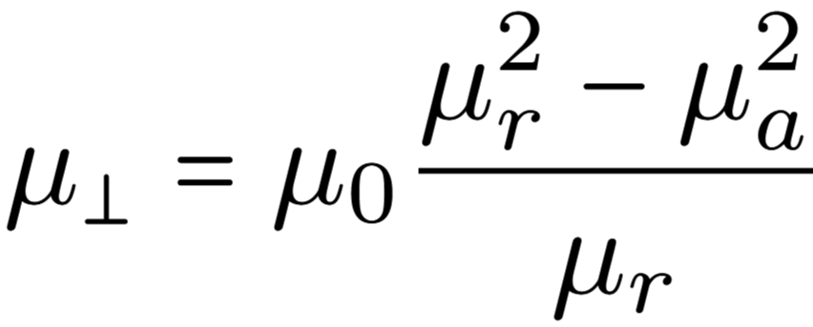
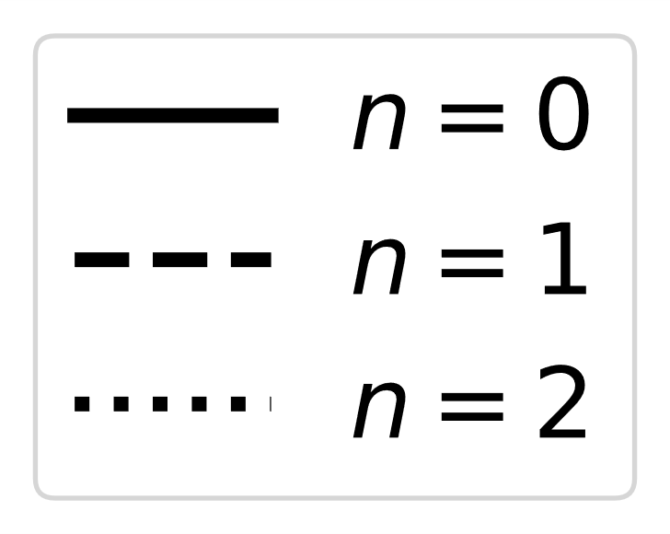
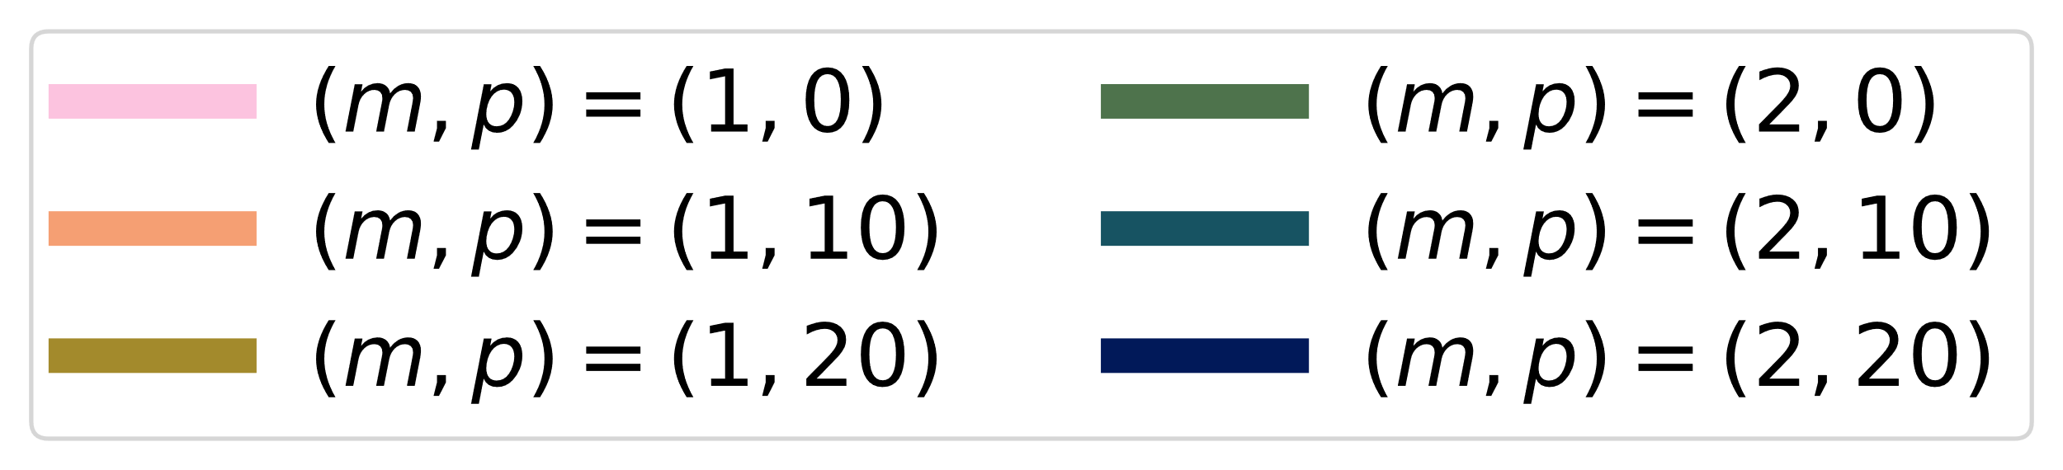

Gyromagnetic Modes
Maxwell equations in a cylindrical cavity
with
$\left(n,m,p\right)=$ angular, radial and longitudinal modes
$ω_{0,1,0,±1}$ slope $=28$ GHz/T
8

Slide 9
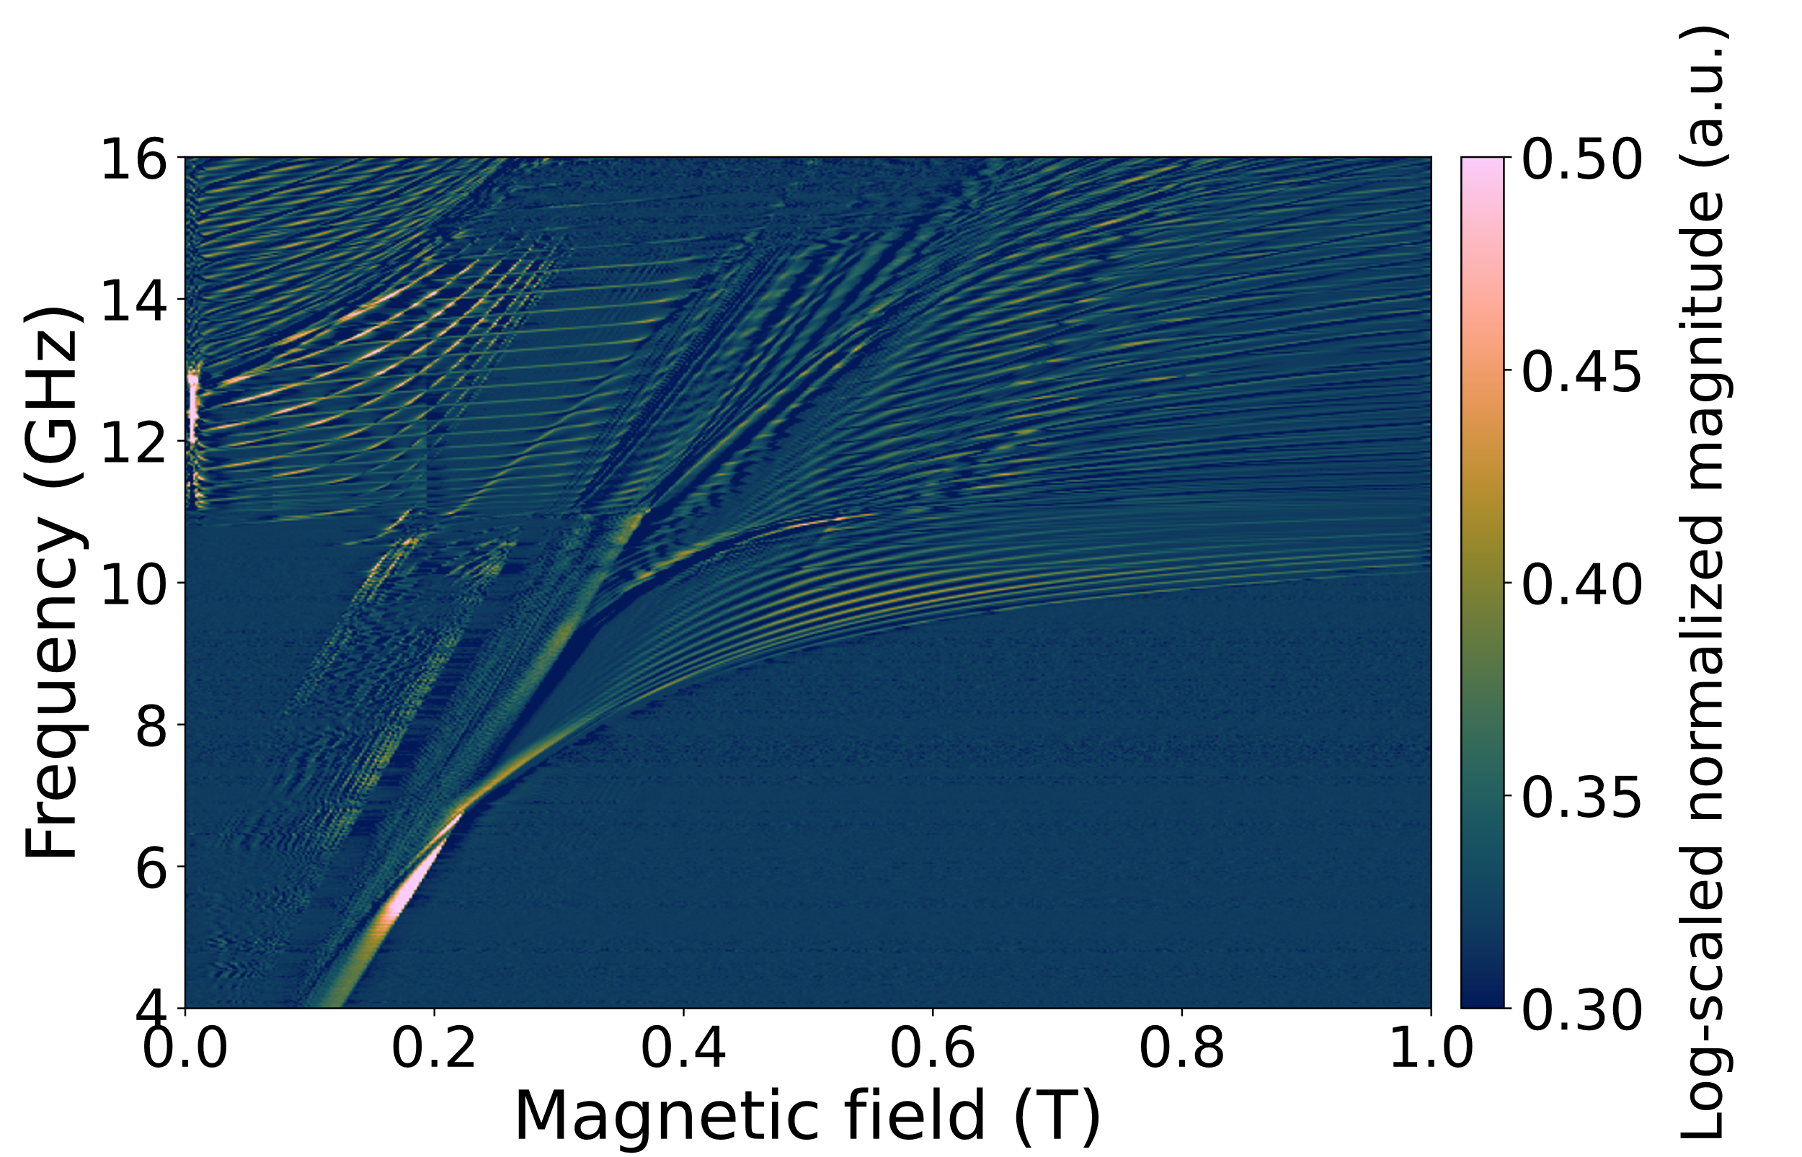
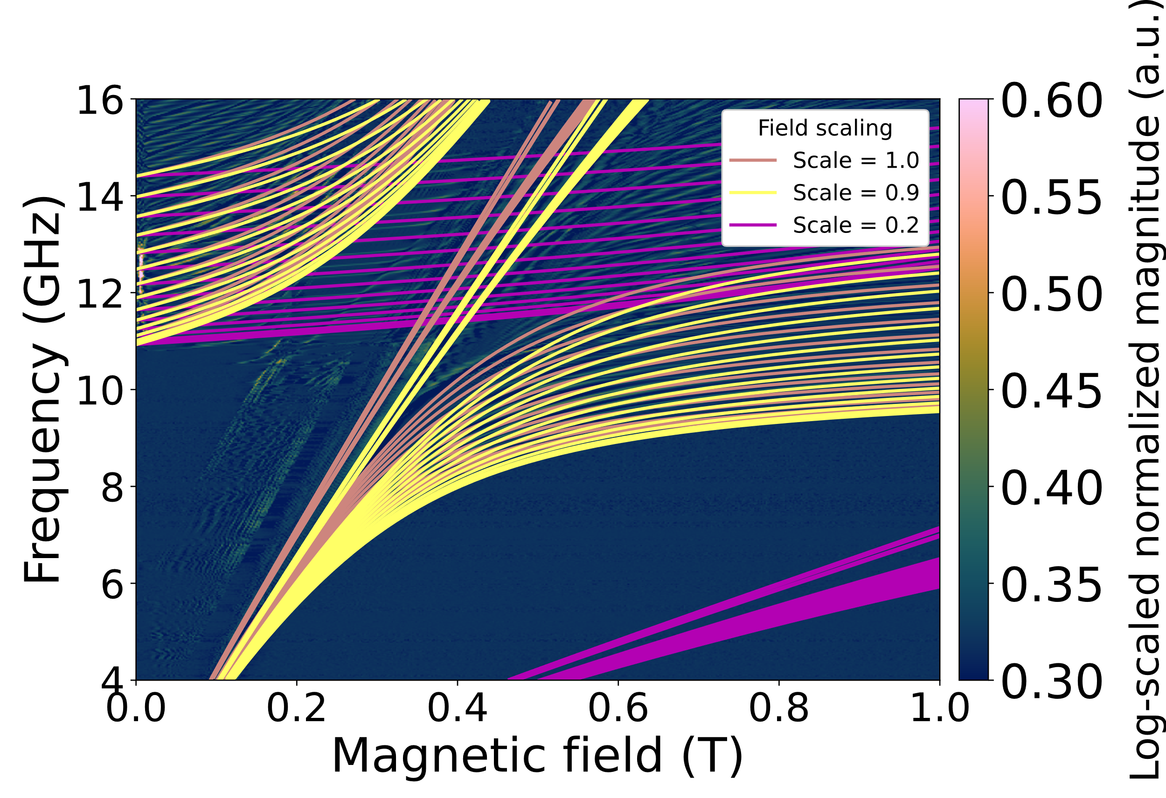
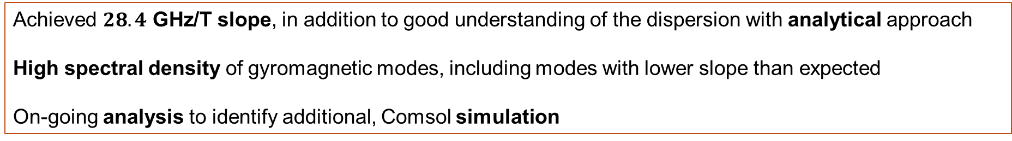
Experimental Results
YIG magnetospectroscopy 20mK
Inhomogeneous B field model overlay​
Achieved $28.4$ GHz/T slope​, in addition to good understanding of the dispersion with analytical approach
High spectral density of gyromagnetic modes, including modes with lower slope than expected​
On-going analysis to identify additional, Comsol simulation​
9

Slide 10
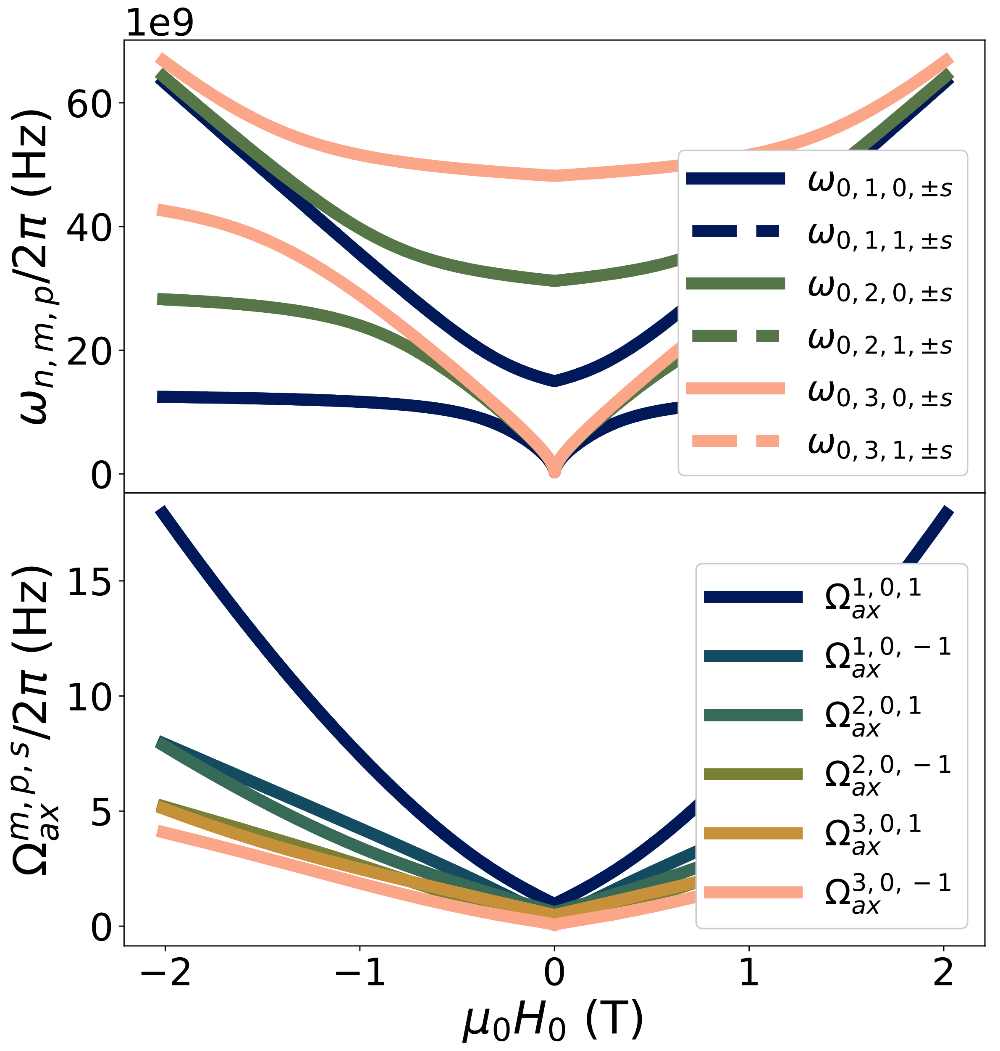
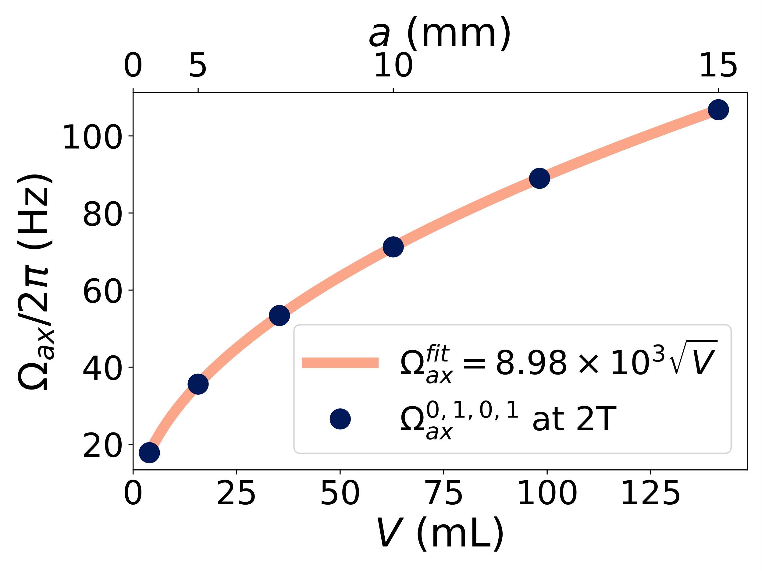
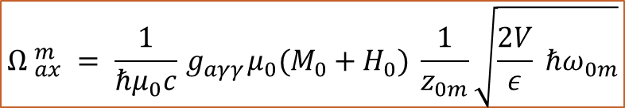
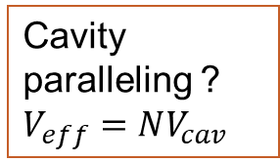
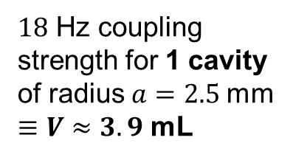
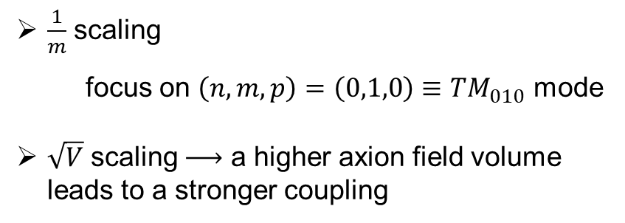
Axion-Photon Coupling
$${Ω }_{ax}^{m} = \frac{1}{ℏμ_{0}c}{ g}_{aγγ}μ_{0}(M_{0}+H_{0}) \frac{1}{z_{0m}}\sqrt{\frac{2V}{ε} ℏω_{0m}}$$
$\frac{1}{m}$ scaling
focus on $\left(n,m,p\right)=\left(0,1,0\right)≡TM_{010}$ mode
$\sqrt{V}$ scaling a higher axion field volume leads to a stronger coupling
$18$ Hz coupling strength for 1 cavity of radius$a=2.5$ mm
$≡V≈3.9$ mL
Cavity paralleling ? $V_{eff}=NV_{cav}$
10

Slide 11
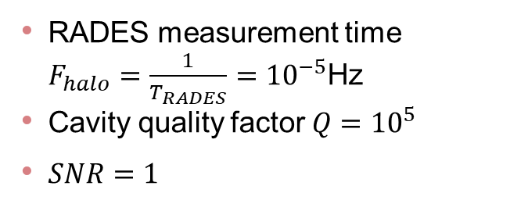
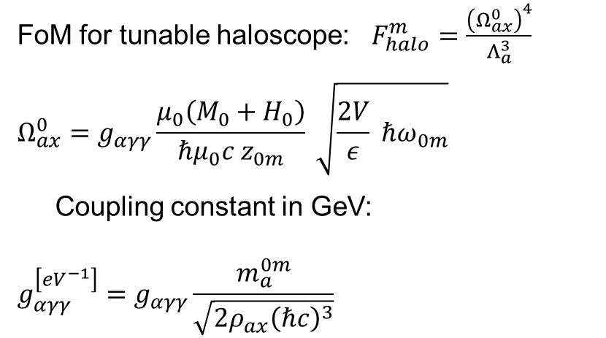
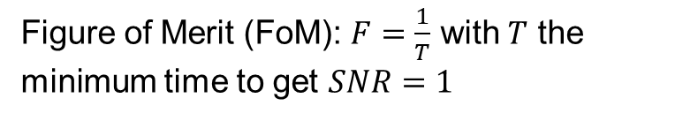
Conventional Haloscope FoM
F-RADES
(branches +/-)
Figure of Merit (FoM): $F=\frac{1}{T}$ with $T$ the minimum time to get $SNR=1$
FoM for tunable haloscope: $F_{halo}^{m}=\frac{{\left(Ω_{ax}^{0}\right)}^{4}}{Λ_{a}^{3}}$
$$Ω_{ax}^{0}=g_{αγγ}\frac{μ_{0}\left(M_{0}+H_{0}\right)}{ℏμ_{0}c z_{0m}} \sqrt{\frac{2V}{ε} ℏω_{0m}}$$
Coupling constant in GeV:
$$g_{αγγ}^{\left[eV^{−1}\right]}=g_{αγγ}\frac{m_{a}^{0m}}{\sqrt{2ρ_{ax}{\left(ℏc\right)}^{3}}}$$
RADES measurement time $F_{halo}=\frac{1}{T_{RADES}}={10}^{−5}$Hz
Cavity quality factor $Q={10}^{5}$
$SNR=1$
1.2 GHz to 66.8 GHz tunability
(Article in preparation)
11

Slide 12
Research Project Goals
Key goals of AXION sensing:
Expand the mass scanning range
Boost the detection sensitivity
Simulate a fake axion signal
Magnetic materials in
resonant cavities
Non-linear coupling
Phase-jammed signal
12

Slide 13
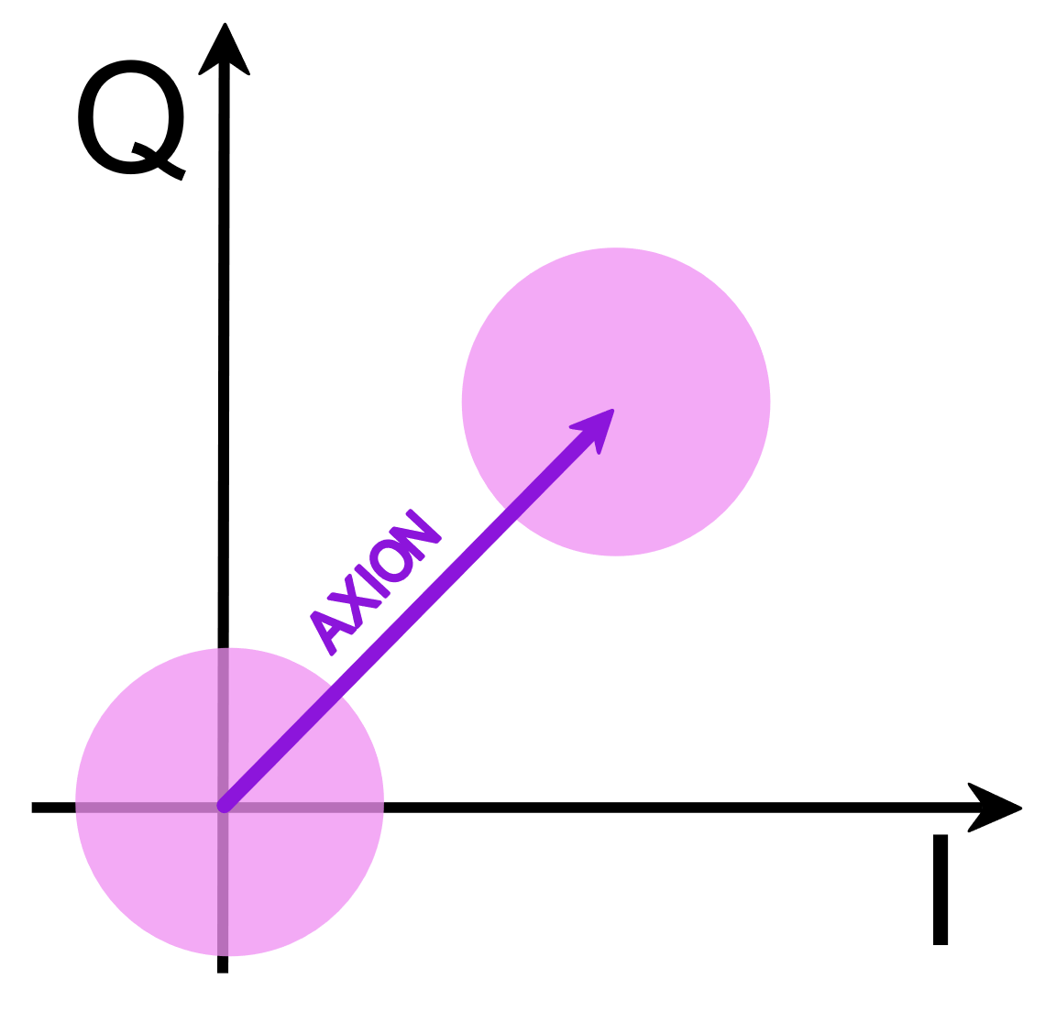
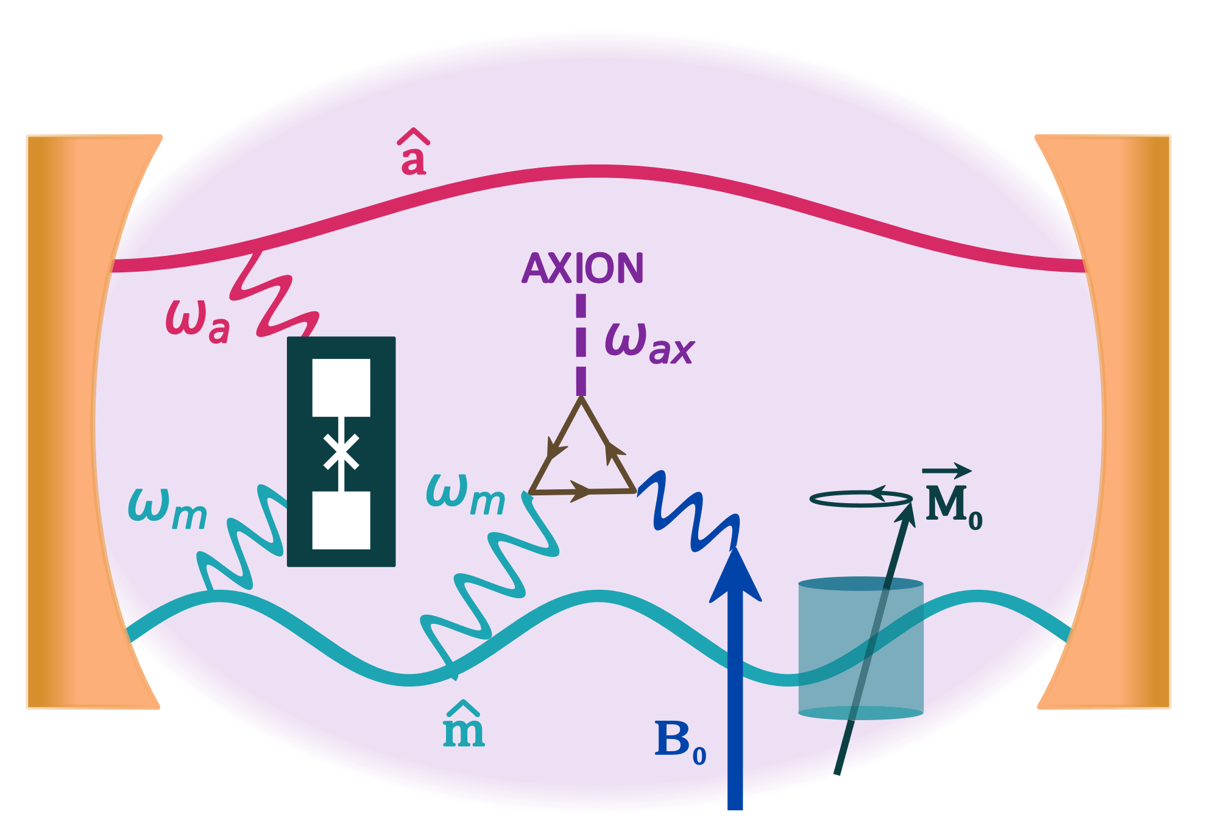
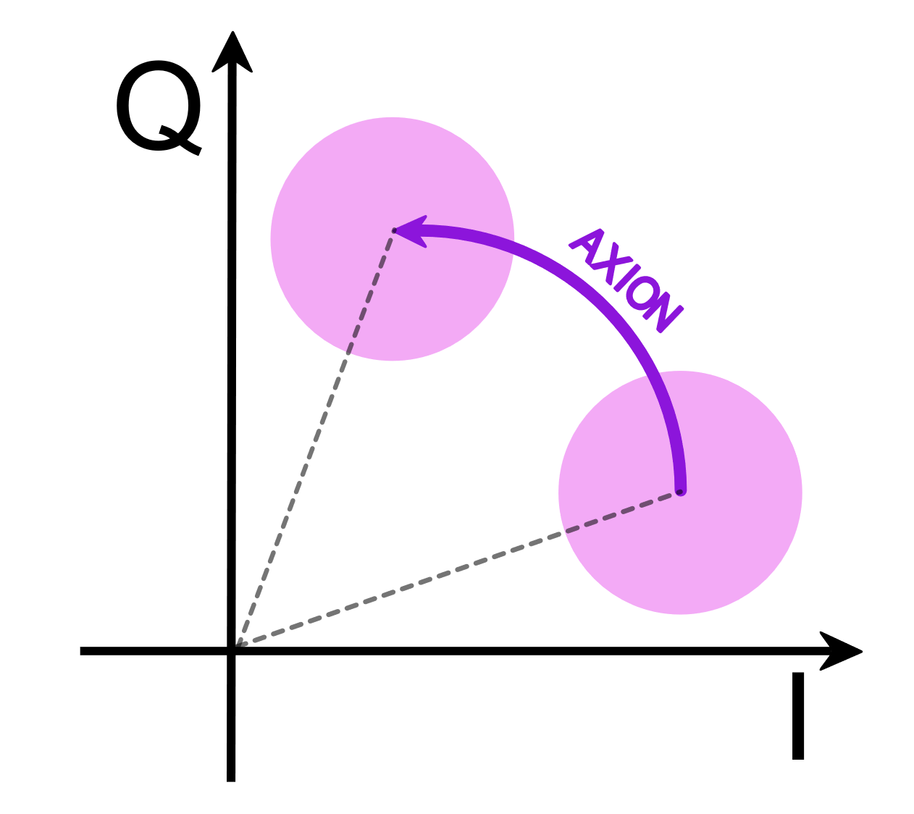



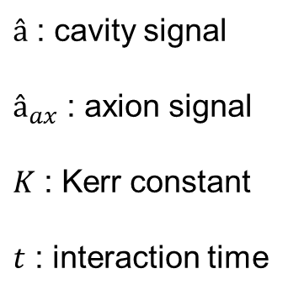
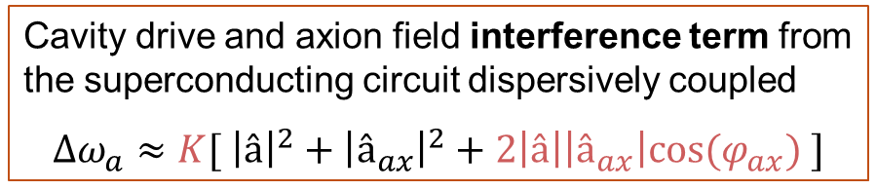
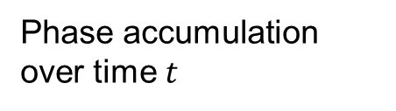
Quantum Detection Scheme
Phase-resolved haloscope with magnet tunability scheme
Conventional haloscope
$$P∝{\left|â+â_{ax}\right|}^{2}$$
$â$ : cavity signal
$â_{ax}$ : axion signal
$K$ : Kerr constant
$t$ : interaction time
with $â_{ax}≪â$
quantum + thermal noise
Non-linear coupling
$$ΔΦ∝{K\left|â+â_{ax}\right|}^{2}t$$
A. Cottet and T. Kontos: New J Phys 28 024504 (2026), Gurevich and Melnikov (1996)
Cavity drive and axion field interference term from the superconducting circuit dispersively coupled
$$Δω_{a}≈K[ {\left|â\right|}^{2}+{\left|â_{ax}\right|}^{2}+2\left|â\right|\left|â_{ax}\right|cos(φ_{ax}) ]$$
Phase accumulation over time $t$
13

Slide 14
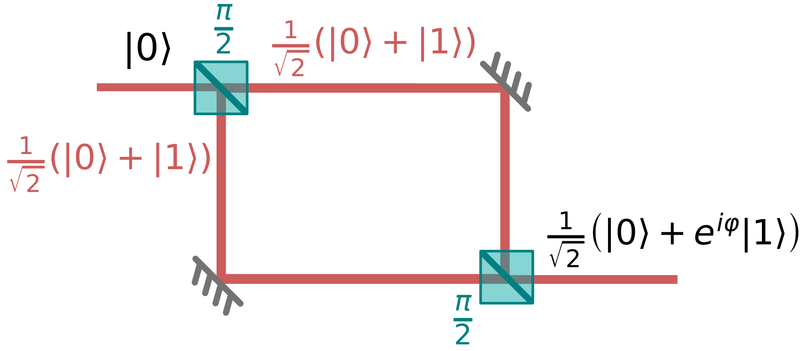
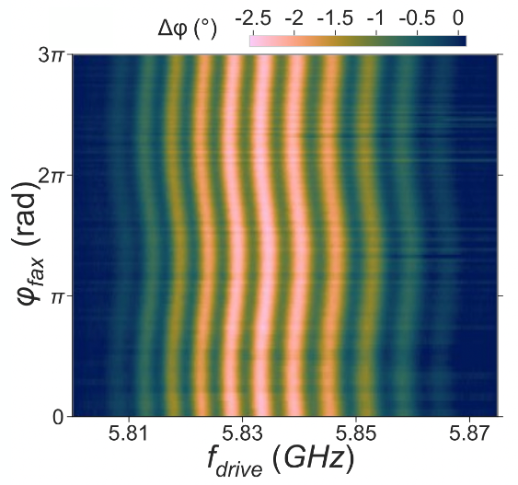
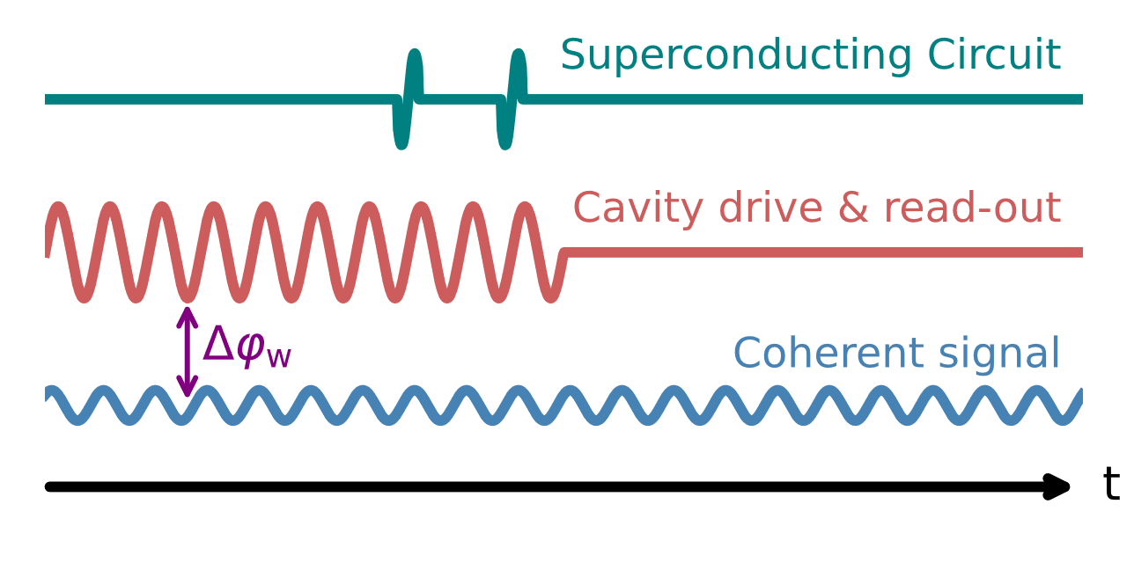
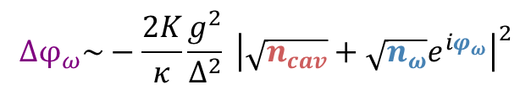

Non-Linear Quantum Interferometry
Ramsey experiment on fake-axion signal
Ramsey fringes are strongly modulated by interfering signal
C. Fruy, A, Théry, et al. (2026), Phys. Rev. A 113, 023706
Fake axion signal
Detection at $ω_{cav}=ω_{fax}$
$$Δφ_{ω}\sim −\frac{2K}{κ}\frac{g^{2}}{Δ^{2}} {\left|\sqrt{n_{cav}}+\sqrt{n_{ω}}e^{iφ_{ω}}\right|}^{2}$$
14

Slide 15
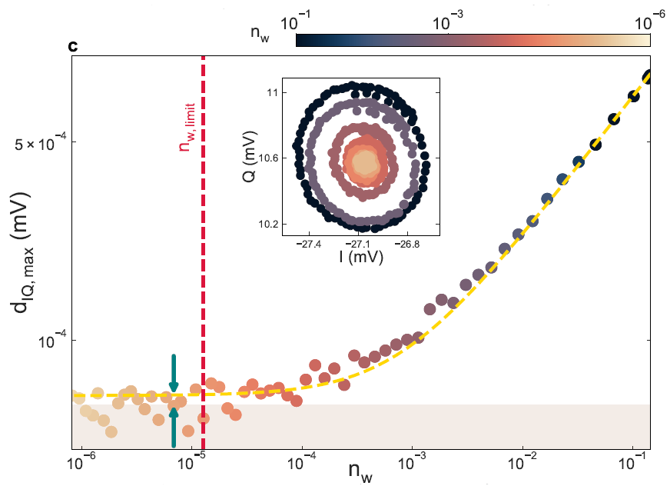
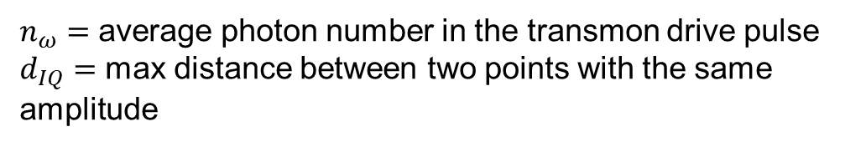
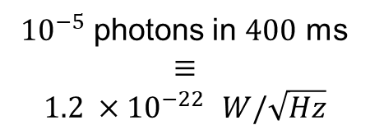

Quantum Enhancement Detection Method
Phase-resolved detection at $ω_{cav}=ω_{fax}$
${10}^{−5}$ photons in $400$ ms
$$≡$$
$1.2 ×{10}^{−22}$ $W/\sqrt{Hz}$
Increased sensitivity at cosmological limit
$F_{halo}=\frac{{{(Ω}_{ax}^{0})}^{4}}{Λ_{a}^{3}}≈$ mHz
$≪$
$F_{phase}≈\frac{Ω_{ax}^{2}}{Λ_{a}^{3}}≈$ 0.4 MHz
Increased Figure of Merit (FoM)
C. Fruy, A, Théry, et al. (2026), Phys. Rev. A 113, 023706
A. Cottet and T. Kontos: New J Phys 28 024504 (2026)
$n_{ω}=$ average photon number in the transmon drive pulse
$d_{IQ}=$ max distance between two points with the same amplitude
15

Slide 16
Research Project Goals
Key goals of AXION sensing:
Expand the mass scanning range
Boost the detection sensitivity
Simulate a fake axion signal
Magnetic materials in
resonant cavities
Non-linear coupling
Phase-jammed signal
16

Slide 17
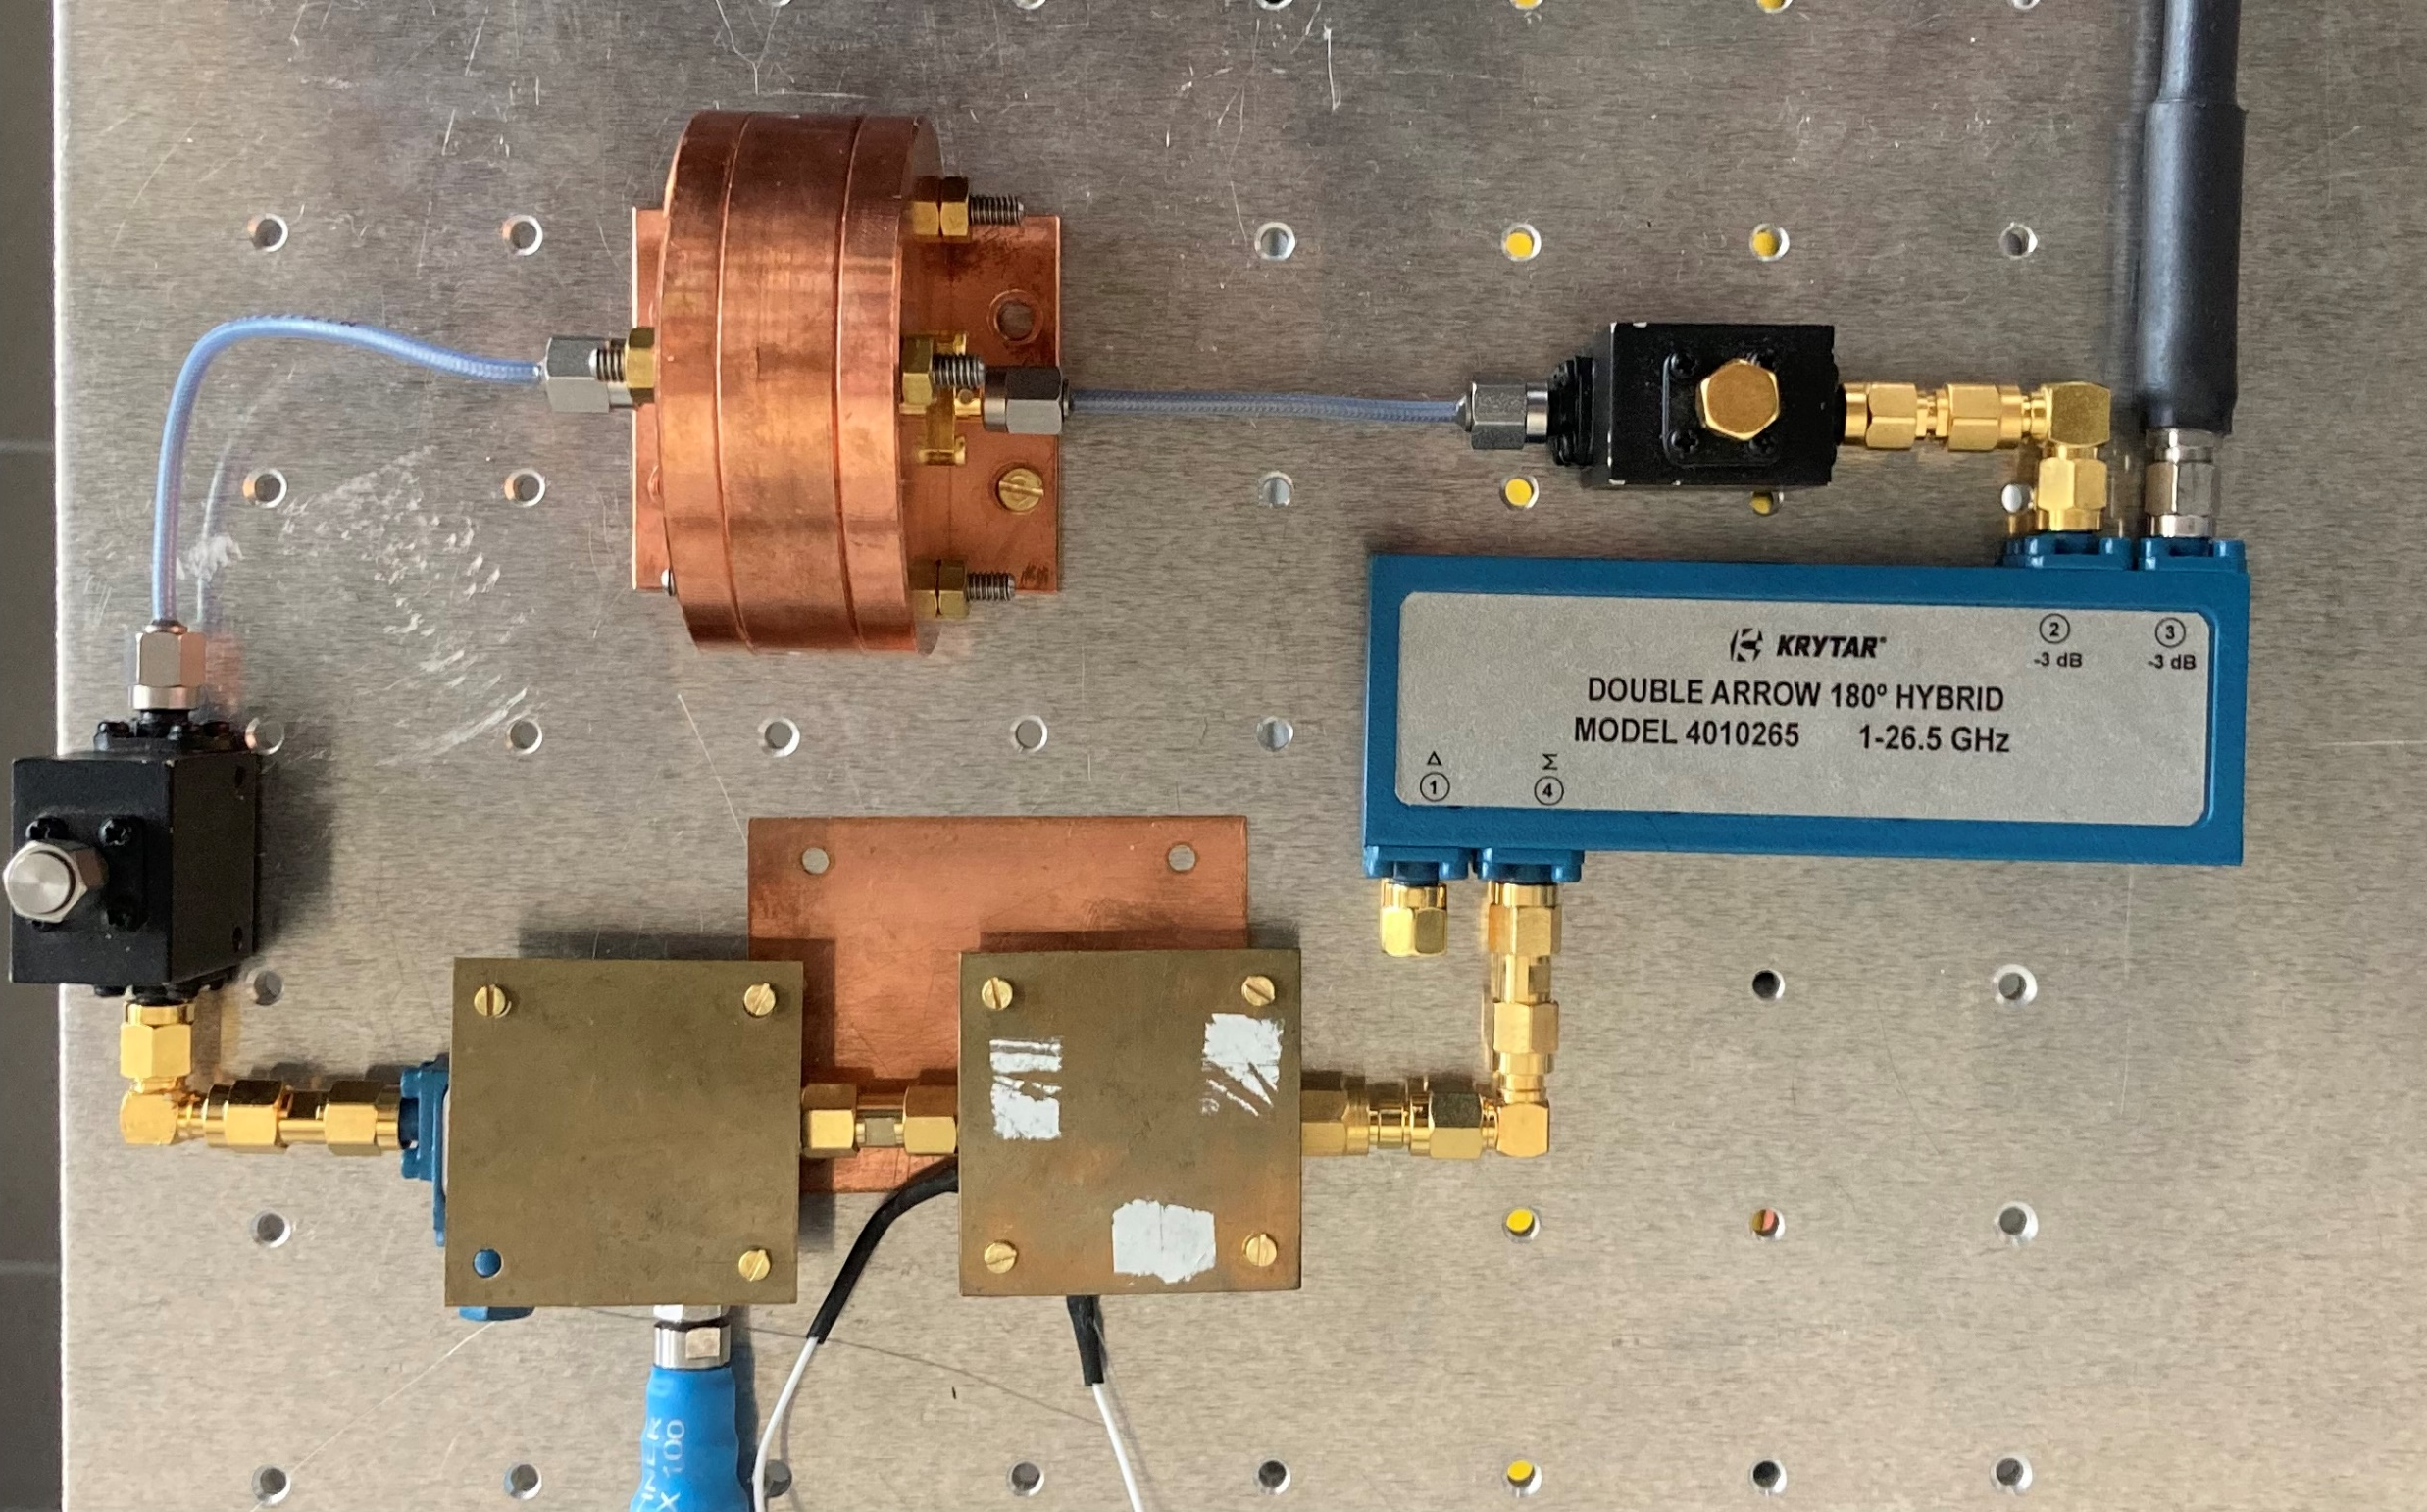
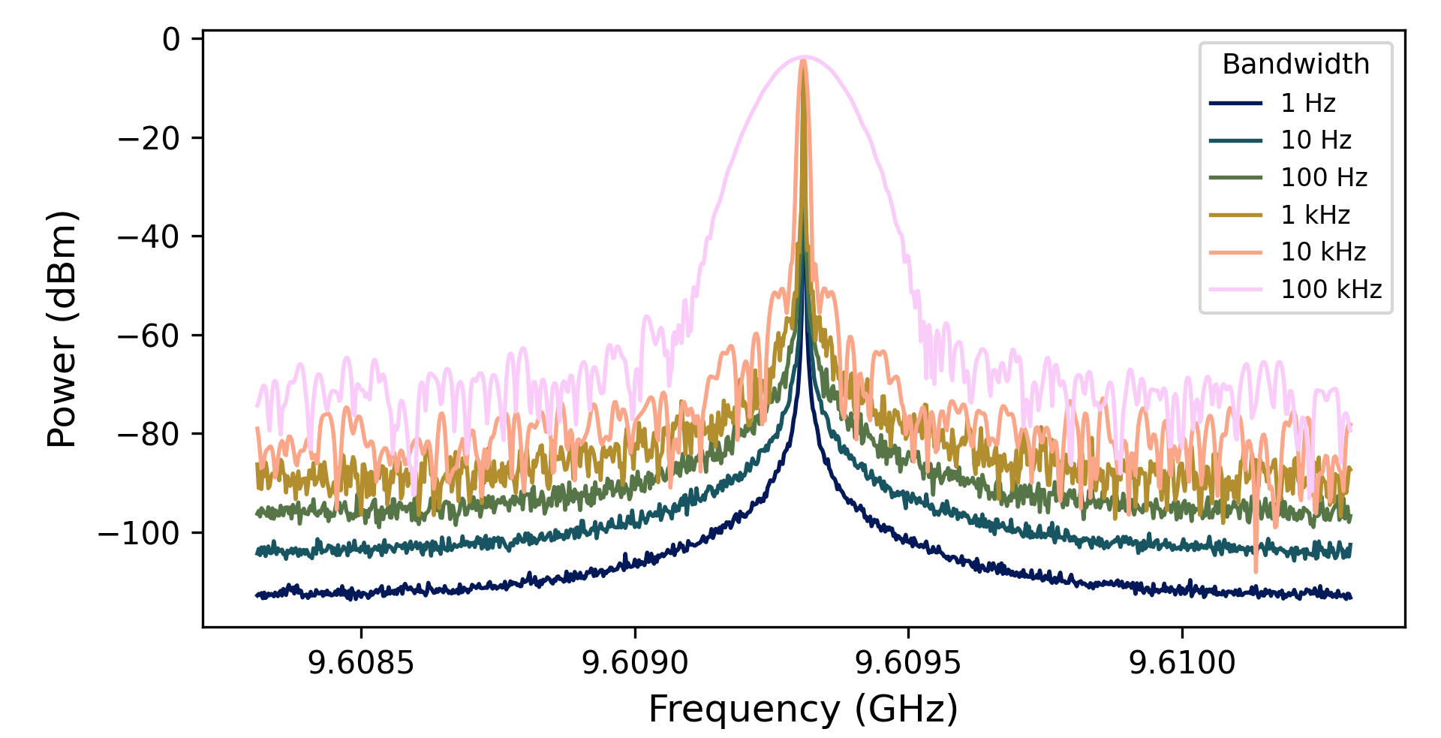
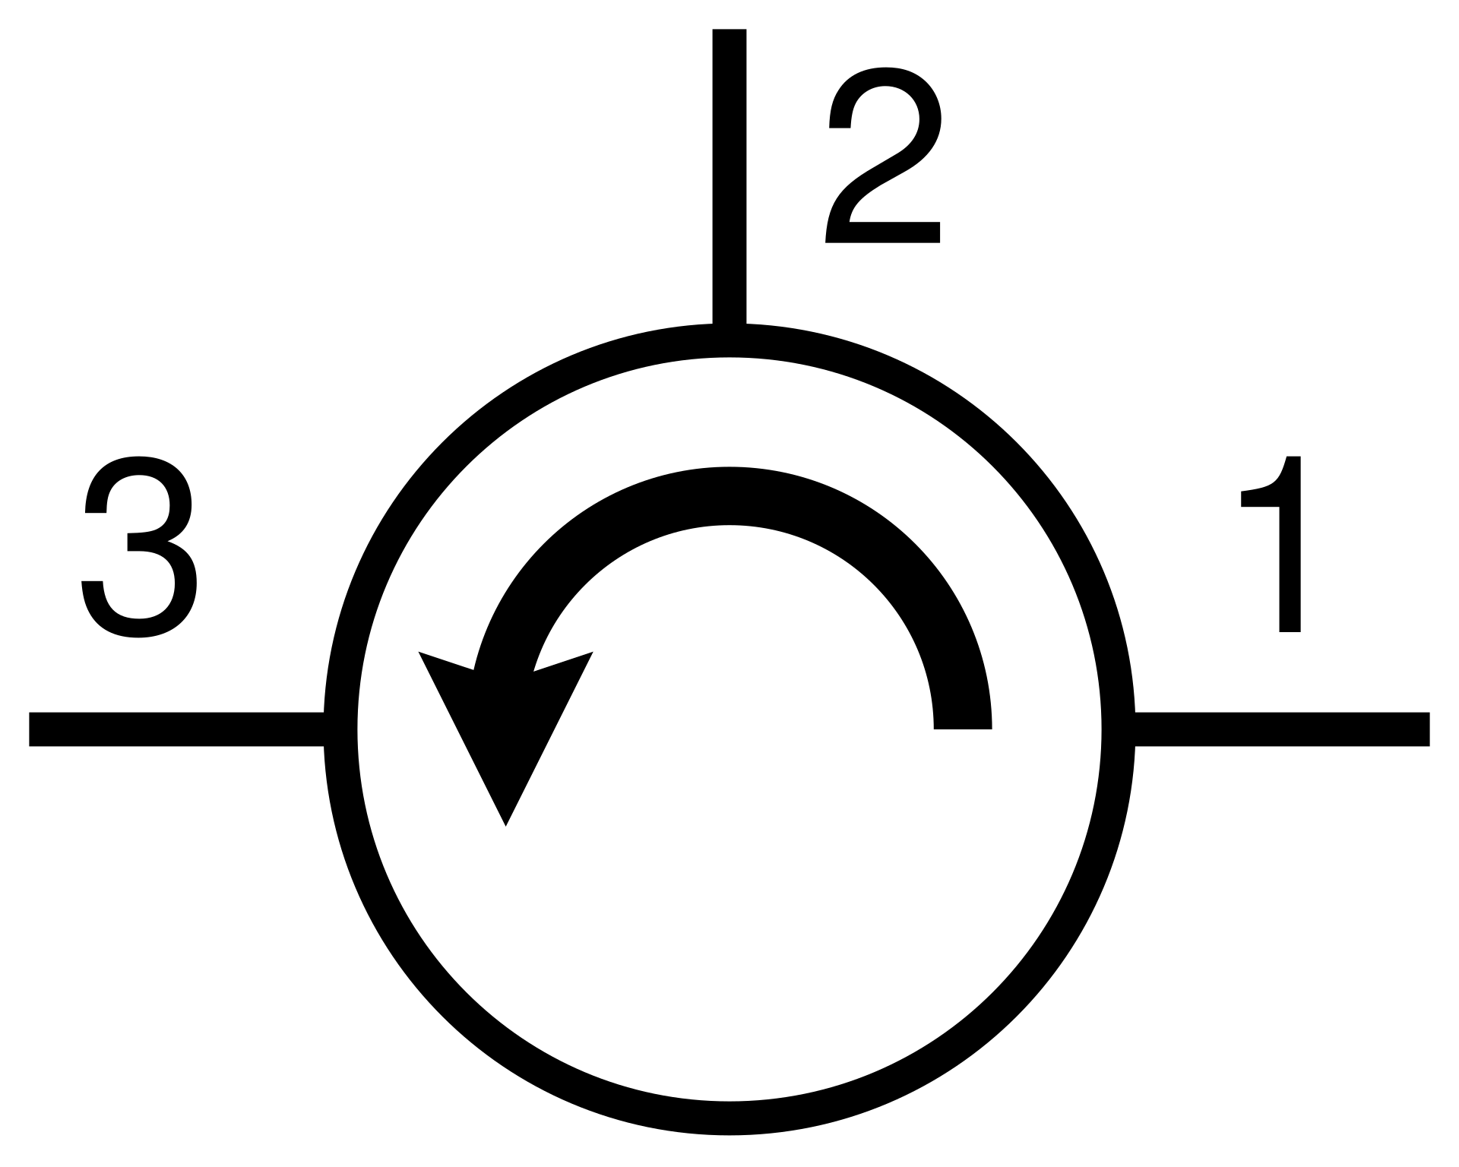





Phase Jamming
$$ω_{0}$$
+15V
Power spectral density:
$$S\left(θ\right)=\frac{kTF}{P_{0}}\left(1+\frac{{Kω}_{α}}{Δω}\right)$$
$θ(t)$: random phase fluctuation
$F$: noise figure
$P_{0}$: oscillator output power at $ω_{0}$
$Δω$: frequency offset relative to $ω_{0}$
$K$: flicker noise sensitivity (scaling factor)
$ω_{α}$: corner angular frequency between flicker and white phase noise
Measurement
instrument- limited
true 1kHz source
David M. Pozar, Microwave Engineering, 4th Edition, Wiley, 2012
more realistic fictitious axion source
17

Slide 18

Key Points and Outlooks
Large tunability of the phase-resolved haloscope through gyromagnetic materials
Technical focus on mode $(0,1,0)$ isolation and manipulation
Tri – partite coupling by implementing gyromagnetic modes in Chloe’s detection setup
Phase – jammed source to simulate $\sim kHz$ linewidth axions
Phase-jamming tunability by using phase shifters in the MASER – like setup
Thank you for your attention !
18

Slide 19


Benchmarking Parameters
19

Slide 20




Quantum Enhancement Detection Method
Phase-resolved detection at $ω_{cav}={ω_{m}=ω}_{fax}$
Increased sensitivity
C. Fruy, A, Théry, et al. (2026), Phys. Rev. A 113, 023706
Sensitivity of ${10}^{−3}$ photons in $400$ ms
Need to increase the magnetic volume to improve sensitivity
20

Slide 21



Gyromagnetic Modes in Cylindrical Cavity
Solving the Maxwell equations in a cylindrical cavity with YIG tensor leads to the Helmholtz equation:
Spatial solution and boundary conditions:
Consider $η=0$, the magnetic dissipation, then:
21

Slide 22




Gyromagnetic Modes Measurements
Copper barillet and teflon holders
Copper barillet and direct coaxial excitation
22

Slide 23




Coupling Strength
The coupling Hamiltonian:
Time harmonic solution to the Helmholtz equation:
Magnetic field:
with the coupling strength
23

Slide 24










Form Factor
For one mode $(n,m,s)$
with
the $m^{th}$ root of $J_{0}$
24

Slide 25

Conventional Haloscope SNR
$SNR=\frac{ΔP_{0}}{\sqrt{ν_{0}}}$ A. Cottet, kT. Kontos 25’
$ΔP_{0}=\frac{2{\left(Ω_{ax}^{0}\right)}^{2}}{Λ_{a}^{2}}$ amplitude of the axionic signal at resonance
$ν_{0}=\frac{4\left(1+2n_{B}\right)}{Λ_{a}T}$ signal variance
$SNR=1 ↔\frac{Ω_{ax}^{4}}{Λ_{a}^{3}}=\frac{1}{T}=F_{halo}$
25

Slide 26


First 3 Modes Coupling Constant
1 cavity
4 cavities in parallel
26

Slide 27

Phase-Jammed Source Setup
Amplifier
https://nardamiteq.com/docs/MITEQ-AFS.PDF
Model : AFS3-04000800-07-10P-4
Freq. range (GHz) : 4 – 8
Gain (dB) : 28
Noise Figure : 0.7
Cavity resonator spectrum
27

Slide 28


Ramsey Experiment: Bloch Sphere
$$Δφ_{ω}\sim −\frac{2K}{κ}\frac{g^{2}}{Δ^{2}} {\left|\sqrt{n_{cav}}+\sqrt{n_{ω}}e^{iφ_{ω}}\right|}^{2}$$
28

