Slide 1
Gravitation
Matteo Barsuglia,
on behalf of the gravitation group

Slide 2

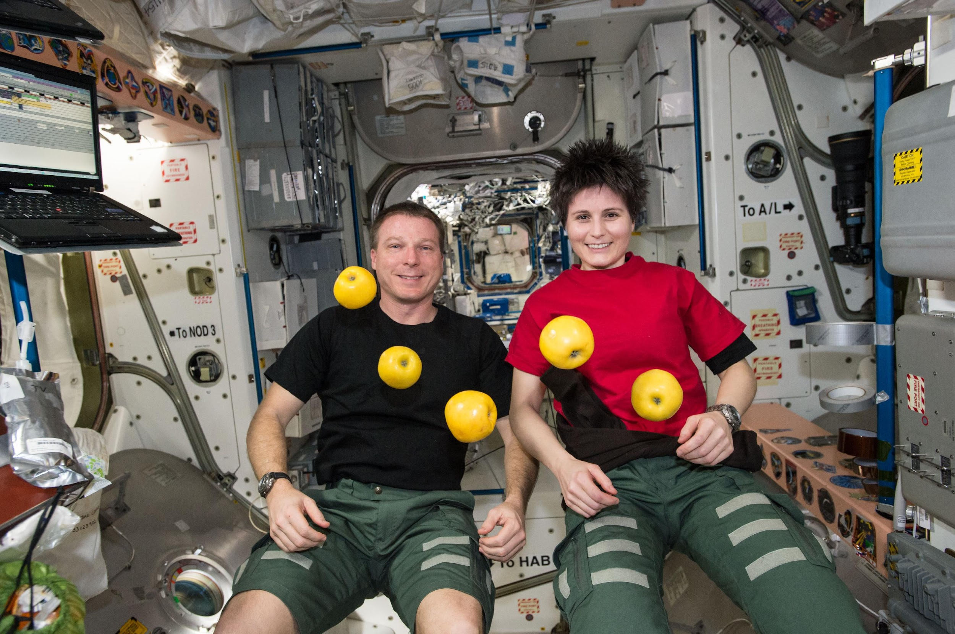
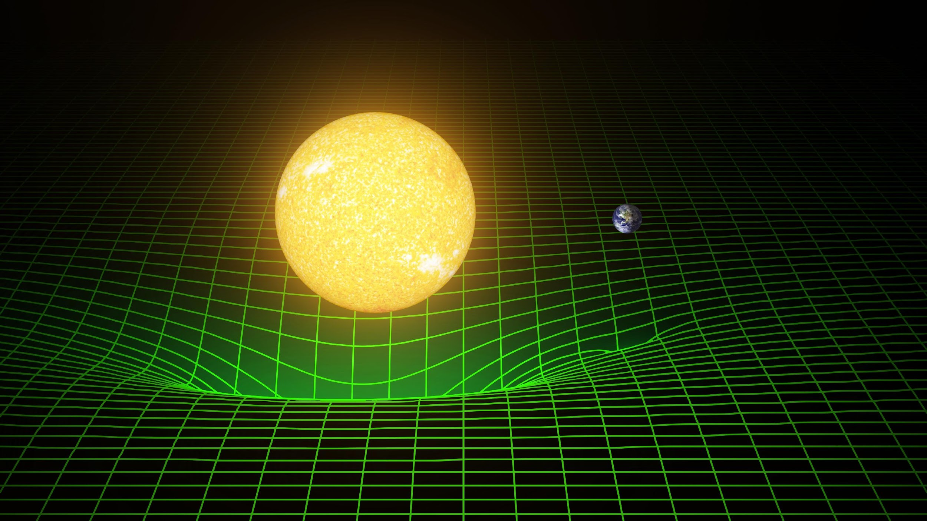
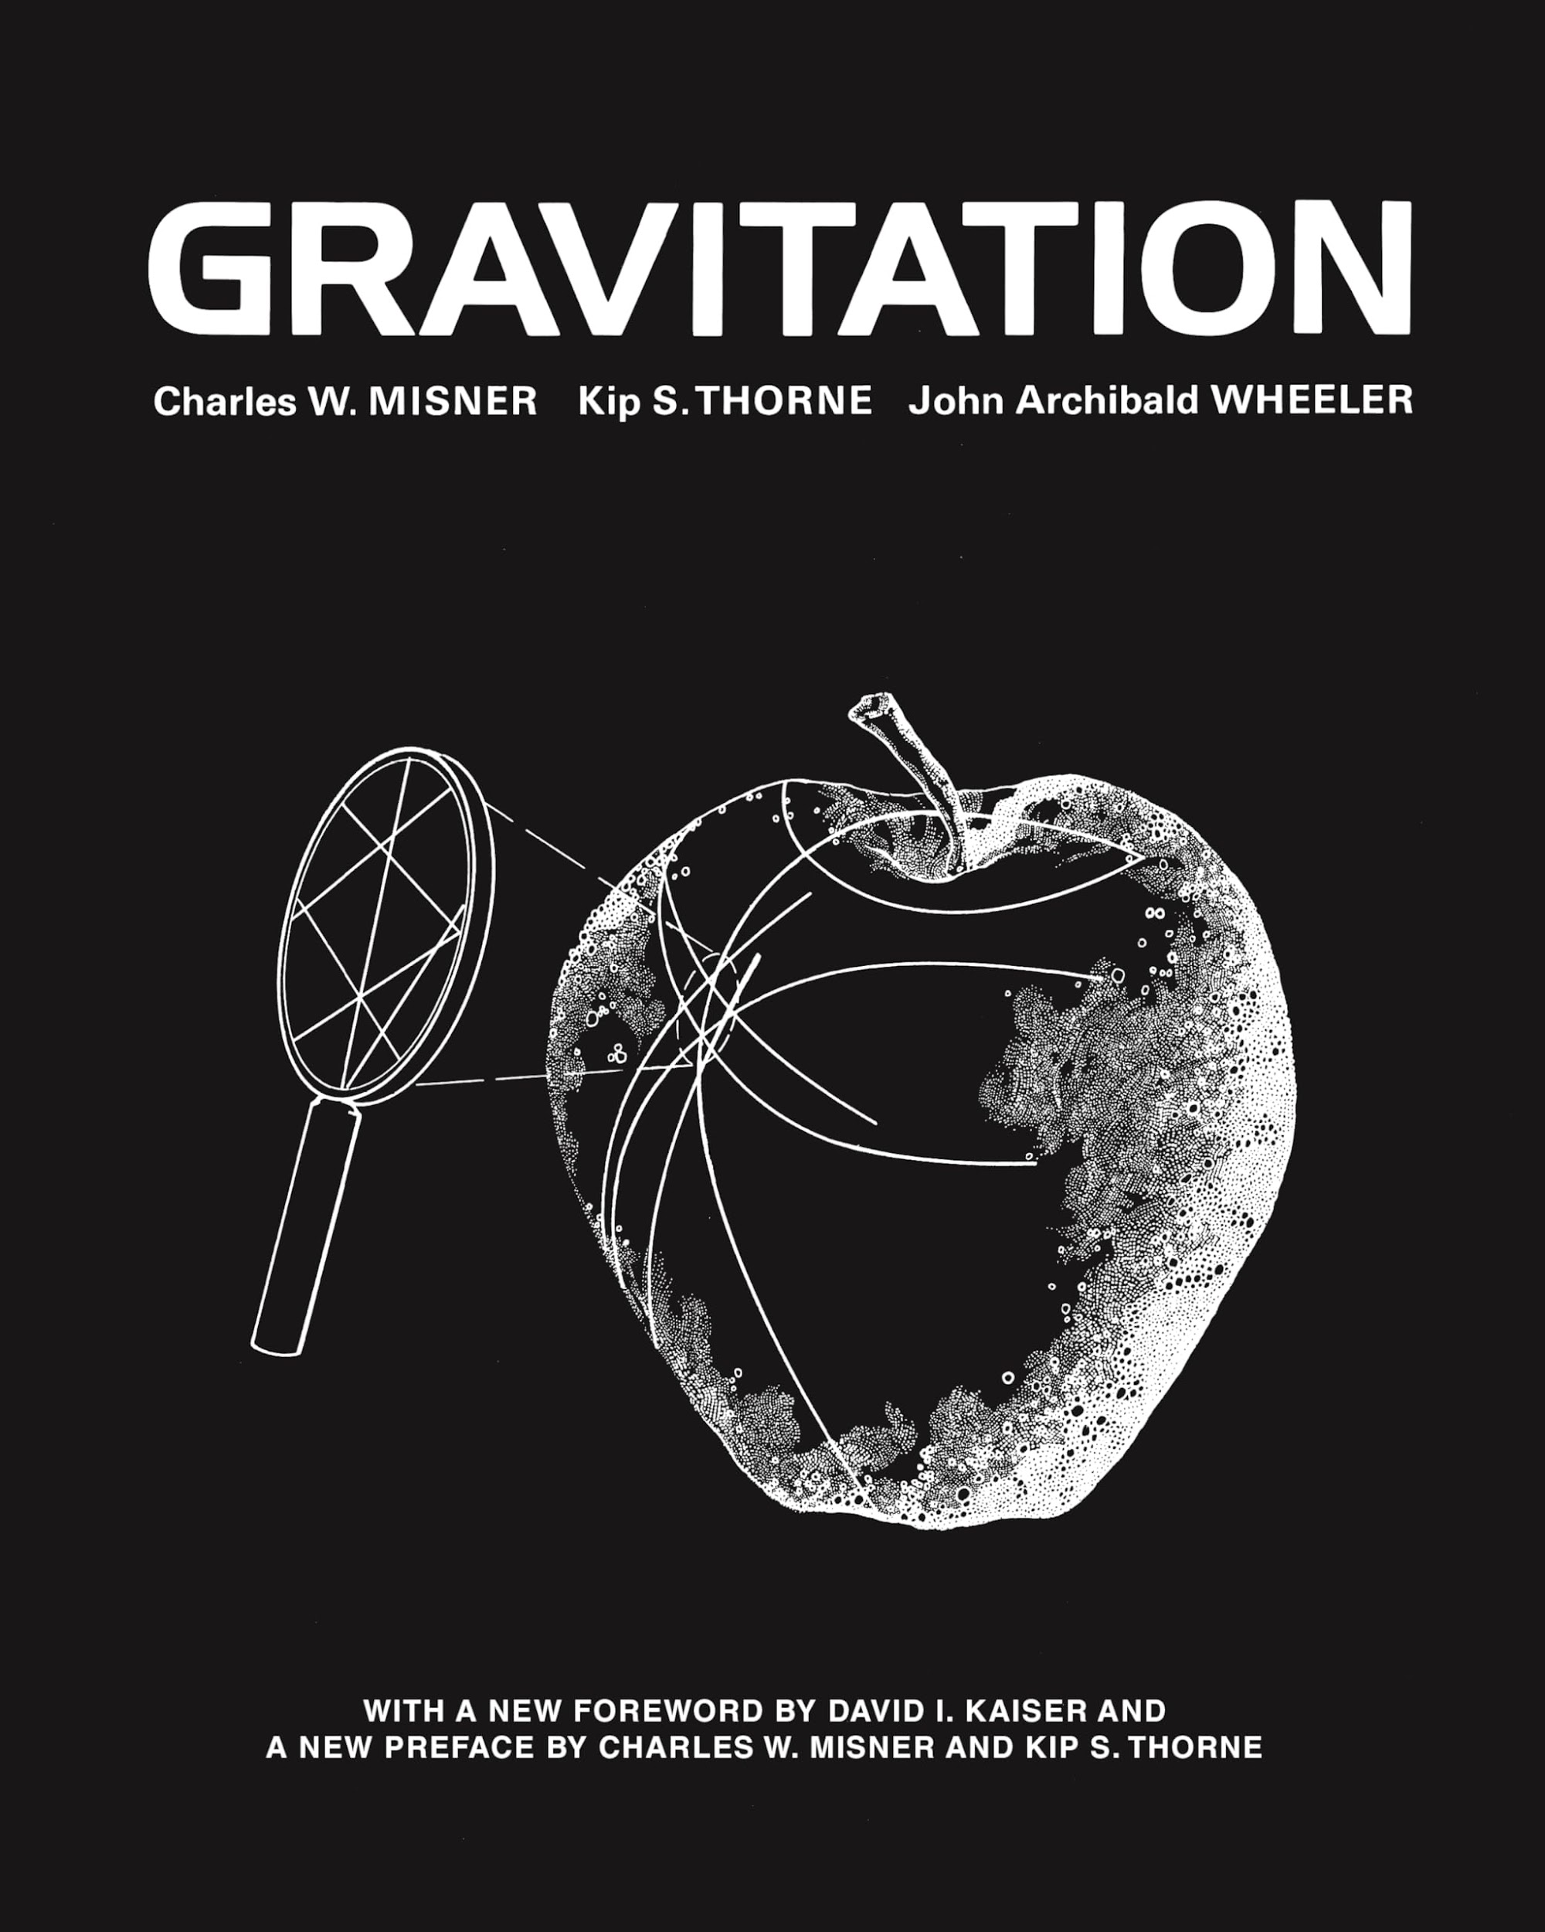
Gravitation in a nutshell
Image: Caltech/MIT/LIGO Lab/(T. Pyle)
2

Slide 3
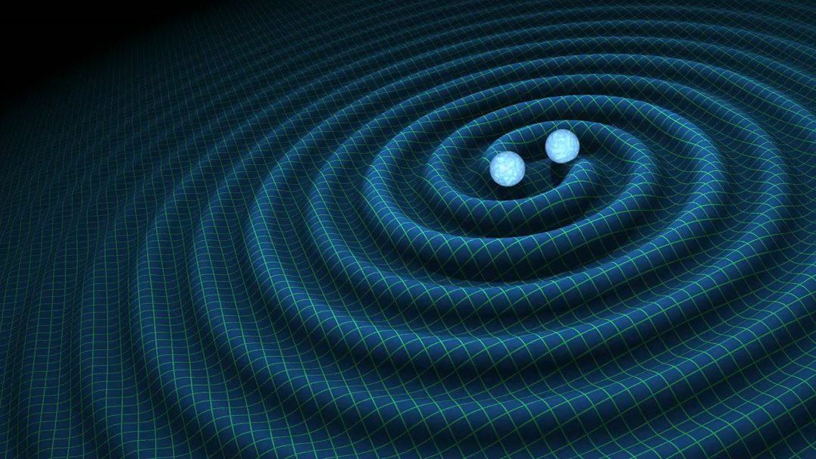
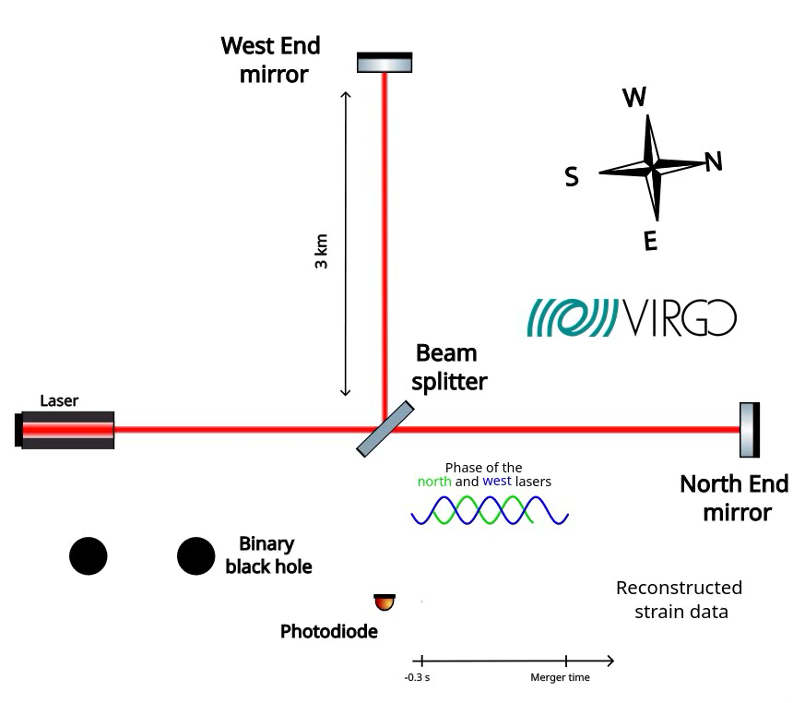
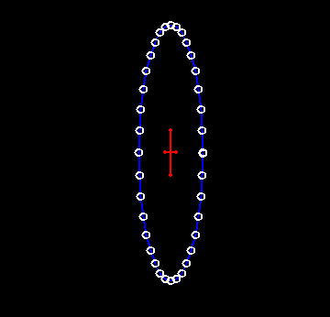
Gravitational waves(GW) in a nutshell
Animation from wikipedia
(Thomas Sainrat)
Image: Caltech/MIT/LIGO Lab/(T. Pyle)
3

Slide 4




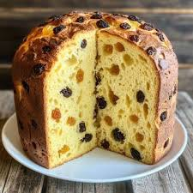

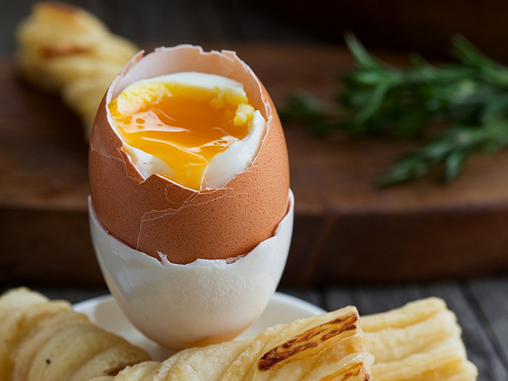
How the gravitation group is addressing the “big questions”
Nature of gravity: How to test quantum gravity? To what extend the general relativity is valid ?
  Consistency of GW waveforms with General Relativity (generation, propagation and the nature of the remnant (post-merger) object
  Testing the general relativity behavior near the black-hole horizon
Black-holes and Compact objects: which is the nature of black holes ? The distribution and evolution of black-holes through cosmic history? The role of super-massive black-holes in the formation/evolution of galaxies?
  Formation and properties of GW sources: black holes (full spectrum of masses) and neutron stars
Inflation and origin of structures: which mechanism generate the cosmic structures? Can we test the early universe using gravitational-waves?
  Detection (or upper limits) of a cosmological GW background
Dark matter: test of dark matter candidates
  Detection (or upper limit) of exotic gravitational-wave sources, dark matter around massive black holes
Dark energy and cosmological constant: is gravity correct at large scales? Why is the vacuum energy so small?
  Measurement of Hubble constant and other cosmological parameters through GW
Multi-messenger “revolution” : study of compact objects, Gamma-ray burst, supermassive black-holes,…

Slide 5
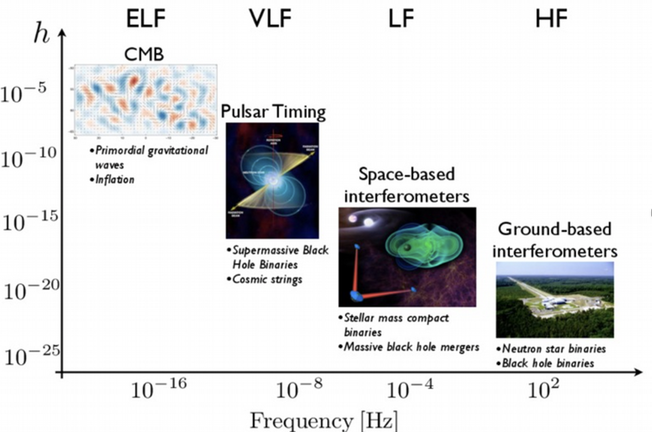
Projects: detection of GW across the whole frequency spectrum
EPTA
LISA
Virgo (LVK)
Einstein Telescope

Slide 6
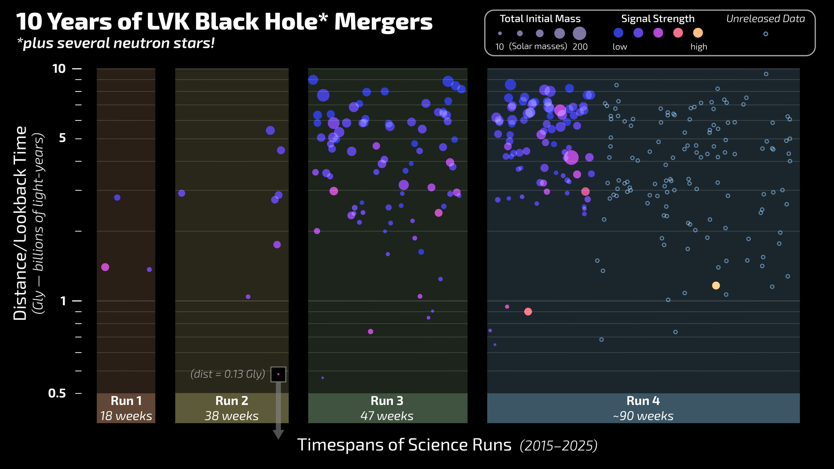
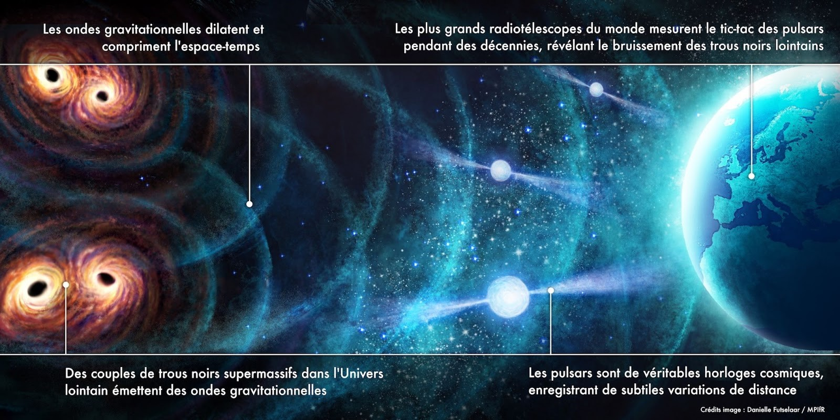
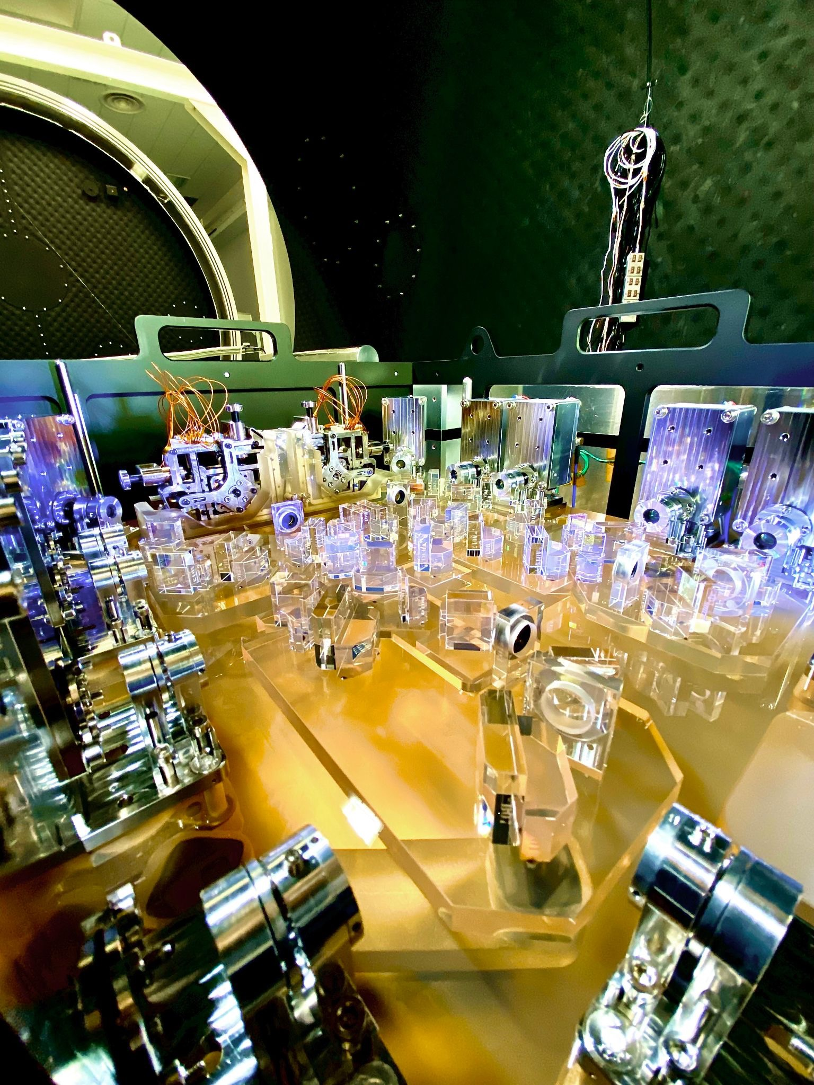
Impact
Detection of more than 300 merging stellar mass binary systems with LIGO-VIRGO-Kagra : APC highly involved in many leadership roles and instrumental contributions
Detection of emerging GW signal in nano-Hz band with Pulsar Timing Array
Building data analysis pipeline (leadership on European level) for LISA
Building optical test benches for LISA (leadership)

Slide 7
Current and past collaborations and synergies
With high-energy astrophysics group : Interactions of binary black-holes with accretion disk
Theory: Detection of cosmological GW background and Pulsar timing array (cosmic strings, MHD turbulence)
Theory/cosmology: inference of cosmological parameters with GW, propagation of gravitational-waves in modified gravity theories
Instrumental developments : strong involvement of technical groups, instrumentation and software

Slide 8
Opportunities
Contribute to the instrumental science of Einstein Telescope
  Squeezing
  Auxiliary benches
  A mid-scale prototype
New techniques for quantum noise reduction/metrology - collaboration with quantum physics groups
New space-based detectors gravity (ESA F3 – STEIN/GUEST)
Application of heterodyne interferometry to other fields (i.e. seismology)
Testing General Relativity – with Theory
Multimessenger (GW – em/neutrinos) – with Astrophysique des hautes énergies
Cosmology: a gravitation/theory/cosmology joint research
AI-assisted data-analysis methods

Slide 9
Challenges
Good organization of the schedules of the different projects with technical services
Instrumental science for Einstein Telescope and Virgo: be useful in a large (and sometimes competitive) environment → build collaborations, don’t disperse forces
Find resources for R&D not always easy (ANR? ERC? CNES): group members are constantly applying
Reinforce instrumental workforce
Clean room and – in general – experimental areas and related infrastructures should work well
Constraints given by the environmental crisis will become larger and larger

Slide 10
Priorities
In relation with ALL the lab “big questions”
Contribute to the Virgo upgrade for the next data taking (squeezing and auxiliary benches)
Contribute to the science of LIGO-Virgo-KAGRA in the next 10 years
Instrumental contribution for Einstein Telescope (squeezing, optical performances,...) → meeting planned with technical services next week.
Development of ”global fit” for LISA data analysis
LISA test benches development, delivery, commissioning and operations at CNES, Toulouse
Preparation of LISA in-orbit characterization and performance modeling
Interpretation of stochastic background and detection of individual supermassive black hole binaries with PTA
Journée prospective du groupe gravitation à la rentrée

Slide 11
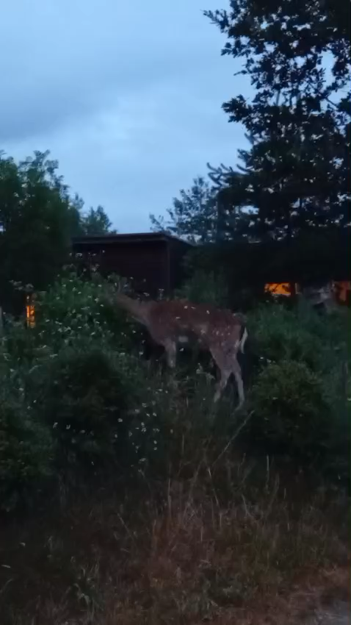
Merci pour votre attention

Slide 12

Big questions

